Slide 1

Fostering Critical Thinking Through Cartoon Clicker Questions
Dr. Kausik S Das
Department of Natural Sciences,
University of Maryland Eastern Shore

Slide 2
Critical Thinking
Ability to understand, apply, analyze, evaluate facts or principles.

Slide 3
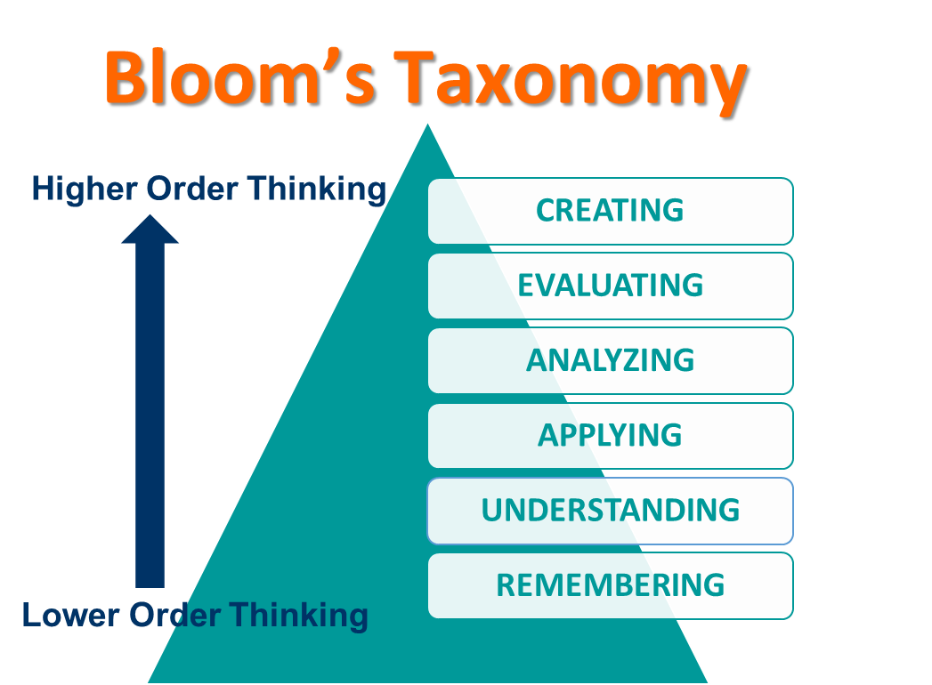
Critical Thinking

Slide 4
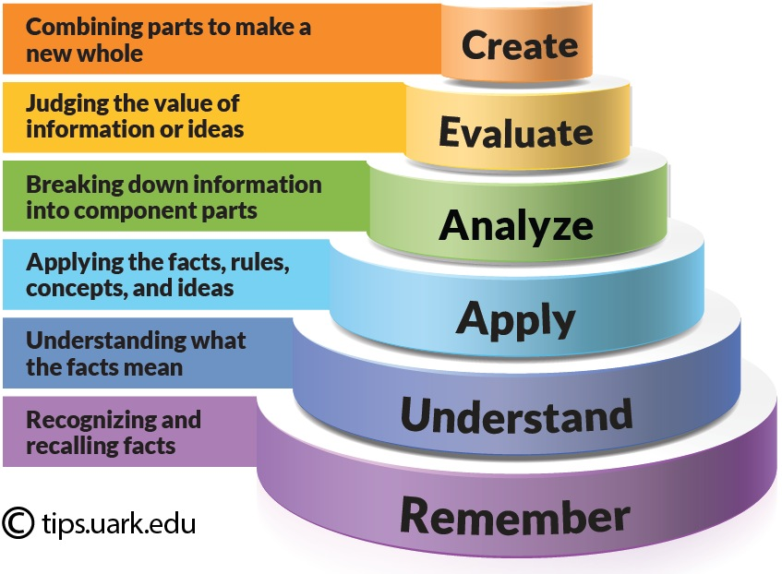

Slide 5
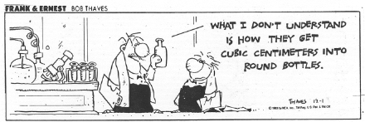
“Intellectual growth” without critical thinking
“progression from ignorant certainty to intelligent confusion”
- Kroll

Slide 6


Slide 7
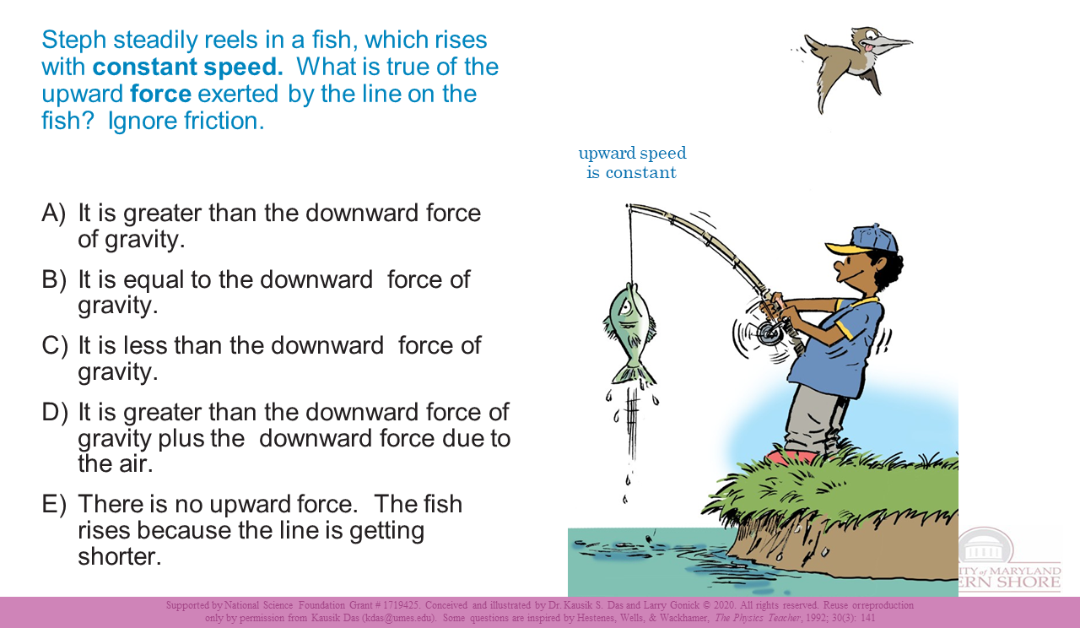

Slide 8
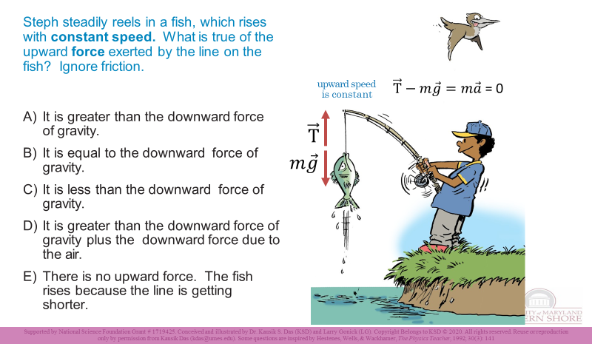

Slide 9
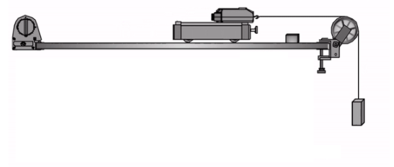

Constant speed
Force sensor

Slide 10
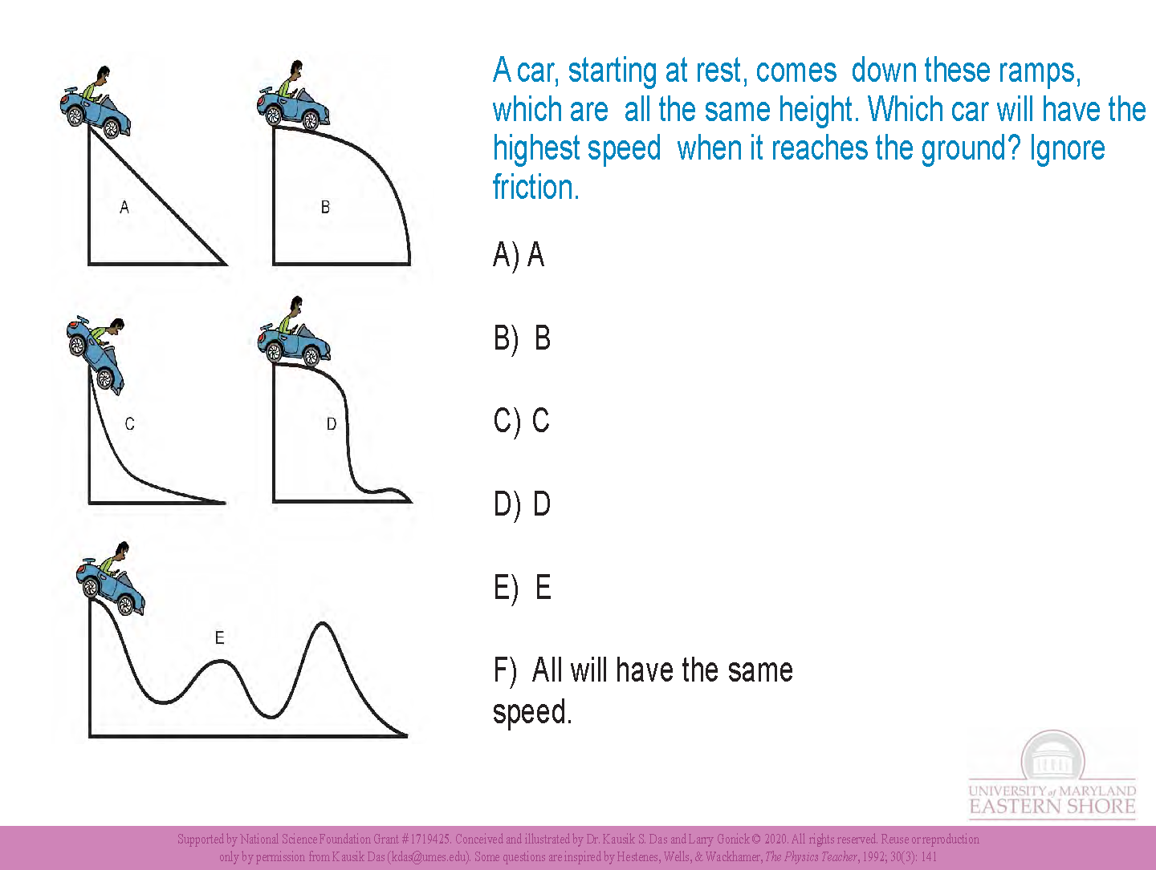

Slide 11
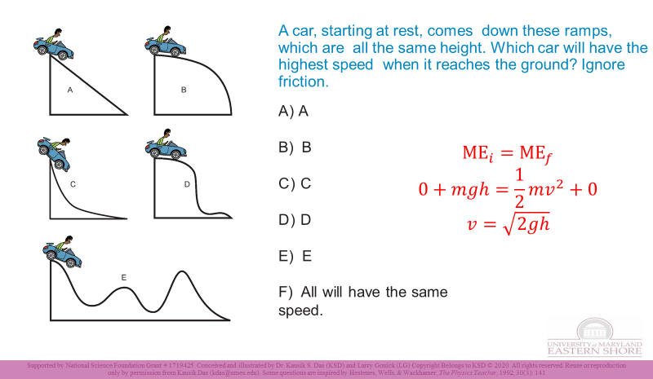

Slide 12
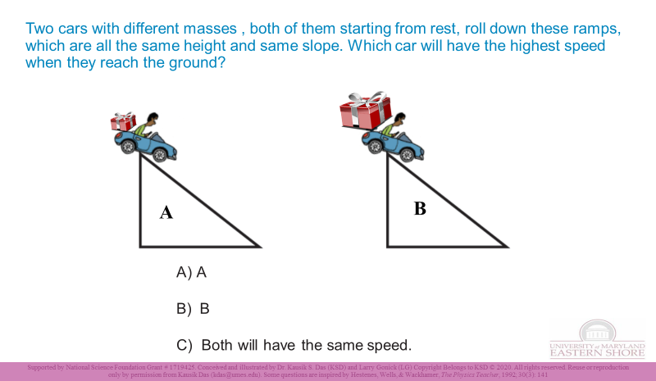

Slide 13
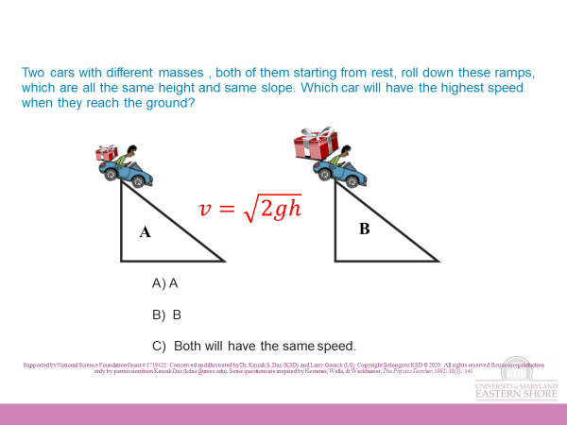

Slide 14
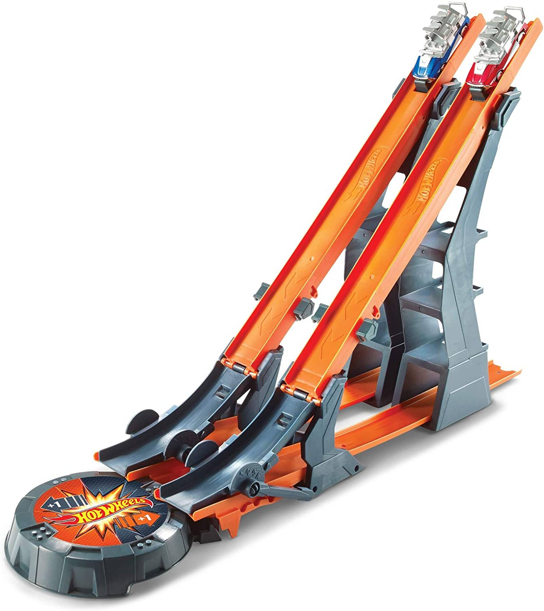
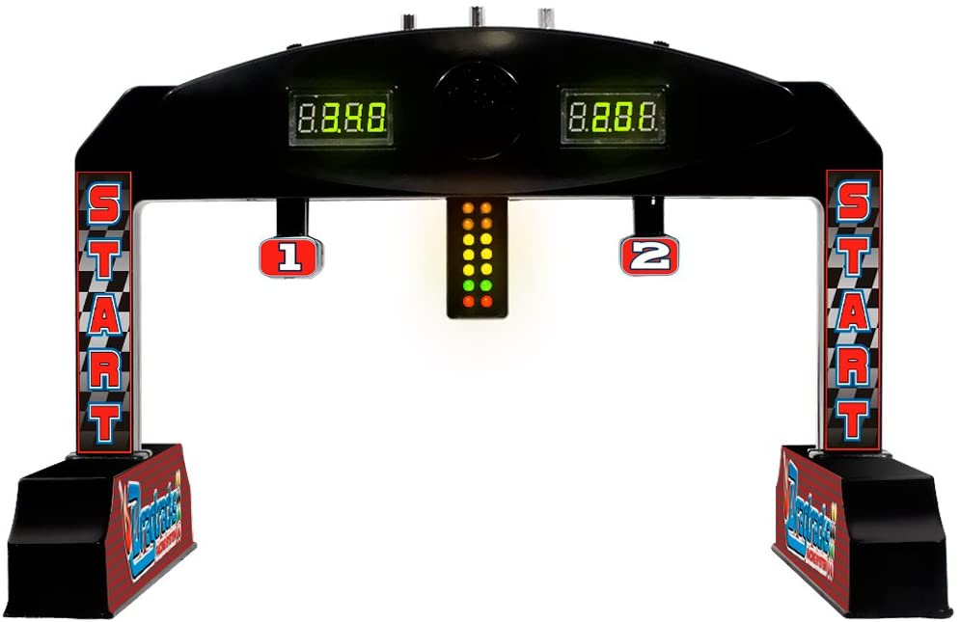

Slide 15
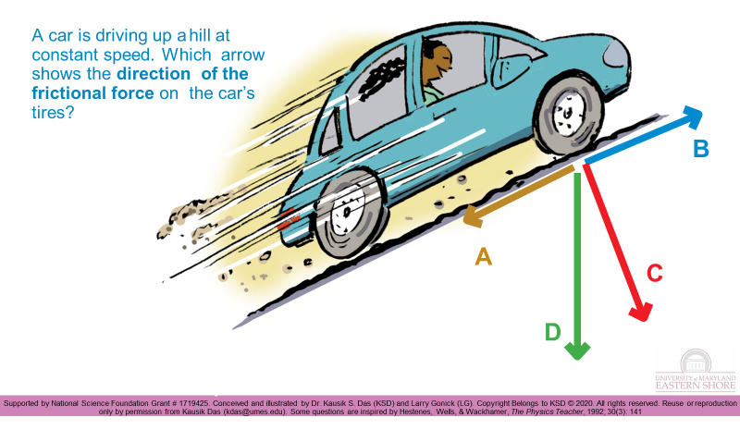

Slide 16


Slide 17
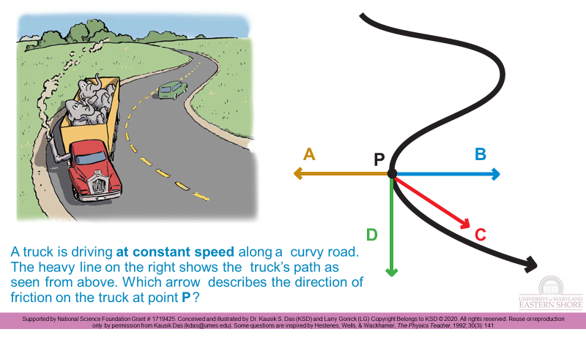

Slide 18
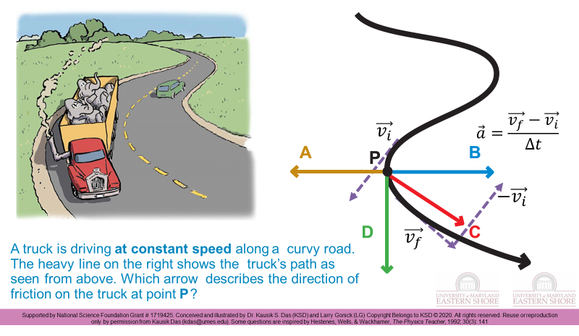

Slide 19
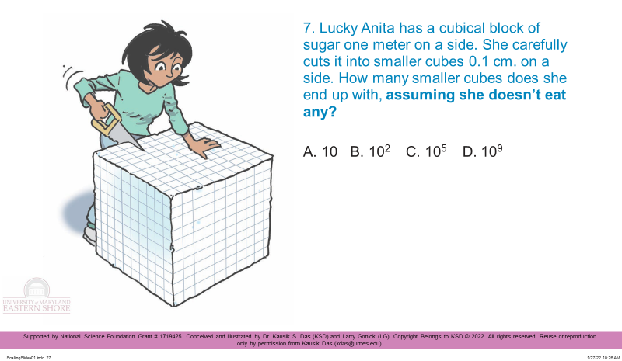
Scaling, Dimension, Growth & Form

Slide 20
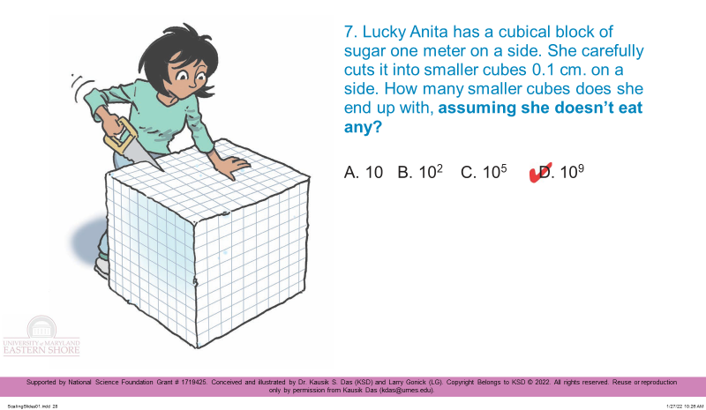
Scaling, Dimension, Growth & Form

Slide 21
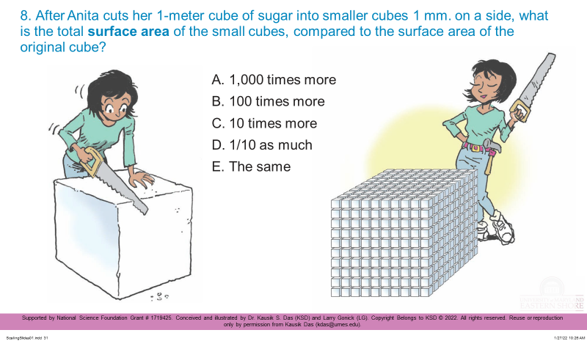
Scaling, Dimension, Growth & Form

Slide 22
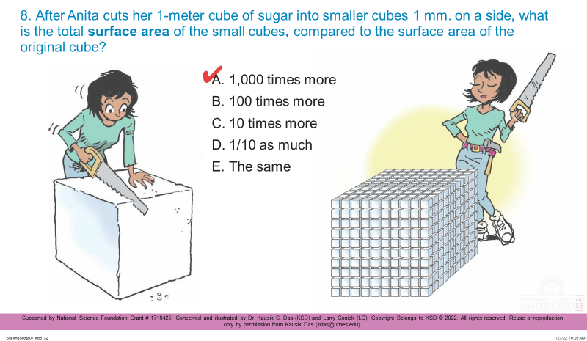
Scaling, Dimension, Growth & Form

Slide 23
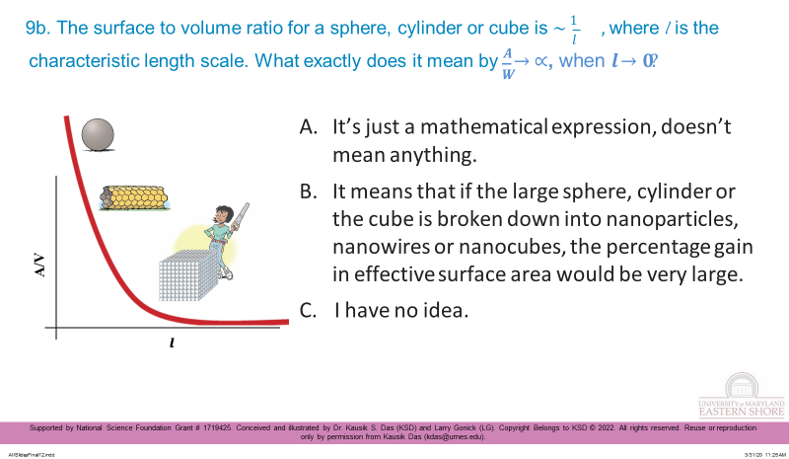
Scaling, Dimension, Growth & Form

Slide 24
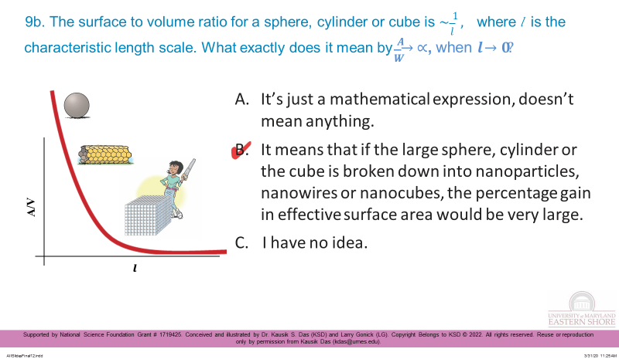
Scaling, Dimension, Growth & Form

Slide 25
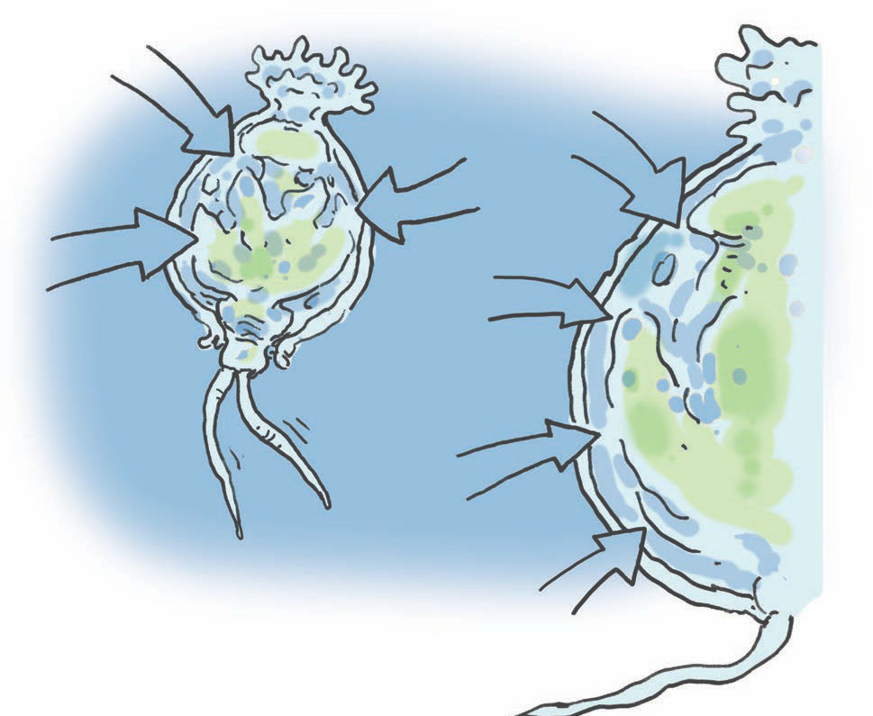
Scaling, Dimension, Growth & Form
O
O₂
O₂
O
O₂
O₂
0.5 mm

Slide 26
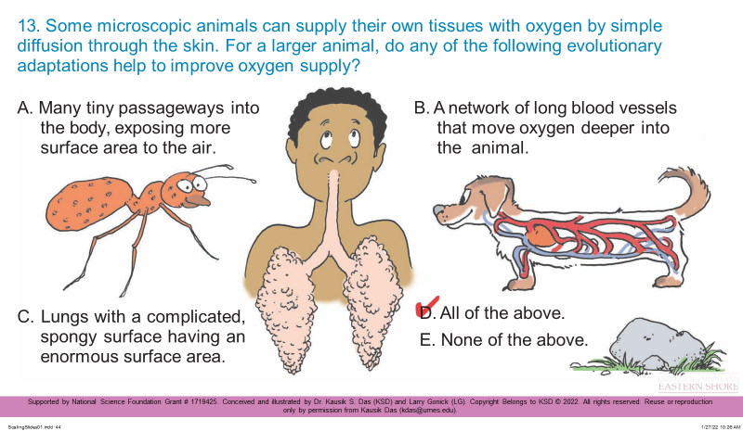
Scaling, Dimension, Growth & Form

Slide 27
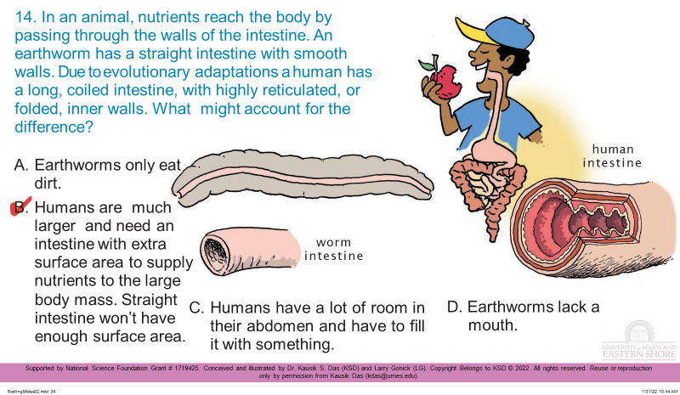
Scaling, Dimension, Growth & Form

Slide 28
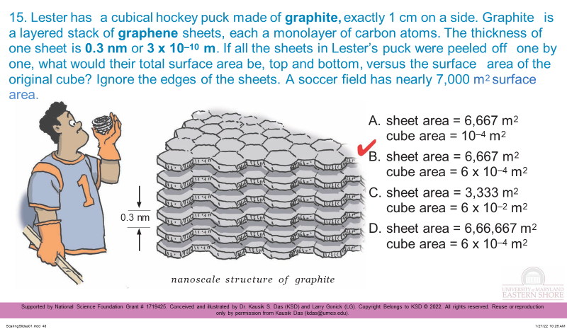
Scaling, Dimension, Growth & Form

Slide 29
Innovation: Authentic discovery-based laboratories
In authentic discovery-based courses, a group of students from diverse background conduct interdisciplinary research where they make an original intellectual or creative contribution to the discipline.

Slide 30
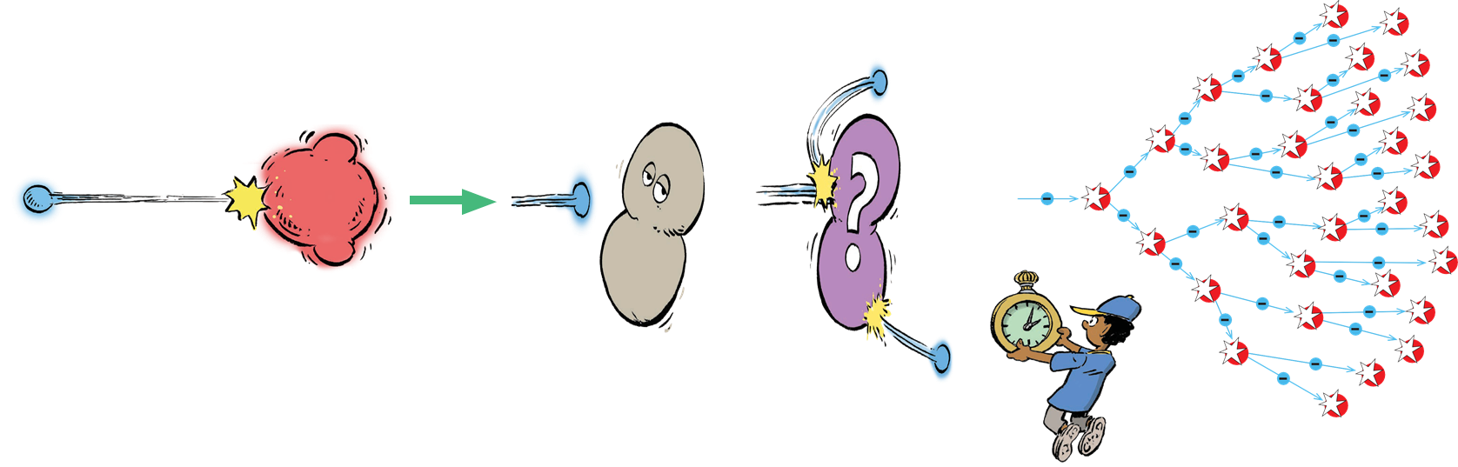
Plasma generation using a kitchen microwave oven
Microwave plasma

Slide 31
Plasma generation using a kitchen microwave oven
Microwave plasma

Slide 32



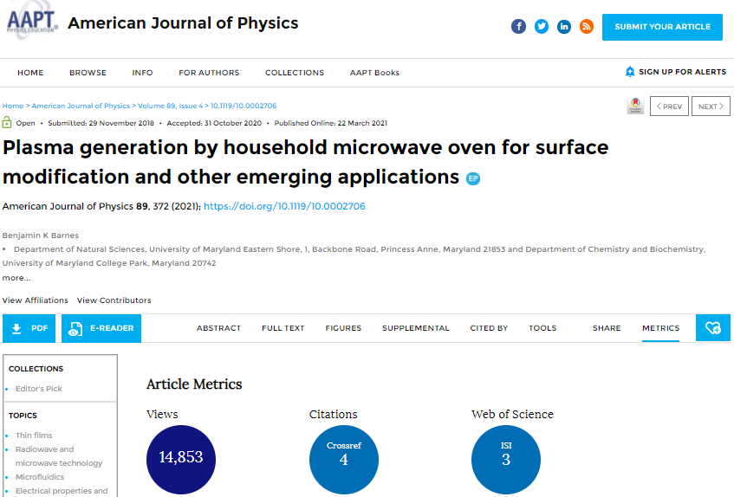
Plasma generation using a kitchen microwave oven

Slide 33

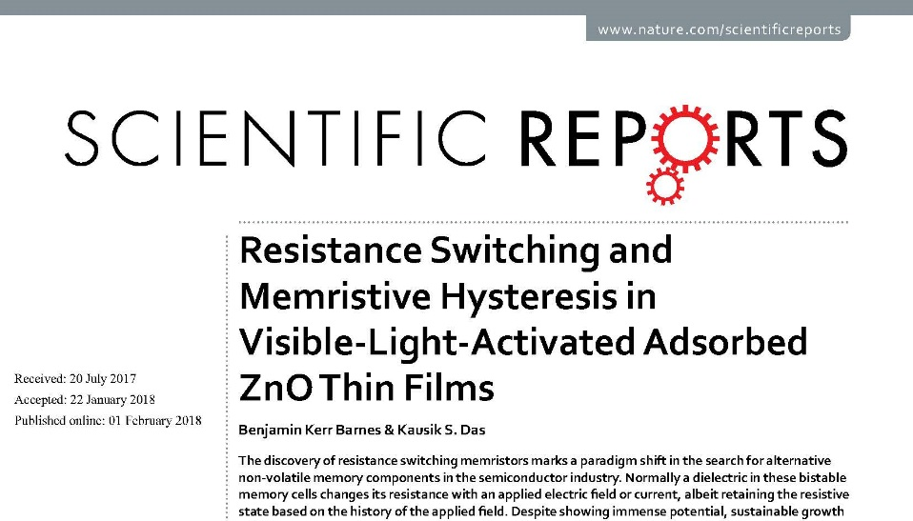

Slide 34
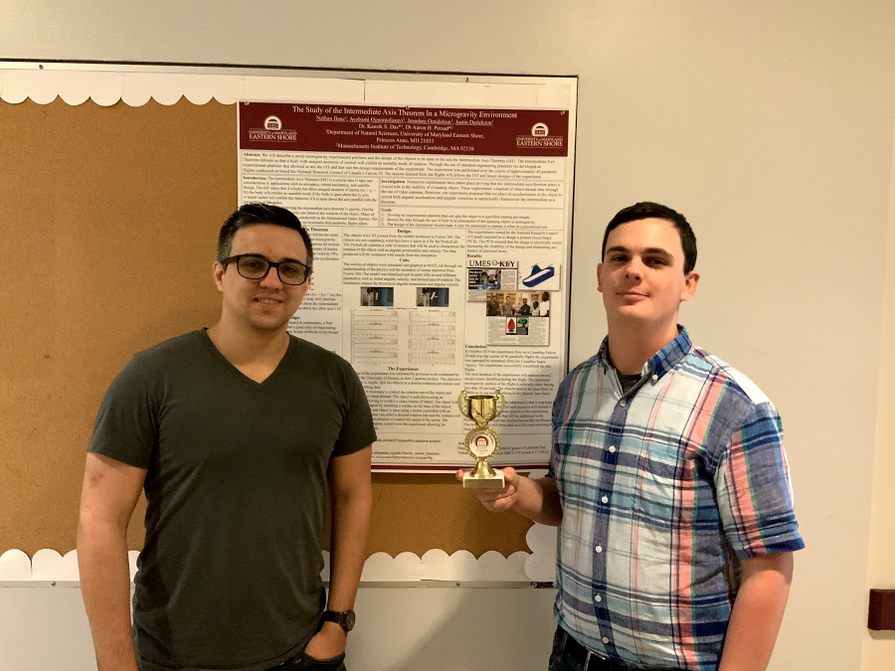
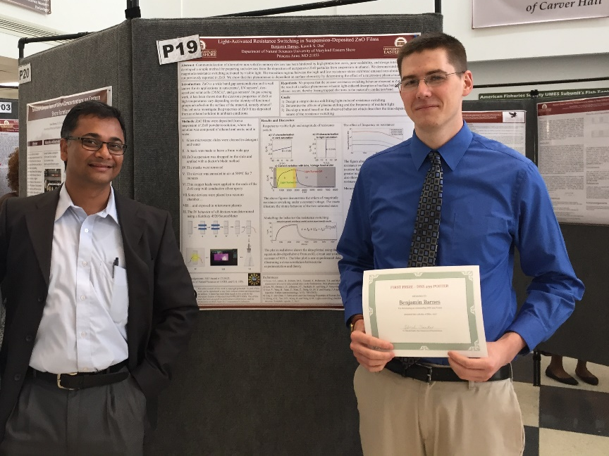
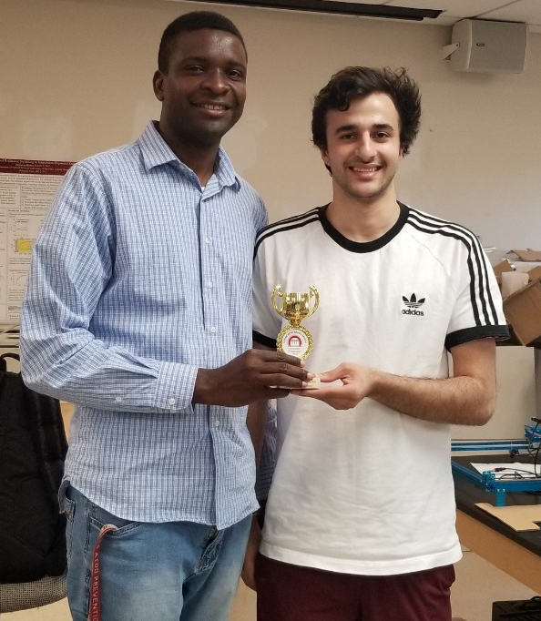
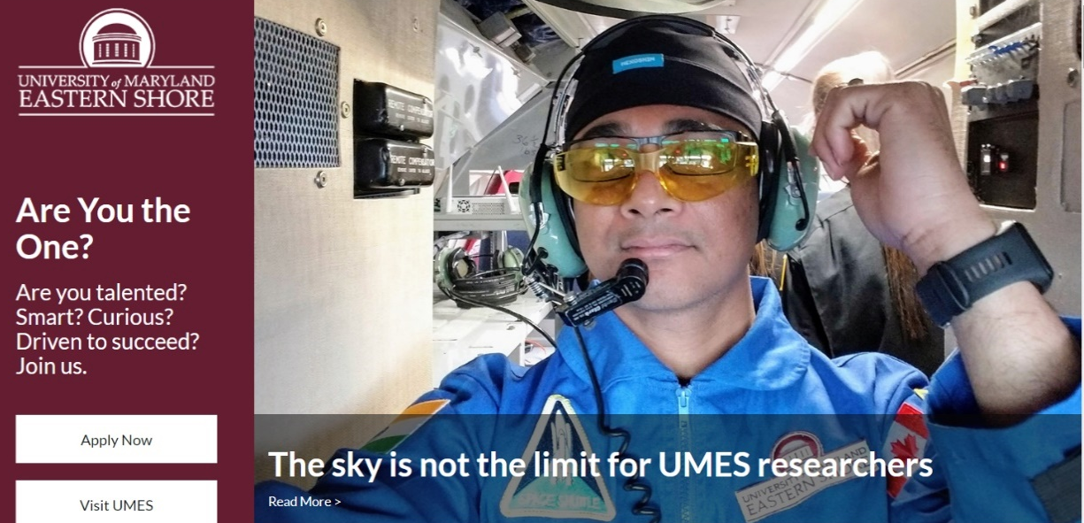
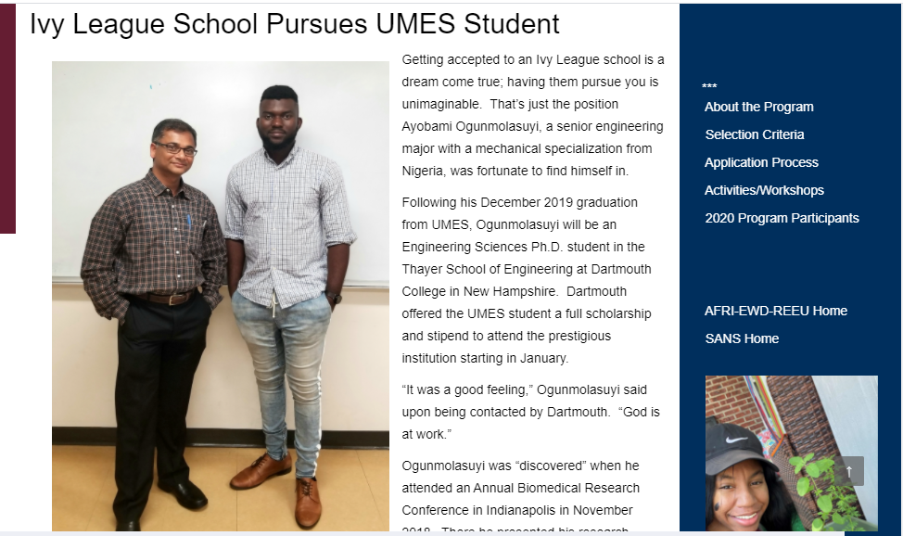
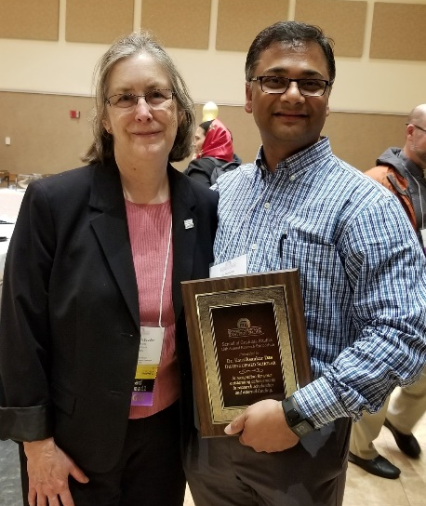
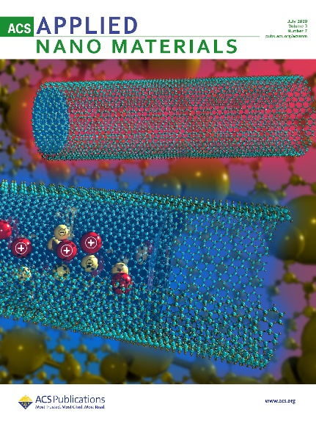



Slide 35
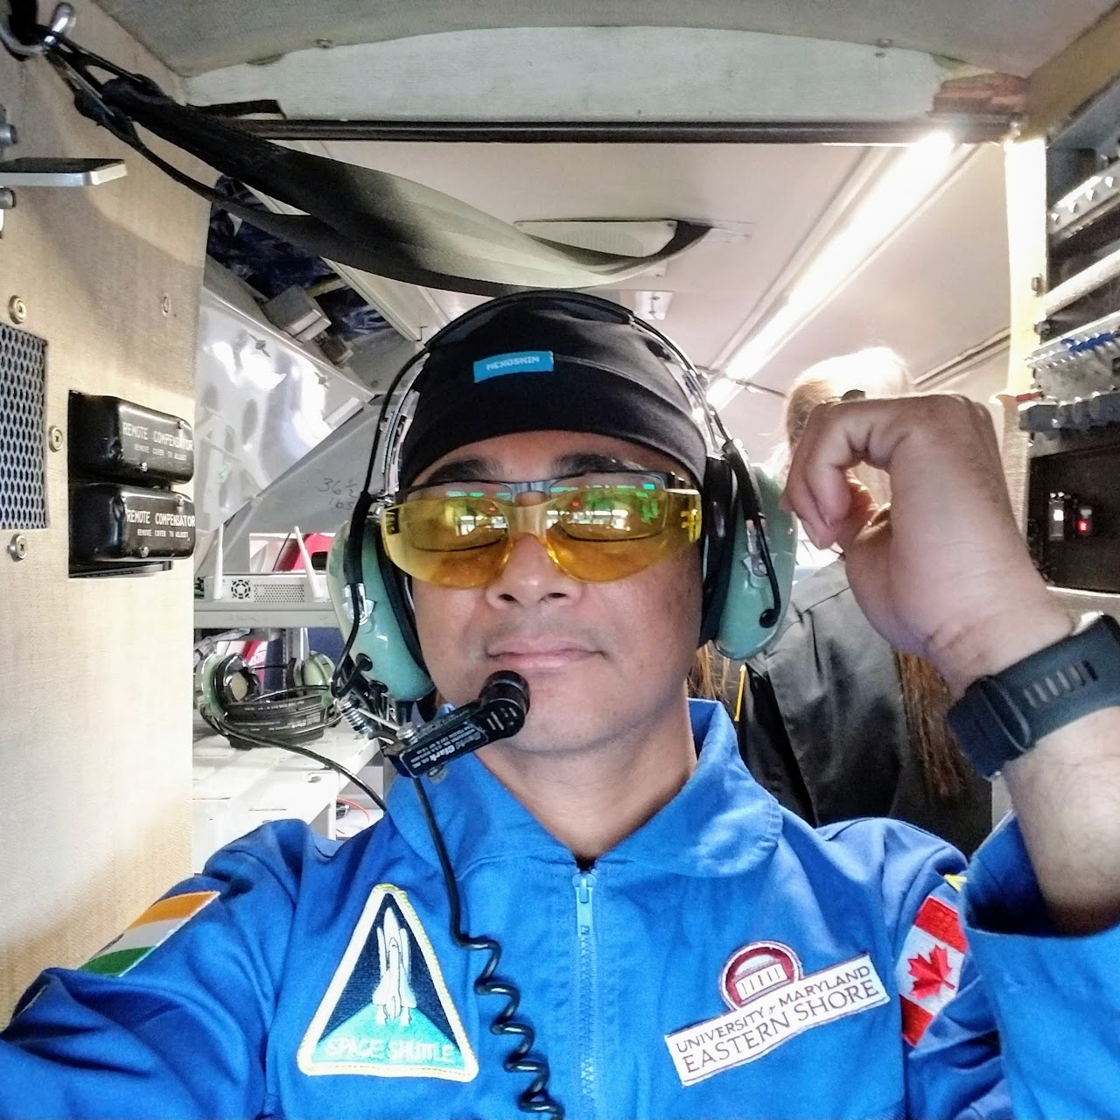
Dynamics of solid body rotation in zero gravity
Asymmetric top rotations give very interesting results in zero gravity.

Slide 36

Dynamics of solid body rotation in zero gravity
Asymmetric top rotations give very interesting results in zero gravity.

Slide 37
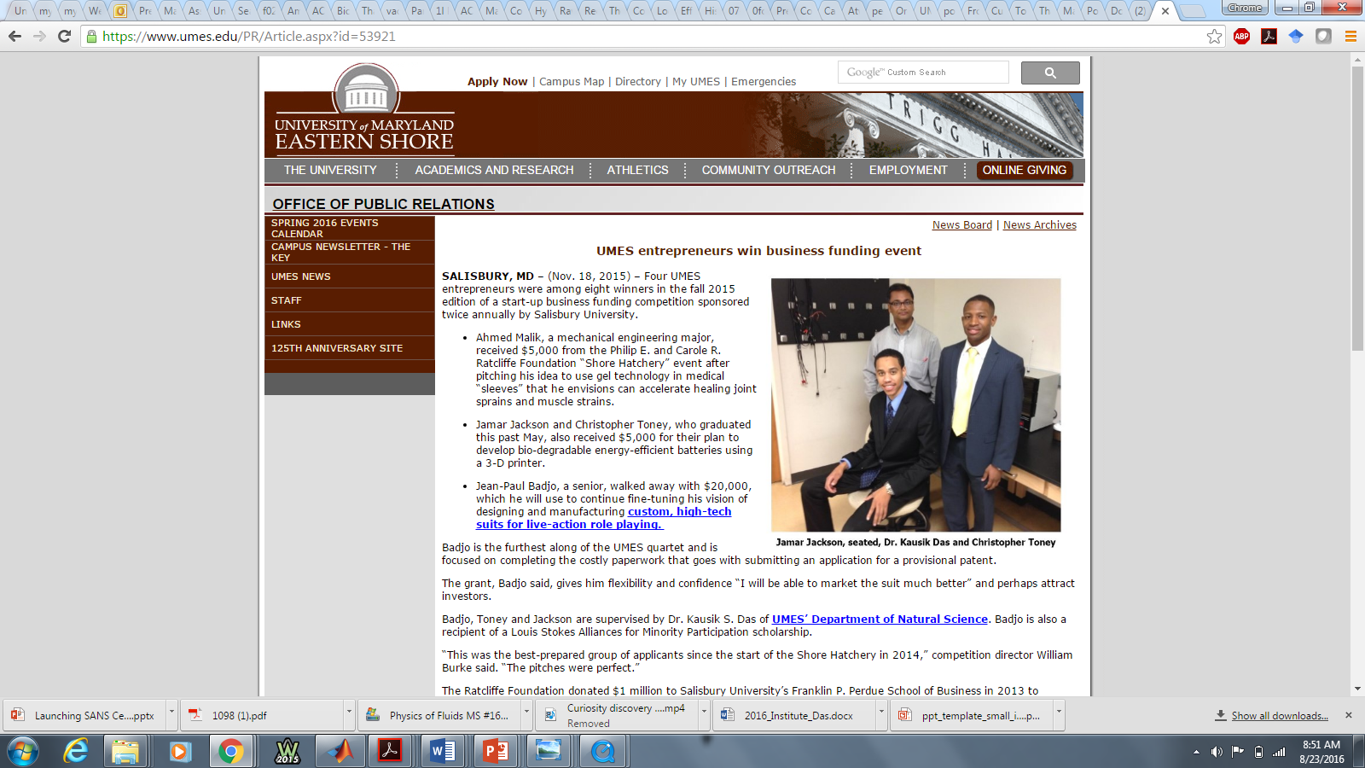
Some Success Stories

Slide 38
Some Success Stories

Slide 39
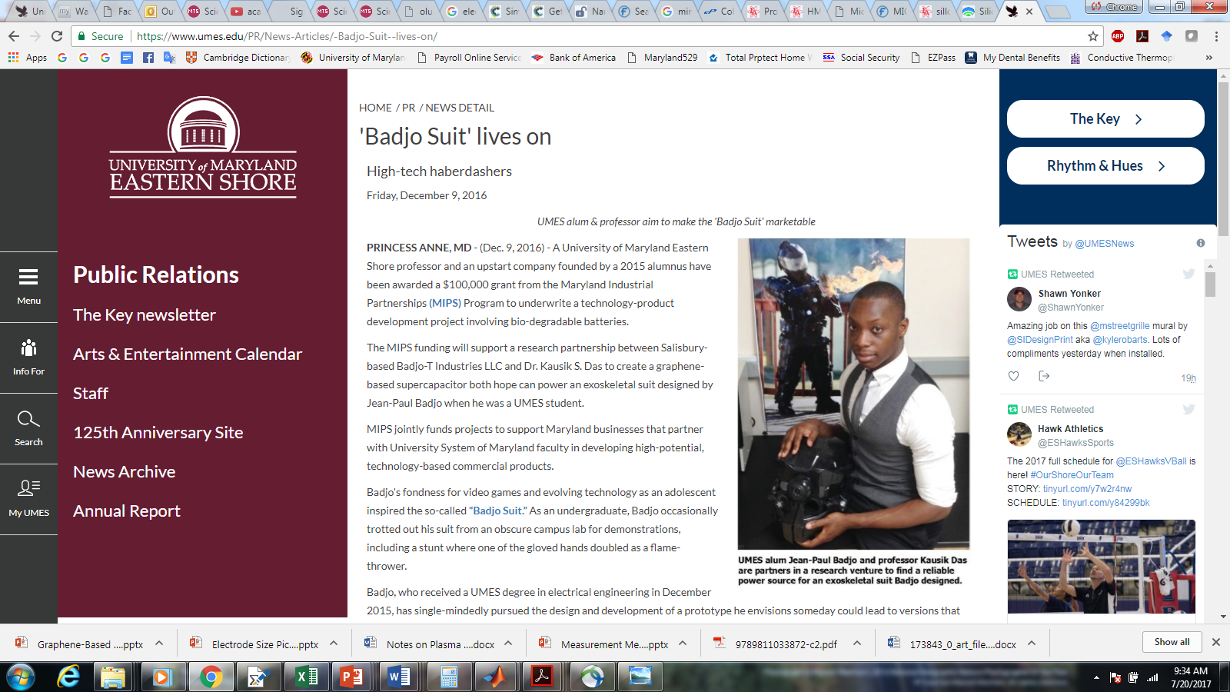
Some Success Stories

Slide 40
Some Success Stories

Slide 41


Thank you for your attention.

