Slide 1

James Freericks, Department of Physics
Georgetown University
Work funded by the NSF and Georgetown

Slide 2


Please join in a moment of silence in solidarity with the citizens of Ukraine

Slide 3
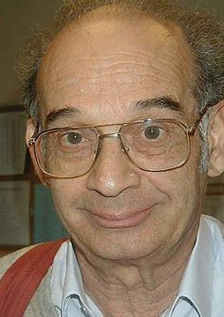
Asher Peres tells us to focus on the real world

Slide 4
Asher Peres tells us to focus on the real world
Quantum phenomena do not occur in a Hilbert space. They occur in a laboratory.

Slide 5
Perhaps you have said in class that we cannot measure position and momentum at the same time

Slide 6
But then how do we measure momentum?

Slide 7
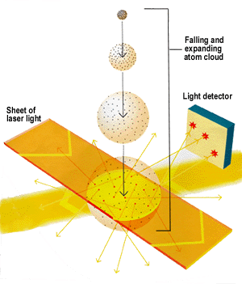
Time of flight

Slide 8
Time of flight
An event starts a clock

Slide 9
Time of flight
An event starts a clock
The particle travels through free space to the detector where it is detected

Slide 10
Time of flight
An event starts a clock
The particle travels through free space to the detector where it is detected
We divide the distance travelled by the time to compute the speed

Slide 11
Time of flight
An event starts a clock
The particle travels through free space to the detector where it is detected
We divide the distance travelled by the time to compute the speed
From the speed we get the momentum

Slide 12
Time of flight
An event starts a clock
The particle travels through free space to the detector where it is detected
We divide the distance travelled by the time to compute the speed
From the speed we get the momentum
At the instant of measurement, we know the position and the momentum of the particle at the same time.

Slide 13
It is simply not true that one cannot measure position and momentum at the same time!
Please don’t tell your students this.

Slide 14
We cannot prepare a quantum state with definite position and momentum, but we can measure position and infer momentum as accurately as you want.

Slide 15
Time of flight gives a great opportunity to talk about real experiments and the relationship between collapse and what is actually measured.

Slide 16

Cindy Regal shows us how to do this with harmonic oscillator wavefunctions.

Slide 17
Prepare the ground state by cooling. Use a double-well structure to transfer to a low excited state. Then release the trap and use time of flight to measure the momentum distribution.

Slide 18
Harmonic oscillator wavefunctions measured by time of flight (Regal)

Slide 19
This is a great example of a second quantum revolution experiment that can be understood even at the high school level!

Slide 20


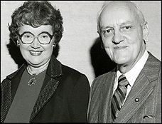



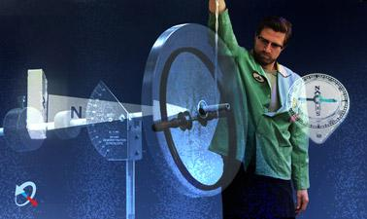
Thanks to
Resources
https://quantum.georgetown.domains
https://www.edx.org/course/quantum-mechanics
https://www.edx.org/course/quantum-mechanics-for-everyone

