Slide 1
Using 3D Printing within my Physics Education through Free Computer-Aided Design Resources
Hannah McPherson
Bridgewater College
hmcpherson@eagles.bridgewater.edu

Slide 2
Outline
What is Computer-Aided Design (CAD)?
CAD Learning Resources
Overview of 3D Printing Process
Example Projects in Physics Education

Slide 3
What is Computer-Aided Design? (CAD)
Software designed for object creation.
Graphic visualization.
Greater accuracy than hand-drawn diagramming.
2D Diagramming
Floor plans, construction blueprints, electrical layouts, ect.
3D Modeling
Object modeling, may lead to 3D printing.

Slide 4
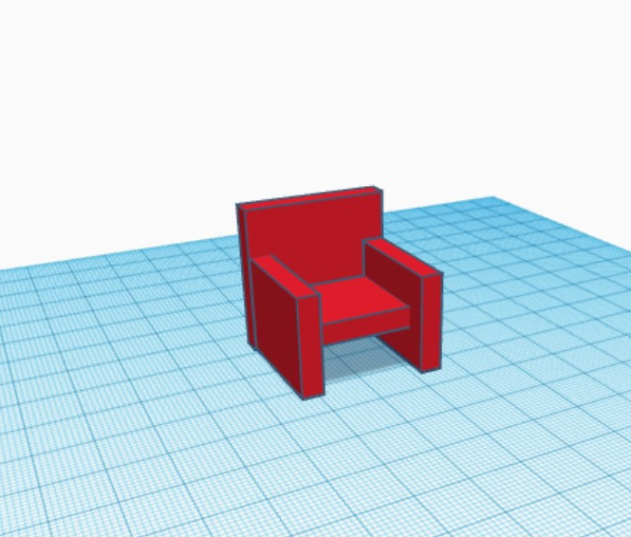
TinkerCAD
Beginner level.
Create a free account at Tinkercad.com!
Class Friendly!
Similar conceptual functionality to AutoCAD.

Slide 5
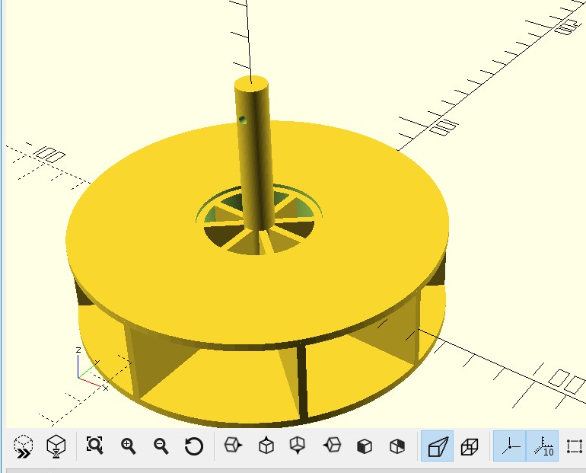
OpenSCAD
Intermediate level
Encouraged for programming inclined students.
Free download to Windows, Mac, or Linux.

Slide 6
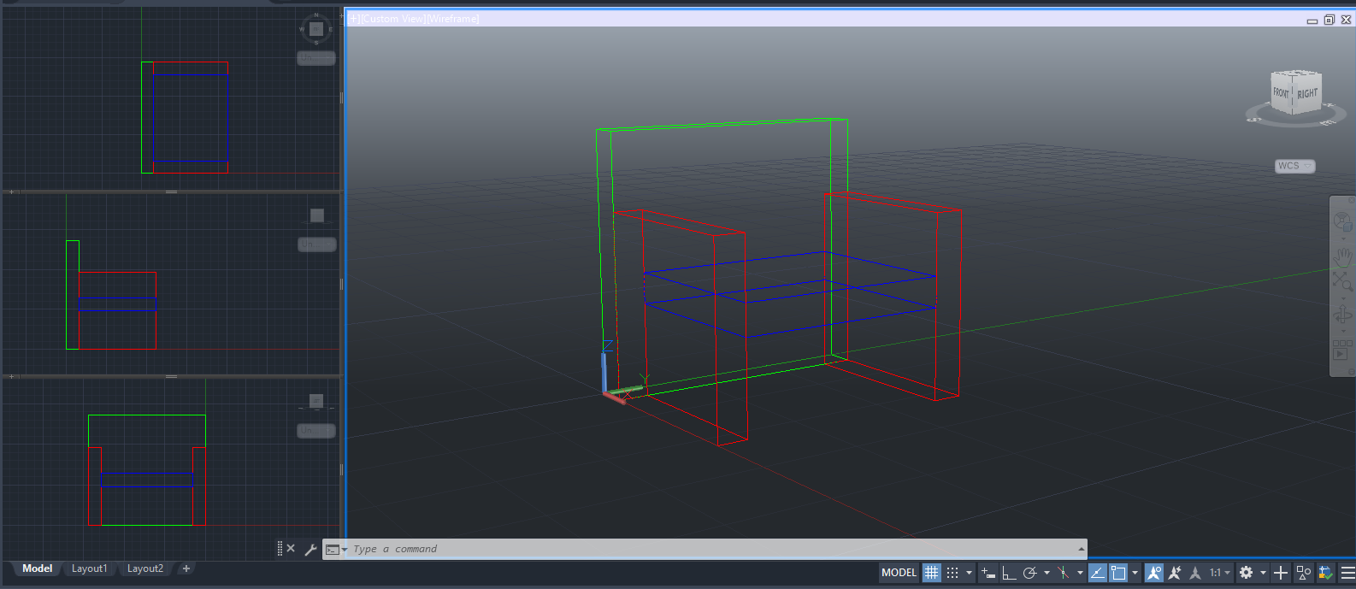
AutoCAD
Commercial-level Engineering software.
2D and 3D modeling capabilities.
Free 1 year student trial.
Available for Windows and Mac.

Slide 7
How does CAD help Students?
Abstract problem solving:
How can I create a given object using these shapes?
Familiarity with software commonly used in Engineering careers.
Easy to use functionality for visualization of objects.

Slide 8
Learning Resources
TinkerCAD
TinkerCAD offers free tutorials for trial projects on their website!
OpenSCAD
“mathcodeprint” on youtube.com offers a beginner series of tutorials to create using OpenSCAD software. https://youtu.be/oTCu2hCuqfg
AutoCAD
https://www.mycadsite.com/tutorials.html. Free tutorials, as well as check-in quizzes and sample files, for using AutoCAD in both 2D and 3D design.

Slide 9
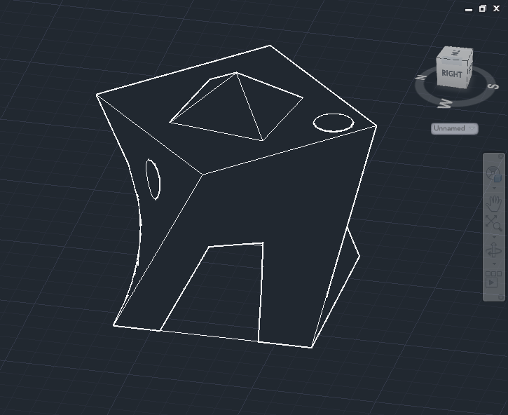
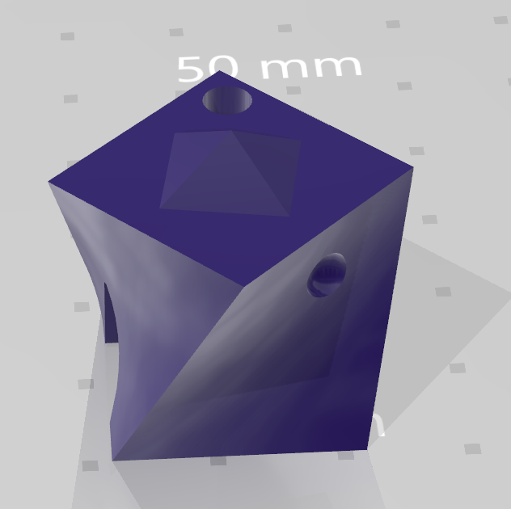
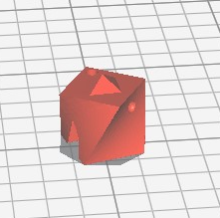
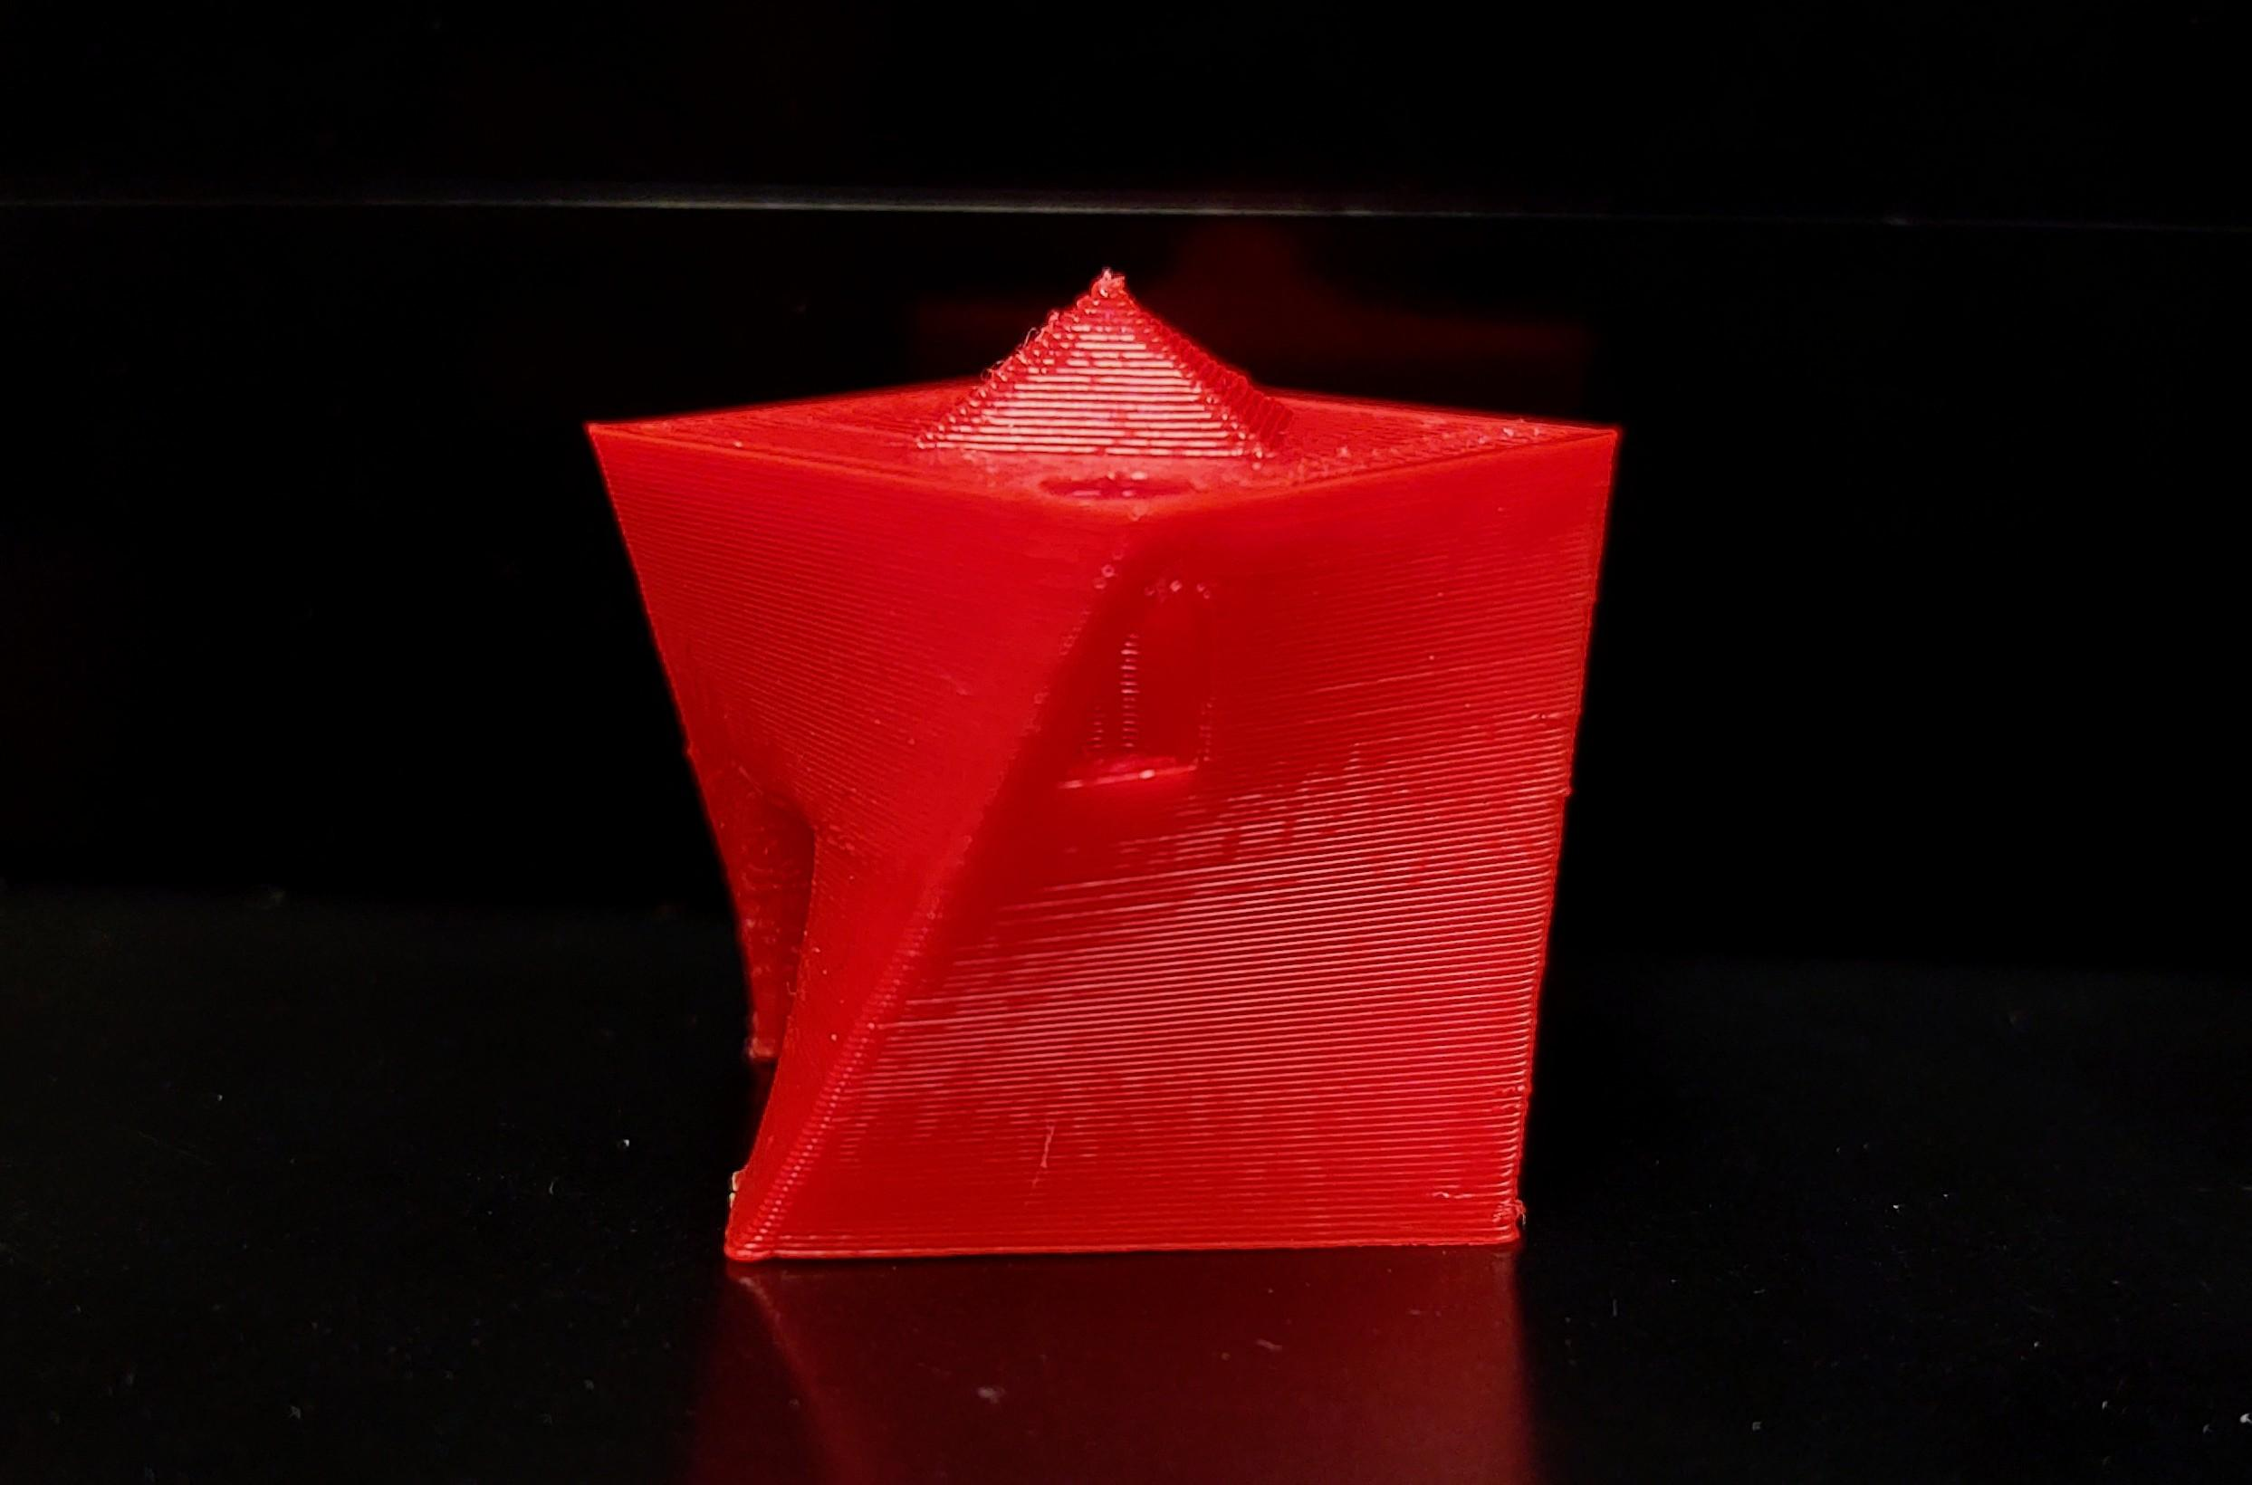
From CAD to 3D Printing: How does it Work?
Create object in preferred CAD environment.
Export object to .stl file.
Splice into gCode.
This splicer is specific to your printer.
Print!

Slide 10
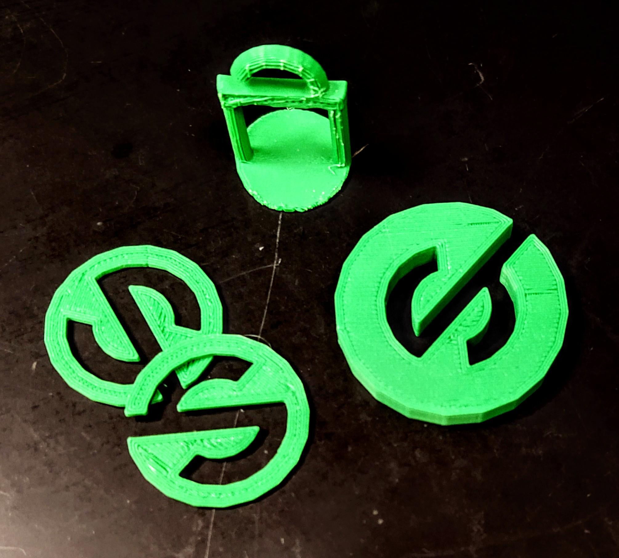
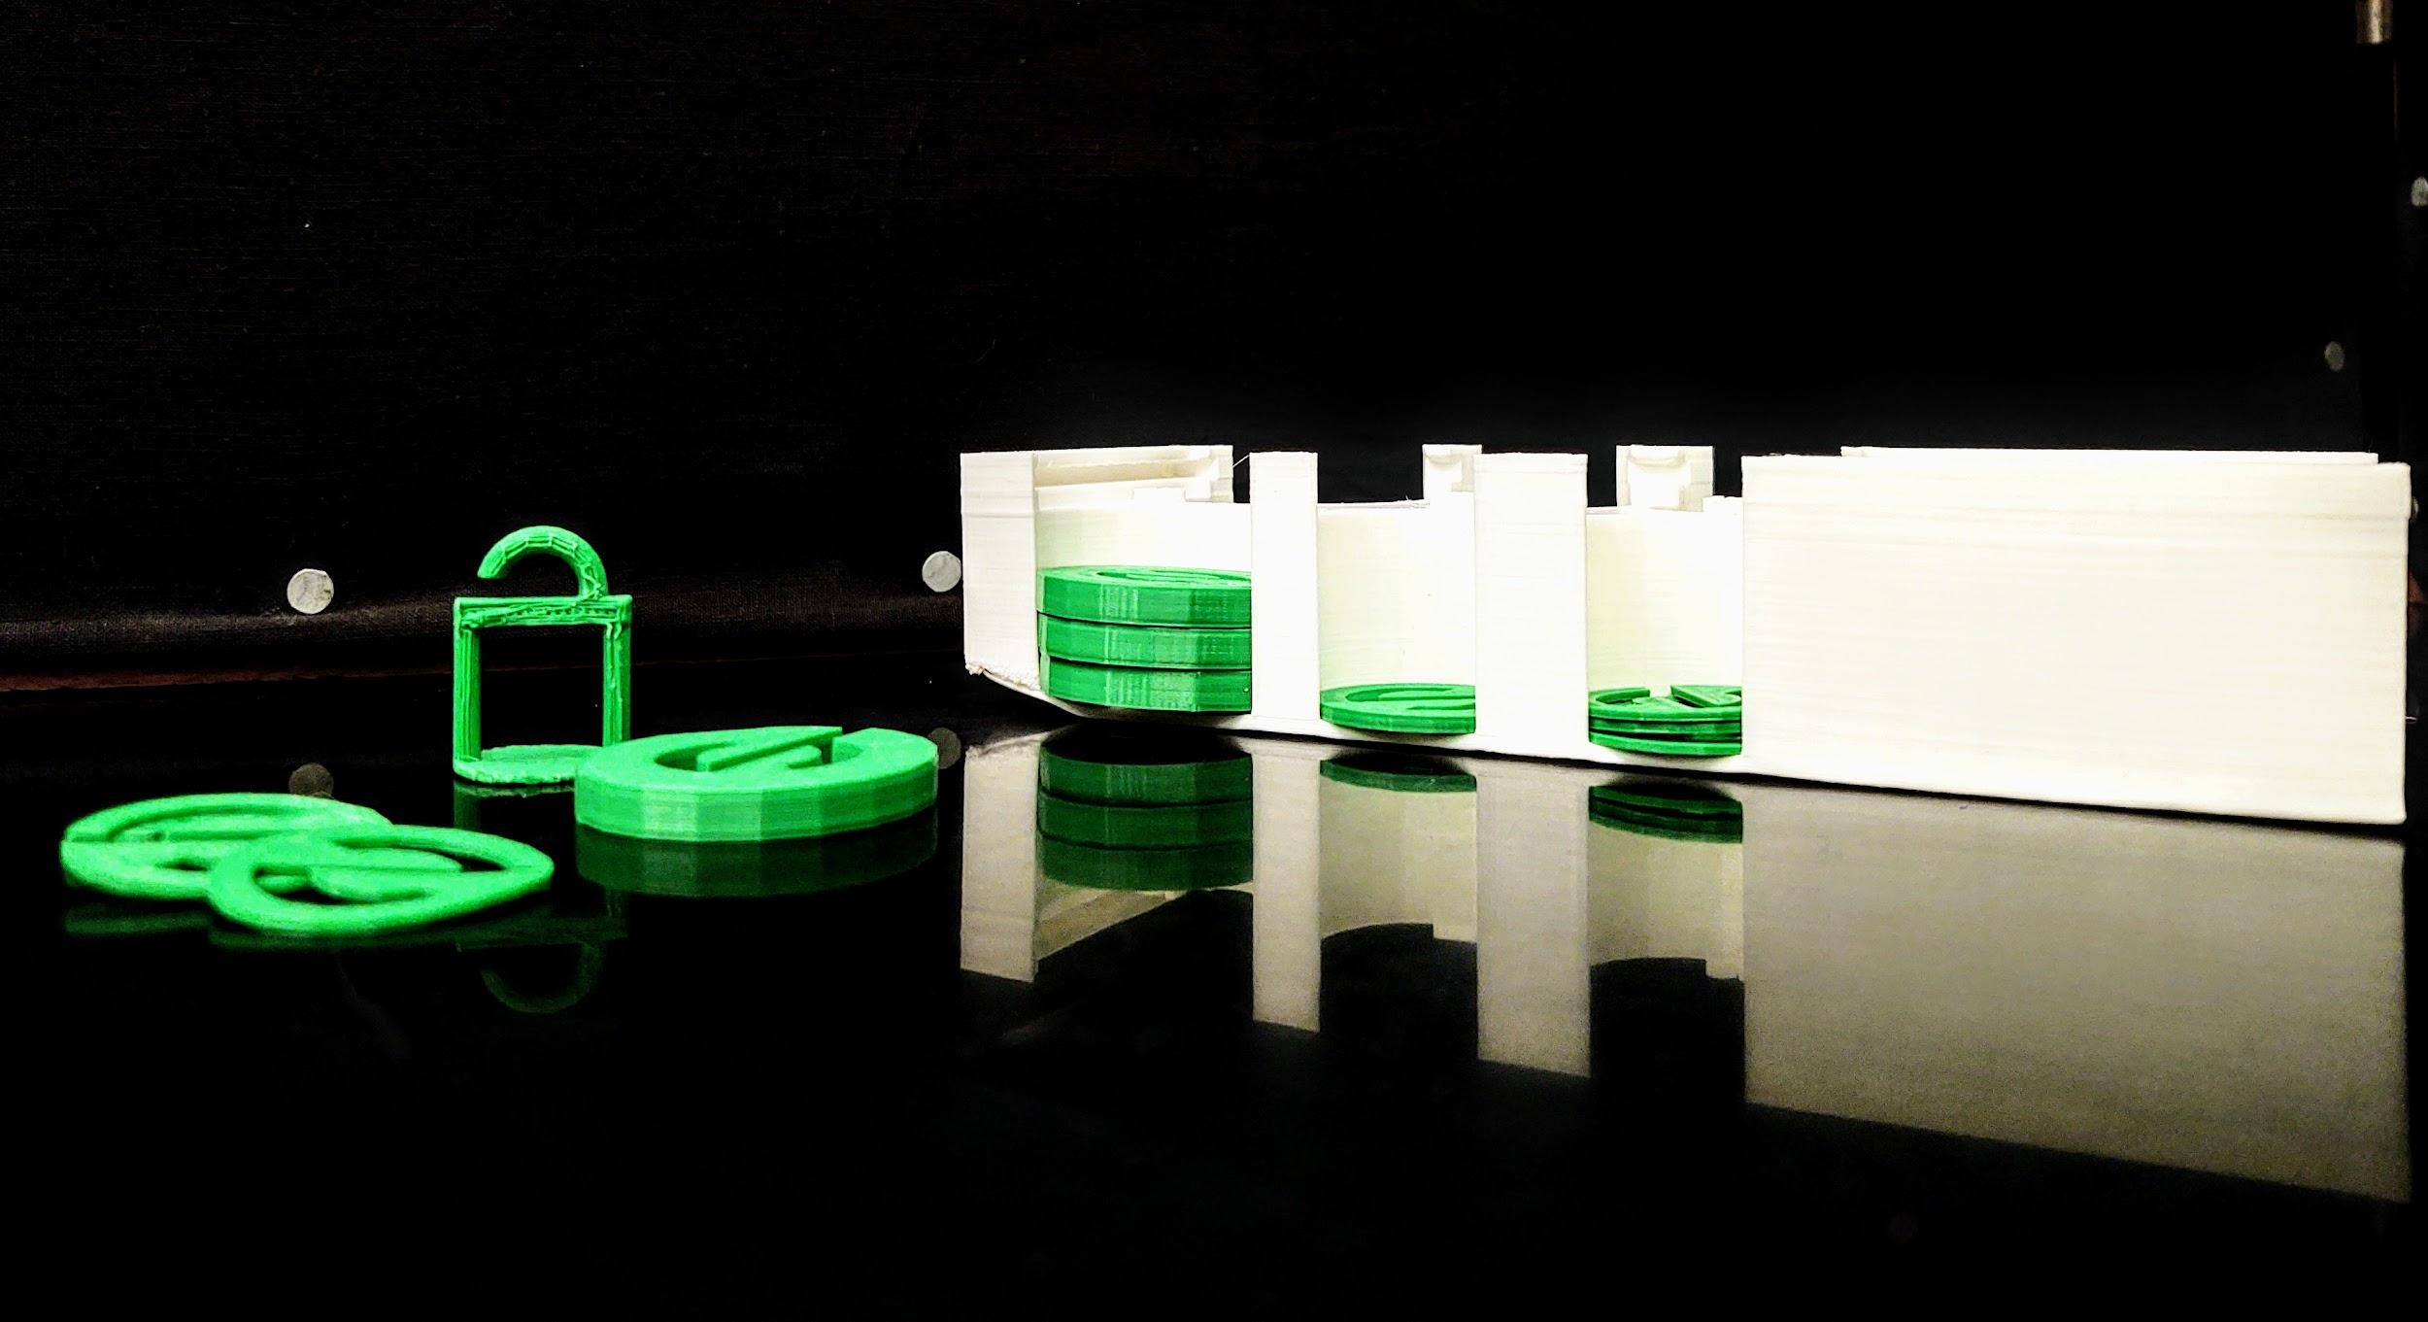
Projects within a Physics Education
Token Masses
Student independently designs objects of various masses.
1g “hanger”, 2g, 5g.
Accurate masses may then be used in lab for extra application.

Slide 11
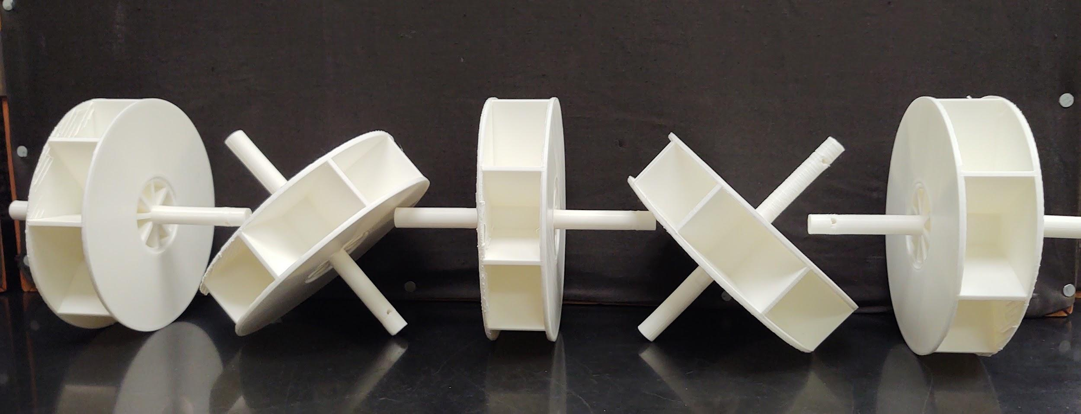
Projects within a Physics Education
Waterwheels
Students design waterwheel objects using CAD software.
Objects are printed and tested for functionality in lab.
Water-wheels should be designed to lift masses when in use.
Creating a “wheel stand” that students must fit their wheels into for testing adds an extra challenge in that designs must be restricted to specific dimensions.

Slide 12
Thank You

