Slide 1
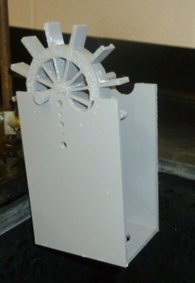
Doing 3D Printing with Students in Physics Labs
Deva O’Neil, Bridgewater, VA
doneil@bridgewater.edu

Slide 2
Outline Opportunities for 3D printing in Physics Examples of 3D printing projects Sharing & Obtaining Resources: PICUP

Slide 3
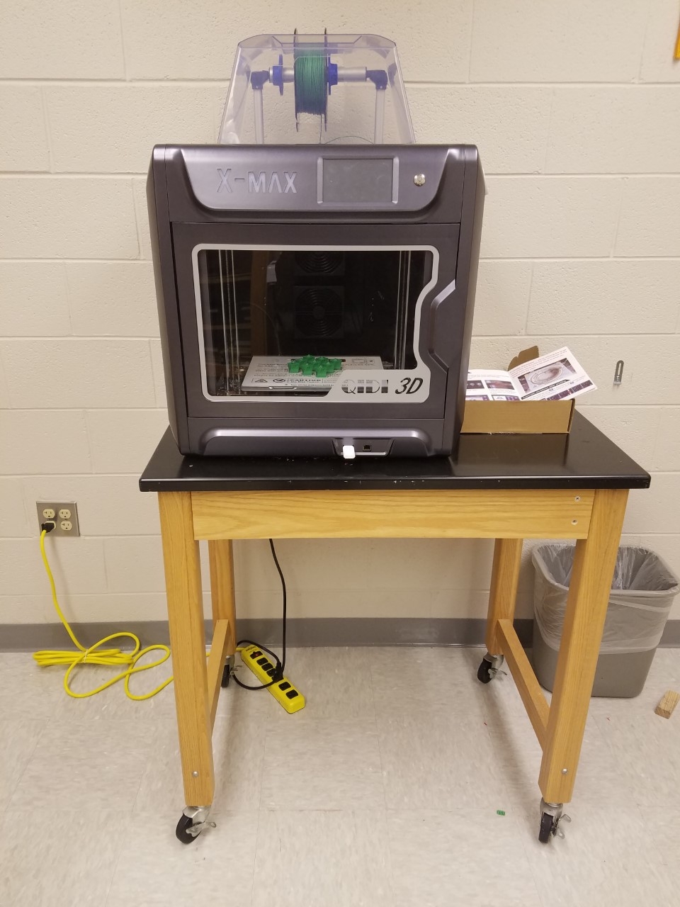
Opportunities
General Physics Labs
Independent Studies in
AutoCAD
Senior Capstone/Design
Projects
Physics Department
Internships

Slide 4
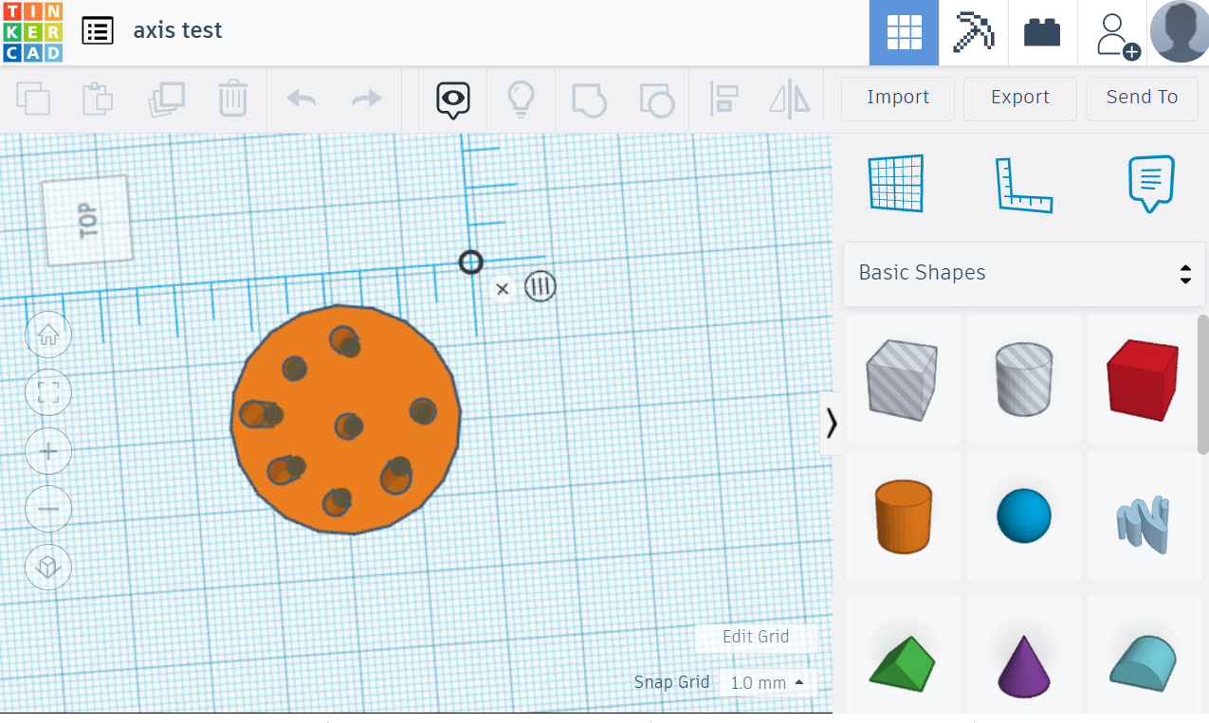
TinkerCAD
Introducing Physics and
Chemistry majors to
computer-aided design

Slide 5
General Physics I - 2 projects over the course of the semester (4 lab sessions) - Choice of 3DP or doing a traditional lab.

Slide 6
Session 1: Design (using TinkerCAD -> students who chose the traditional option did an alternative activity. …Printing… Sessions 2: Use the printed object to do experiment; all students did the same activity, sharing the printed equipment.

Slide 7
Examples of 3D printing projects waterwheel fan cart gear box mechanical arm

Slide 8
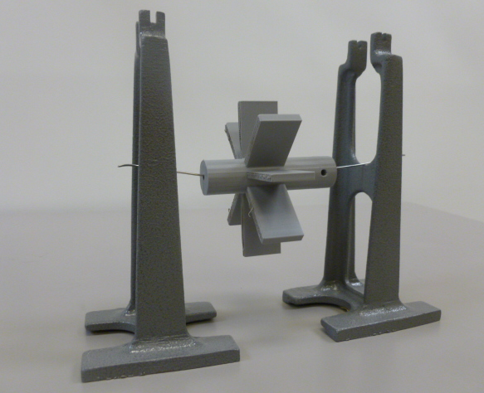
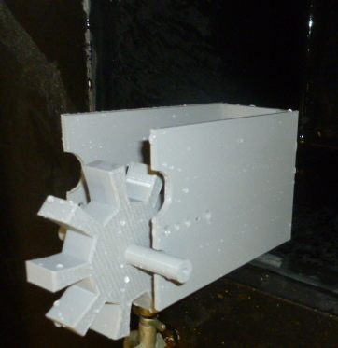
Water Turbine
Goal:
Measure the work done by a turbine in lifting a load using water power.

Slide 9
Share your activities at gopicup.org
Deva O’Neil, doneil@bridgewater.edu

Slide 10
-
Learning Objectives
Learning Objectives | Students who complete this set of exercises will be able to: Apply the concept of density to calculate the potential energy of a water reservoir (Exercise 1) Calculate work done in lifting a load vertically and relate it to power (Exercise 2) Calculate efficiency and identify sources of energy loss (Exercise 3) Practice design thinking and develop CAD skills in designing and printing a water turbine (Exercise 4) Use video analysis to verify that the system is in equilibrium (Exercise 5)

Slide 11
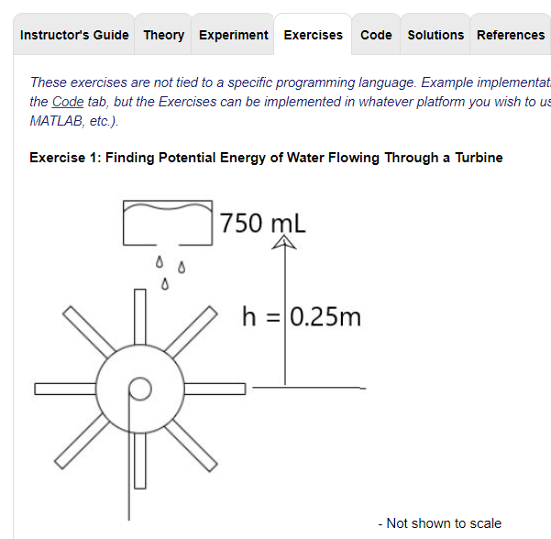
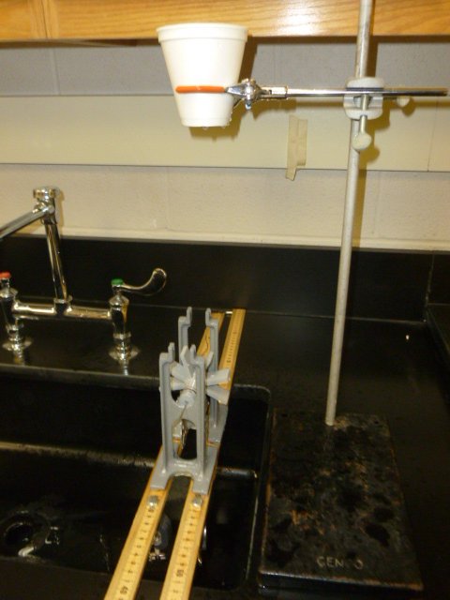
-
Theory | Experiment | Exercises | Solutions | Sample designs

Slide 13
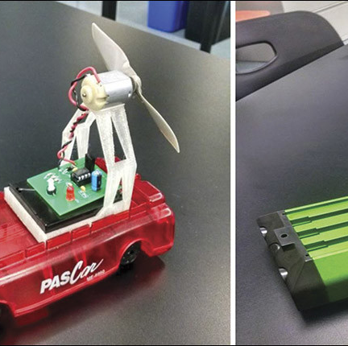
Fan Cart
Design fan blades for a fan cart with the goal of optimizing thrust.
Brian Lamore provides instructions and equipment needed for 3D printed fan carts
Fan Cart: The Next Generation
The Physics Teacher 54, 408 (2016); https://doi.org/10.1119/1.4962775

Slide 14
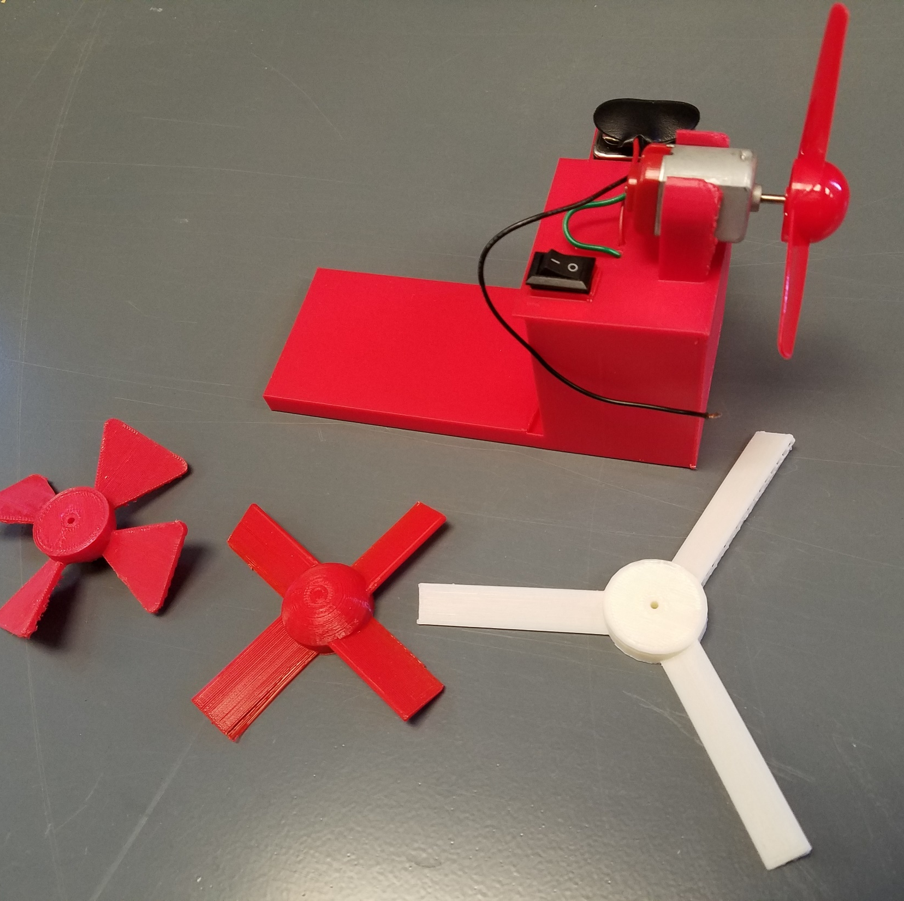
Fan Cart
Introductory physics students designed the fan blades
Chassis and circuitry were designed by students doing an independent study in AutoCAD
Most fan carts were able to generate enough thrust to overcome friction on a low-friction track
Most did not have enough thrust to tow a load.

Slide 15
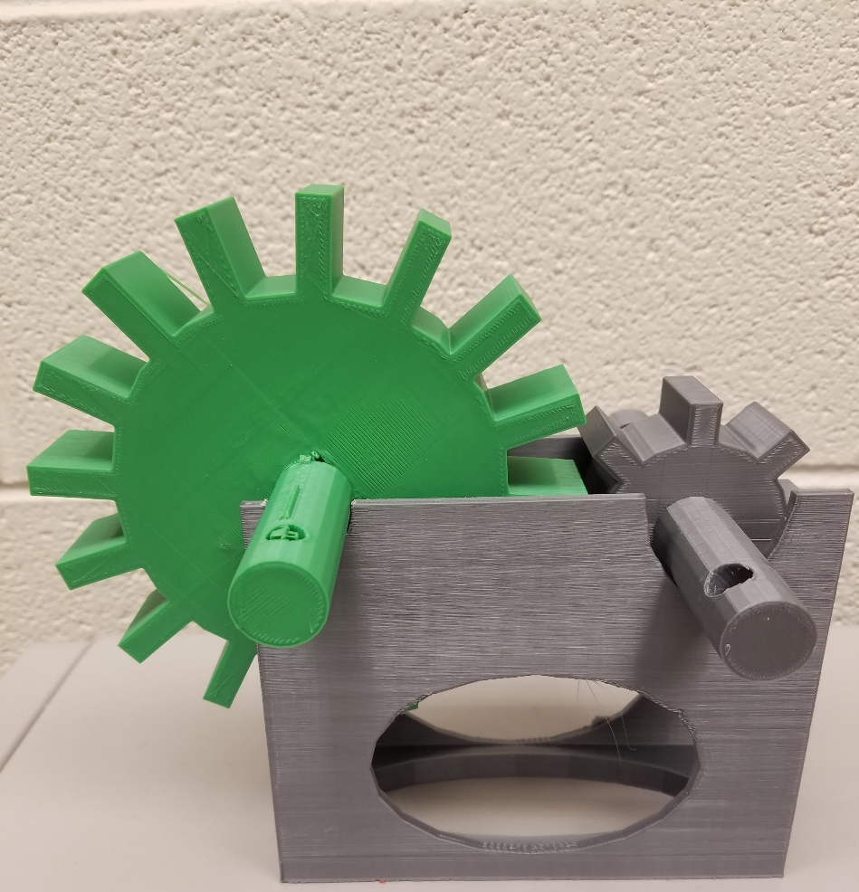
Gear Box
The goal of the project was to achieve a 2:1 gear ratio
Lift a load attached to one gear by cranking the other gear.
Students designed the gears successfully
Difficulty: designing a holder to mount the gears so that they would couple without jamming

Slide 16
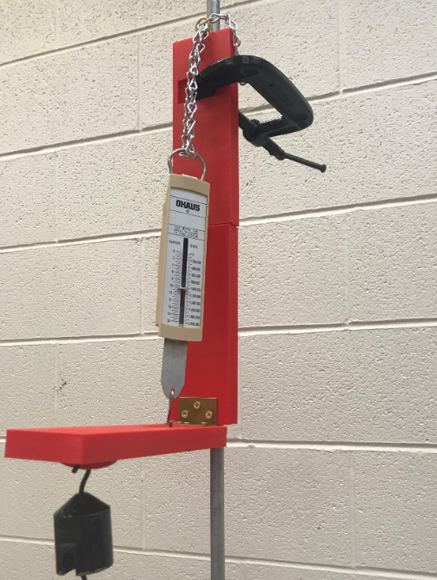
Mechanical Arm Used for torque balance

Slide 17
Share your activities at gopicup.org
Deva O’Neil, doneil@bridgewater.edu

