Slide 1
QuarkNet
Particle Physics in the High School Classroom
Rebecca Jaronski
Lead Teacher, Virginia Tech QuarkNet Center
Physics and Astronomy Teacher, MCPS

Slide 2
Particle Physics: Careers and Opportunities
When I was first recruited to QuarkNet, I had to start from scratch! Even with a physics degree, I had almost no awareness of particle physics.
Introductory physics courses (both high school and at university) rarely have time to cover any modern physics, and particle physics is not a priority.
While universities may offer particle physics seminars or classes as electives, they are usually not a requirement.
This leaves many graduates with little to no knowledge of this very important field of physics! How can they aspire to work at Fermilab? or CERN?

Slide 3
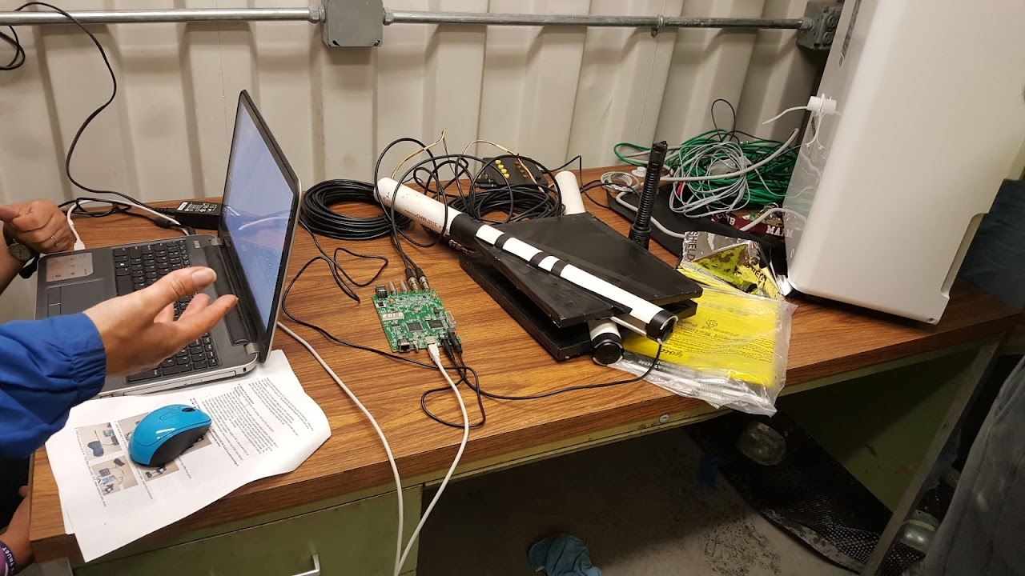
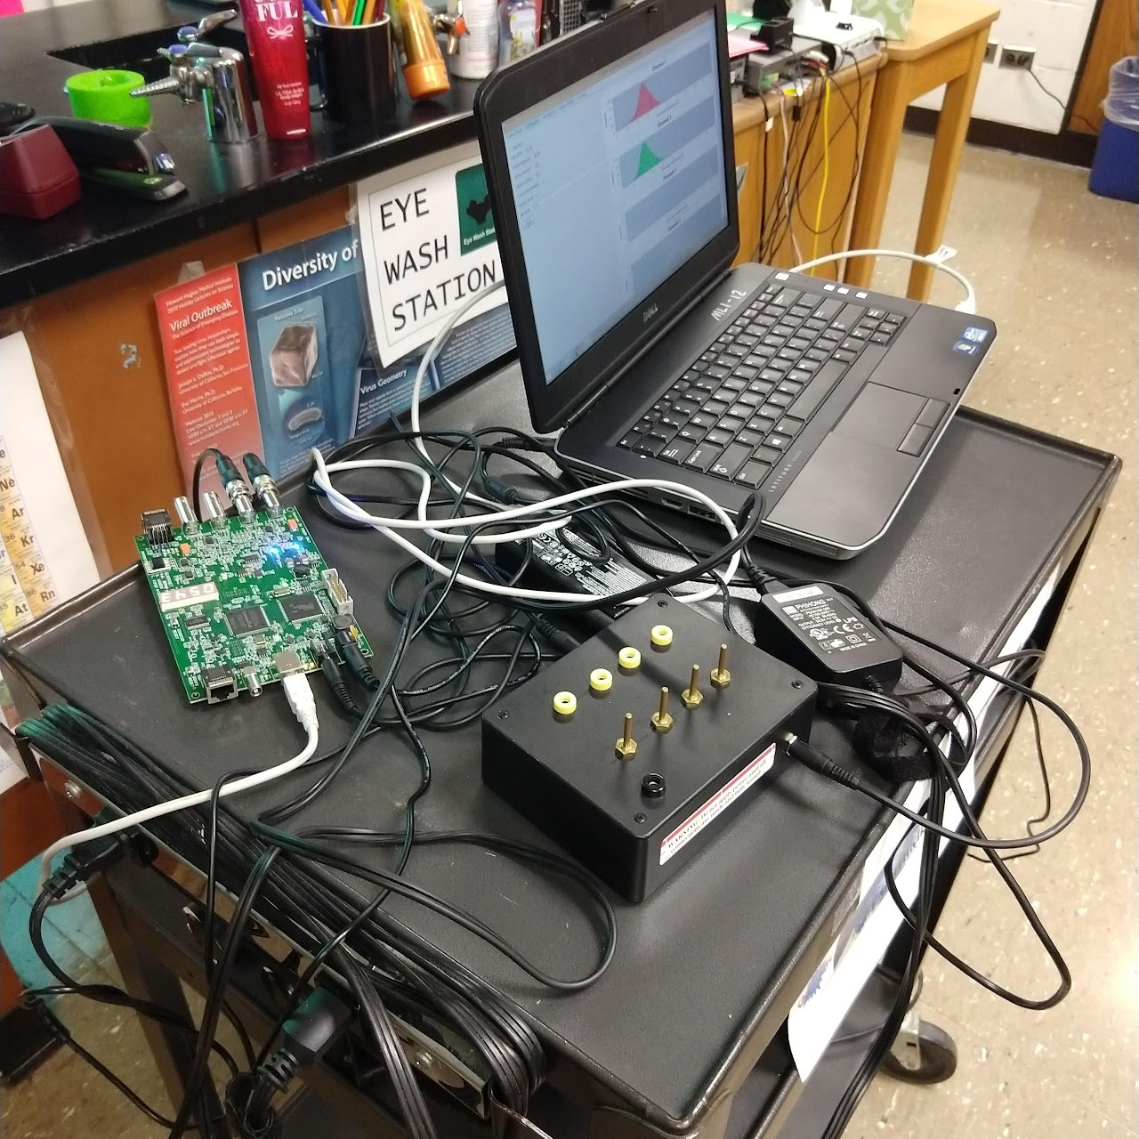
QuarkNet: Benefits to High School Students
Authentic experiences!
Students have the opportunity to use real data from CERN, Fermilab, and other sources in order to discover particle physics.
Some of these experiences can involve collaboration from other students around the world!
E-Labs
Masterclasses
Field Trips
Cosmic Ray Muon Detector

Slide 4
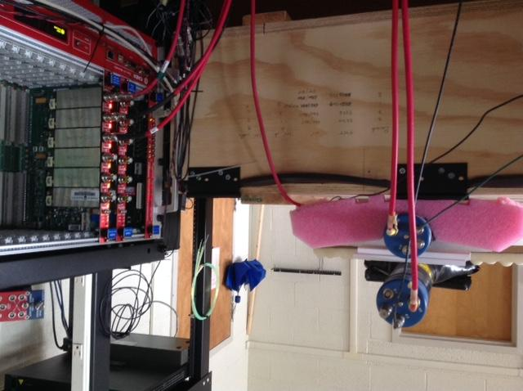
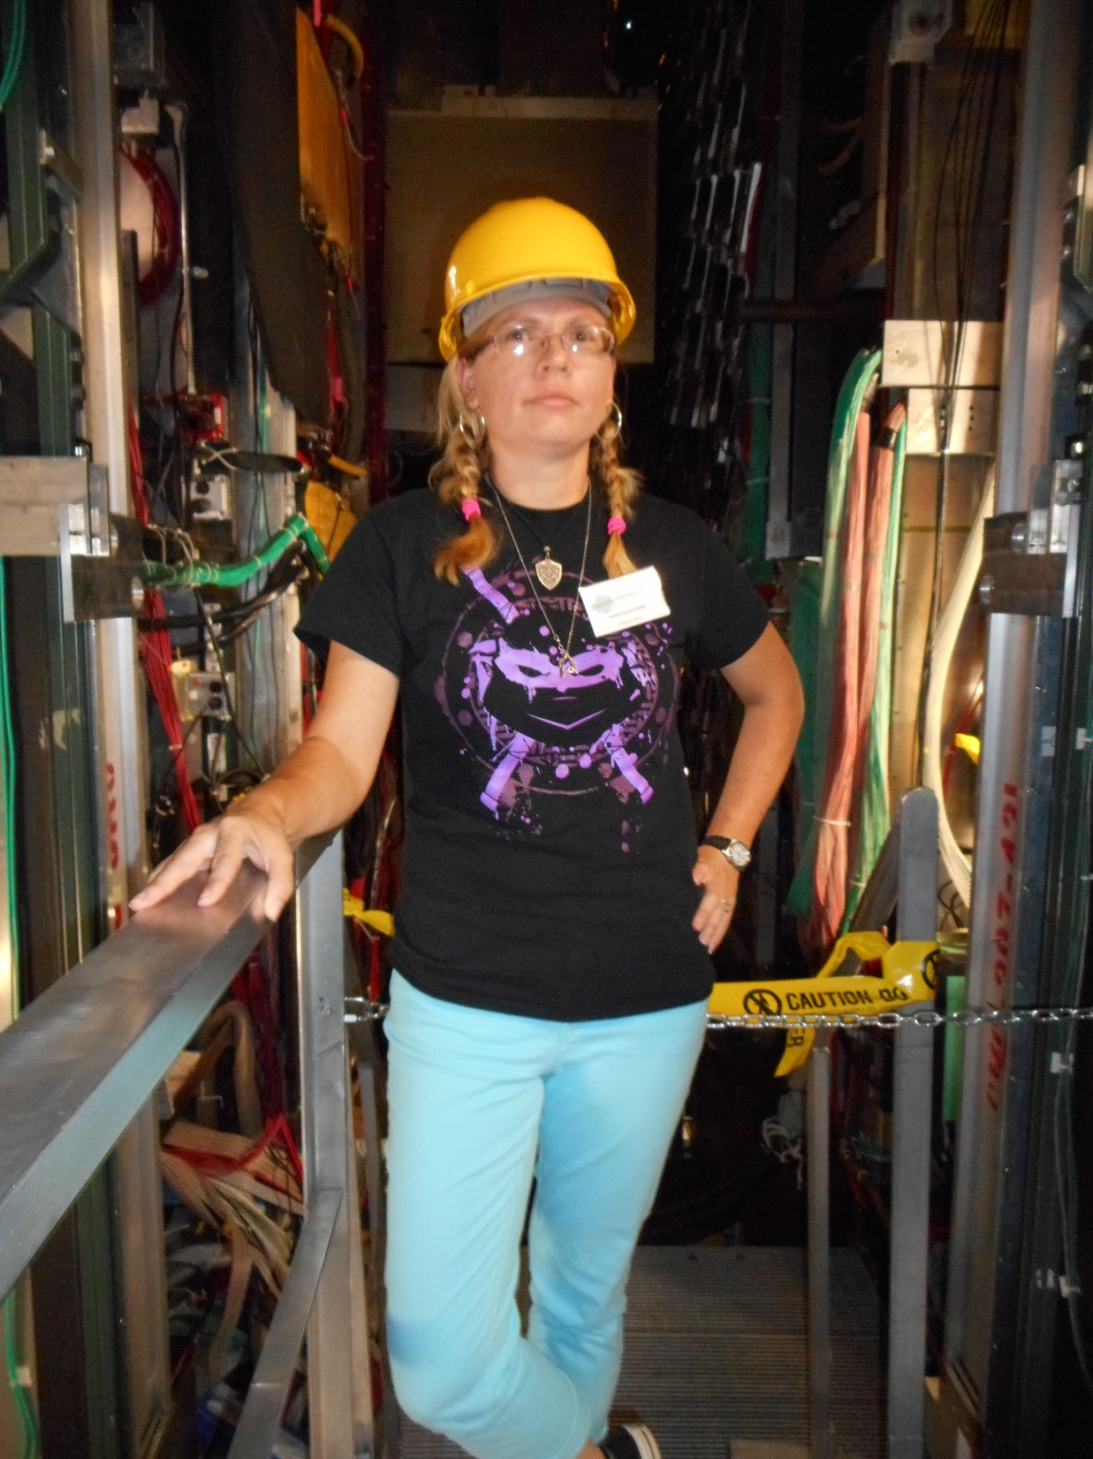
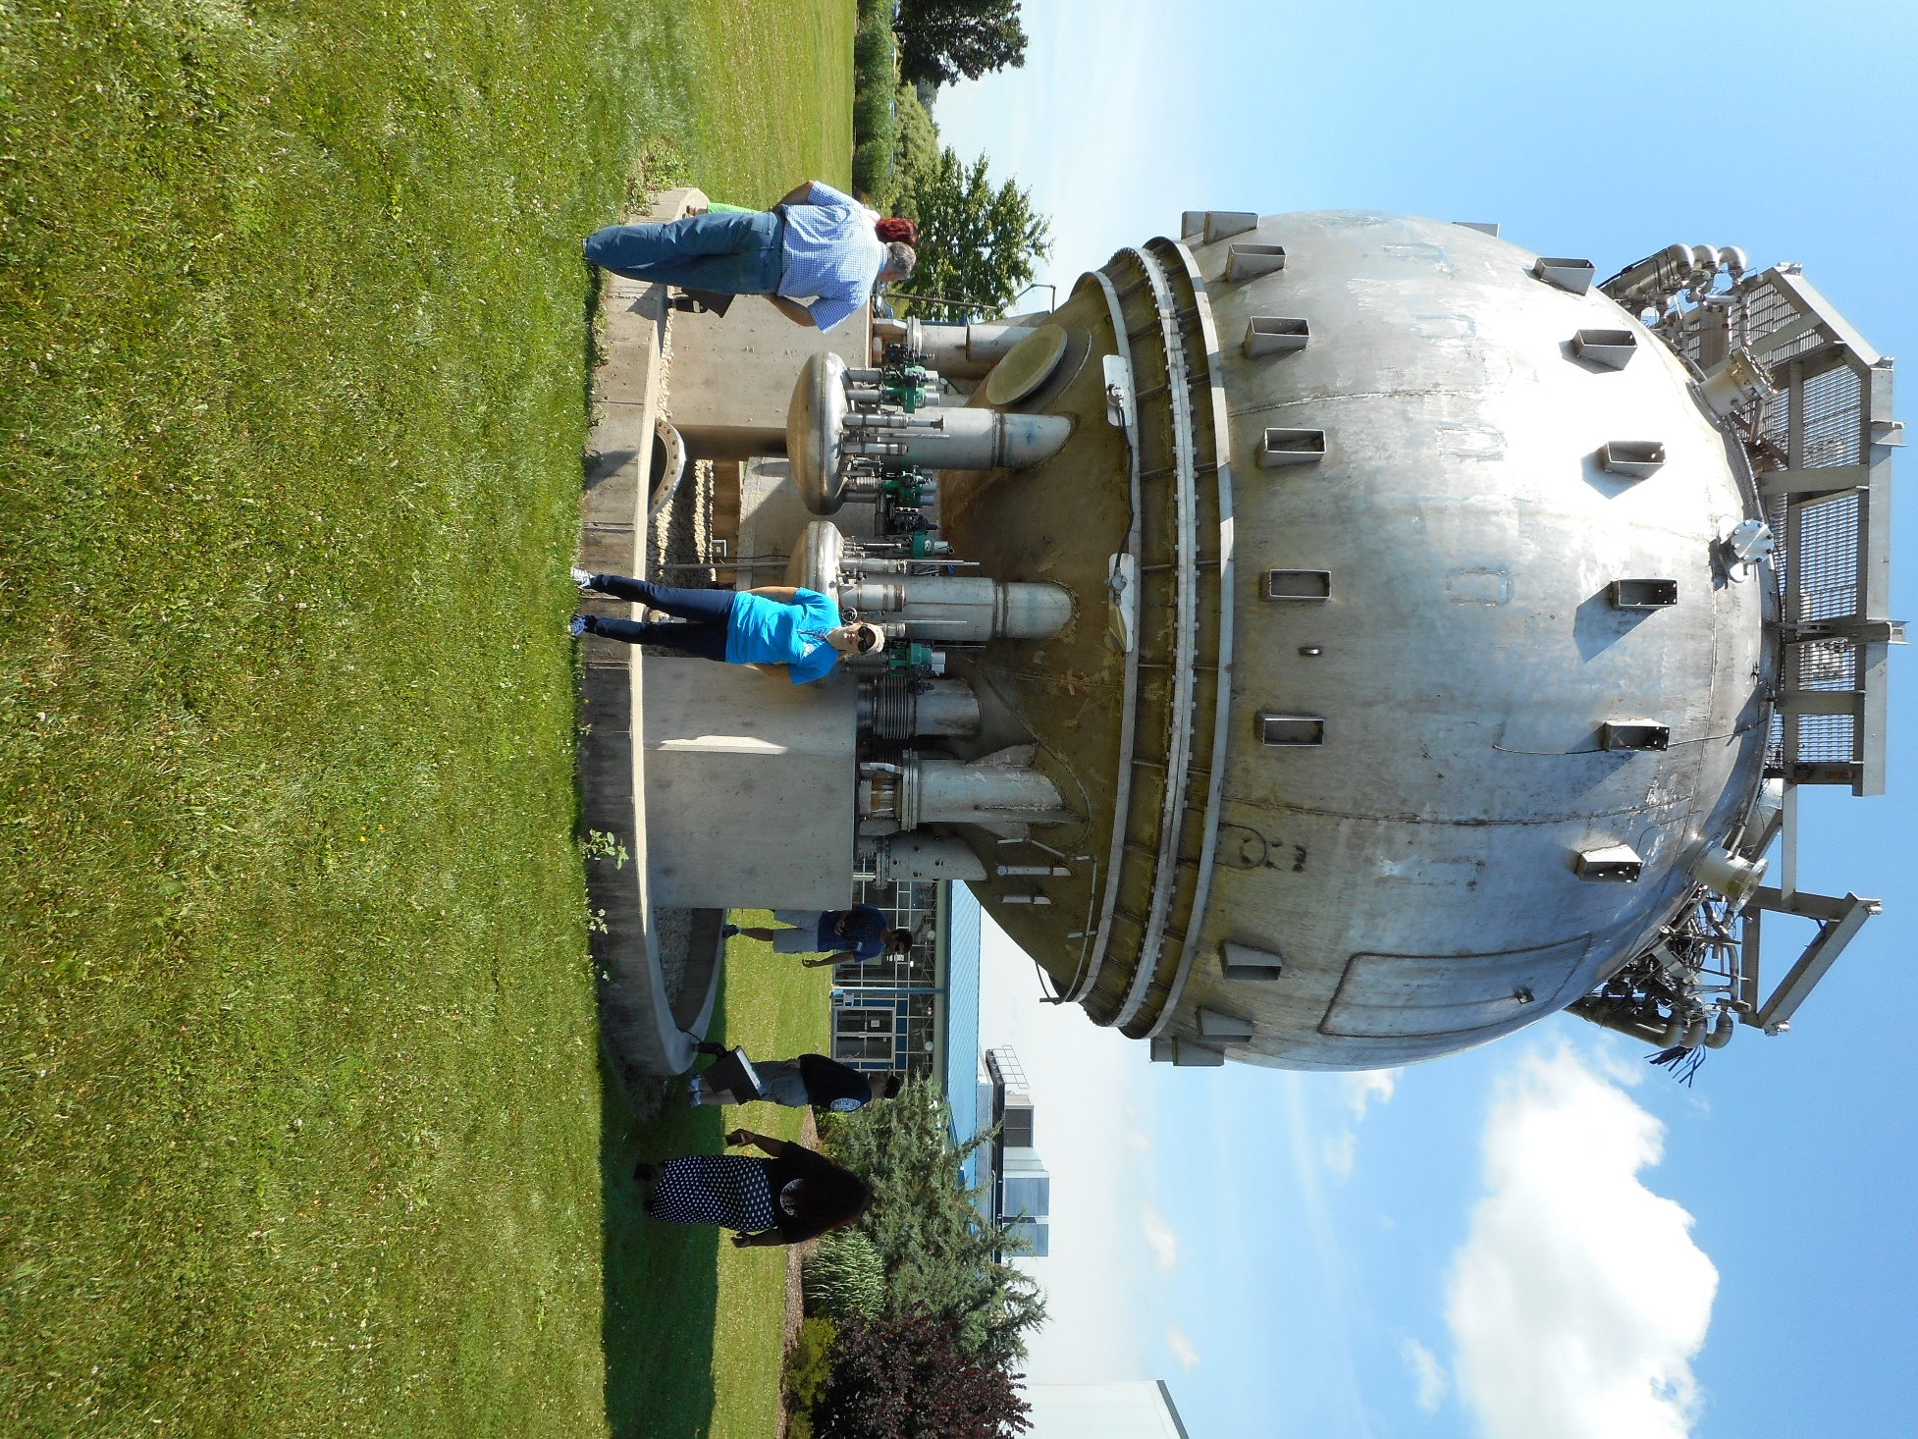
QuarkNet: Benefits to High School Teachers
The best PD ever!
Learn new physics along with teaching methodology- be inspired!
Participate in Research at your QN Center
Travel Opportunities:
DataCamp at Fermilab
Workshops at local universities
CERN Internship
Greece!
QuarkNet’s Data Portfolio is a goldmine!
NGSS aligned
Ready-to-Use Student Activity Sheets
Activities can be applied to many different areas of your curriculum
Activities can be modified to fit your particular needs

Slide 5
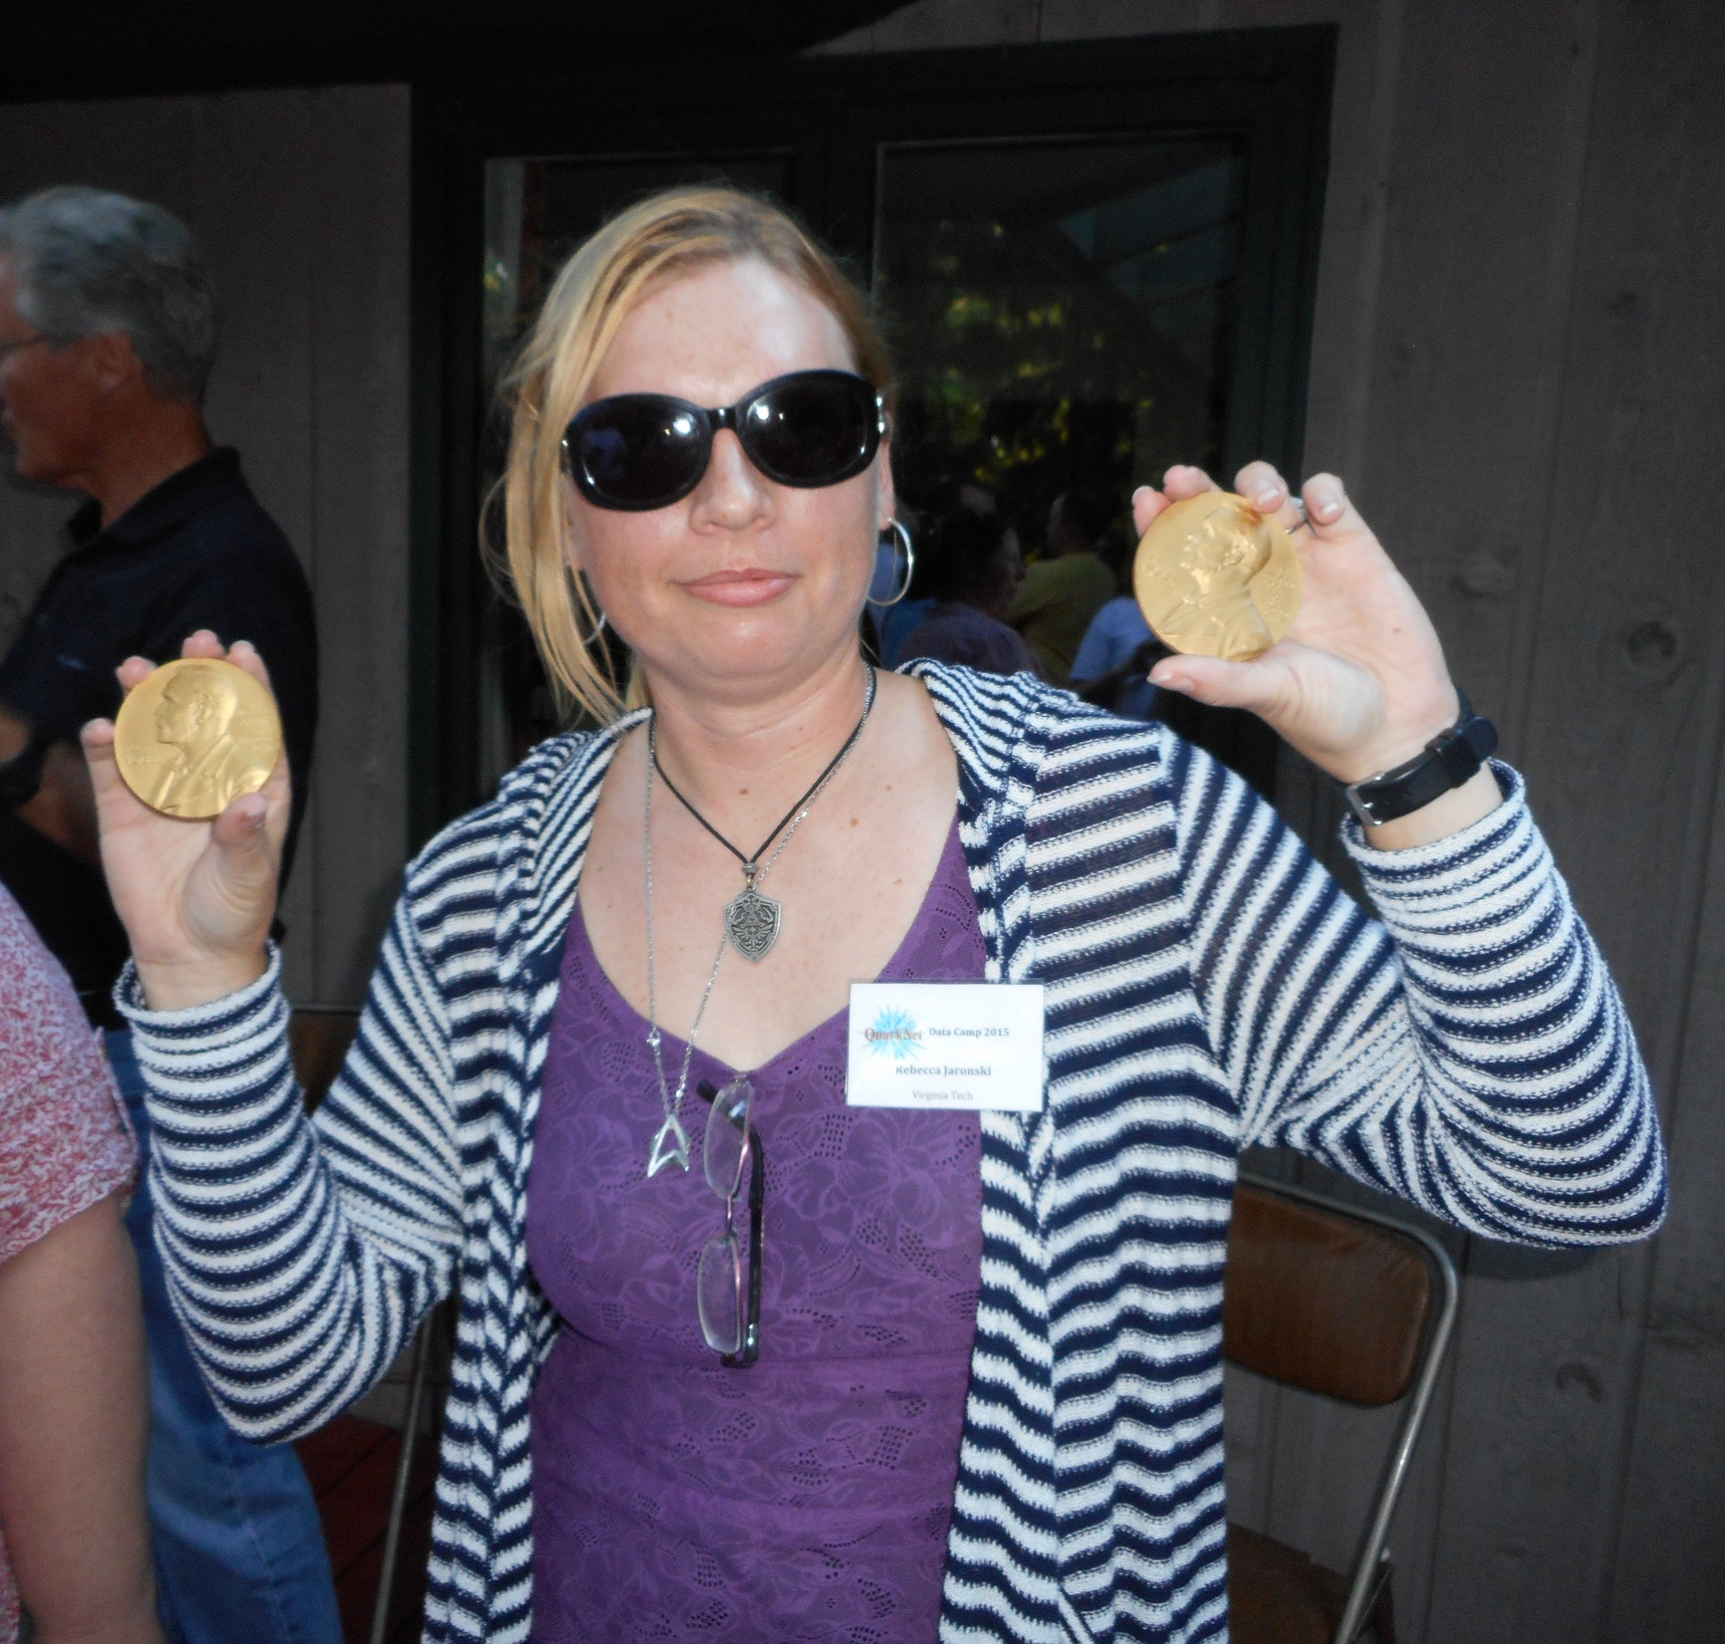
High School Teachers…this could be you!
…holding John Bardeen’s TWO Nobel Prizes in physics…while at a barbecue at Casa Bardeen!

Slide 6
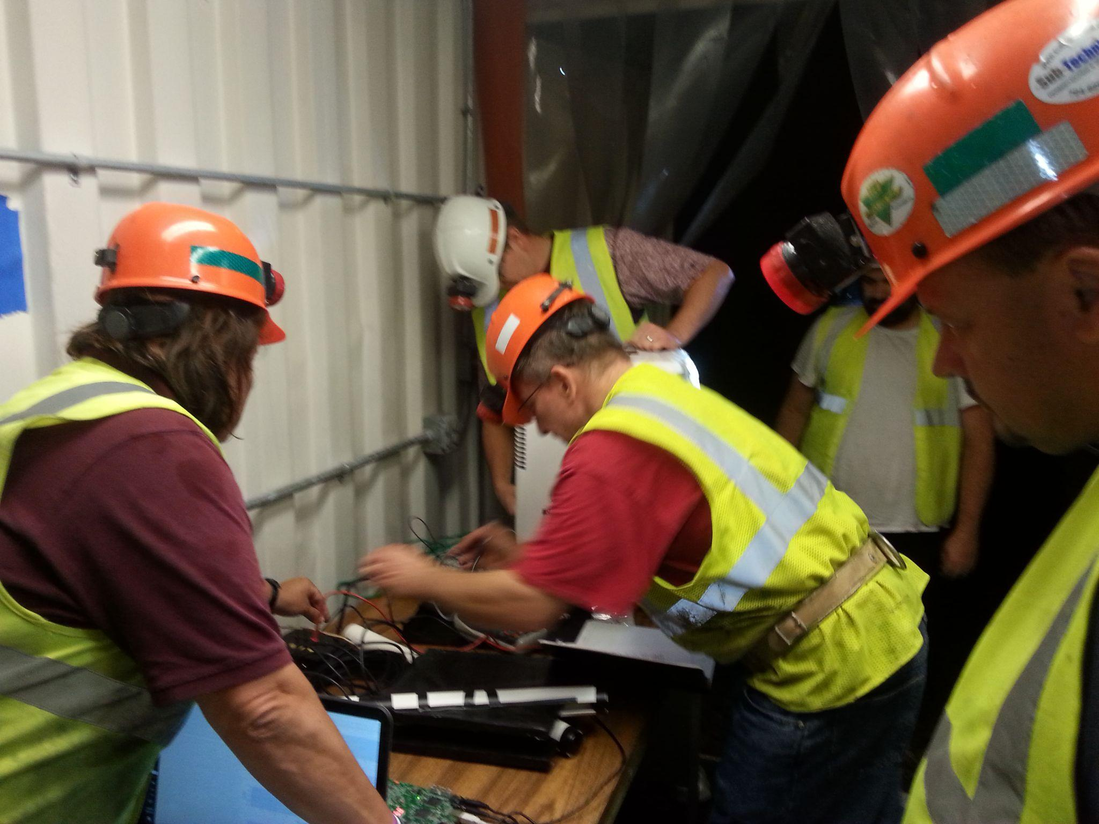
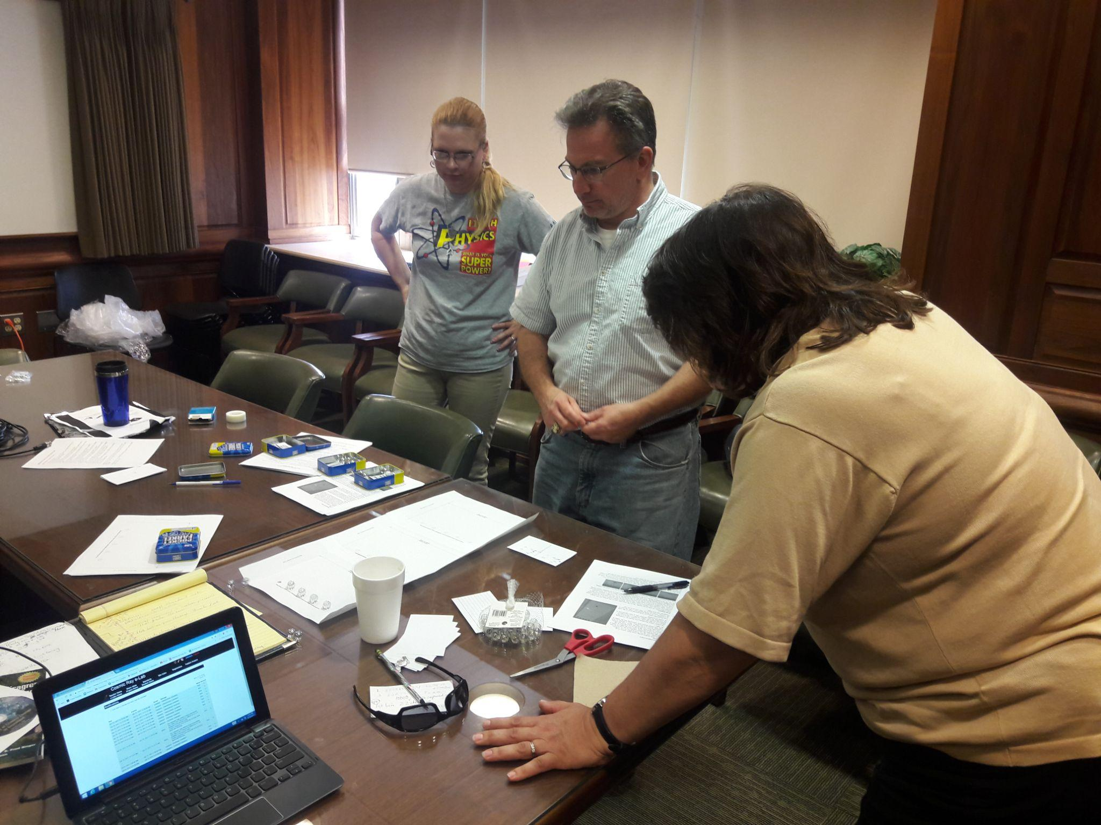
QuarkNet: Benefits to Universities
Student Recruitment
Local teachers will know the quality of your physics programs
Students who have already had research experiences on campus and met faculty may be more likely to apply to your program
Lab/Research Summer Help
Providing teachers with research opportunities also provides YOU with laboratory workers that can be paid through the QuarkNet stipends
Outreach to Community
Is never a bad thing!

Slide 7
Implementing the Data Portfolio: 2 Methods
Dedicated Particle Physics Unit
Some QuarkNet teachers add Particle Physics at the end of the course if time allows
I choose to teach a short Particle Physics unit at the beginning of the year to make sure it happens!
I can then loop concepts back to Particle Physics while teaching Mechanics the rest of the year
‘Sprinkle’ Method
Traditional Introductory Physics covers Mechanics, maybe E&M
Those concepts have applications in Particle Physics!
Some QuarkNet teachers select Data Portfolio activities that relate to specific concepts and use them throughout the year

Slide 8
Method 1: Dedicated Particle Physics Unit
Agenda:
Day 1: Card Sort, Notes Part 1, and Particle Adventure Part 1
Day 2: Particle Adventure Part 2 and Particle Reactions (Notes and Problems)
Day 3: Notes Part 3 and Particle Adventure Part 3
Day 4: The Ghost Particle
Day 5: Penny Lab Part 1
Day 6: Penny Lab Part 2
Day 7: CRAYFIS Lab Part 1
Day 8: CRAYFIS Lab Part 2
Day 9: Review and Particle Physics Bingo!
Day 10: Test
Objectives:
Students will be able to.....
describe the Standard Model of Particle Physics
identify and classify fundamental particles according to the Standard Model
balance particle reactions
conduct a particle physics-type experiment
collect and analyze experimental particle data
Success Criteria:
In order to show mastery, students will...
define leptons, quarks, hadrons, bosons.
use conservation laws to determine allowed particle reactions
design an experiment to measure muon data
create histograms to analyze large data sets

Slide 9
Sample Online/Google Classroom Assignment
Data Portfolio Activity: Mass of US Pennies
Implemented in my class during a Particle Physics unit at the beginning of the year
The Data Portfolio Student Activity sheet is very inquiry-based and student-driven.
For my classroom, I have expanded the given materials into a more formal lab assignment, with an explicit procedure and conclusion questions that draw connections to real particle physics data.

Slide 10
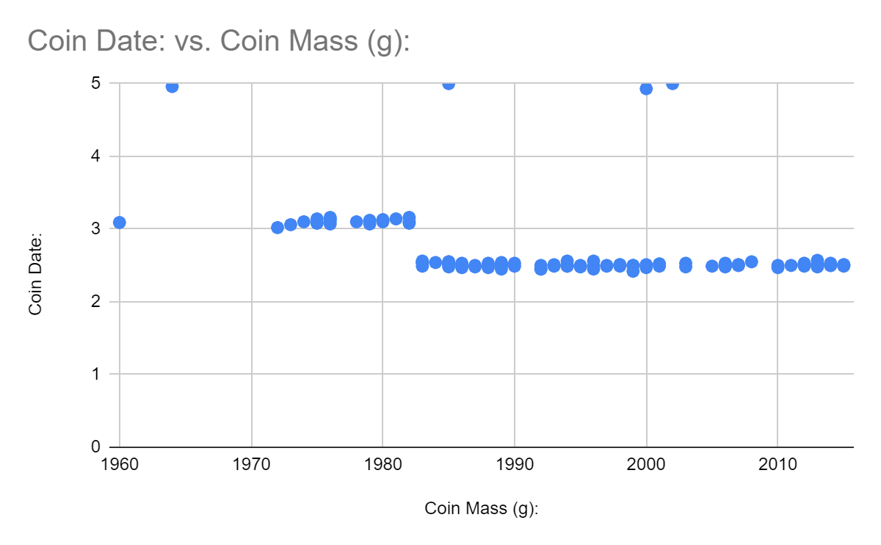
Sample Student Work: Mass of US Pennies

Slide 11
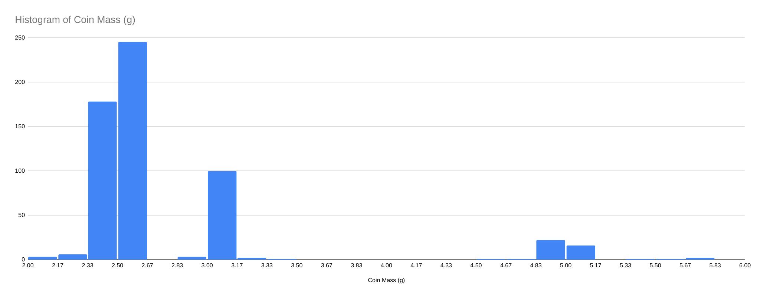
Class Histogram: Mass of US Pennies

Slide 12
Penny Mass Histogram vs CMS Data Histogram
Image Credit: QuarkNet BAMC (Big Analysis of Muons) Lecture, Spring 2020.

Slide 13
Sample Student Work: Penny Mass Conclusion

Slide 14
Sample Assignment: Mass of Z Boson
Data Portfolio Activity: Calculate the Z Mass
Assigned at the end of a unit on Momentum and Collisions
Involves concepts including graphical vector analysis (adding non-perpendicular vectors), conservation of energy and momentum, dimensional analysis, as well as particle physics

Slide 15
Samples of Student Work: Mass of a Z Boson

Slide 16
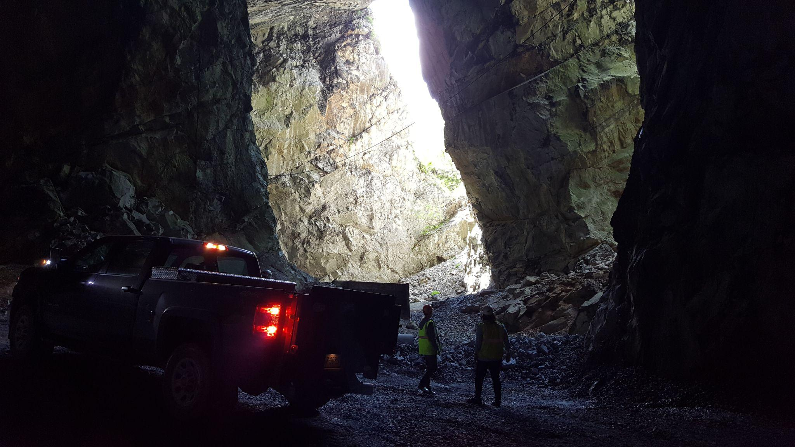
VT QuarkNet is looking for more teachers!
If you are a high school science teacher (or know one) from Virginia, West Virginia, North Carolina that is interested, please contact me:
rebeccajaronski@mcps.org
We offer workshops every summer (stipend and travel support included!)
We can also sponsor a trip to Fermilab’s Data Camp

Slide 17
Thank you very much! Any Questions?

