Slide 1
How to Work with the Air Force Office of Scientific Research
Dr. Kimberly Jacoby Morris AIR FORCE OFFICE OF SCIENTIFIC RESEARCH | 2 April 2022
Cleared for Public Release – Distribution A (AFRL-2021-4394 )

Slide 2
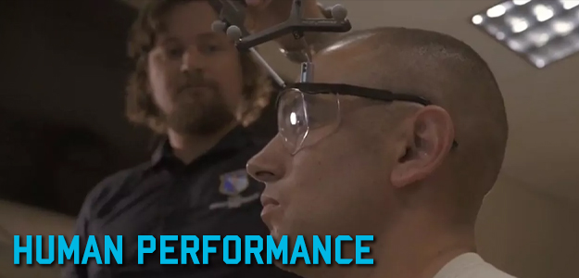
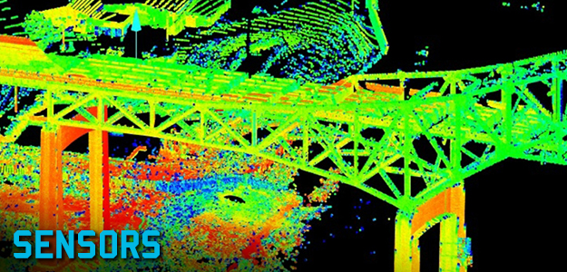
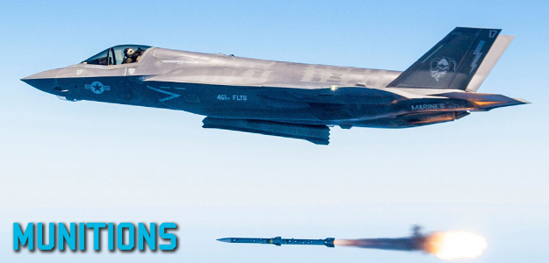
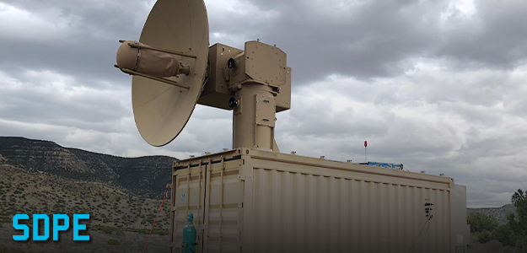
Air Force Research Laboratory At-a-Glance
AEROSPACE SYSTEMS
Aerospace Vehicles, Control,
Power & Thermal Management,
High Speed Systems,
Rocket Propulsion,
Turbine Engines
Laser Systems, Weapons Modeling, Simulation & Analysis, High Power Electromagnetics (HPEM), Directed Energy and Electro Optics
for Space Superiority
DIRECTED ENERGY
HUMAN PERFORMANCE
Training, Adaptive Warfighter Interfaces, Bioeffects, Bioengineering, Aerospace & Operational Medicine
Advanced Space Resilience Technologies, Space Communication
& Navigation Technologies, Space Awareness and Command &
Control, Space Environment
SPACE
VEHICLES
MATERIALS & MANUFACTURING
Structural Materials,
Functional Materials,
Manufacturing Technology,
Support of Operations
Processing & Exploitation ,
Connectivity & Dissemination
Autonomy, Command & Control
and Decision Support, Cyber
Science and Technology
INFORMATION
SENSORS
Radio Frequency (RF) Sensing,
Electro Optical (EO) Sensing,
Spectrum Warfare, Trusted & Resilient Mission Systems, Multi-domain
Sensing Autonomy, Enabling Sensor
Devices & Components
Munitions Airframe, Guidance,
Navigation & Control, Terminal
Seeker Sciences, Modeling &
Simulation Evaluation Sciences
Ordnance Sciences
MUNITIONS
EXPERIMENTATION
Capability & Technology Prototyping
Engineering &
Information Sciences,
Physical & Biological
Sciences
BASIC
RESEARCH
Cleared for Public Release – Distribution A (AFRL-2021-4394 )
Notes:
As a world-class research and development center, at AFRL we lead, discover, develop and deliver.
Lead - Who we are
We are experts in a wide range of technical fields.
Workforce of approx. 6,500 including 1,100 Military (USAF/USSF) and 5,400 Civilians.
Discover - What we do
We lead the Air Force and Space Force in science and technology.
We explore key scientific areas, pursue innovative breakthroughs and push the boundaries of technology. AFRL is at the forefront of innovation.
Develop - Why our work matters
We bridge the gap between research, application and transition.
Ultimately, we provide the Air Force and Space Force with the technology it needs to defend America.
Deliver - When we deliver
We identify future needs and advance technologies to support these capabilities.
We provide superior technology to warfighters in a continuous manner.
Our Vision is to defend America by unleashing the power of innovative air and space technology.
To unleash this power, AFRL pursues research in a wide range of key areas detailed on this slide. One of those areas – and the one we will discuss today – is basic research, managed by the Air Force Office of Scientific Research
AFOSR was established in 1951 to manage basic research for the Air Force in response to a longstanding shortfall in military research. 70 years later, our mission remains the same. Now - and for the last 20 years - as an integral part of AFRL, we seek out and apply the powerful attributes of revolutionary basic science to meet the future requirements of the Department of the Air Force.

Slide 3
Who we are
A small organization with a big mission …
to Discover, Shape, and Champion Bold, High Risk, High Reward Basic Research to profoundly impact the United States Air Force and Space Force
200 personnel – Scientists & Engineers and Business Professionals
Active duty Air Force and Space Force
All-service veterans
Renowned academics
Passionate civil servants
A global network of talent
We partner, grow and discover with a global network of the greatest scientific minds in the world, pulling them into our ecosystem, launching career trajectories, and strengthening their contributions to national defense.
We are the Air Force Research Laboratory/Air Force Office of Scientific Research!
Cleared for Public Release – Distribution A (AFRL-2021-4394)
Notes:
Who we are
A small organization with a big mission.
AFRL/AFOSR is made up of roughly 200 personnel – both scientists and engineers and business professionals – all dedicated to discovering, investing, shaping and championing bold, high-risk, high-reward science around the world.
At AFRL/AFOSR, we are active duty Air Force and Space Force, all-service veterans, renowned academics, and passionate civil servants active in our scientific and Air and Space Force communities.
Our scientists and engineers are highly educated with a majority holding PhDs and well-regarded in their fields of study. Their paths to AFRL/AFOSR have all been diverse, with some spending their earlier careers in higher education and others coming up through government labs. Now in their roles as program officers, each takes their unique experience, spirit of curiosity and practical understanding of Defense demand signals and inspires new generations of scientists and engineers to answer the biggest fundamental challenges in Air and Space power.
When you think about AFRL/AFOSR, think big. The totality of who we are extends beyond our employees. We partner, grow and discover with a global network of the greatest scientific minds in the world, pulling them into our ecosystem, launching career trajectories and strengthening their contributions to national defense.

Slide 4
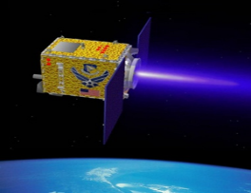
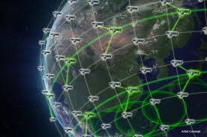
AFOSR Science Portfolios
Engineering and Complex Systems
Information and Networks
Physical Sciences
Chemistry and Biological Sciences
International Office
Dynamic Materials and Interactions
Computational Cognition and Machine Intelligence
Aerospace Materials for Extreme Environments
Biophysics
Asian Office of Aerospace R&D Tokyo
GHz-THz Electronics
Computational Mathematics
Atomic and Molecular Physics
Human Performance and Biosystems
European Office of Aerospace R&D London
Energy, Combustion, and Non-Equilibrium Thermodynamics
Dynamical Systems and Control Theory
Electromagnetics
Mechanics of Multifunctional Materials and Microsystems
Southern Office of Aerospace R&D Santiago
Unsteady Aerodynamics and Turbulent Flows
Dynamic Data and Information Processing
Laser and Optical Physics
Molecular Dynamics and Theoretical Chemistry
North America - Arlington
High-Speed Aerodynamics
Information Assurance and Cybersecurity
Optoelectronics and Photonics
Natural Materials and Systems
Aerospace Composite Materials
Mathematical Optimization
Plasma and Electro-Energetic Physics
Organic Materials Chemistry
Multiscale Structural Mechanics and Prognosis
Science of Information, Computation, Learning, and Fusion
Quantum Information Sciences
Propulsion and Power
Trust and Influence
Physics of Remote Sensing
Agile Science of Test and Evaluation (T&E)
Complex Networks
Space Science
Cognitive and Computational Neuroscience
Ultrashort Pulse Laser-Matter Interactions
Condensed Matter Physics
Cleared for Public Release – Distribution A (AFRL-2021-4394)
Notes:
An AFOSR basic research portfolio is a collection of diverse, high-quality basic research investments and communities orchestrated by AFOSR program officers and focused on Department of the Air Force interests.
AFOSR Program Officers are well positioned to build these portfolios because
They are recognized experts and highly regarded in their respective fields
Critical for identifying and transitioning the most promising science for augmenting DAF capabilities
Advisers to policy makers at high levels shaping national policy!
Their dedication and expertise helps shape the research agenda for the benefit of the Department of the Air Force.
We take “smart” risks in emerging areas of cutting edge science (See Appendix A for examples)
AFRL/AFOSR Funded research is mentioned regularly in research publications and subsequent news coverage
1,400+ publications/58 patents since January 2021; 4,400+/221 in 2020 acknowledging AFOSR support (Dimensions dataset sorted by Funding Agency and year)
Daily university press and tech pub news coverage
Occasional national news coverage
We assess and correct
2021 AFOSR Spring Review with the AFOSR Director focused on how the POs accomplish their mission
Recognizing when a science area should be dropped?
Recognizing emerging science areas?
Recognizing investigators who have the potential for greatness?
Portfolios are reviewed continuously by the POs, the Tech Advisors, and the Chief Scientist Office.

Slide 5
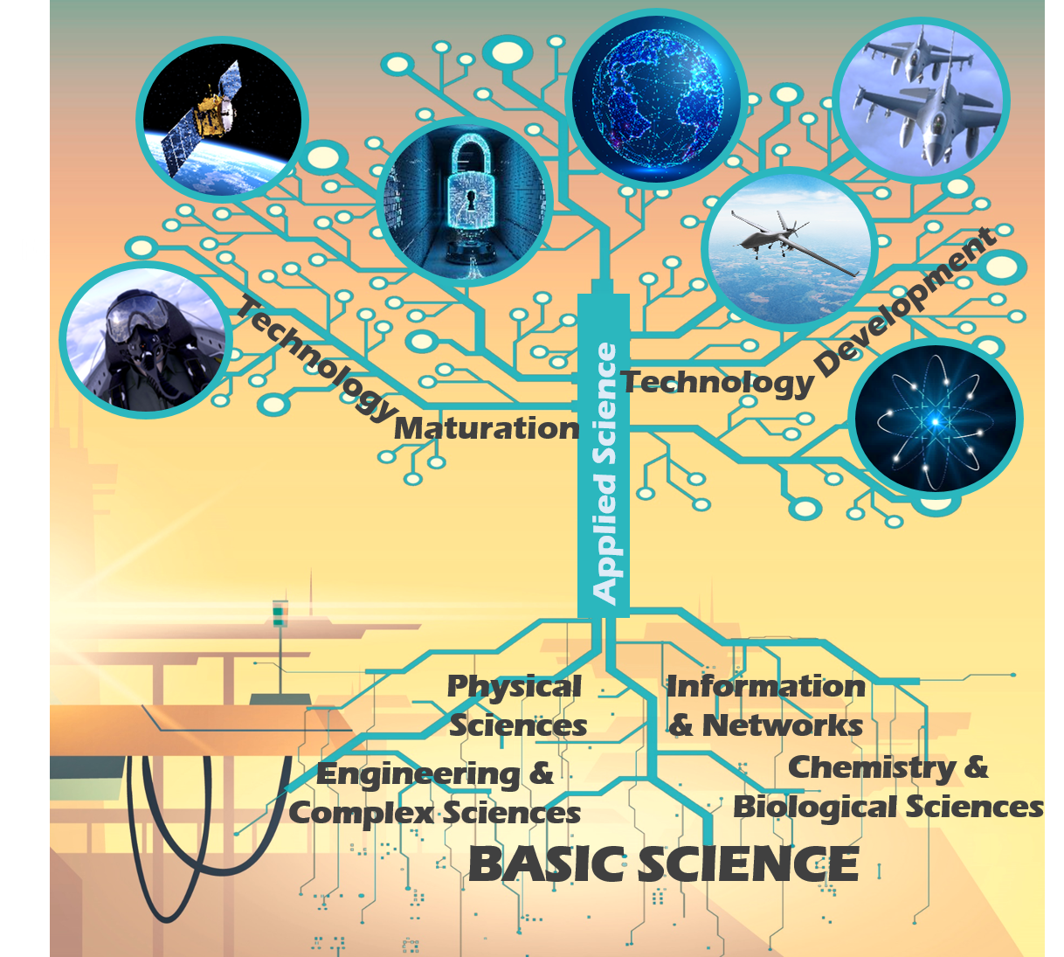
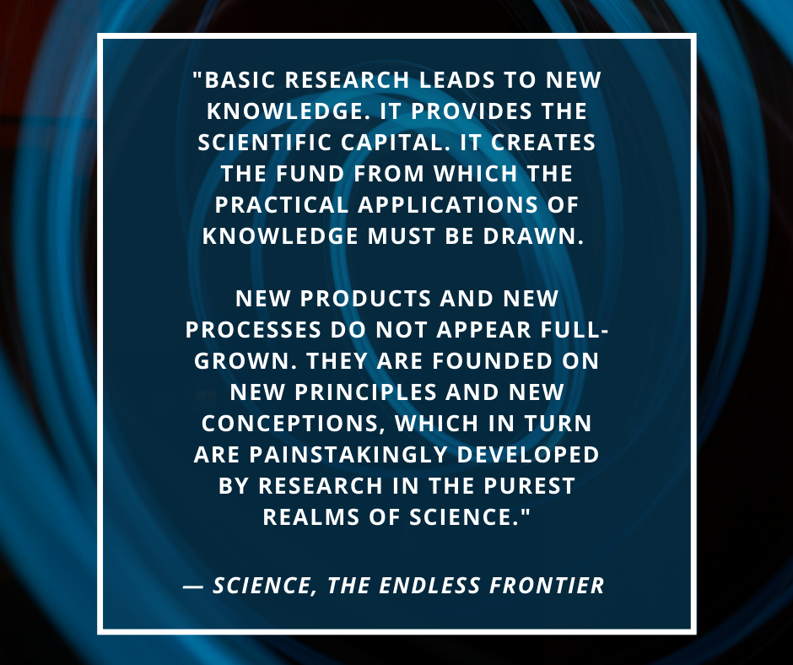
Why we do what we do
Unleashing Science Against Our Adversaries
Cleared for Public Release – Distribution A (AFRL-2021-4394)
Notes:
Why do we do what we do
Depending on who you ask, there is a spectrum of answers to why we do what we do. In the broadest sense, investment in basic science is a vital first step in ensuring the safety and security of our nation and its allies.
You might be thinking, there is a lot of space between investing in basic research and a feeling of national safety and security, and you’d be right, but only with sustained and purposeful investment on the cutting edge of scientific discovery, can our Force stay ahead of its adversaries putting capabilities in the hands of our warfighters and keeping us all safe and secure
In 1945, Vannevar Bush wrote a letter to the president in which he stated, “Basic Research leads to new knowledge. It provides the scientific capital. It creates the fund from which the practical applications of knowledge must be drawn. New products and new processes do not appear full-grown. They are founded on new principles and new conceptions, which in turn are painstakingly developed by research in the purest realms of science.”
AFOSR was established in 1951 [not long after that letter was written] to manage basic research for the Air Force in response to a longstanding shortfall in military basic research.
Today, our basic research investments continue to provide transformational capability that clears the path to new inventions, concepts and capabilities.
By setting and leading entirely new research directions, we advance science in important ways and with broad defense implications for our airmen and guardians of the future.

Slide 6
S&T 2030 Strategy
OBJECTIVE III; Deepen and Expand the Scientific and Technical Enterprise
AFOSR is looking to enhance the recruitment of national and global talent, advancing workforce development, creating a stronger pipeline of technology-proficient military airmen and guardians, and implementing agile workforce practices will significantly strengthen Air Force and Space Force scientific and technical expertise.
Cleared for Public Release – Distribution A (AFRL-2021-4394)
Notes:
AFRL fully embraced the Call to Action from the S&T 2030 Strategy and implemented pilot actions against all the Strategy levels of effort; AFRL is postured for sustained execution and continuous innovation to better serve the Department of the Air Force.

Slide 7
How to Work with Us
Cleared for Public Release – Distribution A (AFRL-2021-4394)

Slide 8
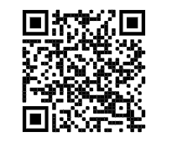
Higher Education
*
*Broad Agency Announcement. Some announcements may also be called Funding Opportunity Announcements (FOAs)
Cleared for Public Release – Distribution A (AFRL-2021-4394)
Notes:
Roughly 70% of our budget is spent on funding basic research grants with higher education. At a high level this is how an interested researcher would approach obtaining funding from the Air Force Office of Scientific Research
Figure out what you want to study; your research question
Review BAAs from all organizations
Find your niche…scope idea
Draft an idea statement
Connect with a Program Officer from BAA to discuss
Work with PO to determine correct funding mechanism
Submit a full proposal on Grants.gov
Get funded or re-scope and try again next year

Slide 9
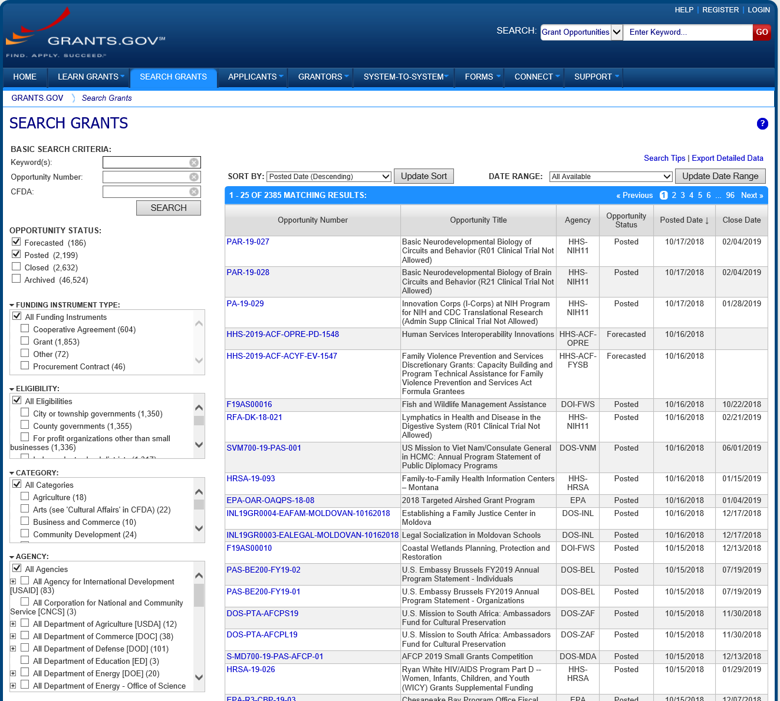
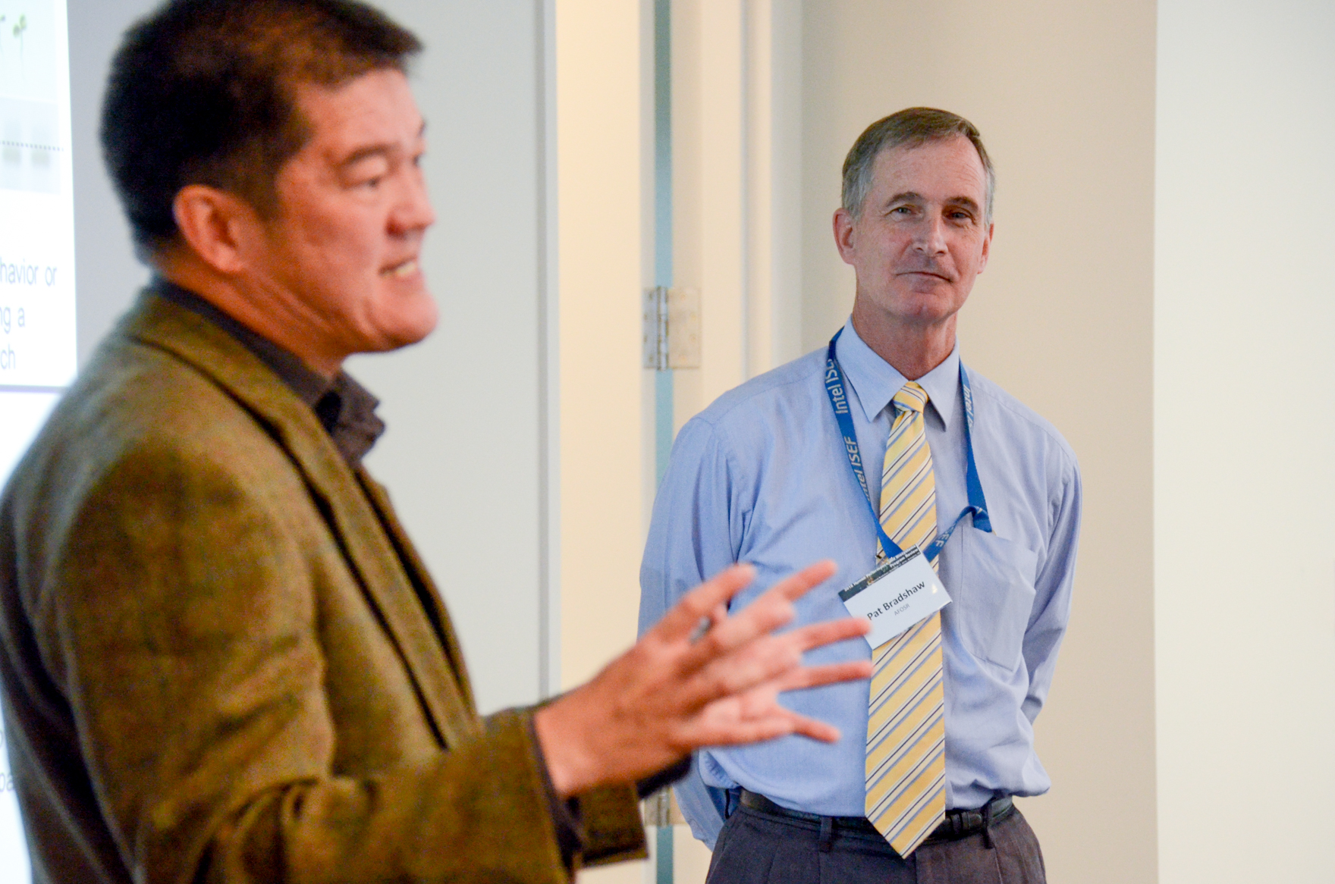
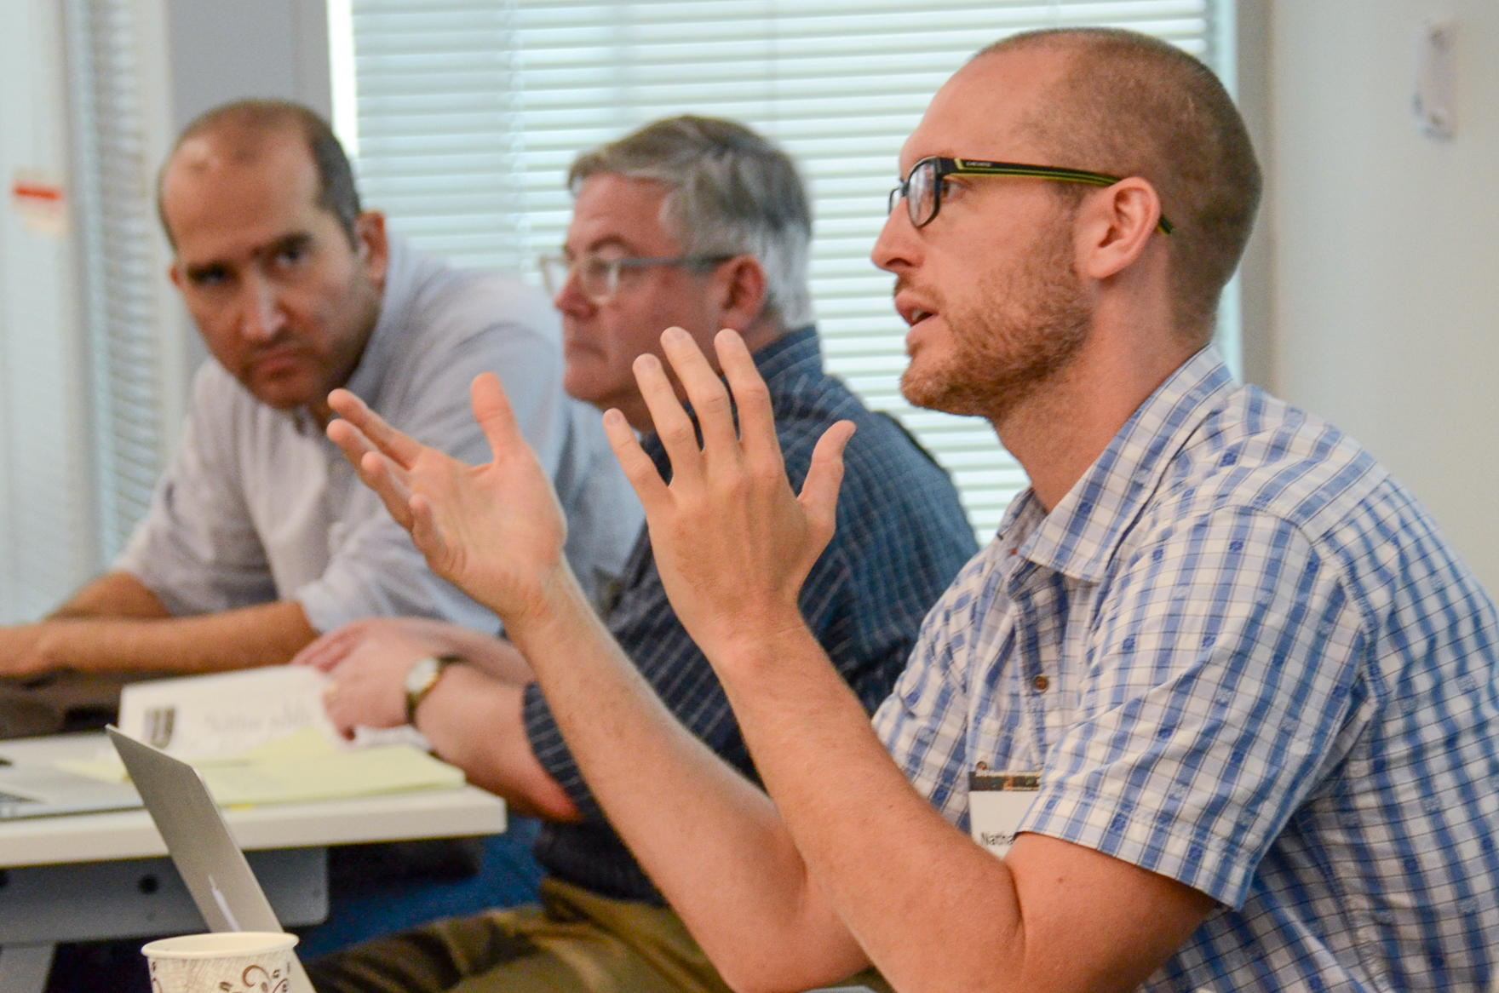
Review Broad Agency Announcements
Researchers should visit www.grants.gov – the official source for finding and applying to Federal grants
Find opportunities that match interests. Search by:
Keyword
Eligibility
Category
Agency etc.
Study and keep current with BAAs
Attend program reviews to understand the directions and needs of program
Cleared for Public Release – Distribution A (AFRL-2021-4394)
Notes:
Figure out what you want to study and develop a research plan
Review BAAs from all organizations
Find your niche…scope idea
Draft an idea statement
Connect with a Program Officer from BAA to discuss
Discuss when and where to submit a full proposal.
Submit a full proposal on Grants.gov
Get funded or re-scope and try again next year

Slide 10
Scope and Draft Idea Statement
Statement doesn’t have to be all-inclusive, but should address the unique value proposition of the research
Statement needs to be specific enough that it catches the interest of the Program Officer
Cleared for Public Release – Distribution A (AFRL-2021-4394)
Notes:
Figure out what you want to study and develop a research plan
Review BAAs from all organizations
Find your niche…scope idea
Draft an idea statement
Connect with a Program Officer from BAA to discuss
Discuss when and where to submit a full proposal.
Submit a full proposal on Grants.gov
Get funded or re-scope and try again next year

Slide 11
Connect with Program Officer
At this point, some Program Officers will want a specifically formatted white paper
Others will want to have a conversation
In person
Over the phone
Via email
If the idea seems promising, Program Officer will initiate an ongoing dialogue setting expectations and explaining the process for full proposal submission.
Cleared for Public Release – Distribution A (AFRL-2021-4394)
Notes:
Figure out what you want to study and develop a research plan
Review BAAs from all organizations
Find your niche…scope idea
Draft an idea statement
Connect with a Program Officer from BAA to discuss
Discuss when and where to submit a full proposal.
Submit a full proposal on Grants.gov
Get funded or re-scope and try again next year

Slide 12
Program Manager Roles
Topical / Program Expert
Educator / Communicator
Team Builder
Advocate
Evaluator
Administrator
Active Member of AFRL, DoD & Scientific Communities
Program Officers’ empowerment is a key component of our success
Cleared for Public Release – Distribution A (AFRL-2021-4394)

Slide 13
Determine the Correct Funding Mechanism
There are many different mechanisms for universities to obtain basic research grant funding:
Traditional grants
University Research Initiatives (i.e. Multidisciplinary University Research Initiative (MURI), Defense University Research Instrumentation Program (DURIP)
Special Programs (i.e. HBCU/MSI, Young Investigator Program (YIP), Presidential Early Career Awards for Scientists and Engineers (PECASE))
Traditional grants can be awarded year-round from the general Broad Agency Announcement
Other opportunities have specific deadlines
Cleared for Public Release – Distribution A (AFRL-2021-4394)
Notes:
Figure out what you want to study and develop a research plan
Review BAAs from all organizations
Find your niche…scope idea
Draft an idea statement
Connect with a Program Officer from BAA to discuss
Work with PO to determine correct funding mechanism
Submit a full proposal on Grants.gov
Get funded or re-scope and try again next year

Slide 14
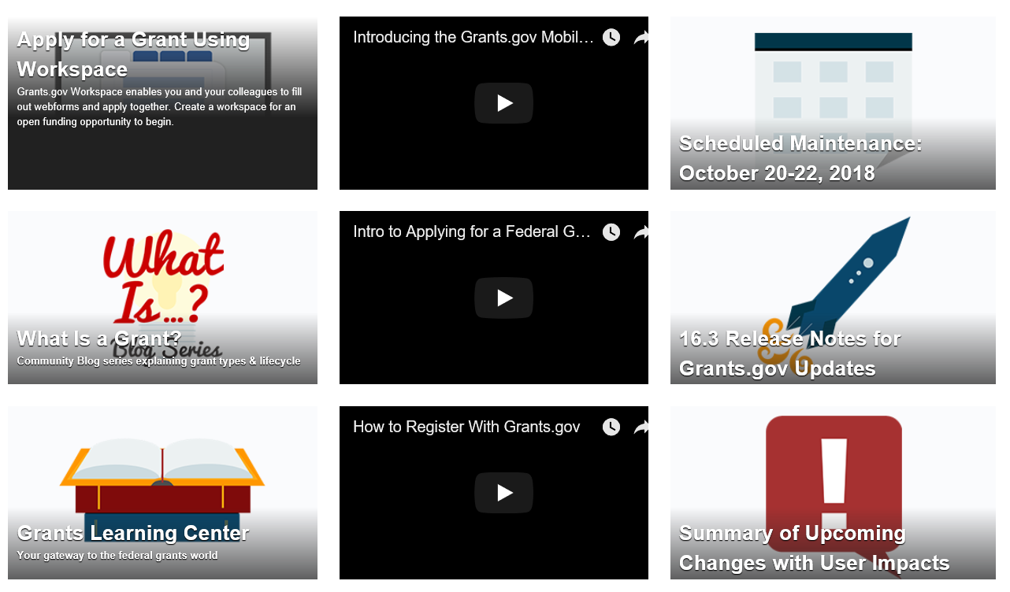
Submit Full Proposal
Full proposals should include
Strong technical merit
U.S. Air Force or U.S. Space Force relevance
Solid budget justifications
Full details can be found in the Broad
Agency Announcement
Grants.gov also provides a number of tutorials for using the site
Cleared for Public Release – Distribution A (AFRL-2021-4394)

Slide 15
Peer Review
TECHNICAL: The impact of proposed program on K-16 education and outreach workforce development. The alignment of project topic area to AFOSR/DoD research areas of interest. The potential your proposed project offers to enhance your institution’s ability to educate future scientists and engineers through skills and awareness-building instrumentation in disciplines important to DoD missions. Will the proposed approach produce the desired results? What are its strengths and weaknesses? Comment on the key personnel's qualifications, capabilities, related experience, and past performance. Additional comments and relevant issues? OTHER CRITERIA: Comment of the adequacy and/or availability of the facilities, equipment, hardware, simulation tools and techniques integral to the objectives of the proposed research. Comment on the realism and reasonableness of the proposed project cost.
Cleared for Public Release – Distribution A (AFRL-2021-4394)

Slide 16
Budget Justification
For Personnel Management:
Discuss realism and reasonableness of the (a) number of personnel, (b) labor mix, (c) level of effort etc.
Consumables and facility Chargers:
Provide JUSTIFICATION and explanation with respect to proposed research. Provide quotations and/or links to the price structure of consumables, materials supplies, and facility charges.
Other Direct Costs
Provide Justification for direct costs
Travel:
For travel or quantity of trips, (a) rationale for travel, (b) the amount of travel or quantity of trips, and (a) the number of personnel traveling in terms of realism and reasonableness for the work
Cleared for Public Release – Distribution A (AFRL-2021-4394)

Slide 17
Get Funded! Get started and stay involved
POs weigh several factors in selecting proposals for funding:
Identify overlap with program interests, and connection to DOD's labs
Potential for scientific breakthroughs
Strategic directions
Budget realities
Peer review to gauge scientific merit
Once funded, remain engaged and continue with the process.
Continue reviewing BAAs
Request invitations to program reviews of interest
Collaborate with other PIs in the program
Workshops and Reviews
Cleared for Public Release – Distribution A (AFRL-2021-4394)

Slide 18
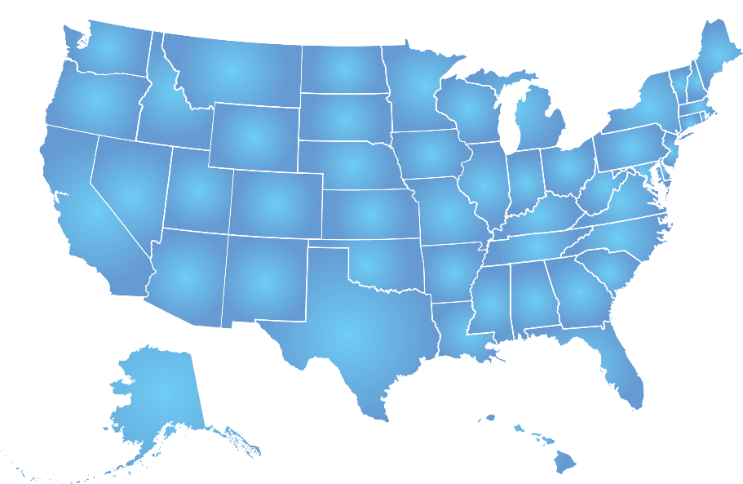
Starfleet Academy: Workforce Development
K-12 STEM Outreach
K-12 STEM Map
30
Installations
5
Programs
15
Programs
45
Competitions
173
Competitions
319
Competitions
??
Controlled Unclassified Information (CUI)
Notes:
Opportunities for AFRL scholars, internships, competitions, challenges, scholarships

Slide 19
We are AFOSR and we science!
Cleared for Public Release – Distribution A (AFRL-2021-4394)

Slide 20
Questions? Kimberly.jacoby_morris@us.af.mil
Cleared for Public Release – Distribution A (AFRL-2021-4394)

