Slide 1
New State Guidelines for Advanced Physics April 2, 2022 9:00 – 9:15
Presented by:
Gregory MacDougall, Science Specialist (gregory.macdougall@doe.virginia.gov)
Anne Petersen, Science Coordinator (anne.petersen@doe.virginia.gov)
Myra Thayer, Science Specialist (myra.thayer@doe.virginia.gov)

Slide 2
Thank You!
Initial Writers
Becca Bissell
Brian Meechan
Initial Reviewers (VCU)
Kerwin Foster
Richard "Inho" Joh
Muruges Duraisamy

Slide 3
Standards
Guidelines
Notes:
The Standards of Learning (SOL) for Virginia Public Schools establish minimum expectations for what students should know and be able to do at the end of each grade or course in English, mathematics, science, history/social science and other subjects.
The intent of the content guidelines is to inform instruction and to ensure that the science content is taught equitably across the Commonwealth. These courses will not be tested with a Standards of Learning statewide assessment; instead, these guidelines can be used to inform classroom instruction and assessment to include the use of performance assessments. Feedback on the content guidelines is appreciated and will guide development of potential future Virginia Standards of Learning for these courses.

Slide 4
The Task: Creating Guidelines
- Aligned to SCED Code 3152
“Usually taken after a comprehensive initial study of physics, Physics—Advanced Studies courses provide instruction in laws of conservation, thermodynamics, and kinetics; wave and particle phenomena; electromagnetic fields; and fluid dynamics.”

Slide 5
The Task: Creating Guidelines
- Aligned to SCED Code 3152
Reflects research on depth versus breadth of physics content (UVA’s Robert Tai and many others)

Slide 6
The Task: Creating Guidelines
- Aligned to SCED Code 3152
Reflects research on depth versus breadth of physics content
Designed to increase student appreciation of physics content
Physics
Is
Phun!
Notes:
This is not meant to be a pre-AP Physics course that emphasizes problem solving. It is designed for teachers and students to inquire into physics topics of interest to the students.

Slide 7
Advanced Physics
Content Guidelines
Curriculum Framework
Ready to be reviewed now
Ready June 30
Where can I get a copy?
gregory.macdougall@doe.Virginia.gov
Where can I get a copy?

Slide 8
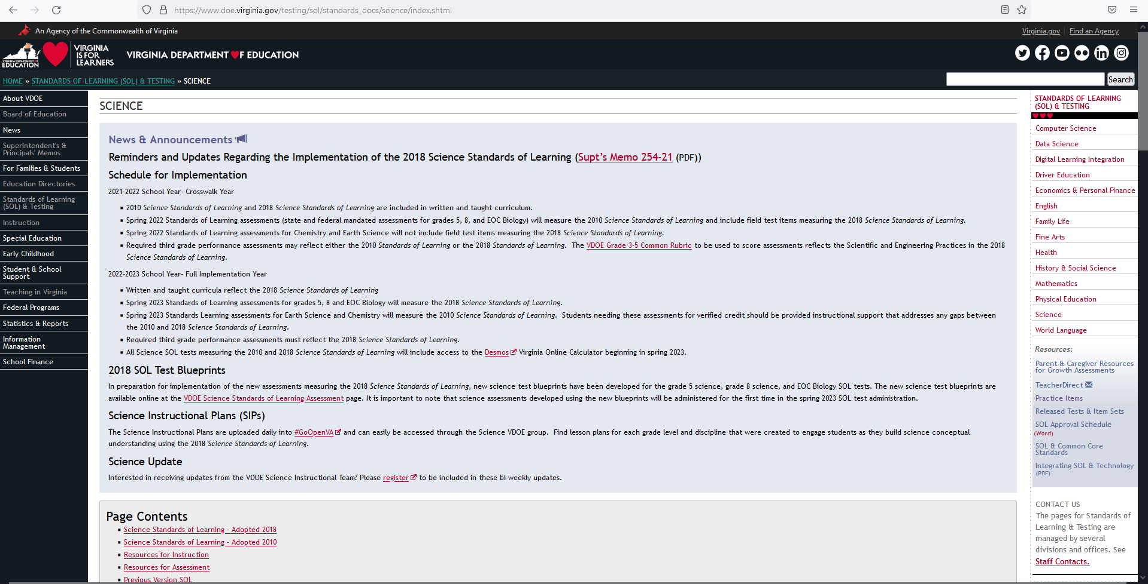

Slide 9
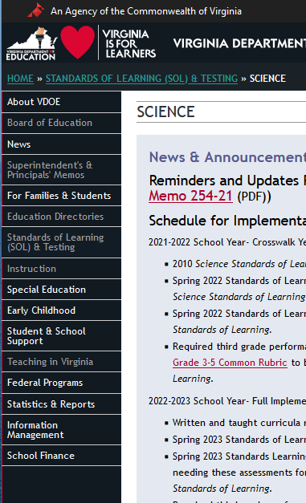
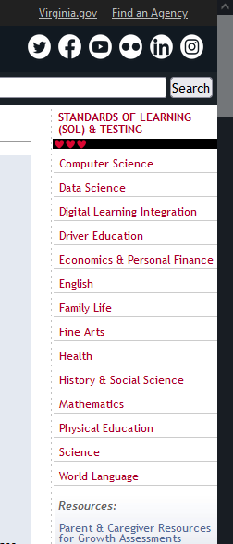
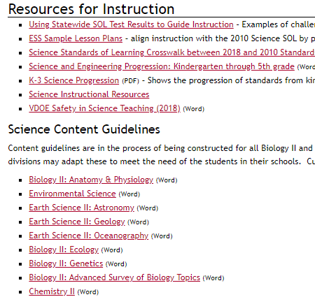
Standards of Learning (SOL & Testing
Physics II will be in this list.

Slide 10
Thank You!
Gregory MacDougall, Science Specialist (gregory.macdougall@doe.virginia.gov) Anne Petersen, Science Coordinator (anne.petersen@doe.virginia.gov) Myra Thayer, Science Specialist (myra.thayer@doe.virginia.gov)

