Slide 1
CP phase correlation between SM and new physics
Hisakazu Minakata, Center for Neutrino Physics, Virginia Tech
Ivan Martinez-Soler, HM, arXiv:1806.10152_v2 (replaced in this week)

Slide 2
Question I want to address ultimately is
How can we conclude the neutrino story?
Too big question?
May be..
Do you mean “how can we understand the origin of nu mass?
Desirably yes. But what I meant was more modest goal:
How can we become confident that 3 nu paradigm is nature’s choice?

Slide 3
Unitarity triangle?

Slide 4
Unitarity triangle: model independent test
Determine |U_{e1}|, |U_{e2}|, |U_{e3}|, separately JUNO (+Daya Bay etc)
Determine |U_{μ1}|, |U_{μ2}|, |U_{μ3}|, separately “ν_{μ}-JUNO”
For JPARC beam, L=300x30=9000 km, pretty hard….
6x10²⁰ ν_{e}-bar/s (1GW_{e}) 6x10²⁰ pion/kaon decay / s (stopped π/K) → need year
See slide

Slide 5
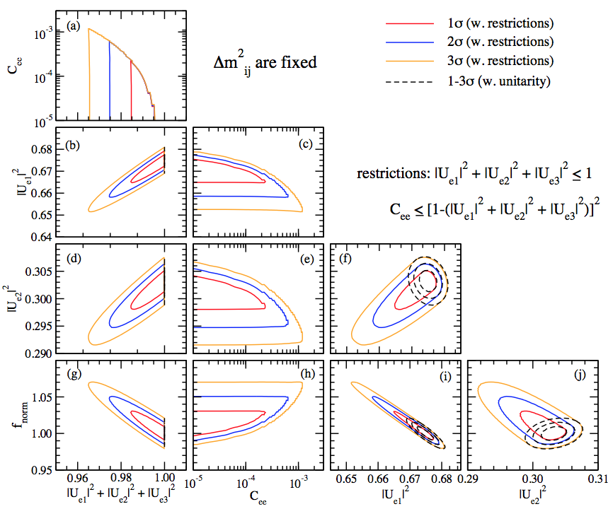
Sensitivity to C_{ee} and 1-Σ|U_{ei}|² from JUNO 5 years
3% flux uncertainty assumed
C_{ee} ~ 10⁻⁴ (1 σ)
1-Σ|U_{ei}|² ~ 0.01

Slide 6
Need some other way

Slide 7
Physically, we are probably in such a situation that ..
New Physics BSM
SM

Slide 8
2 scenarios
High scale unitarity violation
Low scale unitarity violation
New Physics BSM
New Physics BSM
SM
SM
A lot of difference in physics !

Slide 9
Helio-UV perturbation theory

Slide 10
In both ways, active 3x3 nu space is almost like standard 3 flavor mixing
But with non-unitary flavor mixing matrix N
Alpha parametrization for N

Slide 11
U₁₃U₁₂ transformed basis: tilde basis
Perturb by 2 small expansion parameters: ε and alpha’s

Slide 12
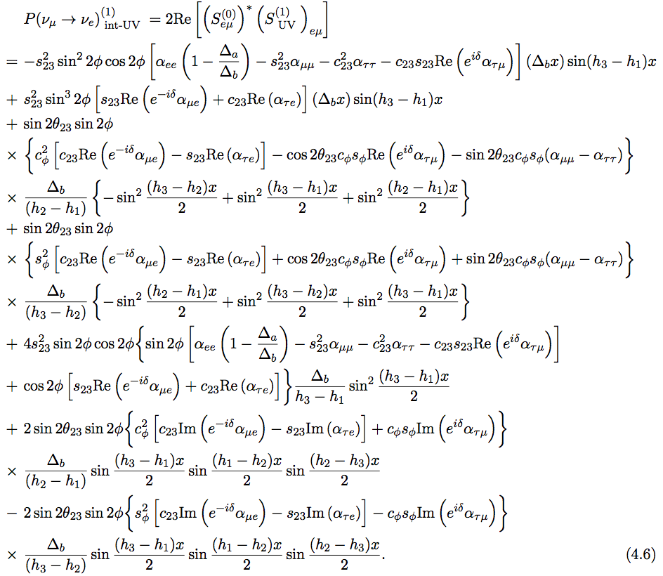
“extrinsic” UV contribution
“intrinsic” UV contribution

Slide 13
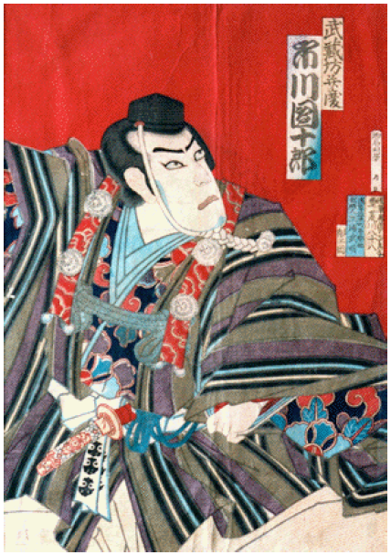
Canonical phase combination!

Slide 14
Canonical phase combination: δ vs. alpha correlation
General formula for S matrix
δ and alpha always come in this combination!
Let us call “canonical phase combination”
What does this relation mean?

Slide 15
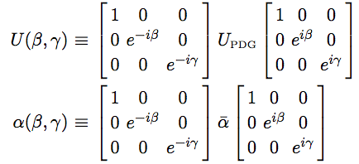
U_{MNS} phase convention dependence

Slide 16
3 useful conventions of U_{MNS}

Slide 17
Depending upon which convention of U_{MNS} I take, the “canonical phase combination” is different
U_{ATM}
U_{PDG}
U_{SOL}
No correlation between δ and α’s in U_{SOL}convention!

Slide 18
What that means?
Practical message: Use U_{SOL} convention of U_{MNS} to avoid unwanted phase correlation → better for analysis purpose
But, the question is: what is the meaning of phase convention dependence?
Opinion 1: Phase correlation superficial
Opinion 2: Phase correlation universal, all channel, all U_{MNS} except for U_{SOL}
If 2, framework (unitarity violation) knows how α phase must come in to SM

Slide 19
Sorry for a loose end but..
How to carry out leptonic unitarity test not so trivial even at start..
Someone must do a complete thinking or preparation before experimentalists are ready to do the job
I will try to answer which opinion is correct in this summer

