Slide 1

Status of consideration of implementation of nuSTORM at CERN
Mike Lamont
12th August 2018
Jonathan Gall, John Osborne – SMB
Ken Long – Imperial University, London
Marco Calviani –EN/STI and team
Claudia Ahdida – HSE/RP and Radiation Protection (RP) team
Wolfgang Bartmann - TE/ABT

Slide 2
PBC - scientific goal
Explore the opportunities offered by the CERN accelerator complex to address some of today’s outstanding questions in particle physics
These experiments would typically:
  enrich and diversify the CERN scientific program,
  exploit the unique opportunities offered by CERN’s accelerator complex and scientific infrastructure,
  complement the laboratory’s collider programme (LHC, HL-LHC and possible future colliders).
  Examples of physics objectives include searches for rare processes and very-weakly interacting particles, measurements of electric dipole moments, etc.

Slide 3
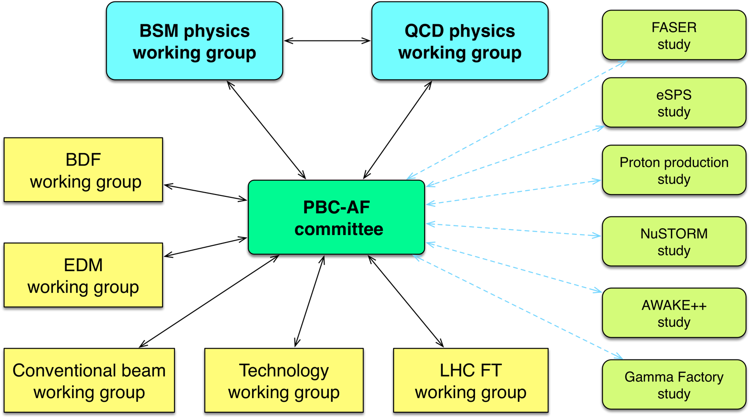

Slide 4
nuSTORM@FNAL proposal
Neutrinos from STORed Muons - Proposal to the Fermilab PAC – July 2013
Fast extraction from MI at ~120 GeV
  8e12 protons/1.33 s cycle
Conventional pion production and capture (horn)
  Quadrupole pion-transport channel to decay ring
Low-energy muon decay ring

Slide 5
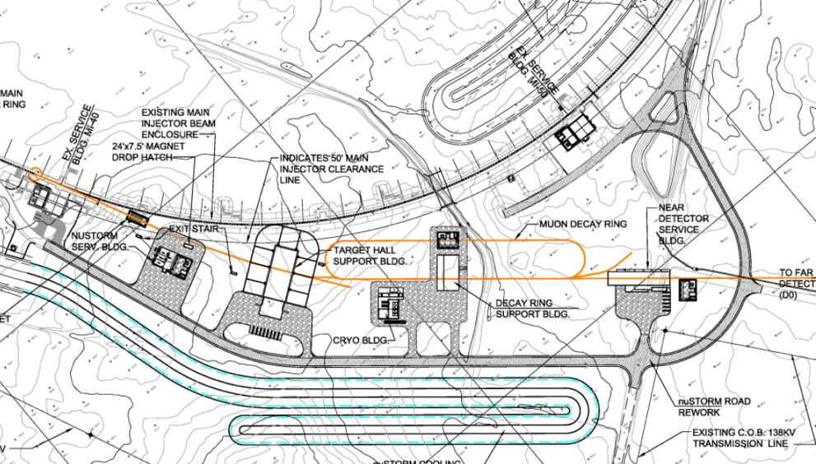
FNAL proposal
Fermilab report details:
  Decay ring support building
  Target hall support building
  Near detector service building
  Far detector
  Cryogenic building
Fermilab design – Surface buildings site plan
Well developed, and costed, proposal – a reference point together with input from Ken, Jaroslaw and team

Slide 6
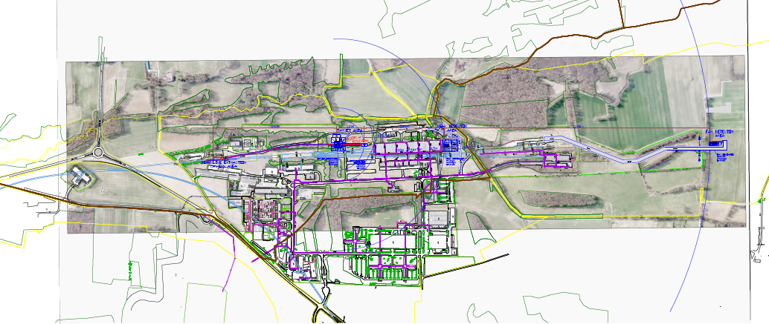
CENF - short baseline neutrino facility
Primary beam
~600 m from target area
Near Detector Facility
@456 m from target,
EHN1 extension
Secondary beam
Far Detector Facility
In front of EHN1
@1600 m from target
North Area
100 GeV/c
Fast extraction
Protons per cycle 4.8e13
15 m deep
→ 4.5x10¹⁹ pot/yr

Slide 7
Summary of CENF studies
Lots of work done and executed
Advanced integration of beam elements, plus ventilation and radiation protection
Civil engineering works also performed
… then stopped in 2014
Lots of input for new projects, such as BDF (and/or nuSTORM)

Slide 8
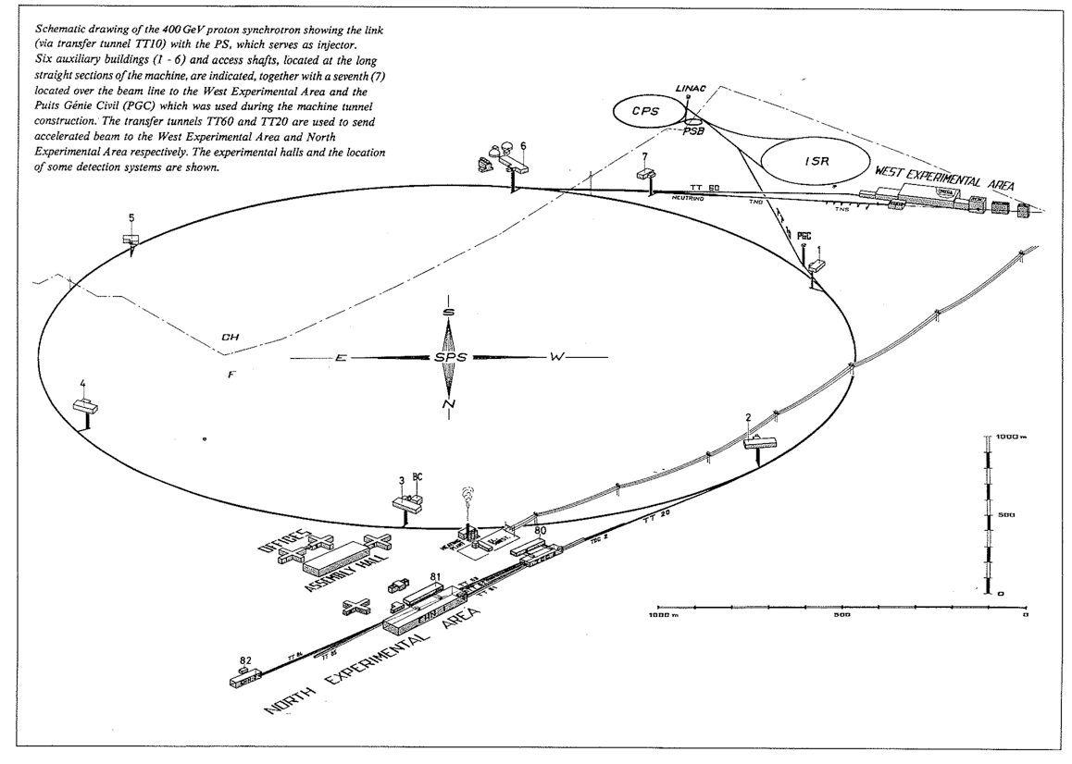

SPS
LEIR
LINAC3
LINAC4
2
AD
ELENA
ISOLDE
nTOF
TI2: LHC
Beam 1
LHC
HIRADMAT
R_{av =} 1.1 km
LSS6: fast extraction
AWAKE
(formerly CNGS)
LSS1: injection,
internal beam dump
LSS4: fast extraction
TI8: LHC
Beam 2
BEAM
DIRECTION
LSS3: RF
LSS2: slow-extraction
SHiP
North Area (NA): max 450 GeV
[1] J.B. Adams, The CERN 400 GeV Proton Synchrotron, 1977

Slide 9
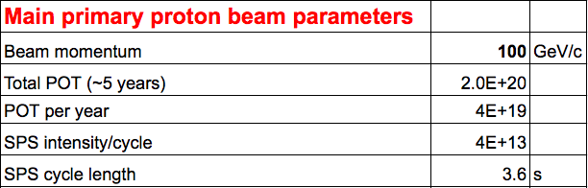
nuSTORM @ CERN - parameters
Preliminary parameter table developed for discussion
Now aiming at 6 GeV muons instead of 3.8 GeV -> scaled version of ring

Slide 10
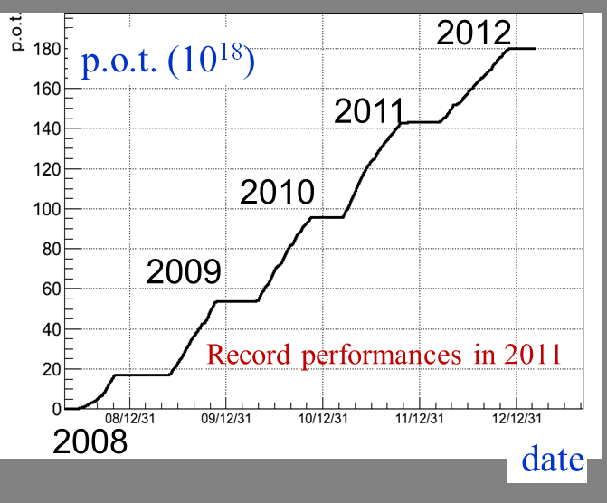
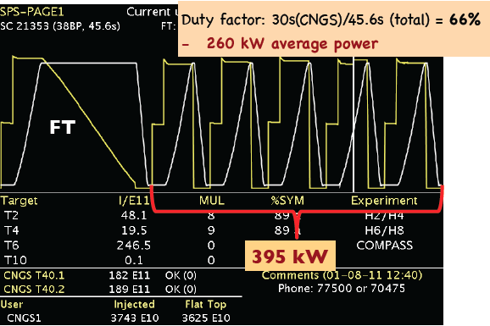
nuSTORM@CERN
SPS can deliver the beam
  e.g. CNGS 400 GeV/c fast extraction
  CNGS approved to 22.5e19 POT
    i.e. 5 years at 4.5e19 POT/year
  From 2008 to 2012 delivered 81% of approved total
In co-existence/competition from other users:
LHC, North Area (+HiRadMat, AWAKE) at present
Growing list for future (SHiP, KLEVER…)

Slide 11
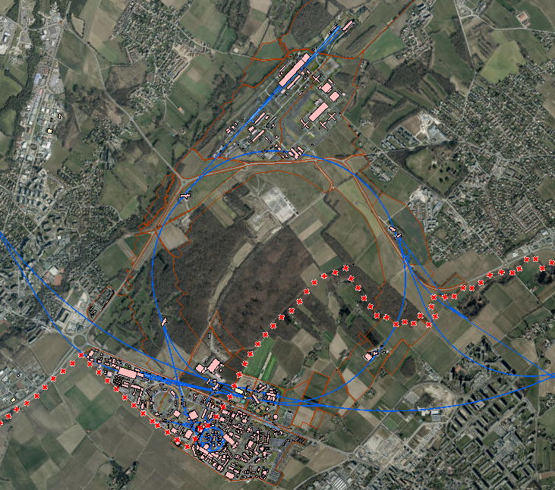
North Area
2 - slow
4 - fast
ex-CNGS
AWAKE
LHC
6 - fast
LHC
HiRadMat

Slide 12
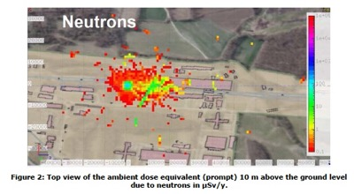
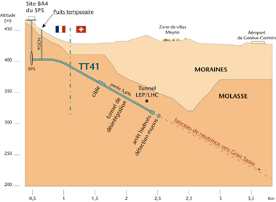
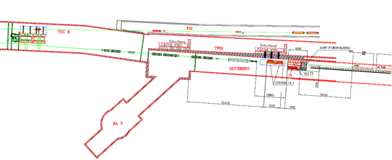
nuSTORM@CERN - siting options
North Area:
  Kick @ LSS1; extract @ LSS2
  Transport to North Area:
    Issues:
      Congestion, radio-protection, slow extraction
CERN to Gran Sasso beam line:
  Beamline directed “down hill” in molasse to serve Gran Sasso
  Would put nuSTORM ring deeper than necessary
  Existing target area hot
LSS6:
  Served West Area Neutrino Facility
  HiRadMat now operational
Preferred option “semi-greenfield” …

Slide 13
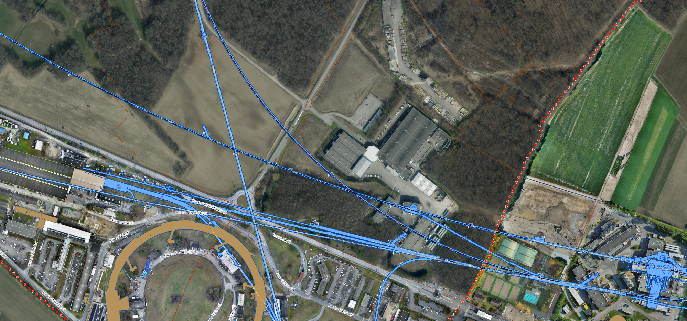
LSS6
LHC
SPS
LHC B1
HiRadMat
nuSTORM
Extraction septa

Slide 14
Extraction from TT61
Possible reach for: 1.8 T (Magenta) or 1.6 T (Yellow) bending fields

Slide 15
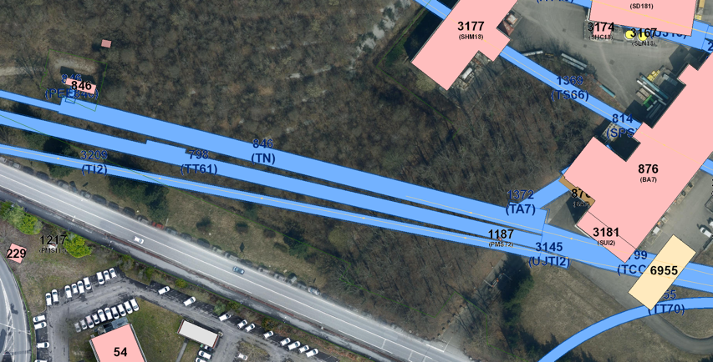
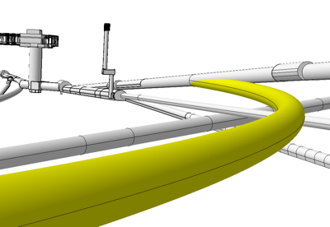
nuSTORM@CERN – SPS Extraction
Extraction from LSS6
  100 GeV protons, large emittance beams (FT beams in SPS)
  May need some changes to beam line equipment in this area – to be confirmed at later stage
TT61 transfer
  Appeared the best location for junction cavern and transfer to new line
Civil Engineering to look at feasibility in detail based on parameters
  Minimum single plane bending radius – 300 m
  Minimum bending radius for horizontal and vertical bending – 480 m
Initial siting guidance from accelerator beam transfer group

Slide 16
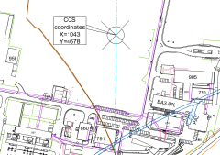
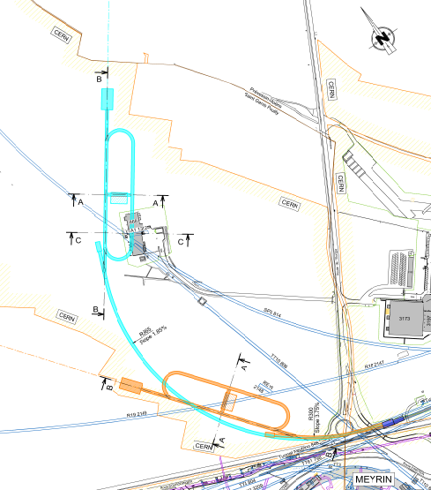
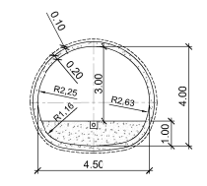
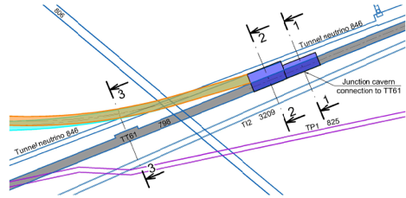
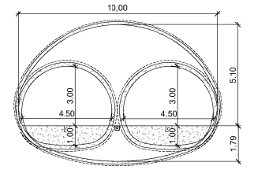
Civil Engineering - development
Latest options 4 and 5
Option 4 with far detector in Prevessin
Option 5 with minimised tunnel length
CERN land
Within molasse
Potential far detector at Prevessin
Option 4
Route de l’Europe
Typical section at 1-1
Option 5
TT61 Extract – junction cavern
Typical section at 2-2
CERN Meyrin
Plan view showing options 4 and 5

Slide 17
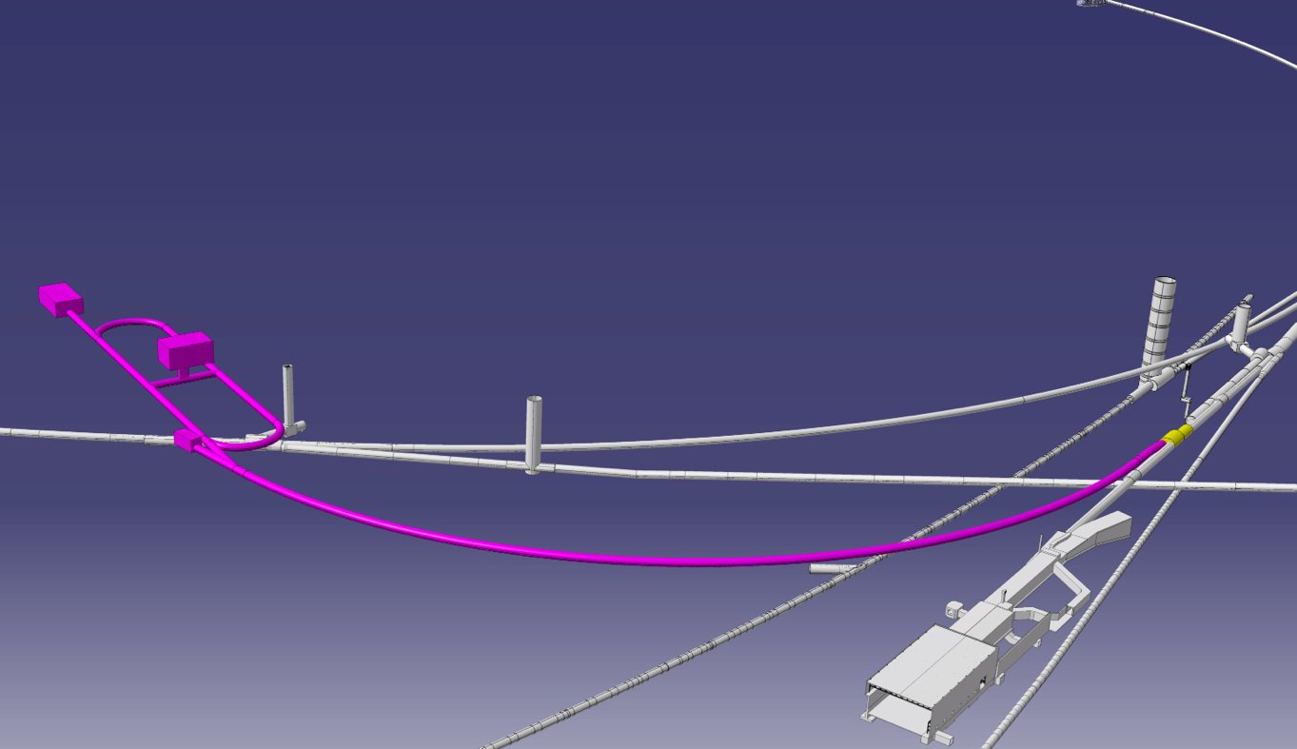
Civil Engineering – Option 4
far detector in Prevessin
Muon ring scaled to 6 GeV

Slide 18
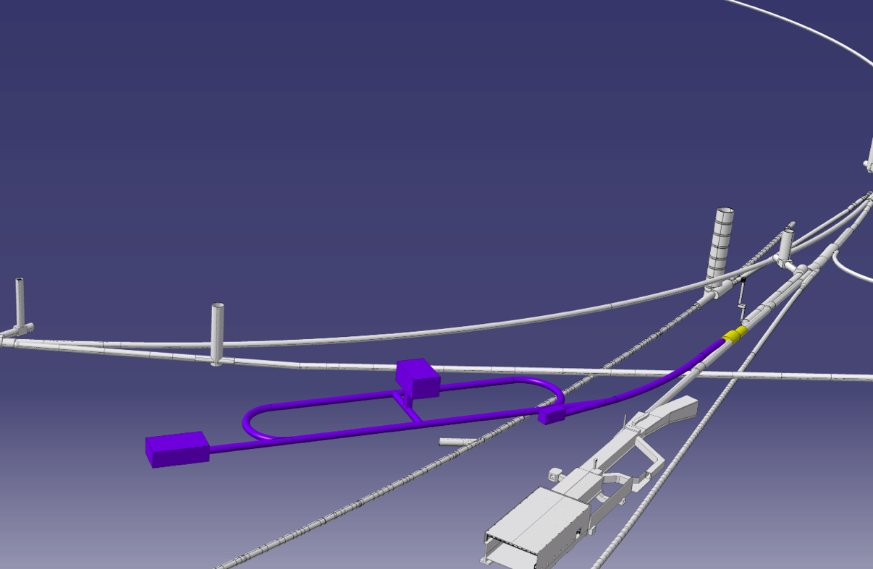
Civil Engineering – Option 5

Slide 19
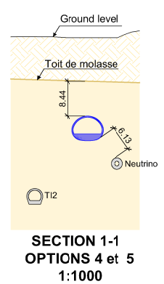
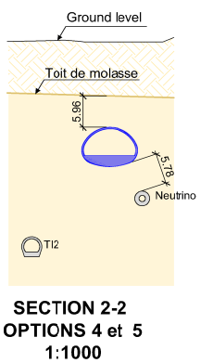
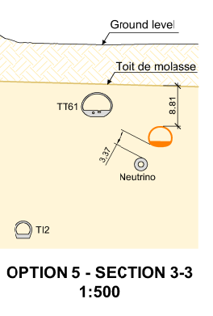
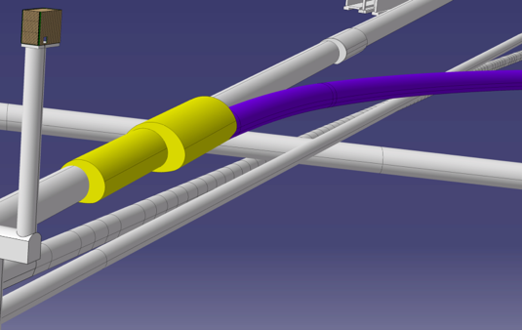
Civil Engineering – Option 4 & 5
3
2
1
3
2
1
TT10
TN(Neutrino)
TT61
TI2

Slide 20
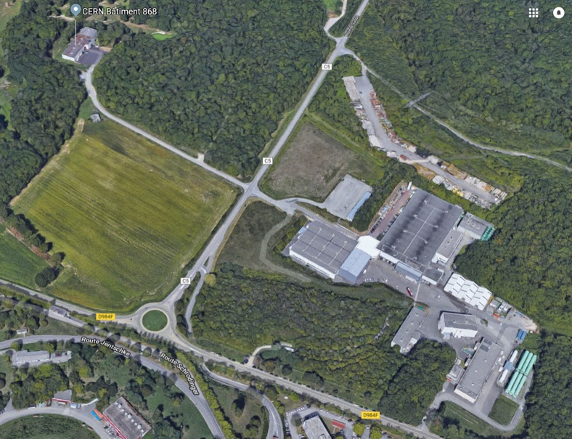
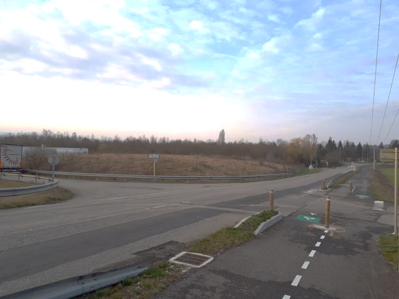
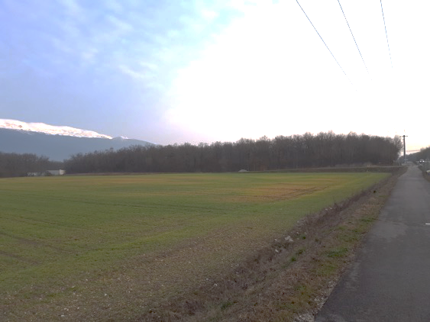
Civil Engineering - Site Access
Existing access roads to point 1 SPS, SM18 and Bat. 846
Overhead electrical supplies
Woodland
1
1
2
2

Slide 21
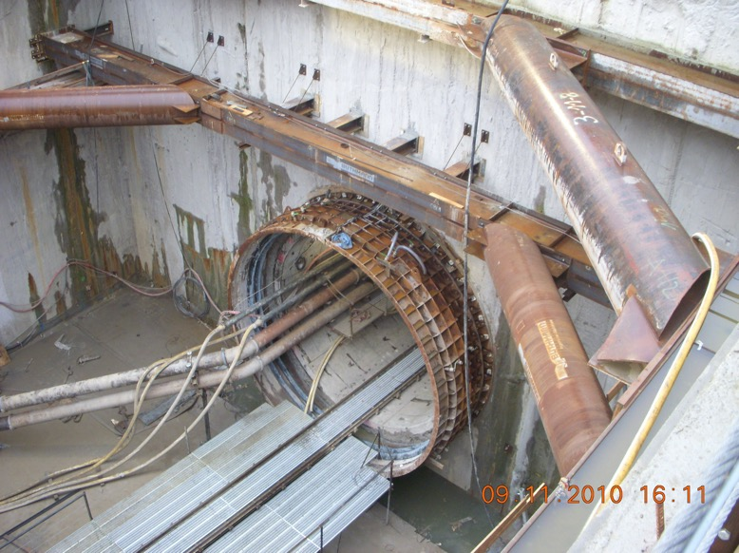
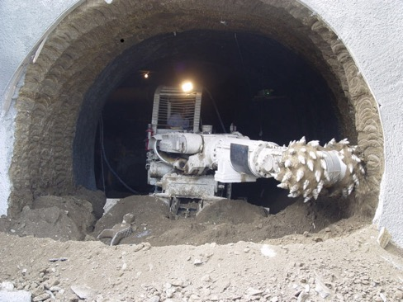
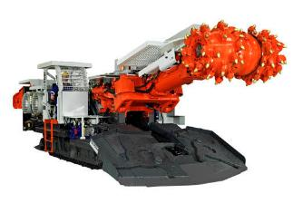
Likely construction method - molasse
Standard tunnelling techniques to be used in competent molasse.
Reduced disruption at surface particularly roads and services

Slide 22
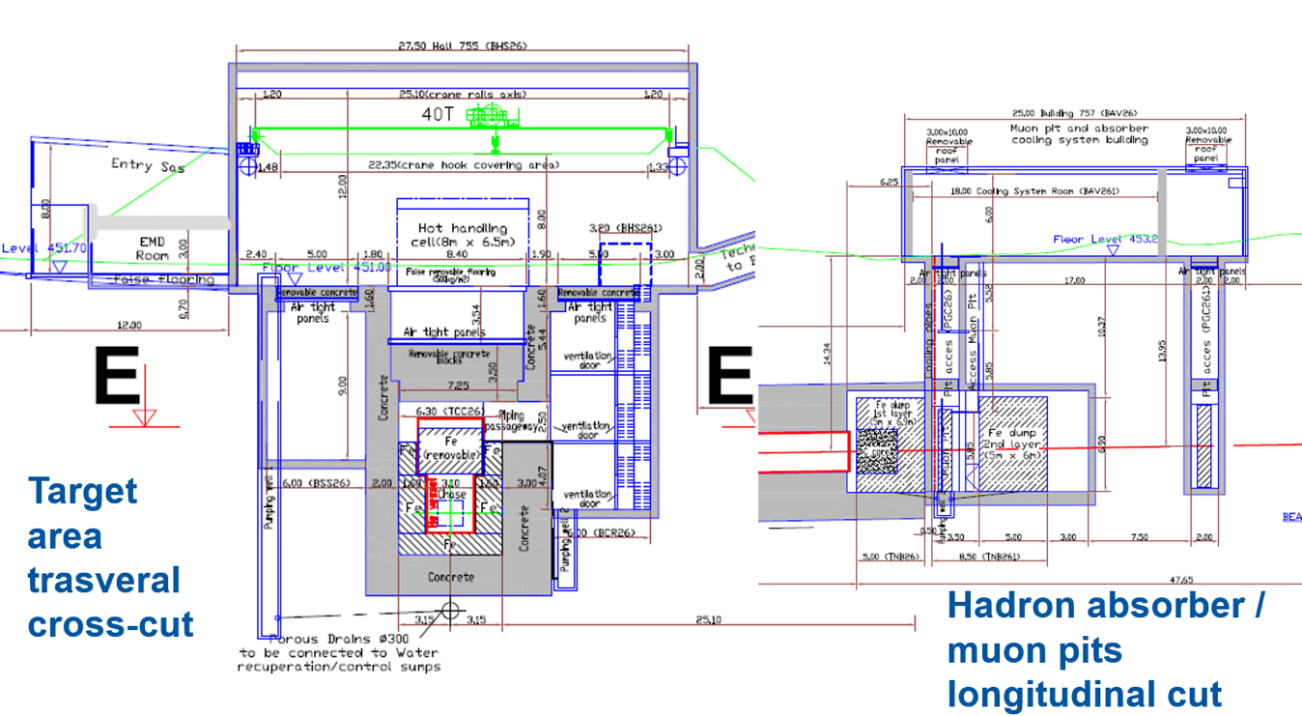
Target complex development - CENF
Marco Calviani

Slide 23
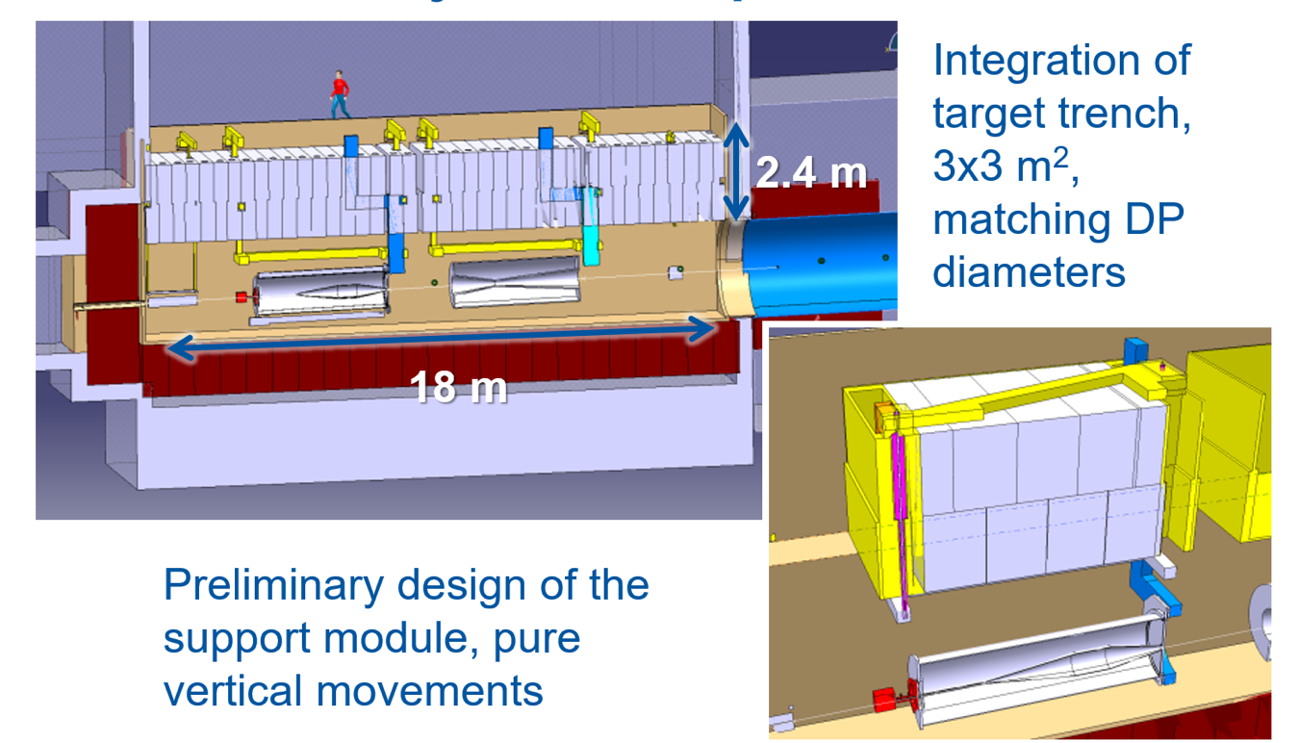
Target complex development - CENF
Marco Calviani

Slide 24
Antiproton production target (AD-T)
Why: it might be an interesting alternative to nuSTORM-like design
Fixed target in the PS complex to produce antiprotons for the AD physics
  26 GeV/c, 1.5*10¹³ ppp
  450 ns (4 bunches)
  0.5x1 mm²
  Iridium target, water-cooled
  Magnetic horn, 400 kA
  Collimators, dump, quadrupoles, dipoles (dog-leg)
Marco Calviani

Slide 25
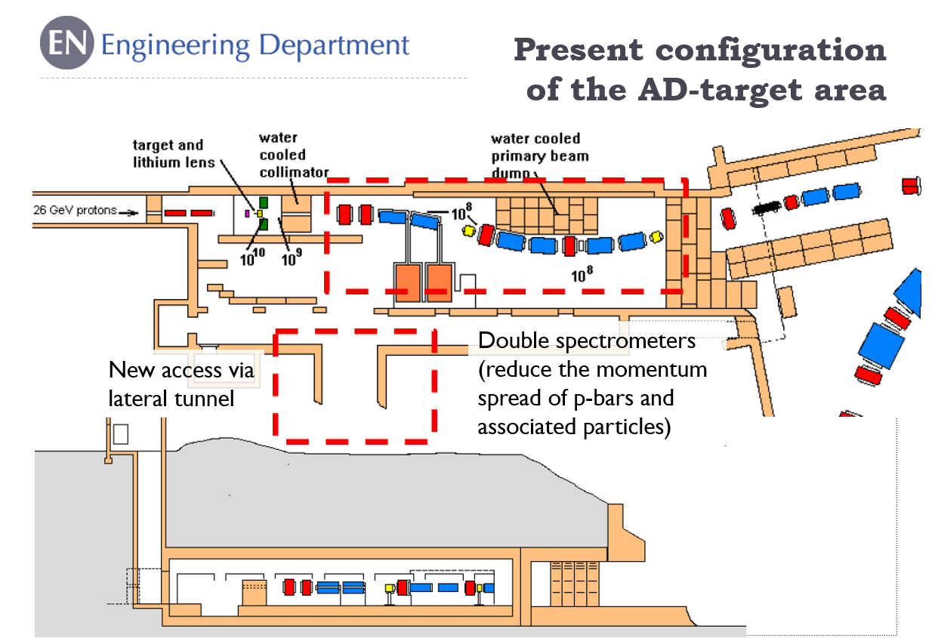
Marco Calviani

Slide 26
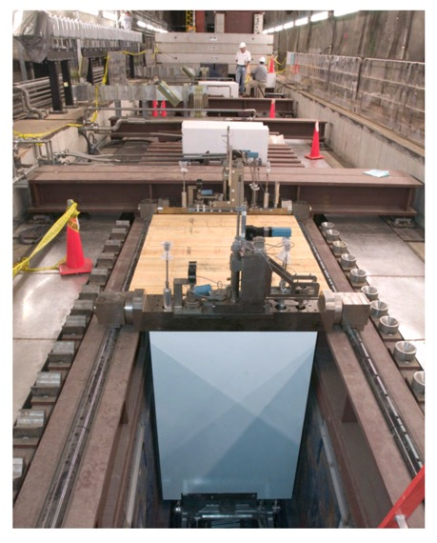
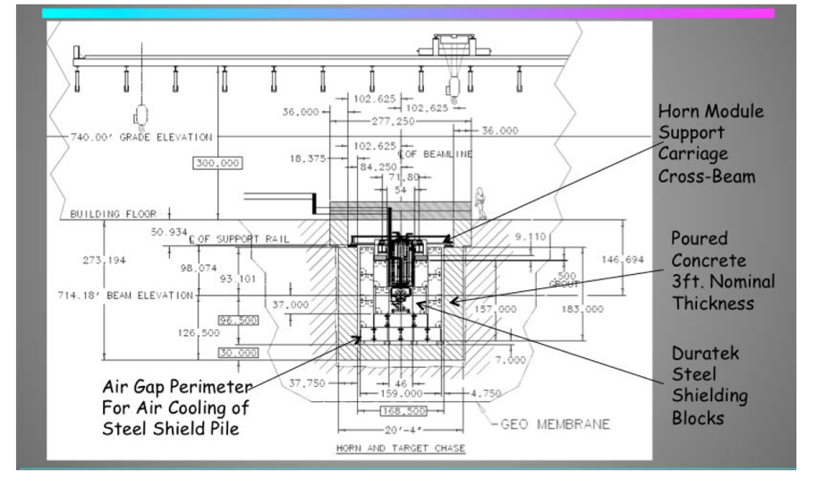
nuSTORM proposal
FNAL proposition based on a NuMI (AP0) style target station design, i.e. equipment in a “chase”
arXiv:1308.6822v1
Marco Calviani

Slide 27
Production target
FNAL proposes a 2λ target based on NuMI design (graphite, water-cooled)
  Is this the most optimized solution for a 5 GeV/c pion beam??
  Inconel-based was proposed but not analysed
Can we use the experience out of the Ir-based or Ta-based segmented target from AD-T?
  Certainly a more point-like source for the focusing horn?
Ta and Au were also considered in the proposal
Marco Calviani

Slide 28
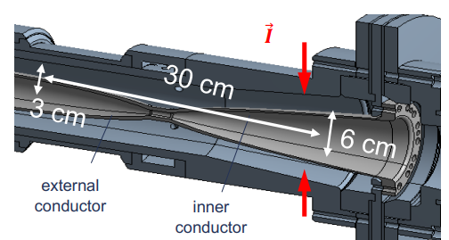
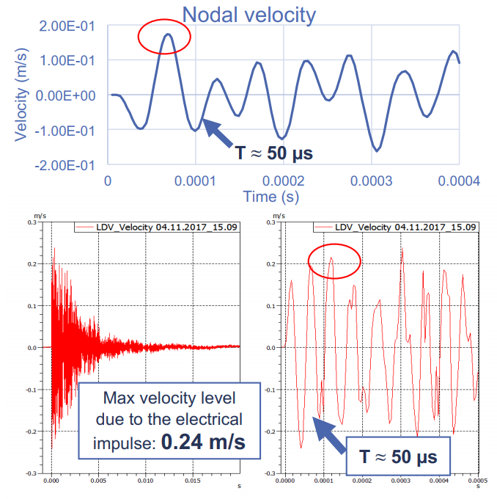
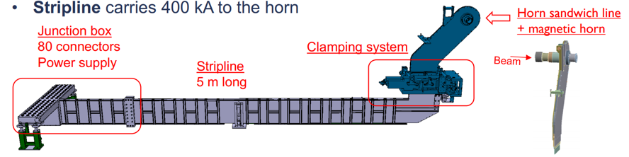
Magnetic horns
nuSTORM proposed NuMI-style horns
CERN experience with CNGS ones
LAGUNA-LBNO studies allowed developing a genetic algorithm for shape optimisation (still employed today by LBNF)
Recently AD magnetic horn rebuilt from scratch (calculations & production & soon pulsing tests)
Link for AD-horn R&D
Marco Calviani

Slide 29
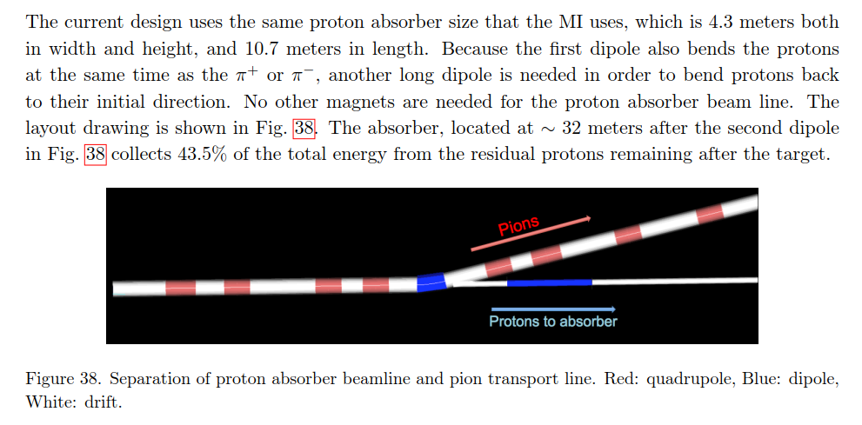
Injection line and proton absorber
Injection line has a single dipole → significant radiation in the decay ring !!!??
Proton absorber similar to a TIDVG-like assembly? Not studied in the FNAL study (?)
arXiv:1308.6822v1

Slide 30
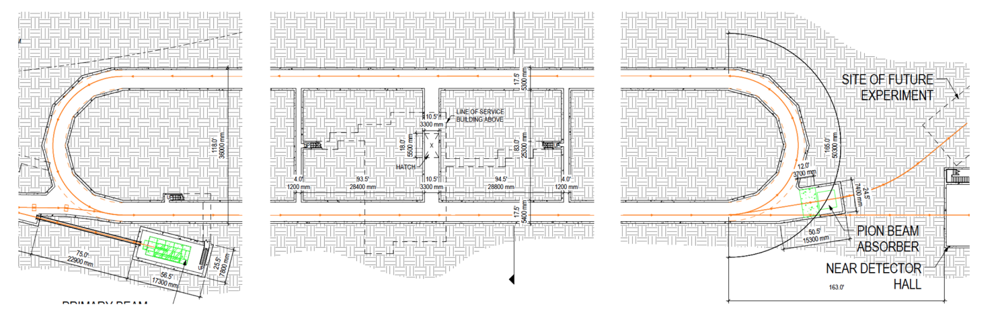
3.7 GeV/c arcs
2
1
5 GeV/c injection
arXiv:1308.6822v1
Proton dump
  O(100 kW) → TIDVG4-5 design (modified as external dump) appropriate (no worries here)
Pion dump
  O(2-3kW [ref]) → passive (iron) absorber should be enough
Is the pion dump required if we have a dog-leg?

Slide 31
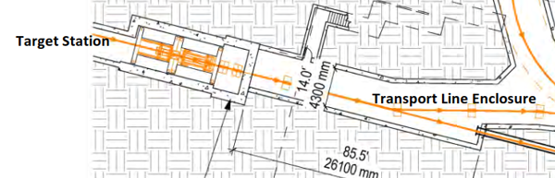
Ideas for nuSTORM
A target area based on AD-T concept with vertical handling (a-la-CENF/NuMI) might be possible alternative
  Target area much smaller and dose rate confined
~Site independent… could be even at a depth
Marco Calviani

Slide 32
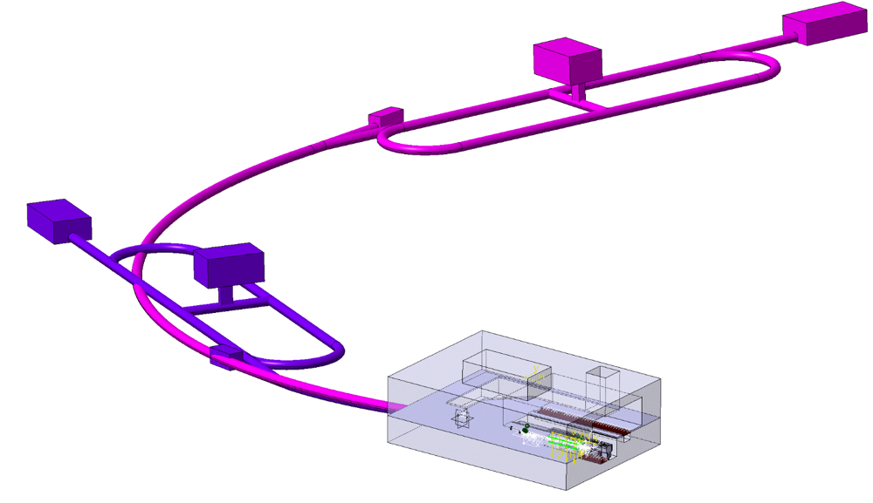
Preliminary draft target complex development
Decay ring support building
Near detector
Primary Beam absorber
Muon decay ring
Target complex
Based initially on FNAL designs, developed for CERN situation
Initial ideas:
  Production target, focusing horn, pair of capture quadrupole, collimators ++ dipoles (not in FNAL proposal)
  Helium Vessel
  Underground cavern with shaft to surface building offset
Further work required to understand requirements in detail. Currently quite preliminary.

Slide 33
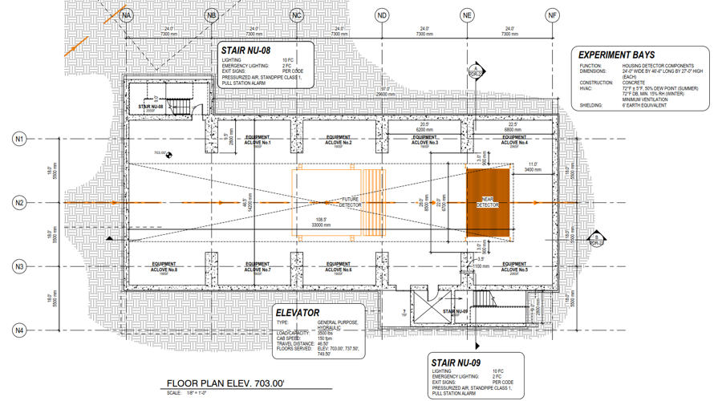
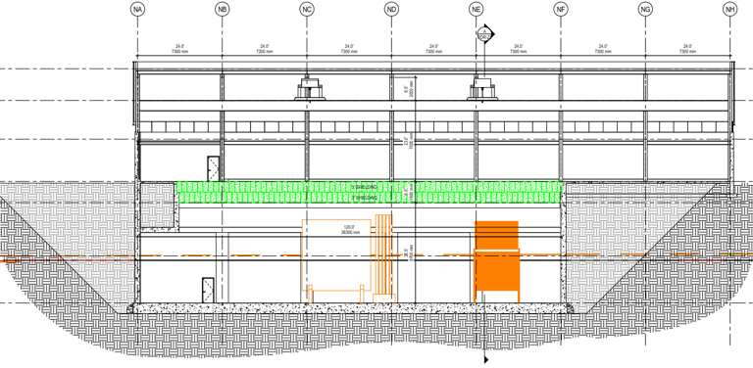
Detector Hall
Currently based on FNAL proposals ≈50 x 16.5m in plan.
Near detector foreseen
Possibility for far detector to be considered.

Slide 34
Radiation Protection
Well established methodology at CERN for radiation protection studies
Detailed evaluation was performed for CENF
Target at ~15 m
Resources not available for a detailed study at present but RP are in the loop
Based on CENF and wide ranging experience and the fact the proposed nuSTORM installation is in the molasse and at a depth of >20 m - looks OK

Slide 35
Conclusions 1/2
SPS can provide beam and fast extraction
Potential extraction point and site identified
Initial civil engineering sketches performed
Initial thoughts on target/horn/absorbers (considerable expertise at CERN)
Target complex concept sketched
Radiation protection – no dedicated study yet performed but at first sight, given proposed depth, should be manageable

Slide 36
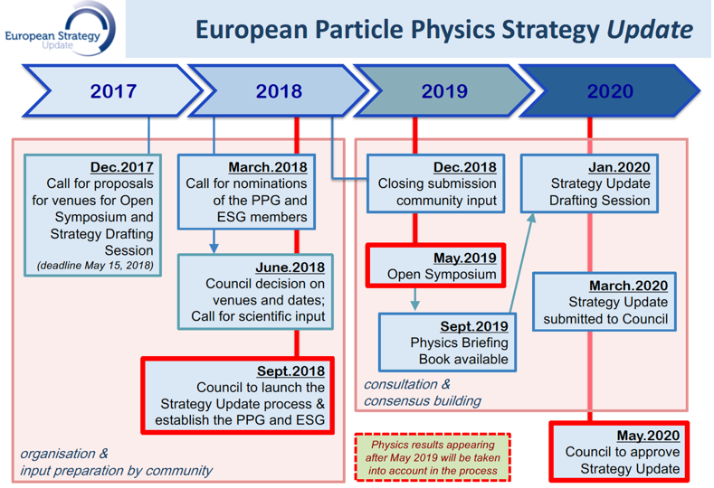
Conclusions 2/2
NB: really only a sketch at the moment – limited resources
“Exploratory study” to go to ESPP update in December
  10 page “executive summary” plus a more detailed CERN report

