Slide 1
nuSTORM

Slide 2
nuSTORM optimised for steriles at FNAL
nuSTORM

Slide 3
Neutrinos from stored muons
Scientific objectives:
  %-level (ν_{e}N)cross sections
    Double differential
  Sterile neutrino search
    Beyond Fermilab SBN
Precise neutrino flux:
  Normalisation: < 1%
  Energy (and flavour) precise
π ➔ μ injection pass:
  “Flash” of muon neutrinos

Slide 4
Working specitifation of nuSTORM for neutrino interactions
nuSTORM

Slide 5
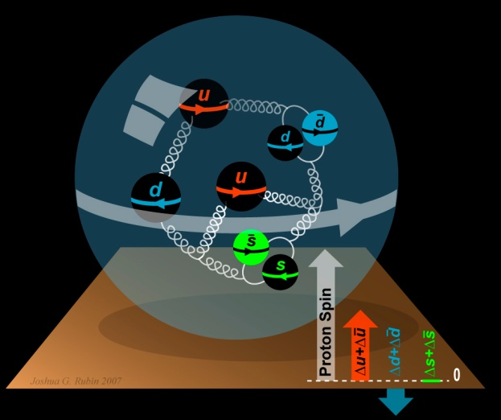
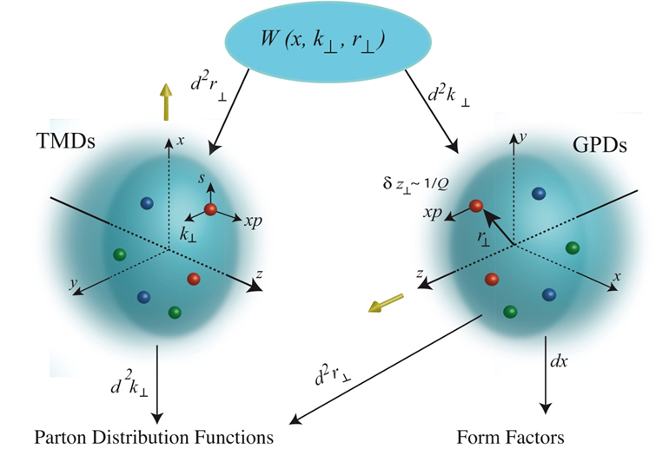
To understand the nucleon and the nucleus
W\ Dan Watts (Edin/York)
Neutrino unique probe: weak and chiral:
  Sensitive to flavour/isospin and 100% polarised
How could neutrino scattering help?
  Nucleon (e.g.):
    Spin puzzle
  Nucleus (e.g.):
    Multi-nucleon correlations
    Precise determination of:
      Model parameters or, better,
      Theoretical (ab initio) description
Can the neutrino’s unique properties compete with the rate in, e.g. electron scattering?
  Measure weak charge directly; rate and Q² dependence:
    For e⁻ rely on interference with photon, 10⁻⁶-level asymmetry
  To be studied!
Benefit of nuSTORM:
  Precise flux and energy distribution

Slide 6
Specification: energy range
Guidance from:
  Models:
    Region of overlap
    0.5—8 GeV
  DUNE/Hyper-K far detector spectra:
    0.3—6 GeV
Cross sections depend on:
  Q² and W:
    Assume (or specify) a detector capable of:
      Measuring exclusive final states
      Reconstructing Q² and W
    → E_{μ} < 6 GeV
So, stored muon energy range:
DUNE
Hyper-K
1 < E_{μ} < 6 GeV

Slide 7
nuSTORM
& the CERN Physics Beyond Colliders study group
See M. Lamont’s talk
nuSTORM

Slide 8
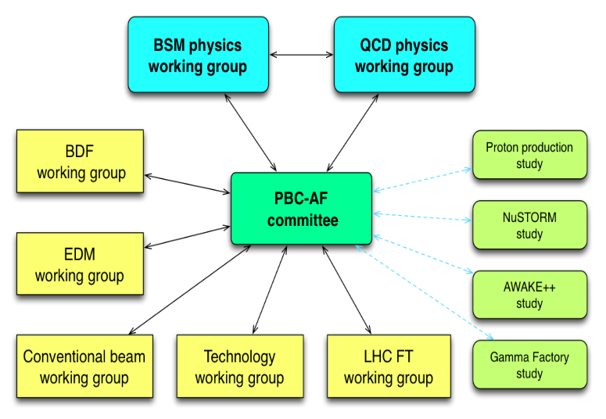
Physics Beyond Colliders study group
http://pbc.web.cern.ch

Slide 9
Implementation @ CERN Exploratory study
A credible proposal for siting at CERN, including:
  SPS requirements
  Fast extraction, beam-line
  Target and target complex
  Horn
  Siting
  Civil engineering
  Radio-protection implications

Slide 10
I. Efthymiopoulos

Slide 11
Target hall, detector hall, RP
J. Gall; https://indico.cern.ch/event/706741
Detector hall taken from FNAL design
Radio-protection (RP):
  Evaluation based on LBNO studies
  Requires appropriate engineering; not viewed as ‘in principle problem’

Slide 12
Taking the work forward
nuSTORM

Slide 13
Conclusions
nuSTORM can deliver:
  νN scattering measurements with precision required to:
    Serve the long- and short-baseline neutrino programmes
    Provide a valuable probe for nuclear physics
CERN PBC study: opportunity to define innovative programme:
    nuSTORM:
      Delivers critical measurement: ν_{e}/ν_{μ} N scattering;
      Has discovery potential: sterile neutrinos;
      Potential for 6D ionization-cooling programme to follow MICE

Slide 14
Taking the physics study forward
Goal:
  Sister publication to:
    ‘Light sterile neutrino sensitivity at the nuSTORM facility’, doi.org/10.1103/PhysRevD.89.071301, Phys.Rev. D89 (2014) 071301
  Document case for and performance of scattering programme
  Target:
    Autumn 2018
Fixed points, working backwards:
  Paper to Journal ~Nov/Dec 2018
  Presentation of principal results NuInt18: GSSI 15—19 October 2018
  W/s in advance of NuFact18; VT 12—18 August 2018
Some support through IPPP: collaboration between NP/PP:
  Dan Watts (NP experiment, Edinburgh) and KL:
    “Bridging the gap between neutrino-nucleus and electro-nucleus scattering at nuSTORM and JLAB”
  Opportunity to host one or more working meeting at IPPP
Discussion this
afternoon.

