Slide 1


The Integrable Optics Test Accelerator
Ben Freemire (NIU) & Jeff Eldred (FNAL)
NuFact 2018, Virginia Tech
Thursday, 16 August, 2018

Slide 2
Contents
Introduction
Fermilab Accelerator & Science Technology facility and Integrable Optics Test Accelerator
Experimental Program – Integrable Optics
Experimental Program – Space Charge Compensation using an Electron Column
Status & Schedule
Outlook

Slide 3
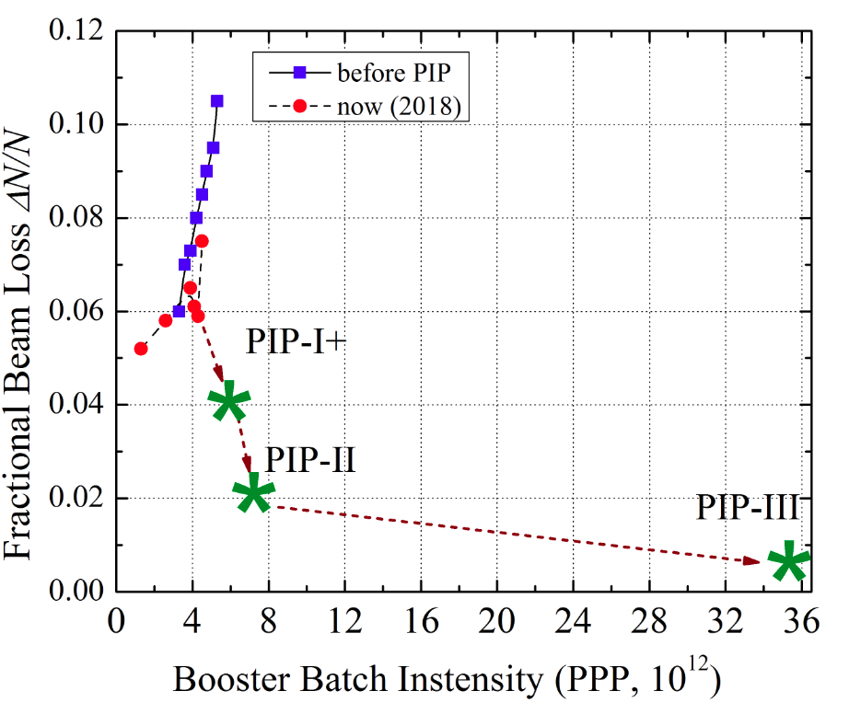
Present Hadron Machine Limitations
Beam loss major contributor to machine operating limits
1 W/m loss accepted, independent of beam power
Larger beam power means better control of losses
We will use Fermilab as an example in this talk
Upgrade plans call for larger bunch intensity & beam power
1.2 MW seems achievable using existing technology
Innovative accelerator physics techniques enable 2+ MW operation

Slide 4
DUNE Physics Sensitivity & Staging
S. Söldner-Rembold,
FNAL Users Meeting 2018
DUNE needs 2.4 MW beam power to achieve physics goals
  Allows for 5σ measurement of mass hierarchy, and 3-5σ measurement of CP violation for most values of δ_{CP}
Relies on staged implementation of LBNF
  Increase detector fiducial mass
  Increase beam power 1.2 →2.4 MW

Slide 5
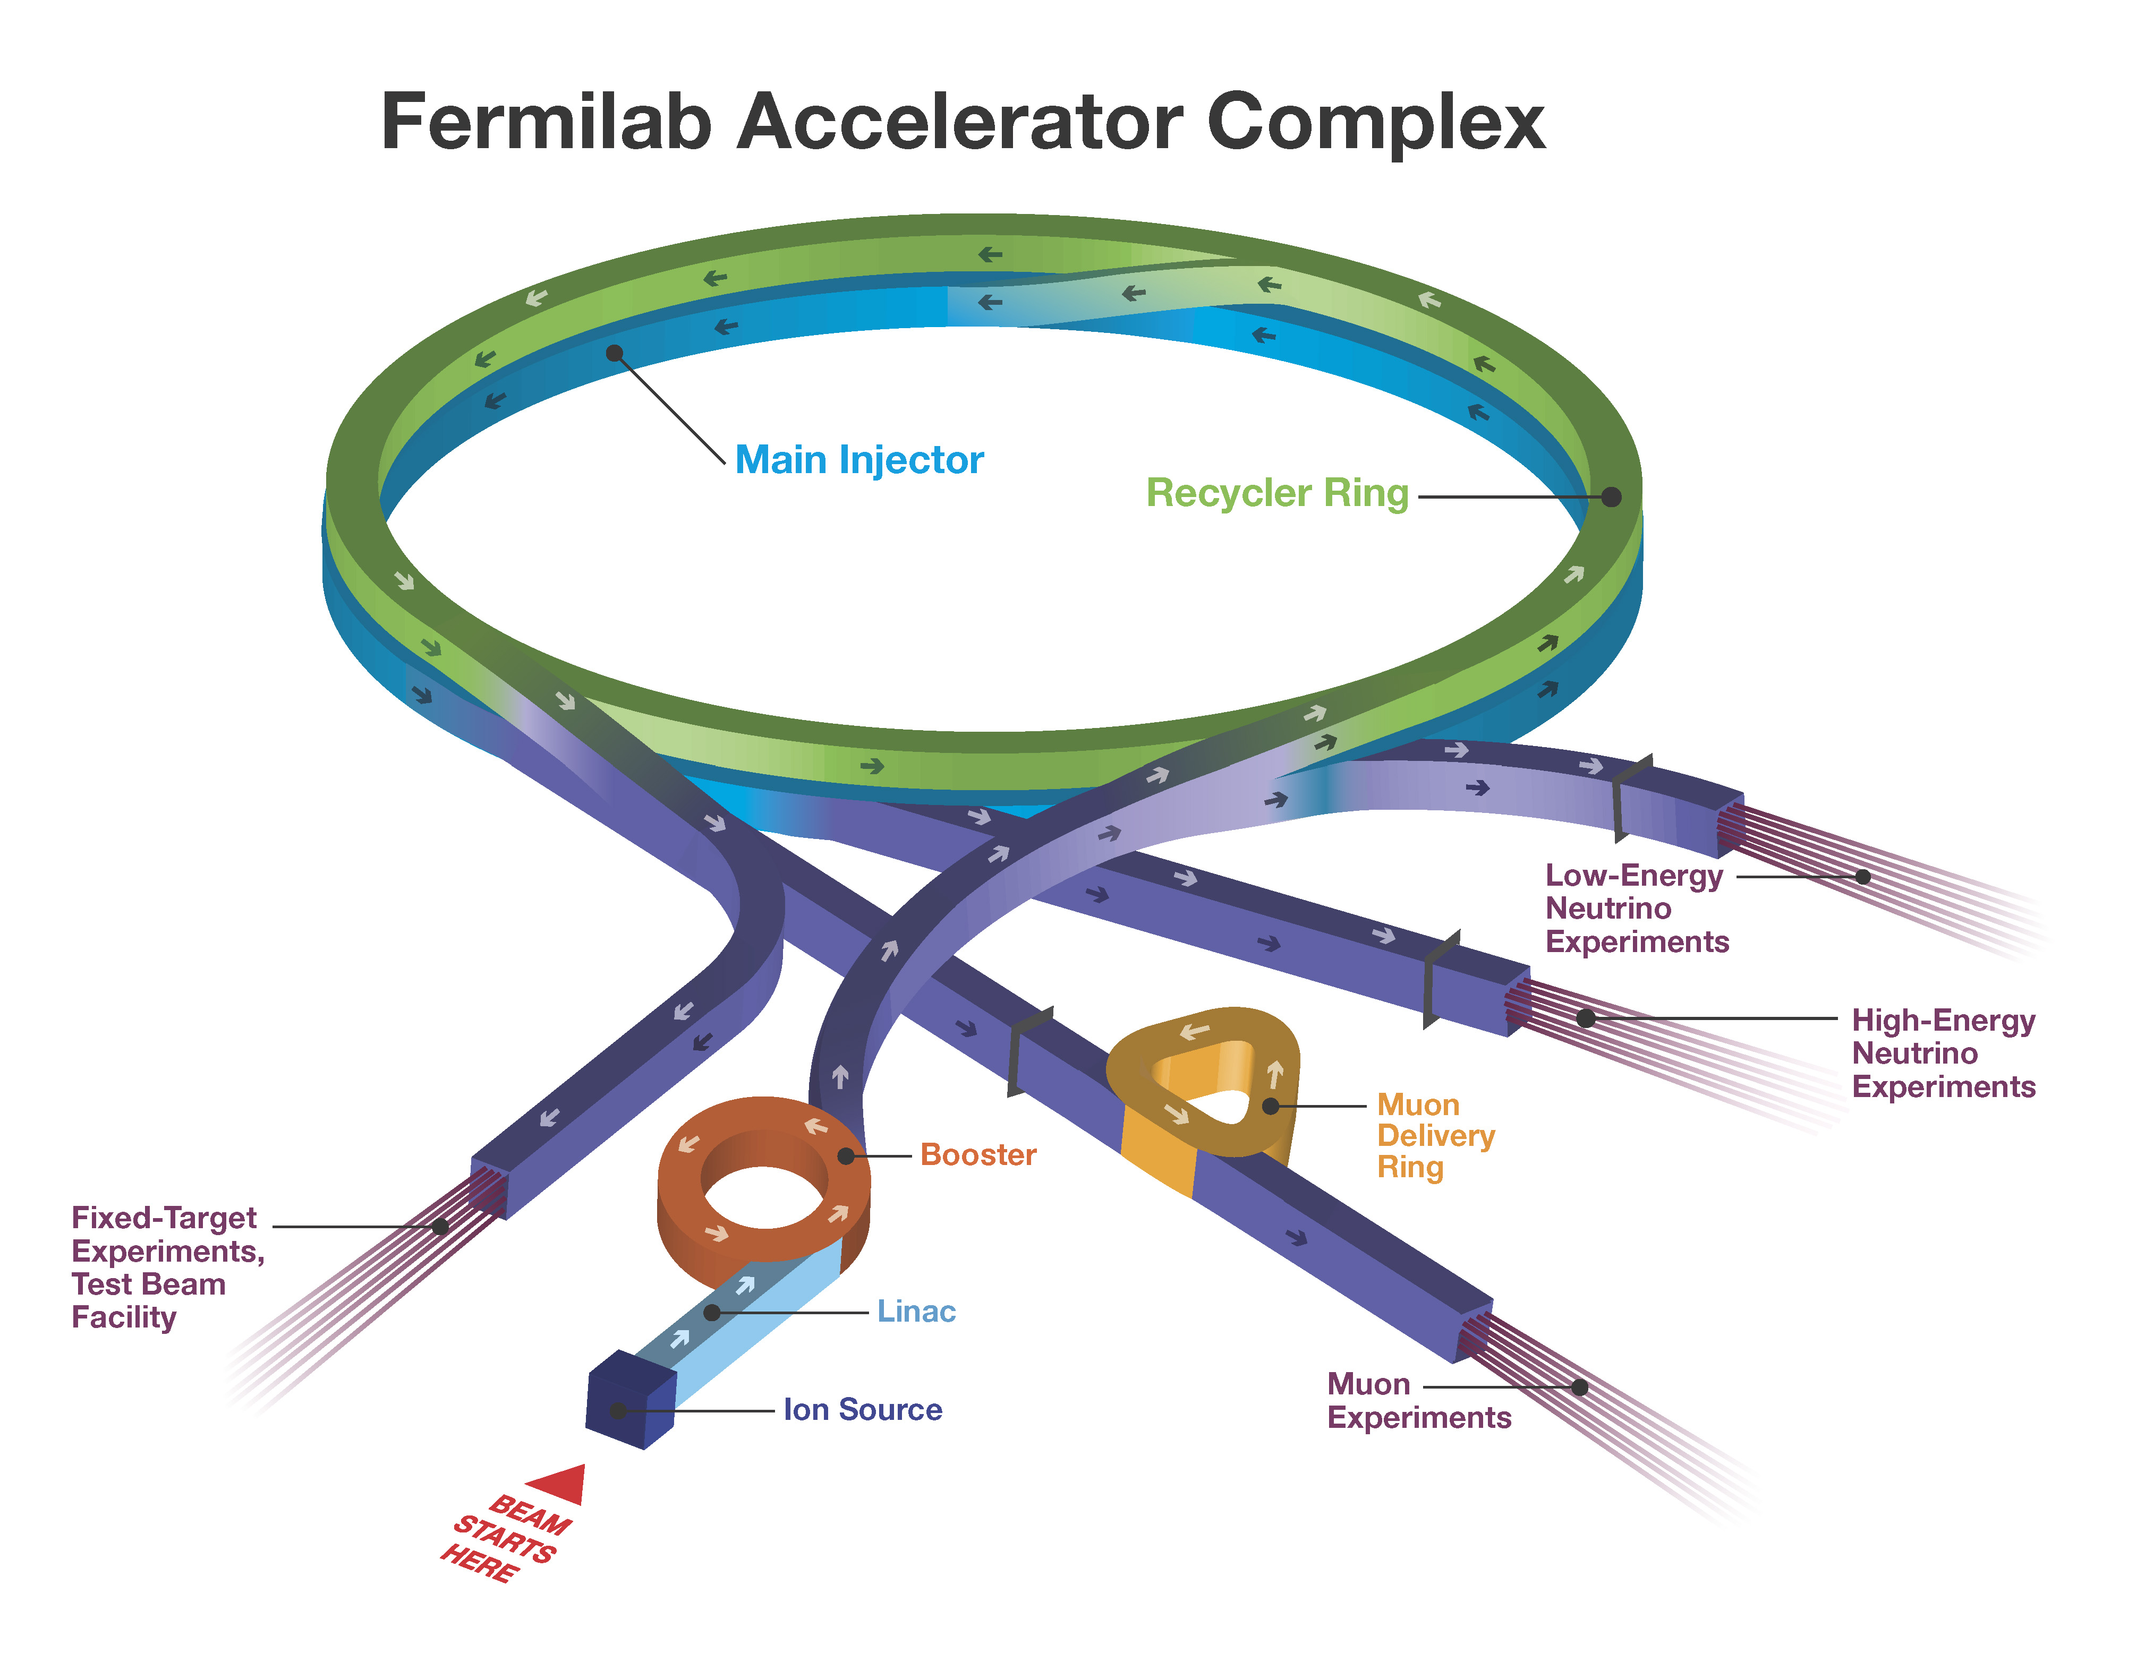
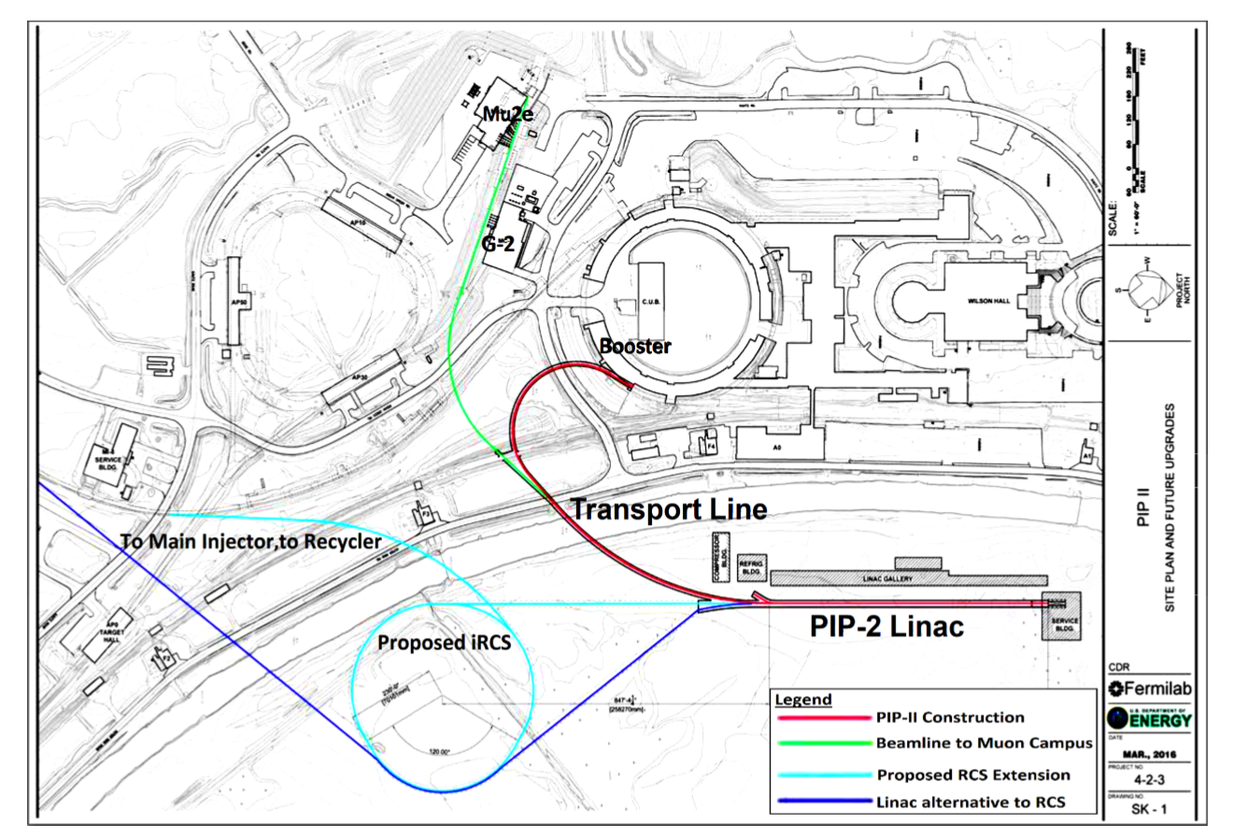
Fermilab Accelerator Complex of the Future
To achieve 1.2 MW (PIP-II), NC linac must be replaced with SC linac
To achieve 2+ MW (PIP-III), booster must be replaced
‘Integrable’ RCS is robust & cost-effective solution
linac not to scale

Slide 6
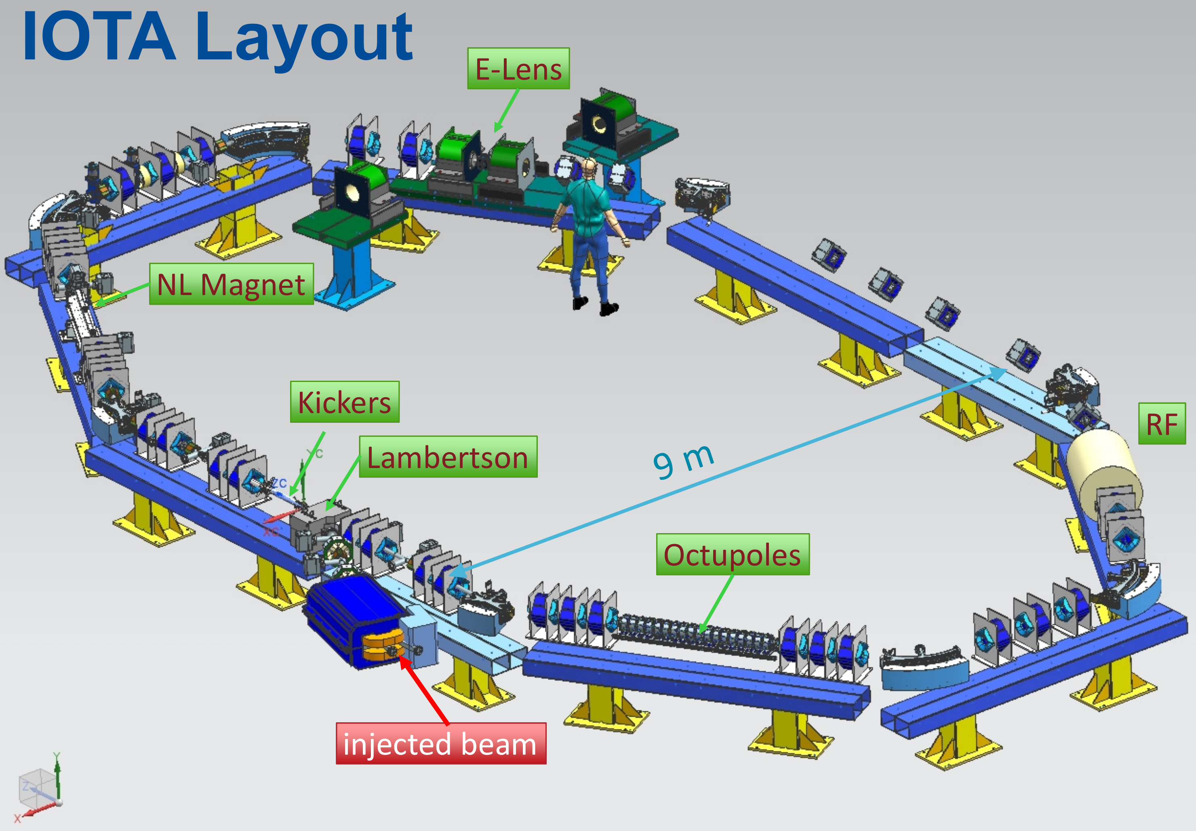
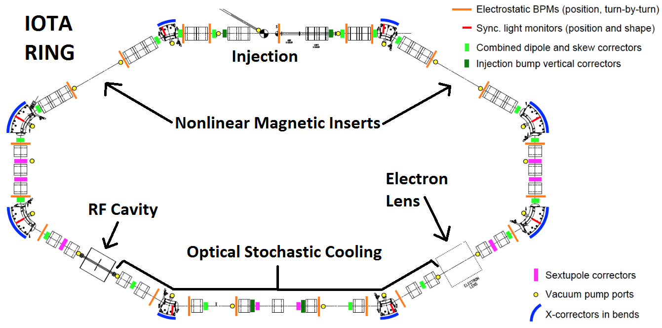
Integrable Optics Test Accelerator
Fermilab Accelerator & Science Technology (FAST) facility home to the Integrable Optics Test Accelerator (IOTA)
Storage ring for advanced beam physics research
Accepts both electrons and protons
Experimental program includes
  Nonlinear Integrable Optics
  Space Charge Compensation
  Optical Stochastic Cooling

Slide 7
Nonlinear Integrable Optics

Slide 8
Nonlinear Integrable Optics
Strong nonlinear focusing can be beneficial to accelerator beams:
  Decoherence suppresses beam halo formation
  Landau damping mitigates collective instabilities
  Steep Hamiltonian resistant to perturbations
However, octupoles introduce fourth-order resonances which have to be carefully corrected or avoided
For nonlinear integrable optics, the lattice optics are carefully tuned so that the nonlinear channel does not introduce any resonances
There will be two integrals of motion for the two transverse degrees of freedom
Notes:
Two integrals of motion = known stable orbits. One integral of motion = resonances & possibly unstable orbits. Zero integrals of motion = resonances & chaos. Nearly integrable motion = chaos closely bounded by stable motion.

Slide 9
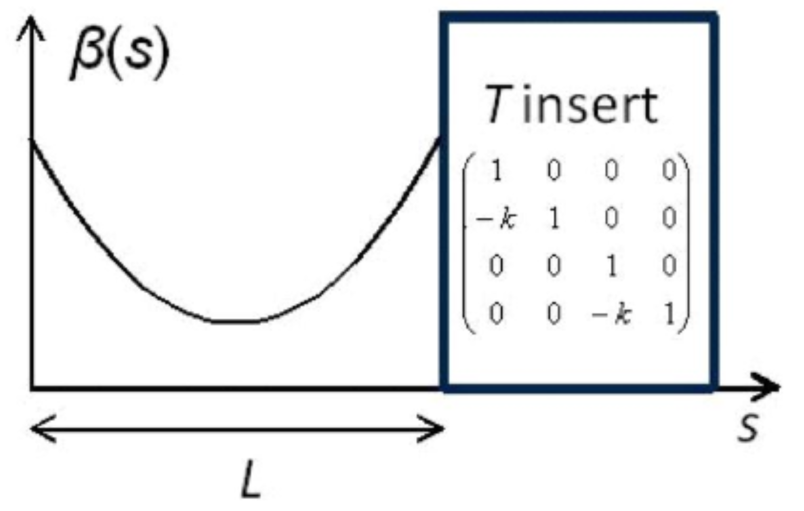
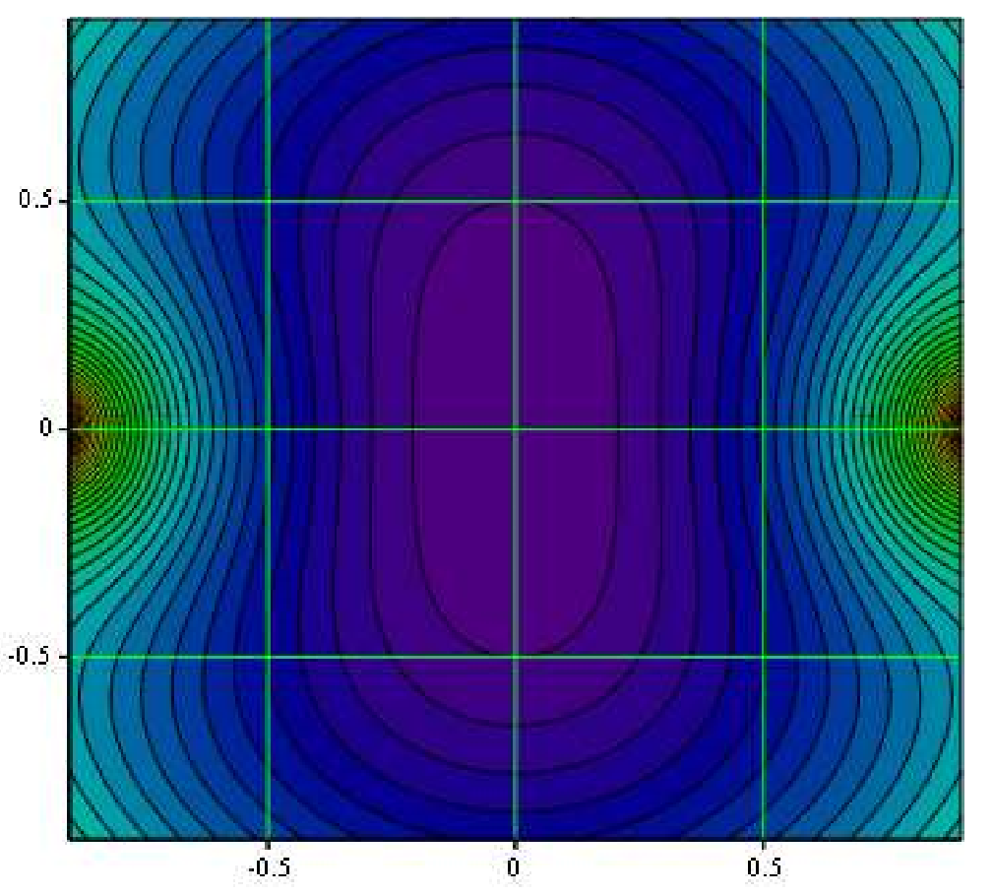
Danilov-Nagaitsev Integral Design
Nonlinear kick separable in elliptic coordinates:
Time-independent kick:
V. Danilov, S. Nagaitsev “Nonlinear Lattices with One or Two Analytic Invariants” PRST-AB 2010.
Magnet potential contours
Drift with matched beta functions and zero dispersion
Followed by T insert with pi-integer phase advance
Appropriate selection of potential in drift provides time-independent kick (avoid resonances)
Notes:
T insert composed of linear magnets (dipoles & quadrupoles), transfer matrix = thin, axially symmetric lens. Nonlinear insert is dispersion-free with a potential tailored to beam size.

Slide 10
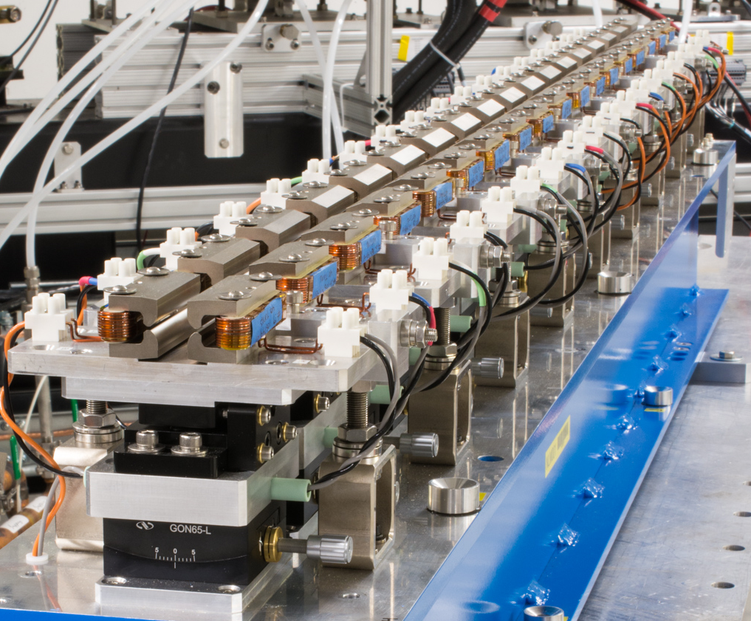
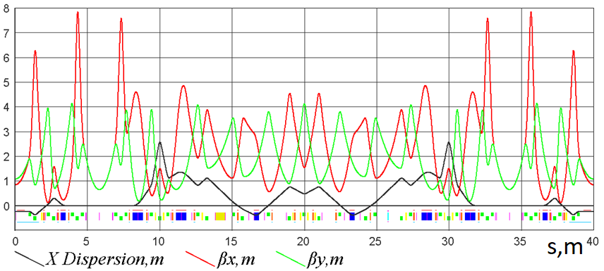
IOTA Lattice
Nonlinear insert:

Slide 11
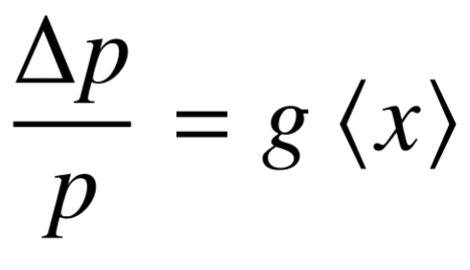
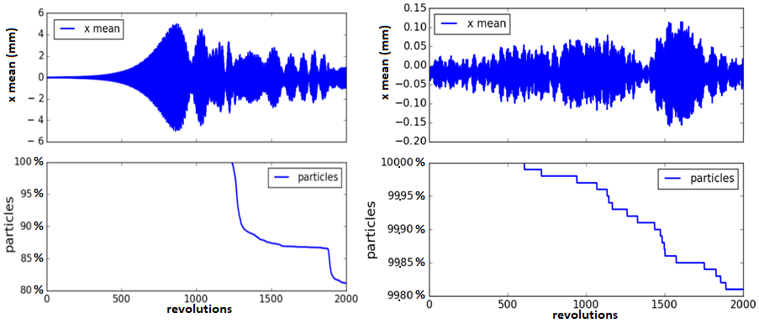
Simulation of Anti-Damper in the IOTA Lattice
Emulate a collective instability with an anti-damper:
Nonlinear element reduces max centroid oscillation by factor of 50 and reduces particle loss by factor of 100
Stern, Amundson, Macridin, IPAC 2018
Without nonlinear magnet
With nonlinear magnet
Notes:
Measure mean bunch position at one location, apply momentum kick equal to gain x mean bunch position at different location. g < 1 for anti-damper. One of the first experiments that can be done in IOTA, with electrons.

Slide 12
General Lattice Strategy for Integrable Optics
Standard FODO Cell:
Q_{F}
Q_{D}
Dip
Q_{F}
Dip
Q_{D}
Dip
Q_{F}
Dip
Q_{D}
Q_{F}
Nonlinear
Insertion:
Q_{D}
Q_{F}
Q_{D}
NL
Q_{D}
Q_{F}
Q_{D}
Design for a standard FODO lattice with arcs and straights
Match beta in nonlinear insert with focusing triplet
Adjust FODO cell to eliminate dispersion in nonlinear insertion
Adjust phase-advance between nonlinear insertions to pi-integer
Nonlinear Integrable Optics at cost of increased circumference
Notes:
Many accelerators designed as FODO arcs with dispersion-suppressed straights. One can split arcs to add nonlinear insert. Existing machines would need to have free space to add integrable optics, and probably would not maintain periodicity.

Slide 13
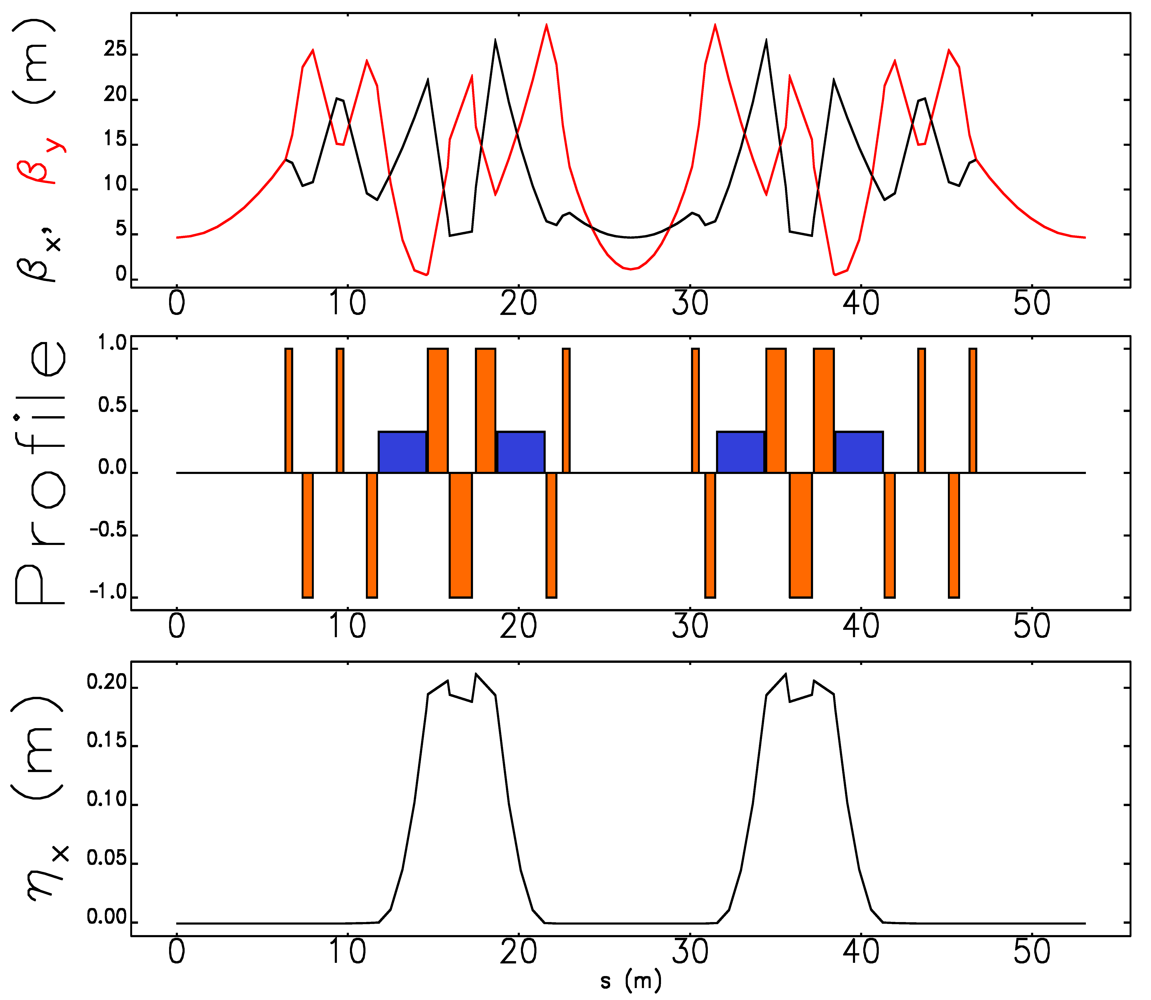
Integrable RCS Design
Periodicity: 12
Circumference: 636 m
Bend-radius rho: 15.4 m
Max. beta x,y function: 28 m
Max. dispersion function: 0.22 m
RF insertion length: 7.2 m, 4x 1.3 m
NL insertion length: 12.7 m
Insert phase-advance: 0.3
Minimum c-value: 3 cm
Beta at insert center: 5 m
Betatron tune: 21.6
Natural chromaticity: -79
Synchrotron tune: 0.08
NL
NL
Eldred, Valishev IPAC 2018
Notes:
One potential design of new integrable RCS. Straight sections dispersion free. Nonlinear insert on edges (betas matched). RF in center. 1 of 12 cells comprising ring.
Better than booster: max. beta reduced, no transition crossing, circumference consistent with five batch injection.
Tune & chromaticity matched in x and y.

Slide 14
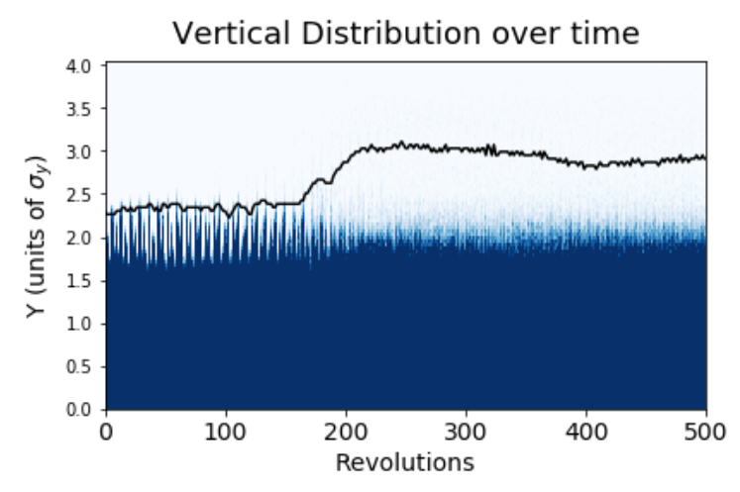
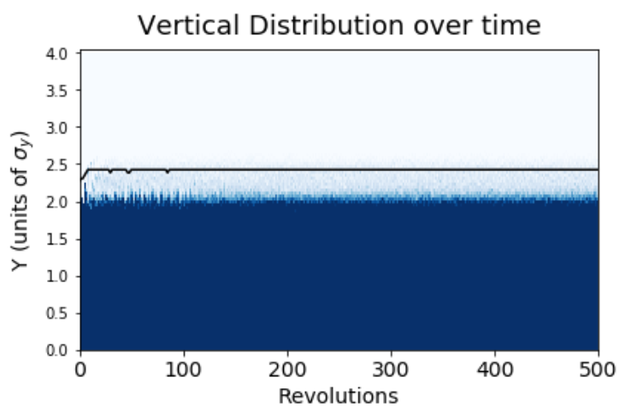
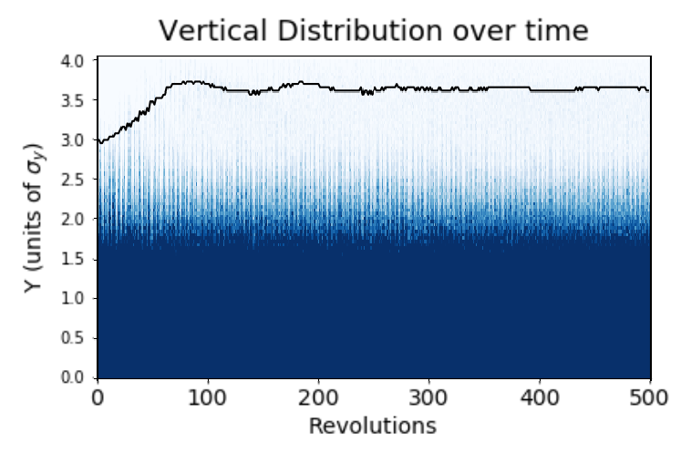
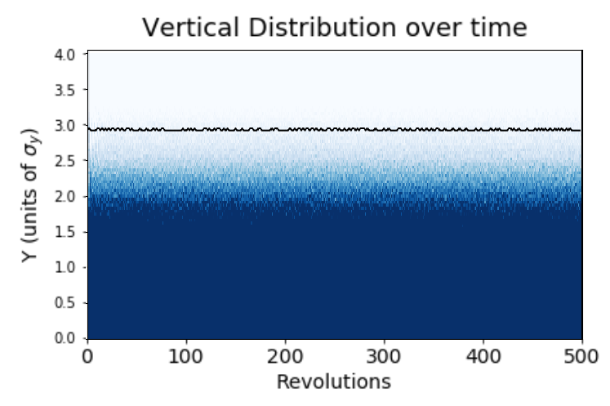
Transverse Beam Halo in iRCS Simulation
KV
Conventional
Integrable
Waterbag
Eldred, Valishev IPAC 2017
Notes:
Intense mismatched KV & Waterbag beams generate halo (left).
Integrable design provides rapid nonlinear decoherence, which strongly suppresses halo.
Integrable design enables stronger nonlinear focusing than previously achievable.

Slide 15
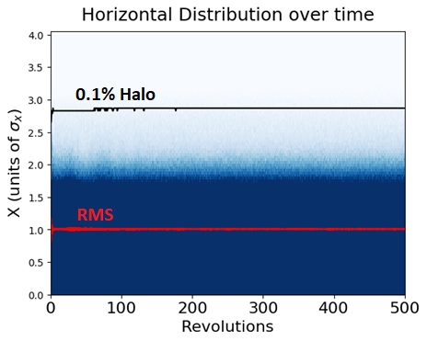
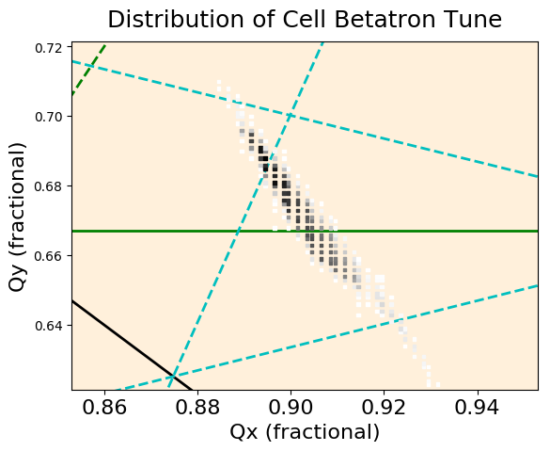
High Intensity Simulation of iRCS
Beam injected with 20% mismatch
Laslett tune shift of 0.4, corresponding to 3.2e13 protons
Stable for at least 5,000 revolutions, halo strongly suppressed
Caveat: perfect lattice with no errors
Eldred, Valishev IPAC 2018
Notes:
iRCS stable under very strong nonlinear focusing at intensities similar to those of upgrade.
No sextupoles in lattice (3rd order resonance), but 4th order resonances present – not a problem.

Slide 16
Space Charge Compensation

Slide 17
Space Charge Compensation
Another way of mitigating beam loss is through space charge compensation
Undesirable effects of Coulomb repulsion can be mitigated by making beam pass through plasma column of opposite charge with same charge distribution
  Required total charge of plasma column decreases with increasing beam energy
Concept successfully applied to transport high current, low energy proton and H⁻ beams in RFQs of linacs
In circular machines, suppression of e-p instabilities can be achieved using a solenoidal magnetic field of sufficient strength

Slide 18
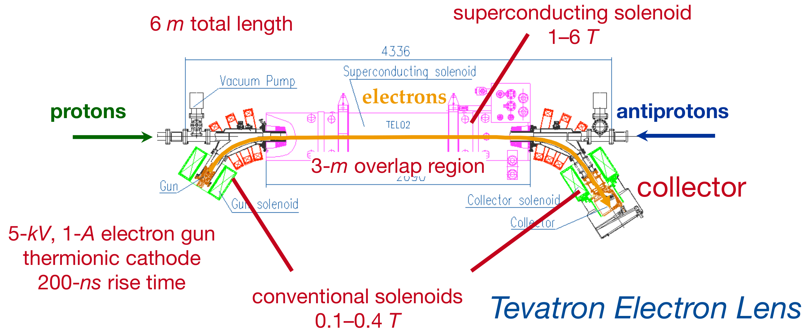
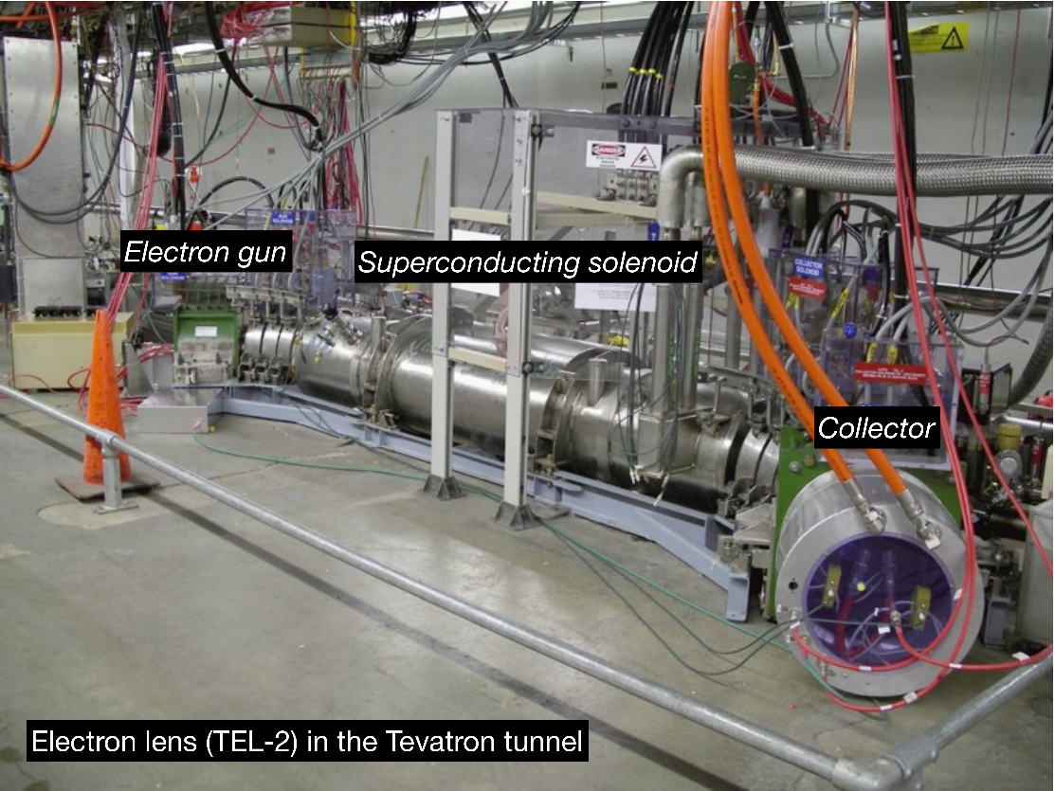
Electron Lenses
Electron Lenses successfully deployed at Fermilab (and Brookhaven and …) to compensate space charge tuneshift
External electron beam injected co-propagating with beam for short region
Transverse profiles must be carefully matched
Electron gun provides electron beam
Strong solenoid magnet confines electrons and suppresses instabilities
Additional magnets needed for injection and extraction

Slide 19
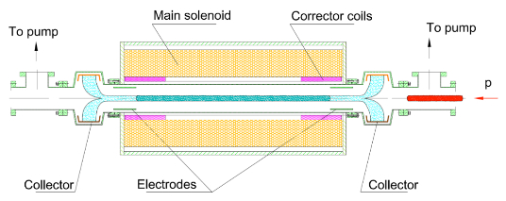
Electron Columns
Similar to Electron Lens
  Electrons provide negative charge to compensate Coulomb repulsion
Electrons produced by ionization of gas by beam in region of Column
Electron transverse distribution matches beam intrinsically
Electrodes at both ends provide longitudinal confinement
Solenoid magnet confines electrons transversely
  Strong enough to suppress e-p instability
  Weak enough to allow plasma ions to escape
Does not require electron gun, collector, or transport magnets
Does require additional pumping to maintain vacuum in rest of ring

Slide 20
Electron Column Status
Space charge compensation using an Electron Column planned for proton beam operation in IOTA
Simulation studies underway to
  Predict evolution of beam and Column
  Optimize Column parameters
    Gas density
    Electric & magnetic field strength
Two passes of the IOTA proton beam through Electron Column show space charge compensation
  Some key plasma processes missing
    Recombination
    Particle collisions
Inclusion of rest of IOTA lattice in simulation underway

Slide 21
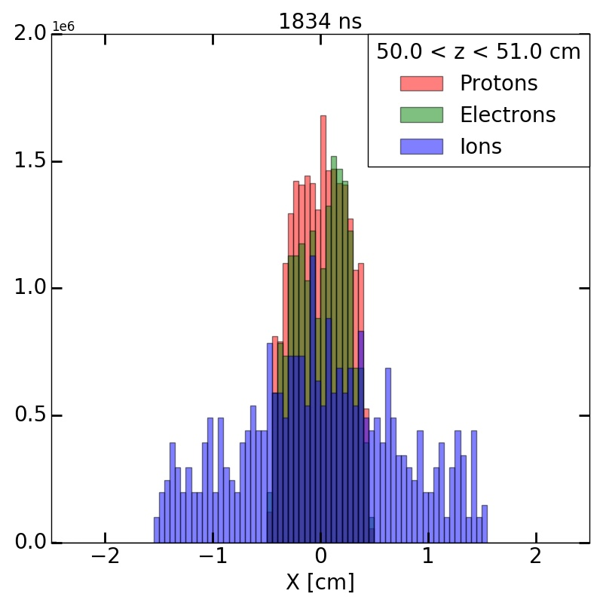
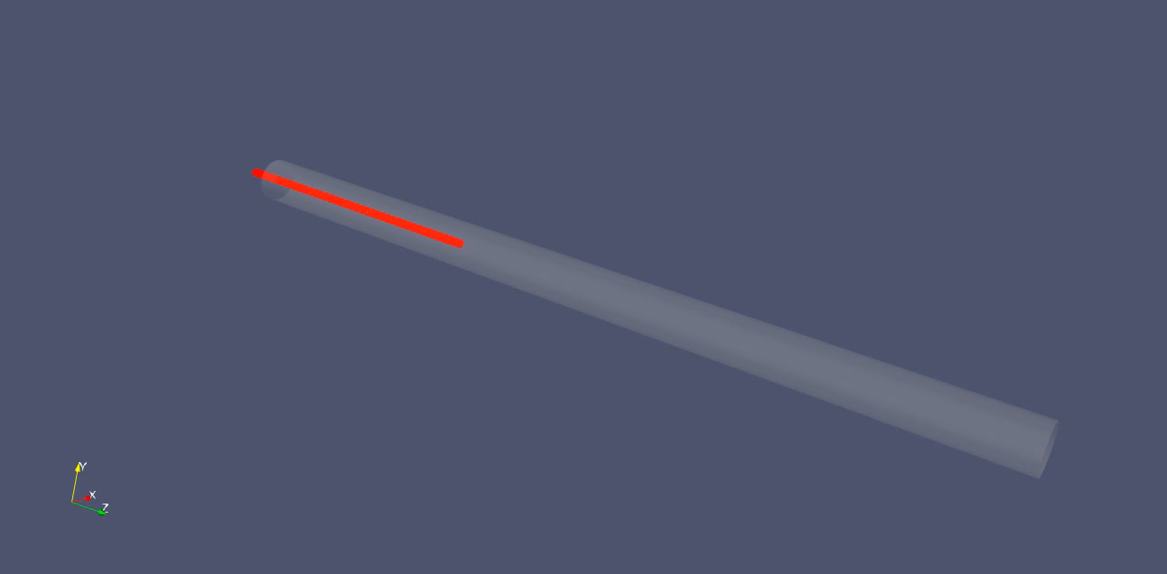
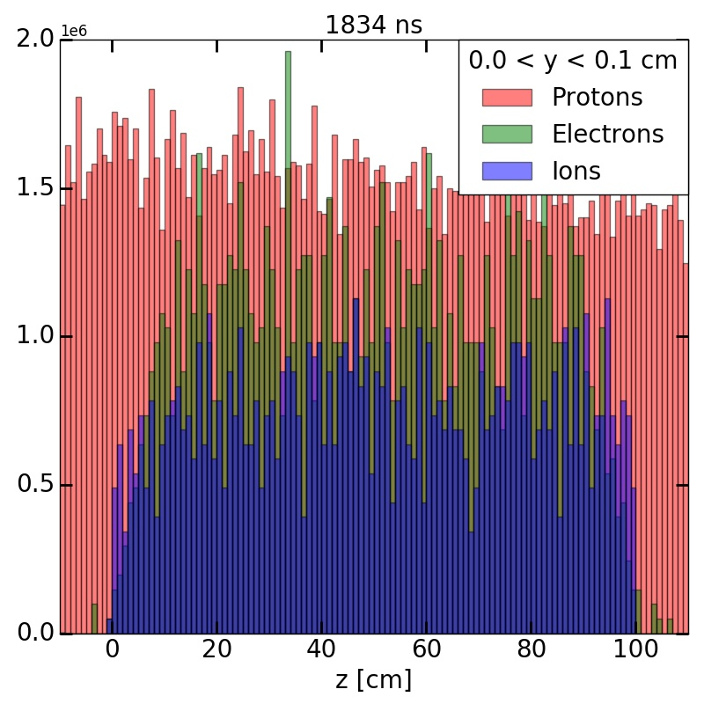
Particle Distributions After First Pass
Transverse profile of plasma electrons at Column center and beam well matched after first pass
Density of electrons approaching that of beam
Freemire, et al, IPAC 2018

Slide 22
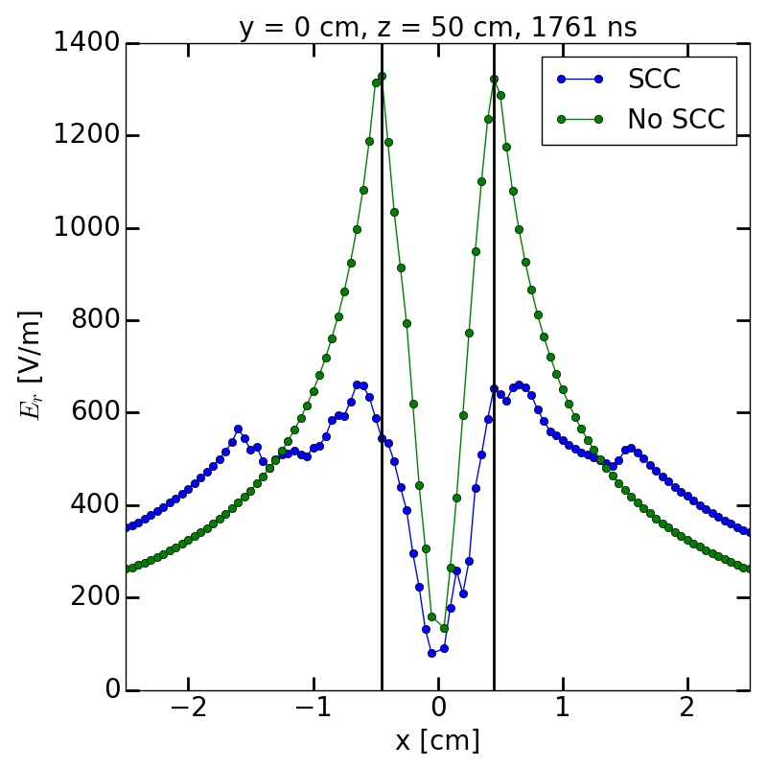
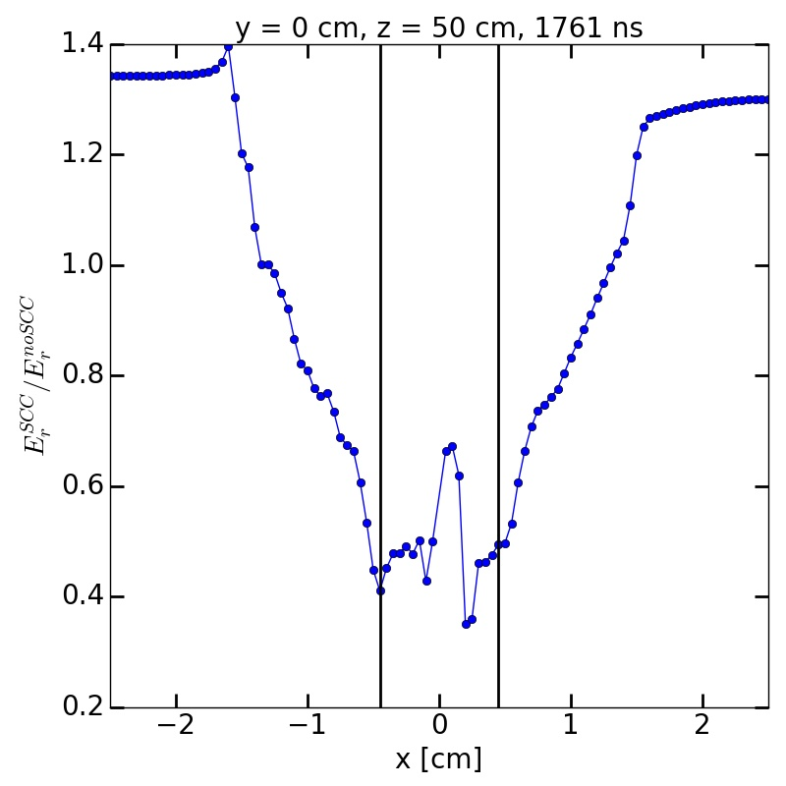
Space Charge Compensation After First Pass
Freemire, et al, IPAC 2018
Beam
Boundary
To quantify effect of space charge compensation, simulations with ionization (SCC) and without ionization (no SCC) performed
Significant reduction in radial electric field within beam radius observed

Slide 23
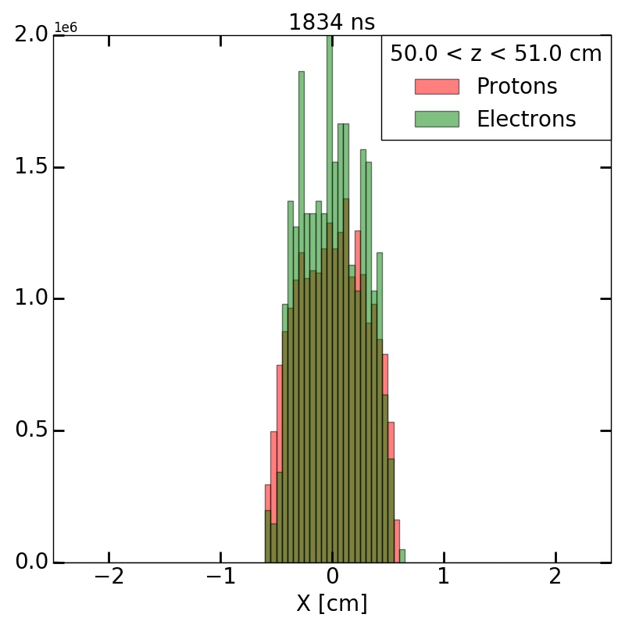
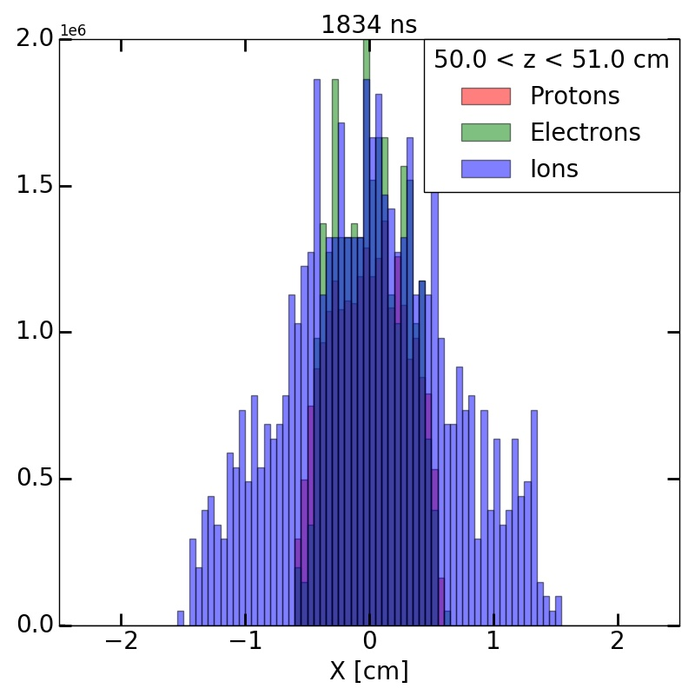
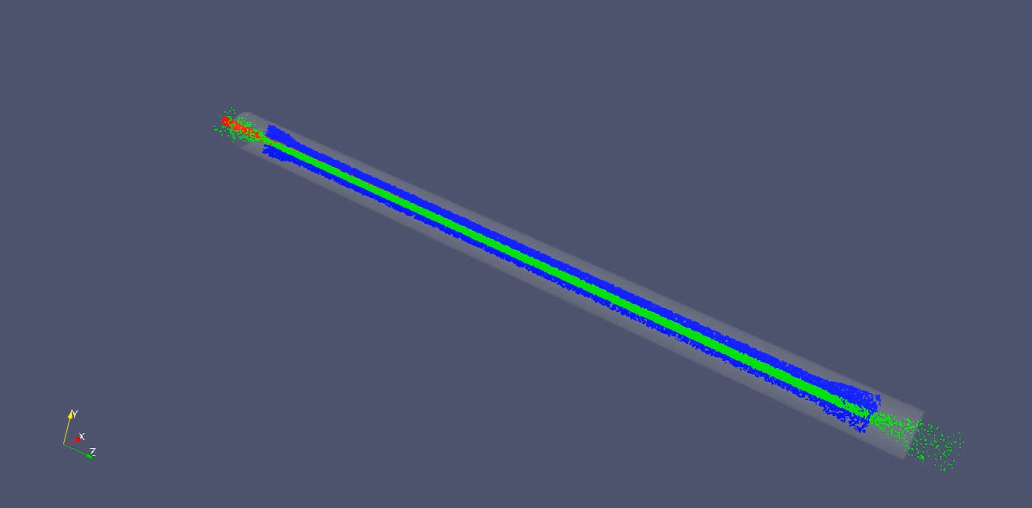
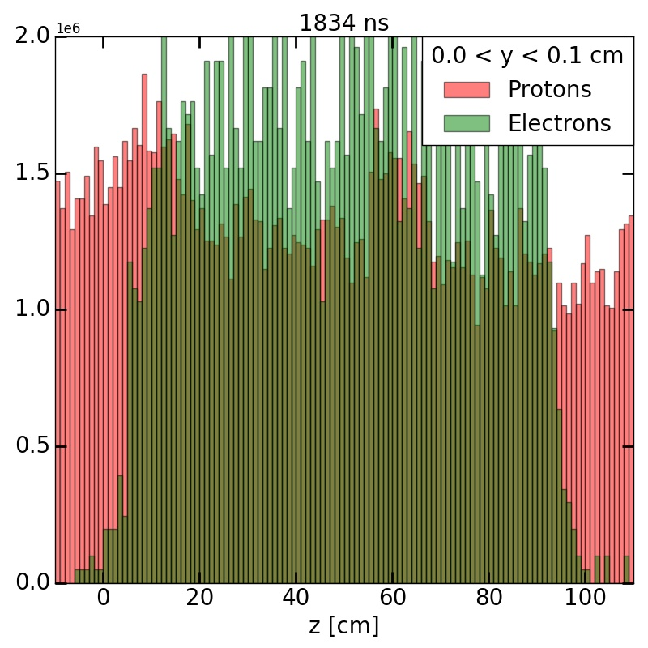
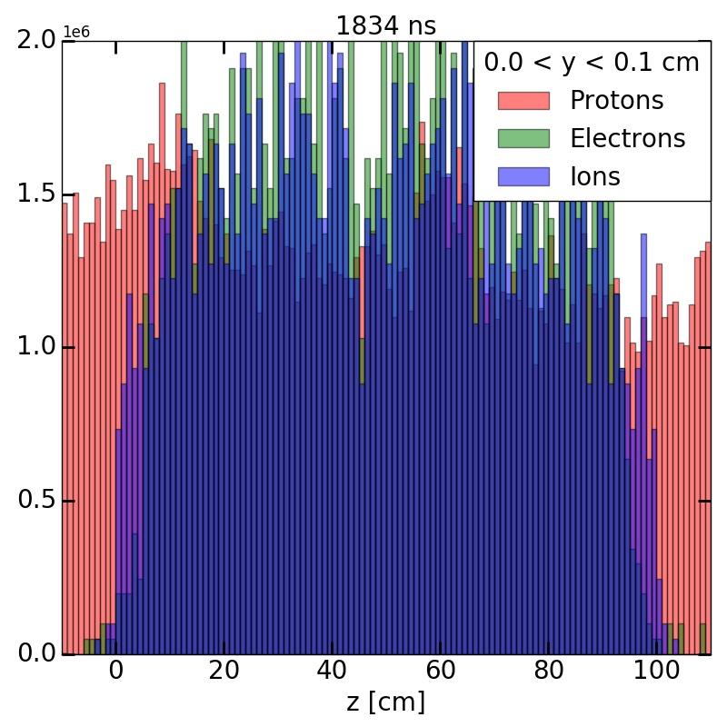
Particle Distributions After Second Pass
Transverse distribution of electrons still closely matched to that of beam
Density of electrons now greater than beam
Ion density also surpasses beam density
  Leads to reduction in space charge compensation
Freemire, et al, IPAC 2018

Slide 24
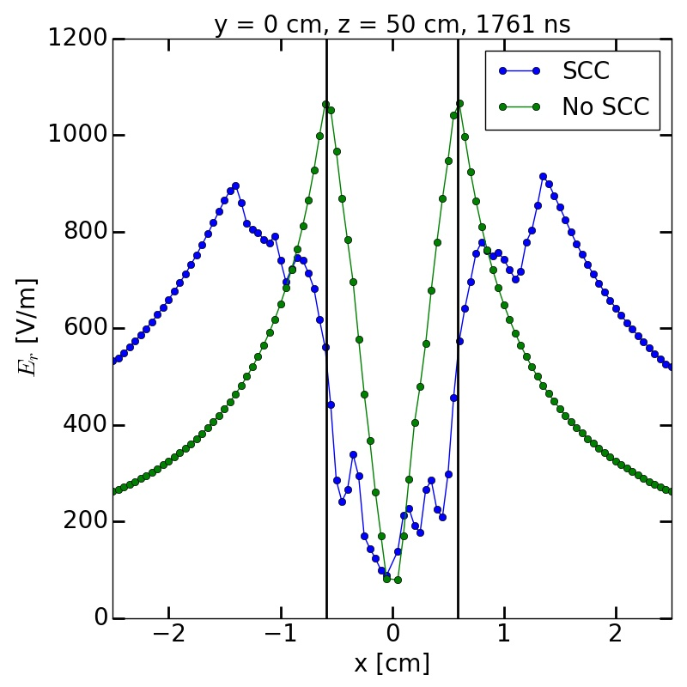
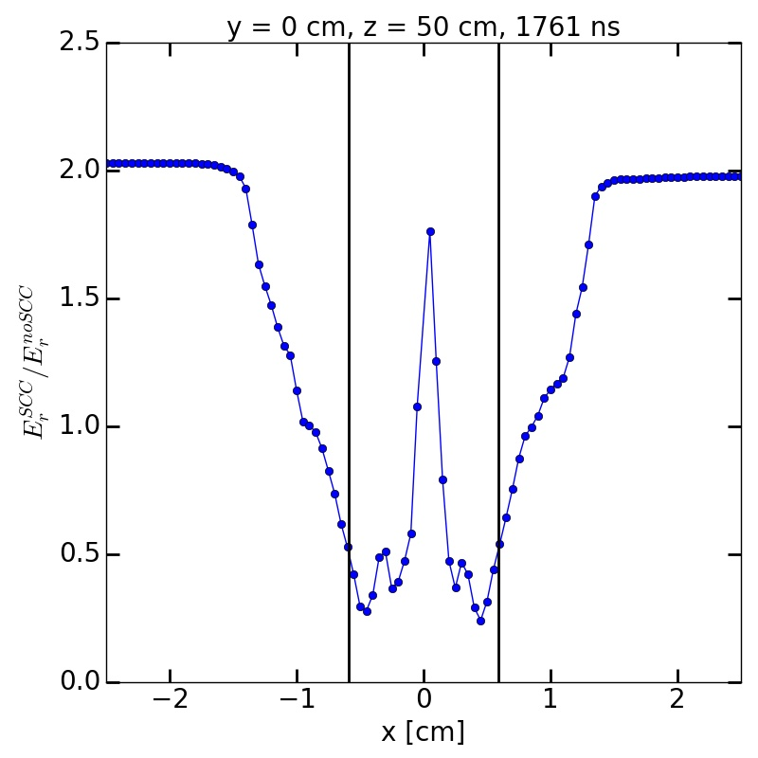
Space Charge Compensation After Second Pass
Freemire, et al, IPAC 2018
Degree of space charge compensation similar to first pass
Transverse slice shown at center of Column
Plasma oscillations result in non-homogeneity of local density
Compensation determined by average plasma distribution over length of Column

Slide 25
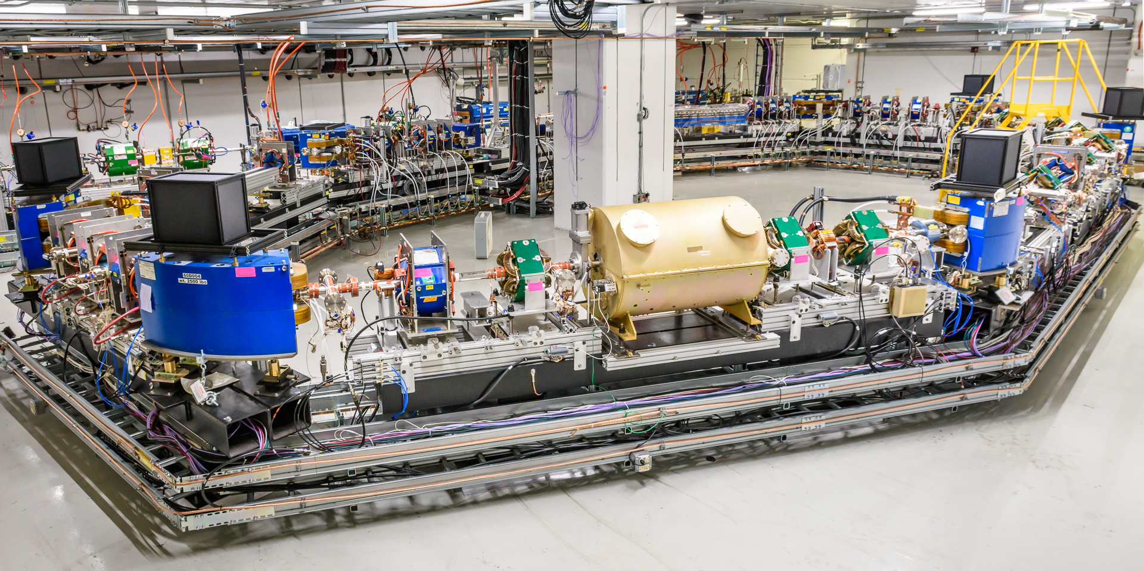
Status & Schedule
Vacuum system for IOTA ring completed July 30th
Cooldown of cryomodules underway
Commissioning of electrons in IOTA imminent
Experiments with electrons through 2019
Shutdown to install RFQ for proton beam late 2019
Experiments with protons ~2020

Slide 26
Outlook
Accelerator R&D at IOTA could lead the way to more intense beams, both at Fermilab and abroad
FAST/IOTA excellent opportunity for accelerator physics & engineering students
Strong experimental program at IOTA including
  Nonlinear integrable optics
  Space charge compensation
  Optical stochastic cooling
  …
We welcome collaborators interested in developing technology to enable the production of bright beams

Slide 27
Acknowledgements
Thank you to all of the FAST/IOTA team, in particular Vladimir Shiltsev, Sasha Valishev, and Swapan Chattopadhyay
The rest of the Electron Column group: Giulio Stancari, Chong Shik Park, Moses Chung, Chad Mitchell, and Gregg Penn
This work is supported by the US DOE Office of HEP, and the General Accelerator Research and Development Program

Slide 28
Backup Slides

Slide 29
Electron Column Simulation / IOTA Parameters
Beam Parameters
Beam Species | Proton
Beam Energy | 2.5 MeV (p = 68.5 MeV/c)
Beam Current | 8 mA
Beam Pulse Length | 1.77 µs
Beam Distribution | KV (transverse), Step function (longitudinal)
Hardware Parameters
Column Length | 1 m
Pipe Radius | 2.54 cm
Electrode Positions | 0, 100 cm
Electrode Strength | -5 V
Solenoid Field | 0.1 T
Gas Parameters
Gas Species | Hydrogen
Gas Density | 1.65x10¹³ cm⁻³ (5x10⁻⁴ torr)
Ionization Process | p + 2H₂ → p + e + H₃⁺ + H
Ionization Cross Section | 1.82x10⁻¹⁷ cm²
Plasma Electron Energy, Spread | 45 eV, 19 eV
Numerical Parameters
Particles Injected/Step | 500
Grid Spacing, x,y,z | 0.5, 0.5, 1.0 cm
Time Step | 70 ps
Simulation Length | 1.83 µs
Number of Passes | 2

