Slide 1

Neutral Particle Transport Methods
Prof. Alireza Haghighat
Virginia Tech
Virginia Tech Transport Theory Group (VT³G)
Director of Nuclear Engineering and Science Lab (NSEL) at Arlington
Nuclear Engineering Program, Mechanical Engineering Department
Supernova Physics at DUNE Workshop, Virginia Tech, Blacksburg, Virginia, March 11-12, 2016

Slide 2
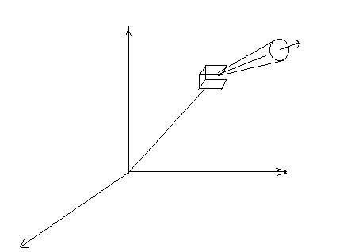
Particle Transport Theory
Objective
Determine the expected number of particles in a phase space (d³rdEdΩ) at time t:
z
dE
d³r
Ω
dΩ
r
y
x
Number density is used to determine angular flux/current, scalar flux and current density, partial currents, and reaction rates.

Slide 3
Simulation Approaches
Deterministic Methods
  Solve the linear Boltzmann equation to obtain the expected particle flux/current/reaction rate in a phase space
Statistical Monte Carlo Methods
  Perform particle transport experiments using random numbers (RN’s) on a computer to estimate expected number of particles in phase space and associated uncertainty.

Slide 4

Deterministic – Linear Boltzmann Equation
Integro-differential form
streaming
collision
scattering
fission
Independent source
Integral form
4

Slide 5
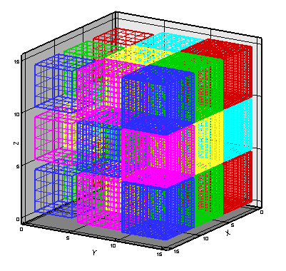
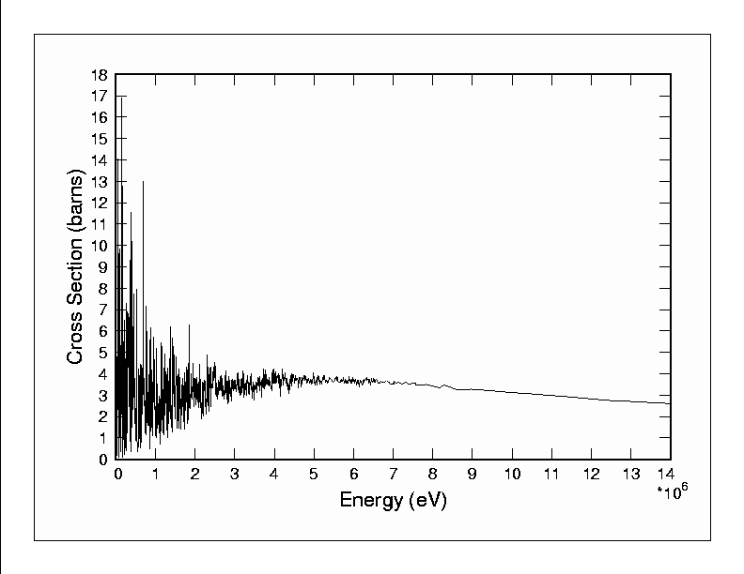
Integro-differential - Solution Method
Angular variable: Discrete Ordinates (Sn) method:
A discrete set of directions { } and associated weights {w_{m}} are selected
Spatial variable
Integrated over fine meshes using FD or FE methods
Energy variable
Integrate over energy intervals to prepare multigroup cross sections, σ_{g}
A typical shielding problem
Memory : 80 angles x 50 g x 106 x 8bye/word = 32 GB

Slide 6
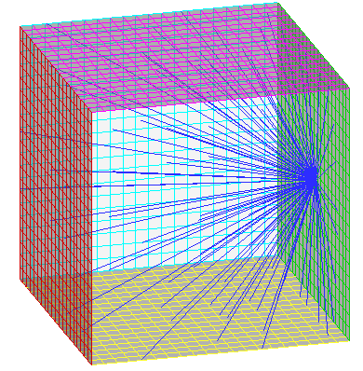
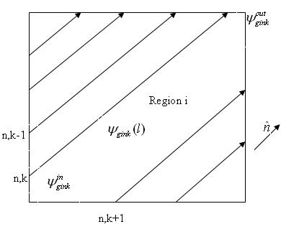
Integral - Solution method
Characteristic Method (CM): Model is partitioned into coarse meshes and transport equation is solved along the characteristic paths (k) (parallel to each discrete ordinate (n)), filling the mesh, and averaged

Slide 7
Monte Carlo Methods
Perform an experiment on a computer; “exact” simulation of a physical process
Path-length
Type of collision
Scattering angle (isotropic scattering)
Sample
S (r, E, Ω)
✴
Tally (count)
absorbed
Issue:
Precise expected values; i.e., small relative uncertainty,
Requires significant computation time, Variance Reduction techniques are needed for real-world problems!

Slide 8
Deterministic vs. Monte Carlo
Item | Deterministic | MC
Geometry | Discrete/ Exact | Exact
Energy treatment – cross section | Discrete | Exact
Direction | Discrete/ Truncated series | Exact
Input preparation | Difficult | simple
Computer memory | Large | Small
Computer time | Small | Large
Numerical issues | Convergence | Statistical uncertainty
Amount of information | Large | Limited
Parallel computing | Complex | Trivial

Slide 9
Advanced Algorithms/codes for solving the linear Boltzmann Equation
  PENTRAN (1996)
  TITAN (2004)

Slide 10
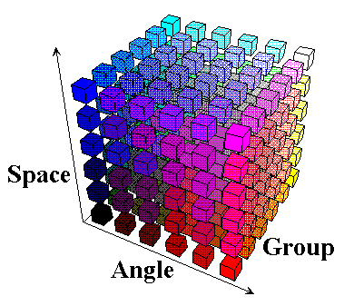
PENTRANTM
- (Parallel Environment Neutral-particle TRANsport)
(G. Sjoden and A. Haghighat, 1996)
ANSI FORTRAN 90 with MPI library (Export classification 0D999B available for use in most countries)
Cartesian geometry
Coarse-mesh-oriented data structure allowing localized meshing, differencing scheme
Parallel processing: Hybrid domain decomposition (angle, energy, and/or space); Parallel I/O; Partition memory
Adaptive Differencing Strategy (ADS): Diamond Zero (DZ) → Directional Theta-Weighted differencing (DTW) → Exponential-Directional Iterative (EDI)
Fully discontinuous variable meshing - Taylor Projection Mesh Coupling (TPMC)
Angular quadrature set: Level symmetric (up to S20) and Pn-Tn with OS

Slide 11
Discretized x-y-z Sn formulation in PENTRAN
(discrete ordinates, finite volume, multigroup)
where

Slide 12
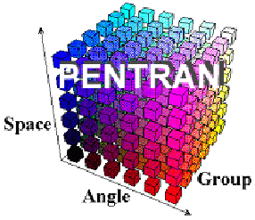
PENTRAN Code System
Pre-processing
PENMSH-XP (prepares mesh, source, and material distributions)
S_{N} Transport Calculation
(Parallel Environment Neutral-particle TRANsport)
Post-processing
PENPRL (extract flux values and compare with experimental data)

Slide 13
Benchmarking and Applications of PENTRAN
Benchmarking
Kobayashi 3-D Benchmarks
VENUS-3 Benchmark facility
C5G7 Criticality benchmark
Real-world Problems
BWR Core-Shroud
Pulsed Gamma Neutron Activation Analysis (PGNAA) device
X-Ray room
CT Scan
Time-of-Flight (TOF)
Co source
Storage CASK
UF Training Reactor

Slide 14
TITAN - Hybrid Sn & CM Algorithm
(C. Yi, A. Haghighat, 2004)
Sn Solver
CM solver

Slide 15
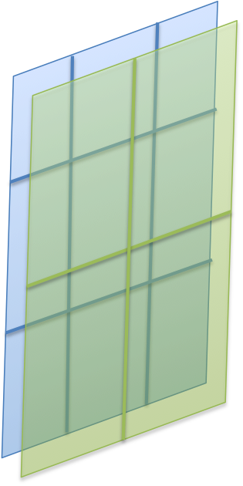
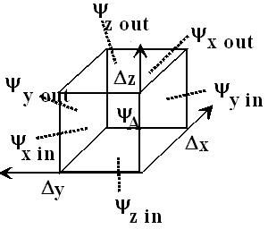
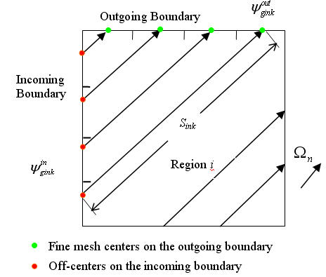
TITAN Sn-CM Algorithm
Sn
CM
A
B
E.g., LD Scheme;

Slide 16
TITAN – A 3-D Parallel Hybrid Transport Code
Written in Fortran 90 (with some features in Fortran 2003 standard, such as dynamic memory allocation and object oriented23) and MPI library
Compiled by Intel Fortran Compiler (ifc 8.0+) or PGI f90 compiler (pgf90 6.1)
Coarse-mesh-oriented data structure allowing localized meshing, quadrature and solver.
Coarse-mesh based Hybrid Algorithms
  Sn and Characteristics
  Sn with fictitious quadrature and ray tracing for image reconstruction for SPECT
Notes:
Our code adopts the two level meshing scheme utilized in the PENTRAN code for Cartesian geometry.
The meshing scheme divides the whole problem model into coarse meshes (CM), and each coarse mesh can be further filled with uniform fine meshes (FM). The coarse-mesh/fine-mesh scheme can allow different mesh size in different regions. This flexibility is usually required for a transport code designed for solving reactor or other real system problems.
Both Sn and MOC will try to calculate the outgoing fluxes by solving the transport eq. based on the incoming fluxes. In this sweeping process, the fluxes inside are updated. And the outgoing fluxes will be the incoming flux for the next adjacent coarse mesh along the direction. If the incoming or outgoing boundaries of the coarse mesh are aligned with the model boundaries, model boundary conditions are applied.

Slide 17
  Simplified ray-tracing with fictitious-quadrature-set solver for SPECT image reconstruction
Ray-tracing with Fictitious Quadrature
S_{N}
CM
TITAN

Slide 18
TITAN Benchmarking and Application
OECD/NEA Benchmarks
  C5G7 MOX
  Kobayashi
  3-D parameter space
  VENUS-2
Applications
  Adjoint calculation for the AIMS active interrogation simulation tool
  mPower reactor core and external modeling
  Modeling of a penetration duct in a nuclear reactor
  Benchmarking the multigroup SDM (subgroup decomposition method) algorithm (developed by Georgia Tech)
  Medical applications
    Modeling a CT machine
    Developed an image reconstruction algorithm, TITAN-IR

Slide 19
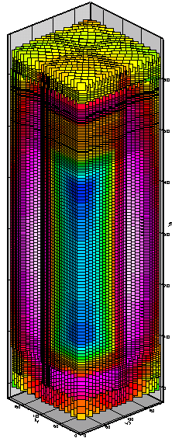
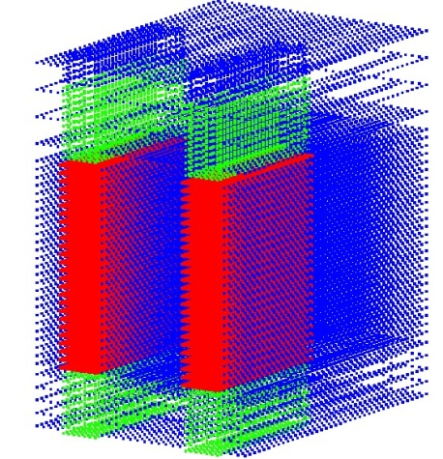
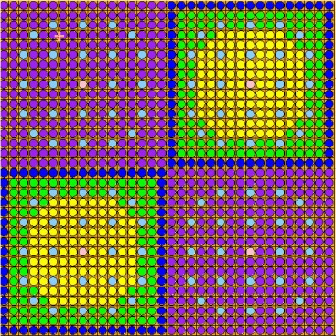
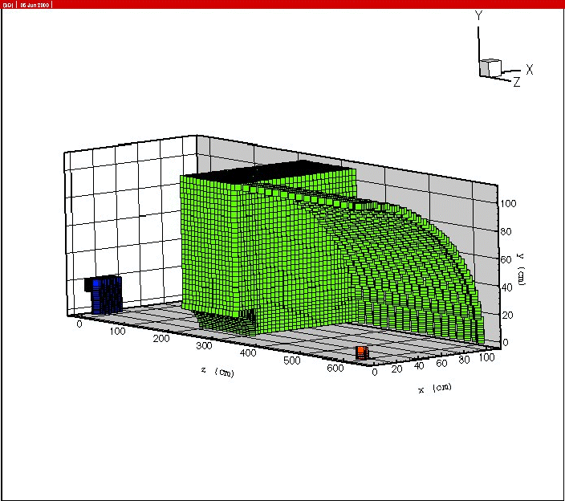
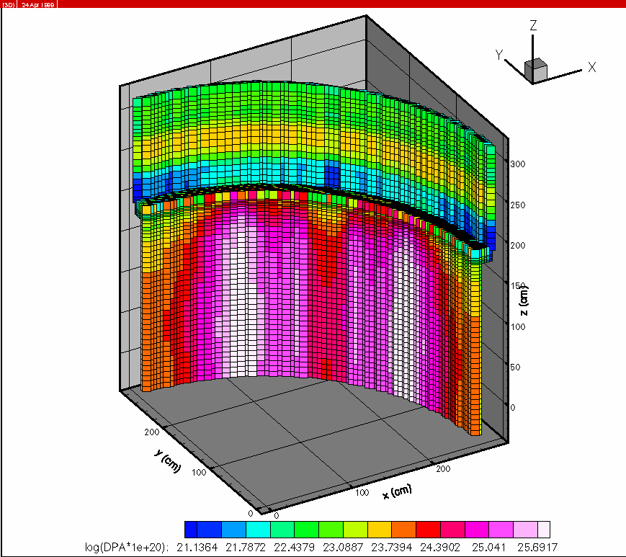
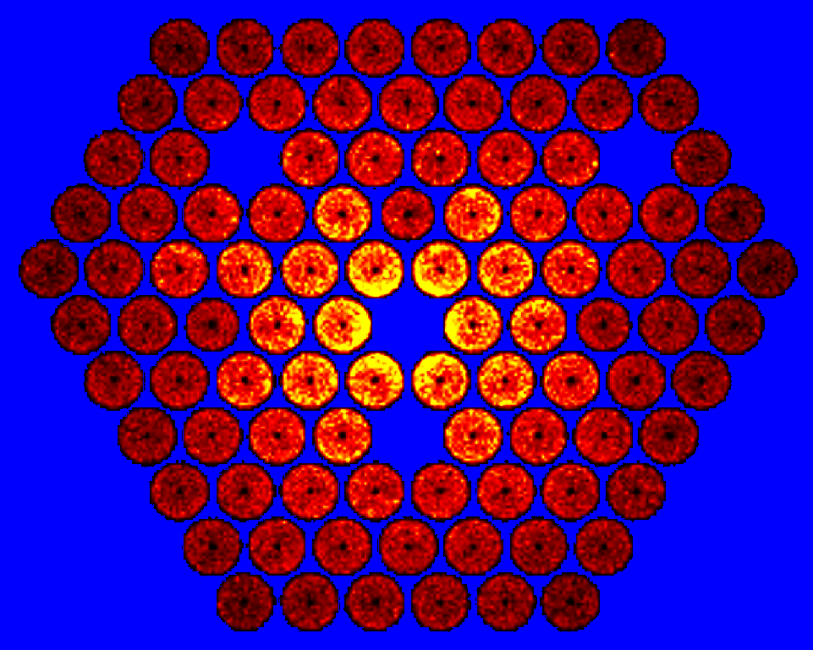
Modeling nuclear systems-Samples
Fission Density in Penn State Reactor
Meshing for modeling a Time-of-Flight (TOF) Experiment
Neutron flux distribution throughout a spent fuel dry cask
3-D Meshing of a BWR core and structure
Power, Nondestructive Detection, Medicine (past work)
3-D DPA of a BWR core shroud
SPECT Imaging
A 3-D mesh model for the UF Nuclear Reactor
XY mesh model for a benchmark with UO2 and MOX fuel
With 10’s and 100’s processors, still requires hours of computation time

Slide 20
Why not hybrid Monte Carlo – deterministic methods?
  Variance reduction (VR) with the use of deterministic importance function
  VT³G has developed CADIS variance reduction methodology and automated VR software A³MCNP in 1997; CADIS has become popular recently!

Slide 21
“Forward” Transport & “Importance” Equations
“Forward” transport equation is expressed by
“Importance” equation is expressed by
where
in V
where
,
in V

Slide 22
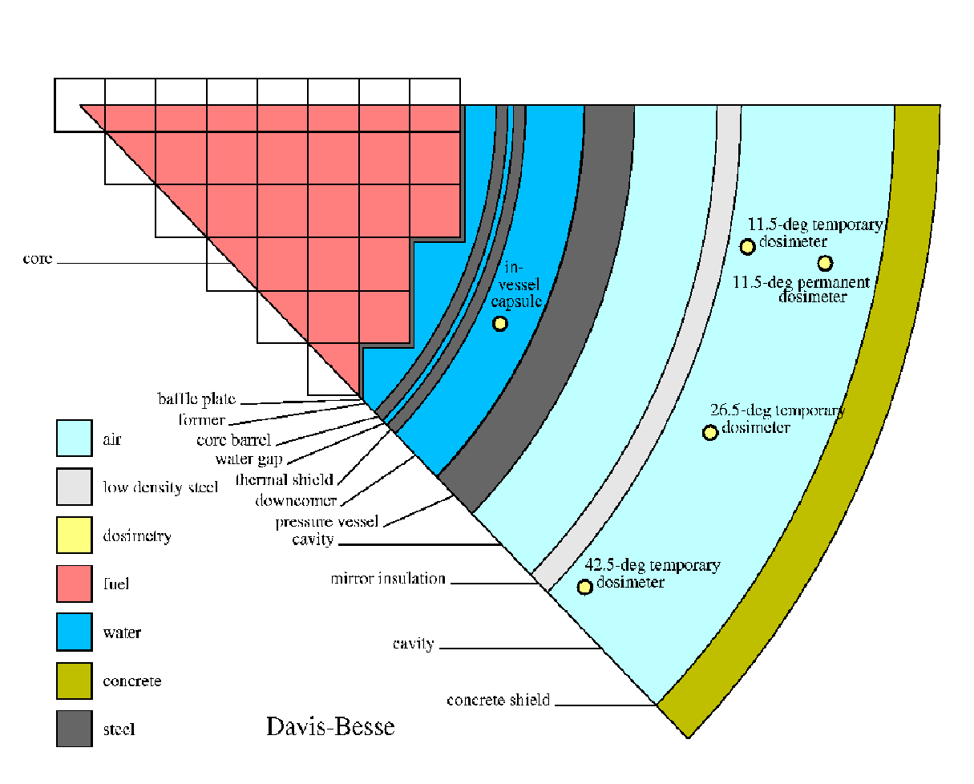
An application of Adjoint function - Detector Response
Detector response is obtained by
If derive the commutation relation between the “forward” and “adjoint” transport equations,
Then, we obtain the following equality
If we consider
Then,
detector

Slide 23
Calculation of detector Response
Detector
Standard
Importance Function Methodology
Passive
Passive
Where,
Where,

Slide 24
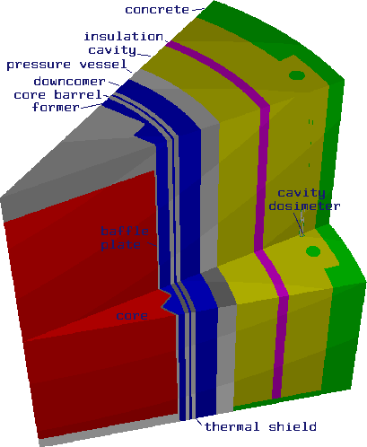
CADIS – Consistent Adjoint Driven Importance Sampling
(J. Wagner and A. Haghighat, 1997)
Description:
Uses an approximate 3-D S_{N} importance function distribution for
source biasing
transport biasing – splitting & rouletting
in a consistent manner, within the weight-window technique .
Detector
Source

Slide 25
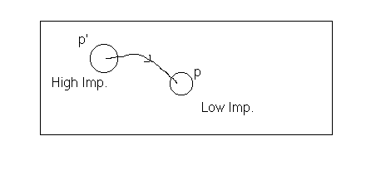
CADIS
Transport biasing
Source biasing
Particle weight
If <1, particles are processed
through the Russian roulette,
Otherwise, particles are split
Particle statistical weight

Slide 26
A³MCNP - Automated Adjoint Accelerated MCNP
(J. Wagner and A. Haghighat, 1997)
Step 1
➢ mesh distribution
➢ material composition
➢ input files
➢ multi-group cross sections
➢ S_{N} adjoint function
Step 2
➢ VR parameters
Step 3
➢ non-analog MC Calculation

Slide 27
Applications
PWR Cavity dosimetry
BWR core shroud
Spent fuel Storage cask

Slide 28
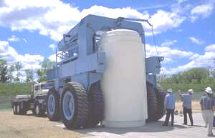
Simulation of Storage Cask
  CASK library
  (22n, 18g)
  17 Materials
  318,426 fine meshes
  (1000 coarse meshes)
  (40 z-levels)
  P_{3,} S₁₂ (168 directions)
  1.48 GB per processor 8 processors (~12 GB Total)
  16-processor, PC-Cluster (4GB/proc)

Slide 29
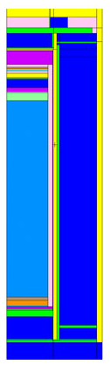
Timing Results
MC is an average in four annular tally segments
(Axial Mid-plane) (1-σ Relative Error = 1%)
Model | # CPU | Run Time (hrs) | Speedup
Unbiased Cont. Energy | 8 | 214 | 1.0
A³MCNP Cont. Energy | 1 | 1.5 | 140

Slide 30
Segments Near Top
(494 cm – 563 cm)
No results for unbiased MCNP after 214 hours on 8 processors! Requires months & years!
A³MCNP on 1 processor after 8 hours achieve a relative error less than 5%

Slide 31
Even advanced fast particle transport methods are slow, because of significant number of unknowns

Slide 32
Development of Transport Formulations for
Real-Time Applications
Physics-Based transport methodologies are needed:
Developed Multi-stage, Response-function Transport (MRT) methodology
  Based on problem physics partition a problem into stages (sub-problems),
  For each stage employ response method and/or adjoint function methodology
  Pre-calculate response-function or adjoint-function using an accurate and fast transport code
  Solve a linear system of equations to couple all the stages

Slide 33
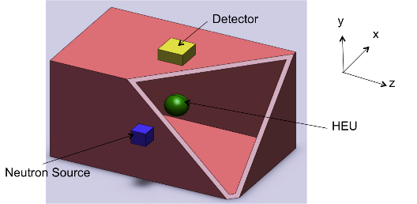
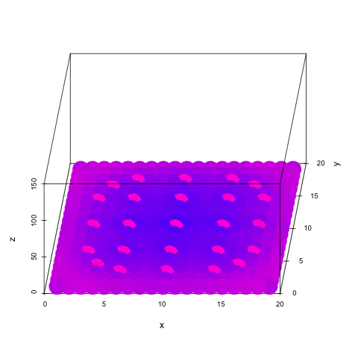


Examples for MRT Algorithms
Nondestructive testing: Optimization of the Westinghouse’s PGNNA active interrogation system for detection of RCRA (Resource Conversation and Recovery Act) (e.g., lead, mercury, cadmium) in waste drums (partial implementation of MRT; 1999)
Nuclear Safeguards: Monitoring of spent fuel pools for detection of fuel diversion (2007) (funded by LLNL) (INSPCT-s software)
Nuclear nonproliferation: Active interrogation of cargo containers for simulation of special nuclear materials (SNMs) (2013) (in collaboration with GaTech) (AIMS software)
Spent fuel safety and security: Real-time simulation of spent fuel pools for determination of eigenvalue, subcritical multiplication, and material identification (partly funded by I²S project, led by GaTech) (Ongoing) (RAPID software, filed for patent)
Image reconstruction for SPECT (Single Photon Emission Computed Tomography): Real-time simulation of an SPECT device for generation of project images using an MRT methodology and Maximum Likelihood Estimation Maximization (MLEM) (filed for a patent, June 2015) (TITAN-IT software)

Slide 34

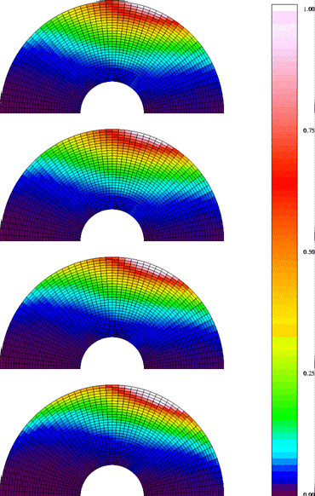
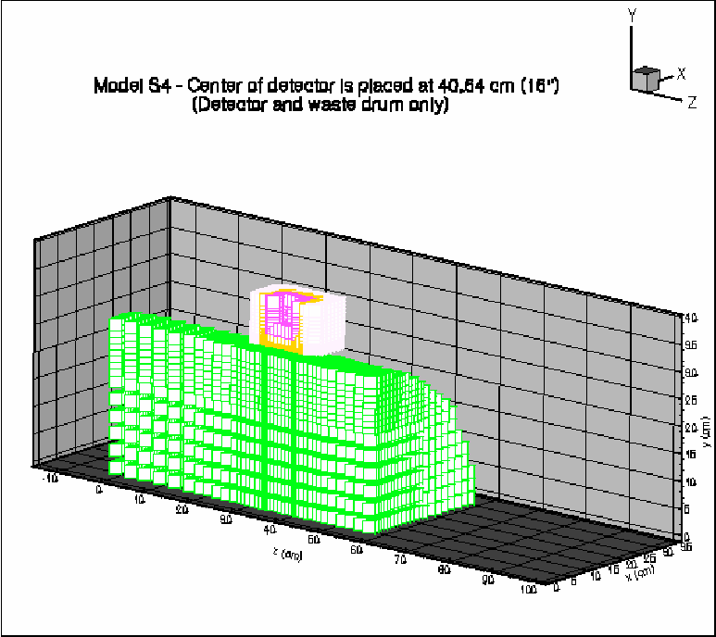
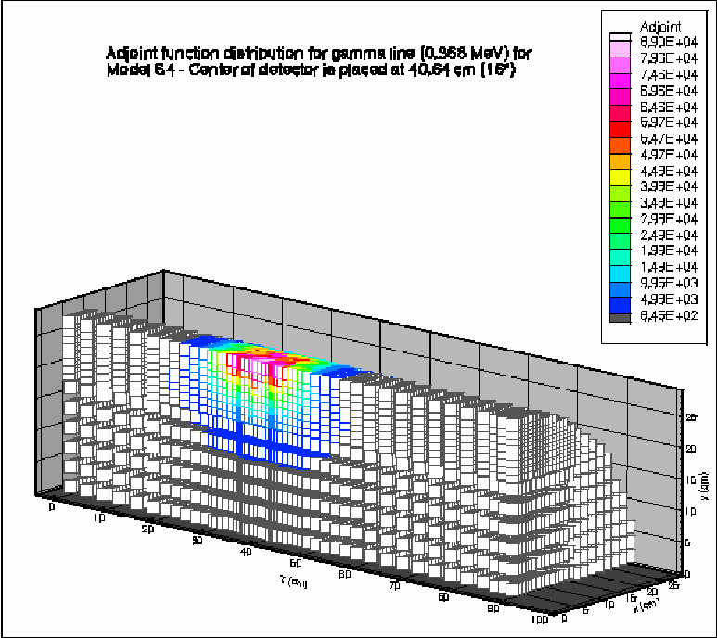
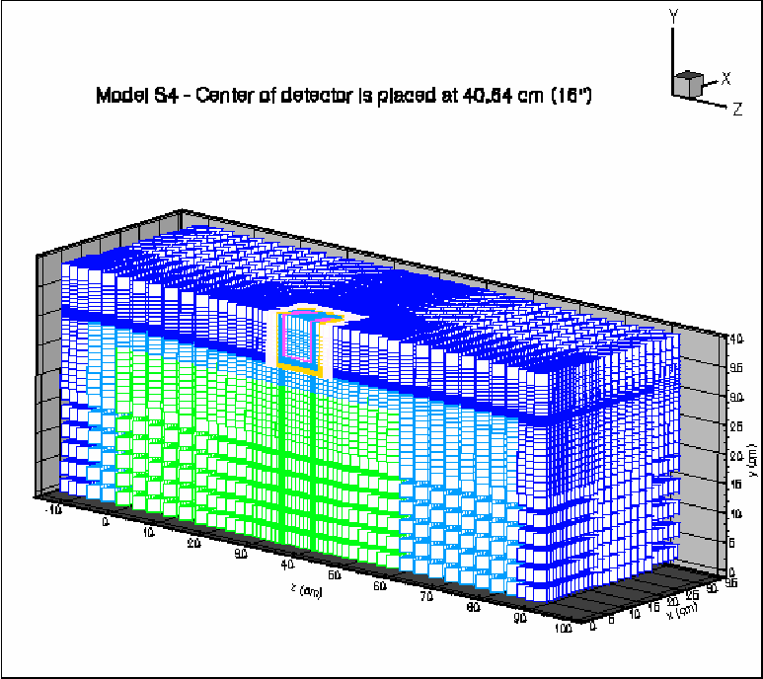
Nondestructive Testing via Active Interrogation - Optimization of Pulsed Gamma Neutron Activation Analysis (PGNAA) device
Stage 1 - Determined the thermal neutron flux distribution throughout the waste using a time-dependent MCNP Monte Carlo calculation
Stage 2 - Determined the gamma flux at the face of a gamma detector using an “importance function” obtained from a 3-D PENTRAN deterministic calculation.
Achieved excellent agreement with the experimental results (within the experimental uncertainties).
Importance Function
Mesh distribution
Detector Contribution

Slide 35
Atucha-I Spent Fuel Pool Inspection (Development of a tool for safeguards) (funded by LLNL)
Objective – Identification of missing/moved assemblies for safeguards
Approach – Combination of measurement and on-line computation to obtain trending curves

Slide 36
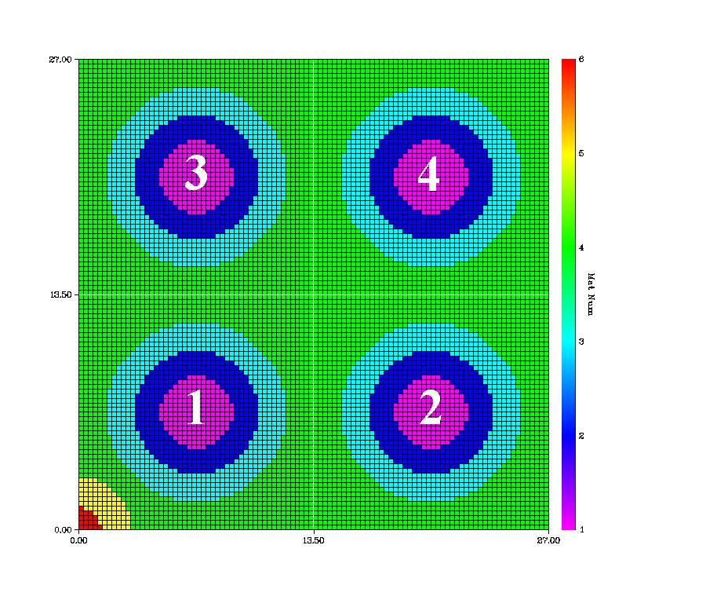
Hybrid Methodology
Source (S = S_{intrinsic} + S_{subcritical-Multiplication})
  Intrinsic Source
    Spontaneous fission & (α, n) from fuel burnup calculation (ORIGEN-ARP)
  (Created a database)
  Subcritical Multiplication (Hybrid method)
    Simplified fission-matrix (FM) method
    Use MCNP Monte Carlo to obtain a_{i,j} for each pool type
  (Created a database for coef. a_{ij})
Adjoint function
  Is obtained using the PENTRAN transport code
(Created a database for multigroup adjoint for different lattice sizes)

Slide 37
INSPCT-S program
Input databases
tolerance

Slide 38
RAPID (Real-time Analysis for spent fuel Pool and cask In-situ Detection)
Prof. Alireza Haghighat, Dr. William Walters (postdoctoral fellow), and Nathan Roskoff (PhD student) have developed^{1,2,3} an accurate and fast software tool RAPID for monitoring of spent fuel pool and cask criticality safety and safeguards.

Slide 39
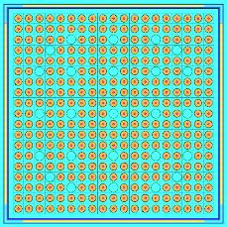
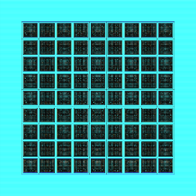
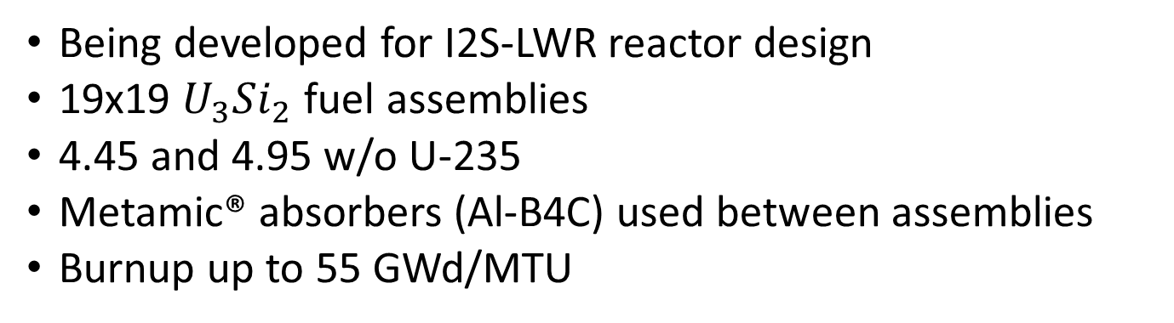
Reference Spent Fuel Pool
Being developed for I2S-LWR reactor design
19x19 $U_{3}Si_{2}$ fuel assemblies
4.45 and 4.95 w/o U-235
Metamic® absorbers (Al-B4C) used between assemblies
Burnup up to 55 GWd/MTU
Whole pool made up of 8 9x9 segments
One 19x19 Assembly
9x9 segment of spent fuel pool

Slide 40
Spent Fuel Eigenvalue Results
Added energy spectrum in addition to radial source distribution
2000x speedup (~2.5 min) for a few hundred pcm
The highest and lowest range of assumptions almost bracket the MCNP value
Fission Matrix
MCNP Reference

Slide 41
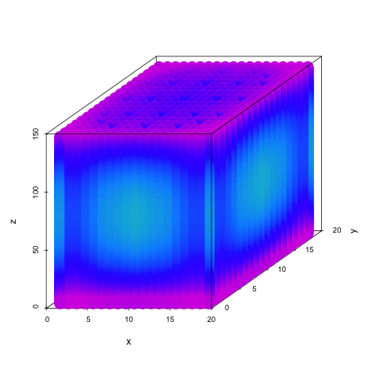
Post Processing: 1x1 Pool Layout
3-D Fission Density
Y-level Animation
Z-level Animation

Slide 42
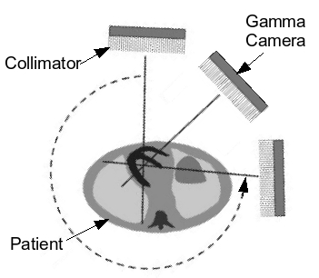
Introduction to Single Photon Emission Computed Tomography (SPECT)
  17 million procedures in the US in 2010
  Nuclear medicine imaging procedure
  used to examine myocardial perfusion,
  bone metabolism, thyroid function, etc.
  Functional imaging modality
  Radiopharmaceutical injected/ingested and localizes in a part of the body
  Emitted radiation detected at a gamma camera to form 2D projection images at different angles
  Collimator in front of the gamma camera provides spatial resolution
  Projection images can be reconstructed to form a 3D image of the radionuclide distribution

Slide 43
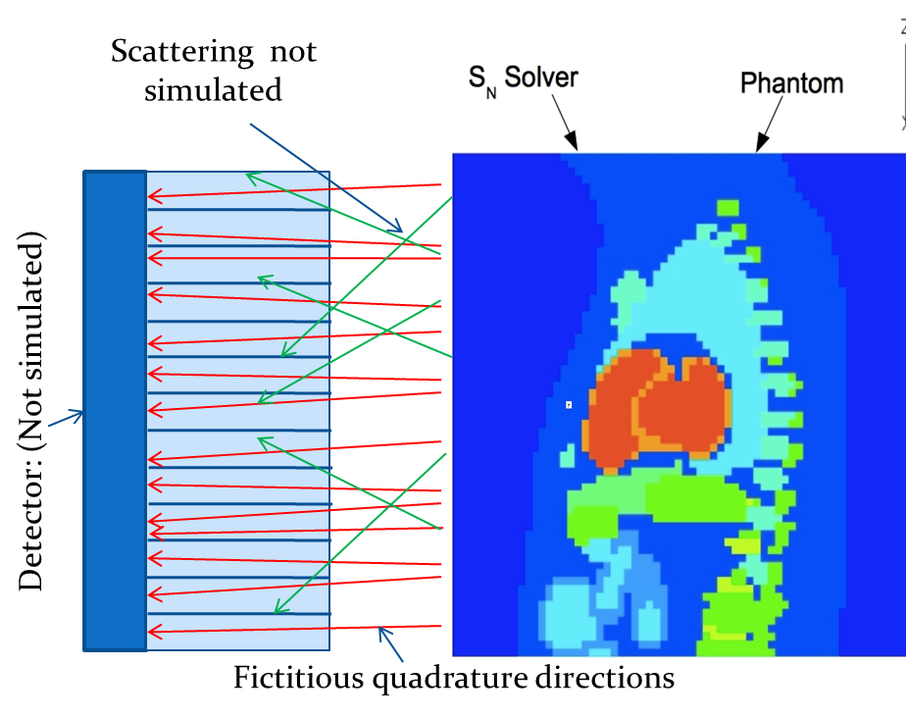
4-Stage TITAN Hybrid formulation for SPECT simulation
Stage 4
Stage 1
Stage 1- Sn calculation in phantom
Stage 2 – Selection of fictitious angular quadrature & Circular OS (COS) directions
Stage 3 – Sn with fictitious quadrature
Stage 4 – ray tracing
Stage 2
Stage 3

Slide 44




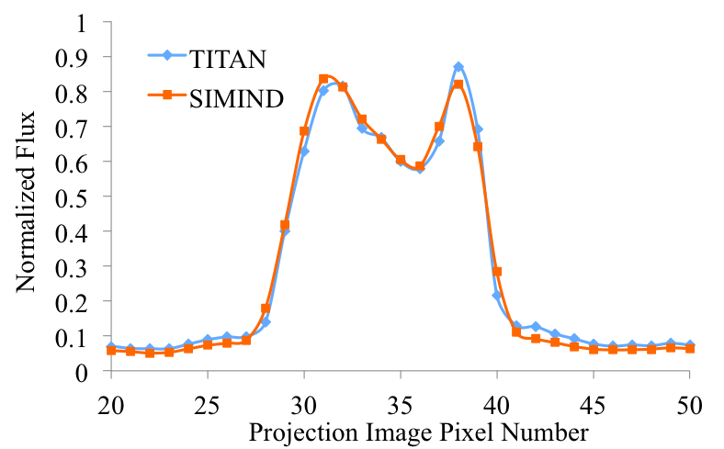




Example of Benchmarking TITAN Projection Images
SIMIND Comparison
  NURBS-based cardiac-torso (NCAT) phantom with Tc-99m (140 keV)
SIMIND generated projection images
Anterior Left lateral Posterior Right lateral
TITAN generated projection images
Anterior Left lateral Posterior Right lateral
Number of Projection Images | 1 | 4 | 8 | 45 | 90
SIMIND Time (sec) | 17 | 67 | 140 | 754 | 1508
TITAN Time (sec) | 200 | 202 | 212 | 274 | 352
Times are for a single processor
Notes:
Note: SIMIND and TITAN have difference cross sections and collimator representations
Max relative differences: 16.4%, -12.8%, -23.5%, -25.8%

Slide 45

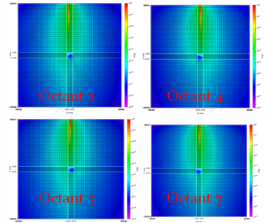
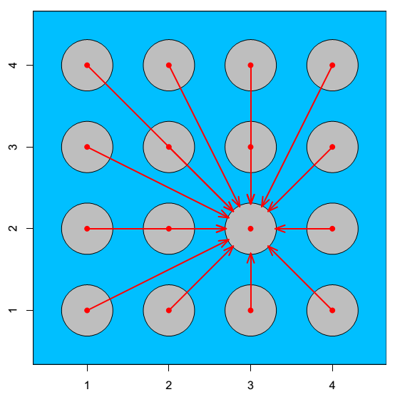
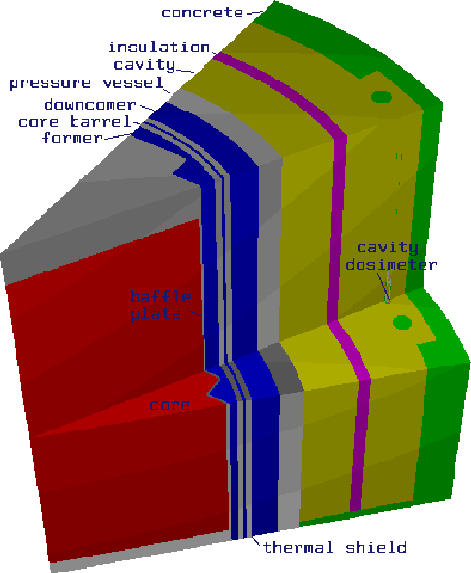
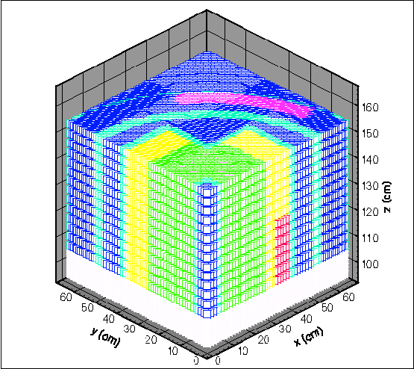
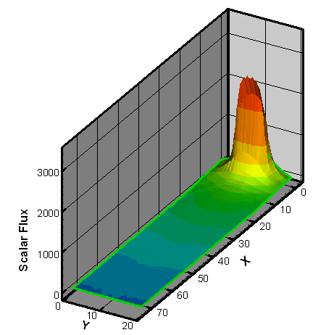
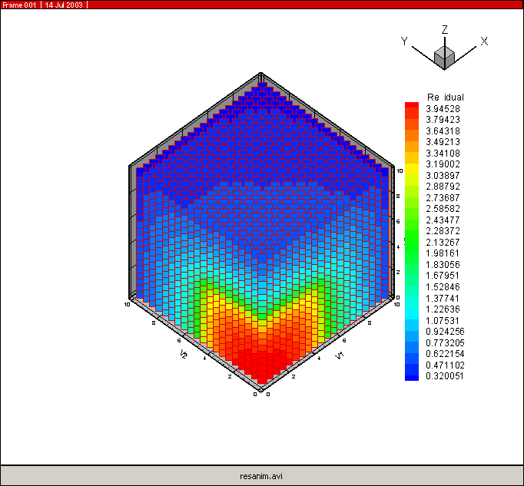
1986-1989 | Vector computing of 1-D Sn spherical geometry algorithm Development an adjoint methodology for simulation TMI-2 reactor | Prof. Haghighat
1989-1992 | Vector and parallel processing of 2-D Sn algorithms Simulation of Reactor Pressure Vessel (RPV) | Prof. R. Mattis, Pitt. Prof. B. Petrovic, GT
1992-1994 | Parallel processing of 2-D Sn algorithms & Acceleration methods Determination of uncertainties in the RPV transport calculations | Dr. M. Hunter, W Prof. B. Petrovic, GT
1994-1995 | 3-D parallel Sn Cartesian algorithms Monte Carlo for Reactor Pressure Vessel (RPV) benchmark using Weight-window generator; deterministic benchmarking of power reactors | Dr. G. Sjoden, DOD Dr. J. Wagner, ORNL
1995-1997 | Directional Theta Weight (DTW) differencing formulation PENTRAN (Parallel Environment Neutral Particle TRANsport) code system CADIS (Consistent Adjoint Driven Importance Sampling) formulation for Monte Carlo Variance Reduction A³MCNP (Automated Adjoint Accelerate MCNP) | Dr. B. Petrovic Dr. G. Sjoden, DOD Dr. J. Wagner, ORNL
1997-2001 | Parallel Angular & Spatial Multigrid acceleration methods for Sn transport Hybrid algorithm for PGNNA device PENMSH & PENINP for mesh and input generation of PENTRAN Ordinate Splitting (OS) technique for modeling a x-ray CT machine | Dr. V. Kucukboyaci, W Dr. B. Petrovi, GT Prof. Haghighat Prof. Hgahighat
2001-2004 | Simplified Sn Even Parity (SSn-EP) algorithm for acceleration of the Sn method RAR (Regional Angular Refinement) formulation Pn-Tn angular quadrature set FAST (Flux Acceleration Simplified Transport) PENXMSH, An AutoCad driven PENMSH with automated meshing and parallel decomposition CPXSD (Contributon Point-wise cross-section Driven) for generation of multigroup libraries | Dr. G. Longonil, PNNL Dr. A. Patchimpattapong, IAEA Dr. A. Alpan, W
2004-2007 | TITAN hybrid parallel transport code system & a new version of PENMSH called PENMSHXP ADIES (Angular-dependent Adjoint Driven Electron-photon Importance Sampling) code system | Dr. C. Yi, GT Dr. B. Dionne, ANL
2007-2011 | INSPCT-S (Inspection of Nuclear Spent fuel-Pool Calculation Tool ver. Spreadsheet), a MRT algorithm TITAN fictitious quadrature set and ray-tracing for SPECT (Single Photon Emission Computed Tomography) FMBMC-ICEU (Fission Matrix Based Monte Carlo with Initial source and Controlled Elements and Uncertainties) | W. Walters, PhD Cand. Dr. C. Yi, GT Dr. M. Wenner, W
2011-2013 | New WCOS (Weighted Circular Ordinated Splitting) Technique for the TITAN SPECT Formulation Adaptive Collision Source (ACS) for Sn transport AIMS (Active Interrogation for Monitoring Special-nuclear-materials), a MRT algorithm | K. Royston, PhD Cand. W. Walters, PhD Cand.
2014-2015 | TITAN-SDM - includes Subgroup Decomposition Method for multigroup transport calculation TITAN-IR - TITAN with iterative image Reconstruction for SPECT RAPID - Real-time Analysis for spent fuel Pool in situ detection | N. Roskoff, PhD Stud. K. Royston, PhD Cand. W. Walters, PhD Cand.
VT³G Milestones & Contributing Current/Former Students (1986-2015)
ADIES
TITAN
INSPCT-S
AIMS

Slide 46
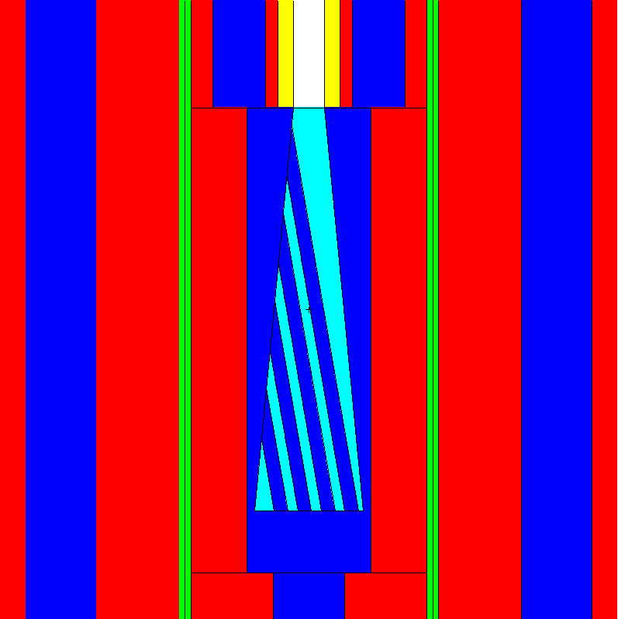
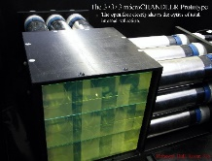

VT³G collaborations with VT Physics Department
Advanced Reactor Design
  Analysis of GEM*STAR accelerator-driven subcritical system for power generation, burning nuclear waste, conversion of weapon-grade plutonium (ongoing)
Nuclear security, safeguards & nonproliferation
  Optimization of CHANDLER antineutrino detection system, and shielding design (ongoing)
GEM*STAR Design
Cosmic Fast Neutrons
IBD Neutrons

Slide 47
Concluding Remarks
Modeling and simulation is essential for the design of effective detection systems
  The importance function can provide valuable information for effective use of a detector
  VT³G’s MRT methodologies and advanced software can be very valuable for monitoring a system, adjustment of physics models, parametric studies, etc.
  NOTE: VT³G has developed ADIES for automatic variance reduction of Monte Carlo electron transport

Slide 48
Thanks!
Questions?

Slide 49
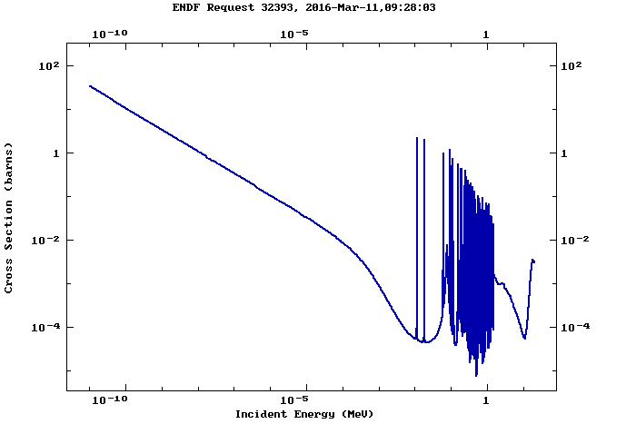
Absorption Cross-Section of Ar-40

