Slide 1


Charmless B_{S} decays at Belle
Bilas Pal, On behalf of the Belle Collaboration
University of Cincinnati

Slide 2
Outline
Recently measured Charmless B_{s} decays at Belle
  First observation of B_{S}→K⁰K⁰ Phys. Rev. Lett 116, 161801 (2016)
  Radiative B_{s} decays Phys. Rev D 91, 011101 (R) (2015)
    B_{s}→φγ
    B_{s}→ γγ

Slide 3
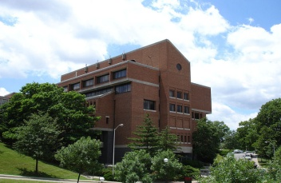
B_{S}→K⁰K⁰
Mainly “b→s” penguin decay, therefore
measurement of this decay is of considerable
interest in the field of potential
New Physics Sensitivity.
All B_{S}→h⁺h^{’-}, where h^{(‘)} is either a π or K have now
been observed, neutral combinations are yet to
be observed. The decay B_{S}→K⁰K⁰ is of particular
interest, because of its large predicted BF.
Predicted branching fraction is (1.6-2.7)×10⁻⁵
The presence of non-standard particles or couplings such as model with Z’ coupling may enhance the branching fraction up to 3.0×10⁻⁵ [Q. Chang, X. Q. Li and Y. D. Yang, J. Phys. G 41, 105002 (2014)]
It has been argued in [A. Hayakawa, Y. Shimizu, M. Tanimoto and K. Yamamoto, PTEP 2014, no. 2, 023B04 (2014); S. Baek, D. London, J. Matias and J. Virto, JHEP 0612, 019 (2006)] that the direct CP asymmetry (A_{CP})of this decay mode is very promising observable to search for the new physics. It was shown that the A_{CP} is not more than 1% in SM, can be 10% larger in the presence of SUSY, while the branching ratio remain unaffected.

Slide 4
B_{s}→K⁰K⁰
This analysis uses 121.4/fb of Belle data collected at Y(5S) resonance.
Previously this decay mode was searched by Belle with 23.6/fb of data and set an upper limit of B(B_{s}→ K⁰K⁰)<6.6×10⁻⁵ at 90% CL.
K⁰ mesons are reconstructed only via the decay K_{S}→π⁺π⁻.
Multivariate analyzer (Neural Network) is used to reduce the Continuum background
Distinguish signals from Background using Shape variables
3D fit is performed to extract the signal yield
Fit Model are studied from MC simulations, peak positions and resolutions are then calibrated using high statistics control sample.

Slide 5
B_{s}→K⁰K⁰
The three peaks in M_{bc} arise from Y(5S)→B_{s}B_{s}, (B_{s}B*_{s}+B*_{s}B_{s}), B*_{s}B*_{s}
The latter two channel dominates with production fractions (7.3+/-1.4)% and (87.0+/-1.7)%, respectively. These fractions are fixed in the fit obtained from another Belle analysis [PRD 87, 031101(R) (2013)]

Slide 6
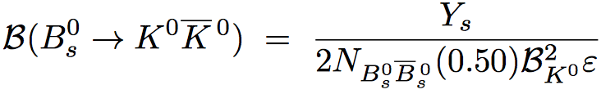
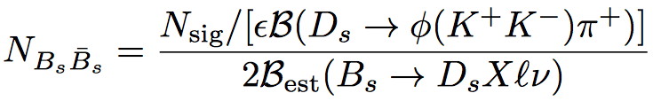
B_{s}→K⁰K⁰
We observed 29.0(+8.5,-7.6) signal events with a significance of 5.1 standard deviations including the systematic uncertainty.
The measured branching fraction is
In our analysis N_{BsBs} corresponds (6.53+/-0.66)e6 B_{s}B_{s} pairs. [PRD 92, 072013 (2015)]
For this we have used the semi-inclusive studies of semileptonic B_{s} decays
B_{est} is obtained using the LHCb results.
Previously N_{BsBs} is calculated using , The value was (7.1+/-1.3)e6

Slide 7
B_{s}→K⁰K⁰
This measurement is in good agreement with the Standard Model expectations and is the first observation of a charmless two-body Bs decays involving only neutral hadrons
Because of the small available statistics we haven’t performed the CP violation for this decay mode. However, in future Belle II (~5/ab of data) we expect ~1200 events and could be used to perform the CP violation study.

Slide 8
Non-resonant/other background
We check by fitting the sidebands of (a) and (b) separately with the nominal 3D-fitter. We found -0.7(+2.9,-2.1) events from (a) and 1.6(+2.2,-1.2) events from (b). These are consistent with zero.
Also it is checked by generating non-resonant Bs→KSpi+pi- MC. We expect 0.001 events from simulation.
Background subtracted distributions (sPlot)
Generating Bs→K_{S}K^{*0(}892) and Bs→K^{*0(}892)K^{*0(}892) MC, we check whether these decays can pollute our signal. None of them contribute under the signal decays.

Slide 9
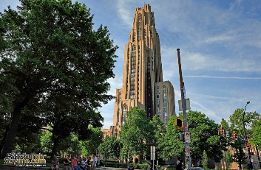
Systematic uncertainty

Slide 10
Radiative B_{s} decays
In the Standard Model, the decays B_{s}→φγ and B_{s}→γγ are explained by the radiative transitions b→sγ and b→sγγ, respectively.
First observation of the decay B_{s}→φγ was made by the Belle Collaboration using 23.6/fb of data collected at Y(5S) resonance and its branching fraction was measured to be B(B_{s}→φγ)=[5.7(+2.2,-1.9)]×10⁻⁵
Stringent constraint by B→X_{s}γ and other exclusive decays
Best BF (35.1±3.5±1.2)×10⁻⁶ is provided by LHCb. [Nucl. Phys. B 867 (2013) 1 ]
The decay B_{s}→γγ has not been observed yet
Previous limit B(B_{s}→γγ)<8.7×10⁻⁶ at 90% CL was set by Belle
Branching fraction of B_{s}→γγ is also constraint by B→X_{s}γ results in R-parity conserving scenario, but may not be in R-parity violating case.

Slide 11
Radiative B_{s} decays
This analysis uses 121.4/fb of Belle data collected at Y(5S) resonance.
φ mesons are reconstructed via the decay φ→K⁺K⁻.
Good quality gamma used (η and π⁰ veto are used)
Multivariate analyzer (Neural Network) is used to reduce the Continuum background
Distinguish signals from Background using Shape variables
Fit Model are studied from MC simulations, peak positions and resolutions (which are fixed) are calibrated using high statistics control sample.

Slide 12
Radiative B_{s} decays
B_{s}→φγ

Slide 13
Radiative B_{s} decays
B_{s}→γγ
Tighter cut on the NN output and performed only 2D fit
This improved measurement supersedes our earlier result and is consistent with theoretical predictions and LHCb result.
This result is an improvement by a factor of about 3 over the previous published result and could be observed at the upcoming Belle II experiment.

Slide 14
Radiative B_{s} decays

Slide 15
Summary
We observed the decay B_{S}→K⁰K⁰ at Belle, this is the first observation of a charmless two-body B_{s} decays involving only neutral hadrons. Measured branching fraction are in good agreement with SM predictions.
Improve measurements of the branching fraction of B_{s}→φγ is presented, which is consistent with theoretical predictions and LHCb result.
Upper limit on the branching fraction of the decay B_{s}→γγ is presented
After many year of its shutdown, Belle is still producing important results.
Construction of Belle II is currently in progress, aim to collect 40 times larger(~5/ab at Y(5S) resonance) data than we have in Belle, expecting many interesting results from Belle II.

