Slide 1


Tree-level New Physics searches in semileptonic decays at Belle
Christoph Schwanda
Institute of High Energy Physics
Austrian Academy of Sciences

Slide 2
Outline of this talk
Measurement of B⁰ → D^{*-}τ⁺ν with semileptonic tag (winter 2016 preliminary)
  arXiv:1603.06711
Search for B⁰ → π⁻τ⁺ν with hadronic tag
  Phys. Rev. D93, 032007 (2016)

Slide 3

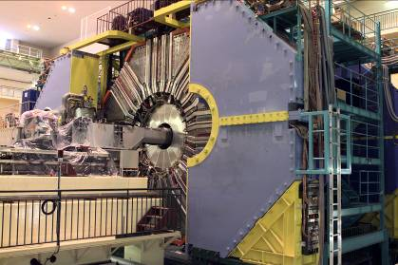
1999 – 2010: B factory at KEK (Japan)
Linac
KEKB double
ring e⁺e⁻ collider
e⁺e⁻ → Y(4S) → BB
Belle detector
World largest B meson sample
~771 million BB events
Over 450 Belle physics publications

Slide 4
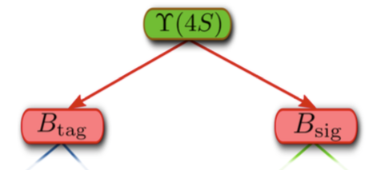
Tagging techniques for Y(4S) events
Tagging provides:
  Background suppression
  Information on B_{sig}
  (4-momentum)
PURITY
EFFICIENCY
Untagged
No requirement on B_{tag}
High efficiency,
low purity
Semileptonic tag
B_{tag} → D*lν
Efficiency ~O(0.2%)
Hadronic tag
B_{tag} → hadrons
Efficiency ~O(0.1%)

Slide 5
B → D*τν with semileptonic tag

Slide 6
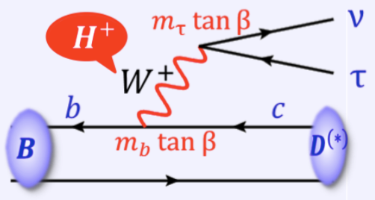
New Physics in B → D*τν
Semitauonic B decays of type b → cτν are sensitive probes to search for New Physics. NP can change the branching ratio and the D*/τ polarization.
Type II 2HDM
A charged Higgs of spin 0 mediates the decay instead of the W
Can enhance or decrease the BR of B → D*τν
Leptoquark models
LQs are bosons which couple to a lepton-quark pair
Carry color and electric charge, baryon and lepton number
LQ models which generate an effective tensor operator lead to an effect in B → D*τν

Slide 7
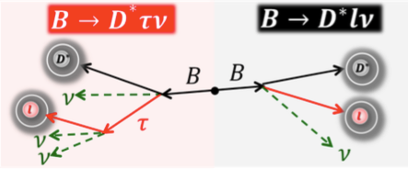
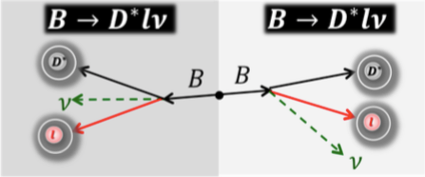

Principle of the measurement
Signal event
Simultaneously reconstruct signal and normalization events
D* reconstruction:
D^{*+} → D⁰π⁺, D⁺π⁰ (~100%)
  10 D⁰ modes (~37%)
  5 D⁺ modes (~22%)
Semileptonic tag: combine
D^{*+} with an oppositely charged lepton, calculate cos θ_{B,D*l}
Require two tagged B candidates per event of opposite charge
Normalization event

Slide 8
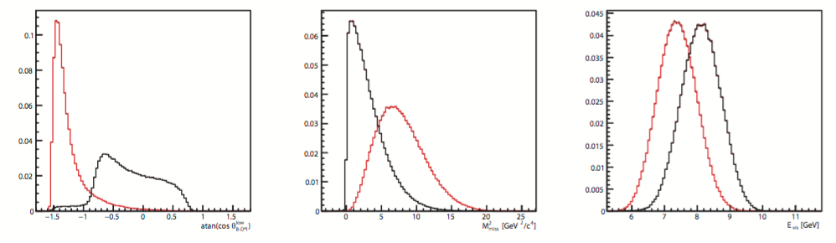
Principle of the measurement (2)
E_{vis}
Neural network to separate
signal and normalization
events using:
  signal-side cos θ_{B,D*l}
  missing mass squared
  visible energy
Determine the number of signal and normalization events by a two dimensional maximum likelihood fit
  Fit variable 1: neural network output
  Fit variable 2: sum of energies of neutral clusters not associated to reconstructed particles E_{ECL}
  Signal, normalization and B → D**lν yields are floated in the fit, other components are fixed to MC expectation
Cos θ
M²_{miss}

Slide 9
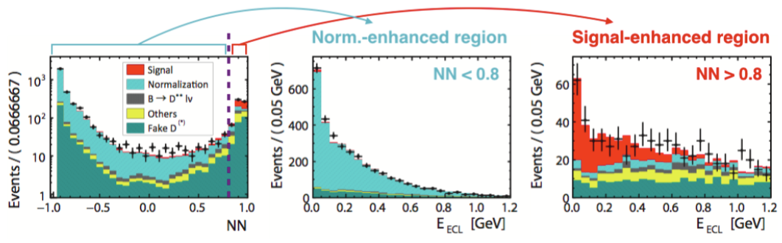
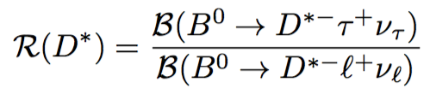
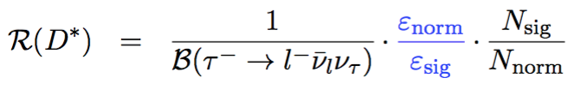
Fit result

Slide 10
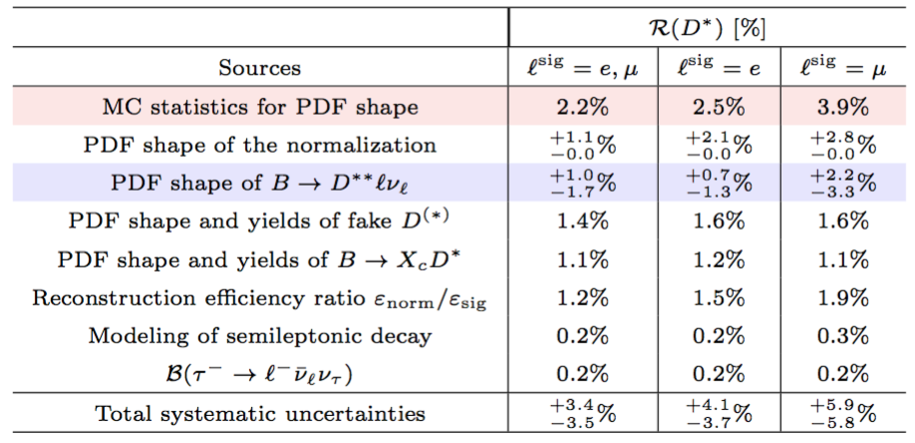
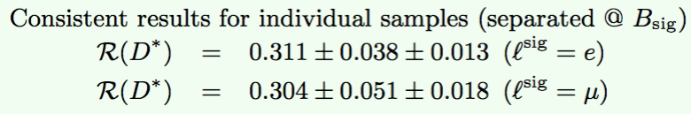
Systematic uncertainty / stability

Slide 11

Comparison to other measurements
This measurement
The difference with the SM prediction is at the level of 4.0 sigma for all four measurements combined

Slide 12
B → πτν with hadronic tag

Slide 13
Motivation
Within the type II 2HDM, the branching fraction of B → πτν can be modified similarly to B → D^{(*)}τν
Current experimental situation: B → τν branching fraction is SM-like while B → D^{(*)}τν exhibits a ~4σ anomaly
B → πτν thus provides additional insight and in particular is an independent probe of the b → uτν transition

Slide 14
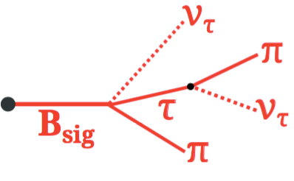
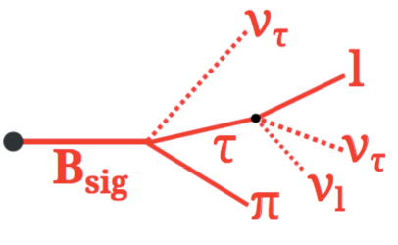
Principle of the measurement
B_{tag} reconstructed in a hadronic mode
τ reconstruction (~71%):
  τ → e/μνν
  τ → π/ρ(ππ⁰) ν
Background is suppressed with a multivariate discriminator (boosted decision trees)
Signal is extracted from a one-dimensional fit to E_{ECL}

Slide 15
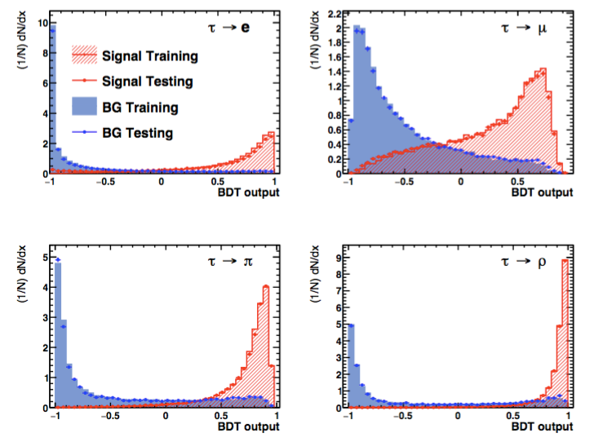
Boosted decision trees (BDTs)
One BDT for every τ mode
Discriminant variables:
  Missing
  energy and momentum
  K_{L} veto
  …
Background: dominant b → c decays

Slide 16
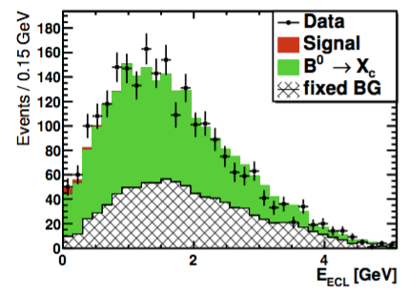
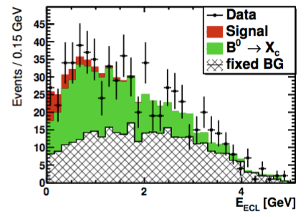
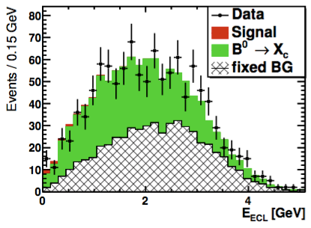
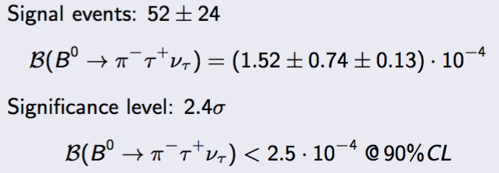
Fit result
Electron mode
Pion mode
Rho mode

Slide 17
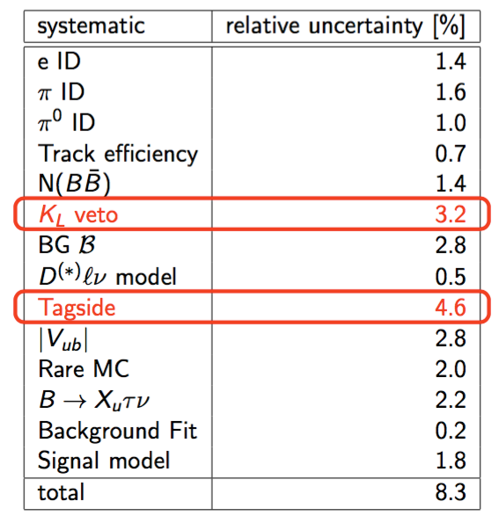
Systematic uncertainty

Slide 18
SUMMARY

Slide 19
Summary
  New preliminary Belle result for R(D*) obtained with semileptonic tagging [arXiv:1603.06711]
    R(D*) = 0.302 +/- 0.030(stat) +/- 0.011(syst)
    Confirms the excess seen by other experiments and brings to tension with the SM to 4.0σ
  Search for B⁰ → π⁻τ⁺ν at Belle
  [Phys. Rev. D93, 032007 (2016)]
    Br(B⁰ → π⁻τ⁺ν) < 2.5 x 10⁻⁴ @ 90% C.L.
We need the Belle II data to clarify the experimental situation

Slide 20
backup

