Slide 1
Heavy Flavor results from CMS
Keith Rose
On behalf of the CMS Collaboration
HQL2016
26 May 2016

Slide 2
Outline
Introduction
Spectroscopy of SM standard candles (J/Ψ, Υ(ns))
Double J/Ψ spectroscopy
B branching ratio measurements
B rare decays, FCNC processes
Run II overview

Slide 3
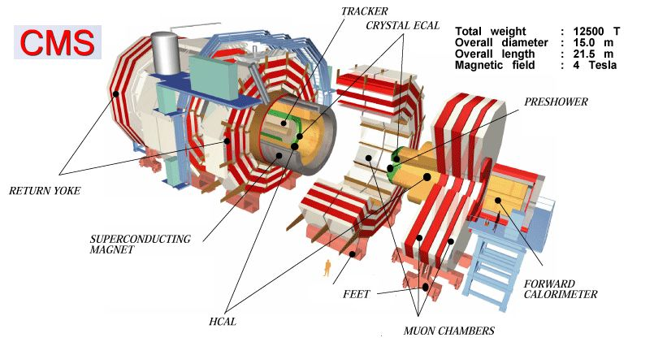
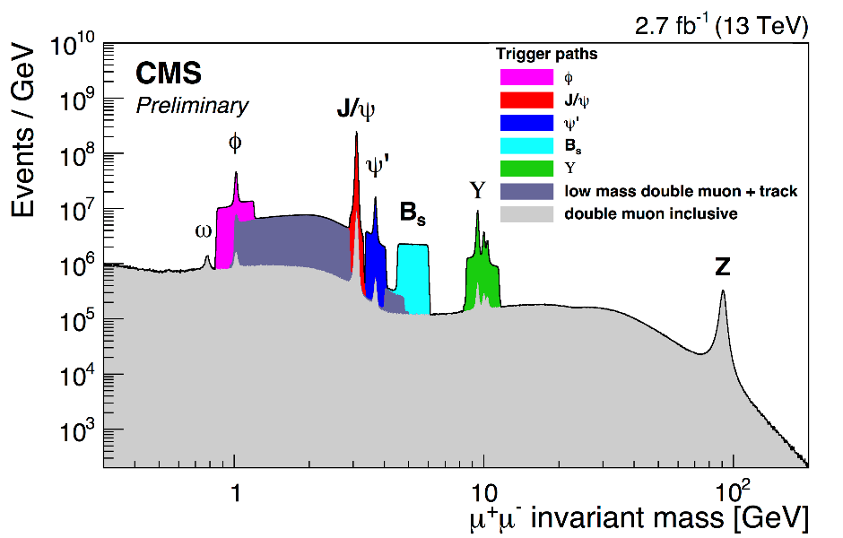
CMS and spectroscopy
CMS detector is well suited for a broad physics program
Tracker and Muon chambers at wide range of coverage in η
Flexible trigger system sensitive to variety of signal
Complementary coverage in p_{T} and η to experiments such as LHCb

Slide 4
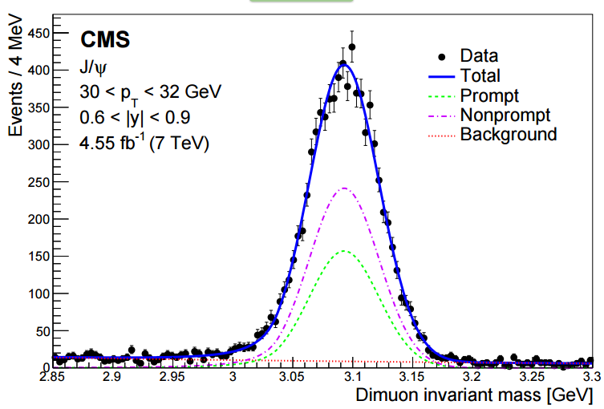
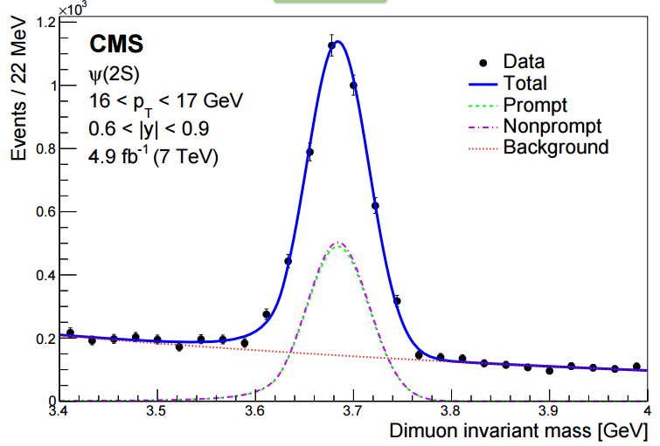
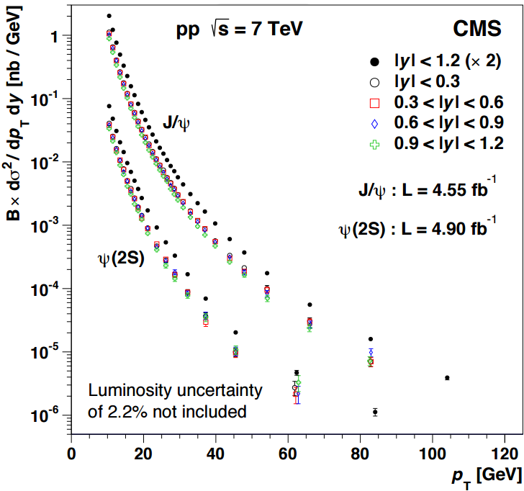
NRQCD studies:
J/Ψ, Ψ(2s) double-diff. σ
CMS BPH 14 001
Published:
PRL114 (2015) 191802
LHC gives us access to p_{T} regimes well above –onia masses where NRQCD is most effective
Measure J/Ψ and Ψ(2S) xsec in bins of p_{T}, η out to p_{T} > 100 GeV, improves on prior reach of 50 GeV at CMS
Measure particle yields in small windows to minimize resolution effects, apply efficiency/acceptance
New spectrum can be used as input to future NRQCD fits in this regime

Slide 5
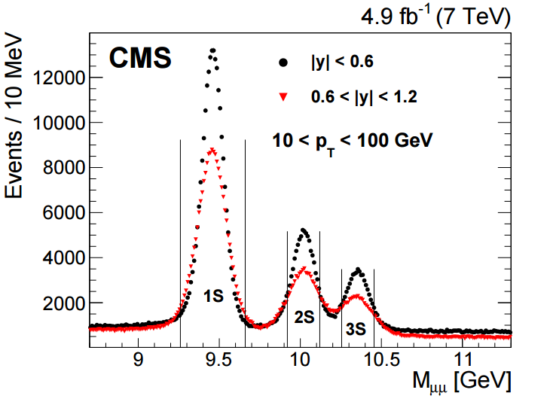
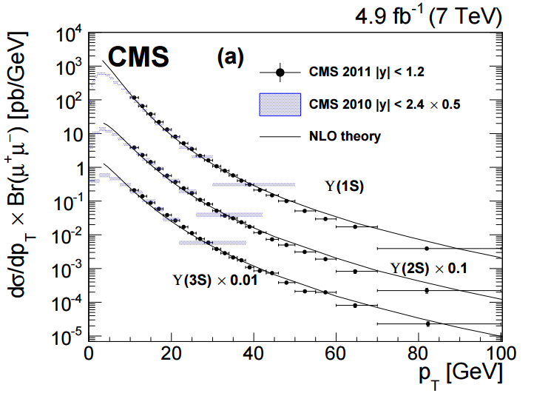
NRQCD studies:
Υ(1s), Υ(2s), Υ(3s) xsec
Upsilon production similarly improved in Run 1
Cross-section (right) from 2011 compared to 2010 measurement and theory computed by Gong, et. al. (PRL112 (2014) 032001)
2010 cross-section scaled by 0.5 to account for lesser |y| coverage
Results are generally compatible between 2010 and 2011
CMS BPH 12 006
Published:
Phys. Lett. B 749 (2015) p.15

Slide 6
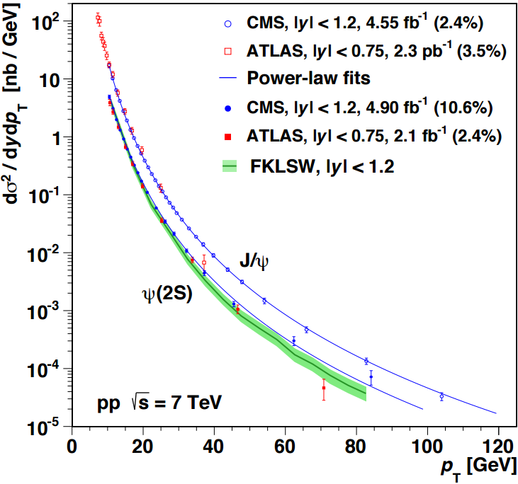
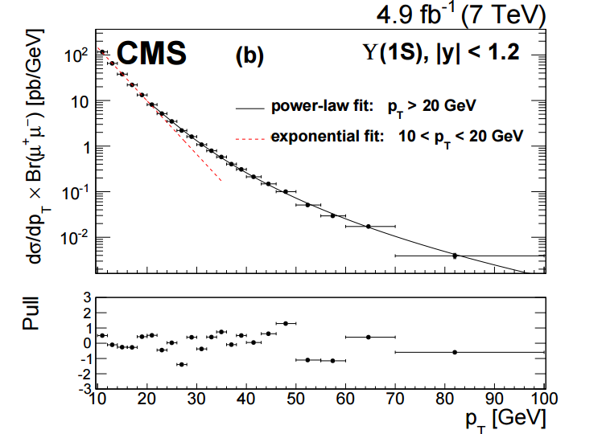
NRQCD studies:
Cross-sections and fits
Differential cross-section in p_{T} for J/Ψ and Ψ(2s) (left), and Υ(1s) (right)
Test of NRQCD formalism where predictions are factorized into short-distance terms governed by PDFs and long-distance matrix-elements (LDMEs)
LDMEs are model-independent, should be valid for all measurements
Previous derivations of LDMEs found to be valid at p_{T} > 20 GeV
Power law behavior suspected, and data conforms nicely to such a fit.

Slide 7
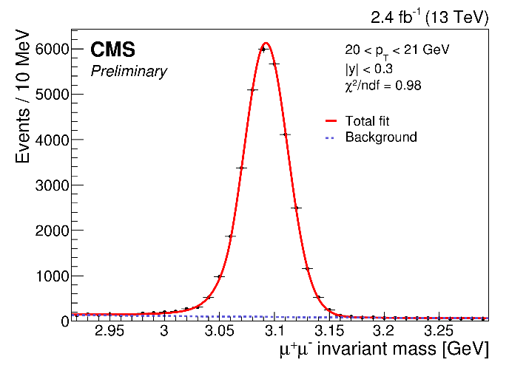
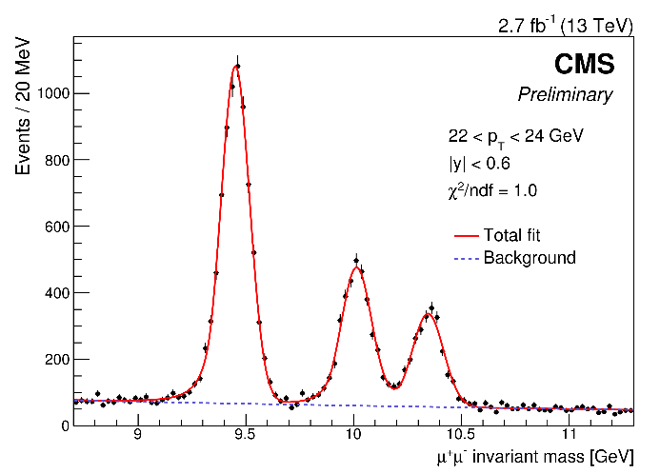
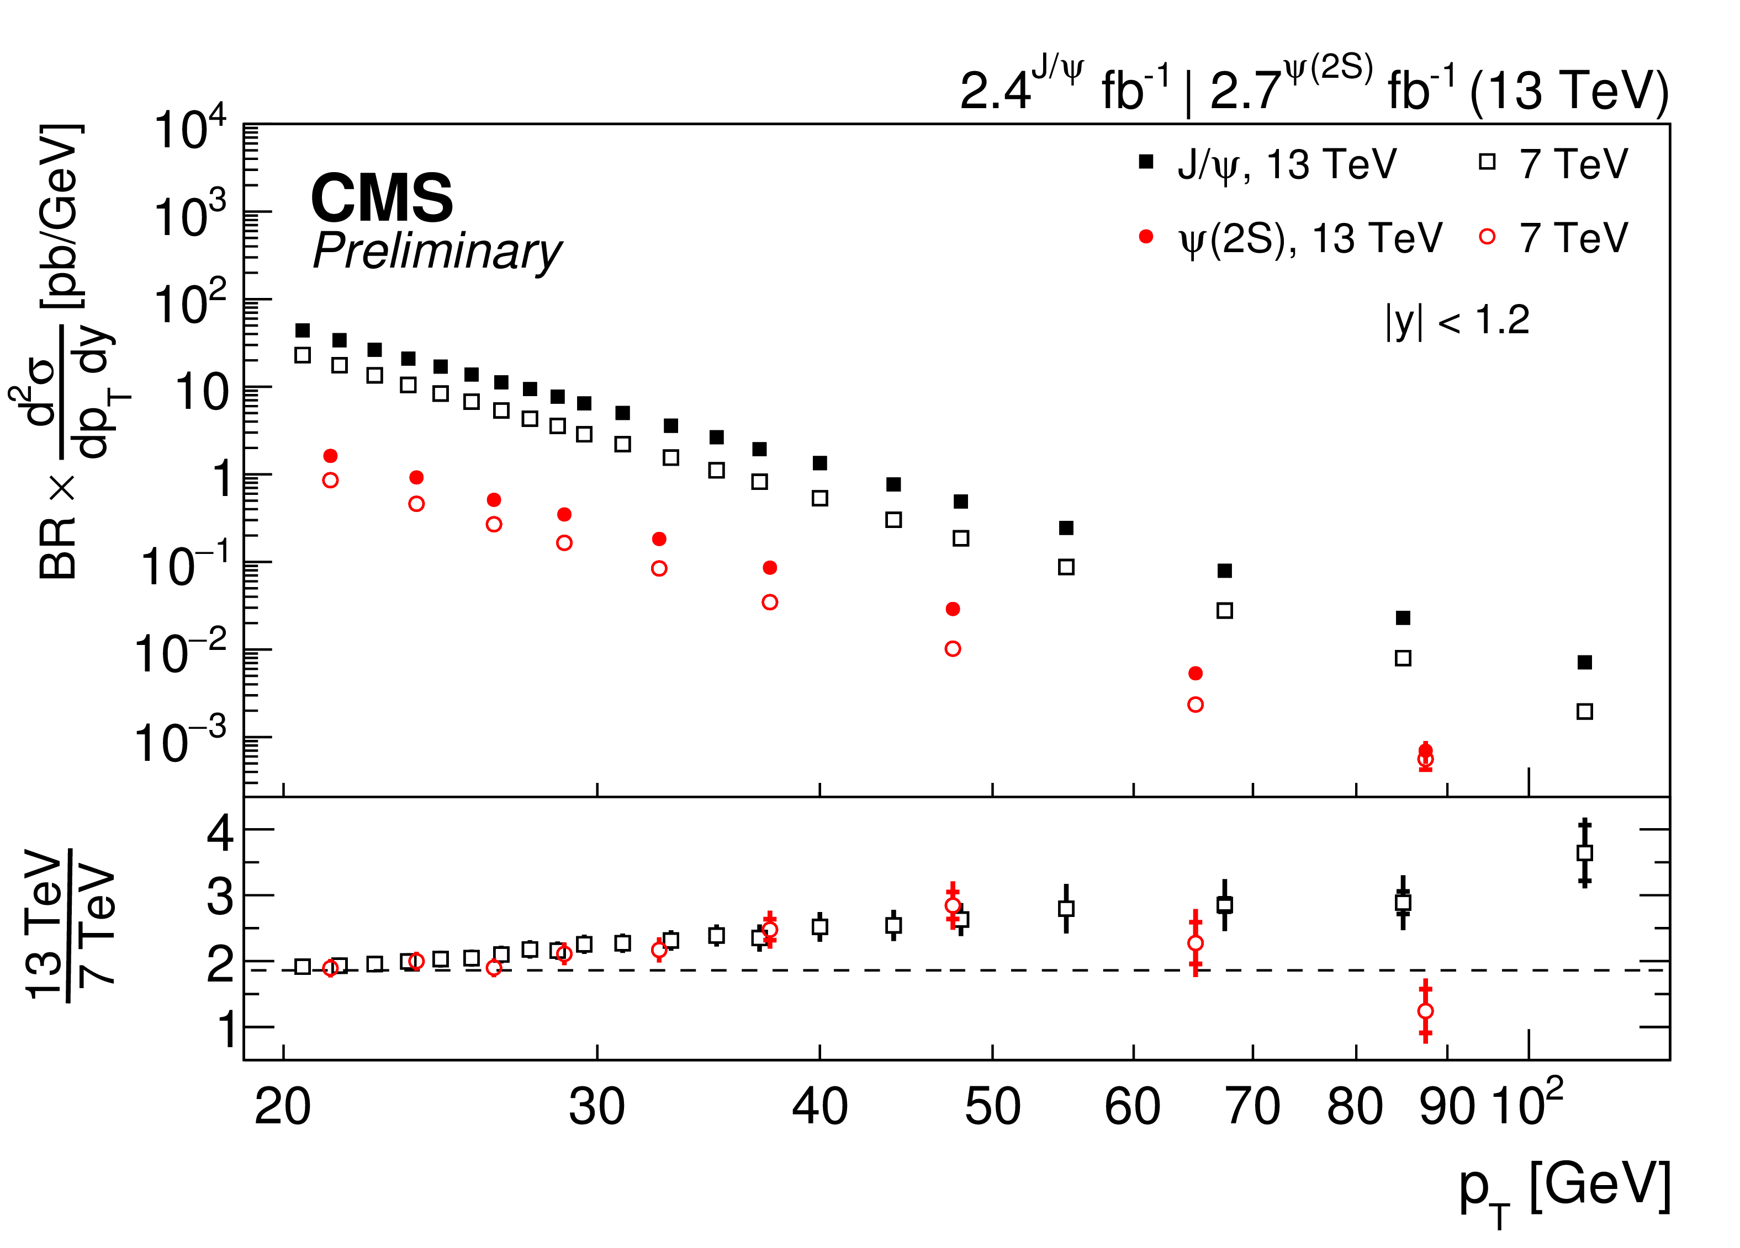
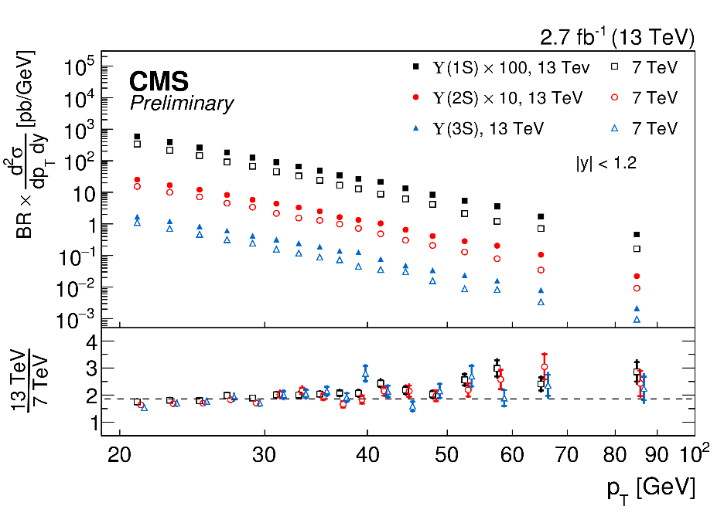
Quarkonium cross-sections
@ 13 TeV
Very clean J/Ψ and Υ signals in early 13 TeV data – comparing cross sections, validates expected factor of ~2 increase in production between regimes

Slide 8
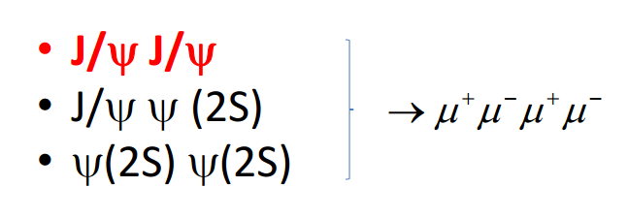

Prompt Double J/Ψ production
Double J/Ψ production phase space @ CMS nicely complements LHCb
Non-trivial contribution from double parton-scattering (DPS)
  Cannot be modeled by current NRQCD predictions
Potential grounds for discovery
  η_{b} (highly suppressed by current predictions)
  Pseudo-scalar Higgs (NMSSM)
  Tetraquark bound state

Slide 9
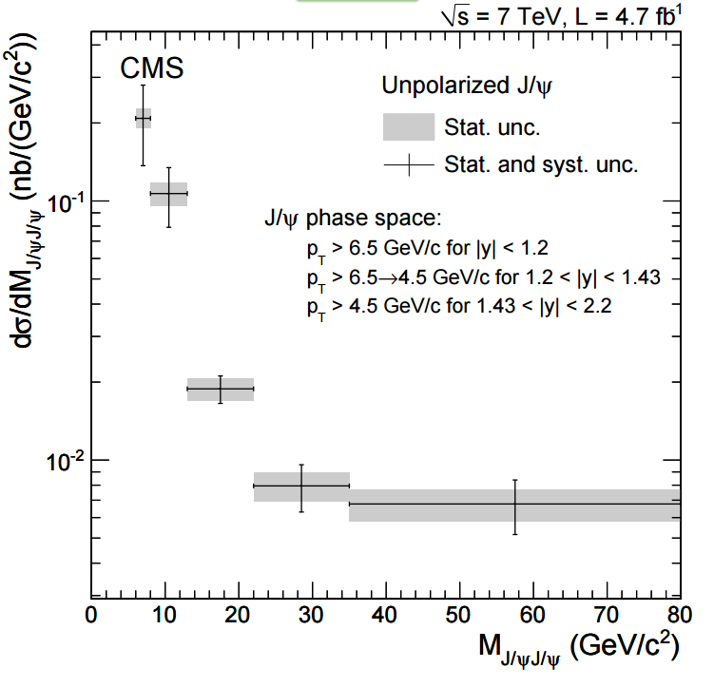
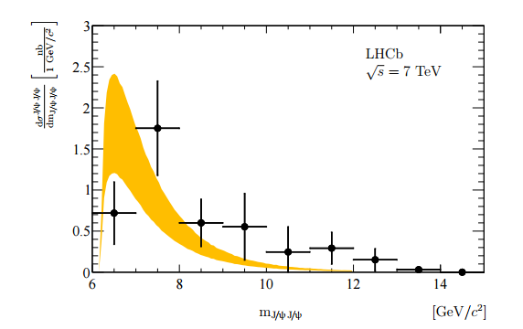
Prompt Double J/Ψ measurement
CMS BPH 11 021
Published:
JHEP09 (2014) 094
Accounting for prompt double J/Ψ only:
-0.05 < ct < 0.10
δd < 8
Both J/Ψ within 3σ of mass peak
CMS reach is complementary to LHCb in p_{T} and η.
LHCb-PAPER-2011-013
Published:
Phys.Lett.B 707 (2012) pp 52-59

Slide 10
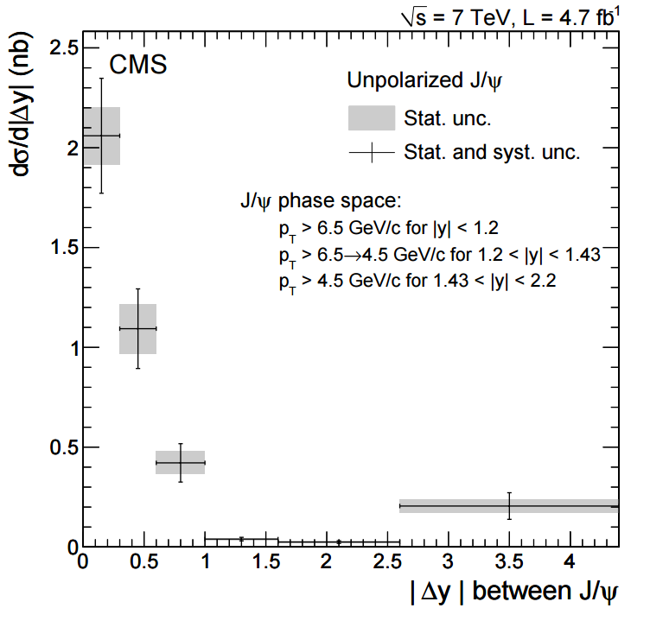
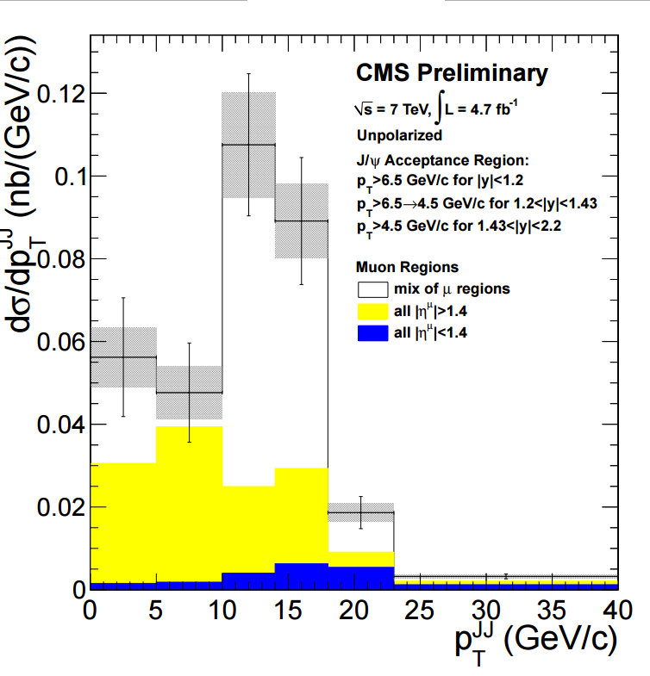
Prompt Double J/Ψ measurement
Δy between J/Ψ, system p_{T}
As shown above, p_{T} of double J/Ψ system has interesting features which arise from crossing through regions of CMS acceptance.
Important to keep acceptance in mind when developing trigger, creating strategy for Run 2
DPS contribution – not modeled by NRQCD. For a search, this becomes irreducible background

Slide 11
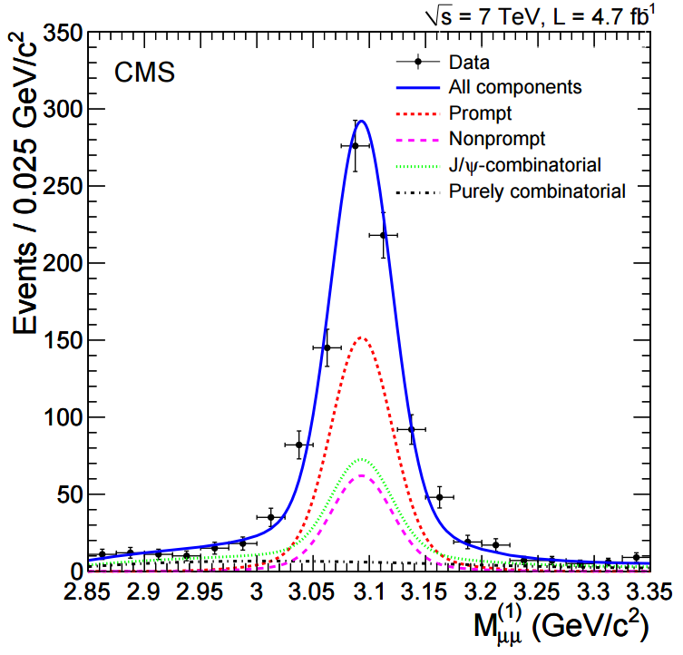
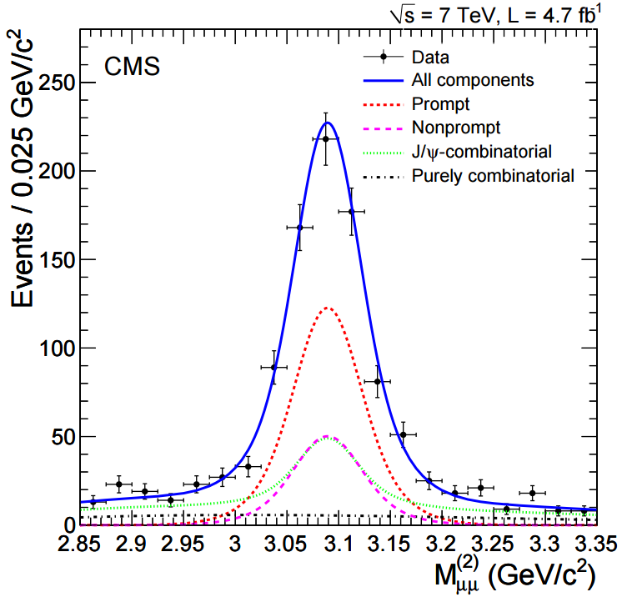
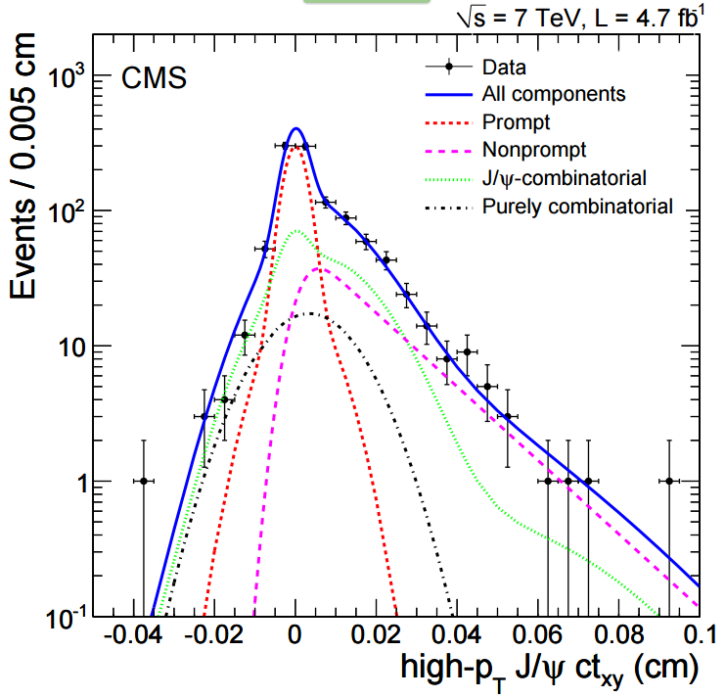
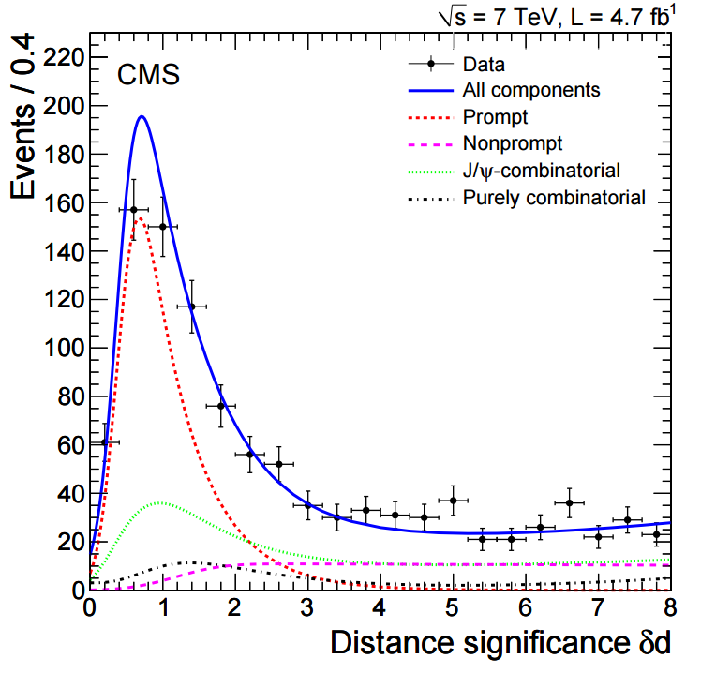
Prompt Double J/Ψ
Modeling non-resonant production
Critical to understand and model non-resonant double J/Ψ production
Mass spectrum peak for J/Ψ derived from simulation, as is decay length from non-prompt decay.
Background contributions are data-driven, using di-μ pairs from sidebands around J/Ψ mass peak
Fit of kinematics of double-J/Ψ appears to describe the current data well at CMS
Search technique can be refined for use in Run II, extended to other channels (ΥΥ production, ΥΥ and J/ΨJ/Ψ decaying to μμee)

Slide 12
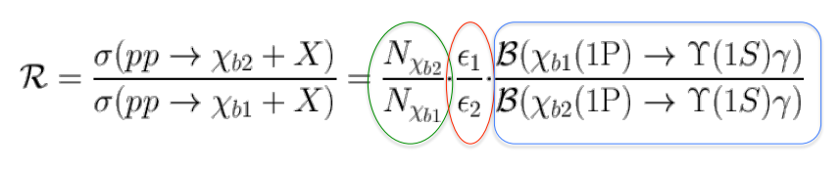
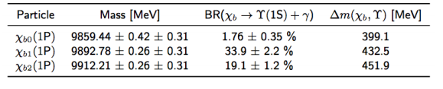
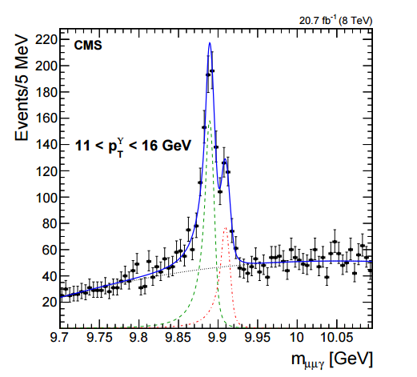
Observable: χ_{b2}/χ_{b1} cross-section ratio
Measure decay into Υ + photon, photons measured using e⁺e⁻ conversion only
Conversions measured in tracker – good energy resolution, can separate respective mass peaks
Measurement is (as above):
  Standard counting from likelihood fit
  Efficiency from simulation
  BR from PDG
Measurement binned in 4 p_{T} bins between 7 GeV and 40 GeV
CMS BPH 13 005
Phys. Lett. B 743 (2015) 383

Slide 13
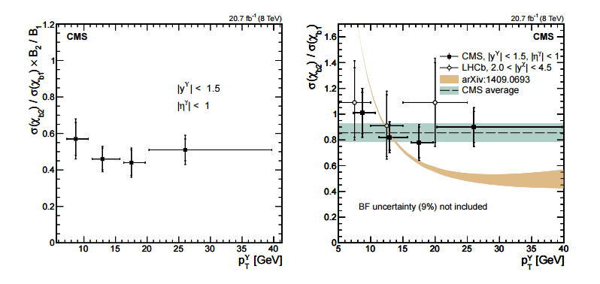
Observable: χ_{b2}/χ_{b1} cross-section ratio
Absolute ratio (left) and normalized to br (right).
Right figure features LHCb measurement, as well as most recent NRQCD theoretical prediction
(Likhoded et. al
PRD 90 (2014), 074021)
Present published ratio is most precise yet, complements LHCb measurement well and extends reach in p_{T} to 40 GeV.
Theory is derived from extrapolation of NRQCD based on p-wave charmonium observation
Dotted line (right) is linear fit to measured ratio in CMS, representing the case of dominance by color octet contributions. More precise measurements are needed!

Slide 14
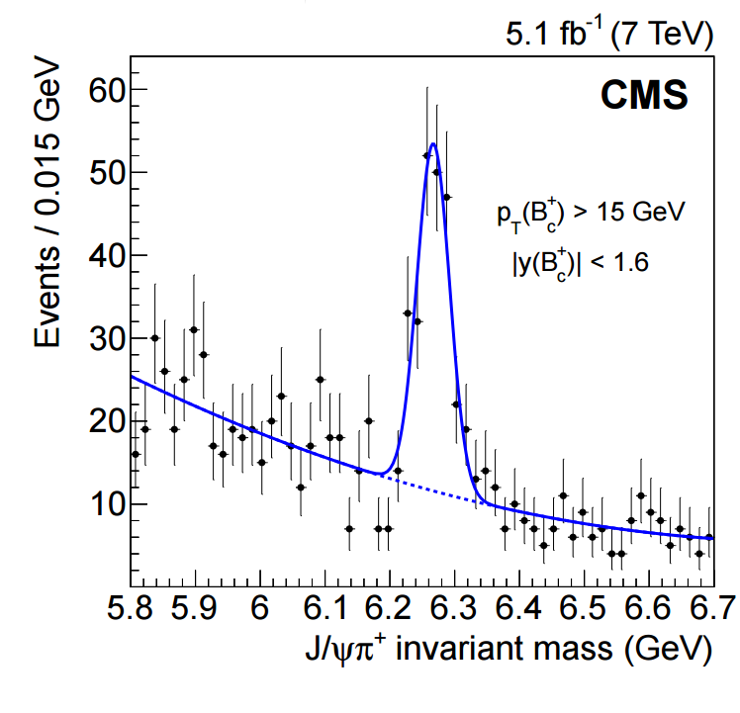

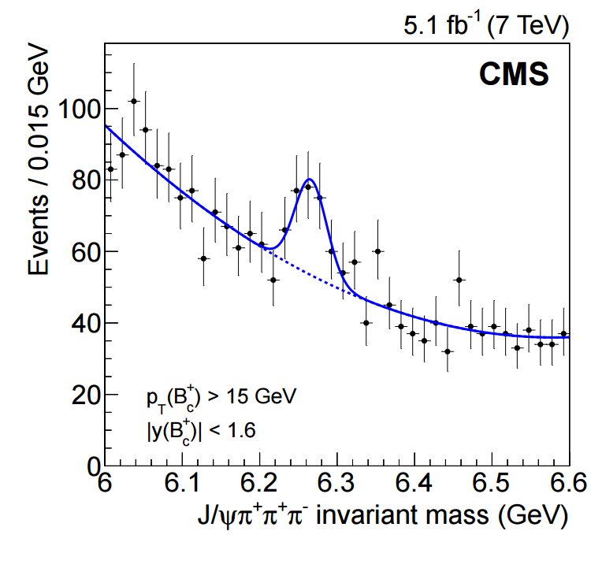

Observation of B_{c} properties via branching ratios
Decay of B_{c} is a vital component of CMS program
Complements LHCb measurement, necessary to evaluate background for other rarer B decay signatures
Observation of decay to J/Ψ + 3π would be the first experimental confirmation of LHCb result.
CMS BPH 12 011
JHEP 01 (2015) 063

Slide 15

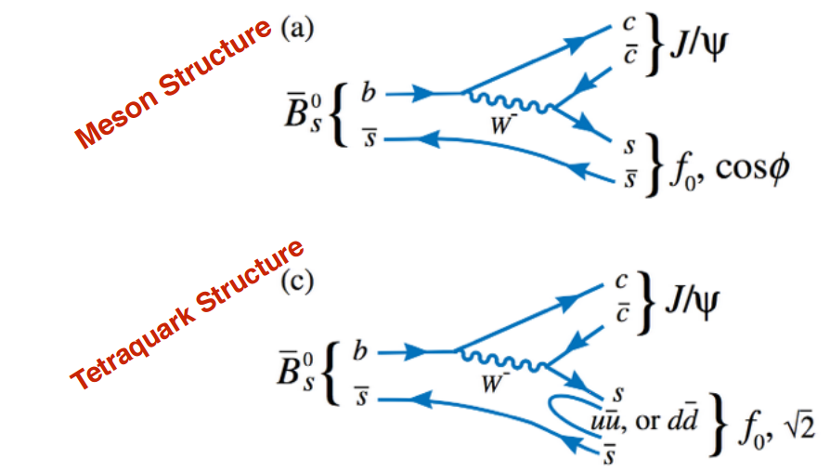
Study of f₀(980) via branching ratio analysis
Measurement of f₀ decay helps understand the CP-odd portion of B_{s}⁰
Measurement of the lifetime is necessary to improve our understanding of the CP mixing phase (mixing may be enhanced by new physics)
f₀ (and other scalar mesons) are unusual, do not follow naïve mass hierarchy based on quark model
Suggests potential for new structure, e.g. tetraquark states

Slide 16
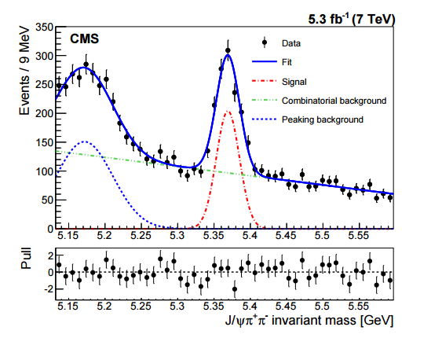
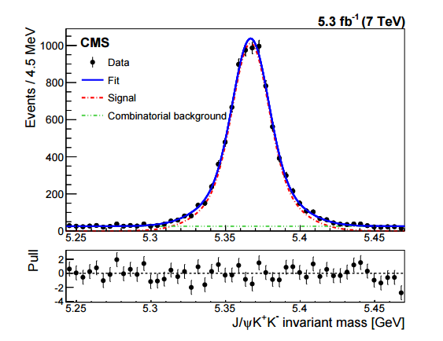
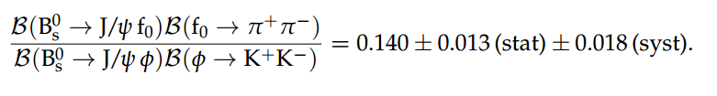
Measurement of f₀(980) branching ratio
CMS BPH 14 002
Submitted to PLB
Consistent with SM theory prediction of roughly 0.2!

Slide 17
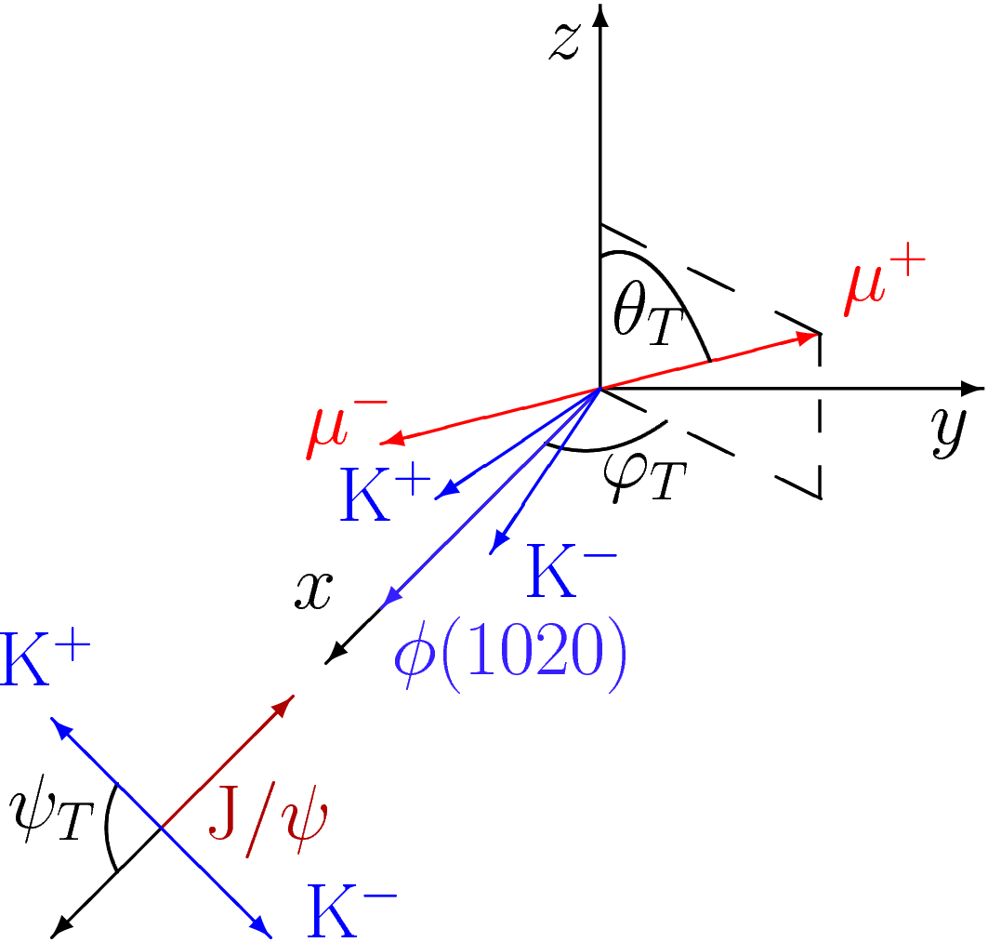
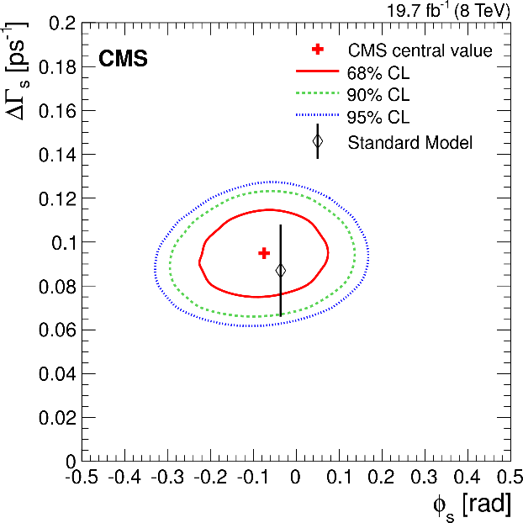
Analysis of B_{s}⁰ to J/Ψφ angular distribution
The weak mixing angle φ_{s} is extracted from further analysis of the J/Ψφ decay mode angular distribution
Measurement performed on angles θ_{T}, ϕ_{T}, ψ_{T} shown at right
Found to be in good agreement with SM within 1σ
CMS BPH 13 012
Submitted to PLB

Slide 18
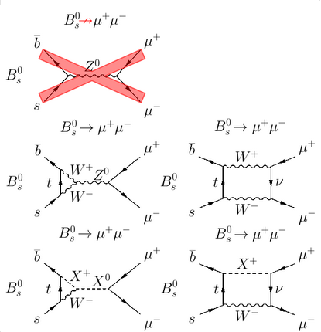
Measurement of rare
B 2μ decays
Measurement of the highly suppressed B⁰ -> 2μ decay mode is critical to our understanding of the SM and potential physics beyond
First-order diagram is forbidden, requires FCNC (BSM)
SM contributions to this channel come from higher-order diagrams
Presence of a new particle (X here) could enhance production in this channel, potentially could be measured at LHC as lumi ramps up

Slide 19
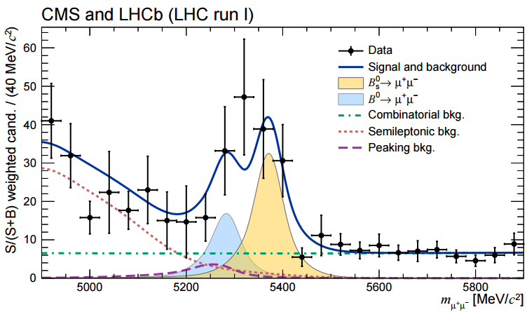
Measurement of rare
B 2μ decays
First combined paper from CMS/LHCb (Nature 522, 68-72 (04 June 2015))
In combined dataset, expect ~100 B_{s} decays, ~10 B_{d} decays

Slide 20
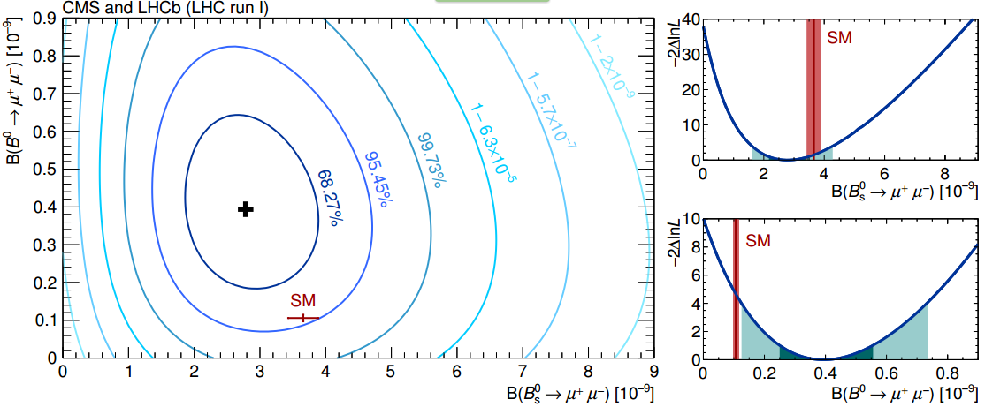
Measurement of rare
B 2μ decays
B_{s} rate is consisted with SM within 1.2σ, B_{d} rate within 2.2σ
Overall 6σ observation of B_{s} -> 2μ! (3σ evidence of B_{d} -> 2μ). Currently a rare decay, but liable to be benchmark analysis at HL-LHC!

Slide 21
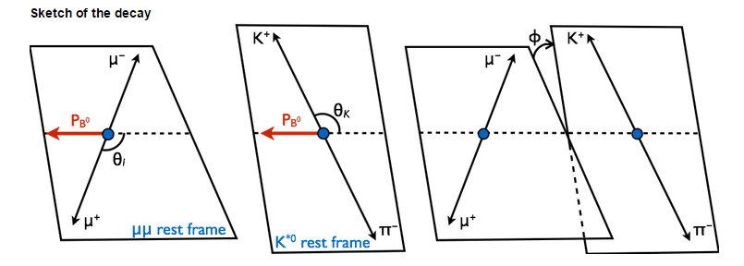
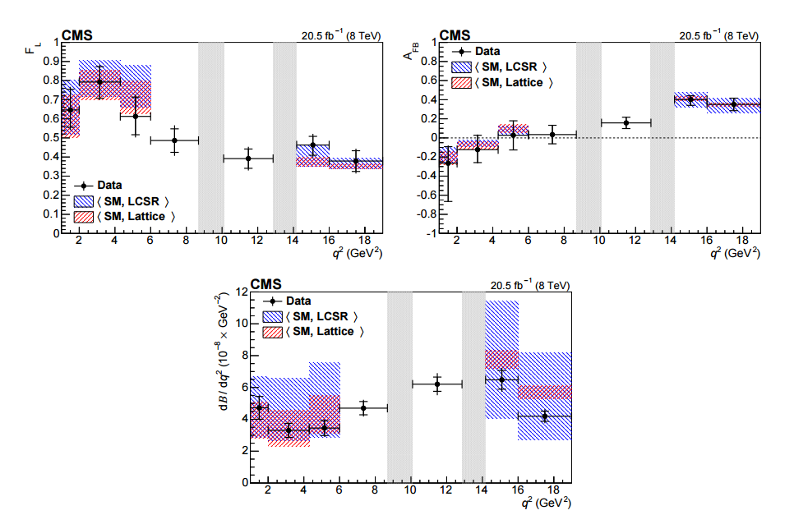
Angular measurement of
B to K^{*0} + 2μ
Similar to B -> 2μ, this decay channel is clean theoretically and, as an FCNC process, reasonable ground for evidence of new physics.
Angular analysis in 3 variables (θ_{i}, θ_{k}, φ)
CMS BPH 13 010
Published:
Phys. Lett. B 753
(2016) p.424
Observation of longitudinal polarization fraction of K^{*0} (upper left), m pair asymmetry (upper right) and differential branching fraction (bottom) all as a function of dimuon invariant mass.
Good agreement with SM theory.

Slide 22
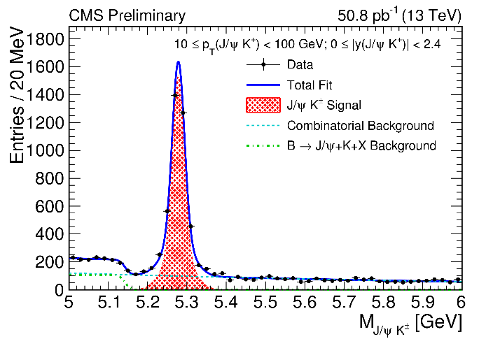
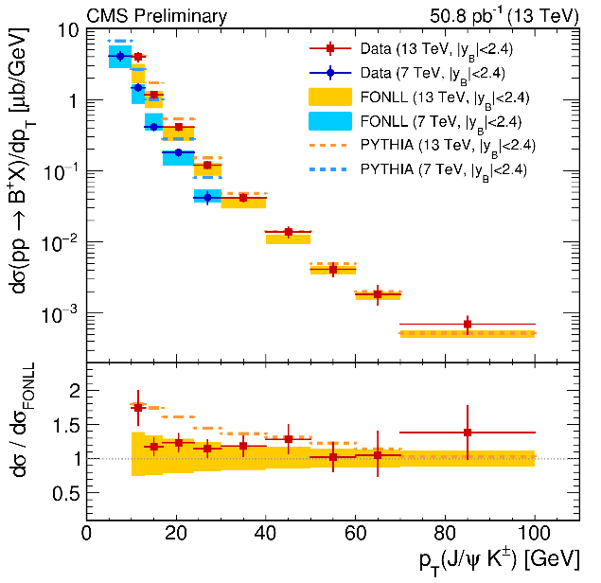
Ongoing Run II
B⁺ K⁺J/Ψ
CMS resumed physics program in May 2015
Updated trigger menu including new paths w/ displaced track requirements – seen below B⁺ event with clean displaced J/Ψ
Clean B⁺ observation – good stepping stone in early data

Slide 23
Conclusion
A broad spectrum of analyses have been completed on the CMS experiment in the field of spectroscopy in the past year alone.
Many results are among the most precise measurements recorded, complementary to the LHCb phase space
New observations, including the B -> diμ decay channel
After long shutdown, the LHC (and CMS) are back in operation in a new energy regime and have already seen many standard candles

