Slide 1



Recent Results on
Radiative and Electroweak Penguin
B Decays at Belle
Akimasa Ishikawa
(Tohoku University)

Slide 2
Introduction
Loop processes are sensitive to physics Beyond the Standard Model (BSM) since unobserved new particles might be able to enter in the loop.
Radiative and Electroweak Penguin B decays are experimentally and theoretically clean due to final states having color singlet photons or leptons.

Slide 3
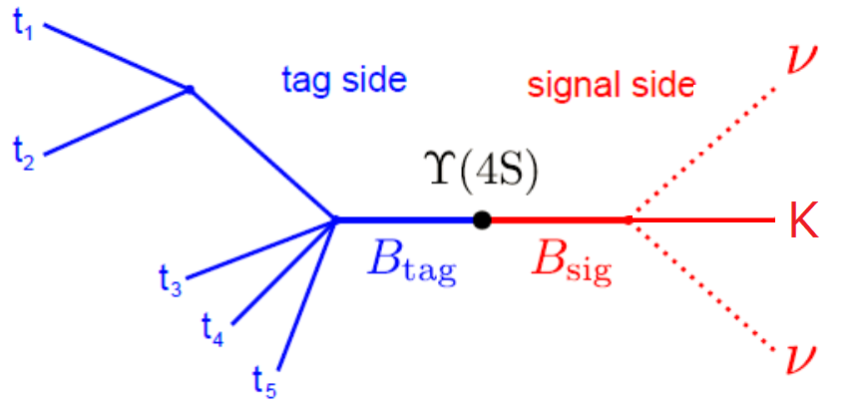
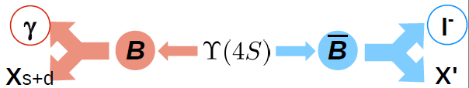
Tagging Methods
Two B mesons are produced from Y(4S).
For some analyses, one of the B meson is tagged
  To study/search for decays with multiple neutrinos : B→Kνν
  To know the flavor of the other B meson : A_{CP}(B→X_{s+d} γ)
  To improve the sensitivity : BF(B→X_{s}γ)
There are several tagging methods
  Hadronic tagging : reconstruct hadronic B decays
  Semileptonic tagging : reconstruct semileptonic B decays
  Lepton tagging : just require a hard lepton from B decays
Purity
Efficiency
Hadronic tagging
Lepton tagging

Slide 4
Radiative Decays

Slide 5
BF(B→X_{s}γ)
Branching fraction of Inclusive B→X_{s}γ is very sensitive to BSM.
  Charged Higgs in 2HDM
    Constructive to SM amplitude
    Almost no tanβ dependence
  SUSY
    Constructive or destructive to SM
    Depending on SUSY parameters
Very precise prediction available.
  7% precision
M. Misiak et al, Phys. Rev. Lett. 114, 221801 (2015)

Slide 6
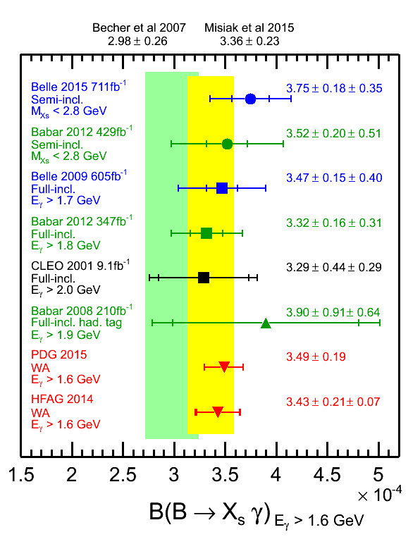
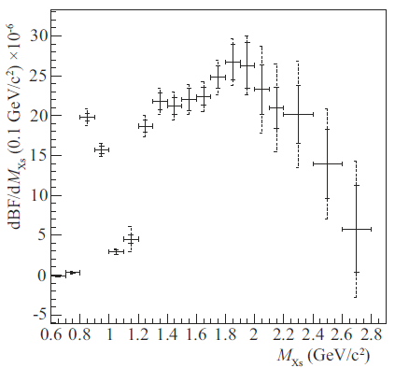
Measurement of BF(B→X_{s}γ)
T.Saito, A. Ishikawa, et al (Belle Collaboration) PRD 91, 052004 (2015)
711fb⁻¹
Sum of exclusive method adopted
  38 Xs decay modes
    Kπ, K2π, K3π, K4π, Kη, Kηπ, Kηππ, 3K, 3Kπ
  Mass of hadronic system <2.8 GeV
    corresponding to Eγ > 1.9GeV
  BF measured in each MXs bin and then combined
  Extrapolated to E_{γ} > 1.6GeV
Best measurement with sum of exclusive method
  Second best for all measurements

Slide 7
Limit on Charged Higgs in 2HDM
World Average is consistent with the prediction by M. Misiak et al
This can be used to constrain charged Higgs mass in 2HDM
at 95% CL
Luis Pesantez

Slide 8
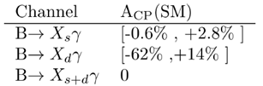
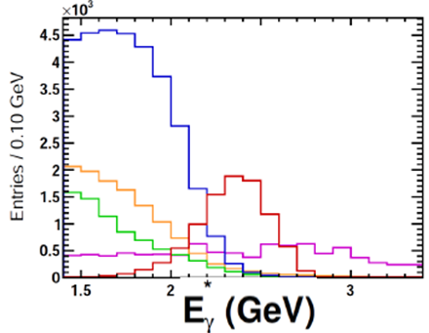
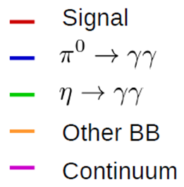
Direct CP Asymmetry in B→X_{s+d}γ
Theoretical prediction is very precise thanks to Unitarity of the CKM matrix.
  If deviated from 0, clear new physics signal
Inclusively reconstruct photon with 1.7 < E_{γ} < 2.8GeV
  Veto for asymmetric decays of π⁰(η)→γγ
High momentum lepton to tag flavor of the other B
  Correction of mixing applied
M. Benzke et al, PRL 106, 141801 (2011)

Slide 9
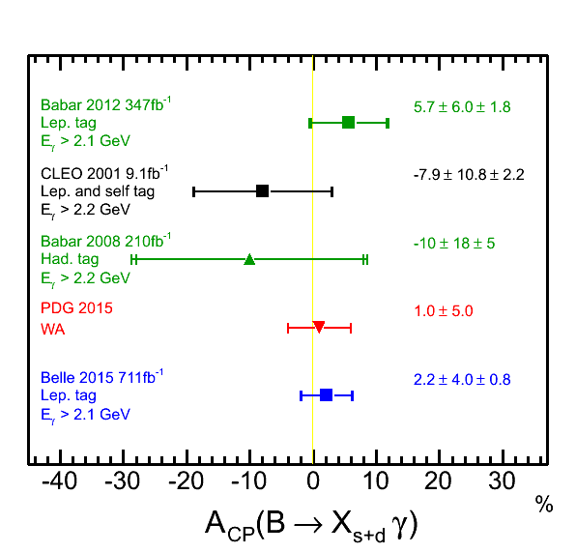
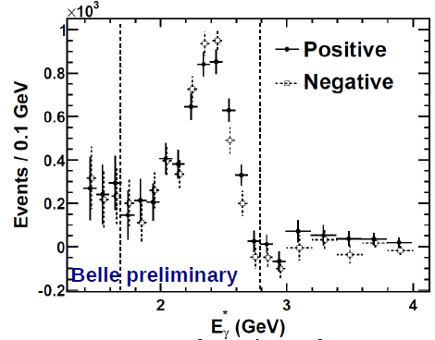
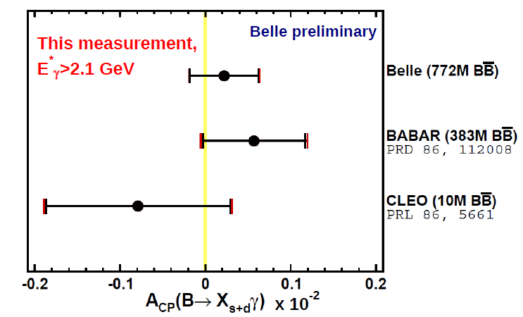
Result for A_{CP}(B→X_{s+d}γ)
L. Pesantez et al (Belle Collaboration) PRL 114, 151601 (2015)
711fb⁻¹
Belle performed world best measurement
  Even better than PDG 2015!
The result is consistent with null
Still statistical error dominates → Belle II

Slide 10
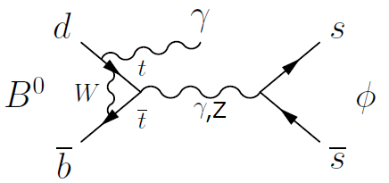
Search for B→φγ
Z. King et al (Belle Collaboration) to appear in PRD, arXiv:1603.06546
711fb⁻¹
Proceeds via b→d penguin annihilation
  Suppressed by V_{td}
  Prediction : B(B→φγ) ~ O(10^{-11~12})
Dominant continuum background suppressed by Neural Net
Simultaneous fit to M_{bc}, ΔE, NN, cosθ_{hel} to extract signal yield.
  Consistent with null
Set a limit on BF
  Almost one order of magnitude better than previous search
90% C.L.

Slide 11
Electroweak Penguin Decays b→sl⁺l⁻ and b→(s,d)νν

Slide 12
Full Angular Analysis of B⁰→K*⁰l⁺l⁻
LHCb reported 3.4σ deviation from a SM prediction in P₅’ for 4 < q² < 8GeV² which was obtained from full angular analysis of B⁰→K*⁰μμ
  There is a discussion that the deviation can be explained by a charm loop
Global fit to radiative and EW penguin B decays gives Wilson coefficient C₉ deviated about -1 from SM values
  Driven by P5’, F_{L}, B(Bs→φμμ) etc.
Independent analyses/checks are desired.
S.Descotes-Genon et al, PRD 88 074002 (2013)

Slide 13
Differential Decay Width for B→K*ll
Differential decay width as a function of 4 variables, q², θ_{l}, θ_{K}, and φ, is expressed in terms of form factor independent observables, P_{i}’.
S. Descotes-Genon et al. JHEP 05 (2013) 137

Slide 14
Analysis of B⁰→K*l⁺l⁻
A. Abdesselam, et al (Belle Collaboration), arXiv:1604.04042
711fb⁻¹
Electron mode
Only neutral B⁰ used
Neural Net based selections were adopted to improve the sensitivity
  69±12 and 118±12 signal events were reconstructed for electron and muon modes.
Since the number of signal events is small, folding method was adopted to extract P₄’, P₅’, P₆’ and P₈’ as LHCb did in 2013.
The fit is performed in bins of q²
Muon mode

Slide 15
Result for P₅’
A. Abdesselam, et al (Belle Collaboration), arXiv:1604.04042
711fb⁻¹
The result for 4< q² < 8 GeV² is 2.1σ deviated from a theoretical prediction with the same direction as LHCb observed.

Slide 16
Results for P₄’, P₆’ and P₈’
Consistent with theoretical predictions

Slide 17
Measurement of A_{FB}(B→Xsl⁺l⁻)
Y. Sato, A. Ishikawa, et al. (Belle Collaboration) PRD 93 032008 (2016)
711fb⁻¹
A_{FB} in exclusive B→K*l⁺l⁻ decays was measured by many experiments while A_{FB} in inclusive decays was not yet.
Different systematic uncertainties in inclusive decays than those in exclusive decays.
  Important tool for independent check of C₉ deviation
Precise prediction possible but experimentally it was hard to measure.

Slide 18
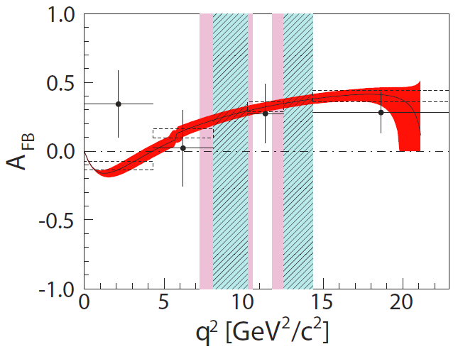
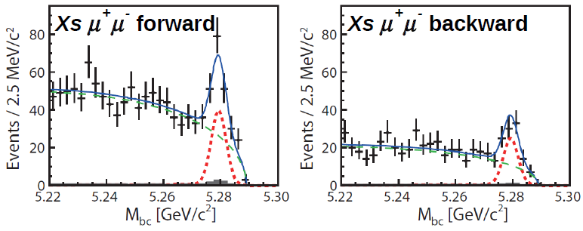
A_{FB}(B→X_{s}l⁺l⁻) with Semi-Inclusive Technique
Y. Sato, A. Ishikawa, et al. (Belle Collaboration) PRD 93 032008 (2016)
711fb⁻¹
Reconstruct 36 decay modes
20 self-tag decay modes used to measure A_{FB}
The result is consistent with a SM prediction within error.
Still statistically dominated ➔ Belle II

Slide 19
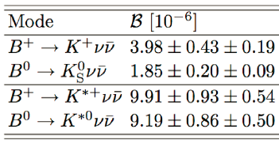
Search for B→hνν
If C₉ is deviated from the SM value, vector current in b→sνν could be also affected in some BSM models.
Proceeds via penguin or box diagrams
Theoretically very clean.
  No charm loop as in b→sl⁺l⁻
Experimentally, need to tag the other B meson due to final states having multiple neutrinos.
Hadronic B decays are used for tag side.
A. Buras, et al. JHEP 02 184 (2015)

Slide 20
Results on B→hνν
O. Lutz, et al (Belle Collaboration) PRD 87 111103(R) (2013)
711fb⁻¹
1104 exclusive hadronic decays are used for tagging
  Typical tagging efficiencies for B⁺ and B⁰ are 0.3% and 0.2%, respectively.
Reconstruct h candidates
Vetoing K_{L} using K_{L} and muon detector
Momentum requirement
  P_{h} > 1.6GeV
Extra energy in ECL used for signal extraction
Best upper limits on BF for
  h = K*⁺, π⁺, π⁰, ρ⁺
About 5 times larger UL than prediction for B→K*νν ➔ Belle II

Slide 21
Summary
Radiative and EW penguin B decays are sensitive to BSM.
We performed BSM searches using many observables.
  Full angular analysis of B→K*l+l- shows 2.1σ deviation of P₅’ in the 4<q²<8GeV² bin as the same direction as LHCb.
  Independent checks of the deviation of Wilson coefficient C₉ is very important using B→Xsl⁺l⁻ and/or B→K⁽*⁾νν which need very high statistics ➔ Belle II
Still important analyses are in pipeline. Some of which to be presented at ICHEP 2016 @ Chicago.
Stay tuned!

Slide 22
Acknowledgement
This talk is supported by Grants-in-Aid for Scientific Research B, No. ??????, “World best sensitivities of new physics searches with Electroweak Penguin B decays and development of light and fast-readout pixel detector” from the Ministry of Education, Culture, Sports, Science, and Technology, Japan.

Slide 23
backup

Slide 24
Search for B_{s}→γγ
D. Dutta, et al (Belle Collaboration) PRD 91, 011101(R) (2015)
121fb⁻¹
Sensitive to RPV SUSY
  RP conserving SUSY effect to B_{s}→γγ is constrained by B(b→sγ)
Prediction on BF is ~10⁻⁶
Measured on Y(5S)
  Y(5S)→Bs⁽*⁾Bs⁽*⁾
Two hard photons
Simultaneous fit to M_{bc} and ΔE
Set a limit on BF
  < 3.1 ×10⁻⁶
Exclude large contribution of RPV SUSY

Slide 25
Measurement of B_{s}→φγ
D. Dutta, et al (Belle Collaboration) PRD 91, 011101(R) (2015)
121fb⁻¹
Counter part of B→K*γ
Measured on Y(5S)
  Y(5S)→Bs⁽*⁾Bs⁽*⁾

