Slide 1
Direct Neutrino Mass Measurement in the Project 8 Experiment
PNNL-SA-118235
Brent VanDevender for The Project 8 Collaboration
Pacific Northwest National Laboratory
Richland, WA

Slide 2
Introduction/Overview
Direct neutrino mass measurements after KATRIN
  why?
  how?
Project 8 concept
  Cyclotron Radiation Emission Spectroscopy (CRES)
  Atomic Tritium
Project 8 results and future prospects
  first demonstration of CRES with new results
  Conceptual design for sensitivity m_{νe}< 2 eV
  Prospects for inverted hierarchy sensitivity (m_{νe}< 50 meV*)
* My “meV”s are lowercase – i.e., milli, 10⁻³!

Slide 3
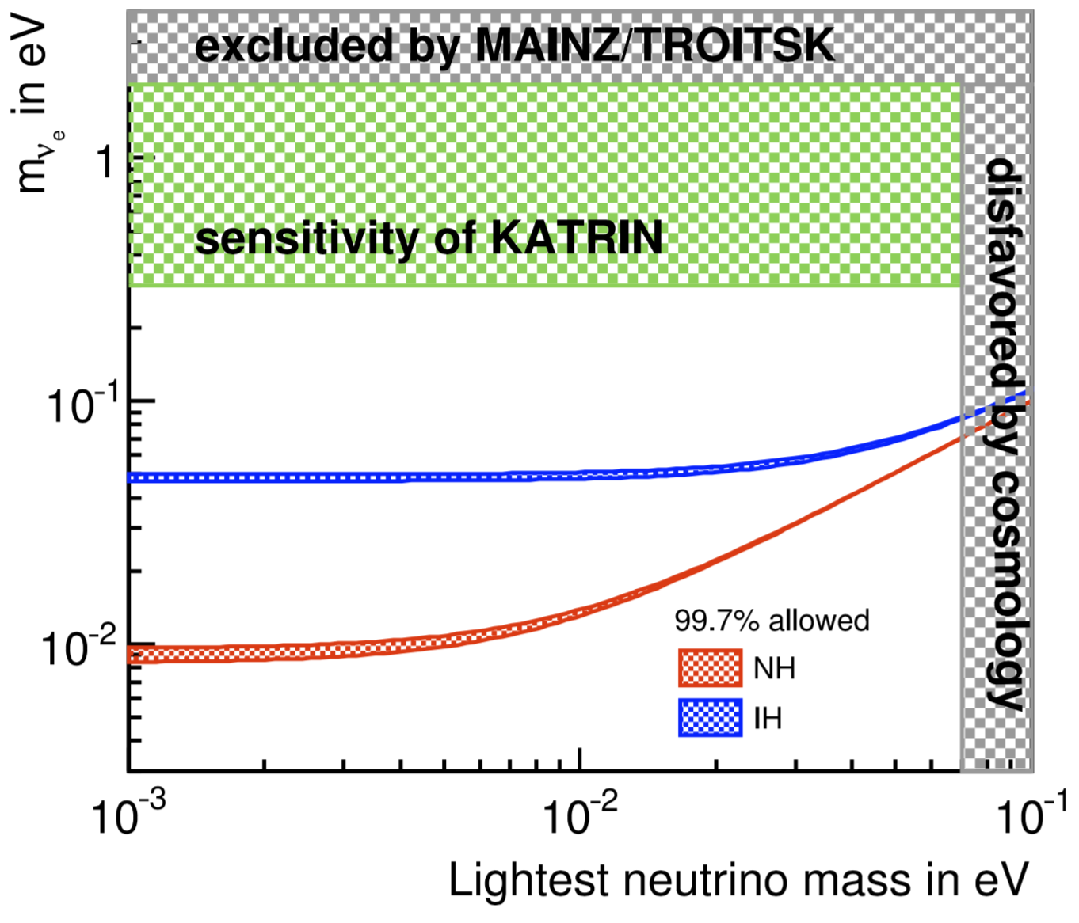
The next generation direct mass measurement should probe the inverted hierarchy.
Qian and Vogel, Progress in Particle and Nuclear Physics 83 (2015).
KATRIN will exhaust the degenerate mass regime ((Δm_{ij}²)^{1/2} << m₁ ≈ m₂ ≈ m₃).
The next generation experiment should probe the bottom inverted hierarchy, m_{νe} ≈ 50 meV.
Cosmological limits will be able to exclude inverted hierarchy if observation still favors m_{νe} = 0.

Slide 4
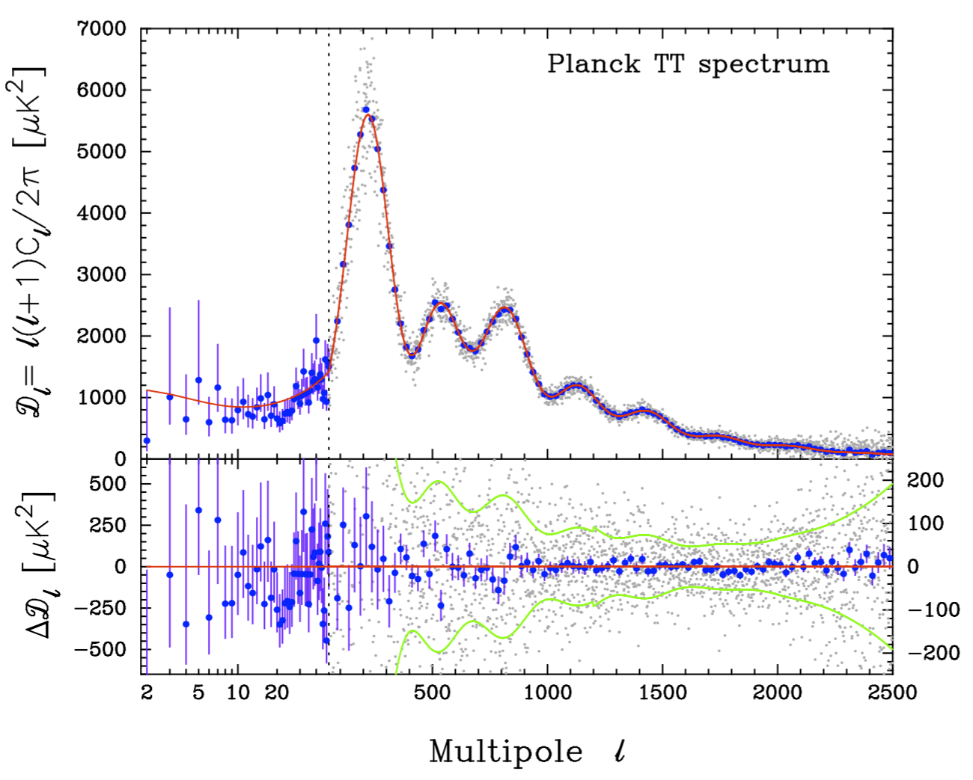
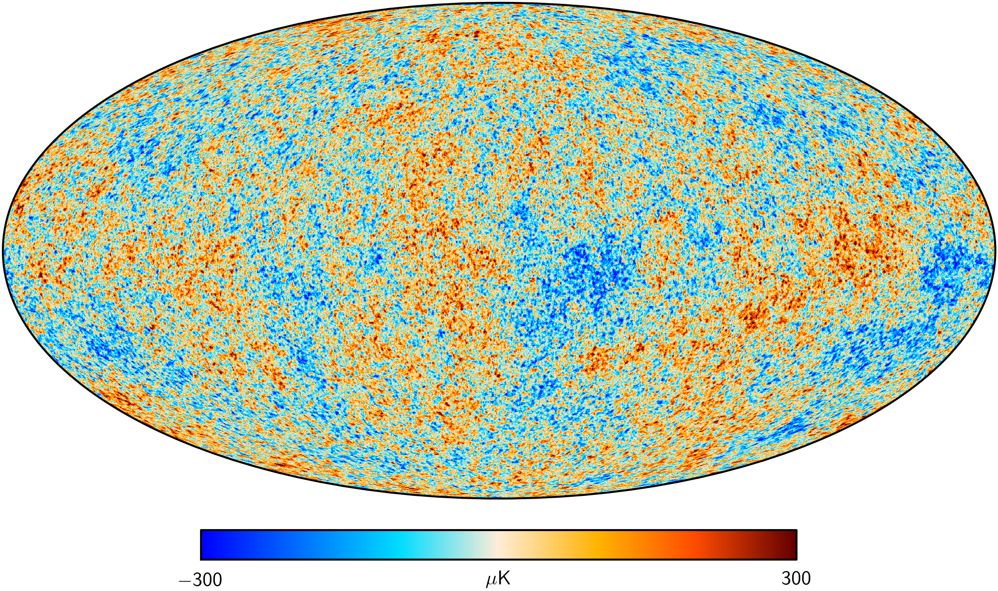
Sensitivity in cosmology is driven by resolution of small-scale (high-multipole) structure.
Cosmic Microwave Background Temp.
Planck Legacy Archive [A&A 571 A16 (2014)]
increasing Σm_{i} moves power from high to low multipole l.
Planck + WMAP polarization: Σm_{i} < 0.66 eV (95% C.L.).
Add gravitational lensing: Σm_{i} < 0.85 eV (95% C.L.).
Tension and model-dependence in cosmological data.
A direct neutrino mass measurement, or even a more restrictive limit is preferred.

Slide 5
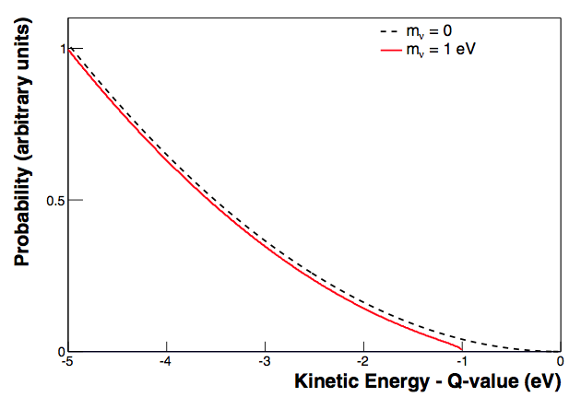
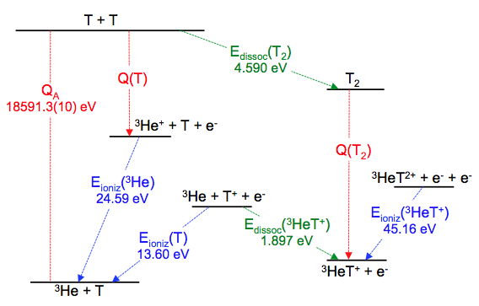
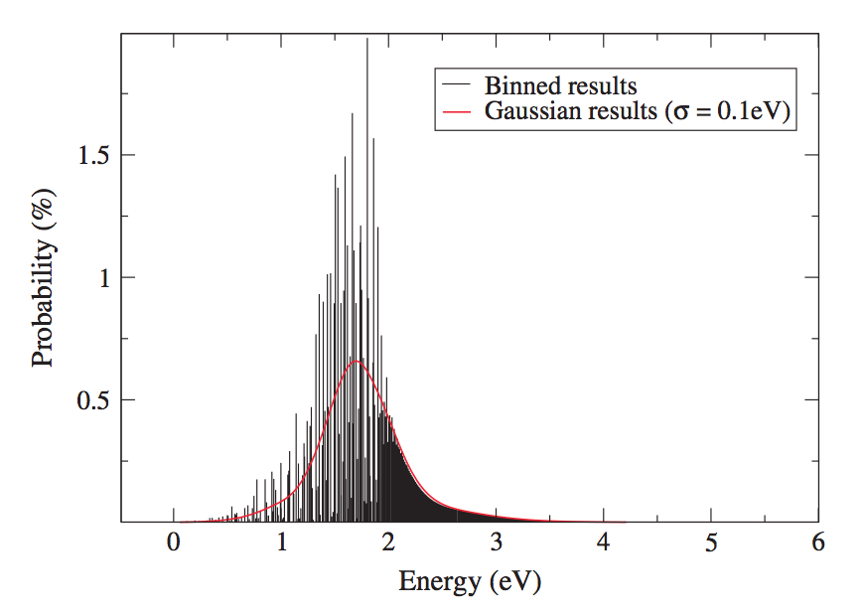
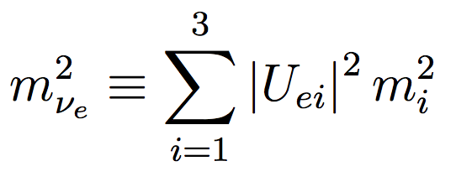
The Tritium Endpoint Method
Bodine, Parno and Robertson, Phys. Rev. C 91 (2015).
~10⁻¹³ decays into last 1 eV
rotation and vibration of molecular ³HeT⁺ daughter
Q ≈ 18.6 keV
Doss et al., Phys. Rev. C 73 (2006)
Tritium Beta Decay: ³H → ³He⁺ + e⁻ + ν_{e} + Q.
High-precision spectroscopy on the e⁻.
Neutrino mass manifests as a deviation at the energy endpoint.
Fit the spectral shape with m_{νe}² as a free parameter:

Slide 6
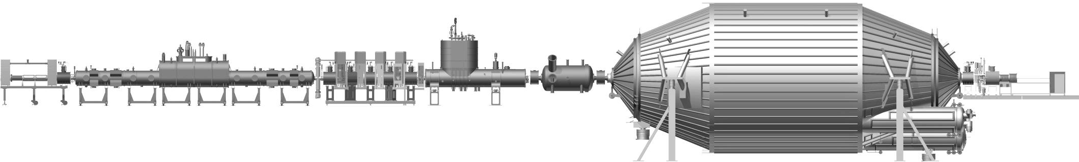
Tritium Endpoint Experimental Sensitivity and Size
Statistical sensitivity is driven by the intensity of the tritium source. Size is driven by how your e⁻ spectroscopy technique accommodates that intensity.
Main spectrometer
Rear Section
Tritium Source
Differential Pumping
Cryogenic Pumping
Pre Spectrometer
Detector
10 m
70 m
KATRIN uses the maximum possible source column density – statistical sensitivity can only improve by expanding the source radially.
  The spectrometer(s) must expand proportionally.
  Sensitivity to inverted hierarchy m_{νe} required ~100s of meters diameter!
  KATRIN is already the best possible experiment of its kind!
Improvement in neutrino mass sensitivity will require a spectrometer with a better source scaling relation.
Sensitivity to inverted hierarchy masses will require an atomic tritium source to avoid final-state systematic uncertainty.

Slide 7
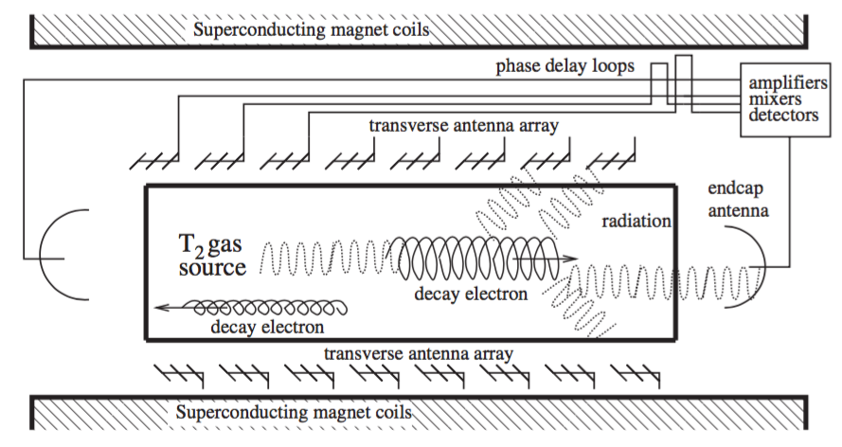
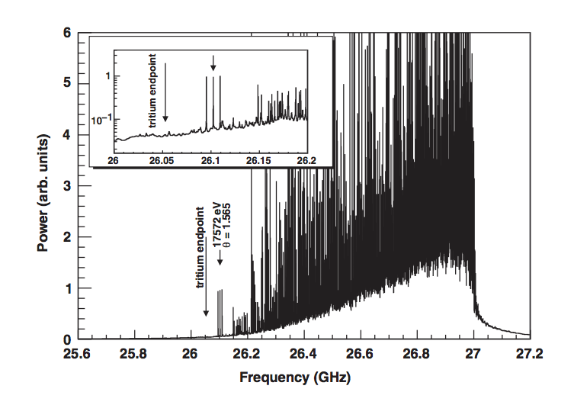
Project 8 and Cyclotron Radiation Emission Spectroscopy (CRES)
Monreal and Formaggio, Phys. Rev. D 80 (2009).
Project 8 will use CRES:
  Detect ~fW μwave cyclotron radiation from magnetically trapped electrons.
  Tritium source is transparent to μwaves → improved scaling ~volume.
  Nondestructive frequency domain technique – extreme precision w/ absolute standards.
Kinetic energy and frequency are related by relativistic kinematics:

Slide 8
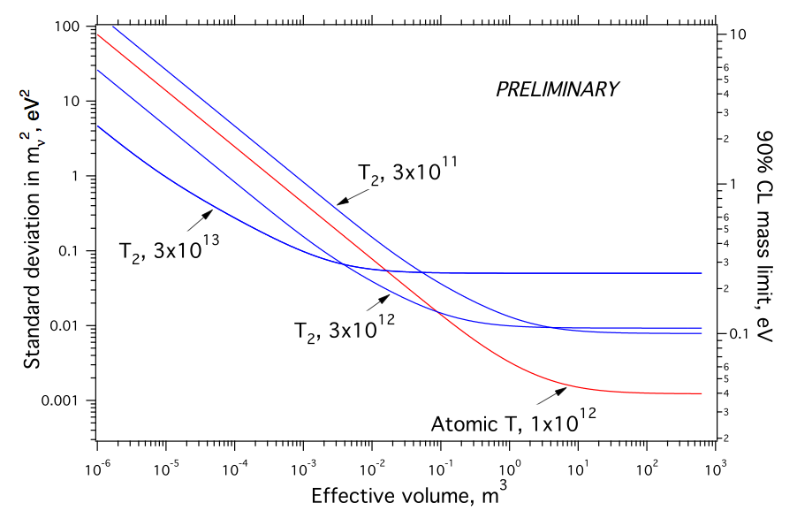
Project 8 Estimated Sensitivity
1 year live time
molecular source (T₂)
Doe et al., arXiV 1309.7093 (2013)
Mainz/Troistk
atomic source (T)
Insufficient e⁻ lifetime
KATRIN
T₂ final states
inverted hierarchy
δB/B ~ 10⁻⁷
Sensitivity estimates include: statistics, frequency broadening from finite e⁻ lifetimes, conservative background estimates, molecular final state systematic and B-field variations.
“Effective volume” is the real instrumented source volume and e⁻ trap/detection efficiency.
Most sensitive estimate is m_{νe} < 40 meV for an atomic source with 0.1ppm field uniformity.

Slide 9
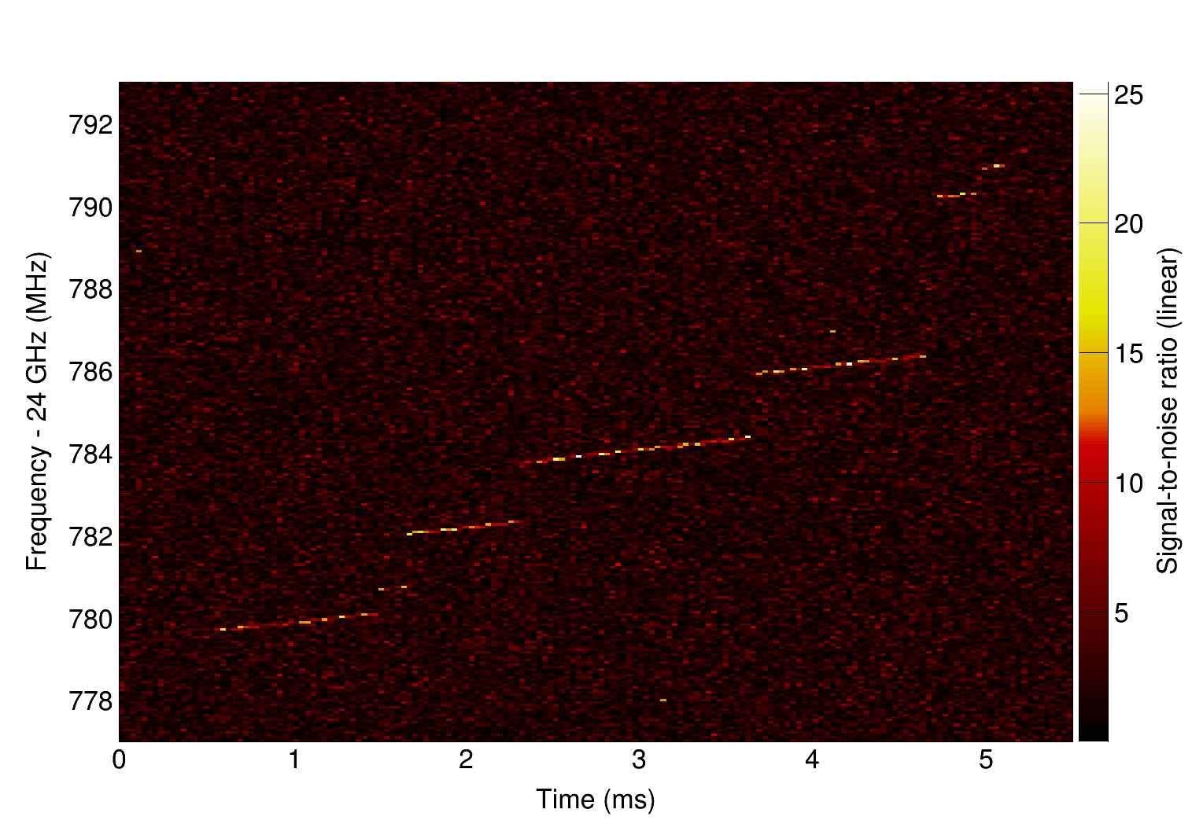
Typical CRES event
1 MHz ≈ 20 eV
electron scatters inelastically, losing energy and changing pitch angle.
frequency chirps linearly, corresponding to ~1 fW radiative loss.
start frequency of the first track gives kinetic energy.

Slide 10
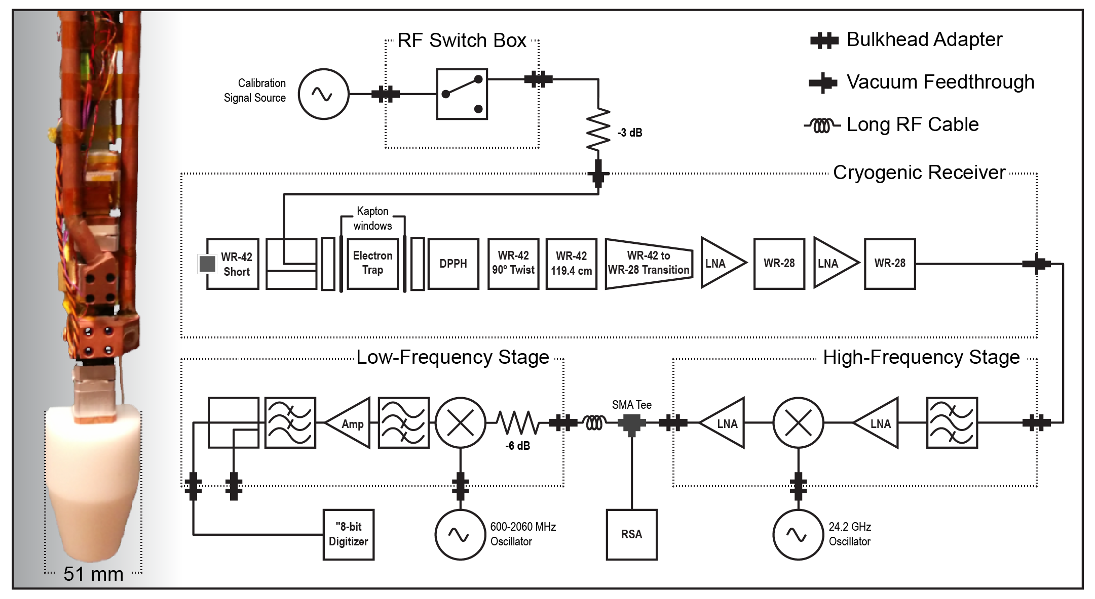
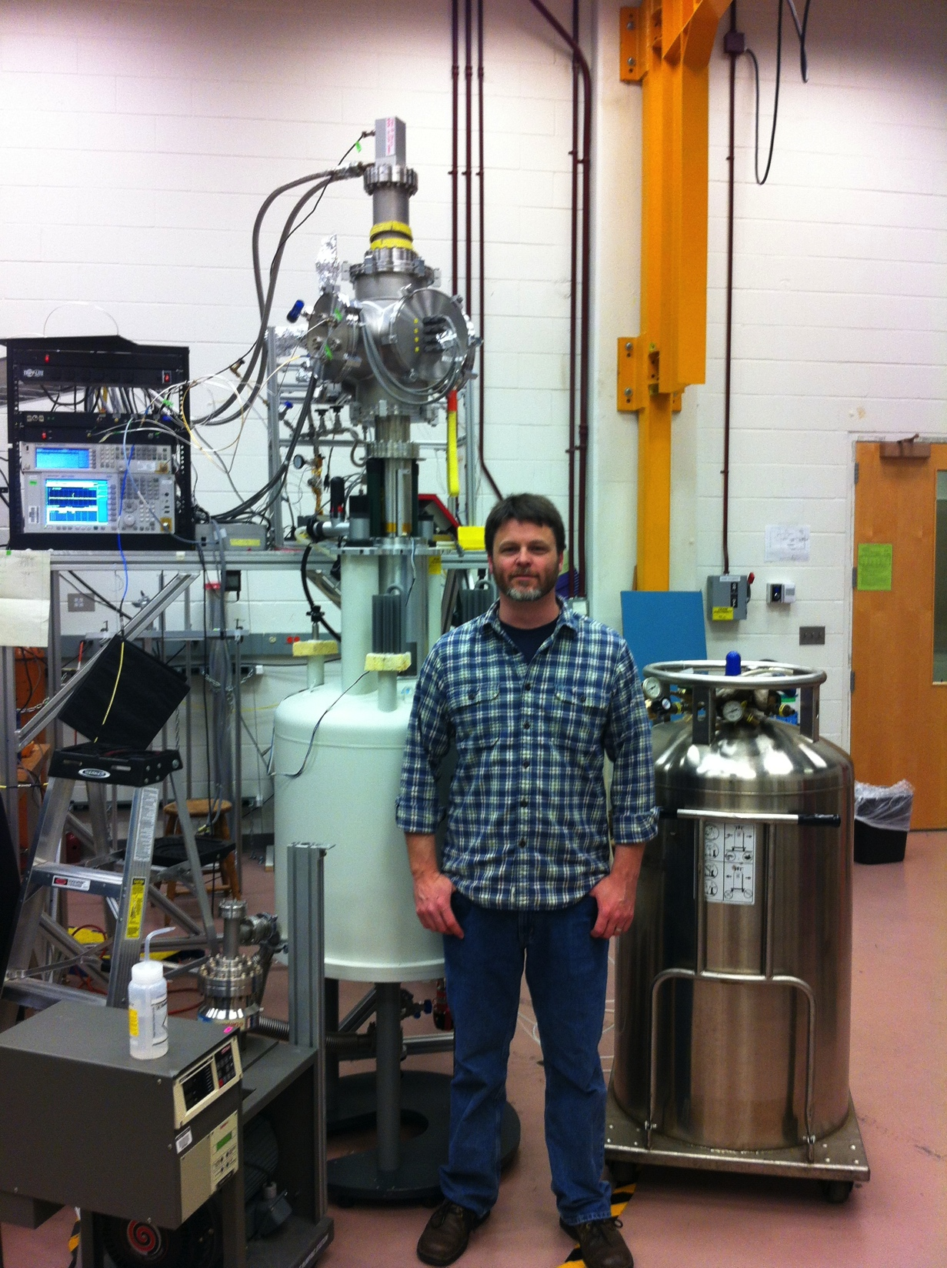
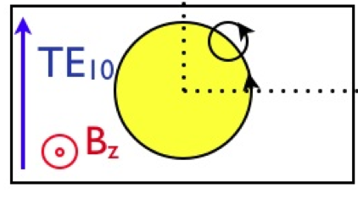
CRES ^{83m}Kr Prototype Demonstration (Phase I)
30.477 keV (L3)
30.424 keV (L2)
shake-off
30.227 keV (L1)
4.3 mm
10.7 mm
Published* 15 eV FWHM resolution w/ harmonic (B~z²) trap.
Recently obtained 3.6 eV FWHM w/ more uniform “bathtub.”
2.1 eV FWHM from same data w/ high-power cut.
Resolution is understood to follow from B-field variations.
*Asner et al., Phys. Rev. Lett. 114 (2015).

Slide 11
First CRES Measurement of Tritium Endpoint (Phase II)
Five harmonic (B~z²) traps w/ ESR magnetometers → longer bathtub.
Circular waveguide → reclaim 3 dB signal from circularly polarized signal.
Colder amplifiers w/ improved termination → lower noise/higher gain.
First ^{83m}Kr conversion electrons last Thursday!
Expect tritium data this calendar year → m_{νe} < 10—100 eV.

Slide 12
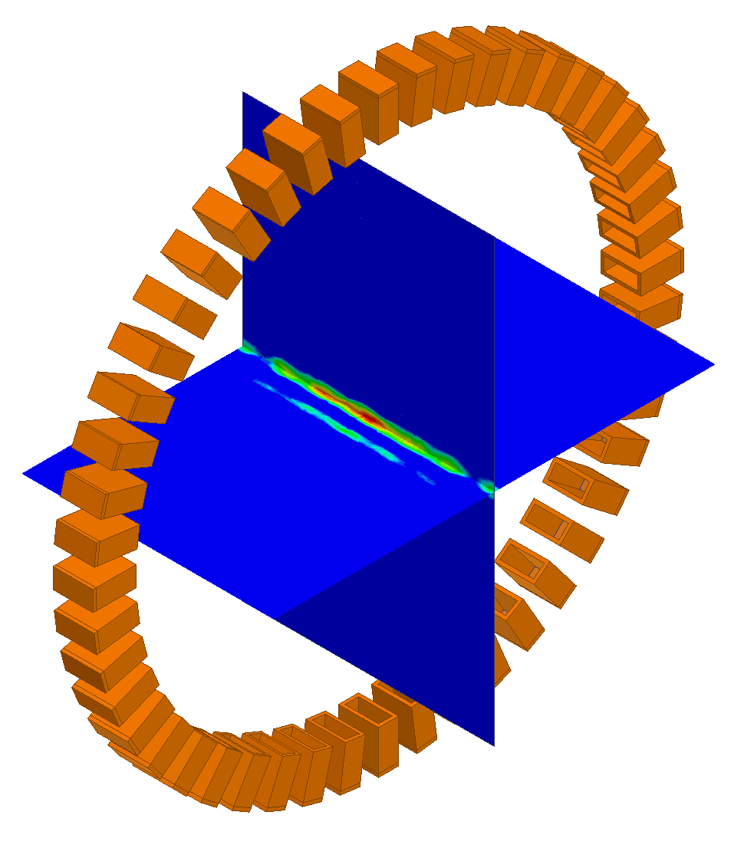
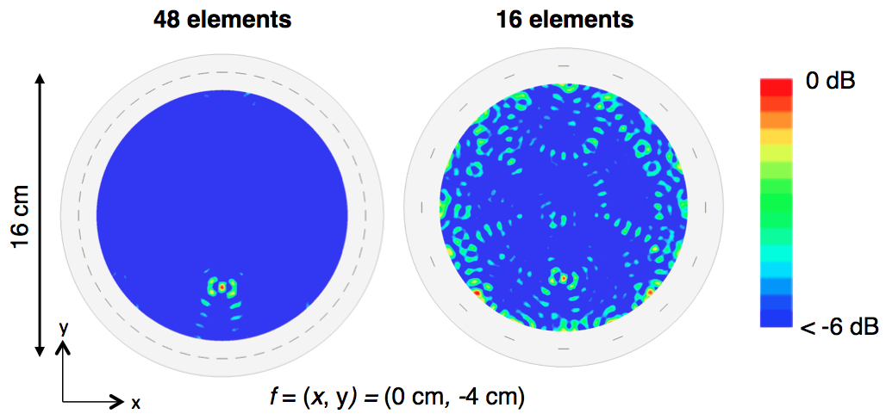
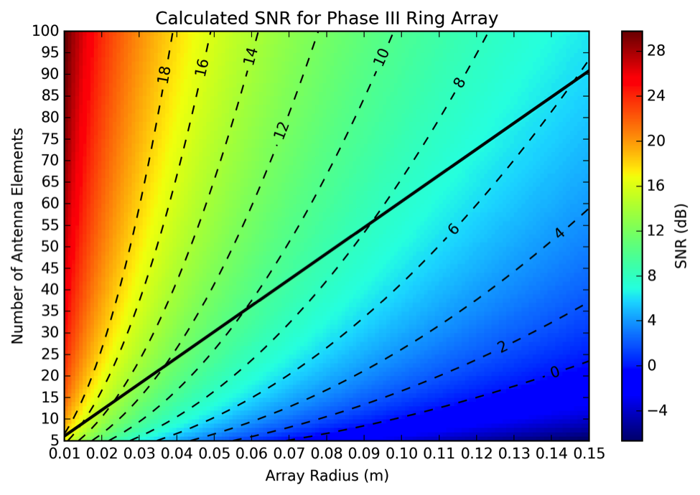
First Competitive Mass Limit – m_{νe} < 2 eV (Phase III)
f(x, y) = (0 cm, 0 cm)
Phase III moves waveguide → free space to accommodate more tritium volume.
Working concept is for two 10-cm diameter 30-element ring arrays with digital beam forming:
  CRES SNR > 10 dB.
  fiducial volume ≈ 200 cm³.
  New-to-us large-bore MRI magnet already obtained.
m_{νe} < 2 eV will take one year starting ca. 2019 or 2020.

Slide 13
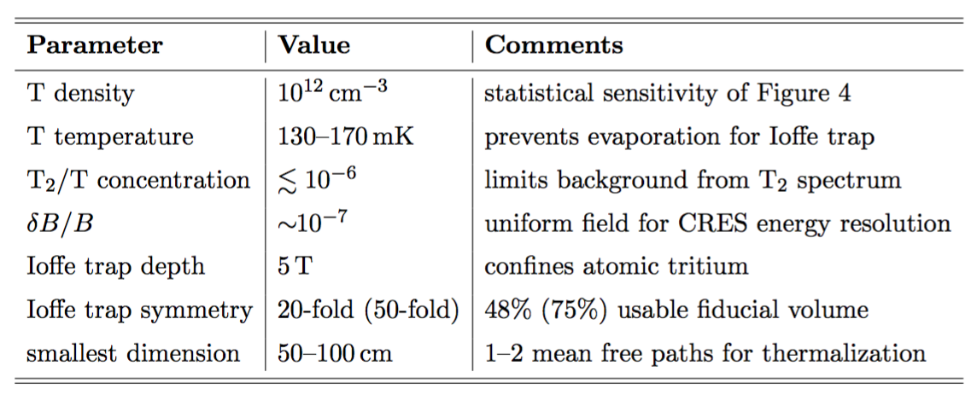
Inverted Hierarchy Sensitivity (Phase IV)
Atomic tritium source design constraints
Phase IV adds more instrumented tritium volume and switches to atomic tritium:
  Tritium atoms trapped via magnetic moment in a Ioffe trap to prevent recombination at the walls.
  Decay and scattering heat removed by thermal exchange with ⁴He in contact with the physical vessel.
  Antenna array engineered to coexist with Ioffe trap on the inner walls of the physical vessel.
ALPHA atomic anti-hydrogen Ioffe trap
[Amole et al., NIM A 735 (2014)]

Slide 14
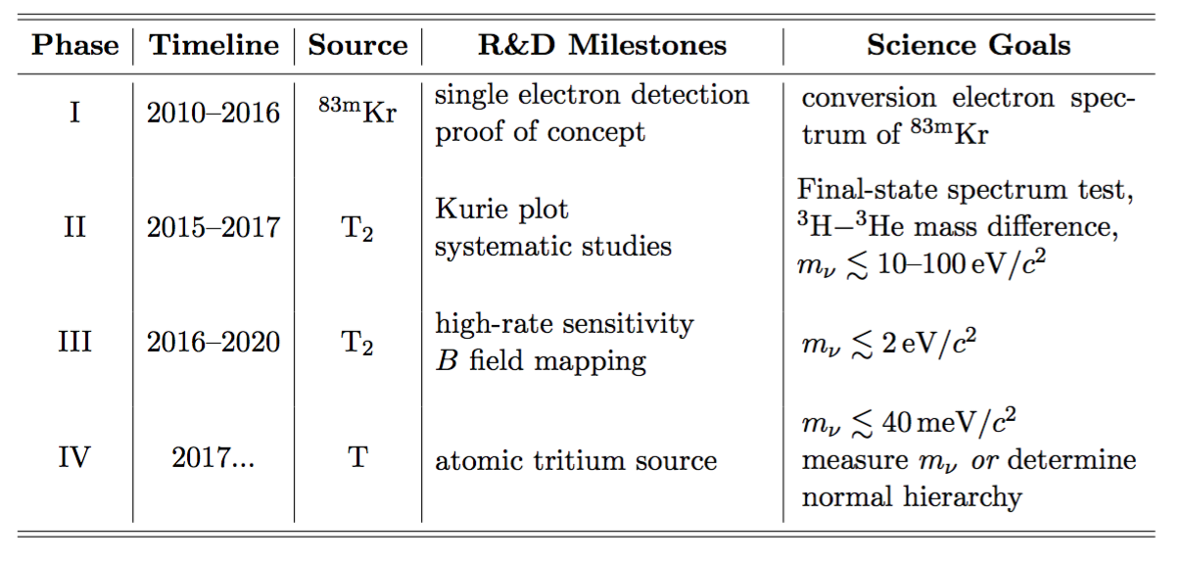
Conclusions and Outlook for Project 8
Phases and Goals of Project 8
Project 8 plan is organized into four phases, executed in parallel:
  Phase I – First results are published with new and improved results to be published soon.
  Phase II – first data with ^{83m}Kr last week, first tritium data this Fall.
  Phase III – Quantitative conceptual design for a receiver array that could compete with current m_{νe} < 2 eV sensitivity in a year.
  Phase IV – Design constraints required by inverted hierarchy sensitivity are derived. Quantitative conceptual design of atomic tritium source beginning now.

Slide 15
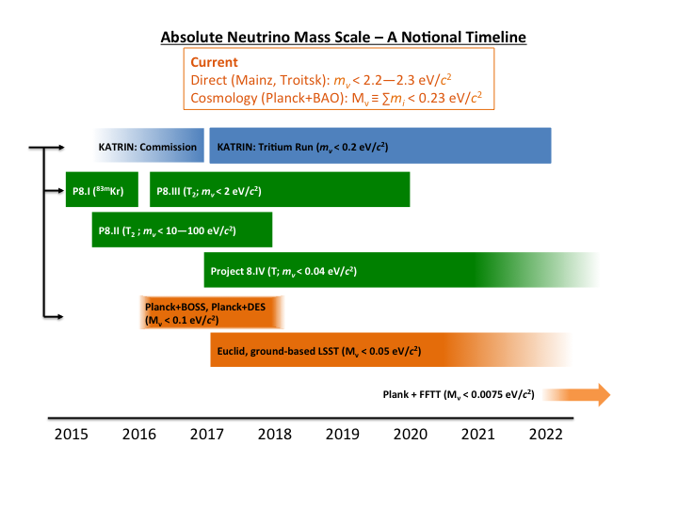
Conclusions and Outlook for Direct Mass Measurements

Slide 16
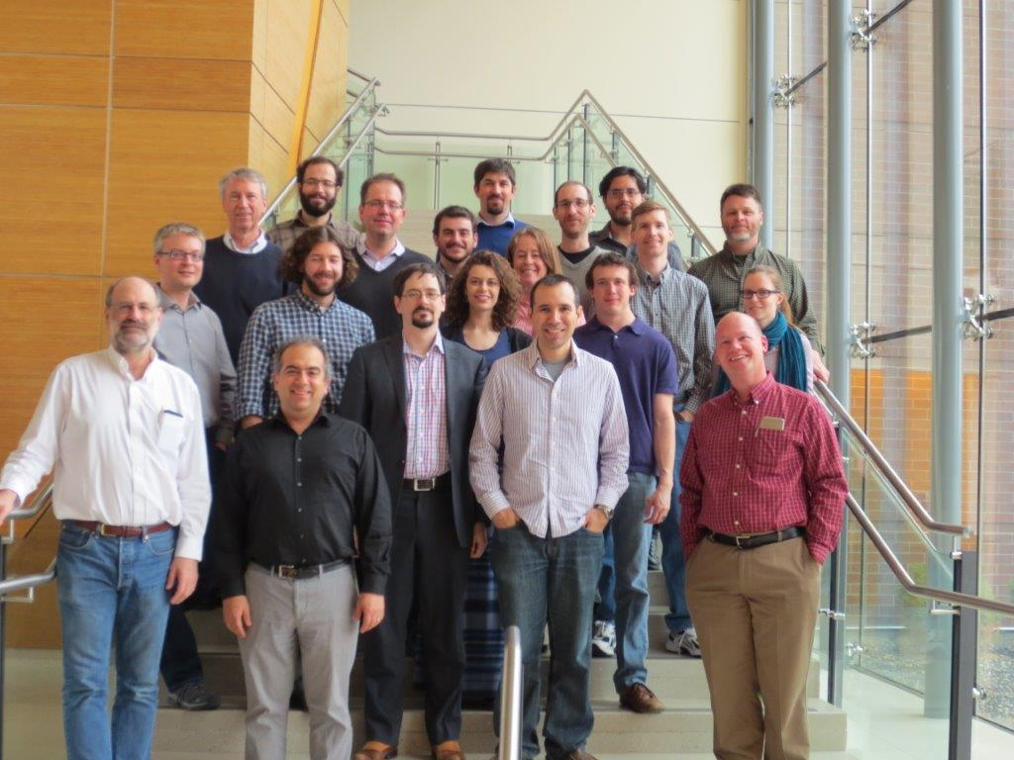
Project 8 Collaboration
Karlsruhe Institute of Technology
Thomas Thuemmler
Johannes Gutenberg University, Mainz
Sebastian Boeser, Christine Claessens
Lawrence Livermore National Laboratory
Kareem Kazkaz
Massachusetts Institute of Technology
Joseph Formaggio, Evan Zayas
Pacific Northwest National Laboratory
Mathieu Guigue, Mark Jones, Noah Oblath, Jonathan Tedeschi, Brent VanDevender
University of Washington
Peter Doe, Ali Esfahani, Martin Fertl, Eric Machado, Hamish Robertson, Leslie Rosenberg, Gray Rybka
Smithsonian Astrophysical Observatory
Shep Doeleman, Jonathan Weintroub, Andre Young
University of California, Santa Barbara
Luiz de Viveiros, Benjamin LaRoque, Benjamin Monreal
Yale University
Karsten Heeger, Luis Saldana, Penny Slocum

