Slide 1
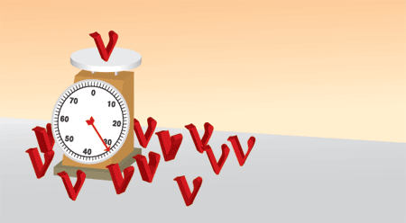
Search for heavy neutrinos in kaon decays
L. Littenberg
(work mainly done by
A.T.Shaikhiev INR RAS)
HQL-2016

Slide 2
Outline
Motivation
Previous heavy neutrino searches
Experiment BNL-E949
Selection criteria
Efficiency and background study
Peak search method
Results and conclusions
Something else?

Slide 3
Motivation
We know the Standard Model is incomplete
  It doesn’t explain the baryon asymmetry of the universe
  It doesn’t explain dark matter or dark energy
  It assumed massless neutrinos
Massive, oscillating neutrinos suggest this sector might be a portal to BSM physics
  A lot of work in progress measuring the 3-neutrino mixing parameters and searching for additional light (~eV) neutrinos
  But it’s also worth following up the 35-year old suggestion of Robert Shrock – to search for heavier ones
Of course, must first ask – are they ruled out by current phenomenology?

Slide 4
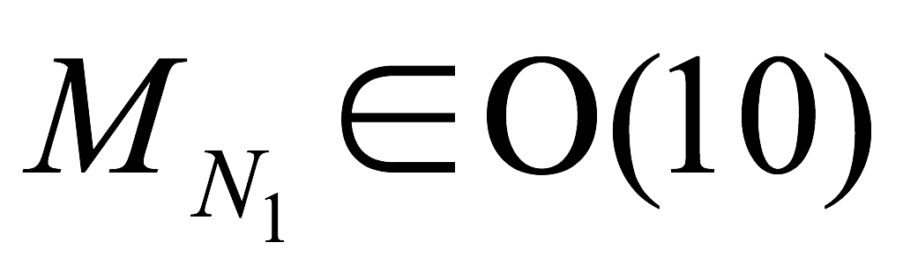
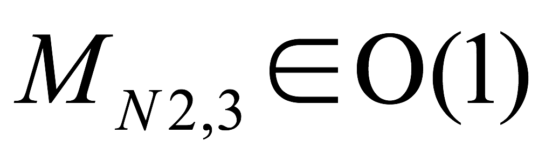
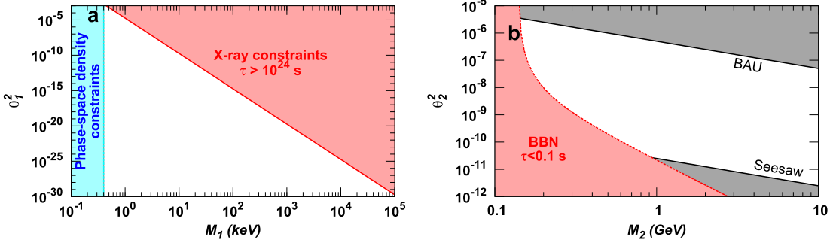
Constraints in the νMSM
JHEP0808:008,2008
(arXiv:0804.4542v2 [hep-ph]),
Ann.Rev.Nucl.Part.Sci.59:191-214,2009D
(arXiv:0901.0011v2 [hep-ph])
SM + 3 neutral right-handed heavy leptons
keV
GeV
N_{2,3}
Dark matter
baryon asymmetry
θ₁ and θ₂ - mixing angles with SM particles
Notes:
nuMSM (Minimal Standard Model) neutrino oscillations, dark matter and baryon asymmetry of the Universe. N1 mass > 300 eV and less than 100 MeV to serve as DM particle. Masses of N2 and N3 need to be almost degenerate to tune CP-violation to explain the baryon asymmetry.

Slide 5
How to find heavy neutrinos?
R. Shrock PRD 24 1232 (1981)
Meson decays
The search for additional peaks
Heavy neutrino decays
“Nothing”→ leptons and hadrons
ρ is a kinematic factor
ν_{H} → e⁺e⁻ν_{α}, μ±e ν_{α}, μ⁺μ⁻ν_{α}
→ π⁰ν, πe, πμ, Ke, Kμ, …
e

Slide 6
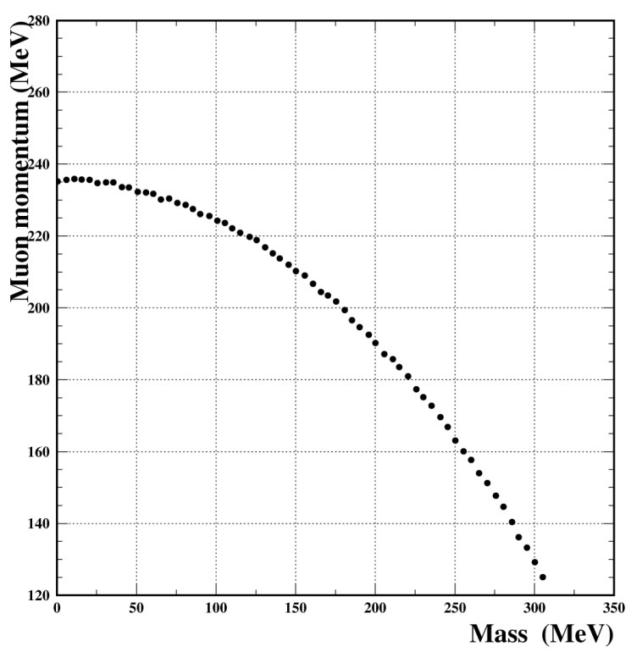
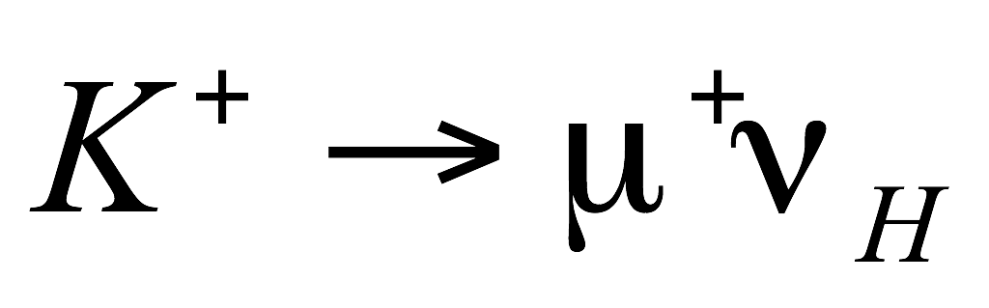
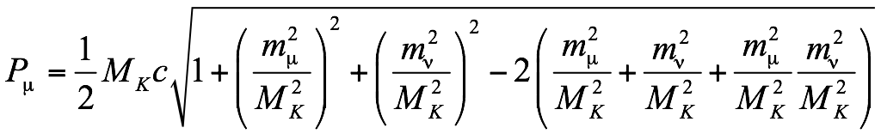
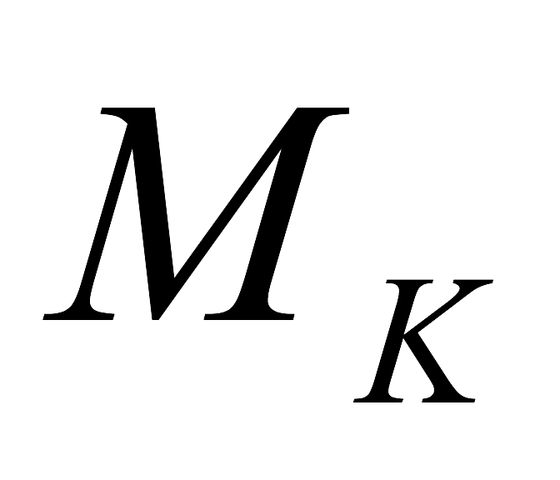
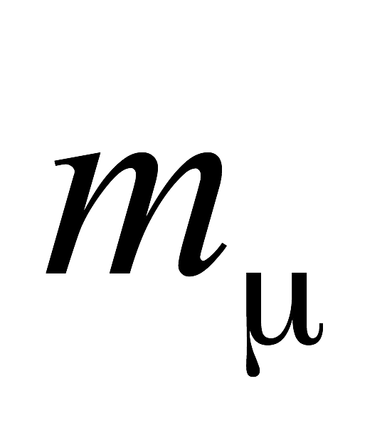
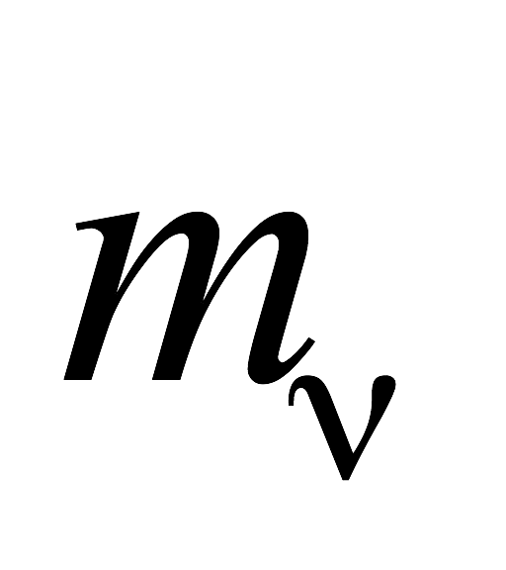
ν_{h} Mass vs μ Momentum
two body decay
- kaon mass
- muon mass
- heavy neutrino mass

Slide 7
Current limits
plot from
PRD91, 052001 (2015)
Our sensitivity region
175-300 MeV

Slide 8
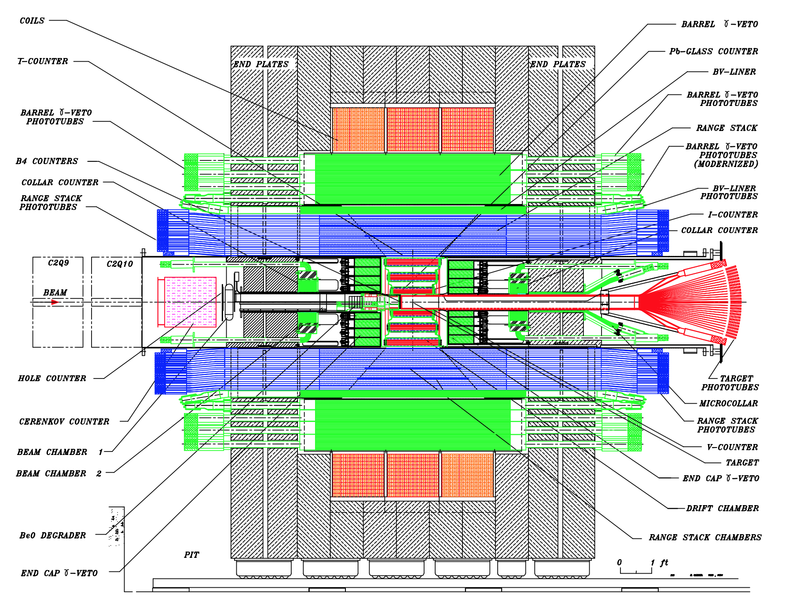
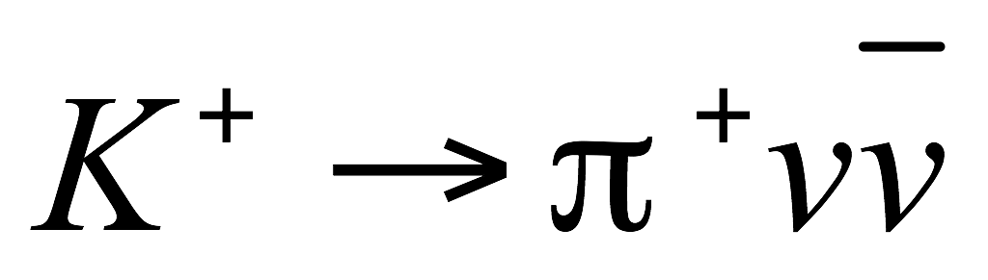
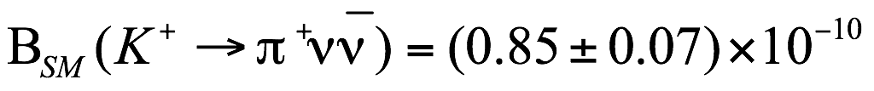

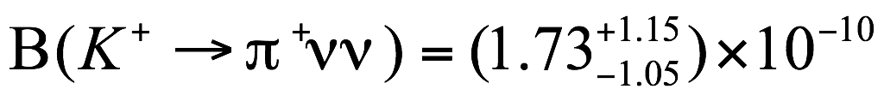
Experiment BNL E949
Phys. Rev. D 79, 092004 (2009)
SM expectation
E949 + E787
_
4 + 3 (from Е787) = 7

Slide 9
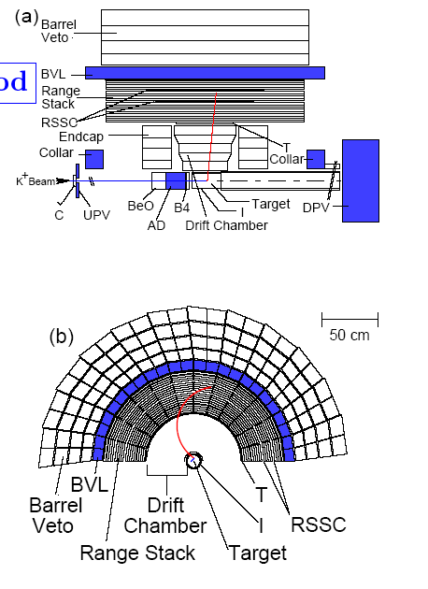
The Detector
~700 MeV/c, separated, kaon beam is slowed down by degraders.
K⁺ stops and decays in scintillating fiber target
Hermetic photon veto system
Measure π⁺ momentum in drift chamber, energy and range in target and Range Stack (RS)
π⁺ stops and decays in RS – observe π⁺→μ⁺→e⁺ decay chain
  For the heavy ν search, only μ that somehow pass the online decay chain cut are available

Slide 10
Heavy neutrino trigger
has a similar experimental signature to
single charged particle + “nothing”
use standard E949 trigger
Wait at least 2 ns for K⁺ to decay
Photon veto: no showers in RS, Barrel,…
Stopping layer in RS between 6 and 18, layer 19 veto
Additional refined requirements of the charged track range taking into account number of the target fiber hits and the track’s downstream position (refined range)
π⁺ identification: online check π⁺→µ⁺ decay chain in the stopping counter
Additional monitor triggers and Monte Carlo simulation were used to measure efficiency of these requirements.

Slide 11
Strategy
Search for an additional peak in the muon spectrum below the K_{μ2}.
Split full sample into 1/20 and 19/20. 1/20 – acceptance verification, background study; 19/20 – blinded sample
Measure acceptance using monitor samples.
Use K_{μ2} and K_{μνγ} decays to verify the total acceptance measurement.
Study the main background shape (K_{μνγ})
Measure the momentum resolution for the signal region
Analyze full data sample

Slide 12
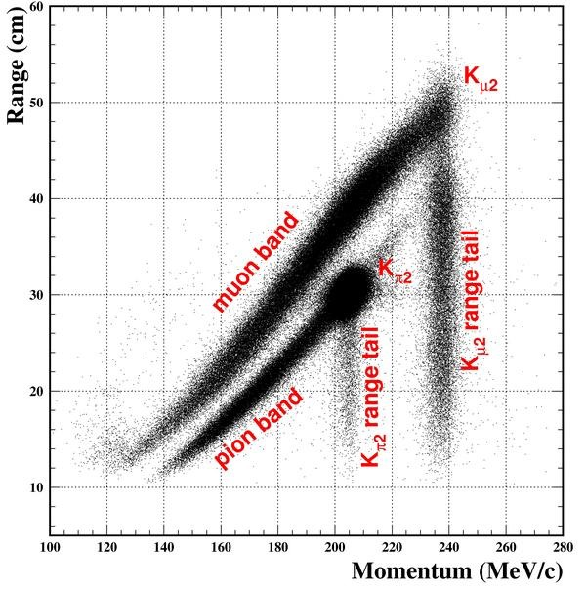
Data sample
Data were taken for 12 weeks from March to June 2002
Total number of stopped kaons - 1.70⋅10¹²
Every 20th event of full sample was selected to form 1/20 sample
1/20 sample
Muon band: generally K_{μ2γ}, K_{μ3} decays
Pion band: K_{π2γ}, K_{π2} in which pion scatters in the target or RS and scattered beam pions

Slide 13
Additional selection criteria
Fiducial cuts. To select events in the detector fiducial volume
Beam cuts. To identify the incoming particle as a kaon & suppress extra beam particles at track time
Delayed coincidence. To suppress kaon decays in flight
Target cuts. Numerous requirements were placed on the activity in the target to suppress background and ensure reliable determination of the kinematic properties of the μ
Range-momentum cut selected muon band (c.f.pion band was selected in the main E949 analysis)
Photon veto cuts. To suppress photon activity in the detector. Loose – for background study, tight – for full sample

Slide 14
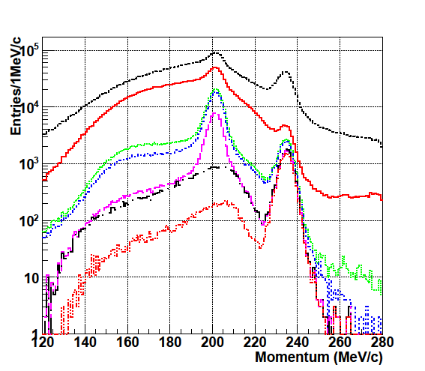
1/20 Data Sample
after trigger
after fiducial volume
after beam cuts
after delayed coinc.
after target cuts
after range-momentum
after loose γ veto

Slide 15
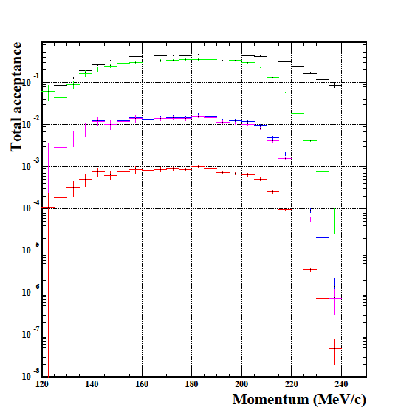

Total acceptance
after fiducial cuts
after refined range
after pion identification online
after kinematic cuts
after all other cuts
tight photon veto applied
Single event sensitivity (S.E.S.) for heavy neutrino with mass m=250 MeV (corresponds to muon momentum p=163.6 MeV/c)

Slide 16
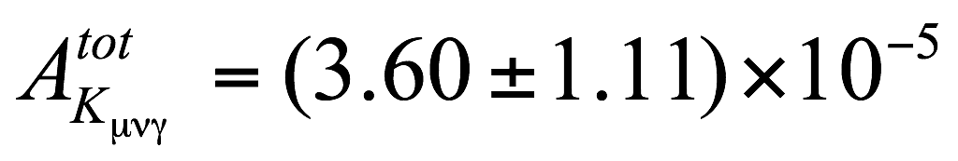
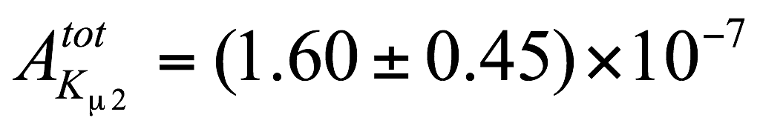
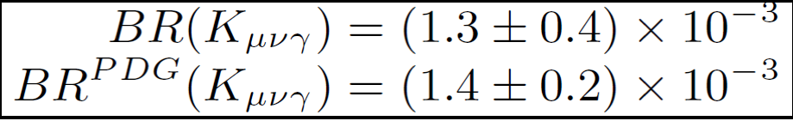
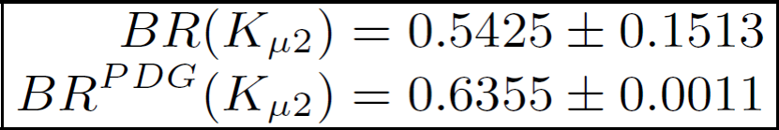
Total acceptance verification
The K_{μ2} branching ratio measurement
The K_{μνγ} branching ratio measurement
High trigger rejection by
Layer 19 veto
Refined range requirement
Online pion identification
because these cuts were designed to suppress K_{μ2} decay
High trigger rejection by photon veto requirement due to one photon in the final state
Use Monte Carlo simulation to study acceptance. Photon detector thresholds ~1 MeV for data. Noise is not implemented in MC
Insufficient statistics to measure acceptance for this decay with high precision:
140<p_{μ}<200 MeV/c

Slide 17
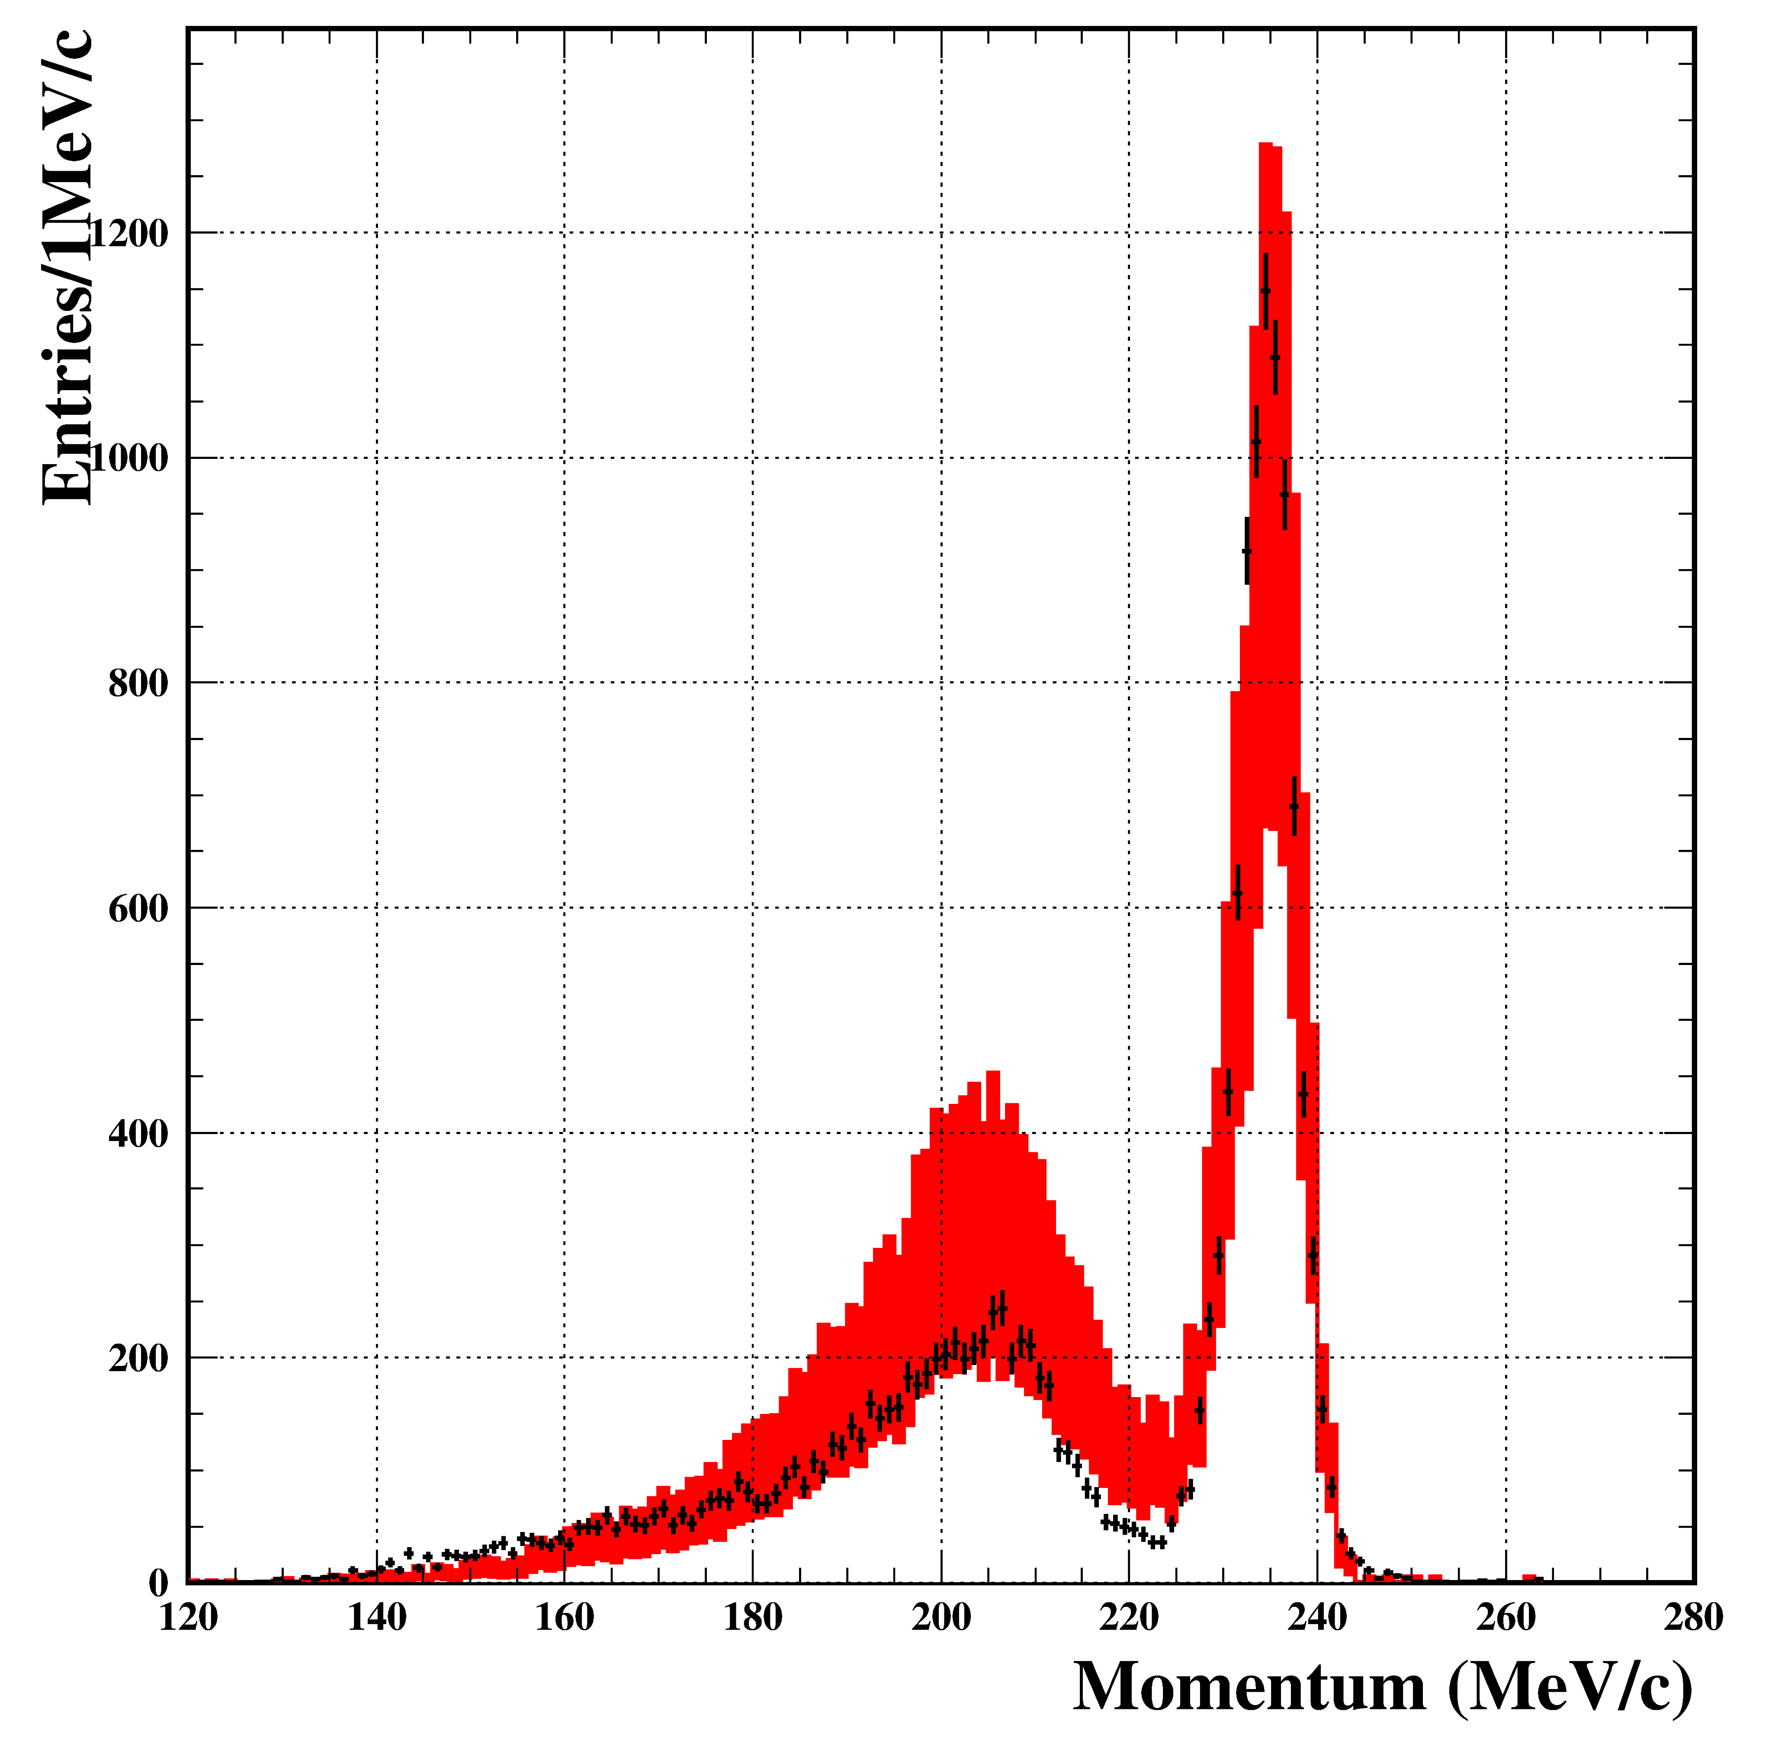


Background study.
1/20 DATA
MC K_{μ2}+K_{μνγ}
Monte Carlo and experimental spectra are consistent. MC shape doesn’t have obvious bumps or valleys, so we may conclude that experimental background shape should have smooth behavior, but we don’t know exact background shape.
MC includes all errors

Slide 18
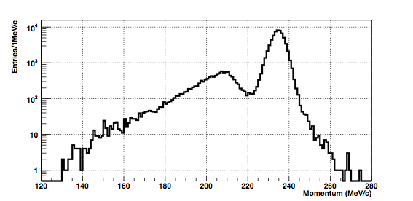
Analyze full data sample
K_{μ2} peak
Signal region
130-200 MeV/c
K_{μνγ}
Muon momentum spectrum after opening the box. All cuts applied

Slide 19
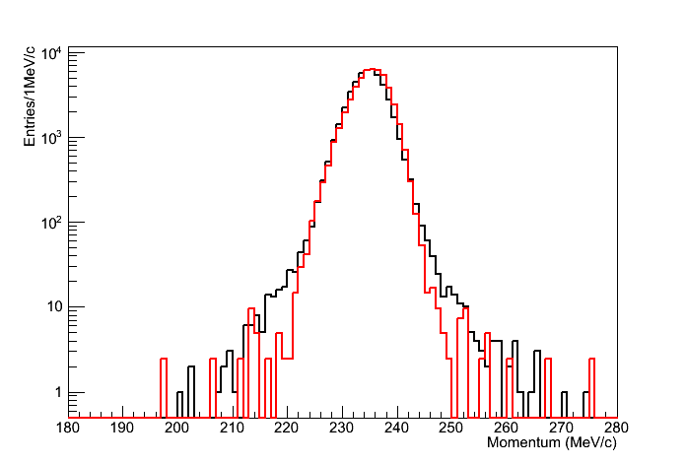
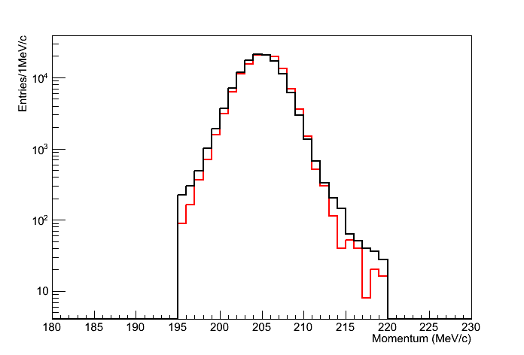
K_{μ2}/K_{π2} resolution
Data MC
K_{μ2}
K_{π2}
MC simulation of the K_{μ2}/K_{π2} decays is consistent with data. Thus we may use MC to study the detector resolution for a possible ν_{Heavy} signal.
Result: σ(p) ~ (-0.107 + 0.0128p) ± 0.14 ± 0.05 (i.e. ~1.2%)

Slide 20
Peak search method
We don’t know exact background shape due to very low acceptance for background. But it is not really necessary because the background fitting is data-driven
Define shape locally: choose ±6σ region around the point of interest and fit it with a 2nd order polynomial
Use Gaussian with known sigma as a signal
Use likelihood approach a la Higgs search to get upper limit (Eur.Phys.J.C71:1554,2011 (arXiv:1007.1727 [physics.data-an]) )

Slide 21
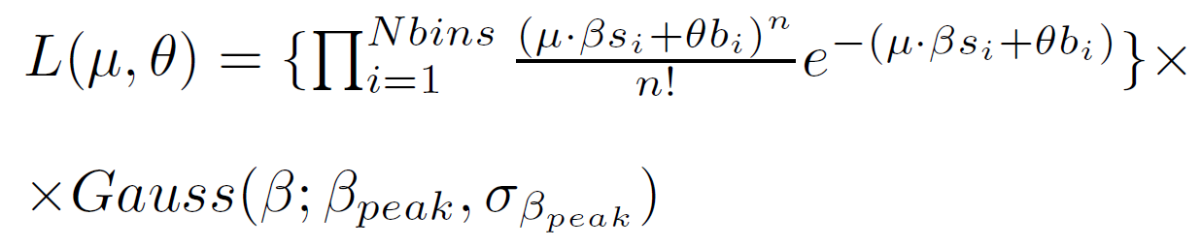
Peak search method
Construct the following likelihood function
s and b – signal and background distributions. Since background distribution is taken from data fit, θ=1, μ is signal strength parameter;
s – gaussian n_{i} – number of observed events in each bin.
β takes into account acceptance of the point of interest (β_{peak}) and its total error (σ_{β})

Slide 22
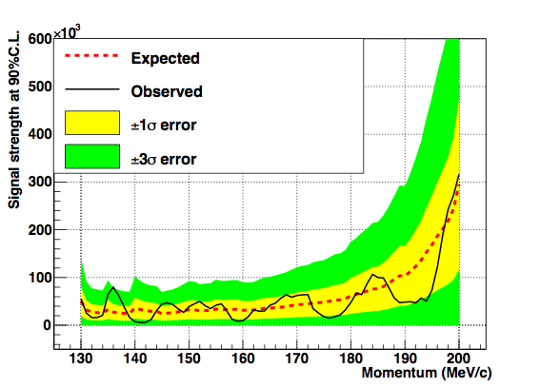

Results
No evidence for heavy neutrino existence was observed in mass region 175-300 MeV/c²
Using this plot it is possible to calculate mixing matrix element upper limit
Y-axis = N_{candidates}/Acc

Slide 23
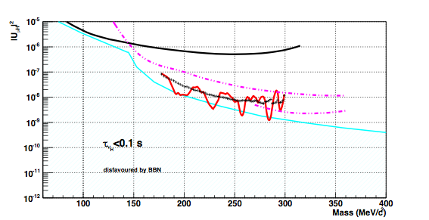
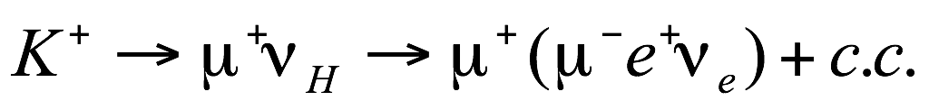
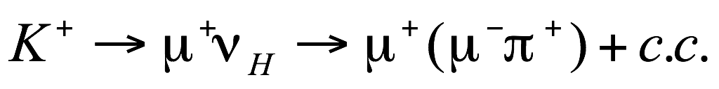
Results
Previous peak search experiment
Phys.Lett. B104 , 84 (1981)
Phys.Rev.Lett. 49,1305 (1982)
Proceedings of Neutrino84, Dortmund (1984)
CERN PS191
Phys.Lett. B203, 332 (1988)
New observed upper limit
Black crosses are expected upper limit based on background fit shape

Slide 24
Conclusion
The existence of heavy neutrinos in the mass region 175-300 MeV/c² was probed using the E949 experimental data set
No evidence was found for them
The previous best constraints from CERN PS191 were improved by a factor 5-10.
New mixing matrix element |U_{μH}|² upper limit varies between 10⁻⁹ and 10⁻⁸
In contrast to CERN PS191 or BBN lower limit our result is model-independent.

Slide 25
What else is this data good for?
Could look for >2 body decays where one daughter is a muon and the other bodies are invisible
E.g. K⁺→ μ⁺ννν, which hasn’t been probed since 1973
There is a SM contribution, mediated by diagrams like
Gives a BR ~ 10⁻¹⁶
So any practical observation will indicate BSM physics.

Slide 26
More of Artur’s Slides

Slide 27
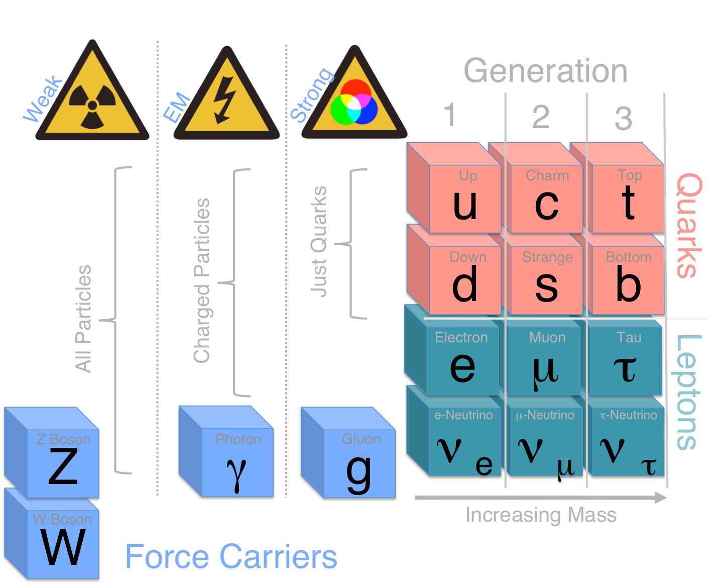
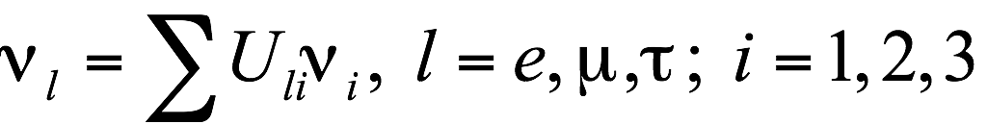


Standard Model neutrino
Standard Model neutrino is massless particle
Higgs

Slide 28


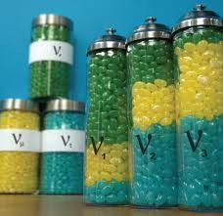

Why do we need heavy neutrinos?
Although the Standard Model has been hugely successful in explaining a rich variety of experimental data (gaining further credence from the Higgs boson observation) it is known to be incomplete.
There is new physics beyond the Standard Model, but we don’t know exactly what is it
Neutrino mixing and
oscillation
Dominance of matter
over antimatter
Dark matter and dark energy

Slide 29
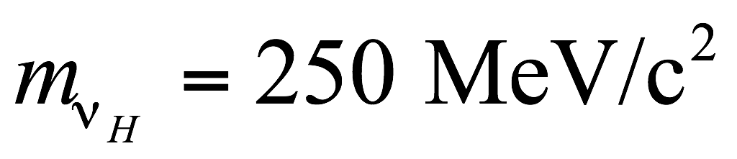
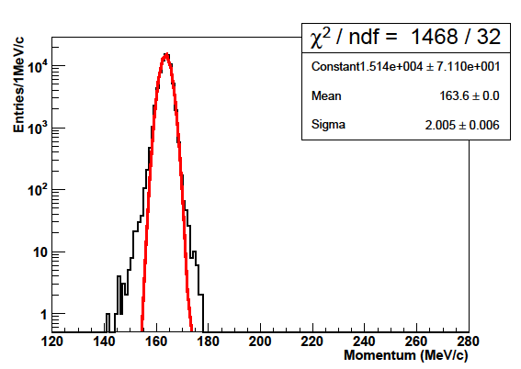
Signal resolution
MC simulation of the decay with
All cuts applied
Signal distribution looks Gaussian at least in ±3σ region

Slide 30
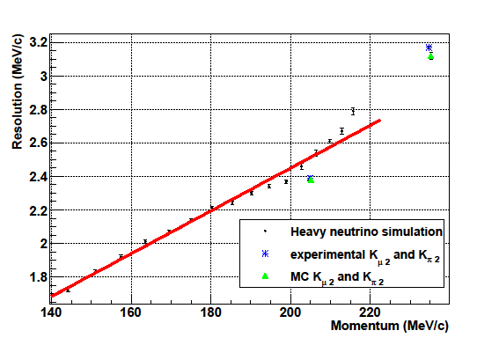
Resolution. MC simulation
Signal resolution is measured within main trigger.
Maximum difference between MC heavy neutrino points and fitted line
MC and data difference
by comparing K_{μ2}/K_{π2} points

Slide 31
Peak search method
“Asimov” data set based on background shape was generated to calculate expected upper limit (background-only hypothesis)
Use the same upper limit calculation method but with experimental data to get observed upper limit

Slide 32
Changes after unblinding data
By default we used χ² method to define background shape locally, but it does not work well for low statistics in low momentum region. So, we changed to log-likelihood method for the background definition
The ±9σ region is not suitable for high momentum region to define background shape, ±6σ is enough for that purpose.

Slide 33
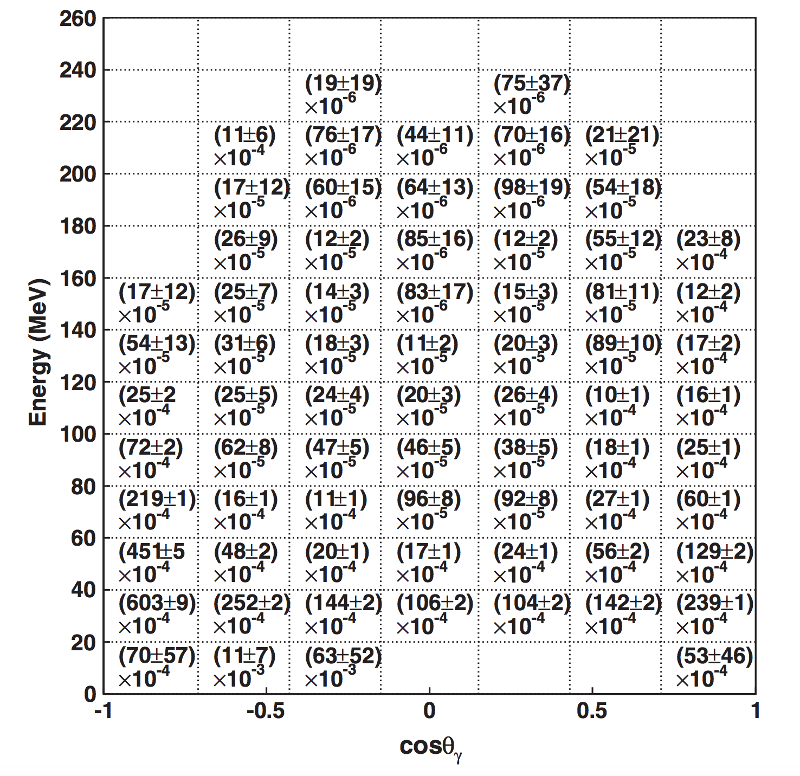
Photon inefficiency
Obtained ned by fitting
K⁺ → π⁺π⁰ → π⁺γγ where the π⁺ and one γ are measure. This determines the second γ‘s energy and direction.

