Slide 1
Recent results from NA48/2 (LFV, DP) and NA62 (Neutral Pion Form Factor)
On behalf of the NA62 collaboration
Nicolas Lurkin
School of Physics and Astronomy, University of Birmingham
XIIIth International Conference on Heavy Quarks and Leptons, 24-05-2016

Slide 2
Outline
NA48/2 - $NA62_{R_{K}}$ experiment
Lepton Number Violating (LNV) decay $K^{±}→π^{∓}μ^{±}μ^{±}$
Search for resonances in $K^{±}→π^{∓}μ^{±}μ^{±}$ and $K^{±}→π^{±}μ^{+}μ^{−}$
Dark Photon (DP) searches in $π^{0}$ decay
$π^{0}$ electromagnetic transition form factor (TFF) measurement

Slide 3
CERN NA48/NA62 experiments
Experiments history
Earlier | NA31
1997 2001 | NA48 ($K_{S}$/$K_{L}$) | $Re\left(ε^{′}/ε\right)$ Discovery of direct CPV
2002 | NA48/1 ($K_{S}$/hyperons) | Rare $K_{S}$ and hyperon decays
2003 2004 | NA48/2 ($K^{+}$/$K^{−}$) | Direct CPV, Rare $K^{+}$/$K^{−}$ decays
2007 2008 | $NA{62}_{R_{K}}$ ($K^{+}$/$K^{−}$) | $R_{K}=K_{e2}^{±}/K_{μ2}^{±}$
2014 | NA62 ($K^{+}$) | $K^{+}→π^{+}ν\overline{ν}$, Rare $K^{+}$ and $π^{0}$ decays
Jura mountains
France
NA48/NA62:
Centre of the LHC
Switzerland
SPS
LHC
Geneva airport
Kaon decay in flight experiment
NA62: currently $\sim$200 participants, 29 institutions from 13 countries

Slide 4
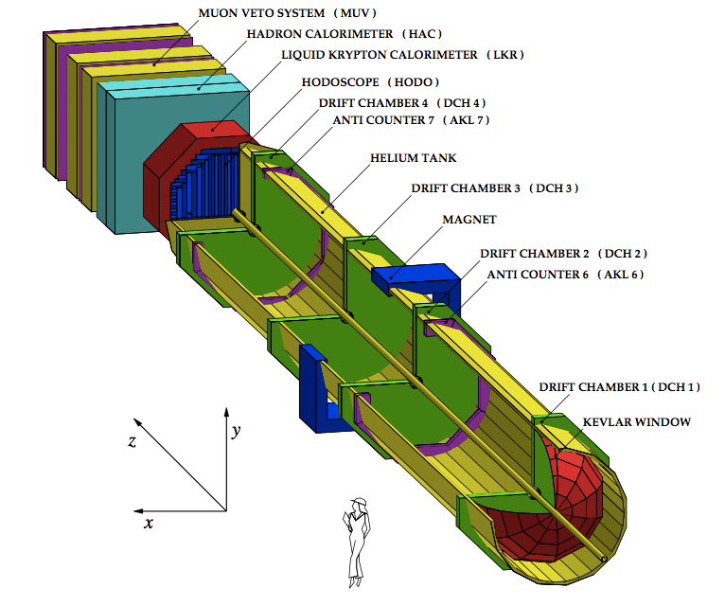
Experimental Setup (NA48/2 – $NA{62}_{R_{K}}$)
Principal subdetectors
Scintillator hodoscope (HOD)
Low-level trigger, time measurement (150 ps)
Magnetic spectrometer (4DHCs)
4 views/DCH high efficiency
${σ_{p}}/p=1.02\%⊕0.044\%⋅p$ [GeV/c] NA48/2
$=0.48\%⊕0.009\%⋅p$ [GeV/c] $NA{62}_{R_{K}}$
Liquid Krypton EM calorimeter (LKr)
High granularity, quasi-homogeneous
${σ_{E}}/E=\left({3.2}/{\sqrt{E}}⊕9/E⊕0.42\right)\%$ [E in GeV]
$σ_{x}=σ_{y}=\left({4.2}/{\sqrt{E}}⊕0.6\right)$mm [E in GeV] (1.5 mm @ 10 GeV)
NA48/2
$P_{K}=60±3$ GeV/c
3-track vertex trigger
Simultaneous ${K^{+}}/{K^{−}}$ beam
$NA62_{R_{K}}$
$P_{K}=74±2$ GeV/c
$K_{e2}$ trigger Alternate ${K^{+}}/{K^{−}}$ beam

Slide 5
LNV in the $K^{±}→πμμ$ decays
Majorana Neutrinos
Asaka-Shaposhnikov model ($ν$MSM) [PLB 620 (2005) 17]: three sterile neutrinos $N_{i}$ in the SM to explain Dark Matter ($N_{1}$, $𝒪$(keV)) + Baryon Asymmetry and low $ν$ mass ($N_{2,3}$ $𝒪$(100 MeV – few GeV))
Effective vertices with $W^{±}, Z$ and SM leptons with $U$ mixing matrix
Production of $N_{2,3}$ in $K^{±}$ decays and $N_{2,3}$ decay for $m_{2,3}<m_{K}−m_{μ}$ $K^{±}→μ^{±}N, N→π^{±}μ^{∓}$
$BR\left(K^{±}→μ^{±}N\right)×BR\left(N→π^{∓}μ^{±}\right) \sim {\left|U_{μ4}\right|}^{4}$
Inflatons
Shaposhnikov-Tkachev model [PLB 639 (2006) 414]: $ν$MSM + real scalar field (inflaton $χ$) with scale-invariant couplings to explain universe homogeneity and isotropy on large scales/structures on smaller scales
$χ$-Higgs mixing ($θ$), $χ$-Higgs coupling $→$ universe reheating, $τ_{χ} \sim \left({10}^{−8}−{10}^{−12}\right)$
Production in Kaon decays: $m_{χ}<354 MeV/c^{2}$ and $BR\left(K^{±}→π^{±}χ\right)=1.3×{10}^{−3}\left(\frac{2\left|{\vec{p}}_{χ}\right|}{M_{K}}\right)θ^{2}$
For this result

Slide 6
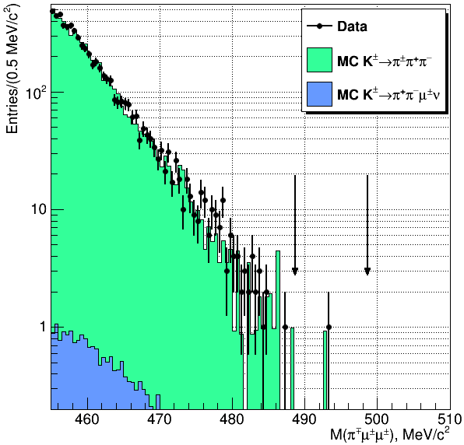
LNV: Same-Sign Muon Sample
Blind analysis:
Selection based on simulation of $K^{±}→π^{∓}μ^{±}μ^{±}$ and $K^{±}→π^{±}π^{+}π^{−}$ (background, similar topology)
3-track vertex topology, 2 same-sign muons, 1 odd-sign pion, no missing momentum
First-order cancellation of systematic effects
Control region: $M_{πμμ}<480 MeV/c^{2}$
Signal region: $\left|M_{πμμ}−M_{K}\right|<5 MeV/c^{2}$
$$M\left(π^{∓}μ^{±}μ^{±}\right)$$
Results:
Event in Signal Region: $N_{obs}=1$
Expected background from MC: $N_{exp}=1.163±{0.867}_{stat}±{0.021}_{ext}±{0.116}_{syst}$
From Rolke-Lopez statistical method: $BR\left(K^{±}→π^{∓}μ^{±}μ^{±}\right)<8.6×{10}^{−11} @ 90\% CL$

Slide 7
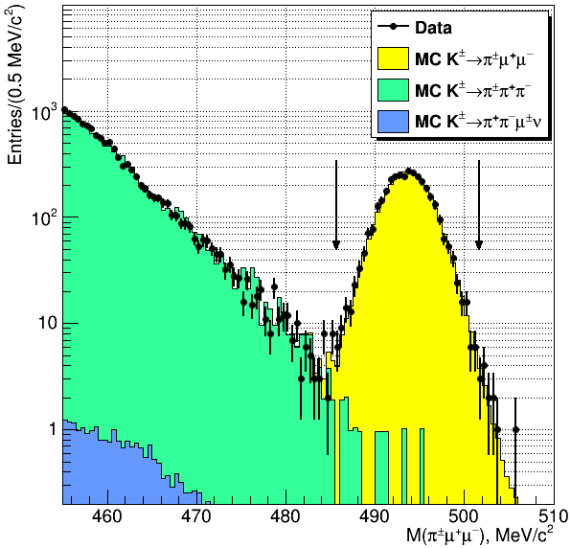
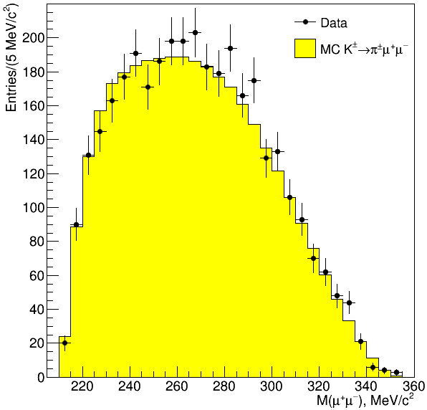
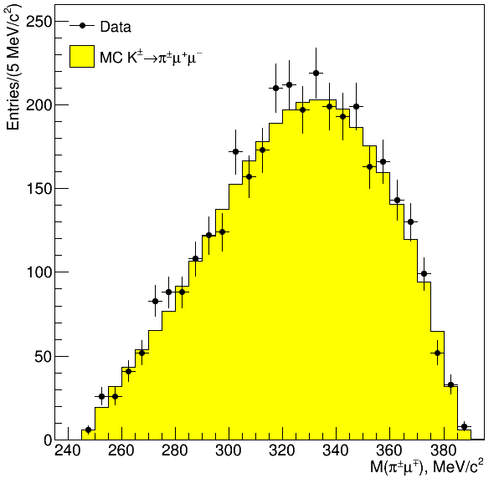
LNC: Opposite-Sign Muon Sample
Selection
Similar to same-sign
3-track vertex, 2 opposite-sign muons, 1 pion, no missing momentum
First-order cancellation of systematic effects
Signal region: $\left|M_{πμμ}−M_{K}\right|<8 MeV/c^{2}$
$$M\left(π^{±}μ^{+}μ^{−}\right)$$
Results
Event in Signal Region: 3489 $K^{±}→π^{±}μ^{+}μ^{−}$ candidates
Background: $\left(0.36±0.10\right)\%$
See [Phys. Lett. B697 (2011) 107] for previous measurement of BR and FF
Search for resonances in $M_{πμ}$ and $M_{μμ}$ invariant masses
step=$0.5σ\left(M_{res}\right)$ and window=$±2σ\left(M_{res}\right)$
Limit using Rolke-Lopez from $N_{obs}$ and $N_{exp}$ for each hypothesis
$$M\left(μ^{+}μ^{−}\right)$$
$$M\left(π^{±}μ^{∓}\right)$$

Slide 8
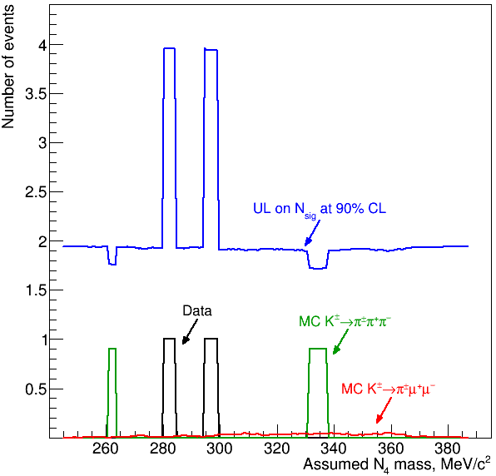
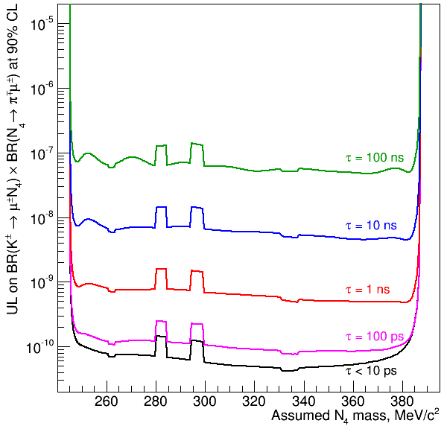
LNV and LNC: Resonances searches
Search for $K^{±}→μ^{±}N_{4}\left(N_{4}→π^{∓}μ^{±}\right)$decays, 284 mass hypotheses
2 possibilities for $M\left(π^{∓}μ^{±}\right)$, closest to $M_{res}$ chosen
Never exceeds $+3σ$: no signal observed and $UL\left(BR\right)\sim {10}^{−10}$ for $τ <100$ ps
Upper limit on $BR\left(K^{±}→μ^{±}N_{4}\right)BR\left(N_{4}→π^{∓}μ^{±}\right)$
$UL\left(BR\right)=\frac{UL\left(N_{sig}\right)}{N_{K}∗Acceptance}$
$$N_{obs} vs. M_{res}$$
$$UL(BR) vs. M_{res}$$
Statistical significance
$z=\frac{\left(N_{obs}−N_{exp}\right)}{σ\left(N_{obs}\right)⊕σ\left(N_{exp}\right) }$
$$z vs. M_{res}$$

Slide 9
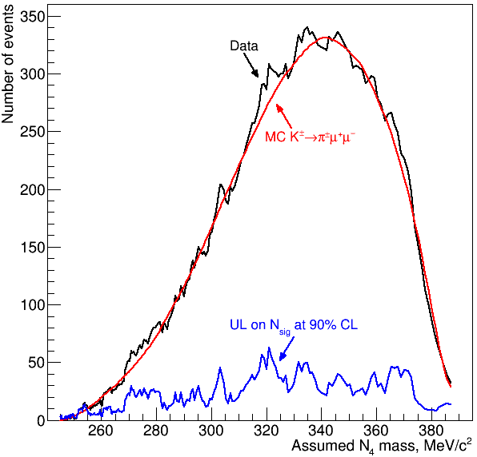
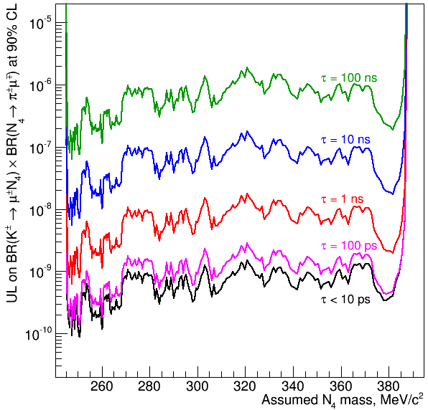
LNV and LNC: Resonances searches
Search for $K^{±}→μ^{±}N_{4}\left(N_{4}→π^{∓}μ^{±}\right)$decays, 284 mass hypotheses
2 possibilities for $M\left(π^{∓}μ^{±}\right)$, closest to $M_{res}$ chosen
Never exceeds $+3σ$: no signal observed and $UL\left(BR\right)\sim {10}^{−10}$ for $τ<100$ ps
Search for $K^{±}→μ^{±}N_{4}\left(N_{4}→π^{±}μ^{∓}\right)$decays, 280 mass hypotheses
Never exceeds $+3σ$: no signal observed and $UL\left(BR\right)\sim {10}^{−9}$ for $τ<100$ ps
Upper limit on $BR\left(K^{±}→μ^{±}N_{4}\right)BR\left(N_{4}→π^{∓}μ^{±}\right)$
$UL\left(BR\right)=\frac{UL\left(N_{sig}\right)}{N_{K}∗Acceptance}$
$$N_{obs} vs. M_{res}$$
$$UL(BR) vs. M_{res}$$
Statistical significance
$z=\frac{\left(N_{obs}−N_{exp}\right)}{σ\left(N_{obs}\right)⊕σ\left(N_{exp}\right) }$
$$z vs. M_{res}$$

Slide 10
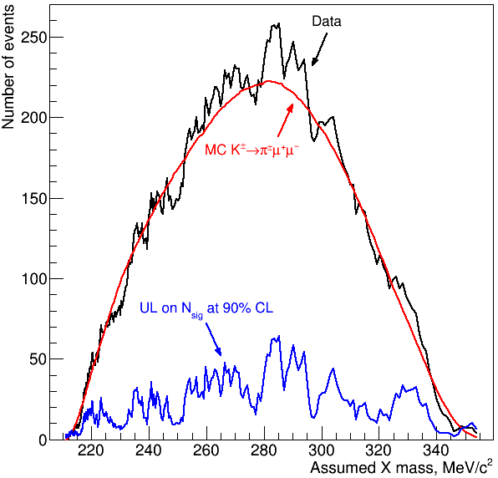
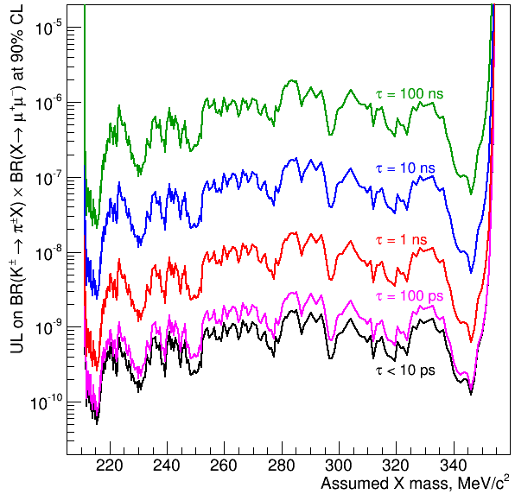
LNV and LNC: Resonance searches
Search for $K^{±}→μ^{±}N_{4}\left(N_{4}→π^{∓}μ^{±}\right)$decays, 284 mass hypotheses
2 possibilities for $M\left(π^{∓}μ^{±}\right)$, closest to $M_{res}$ chosen
Never exceeds $+3σ$: no signal observed and $UL\left(BR\right)\sim {10}^{−10}$ for $τ<100$ ps
Search for $K^{±}→μ^{±}N_{4}\left(N_{4}→π^{±}μ^{∓}\right)$decays, 280 mass hypotheses
Never exceeds $+3σ$: no signal observed and $UL\left(BR\right)\sim {10}^{−9}$ for $τ<100$ ps
Search for $K^{±}→π^{±}X\left(X→μ^{+}μ^{−}\right)$decays, 267 mass hypotheses
Never exceeds $+3σ$: no signal observed and $UL\left(BR\right)\sim {10}^{−9}$ for $τ<100$ ps
Upper limit on $BR\left(K^{±}→μ^{±}N_{4}\right)BR\left(N_{4}→π^{∓}μ^{±}\right)$
$UL\left(BR\right)=\frac{UL\left(N_{sig}\right)}{N_{K}∗Acceptance}$
$$N_{obs} vs. M_{res}$$
$$UL(BR) vs. M_{res}$$
Statistical significance
$z=\frac{\left(N_{obs}−N_{exp}\right)}{σ\left(N_{obs}\right)⊕σ\left(N_{exp}\right) }$
$$z vs. M_{res}$$

Slide 11
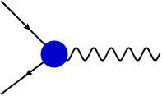
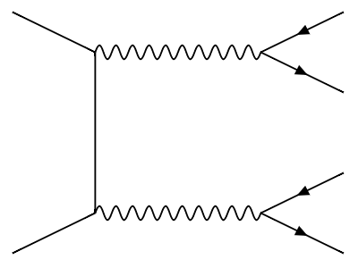
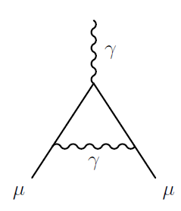
Dark Photon Searches
Simplest hidden sector model: Extra U(1) symmetry with gauge boson $A^{′}$ [B.Holdom, Phys. Lett. B166 (1986) 196]
QED-like interactions with SM fermions
$ℒ \sim g^{′}q_{f}{\overline{ψ}}_{f}γ^{μ}ψ_{f}U_{μ}^{′}$
Coupling constants and charges generated through kinetic mixing between QED and the new U(1) gauge bosons
$ℒ_{mix}=−\frac{ε}{2}F_{μν}^{QED}F_{dark}^{μν}$
Motivations:
Possible explanation for positron excess in cosmic rays (PAMELA, FERMI, AMS-02) by dark matter annihilation
Possible solution to the muon g-2 anomaly
$$e^{−}$$
$$A^{′}$$
$$e^{+}$$
$$γ$$
$$A^{′}$$
$$χ$$
$$A^{′}$$
$$e^{+}$$
$\sim$TeV
$$e^{−}$$
$$γ$$
$$A^{′}$$
$$e^{+}$$
$$χ$$
$\sim G$eV
$$e^{−}$$
$$μ$$
$$A^{′}$$
$$μ$$

Slide 12
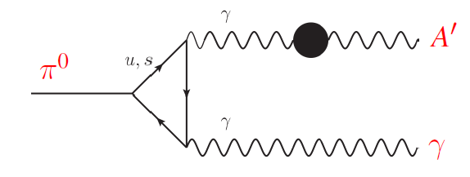
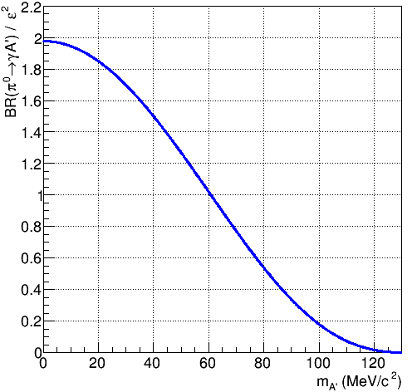
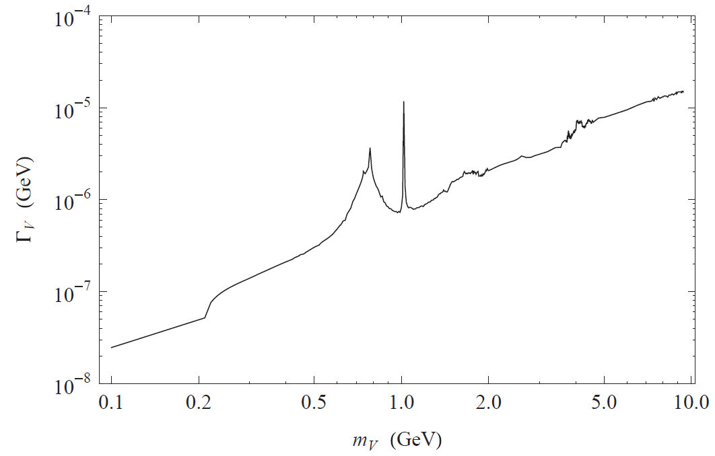
DP: $π^{0}→γA^{′}$ Decay
Production Batell, Pospelov and Ritz, [PRD80 (2009) 095024]
$BR\left(π^{0}→γA^{′}\right)=2ε^{2}{\left(1−\frac{m_{A^{′}}^{2}}{m_{π^{0}}^{2}}\right)}^{3}BR\left(π^{0}→γγ\right)$
Mixing parameter $ε$ and dark photon mass $m_{A^{′}}$
Loss of sensitivity as $m_{A^{′}}$ approaches the $m_{π^{0}}$ threshold
For $ε^{2}>{10}^{−7}$ and $m_{A^{′}}>10 MeV/c^{2}$ mean free path is negligible and prompt decay is assumed
Signature similar to $π_{D}^{0}$ $π_{D}^{0}→γe^{+}e^{−}$; $π^{0}→γA^{′}$ $↳e^{+}e^{−}$
$$BR\left(π^{0}→γA^{′}\right) vs. m_{A^{′}}$$
Valid for $ε^{2}≪1$
Decay Batell, Pospelov and Ritz, [PRD79 (2009) 115008]
Accessible in $π^{0}$ decay, assuming only into SM fermions $Γ_{A^{′}}≈Γ\left(A^{′}→e^{+}e^{−}\right)$ $≈αε^{2}m_{A^{′}}/3$
$A^{′}$ decay BRs
$A^{′}$ decay width into SM fermions
$$e^{+}e^{−}$$
Assuming $ε^{2}={10}^{−4}$
$$μ^{+}μ^{−}$$
$$2m_{μ}$$
$$m_{π^{0}}$$
$$m_{π^{0}}$$
$m_{A^{′}}>2m_{π^{0}}$: hadronic decay contribution
hadrons

Slide 13
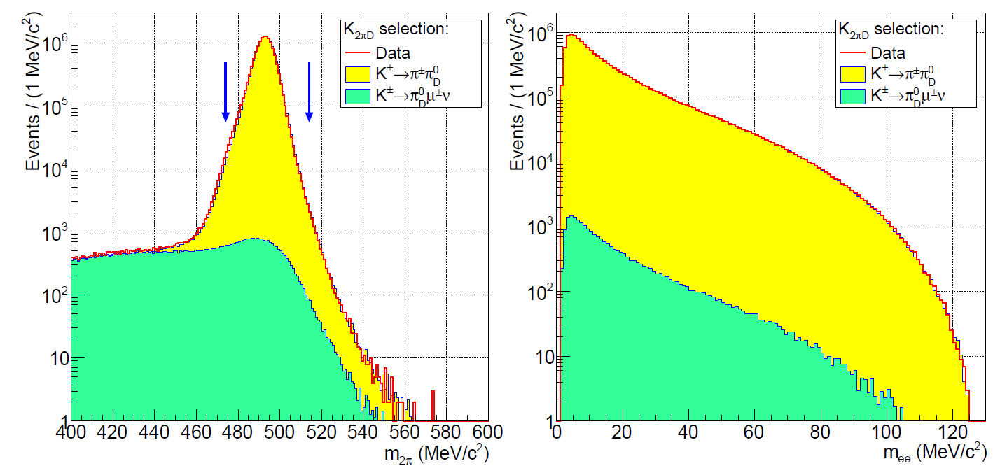
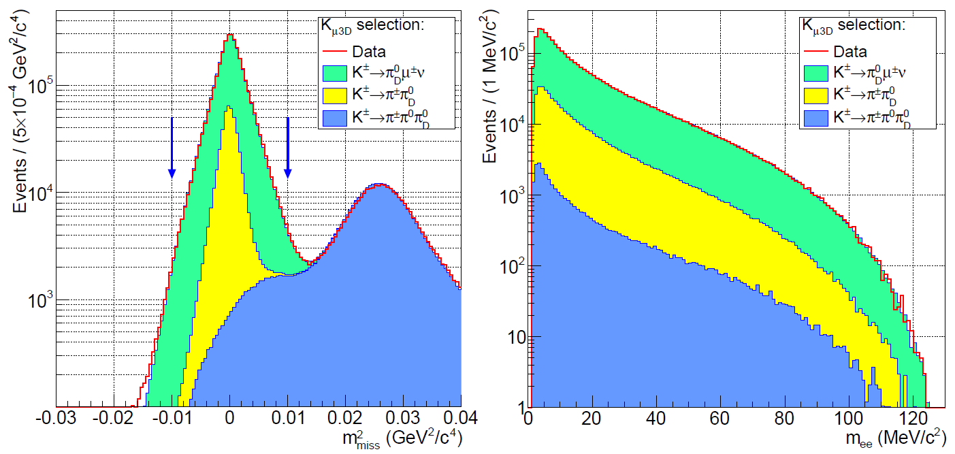
DP: NA48/2 Data Sample
NA48/2 data: $\sim 2×10^{11} K^{±}$ decays in the fiducial region
$π/μ/e$ separation using $E/p$
Selection for $K^{±}→π^{±}π_{D}^{0}$
Three-track vertex topology
$\left|m_{πγeee}−m_{K}\right|<20 MeV/c^{2}$
$\left|m_{γee}−m_{π^{0}}\right|<8 MeV/c^{2}$
No missing momentum
Selection for $K^{±}→π_{D}^{0}μ^{±}ν$
$\left|m_{γee}−m_{π^{0}}\right|<8 MeV/c^{2}$
No missing mass
$$m_{2π}$$
$$m_{ee}$$
$$m_{miss}^{2}$$
$$m_{ee}$$
Sensitivity determined by irreducible $π^{0}$ Dalitz decay (1.2%)
Acceptance for both signature depending on $m_{A^{′}}$ up to 4.5%

Slide 14
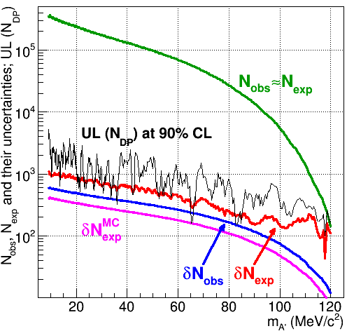
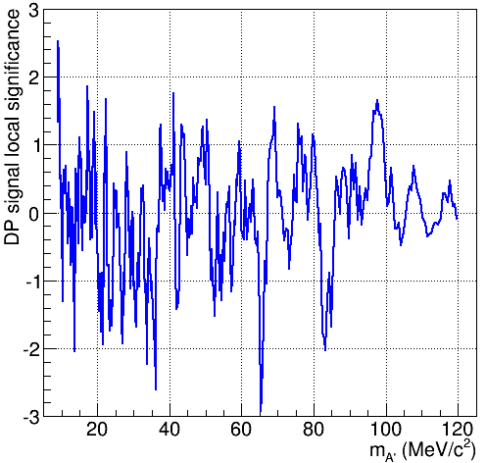
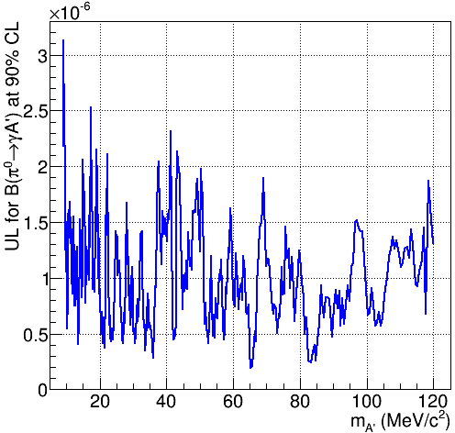
DP: Signal Search
Scan for narrow peaks in $e^{+}e^{−}$ invariant mass spectrum
$σ_{m_{ee}}=0.011×m_{ee}$
Range: $9 MeV/c^{2}≤m_{A’}<120 MeV/c^{2}$
Variable DP mass step: $≈0.5σ\left(m_{A^{′}}\right)$
mass-window: $±1.5σ\left(m_{A^{′}}\right)$
Limits from $N_{obs}$ and $N_{exp}$ for each of the 404 $m_{A^{′}}$ hypotheses
$$N_{obs}, N_{exp} vs. m_{A^{′}}$$
$$z vs. m_{A^{′}}$$
$$UL(BR) vs. m_{A^{′}}$$
Local signal significance never exceeds $3σ$:
no DP signal is observed.

Slide 15
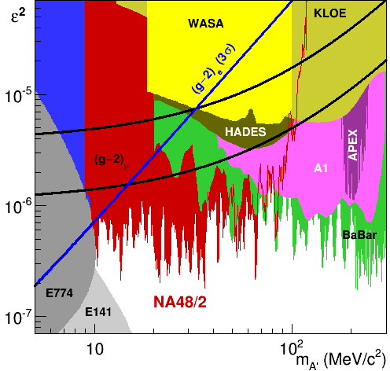
DP: Final NA48/2 Result
[Phys.Lett. B746 (2015) 178]
Improvement on the existing limits in the $m_{A’}$ range $9−70 MeV/c^{2}$
Most stringent limits are at low $m_{A’}$(kinematic suppression is weak)
Sensitivity limited by the irreducible $π_{D}^{0}$background, ULs are 2-3 orders of magnitude above SES.
Upper limit on $ε^{2}$ scales as $∼{\left(1/NK\right)}^{\frac{1}{2}}$: modest improvement with larger samples
If DP couples to quarks and decays mainly to SM fermions, it is ruled out as the explanation for the anomalous ${\left(g−2\right)}_{μ}$

Slide 16
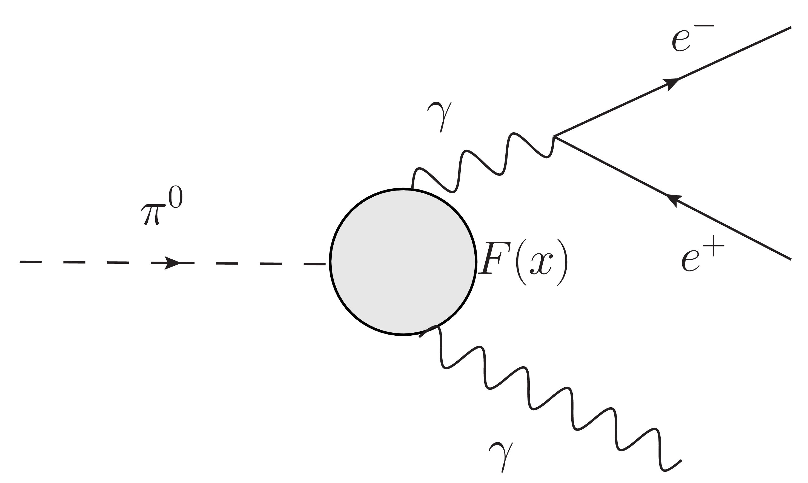
$π^{0}$ TFF: Dalitz Decay
$$π^{0}→e^{+}e^{−}γ$$
Kinematic variables
$x=\frac{{\left(p_{e^{+}}+p_{e^{−}}\right)}^{2}}{m_{π^{0}}^{2}}$, $y=\frac{2p_{π^{0}} ⋅\left(p_{e^{+}}−p_{e^{−}}\right)}{m_{π^{0}}^{2}\left(1−x\right)}$
Differential decay width
$\frac{1}{Γ\left(π_{2γ}^{0}\right)}\frac{d^{2}Γ\left(π_{D}^{0}\right)}{dxdy}=\frac{α}{4π}\frac{{\left(1−x\right)}^{3}}{x} \left(1+y^{2}+\frac{r^{2}}{x}\right)\left(1+δ\left(x,y\right)\right){\left|F\left(x\right)\right|}^{2}$
Form factor varies slowly:
Approximation $F\left(x\right)≈1+ax$
Slope measured from Dalitz decays from $K^{±}→π^{±}π_{D}^{0}$
Expectation from VMD: $a≈0.03$
Enters hadronic light-by-blight scattering contribution to ${\left(g−2\right)}_{μ}$ A. Nyffeler [arXiv:1602.03398]
Model independent measurement: important test of the theory models
Radiative
corrections
Electromagnetic Transition Form factor

Slide 17
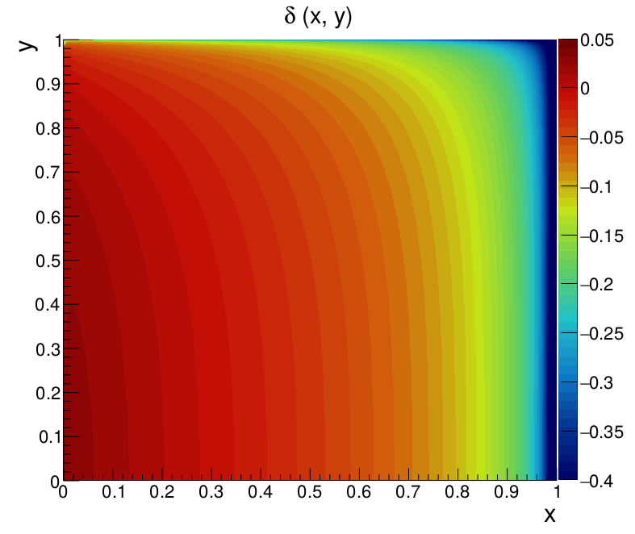
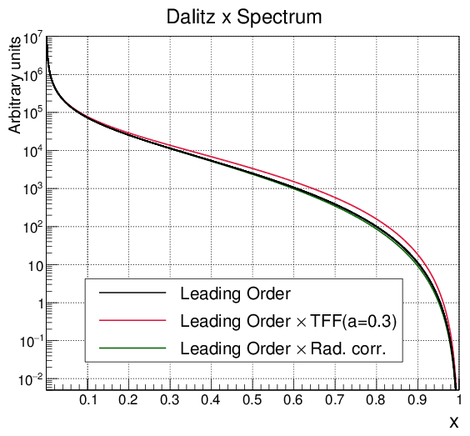
$π^{0}$ TFF: Radiative Corrections
Corrections from NLO differential width encoded in $δ\left(x,y\right)$
Mikaelian and Smith [Phys.Rev. D5 (1972) 1763]
Husek, Kampf and Novotny [Phys.Rev. D92 (2015) 5, 054027]
Corrections of same magnitude as TFF
New generator with radiative correction and simulation of bremsstrahlung photon.
$$δ(x,y)$$

Slide 18
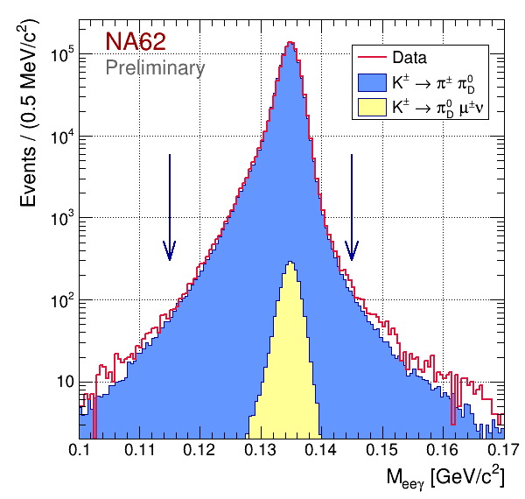
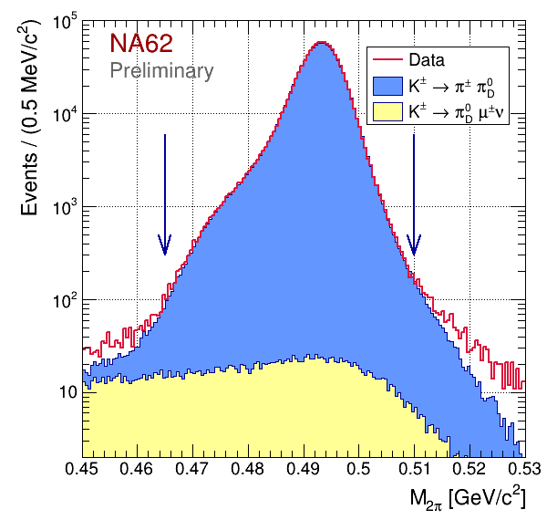
$π^{0}$ TFF: Measurement principle
Select pure $π_{D}^{0}$ sample from
3-track vertex topology
One photon candidate and max three well reconstructed tracks
Identification by reconstructed kinematics $115 MeV/c^{2}<M_{eeγ} <145 MeV/c^{2}$ $465 MeV/c^{2}<M_{π^{+}π^{0}}<510 MeV/c^{2}$ Dalitz variable $y<1; 0.01< x<1$
Reconstructed Kaon compatible with beam properties and offline L2 and L3 trigger conditions
Build $x$ Dalitz distribution for data and MC (equal population bins)
For each TFF slope value hypothesis, reweight simulated events ($a_{sim}=0.032$) $w\left(a\right)=\frac{{\left(1+ax_{true}\right)}^{2}}{{\left(1+a_{sim}x_{true}\right)}^{2}}$
Minimise $χ^{2}\left(a\right)$ of Data/Simulation wrt. $a$
$$M_{eeγ}$$
$$M_{2π}$$

Slide 19
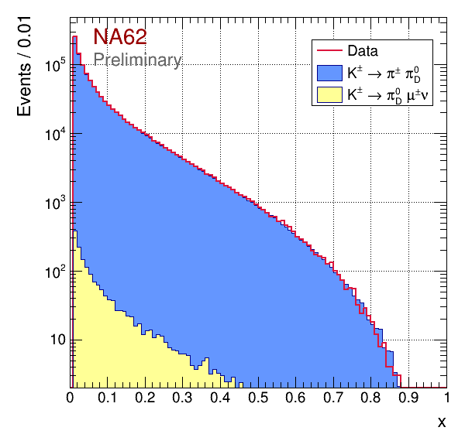
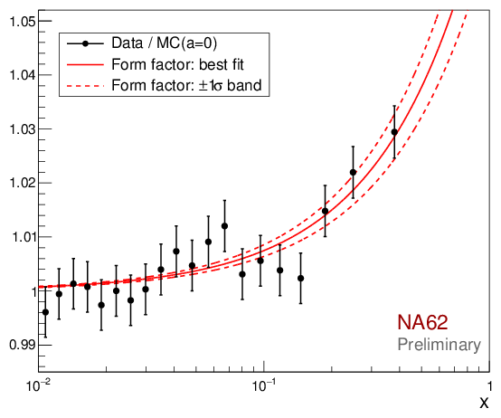
$π^{0}$ TFF: Preliminary Result
Data sample
Kaon decays: $\sim 2×10^{10}$
Fully reconstructed $π_{D}^{0}$ events in the signal region ($x>0.01$): $1.05×{10}^{6}$
Uncertainties
Source | $$δa\left(×10^{−2}\right)$$
Statistical – Data | 0.49
Statistical – MC | 0.20
Beam momentum spectrum simulation | 0.30
Spectrometer momentum scale | 0.15
Spectrometer resolution | 0.05
LKr non-linearity and energy scale | 0.04
Particle mis-ID | 0.08
Accidental background | 0.08
Neglected $π_{D}^{0}$ sources in MC | 0.01
$$x$$
Fit result illustration
Data / MC(a=0) ratio
20 equal population bins
Points in bin barycenters
x
$a=\left(3.70±{0.53}_{stat}±{0.36}_{syst}\right)×{10}^{−2}$
$$=\left(3.70±0.64\right)×{10}^{−2}$$
($χ^{2}$/n.d.f: 52.5/49, p-value: 0.34)
Preliminary

Slide 20
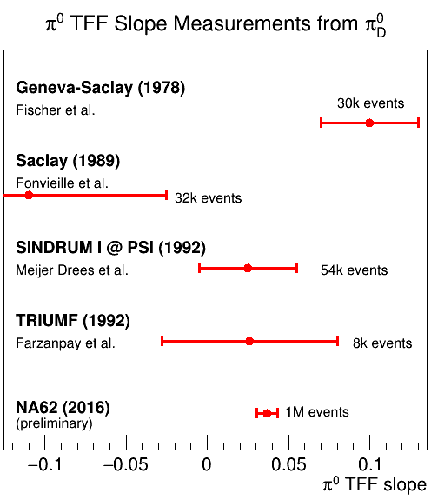
$π^{0}$ TFF: World Data
Theory expectations
K. Kampf et al., EPJ C46 (2006), 191. Chiral perturbation theory: $a=\left(2.90±0.50\right)×{10}^{−2}$
M. Hoferichter et al., EPJ C74 (2014), 3180. Dispersion theory: $a=\left(3.07±0.06\right)×{10}^{−2}$
T. Husek et al., EPJ C75 (2015) 12, 586. Two-hadron saturation (THS) model: $a=\left(2.92± 0.04\right)×{10}^{−2}$
CELLO measurement:
H. J. Behrend et al., Z. Phys. C49 (1991), 401. Extrapolation of space-like momentum region data fit to VMD model: $a= \left(3.26± {0.26}_{stat}\right)×{10}^{−2}$

Slide 21
Summary
LNV decay @ NA48/2
$BR\left(K^{±}→π^{∓}μ^{±}μ^{±}\right)<8.6×{10}^{−11} @ 90\% CL$
Majorana Neutrinos and Inflaton @ NA48/2
$K^{±}→μ^{±}N_{4}\left(N_{4}→π^{∓}μ^{±}\right)$: UL(BR) of the order of ${10}^{−10}$ for $τ<100$ ps
$K^{±}→μ^{±}N_{4}\left(N_{4}→π^{±}μ^{∓}\right)$: UL(BR) of the order of ${10}^{−9}$ for $τ<100$ ps
$K^{±}→π^{±}χ\left(χ→μ^{+}μ^{−}\right)$ : UL(BR) of the order of ${10}^{−9}$ for $τ<100$ ps
Dark Photon searches @ NA48/2
Phys.Lett. B746 (2015) 178
Improved limits on DP mixing $ε^{2}$ in the mass range $9−70 MeV/c^{2}$
The whole region favoured by ${\left(g−2\right)}_{μ}$ is excluded
$π_{D}^{0}$ electromagnetic TFF slope @ $NA{62}_{R_{K}}$
$a=\left(3.70±{0.53}_{stat}±{0.36}_{syst}\right)×{10}^{−2}$
Preliminary model independent result
$\sim 1$ million fully reconstructed $π_{D}^{0}$ decays
Improves TFF precision in the time-like momentum region
First $6σ$observation of non zero slope in time-like region

