Slide 1
CHANDLER Detector
Neutronics Modeling
Alireza Haghighat
William Walters
Nuclear Science and Engineering Lab (NSEL)
Nuclear Engineering Program, Mechanical Engineering Dept.
Virginia Tech Research Center
Arlington, VA
Applied Antineutrino Physics 2015, Dec 7-8, 2015

Slide 2
Outline
CHANDLER detector overview
Inverse beta-decay neutron modeling
Cosmic ray neutron modeling
Spatial coincidence of neutron signals
Cosmic neutron shielding

Slide 3
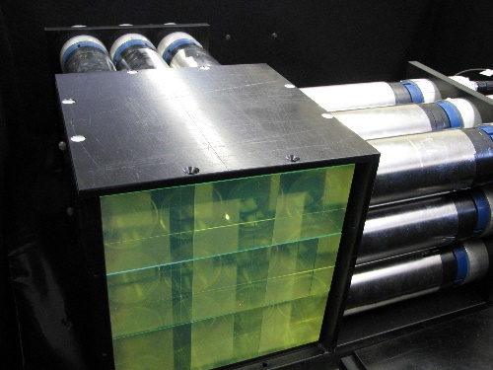
CHANDLER Detector
1x1x1 m³ plastic scintillator
16 layers of 16x16 scintillator cubes
17 layers of LiF-ZnS(Ag) (absorber & scintillator) neutron detector (ND) sheets between each layer
Charge particles absorb in scintillator cubes
Neutrons absorb in LiF-ZnS(Ag) sheets
Each event can be localized to a single cube
3×3×3 microCHANDLER Prototype The open face clearly shows the optics of total internal reflection.

Slide 4
Detector Geometry
EJ-260 Scintillator
EJ-426 ND Scintillator
Polyethylene backing
6.2 cm
…repeating…
16 scintillator layers, 17 neutron absorber layers total

Slide 5
Materials
Material # | Description | Density (g/cc) | Isotopics
1 | EJ-260 Scintillator (PVT) | 1.023 | H(1001) +5.21 C(6000) +4.70
2 | Polyester backing | 1.496 | H(1001) -0.072 C(6000) -0.855 O(8016) -0.569
3 | EJ-426HD Neutron detector [LiF-ZnS(Ag)] | 1.897 | Li (3006) -0.134 F (9019) -0.42433 Zn (30000) -0.75146 S(16000) -0.36854 H(1001) -0.019 C(6000) -0.200
Nlib=.80c ENDF-VII.1 pointwise cross sections, room temperature

Slide 6
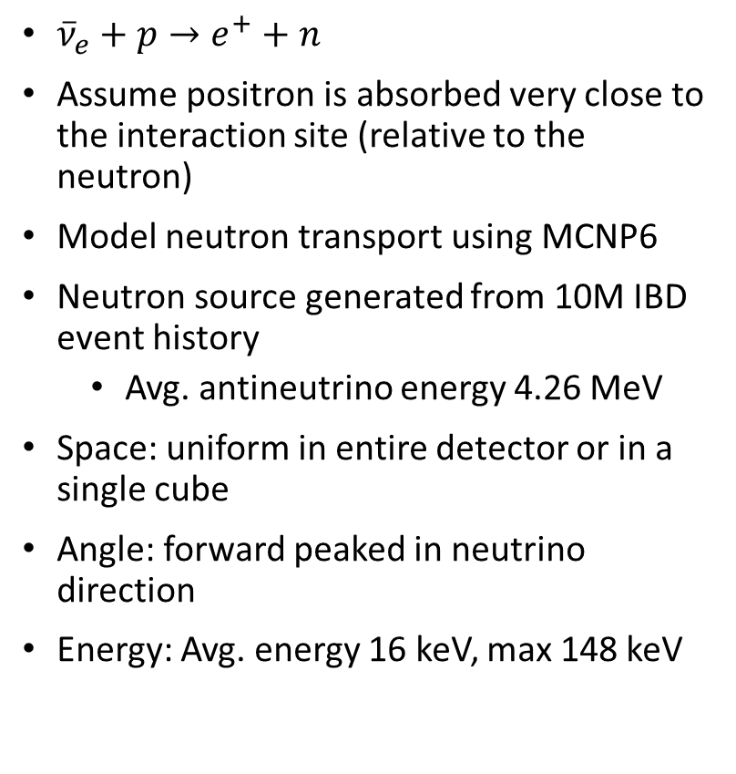
Modeling IBD Neutron Source
Neutron angular dependency
${\overline{ν}}_{e}+p→e^{+}+n$
Assume positron is absorbed very close to the interaction site (relative to the neutron)
Model neutron transport using MCNP6
Neutron source generated from 10M IBD event history
  Avg. antineutrino energy 4.26 MeV
Space: uniform in entire detector or in a single cube
Angle: forward peaked in neutrino direction
Energy: Avg. energy 16 keV, max 148 keV
Neutron Spectrum

Slide 7
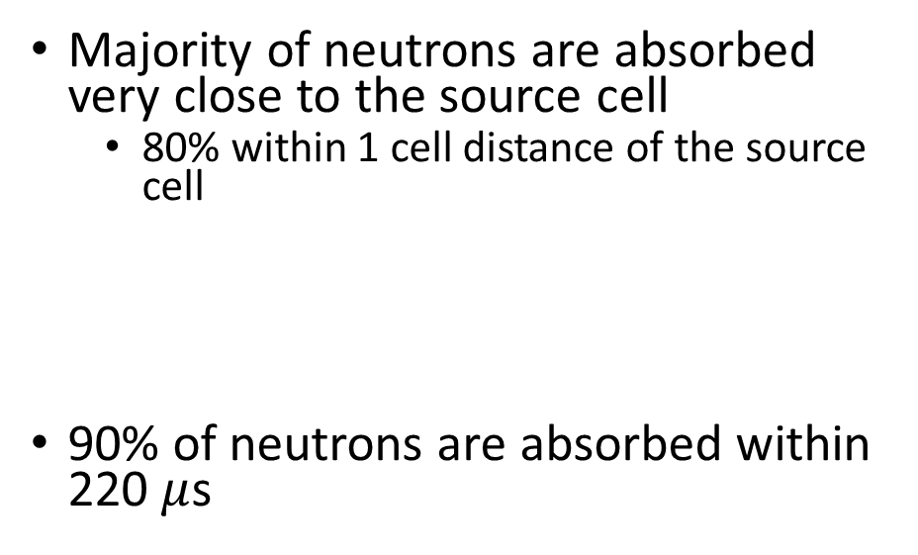
IBD Neutron Modeling
Majority of neutrons are absorbed very close to the source cell
  80% within 1 cell distance of the source cell
90% of neutrons are absorbed within 220 $μ$s

Slide 8
Cosmic ray-generated neutrons
Fast neutrons from cosmic rays can be a problem
  Fast neutron scatters in hydrogen
  Recoil proton deposits energy in scintillator, “looks” like a positron
  Neutron absorbs in Li-6 detector sheet
These neutrons are much higher energy
  Large distance between proton absorption and neutron absorption
  How well is this distinguished from an IBD neutron-positron pair event
Need to achieve a good signal-to-noise ratio (SNR)

Slide 9
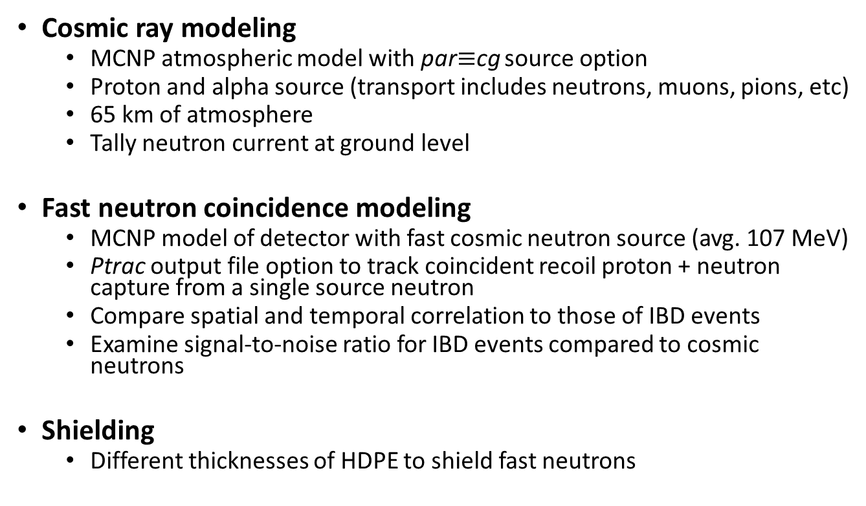
Analyzing and Shielding of Cosmic ray
Cosmic ray modeling
  MCNP atmospheric model with par$≡$cg source option
  Proton and alpha source (transport includes neutrons, muons, pions, etc)
  65 km of atmosphere
  Tally neutron current at ground level
Fast neutron coincidence modeling
  MCNP model of detector with fast cosmic neutron source (avg. 107 MeV)
  Ptrac output file option to track coincident recoil proton + neutron capture from a single source neutron
  Compare spatial and temporal correlation to those of IBD events
  Examine signal-to-noise ratio for IBD events compared to cosmic neutrons
Shielding
  Different thicknesses of HDPE to shield fast neutrons

Slide 10
MCNP6 Atmospheric Model
65 km of atmosphere
  NO soil modeled
150 air cells with varying density and humidity (from USGS data)
MODE n h p q g d t s a | z / k (13 particles)
Manual cell importance
Source
  Protons and Alphas
  Defined by the par=cg cosmic ray option
  Considering three parameters including lattitude, longitude, and date
Tallies:
  Neutron flux as function of altitude
  Neutron current at sea level

Slide 11
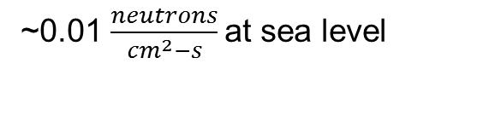
Atmospheric Neutron Flux
Air Density
Neutron Flux
~0.01 $\frac{neutrons}{{cm}^{2}−s}$at sea level

Slide 12
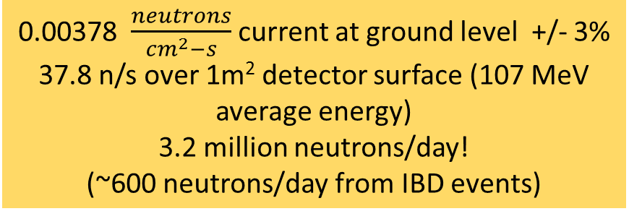
Ground level Neutron spectrum
Energy Spectrum
Integrated Current (bin values)
0.00378 $\frac{neutrons}{{cm}^{2}−s}$ current at ground level +/- 3%
37.8 n/s over 1m² detector surface (107 MeV average energy)
3.2 million neutrons/day!
(~600 neutrons/day from IBD events)

Slide 13
CHANDLER Coincidence Modeling
Goal - model the coincidence from a single fast neutron:
  Recoil proton absorbed in scintillator
  Neutron absorbed in neutron detector
  Find the time and spatial correlation of these absorptions
Source
  Neutron energy from previous step (average 107 MeV)
  Angular distribution from previous step (peaked in –z direction)
PTRAC output
  Outputs individual particle events
  Processed using an in-house code
…repeating…
16 scintillator layers, 17 neutron absorber layers total

Slide 14

Neutron-proton coincidence
Filter ptrac for events with:
  Single proton recoiled
    <6 MeV total energy
  Single neutron absorbed in detector material
0.54% of cosmic neutrons result in this coincidence
  Cosmic neutrons cause ~17,000 events/day; compared to ~500 antineutrino events/day
Spatial and time correlation are shown
  Need to use this to reduce noise further
$$μs$$

Slide 15
IBD vs. cosmic fast neutron coincidence
Cosmic ray
Fast neutron coincidence are more spread out, but still significant overlap

Slide 16
IBD vs. Cosmic fast neutron coincidence
Cosmic Fast Neutrons
IBD Neutrons
Time cut will not be very effective, while space cut can be

Slide 17
Spatial Correlation Anisotropy
Cosmic fast neutron Z-Bias
Cosmic neutrons – z directionality (from space), IBD neutrons – x directionality (from reactor)
Z direction: +1 means the neutron is absorbed in the layer above the cube where the proton is absorbed, -1 is below
  i.e., there is no 0 for the z difference
X/Y directions: 0 means the neutron is absorbed in a layer at the same x/y cube as the proton
Cosmic ray
Layers of ND
IBD Neutron X-Bias

Slide 18
Spatial Cut
Look at individual segments of the neutron detector (x, y, z)
  Order segments by their SNR
  Only accept segments with a high enough SNR
Highest SNR
  +X (IBD neutrons peaked in this direction)
  +Z (Cosmic neutrons peaked away from this direction)
 | p-n Absorption Location Difference (cells) |  |  | Individual Cell |  | Cumulative
# | X | Y | Z | Signal (c/day) | SNR | Signal (c/day) | SNR
1 | 0 | 0 | 1 | 72.2 | 0.491 | 72.2 | 0.491
2 | 1 | 0 | 1 | 42.6 | 0.414 | 114.8 | 0.459
3 | 0 | 1 | 1 | 28.6 | 0.216 | 143.5 | 0.375
4 | 0 | 0 | -1 | 74.6 | 0.211 | 218.0 | 0.296
5 | -1 | 0 | 1 | 17.9 | 0.203 | 235.9 | 0.286
6 | 0 | 0 | 2 | 8.6 | 0.194 | 244.5 | 0.282
7 | 1 | 0 | -1 | 42.2 | 0.179 | 286.7 | 0.260
8 | 1 | -1 | -1 | 18.4 | 0.179 | 305.1 | 0.253
9 | 1 | -1 | 1 | 18.0 | 0.175 | 323.1 | 0.247
10 | 0 | 1 | -1 | 26.5 | 0.150 | 349.6 | 0.235
11 | 1 | 1 | -1 | 17.3 | 0.147 | 366.9 | 0.229
12 | 0 | -1 | 1 | 28.5 | 0.138 | 395.4 | 0.218
13 | 0 | -1 | -1 | 27.9 | 0.112 | 423.3 | 0.206
14 | 1 | 1 | 1 | 18.0 | 0.111 | 441.3 | 0.199
  (0,0,1) means the neutron is absorbed in the layer immediately above the cube in which the proton is absorbed

Slide 19
Signal vs. noise tradeoff
Add more segments inside the cutoff -> higher total signal, lower SNR (noise increases faster than signal)

Slide 20
Shielding of fast neutrons
Previous results without shielding for fast neutrons gives a very low SNR for neutrino events (<0.5)
Add layers of high density polyethylene (HDPE)
How much shielding is required to cut the fast neutron signal to an acceptable level?
1-D model in MCNP6, tallying neutron current with different thickness of HDPE

Slide 21
Shielding of fast neutrons
Decreases average energy slightly
Decreases total current significantly (~2% at 1m of HDPE)

Slide 22
Conclusions & Future Work
Cosmogenic neutrons account for a significant source of noise in the CHANDLER detector, unless shielded
Depending on spatial cutoffs, an SNR (including cosmic neutrons as the only source of noise) of 0.2-0.5 can be obtained for the unshielded case
With 1m of HDPE shielding, the cosmic fast neutron current can be reduced by ~98%; i.e., SNR increases by a factor ~50; therefore, a max. SNR can be ~25
Further Analysis
  No account for any additional neutrons created in the shield from cosmic muons (ideally, the muon detectors would detect and veto these events)
  No account for the change in fast neutron coincidence with the changing neutron spectrum from shielding
  No account of gamma rays
An optimum multi-layered (e.g., poly, Boron, lead) should be designed
Experimental benchmarking against reactors (BR2 & North Anna)

Slide 23
Thanks!
Questions?

Slide 24
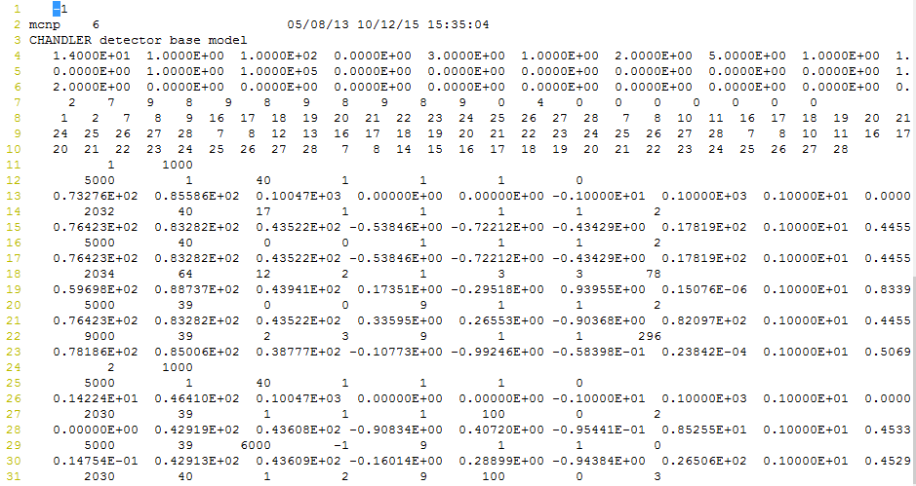
Appendix - PTRAC output file
particle type
(1 =n, 9=p)
Source particle #
Event type:
1000 src
20XX bank
5000 termination
9000 done
x,y,z

