Slide 1
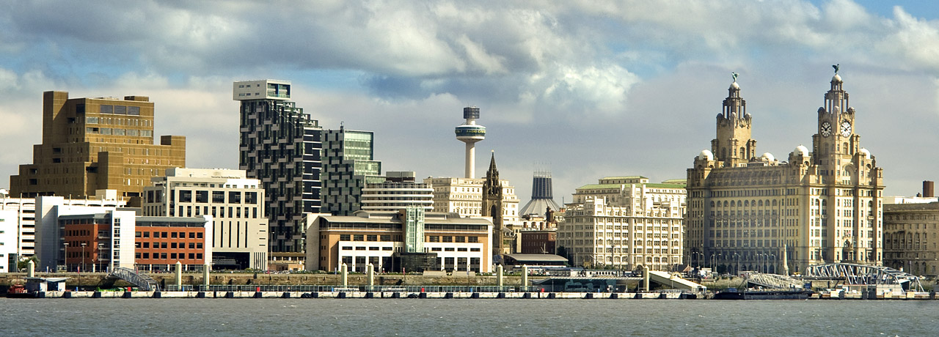
AAP @ LIVERPOOL
Hosting Proposal

Slide 2
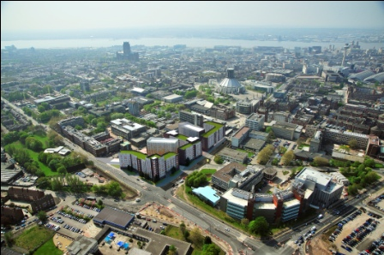
The University of Liverpool
- City Centre Campus
- Full support of the Physics Department to host the meeting
  Experience in hosting international meetings & collaborations
  Large well established groups in Nuclear & Particle physics
    Labs & cleanrooms are available to visit
- International City well connected via Rail and Airport links
  Reasonably priced accommodation
  restaurants, hotels are all within walking distances
- Close to headquarters of UK support program of IAEA
- Recently Established Nuclear Engineering Department in conjunction with
National Nuclear Laboratory Ltd
- Nuclear industry well-established in NW of England
  Ties to NNL, Sellafield, Capenhurst and multiple power stations
  University source of many graduates working in the nuclear industry
Extra funding
University fund for help with
travel
organisation
Application submission imminent

Slide 3
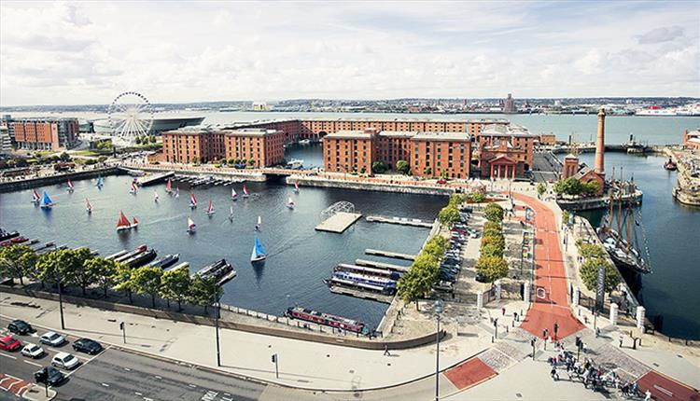
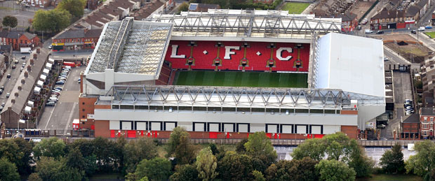

Tourist info
Awarded Cultural capital
birthplace of The Beatles and
UNESCO world heritage site,
Liverpool has world-class attractions,
a proud sporting history
and beautiful coast and countryside
First-class tourist attractions.
Beatles Liverpool, museums and galleries,
our two Premiership football clubs, two cathedrals and much more
Liverpool is officially the World Capital of Pop,
with more Number One hits than any other city.
Has been voted the best conference venue, & friendliest city

Slide 4
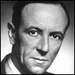
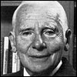
Nuclear Legacy
The Physics department has long history with Joseph Rotblat and James Chadwick
  Both worked on the Manhattan Project from Liverpool
  Chadwick lead tube-alloys and UK Manhattan project contingent from here
  Pontecorvo was employed at Liverpool
http://vgm.liverpool.ac.uk/worldaparticle/
will be running next year
Showcases Chadwick’s Cyclotron
  responsible for early Uranium cross-section measurements
A world in a Particle Exhibition

