Slide 1
STEREO
D. Lhuillier, CEA - Saclay

Slide 2
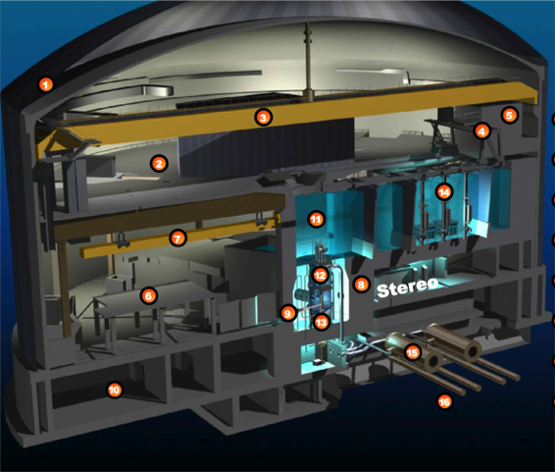
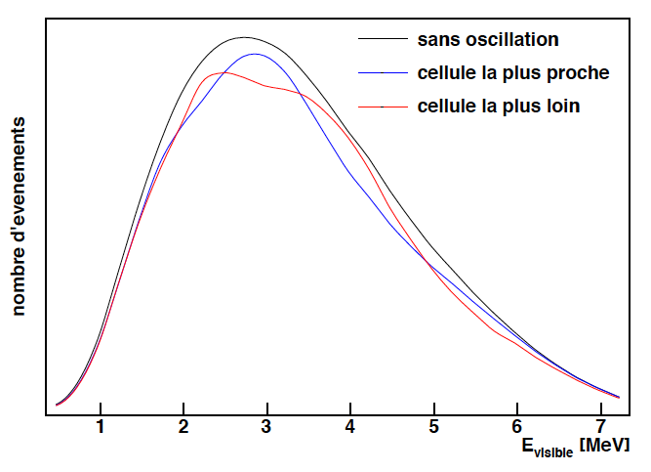
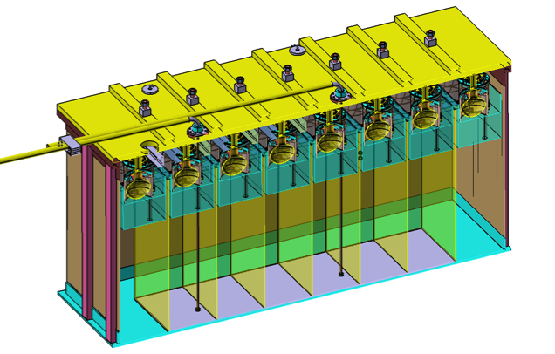
ILL Site
No oscillation
First cell
Last cell
Goal: look for relative spectrum distortions in identical cells
ILL site, Grenoble - France:
57 MW, compact core < 1m
[8.9–11.1] m from core, possible extension to 12.3 m.
High level of reactor background
15 mwe overburden
6 target cells

Slide 3
Strategy of the Stereo Measurement
Oscillation pattern based on relative shape in identical cells
Take advantage of Gd-doped liquid scintillator technology to measure accurate spectra shape.
Cosmic rays induced background is the final limitation:
Overburden from water channel
Online rejection using PSD (stat)
Subtraction of residual background using reactor OFF periods (syst)
Massive shielding against reactor induce accidentals (stat uncertainty)
Sensitive test of the sterile neutrino hypothesis
New reference measurement of pure ²³⁵U neutrino spectrum.

Slide 4
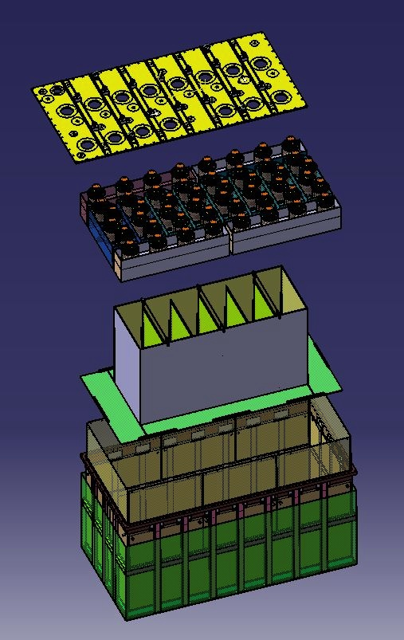
Detector Design
PMTs coupled to LS via a thick acrylic buffer for a better homogeneity
Central cells in acrylic, filled with Gd-doped LS (90 x 90 x 37.5 cm)
Outer crown (no Gd) to improve energy reconstruction and detection efficiency
Reflective plates to suppress dependence on vertex position
Double wall vessel

Slide 5
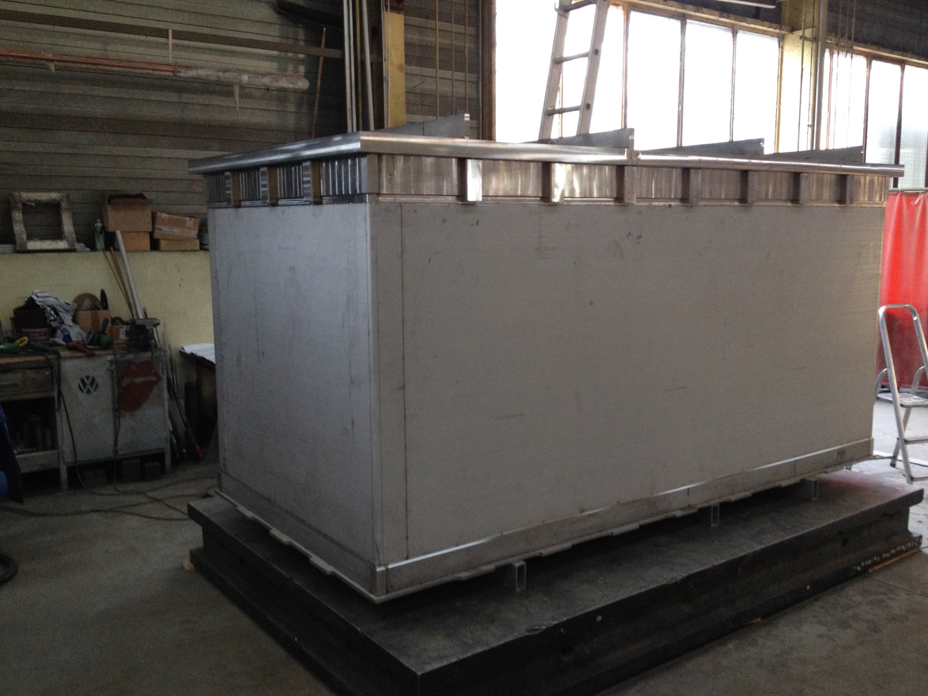
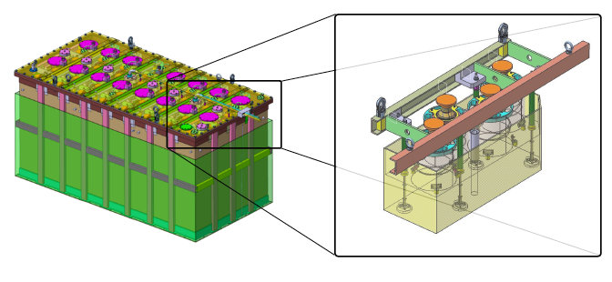
Detector Design
Detector vessel
Acrylic buffers
Detector vessel is built. Working on top lid machining and inner coating
The acrylic buffers will be delivered this week
Delivery of all remaining components expected on late February 2016
Assembly at CNRS-LPSC in Grenoble before transportation to ILL in April 2016.

Slide 6
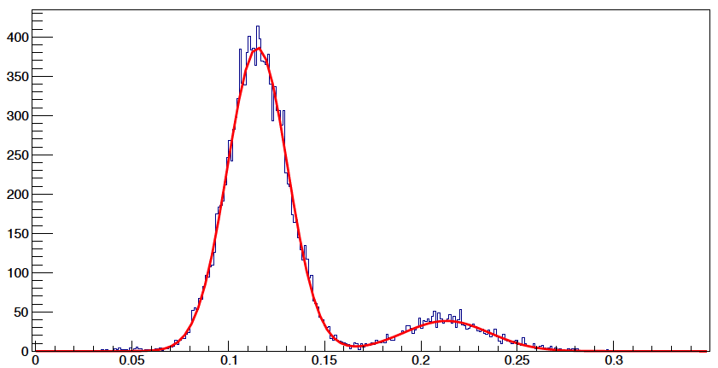
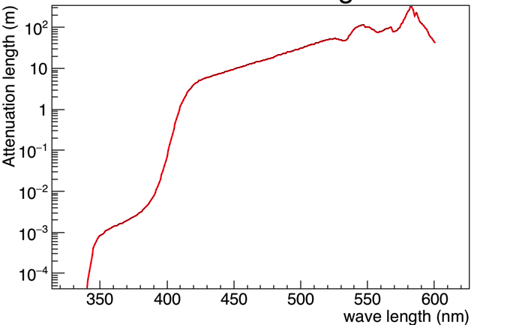
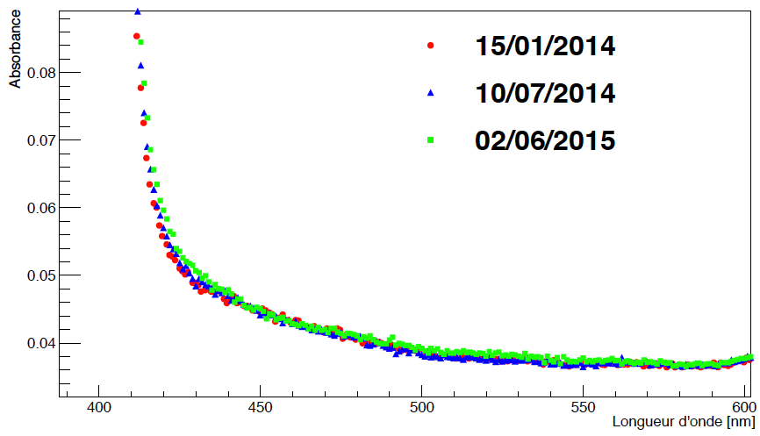
Liquid Scintillator
LAB 75% → protons target
PXE 20% + DIN 5% → light yield and PSD
Gd-complex 0.2% + 1 %THF → neutron capture
PPO + Bis-MSB → wavelength shifters
electron recoils
PSD
proton recoilsc
Transparent
Stable
λ ≳ 5 m

Slide 7
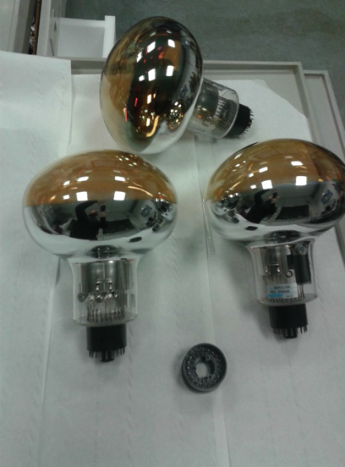
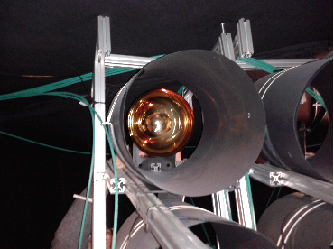
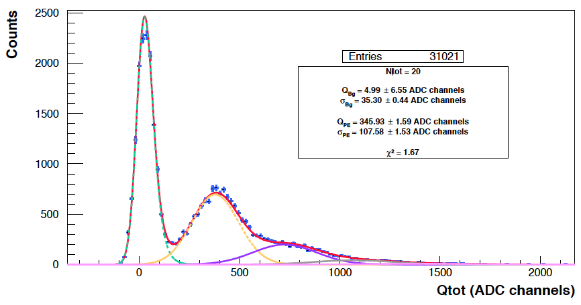
PMTs
8” PMT: New Hamamatsu R5912-100 with improved Quantum Efficiency, 30% at 420 nm
Tests are handled by MPIK Heidelberg in their Faraday lab
New PMTs basis with decoupling system delivered by LPSC-Grenoble
All components tested and to be delivered this month.

Slide 8
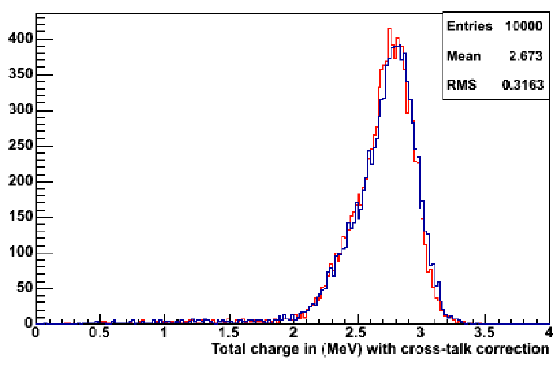
Detector Response
400 pe/MeV expected
Resolution 11.5% (RMS for 2 MeV positrons)
Neutron efficiency 60% with a delayed signal above 5 MeV
Outer crown:
Reduces the difference on neutrons efficiency between center and border cells to 4%
Keep the response to prompt signals identical in central and border cells

Slide 9
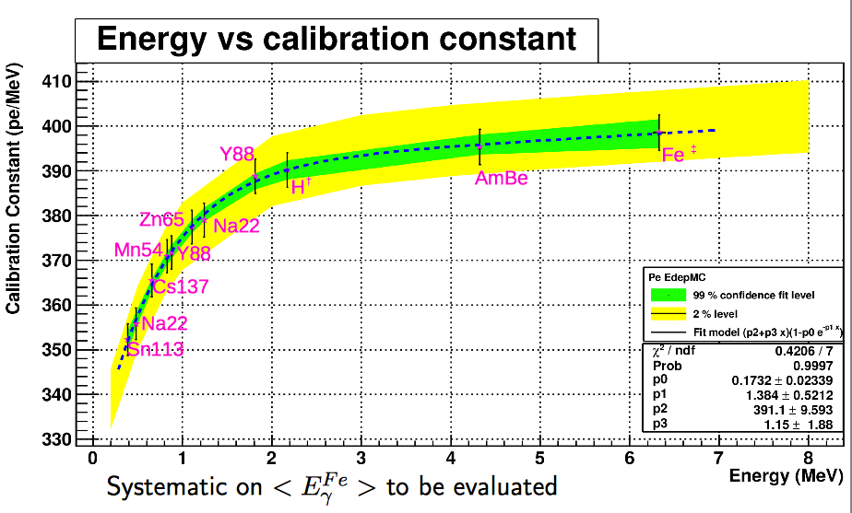
Detector Response
Linearity of the PMTs and electronics validated in the physics range of interest.
The quenching of low energy recoiling electrons introduces a dependence on the way the total energy of an event is deposited.
Circulation of radioactive sources inside and around the detector.
Monitoring of the detector response by a set a LEDs.

Slide 10
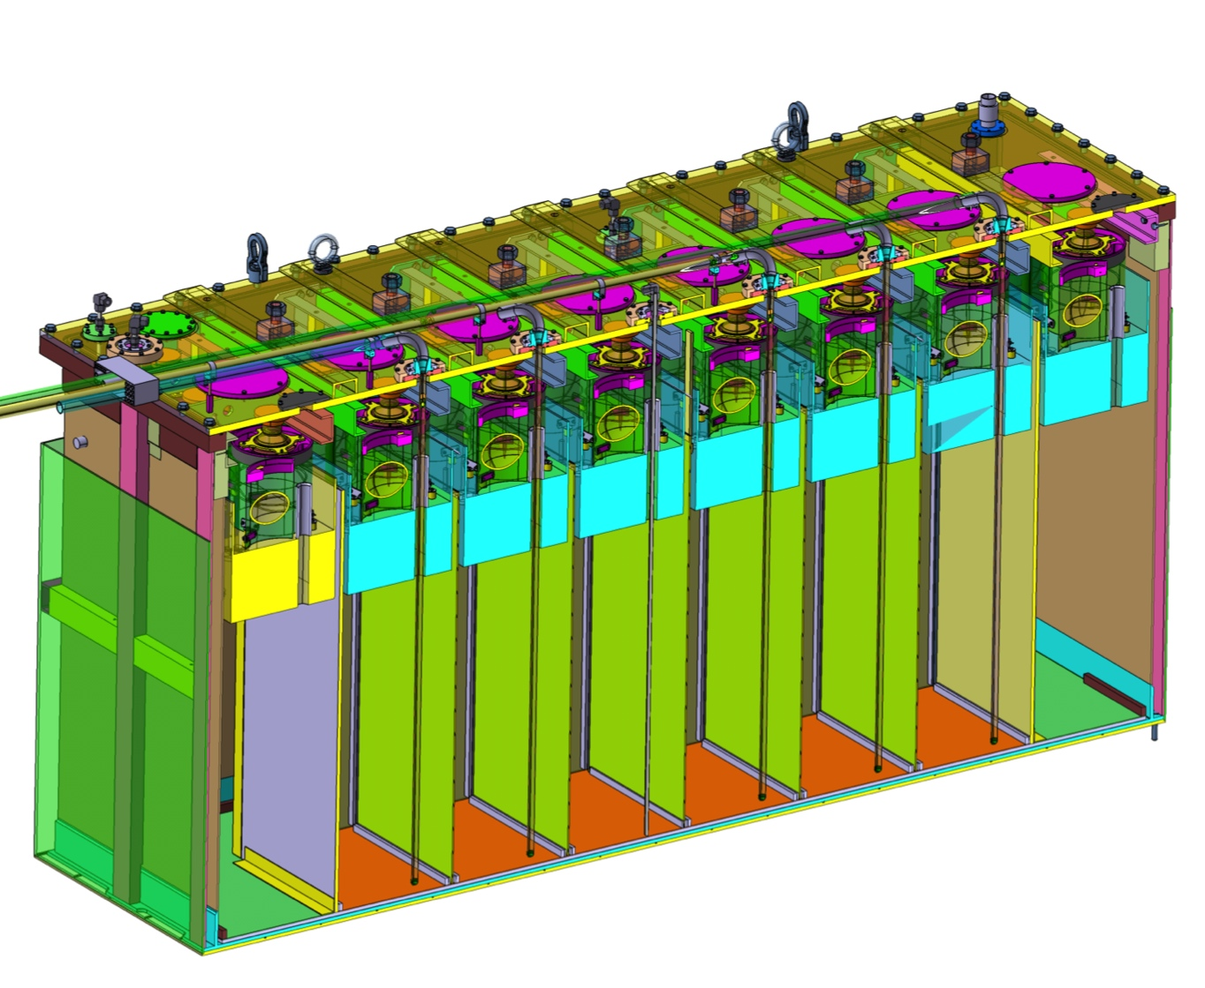
Calibration
3 light injection points per detector cell
+ 12 in the outer crown
Circulation of radioactive sources in calibration tubes

Slide 11
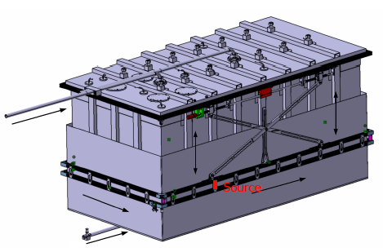
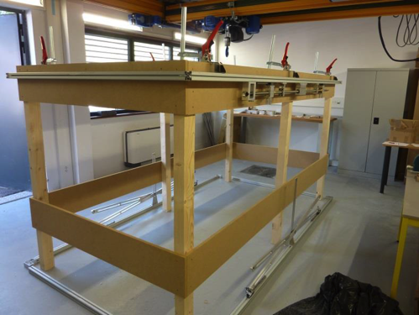
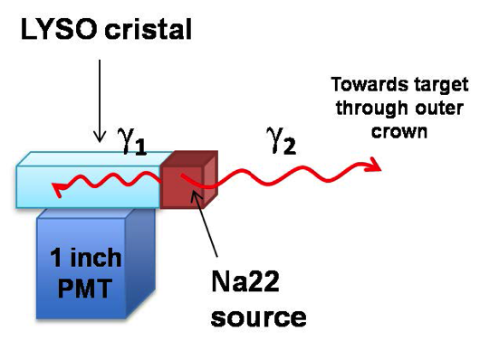
Calibration
Extra information from the deployment of sources underneath and around the detector vessel. Outer crown can be used to veto Compton events
Possibility to tag the direction of a 511 keV γ-ray using a 22Na source coupled with a small LYSO crystal
Setup under test with a mockup of the detector vessel.

Slide 12
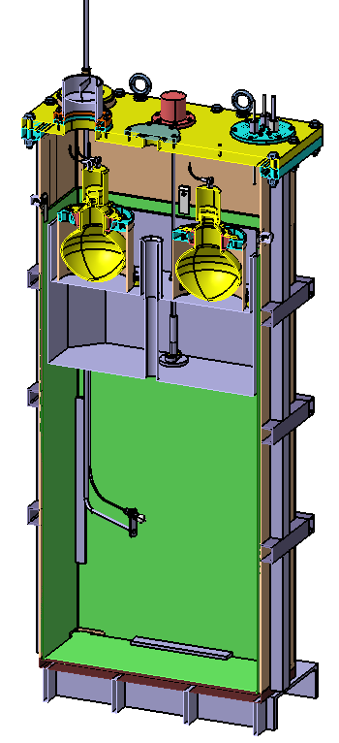
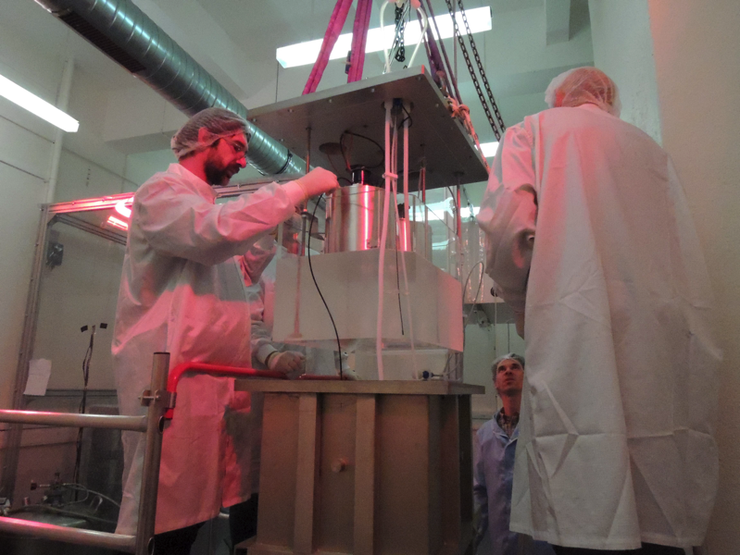
Prototype Cell
The response of a prototype cell has been tested this year.
Same height and width than final config, ½ length.
Equipped with acrylic buffer and reflective plates
Light signals induced in the whole volume by:
Source outside the vessel
Movable light diffuser
Source in central calibration tube

Slide 13
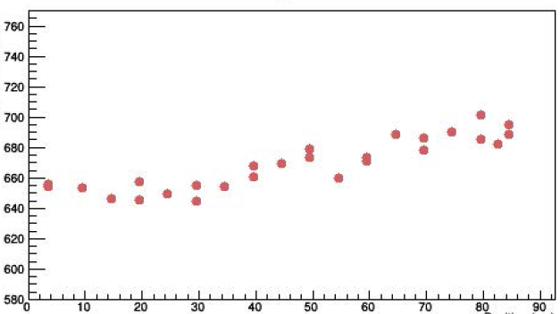
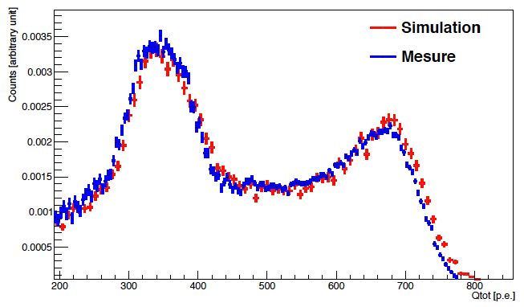
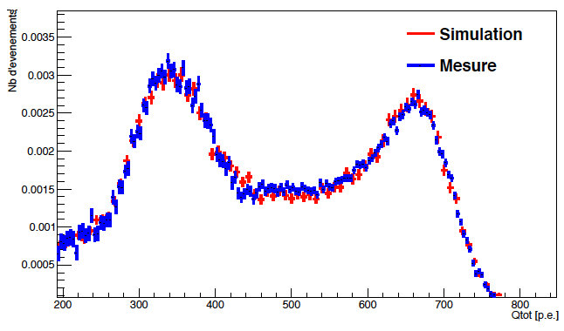
Prototype Cell
⁶⁰Co in central tube
Top
Detected charge (a.u.)
Heigth (cm)
Center
Small vertex dependence (~5%):
Validates the reflective plates
Negligible impact on energy resolution
Good agreement with the simulation

Slide 14
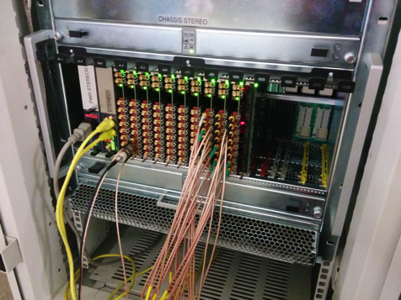
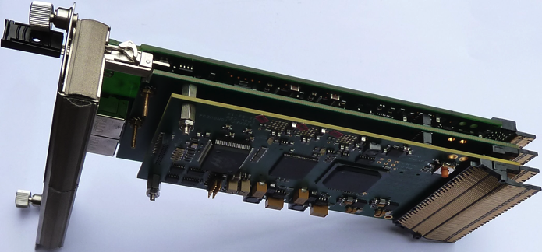
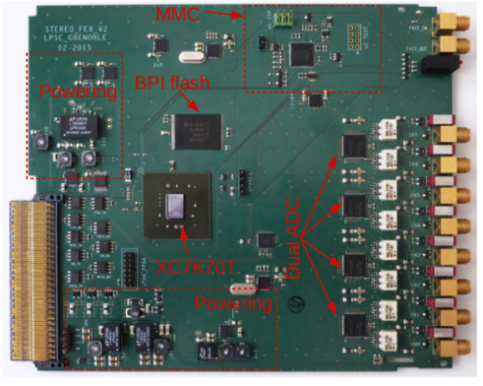
Electronics
Dedicated electronics hosted in TCA crate
Front-end boards are already tested and validated
8-channel FADC 14 bits 250 MHz sampling
Qtot, Qtail, tCFD and pulse
Gain x1 and x20 for single PE
First level programmable trigger (FPGA) validated with muon veto
Trigger board: second level programmable trigger (FPGA) taking into account the 3 detectors : Target cells, outer crown, veto
LED driver for light calibration
TCA crate
Trigger board
Front-end
All cards already delivered and tested

Slide 15
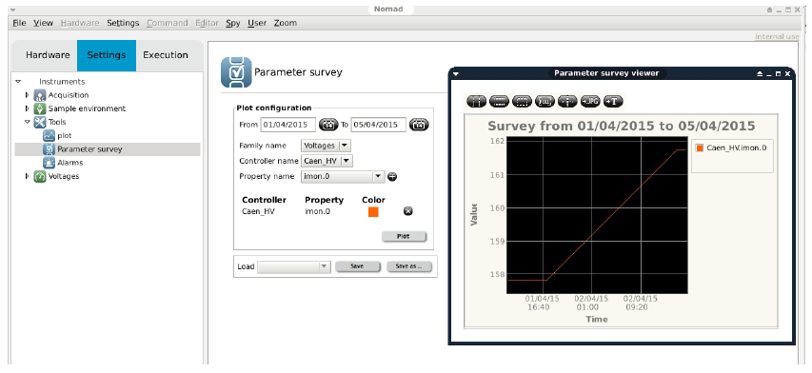
Data Acquisition
Configuration and data collection done using standard ILL software NOMAD
Development of low level driver done at LPSC fully operational
Slow-control, monitoring, alarm system under development

Slide 16
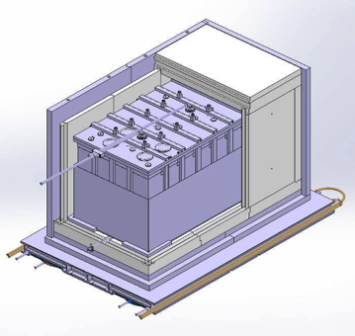
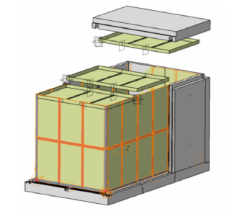
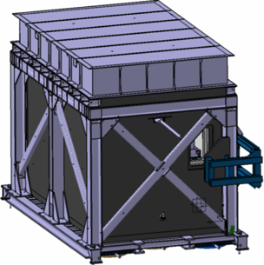
Internal Shielding
Internal shieldings
Magnetic shieldings
Overview
Muon Veto
65 T of lead against external γ-rays
6 T Polyethylene against fast neutrons
B4C layers against thermal neutrons
Soft Iron + μ Metal layers to shield stray B-field
Muon veto umbrella to tag cosmic ray induced background
Seismic study finalized, Fire study still in progress

Slide 17
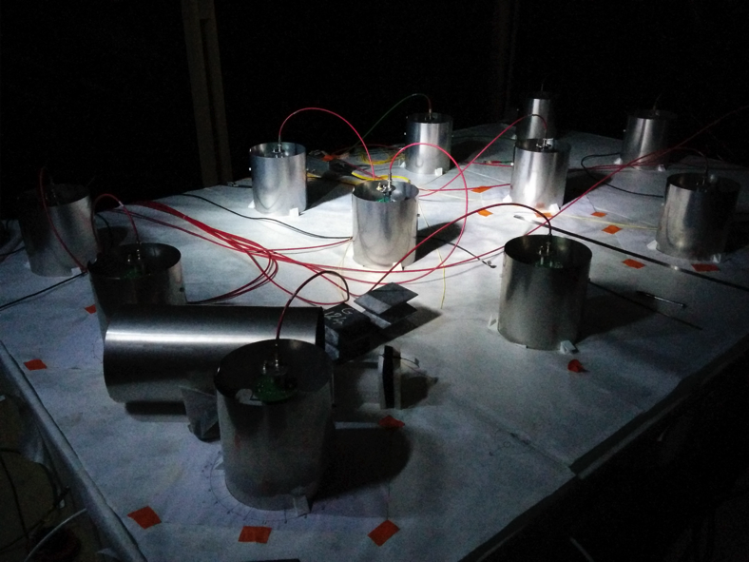
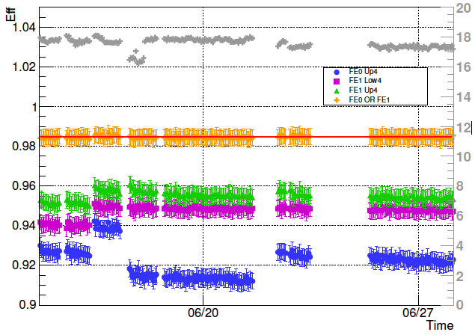
Muon Veto
Water-Cerenkov detector
4x2.6x0.25 m³ water + wavelength shifter (4MU)
20 PMTs on the top
Tyvek diffuser
Results from prototype
Excellent overall efficiency 98.5% and stable
PMTs mapping to reduce sensitivity to γ-rays
Final detector fabricated and soon delivered

Slide 18
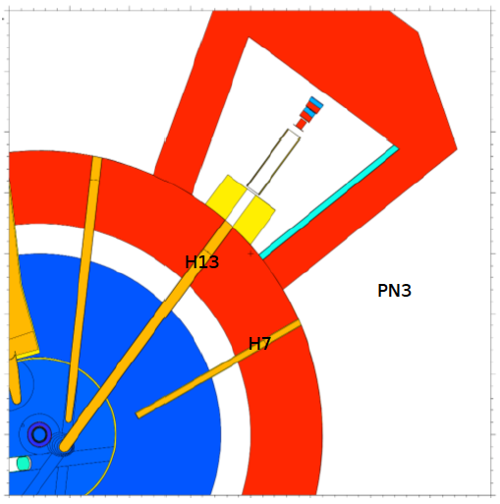
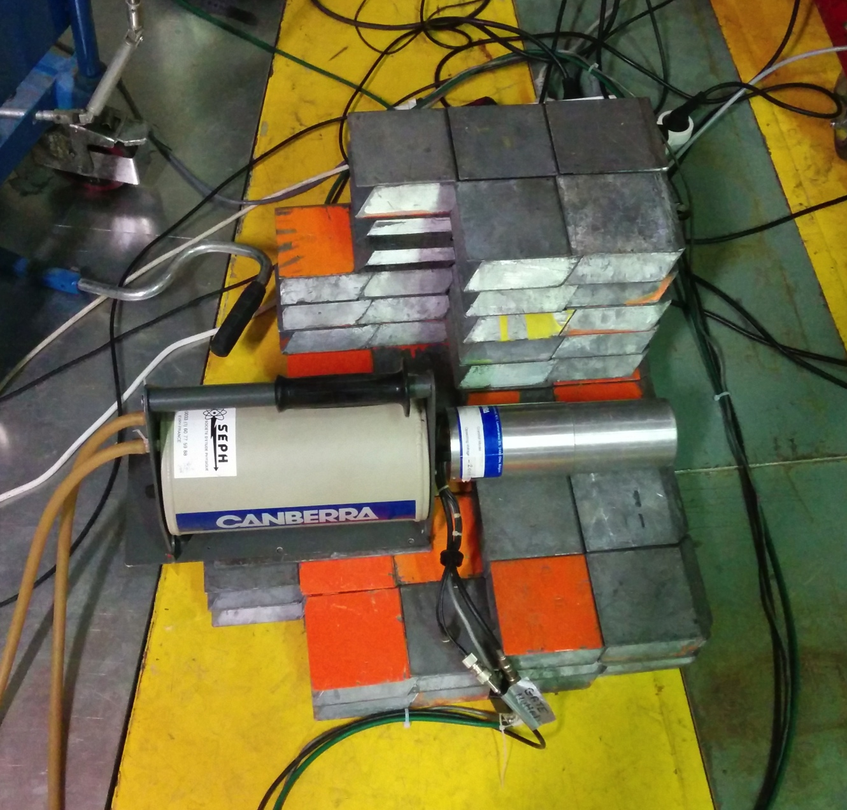
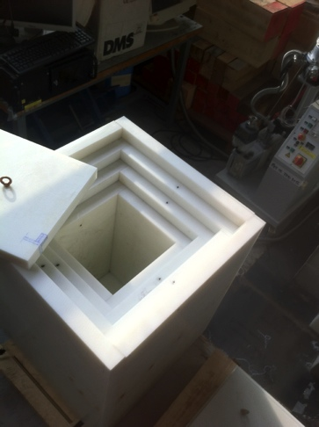
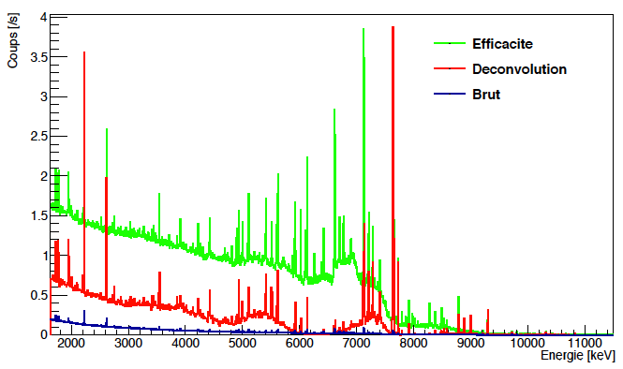
Site Characterization
Extensive γ, μ and n measurements on site performed in 2014-15:
Ge, NaI,³He and fast-n detectors inside various shielding
Data analysis coupled simulation of the detector setups
MCNPX simulations of the reactor and main neutron lines
Energy spectrum and location of all sources
Design of shielding to meet the specifications of <100 Hz in prompt window and 1 Hz in delayed window.
Complete reactor simulations
Stereo
Modular PE shielding
Deconvoluted γ-spectrum
Directionality studies

Slide 19
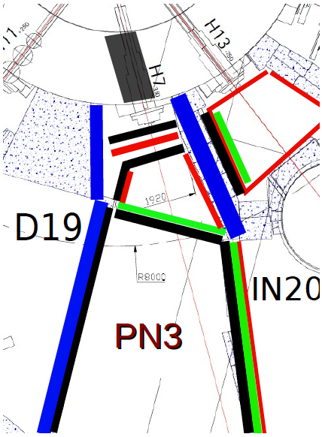
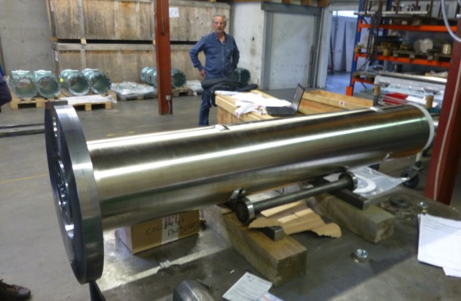
Shielding Configuration
Old “H7” line removed
Combination of heavy concrete, lead and B4 barriers to block γ and n fluxes.
STEREO

Slide 20
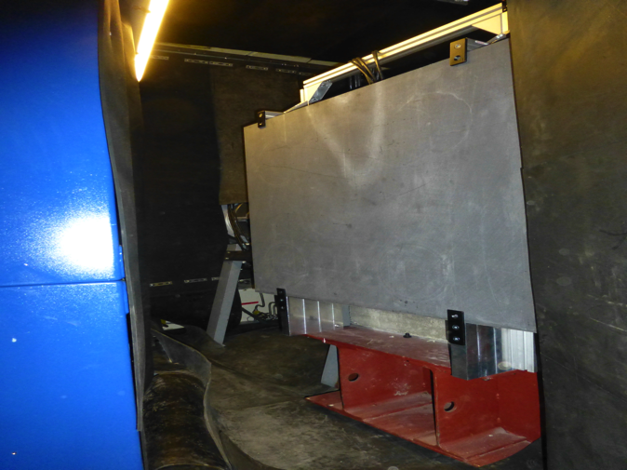
Shielding Configuration
Neutron absorbers added in neighbor primary casemate
STEREO

Slide 21
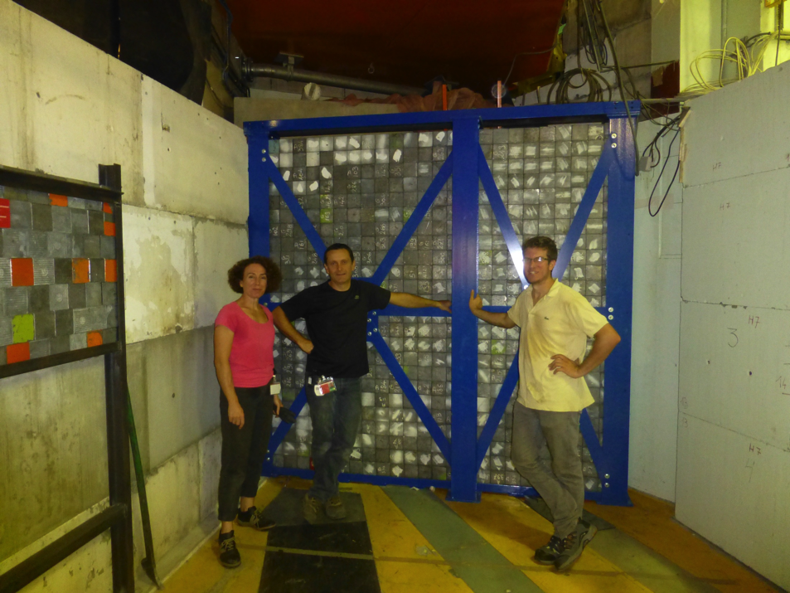
Shielding Configuration
Last front wall installed in Sept. 2015
10 cm lead + 10 cm PE
STEREO

Slide 22
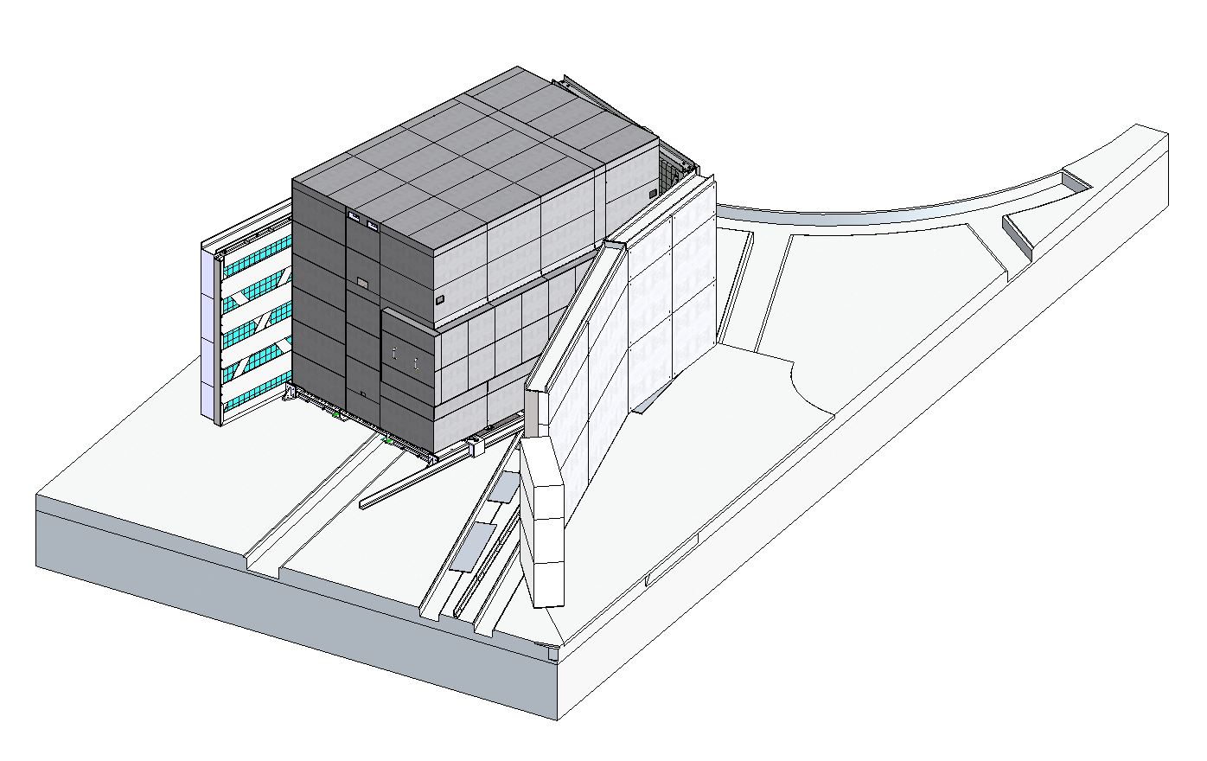
Shielding Configuration
Final reinforcement of the side wall foreseen this winter.
STEREO

Slide 23
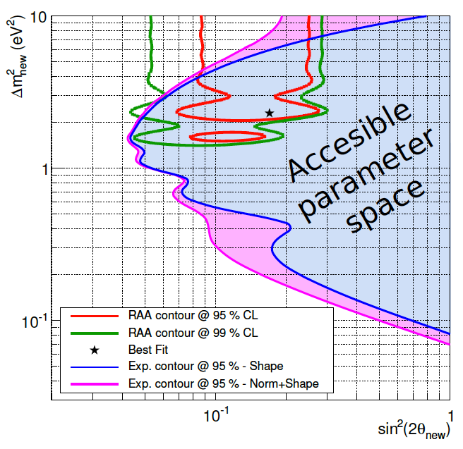
Sensitivity
400 ν per day during 300 days
Signal/Background = 1.5
Detection and reconstruction effects from GEANT4 simulation
Neutrino flux uncertainties + 4% norm uncertainty
Visible E_{e+} > 2 MeV
E_{n} > 5 MeV → ε_{det}=60%
δE_{scale} = 2%

Slide 24
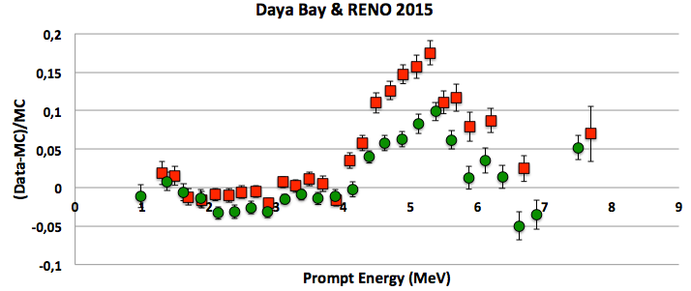
New Reference ²³⁵U Spectrum
120 000 ν expected
Highly enriched fuel
→ pure 235U fission spectrum
Measurement complementary to Double Chooz, Daya Bay and Reno near detectors.
Could bring new insight into the deviation at 5 MeV (see Julia’s talk)
Daya Bay Aug. 2015
RENO Nov. 2015
Caution: RENO normalization?

Slide 25
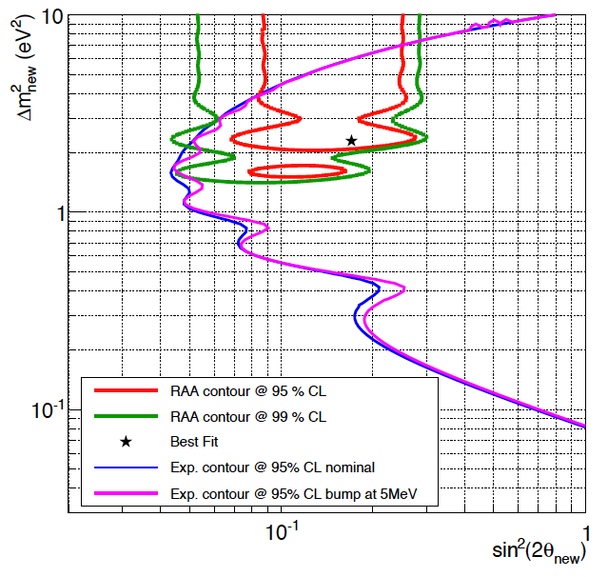
5 MeV Bump
Evolution of the sensitivity when introducing the 5 MeV Bump as a new uncertainty in the predicted spectrum (50% of the amplitude).
To first order the oscillation phase is not compatible with an isolated deviation around 5 MeV.

Slide 26
Conclusion
Sensitivity contours cover the Reactor Anomaly. Emphasis on control of the detector response to control shape distortions.
Final design validated by prototypes and seismic studies
Several external shielding walls have already been installed
Most parts of detector are under fabrication or already delivered, the schedule is now driven by the delivery of some shielding parts and the final safety agreement.
The detector integration will take place at LPSC-Grenoble in Feb-March 2016
First data expected in summer 2016

