Slide 1
CHANDLER: New Technology for Short-Baseline Reactor Experiments
C. Mariani
Center for Neutrino Physics, Virginia Tech
October 22, 2015

Slide 2
Keys to a Short-Baseline Reactor Experiment
Sensitivity to the higher Δm² range (2 eV² and above) requires a compact reactor core and good energy resolution.
Relatively small detectors require careful consideration of isotope used for neutron capture and tagging.
Background is important, needs to be characterized
Detector should be able to work on the surface or with very small overburden
Detector should be portable, cannot use tons of shielding material

Slide 3
Neutron Capture Options
Not the same as in a reactor experiment
Similar backgrounds but different overburden
Detector dimensions and event containments are very different
Neutron Capture on Gadolinium
Neutron Capture on Lithium-6
γ
n
n
⁴He
γ
γ
⁶Li
Gd
E = 4.78 MeV
Electron Equivalent
E ~ 0.5 MeV
(in organic scintillator)
E = 8 MeV
³H
γ
γ
Poorly contained in small detectors
Contained in a few micrometers

Slide 4
Backgrounds
Backgrounds, particularly from cosmic induced neutrons are the most significant challenge.
Difficult to shield muons, and shielding will contribute to enhance the number of neutrons produce by muons.
Multiple neutrons in particular will constitute a problem. Need to measure this on reactor site with a sizable detector.
Random coincident backgrounds is also a problem but can be mitigated by:
Reducing background rates (shielding)
Improving signal pattern recognition, and
Tightening coincidence criteria

Slide 5
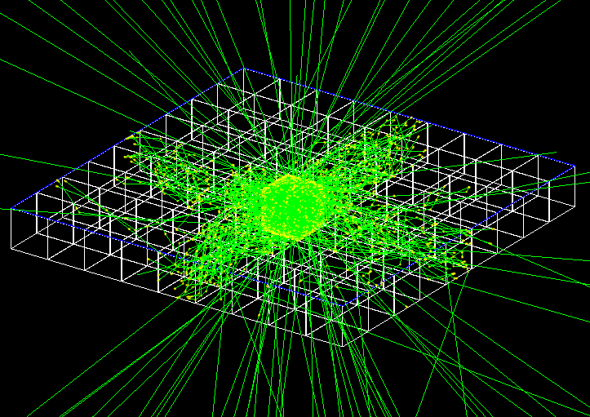
The CHANDLER Detector
$${\overline{ν}}_{e}$$
Neutron
Capture
Positron (e⁺)
e⁺
Detected Light
p
n
⁴He
⁶Li
³H
Time
10 ns
~50 μs
200 ns
Light is transported by total-internal-reflection
Photon Ray Tracing in GEANT4

Slide 6
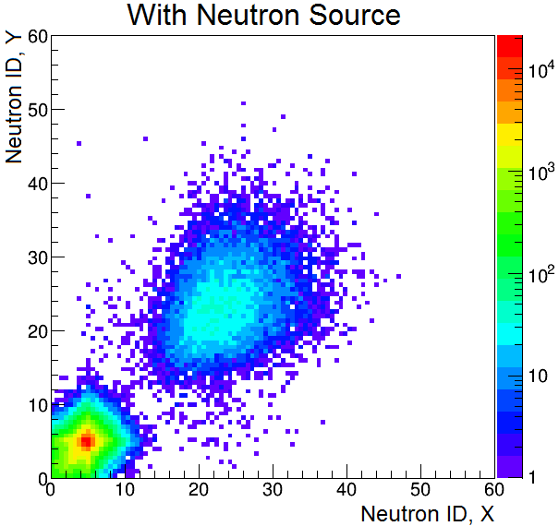
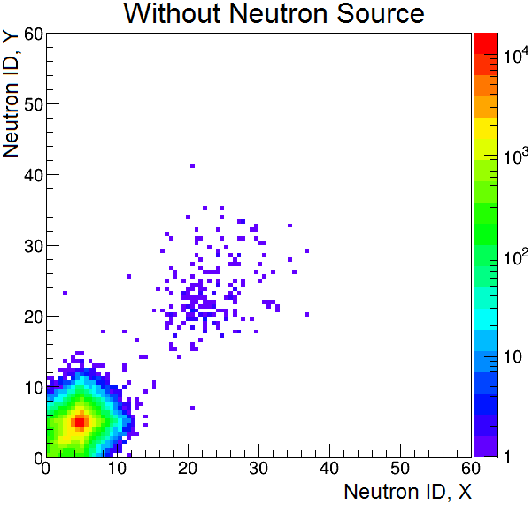
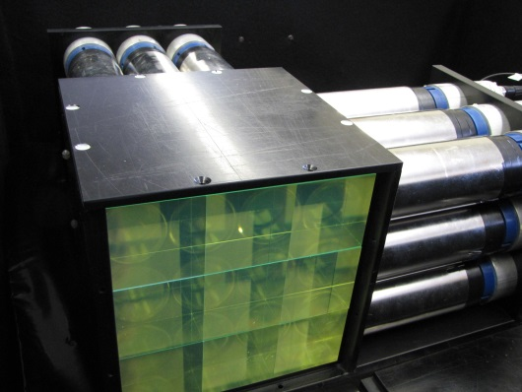
Neutron Capture in MicroCHANDLER
The 18-channel MicroCHANDLER prototype is idea for testing neutron tagging.
For each hit cell, we compute the neutron ID variable as the ratio of the integral of the pulse to the pulse peak value.

Slide 7
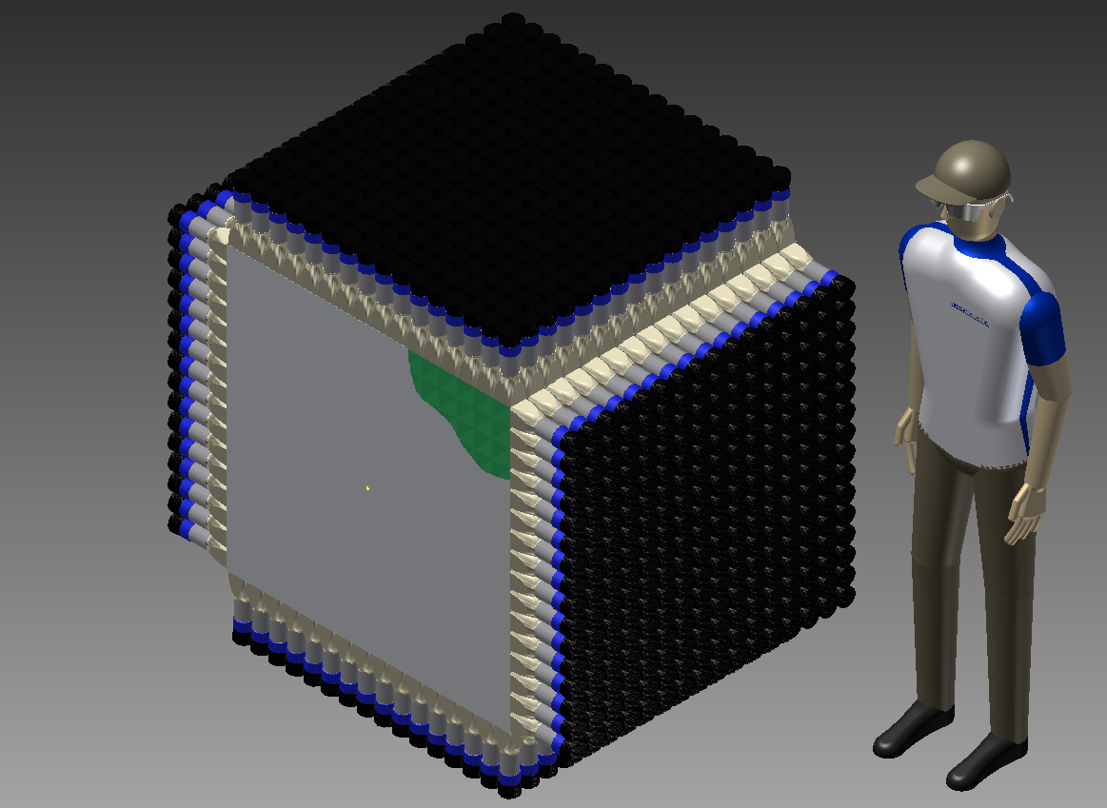
CHANDLER
PMT & Base
Built from commercially available parts that are simple to assemble
PVT Cube
Light Guide
~1 meter
Direction of Neutrino Flux
⁶LiF:ZnS(Ag) Sheet

Slide 8
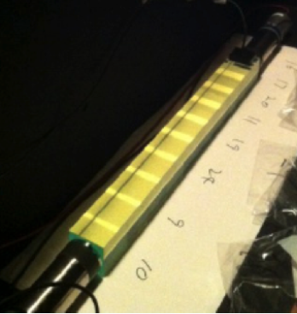
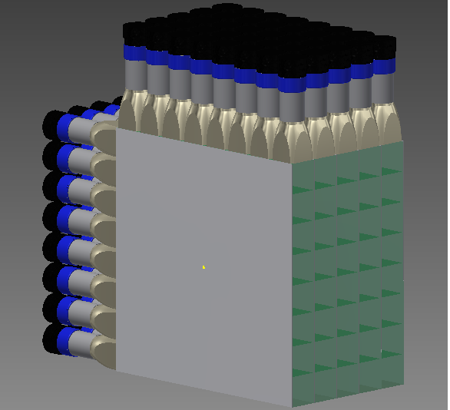
Research and Development Effort
Cube String Studies have been used to study light production, light collection, light attenuation, energy resolution and wavelength shifter concentration.
MicroCHANDLER is a 3×3×3 prototype which we are using to test our full electronics chain, develop the data acquisition system, study neutron capture identification and measure background rates.
MiniCHANDLER is a fully funded systems test (8×8×5) which is currently under construction and will be deployed at a commercial nuclear power plant. It will be used to test any remaining options and optimizations. It will be operational by winter 2016.

Slide 9
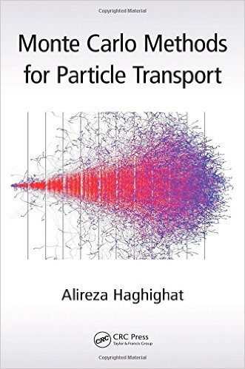
Detector Simulation
We have a full-scale GEANT4 simulation, developed by Jaewon Park, which we are using to study light transport and collection, and neutron transport and capture.
We also have a full-scale MCNP6 simulation, developed by William Walters and Alireza Haghighat, which we are using to study neutron transport and capture (see talk from Ali).
The neutron transport models in GEANT4 and MCNP6 are in very good agreement.

Slide 10
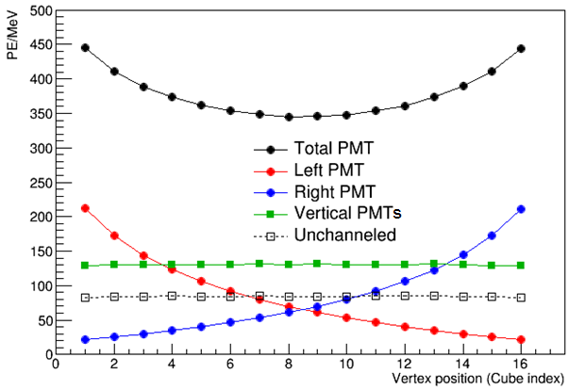
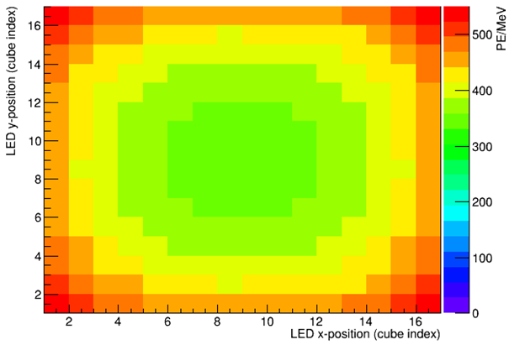
GEANT4: Detector Response vs. Cube Position
Simulation
Most of the light is collected in the 4 PMTs in the TIR channel directions.
About 20% of light is unchanneled, with the largest share in the adjacent PMTs.
Collected light falls off as you move away from the PMT.
Simulation
The largest excursion from the mean is in the corner cells.
The conversion to p.e./MeV assumes light guides, and a PMT with quantum efficiency of 25%.

Slide 11
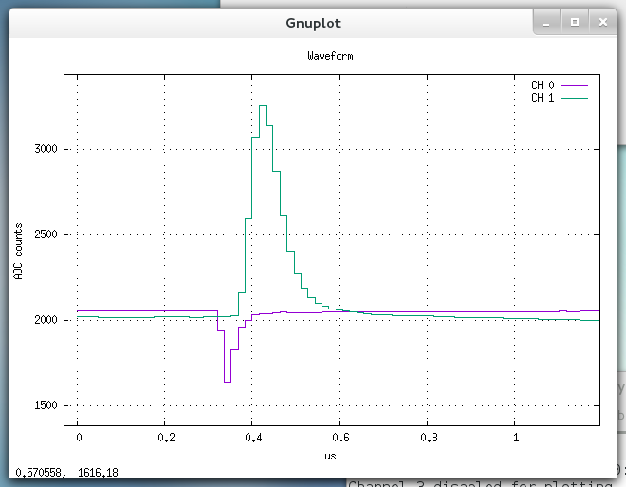
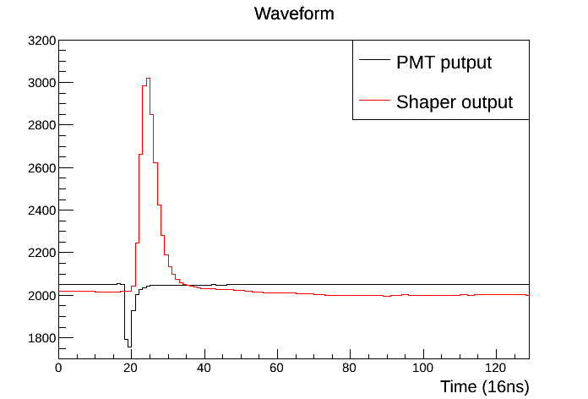
Electronics and DAQ
VME Shaper module 16 ch
CHANDLER Readout Electronics
2 inch high quantum efficiency PMT (R6231-100)
VME 16 ch - Analog Pre-amp and shaper circuit (VT+CREMAT)
VME 64 ch, 16 ns, 12 bit digitizer card (CAEN V1740)
Anode
Preamp
Gain x2
Shaper (25 ns)
Digitizer (16 ns)
Data Storage
Readout Software
VT customized readout system (based on CAEN WaveDump)
Each digitizer connected by dedicated single optical link to the optical card in the computer
Each link speed up to 80 MB/s
Multi-Board readout via parallel processing
Each DAQ processes run on a separate core
DAQ reads out each link as a separate data stream via optical card
Data streams are combined and sorted to identify events via event builder process running on raw data

Slide 12
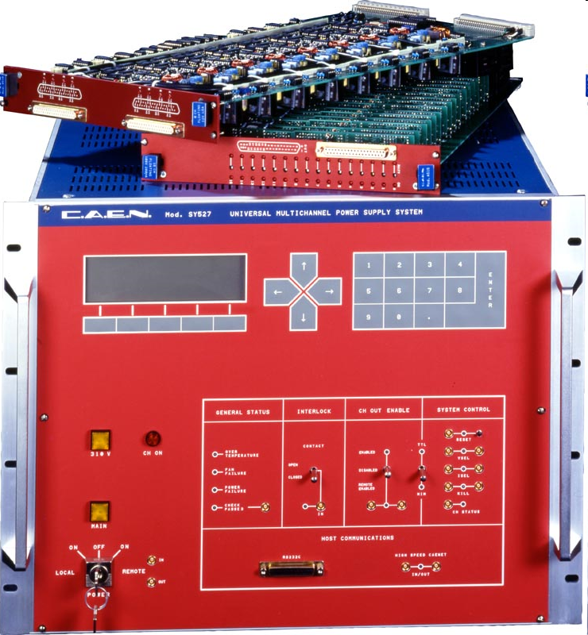
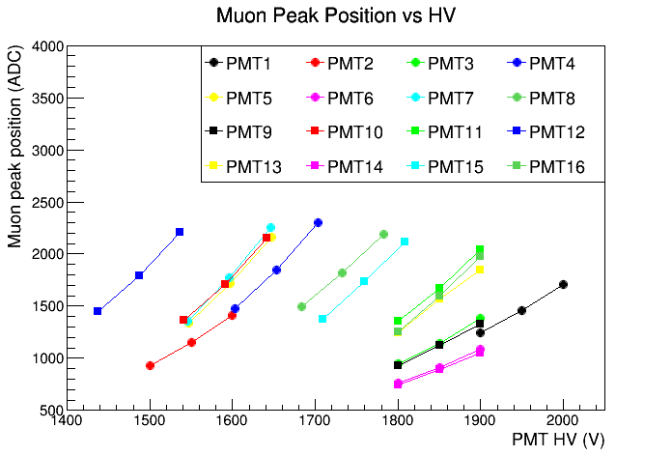
HV system
High Voltage
CAEN SY527 HV Mainframe
3-5 CAEN A734N HV cards
HV Software developed at VT
Possibility to fine control each HV channel
good for calibration and monitoring

Slide 13
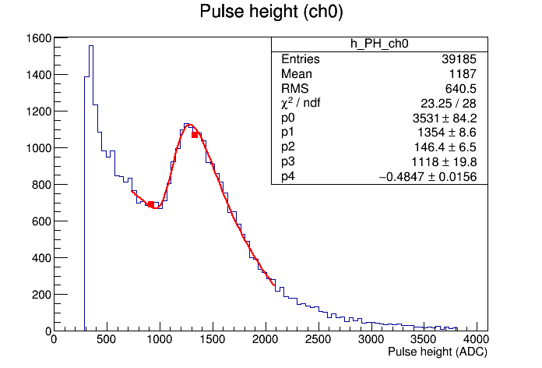
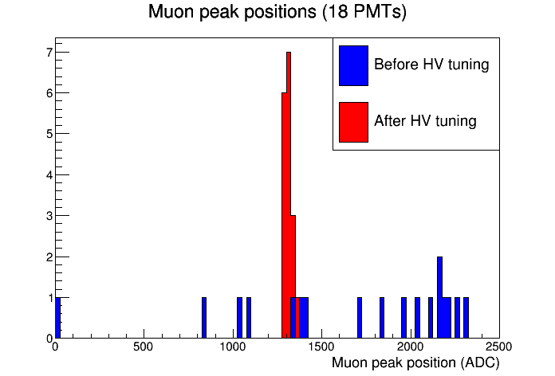
Calibration scheme
Use muons, simple and they are present in the detector, avoiding complicated calibration scheme (not so effective in past experiments while considering the complication of the calibration system and of the risk of the deployment.
μ
Fit model Landau
+
Exponential

Slide 14
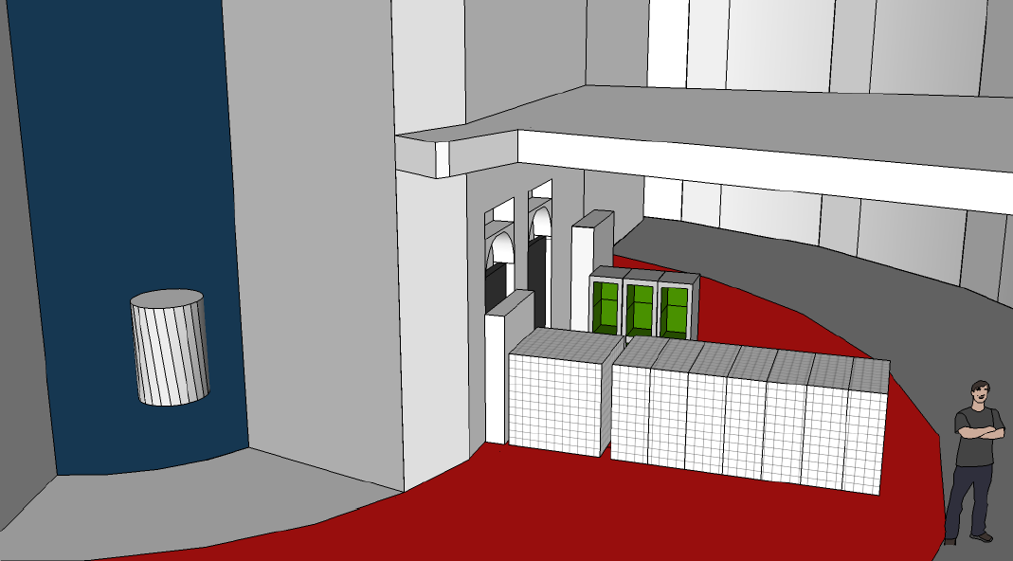
CHANDLER and SoLi$∂$
The two detectors will be deployed at the BR2 reactor operating as a single experiment.
50 cm
BR2
CHANDLER
5.5 m
SoLi$∂$

Slide 15
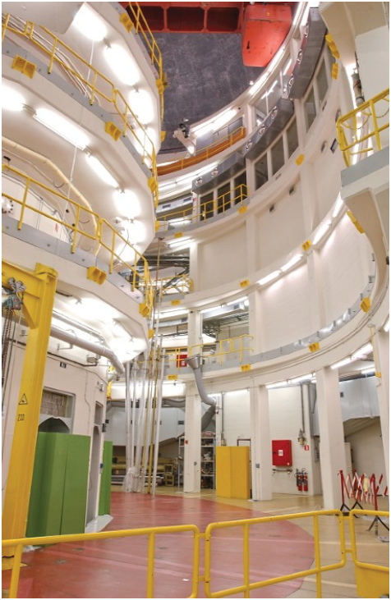
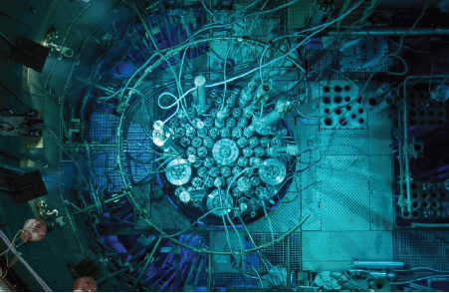
The BR2 Reactor
The 60 MW BR2 reactor is a facility at the Belgian National Nuclear Lab, SCK•CEN.
With a 5.5 meter closet approach this site has the highest reactor antineutrino flux of any publically knowable compact reactor site.
The absence of any beam portals makes for a relatively low-background site with backgrounds dominated by the typical environmental sources.

Slide 16
SoLi and CHANDLER Sensitivity
Distribution of events as a function of L/E for two different values of Δm² .
The red data points are for CHANDLER and the blue data points are for SoLid. Resolutions are fully included and the error bars represent the statistical errors after background subtraction.
Notes:
This plot explains why CHANDLER needs to be on front, energy resolution is important at closer distance. Larger distance needs mass.

Slide 17
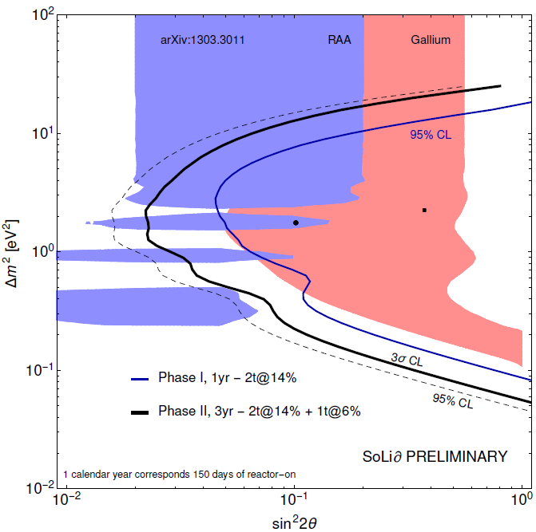
SoLi$∂$ and CHANDLER Sensitivity
The combined sensitivity for the SoLi𝜕/CHANDLER deployment at BR2 is compared to the Gallium and Reactor Anomalies.
The one-year, Phase I SoLi deployment covers most of the low Δm² part of the Gallium Anomaly at 95% CL.
Adding CHANDLER to the three-year Phase II extends the coverage to higher Δm² and pushes the reach well into the Reactor Anomaly.
These sensitivities are purely oscillometric, based on energy spectrum and baseline information alone.
Oscillometric Sensitivity Only

Slide 18
Conclusions
The evidence for a 1 eV² sterile neutrino is persistence but inconclusive.
Electron neutrino disappearance, which must exist if any of the oscillation hints are true, is the most promising way to resolve the sterile neutrino question.
Radioactive source and reactor neutrino experiments will soon be operating to search for short-baseline oscillations.
CHANDLER is a new detector technology with high purity, high efficiency neutron tag and good energy resolution.
Together CHANDLER and SoLid cover most of the ν_{e} disappearance allowed space.

Slide 19
Thank you

Slide 20
Backup

Slide 21
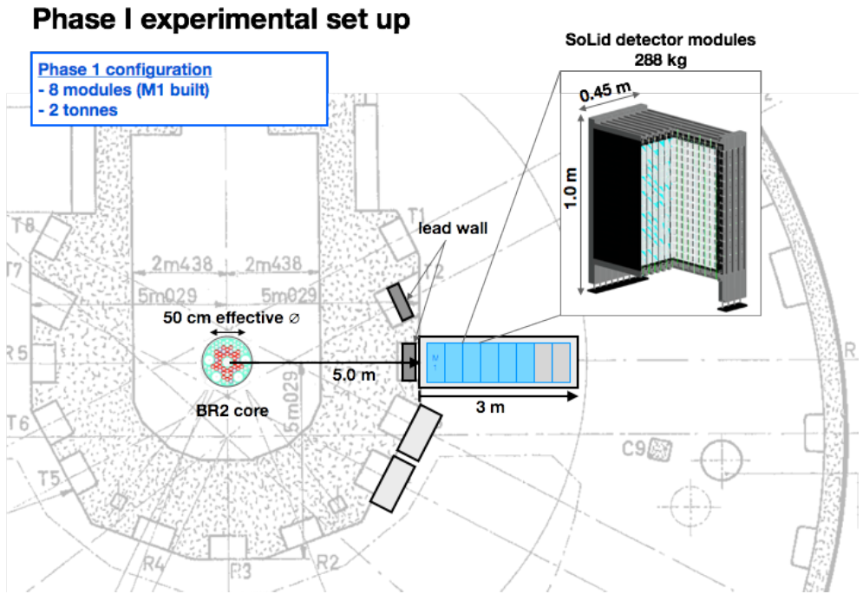
SoLi$∂$ at the BR2 Reactor in Belgium

Slide 22
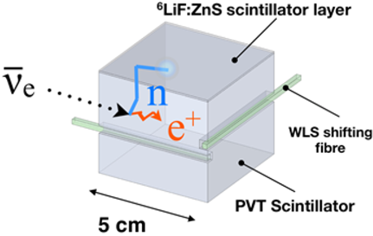
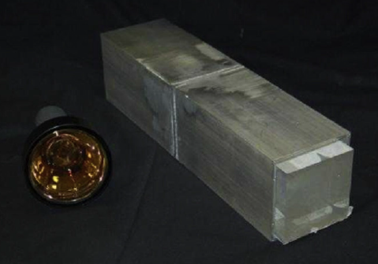
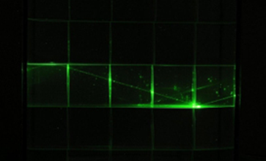
Technological Convergence
LENS
Sweany et al., NIMA 769, 37
The Raghavan Optical Lattice (ROL), invented by the late Virginia Tech professor, Raju Ragahvan, divides a totally active volume into cubical cells that are read-out by total internal reflection. LENS was designed for solar neutrino detection and not optimized for reactor antineutrino detection.
Optically isolated cubes, mated to ⁶LiF:ZnS(Ag) sheets, are used to tag IBD. Light is read-out by wavelength shifting fibers in orthogonal directions. It has the spatial resolution of the ROL optimized for reactor antineutrino detection. The small cross-sectional area of the fibers limits the light collection, dilutes the energy resolution and lowers the efficiency.
Used ⁶LiF:ZnS(Ag) sheets mated to a solid bar of wavelength-shifting plastic scintillator. This prototype demonstrated the feasibility of pairing the sheets to wavelength shifting plastic, but the long bars do not have the spatial resolution required for good background rejection
CHANDLER
Carbon Hydrogen Anti-Neutrino Detector with a Lithium Enhanced ROL

Slide 23
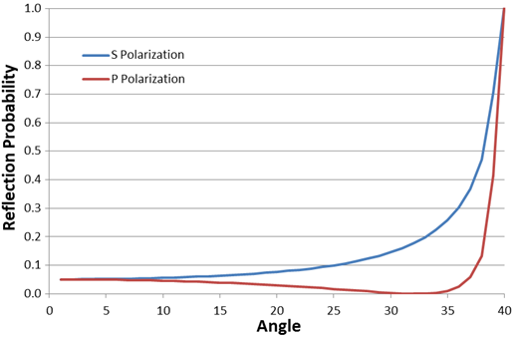
Optics of the Raghavan Optical Lattice
Fresnel Reflections
The optics are based on the interface of PVT (n=1.58) and air (n=1).
The critical angle (θ_{c}) is 39.27°
The Brewster angle is 32.22°
Because θ_{c} < 45° any light capable of passing between cubes will necessarily fall into the total-internal-reflection (TIR) channel in that direction.
Brewster Angle
Critical Angle
Each of the four TIR channels is open to 11.3% of the light produced in a cube.
54.8% of all light can not be channeled.
Some channeled light that gets reflected off of a cube surface perpendicular to the channel direction will reach the PMT in the opposite direction.

Slide 24
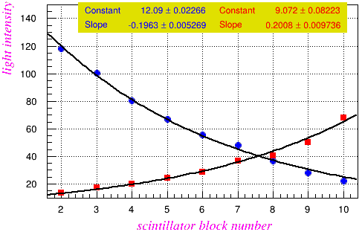
Effective Attenuation Length Study
LED Flasher
PMT1
PMT2
Block: 1 2 3 4 5 6 7 8 9 10
Average Effective Attenuation Length λ = 31.3 cm
Data
There are two contributions to the effective attenuation:
bulk attenuation in the PVT and
Fresnel reflection at the cube interfaces.

Slide 25
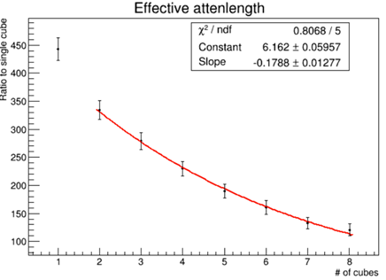
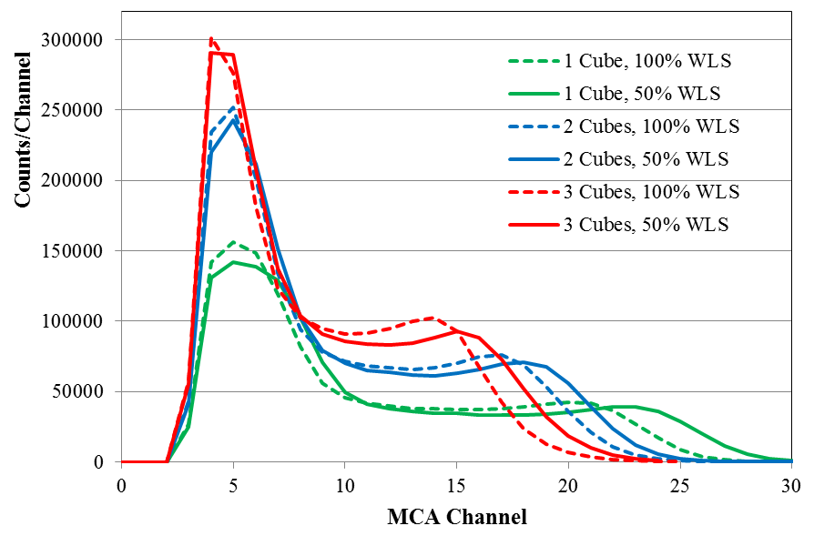
Wavelength Shifter Concentration
The wavelength shifter (WLS) dopant can be a significant source of attenuation.
Effective Attenuation Length for 50% WLS Concentration
The Compton edge of ²²Na was used to study the relative light output.
²²Na (E_{γ} of 511 and 1274 keV)
λ = 34.7 cm
Halving the WLS concentration increases the attenuation length by 10%.
The light collection with lower WLS is greater at each position.
We will also be studying WLS concentrations of 75% and 25%.

Slide 26
Light Output and Collection
An LED flasher was used to determine the resolution as a function of MCA channel.
The ²²Na Compton edge is at 1.06 MeV, and at two cubes from the PMT it reconstructs at channel 20, which corresponds to an energy resolution of 6.5%.

Slide 27
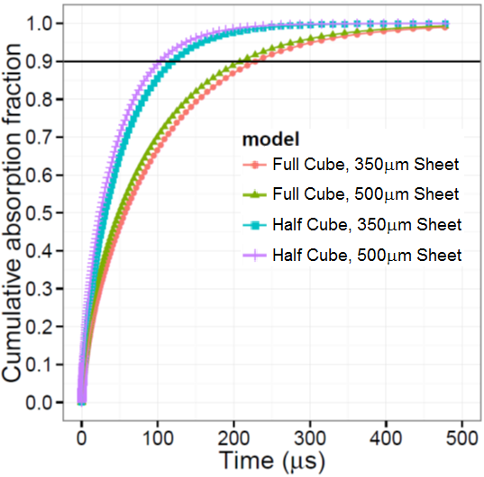
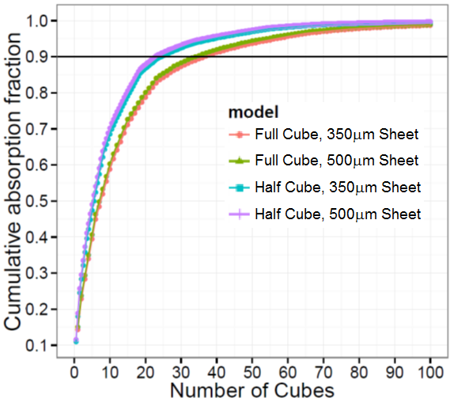
MCNP6: Neutron Transport and Capture
 | ⁶Li Capture | Time for 90% Capture | Volume for 90% Capture
Full Cube, 350 μm Sheet | 51% | 229 μs | 37 cubes
Full Cube, 500 μm Sheet | 55% | 209 μs | 35 cubes
Half Cube, 350 μm Sheet | 69% | 120 μs | 24.5 cubes
Half Cube, 500 μm Sheet | 73% | 103 μs | 23 cubes

