Slide 1



Reactor Antineutrino Directionality via Elastic Electron Scattering in Gd-Doped Water Cherenkov Detectors
Applied Antineutrino Physics 2015
Arlington, VA
December 8, 2015
Daniel Hellfeld
University of California, Berkeley
Department of Nuclear Engineering
Lawrence Livermore National Laboratory
Rare Event Detection Group
Notes:
Hello everyone. My name is Daniel Hellfeld. I received my bachelors in Physics from UC Santa Barbara and a master in nuclear engineering from Texas A&M University this past May. I recently started the doctoral program at UC Berkeley. Most of the work I will be presenting today was done while I was still at Texas A&M.
The work is on the feasibility of antineutrino directionality using elastic electron scattering in WATCHMAN and in general Gd-doped water cherenkov detectors. This was a joint effort between myself and Steven Dazeley.

Slide 2
Outline
Antineutrino interactions and directionality
Reactor antineutrino energy spectrum
Expected signal
Backgrounds
Sensitivity vs. radon, depth, and detector size
Conclusions
Notes:
Just to outline the talk, today I will first introduce antineutrino electron scattering and talk about the cross-sections and directionality. I will then mention the energy spectrum of the antineutrinos emerging from typical LWRs. I will then go into the signal that we expect. Then I will discuss our characterization of all the background we expect to see and the cuts we use to mitigate them.
We will see from the background section that radon presents a large threat to sensitivity and thus I will presents some results for our WATCHMAN like design as a function of radon contamination. We then look at the advantages of placing the detector deeper underground, making the detector larger, and again reducing the radon contamination. I will then wrap up with some of our conclusions.

Slide 3
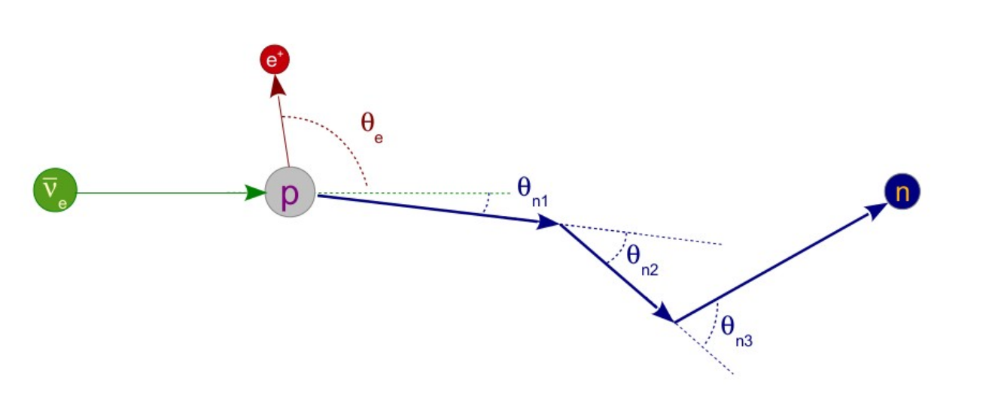
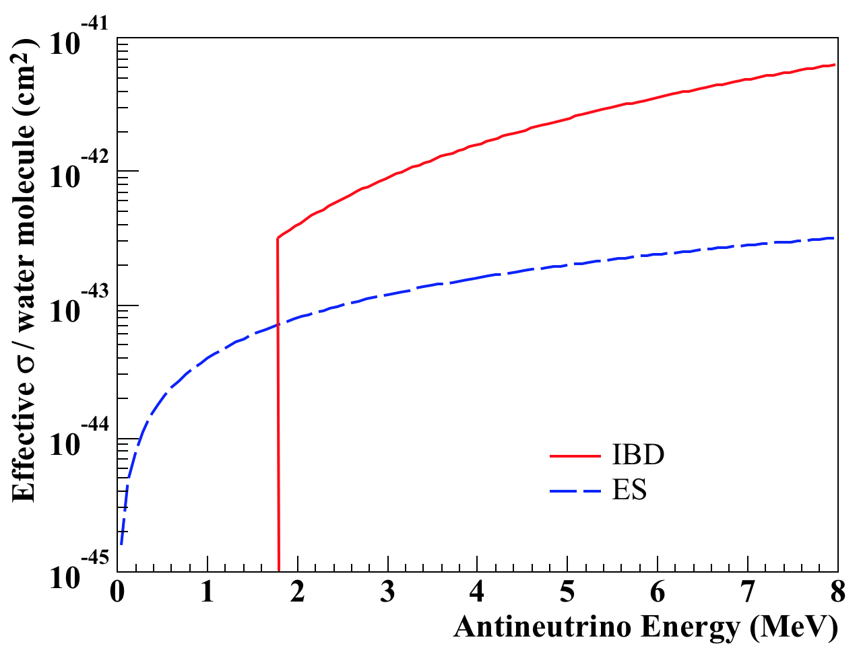
Antineutrino Interactions
Inverse Beta Decay
Electron Scattering
Cherenkov cone
e⁻
θ
e⁻
E. Caden (AAP, 2012)
Notes:
The primary interaction in WATCHMAN is the inverse beta decay interaction, in which a neutrino interacts with a proton to create a neutron and positron. The positron will annihilate and the neutron will thermalize and capture on a Gd nucleus. The coincident detection of the positron and neutron constitute the neutrino signal.
There is also electron scattering in which a neutrino elastically scatters an electron, which can create a detectable cherenkov light cone.
We typically use IBD because the cross section is larger and the coincident detection helps in background reduction. Ill note that, and we will see this again in a couple slides, that the difference between them shrink with decreasing energy and reactor neutrinos typically have low energies. So its not all bad.
We look at scattering for one main reason and that is directionality.

Slide 4
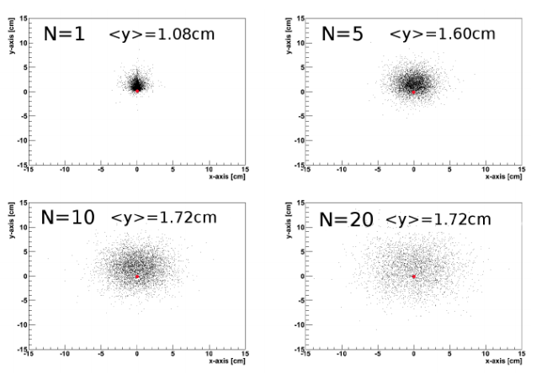
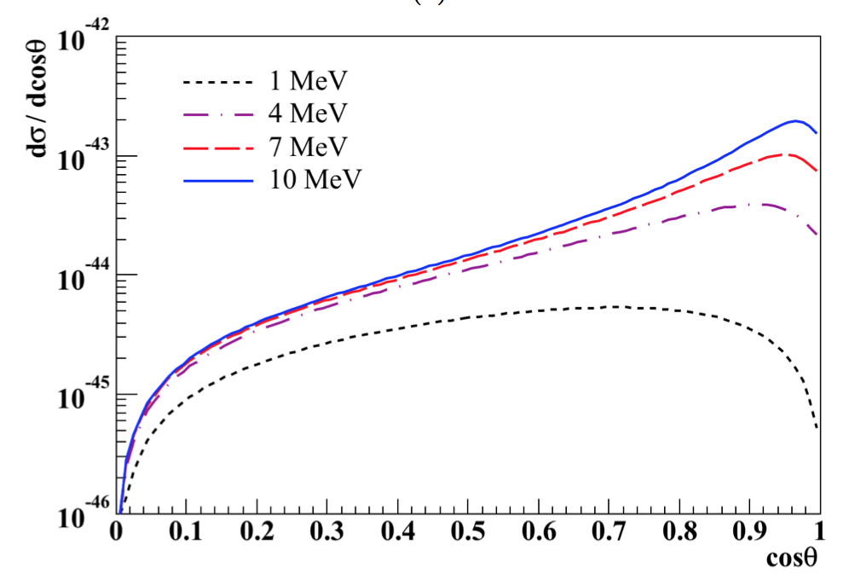
Directionality
Reduce background from multiple nearby reactors
Search for clandestine reactors
Supernova pointing
Inverse Beta Decay
Electron Scattering
C. Langbrandtner (Ph.D. Thesis, 2011)
Notes:
Shown on the left is the neutron locations following IBD after 1, 5, 10, and 20 scatters. We see initially that the neutrons move opposite to the neutrino source, giving good directionality. However it quickly loses this information as it scatters. The timing issue of detecting the neutron before it undergoes a significant amount of scattering is what make directionality with IBD very difficult.
On the other hand, here I show the differential cross section with respect to the cosine of the scattering angle for electron scattering. We see that it is heavily favored in the forward direction. Therefore, with an ensemble of ES events, we can point back to the source.
Now, in this talk we are concerned only with reactor antineutrinos. So lets look at the spectrum

Slide 5
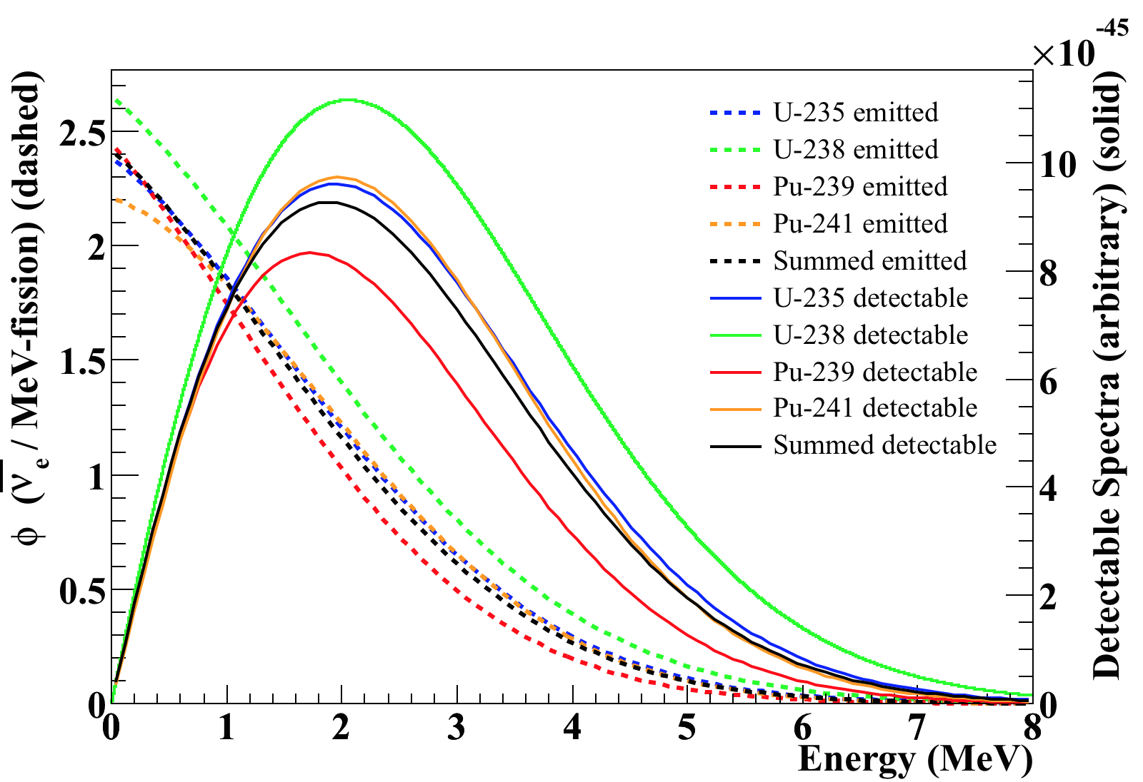
Reactor Energy Spectrum*
Detectable = folded with cross section
Summed = weighted sum using typical mid-cycle PWR fission fractions
(49.6% ²³⁵U, 35.1% ²³⁹Pu, 8.7% ²³⁸U, 6.6% ²⁴¹Pu)**
* P. Vogel, J. Engel, Phys. Rev. D 39, 3378 (1989)
** G. Zacek et al., Phys. Rev. D 34, 2621 (1986)
Notes:
Here I show the typical number of antineutrinos produced per fission per MeV for individual fissionable isotopes in a typical reactor. These are the dashed lines. In a typical mid-cycle PWR, we have the following fission concentrations, and thus we can use a weighted sum of the individual curves to determine the overall curve we would expect to see, shown in black.
The solid lines here represent the detectable or observable spectra by folding the flux with the total cross section. We see that the average observable energy is about 2-3 MeV.
I should mention that most studies only concern themselves with E > 1.8 due to the IBD threshold, so the spectrum below 1.8 is not very well understood. We simply extend current parameterization below and admit that there is some uncertainty to that.

Slide 6
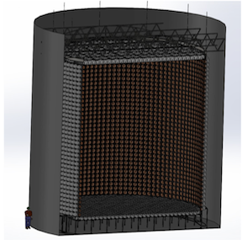
Baseline Detector Design
Access to existing GEANT4 simulation of WATCHMAN detector
3.1 kilotons of Gd-doped water total
2.1 kiloton target
  ~ 4300 12-inch PMTs facing target
1 kiloton veto
  ~ 480 12-inch PMTs facing veto
1 kiloton fiducial
1.5 meter buffer
Assume low-background PMTs
1500 m.w.e. overburden
13 km standoff from 3.758 GWth LWR
Note: WATCHMAN not originally designed for directionality
Notes:
Now, as all of you know this is the WATCHMAN detector with about 15.8 m total diameter and 3 kilotons of Gd-doped water. For this work we actually extended the PMT support structure to 13.8 meters as opposed to the 12.8 meters stated in the white paper. This was to give us a little more buffer region and later we will see why. We have about 4300 PMTs facing the target and 480 facing the veto. For this work we also assumed we were using 10 inch low background PMTs. Of course we have the 1500 meters of water equivalent overburden and a 13km standoff from a 3.8 GWth light water reactor

Slide 7
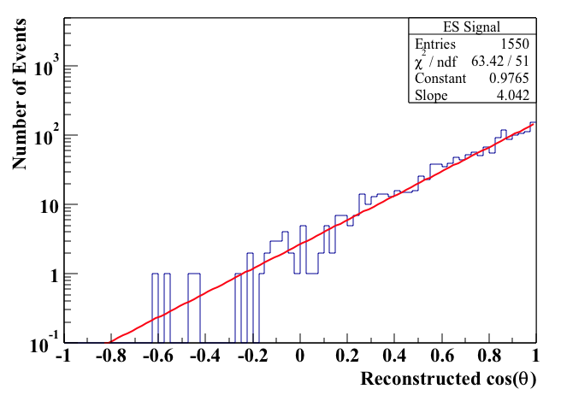
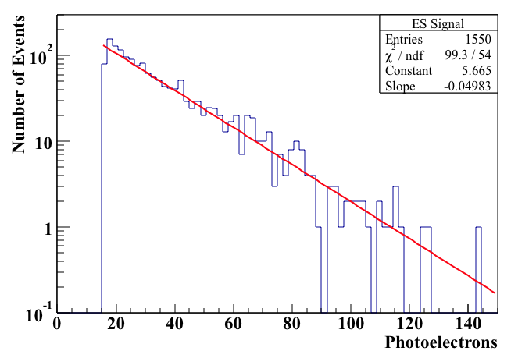
Expected ES Signal
Simulations done with GEANT4 simulation RMSim
Event reconstruction done with BONSAI
(~ 9270 events/5 years)
5 years
5 years
RMSim imposes 16 PE trigger threshold
→ 17% detection efficiency
Notes:
Now we calculate the expected signal using this equation where Ne is the number of available electrons, d is the standoff, phi_i is the number of antineutrino produced per fission per MeV of isotope i, sigma is the cross section, and f_i is the fission rate of isotope i. The results in about 9270 events in 5 years.
A ES generator was implemented in the RMSim package and event reconstruction was done with BONSAI. Ill note that the ES generator has been implemented in RATPAC and is currently waiting as a pull request.
Here I show the 5 year detector response and reconstruction of the scattering angle. I mention that RMSim imposes a 16 PE threshold in order to trigger the detector and thus we see we only have a 17% detection efficiency. We note that the energy distribution seems to be an exponential that extend out to about 140 PE. The reconstruction shows an exponential towards cos(1), reassuring that we can indeed see that ES is forward peaked.

Slide 8
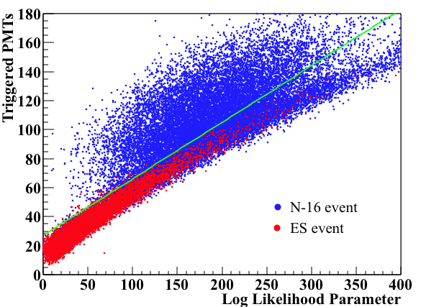
Cosmogenic Radionuclides
  β^{+/-} decay of ¹⁶N, ¹⁵C, ¹¹Be, ⁸B, ⁸Li
    Utilize yields from Super-K FLUKA study*
  Muon rates (relative to KamLAND) obtained from GEANT4 simulation of muons as a function of depth
    provided by David Reyna (SNL)**
  Impose a 10 sec position sensitive veto
    1 meter tube for non-showering muons
    2 meter tube for showering muons
      Results in 67% livetime
  Remove events that reconstruct as more than one Cherenkov cone
    evidence of coincident β and γ
* S. Li, J. Beacom, Phys. Rev. C 89, 045801 (2014)
    ** D. Reyna, arXiv:0604145v2 (2006)
Notes:
Now for backgrounds. First we look at the beta decays of the long lifetime and high yield cosmogenic radionuclides. The muonic yields were taken from a FLUKA study done on Super-K and the muon rates were scaled from an IsoDAR study on KamLAND. To reduce the RN backgrounds, we impose a 10 second position sensitive veto, using a 1 meter tube for nonshowering events and a 2 meter tube for showering events. Assuming all the muons traverse the entirety of the detector results in a livetime of about 67%.
Now, some of these RN beta decay to an excited state and eventually release a gamma ray. Most notably the decay of N-16 results in a 6.1 MeV gamma. If two cones are present within an event, the event reconstruction will have a higher uncertainty (lower log likelihood). We show here the number of triggered PMTs versus the log likelihood for the event for both N-16 and ES events. The single cone ES events display a narrow almost proportionate band while the N-16 has a similar behavior but with a large grouping of low likelihood events. We attribute these events to the beta-gamma events and can thus remove them with a simple cut shown here in green.

Slide 9
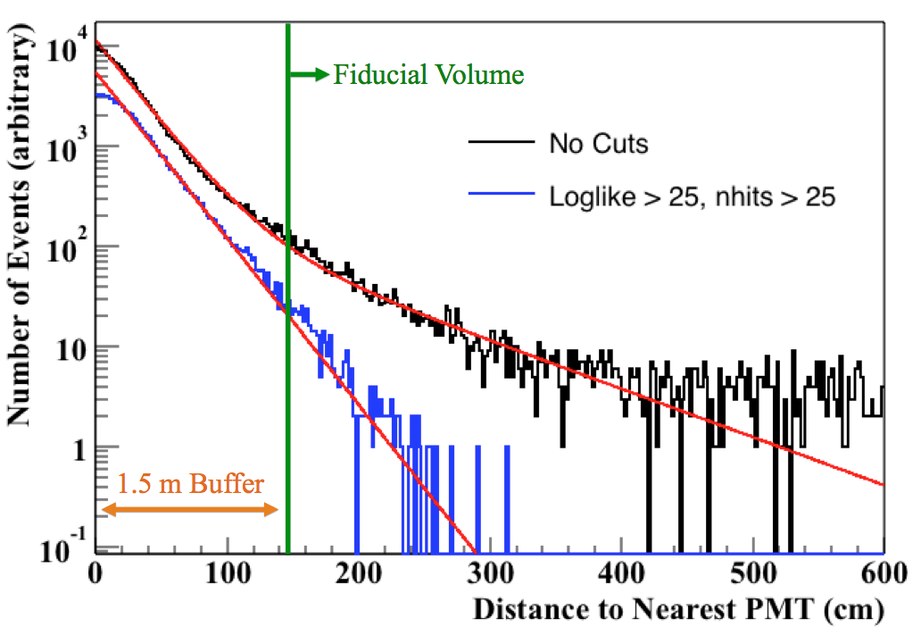
PMT Backgrounds
Mostly interact in buffer, however uncertainty in reconstruction can place them in the fiducial volume
Use exponential behavior to estimate backgrounds
Notes:
The PMTs will contain trace amounts of U, Th, and K, and thus will have some gamma ray activity associated with them. Using 5000 PMTs means will we will have a lot of gamma rays. Most of them however will interact in the buffer region and thus should not contribute any background, however due to the uncertainty of the reconstruction, the events can be place within the FV.
We simulated an arbitrary amount of PMT gammas and show the distance to the nearest PMT for each event in black. With the green line denoting the FV barrier, we see that a lot of events are reconstructed inside. If we force some of the poorly reconstructed events to be removed, we can improve out results, shown here in blue. We notice that the behavior seems to be a decaying exponential away from the PMTs. This is promising for this type of background, because we can essentially reduce it to zero with a large enough buffer zone. We can then use this exponential behavior to predict our PMT background for any sized FV.

Slide 10
²²²Rn / ²¹⁴Bi
Presence of radon gas in detector medium
  Trace amounts of naturally occurring ²³⁸U
  Radon gas migrating out of PMT glass
  Radon gas leaking into detector from mine air
Estimate with radon contamination of 10⁻¹⁴ gU/gD₂O published by SNO*
  Including 67% livetime and 20% detection efficiency results in 1350 events/day (~ 2.5 x 10⁶ events/5 years)
  → Progress must be made in radon removal
    Radon free air
    Uranium removal
    Directed clean water flow (permeable acrylic barrier)
    → Beginning to investigate these methods
* I. Belvis et al., Nucl. Instrum. Methods A 517, 139 (2004)
Notes:
Now, the presence of radon gas in the water will eventually lead to the 3.3 MeV beta decay of Bi-214. The radon can appear from the natural uranium already in the water, the radon gas that migrated out of the PMT glass, and from radon gas leaking into the detector from the outside mine air.
Since it is hard to predict the radon contamination before building the detector, we simply use the published values from the SNO detector, which was 10⁻¹⁴ gU/gHeavy water. If we use this contamination value in our light water detector, we get about 10,000 Bi-214 decays per day somewhere in the FV. If we include the livetime and a 20% detection efficiency, we get about 1350 events a day or 2.5 million every 5 years. This will completely swamp our 1500 ES events in 5 years. So it is not looking too good..

Slide 11
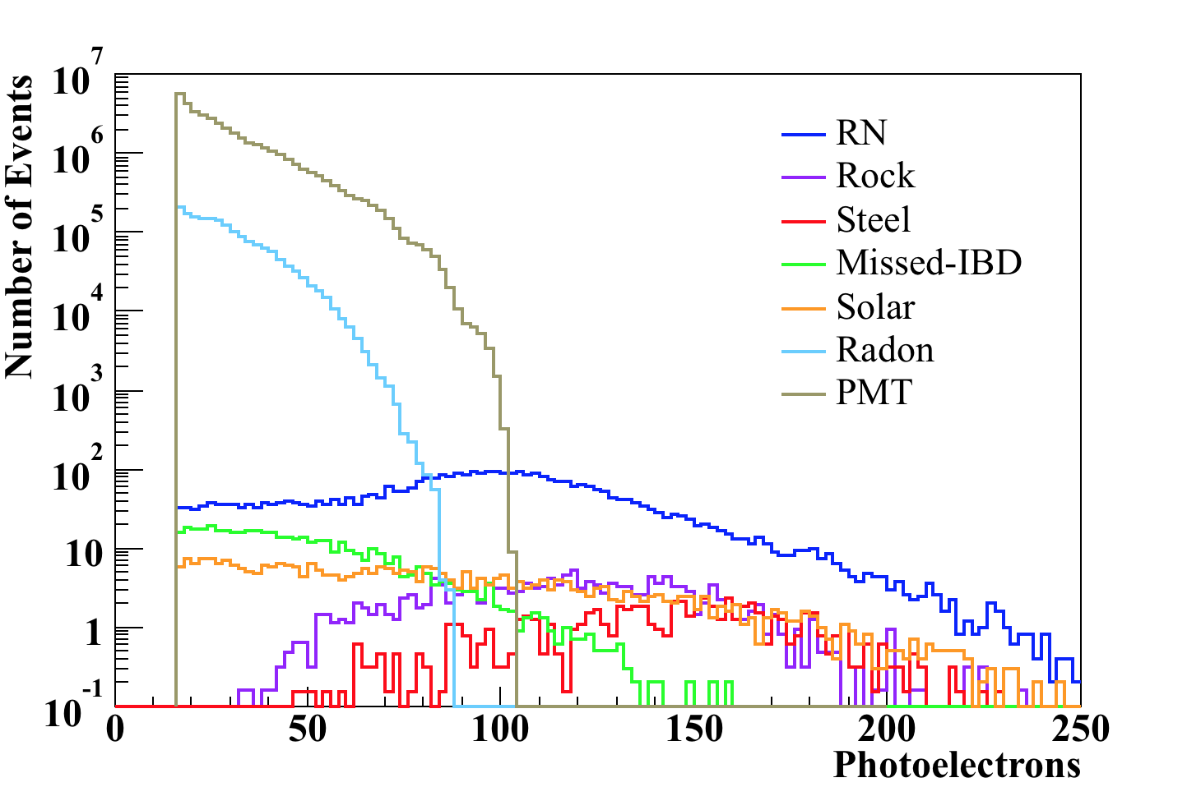
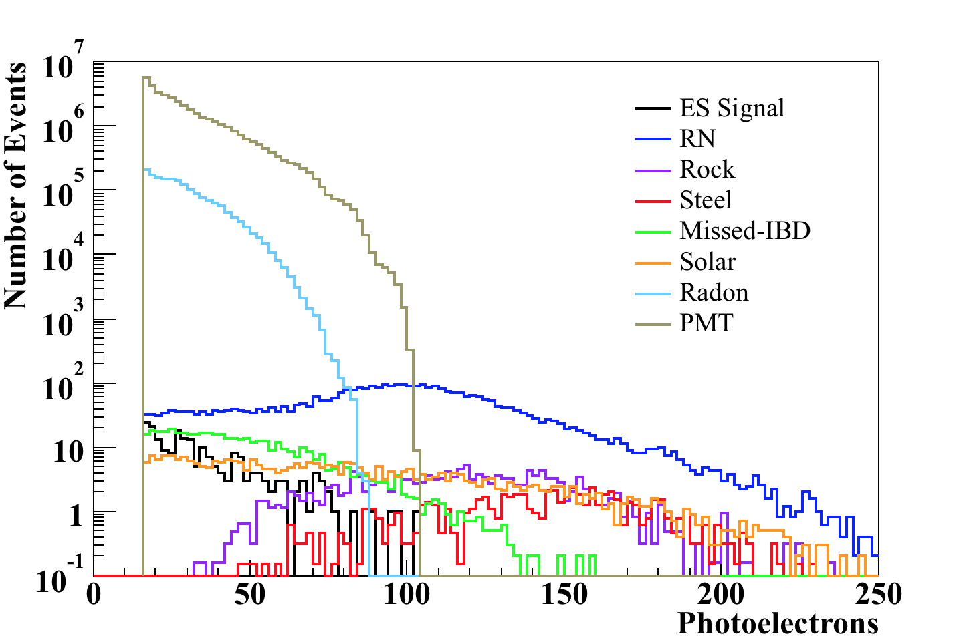
Other Backgrounds
Steel/rock γ’s and solar ν scaled from IsoDAR study on KamLAND*
  Take into account larger fiducial volume and different livetime
Misidentified IBD interactions estimated assuming an event rate of 20 events/day and a 20% missed neutron rate
1 year
Look to higher energies
Reduce fiducial volume
Reduce radon
More overburden
* M. Toups et al., Phys. Rev. D 89, 072010 (2014)
Notes:
Finally, we also include backgrounds from the steel and rock as well as from solar neutrinos. This was done by scaling from the IsoDAR paper on KamLAND, written by Matt Toups.
We also include the misidentified IBD events in which we miss the neutron and approximate it with the quoted value in the white paper of about 20 events per day and 20% missed neutron rate.
Here I have plotted all the backgrounds in the kiloton FV over 1 year. We notice that the PMTs, radon, and cosmogenic radionuclides dominate the backgrounds. The black line here shows the signal. Although this looks very bleak, we note that as we increase the energy of the events the PMT and radon backgrounds decrease dramatically and the PMT backgrounds can be reduced by reducing the FV (this will also hurt our signal though).

Slide 12
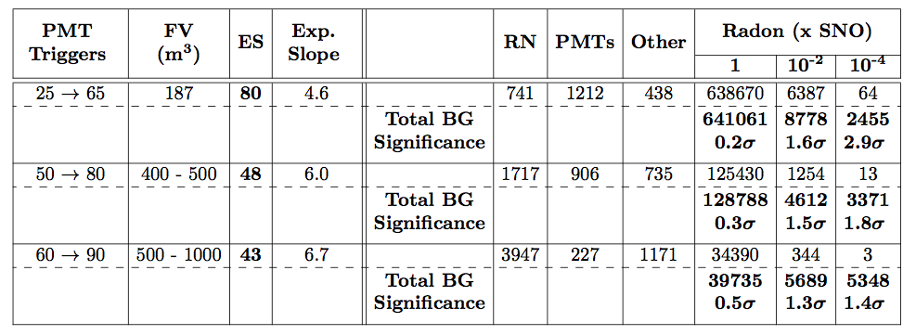
WATCHMAN vs. Radon
*5 years
Low energy slice only relevant with significant fiducialization and radon reduction
Without radon reduction, high energy cuts must be used
  But radionuclides begin to dominate
Notes:
Now the results for our watchman detector. We considered three energy slices to study the effects of the trying to balance the backgrounds (PMTs and radon focused in low energy but RN increases at higher energy). With the lower energy events we use a significantly smaller FV to reduce the PMT background and we see that in five years we get about 80 signal events. The exponential slope column here denotes the C factor that we could determine beforehand. We have broken up the backgrounds here and place rock, steel, solar, and mis-IBDs in the other column. We see that with the radon levels quoted by SNO, we have 80 signal events compared to 640,000 thousands events and thus we have no sensitivity. However with better recirculation techniques, cleaner mine air, etc. we might be able to improve upon the SNO radon, so in this case we include the results if the radon can be reduced by factors of 100 and 10,000. We see that if we can significantly reduce the radon, it seems like watchman could be sensitive to directionality.
We also include high energy slices using slightly different FVs (because now at higher energies, the PMT backgrounds are lower) but now the issues are both with the radon still and the RN. If we reduce the radon significantly, we still run into issues with the RN and thus we look to study how much we can gain by placing the detector deeper.
This is expected because WATCHMAN was not deigned for this application and thus it is not surprising that the depth is not optimal

Slide 13
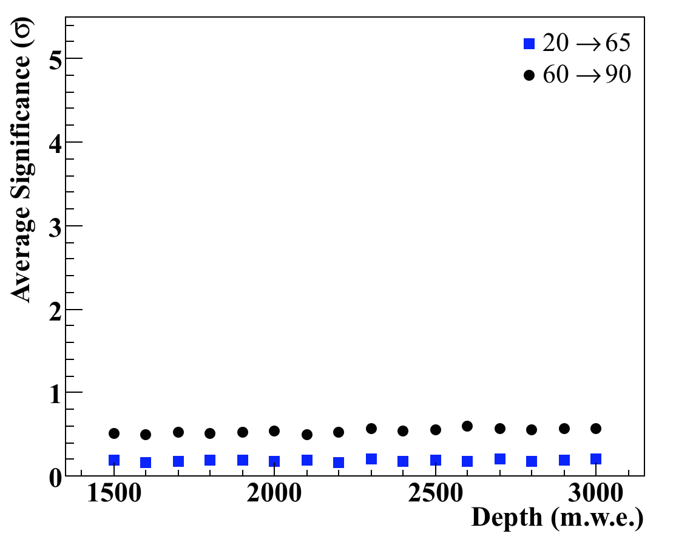
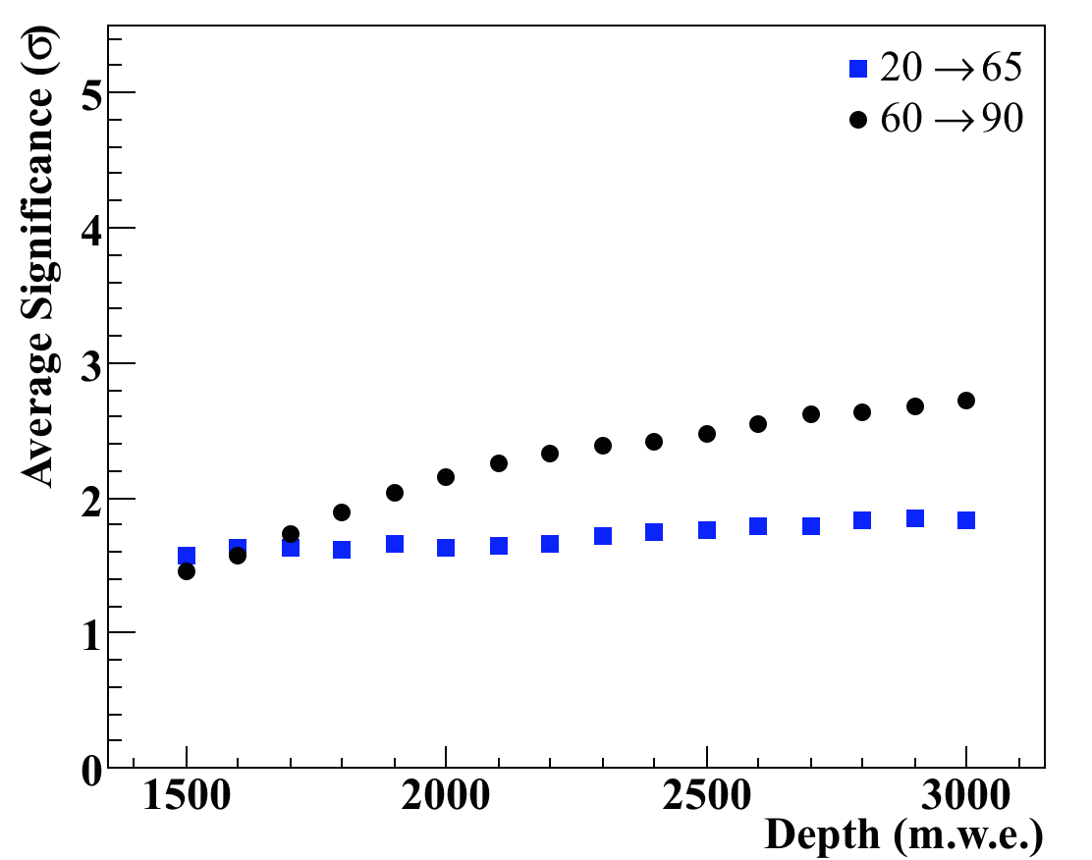
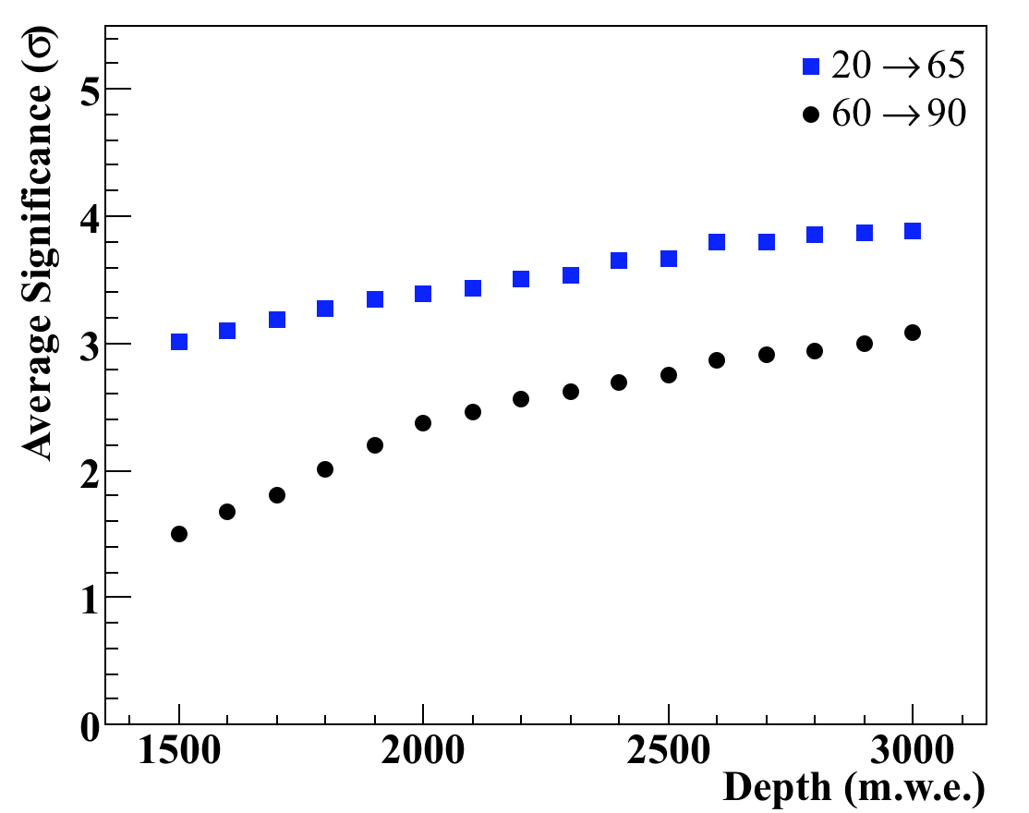
Sensitivity vs. Depth
Determine RN background as function of depth
Recalculate significance for each depth and various radon levels
*5 years
1 × SNO radon
10⁻² × SNO radon
10⁻⁴ × SNO radon
*Data represents mean value of multiple repeated experiments
Notes:
So, we scale our backgrounds according to the muons rates and the livetimes and redo our calculations with the watchman design. We see that at the current radon estimates from SNO, sensitivity seems bleak, not matter the depth. If we can reduce by two orders of magnitude, things start to get interesting and we see we can become sensitive somewhere between 2700 and 3000 mwe. If we shoot for the stars and get a 10,000 factor reduction, we see that the watchman detector at 1500 might be sensitive and gets better with depth.

Slide 14
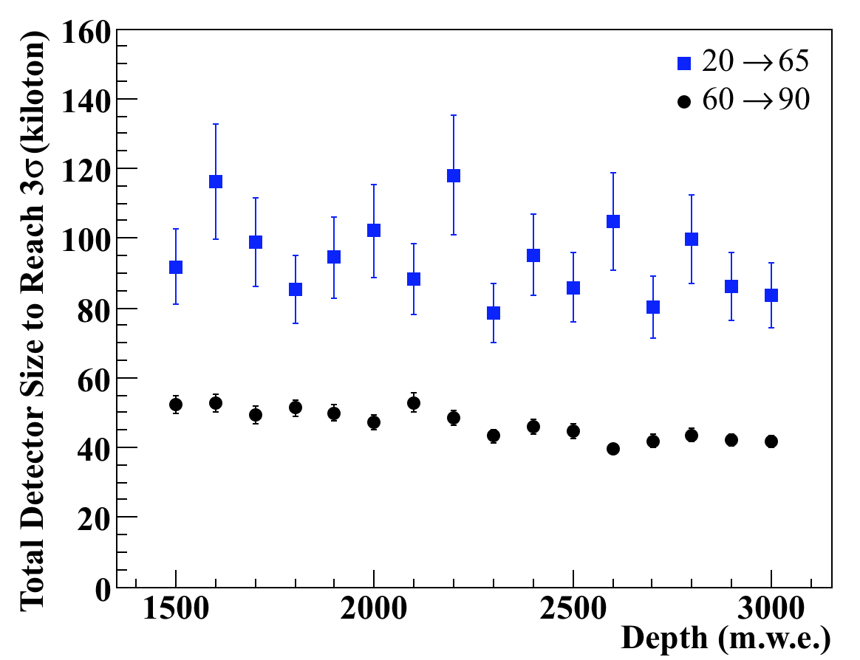
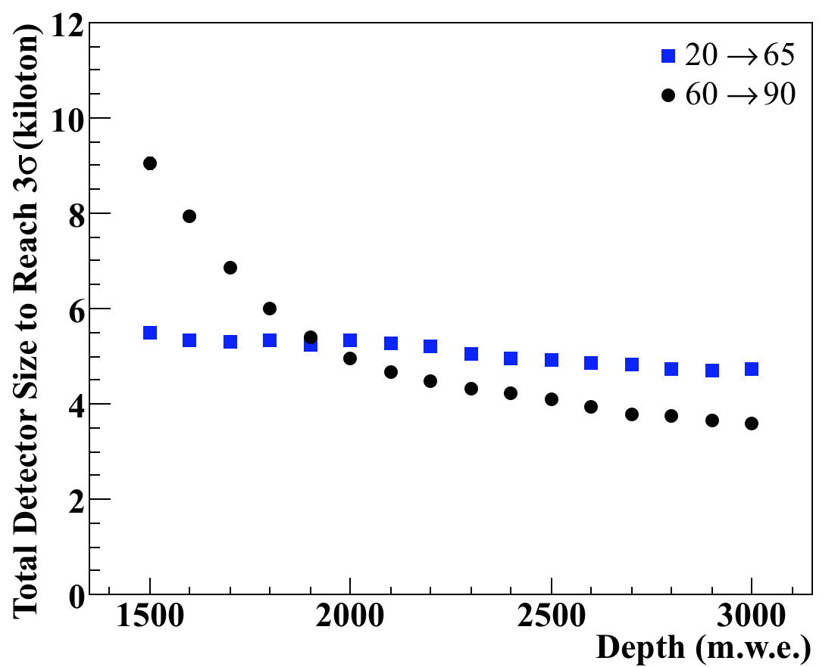
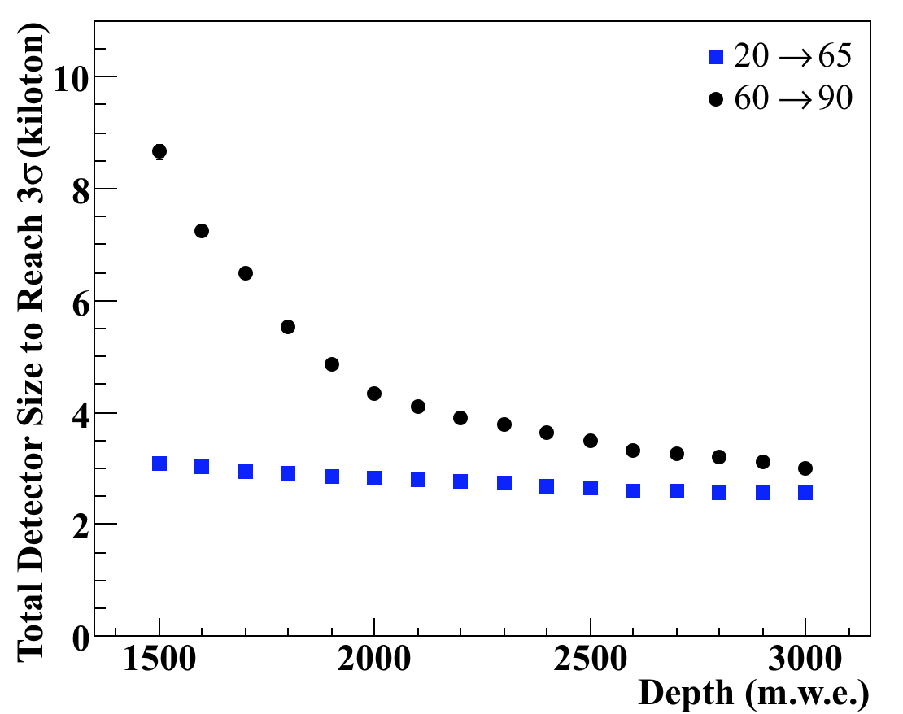
Sensitivity vs. Depth vs. Size
Now determine the detector size required for 3σ
Scale signal with volume, scale significance with signal to noise ratio
*5 years
1 × SNO Radon
10⁻² × SNO Radon
10⁻⁴ × SNO Radon
*Data represents mean value of multiple repeated experiments
Notes:
Now, we general the detector and determine what size detector we would need at what depth and what radon concentration to get a 3 sigma sensitivity. We se that at the current radon estimates, we need a very large detector >40 kilotons, with a slight improvement with depth.
With a two order of magnitude reduction, we get into the 4 – 6 kiloton region depending on the depth.
And for a 10,000 factor reduction, we see that a 3 kiloton detector might be able to do it at the watchman depth

Slide 15
Conclusions
Similar radon contamination as SNO → need much larger detector (> 40 ktons)
×100 reduction in radon → need combination of a larger and deeper detector
×10,000 reduction in radon → 3 kton detector at 1500 m.w.e. (WATCHMAN) should be directionally sensitive
Assumes full power reactor operation with no shutdown periods
Fission fractions are constant in time (no burnup)
Technically the directional sensitivity with respect to an assumed direction
  Need statistical penalty for testing in multiple directions
Paper being submitted to journal soon
Currently at arXiv:1512.00527
Notes:
So as I said before, with no reduction in radon, ES directionality does not seem possible except with a large increase in detector size.
With a moderate reduction in radon, we see that with a combination of more overburden and larger detector, directionality may become possible.
And finally, if we can reduce the radon by 10,000, the current watchman detector design may be directionality sensitive.
All of this depends on the ability to reduce radon in our detector, which at the moment is unclear and we leave for future work..
We mention that the results ive shown here assume the the reactor operates at full power with no shutdowns and that the fuel does not experience burnup (both of which will greatly affect the amount of signal we see).
Also we mention that this study was for an assumed known direction. If the direction was unknown, we would have to apply some penalty when testing in multiple directions.
Ultimately, reactor directionality with ES in water cherenkov detectors is not impossible, but significant amount of work needs to be put into the removal of radon with the target water.

Slide 16
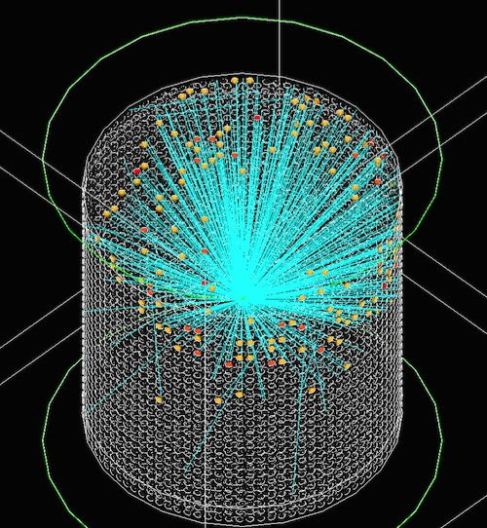
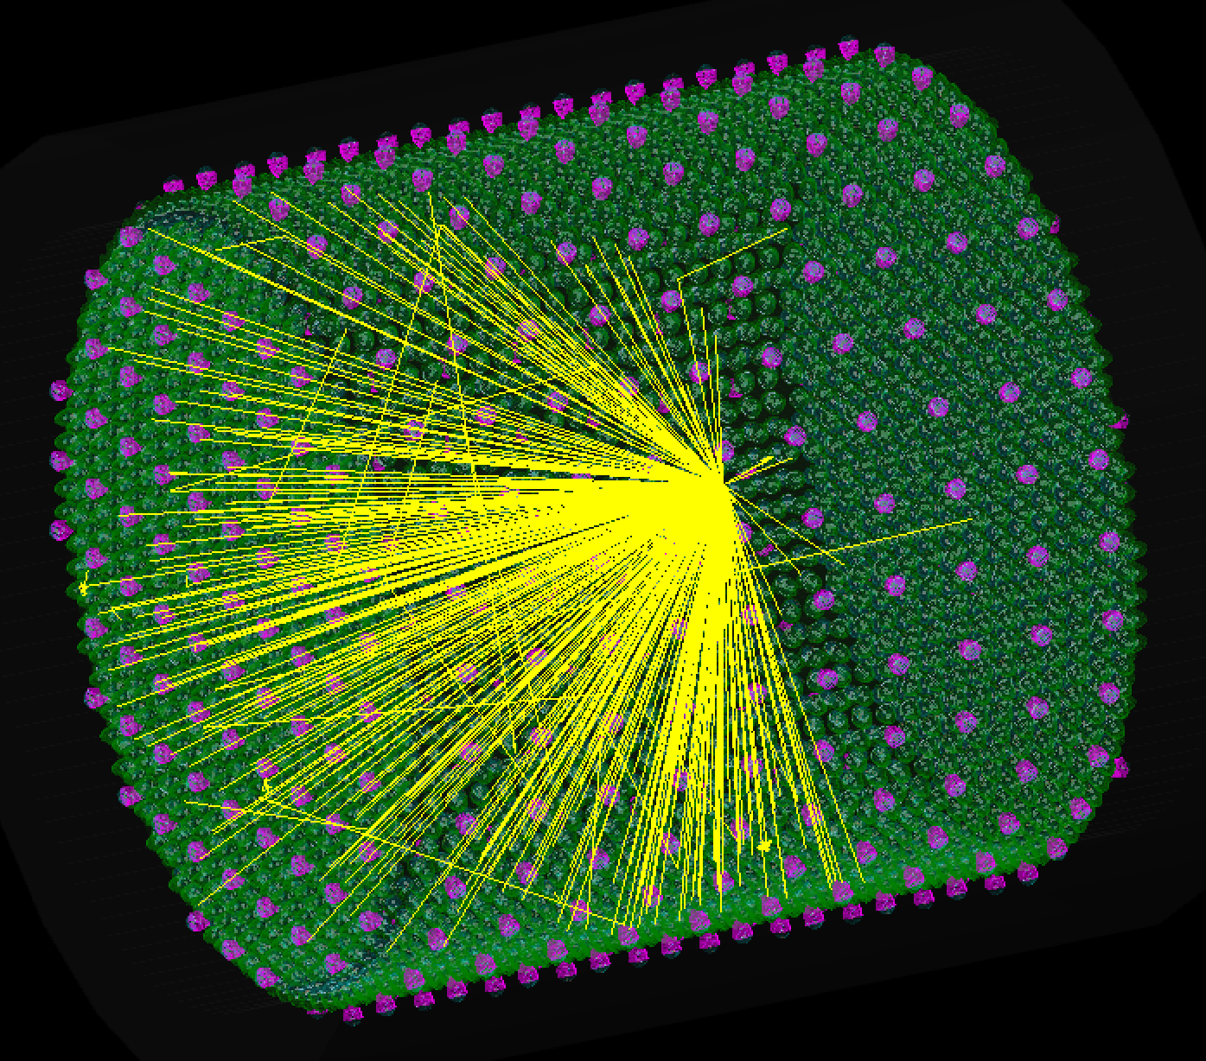
Questions?

Slide 17
Acknowledgements and Disclaimer
Steven Dazeley, LLNL
Adam Bernstein, LLNL
Craig Marianno, TAMU
Marc Bergevin, LLNL
Michael Smy, UCI
This material is based upon work supported by the Department of Energy National Nuclear Security Administration under Award Number: DE-NA0000979 through the Nuclear Science and Security Consortium.
This report was prepared as an account of work sponsored by an agency of the United States Government. Neither the United States Government nor any agency thereof, nor any of their employees, makes any warranty, express or limited, or assumes any legal liability or responsibility for the accuracy, completeness, or usefulness of any information, apparatus, product, or process disclosed, or represents that its use would not infringe privately owned rights. Reference herein to any specific commercial product, process, or service by trade name, trademark, manufacturer, or otherwise does not necessarily constitute or imply its endorsement, recommendation, or favoring by the United States Government or any agency thereof. The views and opinions of authors expressed herein do not necessarily state or reflect those of the United States Government or any agency thereof.

Slide 18
Supplementary Slides

Slide 19
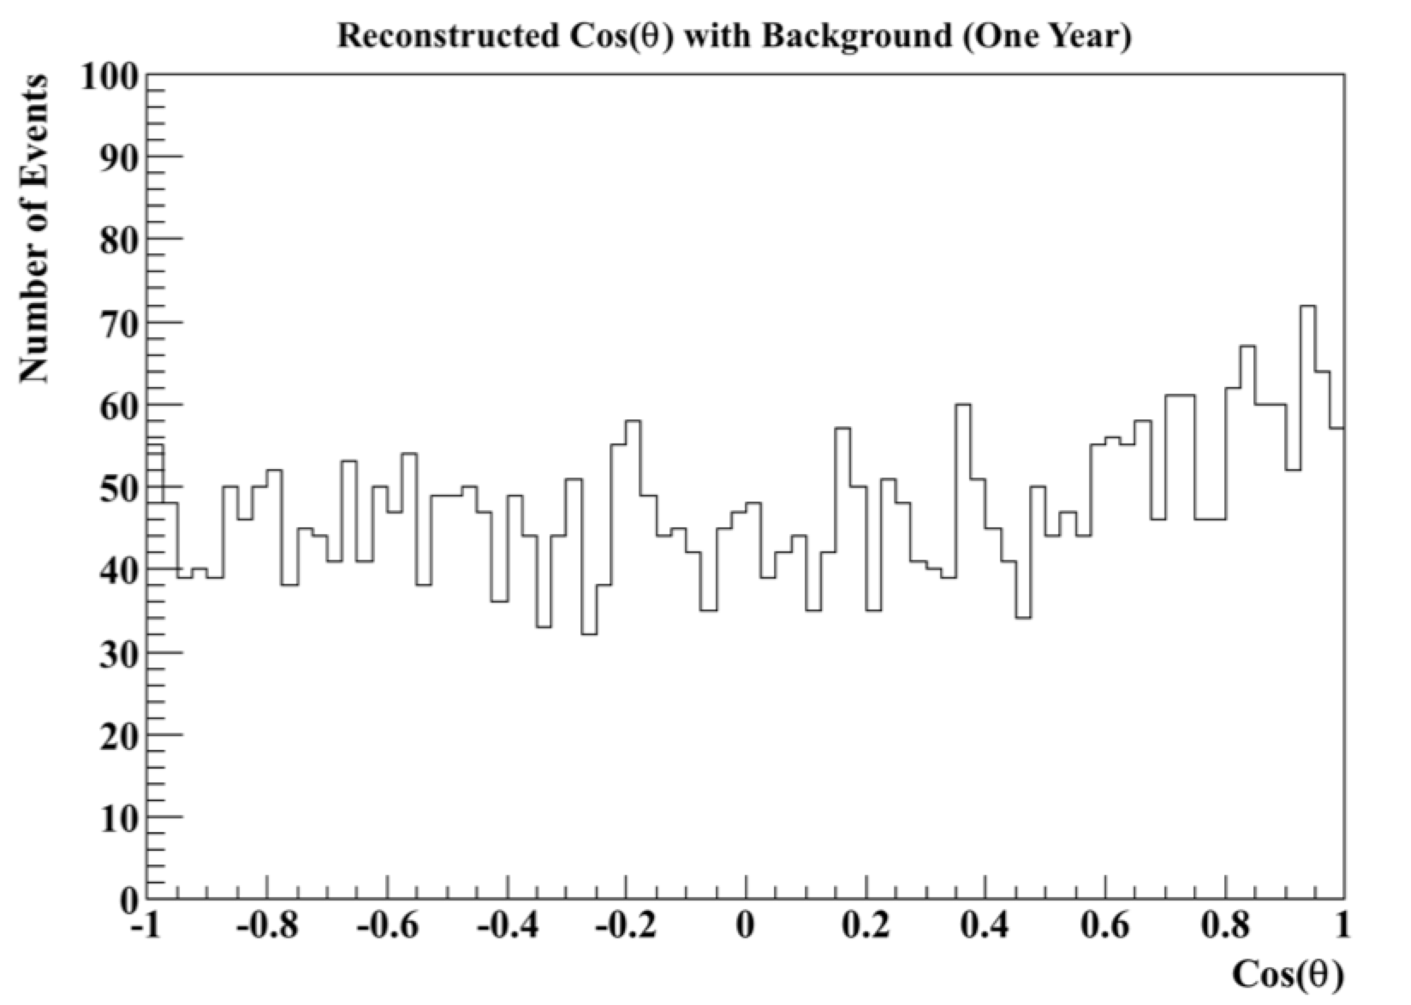
Significance Calculation
Background assumed to be isotropic (ignore solar anisotropy)
Fit signal with constant + exponential (A + Be^{Cx})
Use calibration source to predetermine exponential slope, C
Use uncertainty in exponential normalization B to determine signal significance
B
(This is an exaggerated example)
Notes:
So now that we have our signal and background, how do we calculate the significance of our signal?
We assume our background to be isotropic and thus we distribute the backgrounds randomly across cos(theta) from -1 to 1. The signal will be highly directional (peaked towards cos(1)) and thus should be seen as a peak sitting atop of flat background. As I’ve shown here with an exaggerated sample data set. We fit the signal with a constant plus exponential and assume we can directionally calibrate our detector with an electron accelerator like the one at Super-K to determine the exponential slope a priori. When fitting this in root, the uncertainty in the exponential nomination factor B will already include the uncertainty from A and thus we can determine the signal significance by divided delta B over B.

Slide 20
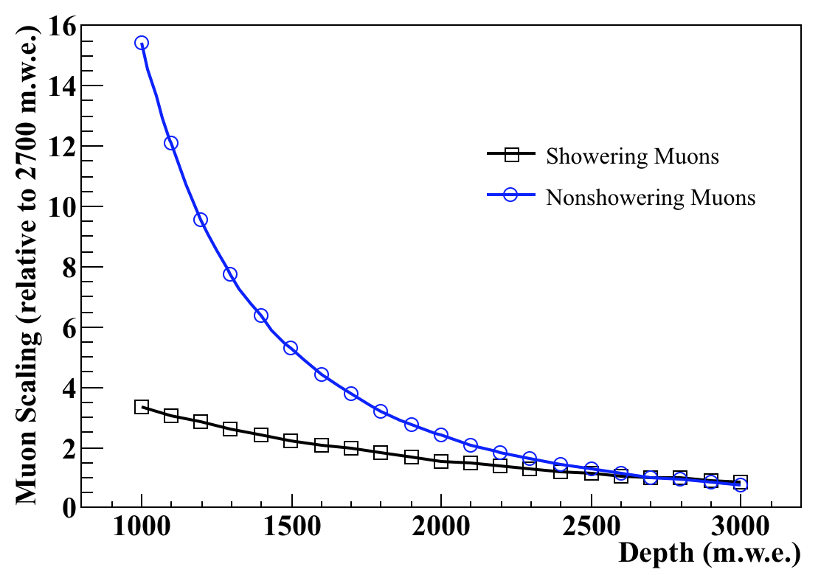
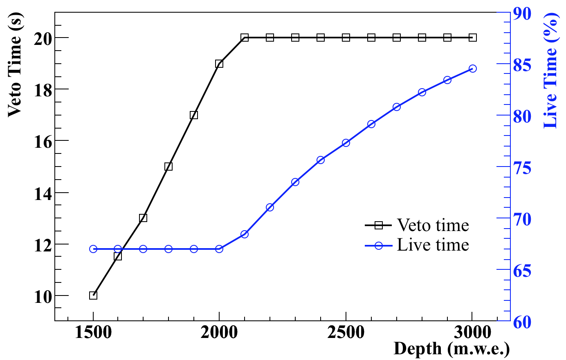
Sensitivity vs. Depth
Muon rate scaling with depth
(relative to KamLAND)
Adjust veto time to reduce more RN with depth
As we increase the depth, we can increase veto time without sacrificing livetime
Notes:
So to do so, we first determine how the muon rates will scale with depth and here I have the results of our Geant4 simulation for showering and nonshowering muons relative to the 2700 KamLAND depth.
So as we increase the depth, we obviously reduce our muon rate and thus we can increase our muon veto time to further reduce our RN background without sacrificing too much livetime. So we include a varied veto time as a function of depth to maintain our 67% liveimte, but place an upper threshold of 20 seconds in order to reduce the complication of allowing the RNs enough time to migrate out of the tubes and produce backgrounds.

Slide 21
More References
[1] N. Bowden et. al., Nuclear Instruments and Methods in Physics Research A 572, 985 (2007).
[2] L. Mikaelyan, in: Proceedings of the International Conference “Neutrino 77”, Vol. 2, Nauka, Moscow, 1978, pp. 383–385.
[3] A. Bernstein, N. Bowden, A. Misner, and T. Palmer, J. Appl. Phys. 103, 074905 (2008).
[4] A. Bernstein et al, Science & Global Security 18, 127 (2010).
[5] T. Lasserre et. al., arXiv:11011.3850.
[6] A. Bernstein et. al., arXiv:1502.01132.
[7] M. Apollonio et. al., Physical Review D 61, 012001 (1999).
[8] C. Giunti, C. Kim, Fundamentals of Neutrino Physics and Astrophysics, Oxford University Press, Oxford, 2007.
[9] P. Vogel, J. Engel, Physical Review D 39, 3378 (1989).
[10] G. Zacek et. al., Physical Review D 34, 2621 (1986).
[11] S. Agostinelli et. al [GEANT4 Collaboration], Nuclear Instruments and Methods in Physics Research A 506, 250 (2003).
[12] The Water Cherenkov Simulator (WCSim) (Repository: https://github.com/WCSim).
[13] M. Smy, in: Proceedings of the International Cosmic Ray Conference, Vol. 5 (HE part 2), Mexico City, Mexico, 2008, pp. 1279–1282.
[14] S. Li, J. Beacom, Physical Review C 89, 045801 (2014).
[15] S. Abe et. al., Physical Review C 84, 035804 (2011).
[16] S. Abe et. al., Physical Review C 81, 025807 (2010).
[17] D. Reyna, arXiv:0604145v2.
[18] J. Felde, Private Communication (Internal LBNE DocDB document number 729-v1) (2010).
[19] I. Belvis et. al., arXiv:0305022v2.
[20] M. Toups et. al., Physical Review D 89, 072010 (2014).
[21] Y. Koshio, Ph.D. thesis, University of Tokyo.
[22] IAEA Safeguards Glossary, International Nuclear Verification Series 3, The International Atomic Energy Agency, 2003,
http://www-pub.iaea.org/books/IAEABooks/6663/IAEA-Safeguards-Glossary.

