Slide 1
Scientific User Facilities at ORNL: New Research Capabilities and Opportunities
Presented to
SESAPS 2011
James B. Roberto
Associate Laboratory Director
Science and Technology Partnerships
Roanoke, Virginia
October 22, 2011

Slide 2
Outline
Introduction
Partnerships at ORNL
Scientific user facilities
  Leadership computing
  Center for Nanophase Materials Sciences
  Neutron scattering: SNS and HFIR
User access

Slide 3
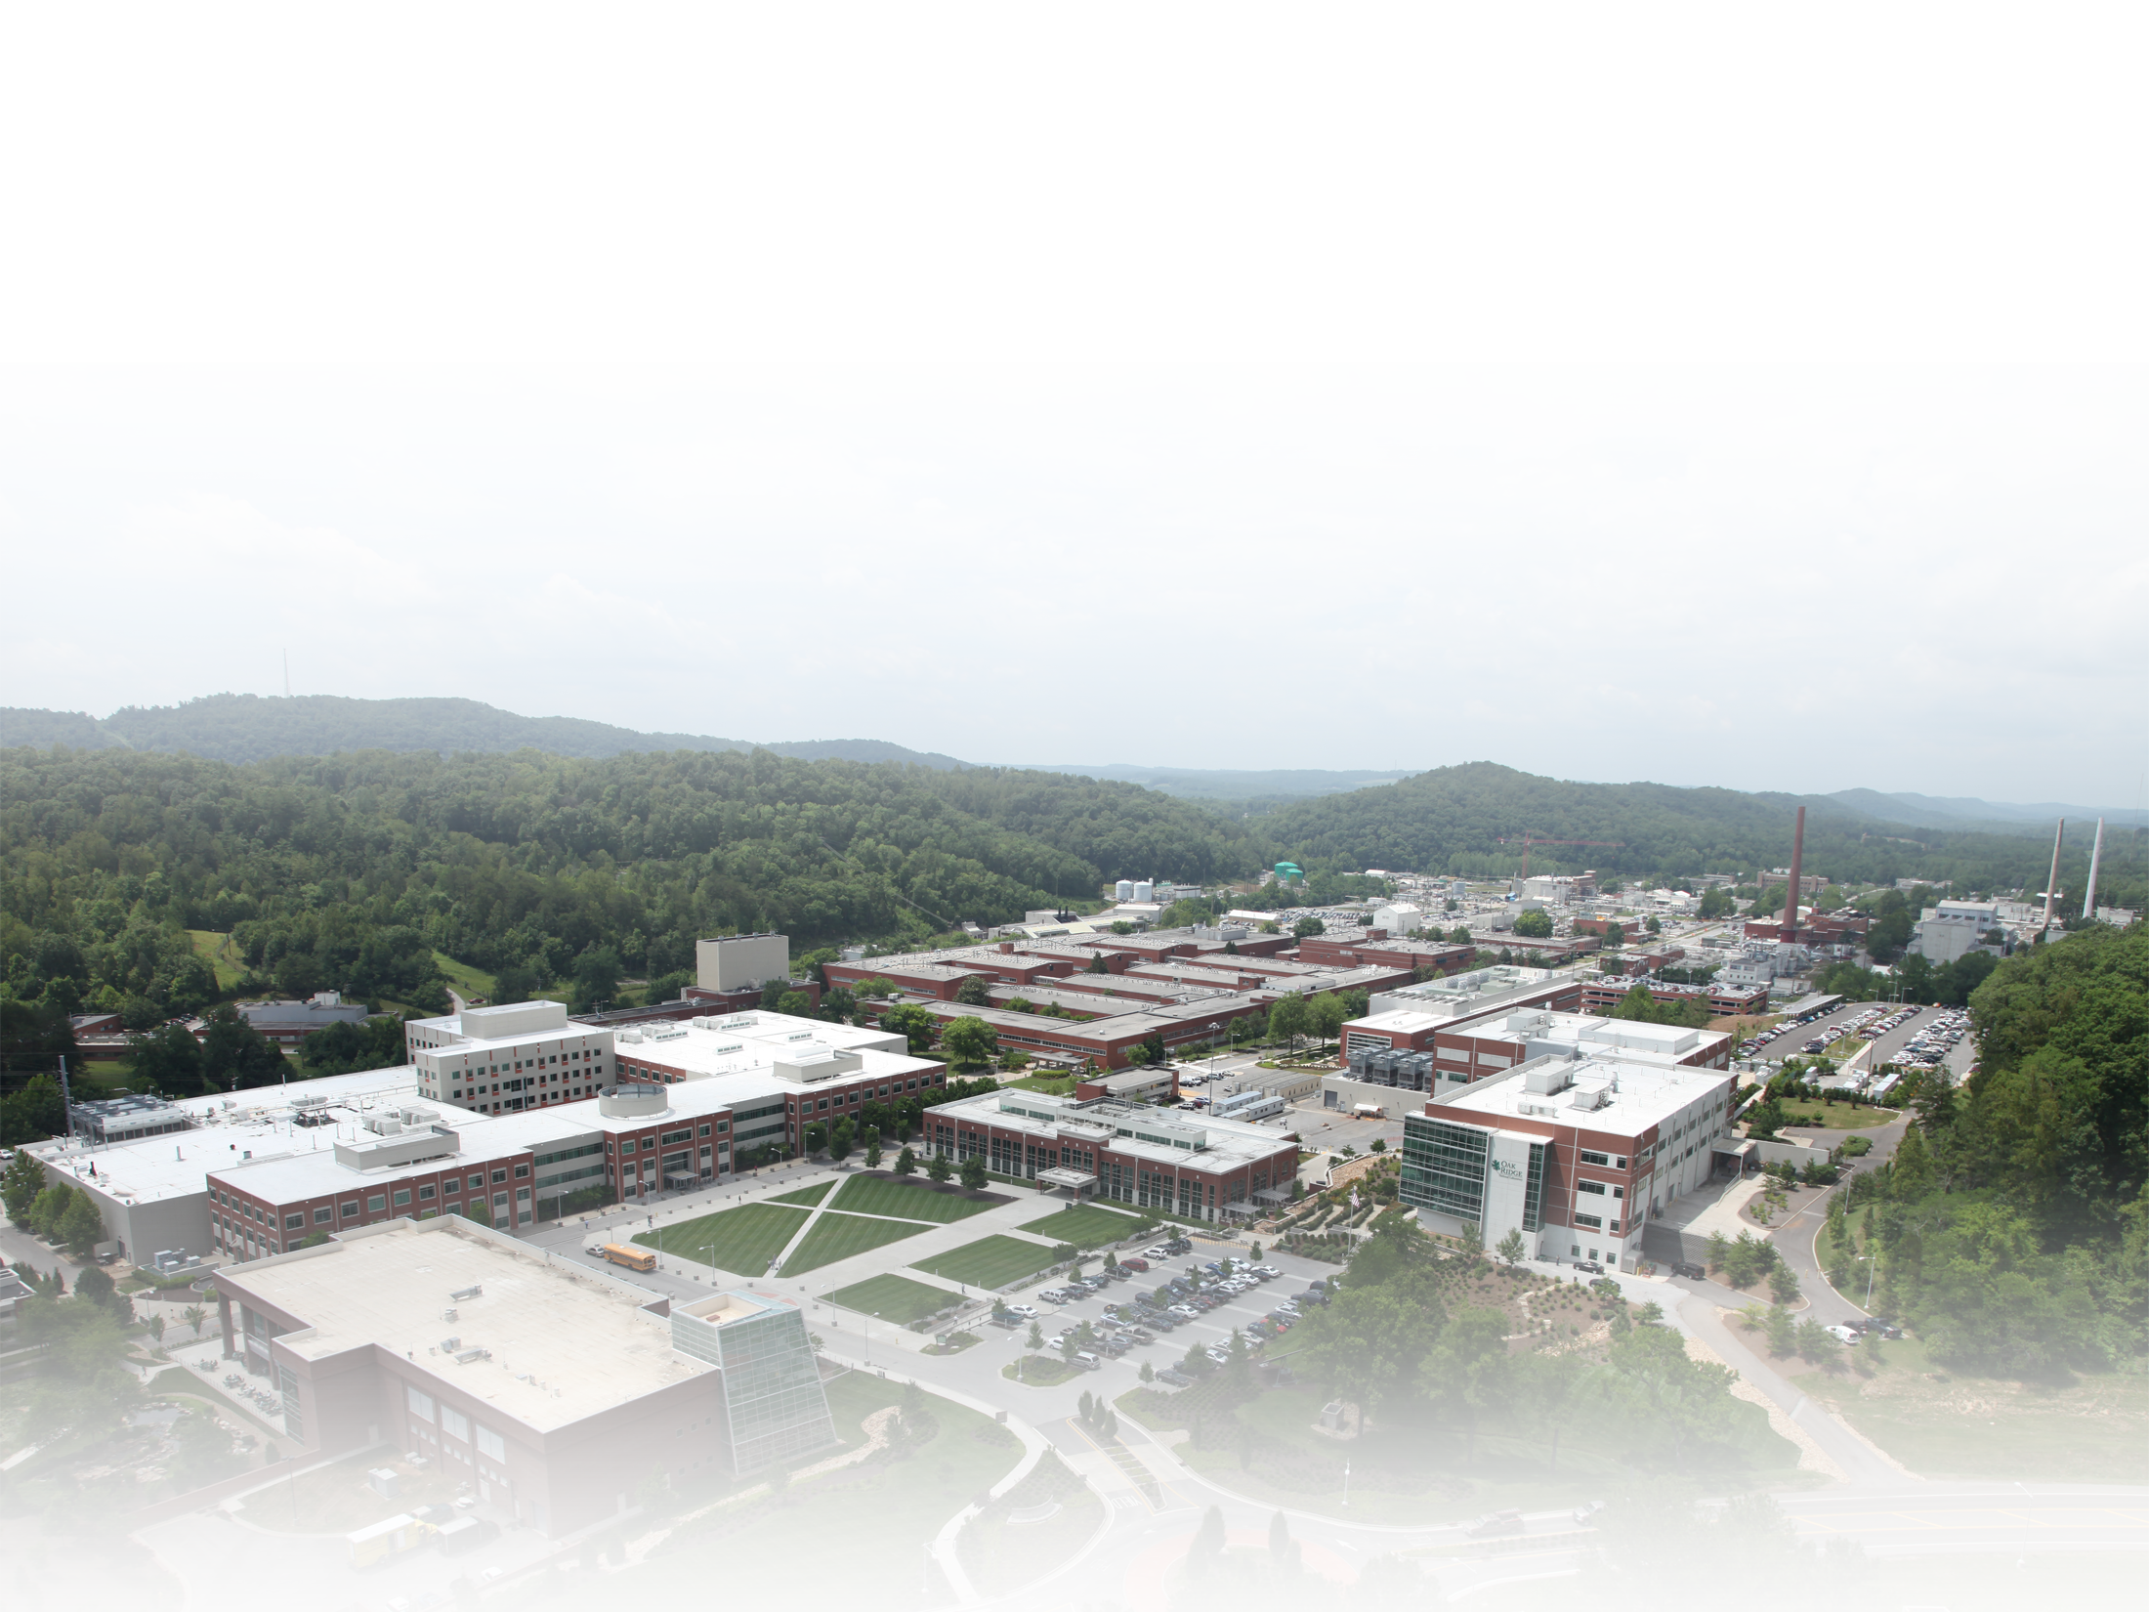

ORNL is DOE’s largest science and energy laboratory
$1.65B
budget
4,650
employees
3,000
research
guests
annually
Extensive
partnerships
with universities
and industry
Nation’s
largest
materials
research
portfolio
Nation’s
most powerful
open scientific
computing
facility
World’s
most intense
neutron
source
World-class
research
reactor
Nation’s
most diverse
energy portfolio
Managing
billion-dollar
U.S. ITER
project
3 Managed by UT-Battelle
for the U.S. Department of Energy
Notes:
3
TODAY: ORNL has well-defined research capabilities (developed through its performance of mission assignments) that are applied to meet the needs of the Department of Energy and other customers, including the Department of Defense, the Department of Homeland Security, NASA, the Nuclear Regulatory Commission, and other federal agencies, as well as other public and private-sector entities. Our $1.65B budget comes to us in projects of various sizes for these customers.

Slide 4
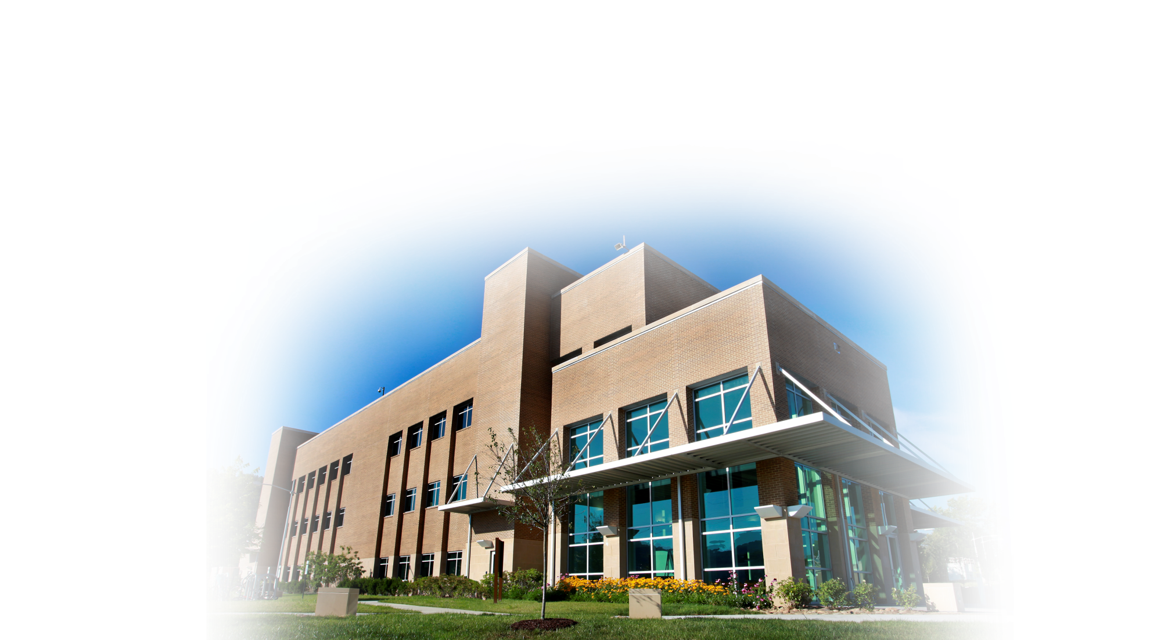
University partnerships are critical to ORNL
Major projects | Research collaborations | Guest researchers | Joint institutes | Outreach
Center for Advanced Simulation of Light Water Reactors (CASL) BioEnergy Science Center NSF petascale computing facility 4 SNS instruments led by university consortia 13 Energy Frontier Research Centers (2 led by ORNL, 11 led by universities) | Projects with 200+ universities Hundreds of joint research publications (70% of ORNL publications have a university coauthor) | Hundreds of faculty and students Thousands of university researchers at 8 national user facilities | Heavy ion research Neutron sciences Biological sciences Computational sciences | Distance education HBCU/MEI faculty summer research program
Notes:
4

Slide 5
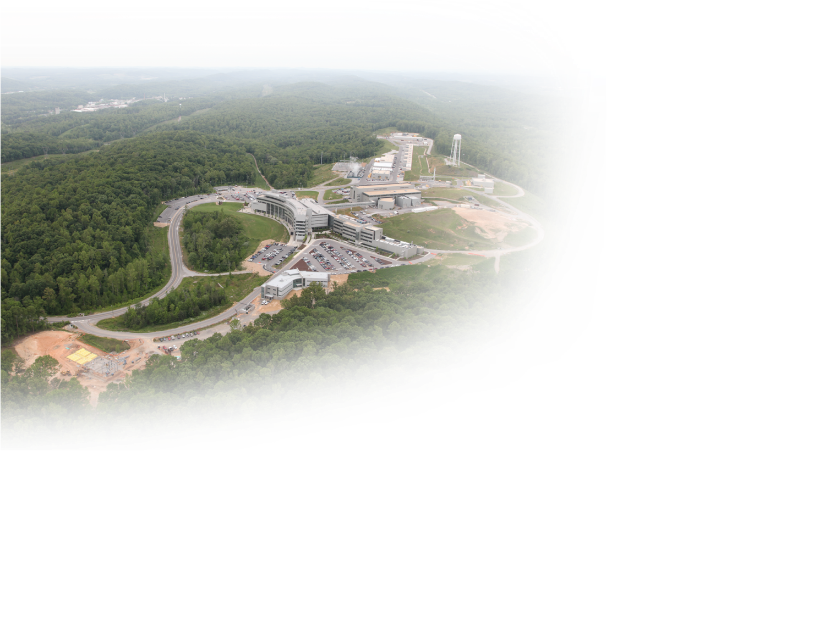

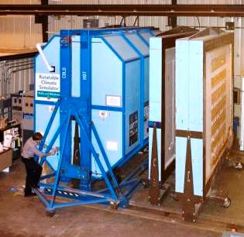
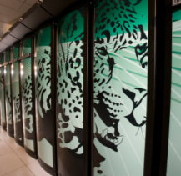
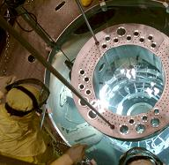
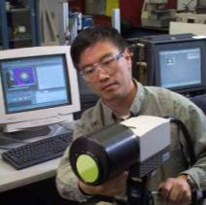

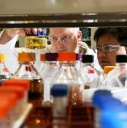
Our distinctive facilities bring thousands of researchers to ORNL each year
Spallation
Neutron Source
Center for
Nanophase
Materials Sciences
Holifield Radioactive
Ion Beam Facility
Building Technologies Research and Integration Center
Oak Ridge Leadership Computing
Facility
High Flux
Isotope
Reactor
High
Temperature
Materials Laboratory
National Transportation
Research
Center
BioEnergy
Science
Center

Slide 6
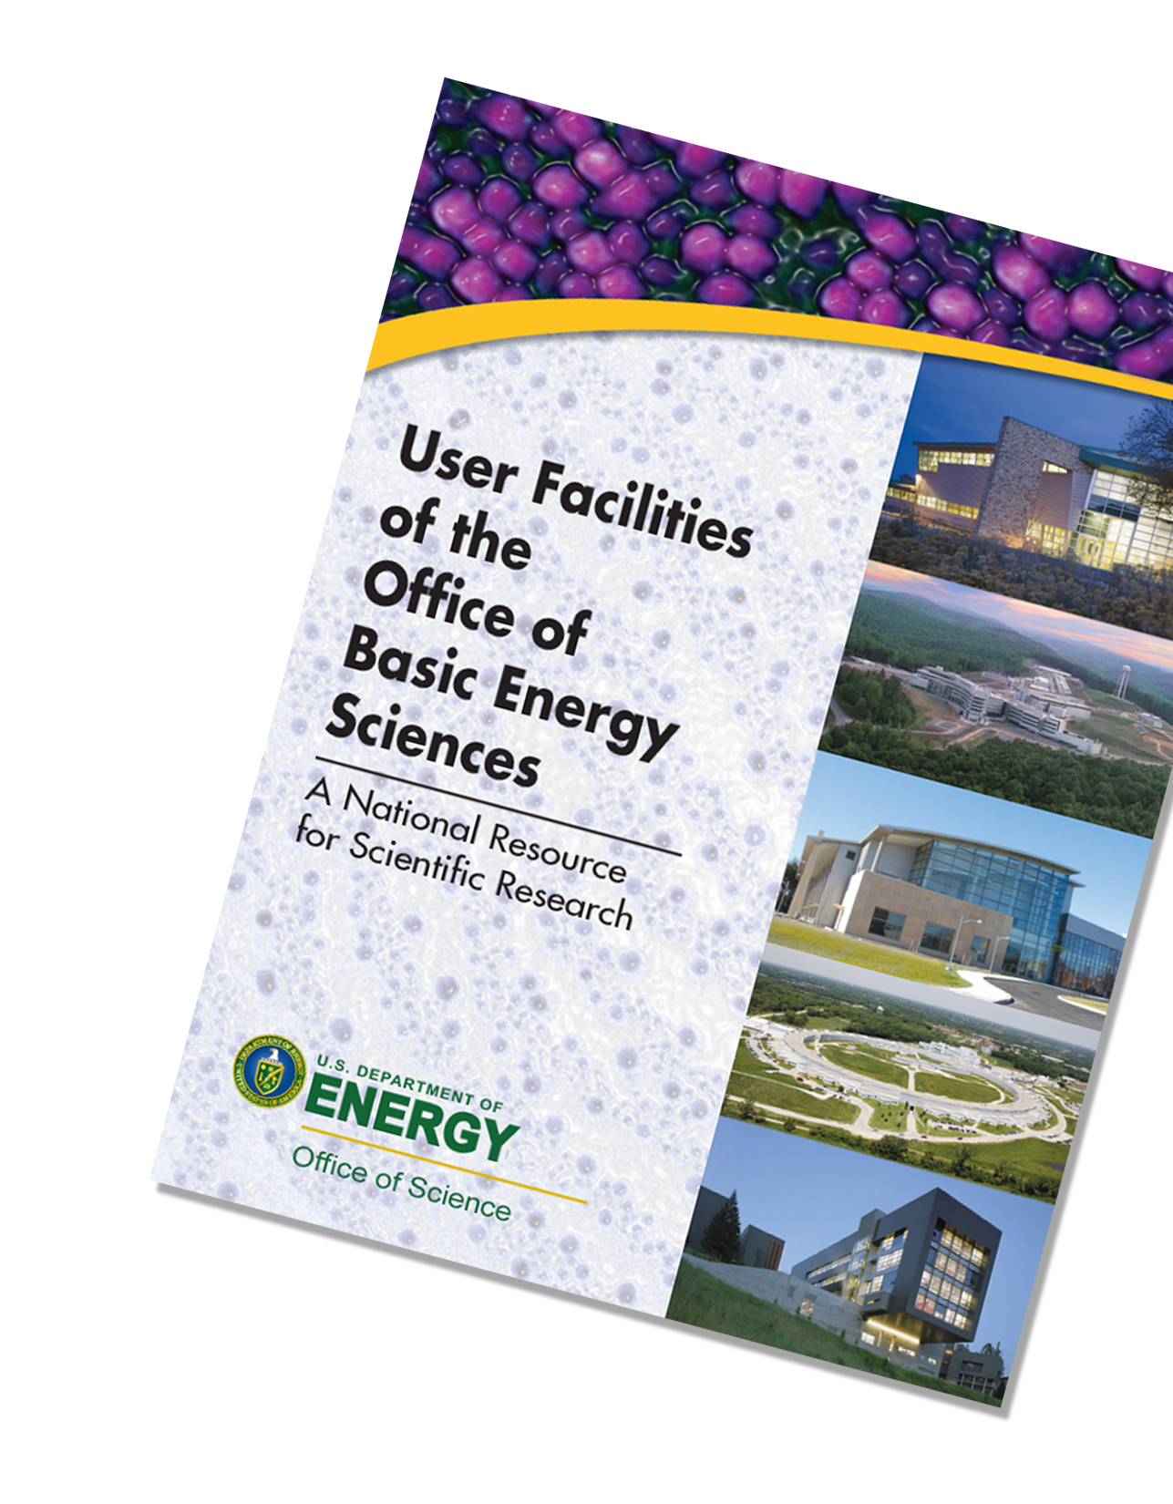
DOE user facilities
State-of-the-art scientific research facilities
  Particle and nuclear physics accelerators
  Synchrotron light sources
  Neutron scattering facilities
  Nanoscale science research centers
  Electron microscopy centers
  Supercomputers
Shared with the science community worldwide
  Open access based on high-quality proposals
  Nonproprietary use is free
  if experimental results are published
  Proprietary users (results are not shared)
  are charged to recover costs
Offering technologies and instrumentation
that are not available elsewhere

Slide 7
ORNL is home to 8 DOE user facilities
Building Technologies Research and Integration Center
Center for Nanophase Materials Sciences (CNMS)
Center for Structural Molecular Biology (Bio-SANS)
High Flux Isotope Reactor (HFIR)
Leadership Computing Facility (LCF)
National Transportation Research Center (NTRC)
Shared Research Equipment (SHaRE) User Facility
Spallation Neutron Source (SNS)

Slide 8

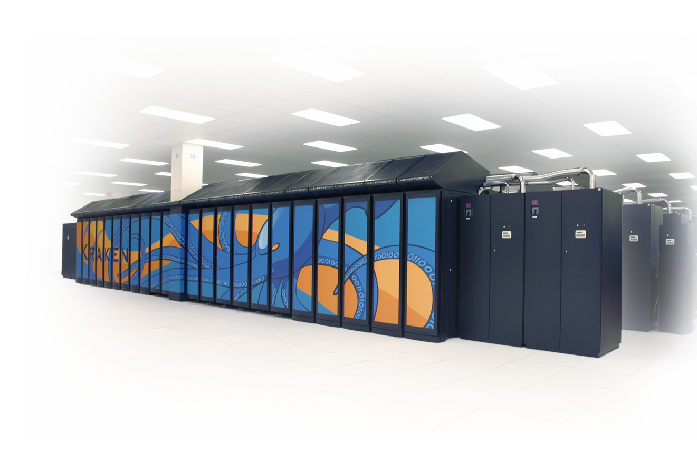
Leading the development of ultrascale scientific computing
DOE’s Oak Ridge Leadership Computing Facility
  Cray XT5 Jaguar operating at >2 PF
  10–30 PF system in development (OLCF-3)
  Exascale system by 2018
NSF National Institute
for Computational Sciences
  Cray XT5 Kraken operating
  at >1 PF
  Partnership with the
  University of Tennessee
NOAA National Climate-Computing Research Center
  Cray XT6/XE6 Gaea operating at 260 TF
  Upgrade to petascale planned for 2012

Slide 9
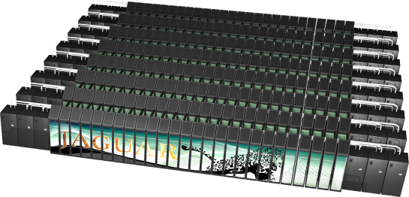
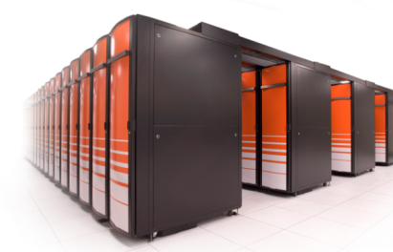
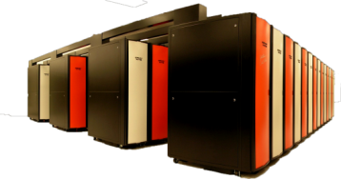
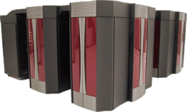
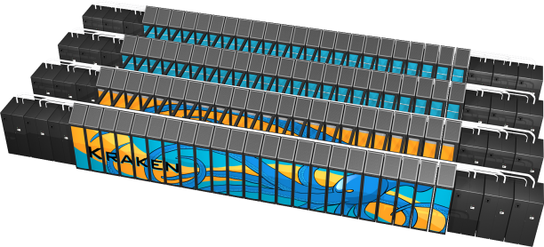
ORNL system performance has increased by 1,000 times since 2004
Hardware: Single-core–dual-core– quad-core/dual-socket, 12-core | Scaling applications and system software is the biggest challenge
NNSA and DoD have funded much of the basic system architecture research | DOE SciDAC and NSF PetaApps programs are funding scalable application work, advancing many apps DOE-SC and NSF have funded much of the library and applied math as well as tools
Cray XT4
Quad-core
263 TF
Cray XT5 systems
12-core, dual-socket SMP
2335 TF and 1030 TF
Cray XT4
Dual-core
119 TF
Cray XT3
Dual-core
54 TF
Cray XT3
Single-core
26 TF
Cray X1
3 TF
2005
2006
2007
2008
2009

Slide 10
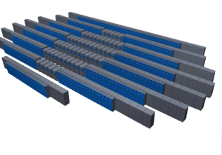
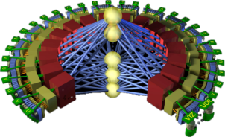
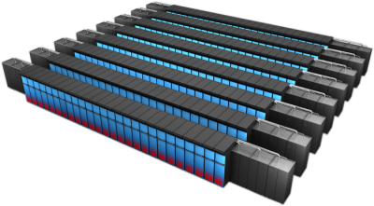
Planning for a 1000 times increase in capability over the next decade
Mission: Deploy and operate computational resources to address global challenges | Vision: Maximize scientific productivity and progress on the largest scale computational problems
Deliver transforming discoveries in climate, materials, biology, energy technologies, etc. Ability to investigate otherwise inaccessible systems, from regional climate impacts to energy grid dynamics | Provide world-class computational resources and specialized services for the most computationally intensive problems Provide stable hardware/software path of increasing scale to maximize productive applications development
OLCF-5:
1 EF
OLCF-4
100-250 PF based
on DARPA HPCS technology
Cray XT5
2+ PF leadership
system for science
OLCF-3
10–30 PF leadership system with some
HPCS technology
2009
2012
2015
2018
Notes:
Scale out to exaflops

Slide 11
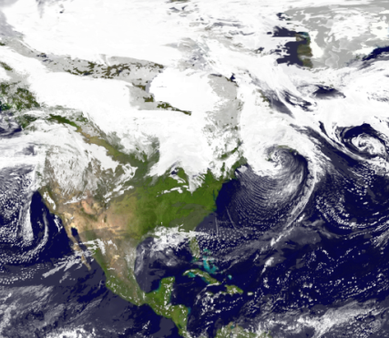
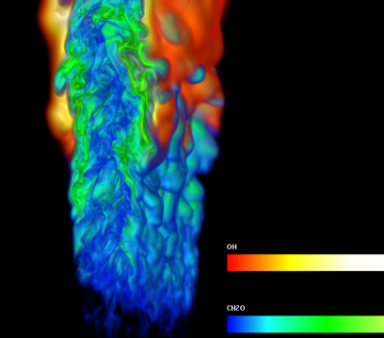
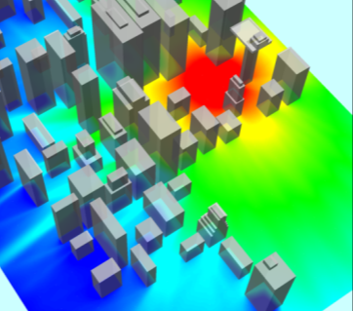
DOE missions require simulation and analysis for policy and decision making
Climate change | Energy | National nuclear security
Understand, mitigate, and adapt to impacts Sea level rise Severe weather Regional climate change Geologic carbon sequestration | Reduce reliance on imported oil and shrink carbon footprint Reduce time and cost of reactor design and deployment Improve combustion efficiency | Maintain a safe, secure, and reliable nuclear stockpile Stockpile certification Predictive scientific challenges Real-time evaluation of urban nuclear detonation
Accomplishing these missions requires exascale resources

Slide 12

Many compelling problems become tractable only at the exascale
Fundamental science | Decipher and comprehend the core laws governing the universe and unravel its origins
Materials science | Design, characterize, and manufacture materials tailored and optimized for specific applications
Earth science | Understand the complex biogeochemical cycles that underpin global ecosystems and control the sustainability of life on Earth
Biology and medicine | Understand relationships from individual proteins through whole cells into ecosystems and environments
Energy assurance | Attain, without costly disruption, the energy required by the nation in guaranteed, economically viable, and environmentally benign ways to satisfy residential, commercial, and transportation requirements
National security | Analyze, design, test, and optimize critical systems for communications, homeland security, and defense Understand and uncover human behavioral systems underlying asymmetric operation environments
Engineering design | Design, deploy, and operate safe and economical structures, machines, processes, and systems with reduced concept-to-deployment time

Slide 13
Improvements in hardware and applications are equally important
Applications
Compiler
Hardware
10
ARK integrator
complex chem
Higher order AMR
10⁹ TF
Multi-core era
New paradigm in computing
8
10⁶ TF
6
AMR
Massively parallel era
USA, Japan, Europe
Log Effective GigaFLOPS
Low mach
Autocode
10³ TF
4
High order
NERSC RS/6000
1 TF
Vector era
USA, Japan
2
NERSC SP3
Cray 2
0
1⁻³ TF
CY 1980
CY 1990
CY 2000
CY 2010
1970
1980
1990
2000
2010
2020
2030
“Effective speed” increases
came from both faster hardware and improved algorithms
Notes:
10/19/2011
13

Slide 14

Access to DOE’s leadership computing resources
DOE’s Advanced Scientific Computing Research program supports Leadership Computing Facilities (LCFs) at Argonne
and Oak Ridge
60% of LCF hours are allocated through the Innovative and Novel Computational Impact on Theory and Experiment (INCITE) program
  Annual call for proposals to address
  high-impact science, engineering,
  and computer science projects
  Successful proposals receive allocations
  of tens of millions of hours
  INCITE 2011: 1.7 billion hours awarded
  to 32 new projects and 25 renewals
Call for 2013 proposals opens in Spring 2012
The INCITE program seeks proposals for high-impact science and technology research challenges that require the power of the leadership-class systems
Notes:
The INCITE program is jointly managed by the Oak Ridge and Argonne Leadership Computing Facilities. The combined INCITE awards for 2011 were 1.7B hours for 57 projects.

Slide 15
The Oak Ridge LCF is supporting 32 INCITE projects in 2011
Project teams range from small to large (dozens of participants)
LCF staff assist INCITE users:
  Supporting research goals
  Assisting in code design and optimization
  Streamlining workflow
LCF staff are available year round
to discuss potential INCITE proposals
Discretionary allocations of LCF hours
can be made at any time to support
INCITE proposal preparation
Average project hours awarded | 29M
Total hours awarded | 930M
Notes:
Not shown here is the degree of collaboration within INCITE projects: many comprise multi-institutional collaborations (e.g. University-DOE, DOE-Industry, etc).

Slide 16
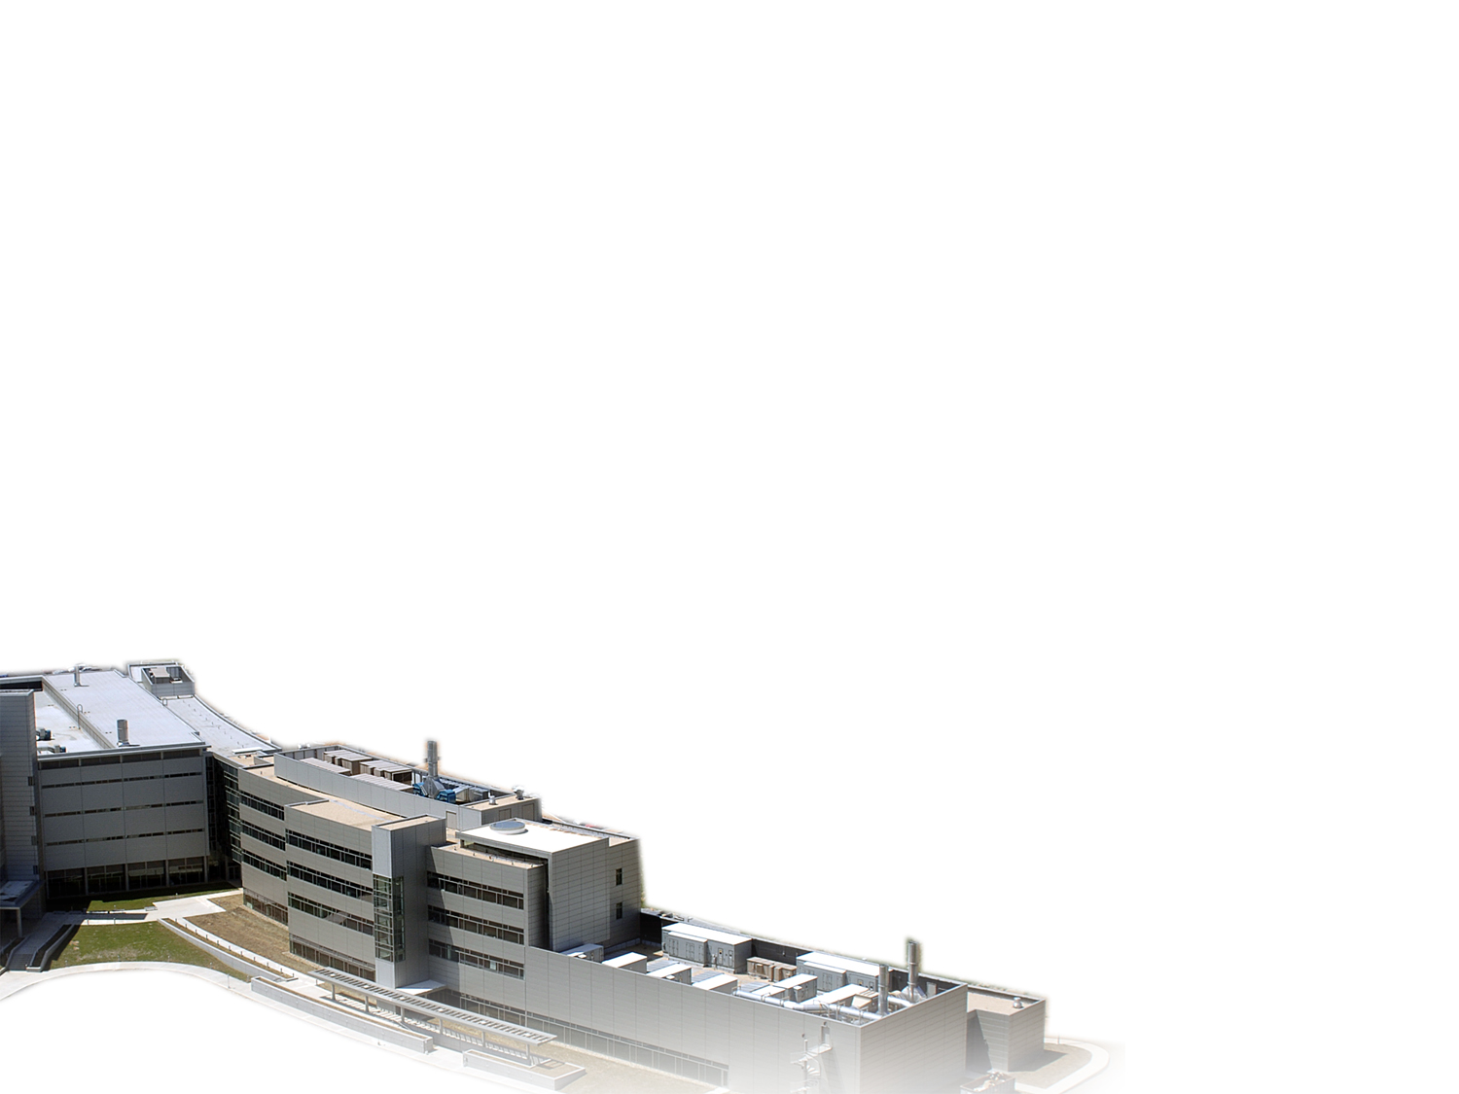
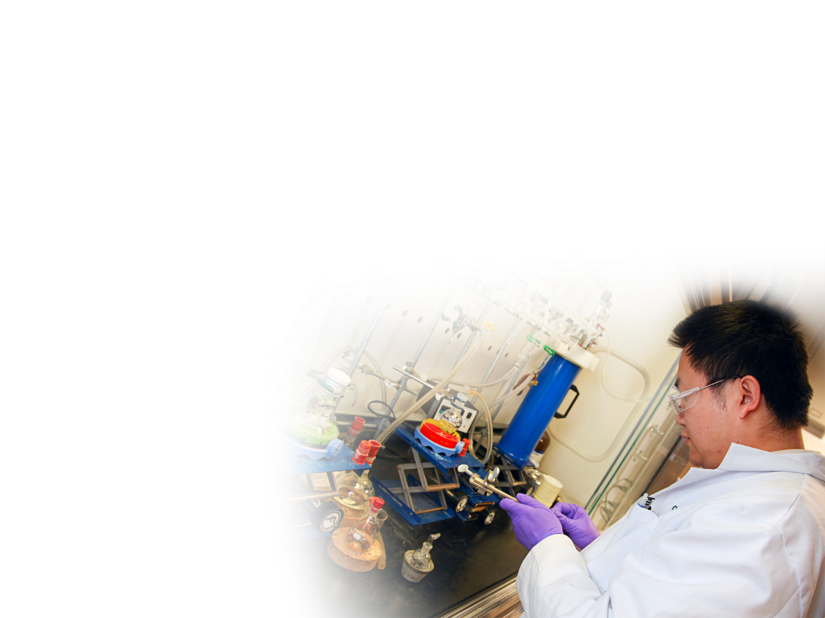
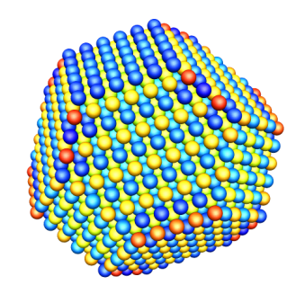
Center for Nanoscale Materials Sciences
DOE’s first Nanoscale Science Research Center
  Nanofabrication (10,000 sq. ft. clean room)
  Nanoscale characterization
  Materials synthesis and chemistry at the nanoscale
Access to world leading facilities (neutron scattering,
electron microscopy, high-performance computing)
Synthesis and processing (thin films, nanofabrication,
laser processing, polymers)
Understanding materials
and chemistry at the length scale where properties
are determined
Notes:
16
Extends our tradition of making our facilities available to university and industry researchers (more than 300 organizations, including 88 companies, performed work at ORNL user facilities in 2006; the CNMS had more than 100 users).

Slide 17
CNMS:
3 research themes and 2 crosscuts
  Theory, modeling, and simulation
Multiscale functionality
of nanostructures
Functional polymer
architectures
Nanofabrication Research
Laboratory
Collective
phenomena
in nanophases

Slide 18
Theme 1: Multiscale functionality of nanostructures
PLD + in situ SPM
Phase transitions
Environment
Microwave microscopy
PLD + sputter growth
Materials: Atomic and molecular structure of interfaces
Characterization:
Revealing
unexpected
phenomena
Photovoltaics
Electro-mechanics
Dimensionality
Batteries
He ion microscope
Transport
Architectures and their influence on collective energy transfer phenomena
High-B, Low-T STM
Fuel cells
Catalysis

Slide 19
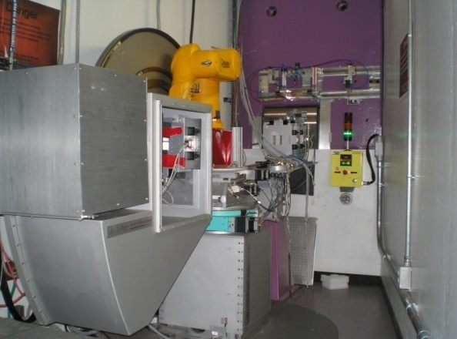
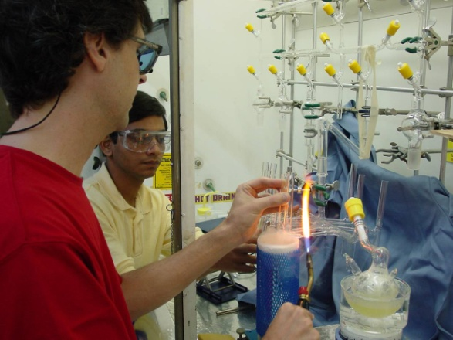
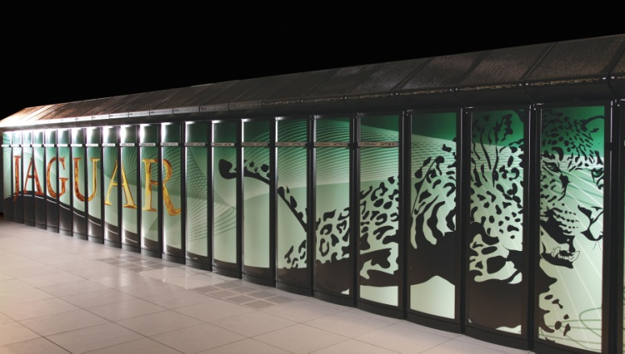
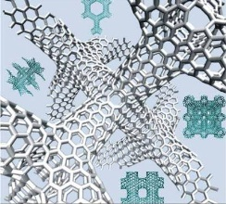
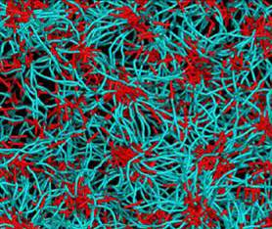
Theme 2: Macromolecular nanoscience
Designing and controlling nanoscale organization for novel properties and functionality
Largest effort in polymer science among DOE labs
Largest group devoted to macromolecular nanoscience
in the DOE nanoscience centers
Couples ORNL’s unique and world-leading strength in polymer synthesis with efforts in neutron and computational science

Slide 20
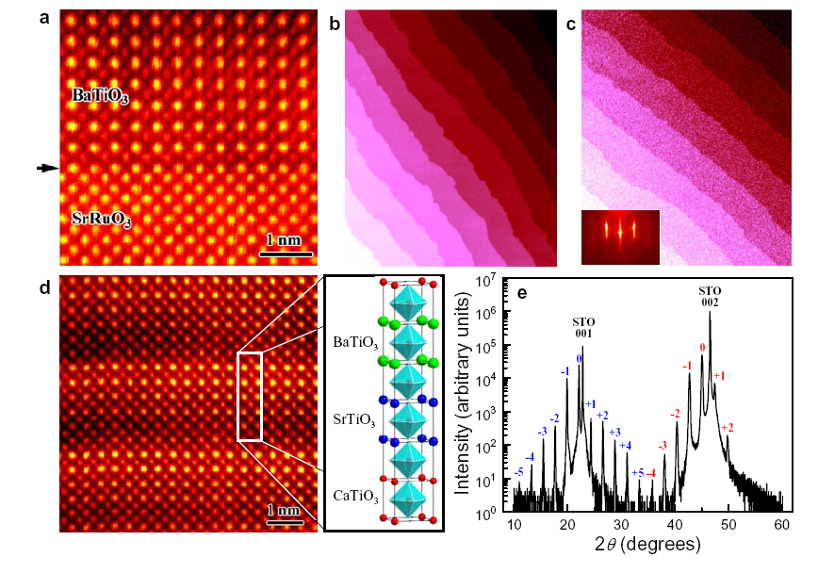
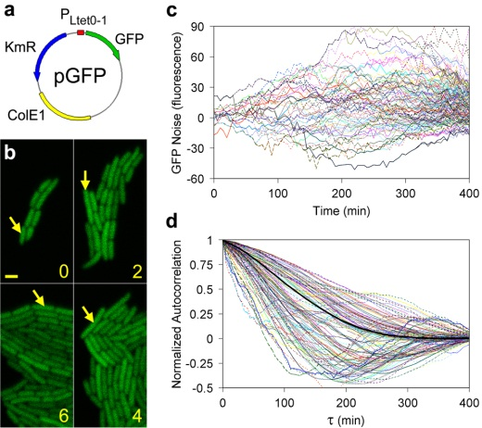
Theme 3:
Collective phenomena in nanophases
Inhomogeneities, dimensional confinement, and materials specificity in cuprate high-T_{c} superconductors | Focus: Cuprates as specific example of materials exhibiting complex emergent behavior resulting from electron correlations
Quantum transport in nanostructures | Focus: Electron and spin transport with corresponding experiments
Nano-enabled synthetic biology | Focus: Compositional and temporal fluctuations, learning from biology where function emerges from stochasticity “A bottom-up strategy for a minimal self-sustaining synthetic organism” Discovering simple and usable biological strategies for synthetic nanoscale systems

Slide 21
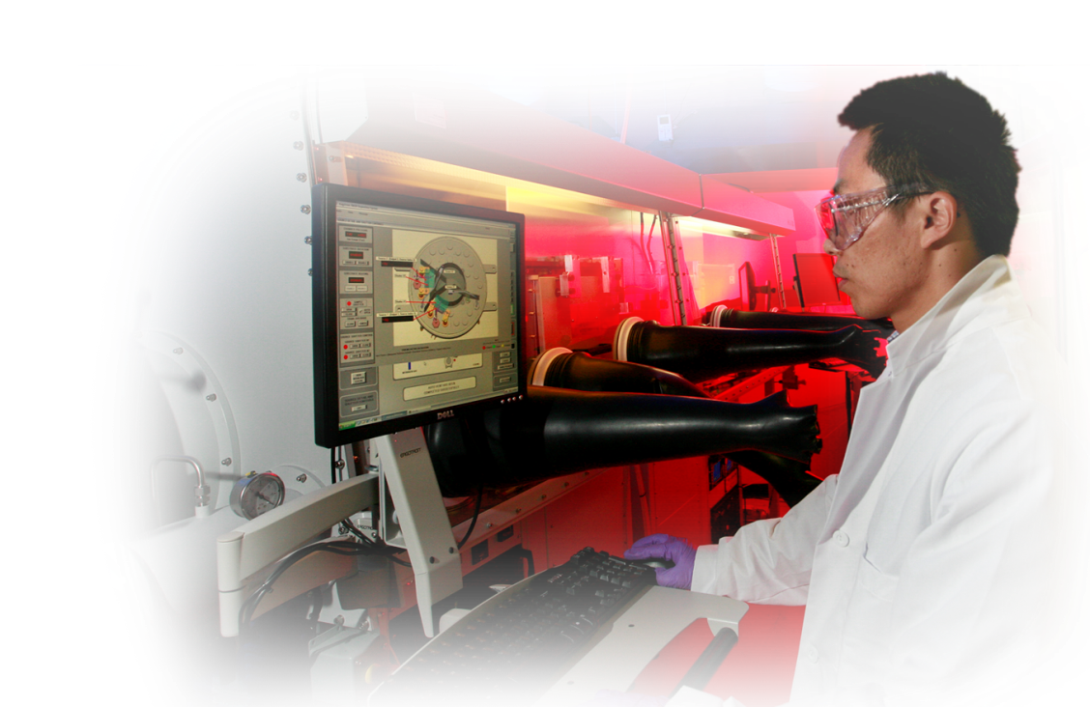
Academic researchers are making heavy use of CNMS
U.S. academic users represent ~60% of total CNMS users
FY11 through June:
  336 unique users (55% U.S. academic, 28% ORNL plus CNMS)
  43,500 user hours (21% more than
  FY10 through June)
Notes:
ORNL fraction had been hovering around 20% until increased to 25% in 2010, mostly due to CNMS staff indentifying as users- more staff proposals, in part supporting other DOE-funded programs they engage in
My best guess for 2011 is we will approach 400 users again; had 320 after 9 months

Slide 22
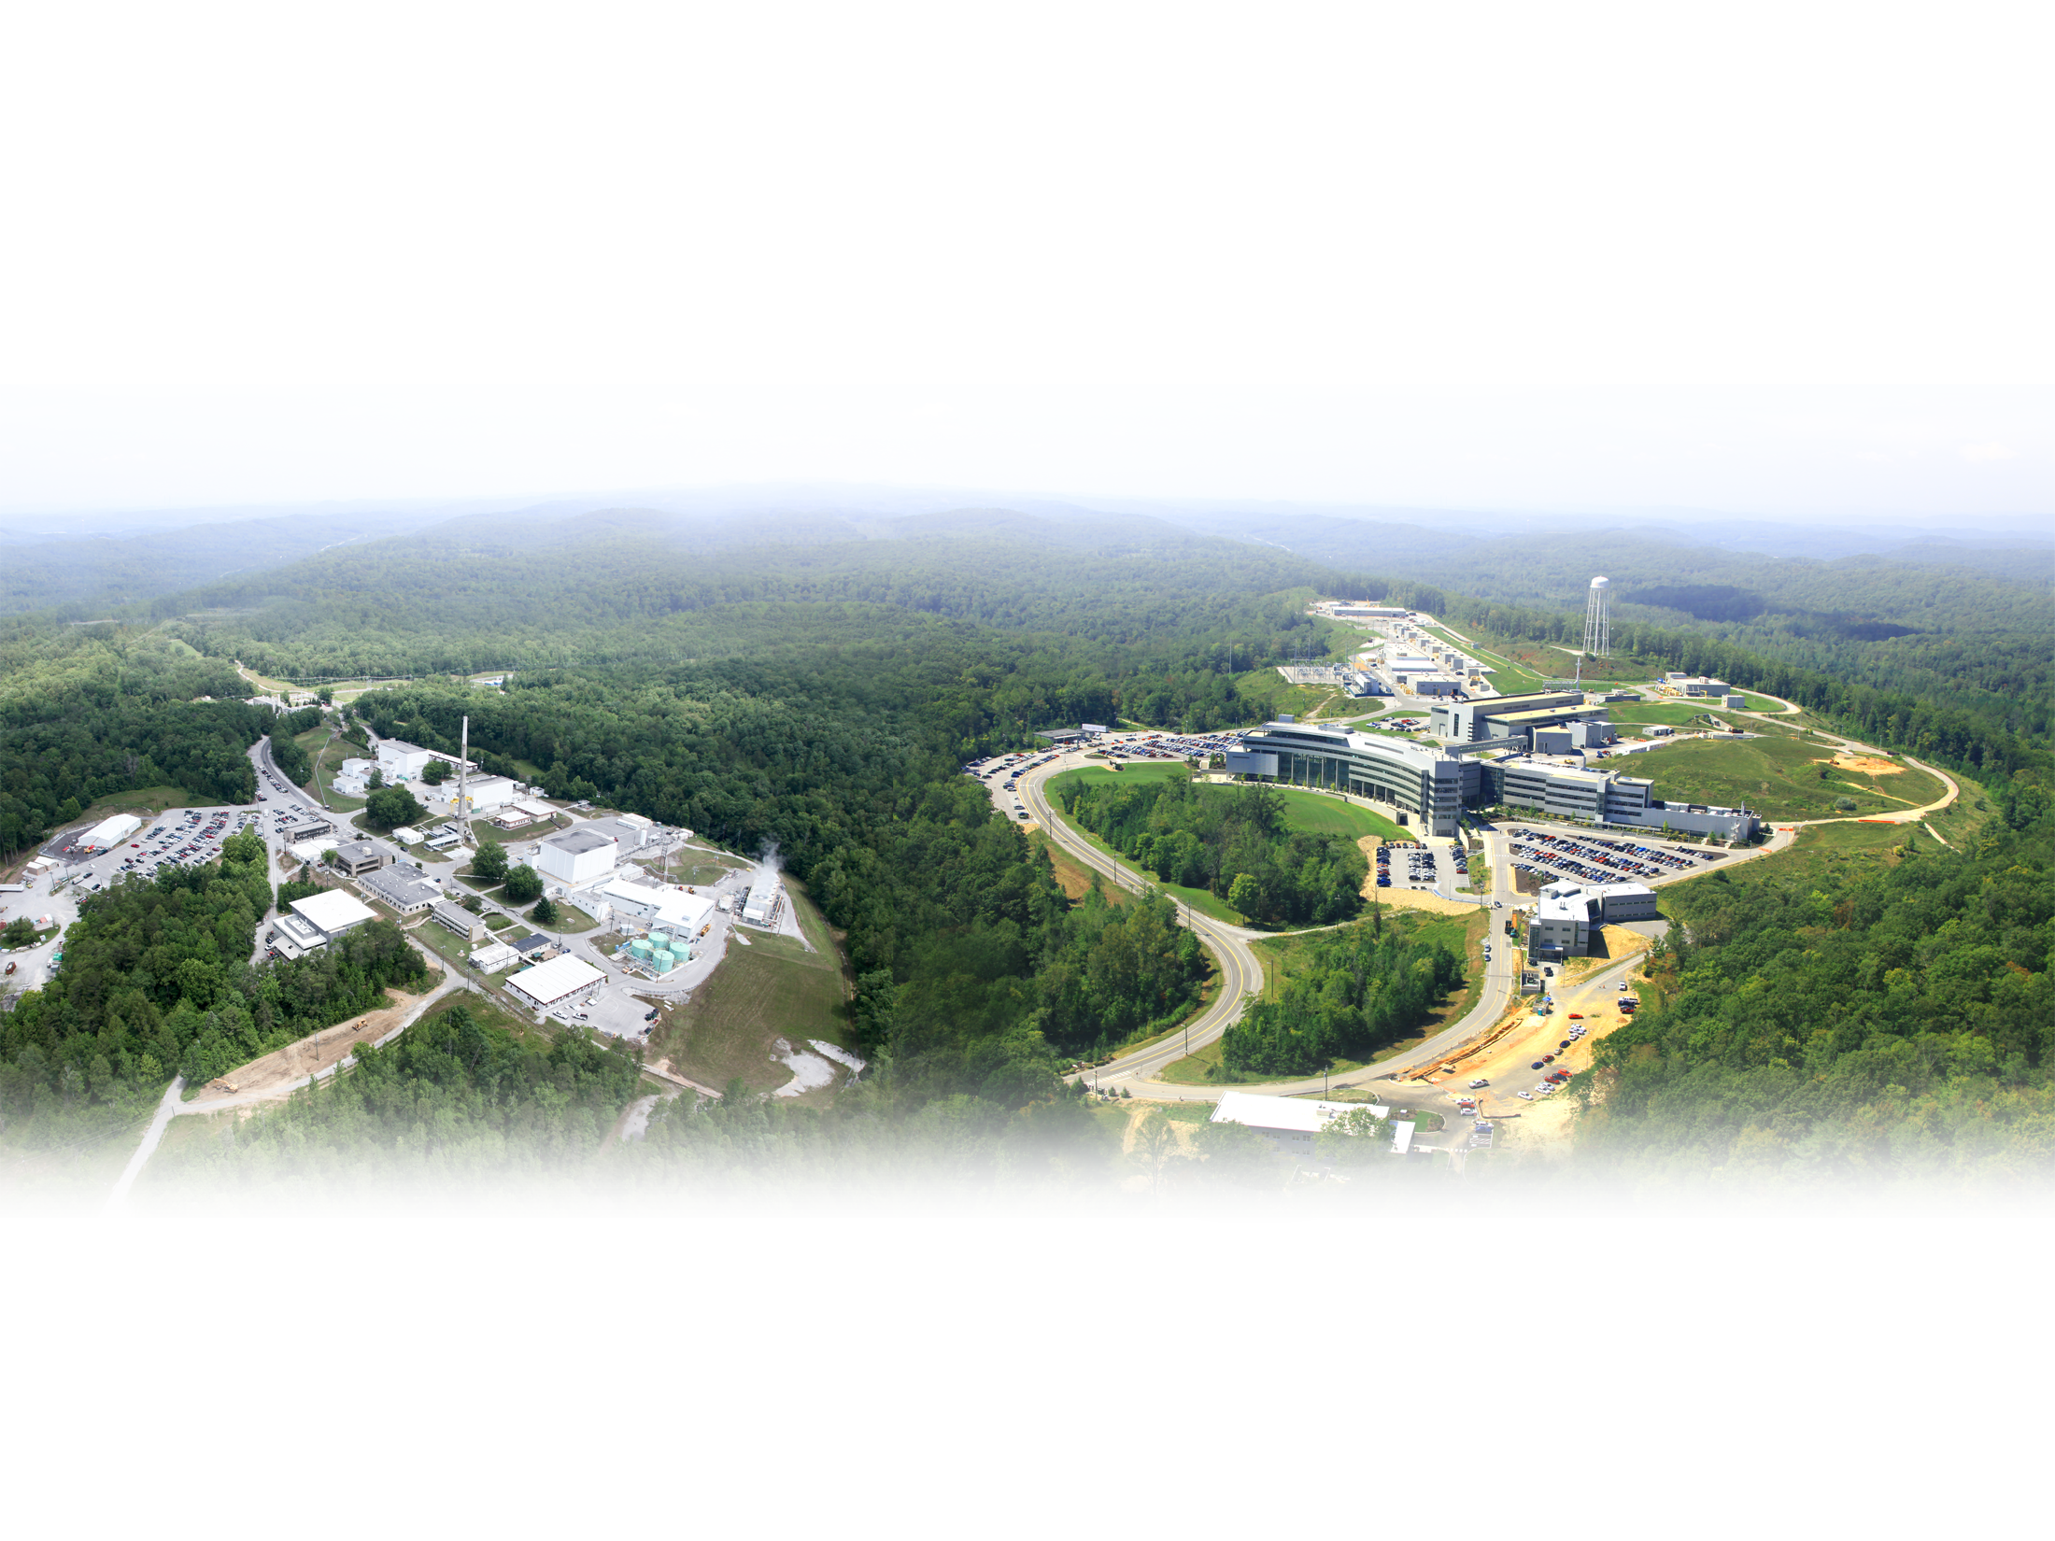
Developing and applying the world’s best tools for neutron scattering
High Flux Isotope Reactor:
Intense steady-state neutron flux
and a high-brightness cold neutron source
Spallation Neutron Source:
World’s most powerful
accelerator-based neutron source
Providing neutrons
to a growing user community
(>1,000 researchers per year)
Joint Institute for Neutron Sciences:
User gateway
for SNS and HFIR
Determining the nanoscale structure and dynamics of materials and biological systems
Notes:
22
SNS construction began in 1999 and was officially completed ahead of schedule when the first neutrons were produced in April 2006 and is the world’s most powerful source of pulsed neutrons. Its scientific instruments are being used to explore the structure and function of materials. A well-developed upgrade path (power upgrade, second target station) will keep SNS at the forefront during its 40-year operating life.
HFIR, which has been in operation since 1965, provides a continuous cold neutron source of unsurpassed brightness, with two new world-class SANS instruments providing the ability to determine nanoscale structures in a vast array of materials (polymers, biological macromolecules, solids).
The Joint Institute for Neutron Sciences is housed on Chestnut Ridge in a facility constructed with funding from the State of Tennessee.
IMAGE: This is a “lightly enhanced” photograph

Slide 23
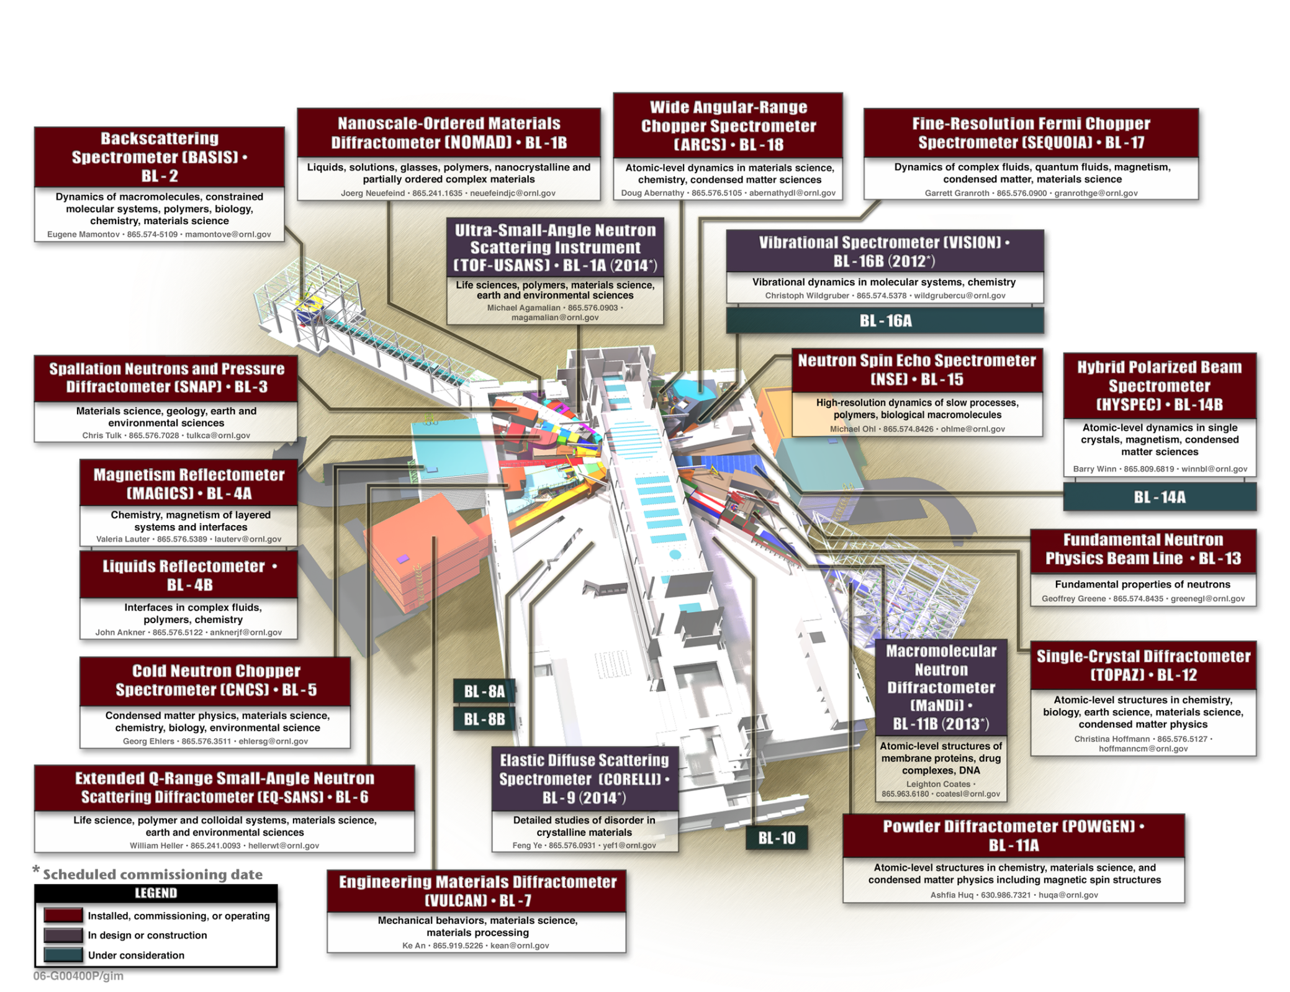
SNS instruments
Notes:
First measurements included powder diffraction, beam images and neutron guide checks
108 of 115 detector modules installed during October/November shut down
Scattering chamber vacuum operational
Next commissioning steps include calibration of Fermi choppers and first monochromatic beam operations
ARCS received first beam in September 2007

Slide 24
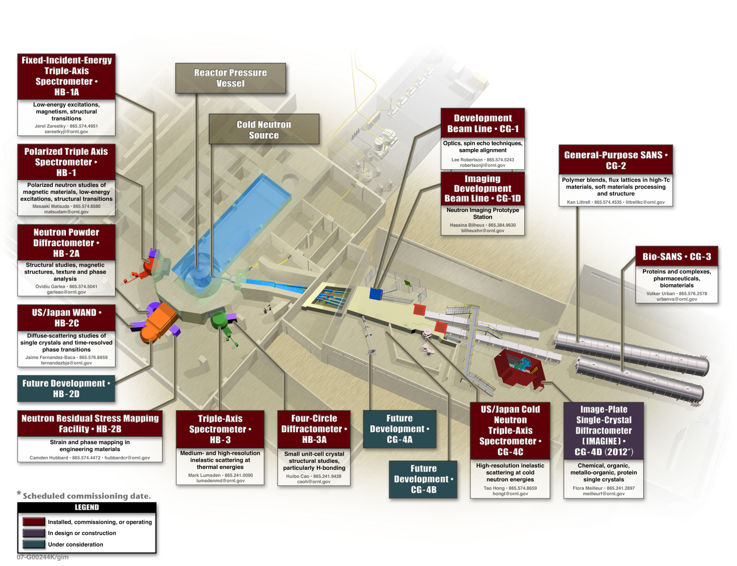
HFIR instruments

Slide 25
Users are increasing as we build to capacity
SNS submitted
SNS accepted
Notes:
2011 is users as of Feb 28, 2011

Slide 26

Gaining access to ORNL’s neutron scattering resources
Participate in research and education programs | Become a user | Engage with ORNL researchers
ORISE internships, fellowships, and research participation program National School on Neutron and X-Ray Scattering Apply for EPSCoR grants from NSF and DOE | Join SNS/HFIR User Group (SHUG) Apply for beam time through competitive online proposal process Receive technical advice, guidance, and assistance from instrument scientists | Invite ORNL scientists to your campus Attend workshops and conferences Bring student groups to ORNL

Slide 27
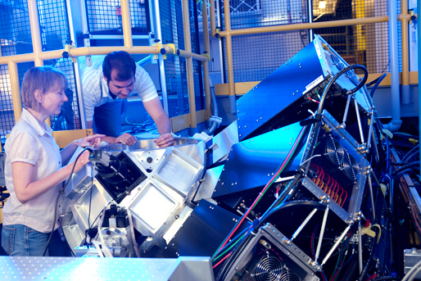
Oak Ridge National Laboratory
Distinctive user facilities for discovery and innovation
Building Technologies Research and Integration Center
Center for Nanophase Materials Sciences (CNMS)
Center for Structural Molecular Biology (Bio-SANS)
High Flux Isotope Reactor (HFIR)
Leadership Computing Facility (LCF)
National Transportation
Research Center (NTRC)
Shared Research Equipment
(SHaRE) User Facility
Spallation Neutron Source (SNS)
www.ornl.gov

