Slide 1
Discrete Molecular Dynamics Simulations of Biomolecules
Feng Ding, Ph.D.
University of North Carolina at Chapel Hill
78th Annual Meeting of the SESAPS, 2011

Slide 2
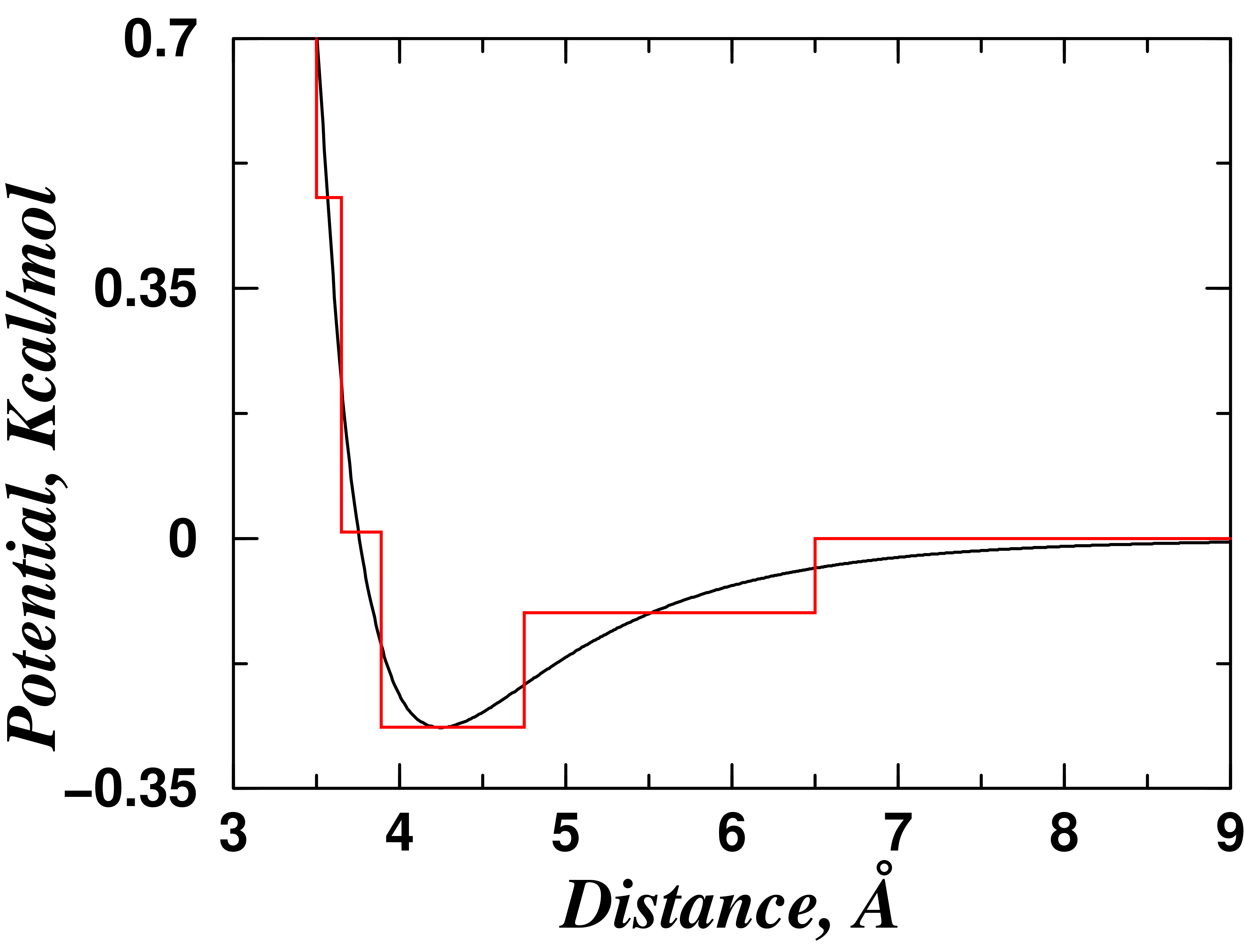
DMD — A special type of MD
R_{ij}
V_{i}
V_{i}’
V_{j}’
R_{ij}
V_{j}
Classical Mechanics:
Conservation of energy, momentum, angular momentum
Dynamics is event driven:
collision prediction, “sorting”, updating only the colliding atoms
Rapaport, D. C., The Art of Molecular Dynamics Simulations, Cambridge University Press, 2ED, 2004
Notes:
DMD is one type of MD. The idea is to use discontinuous step functions to model the interactions. The atoms do not have accelerations and only change their velocities instantaneously when its changes the potential step with respect to another atom.

Slide 3
Introduction to the DMD Algorithm
Start
Predict all neighboring collisions of
Sort the collision events for the soonest one
Re-calculate the neighboring collision of the two atoms
Update the state of the colliding atoms
~ R_{max}
Divide the simulation box into cells
Wall-crossing counted as an Event.
N
Max time reached?
Y
End
Rapaport, D. C., The Art of Molecular Dynamics Simulations, Cambridge University Press, 2ED, 2004
Notes:
In order to efficiently simulate the molecular system. The simulation box is divided into cells, with the cell dimension approximate the interaction range. As the result, an atom only interact with the atoms in the neighboring cells, 9 cells in 2D and 27 cells in 3D. Wall-crossiing, or collision with cell well is counted as Events. Therefore, the algorithm can be described with the flow chart.

Slide 4
DMD – A brief history
The First MD simulation is DMD
Continued development and main applications in hard sphere and granular systems, and polymers.
First dynamics simulation of proteins by continuous potential MD in 1977
Application of DMD for proteins from late 90s
Alder, B. J., and Wainwright, T.E. 1957. Phase Transition for a Hard Sphere System. J. Chem. Phys. 27:2
Rapaport, D. C. 1978. Molecular-Dynamics Simulation of Polymer-Chains with Excluded Volume. J. Phys. A-Mathematical and General 11:L213-L217
Chapela, G. A., S. E. Martinezcasas, and J. Alejandre. 1984. Molecular-Dynamics for Discontinuous Potentials .1. General-Method and Simulation of Hard Polyatomic-Molecules. Mol. Phys. 53:139-159
Smith, S. W., C. K. Hall, and B. D. Freeman. 1995. Large-Scale Molecular-Dynamics Study of Entangled Hard-Chain Fluids. Phys Rev Lett 75:1316-1319.
McCammon, J.A., Gelin, B.R. & Karplus, M. Dynamics of folded proteins. Nature 267, 585−590 (1977).
Zhou, Y., and M. Karplus. 1997. Folding thermodynamics of a model three-helix-bundle protein. Proc Natl Acad Sci U S A 94:14429-14432.
Dokholyan NV, Buldyrev SV, Stanley HE, & Shakhnovich EI, Folding & Design, (1998)
Smith A. C., C. K. Hall, "Bridging the gap between homopolymer and protein models: A discontinuous molecular dynamics study," J. Chem. Phys. 113, 9331-9342 (2000)
Ding, F. & Dokholyan, N.V., Discrete Molecular Dynamics Simulation of Biomolecules; Dokholyan, N.; Ed.; Springer: Berlin, 2011; in press.
Notes:
A brief history of DMD. The first ever MD simulations was done by Alder and Wainwright in late 50s, who was later recognized by the Boltzmann award in 2001 together with Kawasaki. The MD simulations was with Hards sare, which is basically DMD. DMD was under continuous development, but mainly in hard sphare, gradusmen, and polymers. In the mean time, scientiests learned how to simulate continuous potential and in 1977. MD was first used to simulate the dynamics of protein, BPTI, by McCammon and Karplus in 1977. Only until late 1990, DMD was first used to study proteins. Today, we will focus on the recent advanced in DMD and its application in simulations of protiens.

Slide 5
Outline
Optimization of DMD algorithm
Sub-cells
Reduce unnecessary calculation
Parallelization
Applications of DMD in simulation of proteins
Hydrogen bond: Multi-body interaction
Protein folding
Mechanical unfolding of protein
Protein-peptide recognition

Slide 6
Sub-cells
Prediction calculation is proportion to the number of neighbors
A
B
Divide into finer sub-cells
2 D: 3² → π
3 D: 3³ → 4π/3
~2.9
~6.4
Increase the calculation of wall-crossing events
Ding, F. & Dokholyan, N.V., Discrete Molecular Dynamics Simulation of Biomolecules; Dokholyan, N.; Ed.; Springer: Berlin, 2011; in press.
Notes:
The CPU time for predication of collision time is >90%. For each collision events, the recalcuation of collsion time is proportional to the number of neighbors. Ideally, the atoms interact with the given atoms in within a sphere with radius of Interaction range. In order to reduce the number of neighboring atoms, we divide the cells into sub-cells and only include the sub-cells forming the circle.

Slide 7
Reduce the expensive sqrt() calculations
Sqrt() calculation is expensive.
After one collision, all collisions is re-calculated.
V_{ij}
V_{ij}
V_{ij}
d₊
j
j
j
d—
i
i
i
For a given Δt, it is easy to quickly estimate whether two atom will collide within Δt.
Δt can be set as proportional to the atom’s average collision time.
Ding, F. & Dokholyan, N.V., Discrete Molecular Dynamics Simulation of Biomolecules; Dokholyan, N.; Ed.; Springer: Berlin, 2011; in press.
Notes:
Another part of expensive computation is square root calculation. For all predicted collision, only first will take place and all the rest will be wasted. Therefore, we developed an algorithm the reduce the number of SQRT() calculations by setting a predefined delta T. If a collision does not happen within delta T, we will not compute the sqrt(). Other wise, we will. There are multipe ways to set the delta T. it can be the time for the atom to leave the sub-cell. Or it can be dynamically set as the average collision time of a give atom/

Slide 8
An O(1) sorting algorithm
δt, N_{p}
Pt, “Current time”
……
C_{l}, t_{l}
C_{i}, t_{i}
C_{j}, t_{j}
C_{k}, t_{k}
Paul, G. 2007. A complexity O(1) priority queue for event driven molecular dynamics simulations. Journal of Computational Physics 221:615-625.
Notes:
Recently, Garry Paul from BU physical department proposed an elegant way for O(1) sorting algorithm for DMD. The idea is to divide the time into time intervels and inset the collision time into the array. The program can proceed along the array to find the next collisions.

Slide 9
Parallelization
Divide & Conquer
Miller, S., and S. Luding. 2004. Event-driven molecular dynamics in parallel. Journal of Computational Physics 193:10.
Multi-thread/Pipeline
Herbordt, M. C., M. A. Khan, and T. Dean. 2009. Parallel Discrete Event Simulation of Molecular Dynamics Through Event-Based Decomposition. 2009. 20th IEEE International Conference, Boston, MA.
D. Shirvanyants, F. Ding, D. Tsao, S. Ramachandran, & N.V. Dokholyan, in preparation
Notes:
There are also attempts to parallelize the DMD method. First, by Miller and Luding with Divide and Conquer approach. Alternatively, Herbordt from BU Computer Engineering proposed to pipeline the DMD algorithm.

Slide 10
Outline
Optimization of DMD algorithm
Sub-cells
Reduce unnecessary calculation
Parallelization
Applications of DMD in simulation of proteins
Multiscale models
Protein folding
Mechanical unfolding of protein
Protein-peptide recognition

Slide 11
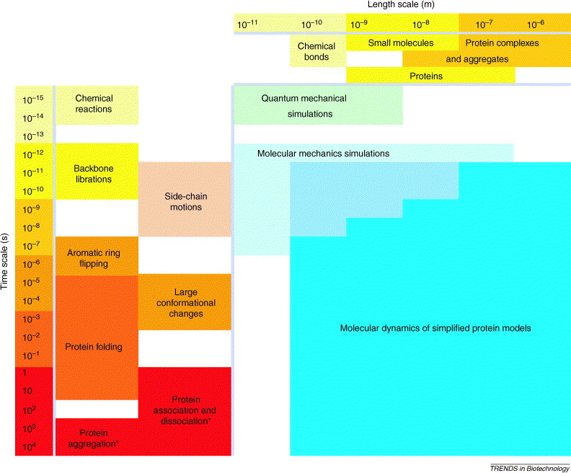
Time and length scales in Biology
Length scale, m
Time scale, s
Ding F. and Dokholyan N.V., Trends in Biotechnology, (2005).
Notes:
The biological process span a wide range of time and length scales. Time scale, chemical reaction in fs, protein folding in ms-s, and aggregation takes place in hours, days, and even months. In terms of sizes, the chemical bonds length is in Angstrom, proteins in 10-100 nm, while the protein complexes and aggregates in 100 nm and even micrometers.

Slide 12
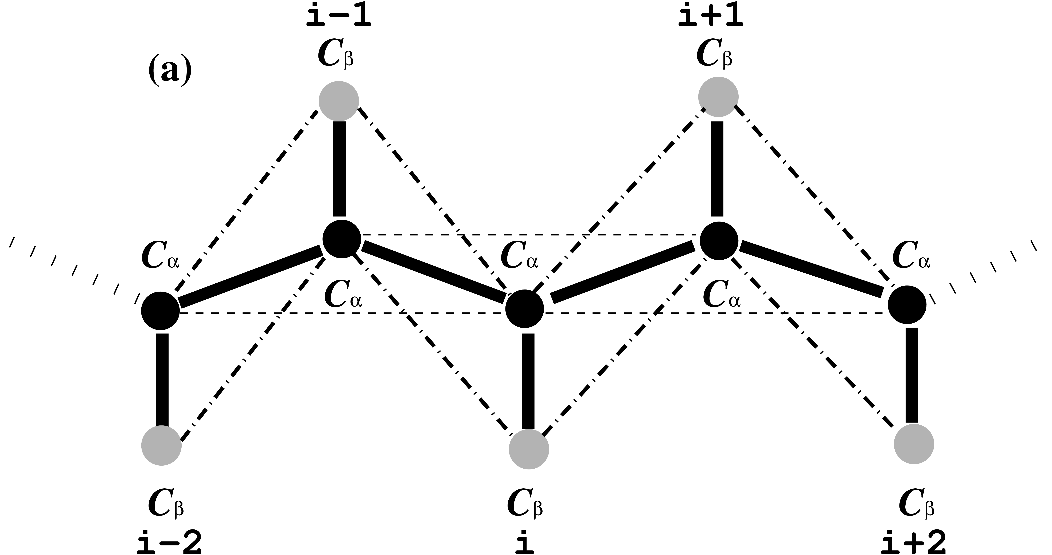
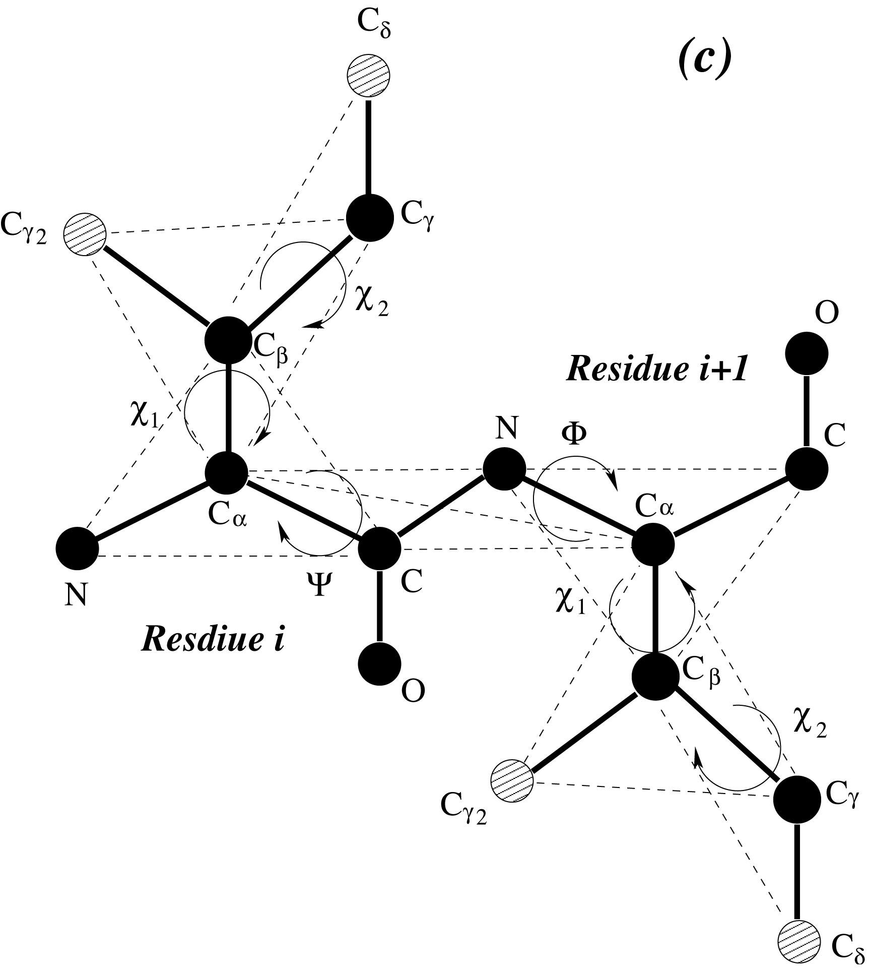
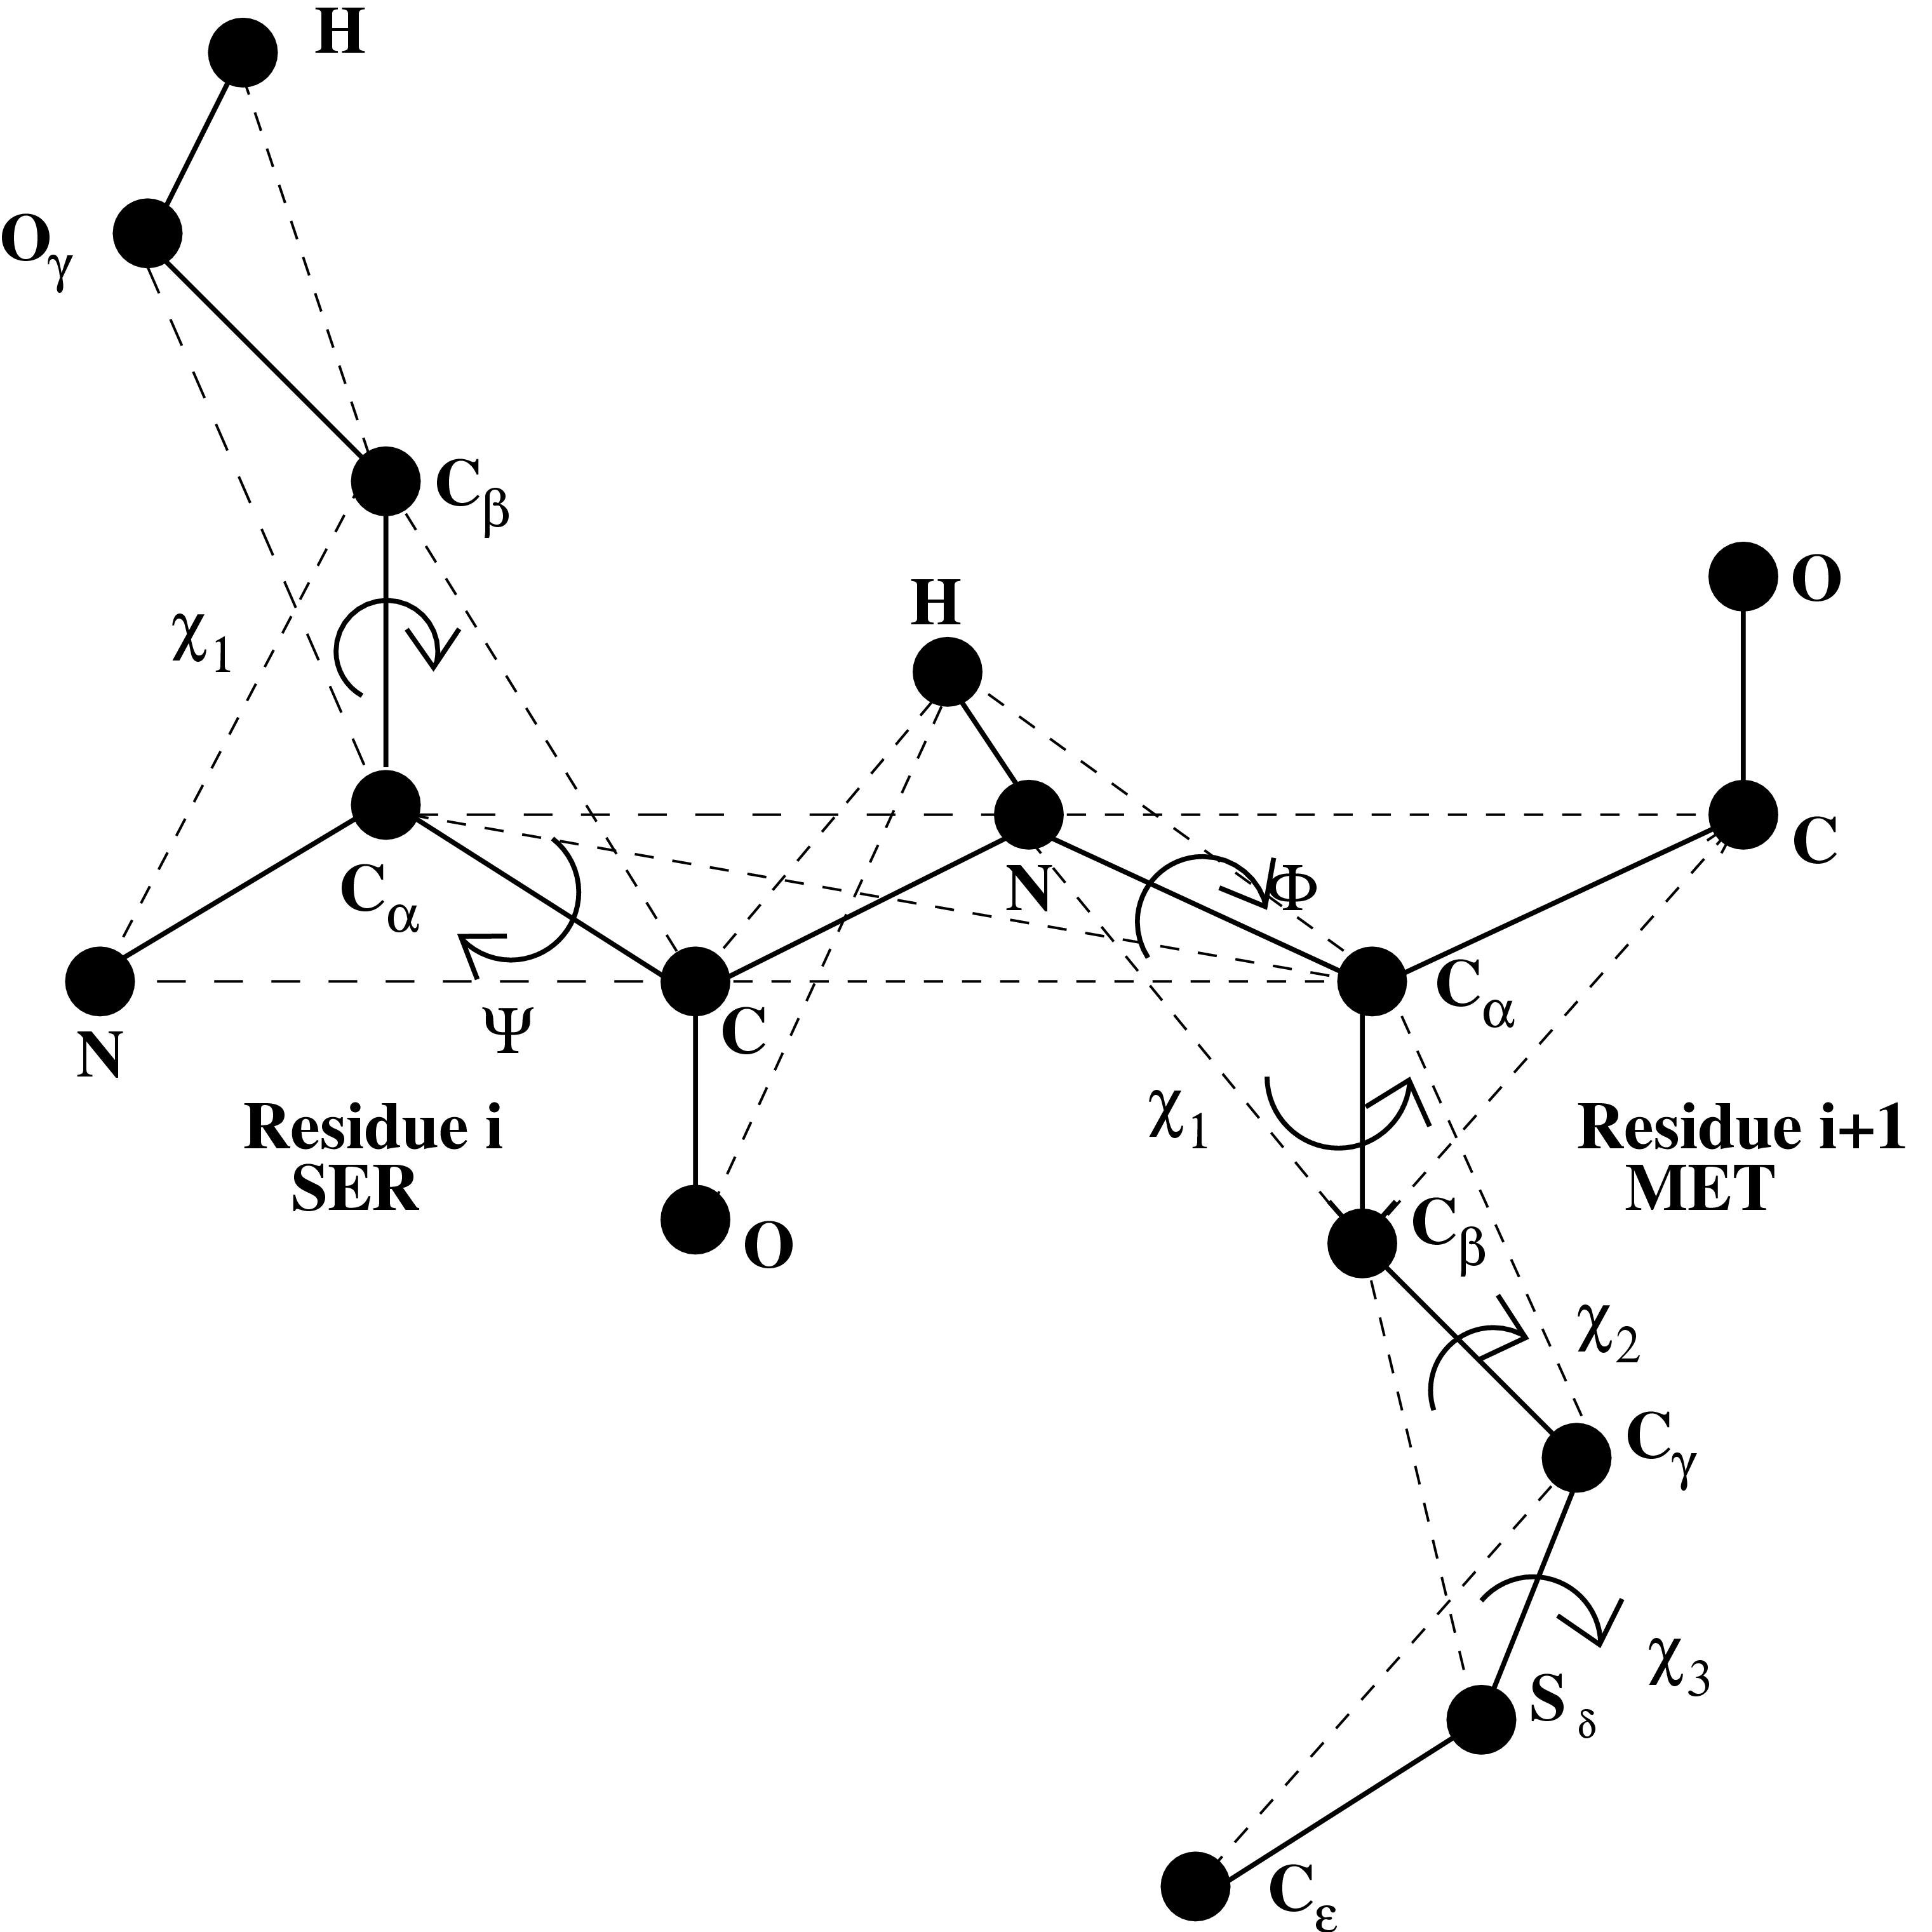
Multi-scale protein models
Two-Bead
Four-Bead
Pseudo All-atom
All-atom
Residue i+1
Residue i
Ding F. and Dokholyan N.V., Trends in Biotechnology, (2005)
F. Ding, D. Tsao, H. Nie, and N. V. Dokholyan, Structure, (2008)
Notes:
Over the years, we have developed a wide range of protein models of different complexity, from simple two bead per amino acid to all-atom models. CG reduces certain degrees of freedom and spans a longer time scale, in the expensive of losing certain atom details, which is great to study some basic principles of molecular behavior. The atomistic models allows the high-resolution studies of biological processes that requires the atomic details, such as predicting the binding a certain ligands.

Slide 13
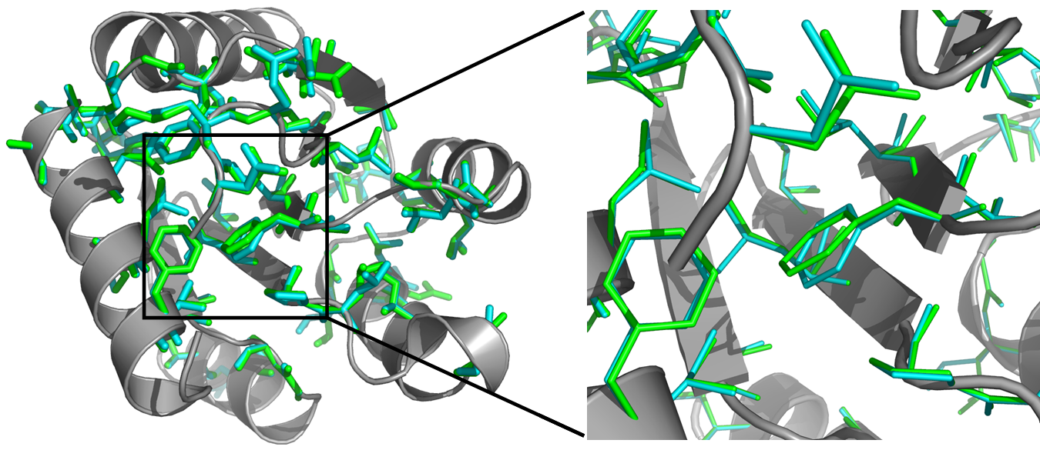
Medusa forcefield
Recapitulate the protein sequence and core packing
Modeling backbone flexibility
Recapitulate the protein stability changes
upon mutation
apomyoglobin (A130L)
Eris server: http://eris.dokhlab.org/
Ding & Dokholyan, Plos Comp. Biol., 2006
Yin, Ding & Dokholyan, Nature Method, 2007
Notes:
We recently developed a Medsua Forcefield, or score function, to describe the energy of a given protein structure. Guided by Medusa Force field, we perform Monte Carlo search of the protein sequence and sidechain packing. We are able to recapitulate the protein native sequence and side chain orientation inside the core. Moreoever, we also benchmarked the force field by prediction the ddG, the stability change upon mutations. We found a significant correlation between predictions and experimental values. Furthermore, we allowed protein backbone change which allowed the estimate of mutations that perturb protein backbone.

Slide 14
Protein folding

Slide 15
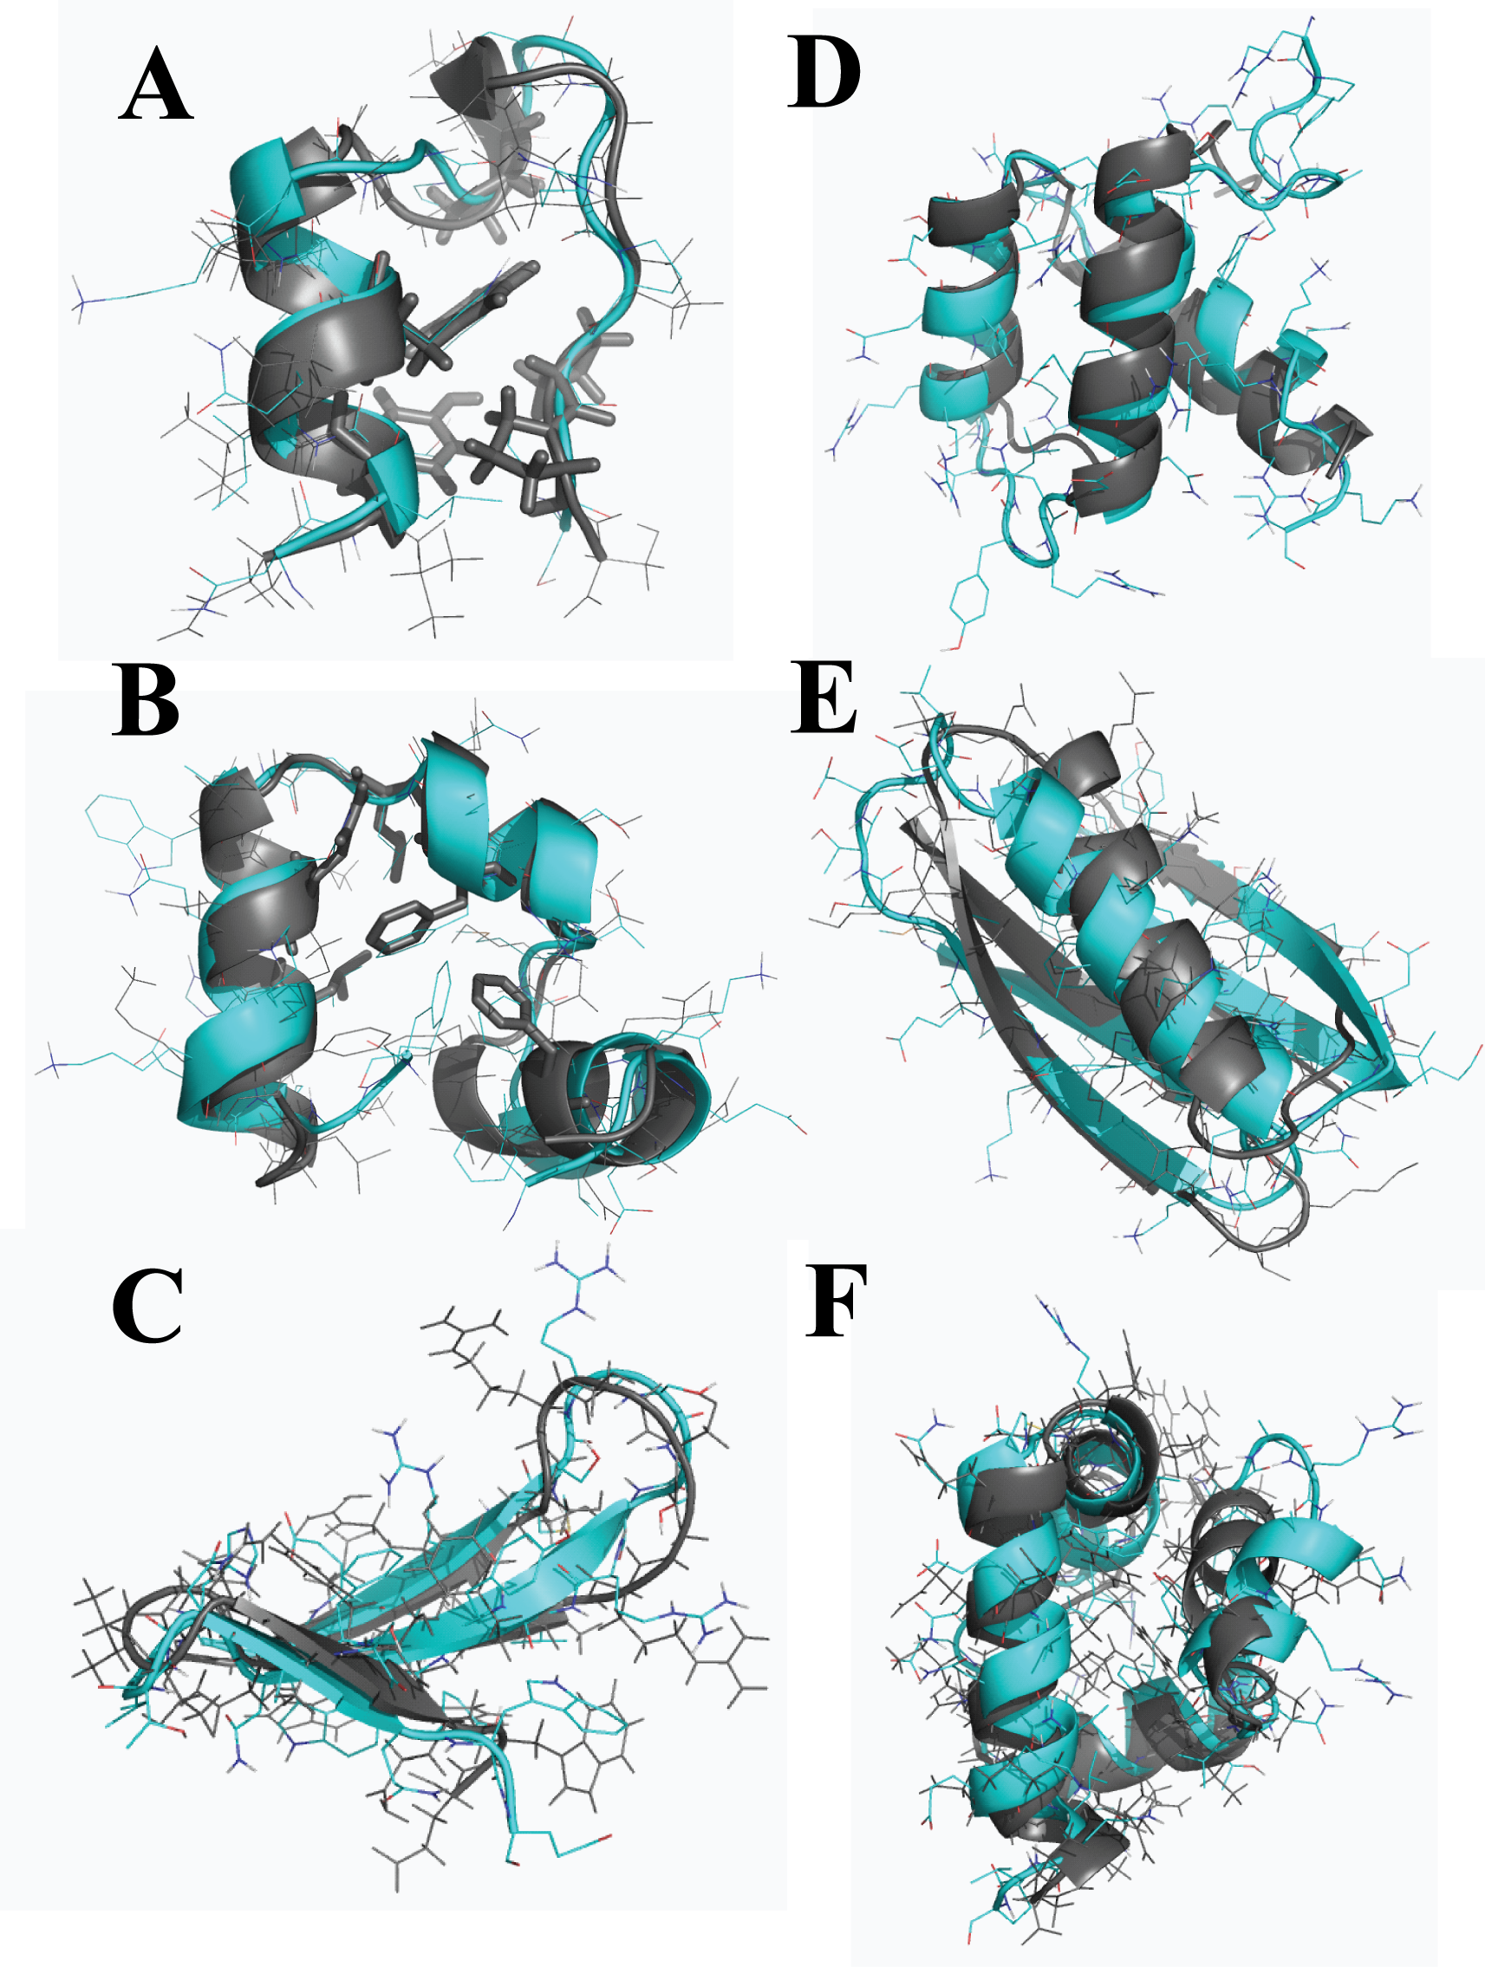
Protein folding using all-atom DMD with Medusa force field
DMD simulation is efficient in protein conformational sampling.
Medusa force field is able to capture the driving force of protein folding.
F. Ding, D. Tsao, H. Nie and N.V. Dokholyan, Structure (2008)
Notes:
With the Medusa Forcefield and DMD for sampling, we perform the benchmark of folding form sequence alone. In six cases of small RNAs (<60aa), we are able to recapitulate the near-native fold.

Slide 16
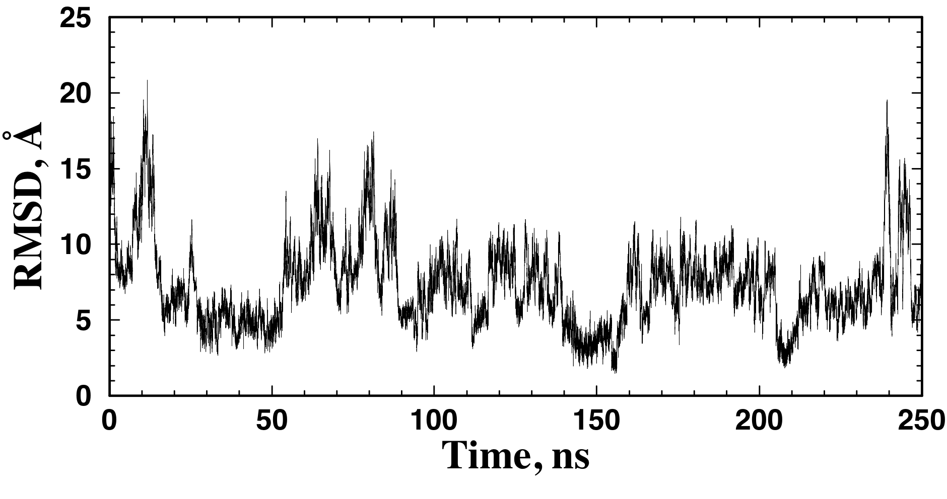
Direct observation of protein folding and unfolding
Fold the three-stranded WW domain to the near-native state.
Sample the refolding and unfolding equilibrium of the WW domain.
Shaw DE et al., Science (330):341-6 (2010)

Slide 17
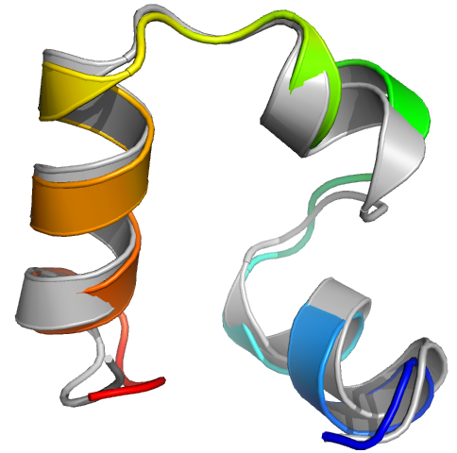
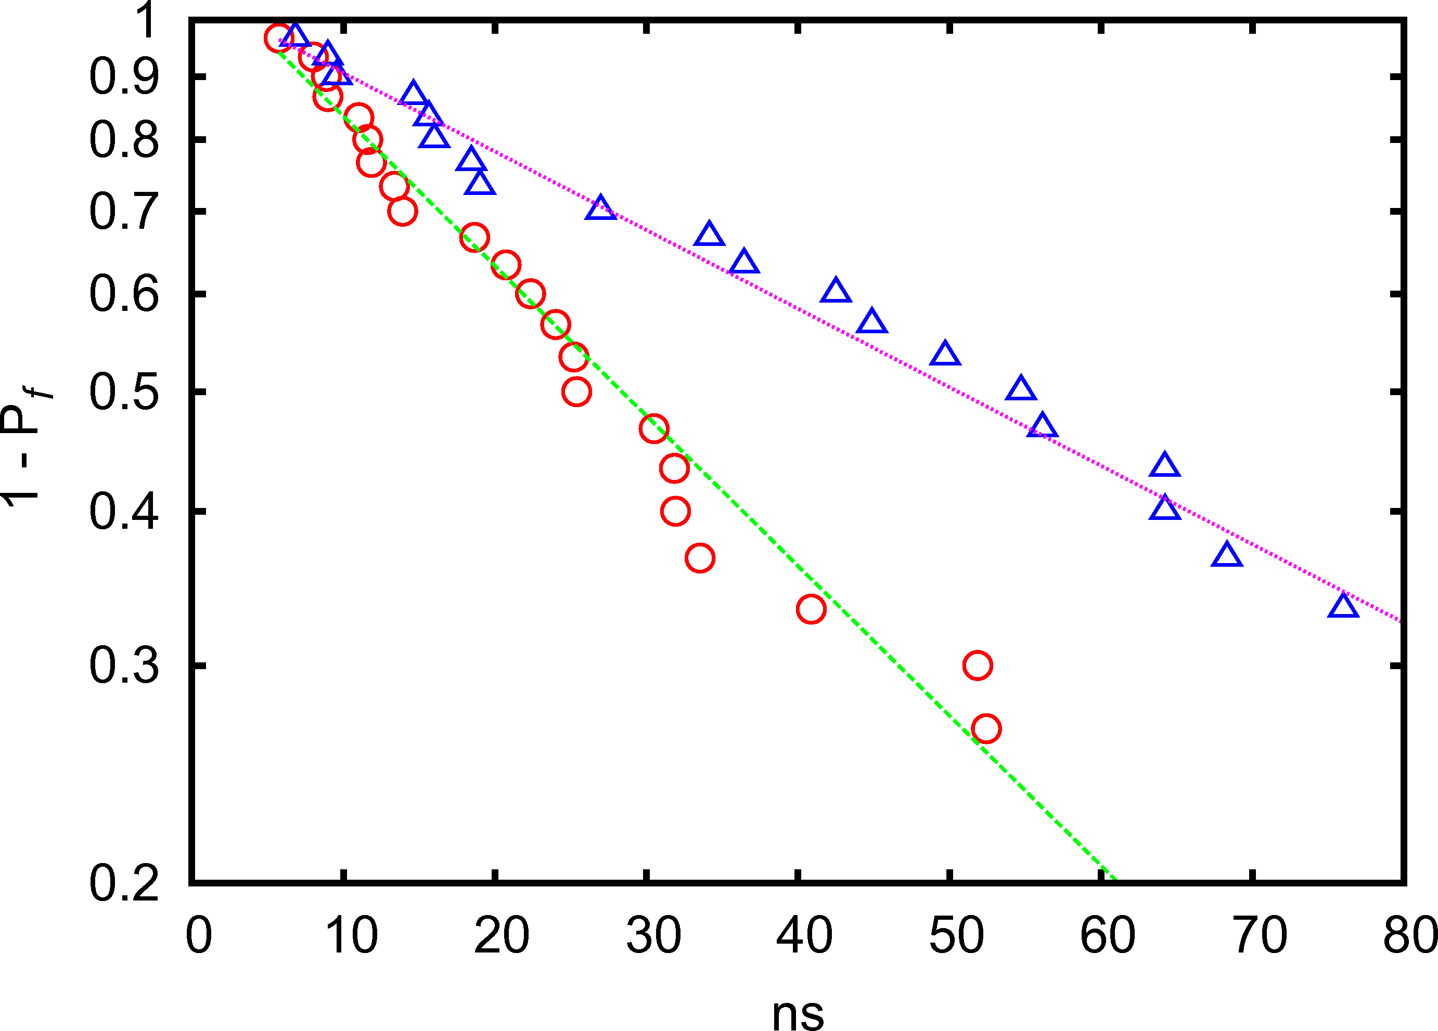
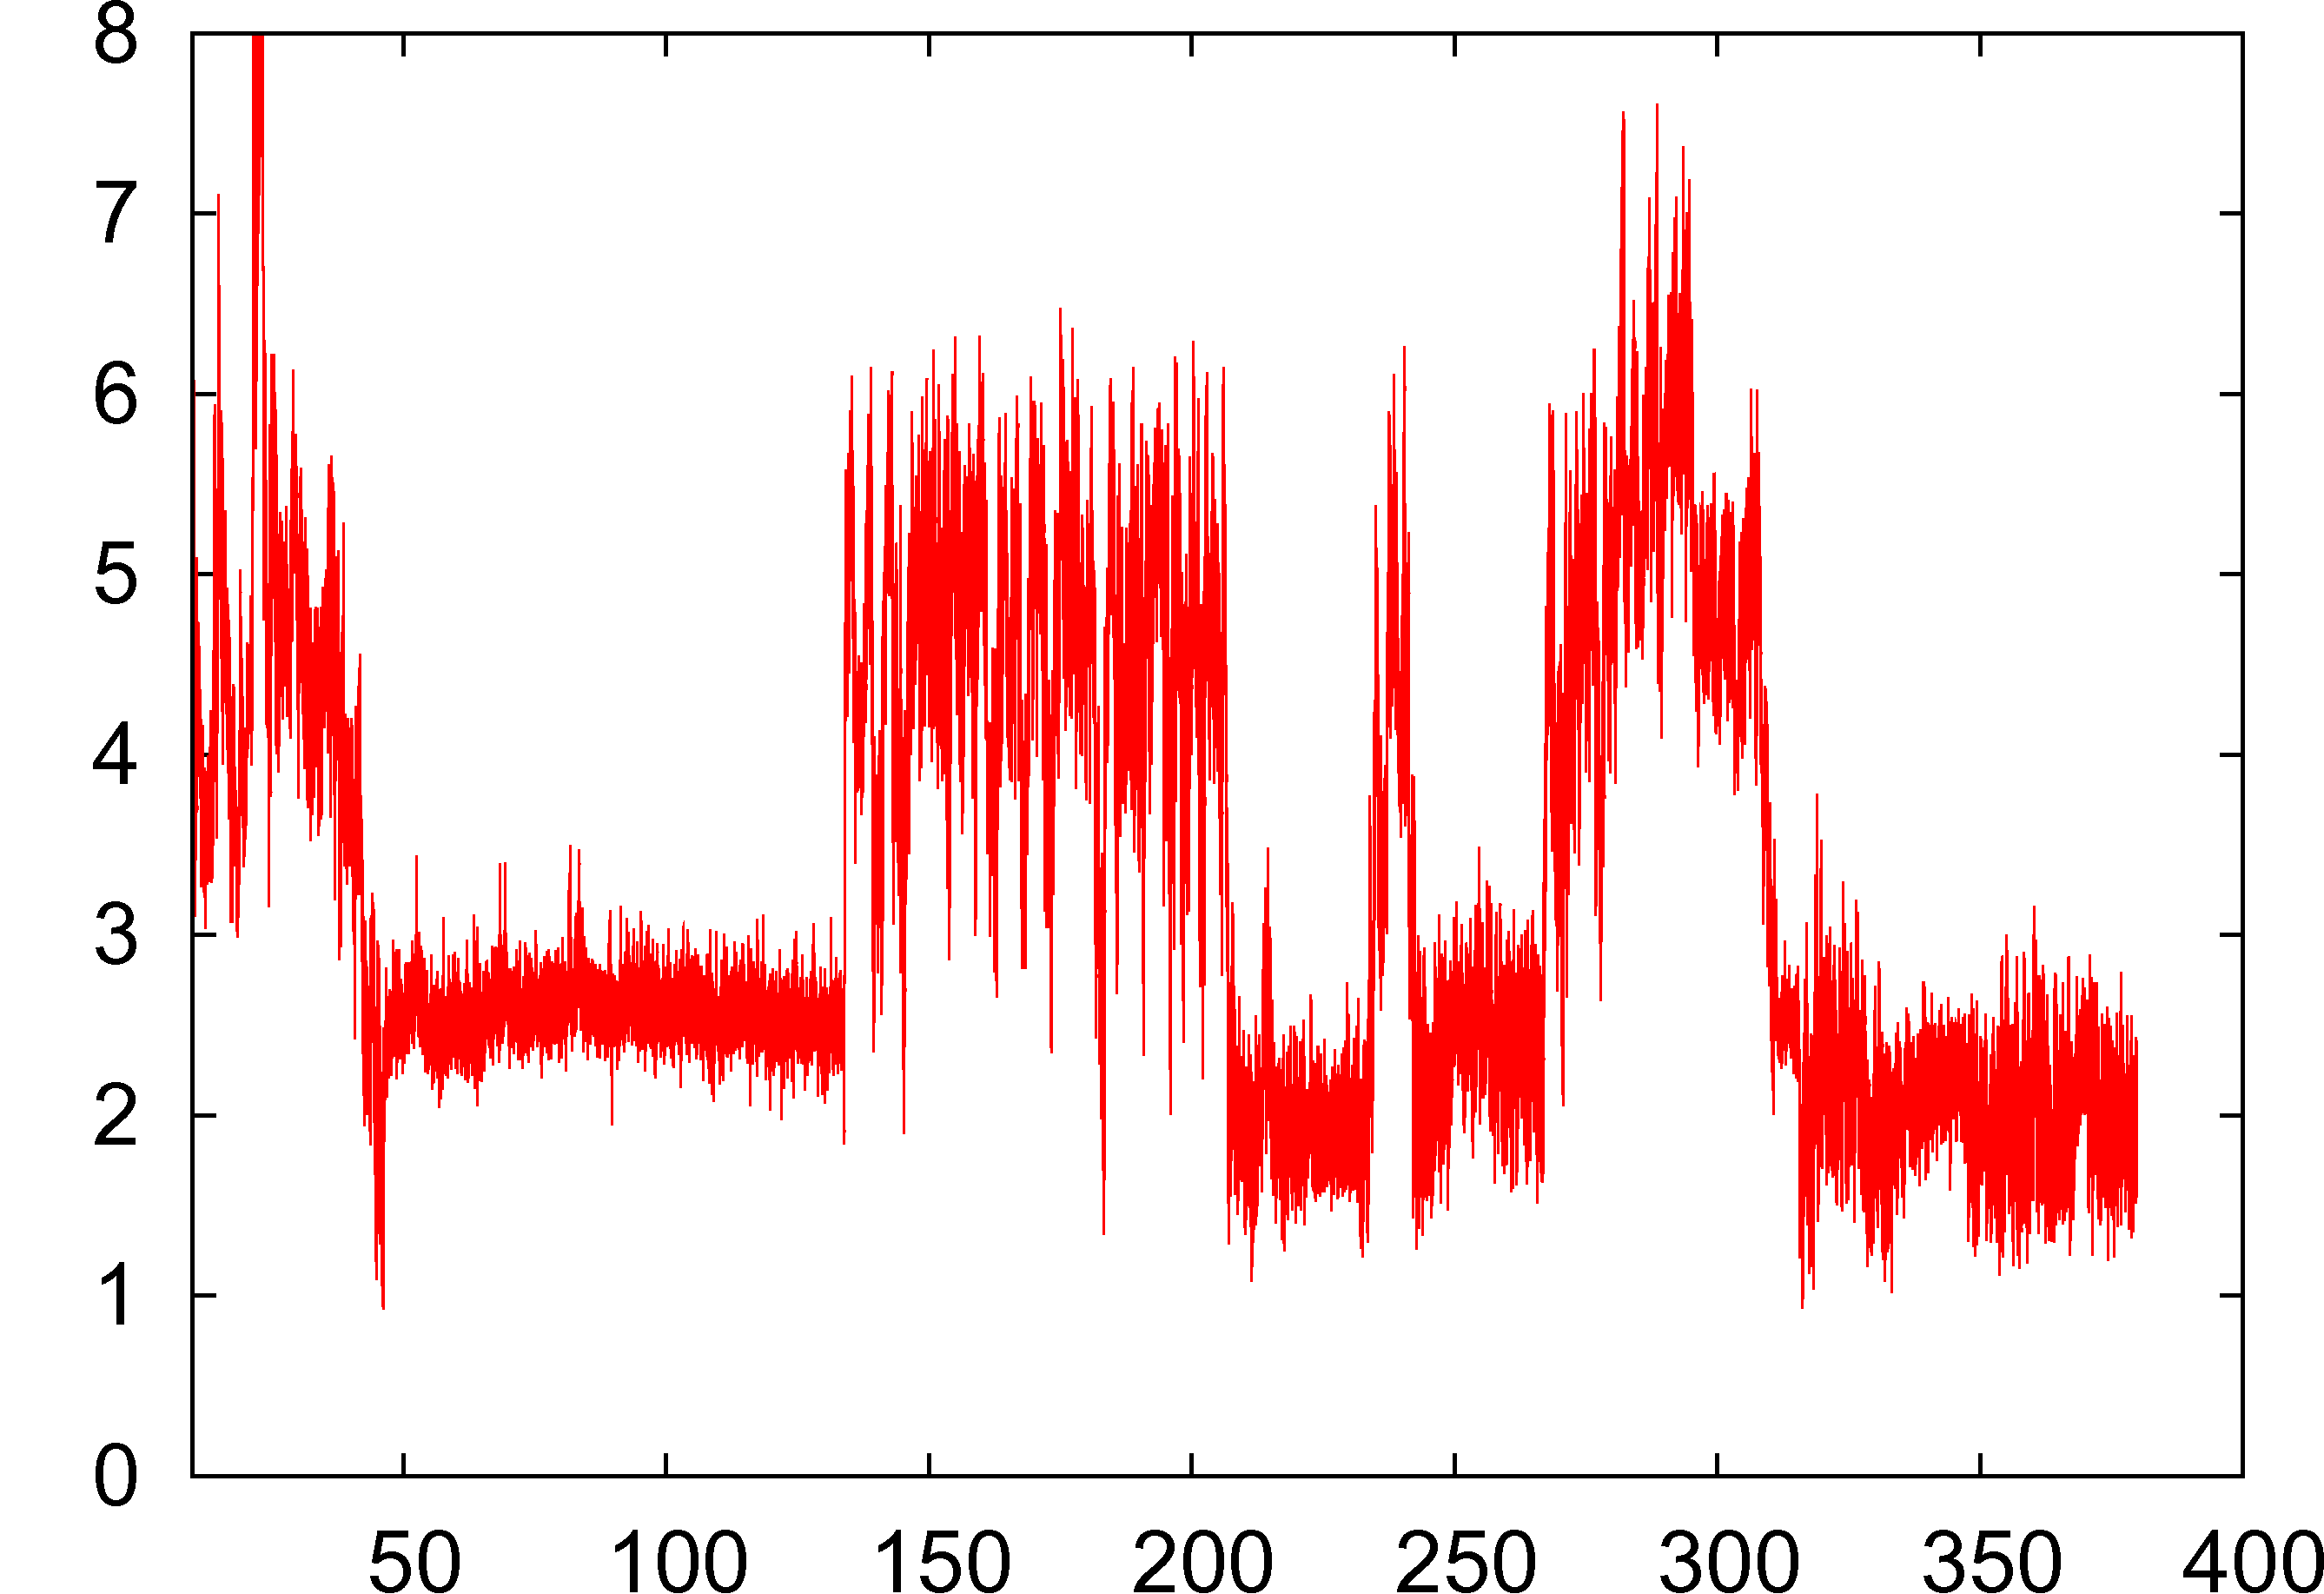
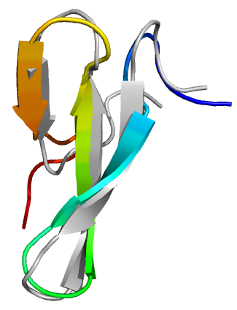
Short Proteins: Vilin Headpiece and WW domain
First folding probability as function of time
WW domain, 68 ns
RMSD
time
Villin headpiece: 35 aa
Exp. Folding time: 2 μs
Villin headpiece, 35 ns
WW domain: 34 aa
Exp. Folding time: 4 μs
30 trajectories x 0.5 μs each, multiple folding events/trajectory
D. Shirvanyants, F. Ding, D. Tsao, S. Ramachandran, & N.V. Dokholyan, in preparation

Slide 18
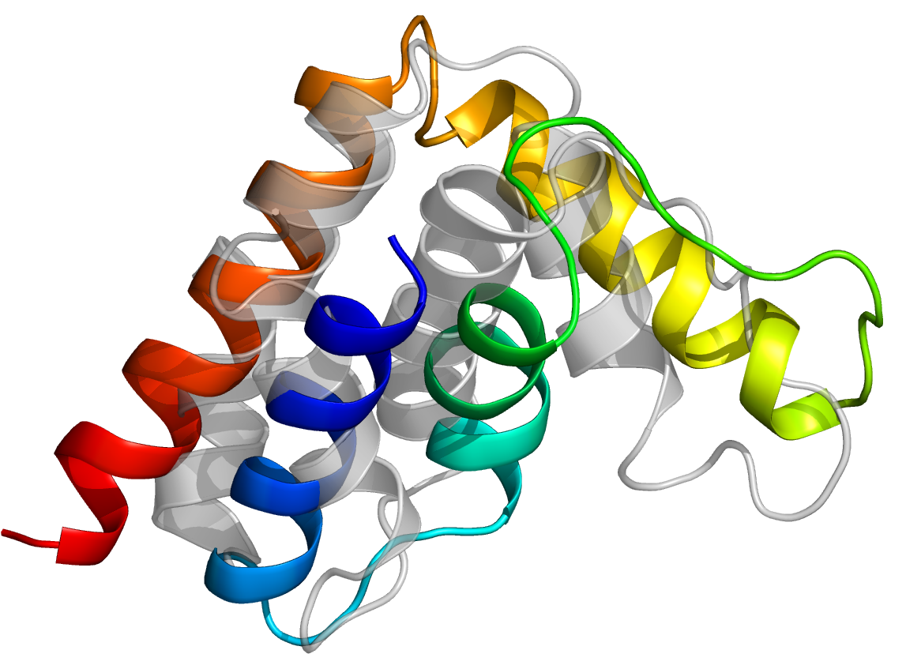
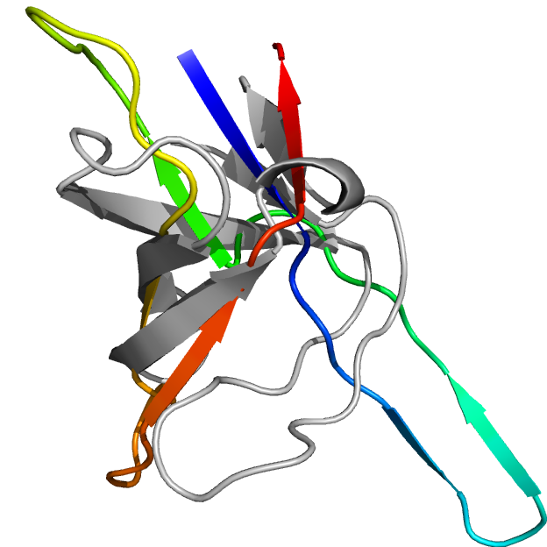
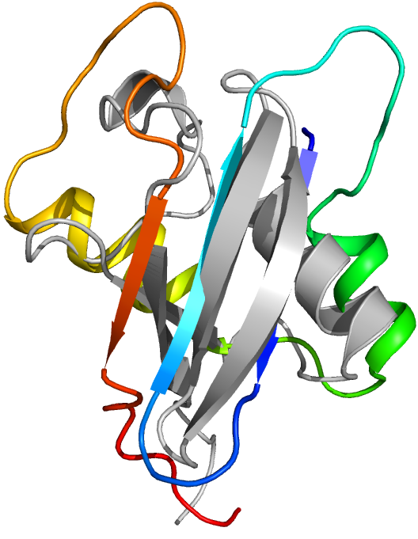
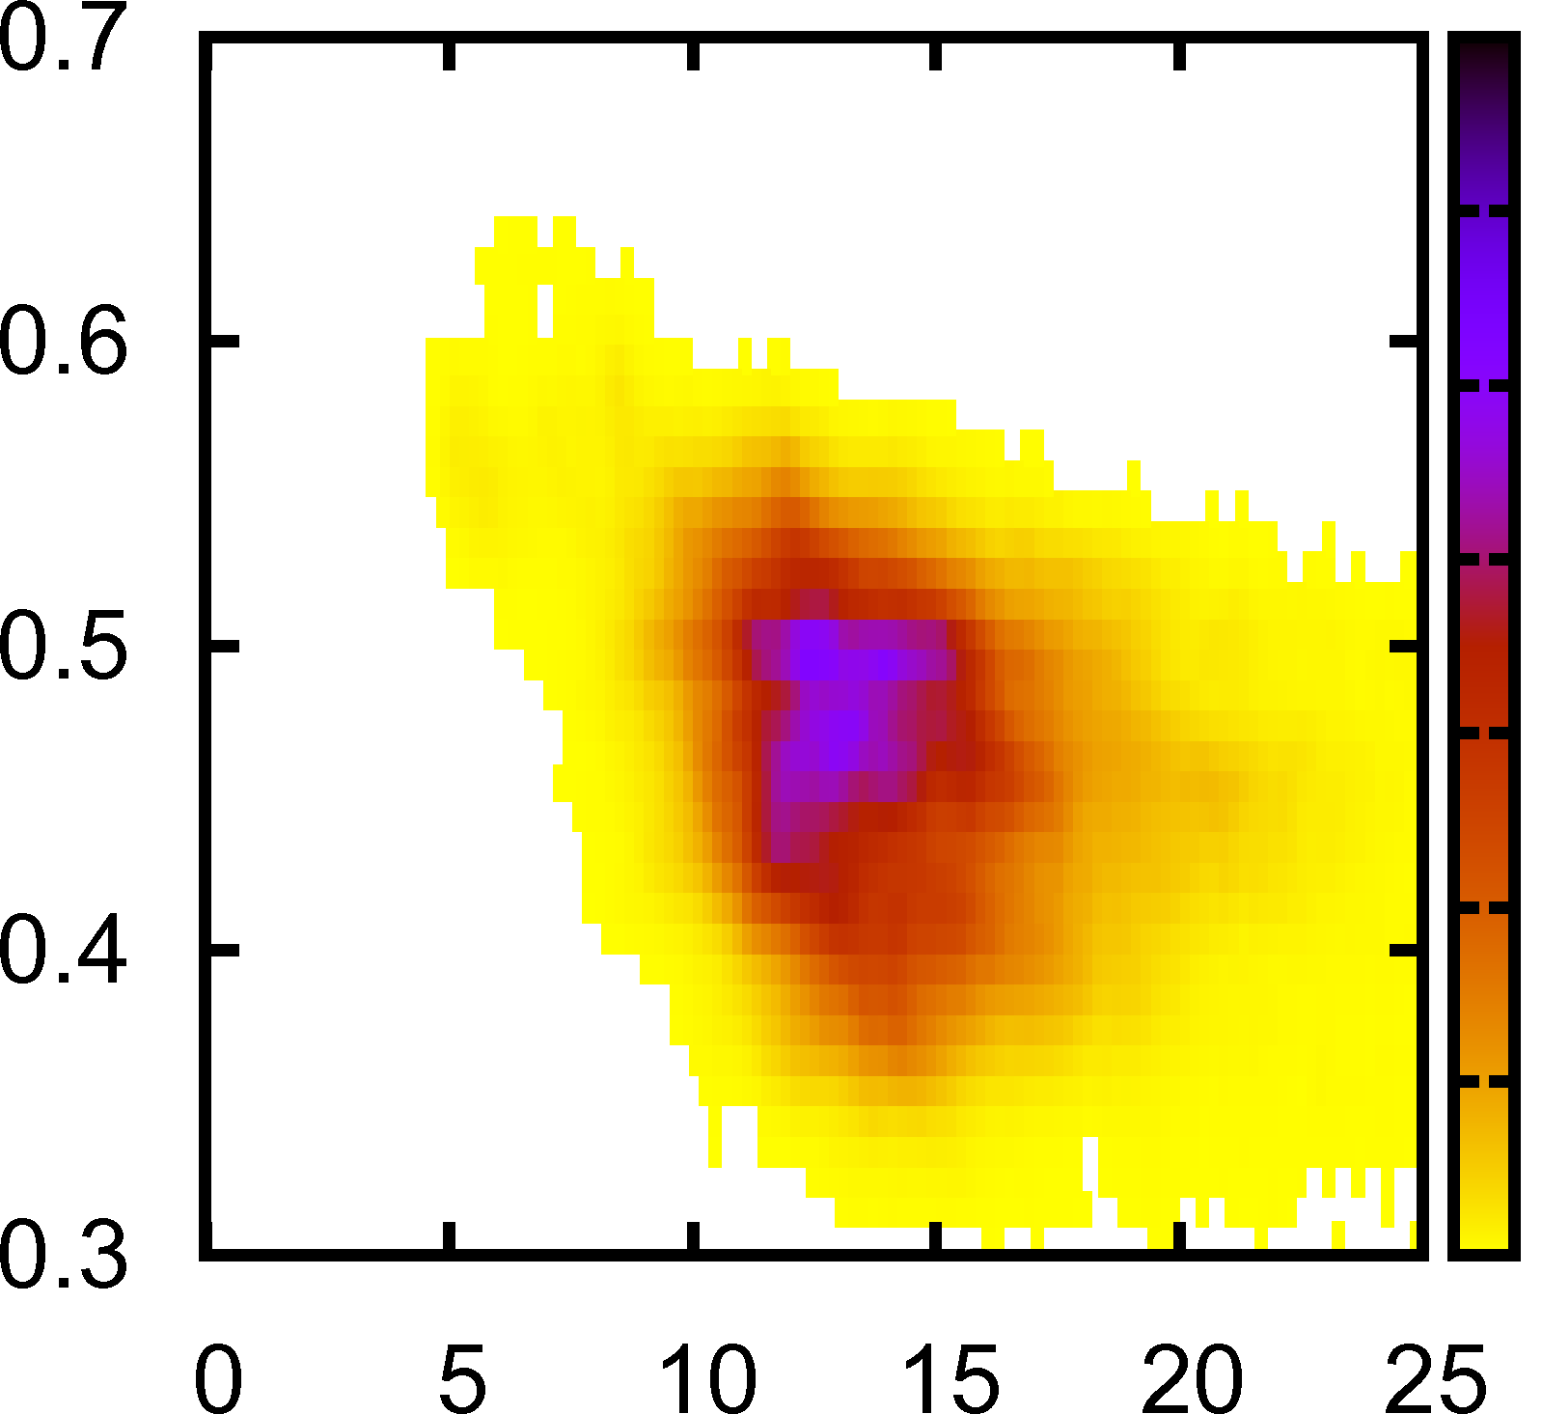
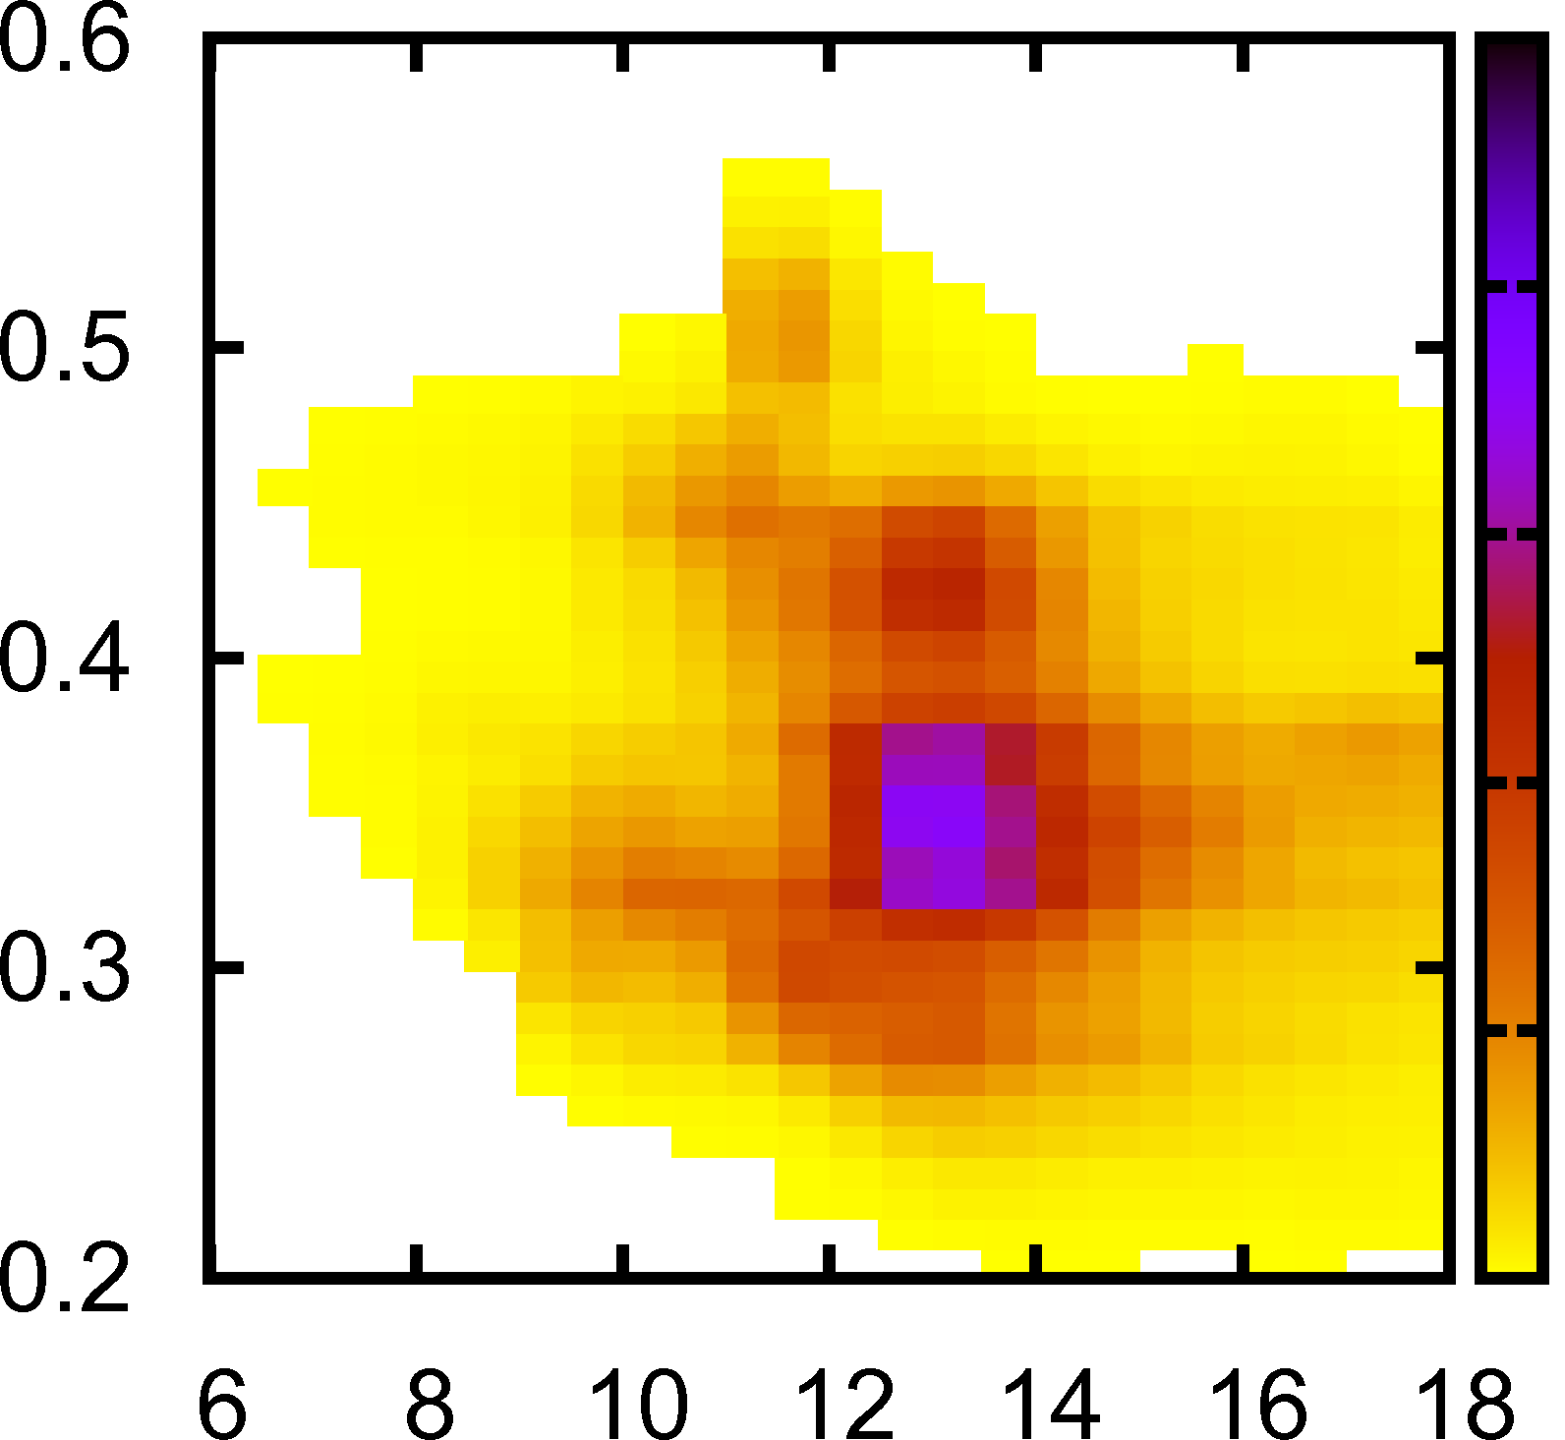
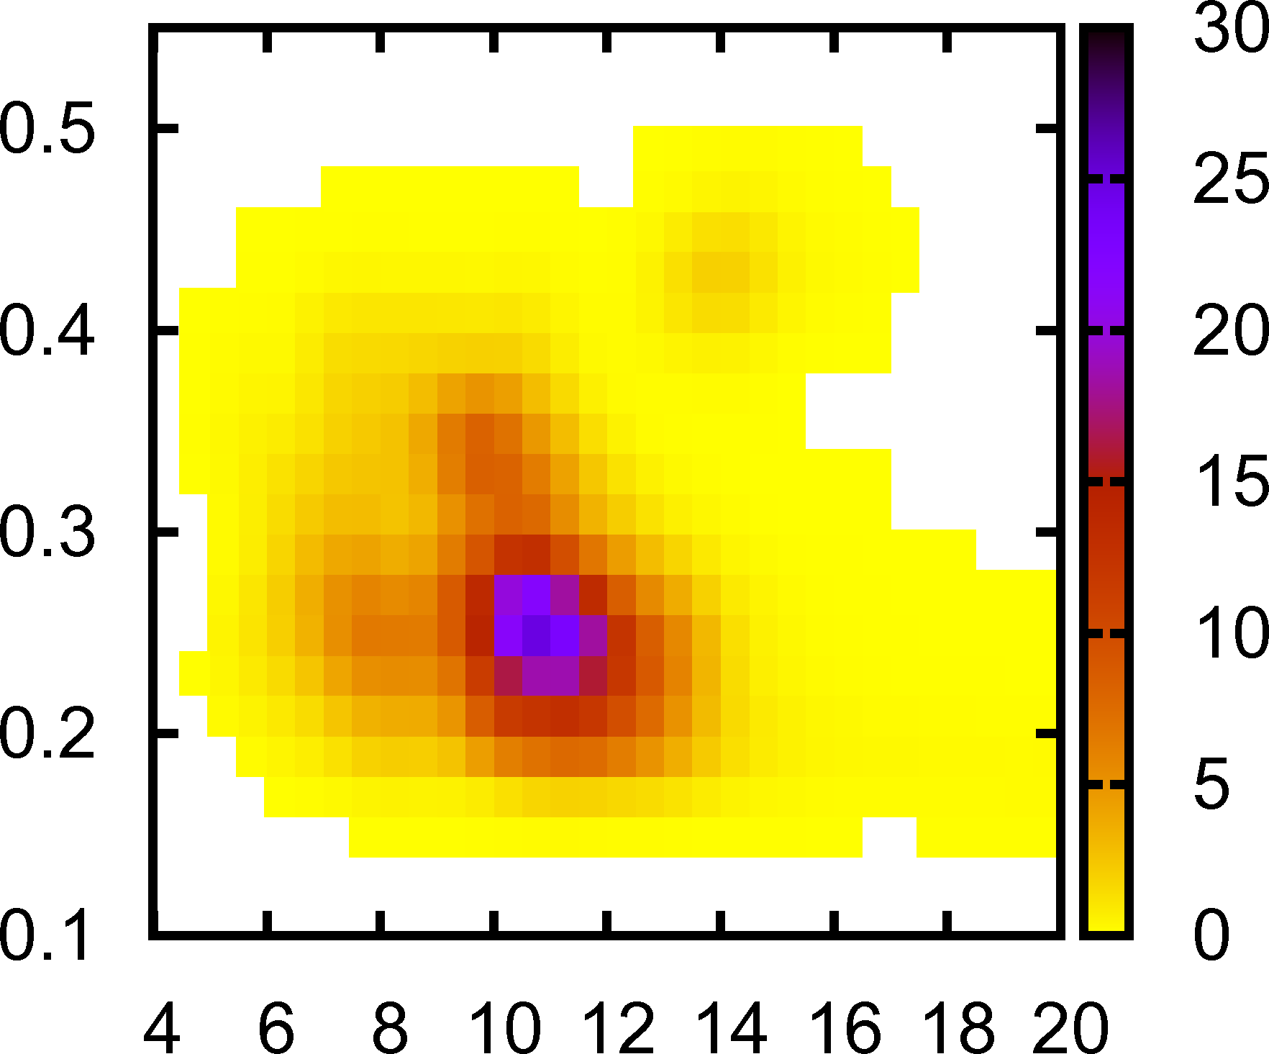
Longer Proteins: 50-90 amino acids
2ABD
1FYN
1UBQ
acyl-CoA-binding protein (ACBP)
Length: 86 aa, Exp folding time: 2 ms
Smallest observed RMSD: 4.7 Å
Src homology domain (SH3)
Length: 56 aa, Exp folding time: 10 ms
Smallest observed RMSD: 6.8 Å
Ubiquitin, Length: 76 aa,
Exp folding time: 10 ms
Smallest observed RMSD: 7.4 Å
Native contacts ratio
RMSD, Å
RMSD, Å
RMSD, Å
D. Shirvanyants, F. Ding, D. Tsao, S. Ramachandran, & N.V. Dokholyan, in preparation

Slide 19
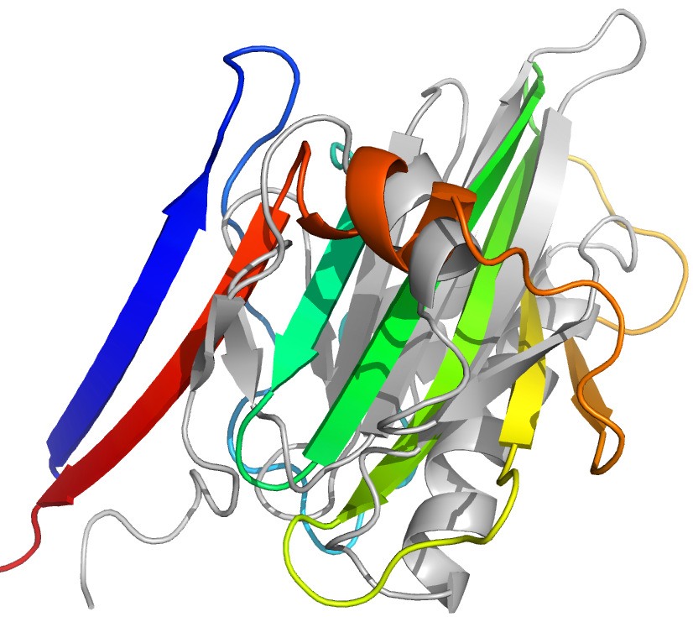
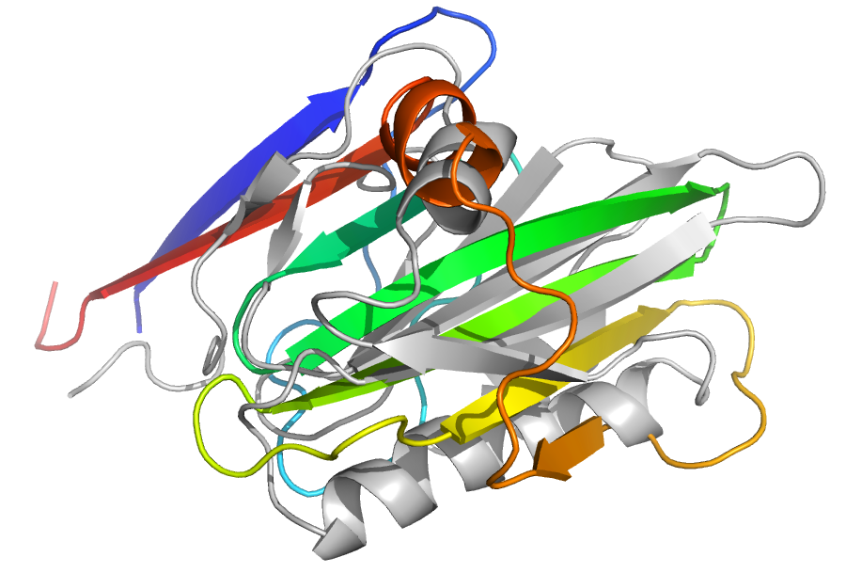
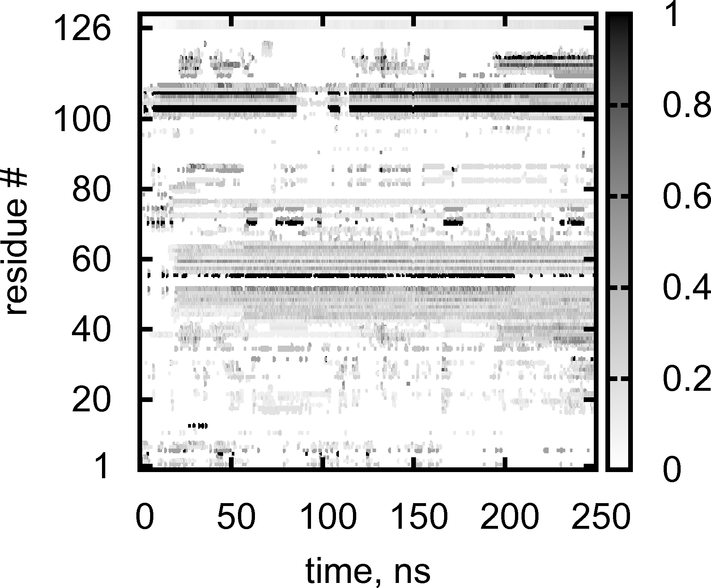
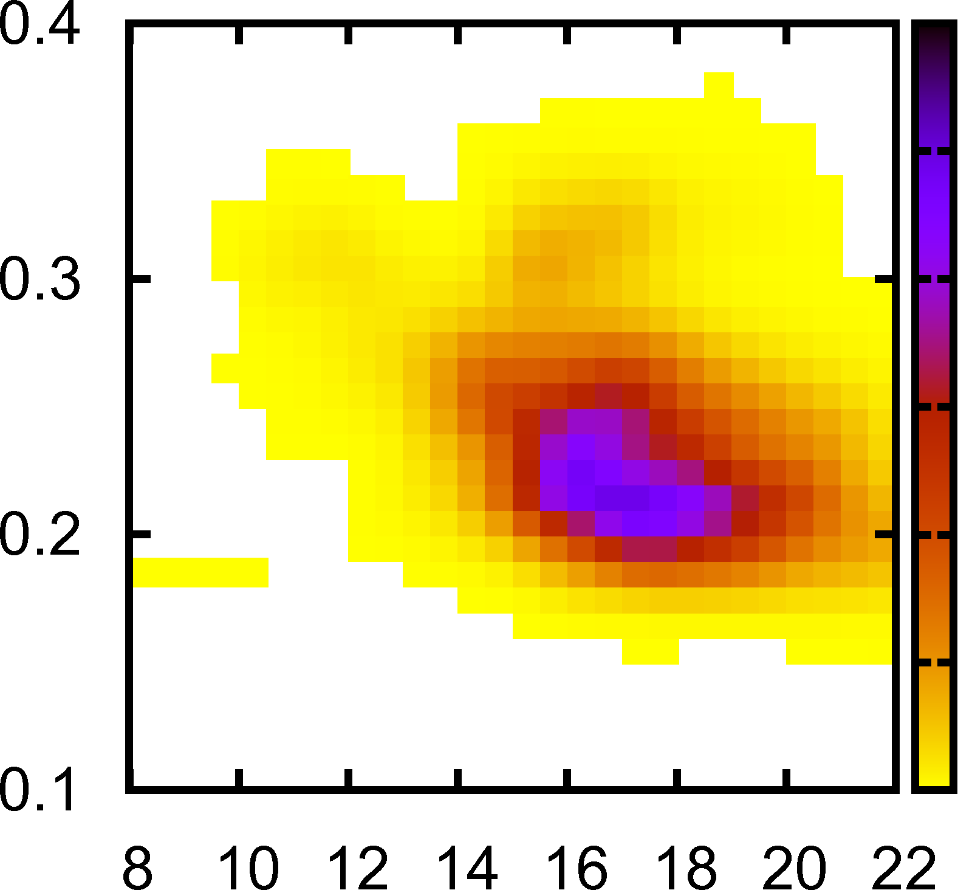
Yet Even Longer Protein: 126 amino acids
Chicken Villin 14T
Length: 126 aa, Exp folding time: 15 ms
Smallest observed RMSD: 9.7 Å
C-term
core
Native contacts ratio per residue
Native contacts ratio
RMSD, Å
D. Shirvanyants, F. Ding, D. Tsao, S. Ramachandran, & N.V. Dokholyan, in preparation

Slide 20
Mechanical Unfolding

Slide 21
In silico pulling experiment
F=dE/dR
E
R
Kesner, B. A., Ding, F., Temple, B. S., and Dokholyan, N. V., Proteins: Structure, Function, and Bioinformatics, (2009)

Slide 22
Critical Force of unfolding
Kesner, B. A., Ding, F., Temple, B. S., and Dokholyan, N. V., Proteins: Structure, Function, and Bioinformatics, (2009)

Slide 23
Recapitulate the Fc of Filamin Ig domains
Kesner, B. A., Ding, F., Temple, B. S., and Dokholyan, N. V., Proteins: Structure, Function, and Bioinformatics, (2009)

Slide 24
Protein-peptide recognition

Slide 25
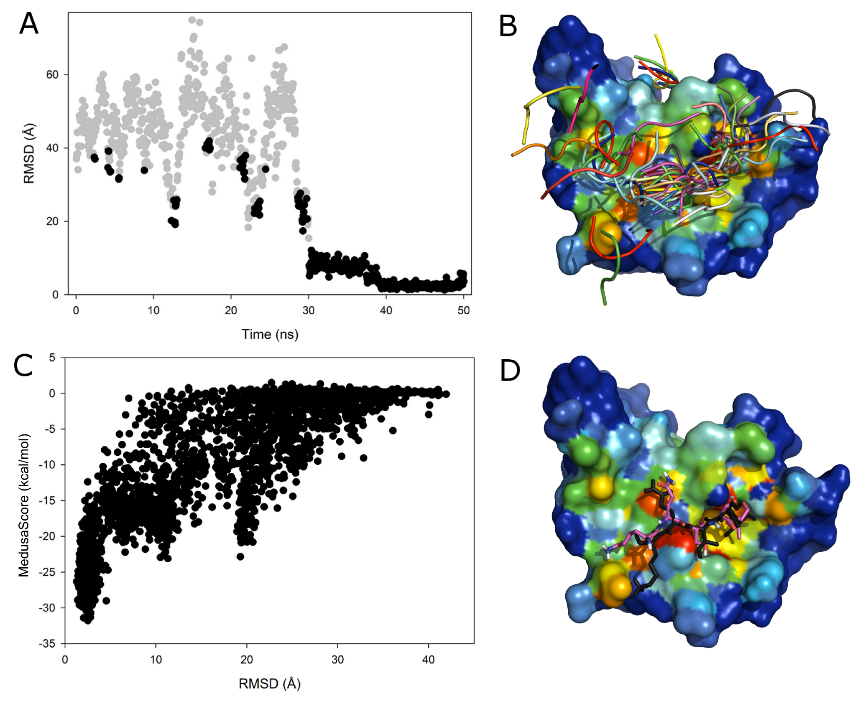
Peptide binding by the PDZ domain
Efficient sampling of
the protein surface.
The near-native state has
a low energy and also
high occupancy.
Dagliyan et al, Pending with revision, 2011

Slide 26
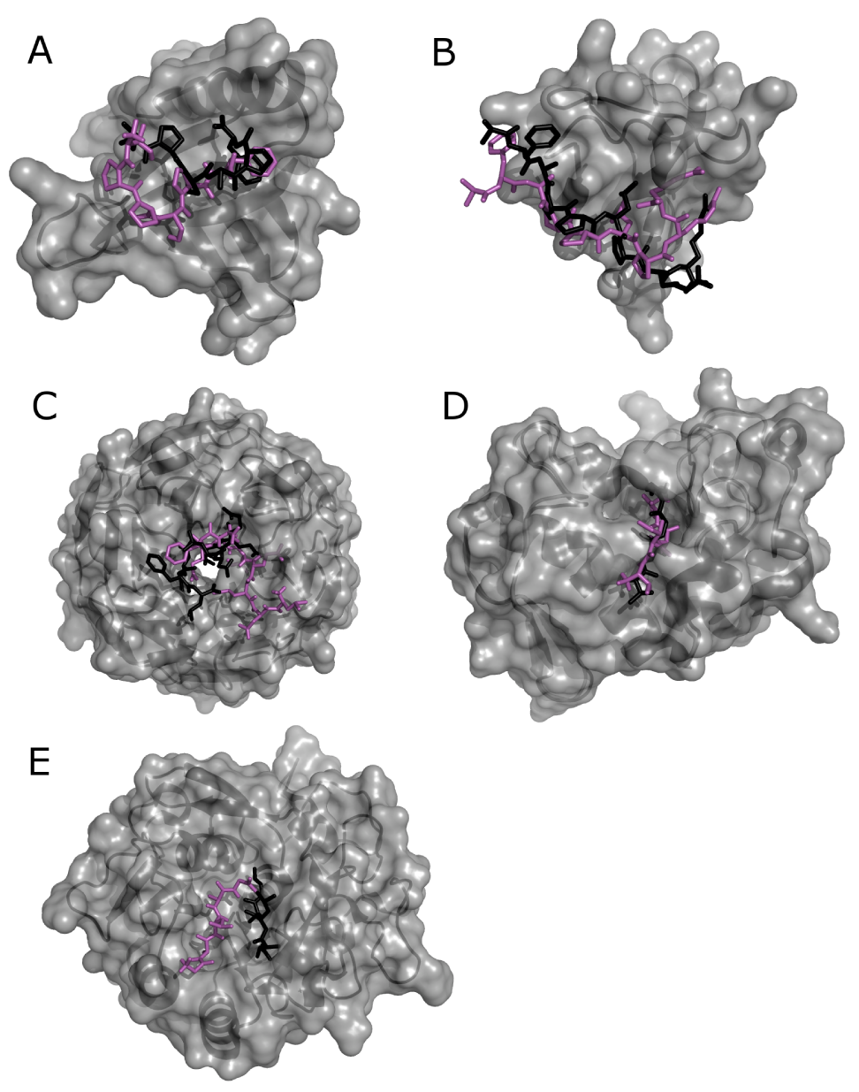
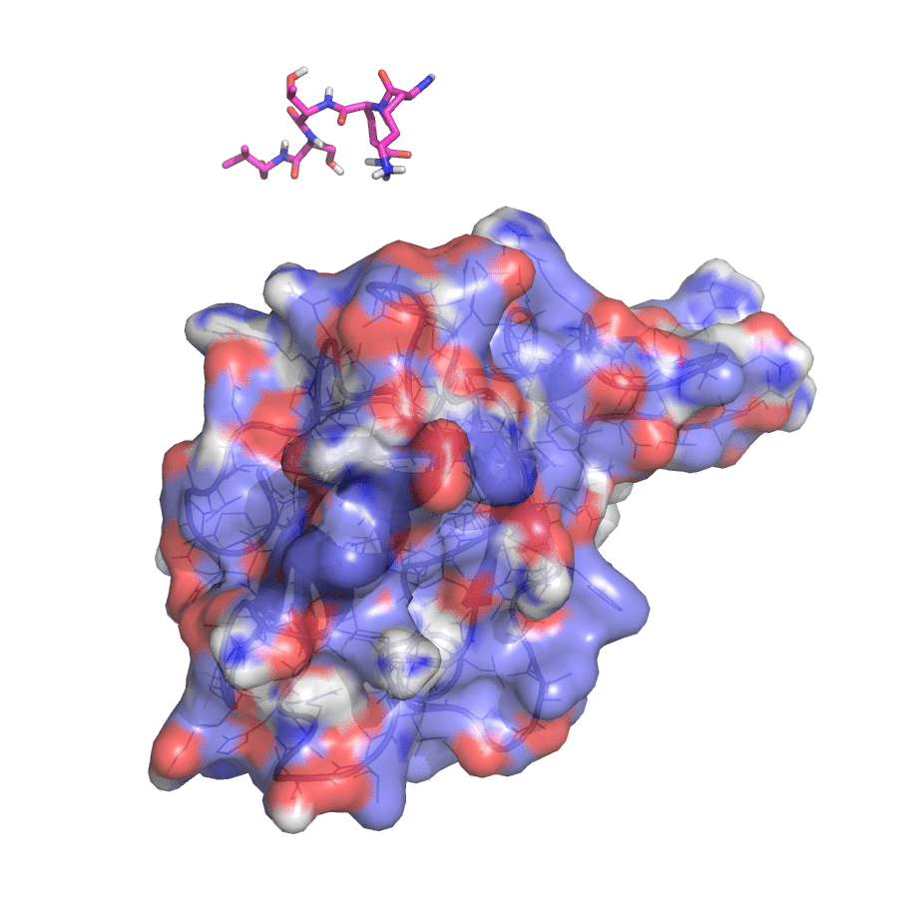
Protein-peptide recognition sampled by DMD
Although the peptide-binding “pocket” is not well-defined, DMD is able to sample the binding site.
Electro-static interaction is important for peptide recognition.
Dagliyan et al, Pending with revision, 2011

Slide 27
Summary
Multiscale DMD models with different levels of coarse-graining up to the high-resolution all-atom models
DMD simulations are highly efficient in conformational sampling, including protein folding and protein-peptide recognition.
DMD with Medusa forcefield is able to accurately capture the conformational dynamics, important for protein design and protein engineering

Slide 28
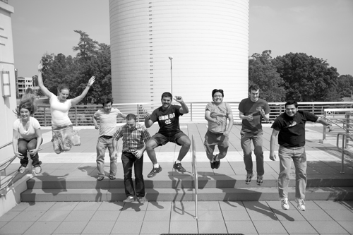
Acknowledgements
Group Members
Nikolay V. Dokholyan
Shuangye Yin
Pradeep Kota
Srinivas Ramachandran
Elizabeth A. Proctor
Douglas C. Tsao
Rachel Redler
David G. Shirvanyants
Huifen Nie
Funding
NIH
UNC Research Council

