Slide 1
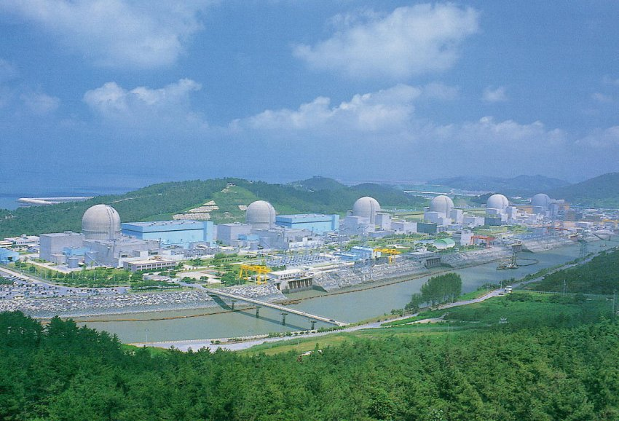
New Results from RENO
Jee-Seung Jang for the RENO Collaboration
GIST, Korea
NuFact 2018
Blacksburg, Virginia, Aug. 13-18, 2018

Slide 2
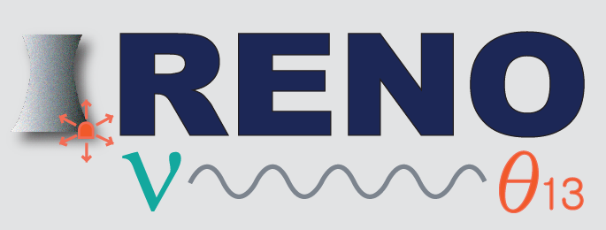
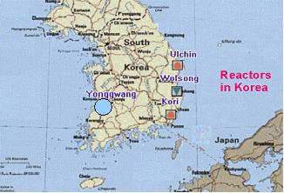
RENO Collaboration
Reactor Experiment for Neutrino Oscillation
(8 institutions and 30 physicists)
Chonnam National University
Dongshin University
GIST
KAIST
Kyungpook National University
Seoul National University
Seoyeong University
Sungkyunkwan University
Total cost : $10M
Start of project : 2006
The first experiment running with both near & far detectors from Aug. 2011
Hanbit nuclear power plant in YongGwang :
16.8 GW (6 reactors)

Slide 3
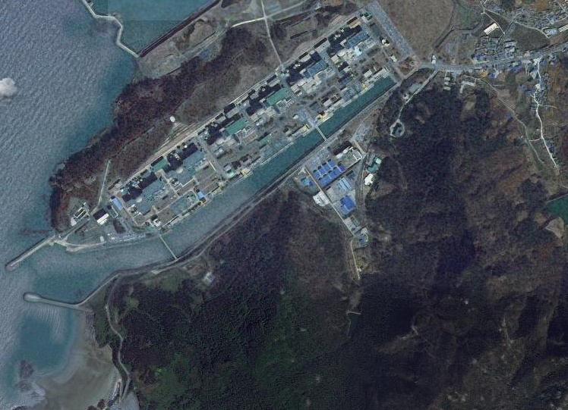
RENO Experimental Set-up
120 m.w.e.
Near Detector
294m
1383m
Far Detector
450 m.w.e.

Slide 4
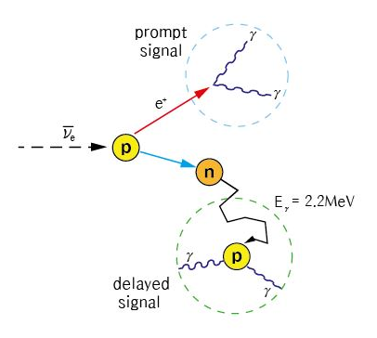
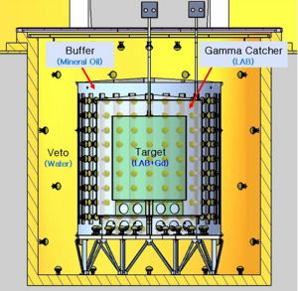
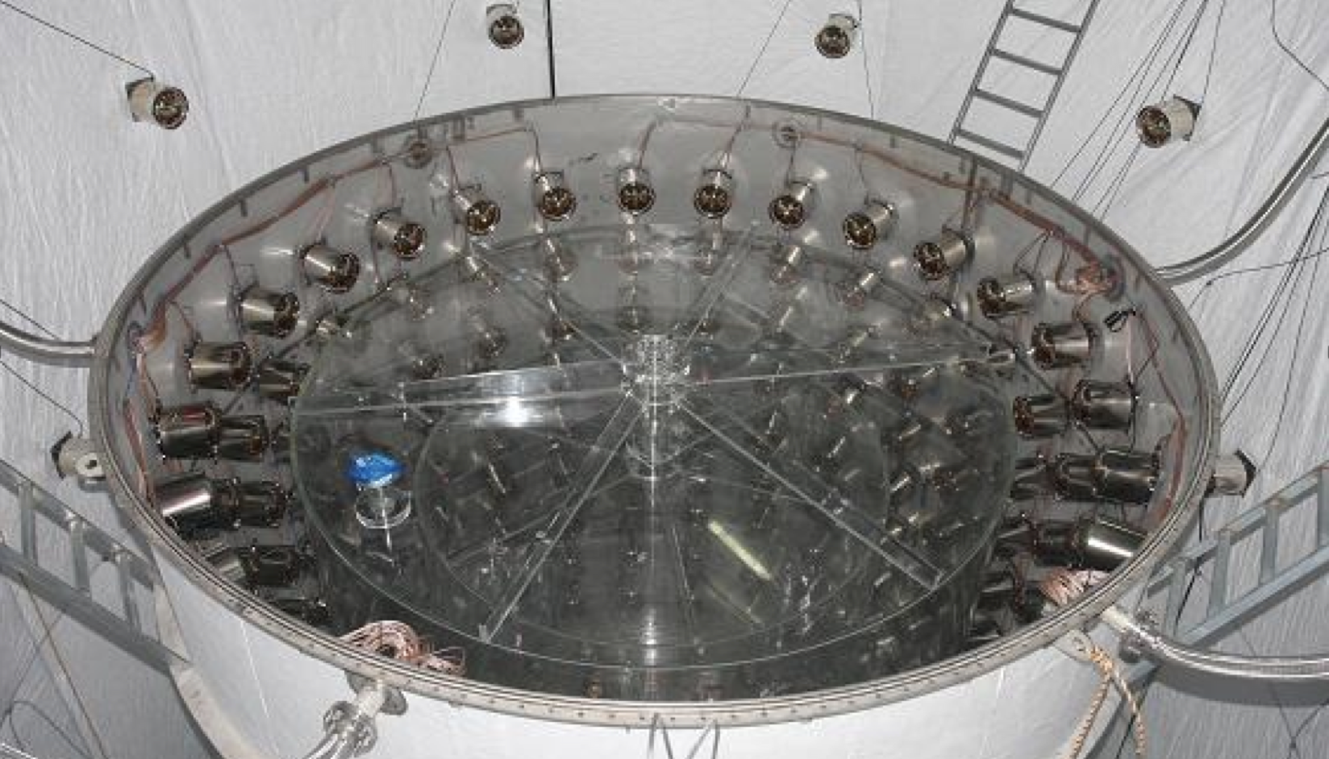
Detection of Anti-neutrino
Inner Detector |  |  | Outer Detector
354 10” PMTs |  |  | 67 10” PMTs
(Target) Gd-LS 16.5 tons | (𝛾 Catcher) LS 30 tons | (Buffer) Mineral Oil 65 tons | (Veto) Water 350 tons
Invers Beta Decay
(IBD)

Slide 5
New RENO Results
■ Precise measurement of |Δm_{ee}² | and θ₁₃ using ~2200 days of data (Aug. 2011 – Feb 2018)
“Measurement of Reactor Antineutrino Oscillation Amplitude and Frequency at RENO” → submitted to PRL (arXiv:1806.00248)
■ Fuel-composition dependent reactor antineutrino yield →
“Fuel-composition dependent reactor antineutrino yield and spectrum at
RENO” → submitted to PRL (arXiv: 1806.00574)
■ Measurement of absolute reactor neutrino flux and spectrum
■ Independent measurement of |Δm_{ee}² | and θ₁₃ with
delayed n-H signals

Slide 6
Measurement of |Δm_{ee}² | and θ₁₃

Slide 7
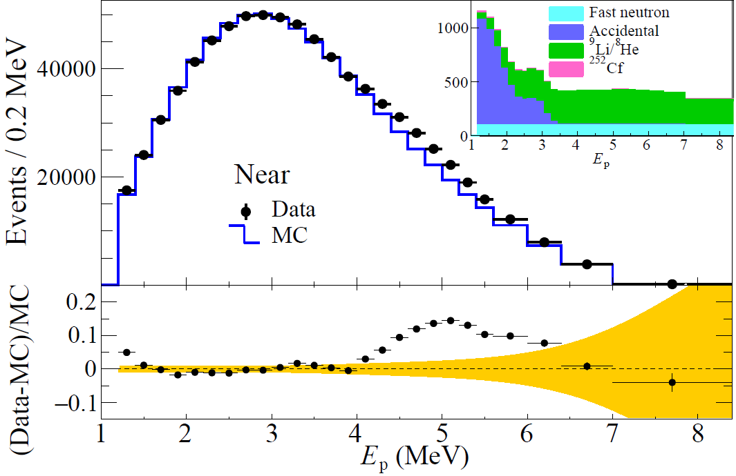
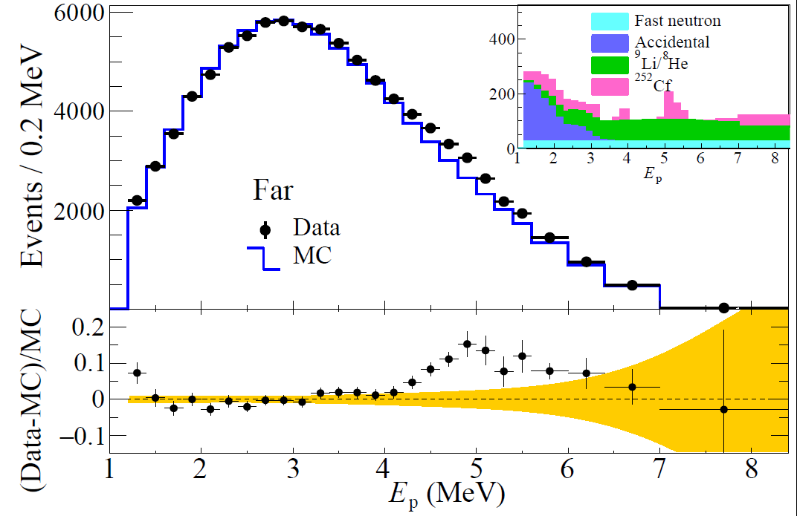
Spectral shape of
observed and expected IBD prompt signal
RENO 2200 days
RENO 2200 days
~2.5%
~2.5%
Clear excess at 5 MeV

Slide 8
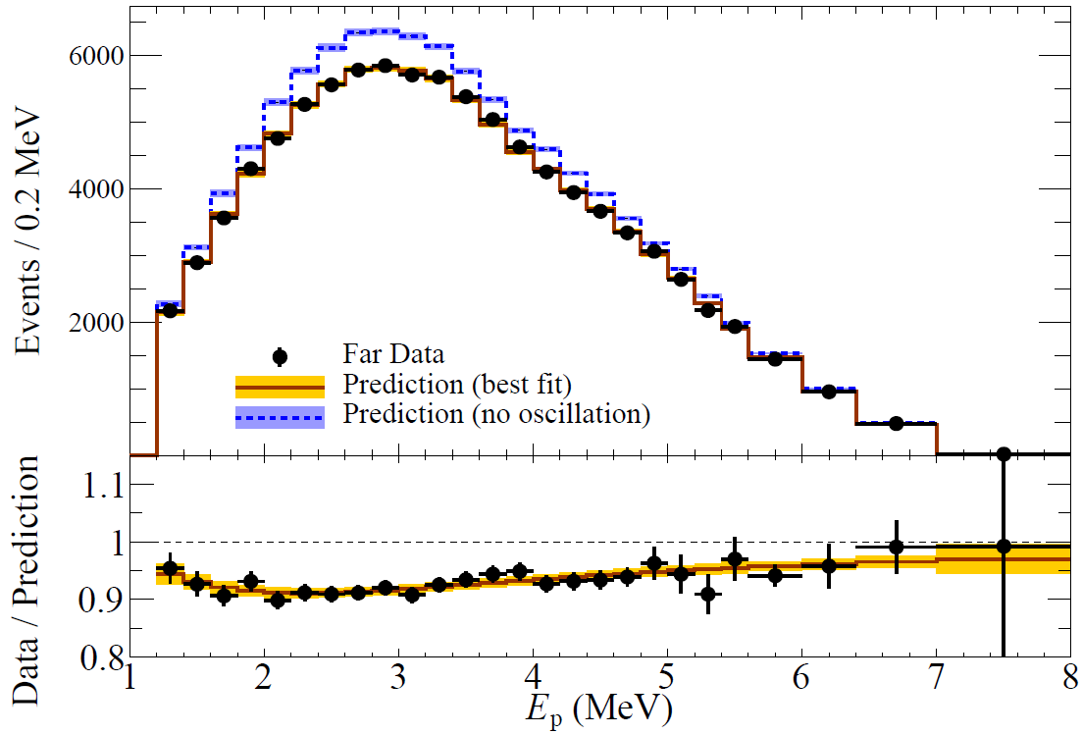
Spectral shape of Far / Near
RENO 2200 days
Energy-dependent disappearance of
reactor antineutrinos

Slide 9
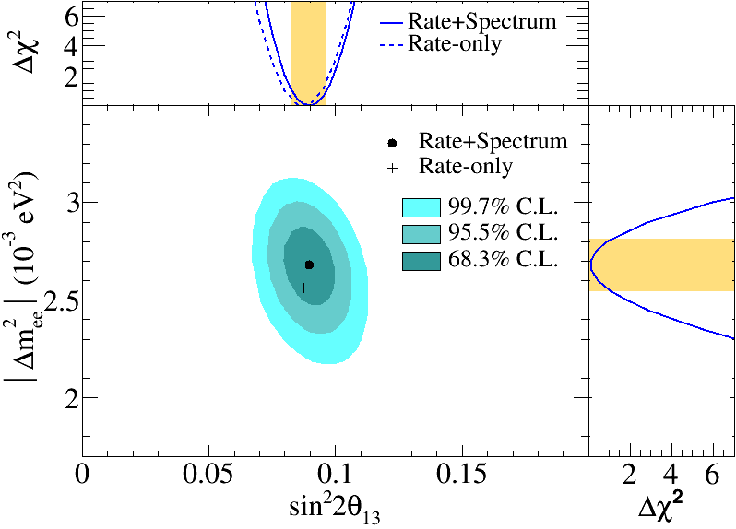
Allow regions for θ₁₃ and |Δm²_{ee}|
RENO 2200 days
sin²2θ₁₃ = 0.0896±0.0048(stat.)±0.0047(syst.)
(± 7.6%)
|△m_{ee}²| = 2.68±0.12(stat.)±0.07(syst.) (×10⁻³ eV²)
(± 5.2 %)

Slide 10
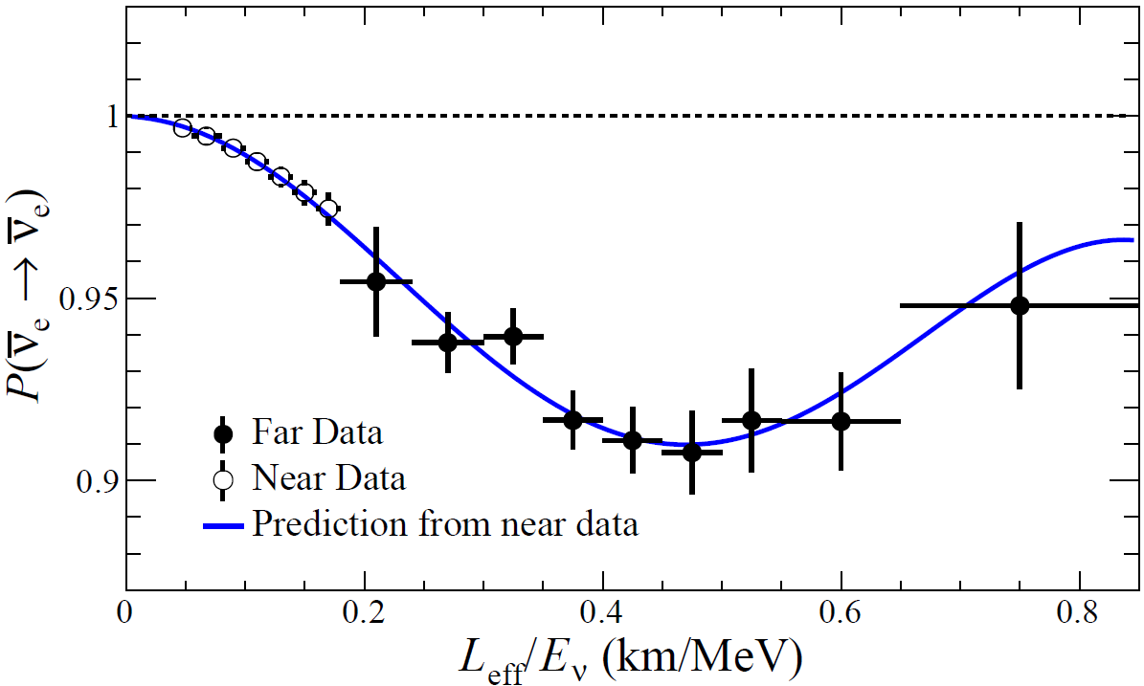
Survival probability of reactor antineutrinos
RENO 2200 days
Clear L/E-dependent disappearance of reactor antineutrinos

Slide 11
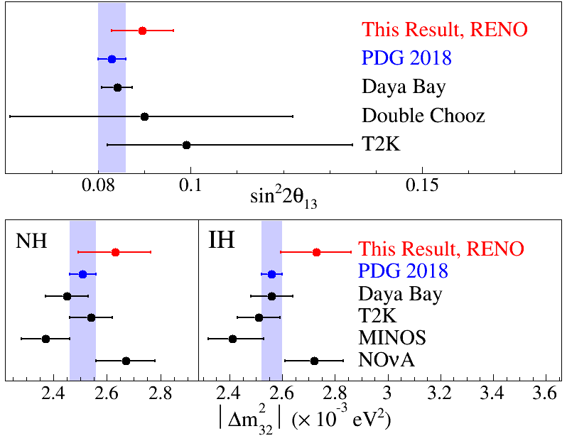
Comparison of θ₁₃ and |Δm²_{ee}|

Slide 12
Fuel composition dependent
anti-neutrino yield

Slide 13
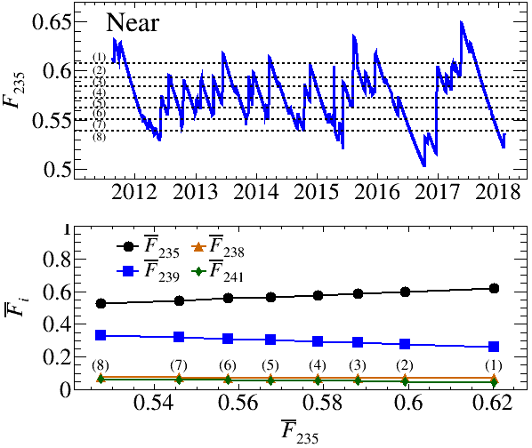
Evolution of Fuel Isotope Fraction
Fission fraction data of each reactor core, is provided by the Hanbit nuclear power plant
and average fission fraction of 6 reactors is used for this study.
Average fission fraction
$f_{235}$: $f_{239}$: $f_{238}$: $f_{241}$= 0.573 : 0.299 : 0.073 : 0.055

Slide 14
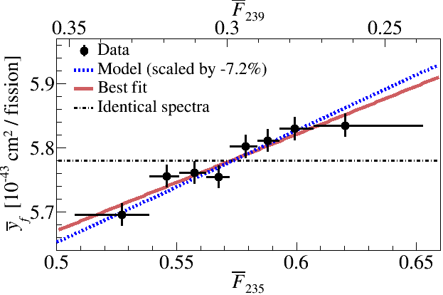
Fuel-Composition Dependent Reactor Neutrino Yield
Average of IBD yield per fission
: time averaged fission fraction of isotope i
No fuel-dependent variation of IBD yield per fission is ruled out with 6.7 𝜎

Slide 15
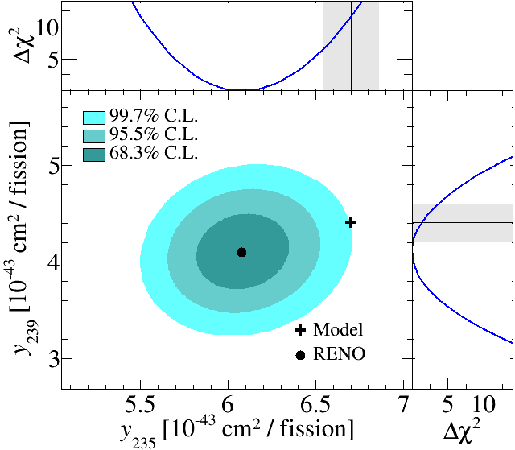
Best-fit result of IBD yields per fission of ²³⁵U (²³⁹Pu)
²³⁵U: 3.5σ deficit relative to Huber-Mueller (H-M) prediction
²³⁹Pu: 1.2σ deficit

Slide 16
Fuel composition dependent
5 MeV excess

Slide 17
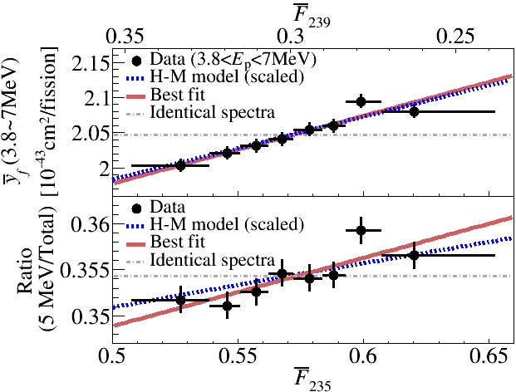
IBD Yield Variation of 5 MeV Excess Region
Weak indication of enhanced yield in 5 MeV excess region due to ²³⁵U isotope fraction increase….

Slide 18
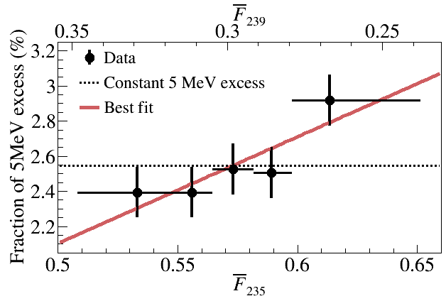
Correlation of 5 MeV excess with ²³⁵U isotope fraction
(2.545 +-0.065) %
(for constant)
${∆χ}^{2}$ = 6.58 (2.6σ)
p-value = 0.010
(End
of reactor cycle)
(Beginning
of reactor cycle)
2.6σ indication of 5 MeV excess coming from ²³⁵U fuel isotope fission

Slide 19
Absolute reactor neutrino flux and spectrum

Slide 20
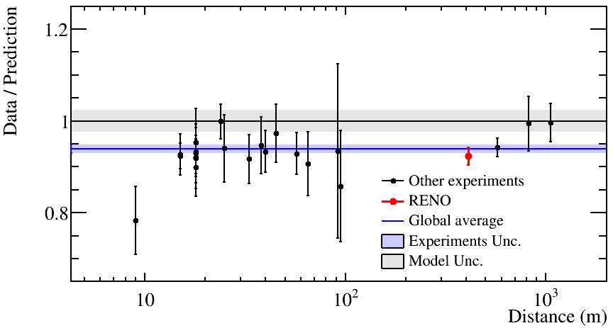
Measurement of Absolute Reactor Neutrino Flux
Cross section calculation
Fayans 85 formalism
$τ_{n}$= 880.2s (PDG2017)
Data / Prediction, RENO 2200 days at near detector
0.924 +- 0.018 (for Huber + Mueller model) 0.966 +- 0.019 (for ILL + Vogel model)
RENO : $\overline{y}f$ = (5.780 +- 0.113) x 10⁻⁴³ cm²/fission
H-M model : $\overline{y}f$ = (6.227 +- 0.149) x 10⁻⁴³ cm²/fission
RENO Preliminary
Deficit of observed reactor neutrino fluxes relative to the prediction (Huber + Mueller model) indicates an overestimated flux or possible oscillation to sterile neutrinos

Slide 21
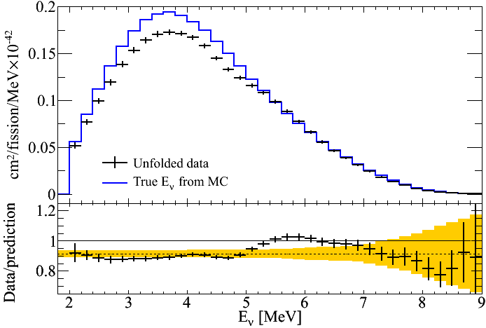
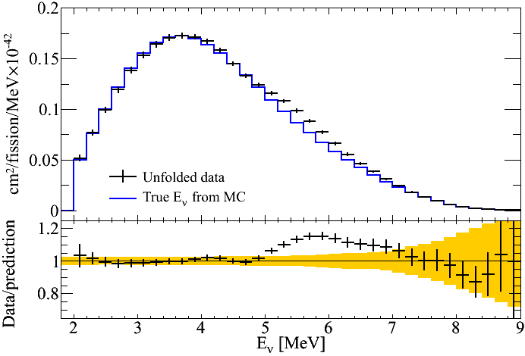
Unfolded Reactor Antineutrino Spectrum
Measured spectrum
vs. H-M prediction
Spectral comparison
RENO Preliminary
RENO Preliminary
* MC is normalized to data in the region excluding 3.6 < E_{p} < 6.6 MeV
Unfolding using iterative method in RooUnfold

Slide 22
IBD events with delayed
neutron captured by Hydrogen

Slide 23
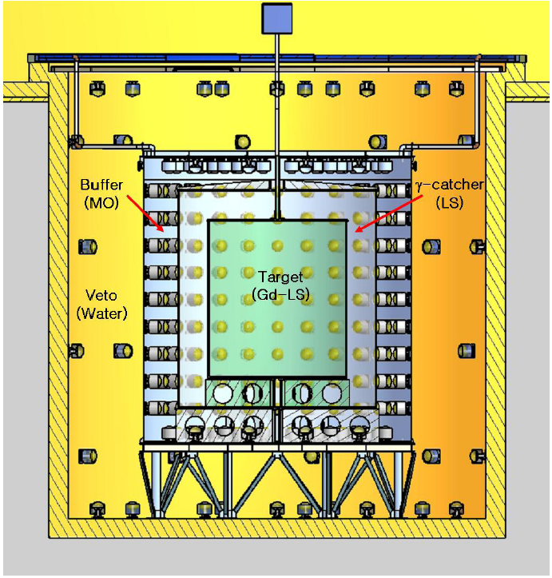
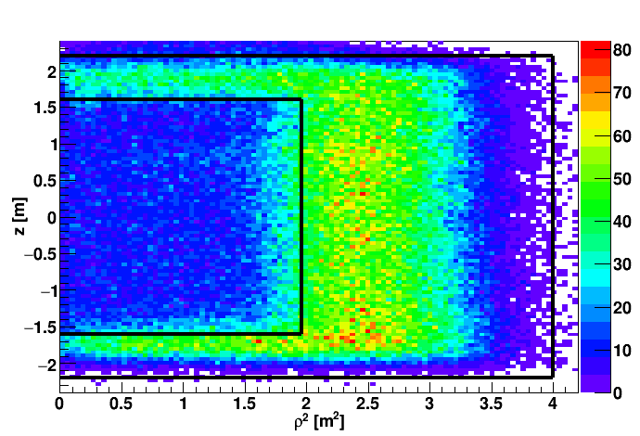
n-H IBD Analysis|
Motivation:
1. Independent measurement of θ₁₃ and |Δm_{ee}² |.
2. Consistency and systematic check on reactor neutrinos.
n-H IBD Event Vertex Distribution
target
γ-catcher

Slide 24
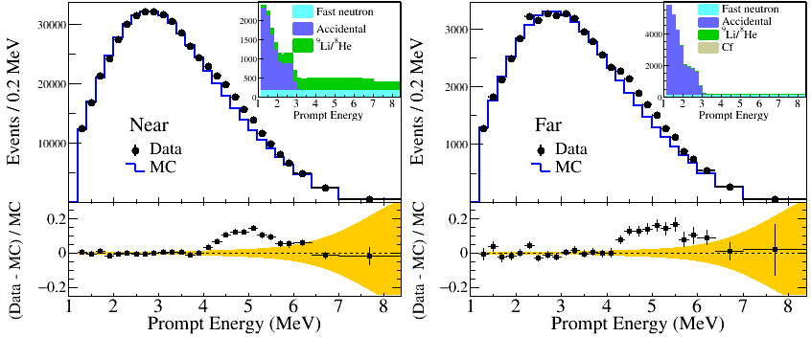
θ₁₃ Measurement with n-H
sin²2θ₁₃ = 0.085±0.008(stat.)±0.012(syst.)

Slide 25
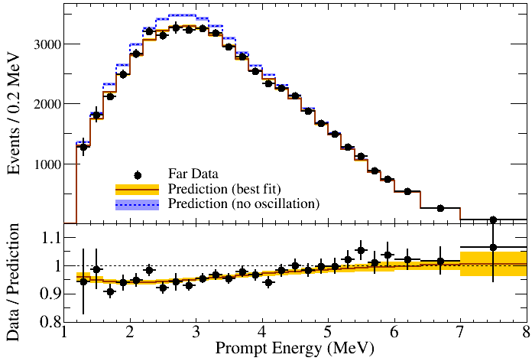
θ₁₃ and |Δm²_{ee}| Measurement with n-H
RENO Preliminary

Slide 26
Summary
More precise measurement of |Δm_{ee}² | and θ₁₃ using 2200 days of data
sin²2θ₁₃ = 0.0896±0.0048(stat.)±0.0047(syst.)
7.6 % precision
|△m_{ee}²| = 2.68±0.12(stat.)±0.07(syst.) (×10⁻³ eV²)
5.2 % precision
Fuel composition dependent reactor antineutrino yield : No fuel dependent IBD yield is ruled out at 6.7 𝜎
First hint for correlation between 5 MeV excess and ²³⁵U fission fraction
Measured absolute reactor neutrino flux : R= 0.924±0.018 (H-M)
Measurement of |Δm_{ee}² | and θ₁₃ using n-H IBD analysis
additional 2~3 years of data taking under consideration to improve Δm_{ee}² accuracy and the fuel dependent IBD yield.

Slide 27
Backup

Slide 28
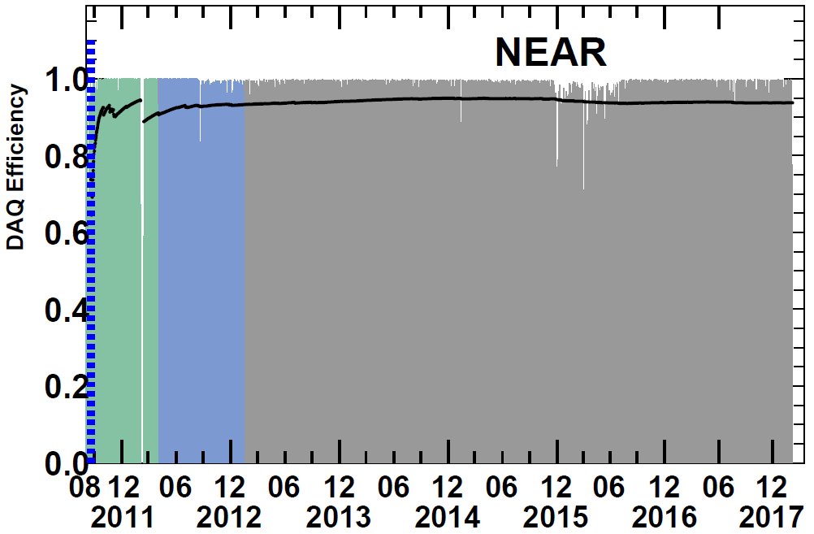
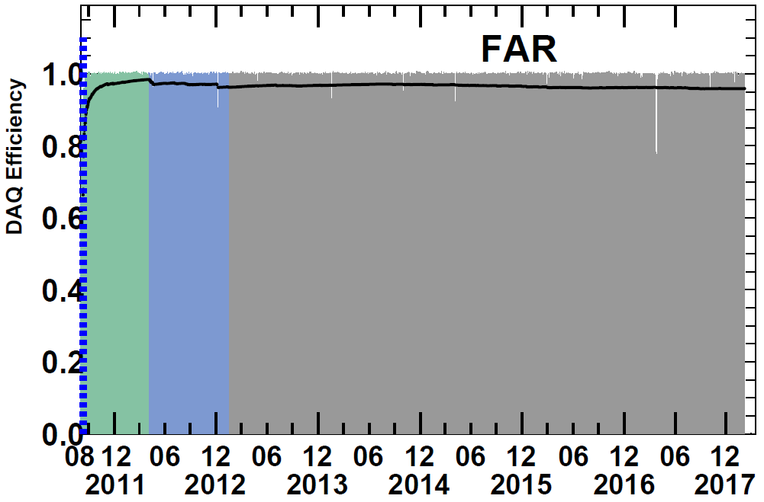
RENO Data-taking Status
Data taking began on Aug. 1, 2011 with both near and far detectors.
(DAQ efficiency : ~95%)
A
A (220 days) : First θ₁₃ result
[11 Aug, 2011~26 Mar, 2012]
PRL 108, 191802 (2012)
B
B (~500 days) : Recent results
Rate+shape analysis (θ₁₃ and |Δm_{ee}² |)
[11 Aug, 2011~21 Jan, 2013]
→ PRL 116, 211801 (2016)
accepted to PRD (arXiv:1610.04326)
Now
C (~2200 days) : New results
Rate+shape analysis (θ₁₃ and |Δm_{ee}² |)
[11 Aug, 2011~7 Feb, 2018]
→ submitted to PRL (arXiv:1806.00248)
C (new results)

Slide 29
Measured Spectra of IBD Prompt Signal
Clear excess at 5 MeV
RENO 2200 days
RENO 2200 days
~2.5%
~2.5%
Near Live time = 1807.88 days
# of IBD candidate = 850,666
# of background = 17,233 (2.0 %)
Far Live time = 2193.04 days
# of IBD candidate = 103,212
# of background = 4,879 (4.8 %)

Slide 30
Backgrounds
Accidental coincidence between prompt and delayed signals
Fast neutrons produced by muons, from surrounding rocks and inside detector (n scattering : prompt, n capture : delayed)
⁹Li/⁸He β-n followers produced by cosmic muon spallation
Accidentals
Fast neutrons
⁹Li/⁸He β-n followers
μ
μ
μ
γ
p
n
⁹Li
n
e
Gd
Gd
n
Gd

Slide 31
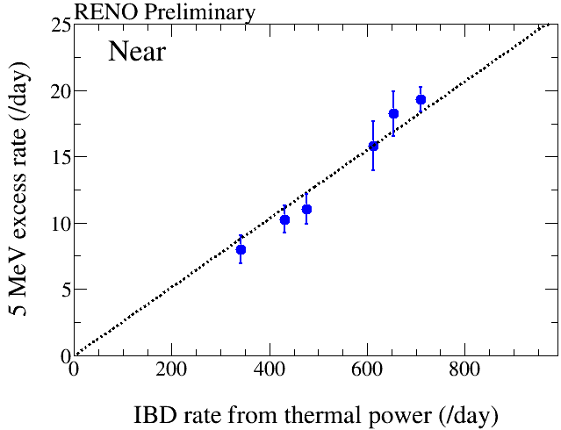
Correlation of 5 MeV Excess with Reactor Power
1400 days of data
5 MeV excess
has a clear
correlation
with reactor
thermal power !
two or three reactors are off
All the six reactors are on
The 5 MeV excess comes from reactors!

