Slide 1
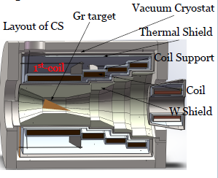
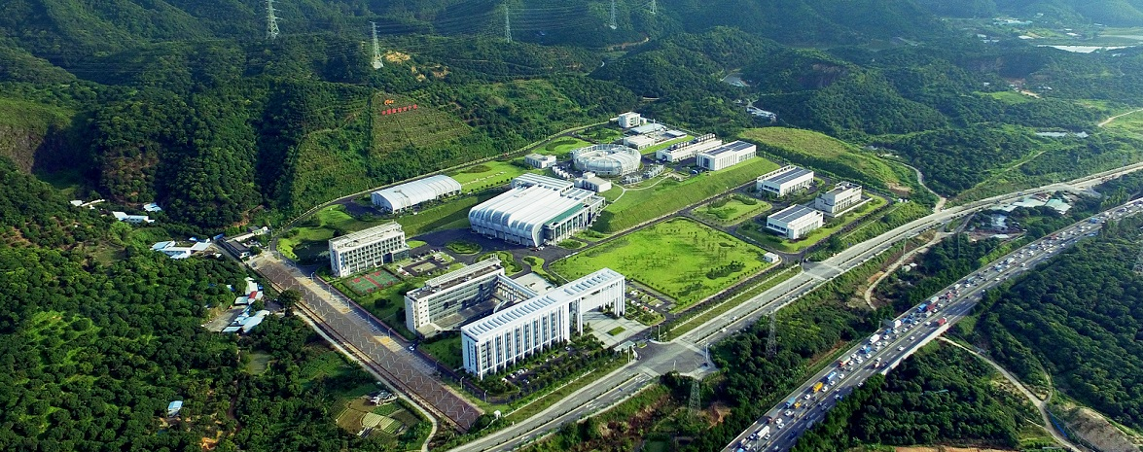
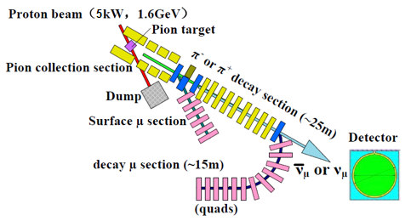
Experimental Muon Source (EMuS) Target Systems Studies
Nikos Vassilopoulos IHEP, CAS

Slide 2
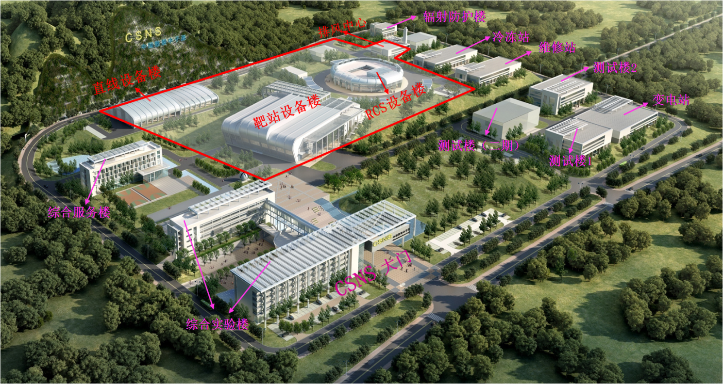
2009-05 (Artist design)
Today

Slide 3
layout
Short CSNS and HEPA description
EMuS layout
Full scheme: muon and pion capture with 4-coils/3-steps Superconducting Adiabatic Solenoid
μ+ capture, 25 ≤ P (MeV/c) ≤ 29.8
insert target
π+ capture for decay muons
Neutrino beam for cross sections
Systematics from monte-carlos: FLUKA and G4 (BERTINI, INCL)
Quadrupole-”Baby scheme”

Slide 4
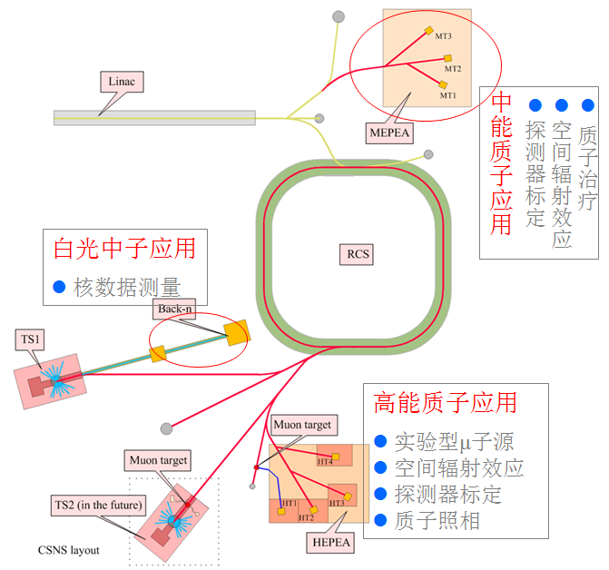
EMuS at CSNS
CSNS jointly by IHEP and IOP
China Spallation Neutron Source (CSNS) is a multidisciplinary research facility based on a high-power proton accelerator (run at 20 kW till end of July with data collected from neutron users)
Largest scientific facility in China (core facility: 1.86 B￥)
Phase-I: 100-kW accelerator, one target station, 3 neutron instruments
Upgrading: 500 kW, 20 neutron instruments (second target station)
Besides neutron scattering, other applications have also great potential
Parameters | CSNS-I | CSNS-II
Beam power (kW) | 100 | 500
RCS Energy (GeV) | 1.6 | 1.6
Beam current (μA) | 62.5 | 312.5
Repetition rate (Hz) | 25 | 25
Linac Energy [MeV] | 80 | 250
EMuS power (kW) | 5 | 25
EMuS repletion rate (Hz) | 2.5 | 2.5

Slide 5
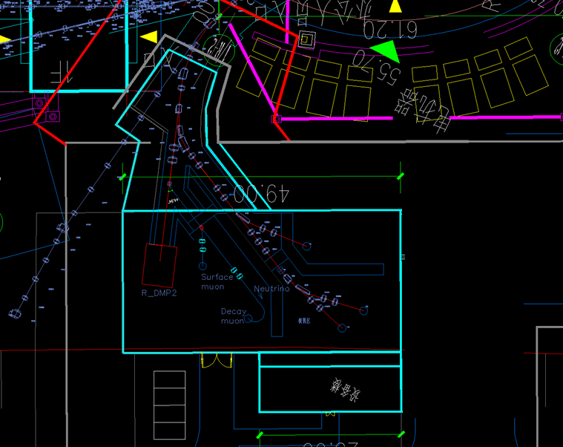
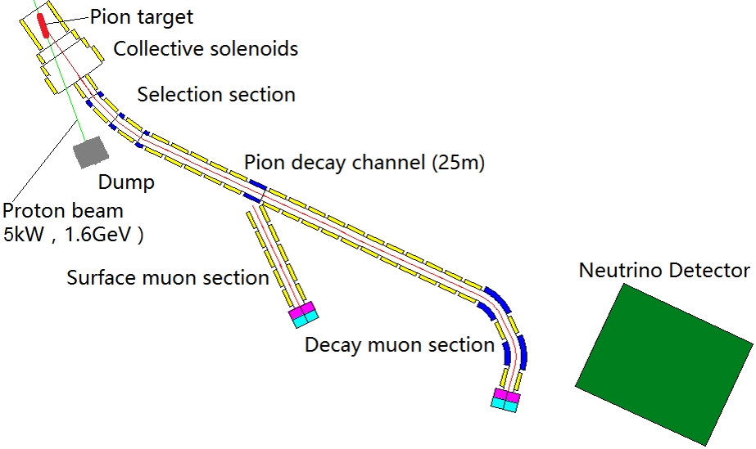
Layout of EMuS at CSNS
Secondary beam operation modes (independent):
Surface muon mode (baseline)
Ref. Pμ=25-29.8 MeV/c
Decay muon mode
Ref. Pμ = 60, 120 MeV
Captured pions ref. Pπ = 128, 225 MeV/c depending on capture field
Momentum spread: <± 10%
Neutrino mode (optional)
Wide energy spectra
Ref. Pπ=300-500 MeV/c
Full scheme/Superconducting beam line
EMuS
Proton beamline
Baseline design completed
Beam dump is being designed for different modes
Full scheme: Superconducting beamlines
Surface muon beamline designed for 3 experimental areas
Decay muon beamline designed for muon momentum up to 450 MeV/c
Baby scheme: room temperature surface muon beamline
Beamline perpendicular to the proton beamline
μSR spectrometer

Slide 6
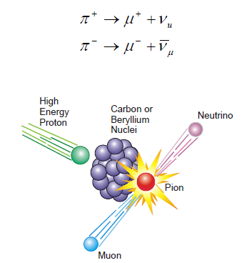
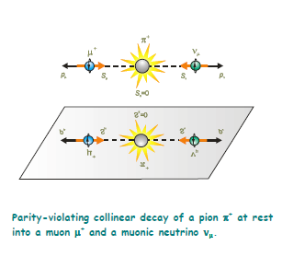
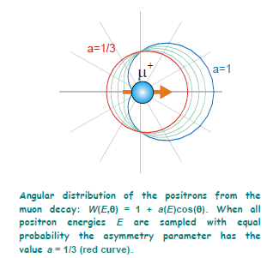
μSR muons for EMuS, the first muon source in China
The high intensity muon source project EMuS is foreseen at CSNS and is being optimized for both muon and neutrino experiments
It is primarily intended for muon science related to μSR techniques in matter physics and chemistry Concerning μSR muons:
surface muons: μ+ from π+ decaying at rest inside target or at its surface, P ≤ 29.8 MeV/c, 100% polarization
cloud muons that are background by causing beam depolarization: any μ+ with P ≤ 29.8 MeV/c produced from π+ decaying in flight near the target
decay muons that are also signal, μ+ from π+ decaying in flight, which can be used also for material science
μSR muons from DAR, produced only at target
Asymmetrical decay
due to week interaction
100 % polarisation
due to DAR pions

Slide 7
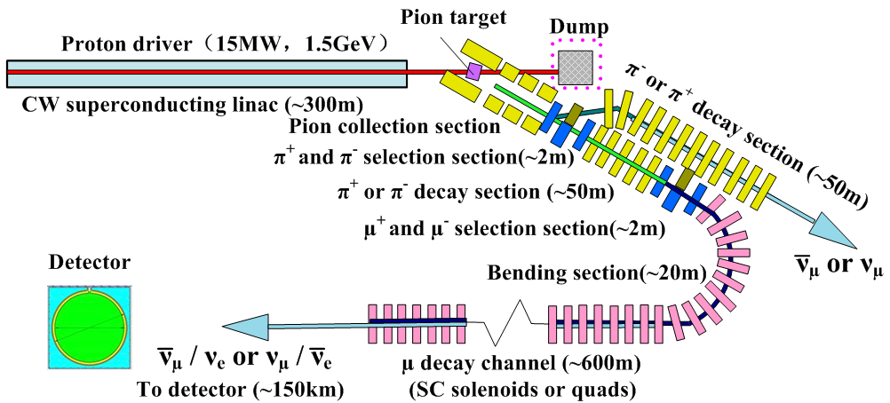
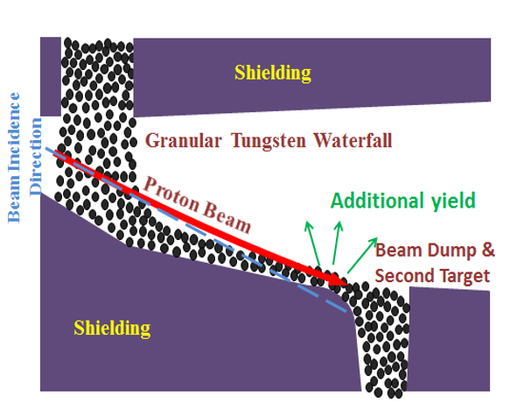
Other applications for EMuS
The neutrino beam is an option under investigation. Motivation of the neutrino beam is the lack of recent cross sections measurements at lower energies
EMuS could act as a high power targetry and accelerator R&D platform for MOMENT, a future muon-decay medium-baseline neutrino beam facility in China
MOMENT
Novel waterfall granular target

Slide 8
Layout of the primary proton beam just before muon and pion capture

Slide 9
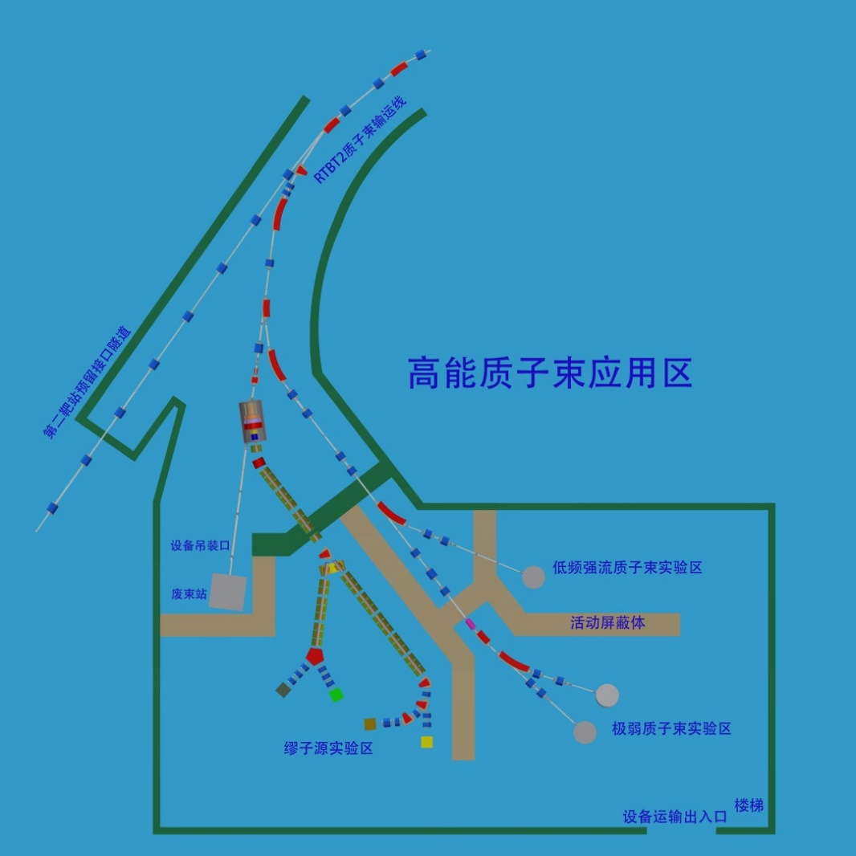
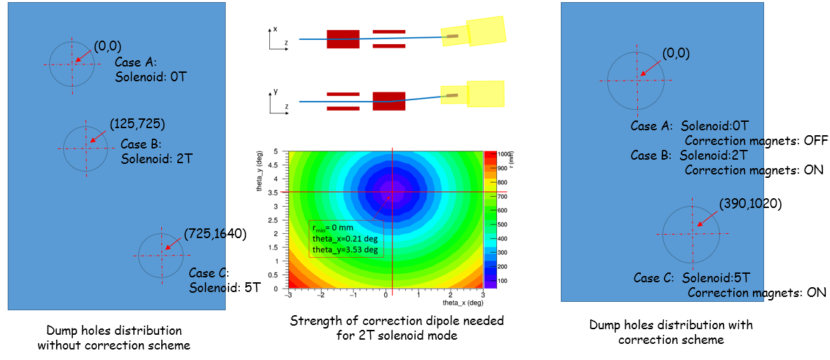
Novel proton extraction and particle capture downstream of the SC
Extraction between 4th-coil and matching solenoid
In order to address the deflection of the spent-protons from the CS field and guide them to the dump, two correction dipoles are needed under study)
Focus doublet
Correction dipoles
Beam spot at center of main target
σx = σy = 5 mm (10 mm optional)
beam dump
10.4 m
Yukai Chen/IHEP

Slide 10
Muon and pion capture: 4-coils/3-steps Superconducting Adiabatic Solenoid

Slide 11
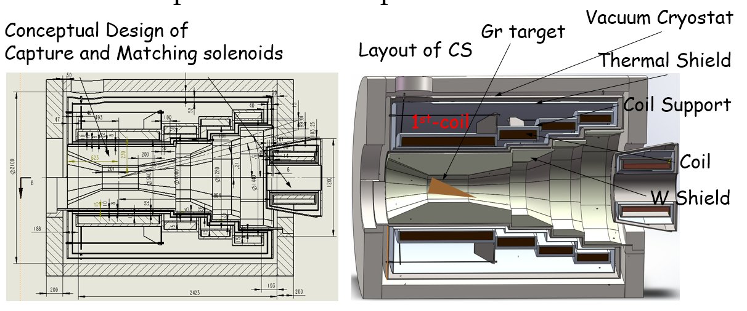
p 100%
~52%
Conductor —Aluminum stabilized NbTi Rutherford cable by Chinese industry:
Hou Zhilong/IHEP
Aluminum
Rutherford cable
Cross section of Rutherford cable
Rutherford cable
Superconducting Capture Adiabatic Solenoid:
Forward spent-proton extraction, proton beam & target tilted in respect to magnetic axis, θp = 15º
4-coils/3-steps design, NbTi-Al coils, adiabatic taper
Graphite target with conical shape
Adiabatic 1 -> 0.5 T for surface muon capture, 5 -> 3 T for pions

Slide 12
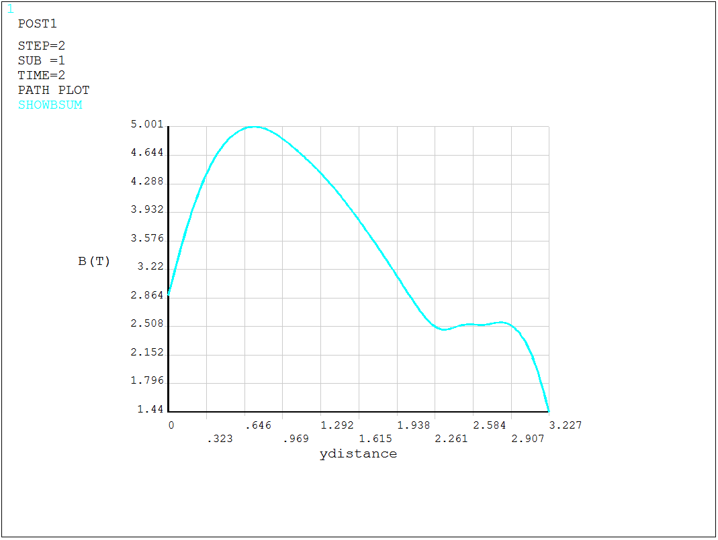
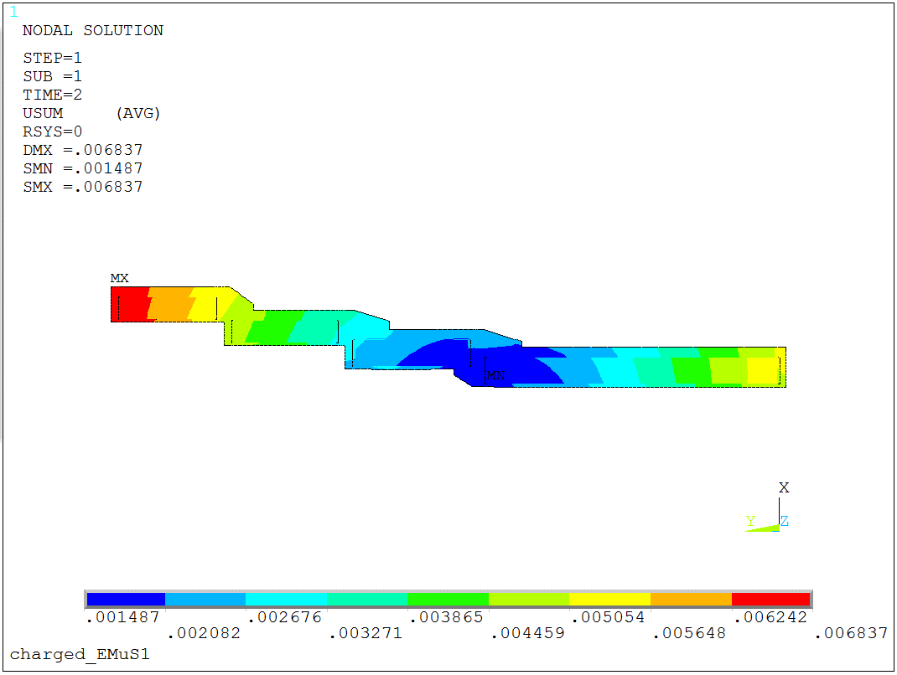
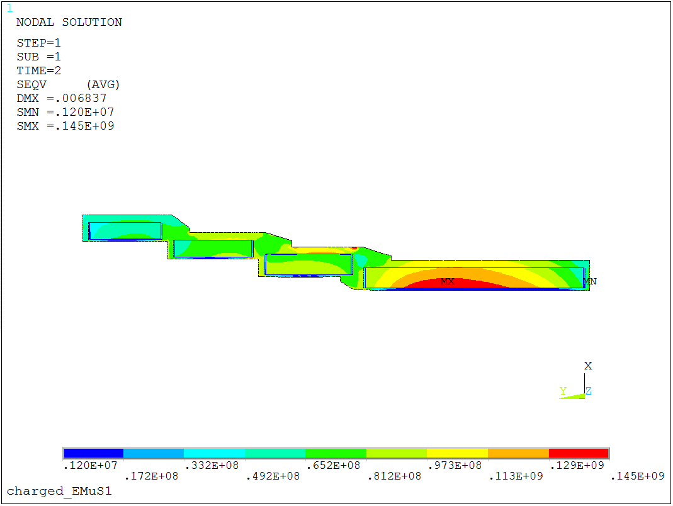
Peak Field 5 T (Slower taper), thermo-mechanical studies on-going
Peak Field 5 T(Slower taper)
coil | Rmin (m) | Rmax (m) | Zmin (m) | Zmax (m) | J (A/mm^2) | Layer
01 | 0.50 | 0.5918 | -0.986 | 0 | 50.55 | 6
02 | 0.56 | 0.6518 | -1.05 | -1.436 | 50.55 | 6
03 | 0.64 | 0.7165 | -1.5 | -1.846 | 50.55 | 5
04 | 0.72 | 0.7965 | -1.91 | -2.23 | 50.55 | 5
05 | 0.23 | 0.24 | -2.38 | -2.68 | 130
06 | 0.23 | 0.246 | -2.7 | -3.2 | 130
Displacement after excited @ 5 T Slower taper
Stress after excited@ 5 T Slower taper
Usum_{max} = 6.84 mm
Seqv_{max} =145 Mpa
Hou Zhilong/IHEP

Slide 13
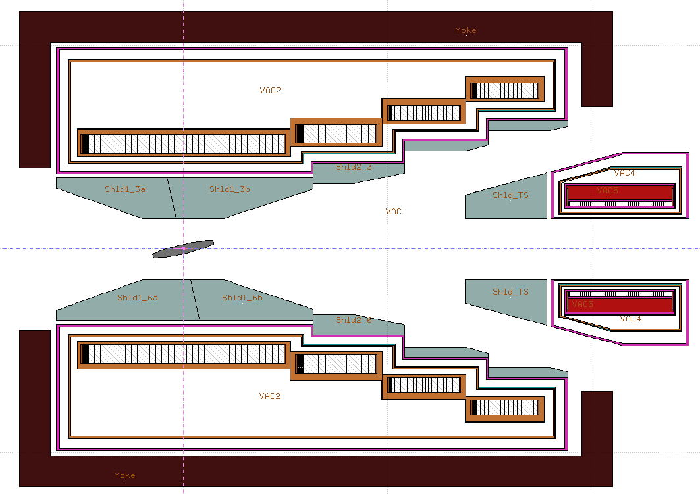
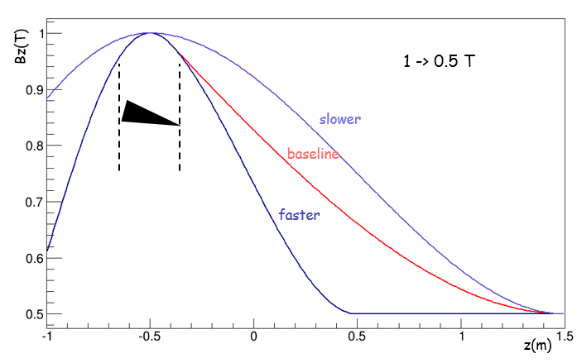
μSR physics: EMuS Full scheme with SC capture solenoid at 1 -> 0.5 T
Tungsten
protons ~52%
CS1 shield thickness: 25 cm
π+
μ+
π+
μ+
μ+
MS1-shield
aperture: 25 cm
MS1 aperture:
25-30 cm
μ+
μ+
μ+
π+
protons 100%
MS1-shield thickness: 45 cm

Slide 14
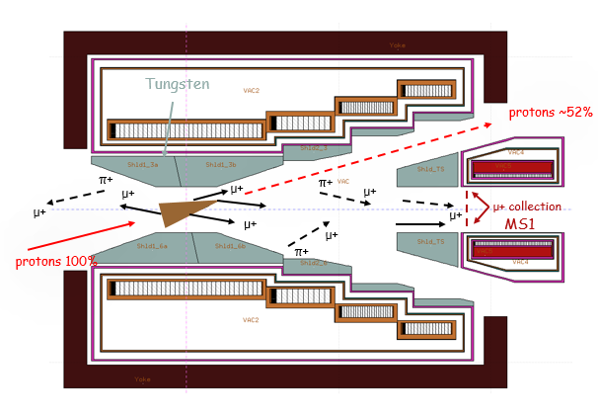
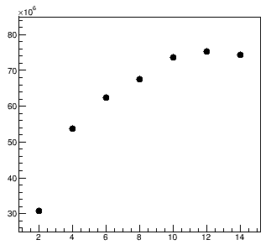
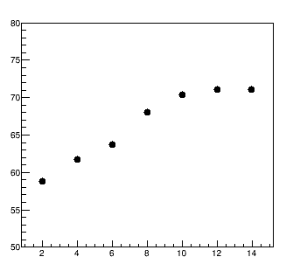
μSR: μ+ with 25 ≤ P (MeV/c) ≤ 29.8, at 1, 2.5 -> 0.5 T
total μ+ and their polarization as function of larger conical radius r1 in terms of proton beam size σ_{b.} with small radius r2 = 0.5 cm for Graphite
μ+/s
*
Polarization (%)
*
conical target for μSR polarization and radiation issues
Gr or SiC
r1 = 4.5 cm , (9σ_{b}), r2 = 0.5 cm ((σ_{b})
L = 30 cm
Fully optimized @ r2 = 6 cm (12σ_{b})
r1 (σ_{b} = 0.5 cm)
r1 (σ_{b} = 0.5 cm)
selection ε_{x} = ε_{y} (π mm mrad) | 10000
Target | 1 T |  | 2.5 T
target radii r1/r2 (cm) | 4.5/0.5 |  | 4.5/0.25
target material | Gr | SiC | Gr | SiC
intensity (x10⁶) μ/sec | 7 | 7 | 18 | 22
polarization | -0.83 | -0.85 | -0.62 | -0.60
surface muon purity (%) | 86 | 85 | 68 | 65
stat. errors for both intensity and polarization < 5%
Bz(T)
z(m)

Slide 15
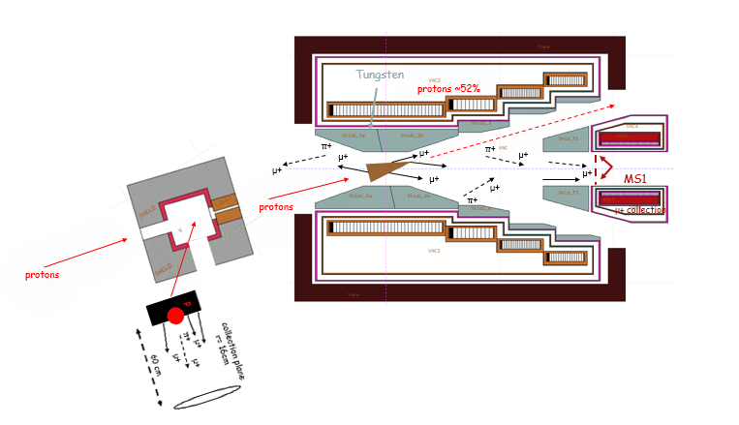
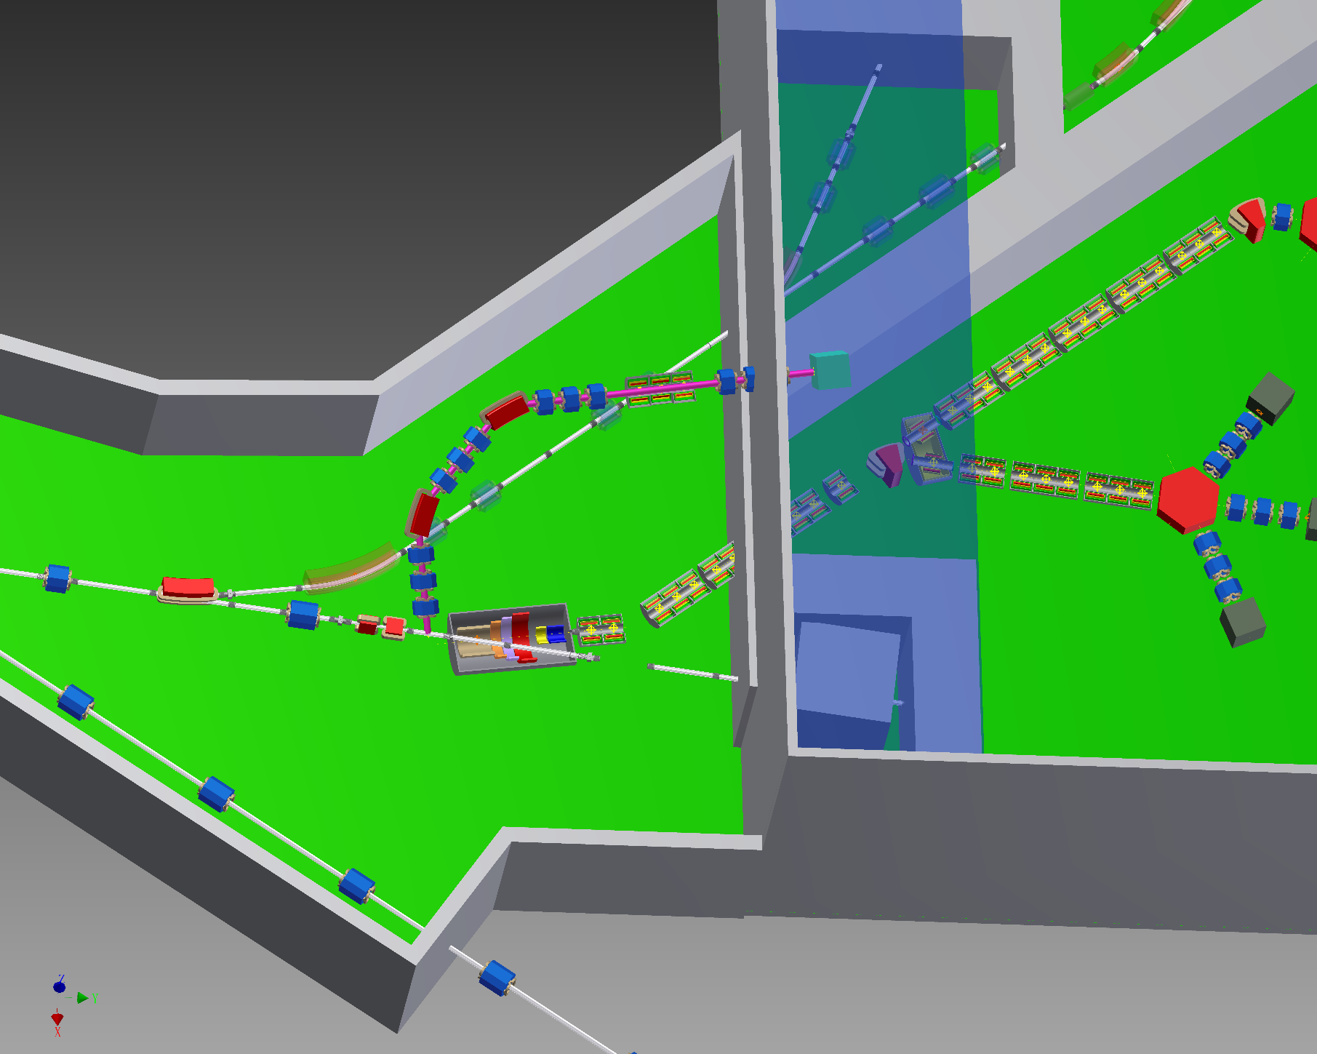
Insert target for Full scheme: SR: μ+ with 25 ≤ P (MeV/c) ≤ 29.8 (complementary for highly polarized beam)
Target material | Slab Gr, Width = 8 σ_{p}
ε (π mm mrad) | 4500
Target, (Height x Length) | 6x6
intensity (x10⁶) μ/sec | 2.9
polarization | -0.96
surface muon purity (%) | 98
statistical error | < 2% on intensity, < 1% on polarization
small target size due to proton’s beam multiple scattering
Target Length less that 1 cm is foreseen
Tilted to minimize proton interaction and keeping similar rate, to be studied

Slide 16
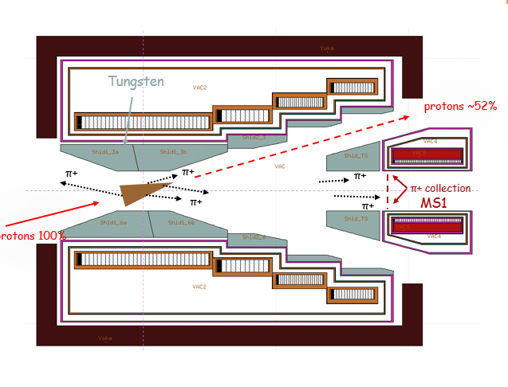
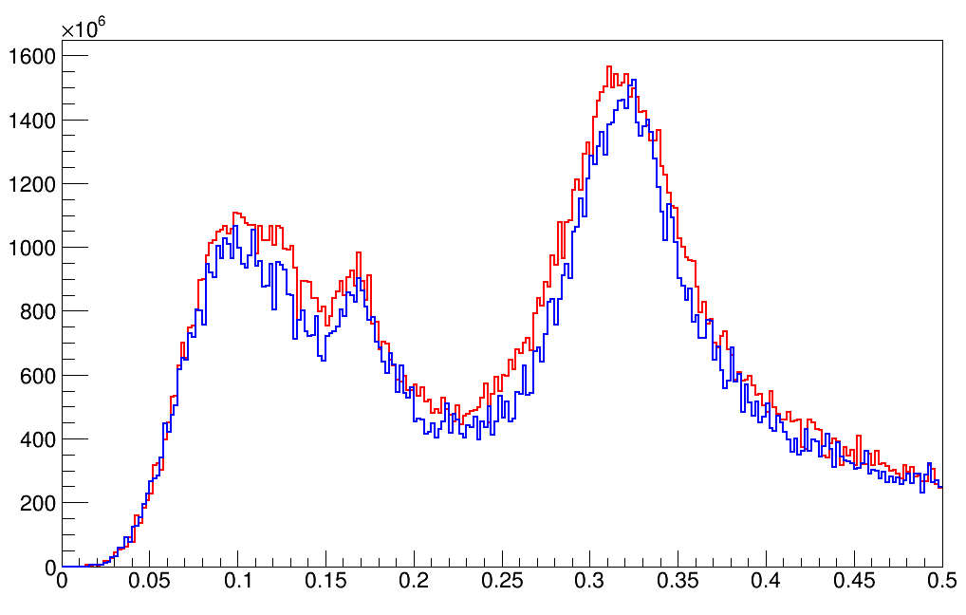
μSR: π+ capture for decay muons @ 5 T conical vs cylinder targets with Graphite
π⁺ / 2 MeV / s
conical as μSR
5 -> 3 T
100000 π mm mrad
cylidrical best
Conical as μSR
Graphite
r1 = 4.5 cm (9σ_{b}), r2 = 0.5 cm (σ_{b})
L = 30 cm
or Cylindrical, best case
Graphite
R = 2 cm (4σ_{b})
L = 30 cm
P GeV/c
μSR target is optimized for best pion production
related to decay muons and neutrinos

Slide 17
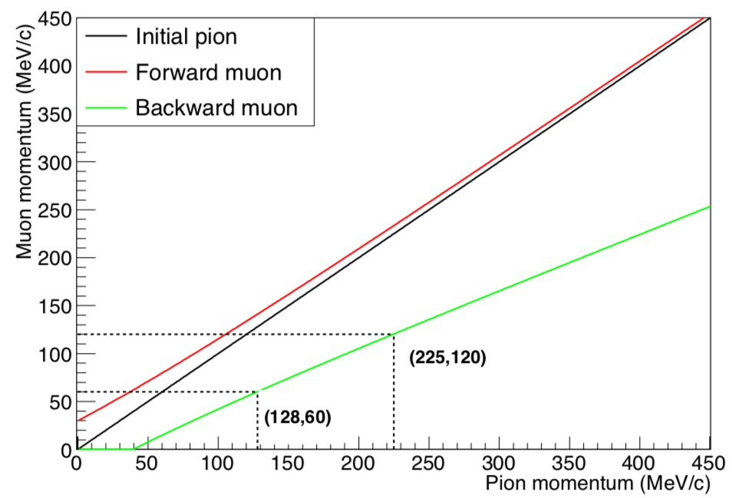
μSR: π+ capture for decay muons @ 5 T
average muon momentum from pion decays
muon momentum MeV/c
decay muons require pion capture momentum at 128 and 225 MeV/c
pion momentum MeV/c
Conical as μSR
Graphite
r1 = 4.5 cm (9σ_{b}), r2 = 0.5 cm (σ_{b})
L = 30 cm
+ or – reflects spin direction of “forward” and “backward” muon

Slide 18
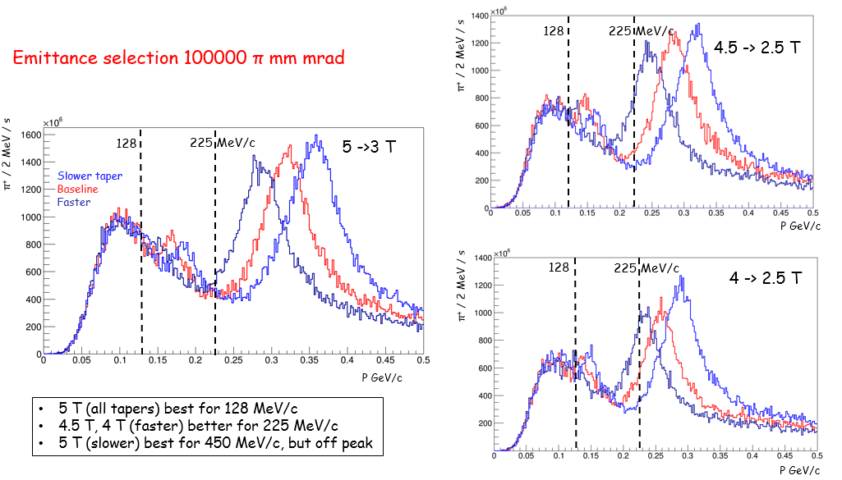
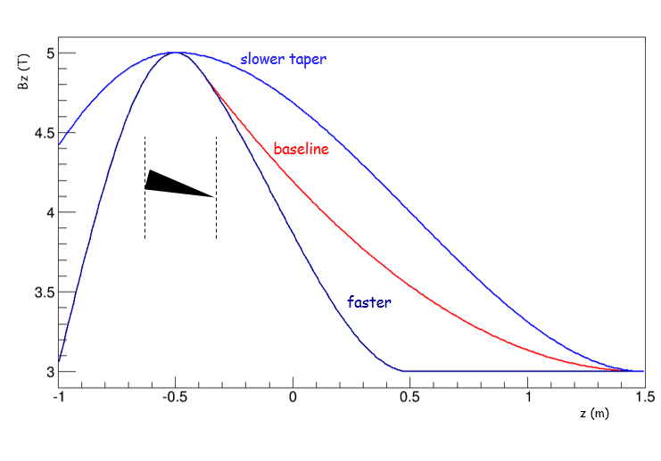
π+ capture for decay muons μ+ : change the field intensity and shape in order to collect required pions
5 T taper variations
Bz(T)
5 -> 3 T
z(m)
P ± 10% (MeV/c) | 128 |  |  | 225
Taper (T) | 4f | 4.5f | 5f | 4f | 4.5f | 5f
i x 10⁹ (π+ /sec) | 8.6 | 9.7 | 12 | 19 | 20 | 13

Slide 19
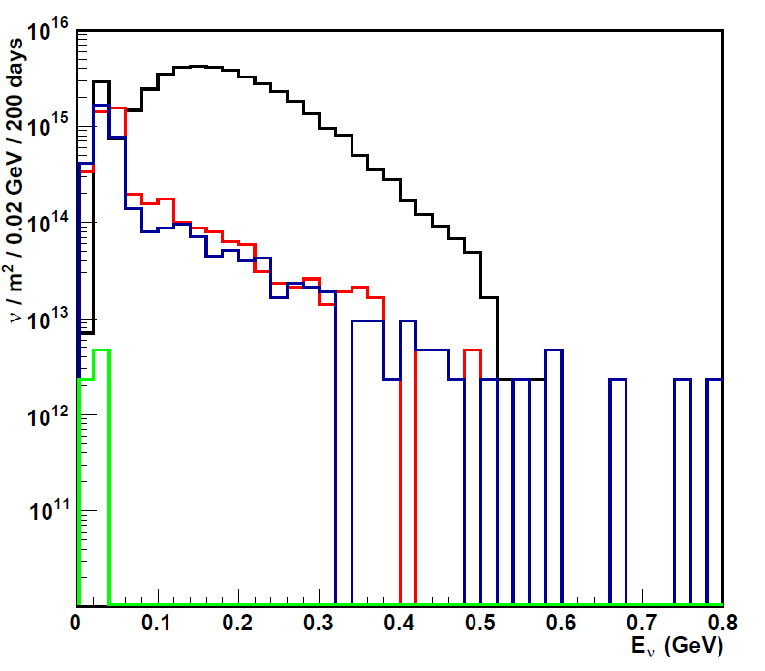
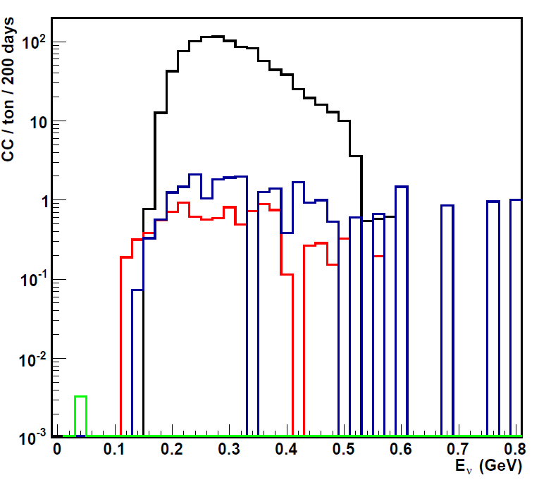
Neutrino beam for cross sections due to lack of recent measurements at low energies
Flux ν_{μ} , <E_{ν}> ~ 200 MeV
CC ν_{μ} , <E_{ν}> ~ 300 MeV
-
ν_{e}
ν_{μ}
ν_{e}
-
ν_{μ}
Simulation parameters
detector at 3 m downstream of decay tunnel
100 % π⁺/π⁻ separation
decay tunnel: L = 25 m, aperture = 30 cm
1-8% stat. error, FLUKA | Ν _{ν} (x10¹⁶) / m² / 200 days |  | CC / ton / 200 days
 | > 53 MeV | % |  | %
ν_{μ} | 3.78 | 94.5 | 959 | 96.5
ν_{μ} | 0.13 | 3.2 | 10 | 1
ν_{e} | 0.09 | 2.3 | 25 | 2.5
ν_{e} | - | - | 0.004 | -
CC ν_{μ} at <E_{ν}> = 300 MeV at EMuS
~ 1000 CC events / ton / year at CSNS – I
x 50 with capture system and decay channel upgrades at CSNS-IΙ
Preliminary study for the muon beam shows severe reduction in neutrino flux
Detector performance analysis needed in order to investigate its value
-
-

Slide 20
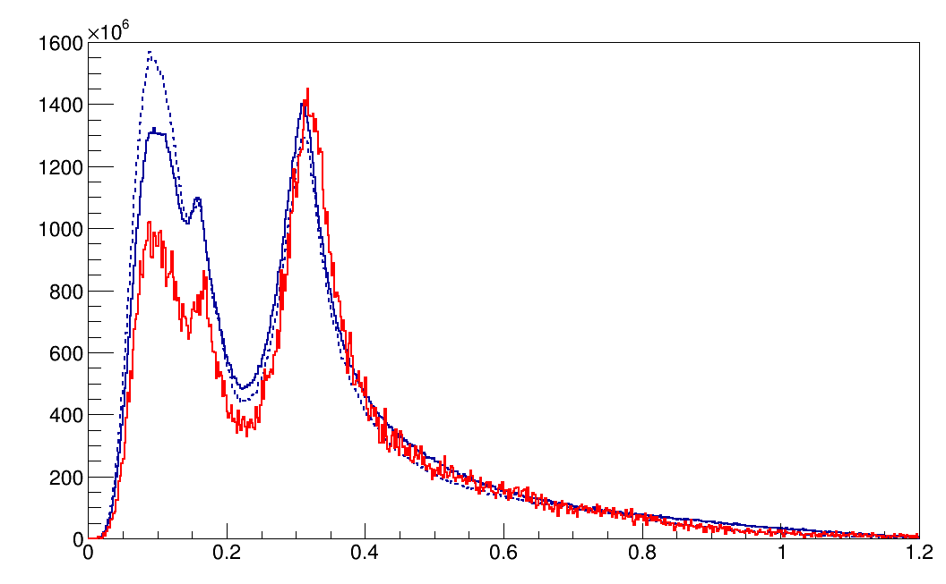
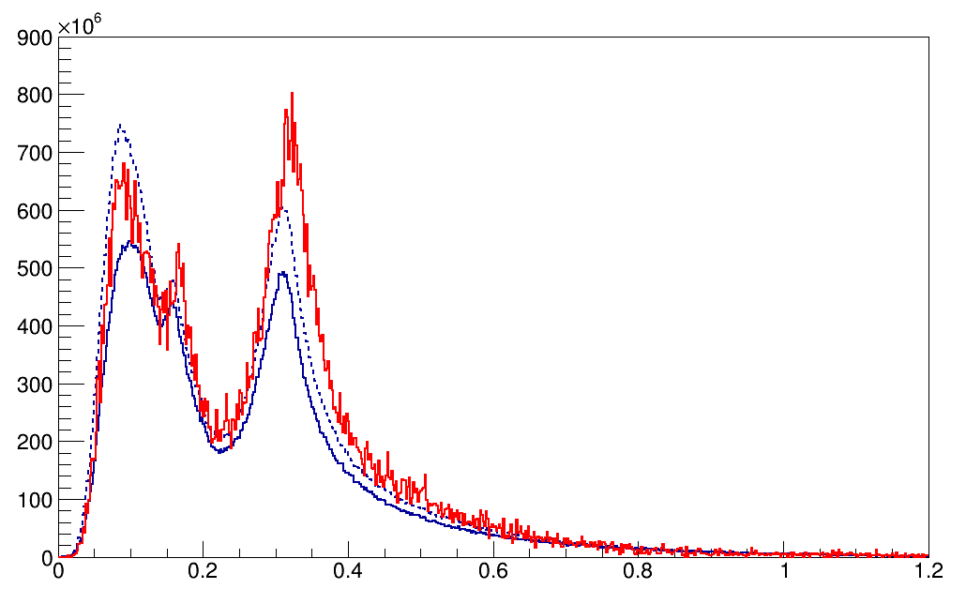
Systematics from monte-carlos: π+ and π- with FLUKA and G4 (BERTINI, INCL) at MS1, 5 Τ
π+, 5 T
π⁺ / 2 MeV / s
G4 bert
FLUKA = 1.7x10¹¹
G4 (bert) = 2x10¹¹
G4 (incl) = 2x10¹¹
G4incl
Ratio π+/π-:
FL = 1.9
G4 (bert) = 2.9
G4 (incl) = 2.2
Same baseline 5T taper used on both
P GeV/c
π-, 5 T
π⁻ / 2 MeV / s
FLUKA = 0.9x10¹¹
G4 (bert) = 0.7x10¹¹
G4 (incl) = 0.9x10¹¹
Total pions are similar with FLUKA and G4 (BERTINI)
G4(INCL) produces more pions
The distribution at the high momentum peak is similar
FLUKA predicts a ratio π+/π- = 2
G4: Song Yingpeng
P GeV/c

Slide 21
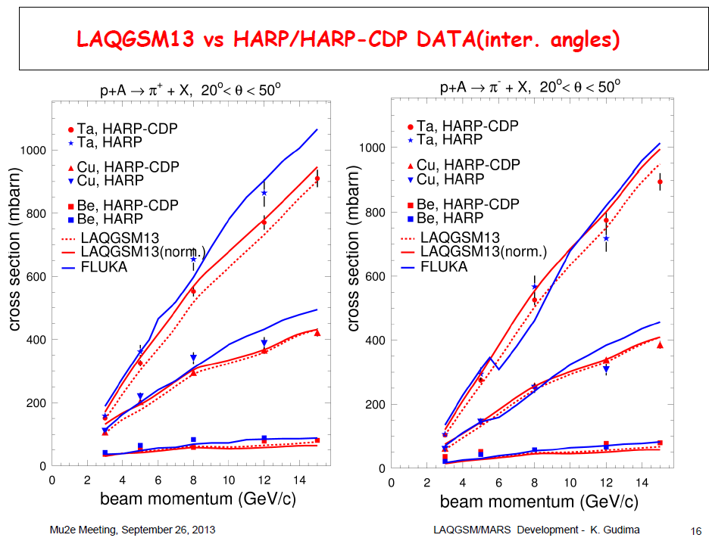
FLUKA vs MARS vs HARP
FLUKA is in agreement with MARS and HARP data @ E_{k} = 2.2 GeV

Slide 22
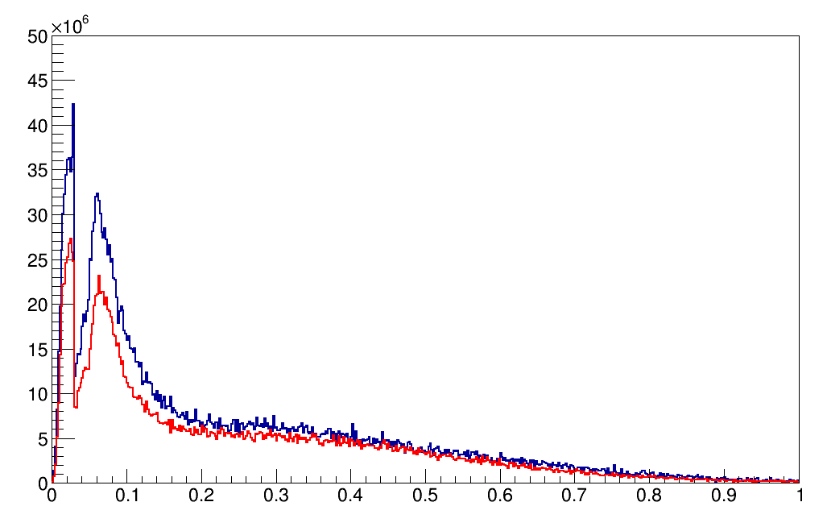
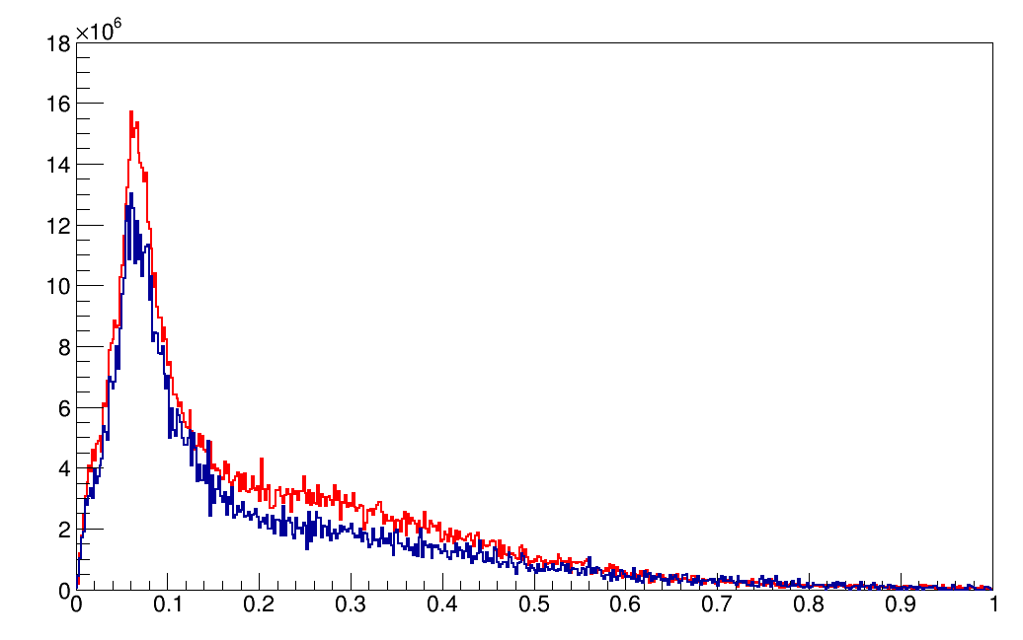
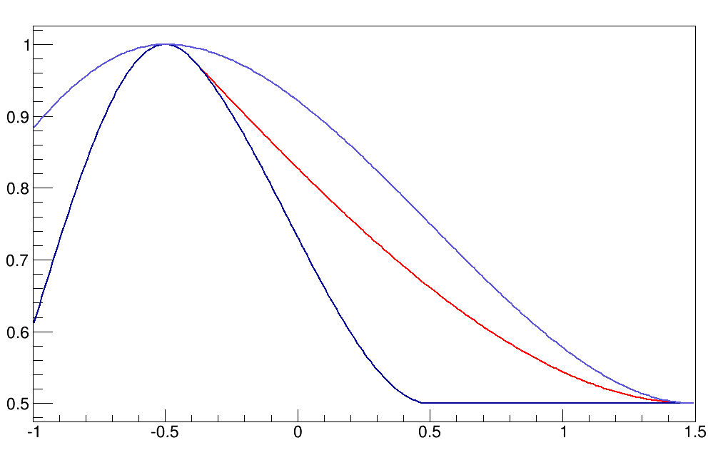
Systematics from monte-carlos: μ+ and μ- with FLUKA and G4 (BERTINI) at MS1, 1 Τ
μ+, 1 T
μ⁺ / 2 MeV / s
FLUKA = 2.2x10⁹
G4 = 2.9x10⁹
P GeV/c
Ratio μ+/μ-
FL = 2
G4 = 3.6
Same baseline 1T taper used on both
μ-, 1 Τ
μ⁻ / 2 MeV / s
FLUKA = 1.1x10⁹
G4 = 0.8x10⁹
For surface muons
FLUKA -25%
FLUKA predicts again a ratio μ+/μ- = 2
Momenta distribution similar
Both codex could be used keeping in mind the difference
G4: Song Yingpeng
P GeV/c

Slide 23
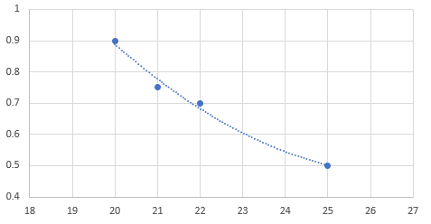
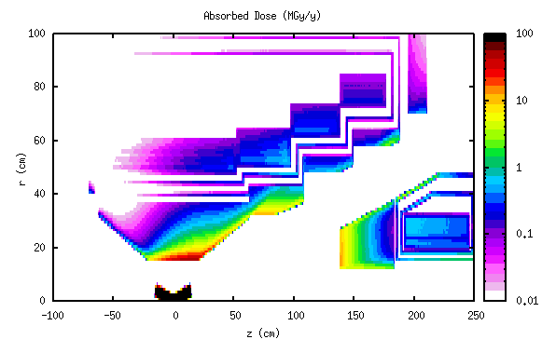
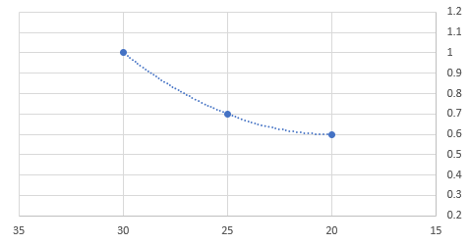
Radiation issues
Low power densities on coils < 1 mW/cm³
neutron flux < 2x10²¹ n/m²/y
Resistivity increase for Al at NbTi wire is solved by 3-month thermal cycling to room temperature
Radiation degradation of the insulator for NbTi-Al wire is solved by optimizing the W-shielding
Shielding optimization for insulator:
Insulator dose limit: 0.7MGy/y
Dose (MGy/y)
SC1 Thickness = 22 cm
Zhao Guang/IHEP
SC1 Thickness (cm)
MS1 aperture = 25 cm
for 45 cm thickness
Dose (MGy/y)
MS1 aperture (cm)

Slide 24
“Baby” scheme, target outside collector only for surface muons
p
μ⁺
window
Sideway μSR collection at 90⁰ with respect to the primary proton beam direction
Quadrupole system low acceptance collector
No SC solenoid
Quads
+ muon beam line
μSR muons collection maximized when proton beam semi-interacting with target’s upstream surface due its Gaussian form: Gaussian beam maximum 3σ_{b} from target’s center with target width 8σ_{b}
collection plane
r= 16cm
Target | Slab Gr – side : 24x24 cm2, width = 8 σ_{p}
ε_{x} = ε_{y} π mm mrad | 4500
Selection | μSR - μ⁺ 25 < P < 29.8 MeV/c
p displacement from target’s center | 0σ_{p} | 1σ_{p} | 2σ_{p} | 3σ_{p} | 4σ_{p}
intensity (x10⁶) μ/sec | 2 | 2.5 | 3 | 3.4 | -
polarization | -0.91 | -0.91 | -0.94 | -0.94 | -
Surface muon purity (%) | 93 | 93 | 95 | 96 | -
stat. error ~ 1% / 0.4% for intensity / polarization
length
width
p
μ+
height
p
π+
μ+
μ+
60 cm
rectangular target

Slide 25
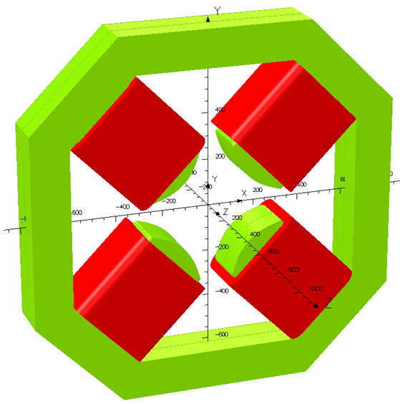
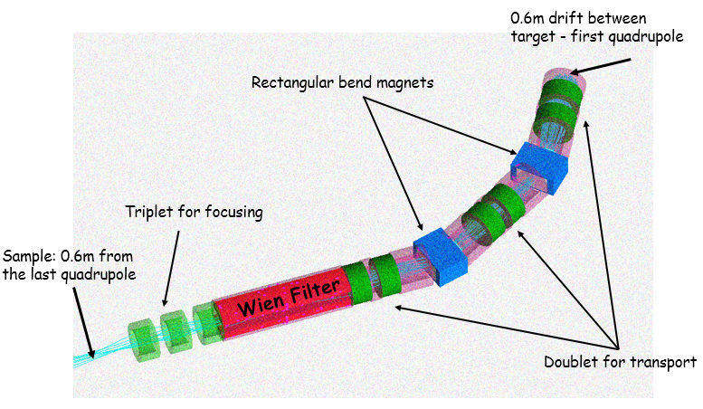
“Baby” scheme, μSR - μ⁺ 25 < P (MeV/c) < 29.8
rectangular target
μSR beamline by Zhou Luping
length
width
p
μ+
height
p
π+
μ+
μ+
60 cm
Available “good” magnetic field radius = 16 cm
μSR @ 4500 π mm mrad
μ⁺/s: max for Cu ~ 10⁷
polarization: 94%
different Graphite target sizes performances
Target material | Slab Gr, Width = 8 σ_{p}
ε (π mm mrad) | 4500
Target, (Height x Length) | 6x6 | 12x12 | 24x24
intensity (x10⁶) μ/sec | 2.9 | 3.3 | 3.4
polarization | -0.96 | -0.96 | -0.94
surface muon purity (%) | 98 | 97 | 96
statistical error | < 2% on intensity, < 1% on polarization
different target materiel performances
Target | Slab, Height x Length = 24x24 cm2, Width = 8 σ_{p}
ε (π mm mrad) | 4500
material | Gr | SiC | Be | Ti | Cu | W
L_{t} / λ_{Ι} | 0.5 | - | 0.57 | 0.86 | 1.6 | 2.4
intensity (x10⁶) μ/sec | 3.4 | 5.4 | 4.5 | 5.5 | 9.4 | 8.5
polarization | -0.94 | -0.94 | -0.94 | -0.94 | -0.94 | -0.92
surface muon purity (%) | 96 | 96 | 96 | 96 | 97 | 96
statistical error | < 2% on intensity, < 1% on polarization
12x12cm2 is similar to 24x24cm2 due to small emittance selection/ quadrupole acceptance

Slide 26
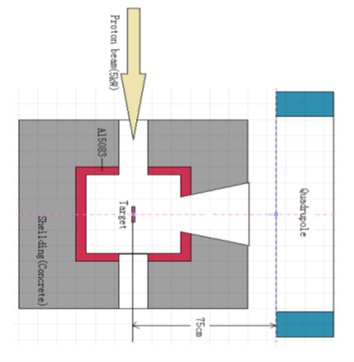
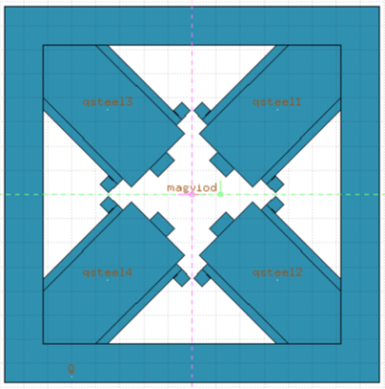
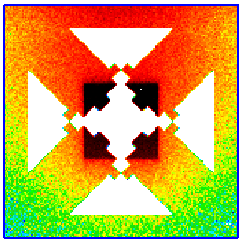
Beam direction
Target area geometric distribution
Quadrupole model for simulation
Mu Qili/IHEP
preliminary
The maximum absorbed dose rate of on the first quadrupole is 0.109 Gy/s (1.96 MGy/y), in the case of incident proton beam power is 5 kW. On epoxy is ~ an order of magnitude less
It can be seen that a square area is formed in the figure, and the absorbed dose in the area is significantly larger than that outside the area, this is because the target area has a 30 cm thick concrete shield
Absorbed dose rate of epoxy map( Gy/s)

Slide 27
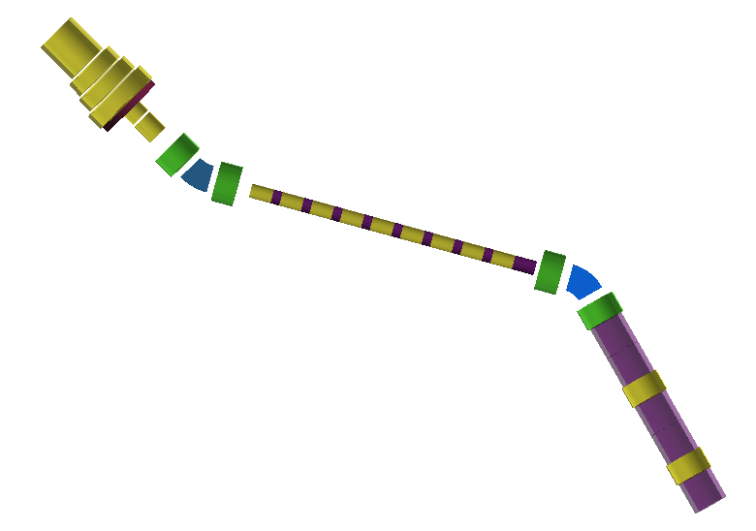
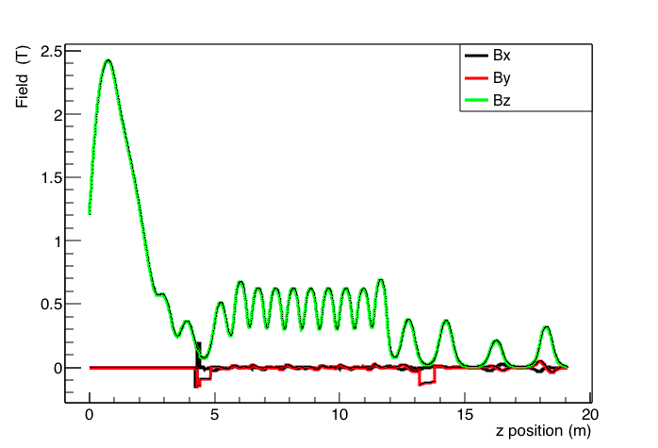
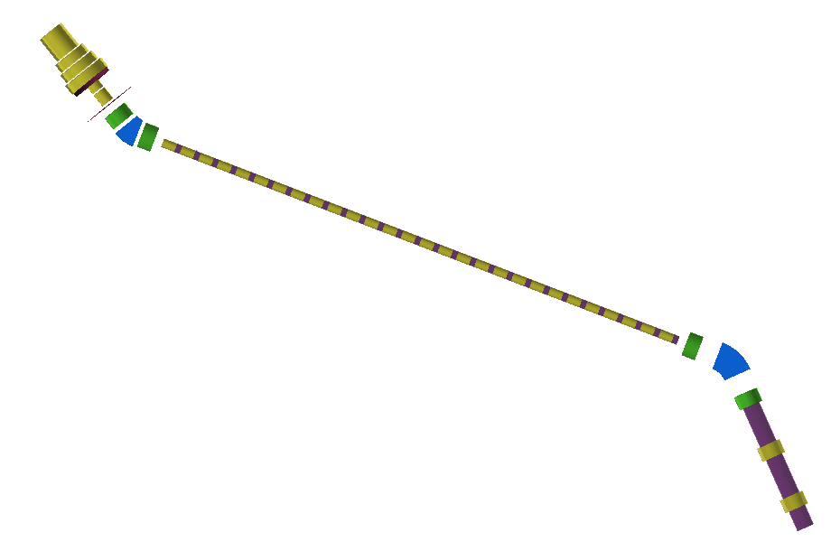
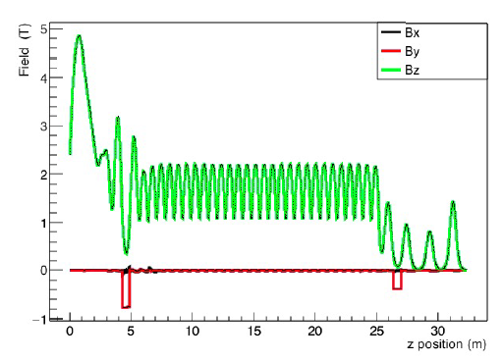
μSR mode schematics
SC adiabatic capture solenoid
Adiabatic capture and transport field
for μSR
Matching solenoid
Charge/momentum selection for μSR muons
5.6 m superconducting transport solenoid
2nd momentum selection,
μSR muons separation
μSR beamline to detector
decay muon/pion mode schematics
Adiabatic capture and transport field for pions
and decay muons
Charge/momentum selection for pion/decay muons
25 m superconducting transport solenoid
pion decay section
μSR muon section
2nd selection,
decay muons
Decay muon section
Y. Song/IHEP

Slide 28
EMuS performance and comparisons

Slide 29
Conclusions on muon/pion collection and neutrinos
Full scheme with 4-coils/3-steps SC solenoid:
SC solenoid has been designed
Radiation analysis shows the feasibility of the SC solenoid
μSR physics with surface muons
7x10⁶ μ+/s with 85% polarization and 86% surface muon purity @ 10000 π mm mrad
1 -> 0.5 T is best for polarization, 85%
Decay muons
5 T for 128 MeV/c, and 4.5 or 4 T for 225 MeV/c pion capture
pion rates ~ 10¹⁰ π+/s @ 100000 π mm mrad
Neutrinos
~ 1000 CC events / ton / year at CSNS – I @ <E> = 300 MeV
Baby scheme “quadrupole” with target outside collector and sideways collection
μSR physics with surface muons
Graphite, 3.3x10⁶ μ+/s with 96% polarization and 97% surface muon purity @ 4500 π mm mrad
Copper, 9.2x10⁶ μ+/s
μSR and decay muons beamlines almost there, are being optimized
Proton beam dump and collimation under study

Slide 30
thanks
EMuS innovation:
Unique SC capture solenoid (5T max.)
Forward capture & spent proton extraction
Coils will be made by Chinese industry
MOMENT at future:
15 MW cw-proton beam
Leptonic CP-violation
DAR
CC-NSI
EMuS as R&D for MOMENT:
MW Capture system
Pion transport/decay
Charge separation
Muon transport/decay channels

Slide 31
extra

Slide 32
muon yields as function of target tilt and length (exit of 1st coil, no-shield)
For baseline target
15º
Total surface muons 10⁸ / second
Polarization along beam axis ~ 80-82%

Slide 33
Proton extraction from RTBT
40 ms
……
410 ns
~ 70 ns
Proton beam structure in RTBT
(25 Hz, two bunches in one pulse)
Layout of proton extraction from RTBT
Extracting one bunch in every 10 pulses from RTBT to EMuS
400 ms
……
~ 70 ns
Proton beam structure transported to EMuS target
(2.5 Hz, one bunches in one pulse)

Slide 34
Lattice adjusting of proton transport line in HEPEA
Layout of HEPEA
Transport line lattice of old version (version 1)
Transport line lattice of new version (version 2)
Lattice adjusting: be compatible to the layout of HEPEA
Bending magnet adjusting: reduce magnet series and make the magnet field less than 1.2 T

Slide 35
Simulation of proton extraction from target station

Slide 36
Summary
To higher field, peak field of baseline model and faster model are 4.87 T and 4.52 T respectively, field at axis of matching coil are 2.5 T, 2.2 T and 2.1 T respectively . The current of the CS2 and CS3 are decreased, the current of the CS1 and CS4 can’t be increased to requirement, which was restricted by the property of the superconducting cable, so the field at axis of matching coil is difficult to reach 3 T. There will be one way, increasing the layer of the CS4 . But in Peak Field 5 T(Slower taper)，the current of CS4 need be decreased. Four coil need be excited respectively, which maybe cause quench easily in higher field model.
The length from peak field to inflection point is about 1.6 m in slower taper model and baseline model.
The length from peak field to inflection point is about 1.0 m in faster model.
There is a pit in faster model.
The shear strength of cable have not matched with the requirement(20 Mpa), the result of 1.5 m cable is very good, but the result of 10 m cable is inconsistent.

Slide 37
Peak Field 5 T(Slower taper)
coil | Rmin (m) | Rmax (m) | Zmin (m) | Zmax (m) | J(A/ mm^2) | Layer
01 | 0.50 | 0.5918 | -0.986 | 0 | 50.55 | 6
02 | 0.56 | 0.6518 | -1.05 | -1.436 | 50.55 | 6
03 | 0.64 | 0.7165 | -1.5 | -1.846 | 50.55 | 5
04 | 0.72 | 0.7965 | -1.91 | -2.23 | 50.55 | 5
05 | 0.23 | 0.24 | -2.38 | -2.68 | 130
06 | 0.23 | 0.246 | -2.7 | -3.2 | 130

Slide 38
Peak Field 5 T(faster)
coil | Rmin (m) | Rmax (m) | Zmin (m) | Zmax (m) | J(A/ mm^2) | Layer
01 | 0.50 | 0.5918 | -0.986 | 0 | 52 | 6
02 | 0.56 | 0.6518 | -1.05 | -1.436 | 12.5 | 6
03 | 0.64 | 0.7165 | -1.5 | -1.846 | 20 | 5
04 | 0.72 | 0.7965 | -1.91 | -2.23 | 54 | 5
05 | 0.23 | 0.24 | -2.38 | -2.68 | 110
06 | 0.23 | 0.246 | -2.7 | -3.2 | 110

Slide 39
Peak Field 1 T(baseline)
coil | Rmin (m) | Rmax (m) | Zmin (m) | Zmax (m) | J(A/ mm^2) | Layer
01 | 0.50 | 0.5918 | -0.986 | 0 | 10.5 | 6
02 | 0.56 | 0.6518 | -1.05 | -1.436 | 8 | 6
03 | 0.64 | 0.7165 | -1.5 | -1.846 | 6 | 5
04 | 0.72 | 0.7965 | -1.91 | -2.23 | 12 | 5
05 | 0.23 | 0.24 | -2.38 | -2.68 | 26
06 | 0.23 | 0.246 | -2.7 | -3.2 | 26

Slide 40
Magnet design for the target station—Thermal Analysis
Temperature nephogram
Thermal load：irradiation heat（unincluding heat by conduction，radiation or convection ）
Cs1：11.11 w，Cs2：9.04 w，Cs3：7.12 w，Cs4：6.61 w
Cold source: 4.5 k two-phase helium forced-flow cooling
Maximum temperature: 5.35 K
Non-uniform thermal load along the circumference

Slide 41
μSR and decay muons at matching solenoid entrance
1->0.5T
μ⁺/s/2MeV
Total muons
Only surface muons
from DAR at target
Beam operation modes (independent):
Surface muon mode (baseline)
Ref. Pμ=29 MeV/c
Momentum spread: <±5%
P(MeV/c)

Slide 42
Reduced target width σ_{p} = 5 mm, 5 kW, less neutrons
FLUKA simulation - preliminary
Target | Slab Gr – side : 48x48 cm2, width = 8σ_{p}
Selection | μSR - μ⁺ 27 < P < 29.8 MeV/c
p displacement
Target width (σ_{p}) | 3 | 4 | 5 | 6 | 7 | 8
ε_{x} = ε_{y} π mm mrad | 100000 | 100000 | 100000 | 100000 | 100000 | 100000
i(x10⁶) μ/sec | 100 | 180 | 215 | 215 | 222 | 225
<Polz> | .77 | .78 | .76 | .77 | .77 | .74
Stat. error ~ 1% / 0.4% for i / <Pol>
Surface muon beam purity ~ 92-95%
better
Collection plane
λ_{Ι} = 48 cm
target w = 3σ_{p}
4σ_{p}
5σ_{p}
6σ_{p}
7σ_{p}
w = 8σ_{p}
p
p
p
p
p
p
p
z
z
z
μ⁺ 27 < P < 29.8 MeV/c
ε_{x} = ε_{y} = 100000 π mm mrad
48 cm
15 cm

Slide 43
1.Absorbed dose rate of epoxy on 1st quadrupole
CONTENTS
Mu Qili
Target area geometric distribution
The first quadrupole structure

Slide 44
2.parameters of targets hitted by proton beam(beam power=5kW)
note:surface muon's
energy is 0-4.12MeV
Mu Qili

Slide 45
Proton beam
1.The maximum absorbed dose rate of epoxy on the first quadrupole is 0.109 Gy/s(1.96e6Gy/y),in the case of incident proton beam power is 5 kW.
2.It can be seen that a square area is formed in the figure, and the absorbed dose in the area is significantly larger than that outside the area, this is because the target area has a 30cm thick concrete shield.
Quadrupole model for simulation
Mu Qili
Absorbed dose rate of epoxy map(Gy/s)

Slide 46
Decay muon
Beam parameters of different decay muon sources
 | EMuS | μE1@PSI | RIKEN-RAL | D-Line@J-PARC
Proton beam power (MW) | 0.005 | 1.3 | 0.16 | 1.0
μ momentum range (MeV/c) | 50-130 | 85-125 | 65-120 | 33-250
Intensity (1E6/s) | 42 | 240 | 1 | 10
Polarization | 0.68 | ~0.75 | ≥0.8 | ~0.8
IP2 (1E6/s) | 19 | 180 | 0.8 | 8
dp/p (FWHM) | 14.1% | 3% | 10% | 15%
x (FWHM) | 60mm | 39mm | ~30mm | ~35mm
y (FWHM) | 76mm | 25mm | ~30mm | ~35mm

