Slide 1

The Injection System for IsoDAR
NuFact 2018
Joe Smolsky
17 August 2018

Slide 2
The Proton Driver for IsoDAR
NuFact 2018
Joe Smolsky
17 August 2018

Slide 3
Outline
IsoDAR experiments
Injection system
Cyclotron
Current research
Medical isotopes
High intensity cyclotrons for neutrino physics:
https://arxiv.org/abs/1807.03759

Slide 4

Outline
IsoDAR experiments
Injection system
Current status of injection system
Cyclotron
Medical isotopes

Slide 5
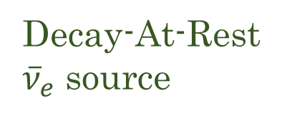
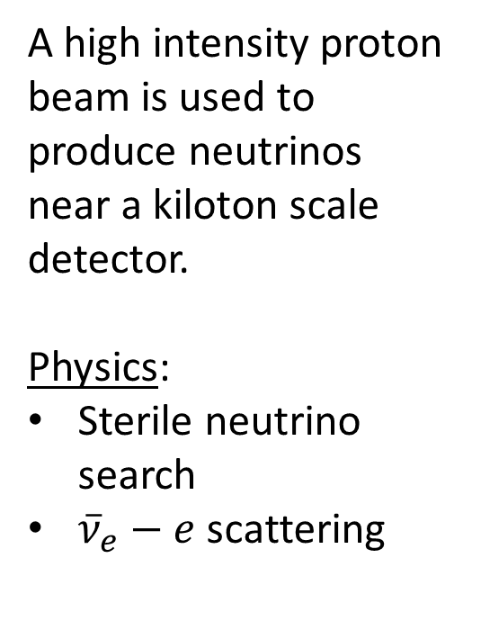
Isotope Decay-At-Rest (IsoDAR) setup
A high intensity proton beam is used to produce neutrinos near a kiloton scale detector.
Physics:
Sterile neutrino search
${\overline{ν}}_{e}−e$ scattering
Proton driver
Decay-At-Rest ${\overline{ν}}_{e}$ source
Detector

Slide 6
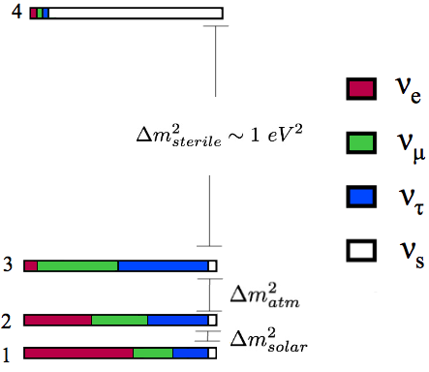
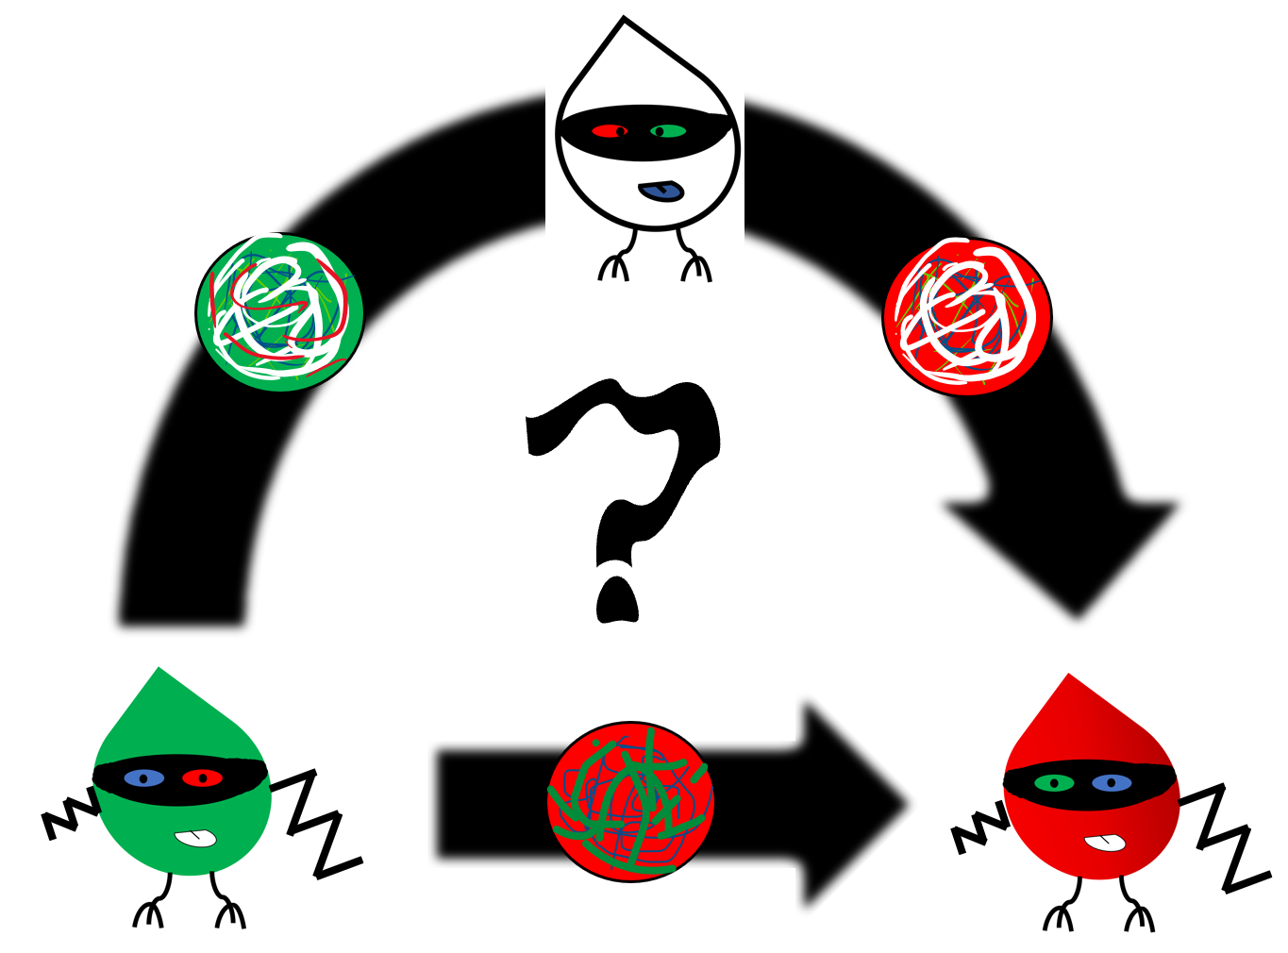
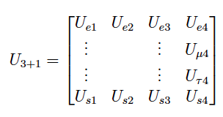

Sterile neutrinos
SM neutrinos: $ν_{e}, ν_{μ},ν_{τ}$
  Interact weakly
Sterile neutrinos: $ν_{s}$
  No standard model interactions
  Mix with $ν_{SM}$ flavors

Slide 7
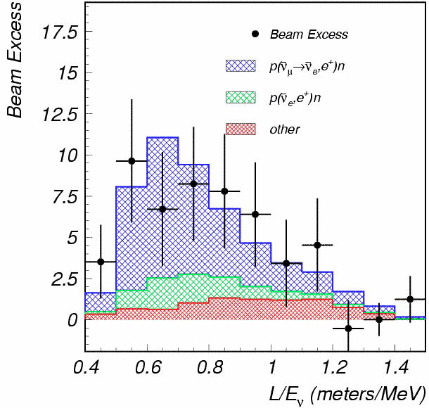
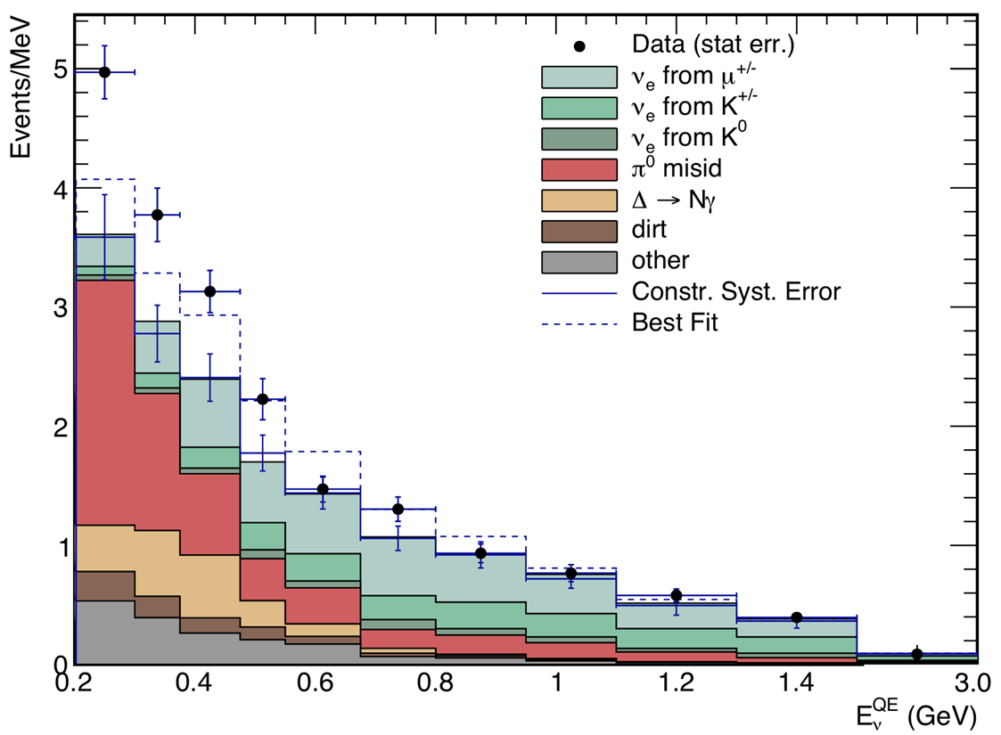
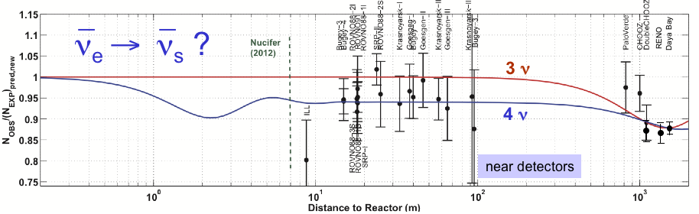
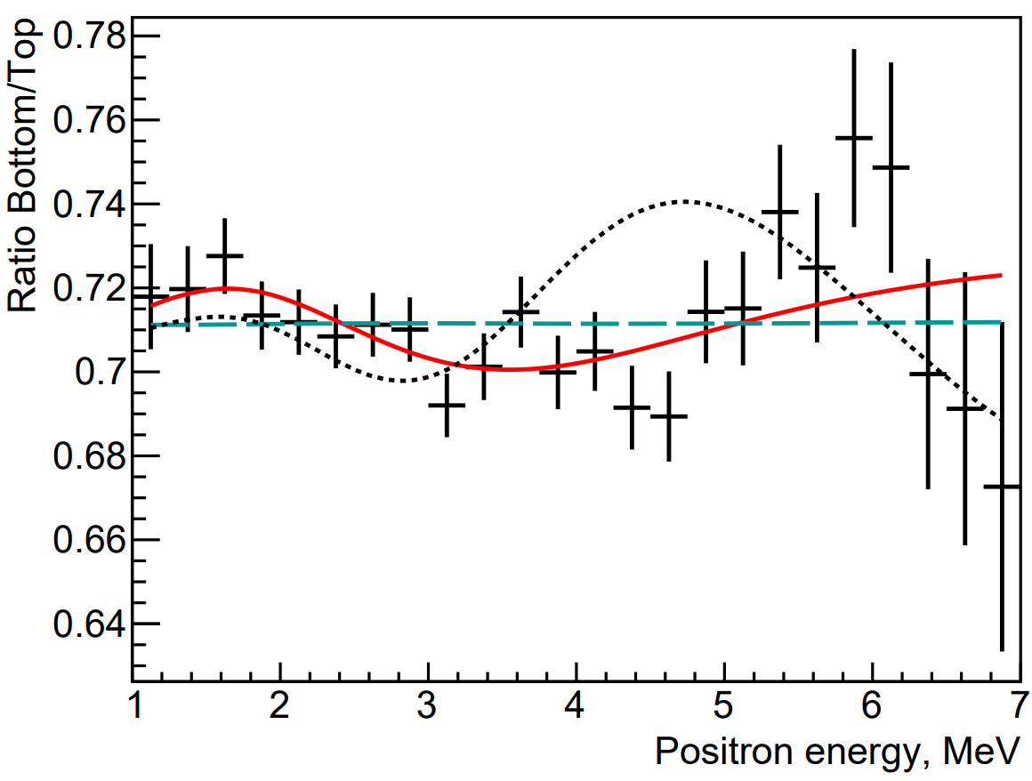
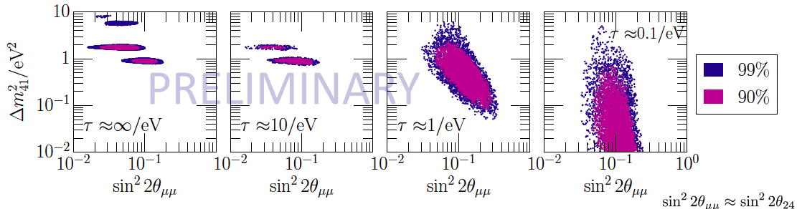


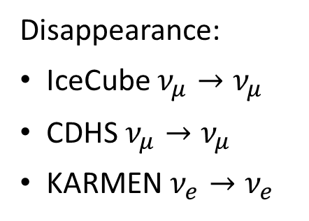

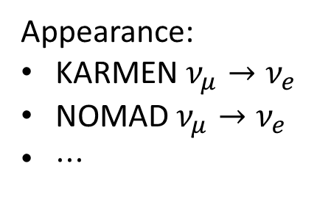

Null results
Data
Anomalies
Disappearance:
IceCube $ν_{μ}→ν_{μ}$
CDHS $ν_{μ}→ν_{μ}$
KARMEN $ν_{e}→ν_{e}$
Appearance:
KARMEN $ν_{μ}→ν_{e}$
NOMAD $ν_{μ}→ν_{e}$
$⋅⋅⋅$
LSND: ${\overline{ν}}_{μ}→{\overline{ν}}_{e}$ excess 3$.8σ$
MiniBooNE: $ν_{μ}→ν_{e}$excess $4.8σ$
Global fits
PRELIMINARY
Reactors: $ν_{e}$ deficit $2$- $4 σ$
DANSS: $ν_{e}$ deficit
Neutrino oscillations + decay global fits

Slide 8
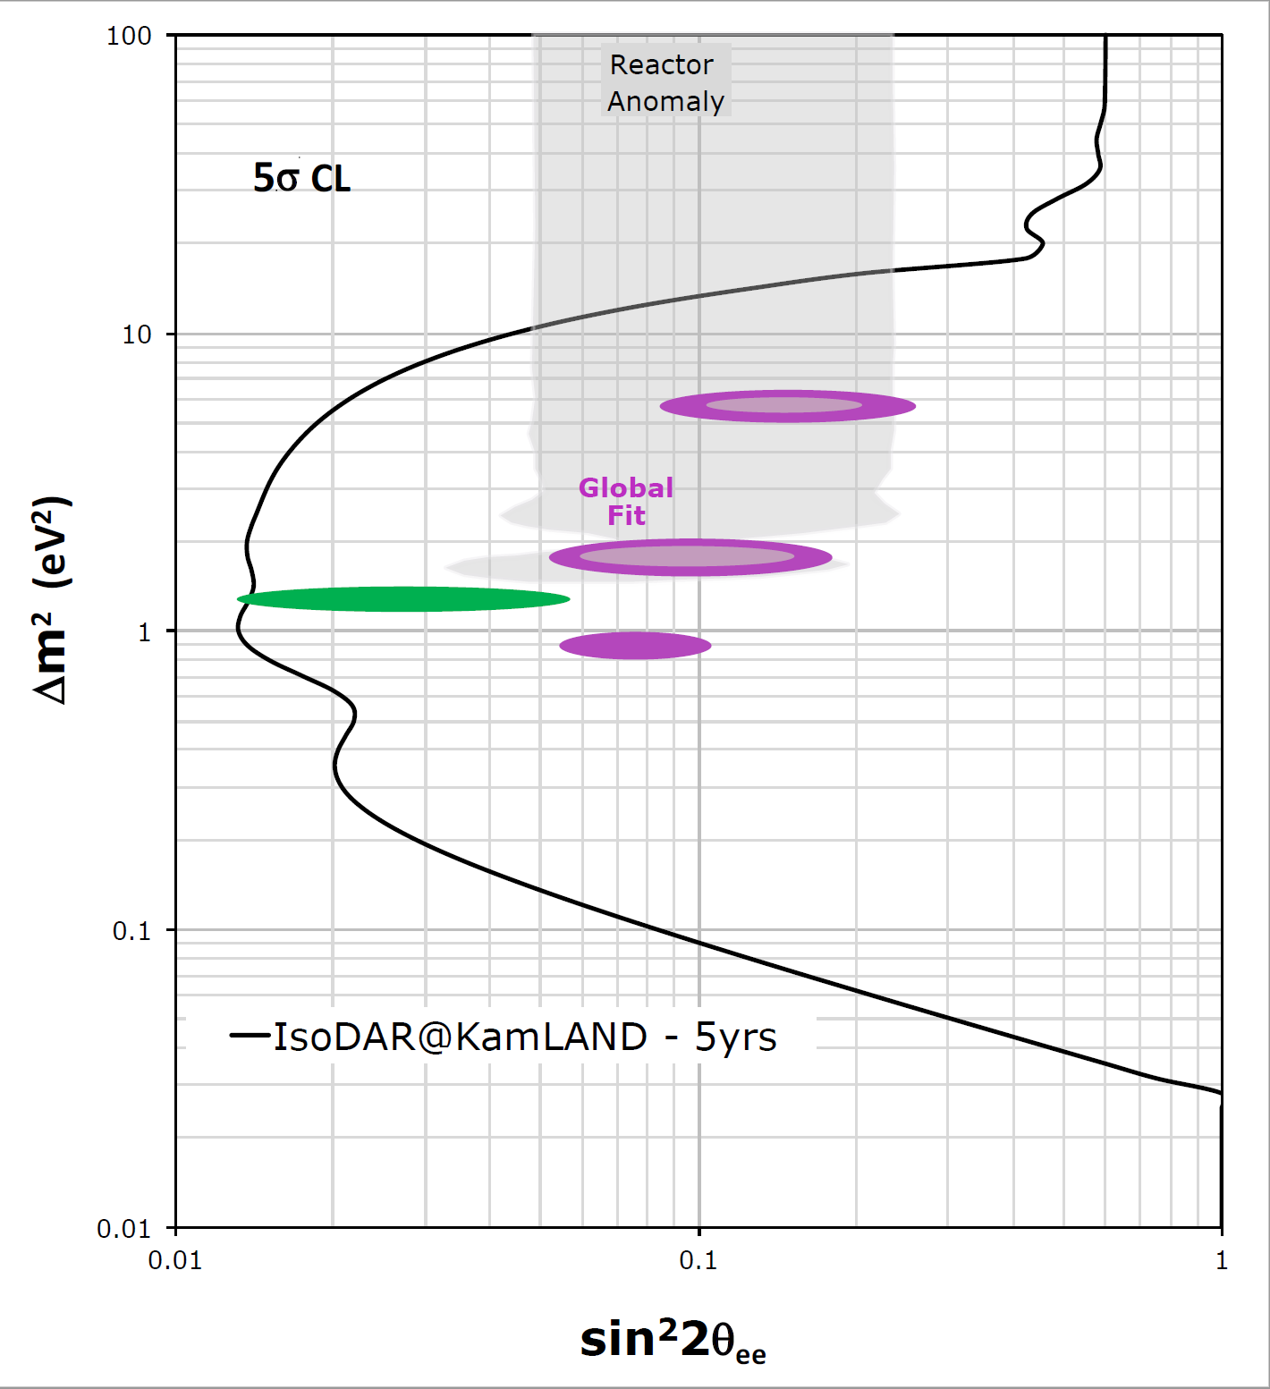
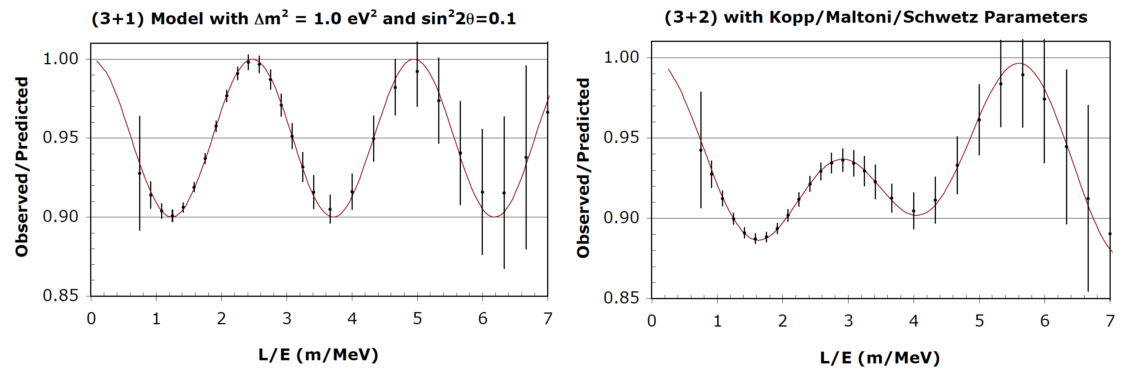
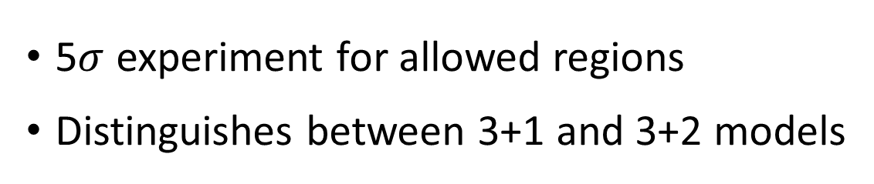

IsoDAR@KamLAND as a definitive $ν_{s}$ search
5$σ$ experiment for allowed regions
Distinguishes between 3+1 and 3+2 models
Collin et al.
1607.00011
Dentler et al.
1803.10661

Slide 9
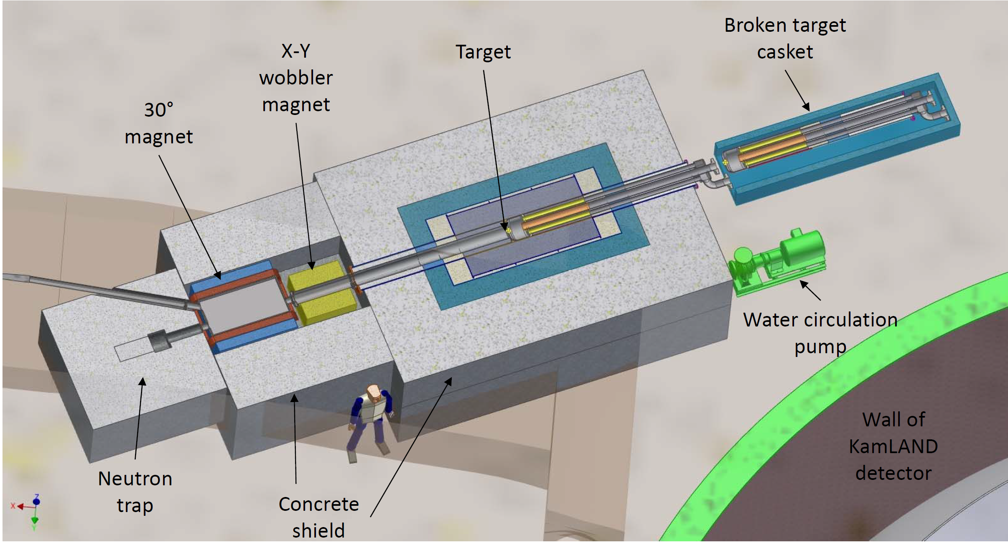
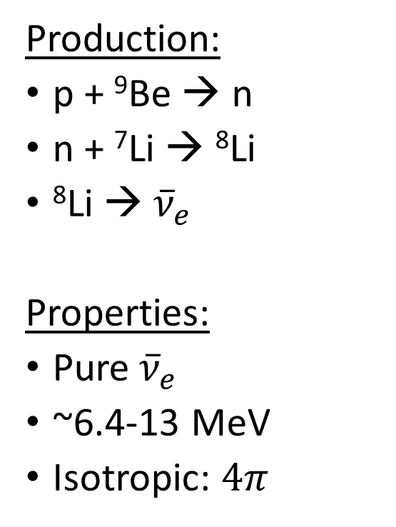
IsoDAR sources
Production:
p + ⁹Be → n
n + ⁷Li → ⁸Li
⁸Li →${\overline{ν}}_{e}$
Properties:
Pure${\overline{ν}}_{e}$
~6.4-13 MeV
Isotropic: $4π$

Slide 10
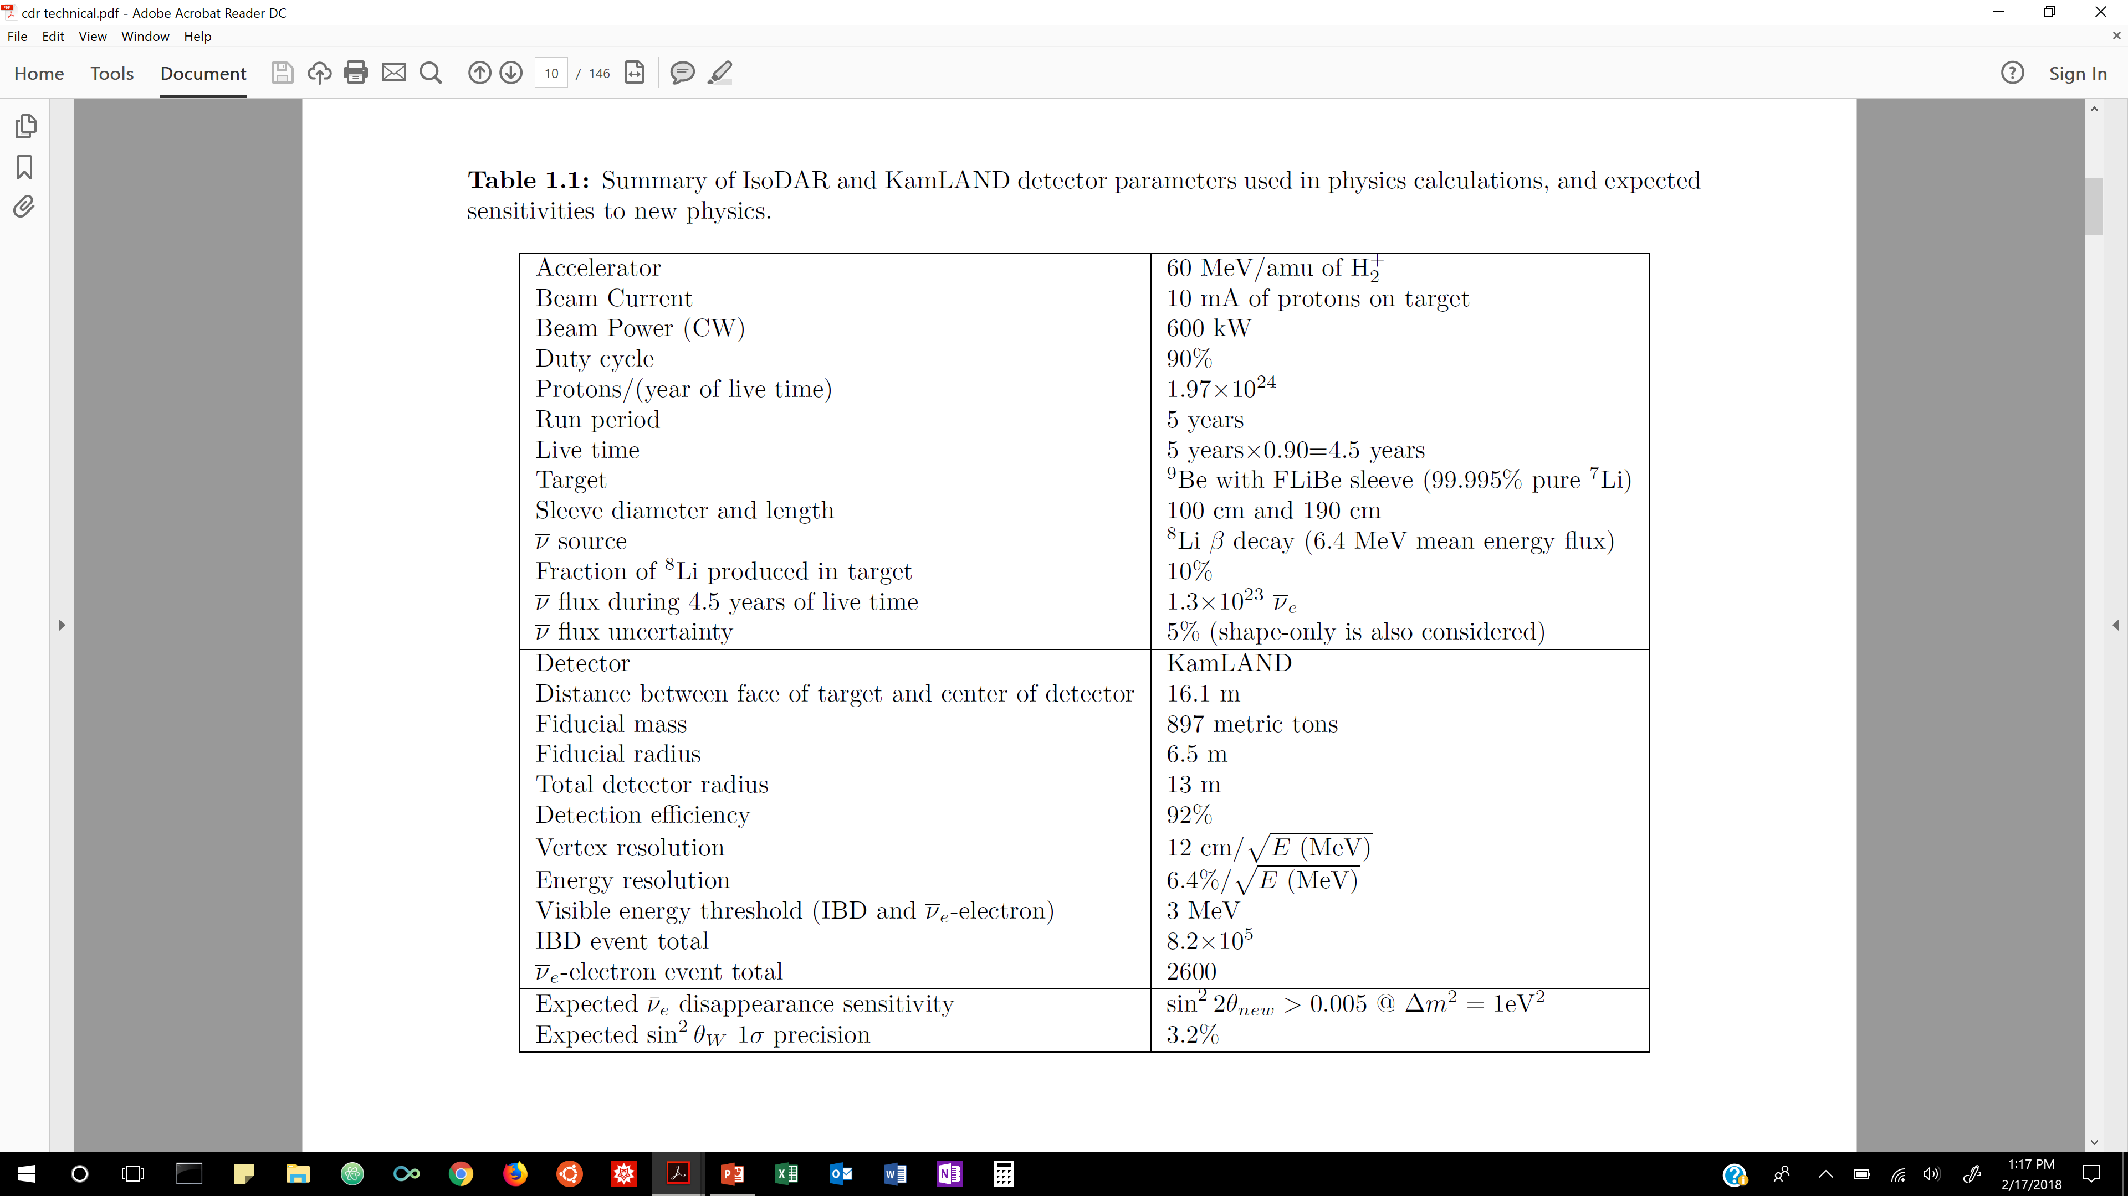

5 years @ KamLAND
Check out Spencer Axani’s talk from WG5 for more details.

Slide 11

5 years @ KamLAND

Slide 12
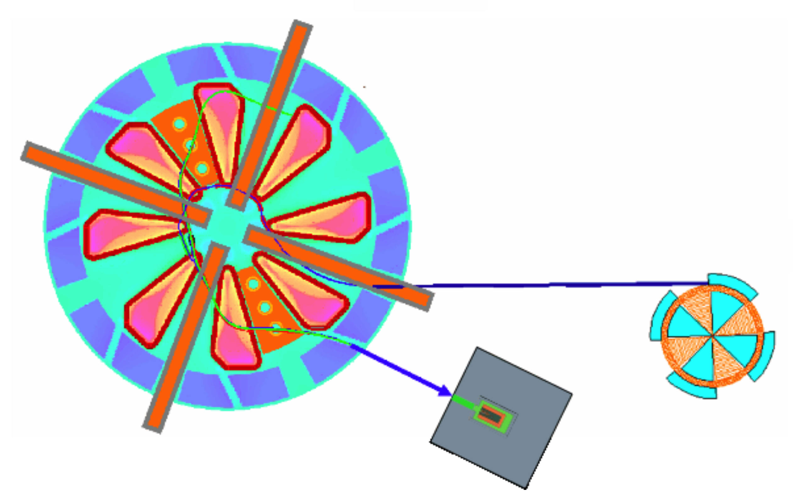


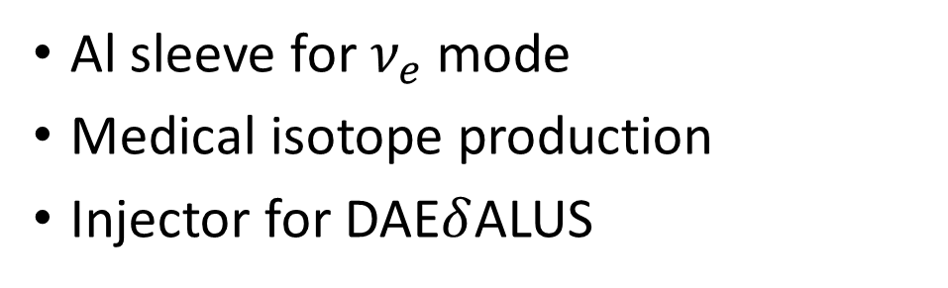





Other possibilities
Al sleeve for $ν_{e}$ mode
Medical isotope production
Injector for DAE$δ$ALUS
$${\overline{ν}}_{μ}$$
$${\overline{ν}}_{μ}$$
Segmented cyclotron
800 MeV
$${\overline{ν}}_{μ}$$
$${\overline{ν}}_{μ}$$
20+ kiloton detector
1.5 – 20 km
IsoDAR cyclotron
60 MeV
$${\overline{ν}}_{μ}$$
$${\overline{ν}}_{μ}$$
$${\overline{ν}}_{μ}$$

Slide 13
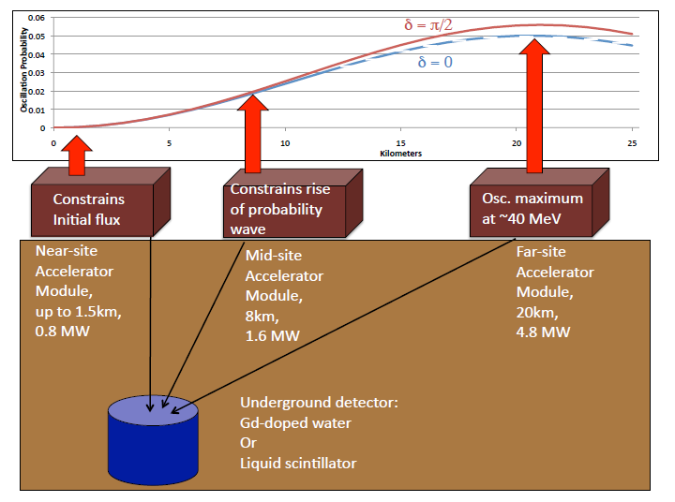
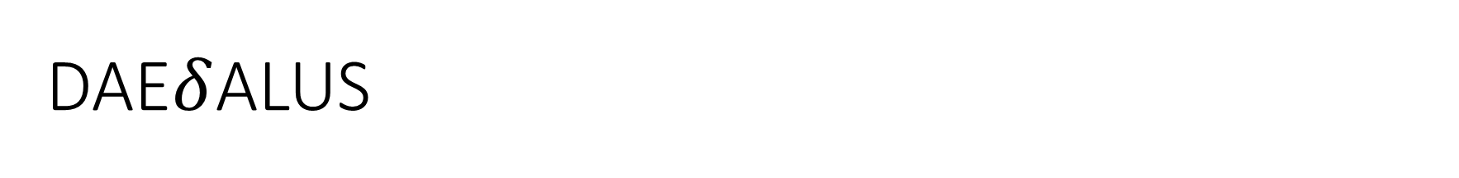
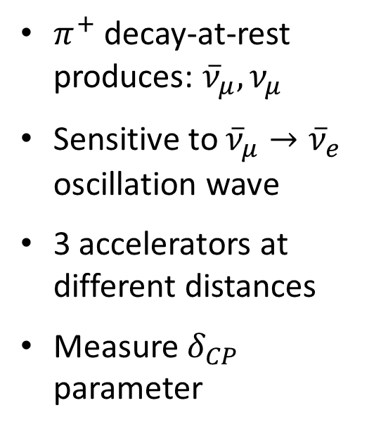
DAE$δ$ALUS
$π^{+}$ decay-at-rest produces: ${\overline{ν}}_{μ}, ν_{μ}$
Sensitive to ${\overline{ν}}_{μ}→{\overline{ν}}_{e}$ oscillation wave
3 accelerators at different distances
Measure $δ_{CP}$ parameter

Slide 14
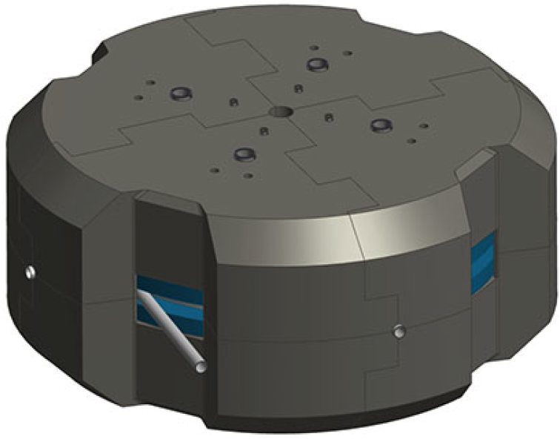
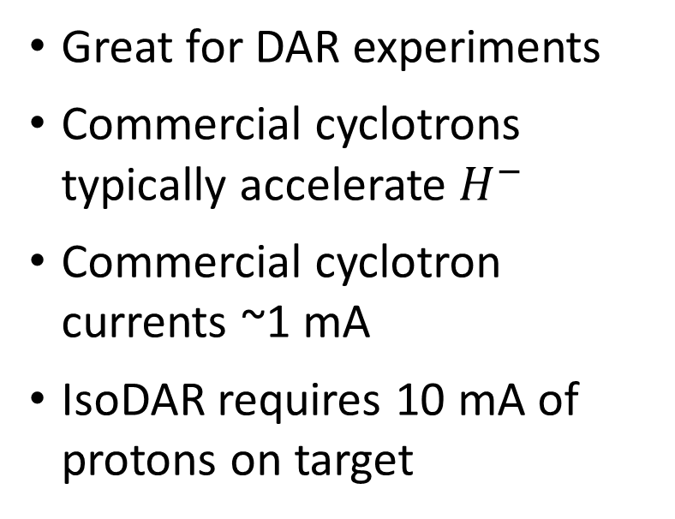
Proton beams from cyclotrons
Great for DAR experiments
Commercial cyclotrons typically accelerate $H^{−}$
Commercial cyclotron currents ~1 mA
IsoDAR requires 10 mA of protons on target

Slide 15
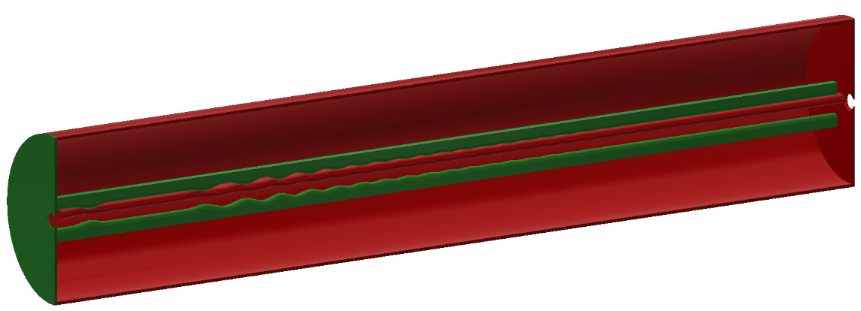
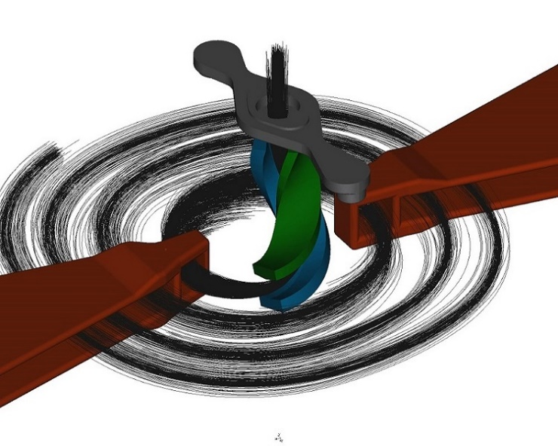
Outline
IsoDAR experiments
Injection system
Cyclotron
Current research
Medical isotopes

Slide 16
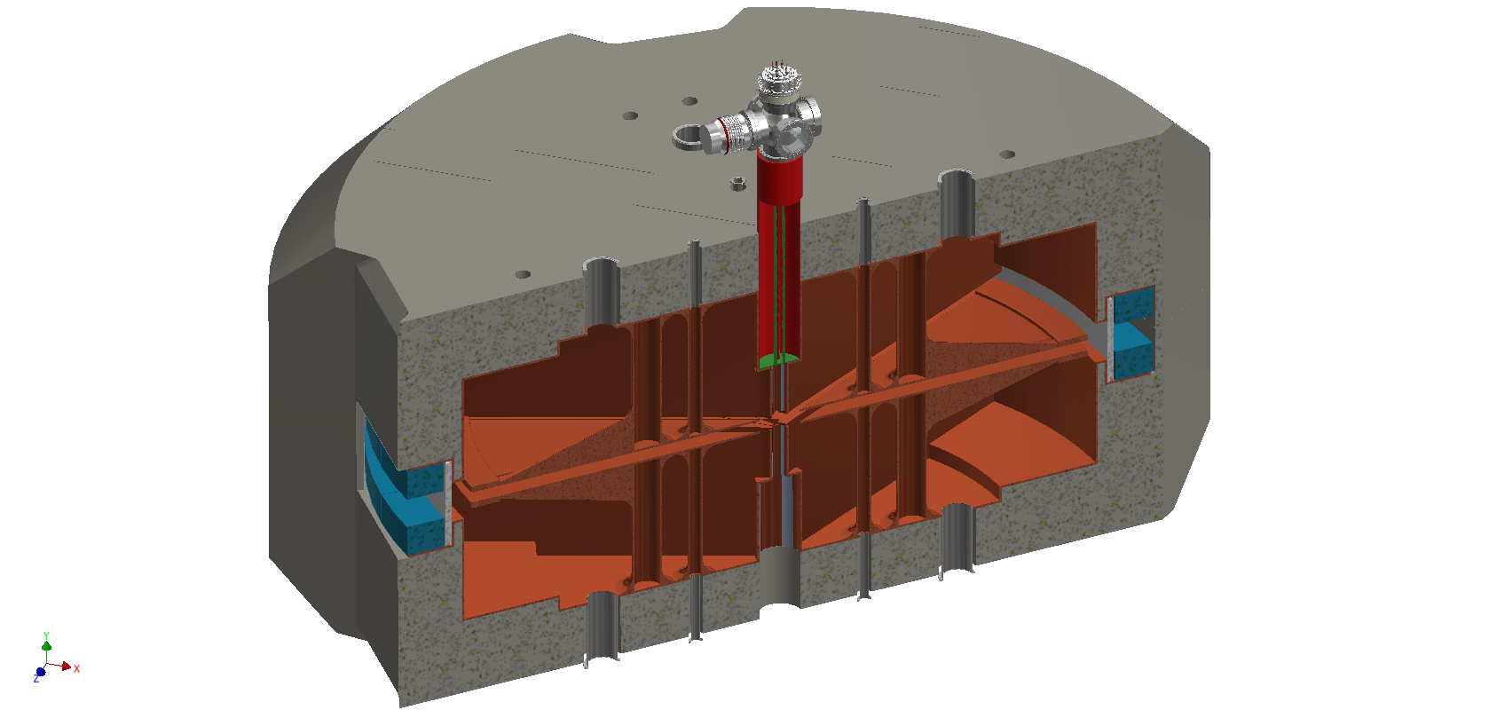
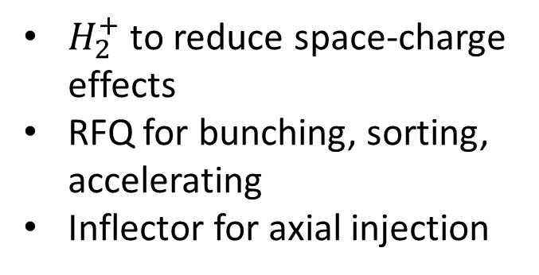

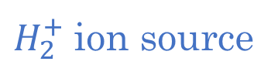
RFQ – Direct Injection Project (RFQ-DIP)
$H_{2}^{+}$ ion source
$H_{2}^{+}$ to reduce space-charge effects
RFQ for bunching, sorting, accelerating
Inflector for axial injection
Spiral inflector and central region
$$RFQ$$

Slide 17
Multi-cusp Ion Source
Faraday cup
Extraction System
Magnets
Filament feedthroughs
Gas inlet
Water cooling
Insulator ring

Slide 18
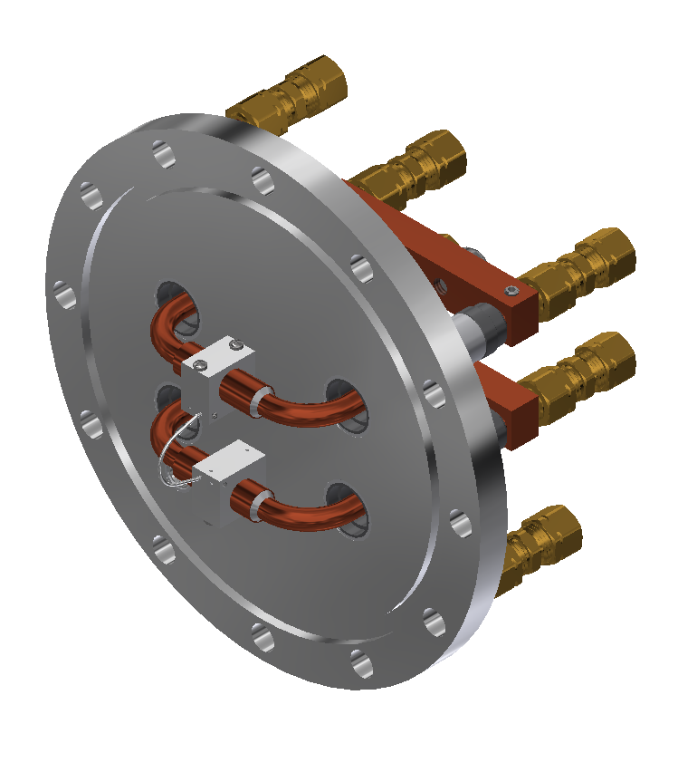
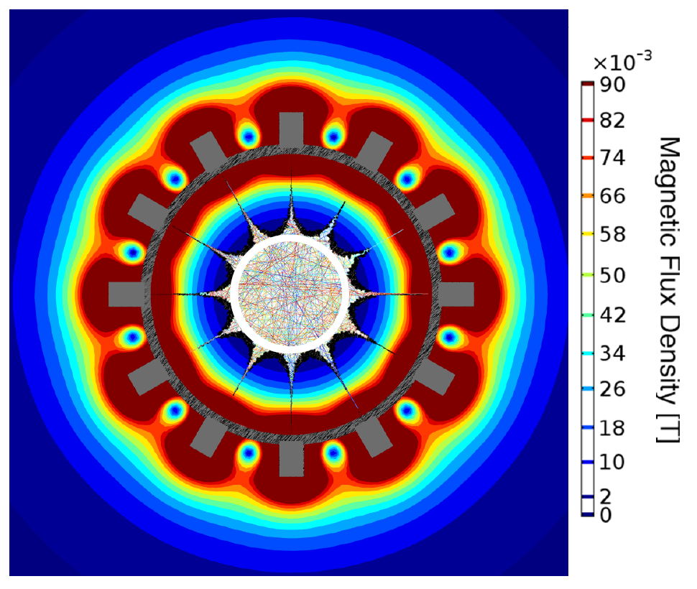
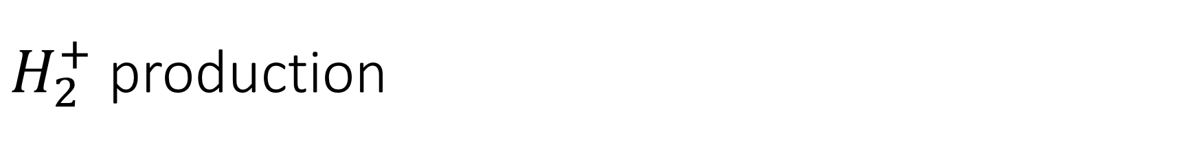
$H_{2}^{+}$ production
Hot tungsten filament ionizes hydrogen molecules
Plasma is confined by SmCo magnets
Small aperture allows ions to drift into extraction system
Design goal of 50 mA/cm²

Slide 19
Extraction system
Slits for steering
Modeled in IBSimu
Electrodes left to right:
  Plasma electrode: 15 kV
  Puller: -5 kV
  3 Lenses: 14.5, -5, 16 kV
  RFQ entrance
Slits allow compensation for small alignment errors
IBSImu: http://ibsimu.sourceforge.net/

Slide 20
RFQ – Direct Injection Project (RFQ-DIP)
$H_{2}^{+}$ ion source
spiral inflector and central region
$$RFQ$$

Slide 21
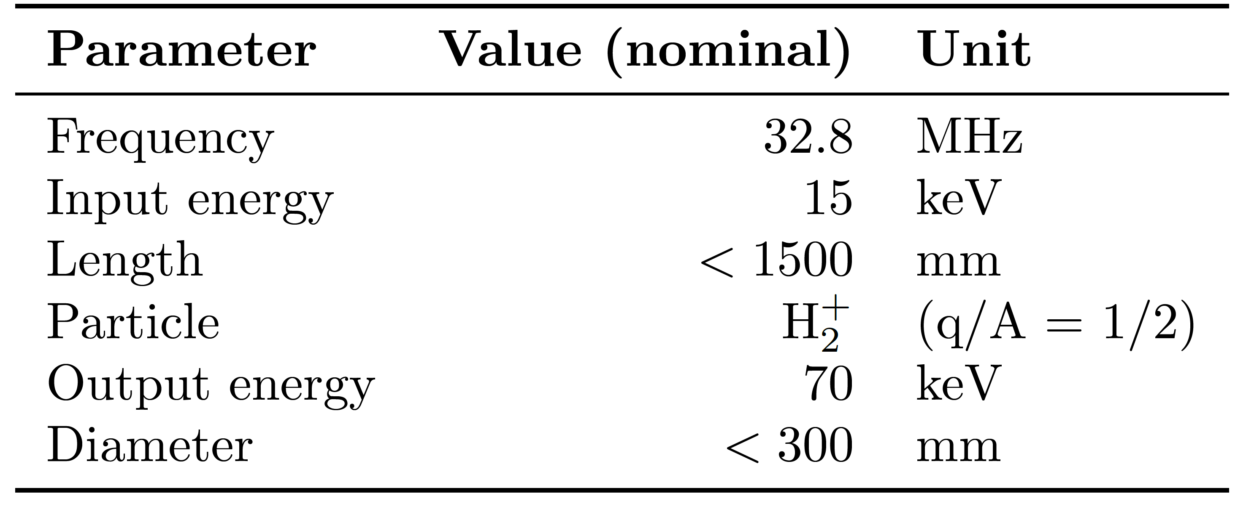
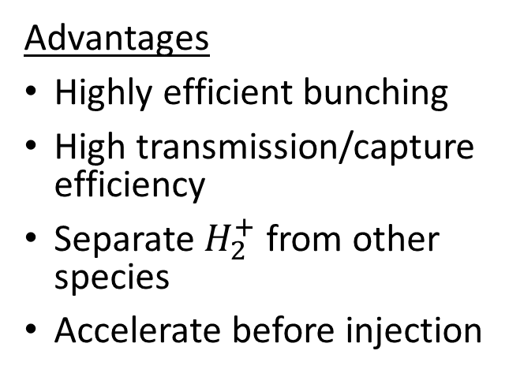
RFQ
Advantages
Highly efficient bunching
High transmission/capture efficiency
Separate $H_{2}^{+}$ from other species
Accelerate before injection
Design Requirements

Slide 22
RFQ
Advantages
Highly efficient bunching
High transmission/capture efficiency
Separate $H_{2}^{+}$ from other species
Accelerate before injection
Design Requirements
Our RFQ is primarily for bunching and not acceleration.

Slide 23
4-vane, split-coaxial design

Slide 24
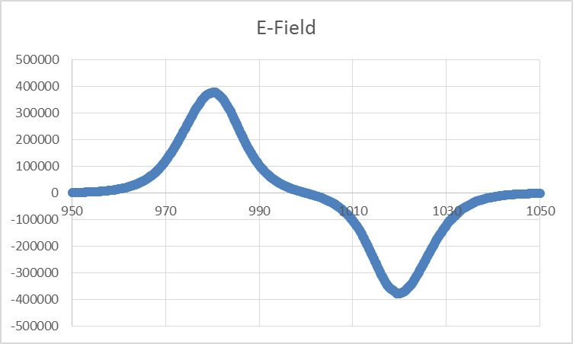
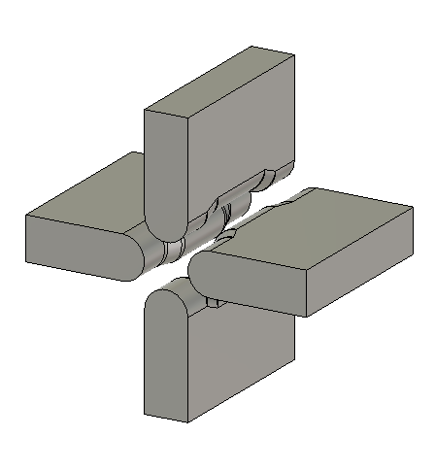
Rebunching cell
Longitudinal focusing at end of RFQ
Adjustable parameter in design

Slide 25
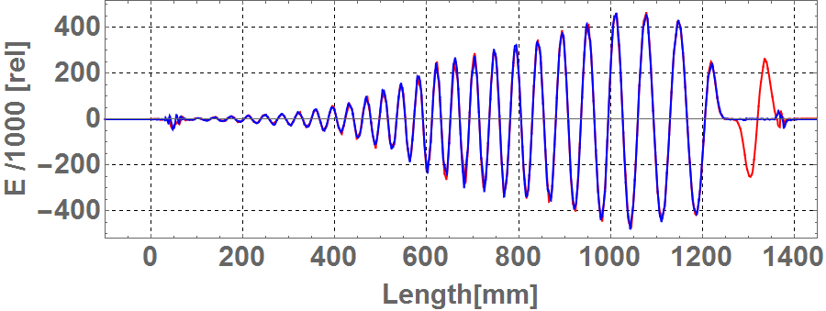
RFQ longitudinal E-field
▬ w/ rebuncher ▬ w/o re-buncher
Re-bunching cell

Slide 26
RFQ – Direct Injection Project (RFQ-DIP)
$H_{2}^{+}$ ion source
spiral inflector and central region
$$RFQ$$

Slide 27
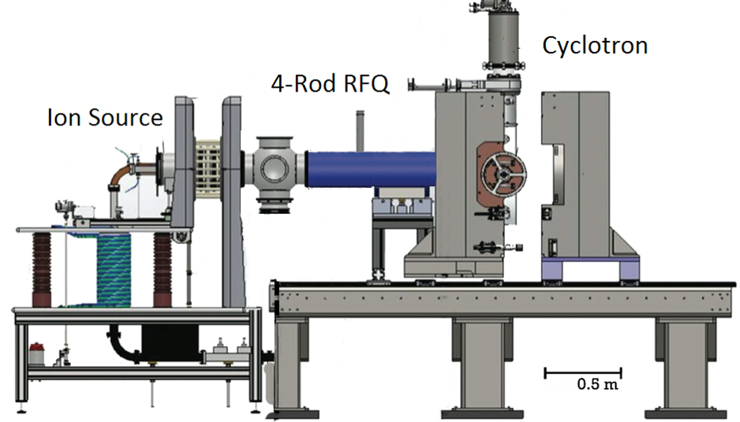
RQF-DIP
NSF funded
Demonstration of ion source, RFQ, spiral inflector system
1 MeV/amu cyclotron

Slide 28
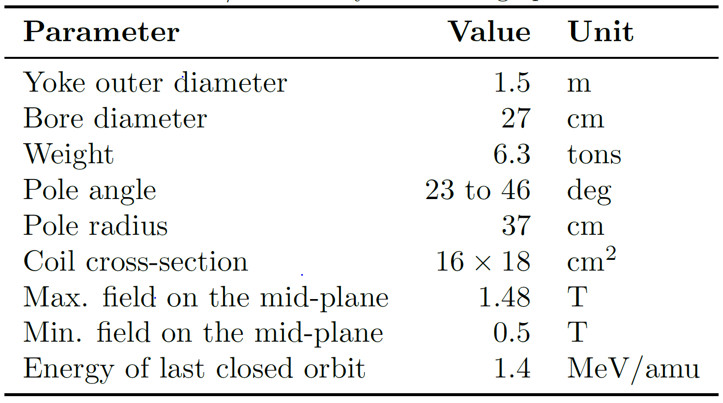
1 MeV/amu cyclotron

Slide 29
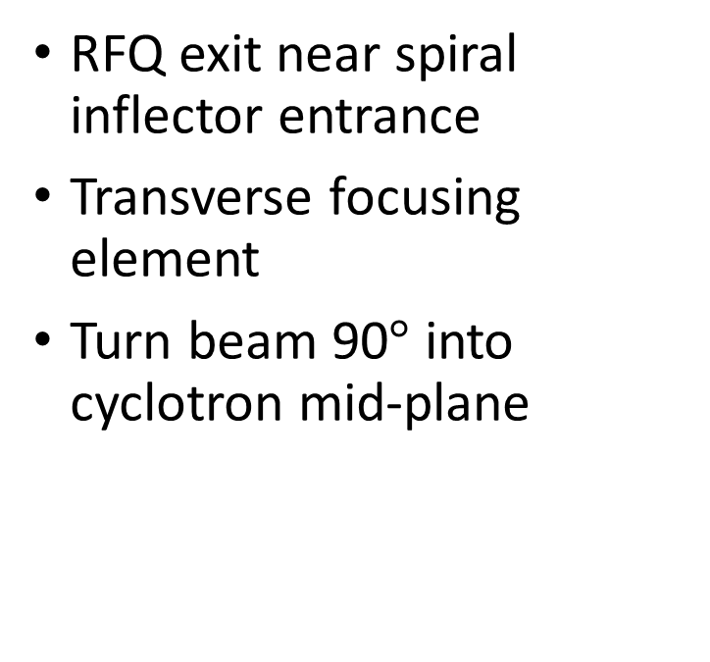
Spiral Inflector and central region
RFQ exit near spiral inflector entrance
Transverse focusing element
Turn beam 90$°$ into cyclotron mid-plane

Slide 30
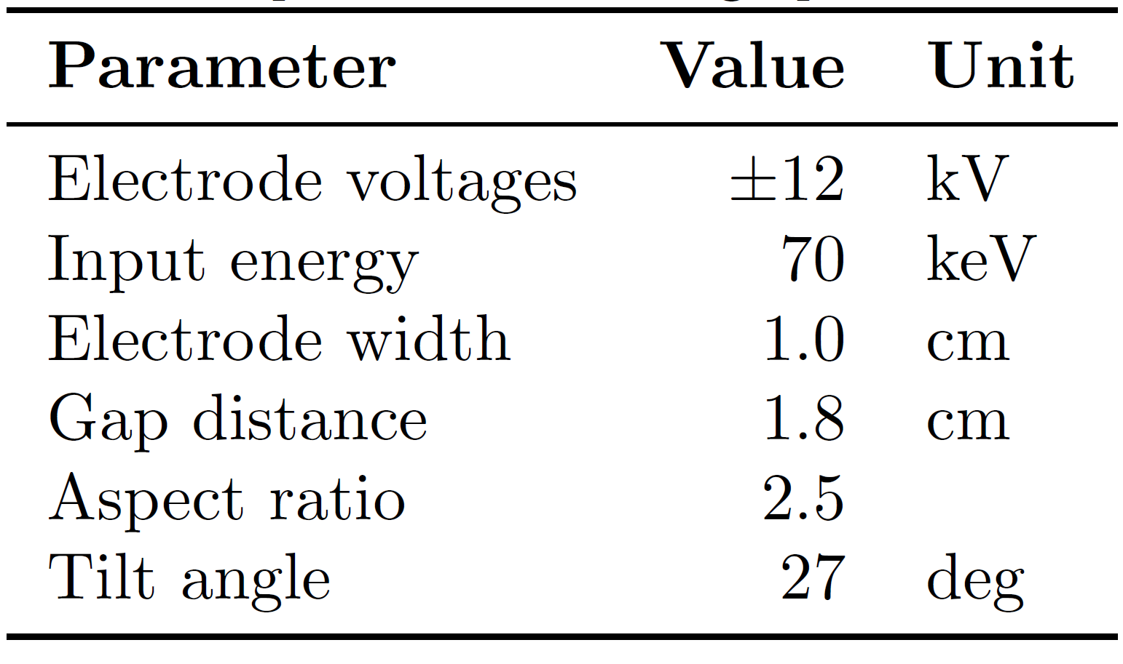
Spiral Inflector

Slide 31
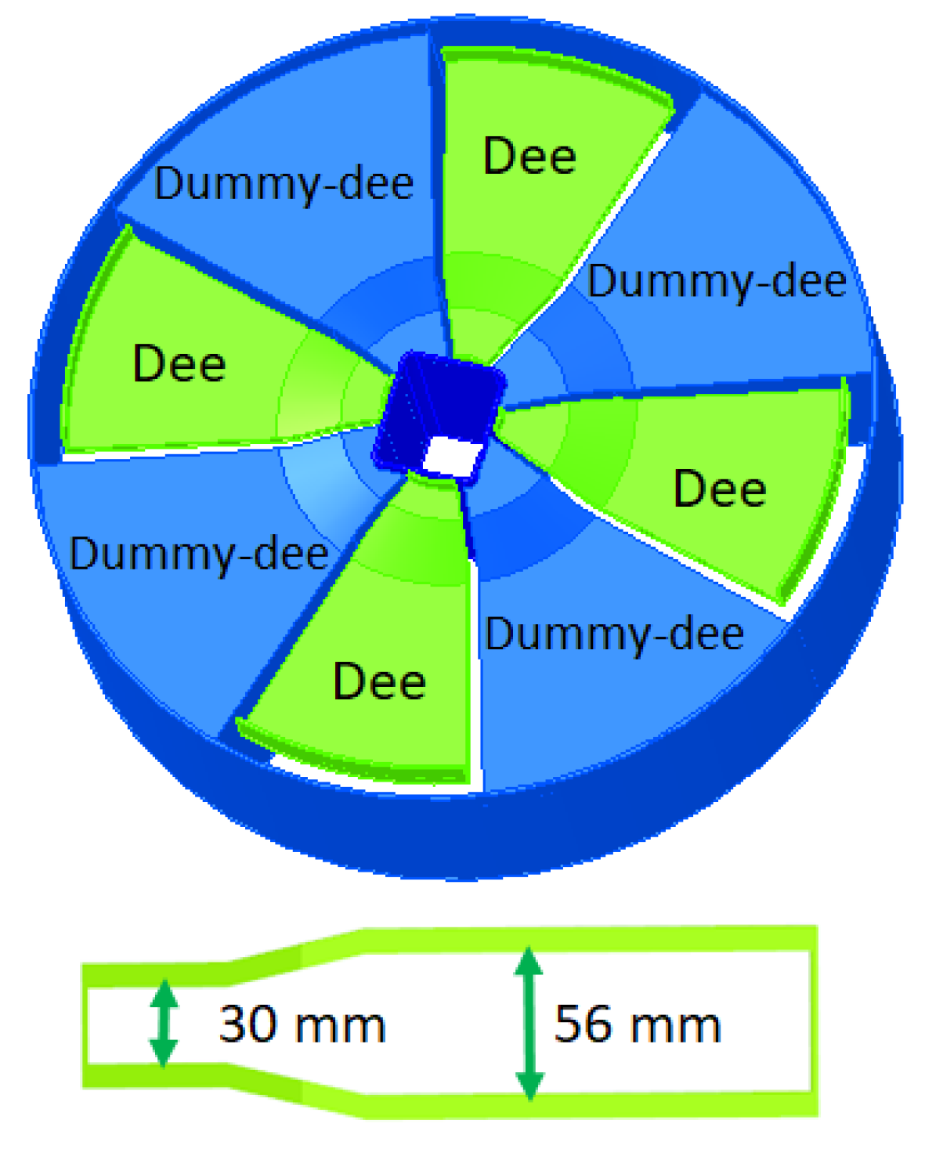
Central region
Collimators to scape halo particles
VP inserts for vertical focusing
INFN-Catania

Slide 32
Outline
IsoDAR experiments
Injection system
Cyclotron
Current research
Medical isotopes

Slide 33
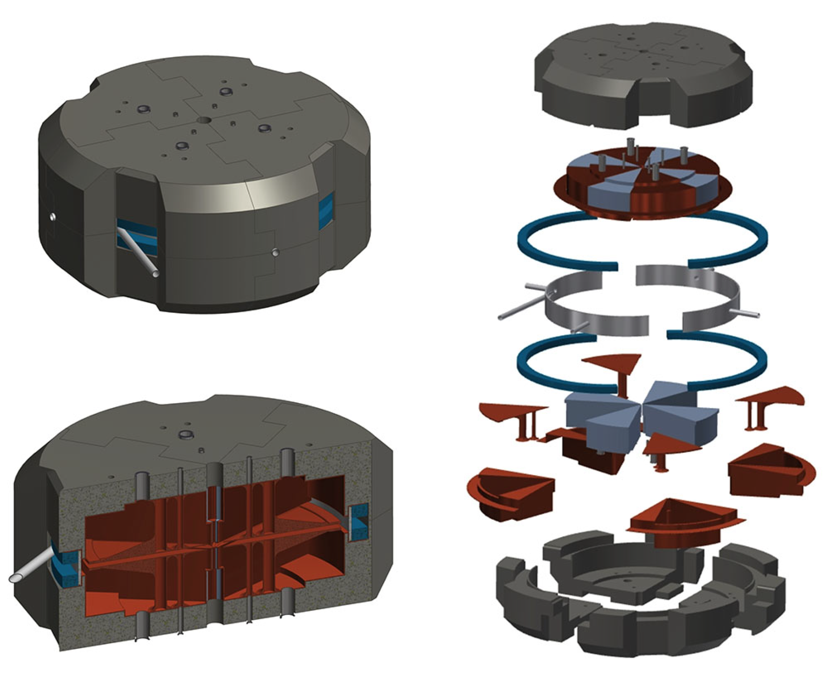
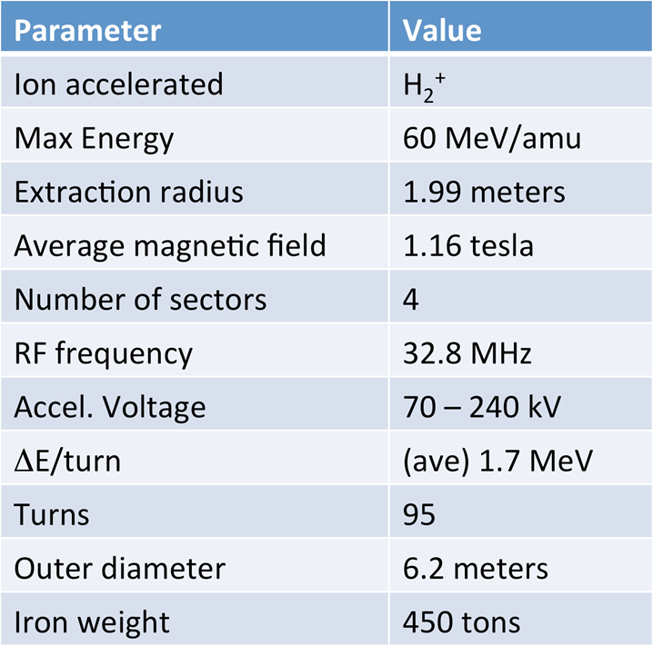
Cyclotron design
Technical CDR: https://arxiv.org/abs/1511.05130 Conventional CDR: https://arxiv.org/abs/1710.09325

Slide 34
Segmentation
Designed for assembly within Kamioka mine
Size limited by mining tunnels
Weight restrictions due to transportation

Slide 35
Split-coil design
Coils come in two pieces
No winding in mine
Notes:
Done at TRIUMF

Slide 36
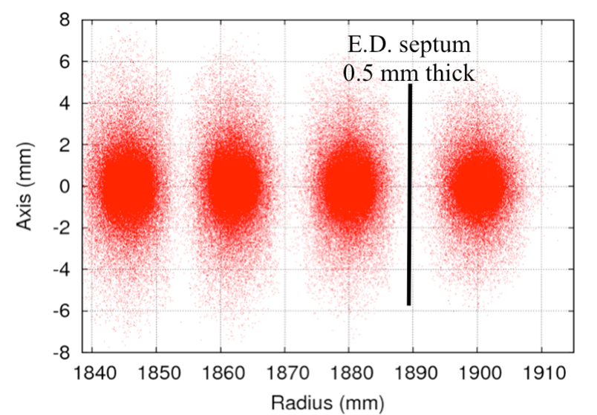
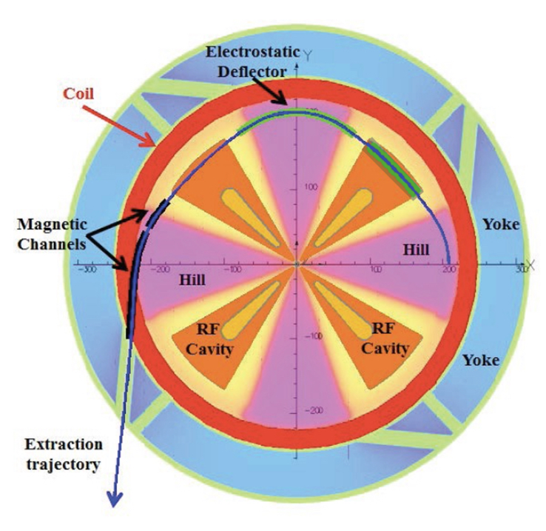
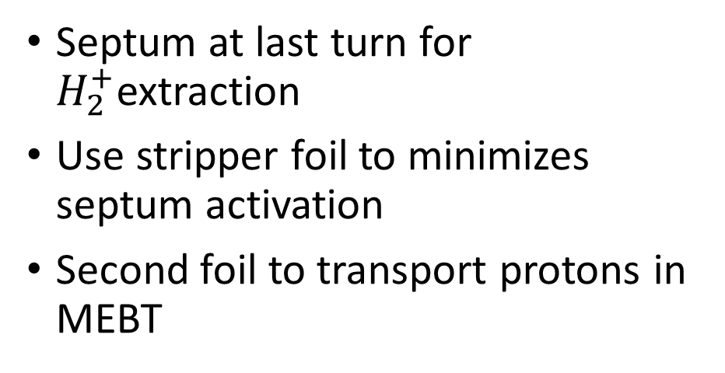
Ion extraction
Septum at last turn for $H_{2}^{+}$extraction
Use stripper foil to minimizes septum activation
Second foil to transport protons in MEBT

Slide 37
Outline
IsoDAR experiments
Injection system
Cyclotron
Current research
Medical isotopes

Slide 38
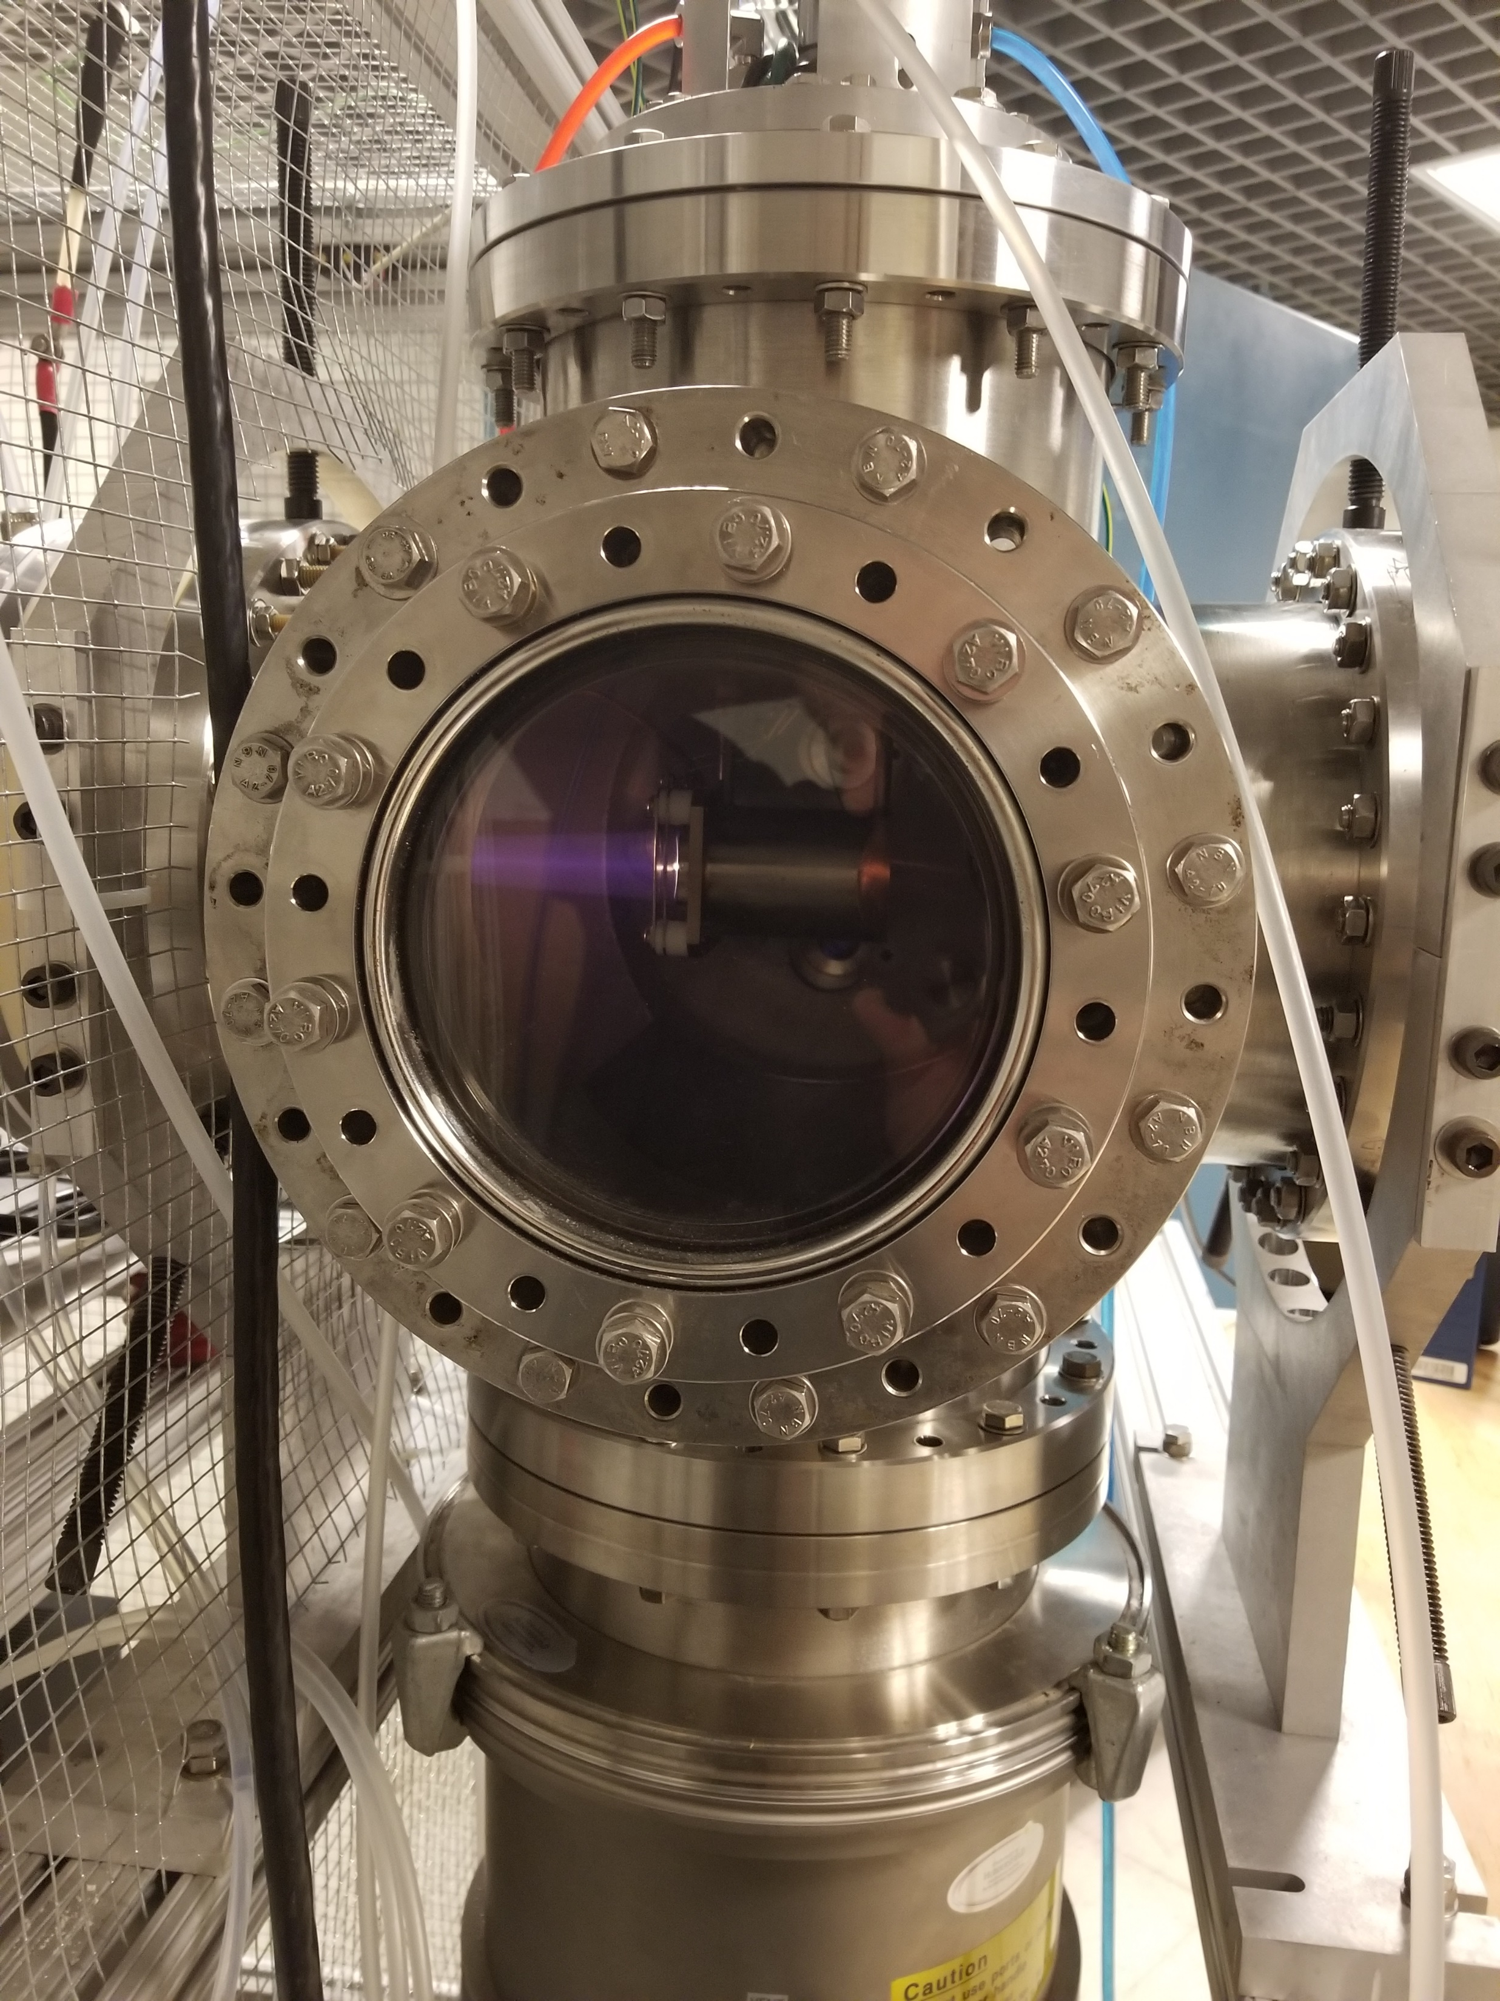
Ion Source tests at MIT
Preliminary source tests underway
Up to 27 mA/cm² using tungsten filament
Emittance scanners in place
LEBT coming soon for species separation by mass and charge

Slide 39

Emittance Test Scan
Beam:
Mass: 2.0000 amu / 3.3211e-27 kg
Charge: 1 e / 1.6022e-19
Energy: 2.0000e+03 eV / 1.0000e+03 eV/amu / 3.2044e-16 J
Velocity: 4.3928e+05 m/s
Relativistic factors: Beta = 0.00147, Gamma = 1.00000
Total current in scan: 2.8727e-01 uA
----------------------
Geometric Information:
Mean position: 4.5982 mm
Mean angle: -4.6014 mrad
RMS beam diameter: 4.0050 mm
2RMS beam diameter: 8.0099 mm
----------------------
Emittances:
RMS emittance: 24.51935 pi-mm-mrad
4RMS emittance: 98.07740 pi-mm-mrad
Normalized RMS emittance: 0.03593 pi-mm-mrad
Normalized 4RMS emittance: 0.14371 pi-mm-mrad
1RMS emittance includes 58.3 % of the beam
4RMS emittance includes 97.3 % of the beam
1RMS
----------------------
Twiss parameters:
Alpha = -2.4632e+00
Beta = 1.6354e-01 mm/mrad
Gamma = 4.3213e+01 mrad/mm

Slide 40

Extraction system results from IBSIMU
Simulation color code
10 mA: red, blue
20 mA: cyan, magenta

Slide 41
RFQ transport using TRACK
10 mA
20 mA

Slide 42


Rebunching cell effects
Without rebunching
With rebunching
Add second slide with boxes

Slide 43
Rebunching cell effects
Without rebunching
With rebunching

Slide 44

RFQ output

Slide 45
Spiral inflector simulation
Spiral inflector: https://arxiv.org/abs/1612.09018
Code paper: https://arxiv.org/abs/1710.00441
Kinetic energy [keV]

Slide 46

Central region
AIMA Developpement simulations using Gaussian input
Design using simulation results in progress

Slide 47

Outline
IsoDAR experiments
Injection system
Cyclotron
Current research
Medical isotopes

Slide 48


60 MeV protons
~50 $μ$A of protons extracted to protect septum
Up to 4 stripping locations possible
Protons can be used to produce medical isotopes
Or also build machine dedicated to isotope production

Slide 49
Imaging: ⁶⁸Ge/ ⁶⁸Ga
⁶⁹Ga/⁷¹Ga + p → ⁶⁸Ge → ⁶⁸Ga
Similar uses as ⁹⁹Mo → ^{99m}Tc
Longer parent half-life:
  270 days vs. 66 hours
Shorter emitter half-life:
  68 minutes vs. 6 hours
Image from: Semantic Scholar

Slide 50


Therapy: ²²⁵Ac
p + ²²⁹Th → ²²⁵Ac → 4$α$+²⁰⁹Bi
Current targets ²²⁶Ra from purified reactor waste
IsoDAR could exceed current production global rates
Medical isotopes with IsoDAR: https://arxiv.org/abs/1807.06627
Image from: Semantic Scholar

Slide 51

Summary
IsoDAR is a definitive $ν_{s}$ search and study of ${\overline{ν}}_{e}−e$ scattering
IsoDAR can serve as an injector cyclotron for DAE$δ$ALUS
Requires 10 mA of 60 MeV protons on target
RFQ-DIP uses $H_{2}^{+}$and RFQ axial injection system
Applications extend beyond particle physics

Slide 52

IsoDAR References
Technical CDR: https://arxiv.org/abs/1511.05130
Conventional CDR: https://arxiv.org/abs/1710.09325
High intensity cyclotrons: https://arxiv.org/abs/1807.03759
Spiral inflector: https://arxiv.org/abs/1612.09018
https://arxiv.org/abs/1710.00441
Sleeve optimization: https://arxiv.org/abs/1805.00410
Medical isotopes: https://arxiv.org/abs/1807.06627
DAE$δ$ALUS/IsoDAR website: https://www.nevis.columbia.edu/daedalus/

Slide 53

?

Slide 54


Slide 55


Slide 56

Ion source over-focused

Slide 57




Beam dynamics with re-buncher
w/o re-buncher
w/ re-buncher
± 20 deg
44.57 %
w/o re-buncher
w/ re-buncher
±2 %
55.17 %

Slide 58
⁹Be target

Slide 59
Target, sleeve, shielding

Slide 60
Production in target and sleeve

Slide 61


$\overline{ν}$ production

