Slide 1
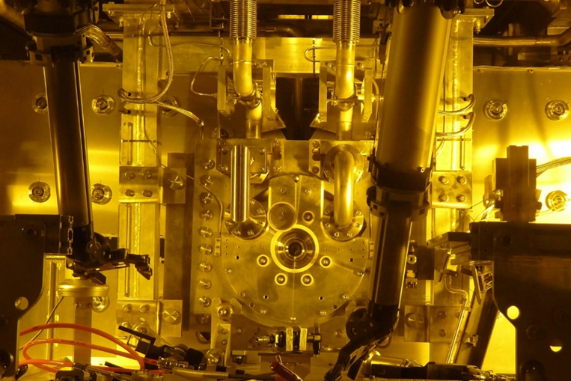


T2K Target and Beam Window Upgrades for 1.3 MW Operation
Chris Densham
(STFC Rutherford Appleton Laboratory)
On behalf of T2K Collaboration

Slide 2
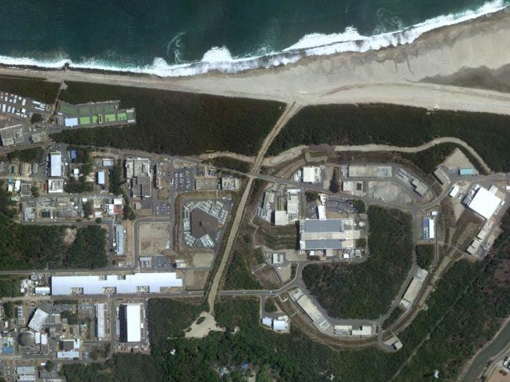
T2K neutrino facility
J-PARC, Tokai, Japan
30 GeV PS
3 GeV PS
T2K Target Station
J-SNS
400 MeV LINAC
Beam dump
Near detector
295 km to Super-Kamiokande

Slide 3
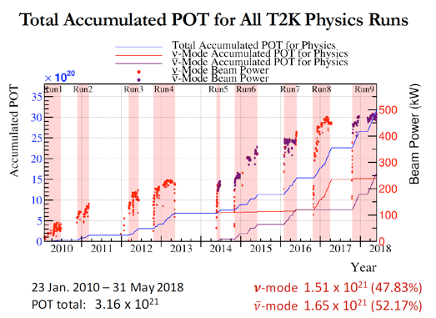
T2K Operational performance

Slide 4
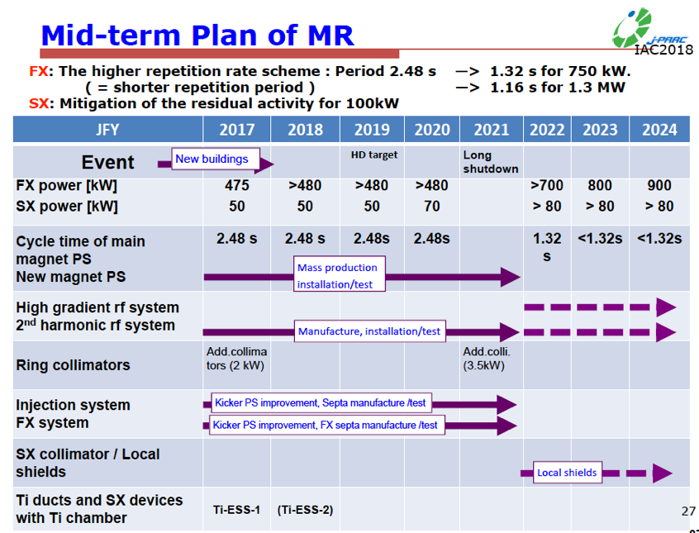
Upgrade

Slide 5
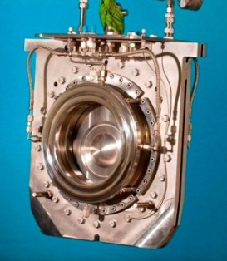
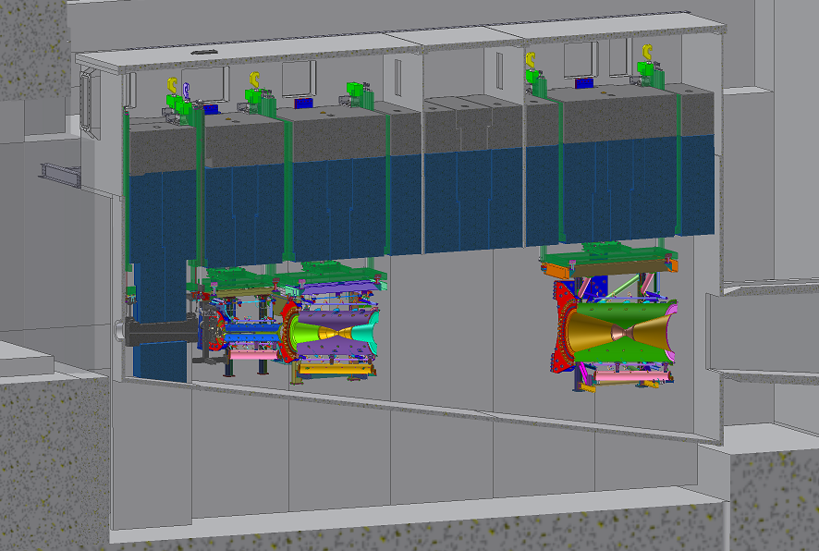
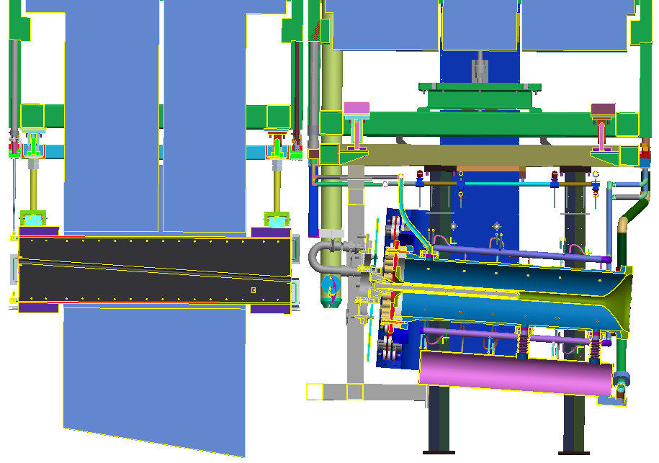
Secondary Beam-line & Target Station
Target station
Helium Vessel
Concrete Blocks
Beam window
Iron shield (2.2m)
Baffle
Target
BEAM
2nd horn
3rd horn
1st horn

Slide 6
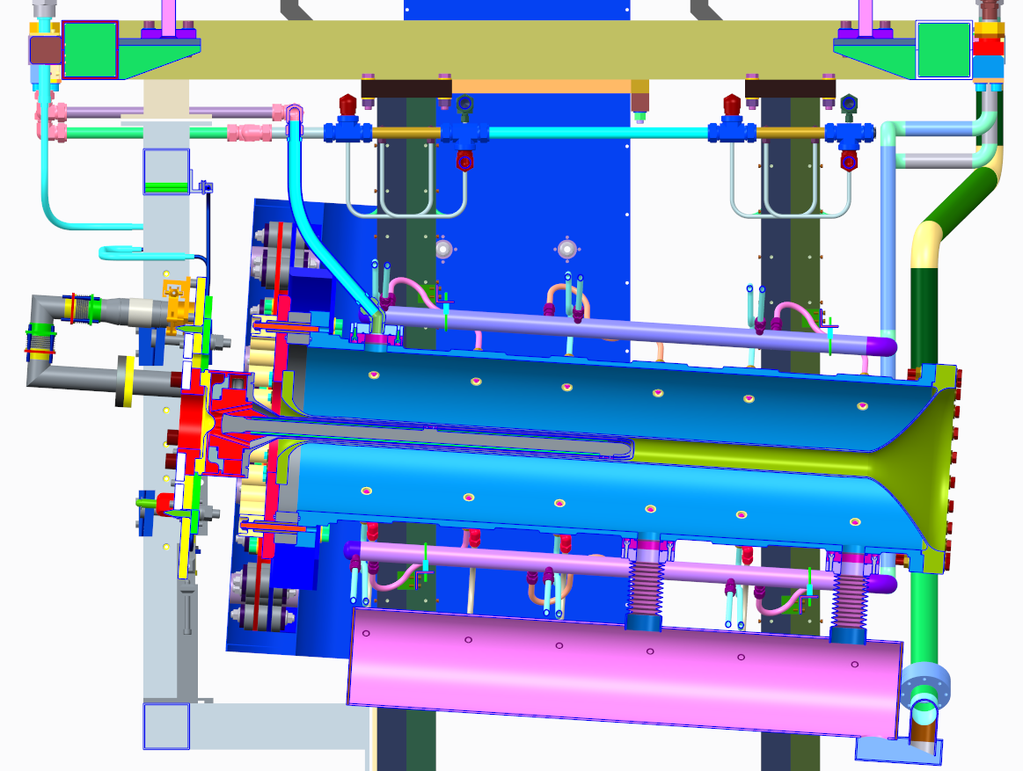
Target & Horn Assembly (latest version)

Slide 7
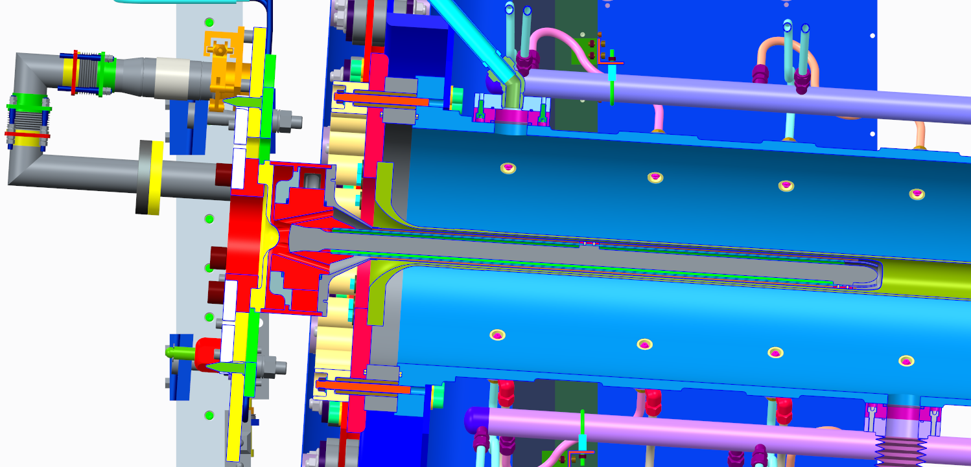
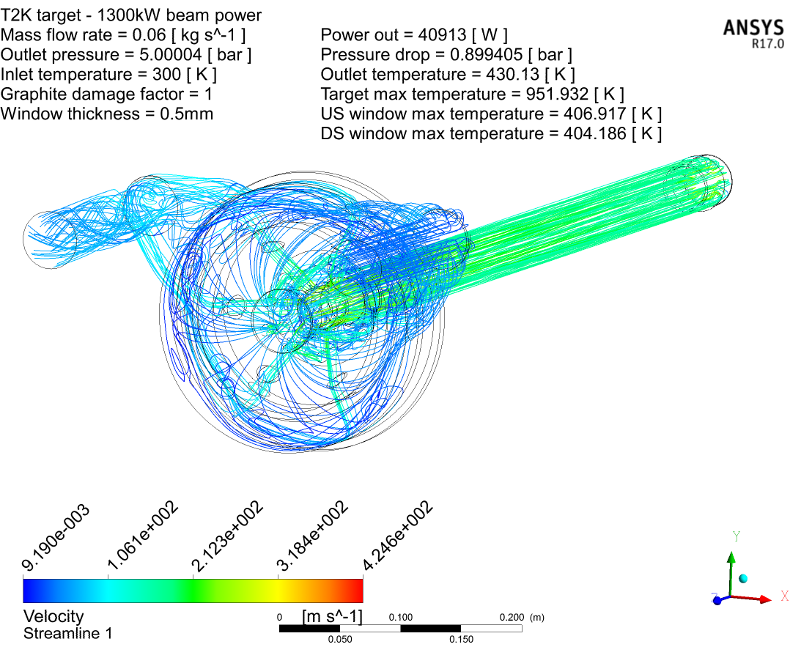
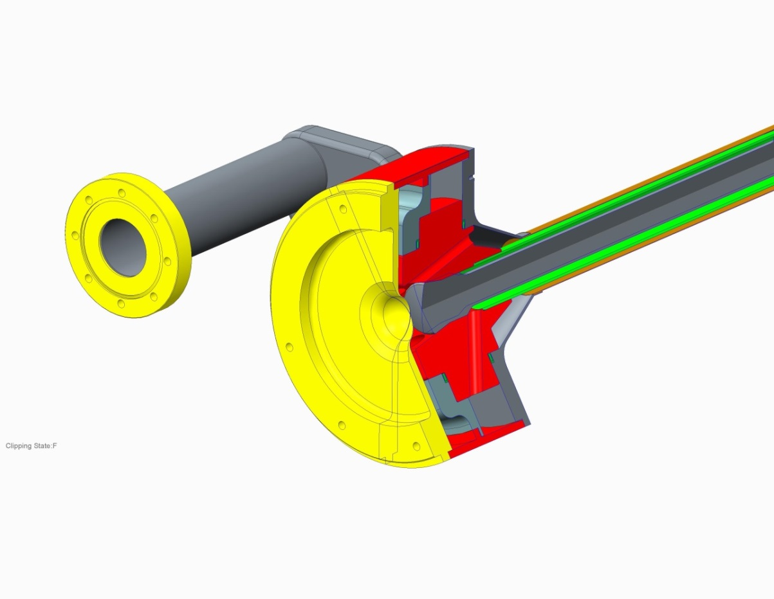
Target & horn
Next target under construction
Next target under construction at RAL
Helium cooling flow lines
p
425 m/s

Slide 8
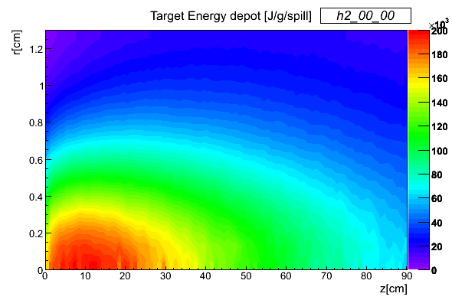
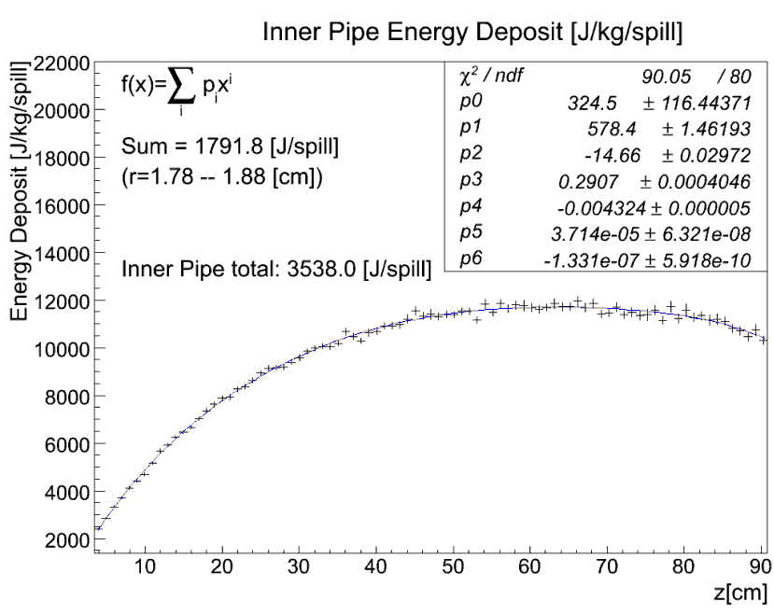
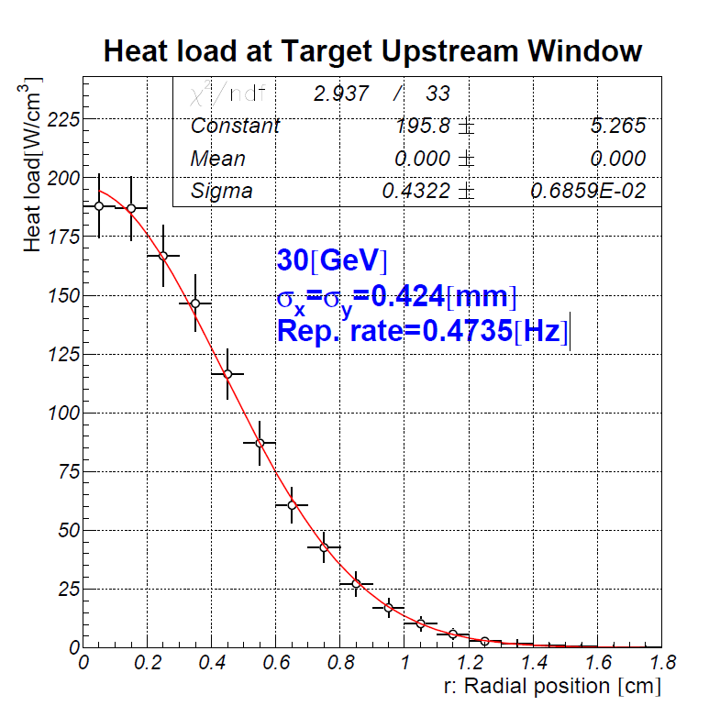
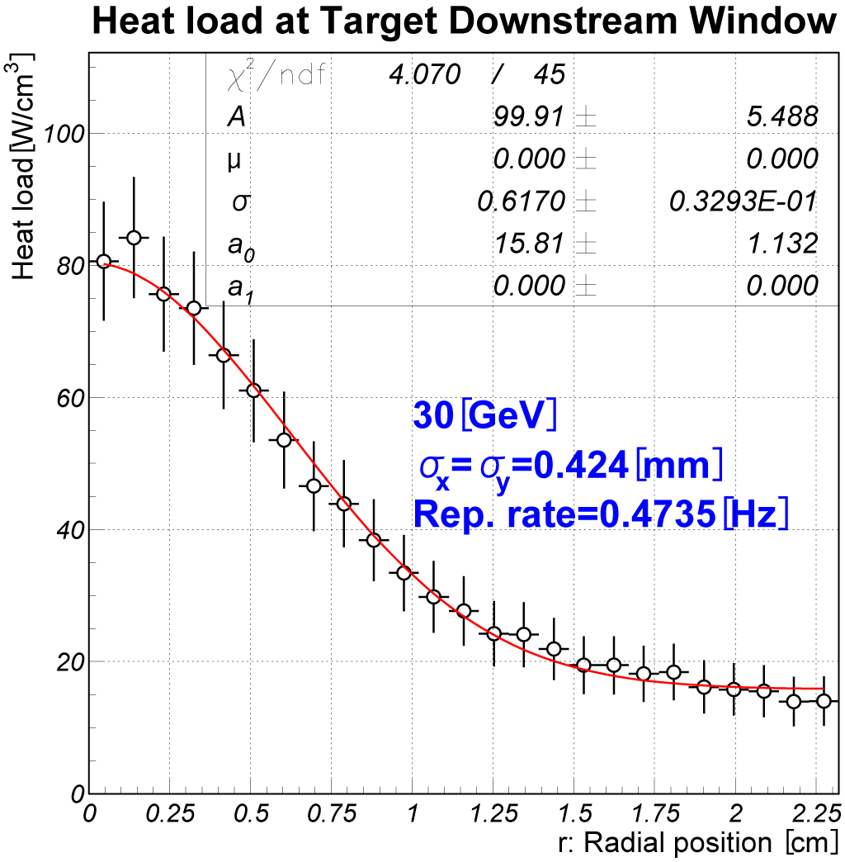
CFX model heat inputs (MARS)

Slide 9
Target upgrade requirements
The increase in design beam power from 0.75→1.3MW will increase the integrated heat load on the target (approx. 23kW → 41kW).
Need to increase helium mass flow rate to keep outlet temperatures within range
Necessary to increase operating pressure to keep velocities and pressure drops within range.
  Increasing the pressure will increase the helium density and therefore heat transfer coefficient.
  Higher operating pressure has the advantage of reduced pressure drop.
  Running at higher pressure reduces the pressure drop and max velocity
  Compressor will be cheaper to purchase and operate (less power consumed).

Slide 10
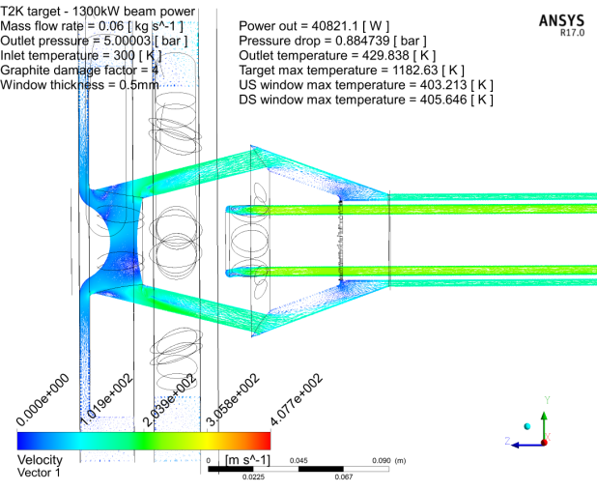
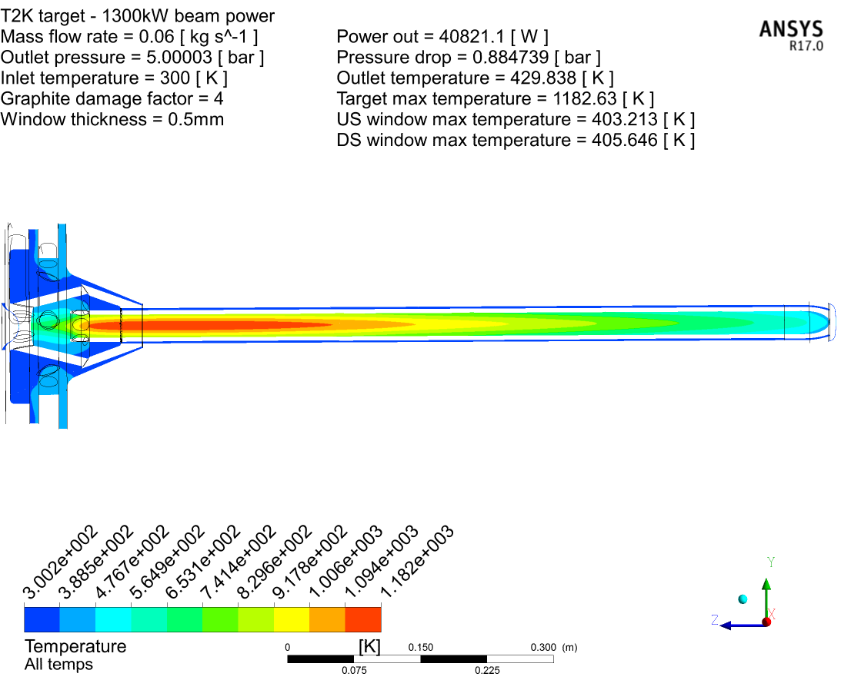
Simulations of target @ 1.3MW
Increased beam power, flow rate & pressure
60g/s @ 5.9bar (5barG outlet) – 1.3MW beam power
Helium flow lines
Damaged graphite
Thermal conductivity 1/4

Slide 11
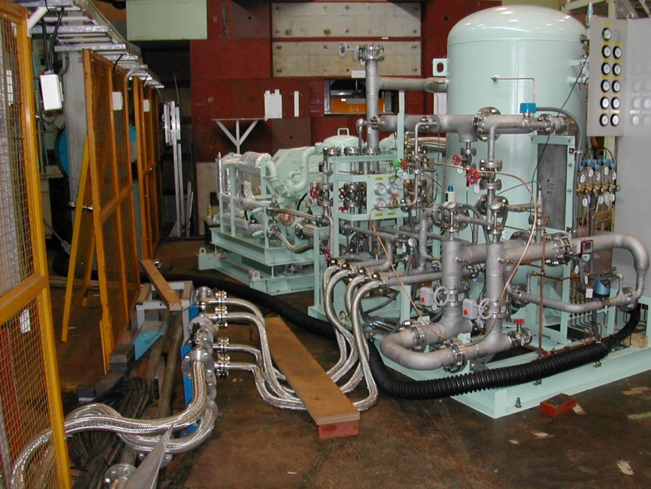
Summary of cooling simulations
Flow rate [g/s] | Outlet Pressure [bar] | Beam power [kW] | Pressure drop [bar] | Max velocity [m/s] | Target core temp (damaged) [K] | Target core temp (new) [K]
32 | 0.9 | 750 | 0.73 | 560 | 1025 | 894.1
60 | 0.9 | 1300 | 1.93 | 870 |  | 960.3
60 | 2 | 1300 | 1.39 | 639 |  | 952.3
60 | 3 | 1300 | 1.09 | 501 |  | 951.1
60 | 5 | 1300 | 0.88 | 425 | 1182.6 | 951.9
NOTE: speed of sound in He ~1000m/s
Existing plant can deliver cooling power for 900 kW operation.
For 1.3MW beam @ 5bar and 60g/s, the velocity and pressure drop are comparable to 750 kW design.
Need to upgrade plant to operate at higher pressure.
Some target modifications needed to operate at higher pressure (e.g. window geometry, weld design, target pipes – bellows & isolators)
Target will run slightly hotter. Need high helium purity to avoid oxidation. (New target will withstand vacuum load to enable helium back fill)

Slide 12
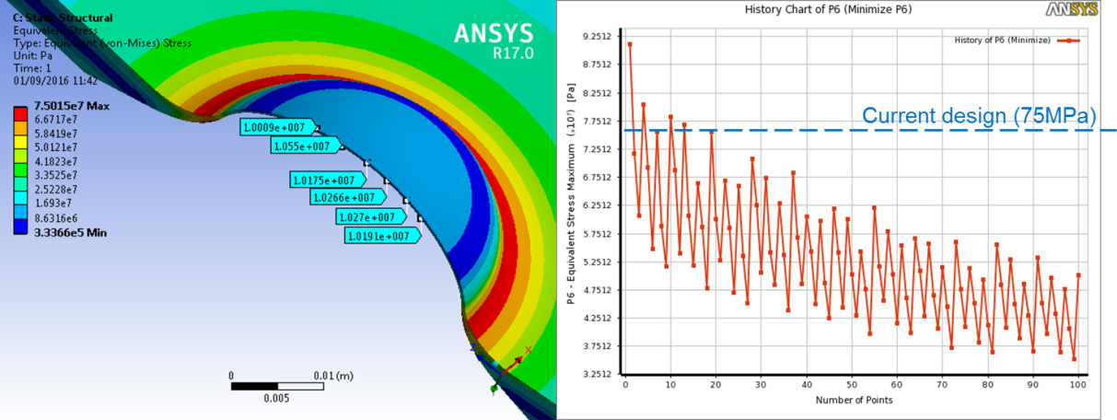
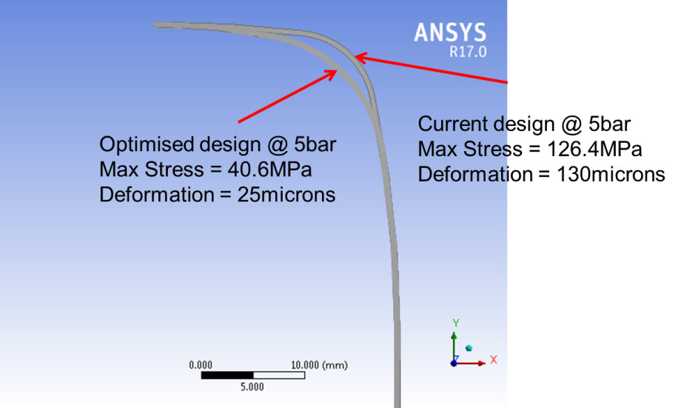
Target window re-optimisation for 5 bar operation
Von-Mises stresses in existing target window at 5 bar
Parameterised re-optimisation of upstream window
Optimised: 75 MPa -> 34 MPa
Plate thickness: 7 mm -> 10 mm
External radius = 7 mm
Internal radius = 25 mm
Downstream window

Slide 13
Effect of pulsed beam on T2K target
Stress waves in graphite: on-centre beam spill
Stress distribution after off-centre beam spill
p
-8 MPa
5 µs beam spill
IG43 Compressive strength = 90 MPa
Tensile strength = 37 MPa
Inertial ‘violin modes’ from worst-case off-centre beam spill
2-sigma beam offset
  0.5 mm amplitude
  6.8 MPa stress
Tolerant to worst case off-centre beam

Slide 14
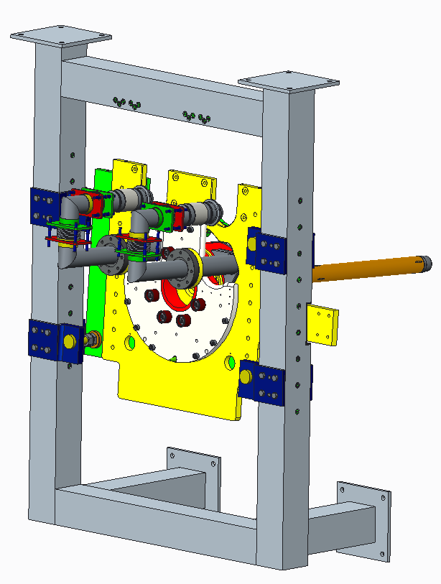
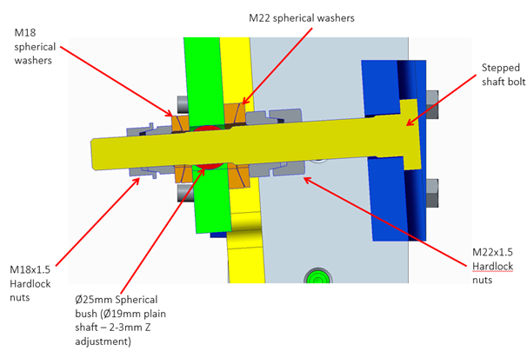
Target supports and horn integration
Increasing horn current from 250 kA to 320 kA will increase vibrations
Target supports redesigned to prevent any movement
E.g. new ‘kinematic’ design feature
Angular adjustment is enabled whilst constraining position using spherical bushes

Slide 15
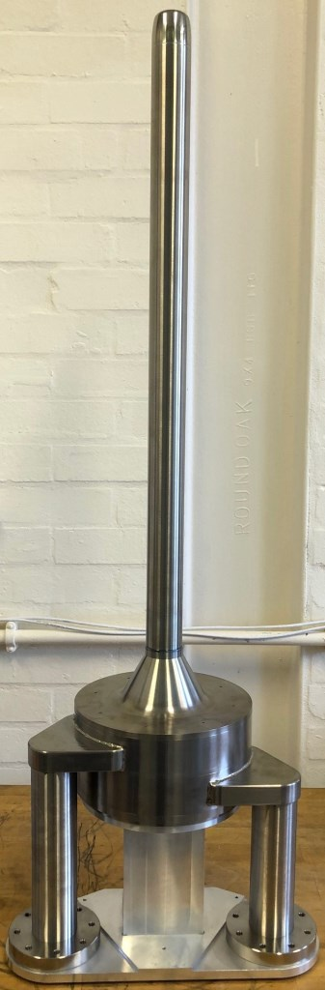
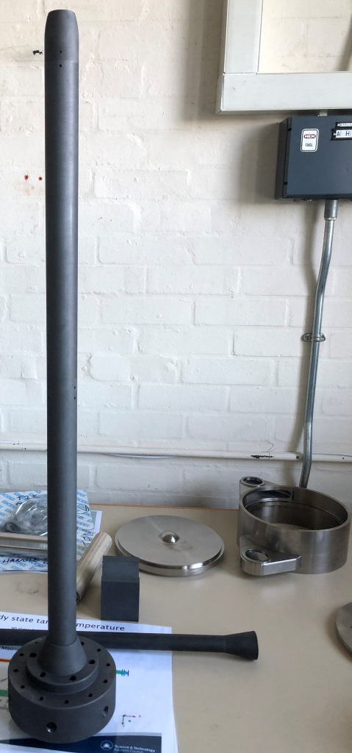
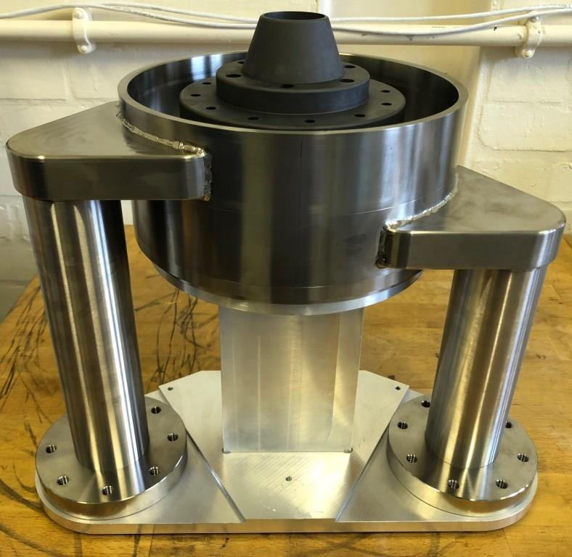
Next target manufacture at RAL

Slide 16
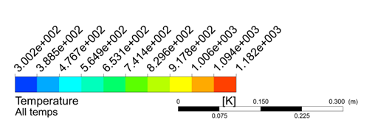
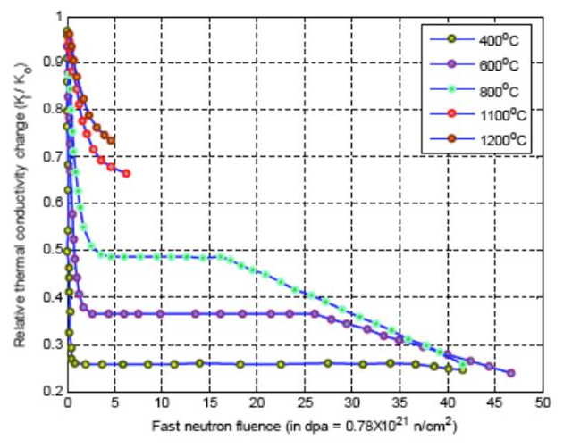
Graphite thermal conductivity degradation
Max core temperature ~900°C at 1.3 MW
(degraded graphite assumed)
Even a low radiation dose drastically reduces thermal conductivity
High temperatures reduce effect
Helium cooling lets target run hot
Also reduces swelling & changes to mechanical properties
As beam power increases, target failures are to be expected
800°C
600°C
400°C

Slide 17
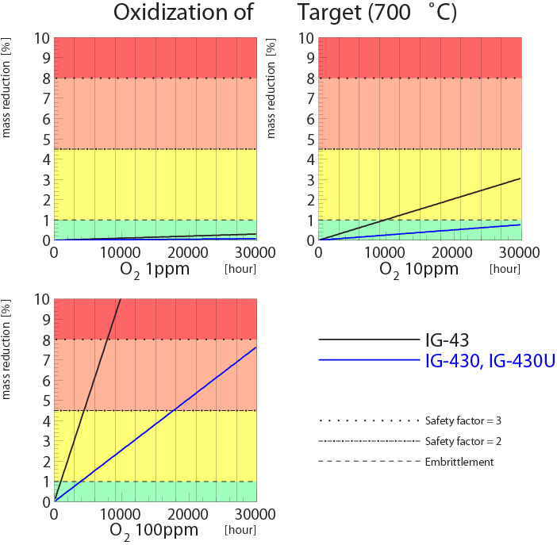
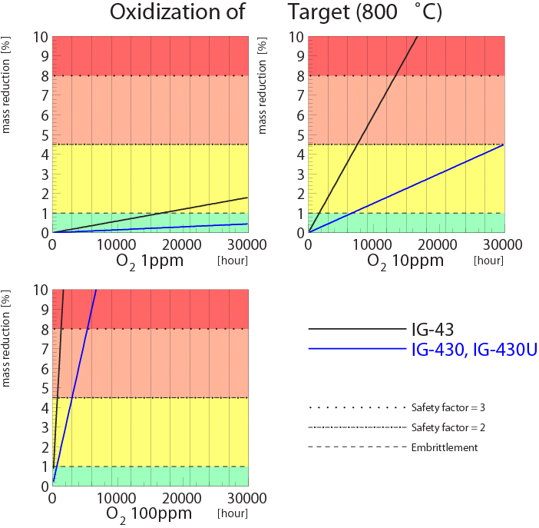
Target lifetime due to Oxidization
IG-43 (non-purified)
800°C
IG-430(U)
(purified)
700°C
Safety factor =2
2year
2year
Target center ~900°C, but surface ~600°C.
O2 contamination is kept as low as possible and will be improved by evacuating next target before back-filling with He

Slide 18
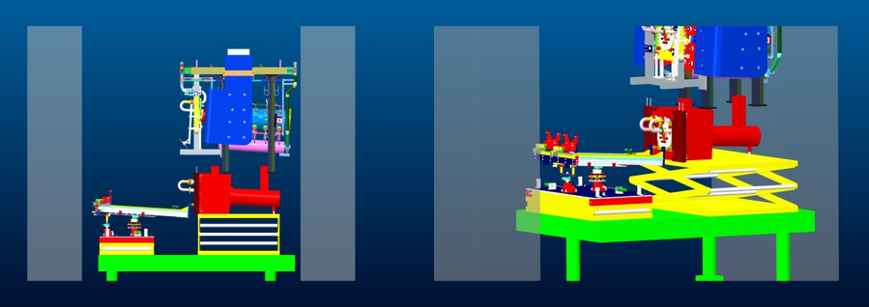
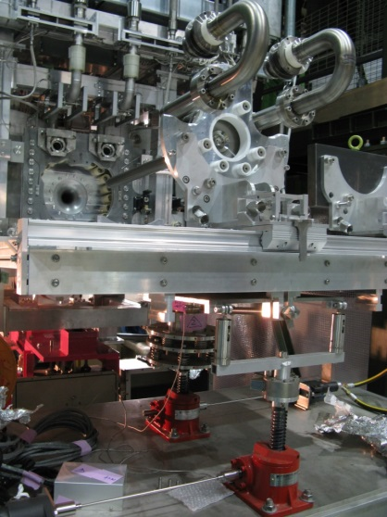
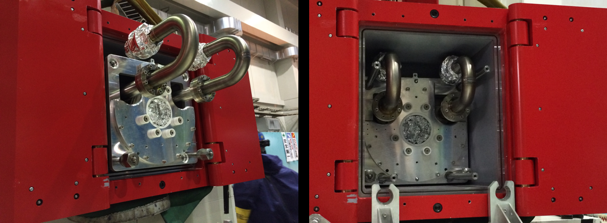
T2K Target & horn in work cell

Slide 19
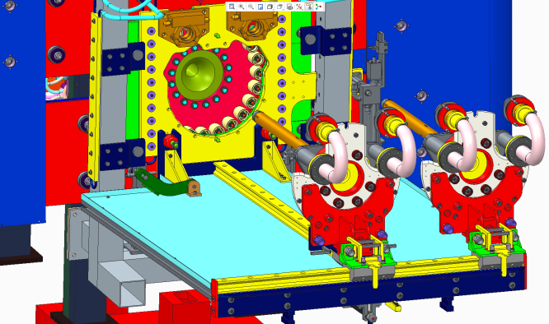
T2K Target remote exchange system

Slide 20
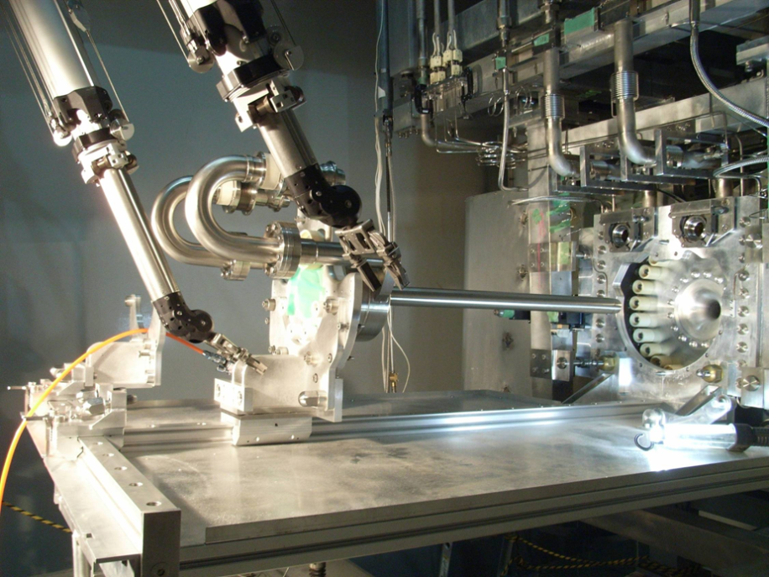
Remote Target Exchange System
Target exchanger and manipulator system. See pipe replacement at:
https://www.youtube.com/watch?v=VWGXz5QHFH4
Notes:
Target exchange procedure
Target exchanger platform on gimbal/spring system, positioned by dual jacks, X and Z rails allow carriage cross over for target removal installation.
View of operators through RMA lead glass window.

Slide 21
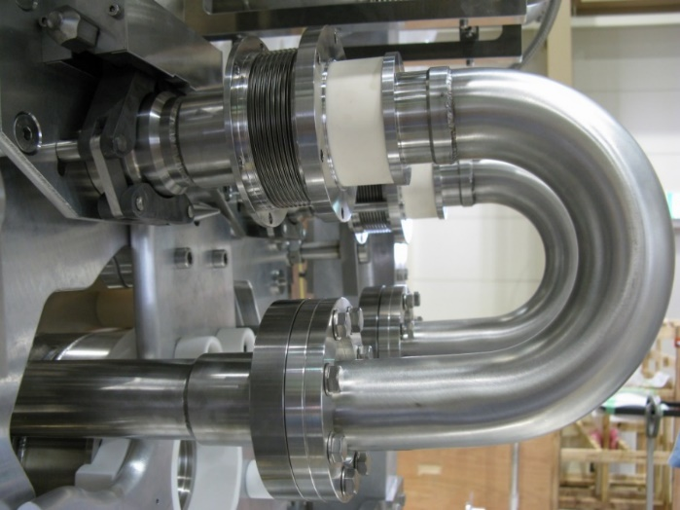
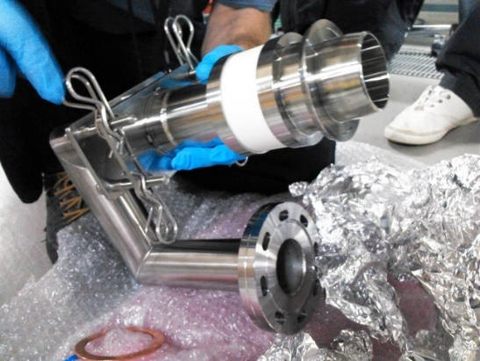
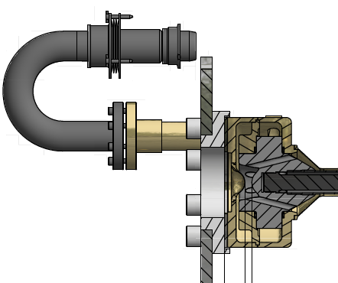

Leak at Helium Outlet Pipe & Remote Handling
Failure of joint/ceramic from movement of stainless pipes (stress relieving) at 450 kW operation
Thermal fatigue failure of the diffusion bonded joint/ceramic
Remote Exchange in 2015
No leak since then
Diffusion bond
(Aluminum)
316L Stainless
Bellows
304L
Stainless
Bent in cold process
Alumina ceramic

Slide 22
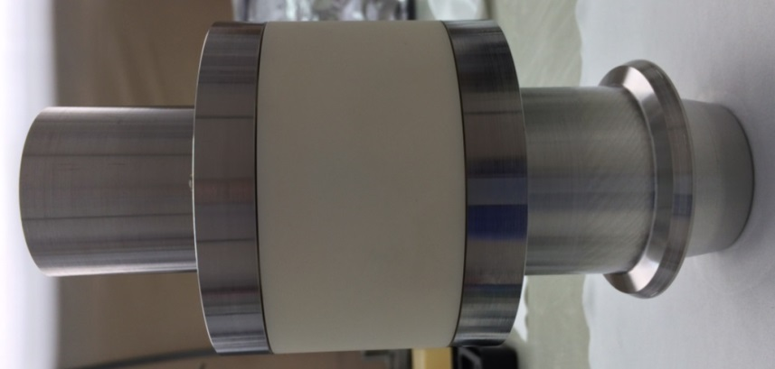
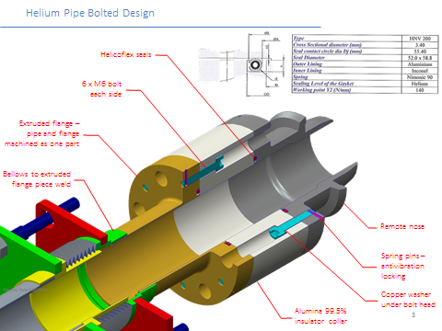
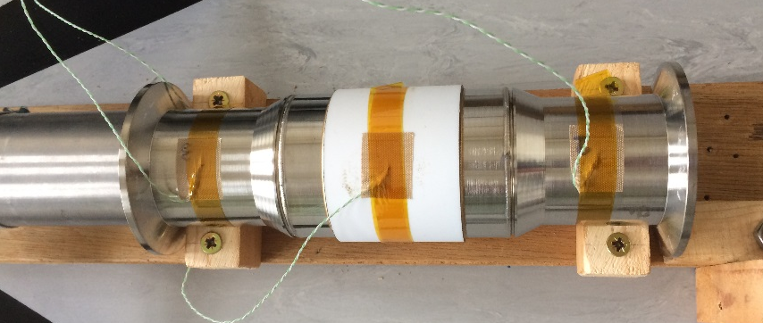
Helium cooling pipe isolator R&D
Existing ‘diffusion’ bonded joint made using aluminium wire
Works well at 485 kW but can it operate at 1.3 MW / multiple 160°C transients? Need to test!
Bolted isolator design with metal helicoflex seals
- Failed after c.10 thermal cycles
We will know in a few months the best solution to use in next target – and whether it can survive multiple beam trips at 1.3 MW
Alternative solution: isolated heat exchanger – reduces temperatures
Brazed ceramic with thermocouples attached undergoing a rapid cooling test
- Survived 10 thermal cycling tests – needs long term testing

Slide 23
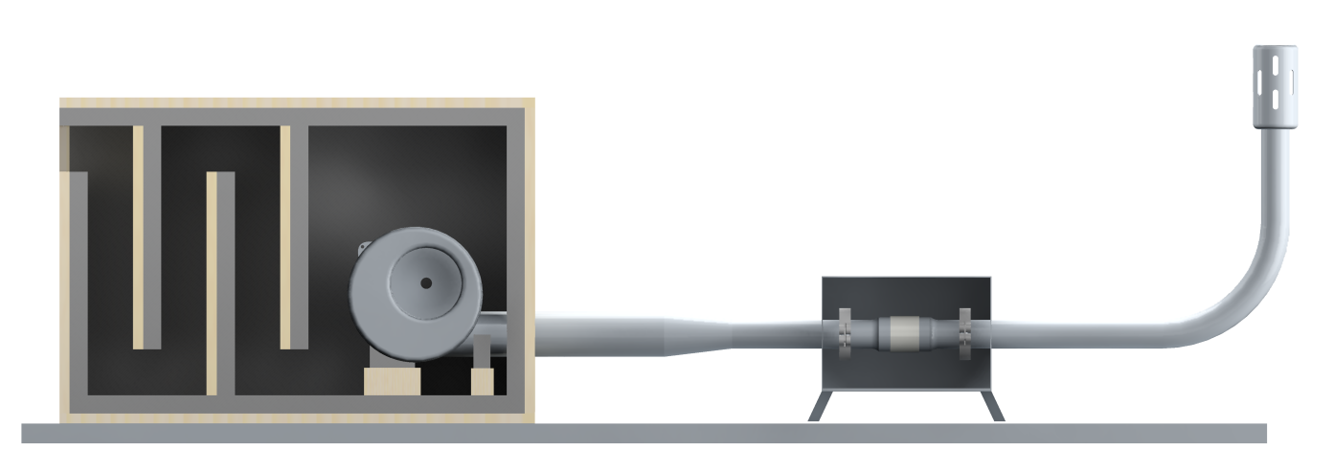
Ceramic Isolator Thermal Fatigue Test Rig
www.stfc.ac.uk
Thermal transients from beam trips at 475 kW operation
- Beam trips cause rapid cooling and repeated thermal cycling of ceramic isolators in helium cooling system
- Expected c.5000 beam trips / year
Beam Power [kW]
He in TS Vessel [℃]
He at Target inlet [℃]
He at Target outlet [℃]
Noise isolation box (rig suitable for 24h running)
Exhaust silencer/exhaust to external outlet
Test ceramic isolator (welded into removable KF flange section for leak testing)
Noise reducing inlet baffles
Forced convection cooling blower
Test section tape heated (low thermal mass), enclosed in stainless box

Slide 24
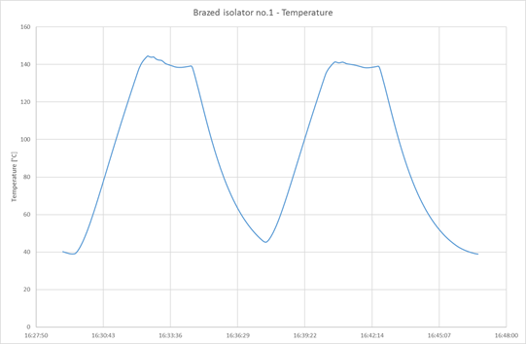
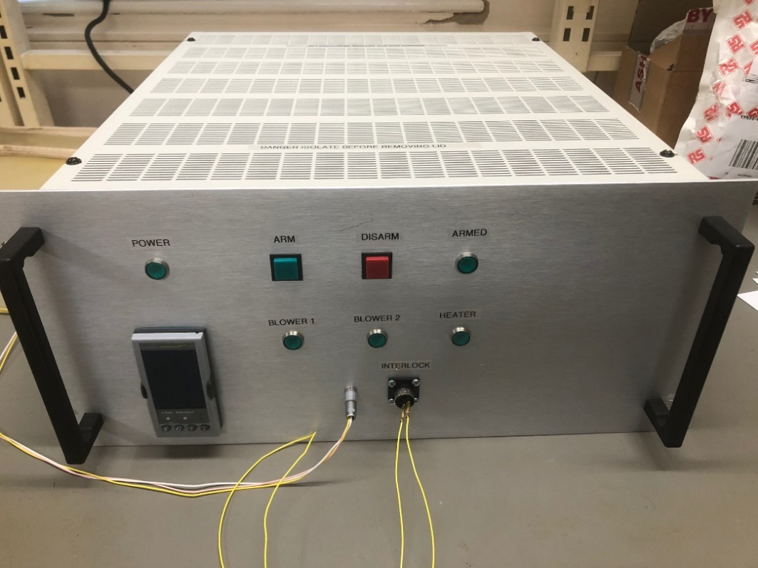
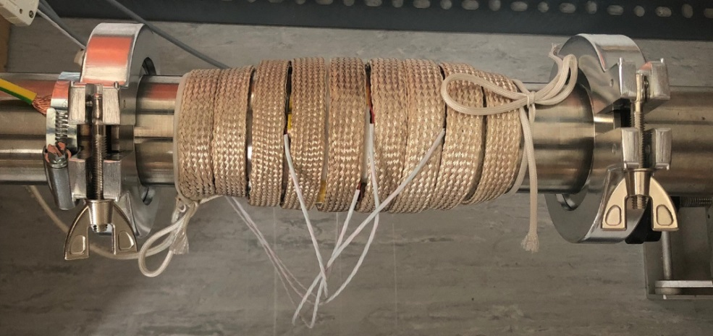
Ceramic Isolator Thermal Fatigue Test Rig
Thermal cycling testing now underway
Eurotherm 3508 controller
Tape heater
Interlock system
PT100
KF50 for quick disconnect/leak testing

Slide 25
Target Summary
Existing target cooling plant suitable for up to 900 kW beam power
Operation at 1.3 MW appears feasible with incremental design changes to target
  windows, weld joints
Thermal cycling test program underway for ceramic isolators
Need new helium plant to operate at higher pressure
Target lifetime at 1.3 MW is not known

Slide 26
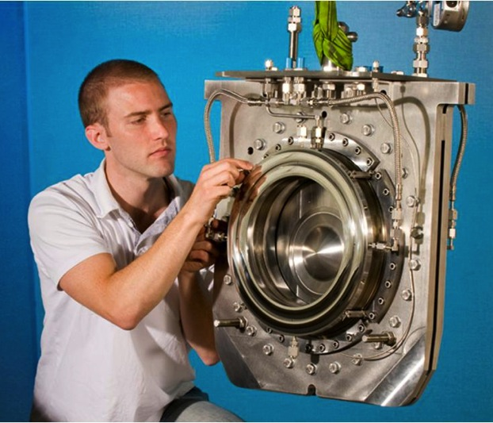
Ti-6Al-4V Beam Window
Periodic thermal stress wave caused by the intense proton beam energy deposition
1.3 MW operation will cause radiation damage of ~2 DPA/ops-year
Significant irradiation hardening and loss of ductility has been reported with 0.3DPA (no higher DPA data exists)
No known data exists on high cycle fatigue (>10³ cycles) of irradiated titanium alloys
Beam Power | PPP | Rep. cycle | POT / 100 days
470kW (achieved) | 2.4 x 10¹⁴ | 2.48 sec | （0.8 x 10²¹）
750kW (proposed) | 2.0 x 10¹⁴ | 1.3 sec | 1.3 x 10²¹
750kW [original plan] | 3.3 x 10¹⁴ | 2.1 sec | 1.3 x 10²¹
1.3 MW (proposed) | 3.2 x 10¹⁴ | 1.16 sec | 2.4 x 10²¹
Ti-6Al-4V
(0.3mm-t)
2mm gap
designed
~8M pulses/yr
～1DPA/yr (MARS)

Slide 27
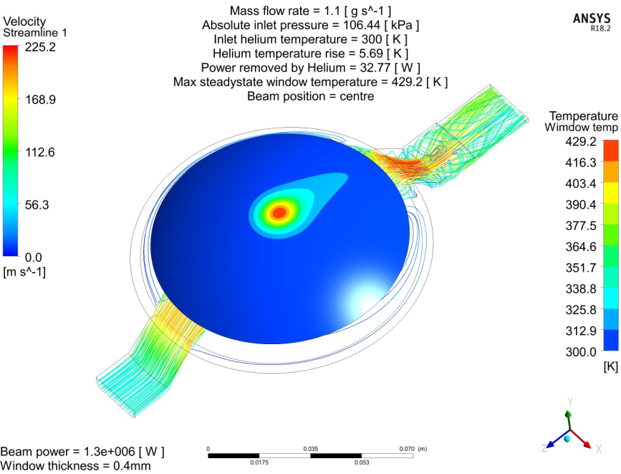
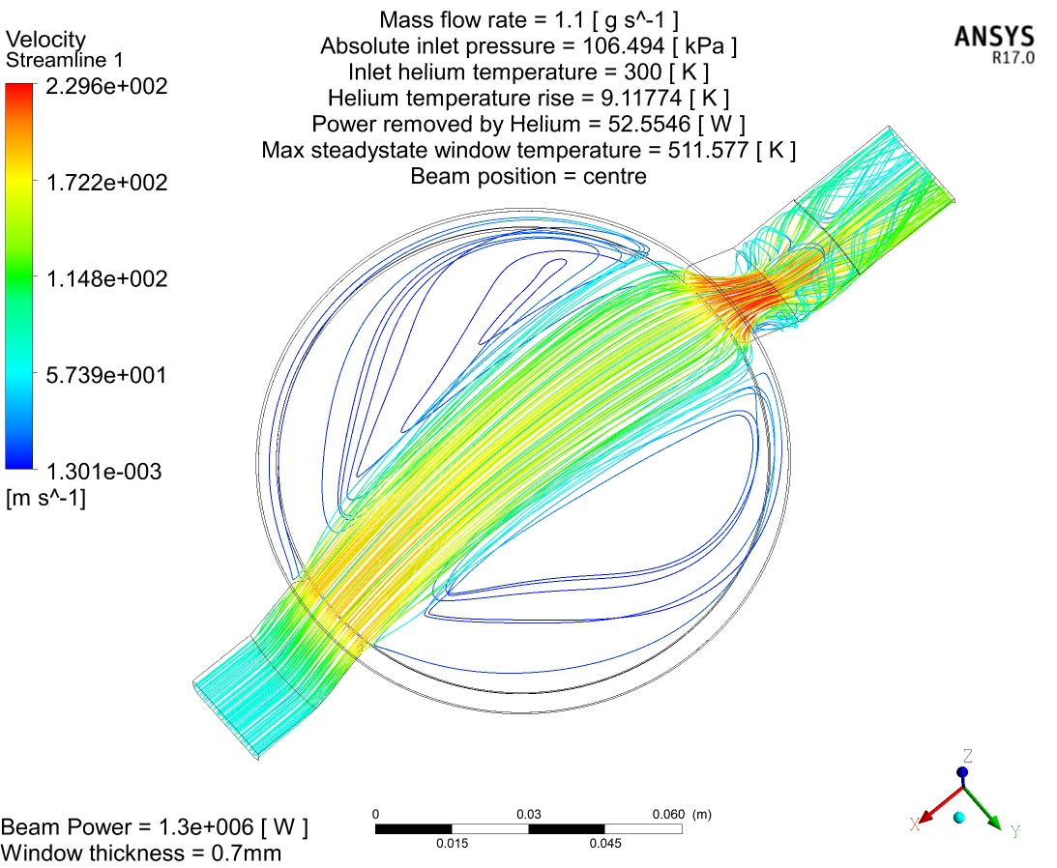
T2K beam window upgrade plans for - 1.3 MW
Strong recirculation zones driven by high speed jet
Helium flow lines
1.3 MW beam (steady state/CW simulation)
Pressure drop 0.06bar @ 1.1g/s
Max velocity 230 m/s

Slide 28
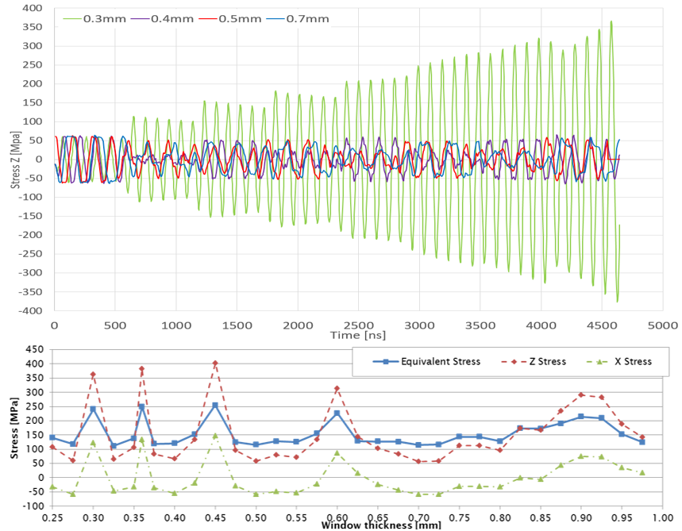
Window thickness upgrade – for beam upgrade
~4.2 µs
80 ns (3σ)
581-598 ns
0.30 mm
2.48 s → 1.16 s
Beam bunch structure can generate stress resonance within thickness of Ti alloy window material
Constructive interference at 0.36 mm (S.F.=1.5)
Destructive interference at 0.40 mm (S.F.=2.6)
0.40 mm selected for next beam window (just manufactured)

Slide 29
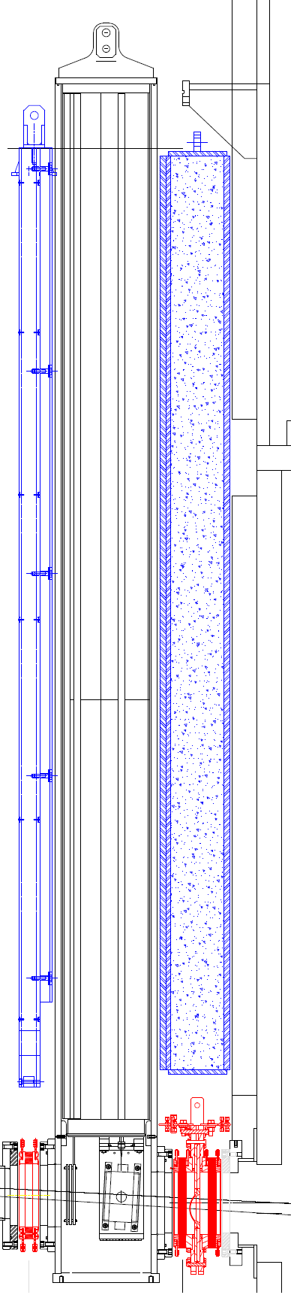
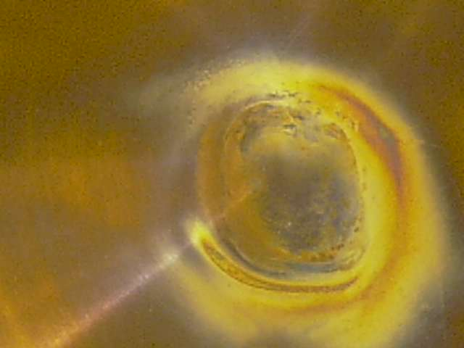


Window Remote Exchange (2017 summer)
30cm
After 2.2 x 10²¹ pot
~2DPA(NRT)
4m
The 1st window operated successfully up to 2.2x10²¹ POT
  Comparable to 1.3MW/ops-yr
Discoloration/deposit/damage of Ti-6Al-4V on TS vessel side visually identified
  Helium in TS vessel was humid, and the damage may be from radio-chemical reaction (accelerator vacuum side show less signatures)
  Need to improve helium circulation system to remove the humidity
We wish to perform PIE at JAEA’s hot-lab, but it will take time to clear radiation safety regulations and license problems at J-PARC

Slide 30






R a D I A T E
Radiation Damage In Accelerator Target Environments
International collaboration to bring together the accelerator target and materials science communities
Next talk by T. Ishida
J-PARC MoU signing & workshop in 2017

Slide 31
Summary
Plan to upgrade beam window thickness from 0.3 mm -> 0.4 mm to increase tolerance of beam window to thickness/bunch structure (and increase helium pressure)
Operation at 1.3 MW appears feasible for upgraded beam window
Radiation damage of materials is main question
→ Ishida-san talk

