Slide 1
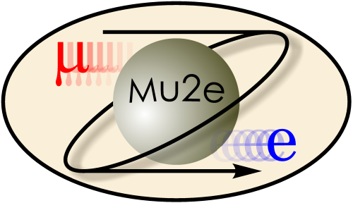

The Mu2e Experiment at Fermilab
Steven Boi, University of Virginia
On Behalf of the Mu2e Collaboration
NuFact 2018

Slide 2
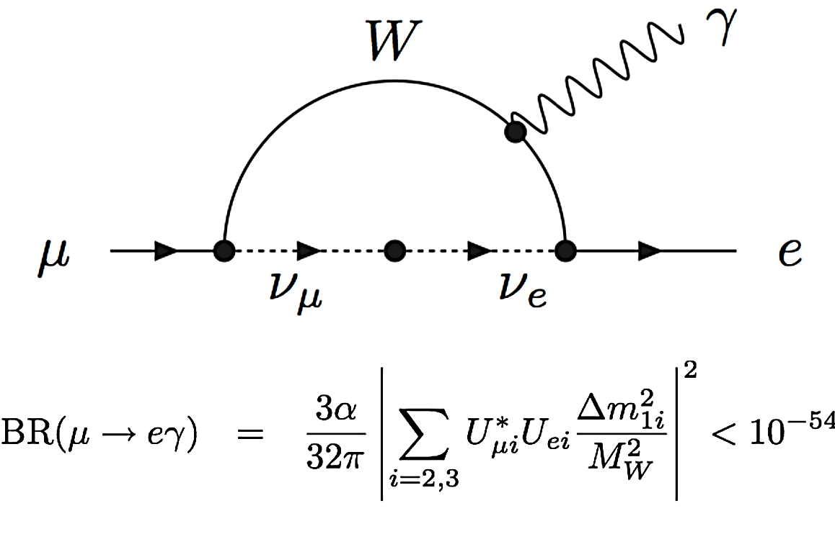
Charged Lepton Flavor Violation and the SM
In an extension of the standard model, one which includes neutrino oscillations, lepton flavor is only approximately conserved, with some charged lepton flavor violation (CLFV) occurring due to neutrino oscillations.
Such a process is exceedingly rare, a rate too small to be observed.
Bonus: since we will never observe this, it is not a background to CLFV searches.

Slide 3
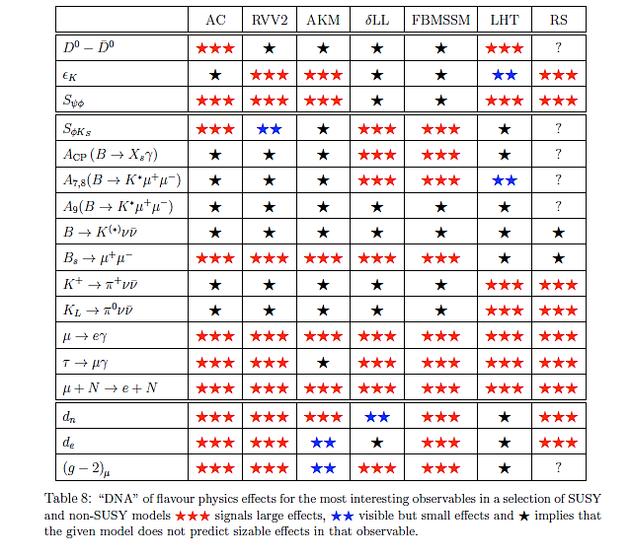
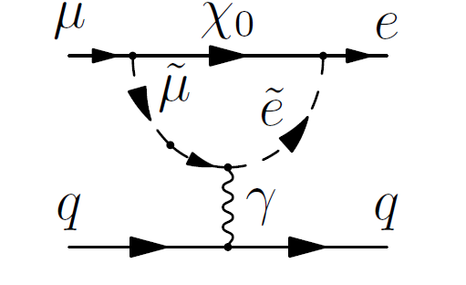
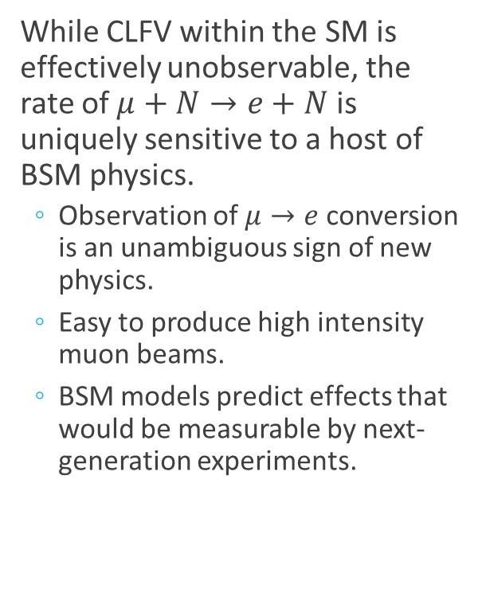
CLFV beyond the SM
While CLFV within the SM is effectively unobservable, the rate of $μ+N→e+N$ is uniquely sensitive to a host of BSM physics.
  Observation of $μ→e$ conversion is an unambiguous sign of new physics.
  Easy to produce high intensity muon beams.
  BSM models predict effects that would be measurable by next-generation experiments.
Flavor physics effects for the most interesting observables in a selection of SUSY and non-SUSY models.
~
★★★
Large effects
★★
Small effects
★
No effects
SUSY
A. de Gouvêa , et al

Slide 4
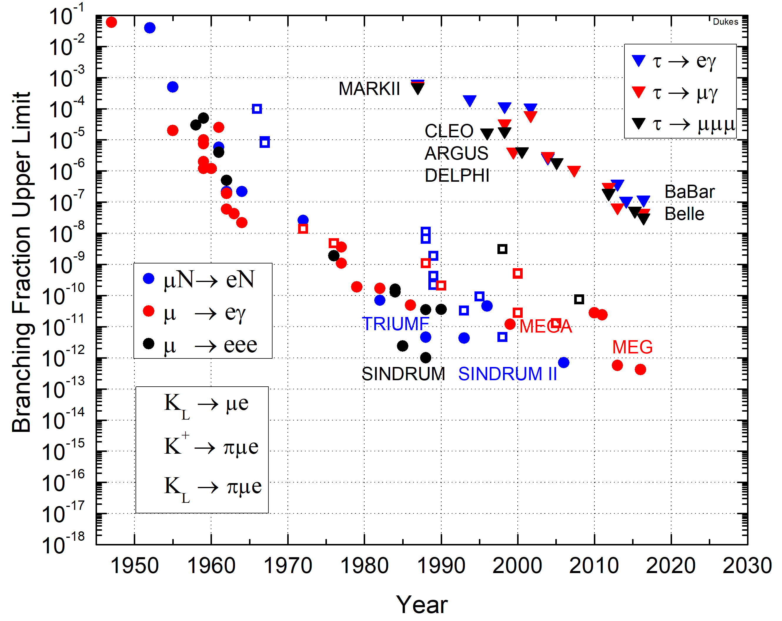
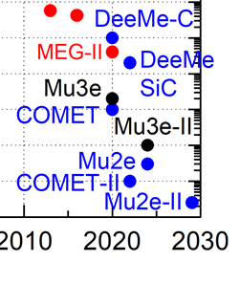
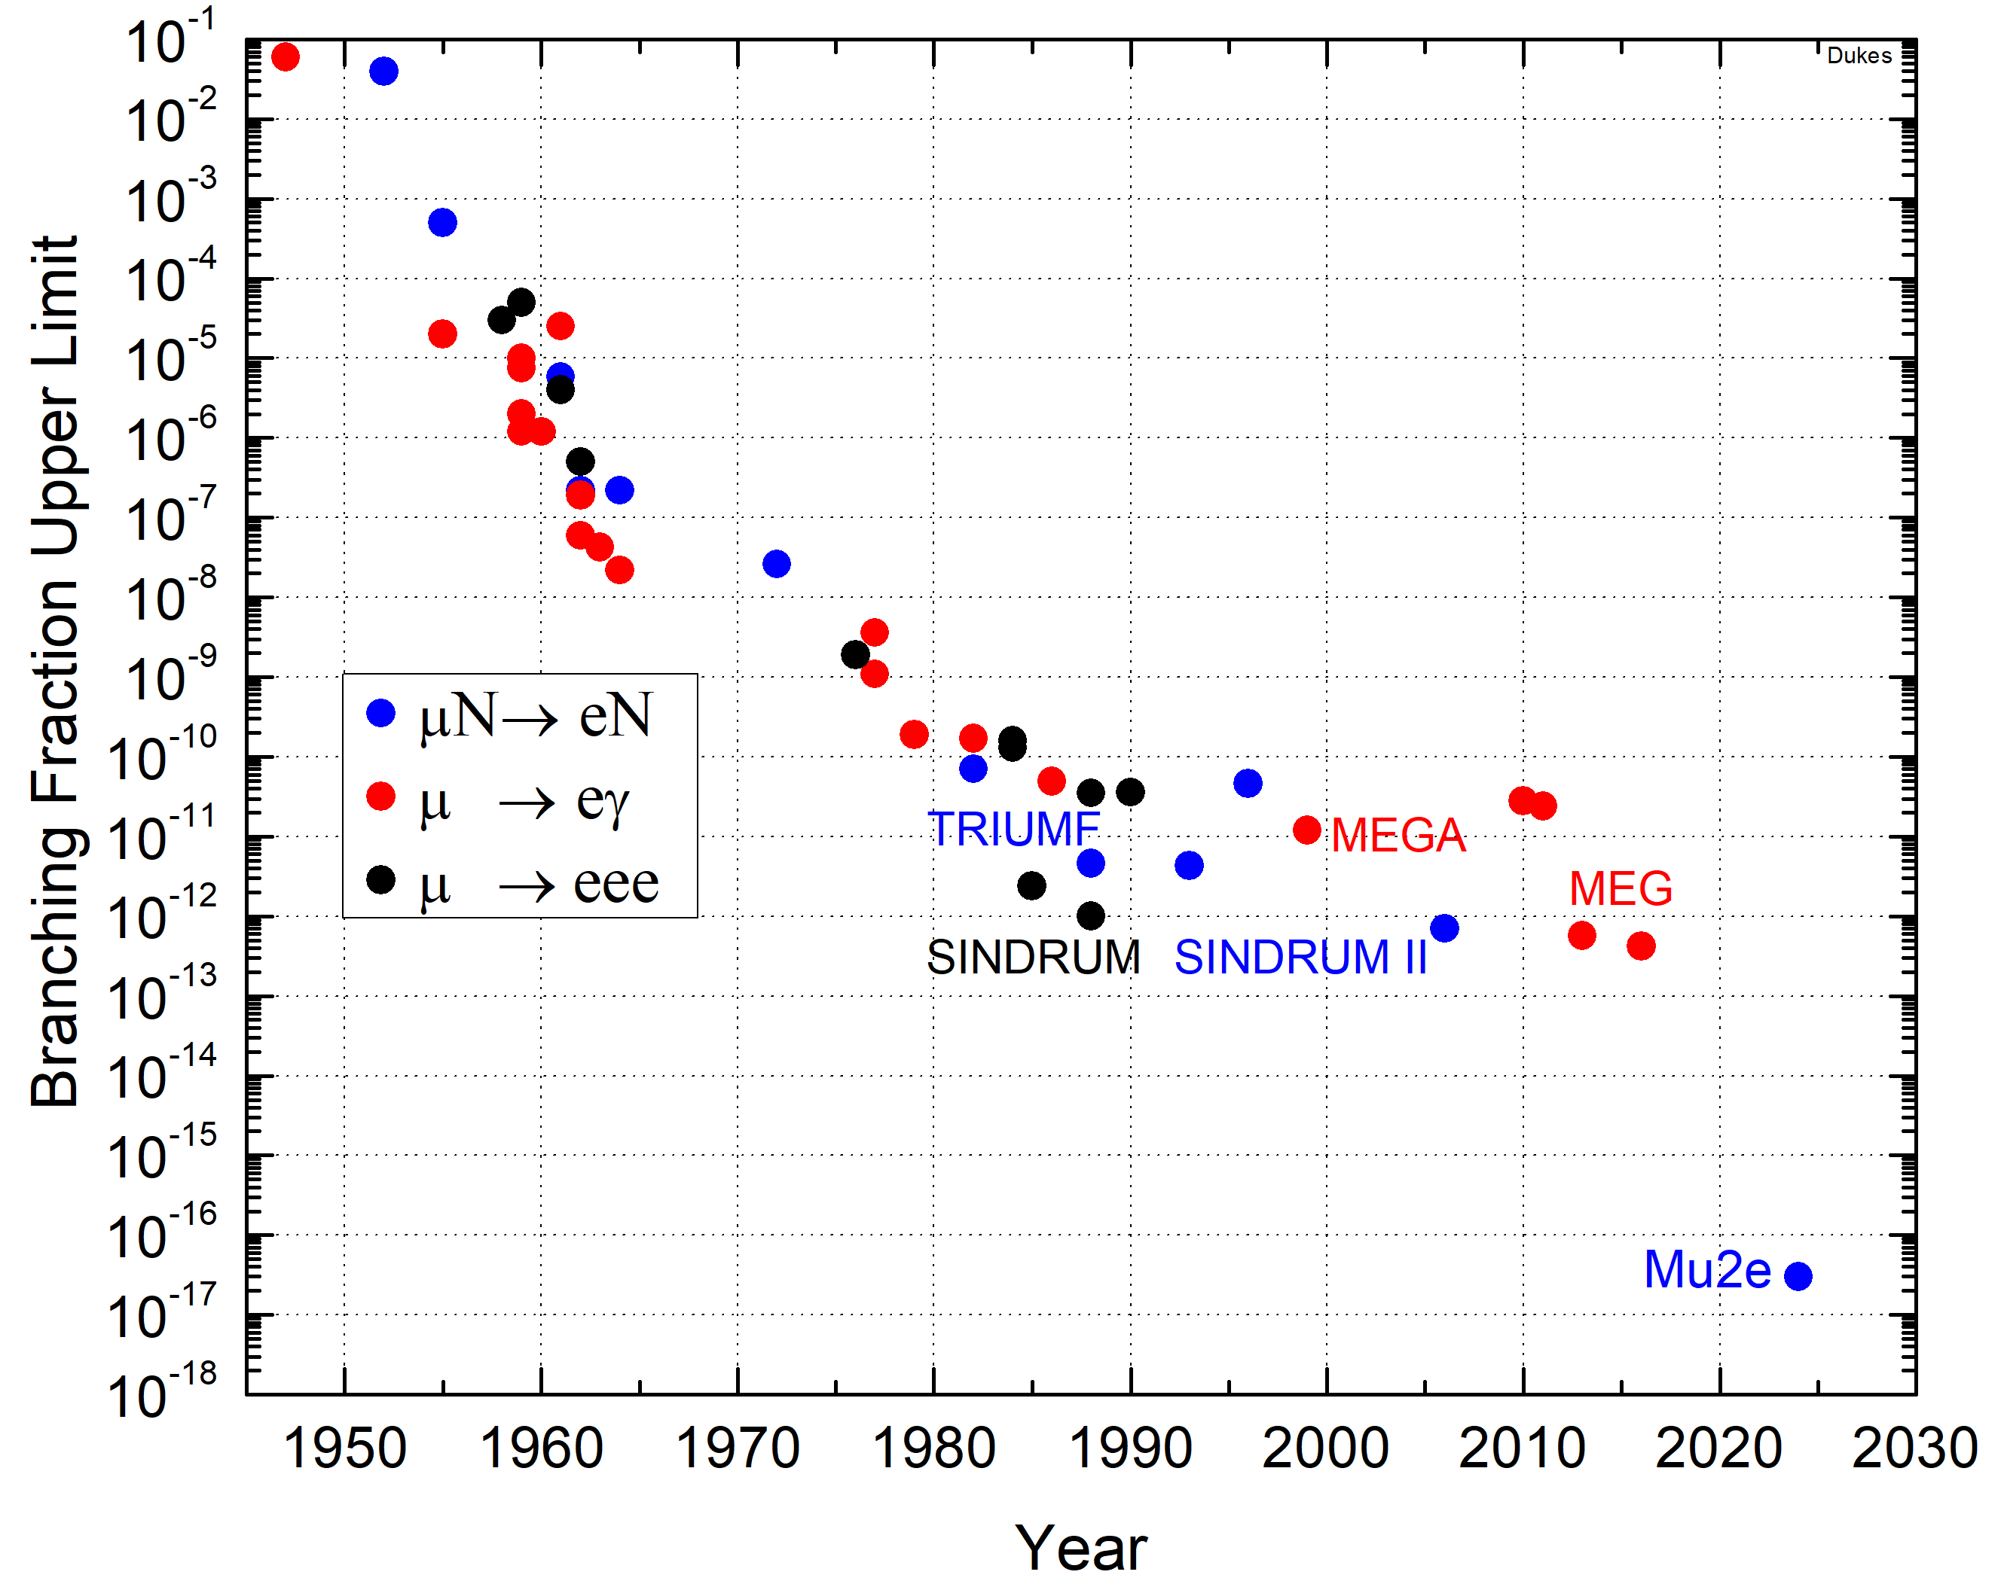

Historical CLFV Searches
Since the 1940s, searches for CLFV have been made, but so far only tighter constraints have been placed.
Next-generation experiments will explore unconstrained phase space favored by many BSM models.
Mu2e intends to improve the sensitivity by four orders of magnitude over the present limit.
$${10}^{−4}$$

Slide 5
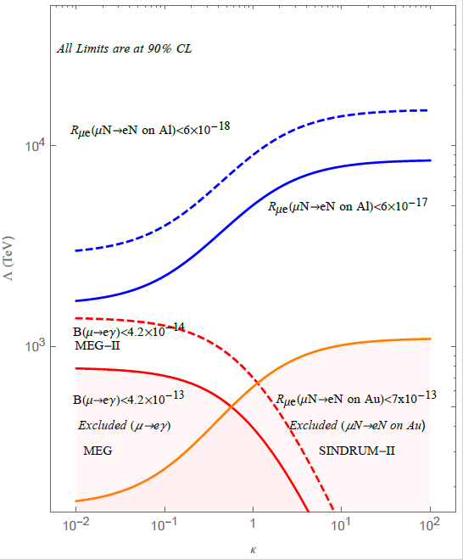


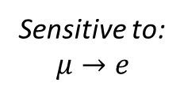
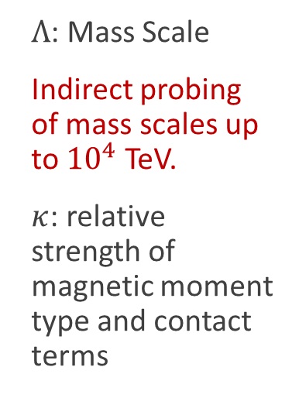
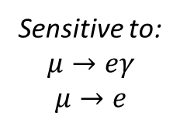
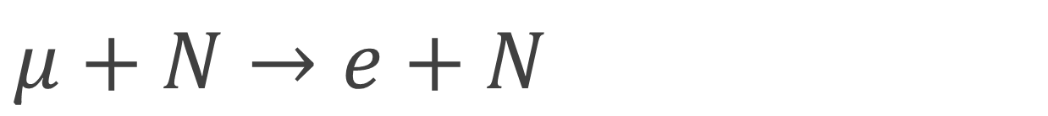


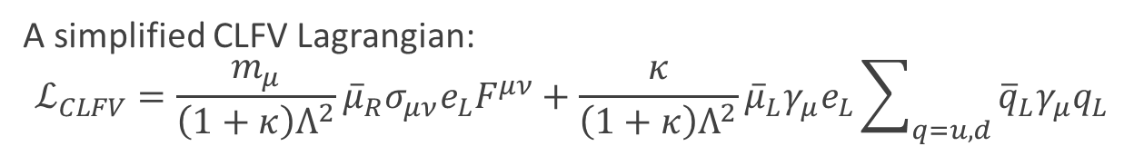
$μ+N→e+N$
A simplified CLFV Lagrangian:
$$ℒ_{CLFV}=\frac{m_{μ}}{\left(1+κ\right)Λ^{2}}{\overline{μ}}_{R}σ_{μν}e_{L}F^{μν}+\frac{κ}{\left(1+κ\right)Λ^{2}}{\overline{μ}}_{L}γ_{μ}e_{L}\sum_{q=u,d}{{\overline{q}}_{L}γ_{μ}q_{L}}$$
Magnetic Moment Type Operator
A. de Gouvêa, R. Bernstein, et al
Sensitive to:
$$μ→eγ$$
$$μ→e$$
$Λ$: Mass Scale
Indirect probing of mass scales up to ${10}^{4}$ TeV.
$κ$: relative strength of magnetic moment type and contact terms
Mu2e
$$Λ (TeV)$$
Contact Term Operator
Sensitive to:
$$μ→e$$
MEG
$$κ$$
Notes:
One can estimate the sensitivity of a given CLFV process in a model independent manner by adding LFV effective operators to the Standard Model Lagrangian, where Λ is the mass scale of new physics and κ is an arbitrary parameter controlling the relative contribution of the two terms. For small κ the first term becomes dominant, and for large κ _only_ the second term becomes relevant.
The first term, a magnetic moment type operator is responsible for the µ→eγ vertex and present also in tree-level µ→e transition, while 2nd term enters in the four-fermion vertices responsible for µ→e and gives no contribution to the μ → eγ decay.
The most stringent limits on κ, Λ parameters, shown on the figure below, come from MEG and Sindrum-II experiment.
The projected sensitivity of the MEG experiment will probe Λ values up to 2000 TeV for κ << 1 scenarios, while having little sensitivity for the case that κ >> 1. The projected sensitivity of the Mu2e experiment will probe Λ values from 2000 to about 10000 TeV over all values of κ. For the higher values of κ, Mu2e will testing mass scaling an order of magnitude higher than the previous experiments.

Slide 6
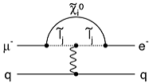

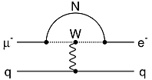

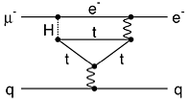

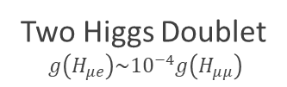

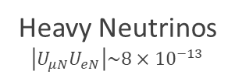
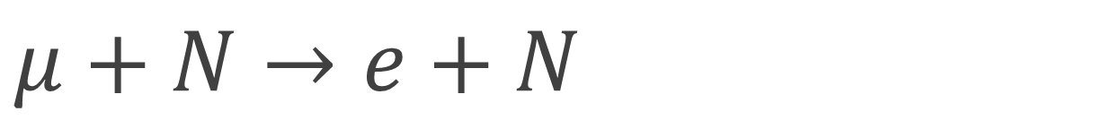
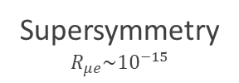
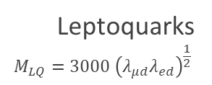

$μ+N→e+N$
  Flavor physics of leptons and dipole moments, arXiv:0801.1826
  Marciano, Mori, and Roney, Ann. Rev. Nucl. Sci. 58, doi:10.1146/annurev.nucl.58.110707.171126
  de Gouvea and Vogel, arXiv:1303.4097v2
A simplified CLFV Lagrangian:
$$ℒ_{CLFV}=\frac{m_{μ}}{\left(1+κ\right)Λ^{2}}{\overline{μ}}_{R}σ_{μν}e_{L}F^{μν}+\frac{κ}{\left(1+κ\right)Λ^{2}}{\overline{μ}}_{L}γ_{μ}e_{L}\sum_{q=u,d}{{\overline{q}}_{L}γ_{μ}q_{L}}$$
Magnetic Moment Type Operator
Contact Term Operator
Supersymmetry
$$R_{μe}\sim {10}^{−15}$$
Compositeness
$$Λ_{c}\sim 3000 TeV$$
Heavy Neutrinos
$$\left|U_{μN}U_{eN}\right|\sim 8×{10}^{−13}$$
Leptoquarks
$$M_{LQ}=3000 {\left(λ_{μd}λ_{ed}\right)}^{\frac{1}{2}}$$
Two Higgs Doublet
$$g\left(H_{μe}\right)\sim {10}^{−4}g\left(H_{μμ}\right)$$
Heavy $Z’$
$$M_{Z^{′}}=3000 TeV/c^{2}$$

Slide 7
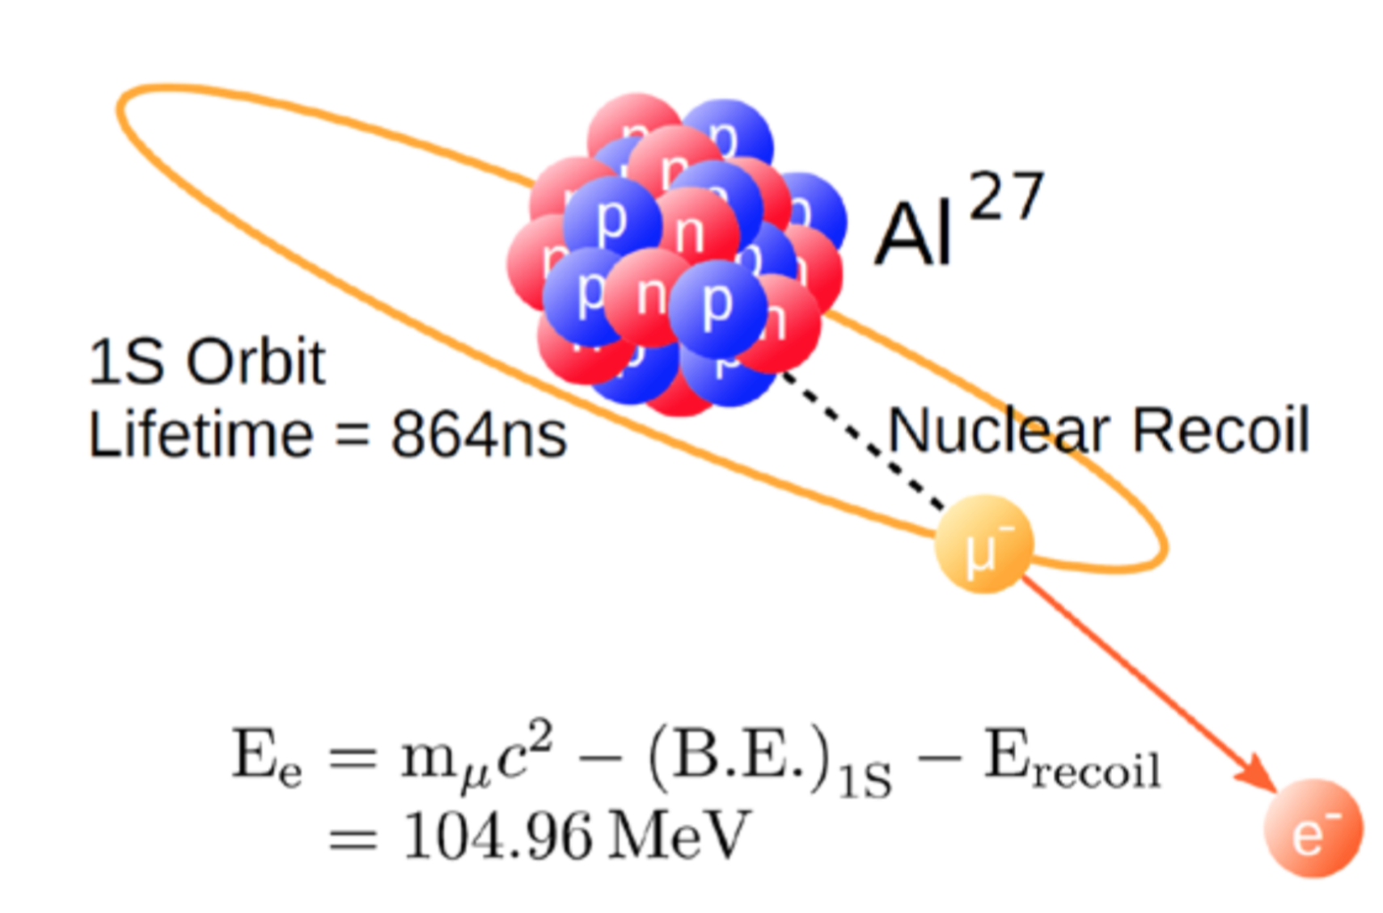
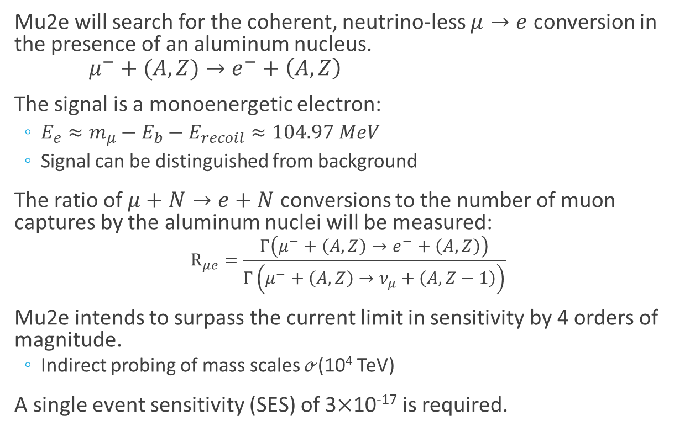
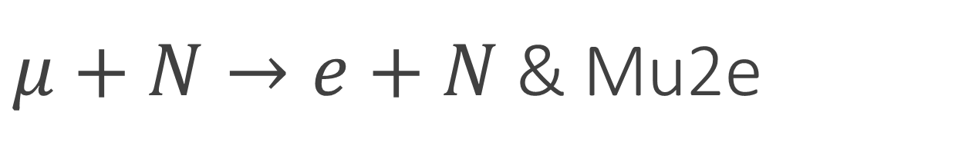
$μ+N→e+N$ & Mu2e
Mu2e will search for the coherent, neutrino-less $μ→e$ conversion in the presence of an aluminum nucleus.
$μ^{−}+(A,Z)→e^{−}+\left(A,Z\right)$
The signal is a monoenergetic electron:
  $E_{e}≈m_{μ}−E_{b}−E_{recoil}≈104.97 MeV$
  Signal can be distinguished from background
The ratio of $μ+N→e+N$ conversions to the number of muon captures by the aluminum nuclei will be measured:
$$R_{μe}=\frac{Γ\left(μ^{−}+\left(A,Z\right)→e^{−}+\left(A,Z\right)\right)}{Γ\left(μ^{−}+\left(A,Z\right)→ν_{μ}+\left(A,Z−1\right)\right)}$$
Mu2e intends to surpass the current limit in sensitivity by 4 orders of magnitude.
  Indirect probing of mass scales $ℴ$(10⁴ TeV)
A single event sensitivity (SES) of 3$×$10⁻¹⁷ is required.

Slide 8
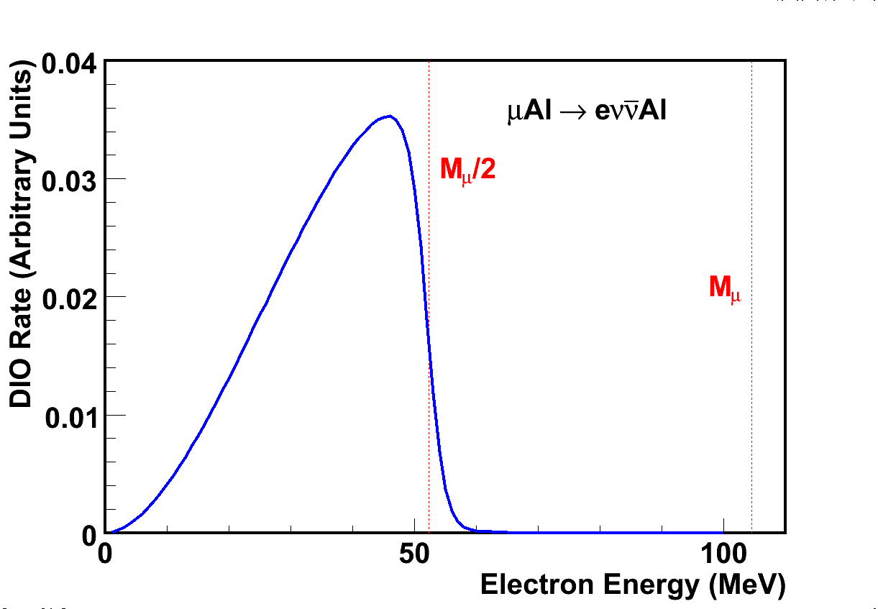

$μ+N→e+N$ & Mu2e
Energy spectrum of electron emitted by muon decay in orbit
$$μN→eν\overline{ν}N$$
Notes:
Long tail due to recoil of the nucleus.

Slide 9
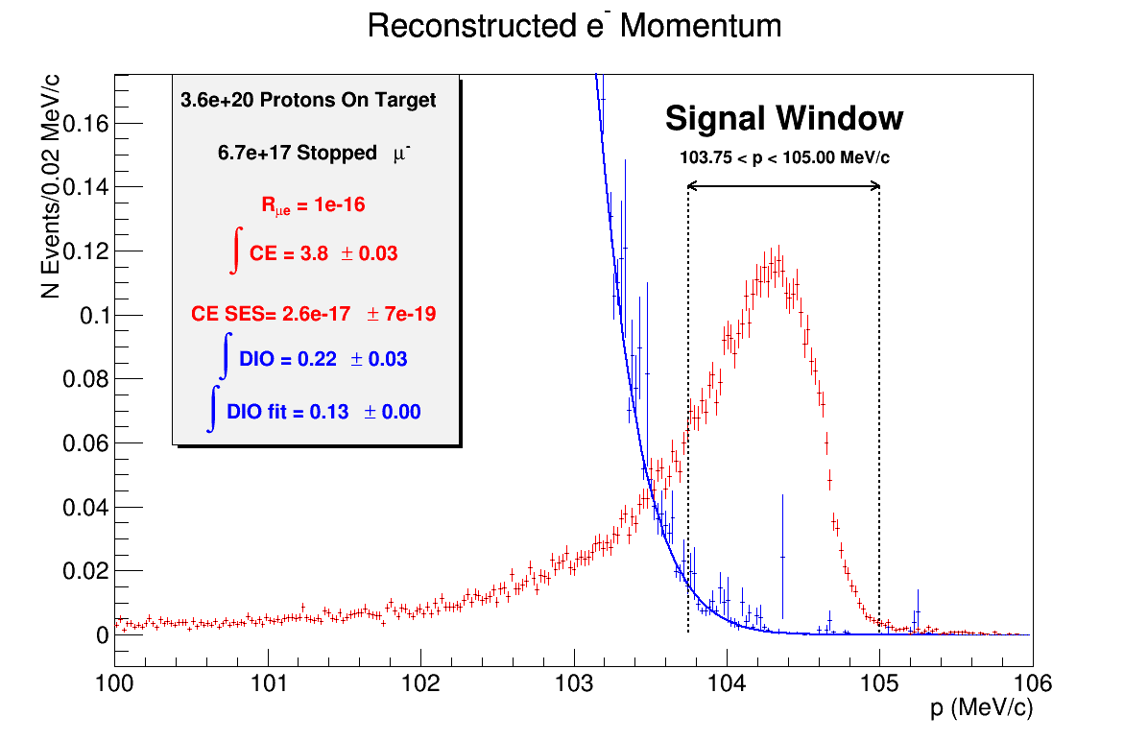
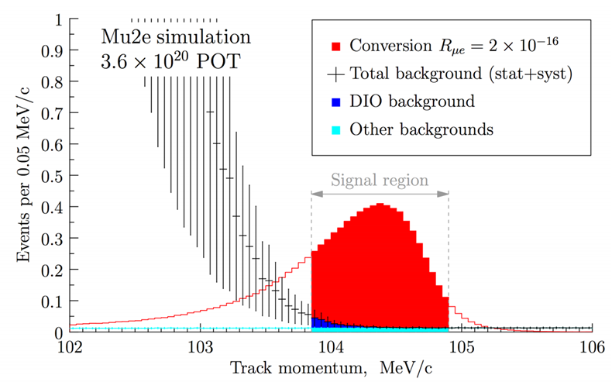
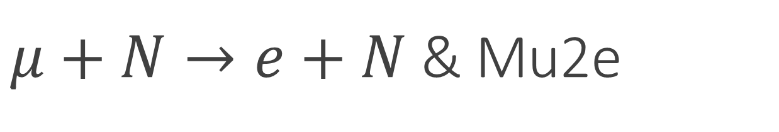
$μ+N→e+N$ & Mu2e
Energy spectrum of electron emitted by muon decay in orbit
For:
3.6x10²⁰ POT
6.7x10¹⁷ μ- stops
assuming:
R_{μe} = 1x10⁻¹⁶
Signal yield = 3.5 evt
DIO yield = 0.20 evt
Notes:
Smearing of conversion-electron signal due to material interactions within the detector.

Slide 10
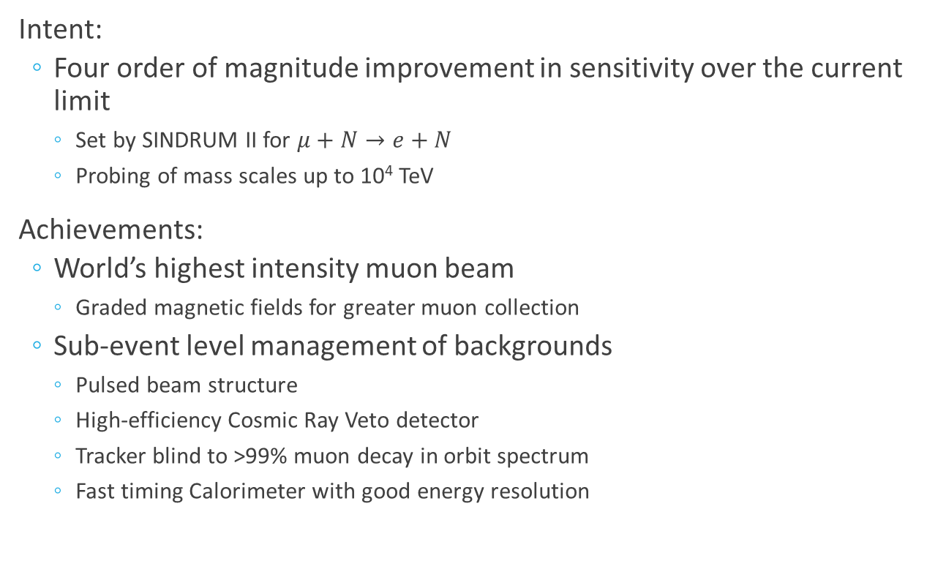
$μ+N→e+N$ & Mu2e
Intent:
  Four order of magnitude improvement in sensitivity over the current limit
    Set by SINDRUM II for $μ+N→e+N$
    Probing of mass scales up to 10⁴ TeV
Achievements:
  World’s highest intensity muon beam
    Graded magnetic fields for greater muon collection
  Sub-event level management of backgrounds
    Pulsed beam structure
    High-efficiency Cosmic Ray Veto detector
    Tracker blind to >99% muon decay in orbit spectrum
    Fast timing Calorimeter with good energy resolution
Notes:
RPC can pair produce creating a conversion-like electron.

Slide 11
The Mu2e Experiment
( at Fermilab )

Slide 12
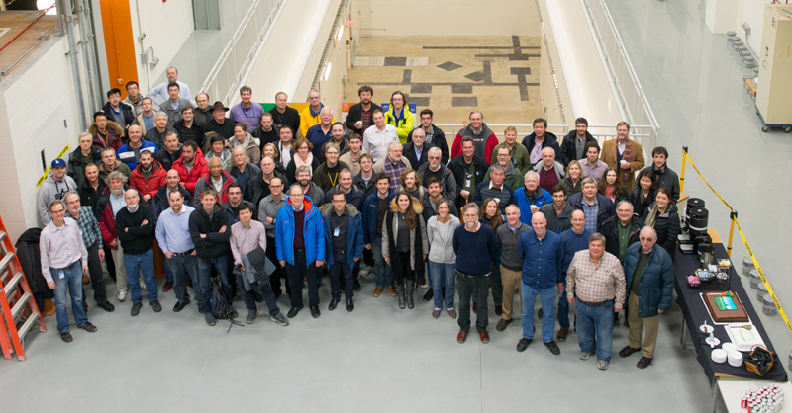
Mu2e Collaboration
Comprised of 229 members from 37 Institutions.

Slide 13
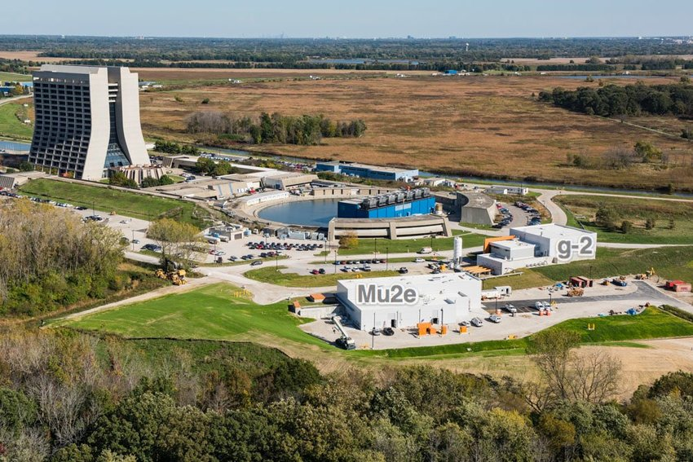
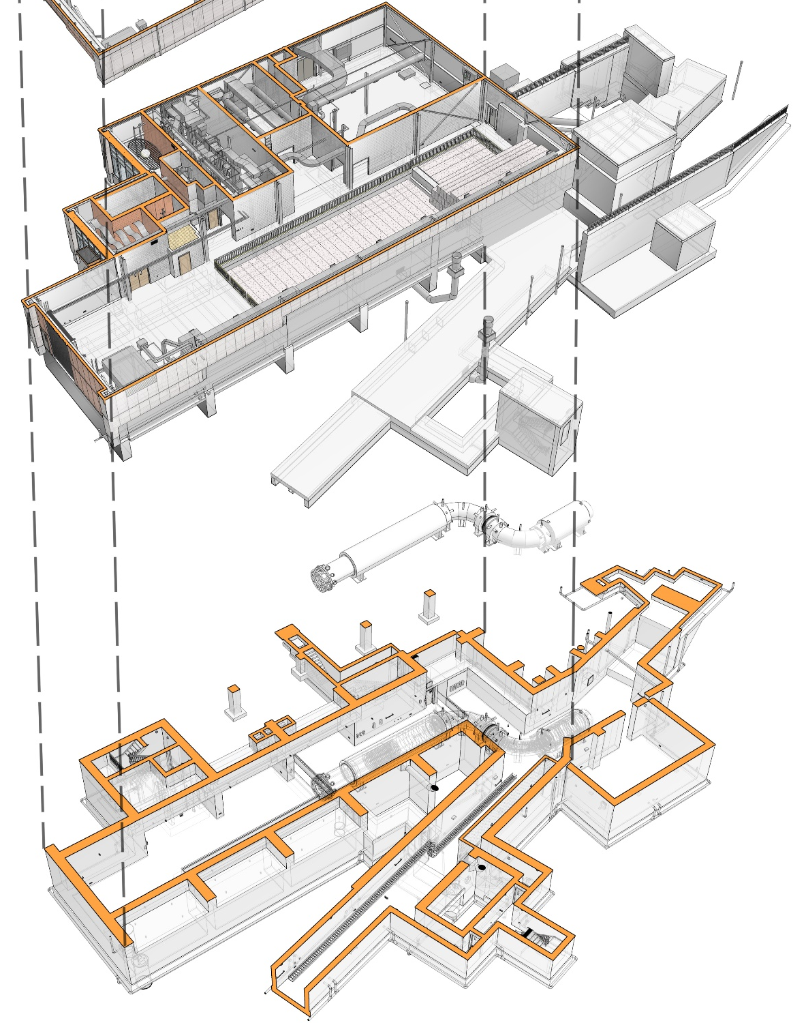
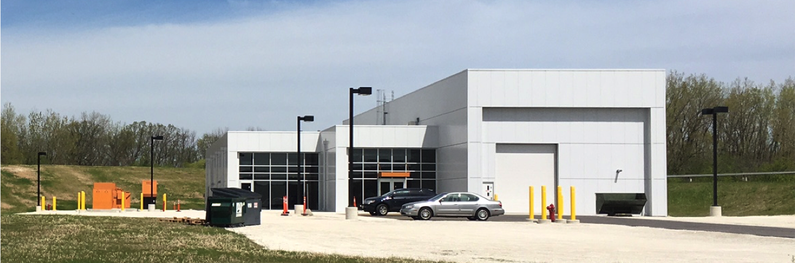
Mu2e at Fermilab

Slide 14
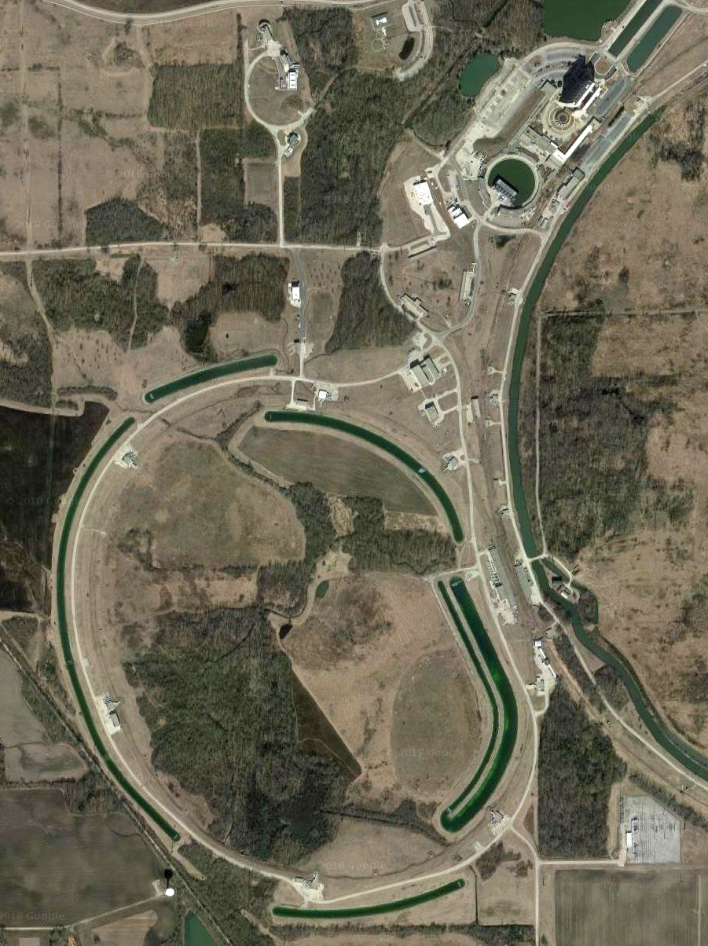
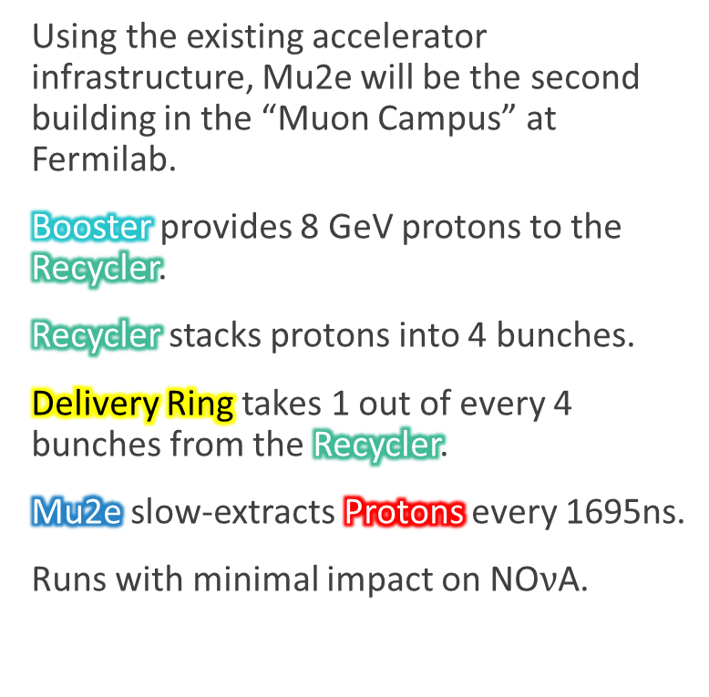
Mu2e Beamline
Using the existing accelerator infrastructure, Mu2e will be the second building in the “Muon Campus” at Fermilab.
Booster provides 8 GeV protons to the Recycler.
Recycler stacks protons into 4 bunches.
Delivery Ring takes 1 out of every 4 bunches from the Recycler.
Mu2e slow-extracts Protons every 1695ns.
Runs with minimal impact on NO$ν$A.
Muon Campus
Protons
Mu2e
Delivery Ring
Booster
Recycler

Slide 15
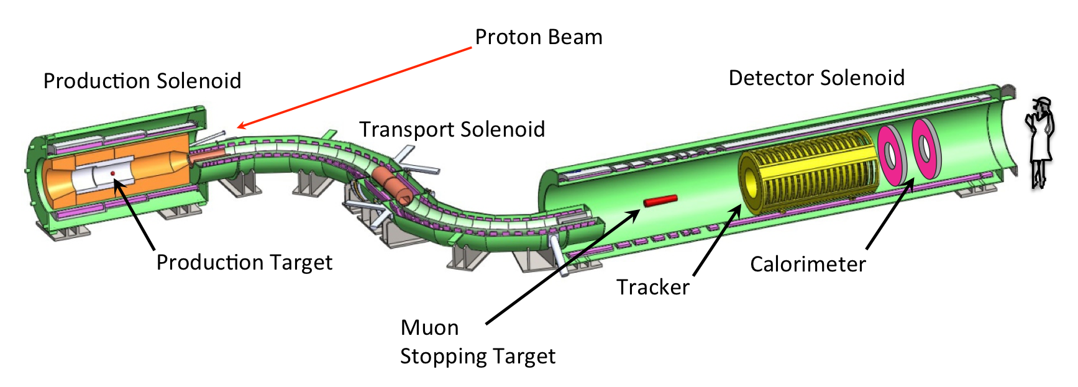

Mu2e Apparatus
The Mu2e Apparatus is divided into three major solenoids:
  Production Solenoid
  Transport Solenoid
  Detector Solenoid
$$\sim 25m$$

Slide 16
Mu2e Apparatus
The Mu2e Apparatus is divided into three major solenoids:
  Production Solenoid
  Transport Solenoid
  Detector Solenoid
$$\sim 25m$$

Slide 17
Mu2e Apparatus
The Mu2e Apparatus is divided into three major solenoids:
  Production Solenoid
  Transport Solenoid
  Detector Solenoid
$$\sim 25m$$

Slide 18
Mu2e Apparatus
The Mu2e Apparatus is divided into three major solenoids:
  Production Solenoid
  Transport Solenoid
  Detector Solenoid
$$\sim 25m$$

Slide 19
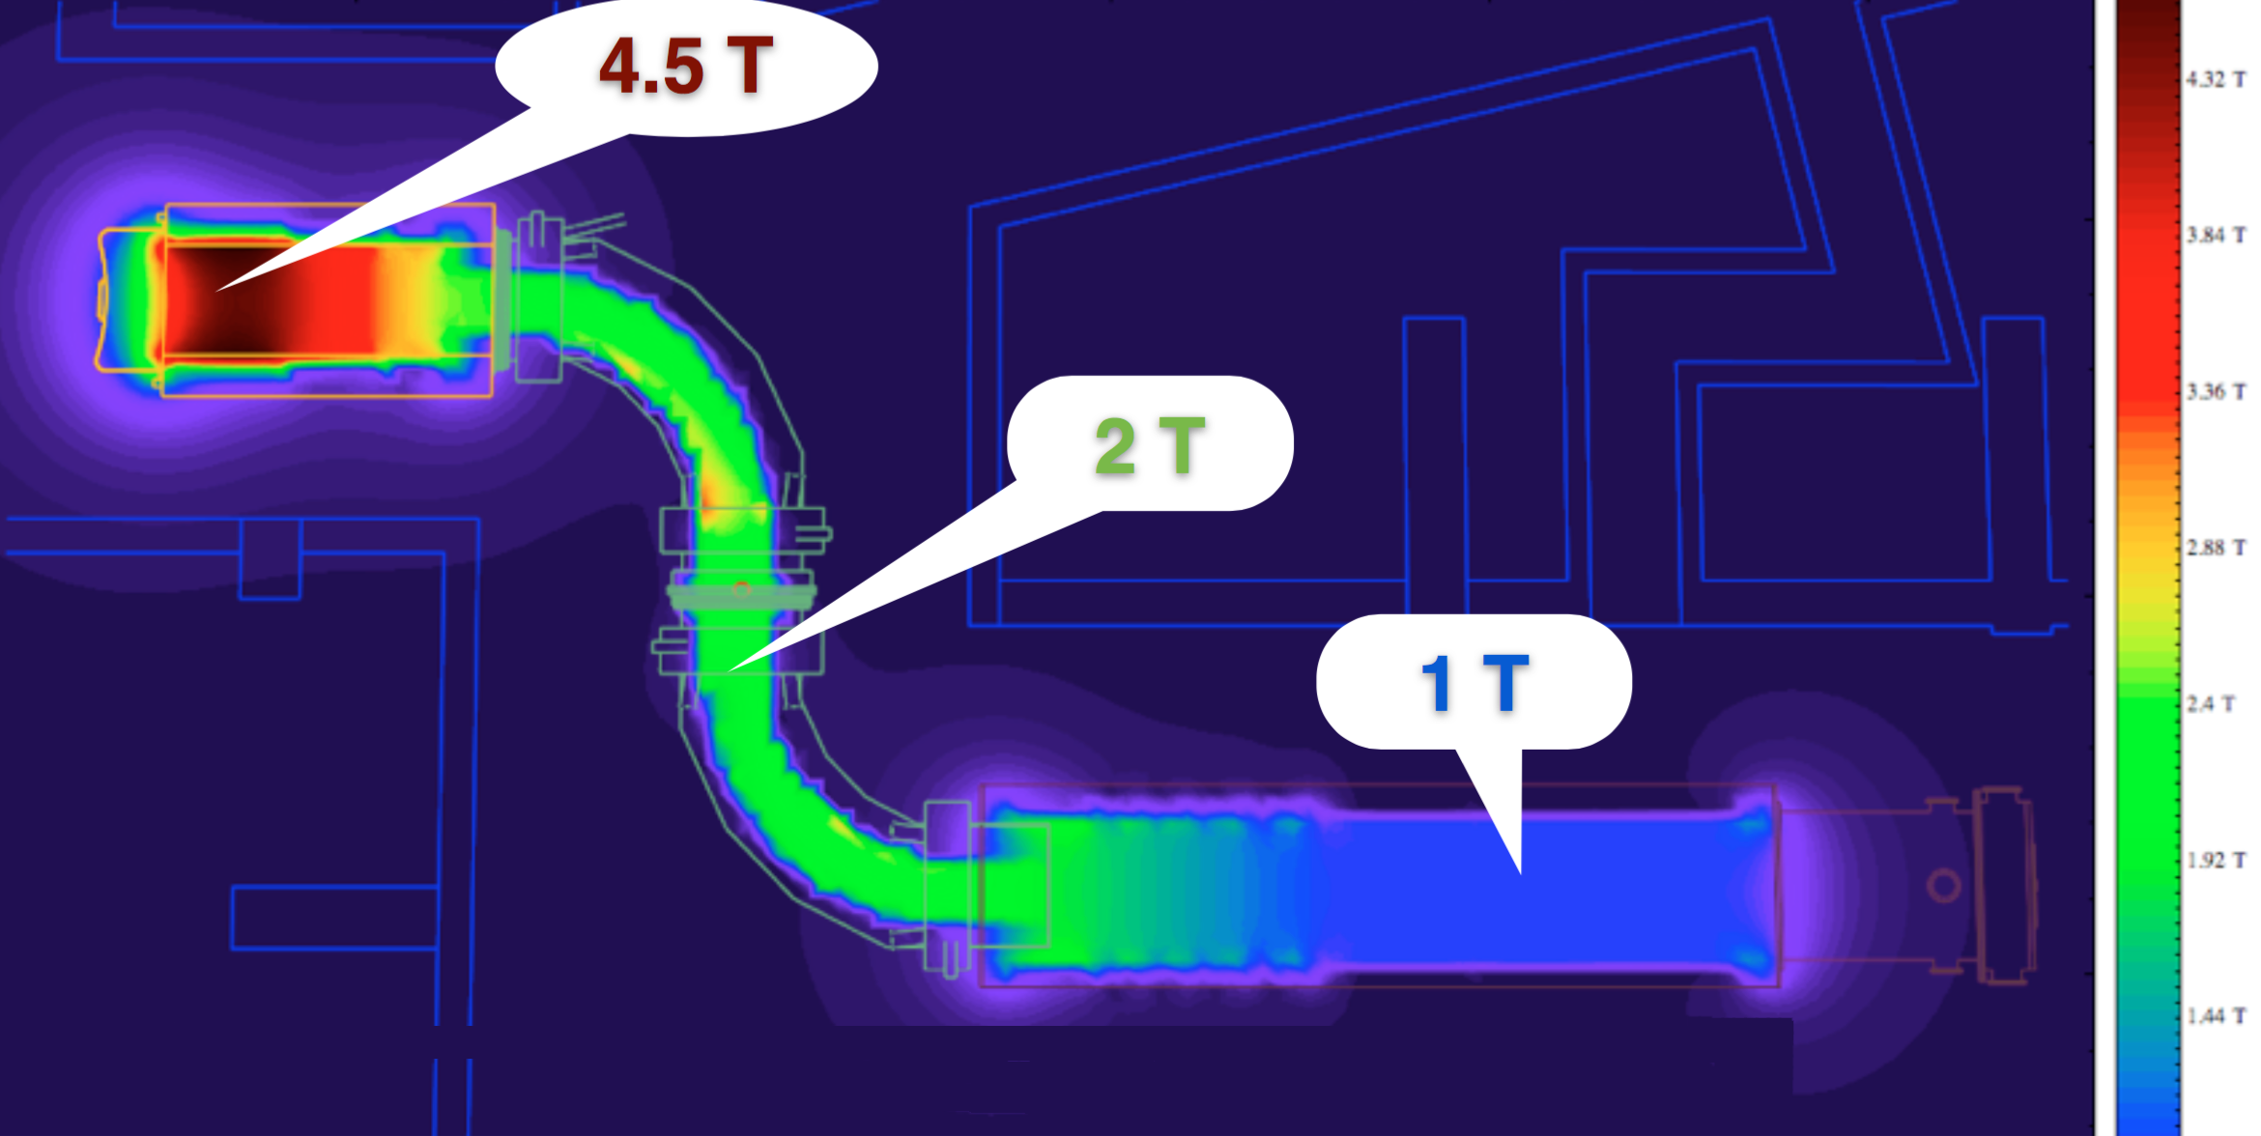
Mu2e Apparatus
Graded magnetic fields sweep particles into the detector solenoid, creating the highest intensity muon beam to date.
1.0T
2.5T
4.5T
2.0T

Slide 20
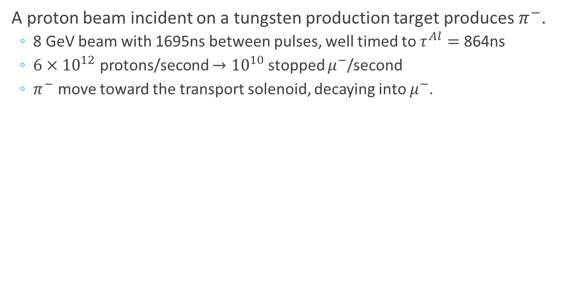
Mu2e Apparatus Production Solenoid
A proton beam incident on a tungsten production target produces $π^{−}$.
  8 GeV beam with 1695ns between pulses, well timed to $τ^{Al}=$864ns
  $6×{10}^{12}$ protons/second $→{10}^{10}$stopped $μ^{−}$/second
  $π^{−}$ move toward the transport solenoid, decaying into $μ^{−}$.
Proton Beam

Slide 21

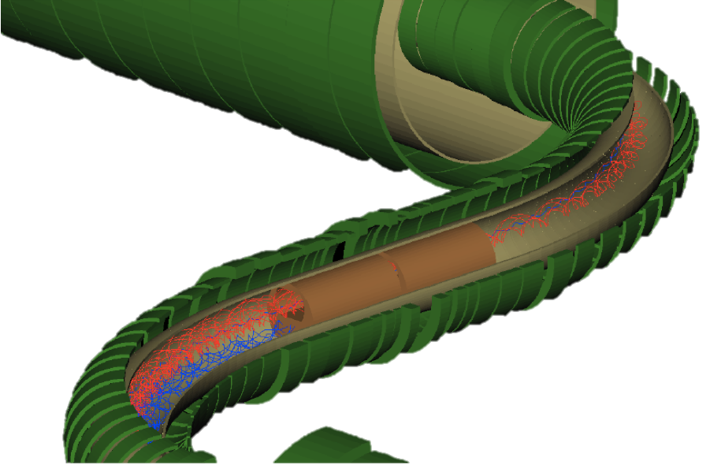



Mu2e Apparatus Transport Solenoid
$π^{−}$ and $μ^{−}$ beam propagate through the transport solenoid (TS) to the detector solenoid.
  Momentum selection
  Sign selecting collimator in the middle of the TS.
$$μ^{−}$$
Sign Selection Collimator
$$μ^{+}$$

Slide 22
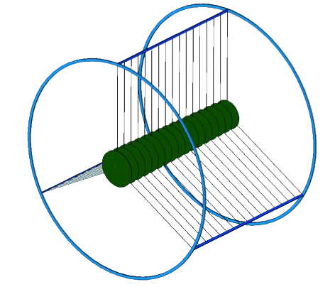


Mu2e Apparatus Detector Solenoid
$μ^{−}$ stop in an Aluminum target comprised of 37 thin 100$μm$ foils.
  With a rate of $6 ×{10}^{12}$ protons/second incident on the production target, $1.1×{10}^{10} μ^{−}$/second reach the stopping target.
  The momentum and energy of $e^{−}$ coming out of the stopping target is measured by the tracker and calorimeter.
Calorimeter
Tracker

Slide 23
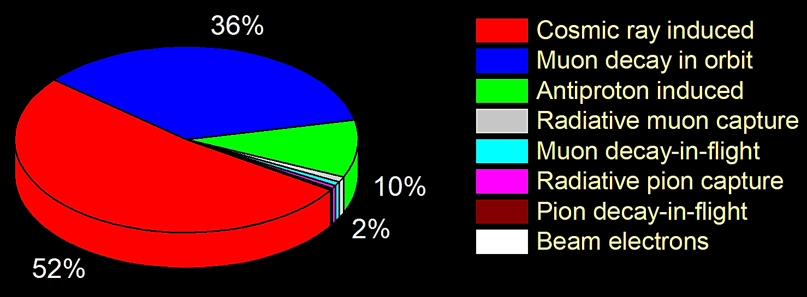

Mu2e Apparatus Backgrounds
The single event sensitivity (SES) is expected to be $3×{10}^{−17}$, which is around 40 $μ→e$ conversion events over the lifetime of the experiment (3 years) at $R_{μe}={10}^{−15}$.
For Mu2e to be a high-sensitivity experiment, the backgrounds which can mimic $μ+N→e+N$ conversion must be well-understood and kept at a sub-event level.
  0.4 events over the lifetime of the experiment.
The three most prominent backgrounds for the experiment are the products of decay in orbit (DIO), anti-proton processes, with the largest background being the production of conversion-like electrons due to cosmic rays.
  Tracker and Calorimeter handles
  Cosmic Ray Veto

Slide 24
Mu2e Apparatus Backgrounds
Energy spectrum of electron emitted by muon decay in orbit
$$μN→eν\overline{ν}N$$
Notes:
Long tail due to recoil of the nucleus.

Slide 25
Mu2e Apparatus Backgrounds
Energy spectrum of electron emitted by muon decay in orbit
Notes:
Smearing of conversion-electron signal due to material interactions within the detector.

Slide 26
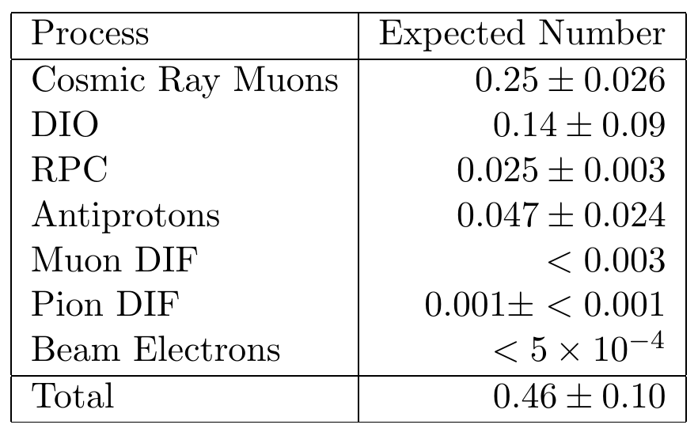
Mu2e Apparatus Backgrounds

Slide 27
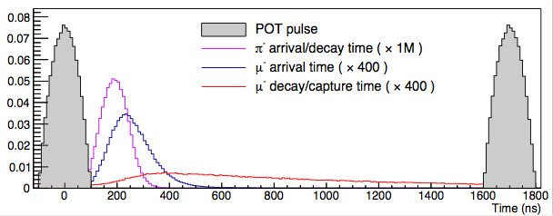
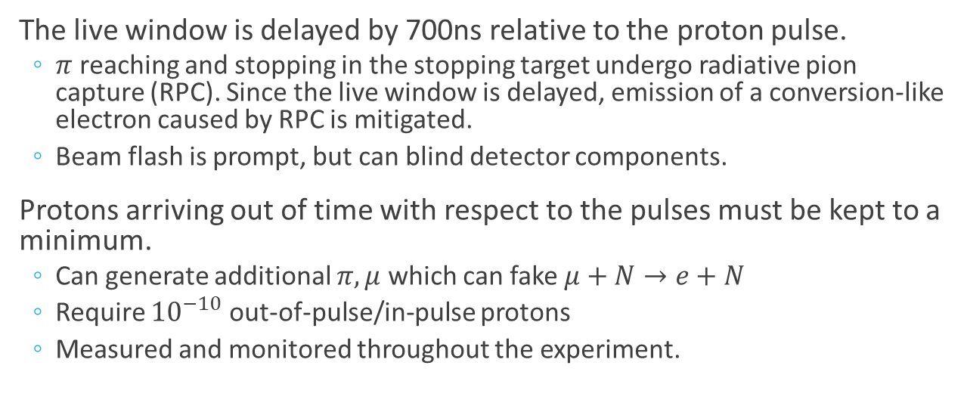



Mu2e Apparatus Backgrounds
The live window is delayed by 700ns relative to the proton pulse.
  $π$ reaching and stopping in the stopping target undergo radiative pion capture (RPC). Since the live window is delayed, emission of a conversion-like electron caused by RPC is mitigated.
  Beam flash is prompt, but can blind detector components.
Protons arriving out of time with respect to the pulses must be kept to a minimum.
  Can generate additional $π,μ$ which can fake $μ+N→e+N$
  Require ${10}^{−10}$ out-of-pulse/in-pulse protons
  Measured and monitored throughout the experiment.
Pulse
Pulse
$π$ capture
$μ$ arrival
$μ$ decay
Live Window

Slide 28
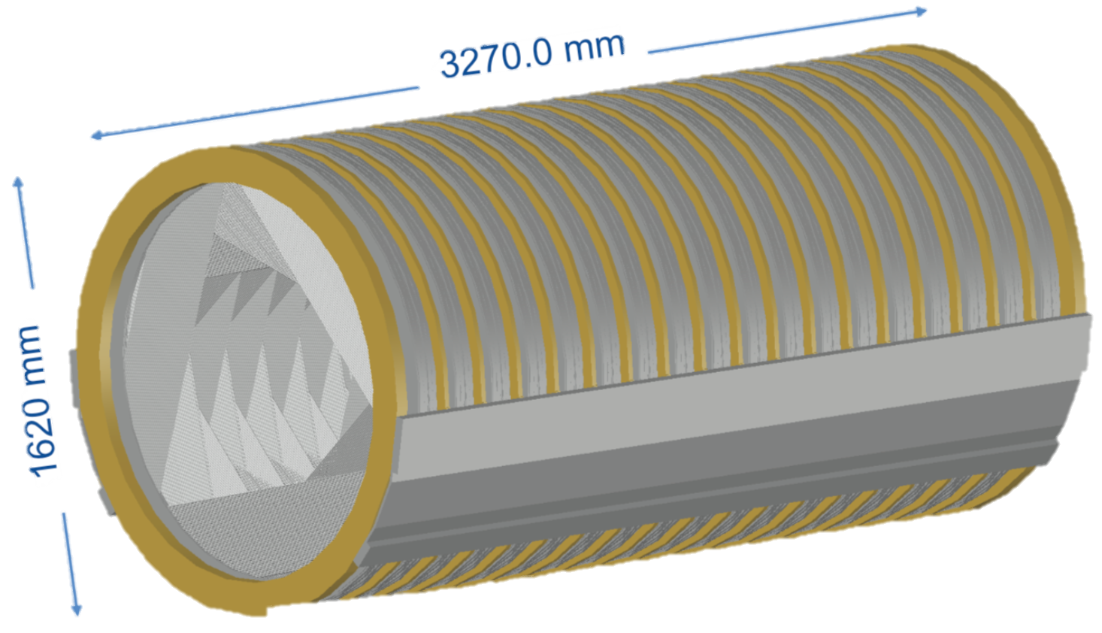
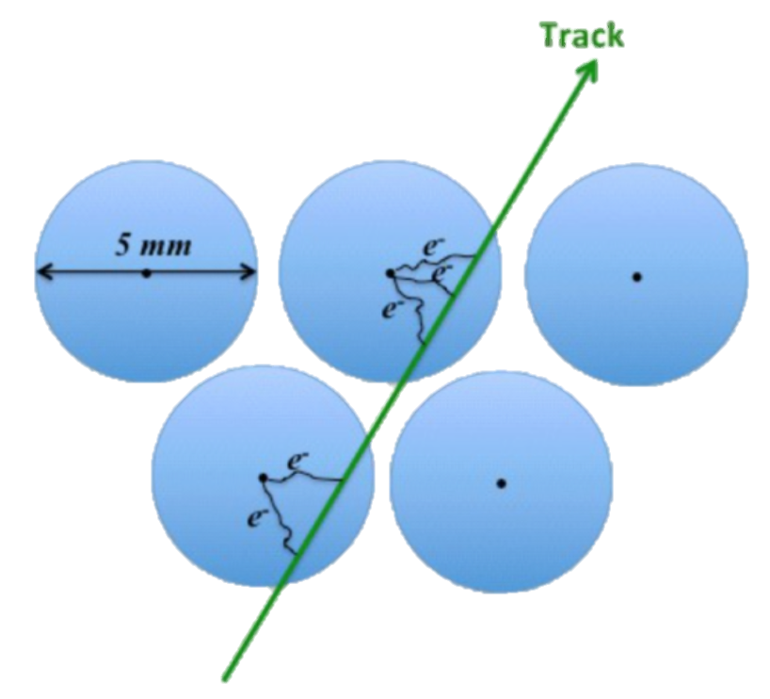



Tracker
High-precision measurements of $e^{−}$ momentum is made using a low-mass, straw drift tube, annular tracker, transverse to the beam axis.
Due to being un-instrumented close to the beam axis, the tracker has the distinct advantage of being blind to beam flash and next to all of the DIO spectrum.
The tracker is built out of panels, 6 panels per plane, 2 planes per station, with 18 stations total in the tracker detector.
  Total 216 panels, ~21,000 straws
  Momentum Resolution <200KeV/c @ 105MeV
  30º rotation for stereo reconstruction
  5 mm diameter straws
  12 𝜇m Mylar walls
  25 𝜇m tungsten wires
  Filled with Ar/CO₂
Stopping Target

Slide 29

Tracker
Energy spectrum of electron emitted by muon decay in orbit
Escape
through center
of Tracker
Fully
fiducial

Slide 30






Tracker
Several tracker panels have been built and tested using cosmic rays and a $Fe^{55}$ source.
  Full plane assembled at Fermilab.
Panel assembly at the University of Minnesota (with Fermilab and U. Houston).
QA of panel components @ CUNY, Duke and LBL/UC Berkeley.

Slide 31




Tracker
Cosmic Rays: Straw hit efficiency as a function of the
distance from the wire
Cosmic Rays: Transverse Resolution
Notes:
Asymmetry (left side) tail on momentum resolution due to energy loss through tracker detector.

Slide 32





Calorimeter
A high-granularity crystal-based calorimeter will measure the energy of $e^{−}$ coming out of the stopping target.
  This measurement is complementary to the Tracker’s momentum measurement.
Tracker
It provides:
  Precise timing $σ_{t}\sim$100ps
  Particle identification
  Seeds for the Tracker
    Protection against pattern recognition errors in Tracker
  $μ$ rejection x200 with 96% $e^{−}$ efficiency
Comprised of 2 annuli of CsI crystal scintillators.
  Radiation Hard
  Good energy resolution ${σ_{E}}/E≈5$% @ 105MeV
Calorimeter
1400 CsI Crystals
  3$×$3$×$20 cm³
2800 SiPMs
  2 SiPMs per crystal
Disk Radii
  37-66cm

Slide 33


Calorimeter
A fully-instrumented prototype calorimeter was built and tested.

Slide 34



Calorimeter
$σ_{E}/E_{dep}$ vs $E_{dep}$
$\frac{σ_{E}}{E_{dep}}≈5\% @ E_{beam}100MeV$

Slide 35



Calorimeter
$Timing$
Χ
η
σ
μ
$σ_{T}$vs $E$
$\frac{σ_{T}\left(T_{1}−T_{2}\right)}{\sqrt{2}}\sim 132ps @ E_{beam}=100MeV$
Log Normal fit on leading edge.
Constant Fraction method used CF = 5%.

Slide 36

Cosmic Ray Veto (CRV)
Cosmic rays infiltrating the experiment have the potential to create electrons and positrons through in-flight decays, as well as secondary interactions and delta-ray production in materials within the experiment’s detector.
It is expected that one conversion-like event will occur per day, which can be suppressed by implementation of the CRV.
The CRV must have an overall efficiency of 99.99%, which limits the number of background events to 0.25 over the run time of the experiment.
Production Solenoid
CRV
Transport Solenoid

Slide 37


Conversion-like $e^{−}$ from Cosmic Rays
Cosmic rays entering the detector have the ability to create conversion-like electrons, faking muon-conversion signal.
The CRV will be active-shielding against the entrance of cosmic rays.

Slide 38




Cosmic Ray Veto (CRV)
Four layers of extruded scintillator, read out by wavelength shifting fibers (WLS) and SiPMs, cover the entire detector solenoid and part of the transport solenoid.
  Total coverage area of 391 m²
  Total mass of $\sim$68,500 kg $≅$ 75.5 tons
  5,504 scintillator extrusions
  52.7 km of WLS fibers
  19,808 SiPMs
  310 Front End Boards

Slide 39


Cosmic Ray Veto (CRV)
Three prototype, 4.5m-long detector modules and detector components have been built and tested.

Slide 40


Cosmic Ray Veto (CRV)
Photoelectron Yield @ 1m
Time Resolution

Slide 41





Cosmic Ray Veto (CRV)
Currently being fabricated at the University of Virginia.
There are 5 CRV posters being presented in the poster session.
  Check them out!

Slide 42
Status of Mu2e
Successfully passed DOE reviews.
The detector hall construction has finished.
The various detectors are currently under construction.
Solenoid installation will begin in 2020.
Experiment commissioning will begin in 2020.
On track to begin taking data in 2022.
 |  |  |  |  |  | PS Fabrication and QA |  |  |  |  |  | Install- ation |  | Mu2e Commissioning/Running
Fabricate and QA TS Modules, Assemble TS
 |  |  |  |  |  |  |  |  |  |  | TS Installation
 |  |  |  |  | DS Fabrication and QA |  |  |  |  |  | Install- ation
 | Accelerator Beamline Construction
 |  |  |  | Tracker Construction and Installation
 | Calorimeter Construction and Installation |  |  |  |  |  |  |  |  |  |  |  |  |  |  |  |  | CD-4 | 16 months of float
 |  |  | Cosmic Ray Veto Construction |  |  |  |  |  |  |  |  |  |  |  | CRV Test
 |  | TDAQ |  |  |  |  |  |  |  |  |  |  |  |  |  |  | KPPs Satisfied
FY 17 |  | FY 18 |  |  |  | FY 19 |  |  |  | FY 20 |  |  |  |  | FY 21 |  |  |  | FY 22

Slide 43


Summary
Mu2e has excellent discovery potential and the ability to reveal BSM physics.
  Improvement in sensitivity by 4 orders of magnitude
  Probing of higher mass scales $ℴ({10}^{4} TeV)$
  Sensitive to a wide range of BSM physics models
  Complementary to searches conducted by other experiments
The experiment is under construction and on schedule to begin commissioning in 2020.
Technical Design Report:
  http://arXiv.org/abs/1501.05241
Web site:
  http://mu2e.fnal.gov

