Slide 1

DUNE as the Next-Generation Solar Neutrino Experiment
Shirley Li
Collaborators: Francesco Capozzi, Guanying Zhu, John Beacom
NUFACT, August 2018

Slide 2
Outline
Data from SK 2016
DUNE comes to rescue!
What is this?
Why haven’t we resolved this?
2/28

Slide 3
Outline
Data from SK 2016
DUNE comes to rescue!
What is this?
Why haven’t we resolved this?
3/28

Slide 4
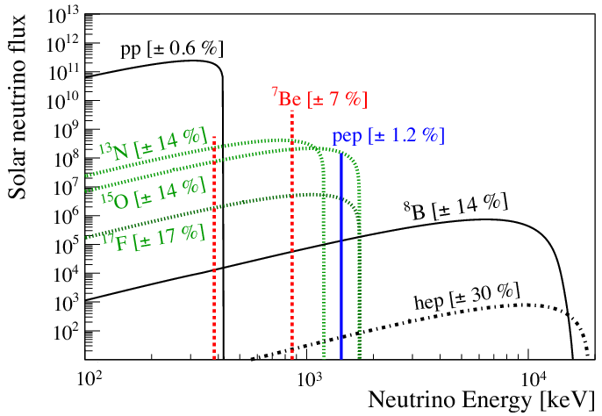
Solar neutrino spectra
0.1 MeV
1 MeV
10 MeV
Borexino 2014
8B: used for oscillation study
hep: haven’t been detected
4/28

Slide 5

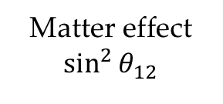
Solar neutrino oscillation
The survival probability
Vacuum oscillation
$$1−\frac{1}{2}\sin^{2}{2θ_{12}}$$
Matter effect
$$\sin^{2}{θ_{12}}$$
Borexino 2014
Good agreement?
5/28

Slide 6
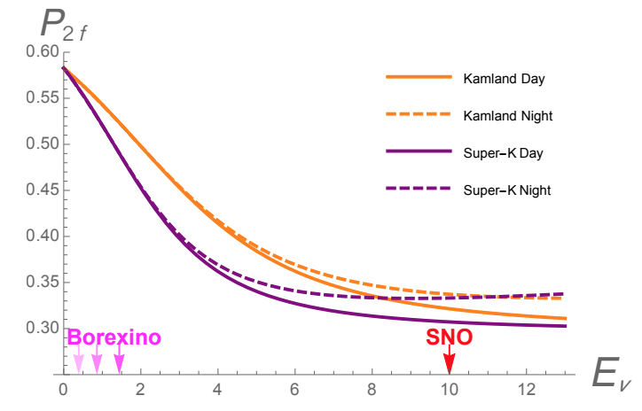
Oscillation phenomena
Two matter-induced effects
Upturn
Day-night effect
Vissani 2017
Both effects depend on neutrino energy
6/28

Slide 7
Current status
Solar & reactor tension
Data from SK 2016
Reactor: vacuum oscillation
Solar: matter effect
Capozzi et al, in prep
Tension driven by day-night effect
7/28

Slide 8
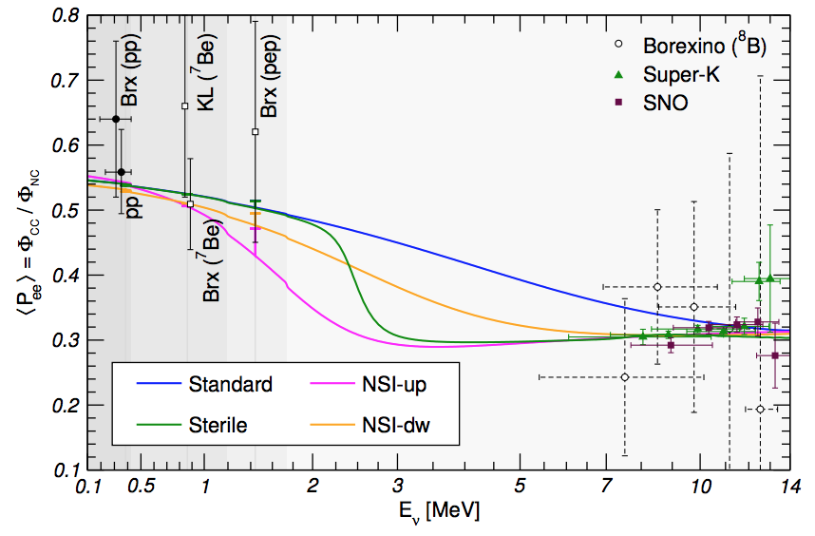
New physics?
Maltoni & Smirnov, 2015
8/28

Slide 9
Outline
Data from SK 2016
DUNE comes to rescue!
What is this?
Why haven’t we resolved this?
9/28

Slide 10
What we want to measure
$φ_{ν_{e}}/φ_{ν}$ as a function of neutrino energy
Upturn
Day-night effect
Vissani 2017
10/28

Slide 11

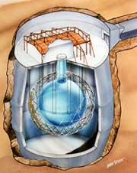
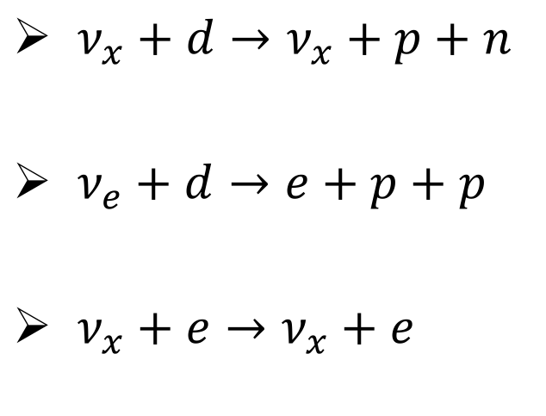
SNO: 1999 -- 2006
Both NC and CC channel
sno.phy.queensu.ca
$ν_{x}+d→ν_{x}+p+n$
$ν_{e}+d→e+p+p$
$ν_{x}+e→ν_{x}+e$
Provides ⁸B $ν$ flux: 4%
11/28

Slide 12
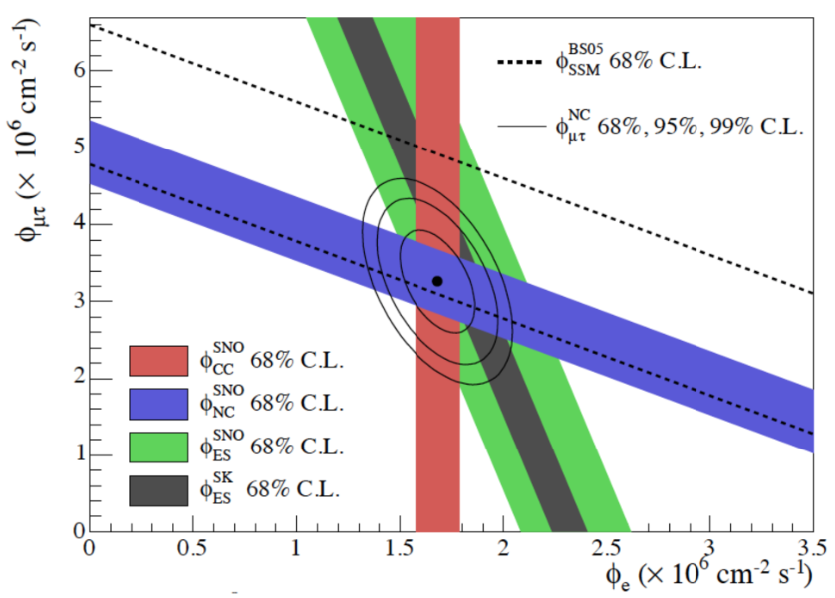
SNO: 1999 -- 2006
Both NC and CC channel
sno.phy.queensu.ca
Provides ⁸B $ν$ flux: 4%
12/28

Slide 13
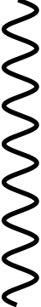










Super-K: 1996 -- present
ES channel only: $ν_{x}+e→ν_{x}+e$
$$ν_{e}$$
$$e$$
$$ν_{e, μ, τ}$$
$$ν_{e, μ, τ}$$
$$W$$
$$Z$$
$$e$$
$$ν_{e}$$
$$e$$
$$e$$
13/28

Slide 14
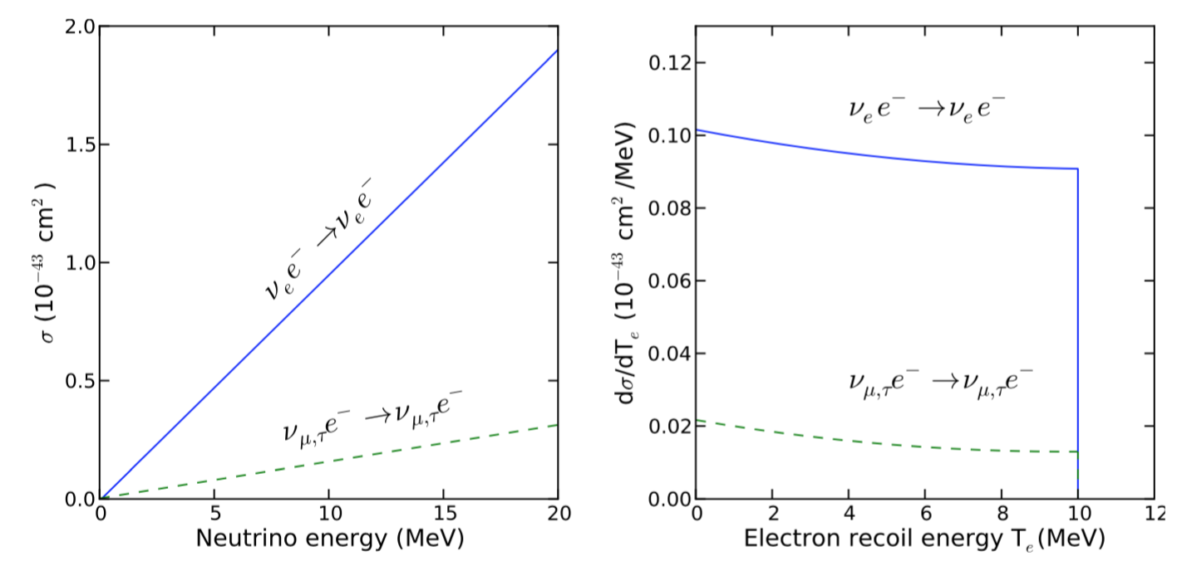


Super-K: 1996 -- present
ES channel only: $ν_{x}+e→ν_{x}+e$
Li 2017
$$f_{e}+1/6(f_{μ}+f_{τ})$$
$\sin^{2}{θ}$ limited by SNO flux
14/28

Slide 15
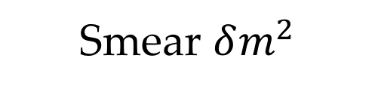
Super-K: 1996 -- present
ES channel only: $ν_{x}+e→ν_{x}+e$
Li 2017
Neutrino energy dependence washed out
Smear $δm^{2}$
15/28

Slide 16
Outline
Data from SK 2016
DUNE comes to rescue!
What is this?
Why haven’t we resolved this?
16/28

Slide 17
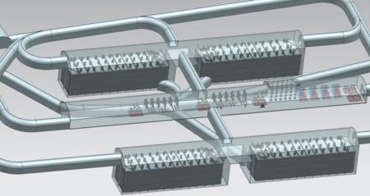
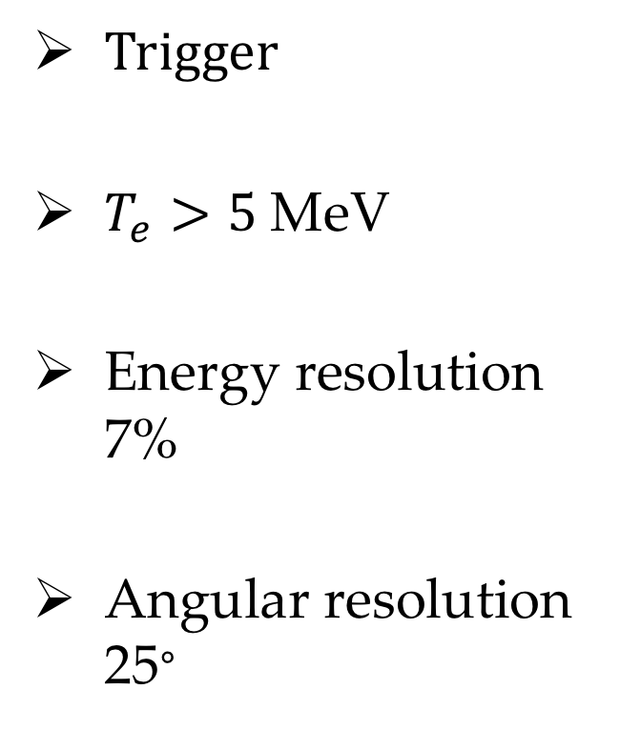
DUNE
4 10-kton liquid argon TPC module
Trigger
$T_{e}>5$MeV
Energy resolution 7%
Angular resolution 25∘
sciencemag.org
17/28

Slide 18




Unique advantage of DUNE
CC channel: $ν_{e}+Ar→e+K^{∗}$
$$ν_{e}$$
$$e$$
$$W$$
$$Ar$$
K*
$$γ$$
18/28

Slide 19
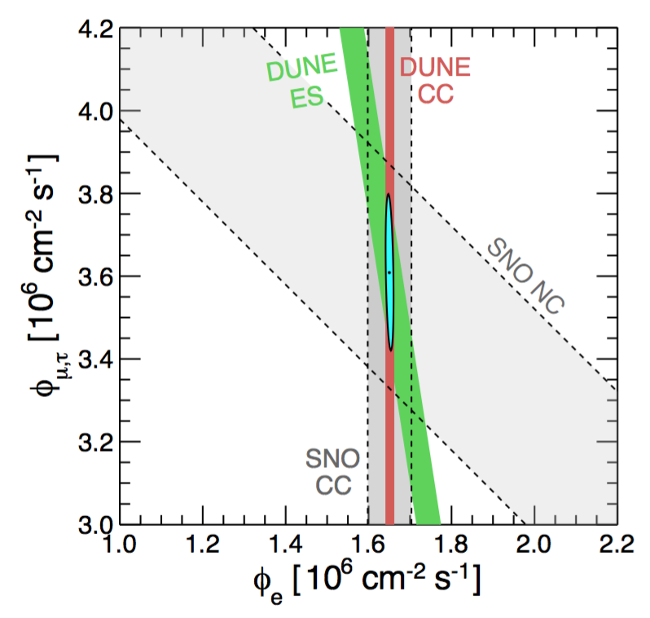
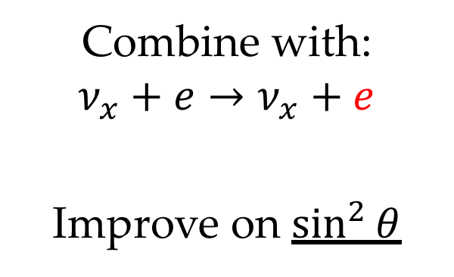
Unique advantage of DUNE
CC channel: $ν_{e}+Ar→e+K^{∗}$
Combine with:
$$ν_{x}+e→ν_{x}+e$$
Improve on $\sin^{2}{θ}$
Capozzi et al, in prep
19/28

Slide 20
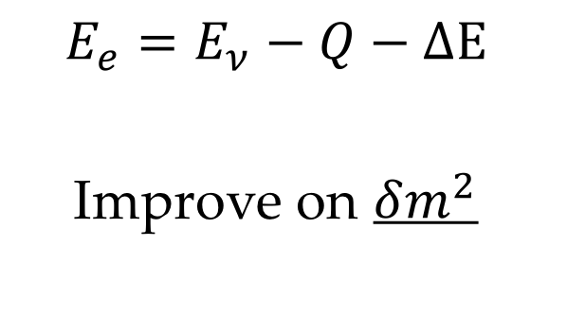
Unique advantage of DUNE
CC channel: $ν_{e}+Ar→e+K^{∗}$
$$E_{e}=E_{ν}−Q−ΔE$$
Improve on $δm^{2}$
20/28

Slide 21
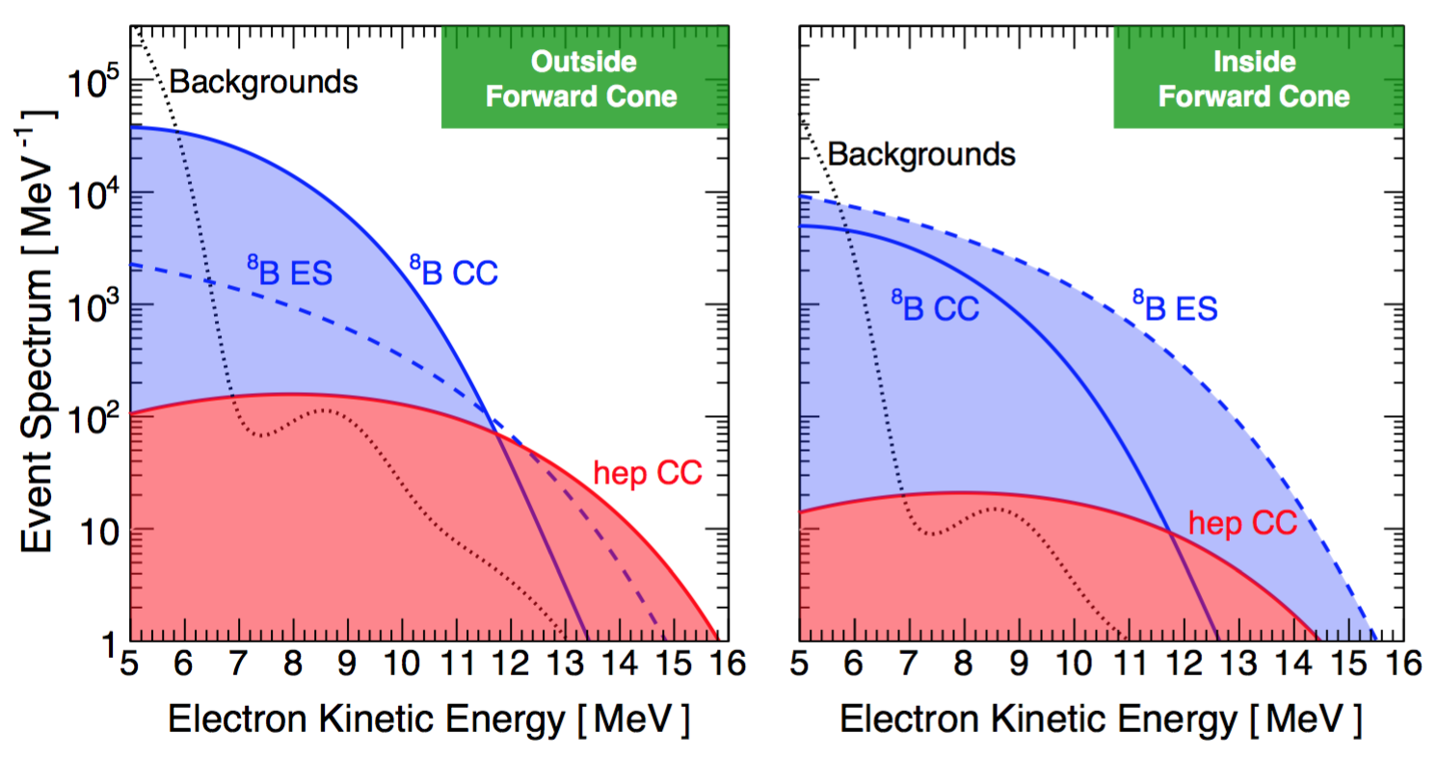
Event rate in DUNE
100 kton-year exposure
Capozzi et al, in prep
21/28

Slide 22
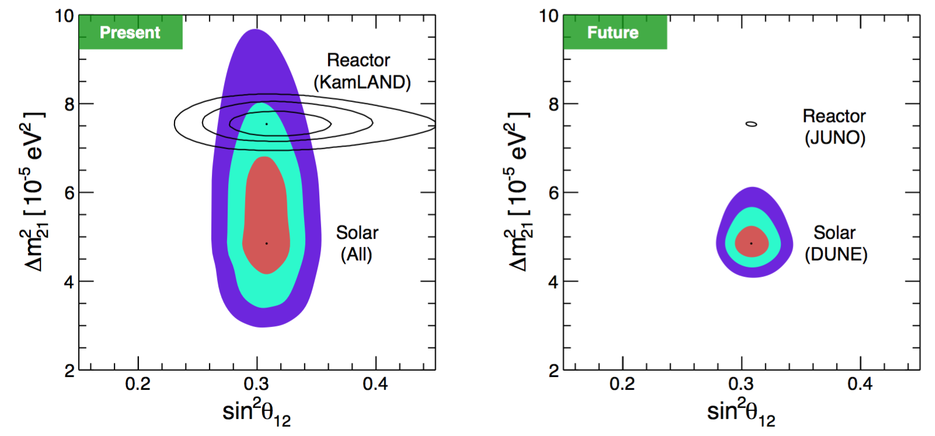
Results
Capozzi et al, in prep
In addition, ⁸B flux 2.5%, hep flux 10%
22/28

Slide 23
Solar neutrino in DUNE
Program
23/28

Slide 24
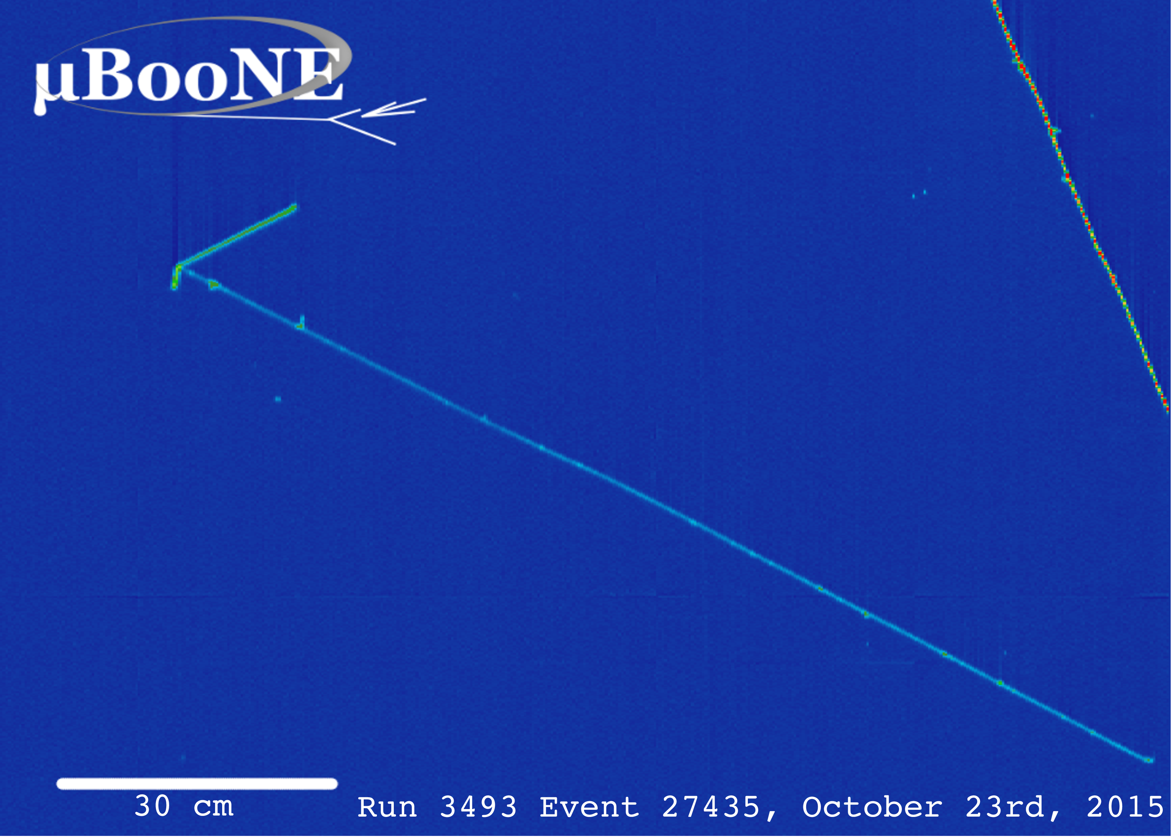
Trigger
24/28

Slide 25
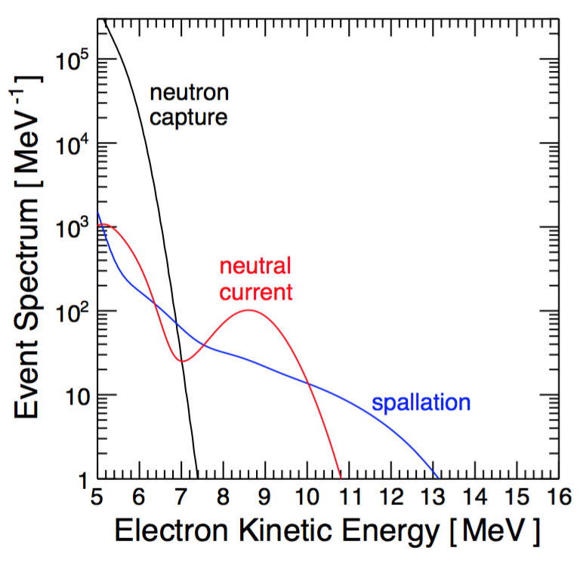
Backgrounds
Capozzi et al, in prep
Three options:
~ 40 cm of water/plastic shielding
Double the exposure
Separating gamma from electron
25/28

Slide 26
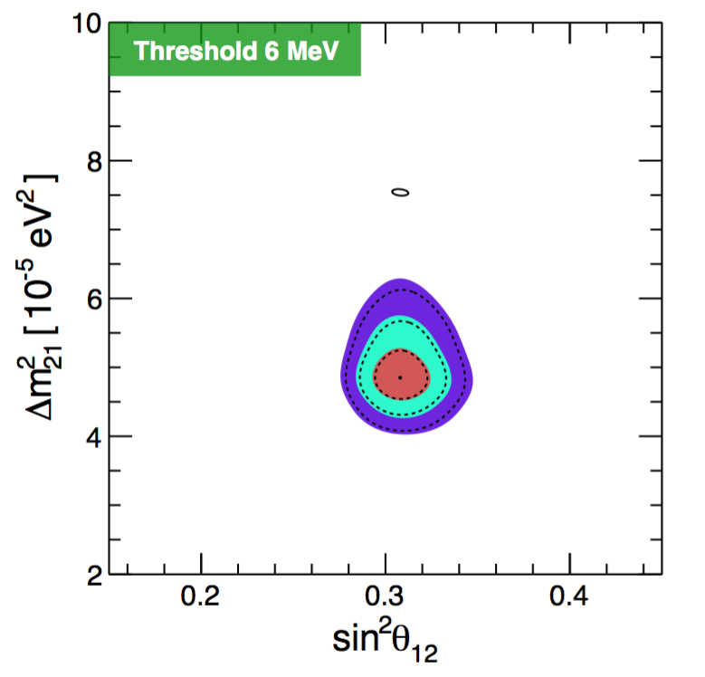
Threshold
Depends on reconstruction & background level
Capozzi et al, in prep
Can be compensated by larger exposure
26/28

Slide 27
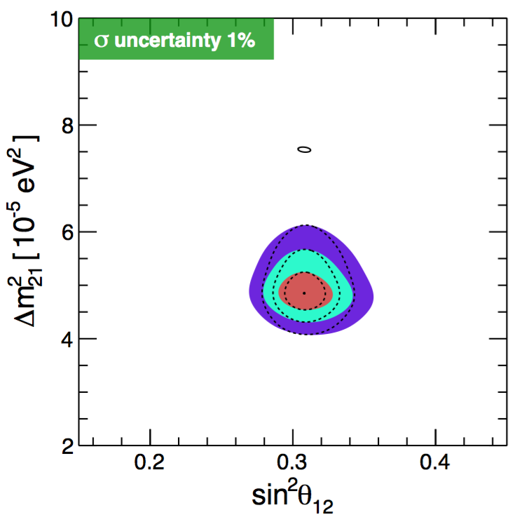
Cross section
Current uncertainty: a few %
Capozzi et al, in prep
27/28

Slide 28
Conclusions
28/28

Slide 29
Back up

Slide 30
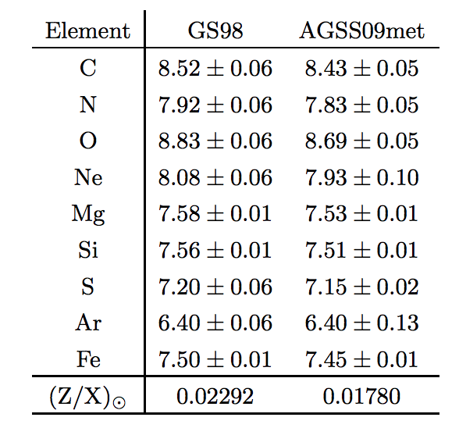
Measured metallicities
24/24

Slide 31
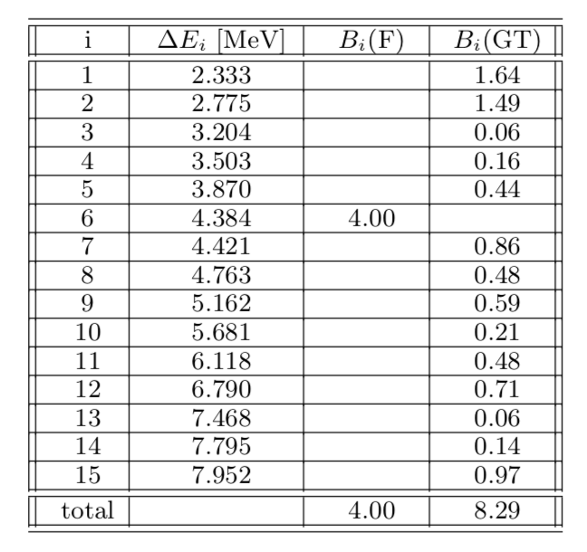
Cross section
24/24

Slide 32
Cross section
24/24

Slide 33
Cross section
24/24

Slide 34
Mass square sensitivity
24/24

