Slide 1
Universal correlation between δ and UV parameters + “model independent UV”
Hisakazu Minakata IFT UAM/CSIC, Madrid
Ivan Martinez-Soler, HM, arXiv:1806.10152
(Fong, HM, Nunokawa, 1609.08623, 1712.02798)

Slide 2
We see things converge
T2K see more and more preference of δ ~ 3π/2 (NOvA ??)
T2K II (proposed, run until 2026) they could see CPV at ~3 σ (expected for ~15x10²¹ POT)
δ ~ 3π/2 is the best case for NOvA for mass ordering (see bi-P plot), will see mass hierarchy at ~3 σ
Already, Bari global analysis says “normal at 3 σ ”
Everybody vs NOvA discrepancy about θ₂₃ seems resolved best fit near maximal
We must think about what is next?
My answer is “paradigm test”

Slide 3
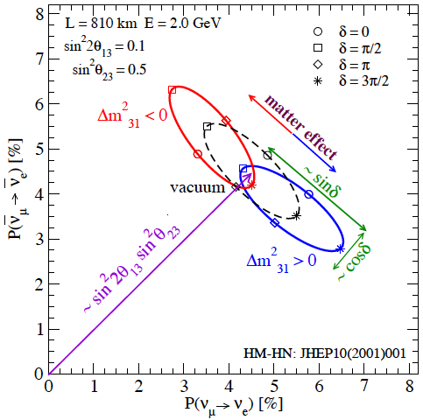
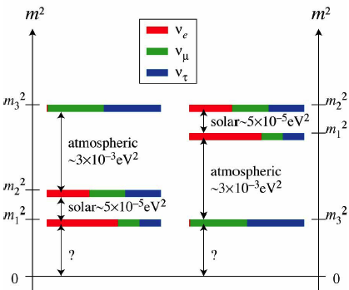
δ=3π/2 (or –π/2) implies that we are at the tip of the ellipse the best case for NOvA
P-\bar{P} bi-probability diagram, proposed by HM-H.Nunokawa, JHEP 2001
Sign of Δm²₃₁ distinguishes normal vs inverted mass ordering
δ and sign Δm²₃₁ couple because (Δm²₃₁ → − Δm²₃₁ , δ →π-δ) symmetry in vacuum (JHEP 2001)

Slide 4
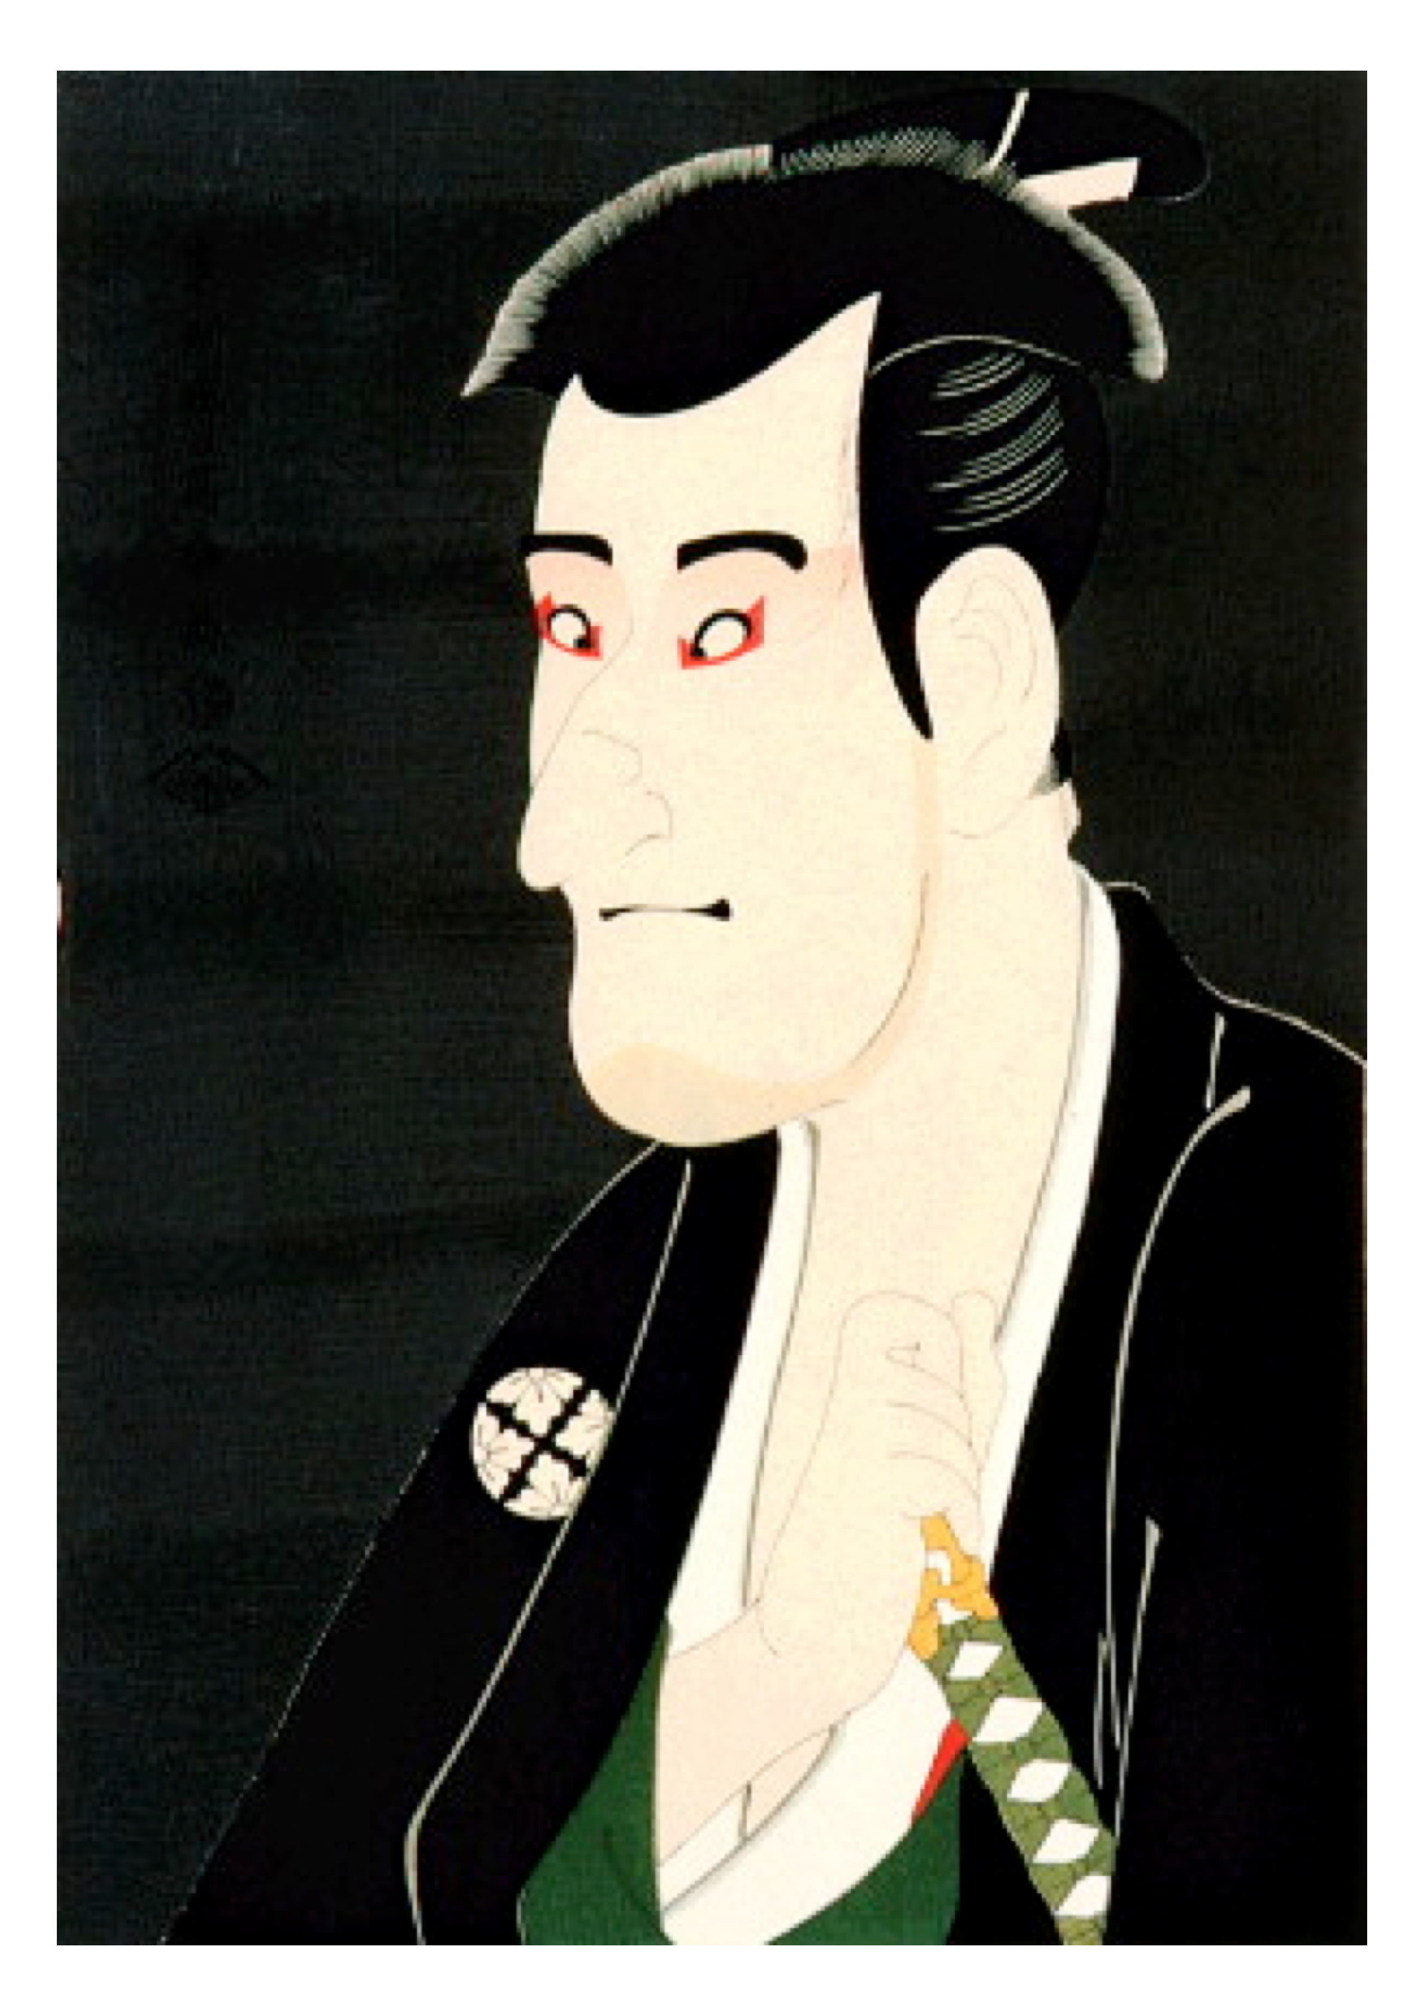
At where unitarity test needed

Slide 5
In what circumstance, do we want to test unitarity ?
We don’t know what is NP that causes UV
Yet, we want to test unitarity
(If we know what is NP, we don’t need unitarity test. We can just go to the model of NP to confront it to experiments!)
The only way we could pursue is to prepare (as much as) model-independent framework for unitarity test

Slide 6
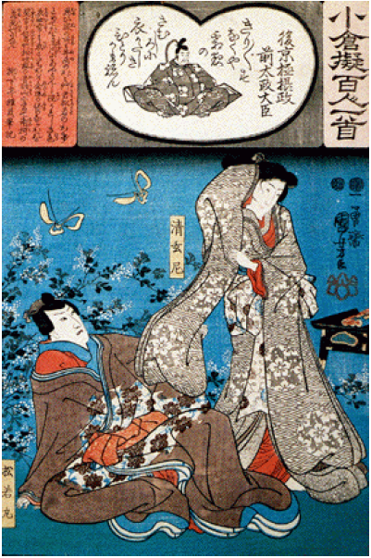
High vs low scale unitarity violation

Slide 7
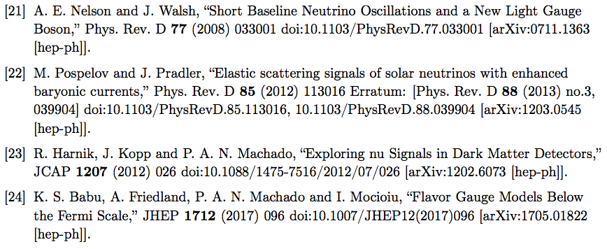
High- vs low-scale unitarity violation
High-scale UV
Low-scale UV
M_{NP} >> electroweak scale
SU(2) x U(1) prevails
stronger constraints from charged lepton sector
μ → e γ, μ → 3e, etc.
Traditional, like high scale seesaw
M_{NP} << electroweak scale
No SU(2) x U(1)
Neutrino experiments can play important role
Various scenarios are proposed motivated by LSND-MiniBoone, DAMA, etc.

Slide 8
High- vs low-scale unitarity violation
High-scale UV
Low-scale UV
lepton flavor universality: NO
zero distance neutrino flavor transition: YES
Kinematical effect of sterile nu emission: YES (if kinematically allowed)
lepton flavor universality: YES
zero distance neutrino flavor transition: NO
Kinematical effect of sterile nu emission: YES

Slide 9
High-energy unitarity violation
Antusch et al JHEP 2006
When high mass sector integrated out we have effective Lagrangian of light neutrinos and leptons but with unitarity violation
Aiming at model-independent formulation !!
Flavor nu states NOT orthogonal with each other

Slide 10
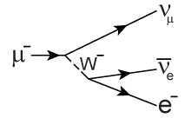
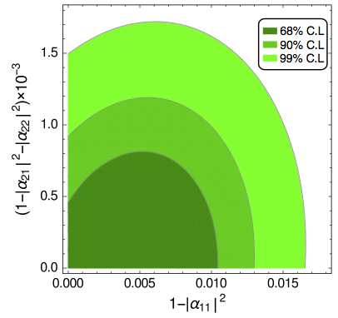
Flavor non-universality
μ → ν_{i}: N_{μi}*
ν_{i}→ ν_{μ}: N_{μi} / √ (NN⁺)_{μμ} because
<ν_{i} | ν_{μ}> = N_{μi} / √ (NN⁺)_{μμ}
Then, = Σ_{i} N_{μi} N_{μi}*/ √ (NN⁺)_{μμ} = √ (NN⁺)_{μμ}
G_{μ} = G_{F} √ (NN⁺)_{μμ} √ (NN⁺)_{ee}
Escrihuela etal PRD2015

Slide 11
δ vs. alpha correlation

Slide 12
Alpha parametrization
Enrique Fernandez-Martinez et al (Madrid) argue that α parametrization is better
The reason is that α less affect the values of MNS parameters: sounds like a good reason
Let us use α !
9 parameters… too many…
correlation between MNS & α parameters?

Slide 13
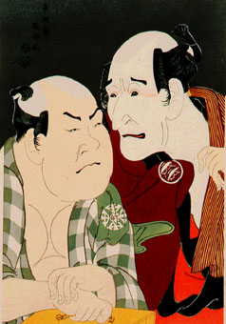
Yes, there is correlation between the two

Slide 14
Result first: δ vs. alpha correlation
General formula for S matrix
δ and alpha always come in this combination!
Let us call “canonical phase combination”
What this relation means?

Slide 15
Meaning of
A bit unusual situation: NP parameter α is correlated with SM parameter δ
Framework of UV (=unitarity violation) itself knows how NP is related with SM mild, model-independent constraints on NP
UV is better defined framework than “NSI put in by hand” approach

Slide 16
Helio-UV perturbation theory

Slide 17
Digging out parameter correlations
Use perturbation theory
small parameters
1st one: ε = Δm²₂₁ /Δm²₃₁
2nd one: UV parameters = alpha’s
helio-UV Perturbation theory

Slide 18
Vacuum mass eigenstate basis
CP phases are concentrated to here

Slide 19
U₁₃U₁₂ transformed basis: tilde basis
Perturb by 2 small expansion parameters: ε and alpha’s

Slide 20
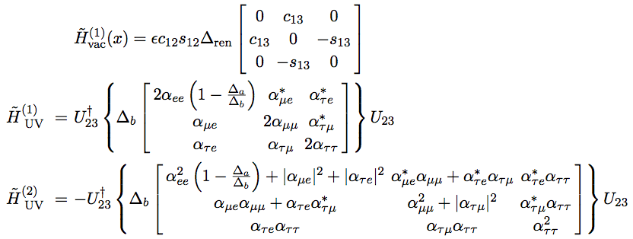
Decomposition of tilde-Hamiltonian
Zeroth-order
Diagonaize by φ rotation eigenvalue h_i
Renormalized helio perturbation
First+second order
HM-S.Parke JHEP2016

Slide 21
3 parts of S matrix
General formula for S matrix
1st order formula
Zeroth-order + helio correction
“intrinsic” UV contribution
“extrinsic” UV contribution

Slide 22
SM part: Simple & compact P
The simplest oscillation formula so far with all order matter and θ₁₃ effects
HM-S.Parke JHEP2016
Simple & compact P

Slide 23
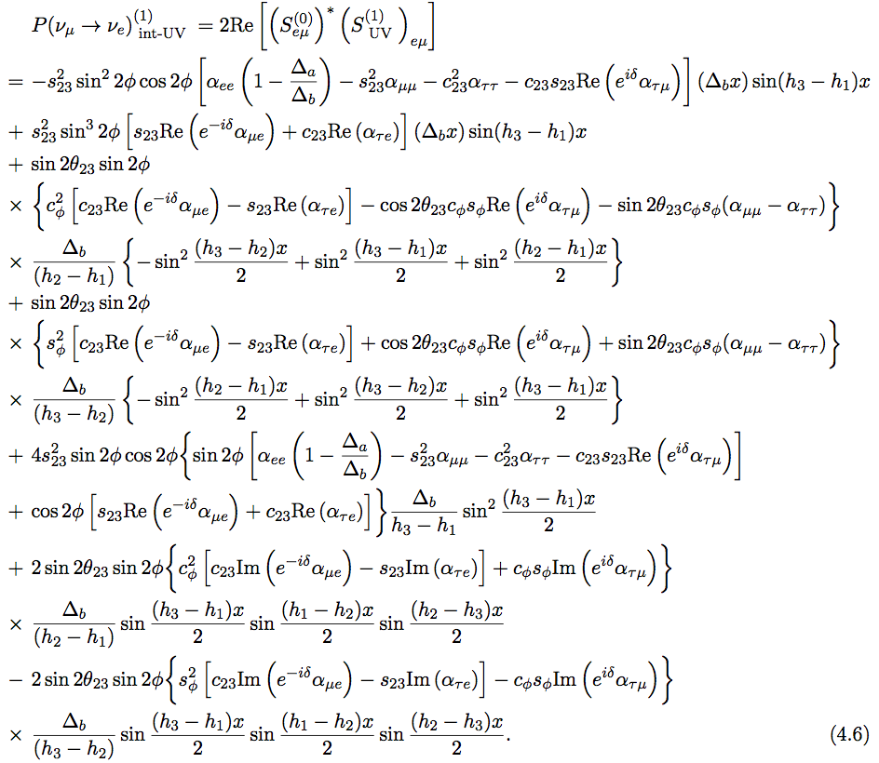
“extrinsic” UV contribution
“intrinsic” UV contribution

Slide 24
Is ν evolution unitary?
Yes !

Slide 25
Unitarity of ν evolution with non-unitary mixing ??
High-scale UV: integrate out NP sector at high energies
3 active nu span the complete state space of neutral leptons at low energies
Then, nu evolution must be unitary
Non-unitarity comes in as initial & final projection
One can show perturbative unitarity

Slide 26
3 active+N-sterile ν model for Low-E unitarity violation
Other models of Low-E UV?

Slide 27
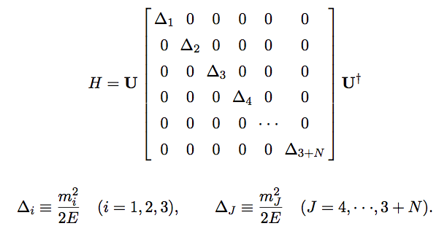
3 active +N sterile unitary model in vacuum
My previous N matrix = U now…..3x3
Schechter-Valle, PRD1980
NxN

Slide 28
What I want to do ?
We want to make observable quantity (oscillation P) “independent” of sterile sector model = mass spectrum, mixing with active nu sector
I will present a concrete way fast oscillation average out regime
Other ways?

Slide 29
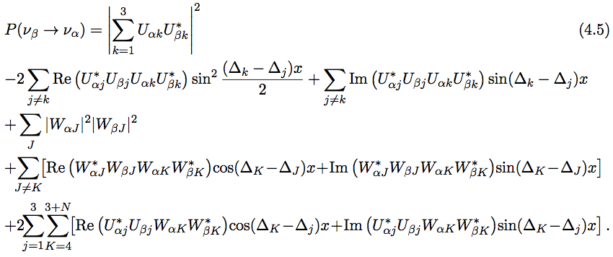
Probability in vacuum
What is this?
Active-active, active-sterile, sterile-sterile oscillations
If Δm²_{as} (Δm²_{ss}) > 0.1 eV², “fast oscillation” due to active-sterile and sterile-sterile Δm² are averaged out

Slide 30
P looks almost standard one, but there is a new term
Probability leakage !
Appearance
U = non-unitary “MNS”
Disappearance
Order ~ W⁴, small!!

Slide 31
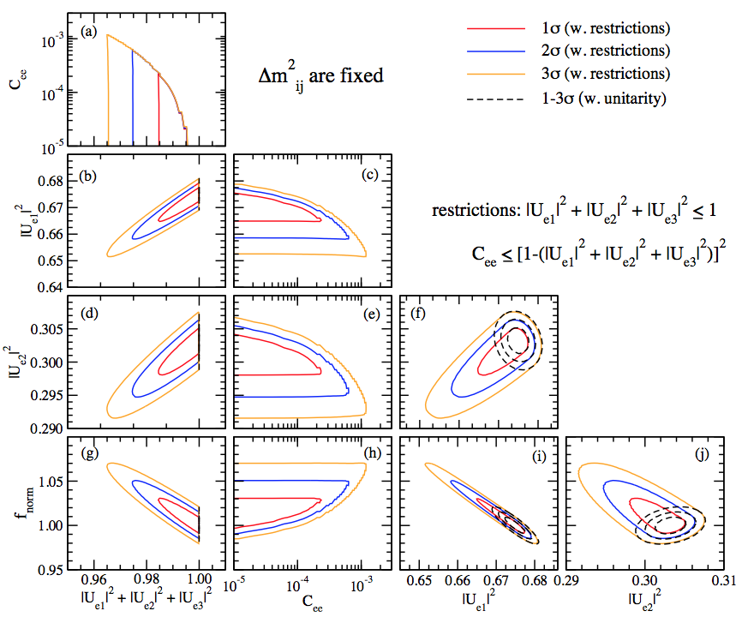
Sensitivity to C_{ee} and 1-Σ|U_{ei}|² from JUNO 5 years
3% flux uncertainty assumed
C_{ee} ~ 10⁻⁴ (1 σ)
1-Σ|U_{ei}|² ~ 0.01

Slide 32
Sterile model-independent P: Prevail to “in matter” ?

Slide 33
A simple formula for oscillation probability in matter w/o unitarity: leading order in W perturbation
X=…
All W² & W⁴ terms avaraged out or suppressed if Δm² > 0.1 eV² except for P leaking term!!
UV effect is in: (1) explicit W correction term, (2) non-unitary U matrix

Slide 34
Where is the region of large UV?

Slide 35
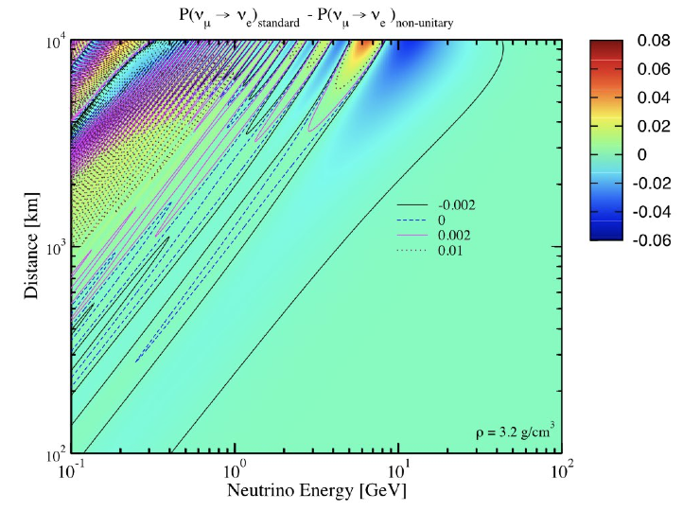
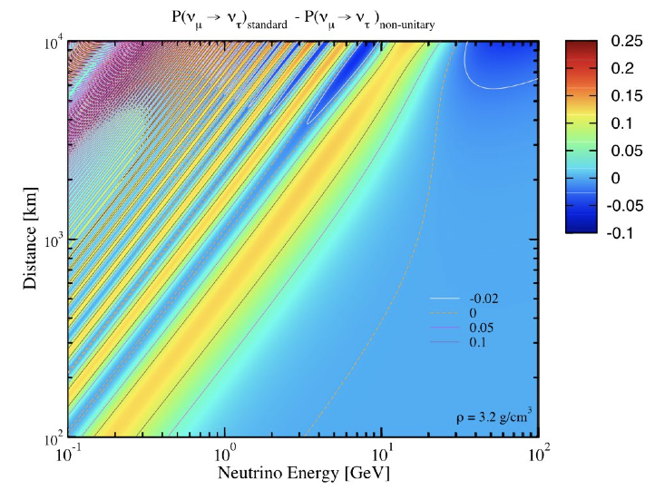
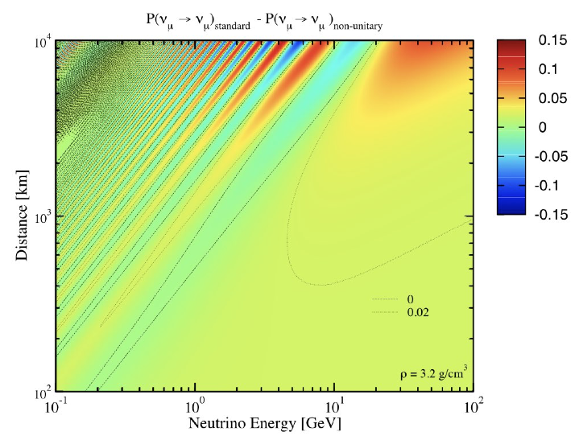
Leading order terms = Zeroth order in W
ΔP large at solar- and atm- MSW enhanced regions

Slide 36
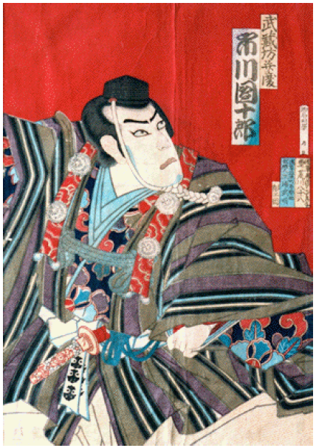
Large ~W² corrections?

Slide 37
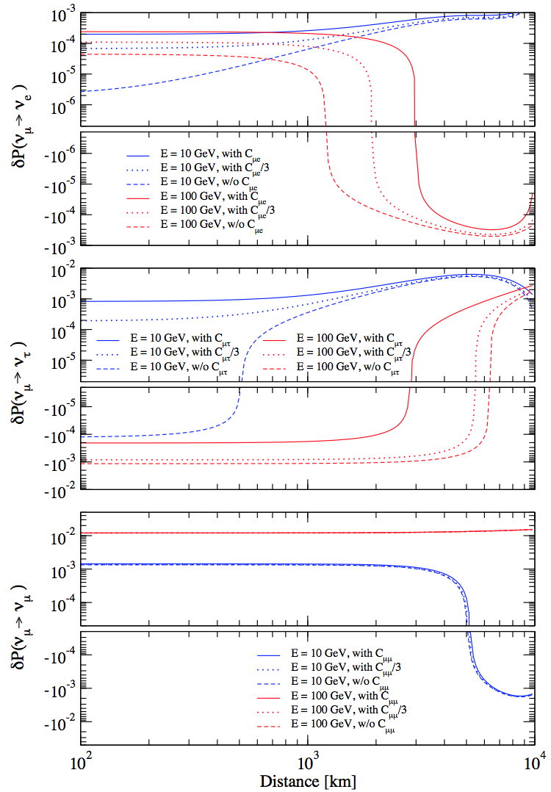
Order W2 correction terms
small in most of the regions of L-E, but sizeable in limited places
High energy, long baseline → IceCube, PINGU, Hyper-K

Slide 38
Summary

Slide 39
Summary (phase correlation)
alpha parameters (which describe NP causing UV) have definite universal correlation with δ
framework of UV (high-scale, or leading-order low-scale) knows how NP should have relation with SM (strange ?)
better framework than “adding NSI ad hoc” (?)
Neutrino propagation unitary with non-unitary mixing matrix

Slide 40
Summary (“model-independent” low-scale UV)
P made insensitive to sterile sector structure if m_{J}² > 0.1 eV² both P in vacuum and in matter
A new term, the “probability leaking (to sterile sector) term” found JUNO analysis C_{ee} ~ 10⁻⁴, 1-Σ|U_{ei}|² ~ 0.01 (both 1 σ)
W² correction sizeable in limited L-E regions
distinguishes between low-E from high-E UV
Large UV and large W² correction both requires L ~ 3000-10⁴ km HK/DUNE, PINGU-IceCube, KM3Net/Orca atm nu

Slide 41
Backup slides

Slide 42
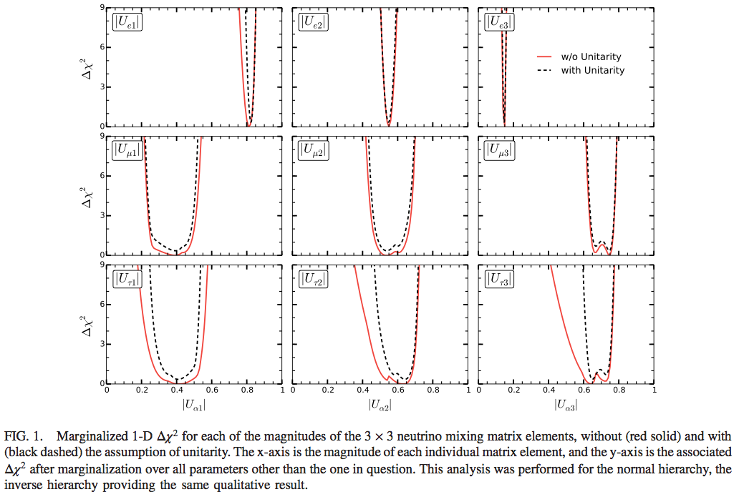
Parke-Ross-Lonergan PRD2016
Without P leaking term!

Slide 43
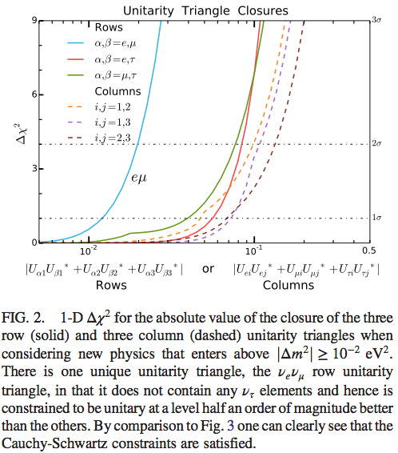
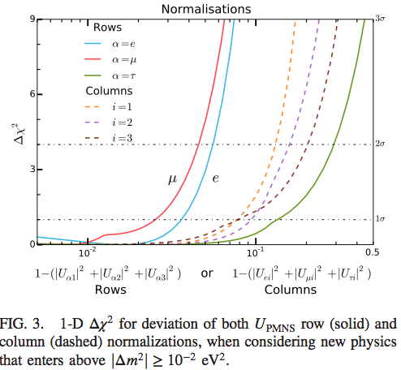
Constraints on unitarity violation (Parke-Ross-Lonergan)

