Slide 1
NuFact 2018 - August 12-18
WG4
Muon Physics Summary
Craig Group, MyeongJae Lee, and Frederik Wauters

Slide 2
Why muons at NuFact?
Same production mechanism for muons and neutrinos.
A neutrino factory is also a muon factory and vice versa.
Muon experiments are complementary to each other and to searches at the Energy Frontier.
Excellent probe for physics beyond the standard model.

Slide 3
So much to cover in WG4!
I will attempt to:
Cover 25 talks
Cover 18 different experiments
Summarize the view of all group members
Many topics:
CLFV (muons,colliders)
g-2
Proton radius puzzle
...

Slide 4
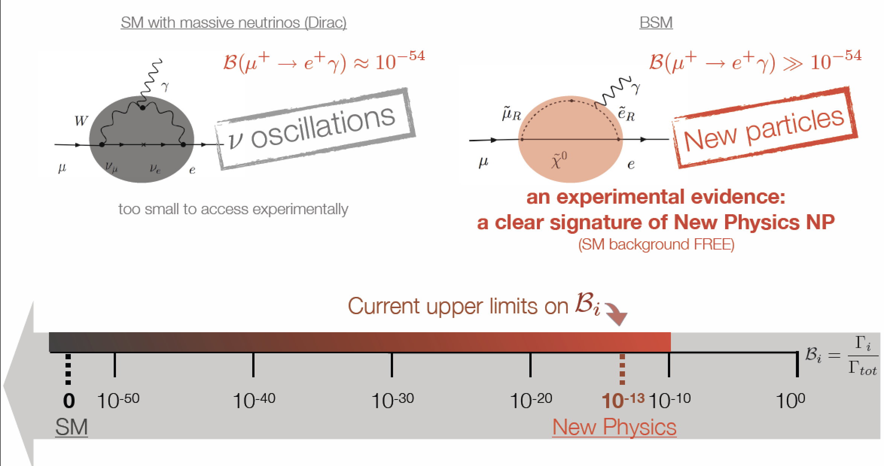
CLFV evidence: A clear signature of New Physics
Muon CLFV experiments strive to keep backgrounds <<1 event and achieve single event sensitivity.
Angela Papa

Slide 5
Pulsed v/s DC Muon Beams
Angela Papa

Slide 6
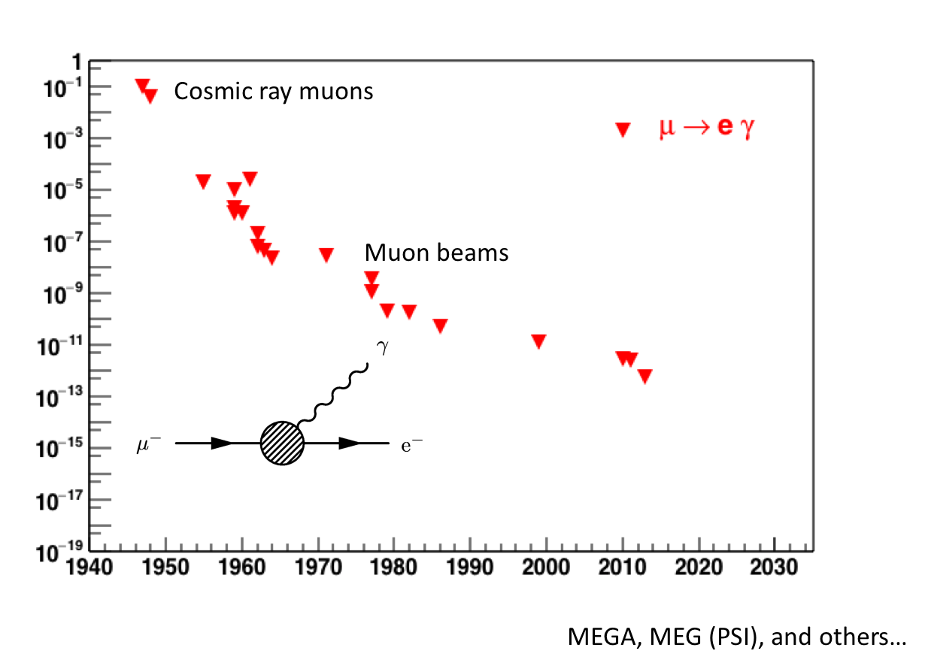
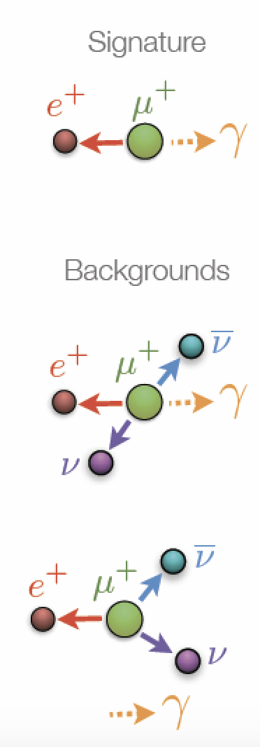
History of CLFV Searches:
Fully reconstruct electron and photon.
DC beam helps control combinatorial bkg.
Current best limit from MEG at PSI.
→ Br<4.2x10⁻¹³ MEG at PSI

Slide 7
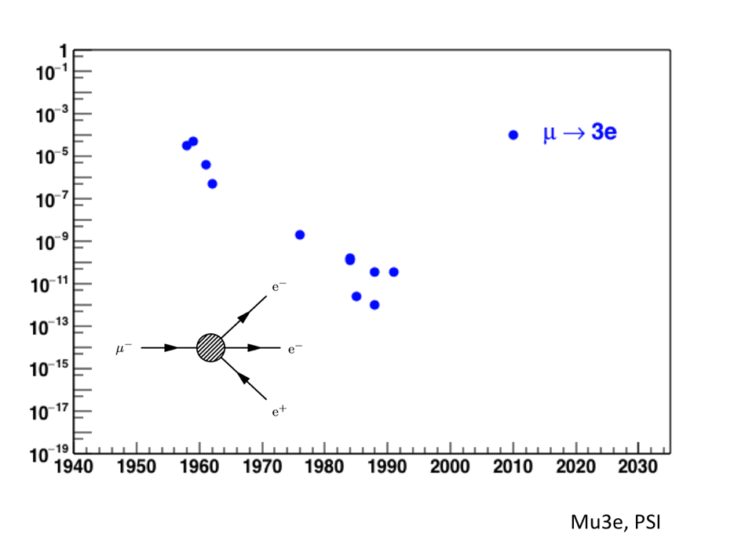
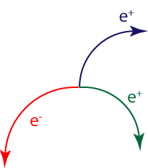
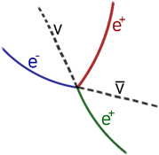
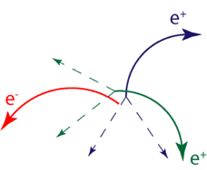
History of CLFV Searches:
Track all three electrons.
DC beam helps control combinatorial bkg
Current best limit 20 years old!
Signal
Backgrounds
Conversion
Combinatorial

Slide 8
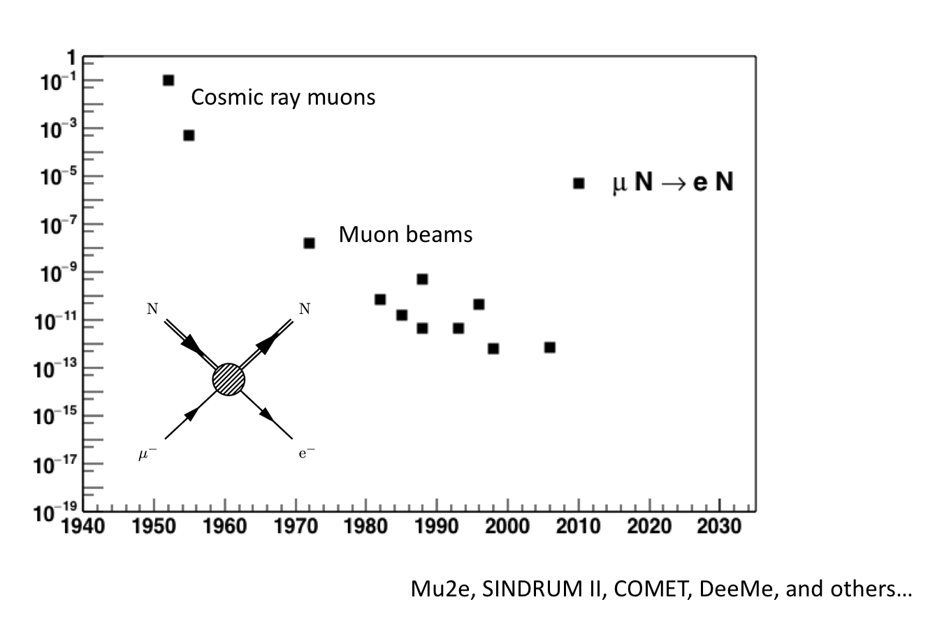
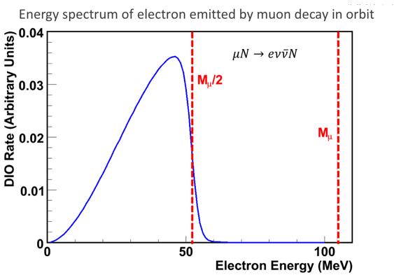
History of CLFV Searches:
Monoenergetic electron ~mass of muon.
Pulsed beam controls prompt bkg
Signal delayed by muon lifetime.
Current best limit from SUNDRUM-II at PSI.
→ 7x10⁻¹³

Slide 9
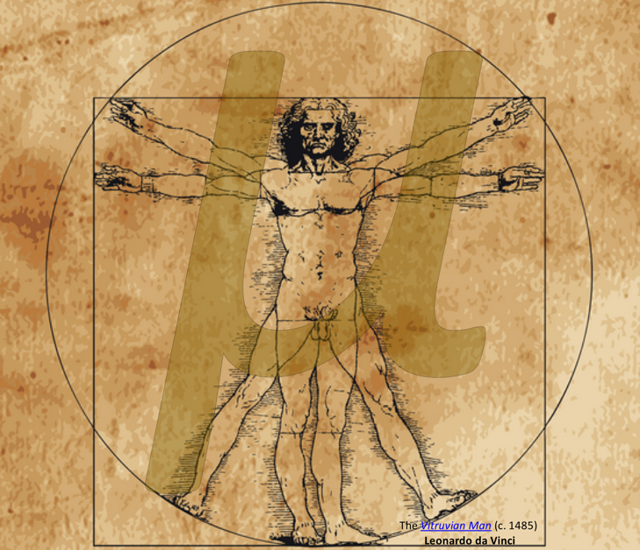
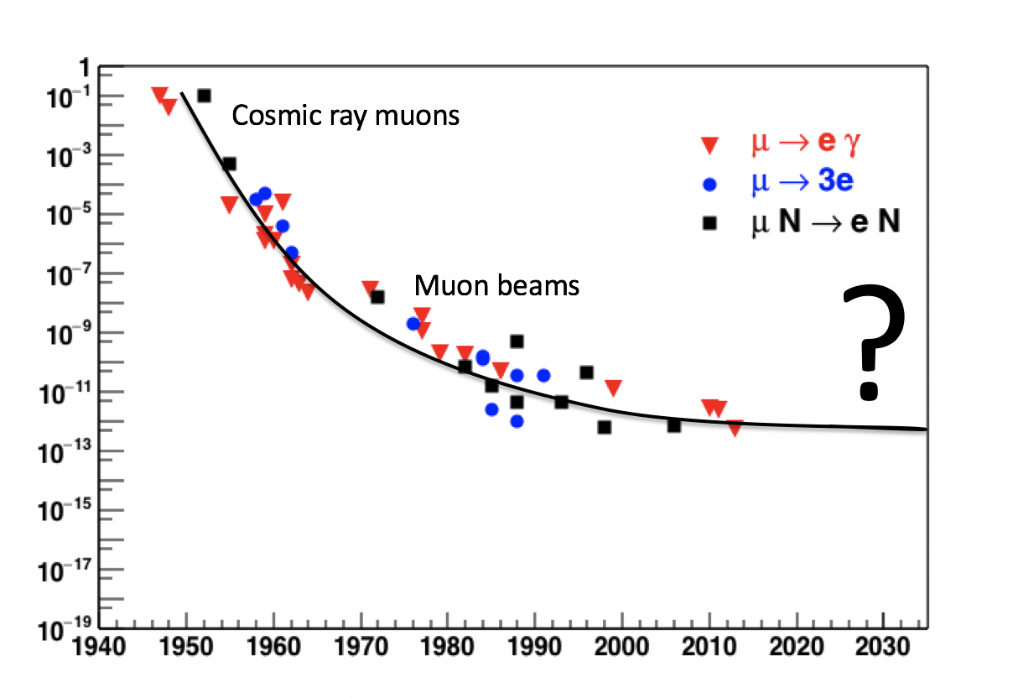
A Renaissance for Muon Physics?

Slide 10
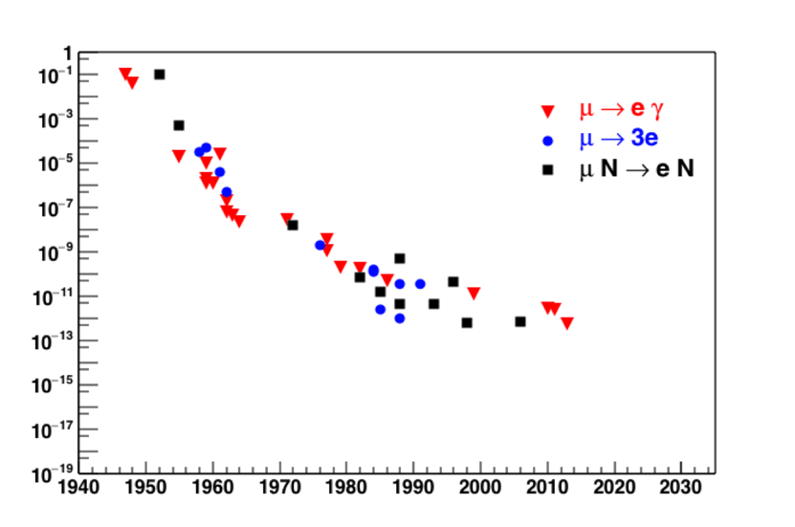
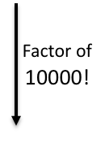
A Renaissance for Muon Physics?
MEG-II
DeeMeI
Mu3e PhaseI
DeeMeII
Mu3e-II
Mu2e, COMET
Mu2e-II
PRISM?
We heard updates on all of these muon CLFV experiments.

Slide 11
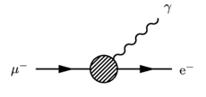
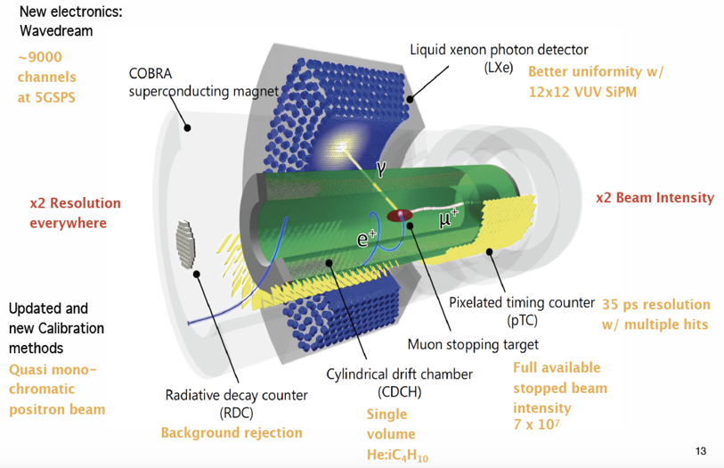
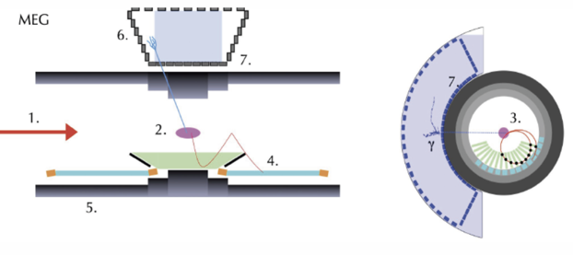
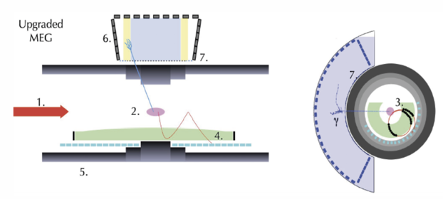
The MEG-II Experiment
Angela Papa

Slide 12
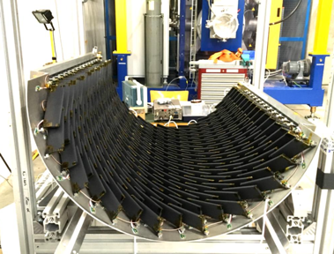
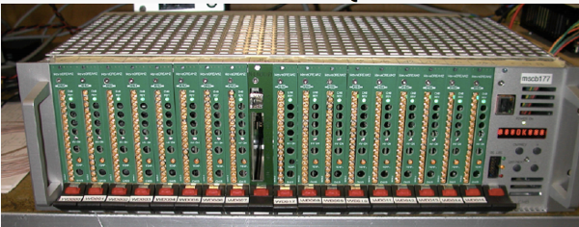
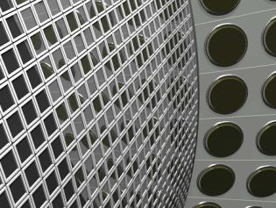
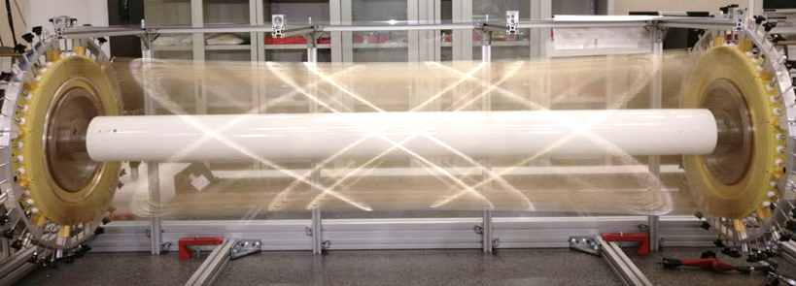
MEG-II Status
Pixel timing counters fully assembled and commissioned.
Improved electronics design ready and used in test-beam runs.
Assembly of new single-volume chamber is complete.
New LXe assembled and filled - commissioning ongoing.

Slide 13
MEG-II Status
Pixel timing counters fully assembled and commissioned.
Improved electronics design ready and used in test-beam runs.
Engineering run should start next year!
Assembly of new single-volume chamber is complete.
New LXe assembled and filled - commissioning ongoing.

Slide 14
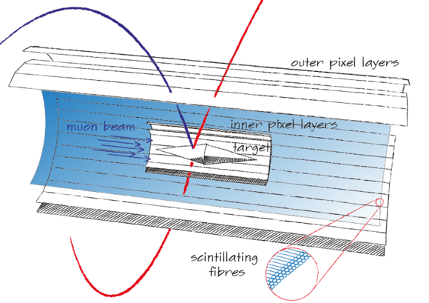
The Mu3e Experiment
2 x double layer of Si pixel detectors
Each layer is < 0.1 % of a radiation length
Scintillating fiber and tile layers provide excellent timing:
350 ps < 500 ps (fibres)
70 ps < 100 ps (tiles)
Frederik Wauters

Slide 15
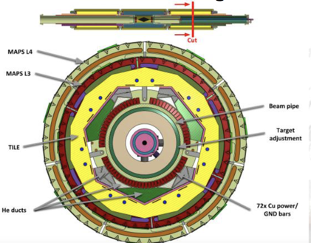
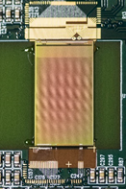
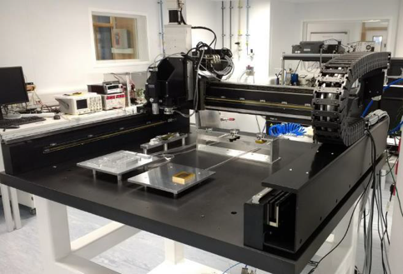
Mu3e Status
Area/services at PSI under construction.
Working toward vertical slice test.
Magnet coming <1 yr.
Mechanical design is complete.
Finalizing the R&D for the HV-MAPS
High Voltage Monolithic Active Pixel Sensors
Detector production tools are underway...

Slide 16
Mu3e Status
Area/services at PSI under construction.
Working toward vertical slice test.
Magnet coming <1 yr.
Mechanical design is complete.
Phase I coming in early 2020s.
Finalizing the R&D for the HV-MAPS
High Voltage Monolithic Active Pixel Sensors
Detector production tools are underway...

Slide 17
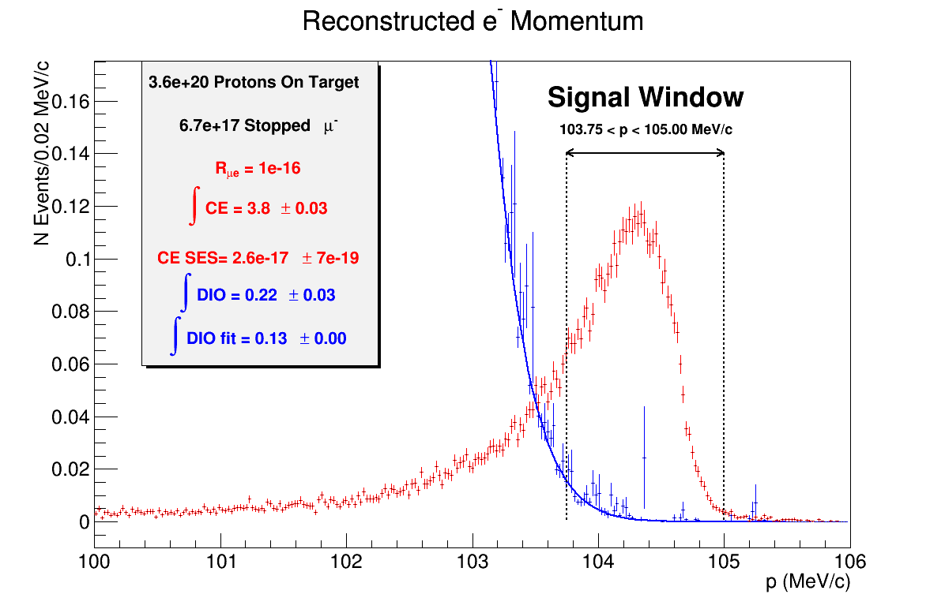
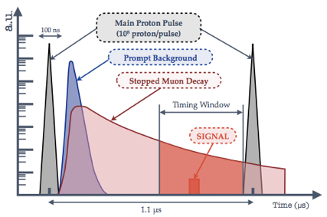
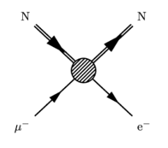
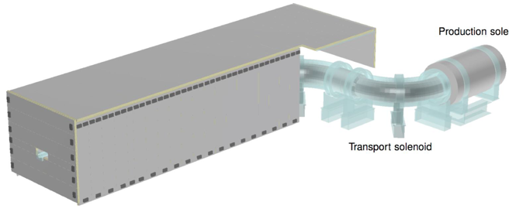
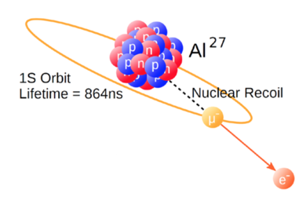
μ− N → e− N Experiments
Momentum resolution must be good (typically <200 keV)
All of these experiments used pulse beams.
Bkg from cosmic rays must be controlled.
Stop muons -> muonic atoms

Slide 18
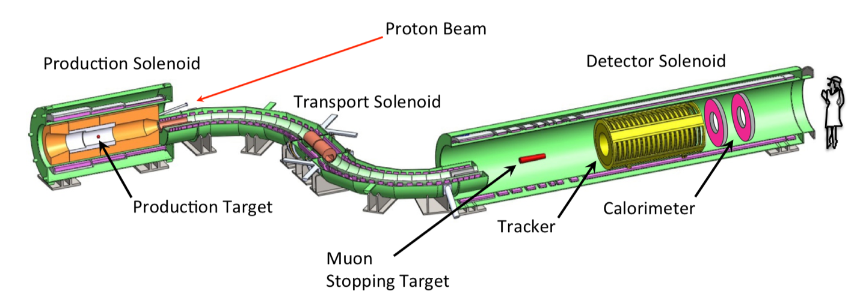
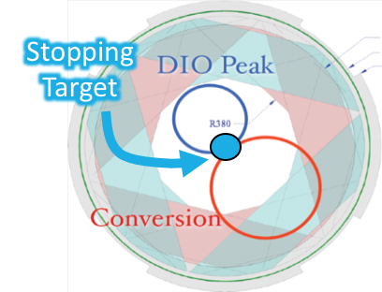
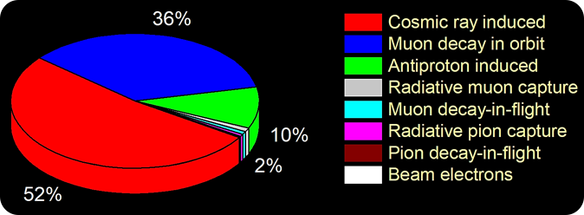
The Mu2e Experiment
SES of 3x10-17 is the target (10,000x better than current results)
(pulsed)
Steve Boi

Slide 19
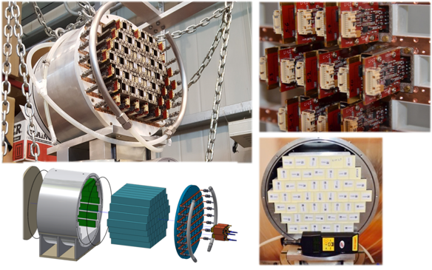
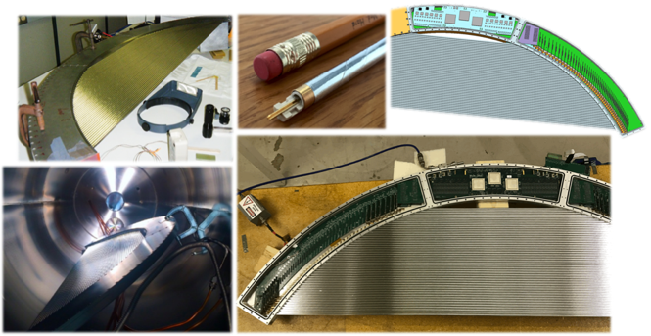
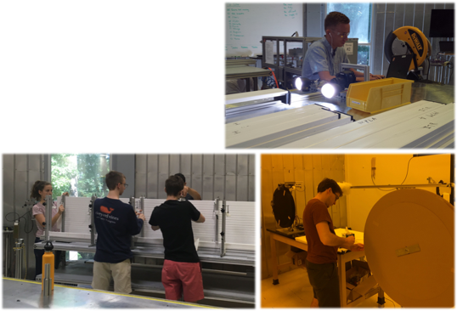
Mu2e Status
Prototype Calorimeter
Prototype Tracker Panels
Cosmic Ray Veto Production Underway

Slide 20
Mu2e Status
Prototype Calorimeter
First physics expected in 2022.
Prototype Tracker Panels
Cosmic Ray Veto Production Underway

Slide 21
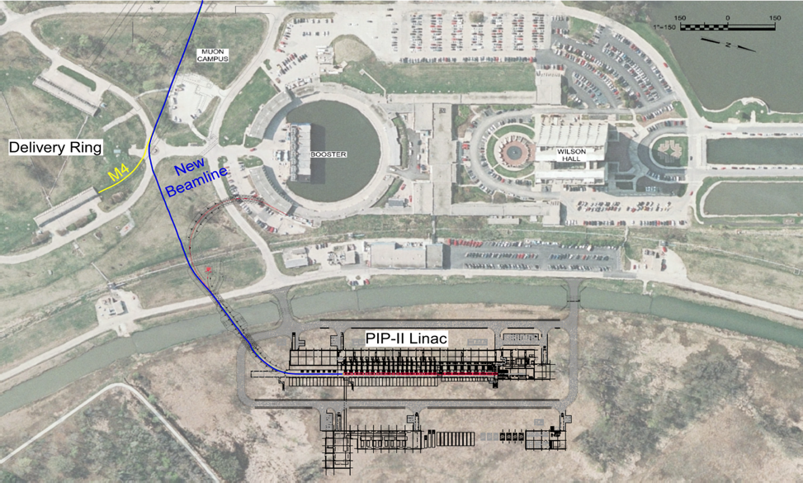
Mu2e-II
→ Working to identify high-priority R&D so that work can begin soon: Mu2e workshop in two weeks at Northwestern – join us! https://indico.fnal.gov/event/17536/
Craig Group

Slide 22
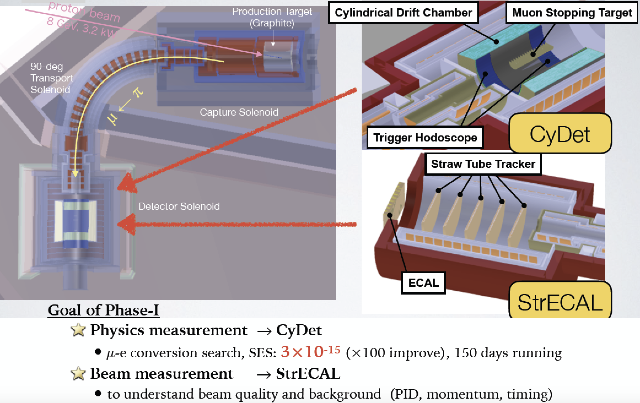
The COMET Experiment (phase I)
Manabu Moritzu

Slide 23
The COMET Experiment (phase II)
Manabu Moritzu

Slide 24
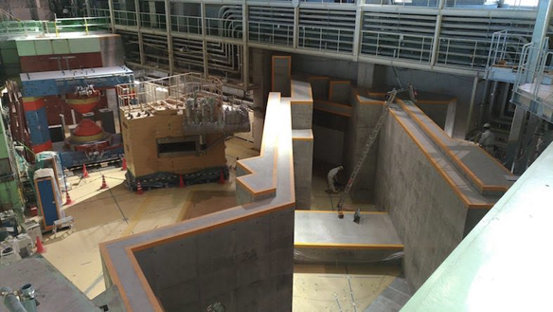
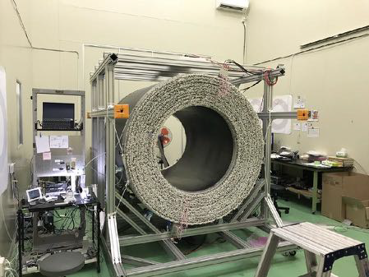
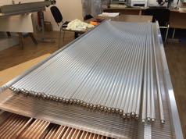
COMET Status
Beamline wall construction is complete.
Transport Solenoid installed,
Production Solenoid winding in progress, and Detector Solenoid are complete.
.
CyDet Cylindrical Drift Chamber cosmic ray studies ongoing. FEBs have been fabricated.
Straws for StrECAL fabricated.
Other StrECAL components also being produced/purchased.

Slide 25
COMET Status
Detectors will be ready next year for phase I!
Beamline wall construction is complete.
Transport Solenoid installed, Production Solenoid winding in progress, and Detector Solenoid are complete.
Beamline wall construction is complete.
CyDet Cylindrical Drift Chamber cosmic ray studies ongoing. FEBs have been fabricated.
Straws for StrECAL fabricated.
Other StrECAL components also being produced/purchased.

Slide 26
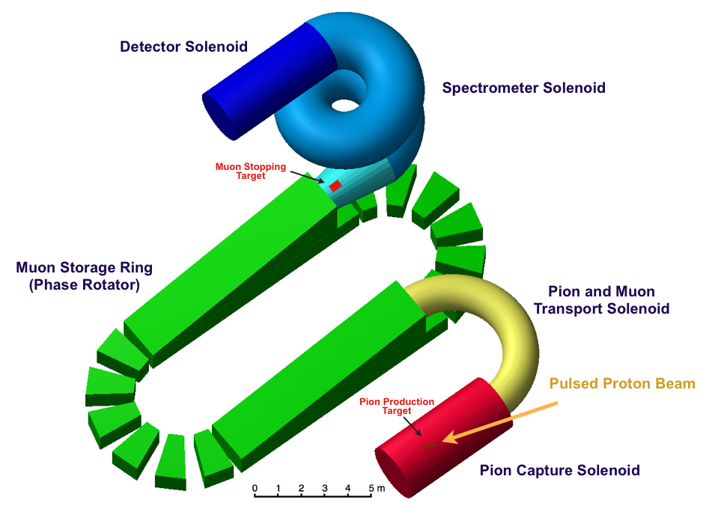
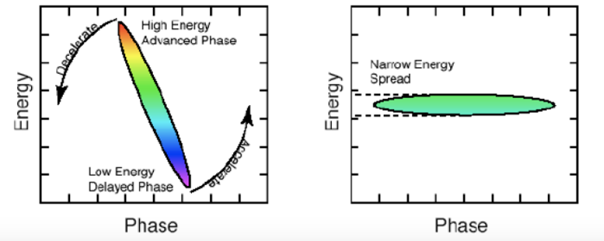
PRISM/PRIME: A Next-Generation μ− N → e− N Experiments
PRISM:
Phase Rotated Intense Slow Muon beam
Requires compressed proton bunch and high power proton beam
Phase rotation in muon storage ring
PRISM/PRIME:
potential upgrade to COMET
SES 3x10⁻¹⁹ suggested with new proton driver
R&D is ongoing…
PRISM is becoming a serious option for the next generation cLFV experiment.
Novel ideas in generating muon beams may open new horizons:
Neutrino factory
Muon collider
...
J. Pasternak

Slide 27
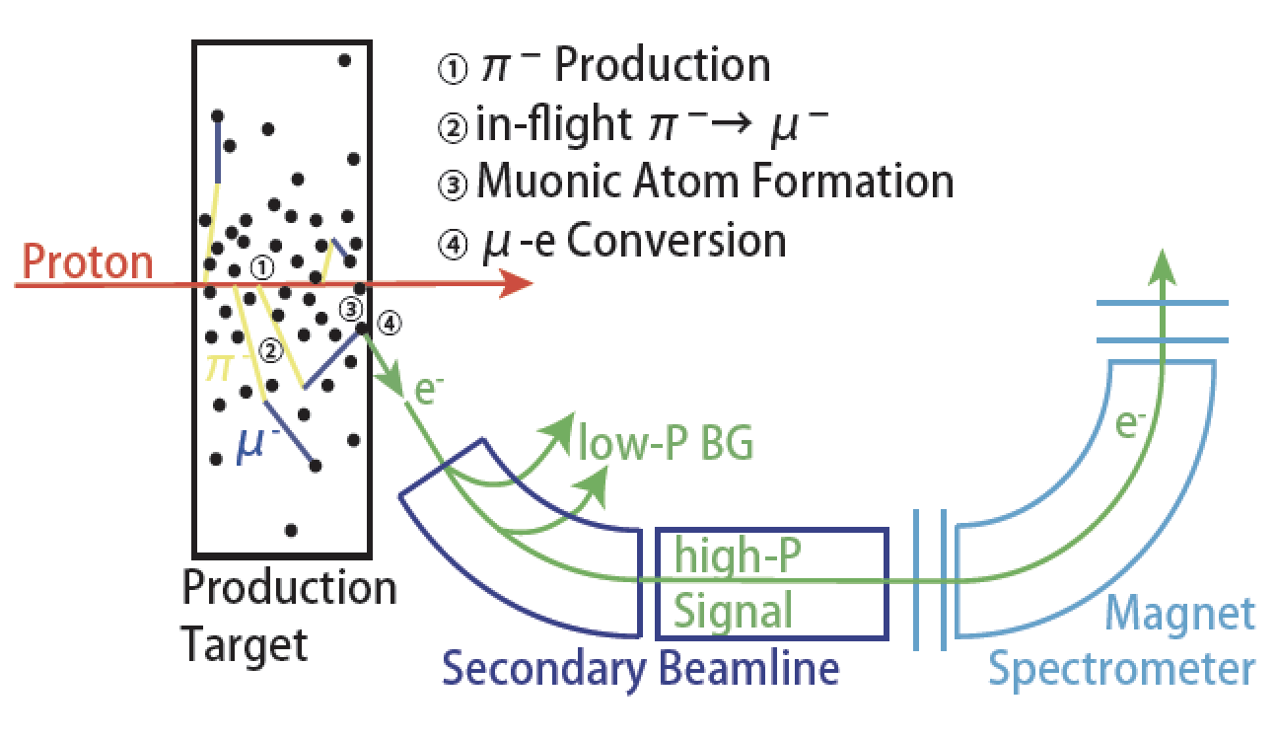
The DeeMe Experiment
Unique: production target is also the stopping target.
Spectrometer is Pacman magnet with MWPC.
Optimization of MWPC to handle beam flash.
Working to measure decay in orbit spectrum - Carbon.
Daiki Nagao

Slide 28
The DeeMe Experiment
Unique: production target is also the stopping target.
Spectrometer is Pacman magnet with MWPC.
Optimization of MWPC to handle beam flash.
Working to measure decay in orbit spectrum - Carbon.
Beam expected in 2019.
Daiki Nagao

Slide 29
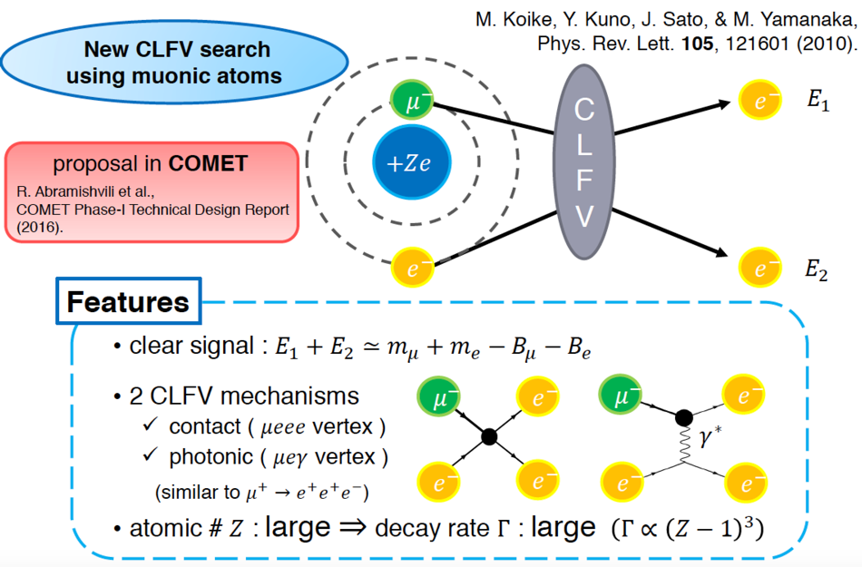
New Proposal: μ− e−→ e− e−
Extra CLFV channel to provide a unique handles on the type of physics interaction leading to CLFV signal.
Joe Sato

Slide 30
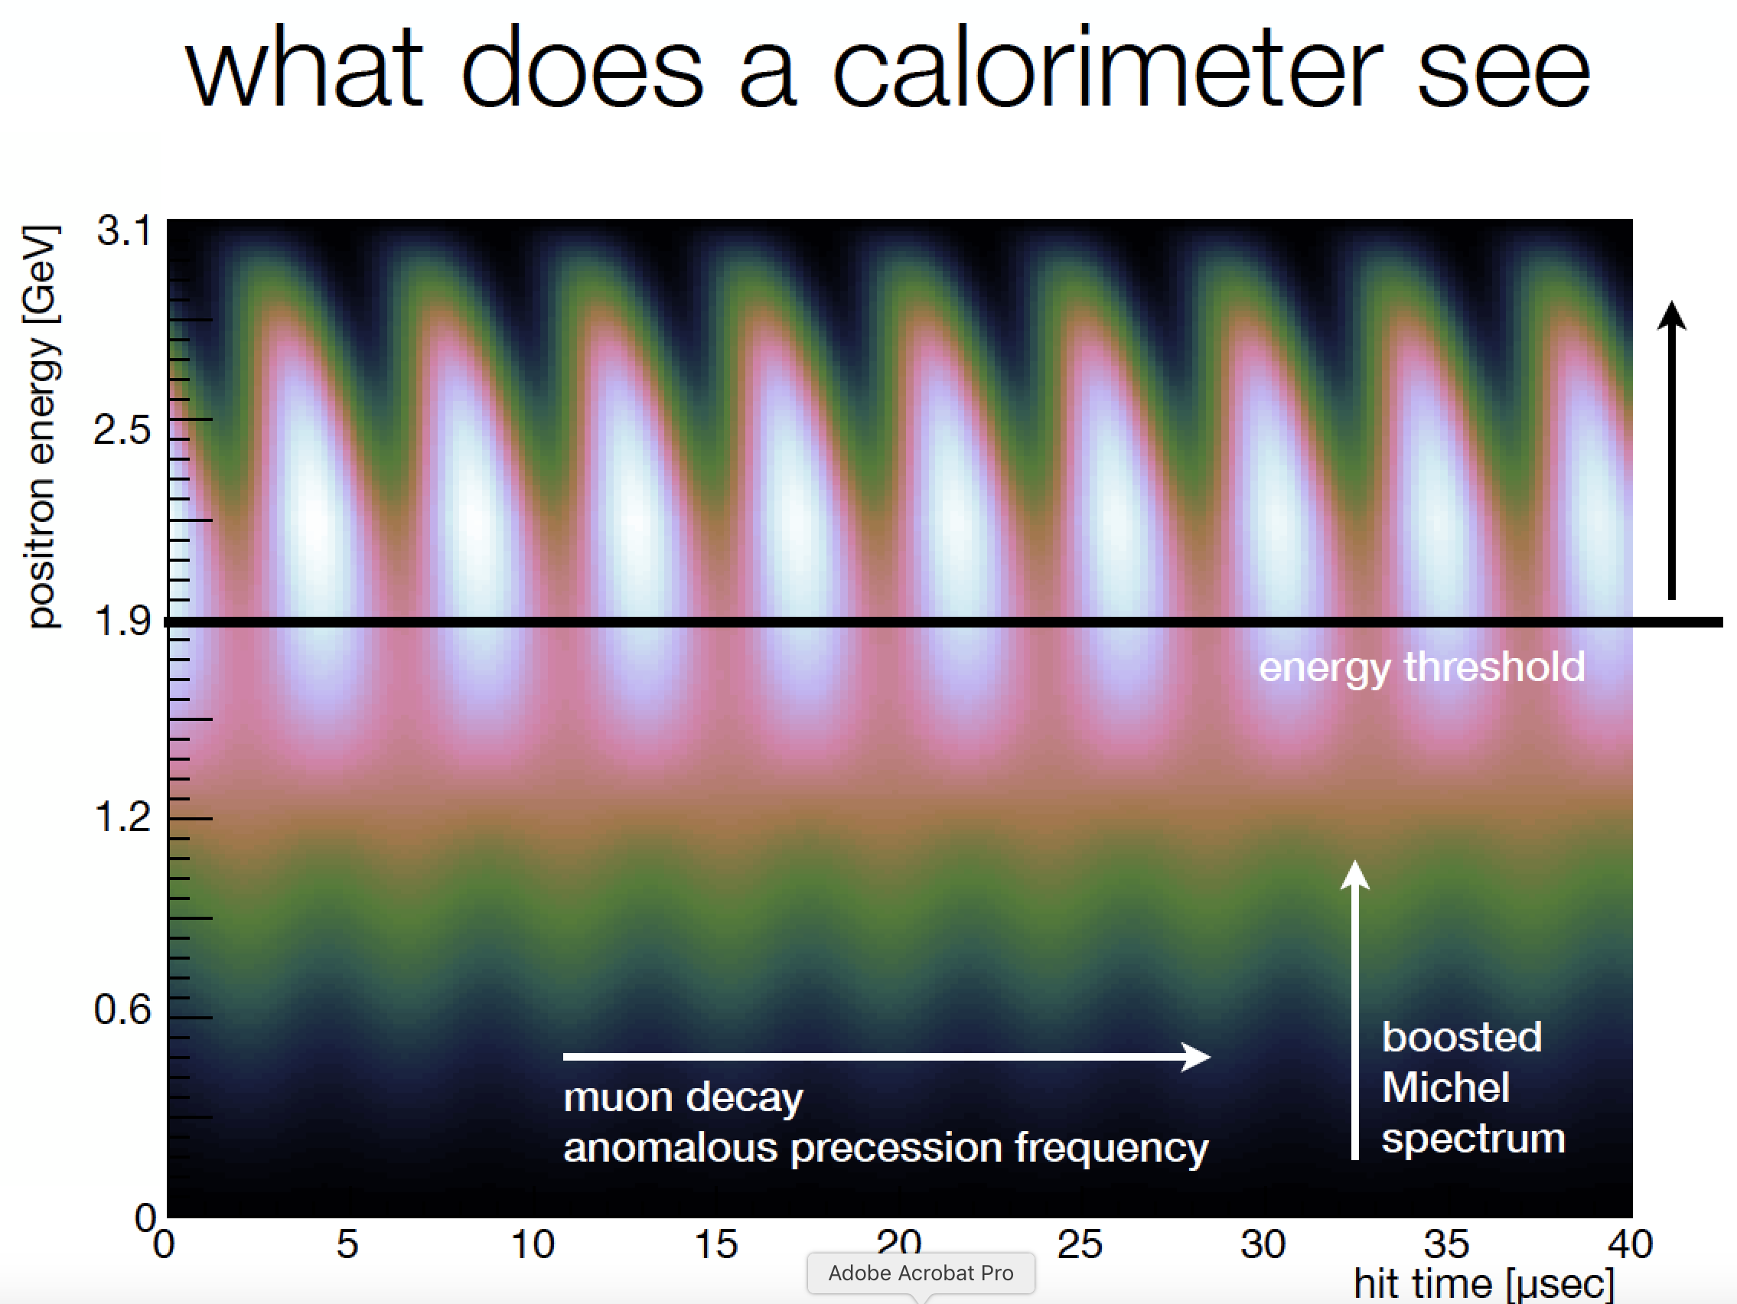
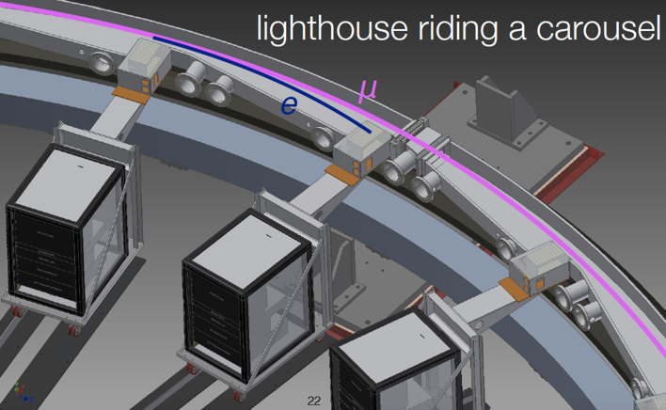
g_{μ}-2 at FNAL: Experimental
Polarized beam
Precession proportional to g-2
“Magic” ɣ for the muon
Parity violating decay
→ positron (electron) prefers (prefers opposite) spin direction.
Jarek Kasper

Slide 31
g_{μ}-2 Experimental Approaches
Measure ω_{a} - want to extract a_{μ}
Either:
E=0 (J-PARC)
“Magic” ɣ (FNAL)

Slide 32
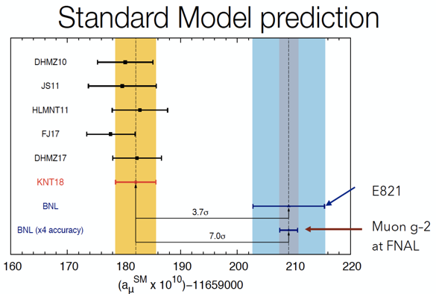
g_{μ}-2 at FNAL: Status
Goal is 4x improvement relative to BNL experiment
More beam and improved purity
Improved instrumentation:
Improved B field uniformity, calibration, and monitoring
New tracker with large azimuthal acceptance and no dead time
New segmented calorimeter with better timing and energy resolution
New laser calibration system
First physics run completed in July!

Slide 33
g_{μ}-2 at FNAL: Status
Goal is 4x improvement relative to BNL experiment
More beam and improved purity
Improved instrumentation:
Improved B field uniformity, calibration, and monitoring
New tracker with large azimuthal acceptance and no dead time
New segmented calorimeter with better timing and energy resolution
New laser calibration system
First results expected soon (paper <1 yr)...
Next physics run 5-10x BNL
First physics run completed in July!

Slide 34
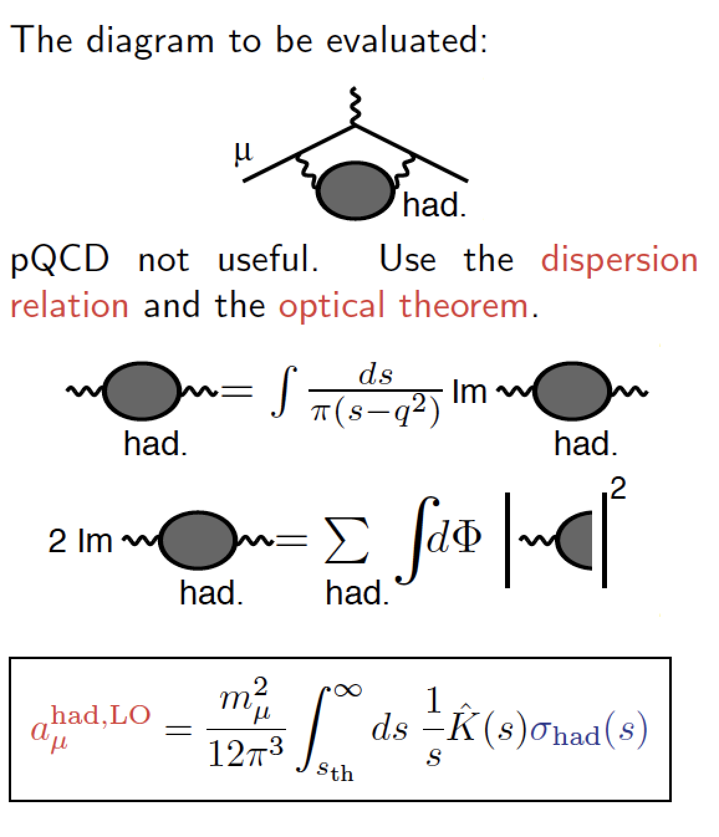
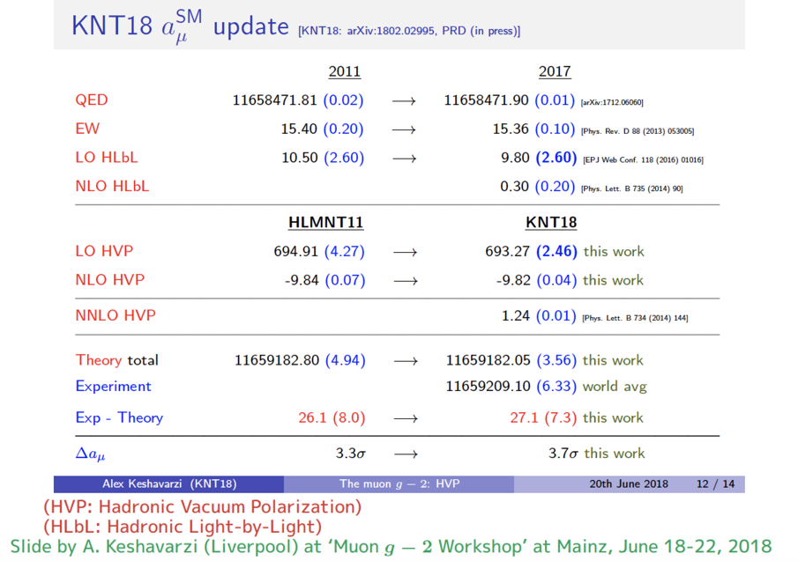
Standard Model Predictions for g_{μ}-2
Daisuke Nomura

Slide 35
CLFV at Colliders
LHC experiments have enough Z bosons to compete with LEP:
𝑍→𝑒𝜇
𝑍→𝑒𝜏/𝜇𝜏
Can also search in Higgs boson decays:
𝐻→𝑒𝜏/𝜇𝜏
Tau decays:
𝜏→3𝜇
And, hypothetical channels (exclude masses above ~3TeV):
Heavy gauge bosons (Z’)
R-parity violating SUSY (sneutrino)
Quantum Black Holes

Slide 36
CLFV at CMS and Atlas
Note: Indirect low-energy Br (Z-eμ) limit: 5 x10⁻¹³
(very strict, but still worth checking at high energy)
Diego Beghin (CMS) Wing Sheung Chan (Atlas)

Slide 37
LHCB: CLFV and Lepton Universality
2-3 𝜎 anomaly in lepton universality ratio R:
Several other 2-3 𝜎 anomalies reported.
Will improve experimental reach significantly as dataset improves.
~2x improvement in new physics scale probed!
Francesca Dordei

Slide 38
CLFV at NA62
Kaon fixed-target experiment at CERN
Primary beam
• 400 GeV/c protons from SPS
Secondary beam
• 6% kaons, 75 GeV/c momentum
• Rest: 70% pions, 24% protons
Stoyon Trilov

Slide 39
Searches for LF/LN violation at NA62
Stoyon Trilov

Slide 40
The Proton Radius Puzzle
r_{p} determined from:
ep scattering
Spectroscopy from muonic hydrogen
Results from these methods are discrepant.

Slide 41
The MUSE Experiment
Are μp and ep interactions different?
If so, does it arise from 2𝜸 exchange effects (μ+ ≠ μ-) or beyond the standard model physics
(μ+ ≈ μ- ≠ e-)?
Commissioning run with all detectors ongoing.
Steffen Strauch

Slide 42
The MUSE Experiment
Production run expected 2019-2020.
Are μp and ep interactions different?
If so, does it arise from 2𝜸 exchange effects (μ+ ≠ μ-) or beyond the standard model physics
(μ+ ≈ μ- ≠ e-)?
Commissioning run with all detectors ongoing.
Steffen Strauch

Slide 43
The PRad Experiment
Goal: Measure proton charge radius using ep elastic scattering:
Unprecedented low Q2 region (~2x10-4 GeV2)
Covers two orders of magnitude in low Q2
Normalize to the simultaneously measured Moller scattering process (control sys)
Extract the radius with precision from subpercent cross section measurement
ep scattering
beam
Chao Gu

Slide 44
The PRad Experiment
Goal: Measure proton charge radius using ep elastic scattering:
Unprecedented low Q2 region (~2x10-4 GeV2)
Covers two orders of magnitude in low Q2
Normalize to the simultaneously measured Moller scattering process (control sys)
Extract the radius with precision from subpercent cross section measurement
ep scattering
Chao Gu

Slide 45
The PRad Experiment
Goal: Measure proton charge radius using ep elastic scattering:
Unprecedented low Q2 region (~2x10-4 GeV2)
Covers two orders of magnitude in low Q2
Normalize to the simultaneously measured Moller scattering process (control sys)
Extract the radius with precision from subpercent cross section measurement
ep scattering
First proton radius results expected this year.
Chao Gu

Slide 46
Muonium and Muonic Hydrogen Experiments
Muonium
Muonic
Hydrogen
Sohtaro Kanda

Slide 47
Muonium and Muonic Hydrogen Experiments
MuSEUM demonstrated HFS at zero field - high field will improve precision.
Preparing for new HFS
measurement in ground-state muonic hydrogen.
Muonium
Muonic
Hydrogen
Sohtaro Kanda

Slide 48
The JEDI Experiment: EDMs
Baryon Asymmetry Problem: New sources of CP violation can be seen in EDM of particles.
Maria Zurek

Slide 49
The JEDI Experiment: EDMs
JEDI goal is direct EDM measurement for charged particles: proton and deuteron
→ Very challenging technically!
Maria Zurek

Slide 50
WG4 Speakers
Diego Beghin
Francesca Dordei
Steffen Strauch
Chao Gu
Sohtaro Kanda
Hajime Nishiguchi
Anna Soter
Diktys Stratakis
Maria Zurek
Joe Sato
Stoyan Trilov
M. Lancaster
Angela Papa
Frederik Wauters
Daiki Nagao
Manabu Moritsu
Steve Boi
Craig Group
Jaroslaw Pasternak
Jarek Kaspar
Daisuke Nomura
Wing Sheung Chan
Thanks to all the speakers for their contributions!

Slide 51
Focus Questions for WG4:
Color code:
Q1: Neutrino/Muon Physics: (Overlaps with WG1 and WG5)
What overlaps exist to non-standard model neutrino interactions?
How would these manifest in both the near term muon/precision measurements sector & in the neutrino sector?
Q2: Beam/Machine/Detector Design: (Overlaps with WG3)
Are the ultimate sensitivities really exploited with current facilities?
How can we improve experiments without increasing the beam power?
What will be the ultimate sensitivity that we can reach even by increasing beam power, and what are its implications?
Cooled muon beams w/ phase rotations? New methods?
Q3: Program Planning: (Overlaps with WG3)
How do you support the physics needs for both DC and pulsed (high sculpted) beam structures in the planning (and cost) of new facilities?
How can muon physics benefit from future neutrino facilities?
Could new ideas from muon physics developments turn out to be useful for future neutrino facilities?

Slide 52
Conclusions
Successful muon working group!
Great attendance including many leaders in the field.
Some productive topics of discussion:
What additional measurements or searches are being considered at planned muon experiments?
What future upgrades are being considered for MEG, Mu2e, and Mu3e?
Worked to streamline focus questions for NuFact 2019.
Would like theory talks involving models that could solve neutrino and muon anomalies. What would these models mean for CLFV experiments? g-2?
The muon working group is a somewhat unique aspect for NuFact, lacking from many other neutrino workshops.
WG4 includes a rich physics program that naturally correlates with neutrinos from accelerators.

Slide 53
Suggested WG4 2019 Focus questions:
Q1: Neutrino/Muon Physics: (Overlaps with WG1 and WG5)
What overlaps exist to BSM neutrino interactions?
How would BSM physics manifest in the muon/precision measurements sector and in the neutrino sector?
Q2: Beam/Machine/Detector Design: (Overlaps with WG3)
What sensitivity can be reached with current or future facilities? Improved detectors? Increased beam power? What are the implications?
Q3: Program Planning: (Overlaps with WG3)
How do you support the physics needs for both DC and pulsed beam experiments in the planning of new facilities?

