Slide 1
nuSTORM facility and cross section workshop

Slide 2
Contents
What is nuSTORM?
Why study neutrino interactions?
nuSTORM for neutrino scattering
nuSTORM & CERN Physics Beyond Colliders study
The benefit of nuSTORM
Conclusions and invitation to participate

Slide 3
What is nuSTORM?
nuSTORM

Slide 4
Neutrinos from stored muons
Scientific objectives:
  %-level (ν_{e}N)cross sections
    Double differential
  Sterile neutrino search
    Beyond Fermilab SBN
Precise neutrino flux:
  Normalisation: < 1%
  Energy (and flavour) precise
π ➔ μ injection pass:
  “Flash” of muon neutrinos

Slide 5
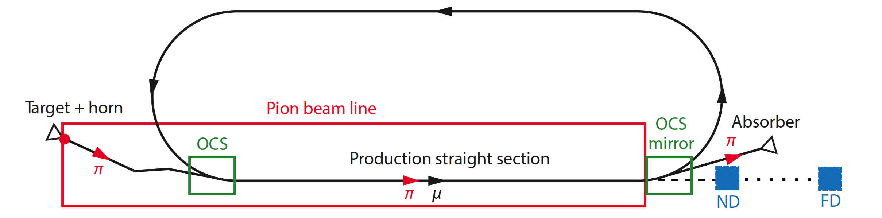
nuSTORM overview
Fast extraction at >~ 100 GeV
Conventional pion production and capture (horn)
  Quadrupole pion-transport channel to decay ring

Slide 6
Neutrino flux
10.1146/annurev-nucl-102014-021930
ν_{μ} flash:
  Pion: 6.3 × 10¹⁶ m⁻² at 50m
  Kaon: 3.8 × 10¹⁴ m⁻² at 50m
    Well separated from pion neutrinos
ν_{e} and ν_{μ} from muon decay:
  ~10 times as many ν_{e} as, e.g. J-PARC beam
  Flavour composition, energy spectrum
    Use for energy calibration

Slide 7
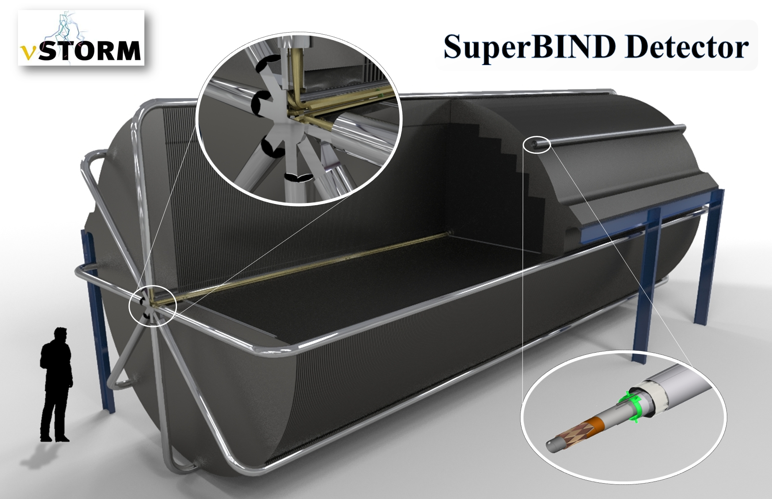
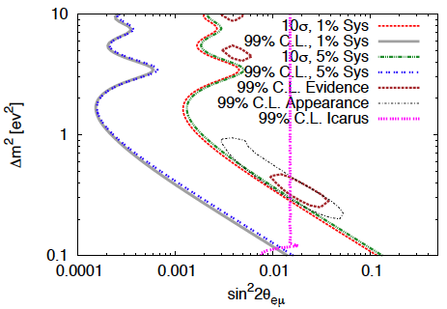
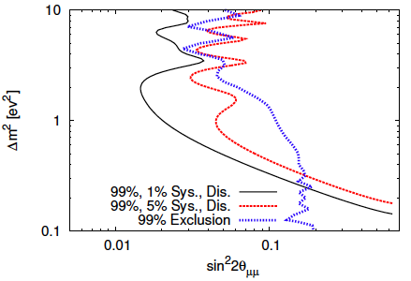
Sterile neutrino search @ FNAL
Adey et al., PRD 89 (2014) 071301

Slide 8
Why study neutrino interactions?
nuSTORM

Slide 9
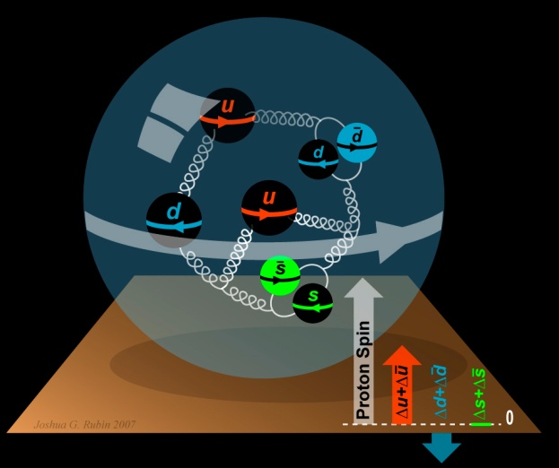
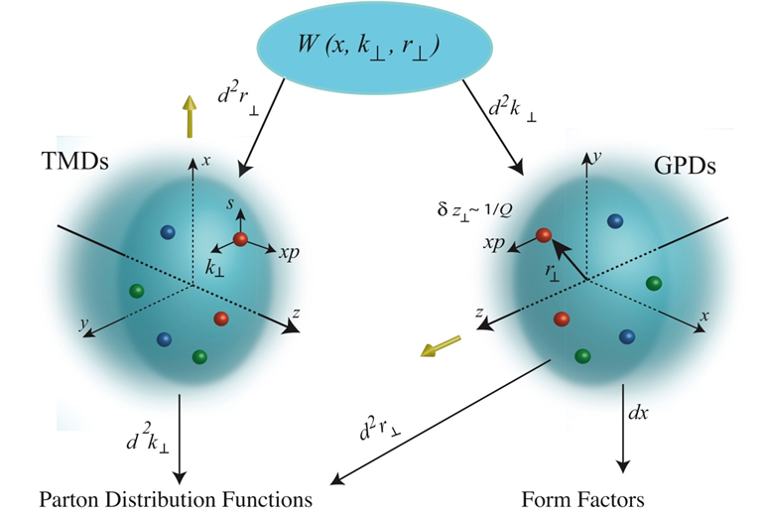
To understand the nucleon and the nucleus
Neutrino unique probe: weak and chiral:
  Sensitive to flavour/isospin and 100% polarised
How could neutrino scattering help?
  Nucleon (e.g.):
    Spin puzzle
  Nucleus (e.g.):
    Multi-nucleon correlations
    Precise determination of:
      Model parameters or, better,
      Theoretical (ab initio) description
Can the neutrino’s unique properties compete with the rate in, e.g. electron scattering?
  Measure weak charge directly; rate and Q² dependence:
    For e⁻ rely on interference with photon, 10⁻⁶-level asymmetry
  To be studied!
Benefit of nuSTORM:
  Precise flux and energy distribution

Slide 10
Search for CPiV in lbl oscillations
Seek to measure asymmetry:
  P(ν_{μ} ➤ ν_{e}) – P(ν_{μ} ➤ ν_{e})
Event rates, convolution of:
  Flux, cross sections, detector mass, efficiency, E-scale
    Measurements at %-level required
  Theoretical description:
    Initial state momentum, nuclear excitations, final-state effects

Slide 11
Systematic uncertainty and/or bias
Phys.Rev. D89 (2014) no.7, 073015; Coloma et al
Uncertainty
(cross section
and ratio)
Event mis-classification
Phys.Rev. D92 (2015) no.9, 091301; Ankowski et al
Energy scale mis-calibration
Missing energy (neutrons)

Slide 12
Search for CPiV in lbl oscillations
Seek to measure asymmetry:
  P(ν_{μ} ➤ ν_{e}) – P(ν_{μ} ➤ ν_{e})
Event rates convolution of:
  Flux, cross sections, detector mass, efficiency, E-scale
    Measurements at %-level required
  Theoretical description:
    Initial state momentum, nuclear excitations, final-state effects
Lack of knowledge of cross-sections leads to:
  Systematic uncertainties; and
  Biases; pernicious if ν and ν differ

Slide 13
nuSTORM for neutrino scattering
nuSTORM

Slide 14
Specification: energy range
Guidance from:
  Models:
    Region of overlap
    0.5—8 GeV
  DUNE/Hyper-K far detector spectra:
    0.3—6 GeV
Cross sections depend on:
  Q² and W:
    Assume (or specify) a detector capable of:
      Measuring exclusive final states
      Reconstructing Q² and W
    → E_{μ} < 6 GeV
So, stored muon energy range:
DUNE
Hyper-K
1 < E_{μ} < 6 GeV

Slide 15
nuSTORM for νN scattering @ CERN — parameters
New specification!
  Requires design update:
    1 < E_{μ} < 6 GeV
Parameter table for discussion

Slide 16
Novel Hybrid FFA solution
Pasternak (nuSTORM w/s)
FFA
FFA
FFA
FODO
Production straight
Hybrid FFA to merge benefits for superior lattice:
  Zero dispersion and no scallop angle (from FODO)
  Large DA and momentum acceptance (from scaling FFA)
Lattice contains:
  Zero dispersion quad injection/decay straight
  Zero-chromatic arc
  Zero-chromatic FFA straight (can be used for experiments too)

Slide 17
Novel Hybrid FFA solution
Pasternak (nuSTORM w/s)
Optics incorporates sections with different optical properties:
  FFA matching cells at the end of the arc
Zero dispersion section maximises muon accumulation efficiency
Large-momentum beam spread remains stable
Tune spread stays between integers and half integers

Slide 18
Momentum acceptance
Pasternak (nuSTORM w/s)
Large dynamic aperture achieved
DA off-momentum studied:
  NO intermediate dips!
Larger momentum acceptance:
  Increased neutrino flux

Slide 19
nuSTORM
& CERN Physics Beyond Colliders study
nuSTORM

Slide 20
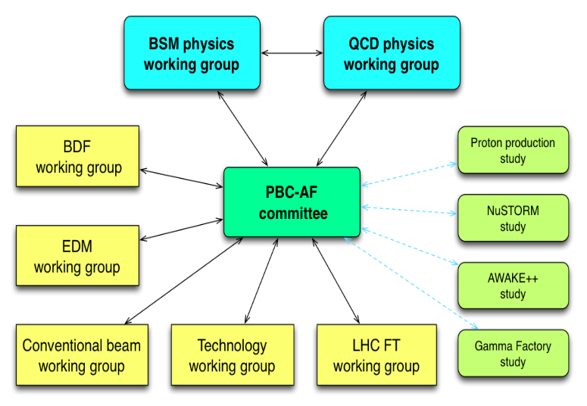
Physics Beyond Colliders study group
http://pbc.web.cern.ch

Slide 21
Implementation @ CERN Exploratory study
A credible proposal for siting at CERN, including:
  SPS requirements
  Fast extraction, beam-line
  Target and target complex
  Horn
  Siting
  Civil engineering
  Radio-protection implications

Slide 22
I. Efthymiopoulos

Slide 23
Status of study
J. Gall; https://indico.cern.ch/event/706741
Options:
  Avoid existing tunnels;
  Tunneling with mollase
  Option 4:
    Preserves possibility of detector at Prevesin site for sterile-neutrino experiment
  Option 5:
    Shorter transfer line
Extraction from SPS:
  Fast extraction into TT61 preferred
  Two options for transfer line:
    1.6 T – easier magnets, longer
    1.8 T – stronger magnets, shorter
Target and capture:
  Initial ideas:
    Prefer ’chicane’ configuration used in AD
    Similar requirements to ENUBET

Slide 24
Extraction from TT61
Lamont (nuSTORM w/s)
Possible reach for: 1.8 T (Magenta) or 1.6 T (Yellow) bending fields

Slide 25
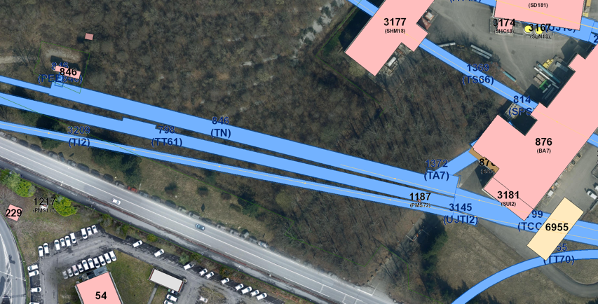
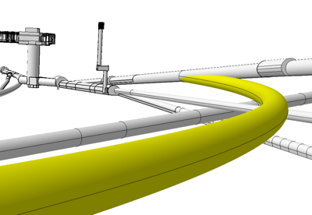
nuSTORM@CERN – SPS Extraction
Lamont (nuSTORM w/s)
Extraction from LSS6
  100 GeV protons, large emittance beams (FT beams in SPS)
  May need some changes to beam line equipment in this area – to be confirmed at later stage
TT61 transfer
  Appeared the best location for junction cavern and transfer to new line
Civil Engineering to look at feasibility in detail based on parameters
  Minimum single plane bending radius – 300 m
  Minimum bending radius for horizontal and vertical bending – 480 m
Initial siting guidance from accelerator beam transfer group

Slide 26
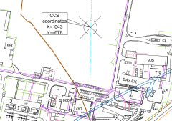
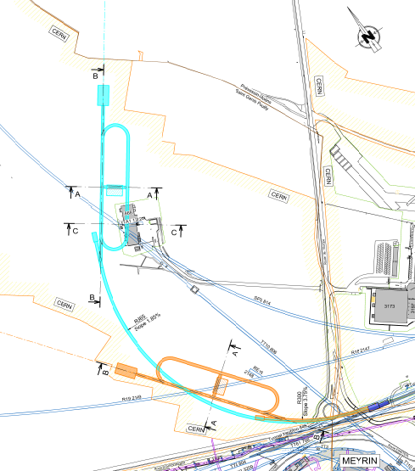
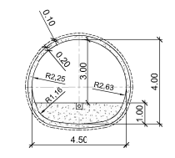
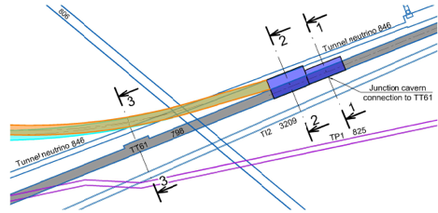
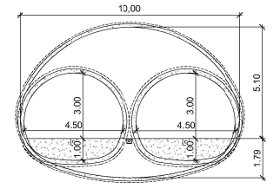
Civil Engineering - development
Lamont (nuSTORM w/s)
Latest options 4 and 5
Option 4 with far detector in Prevessin
Option 5 with minimised tunnel length
CERN land
Within molasse
Potential far detector at Prevessin
Option 4
Route de l’Europe
Typical section at 1-1
Option 5
TT61 Extract – junction cavern
Typical section at 2-2
CERN Meyrin
Plan view showing options 4 and 5

Slide 27
Civil engineering; example
J. Gall; https://indico.cern.ch/event/706741
Option 4

Slide 28
Target hall, detector hall, RP
J. Gall; https://indico.cern.ch/event/706741
Detector hall taken from FNAL design
Radio-protection (RP):
  Evaluation based on LBNO studies
  Requires appropriate engineering; not viewed as ‘in principle problem’

Slide 29
The benefit of nuSTORM
nuSTORM

Slide 30
Systematic uncertainties
Morfin (nuSTORM w/s)
MINERvA example:
  Flux, detector and ‘theory’ contributions comparable
  In some regions detector uncertainties dominate
So, to exploit nuSTORM require excellent detector

Slide 31
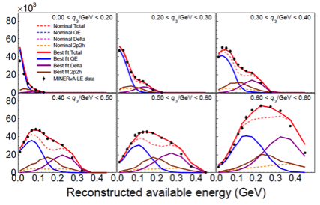
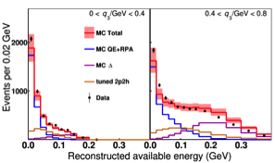
‘Where are we now?’
Morfin (nuSTORM w/s)
ν_{μ} scattering rate vs available energy in bins of q₃
  Improvements in generator (GENIE):
    RPA, 2p2h, low-recoil fit, non-resonant pion production
  Reproduces data
Important:
  Tuned generator also describes ν_{μ} samples

Slide 32
Timescales
When could nuSTORM operate?
  A success-orientated European strategy:
    EPPS Update: 2020
    Design & approval: 2023
    Operation 2028
At this time, DUNE and Hyper-K
will be underway:
  Near-detectors in operation:
    Large data samples
    Sophisticated detectors
    ν-e scattering to determine flux
Need to consider benefit of nuSTORM against this background
Huber (nuSTORM w/s)

Slide 33
Detector options
Soler, Hallsjo (nuSTORM w/s)

Slide 34
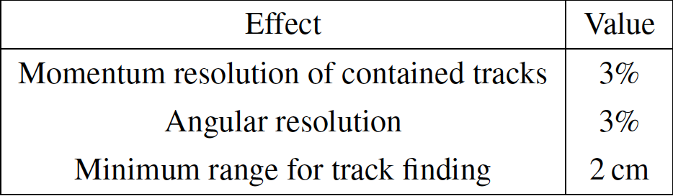
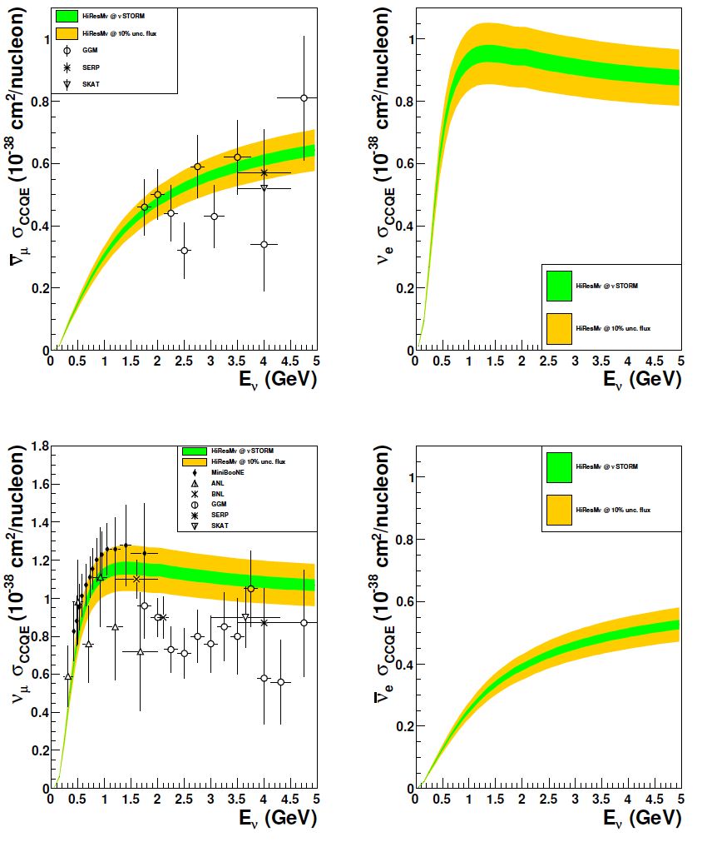
CCQE measurement at nuSTORM
10.1103/PhysRevD.89.071301; arXiv:1305.1419
1% & 10% flux
uncertainty
CCQE at nuSTORM:
  Six-fold improvement in systematic uncertainty compared with (present) “state of the art”
  Electron-neutrino cross section measurement unique
Require to demonstrate:
  ~<1% precision on flux
Cf/synergy with EnuBET
Individual ν_{e} measurements from T2K and MINERvA
[10.1103/PhysRevLett.113.241803, 10.1103/PhysRevLett.116.081802 ]

Slide 35
Conclusions and invitation to participate
nuSTORM

Slide 36
Conclusions
nuSTORM can deliver:
  νN scattering measurements with precision required to:
    Serve the long- and short-baseline neutrino programmes
    Provide a valuable probe for nuclear physics
CERN PBC study: opportunity to define innovative programme:
    nuSTORM:
      Delivers critical measurement: ν_{e}/ν_{μ} N scattering;
      Has discovery potential: sterile neutrinos;
      Potential test bed for technologies/techniques required for Muon Collider
        E.g. host for 6D cooling demonstration to follow MICE

Slide 37
Conclusions from nuSTORM w/s
Agreed to write:
  Sister publication to:
    ‘Light sterile neutrino sensitivity at the nuSTORM facility’,
    doi.org/10.1103/PhysRevD.89.071301, Phys.Rev. D89 (2014) 071301
  Document case for and performance of scattering programme
  Target:
    Autumn 2018
Fixed points, working backwards:
  Paper to Journal ~Nov/Dec 2018
  Presentation of principal results NuInt18: GSSI 15—19 October 2018
Working meeting at IPPP: collaboration between NP/PP:
  Dan Watts (NP experiment, Edinburgh) and KL:
    “Bridging the gap between neutrino-nucleus and electro-nucleus scattering at nuSTORM and JLAB”
  Opportunity to host one or more working meeting at IPPP
All are invited to participate!
  We agreed to view author list of the proposed paper as a ‘proto-collaborator’ list

