Slide 1
The Short Baseline Neutrino Program at Fermilab
Angela Fava for the SBN Collaboration

Slide 2
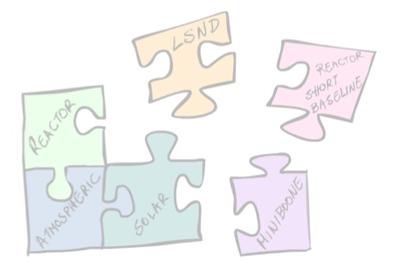
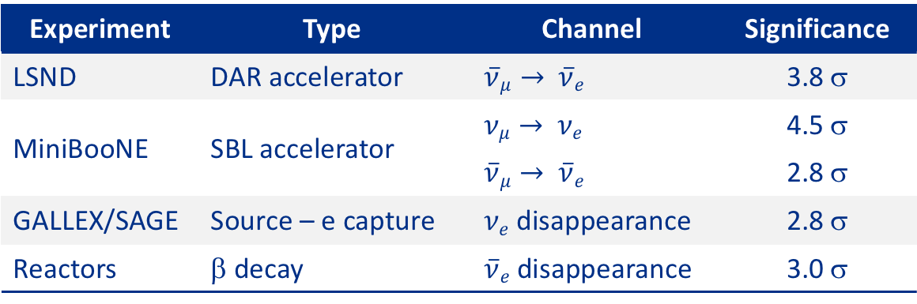
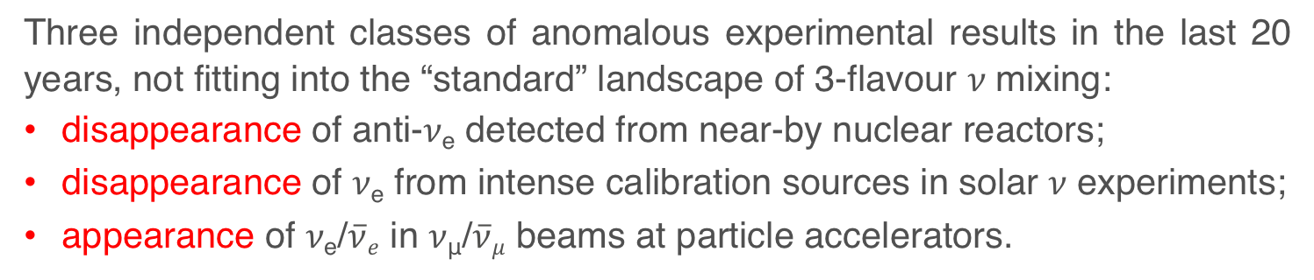
The puzzling picture of short baseline 𝜈 oscillations
Three independent classes of anomalous experimental results in the last 20 years, not fitting into the “standard” landscape of 3-flavour 𝜈 mixing:
disappearance of anti-𝜈_{e} detected from near-by nuclear reactors;
disappearance of 𝜈_{e} from intense calibration sources in solar 𝜈 experiments;
appearance of 𝜈_{e}/$\overline{ν}e$ in 𝜈_{μ}/$\overline{ν}μ$ beams at particle accelerators.
Experiment | Type | Channel | Significance
LSND | DAR accelerator | $\overline{ν}μ→$ $\overline{ν}e$ | 3.8 σ
MiniBooNE | SBL accelerator | $νμ→$ $νe$ | 4.5 σ
 |  | $\overline{ν}μ→$ $\overline{ν}e$ | 2.8 σ
GALLEX/SAGE | Source – e capture | $νe$ disappearance | 2.8 σ
Reactors | β decay | $\overline{ν}e$disappearance | 3.0 σ
See talk by
Z. Pavlovic
Each possibly explained by non standard “sterile” neutrino state(s) driving oscillations at Δm²_{new} ≈ 1 eV² and relatively small sin²(2ϑ_{new}), but no model so far successful in fitting all experimental results at once.

Slide 3
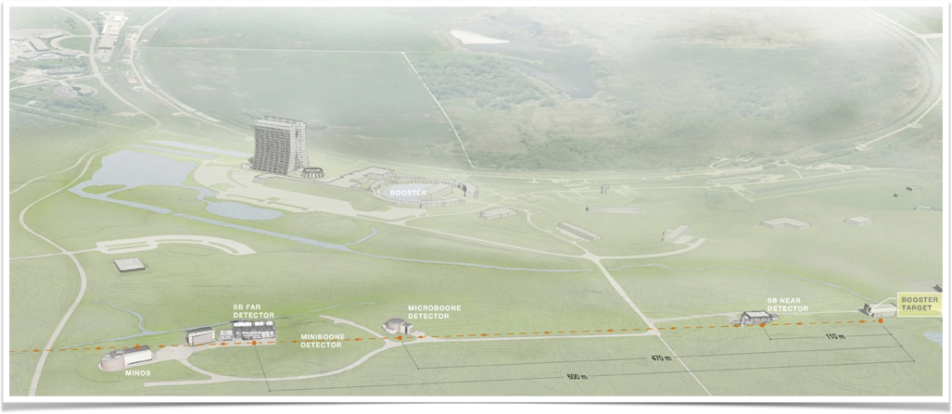
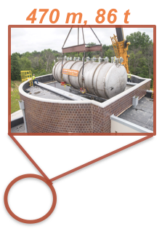
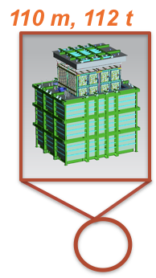
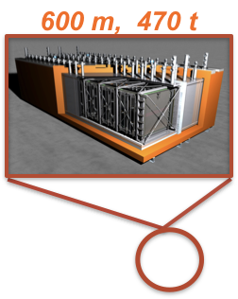
Short Baseline Neutrino Program at Fermilab
Program aimed at definitely solving the “sterile neutrino puzzle” by exploiting:
the well characterized FNAL Booster 𝜈 beamline;
three detectors based on the same liquid argon TPC technique.

Slide 4
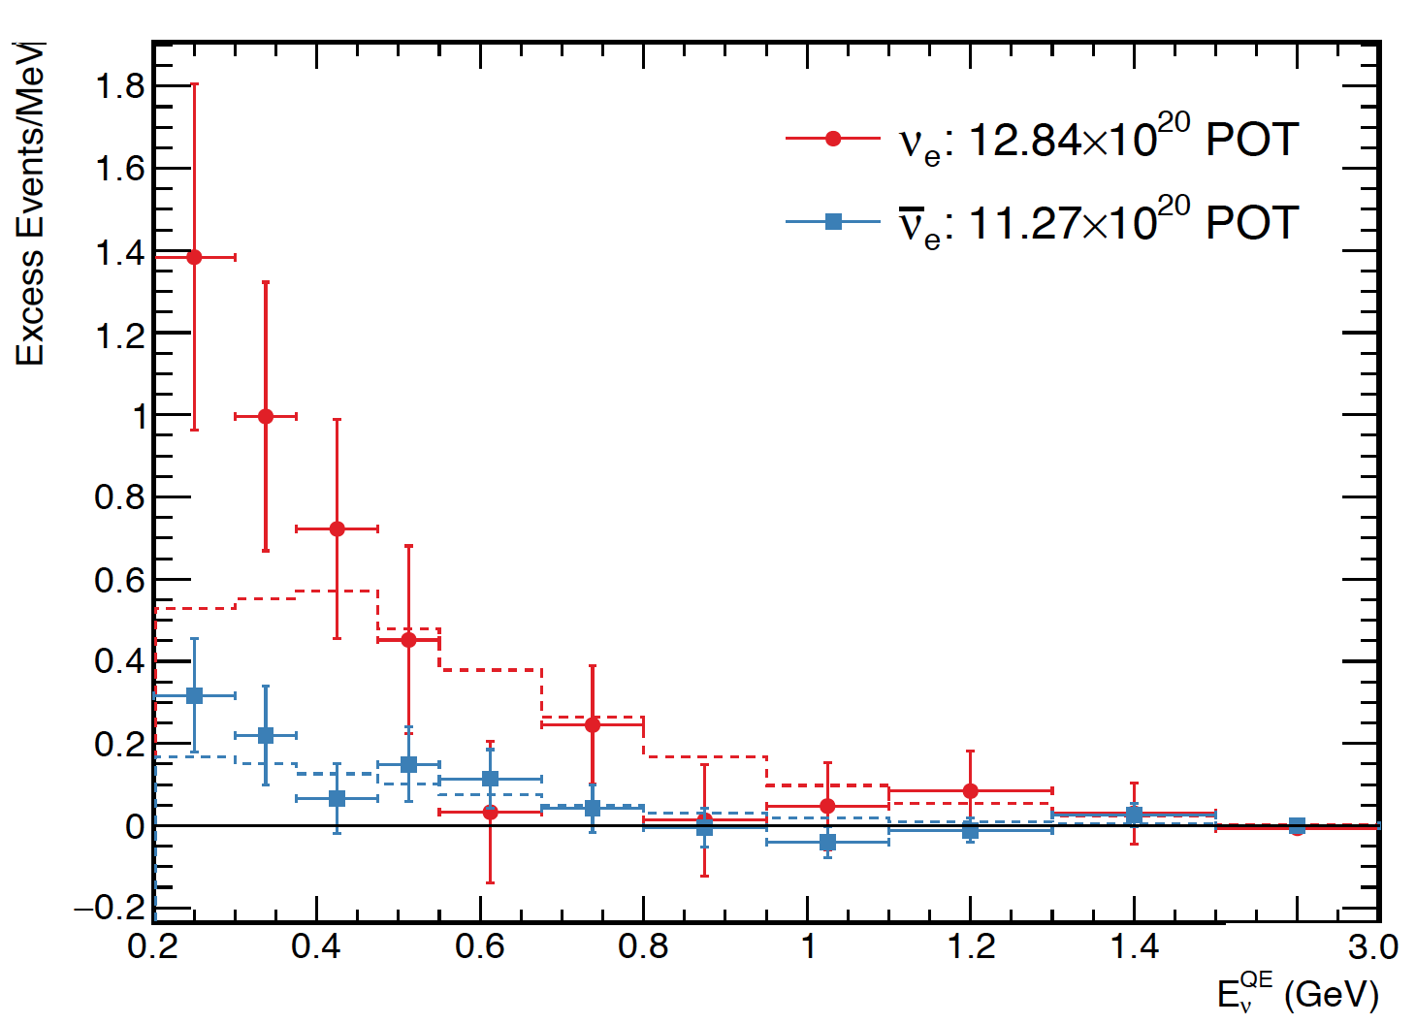
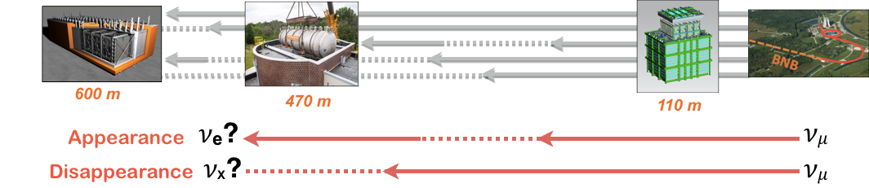
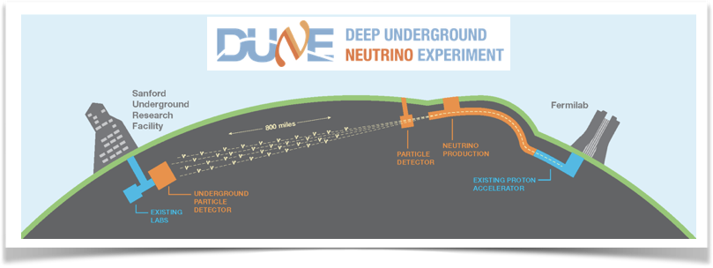
SBN goals
arXiv: 1805.12028
Phase I _ MicroBooNE
Understand the nature of the MiniBooNE “low energy” excess anomaly, using the same beam.
Phase II _SBND + ICARUS
Search for short baseline oscillations both in appearance and disappearance channels.
Lay the ground for future long baseline program
Further develop LAr-TPC detector technology
Measure ν-Ar cross sections at energies relevant to DUNE

Slide 5
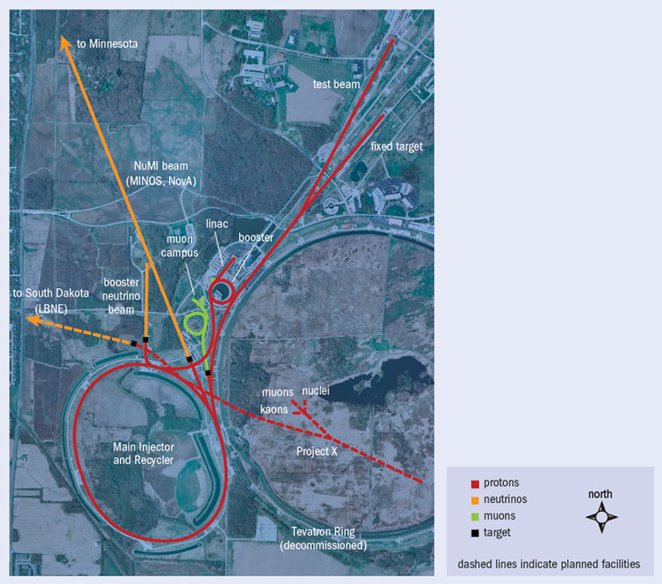
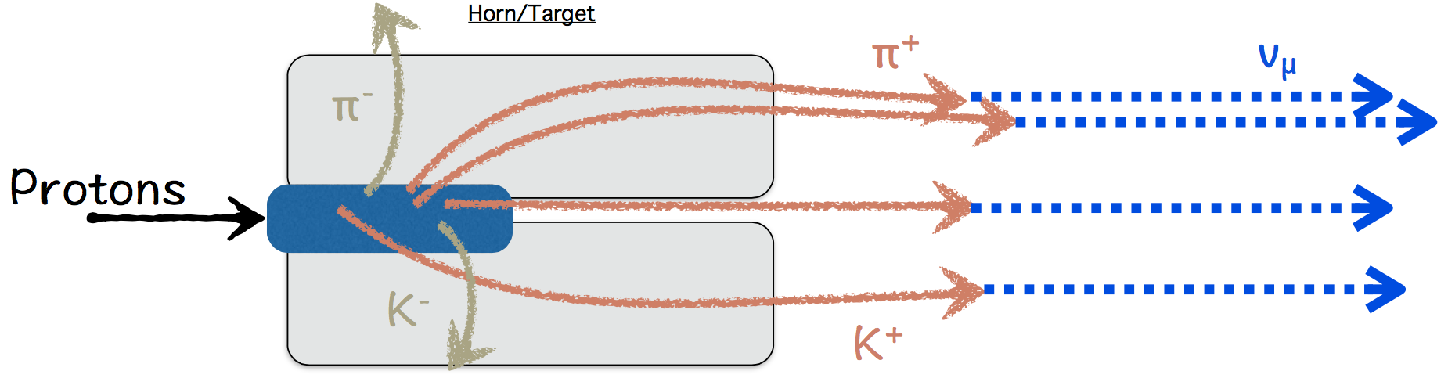
The Booster Neutrino Beam
8 GeV
700 MeV peak energy
0.5% 𝜈 _{e} content

Slide 6


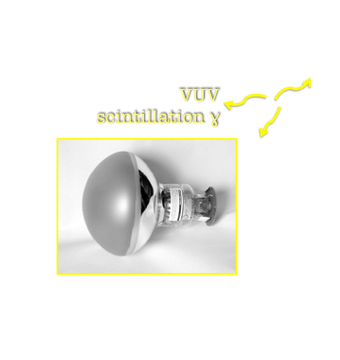
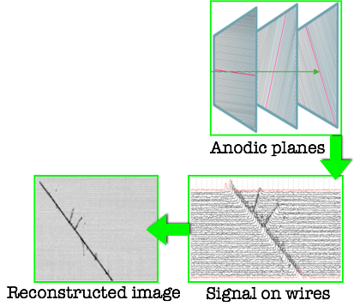


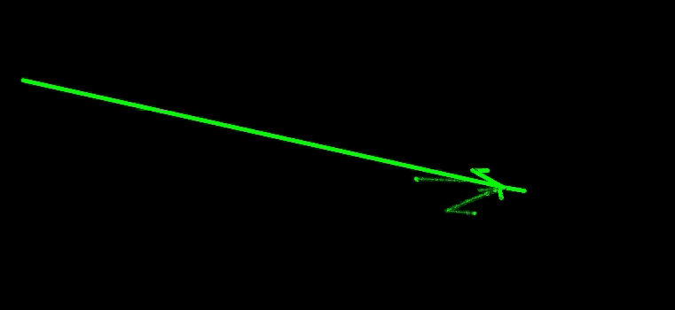
Liquid Argon TPC detection technique
Very well suited for the experimental study of Neutrino Physics.
Massive yet homogeneous target, excellent tracking & calorimetric capabilities.
λ = 128 nm scintillation light:
40000 γ/MeV wo electric field.
Response time ∼ 6 ns ÷ 1.8 µs.
Ionisation electrons:
42000 e⁻/MeV.
Drifted (E) toward planes of wires on which they induce a signal.
Response time = drift time (∼ ms).
Photomultiplier tubes (PMTs)
3D image reconstruction by combining coordinates on different wire planes at the same drift time.

Slide 7
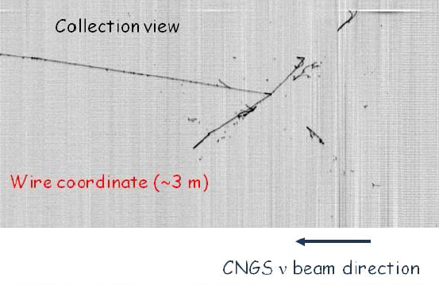
Electron neutrinos in LAr-TPC
Fine tracking & calorimetry essential for e/γ separation and π⁰ reconstruction
E_{dep} = 87±7 MeV
π⁰
M_{inv}= 104 MeV/c²
p = 165 MeV/c
65°
E_{dep} = 108±9 MeV
ICARUS T600
real event
E_{dep} = 229±20 MeV
E_{dep} = 139±12 MeV
44°
π⁰
M_{inv}= 133 MeV/c²
p = 344 MeV/c
Phys. Rev. D95, 072005
7
Gap between vertex and shower.
Ionization in the first segment of showers (1 mip or 2 mips).
π⁰ invariant mass.

Slide 8
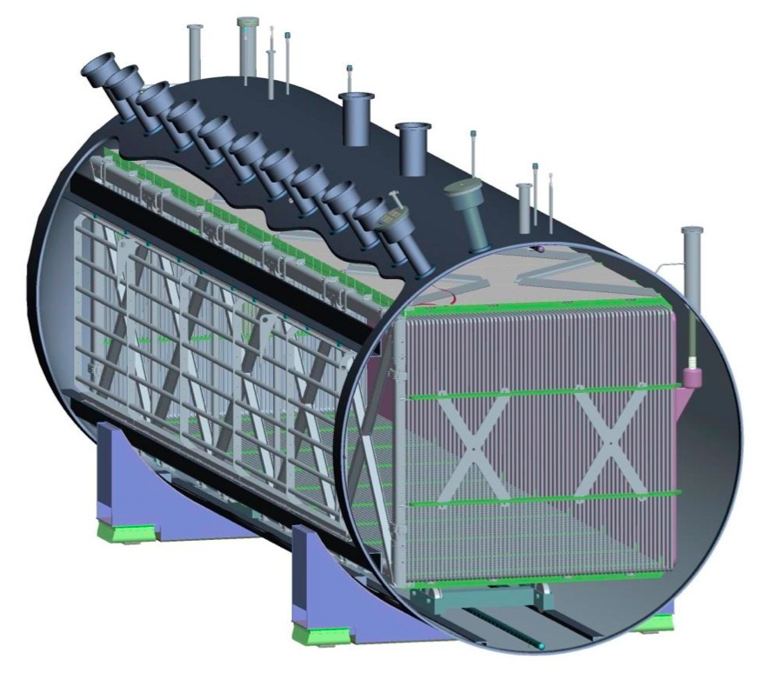
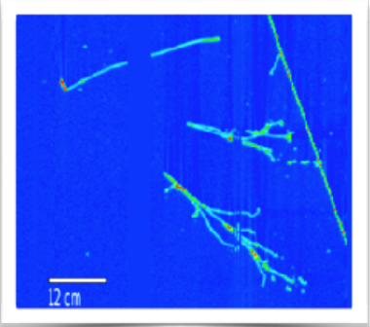
PHASE I _ MICROBOONE
170 t of LAr, 87 t active mass.
470 m from the source.
1 TPC with 2.5 m drift.
3 wire planes with 3 mm pitch.
32 8” PMTs on acrylic support coated with TPB.
Cosmic Ray Tagger (CRT) for identifying cosmic μ.
See talks by:
- L. Jiang
- L. Yates
- K. Woodruff
Stable operation since October 2015.
Understanding the detector effects (noise, diffusion,
recombination, space charge…)
→ essential to understand physics
Great progress on automated event reconstruction
𝜈_{μ} CC inclusive differential cross section and CC π⁰ total cross section
First fully automated 𝜈_{e} and single photon selections
→ towards the low-energy search

Slide 9
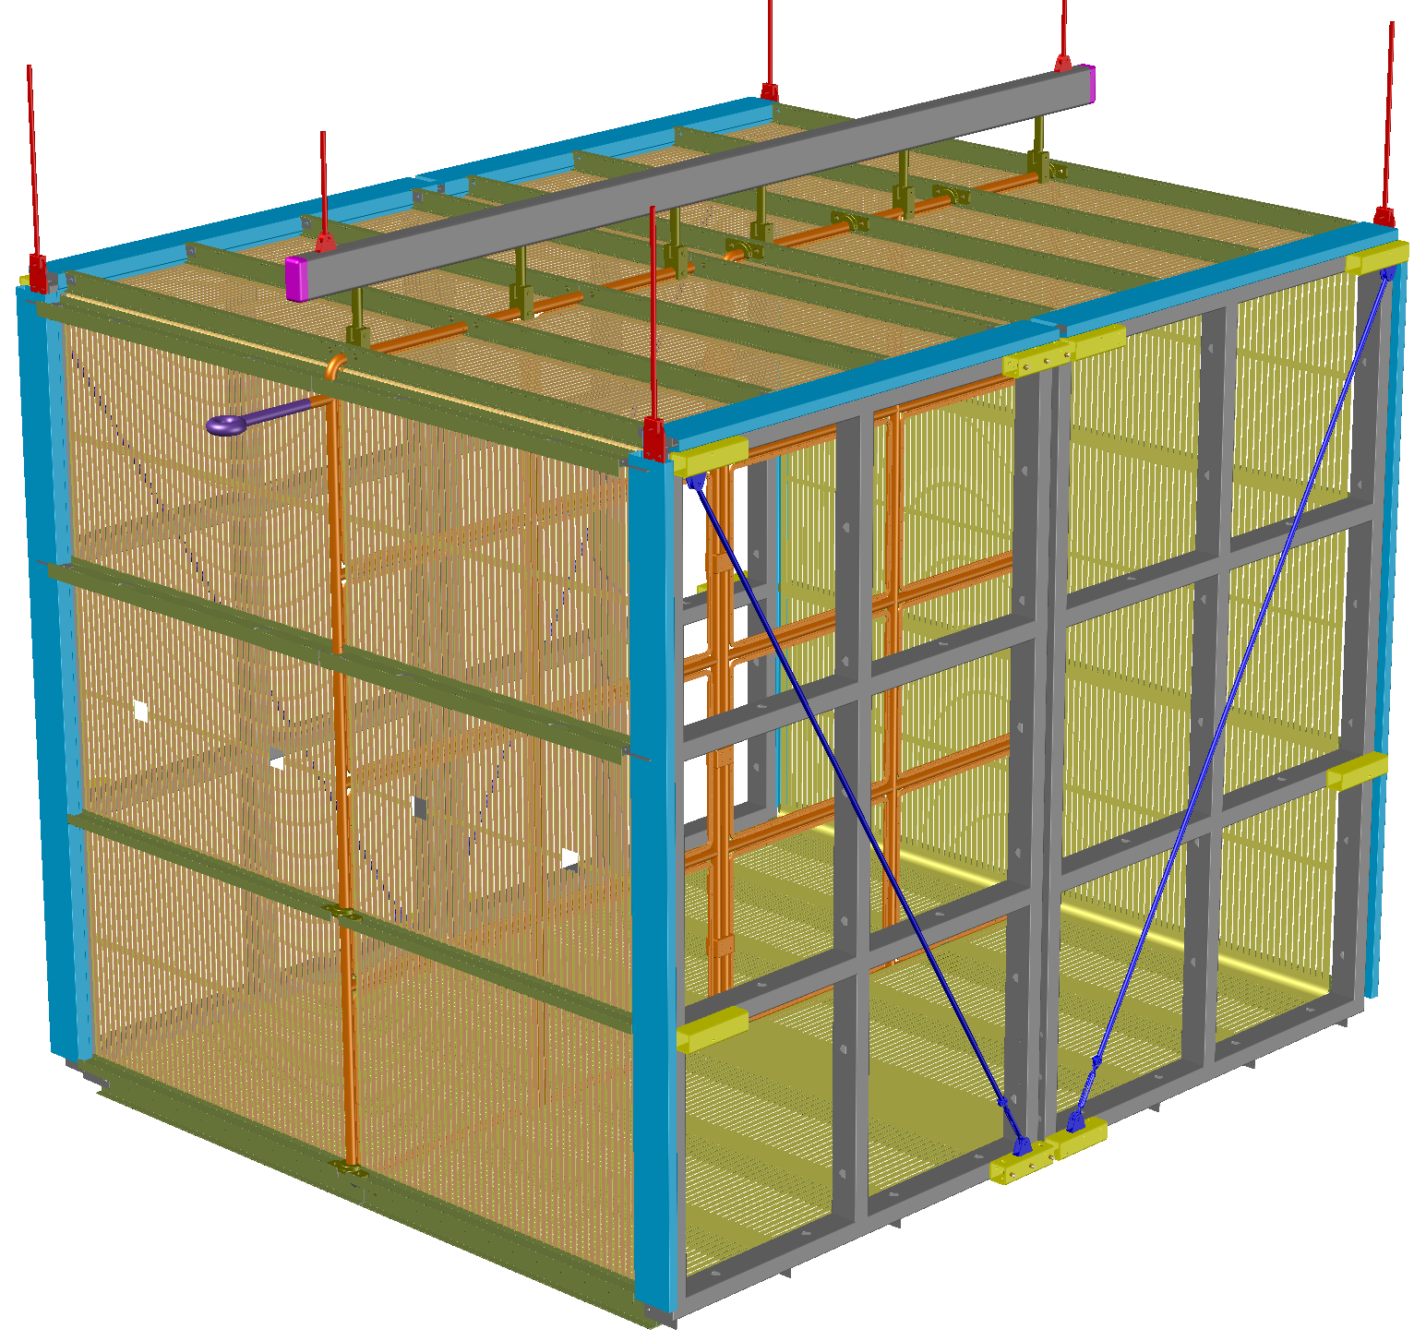
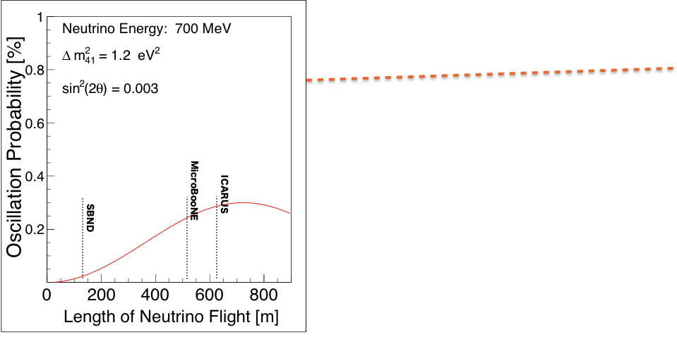
PHASE II_ SBND + ICARUS
-100 kV
260 t of LAr, 112 t active mass.
110 m from the source
2 TPCs with 2 m drift and 3 wire planes.
112 8” PMTs coated with TPB.
4π CRT coverage.
4 m
See talk by J. Zennamo
4 m
5 m
Central cathode
with two 2 m drift regions
It will characterize the neutrino beam before the onset of oscillations, addressing one of the dominant systematic uncertainties.
~ 1.5 million 𝜈_{μ} CC and ~12,000 𝜈_{e} CC interactions per year: largest data sample of neutrino-Ar interactions in the world in foreseeable future.

Slide 10
PHASE II_ SBND + ICARUS
CRT panels (Switzerland) installed for preliminary beam data
Cathode arrived at FNAL!
PMT testing
Anode Plane Assemblies under construction
(US & UK)
Expected data taking 2020

Slide 11
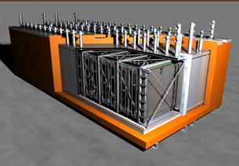
PHASE II_ SBND + ICARUS
760 t of LAr, 476 t active mass.
600 m from the source.
4 TPCs with 1.5 m drift and 3 wire planes.
360 8” PMTs coated with TPB.
Almost full CRT coverage.
See talk by Y.-T. Tsai
Given its large mass and far location ICARUS-T600 will provide high sensitivity to oscillated neutrinos
→ precision search.
~ 10⁵ NuMI off-axis events/year, high statistics for both 1st and 2nd DUNE oscillation peaks.

Slide 12
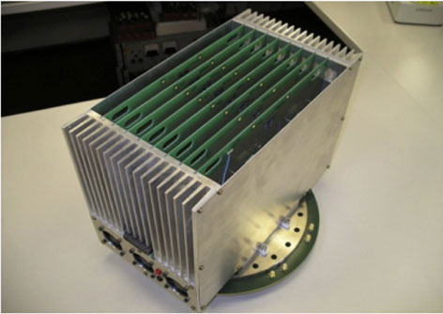
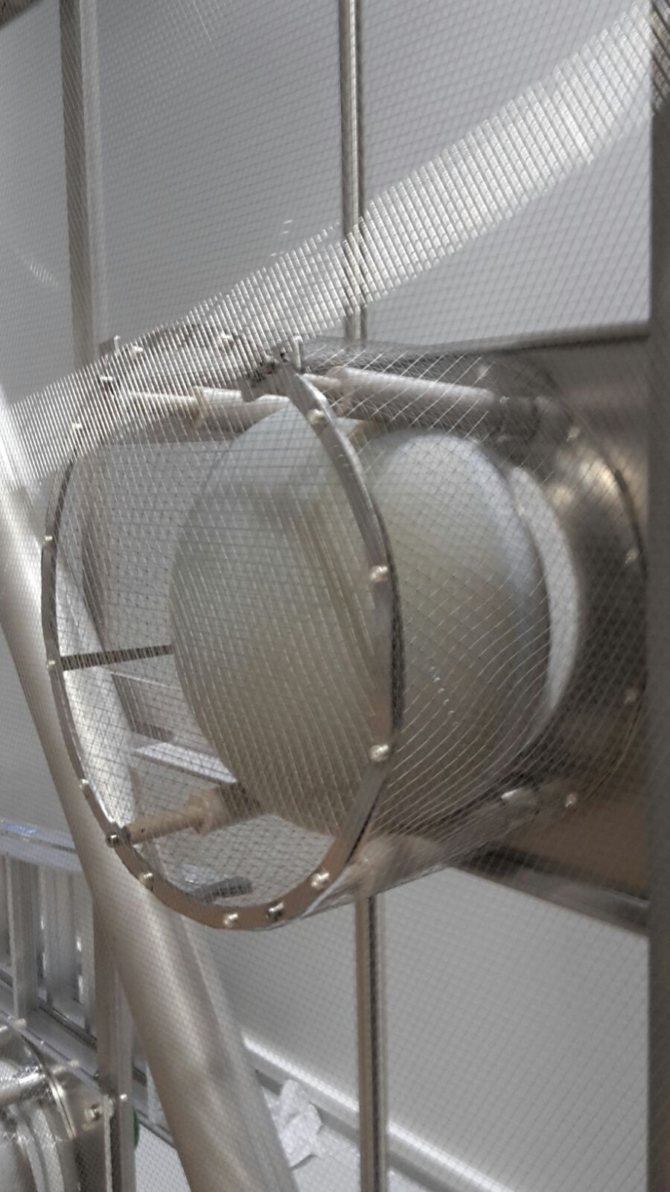
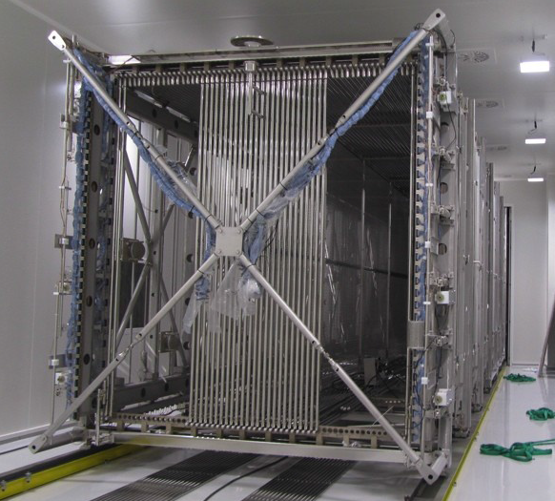
PHASE II_ SBND + ICARUS
Overhauling at CERN 2015-2017
Expected data taking 2019

Slide 13
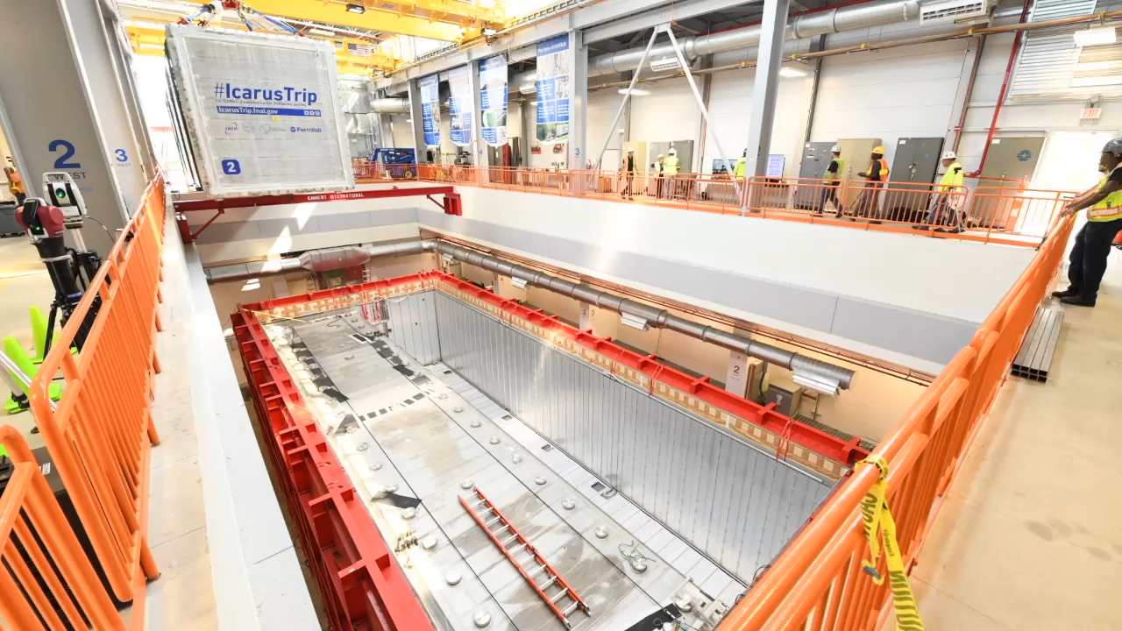
One more flight!
Thanks to Reidar Hahn & James Schultz!

Slide 14
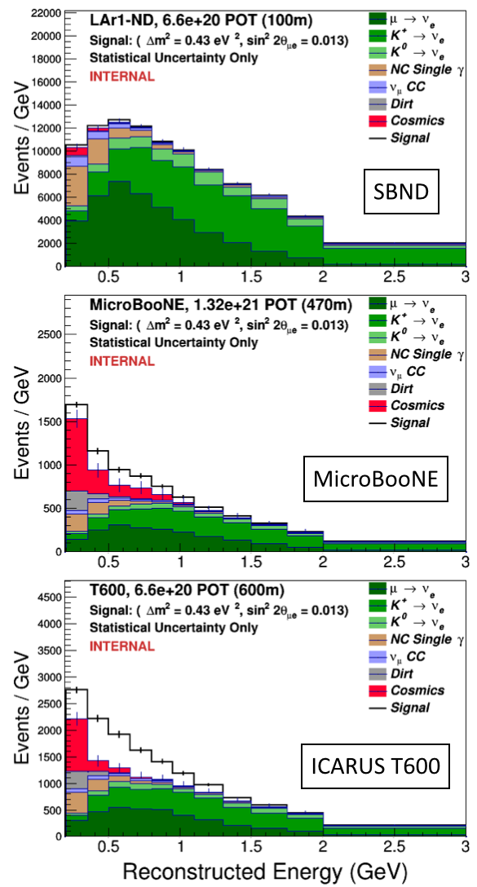
Analysis of sensitivity to oscillations
Correlations between detectors (same beam and experimental technique) allow for cancelations in systematic uncertainty.
The analysis leveraged MiniBooNE expertise in simulating BNB neutrino fluxes.
Major background source related to cosmic rays:
spurious triggers;
several uncorrelated
c-rays in LAr active
volume during drift
window recording.
Detector | 𝜈 every N spills | Cosmic μ in spill every N spills
SBND | 25 | 300
MicroBooNE | 800 | 200
ICARUS | 250 | 50

Slide 15
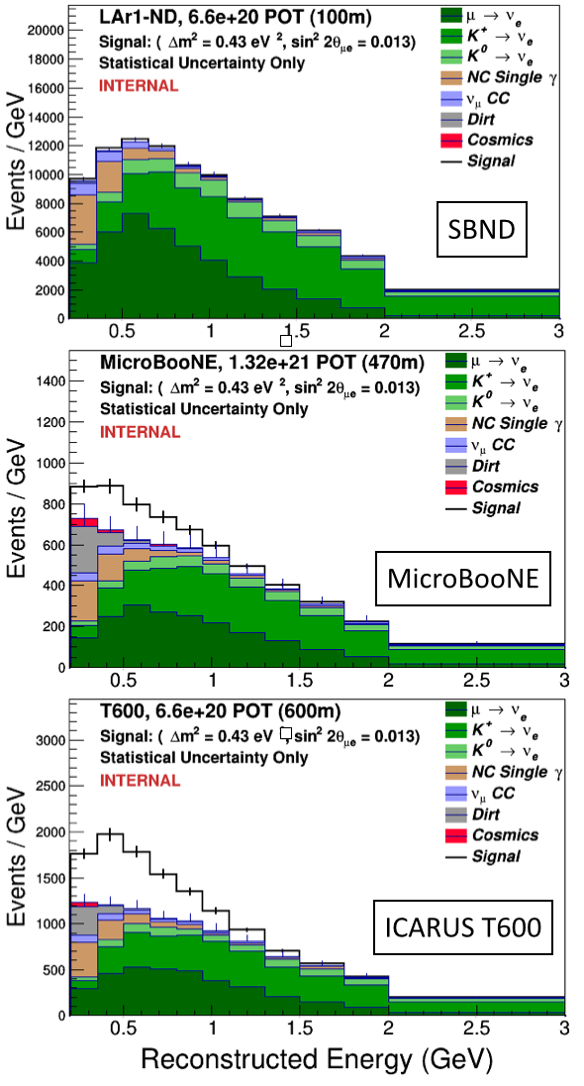
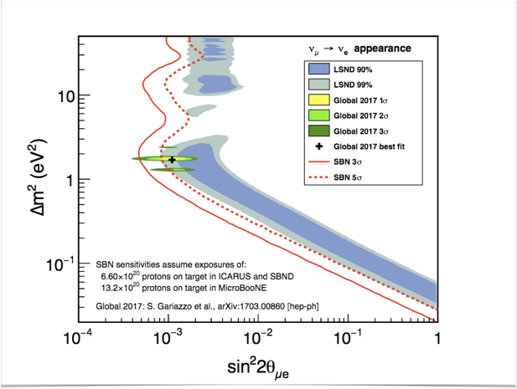
Sensitivity of SBN program in appearance channel
arXiv: 1703.00860
The LSND 99% C.L. region will be covered at ∼ 5 σ level in 3 years of data taking with positive focusing of the BNB (∼ 6.6 x 10²⁰ pot).

Slide 16
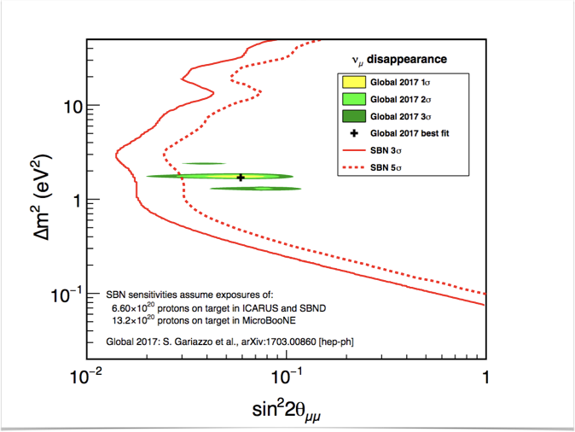
Sensitivity of SBN program in disappearance channel
arXiv: 1703.00860
Sensitivity to 𝜈_{μ} disappearance will be extended by 1 order of magnitude beyond SciBooNE + MiniBooNE limits in 3 years of data taking with positive focusing of the BNB (∼ 6.6 x 10²⁰ pot).

Slide 17
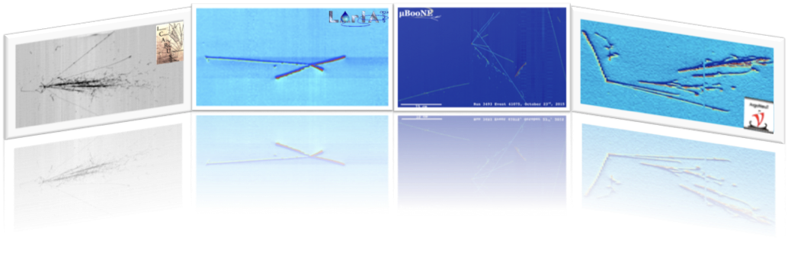
The SBN Program at Fermilab is well on its way to:
an exiting search for neutrino oscillations over short baseline addressing the sterile neutrino puzzle;
make high precision measurements of ν-Ar cross sections;
develop LAr-TPC technology & expertise in preparation for DUNE.

Slide 18
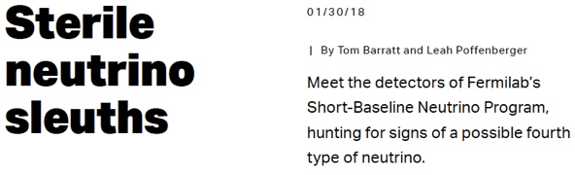
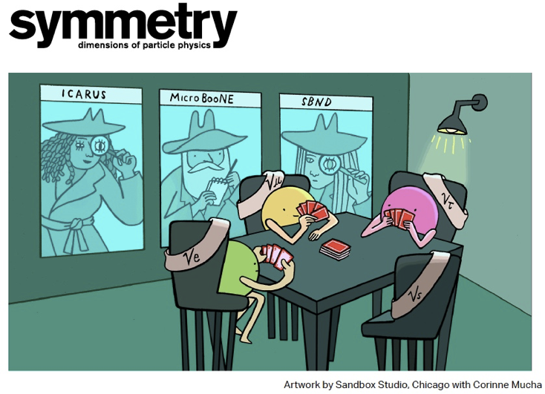

Slide 19
BACKUP

Slide 20
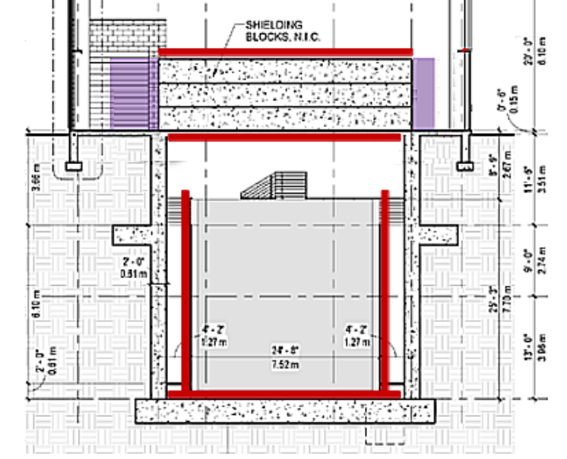
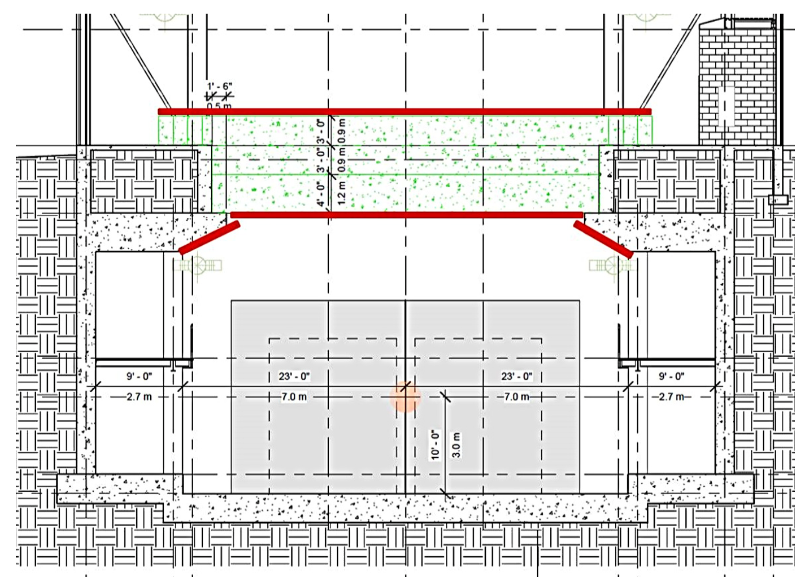
Mitigation of cosmogenic background
3 m of concrete overburden guarantees ~100% reduction of primaries other than muons, with only few percent increase in secondaries.
γ generated by cosmic μ close to the detector remain the main background for ν_{ε} appearance search.
It can be mitigated:
1-to-1 match of ionization charge with scintillation light signals, requiring high resolution of PMT system both in space and time;
external cosmic ray tracker system capable of tagging muons passing near the detector.
SBND
T600
Further rejection of spurious triggers possible by exploiting the bunched structure of the Booster proton beam (2 ns wide bunches every 19 ns).

Slide 21
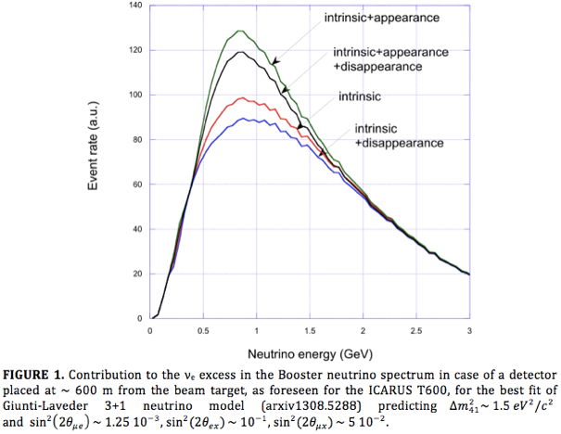
Relevance of 𝜈_{μ}CC disappearance measurement
In the framework of 3+1 model (only 1 light sterile neutrino), three mixing angles are introduced describing 𝜈_{μ} disappearance (θ_{μξ}), 𝜈_{e} disappearance (θ_{εξ}) and appearance (θ_{με}) cross-related through the relation
sin²(2θ_{με}) = 1/4 sin²(2θ_{μξ}) sin²(2θ_{εξ})
Therefore, a possible ν_{e} excess due to the existence of sterile neutrinos will be due to the combined effect of 𝜈_{e} appearance and disappearance
The interplay between these 2 effects can be disentangled by independently measuring 𝜈_{μ} disappearance (or measuring 𝜈_{e} appearance varying the intrinsic 𝜈_{e} contamination of the beam).

