Slide 1
Status of HyperKamiokande
http://www.hyperk.org/
Alain Blondel
University of Geneva & CERN
Many slides from Shiozawa, Neutrino 2018& ICHEP 2018

Slide 2
K. Nakamura, NNN02, CERN, Jan. 18, 2002
A long time story with step-wise use of infrastructure!

Slide 3
A newer version : T. Nakaya, CERN SPSC 2016

Slide 7
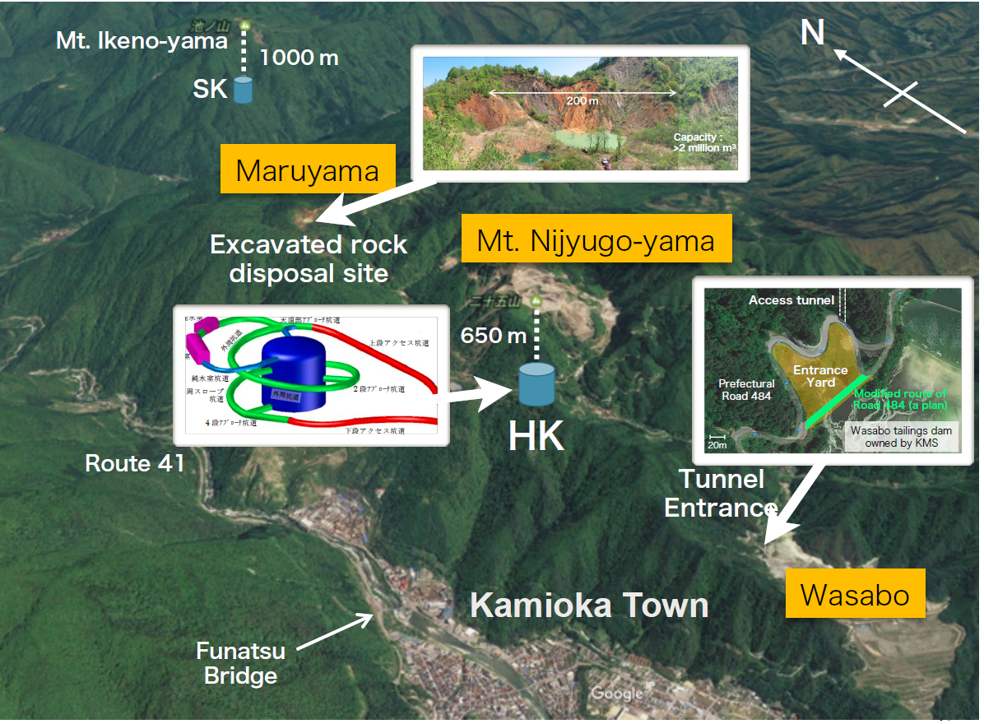

Slide 9
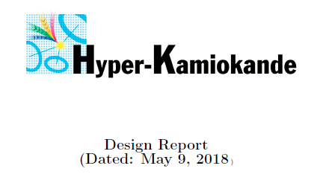
Documentation:
-- letter of intent https://arxiv.org/abs/1412.4673
-- HK Design Report https://arxiv.org/abs/1805.04163

Slide 10
NB SuperK has been running now for > 22 years and still produced very significant results
at neutrino 2018!

Slide 11
Why is matter neutral?
PDG: |(q_{p} + q_{e})/q_{e} | / < 1 × 10⁻²¹
This is a fundamental requirement for the stability of both the Standard Model and our Universe,
but there is no symmetry of the Standard Model that ensures it.
Quarks and leptons are in different multiplets of SU(2)
One common solution: charged leptons and quarks are in the same multiplet of a larger Gauge
symmetry (GUT), with new ‘GUT-isospin’ and ‘GUT-bosons’ transforming leptons ↔ quarks
THIS IMPLIES NUCLEON DECAY
NB: does not preclude e⁺π⁰ !

Slide 16
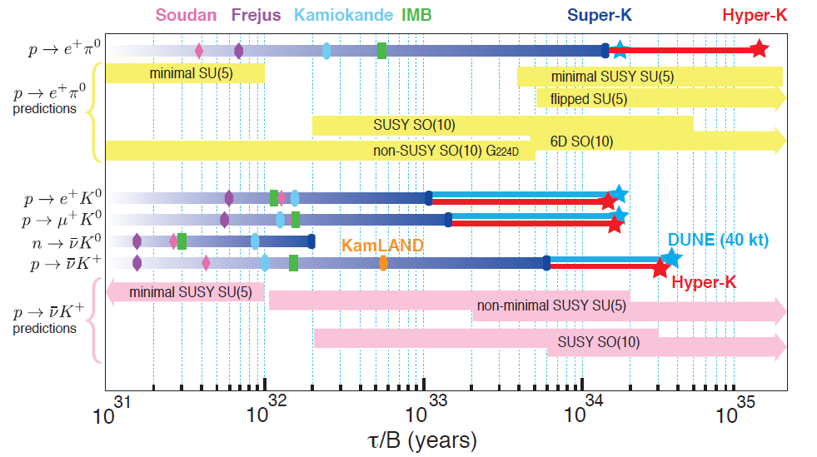
JUNO

Slide 17
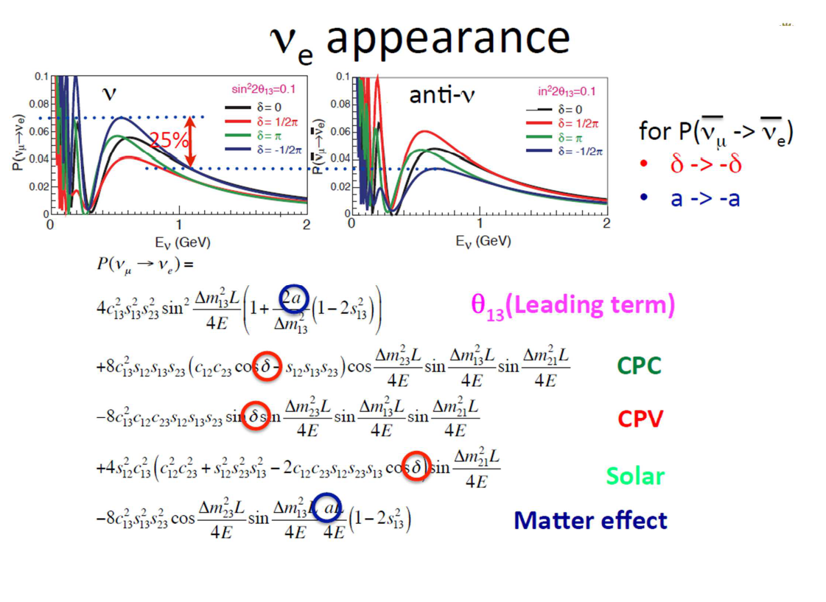
sin δ term is CP violating
cos δ term is not.
sensitivity to δ (precision on δ measurement) is driven by
sin δ term if δ is close to 0 or π → rate asymmetry ν_{e} vs‾ν_{e}
cos δ term if δ is close to ±π/2 → E shift, common to ν_{e} and‾ν_{e}
different systematics!

Slide 20
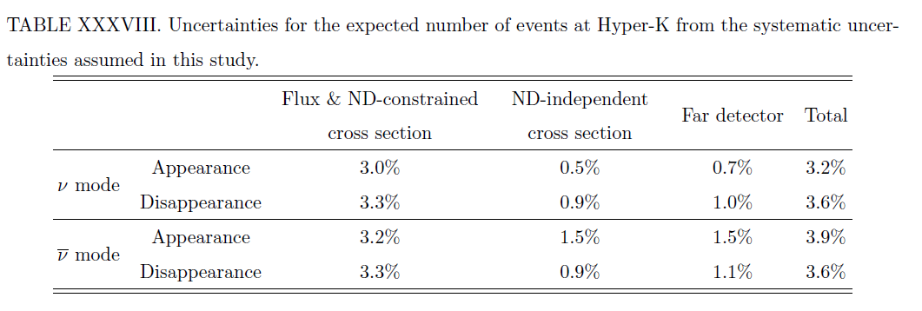
from HK-DR
Errors based on T2K procedure, assuming increase of statistics and improvements of HK vs SK
Considerable room for improvement!
-- change of paradigm/additional data needed for
-- (ν_{e} / ν_{μ}) / (‾ν_{e} /‾ν_{μ}) ratios (errors were assumed maximal here)
→muon mass effect compounded with nuclear effects and kinematic thresholds
-- energy scale uncertainties (energy calibrations and energy response function)
➔ ND280 upgrade + IWC detector – both rely on good knowledge of fluxes
➔ strong support of further improvements of NA61/shine data.

Slide 21
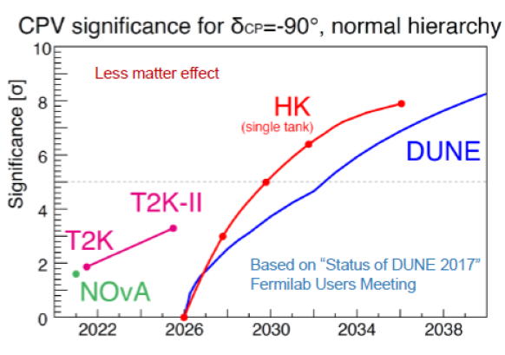
Comments:
-- if 3.4σ NH evidence persists, T2K-II + NOvA will not be far from 5σ by 2026.
-- HK saturation at 8σ driven by assumptions on systematic errors.
➔ strong effort and support to reduce these
-- ND280 upgrade,
-- Further NA61 measurements
-- New IWC near detector (E61)

Slide 22
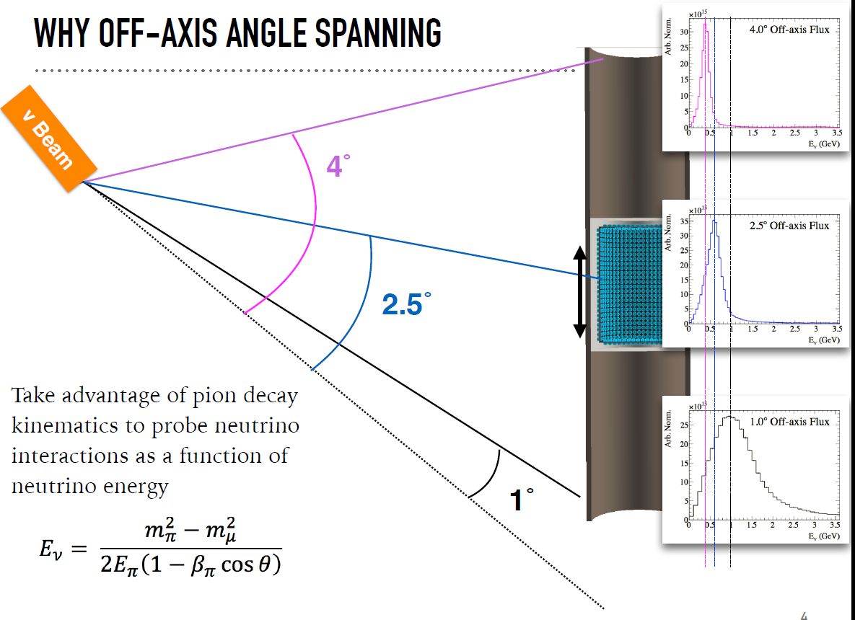
E61:
1. By combination of fluxes taken at different angles,
generate a quasi-monochromatic beam
2. by the same combination of data generate the
Energy Response Function

Slide 26
Some reduction of systematic sensitivities and improvement of error on δ_{CP}

Slide 29
Towards HyperK
-- HyperK was placed on the to-be-funded priority list of MEXT
in Summer 2017 (Ministry of Education Science and Technology)
-- Beam upgrade request to MEXT led by KEK
-- HyperK request to MEXT led by University of TOKYO
-- Funding requests for 2019 are being finalized with MEXT now
(→ end August)
-- Proposal by MEXT will then be made to Japan Government
(Ministry of finance)
-- Funding level and more definite schedule will be known
in Dec. 2018

Slide 30
Timeline as of 2017

Slide 32
Shiozawa, ICHEP

Slide 33
CONCLUSIONS
HYPERK is the next step in the Japan Neutrino adventure
-- it had been planned for a long time.
HyperK has a very broad physics program with unique capabilities
-- proton decay
-- high sensitivity to CP violation
-- High statistics and specific set-up (off axis beam, low energy) and systematics for neutrino oscillation studies
-- rich possibilities for geoneutrinos, solar, supernovae and atmospherics
HyperK can be made. It seemlessly builds on the experience accumulated with SuperK and T2K but offers great systematic challenges!
Further upgrades with Gadolinium and Korean detector

