Slide 1
Status and Future of High-Power Proton Drivers
Sarah Cousineau
nuFACT2018
August 14th, 2018
Blacksburg, Virginia

Slide 2
Outline
What was does the high power operational landscape look like today?
How has our recent experience differed from our expectations?
What are the power-limiting challenges in high power proton facilities today?
What does the high power horizon look like?

Slide 3
Acknowledgements
ISIS (J. Thomason, C. Warsop)
PSI (M. Seidel)
J-PARC (K. Hasegawa, H. Hotchi)
LANSCE (R. Garnett, R. Macek, L. Rybarcyk)
CERN SPS (G. Rumolo, H. Bartoski)
Fermilab (S. Nagaitsev, M. Convery, W. Pellico, P. Adamson)
ESS (M. Lindroos, M. Eshraqi)
Spiral2 (R. Ferdinand)
IFMIF (P.A. Nghiem, J. Knaster)
FRIB (J. Wei)
KOMAC (Y.S. Cho)
MYRRHA (D. Vandeplassche)
CSNS (S. Fu)
CIADS (Lei Yang, H. Jia, Y. He)
Thanks to the many contributors!
*Information gathered 2015-2018

Slide 4
Outline
What does the high power operational landscape look like today?
How has recent our experience differed from our expectations?
What are the power-limiting challenges in high power proton facilities today?
What does the high power horizon look like?

Slide 5
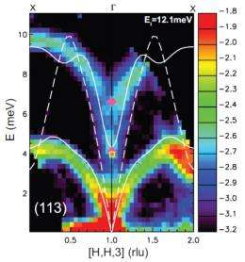
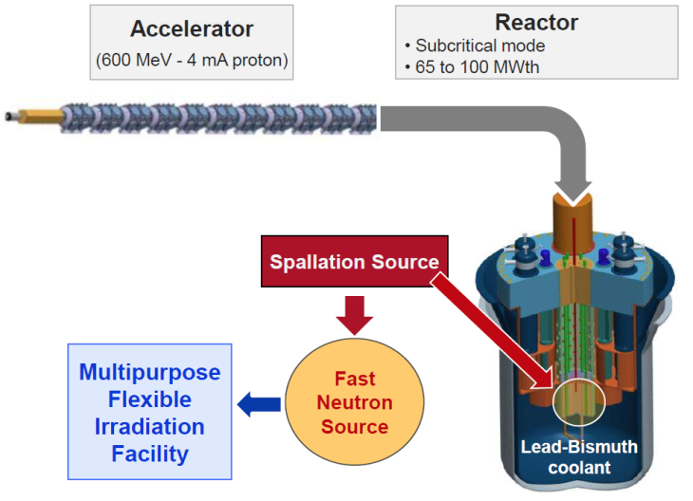
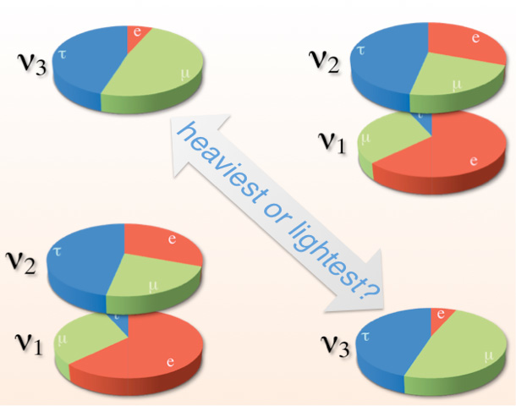
Why High Power Anyway?
Generation of large fluxes of secondary particles beams.
Source beams for colliders.
Future ADS Systems
Materials, Life Science
High Energy Physics
and
Nuclear Physics
Transmutation of nuclear waste
Drivers for nuclear power generation
Materials research for fusion reactors
Neutron beams
Materials irradiation
Isotope production
Radiography
…
“Intensity Frontier”
Neutrino factories
Muon factories
Source beams for colliders
Rare isotope beams
MYRRHA concept
Phys.org. ORNL
http://www-nova.fnal.gov

Slide 6
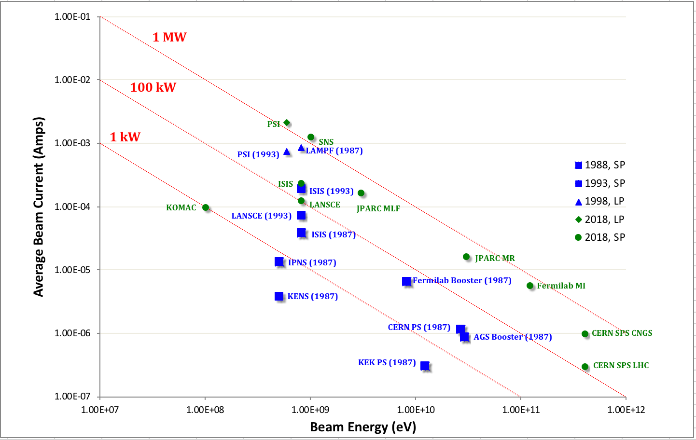
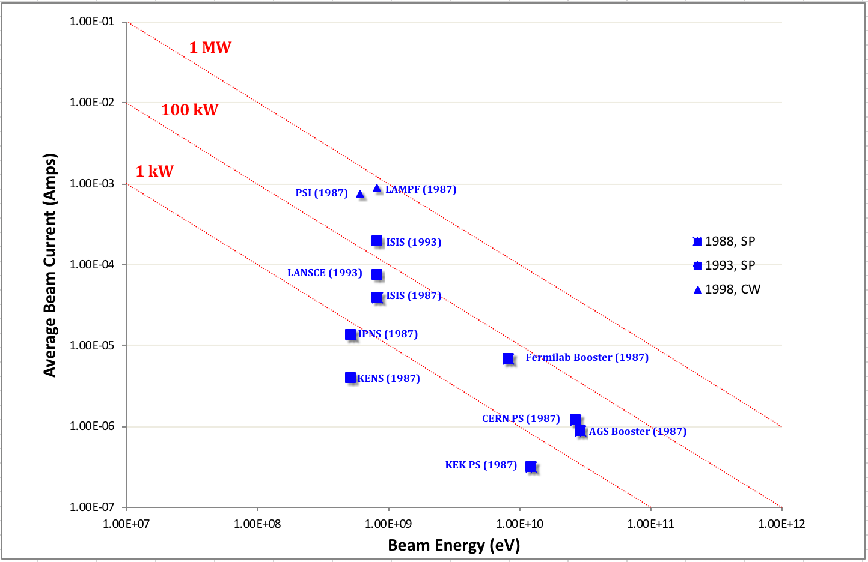
Beam Power Evolution in the Last 30 Years
~25 years ago, the focus in the field was on energy frontier physics, > 1 MW conceptualized...
Today, much greater focus on “Intensity Frontier”:
What is life like at high power?
Cracked the
1 MW barrier
Materials, Life Science
HEP

Slide 7
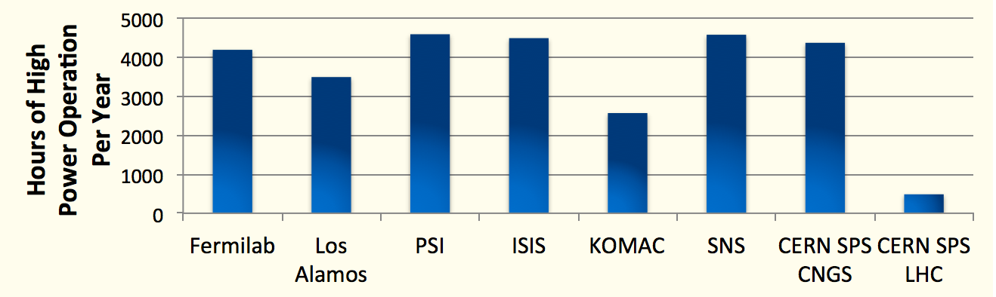
Operating at High Power: Production, Reliability
~4500 hrs/year, allows for maintenance (half of a year)
Difficult to get beyond >92%

Slide 8
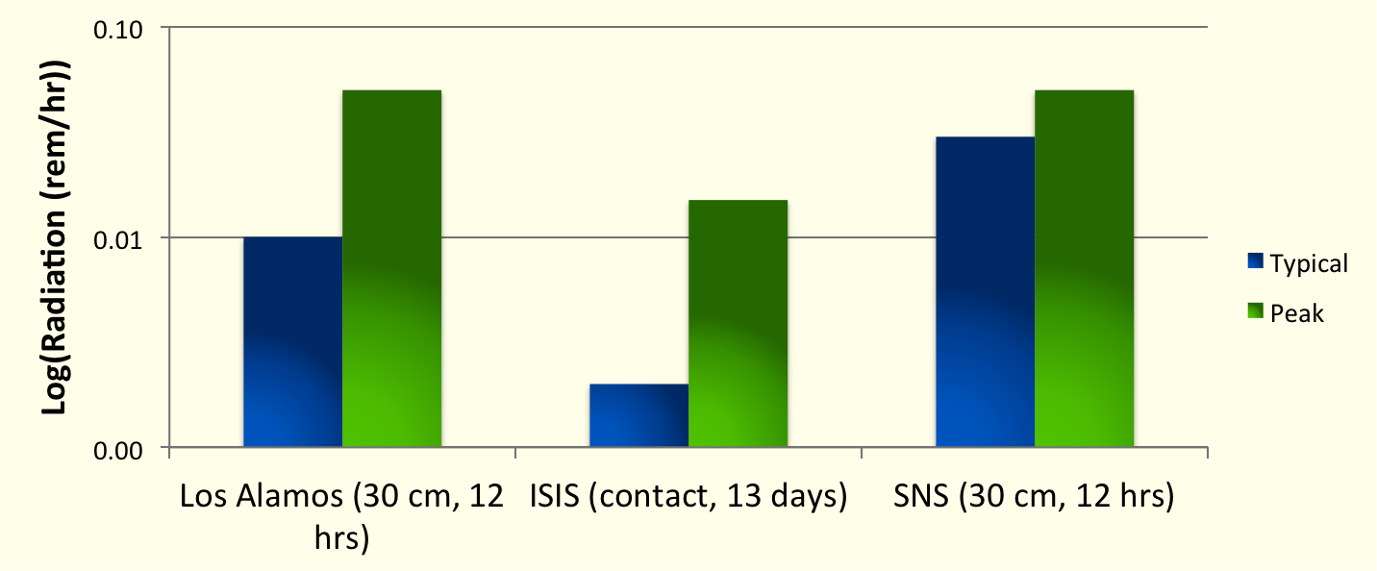
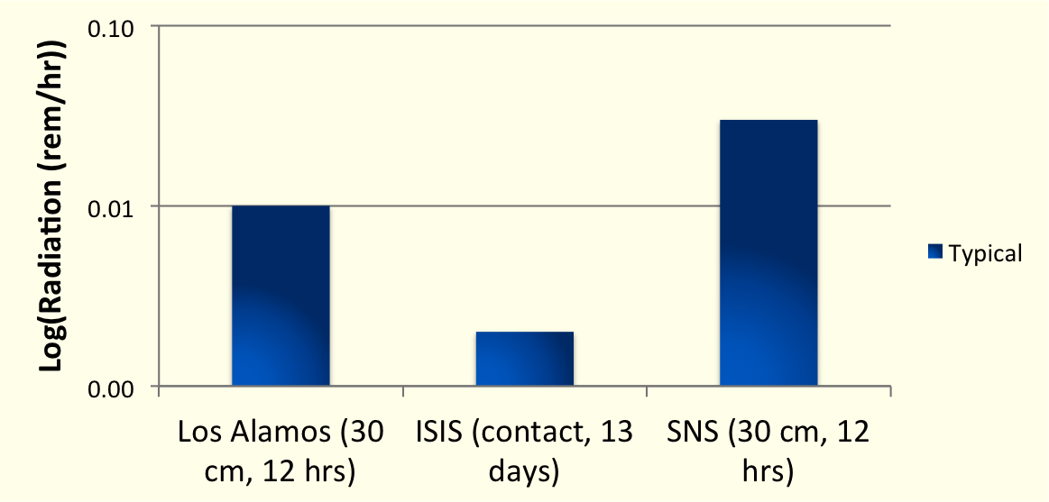
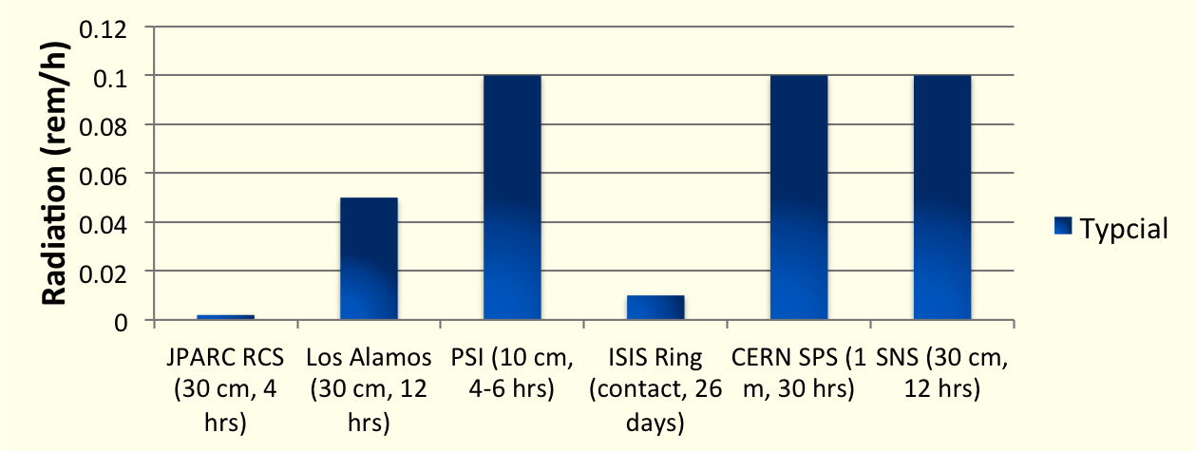
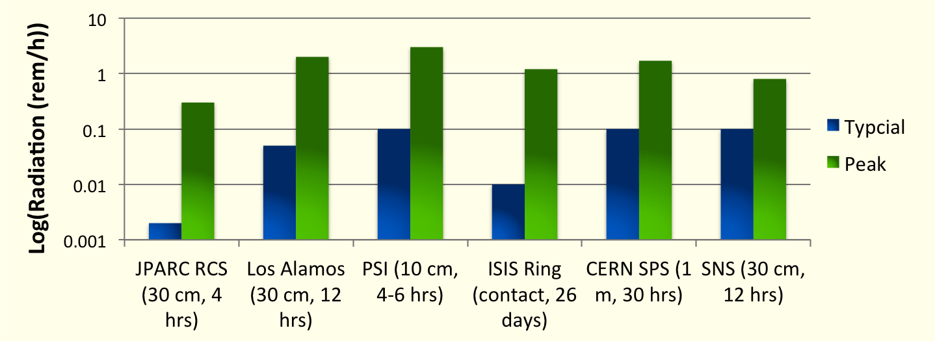
Operational Landscape: Activation
*Numbers contain facility-specific nuances, not meant for direct comparison.
Most areas are below the 100 mrem/hr gold standard and allow for “hands-on” maintenance.
Ring activation 30-60 times higher than linacs.
Linacs
Rings
Peak values are localized spots: usually, injection, extraction, dumps.

Slide 9
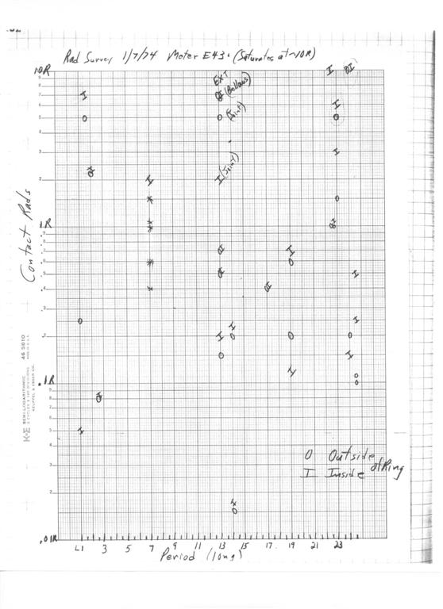
Historical Trends in Activation, Beam Loss
Other numbers, circa 2007:
1/7/74
BNL/AGS injection, extraction, cavities | 20 kW | 1 – 10 rem/hr
PSR | 90 kW | 0.1 – 1 rem/hr
10 rad/h
The gold standard for “hands-on” maintenance is fixed at 1 W/m of beam power deposition
  Fractional beam loss much go down as beam power goes up
Activation, beam loss has been steady as power has been increasing.
New technology, progressively better understanding and control of of beam loss mechanism.
.
1 rad/h
1974 Fermilab Booster activation survey
Courtesy B. Brown

Slide 10
Outline
What does the high power operational landscape look like today?
How has recent our experience differed from our expectations?
  SNS and J-PARC power ramp up experience.
What are the power-limiting challenges in high power proton facilities today?
What does the high power horizon look like?

Slide 11
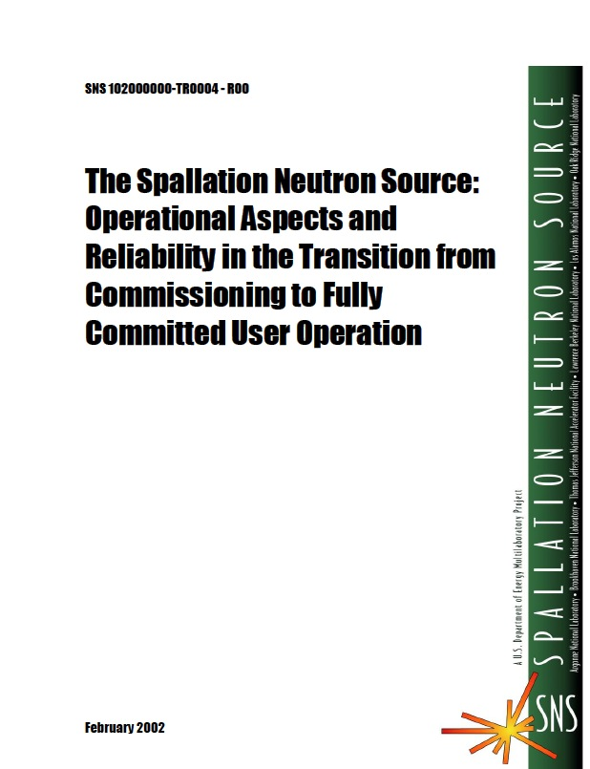
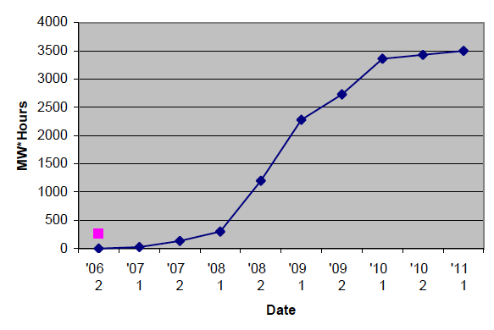
The SNS Power Ramp Up: Expectations vs. Reality
The climb to 1.4 MW was an unprecedented accomplishment...
…But it didn’t always go as planned...
Predicted Ramp Up
1.4 MW
To 1.4 MW in 5 years
Date

Slide 12
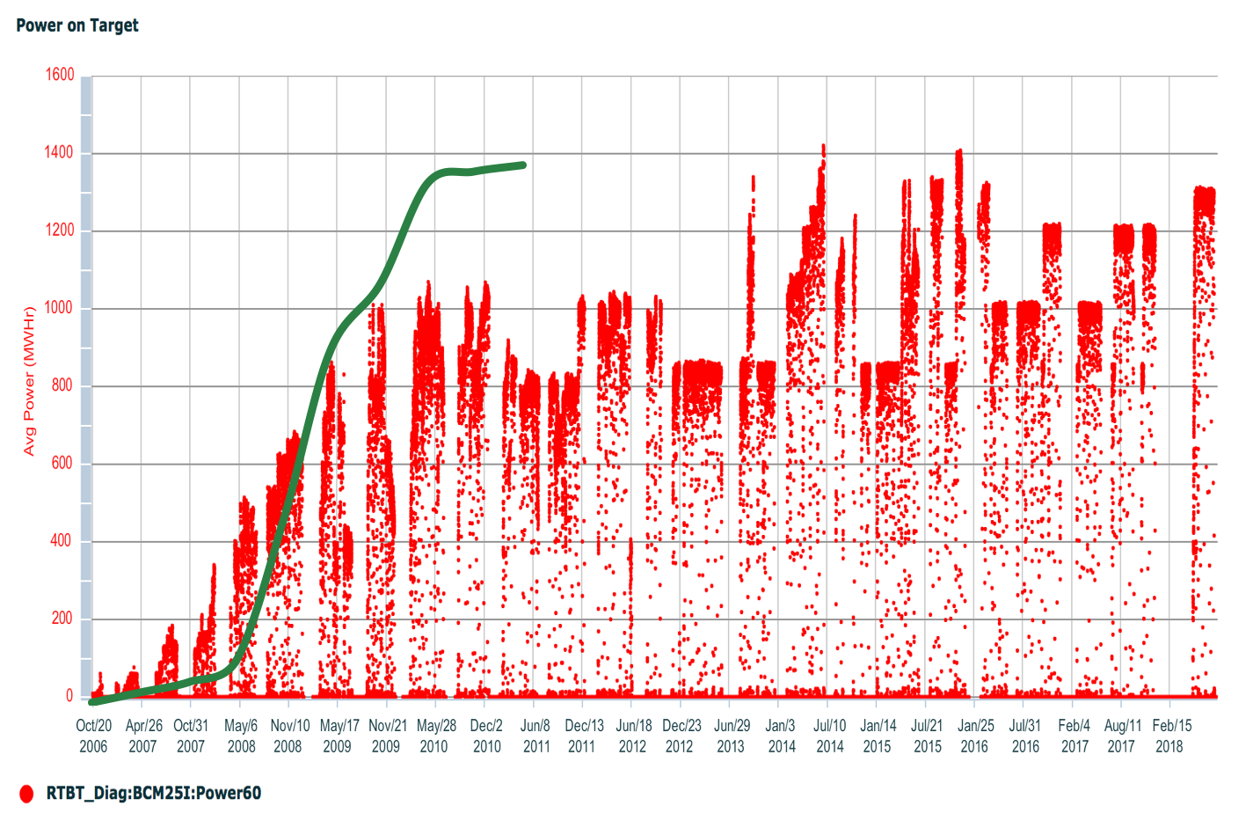
The 12 Year SNS Beam Power History
Target management plan to 1.4 MW
Planned
Target Failures

Slide 13
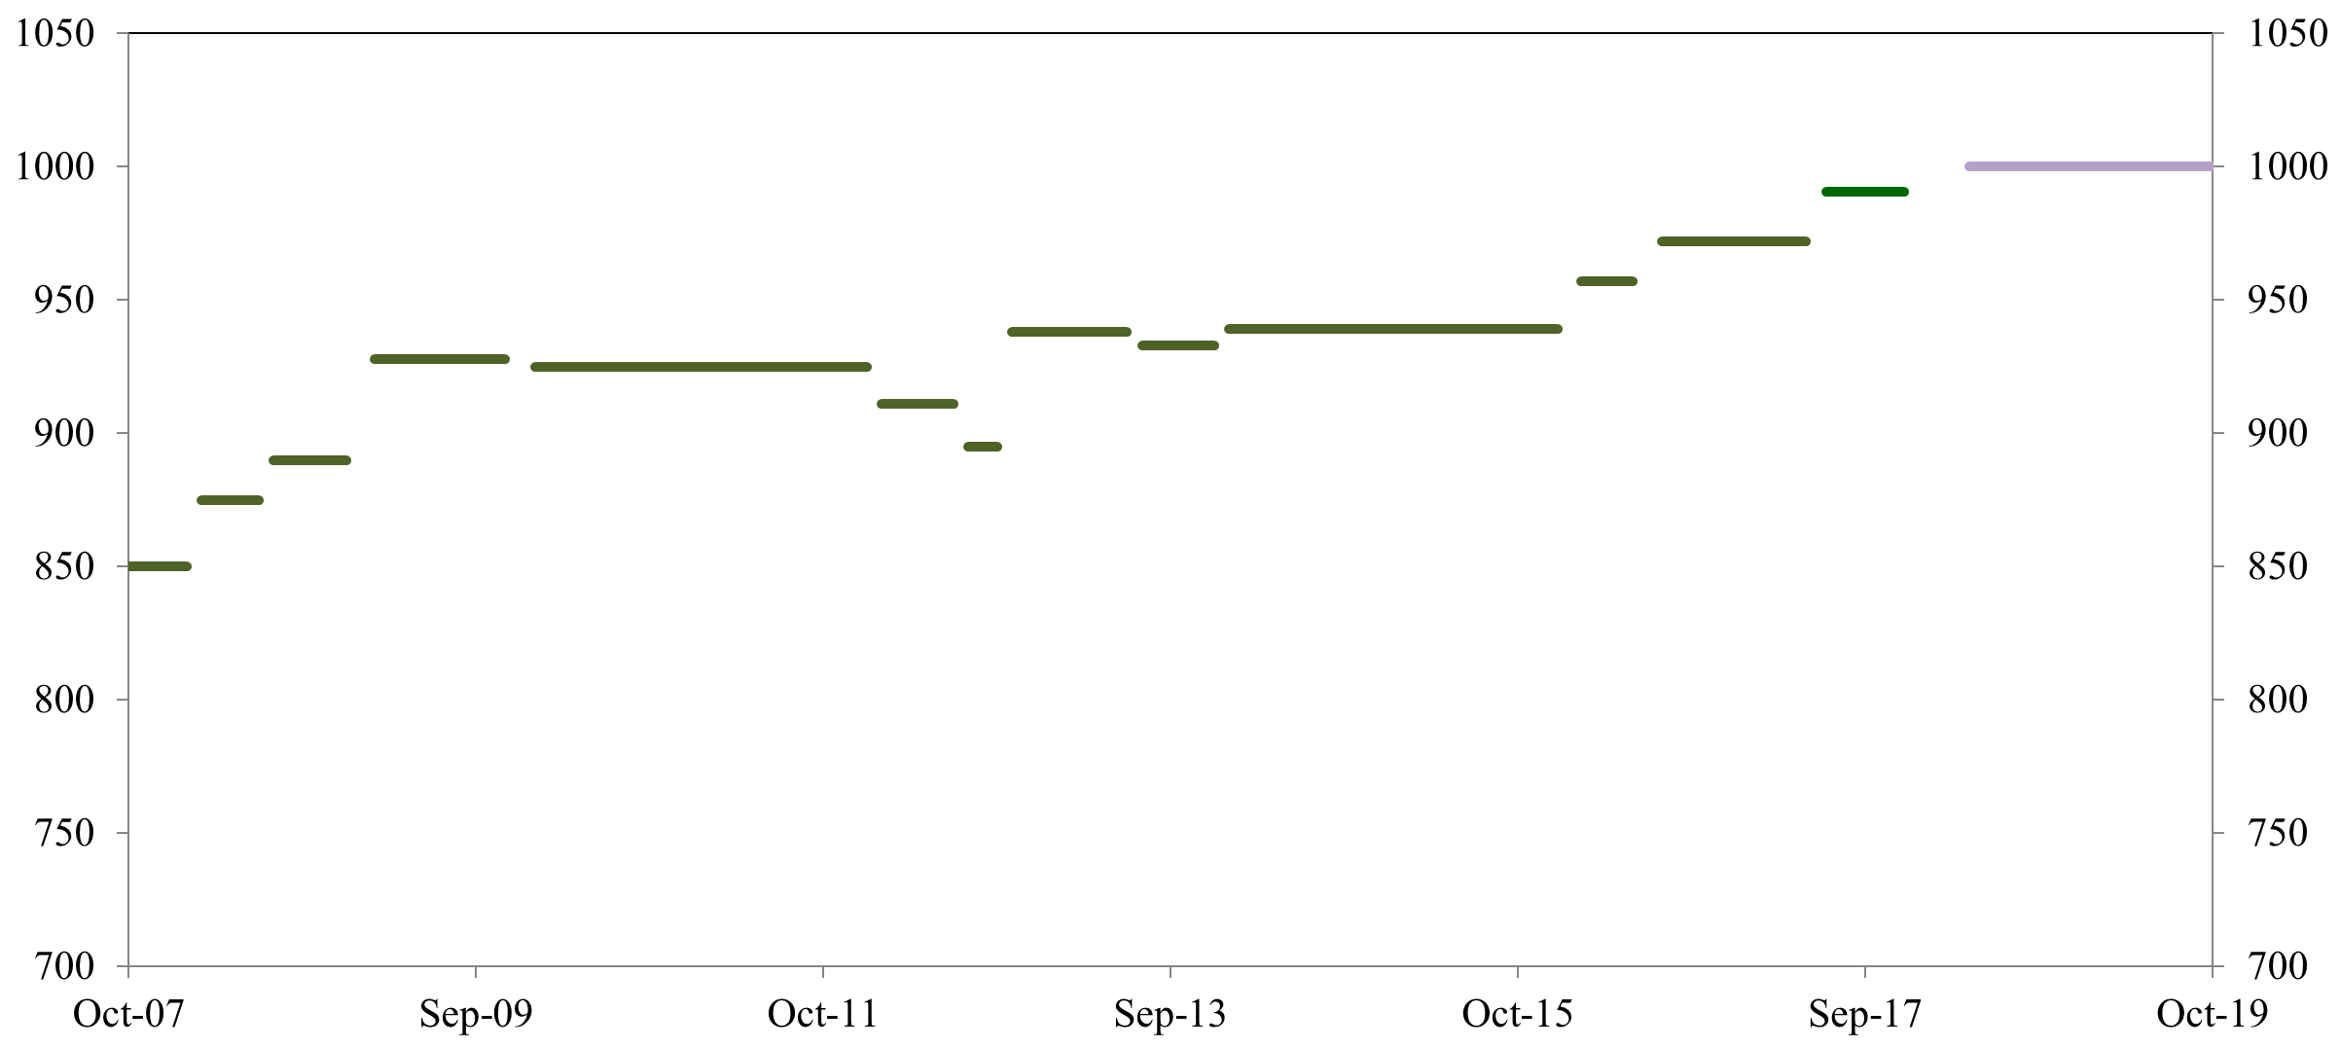
SNS SCL Cavities: Expectations vs. Reality
SNS SCL cavity suffered from issues with field emission, HOM problems, etc.
Getting closer and closer to design.
Generally, SCL is flexible and accommodates different “gradient profiles”
1.01 GeV
Energy (MeV)
First Run
Many different gradient configurations over the years as cavities were services
2006
2006
Date

Slide 14
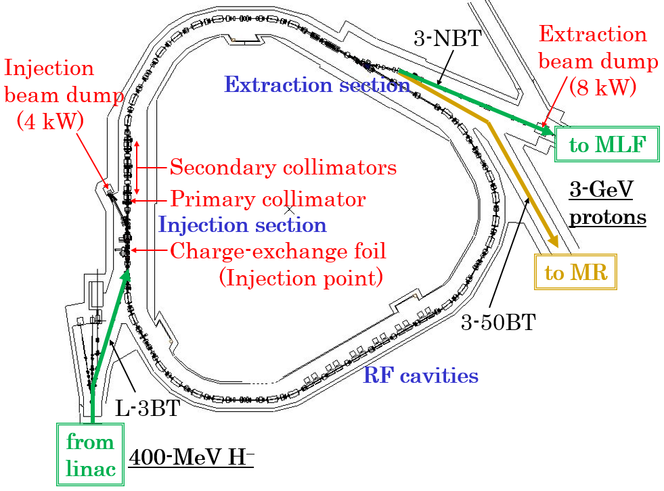
JPARC Facility – Neutron and Neutrino Source
Destinations of the 25-Hz beam pulses
・・・・
・・・・
~95.5% to MLF
~6.5% to MR

Slide 15
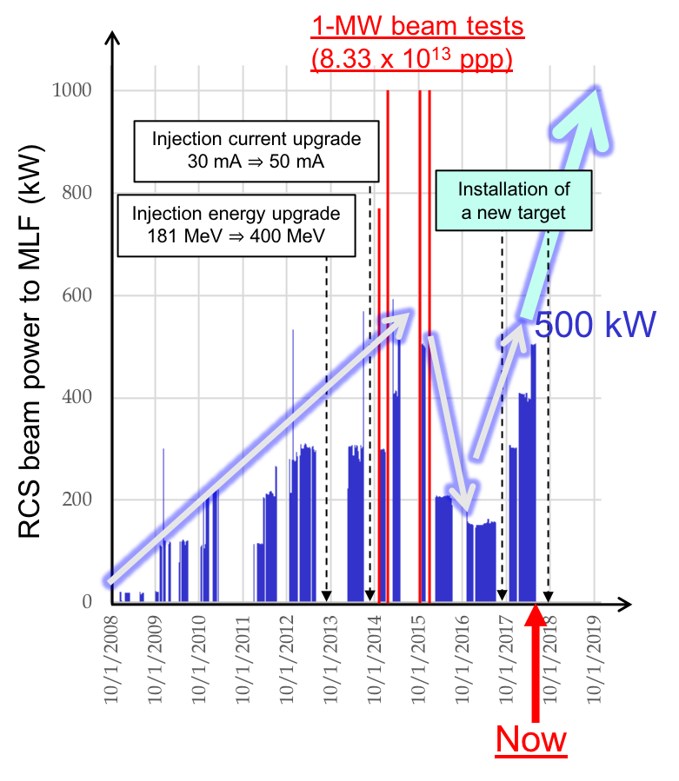
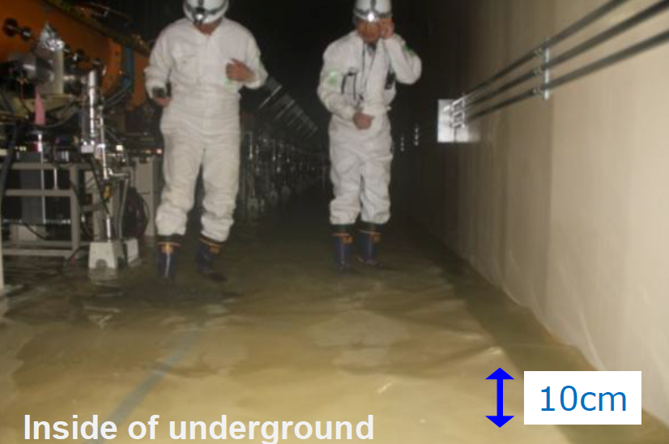
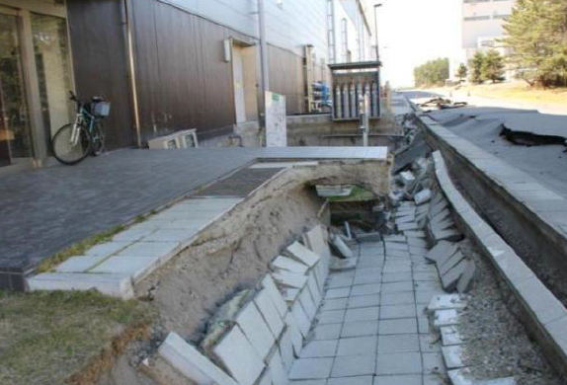
JPARC Power Ramp History
Earthquake
Accelerator is 1 MW capable
Ramping back to 1 MW
Target challenges

Slide 16
Outline
What does the high power operational landscape look like today?
How has recent our experience differed from our expectations?
What are the power-limiting challenges in high power proton facilities today?
What does the high power horizon look like?

Slide 17
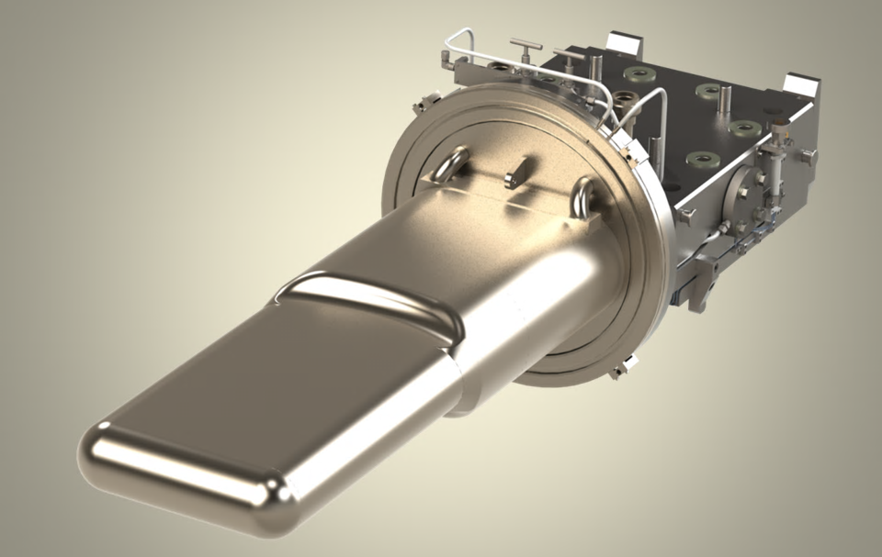
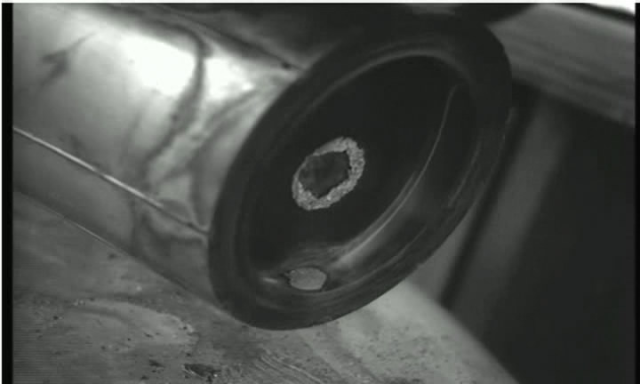
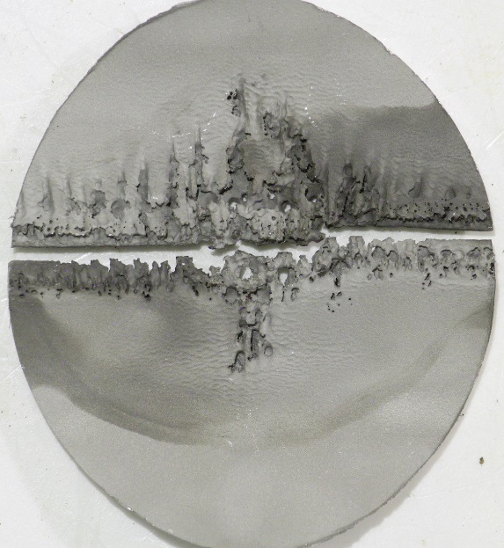
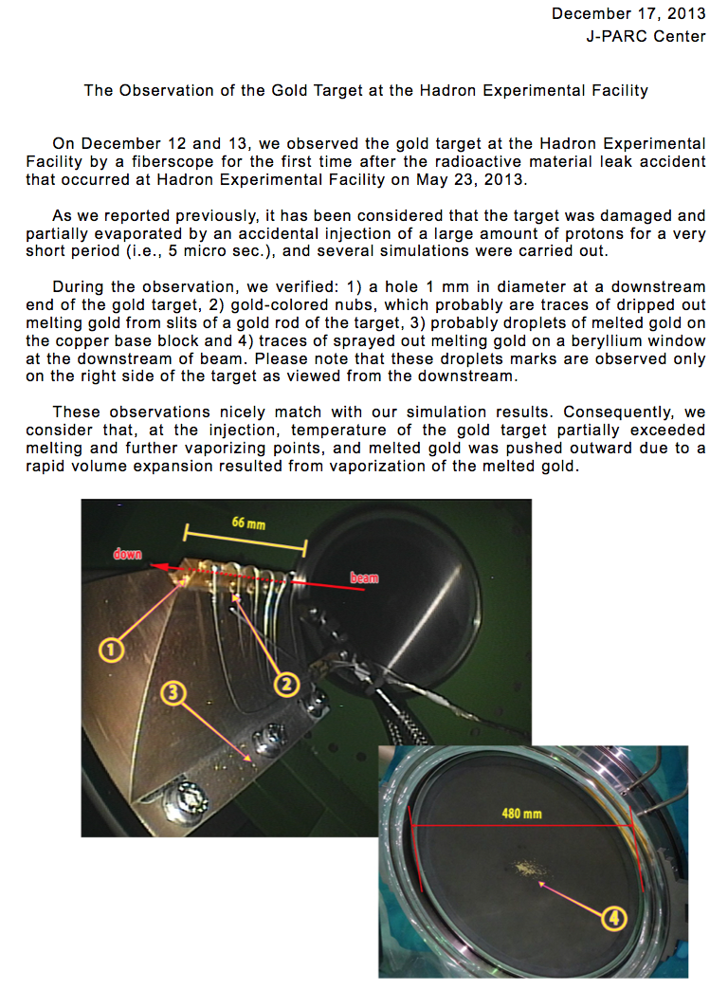
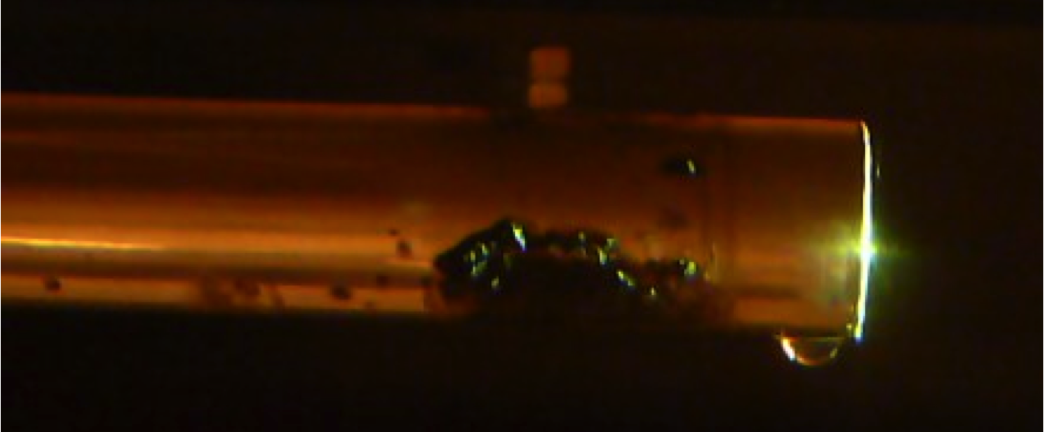
The Targets Challenge
Target failures cause extensive downtime, impact operational schedule.
2010: ISIS T2 failed after combined water leak and high beam density.
Early-life failure issue, now resolved.
z
2013: J-PARC hadron hall gold target failed after design power exceeded due to unexpected shorter pulse.
Tip of NuMi target during removal. Courtesy R. Zwaska
At SNS, targets failed first at weld points (~5) then due to cavitation damage (~2).
Courtesy J. Thomason, ISIS
Leak detector fluid “bubbling” through weld failure on SNS Target
Cavitation damage to inner vessel
Scouring from arcing of horn current
Water drip

Slide 18
Beam Power Limitations: Hardware
Machine | Hardware Limitations
 | Category | Problem
JPARC RCS | RF | DC power supply for RCS acceleration
 | RF | Ringing of chopper RF
SNS | RF | RFQ performance
 | Target system | Target failure problem
PSI | Target system | Cooling of spallation target
 | Target system | Heat load on collimators behind meson production target
LANSCE | Target system | Power limitation (isotope production)
 | Target system | Window power limits
ISIS | Target system | Target 1 not rated for higher power
 | Target system | Target 2 longevity constraints
 | Target system | Moderator cooling
 | RF | Linac HPRF system
Fermilab | Target system | Thermal stress and fatigue
 | RF | Booster and MI RF requires upgrade
CERN SPS | RF | Power limits to preserve tetrods.

Slide 19
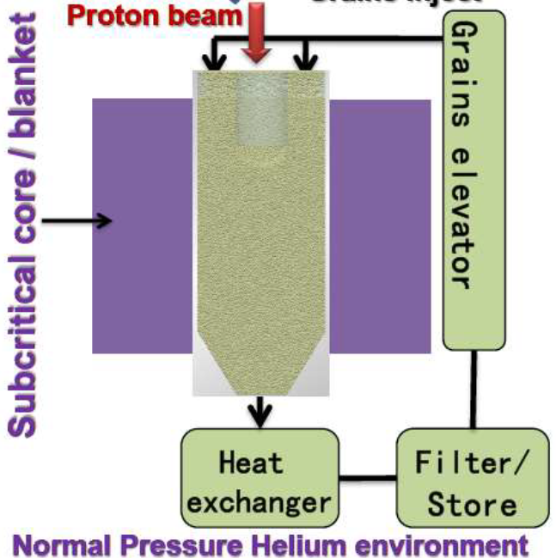
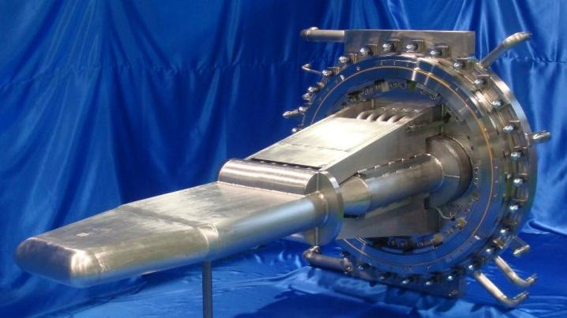
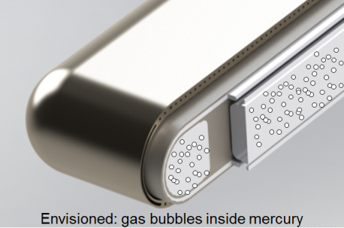
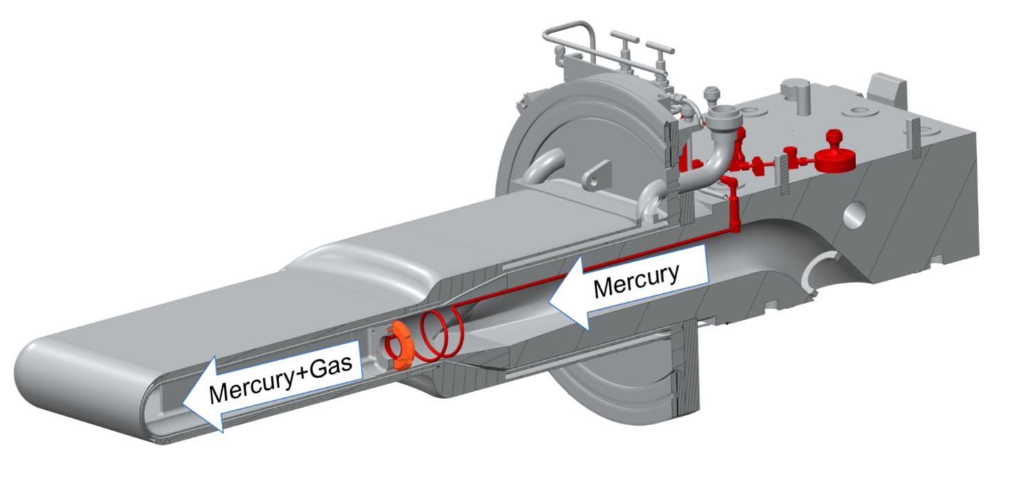
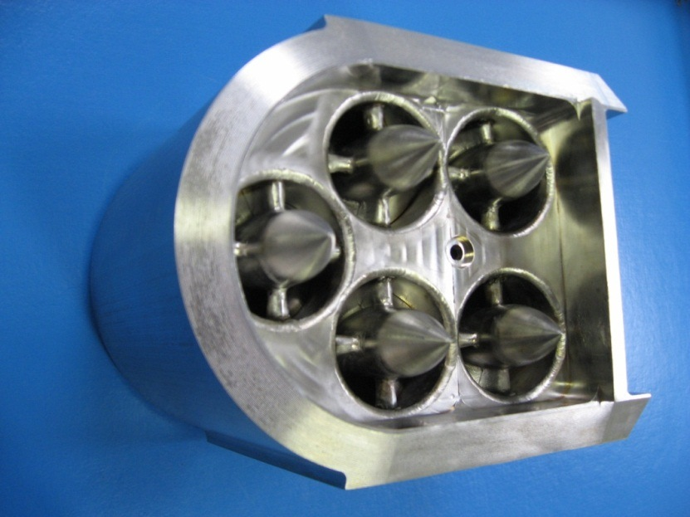
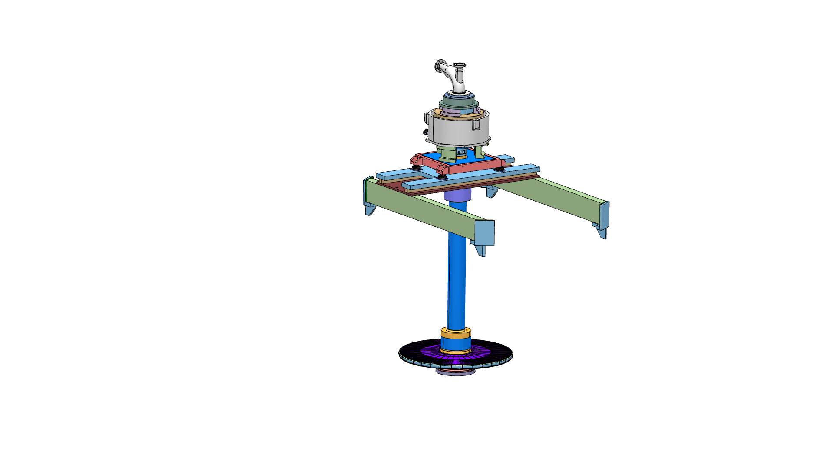
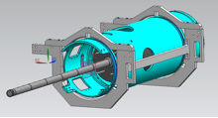
High Power Target R&D Efforts
10 MW, CW
J-PARC gas injector concept
T. Naoe et al, ACCAP 2013
2.0 MW, SP
1 MW, SP
Gas injector development at SNS.
Courtesy L. Yang
1 MW Power Rating 10 MW
1.2 MW
5 MW, LP
PIPII LBNE target
Courtesy R. Zwaska
ESS rotating tungsten target
Courtesy M. Lindroos

Slide 20
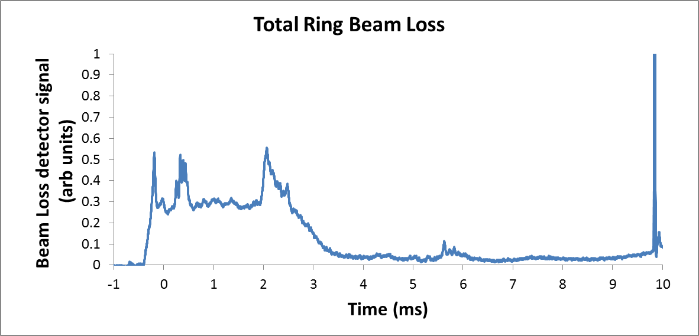
Beam Power Limitations: Beam Loss
After individual hardware issues have resolved, beam loss mechanisms become the power limitation.
Can’t simply “turn up the knob” – Beam loss will scale linearly with power, at best. 1 Watt/meter energy deposition is a hard limit.
H⁻ injection losses…. SNS, LANSCE, J-PARC
Extraction losses… PSI, CERN SPS (from PS)
Instabilities… ISIS, CERN SPS, Fermilab
Adiabatic capture…. ISIS, Fermilab Booster
H⁻ intrabeam stripping.... SNS
Gamma transition… Fermilab Booster
Space charge induced halo, emittance growth… all high intensity machines
…
Most common beam loss mechanisms
ISIS Ring Beam Loss
Injection, capture, instability
Courtesy J. Thomason

Slide 21
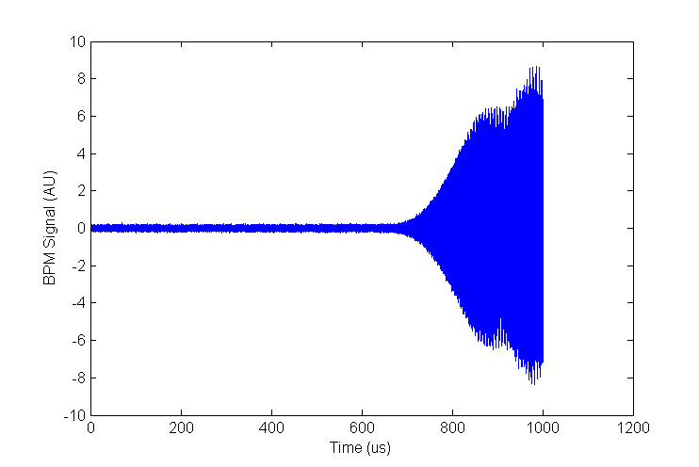
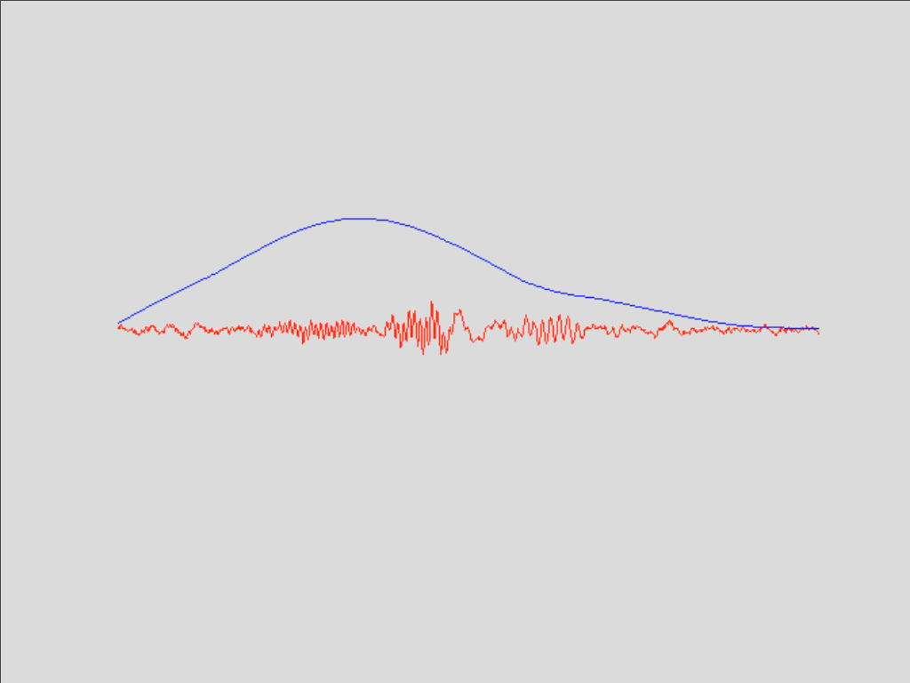
Instability: A Dreaded Beam Loss Mechanism
Beam pipe
Instability
Centroid Position (AU)
Stable beam signal
Turn Number
Charge density
Centroid position
e-P instability observed at SNS
Length of beam in Ring

Slide 22
Outline
What does the high power operational landscape look like today?
How has our recent experience differed from our expectations?
What are the power-limiting challenges in high power proton facilities today?
What does the high power horizon look like?

Slide 23
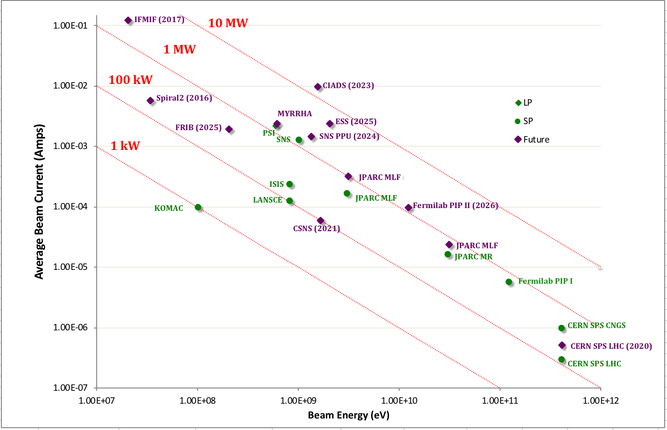
Summary of Future Beam Powers
New class of ADS style machines populating the high I, low E region.
ADS, RIB
Materials, Life Science
High Energy Physics

Slide 24
Driving Technology for Future Machines
Facility | Pulse Type /Purpose | Driving Technology
ESS | Long pulse | Superconducting Linac
FRIB | CW | Superconducting Linac
CIADS | CW | Superconducting Linac
MHYRRA | CW | Superconducting Linac
IFMIF | CW | Superconducting Linac
Spiral2 | CW | Superconducting Linac
CSNS | Short pulse | RCS
Primary technology for next generation machines is superconducting linacs

Slide 25
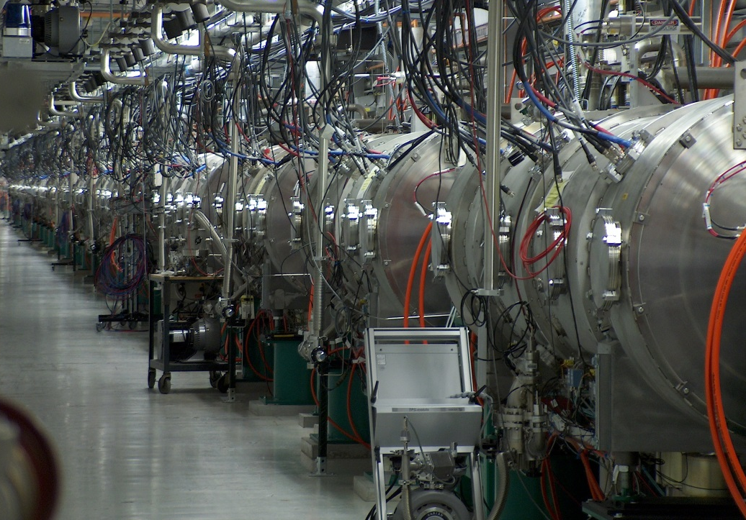
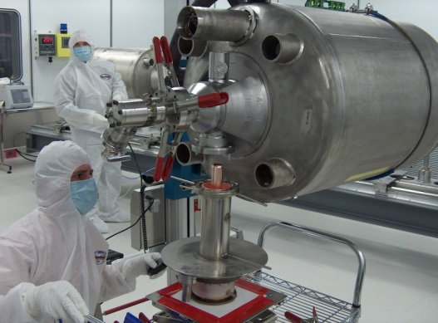
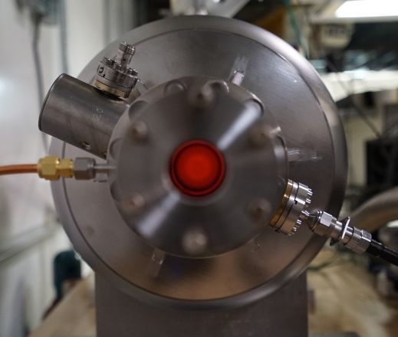
The Future in Superconducting Linac
Based on the SNS 10 year SCL operational experience, the future looks bright!
SNS SCL Statistics:
>99% availability (< 1 trip/day)
Low activation (10-30 mrem)
Flexibile gradient profiles
Fast tune up: 81 cavities in 30 minutes!
Performance relies on continuous cyromodule rework and development.
Challenge for future ADS machines:
Trip rate must be reduced an order of magnitude..

Slide 26
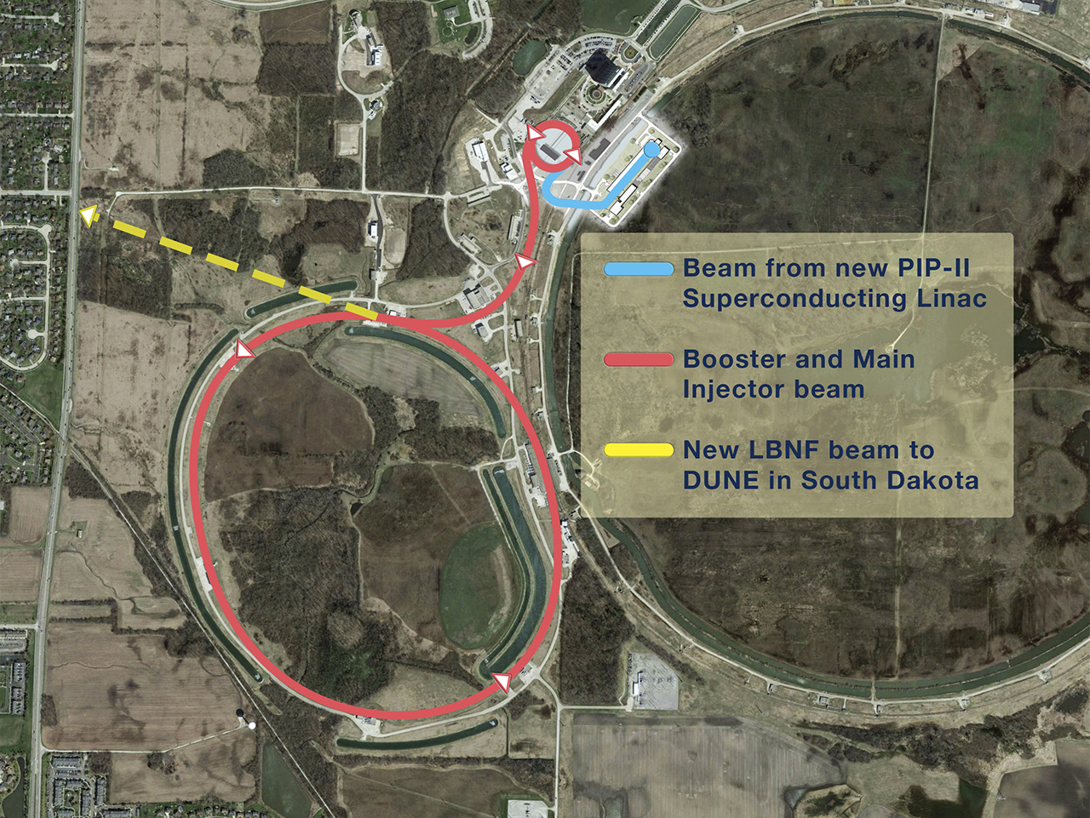
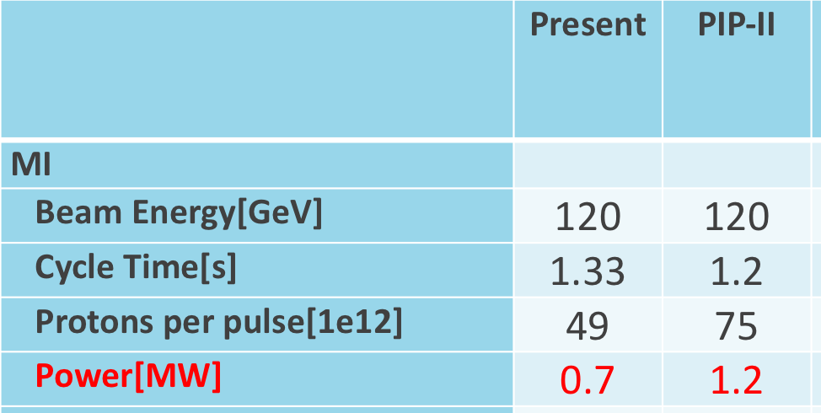
PIPII – High Power Neutrino Source
International Collaboration
Stage: CD0; CD1 anticipated 2018
Project Completion: ~2026

Slide 27
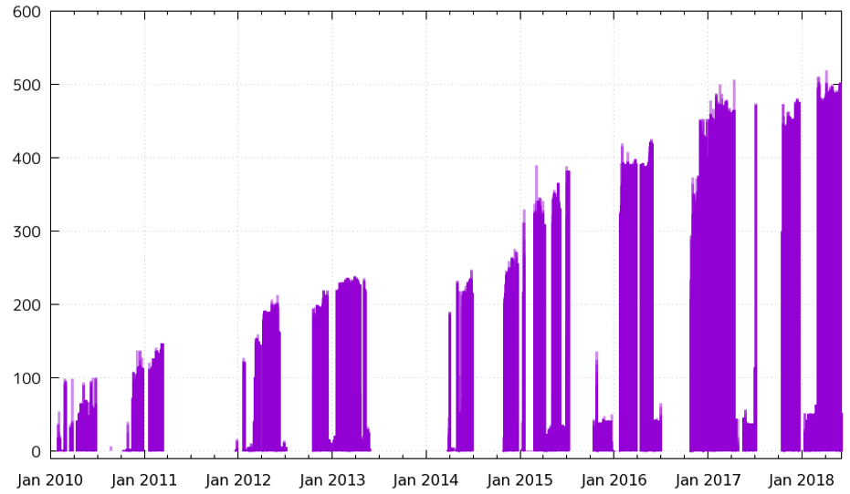
JPARC MR Power Upgrade
Stage: In progress
Project Completion: ~2022
Courtesy H. Hotchi
~500 kW
MR beam power to NU (kW)
The RCS is now delivering the beam to MR
at the beam intensity of ~6.5 x 10¹³ ppp (~78% of the RCS design beam intensity).
The MR has recently achieved a new record of 500-kW beam power
The design beam power of MR is 750 kW. To achieve this and more, the MR operation cycle time will be reduced from 2.48 s to 1.3 s.
Hardware upgrades to get to this are in progress now.
35

Slide 28
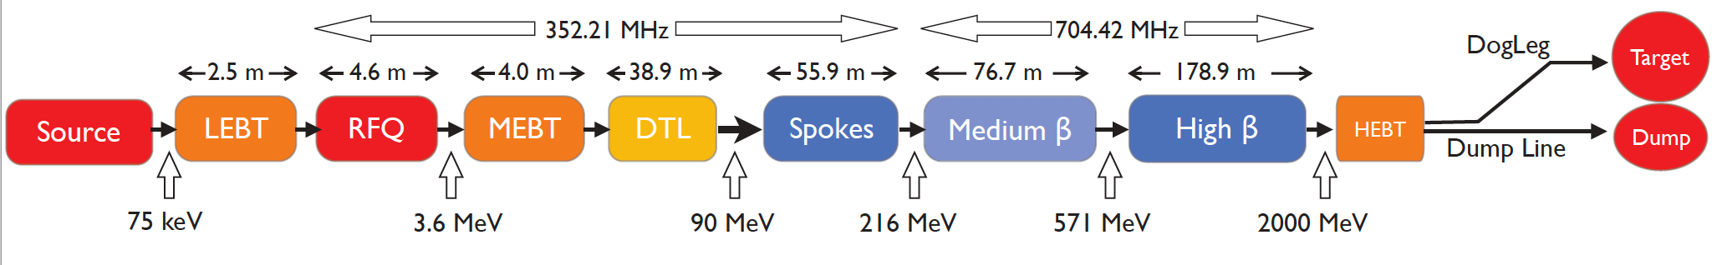
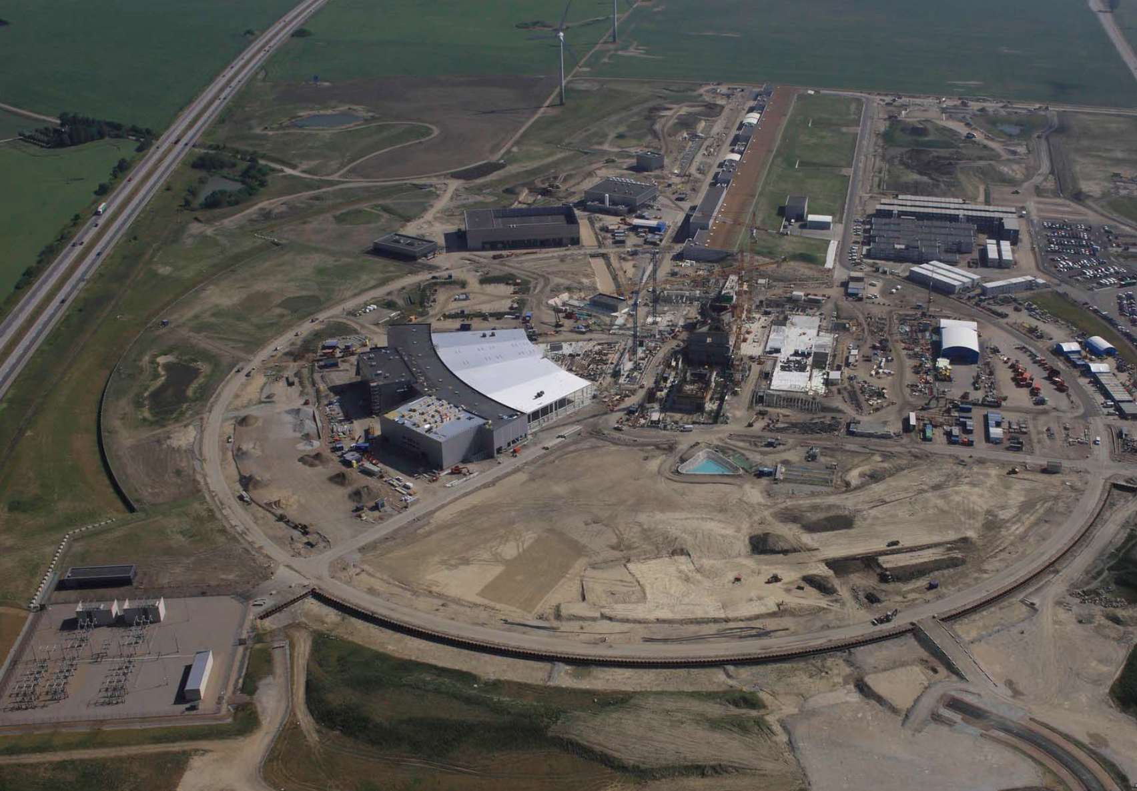
European Spallation Slource
Superconducting Proton Linac
Energy: 2 GeV
Power: 5 MW
Pulse length: 2.8 ms
Stage: 50% complete
Project Completion: ~2025
Courtesy M Eshraqi

Slide 29
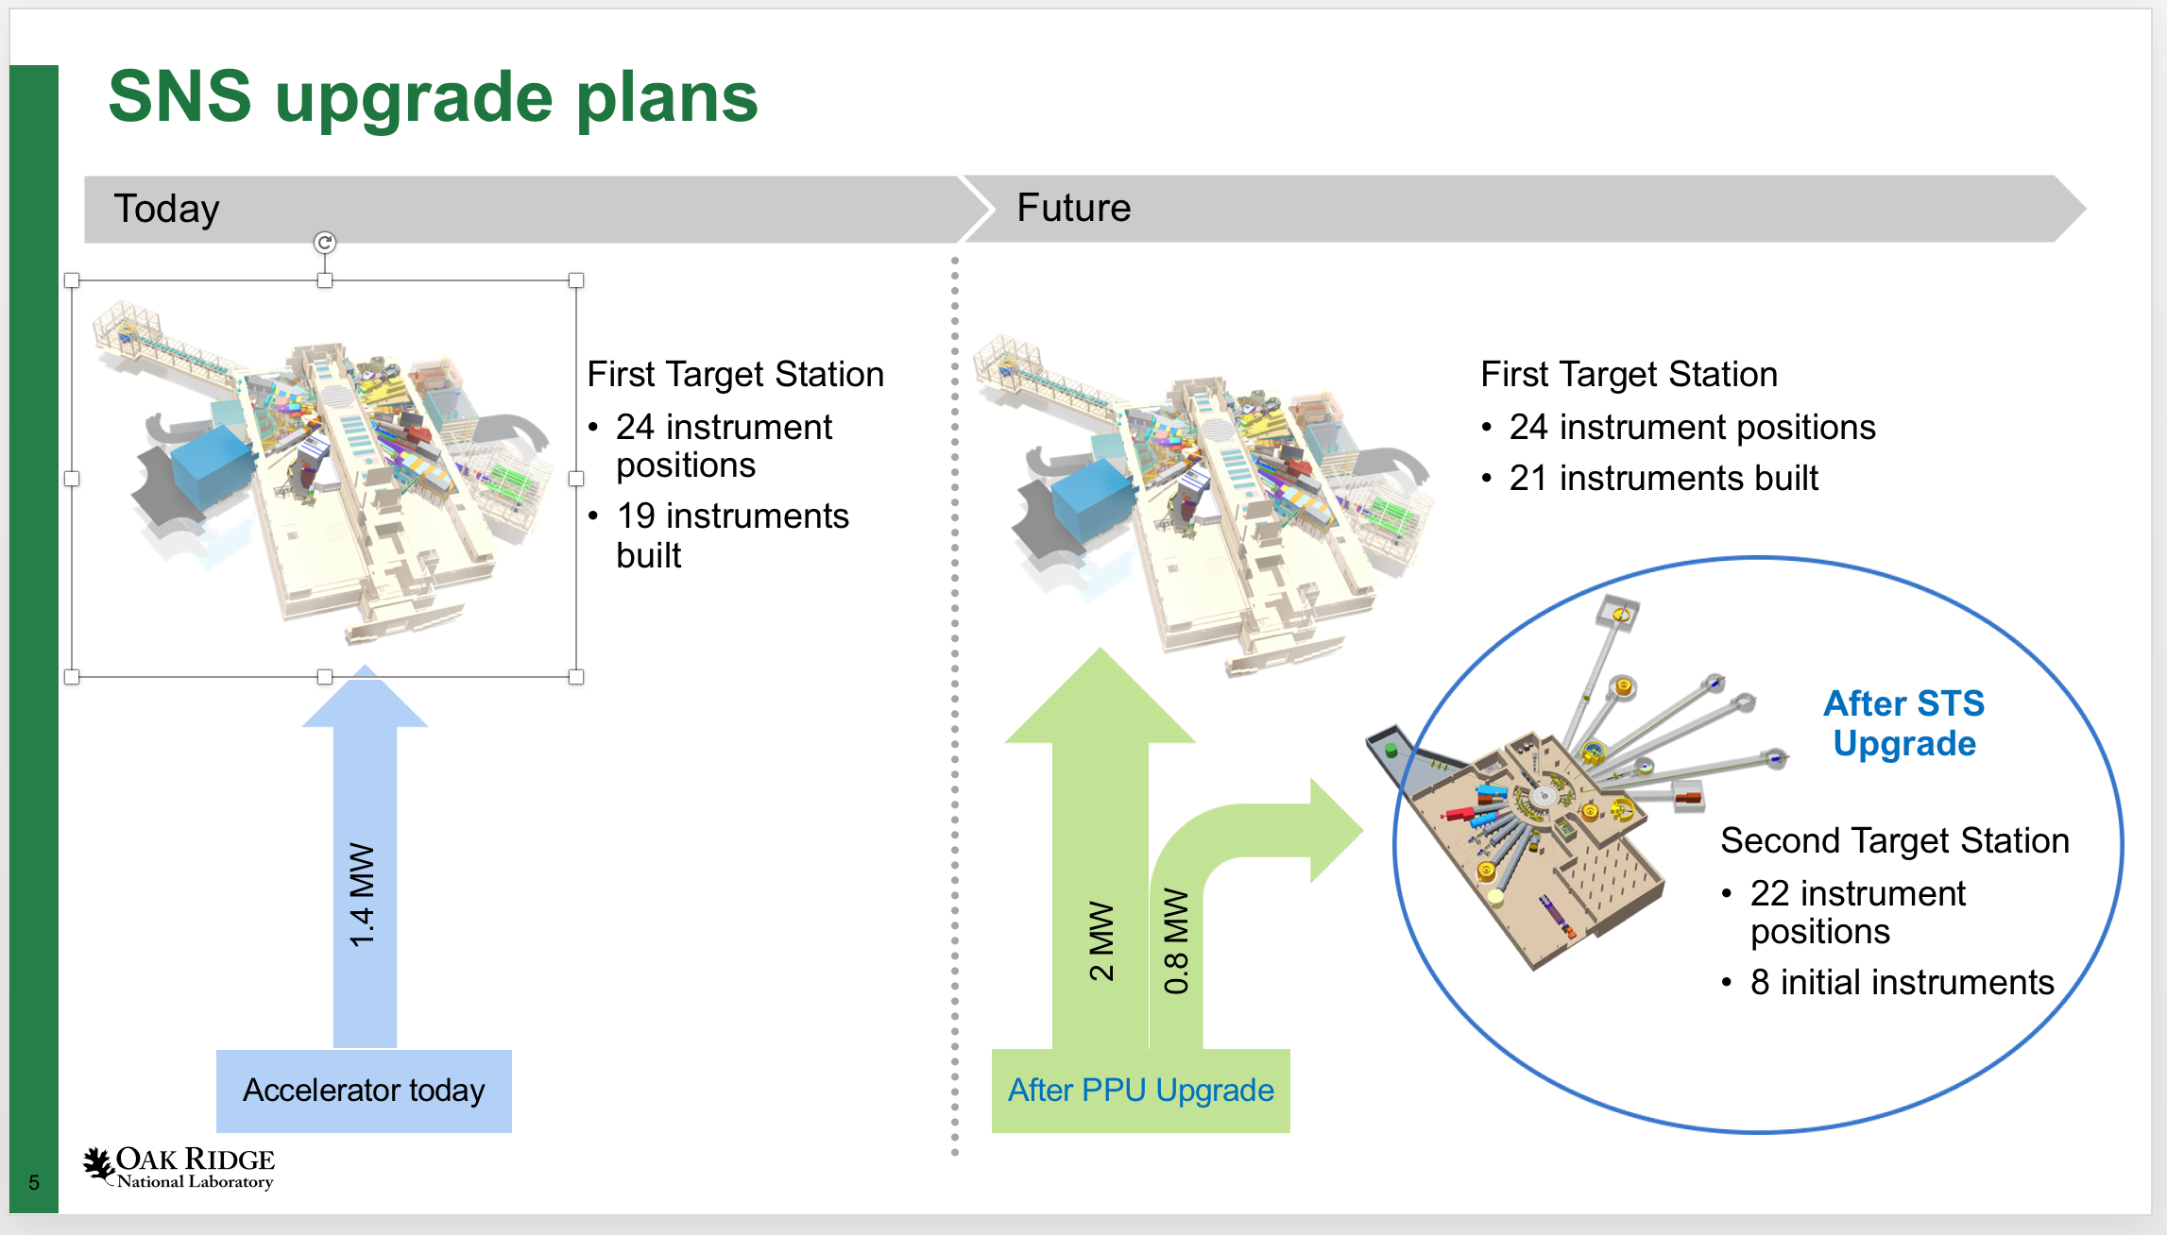
SNS Proton Power Upgrade
Superconducting H- Linac
Energy: 1 →1.3 GeV
Power: 2.8 MW
Pulse length: 1 µs
Stage: CD1
Project Completion: ~2024

Slide 30
Chinese International ADS Project

Slide 31
CIADS – ~1 MW Test Stage
Stage: Anticipate approval 2018
Project Completion: ~2024
Beam trips reasonable compared to today’s numbers
Full scale ADS requires order magnitude better for > 5 min trips
(http://inspirehep.net/record/873011/files/fermilab-fn-0907-di.pdf)

Slide 32

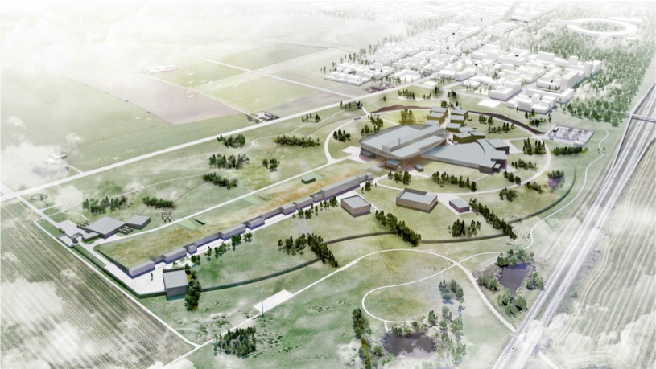
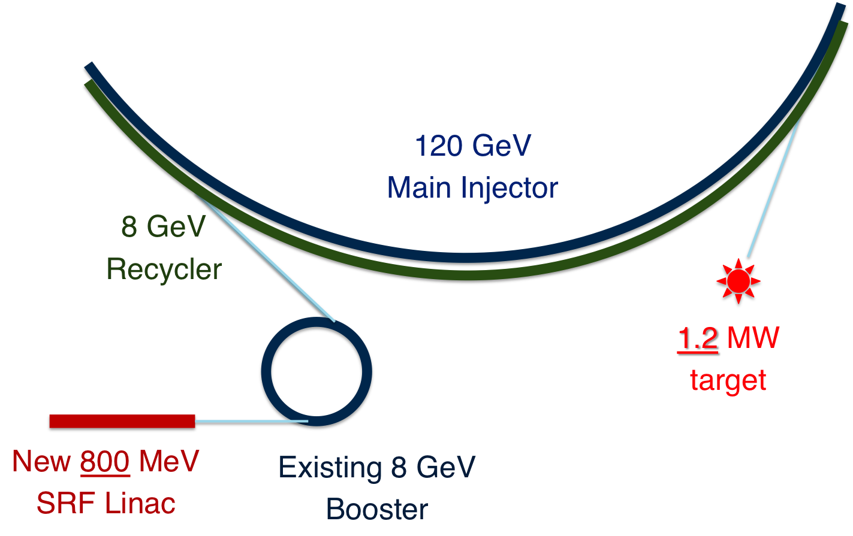
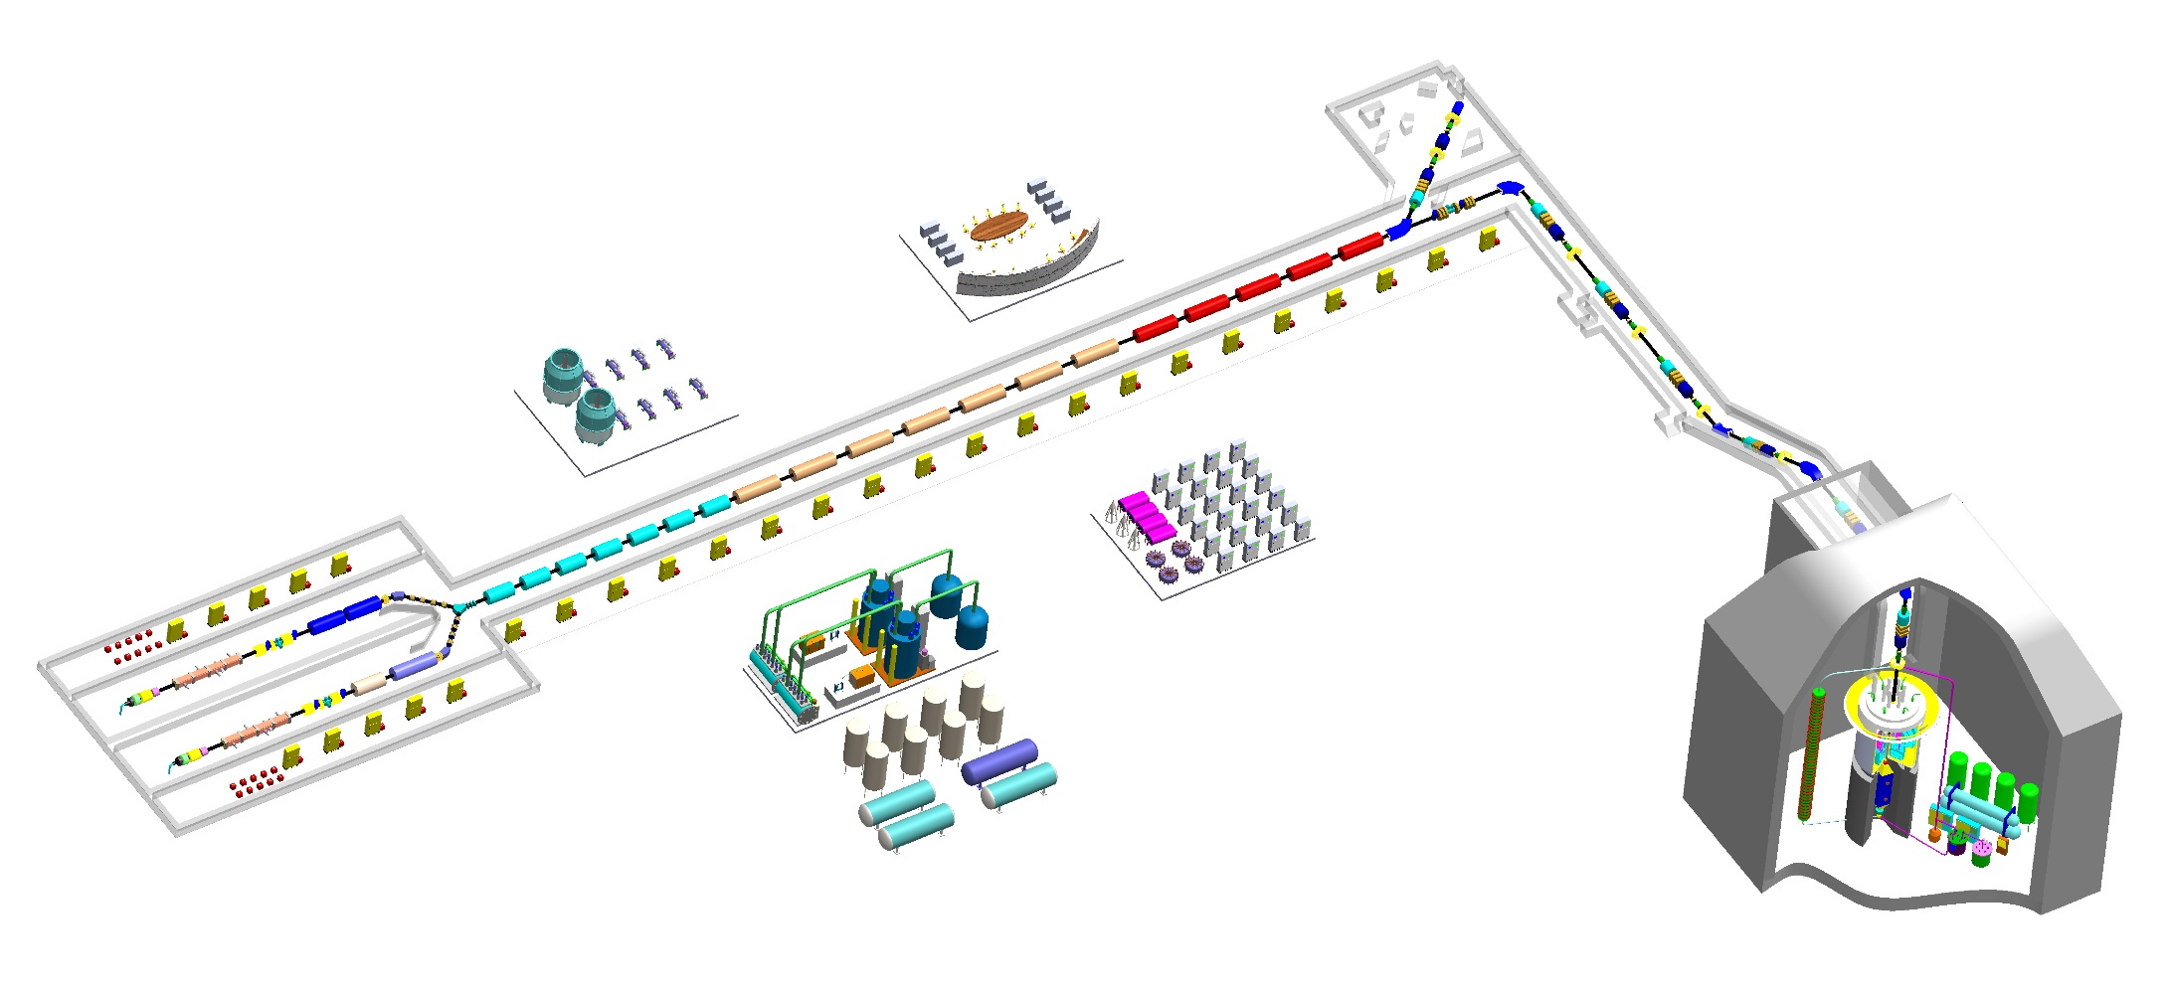
Summary
Beam powers have increased an order of magnitude in the last ~30 years without increasing activations. Future machines need to continue this trend!
ESS, PIPII, CIADS, SNS PPU, JPARC…
The world is watching!
PIP II
ESS
SNS-PPU
CIADS

