Slide 1

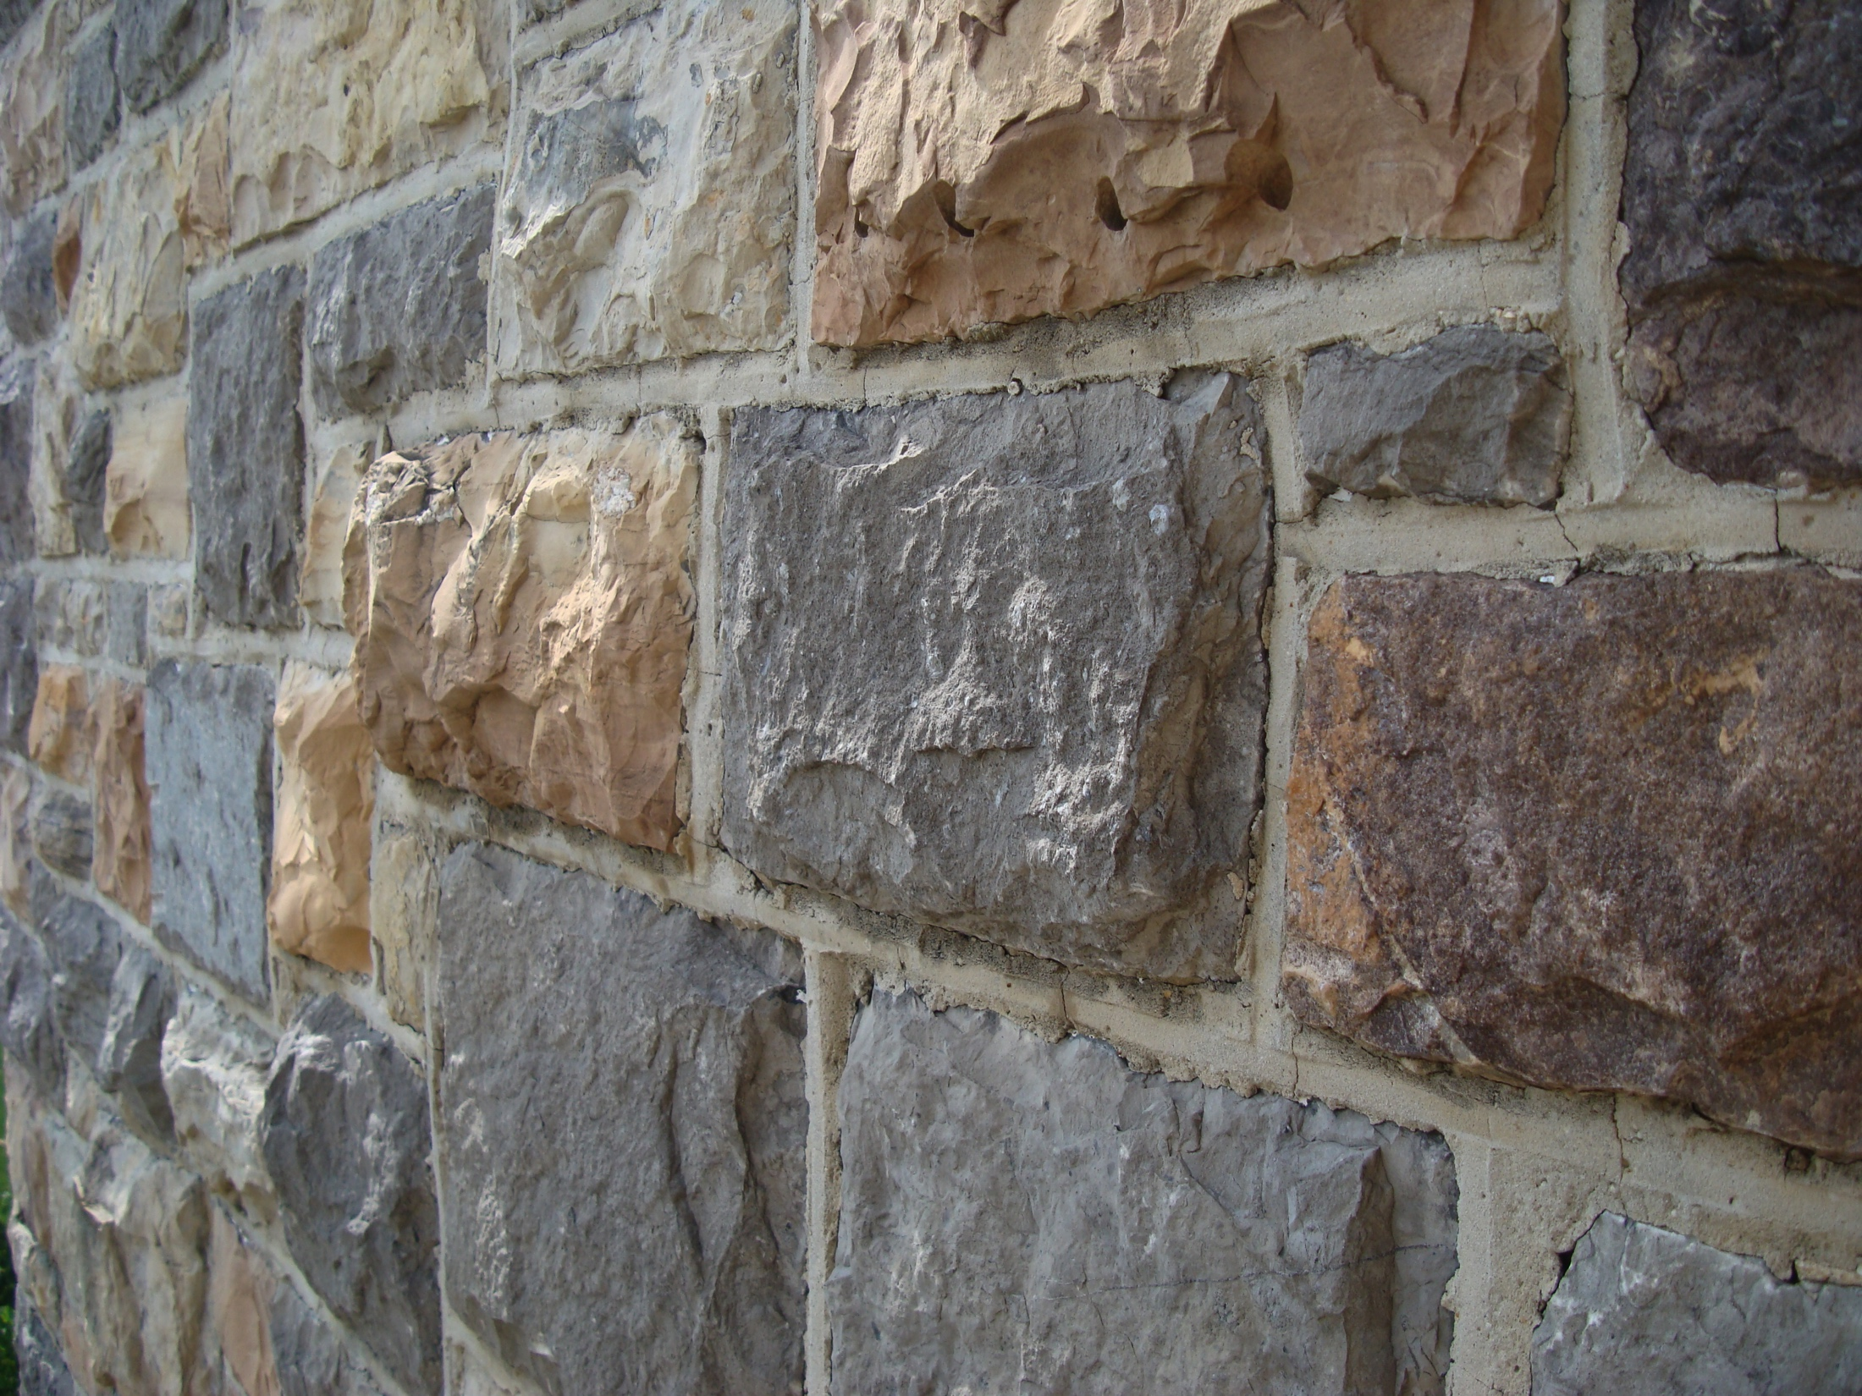

Accelerator neutrino physics overview
Patricia Vahle, William and Mary
NuFACT 2018
Photo credit:
Eric T. Gunther
https://en.wikipedia.org/wiki/Hokie_Stone

Slide 2
Neutrinos Have Mass!
ν_{e}, ν_{μ}, ν_{τ}↔ ν₁, ν₂, ν₃
  Flavor States: creation and detection
  Mass States: propagation
A neutrino created as one flavor can later be detected as another flavor, depending on:
  distance traveled (L)
  neutrino energy (E)
  difference in the squared masses (Δm²_{ij}=m²_{i}-m²_{j})
  The mixing amplitudes (U_{αj})

Slide 3
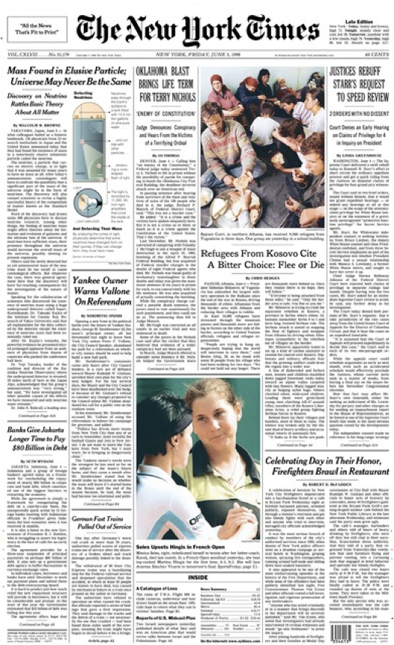
Neutrinos Have Mass!
On the 20th Anniversary of the SuperK discovery, what do we know about neutrino oscillations?
ν_{e}, ν_{μ}, ν_{τ}↔ ν₁, ν₂, ν₃
  Flavor States: creation and detection
  Mass States: propagation
A neutrino created as one flavor can later be detected as another flavor, depending on:
  distance traveled (L)
  neutrino energy (E)
  difference in the squared masses (Δm²_{ij}=m²_{i}-m²_{j})
  The mixing amplitudes (U_{αj})

Slide 4
The PMNS Mixing Matrix
What we know

Slide 5
The PMNS Mixing Matrix
How well we know it
From M. Tortola, Neutrino2018 and
deSalas et al, 1708.01186 (May 2018)

Slide 6
The PMNS Mixing Matrix
Why is the mixing bigger than in quarks?
Is it really 45°?
Is there CP violation?
What we don’t know
The Mass Hierarchy
Are there more than 3?
Are there 2 light and 1 heavy?
What is the absolute mass?
Or 1 light and 2 heavy?
Are neutrinos their own antiparticles?

Slide 7
The PMNS Mixing Matrix
CP violation in neutrinos may help us understand the matter-antimatter asymmetry of the universe.
Why do we care?
The Mass Hierarchy
20 years on, we are still exploring how massive neutrinos fit into the Standard Model. Discrimination among models hinges on precision measurements and answers to these questions.

Slide 8
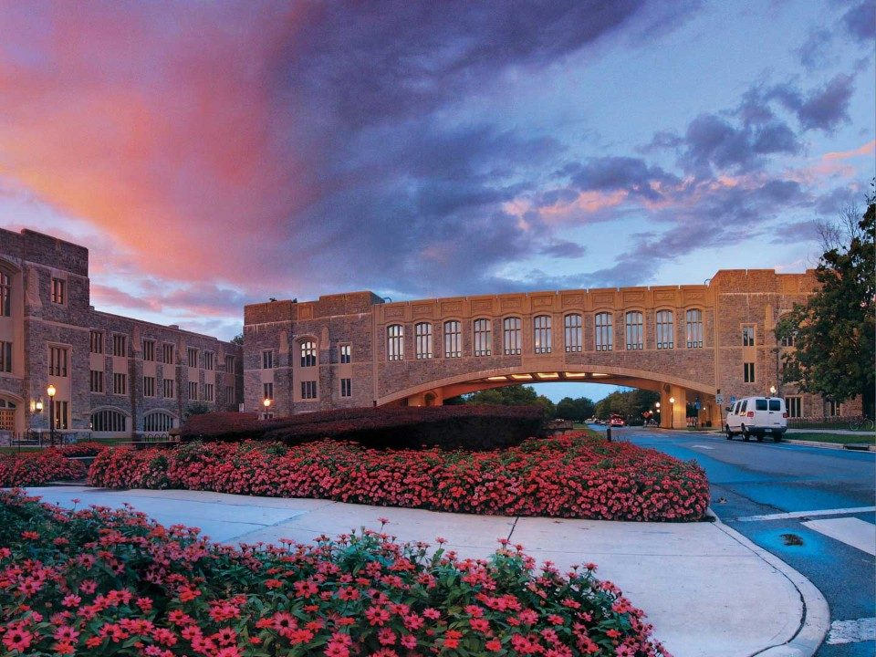
Three Flavor Oscillations
Photo credit:
https://vt.edu/admissions/undergraduate/visit/phototour.html

Slide 9
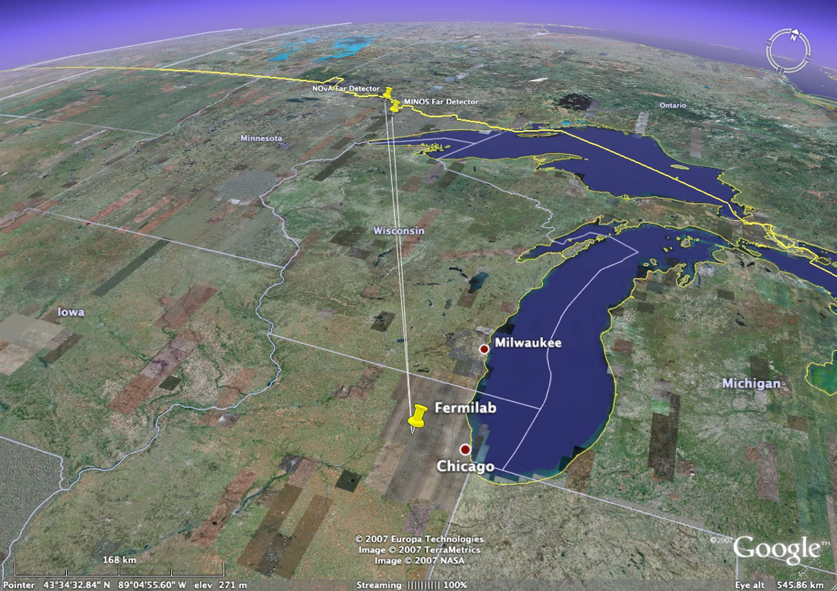
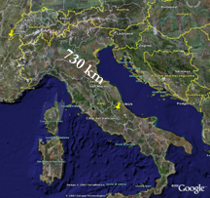
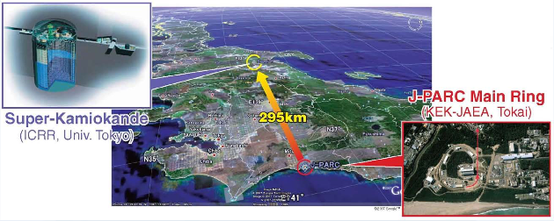
Long-baseline experiments
NOνA
OPERA
810 km
MINOS
735 km
T2K

Slide 10
Long-baseline experiments
NOνA
Study multiple oscillation modes, compare neutrino and antineutrino oscillation probabilities
OPERA
810 km
MINOS
735 km
ν_{μ} disappearance
  clear suppression as a function of energy
  |Δm²₃₂|, sin²(2θ₂₃)
ν_{e} appearance
  θ₁₃, θ₂₃, δ_{CP}, and mass hierarchy
  may be different for neutrinos vs. antineutrinos
ν_{τ} appearance
T2K

Slide 11
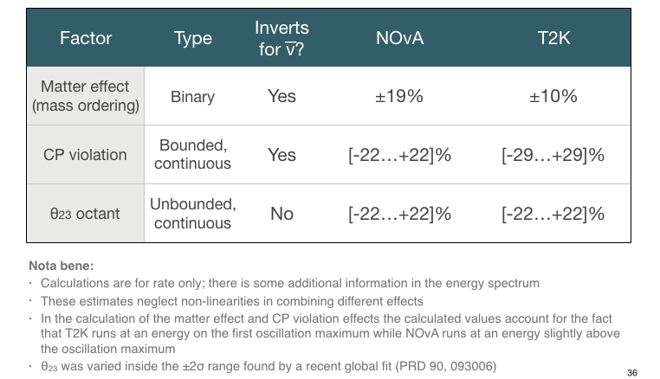
Long-baseline experiments
NOνA
Multiple experiments at different baselines and energies compliment each other and help resolve degeneracies in parameters
MINOS
OPERA
810 km
735 km
T2K
Table courtesy M. Messier

Slide 12
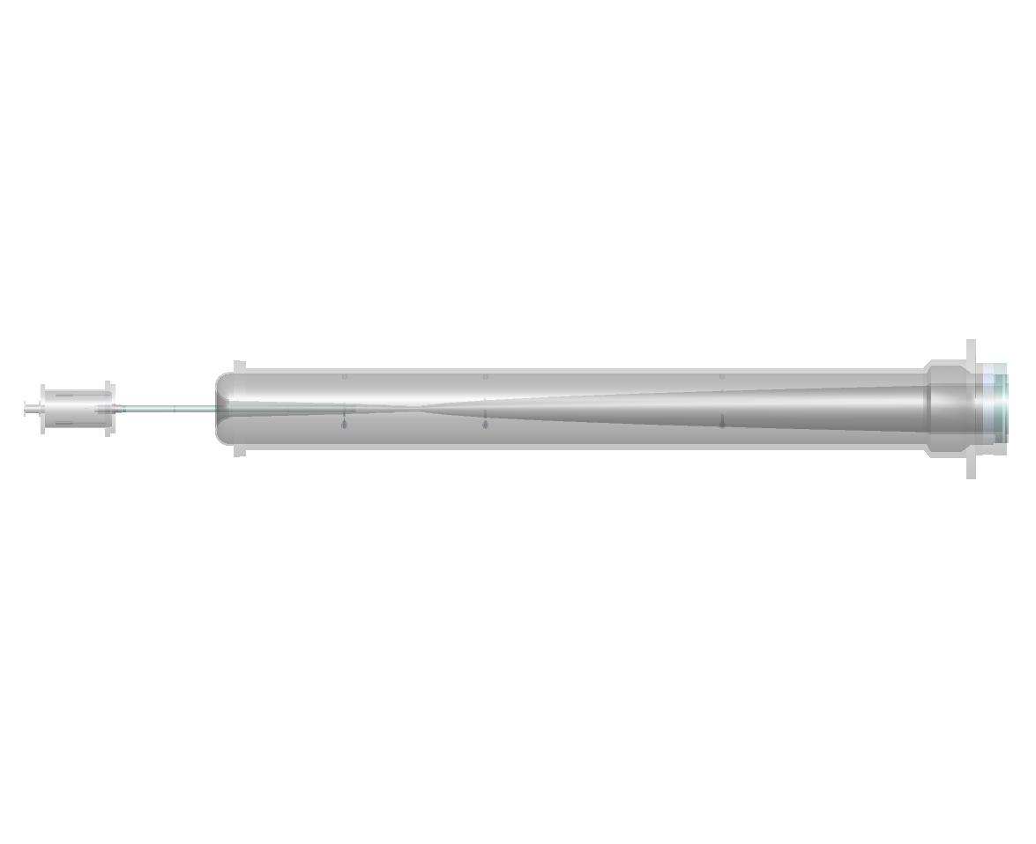
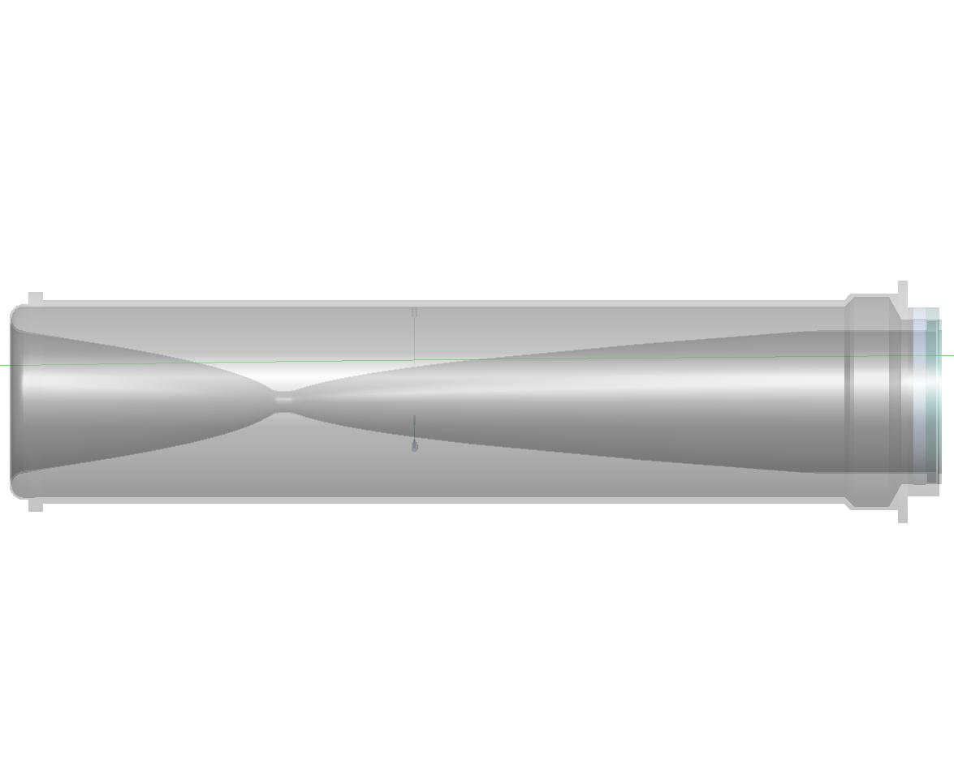
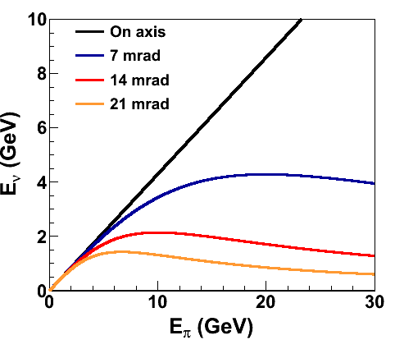
Making a Neutrino Beam
Target
Focusing Horns
π⁻
2 m
ν_{μ}
120 GeV p⁺ from MI
ν_{μ}
π⁺
NOvA is 14 mrad off-axis, sees a narrow band beam peaked at 2 GeV
  Near (but slightly above) oscillation maximum
  Few high energy NC background events
T2K at 2.5º (43 mrad), beam peak 800MeV

Slide 13
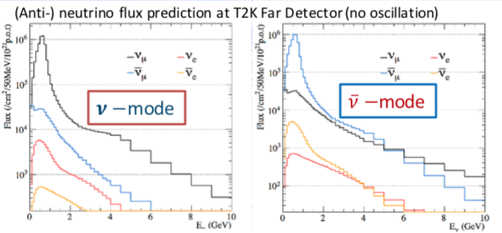
Flux Spectra
External Hadron Production data constrain flux uncertainty to ~10%
Wrong sign flux less than 10% in both neutrino and antineutrino beams
Electron neutrino contamination is small
Neutrino
Mode
Anti-
neutrino
Mode
1-5 GeV
95% ν_{μ}
4% anti-ν_{μ}
1% ν_{e}
1-5 GeV
6% ν_{μ}
93% anti-ν_{μ}
1% ν_{e}
T2K Plots from S. Cao, Moriond 2018

Slide 14
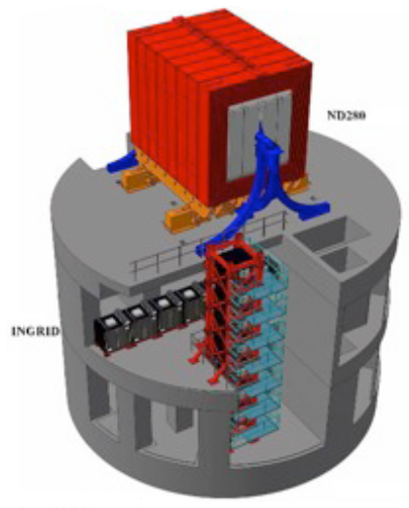
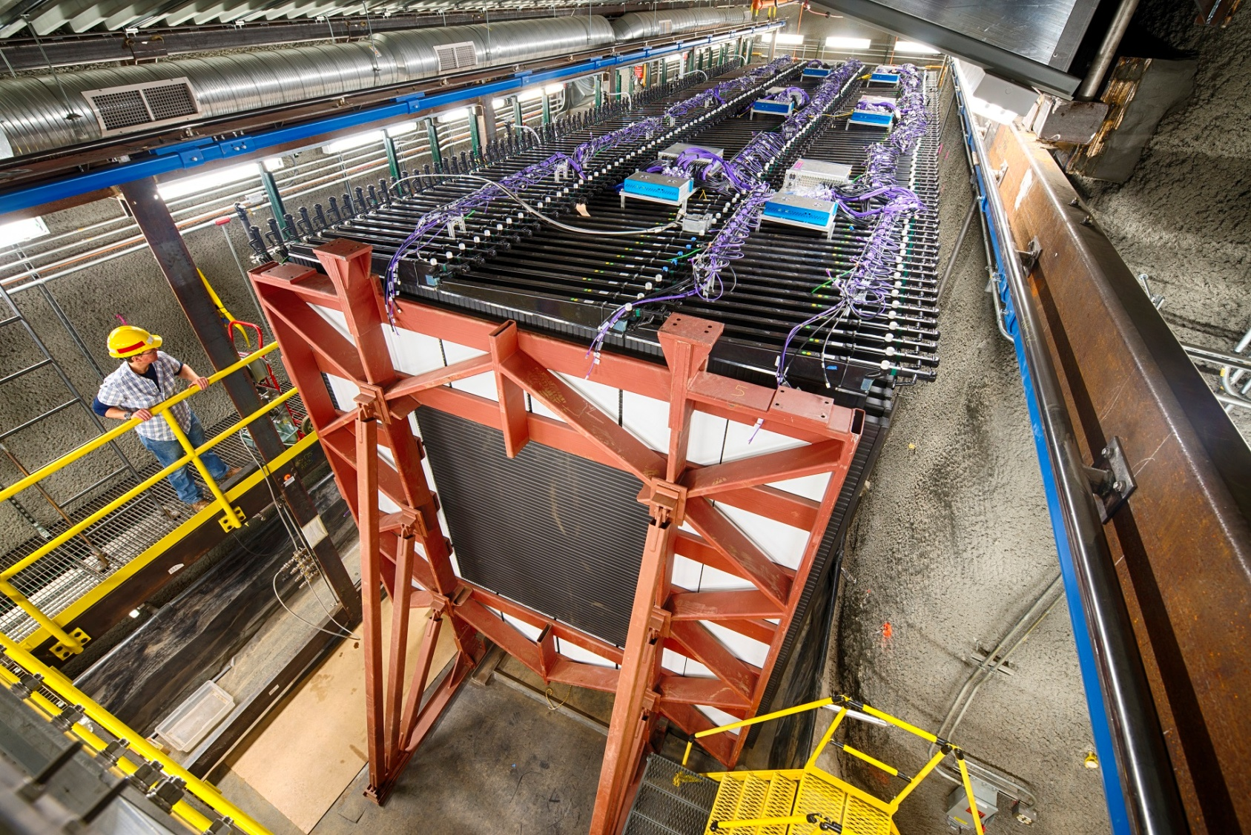
Two detector technique
Near detectors used to predict far expectations and mitigate systematics
NOvA ND:
functionally
identical to FD
T2K ND suite
Ingrid: on-axis
ND280: fine-grained,
off-axis
Near Detectors also used for neutrino interaction measurements. See: M. Judah and C. Wret, Mon. WG2

Slide 15
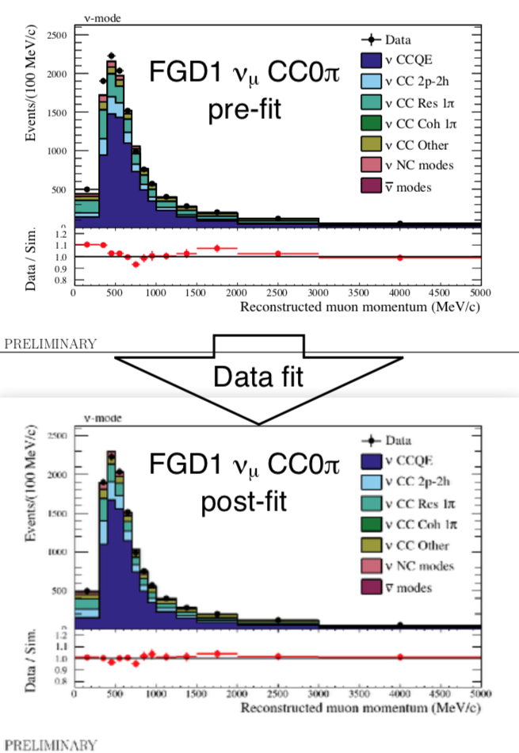
Two detector technique
See: J. Wolcott and
C. Wret, Fri. WG1+2
Near detectors used to predict far expectations and mitigate systematics
ν_{μ}
T2K:
Fit 14 different ND280 samples separated by muon charge and multiplicity with parameterized flux and cross section models
Shape-only systs.
Area-normalized
MC scaled +1.3%
NOvA:
Adjust flux and cross section models guided by external data, adjust empirical MEC model to match data, extrapolate remaining discrepancies in bins of energy resolution using F/N ratio
ν̅_{μ}
Shape-only systs.
Area-normalized
MC scaled -0.5%
M. Wascko, Neutrino2018

Slide 16
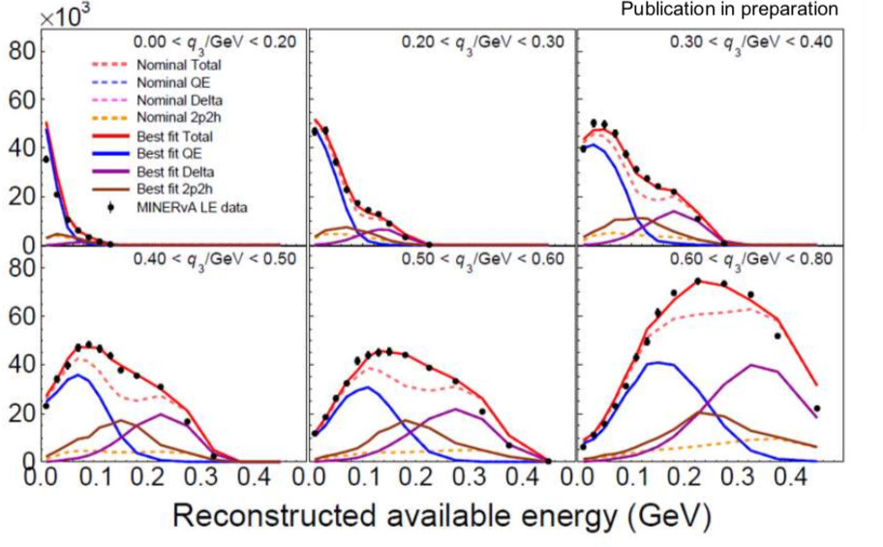
MINERvA
ν_{μ}-CC Inclusive event rate in bins of 3-momentum and energy transfer
Even in 2-detector oscillation experiments, good neutrino interaction modeling makes for a more robust prediction
  Simulation used for acceptance and resolution corrections, helps characterize impact of residual systematic uncertainties
NOvA directly benefits from MINERvA measurements and experience
  Flux from PPFX—package developed on MINERvA based on hadron production data (Phys. Rev. D 94, 092005. 2016)
  neutrino interaction tuning guided by MINERvA experience (e.g. Eur. Phys. J. C76. 2016.)
D. Ruterbories, Neturino2018
Joint NOvA+MINERvA Workshop planned to share GENIE tuning techniques
See: X. Liu, Tues. WG1+2
M. Carneiro, Wed. Plen.

Slide 17
Analysis Basics
Compare electron-neutrino appearance probability in neutrinos to antineutrinos
  in vacuum with no CP violation, the two should be the same
  CP violation enhances oscillation probability for neutrinos while suppressing it for antineutrinos, or vice-versa
  matter effects also introduce mass hierarchy dependent neutrino vs. antineutrino differences
  upper octant enhances both neutrino and antineutrino oscillation probability, while lower octant suppresses both
Inverted Hierarchy
Upper Octant
Lower Octant
Normal Hierarchy

Slide 18
NOvA Appearance Results
Neutrino mode
  58 events observed
  15 bkg expected
Antineutrino mode
  18 events observed
  5 bkg expected
  (including 1 wrong sign)
Strong (>4 sigma) evidence of electron antineutrino appearance
Full analysis power comes from joint fit to ν_{e} appearance and ν_{μ} disappearance spectra in both neutrino and antineutrinos

Slide 19
Appearance Spectra
Neutrino Mode
Antineutrino Mode
Total Observed | 58 | Range
Total Prediction | 59.0 | 30-75
Wrong-sign | 0.7 | 0.3-1.0
Beam Bkgd. | 11.1
Cosmic Bkgd. | 3.3
Total Bkgd. | 15.1 | 14.7-15.4
Total Observed | 18 | Range
Total Prediction | 15.9 | 10-22
Wrong-sign | 1.1 | 0.5-1.5
Beam Bkgd. | 3.5
Cosmic Bkgd. | 0.7
Total Bkgd. | 5.3 | 4.7-5.7

Slide 20
Disappearance Spectra
Total Observed | 113
Best fit prediction | 121
Cosmic Bkgd. | 2.1
Beam Bkgd. | 1.2
Unoscillated | 730
Total Observed | 65
Best fit prediction | 50
Cosmic Bkgd. | 0.5
Beam Bkgd. | 0.6
Unoscillated | 266
Some tension in disappearance of neutrino vs. antineutrino; Antineutrinos show less disappearance. Results are compatible at better than 4% level.

Slide 21
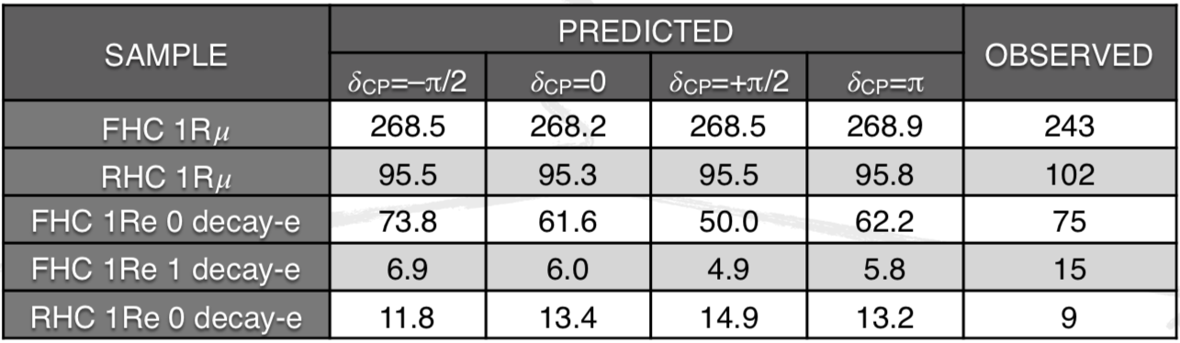
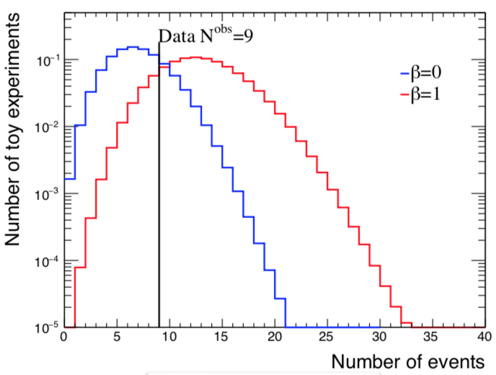
T2K Event Counts
M. Wascko, Neutrino2018
T2K observe fewer appeared electron antineutrinos than expected for any value of delta CP
  Expect 6.5 events with no disappearance
  Distribution of angle and momentum also more consistent with background spectra than appearance spectra
Combining rate+shape:
  No appearance p-value:0.233
  PMNS appearance p-value:0.0867

Slide 22
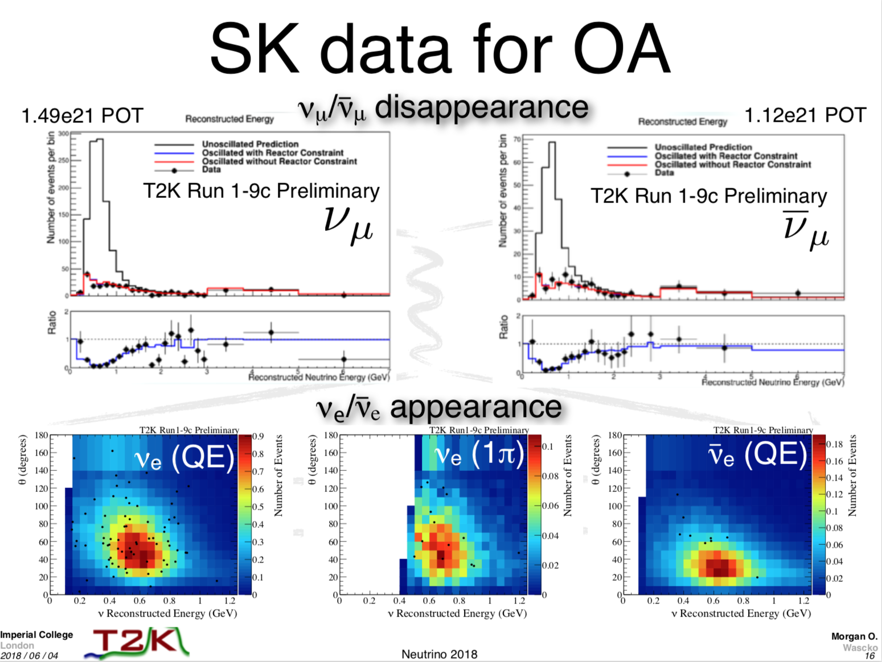

Slide 23
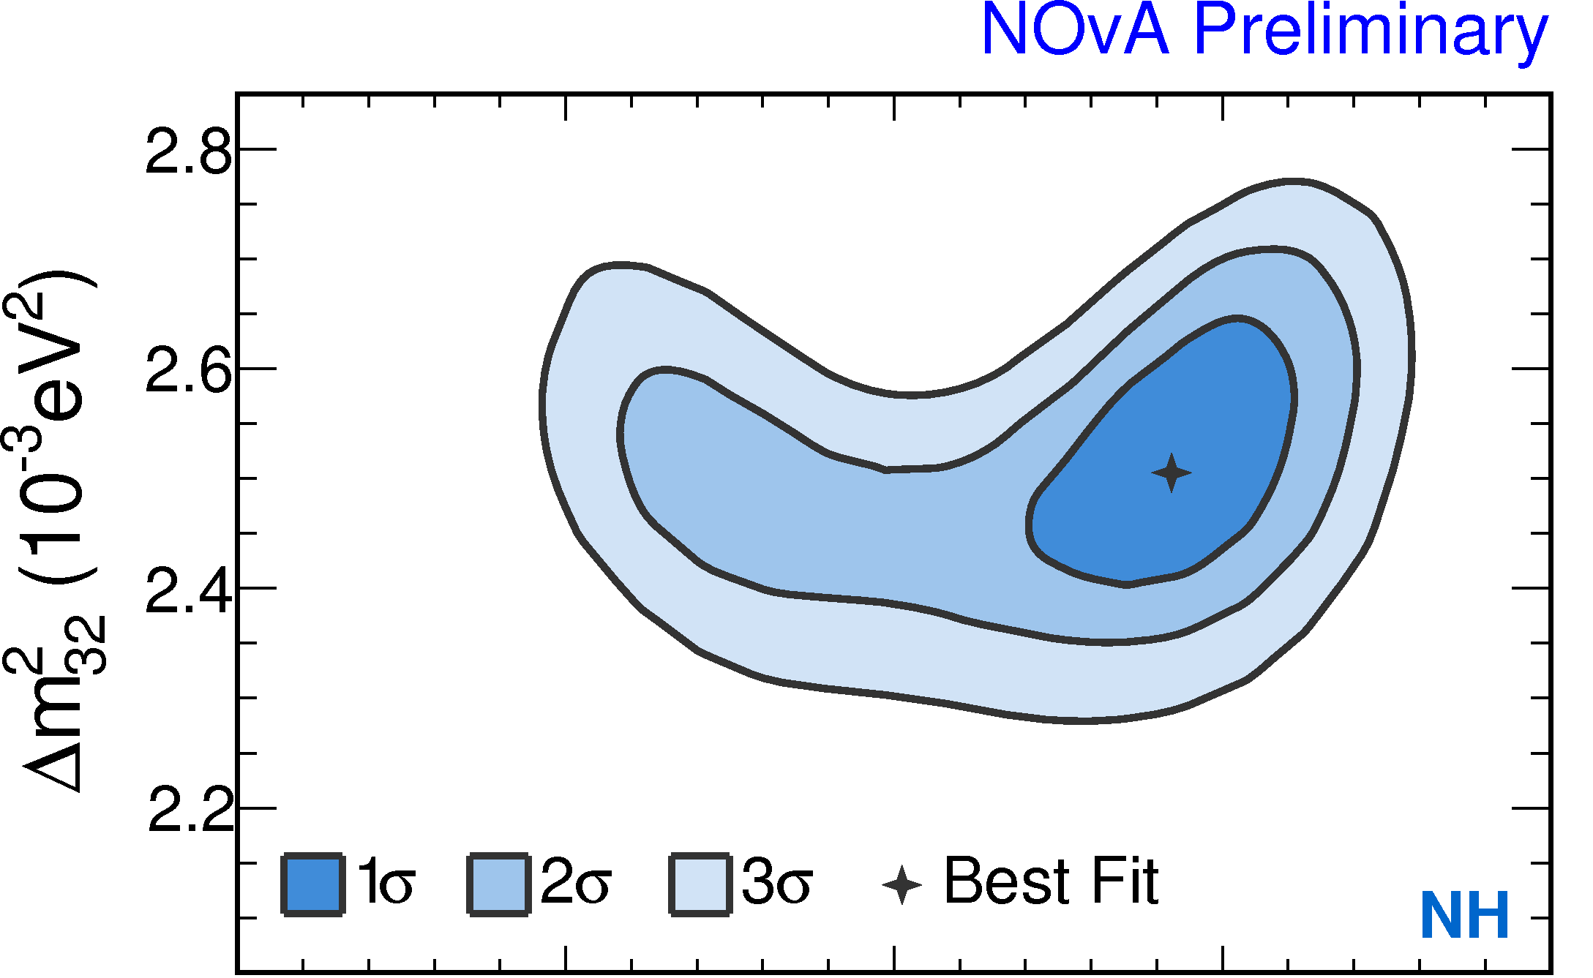
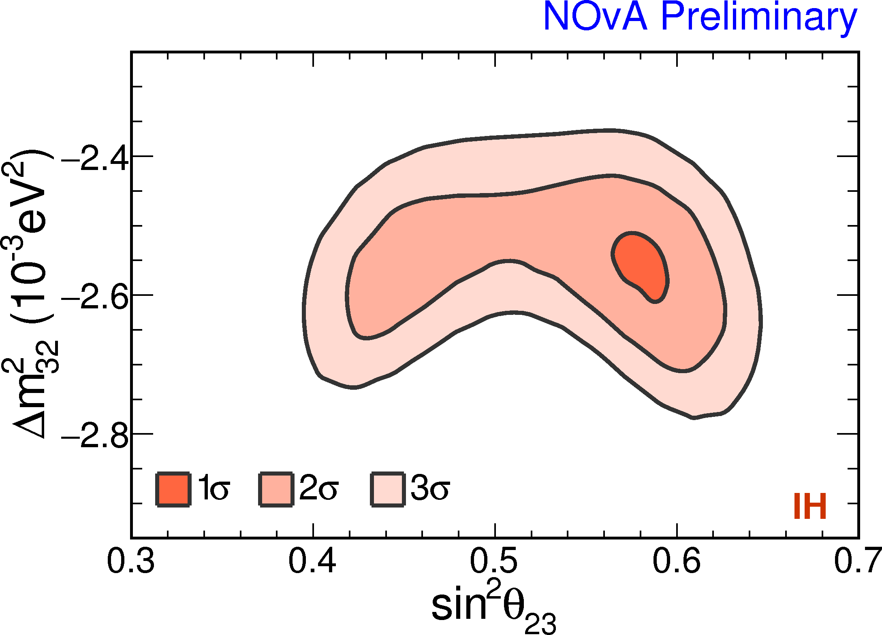
NOvA Fit Results:
Mass splitting and mixing angle

Slide 24
NOvA Fit Results:
Hierarchy and Delta CP
See: J. Bian, Tues. Plen.
E. Smith, Thurs. WG1
Normal Hierarchy preferred at 1.8 sigma
Exclude pi/2 in the IH at > 3 sigma
Significances determined using Feldman-Cousins approach. Leveraged high performance computing at NERSC
http://news.fnal.gov/2018/07/fermilab-computing-experts-bolster-nova-evidence-1-million-cores-consumed/

Slide 25
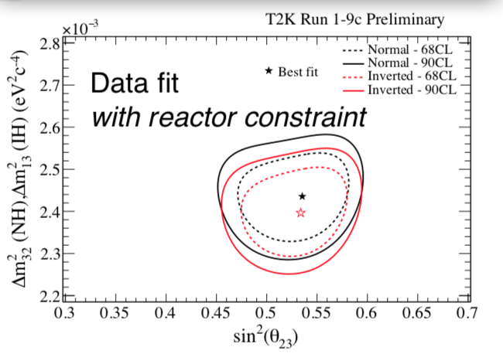
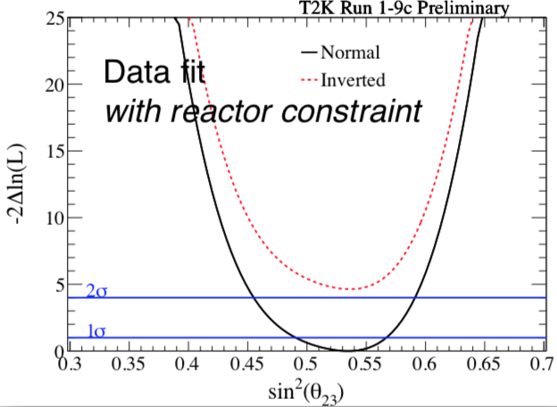
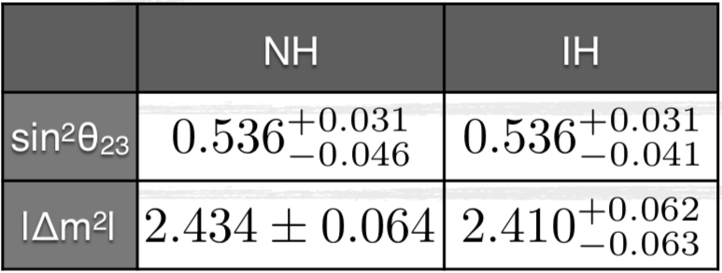
T2K Fit Results:
Mass splitting and mixing angle
M. Wascko, Neutrino2018

Slide 26
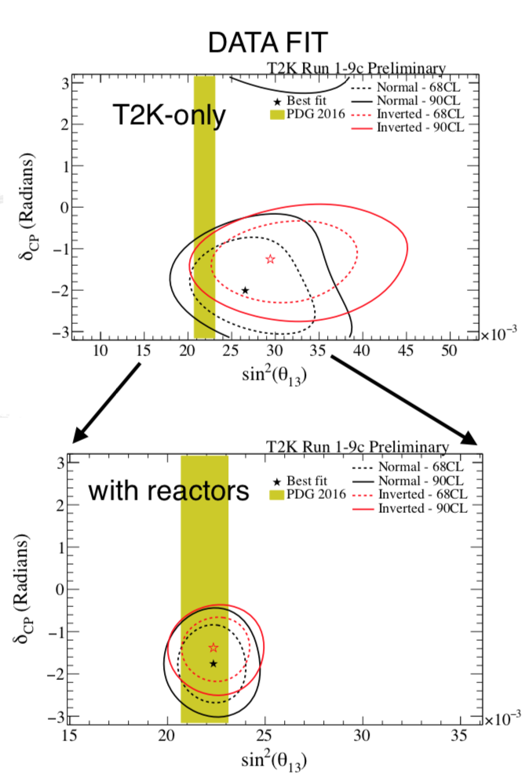
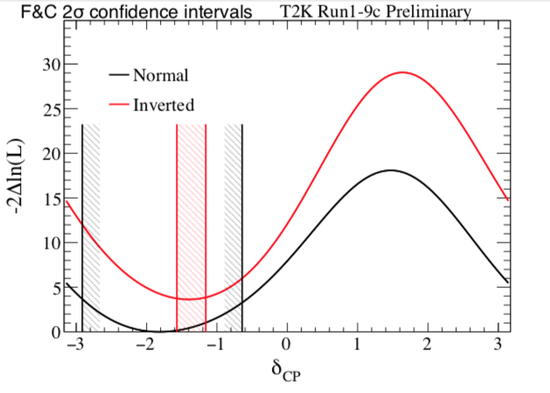
T2K Fit Results
See: S. Dennis, Tues. Plen.
D. Sgalaberna, Thurs. WG1
M. Wascko, Neutrino2018
(Note different phase convention)
CP Conserving values outside the 2 sigma region for both hierarchies
Bayes factor of NH/IH is 7.9

Slide 27
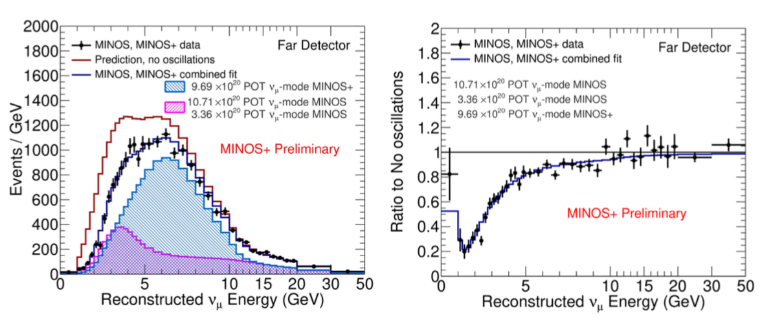
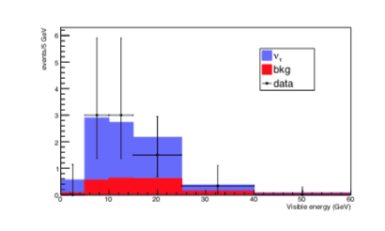
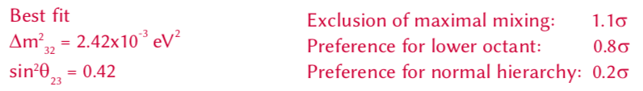
MINOS+ and OPERA
A. Aurisano, Neutrino 2018
Opera final results:
  10 tau neutrino candidates
  6.1sigma evidence of appearance
  20% measurement of mass splitting agrees with disappearance measurements
  Phys. Rev. Lett. 120, 211801

Slide 28
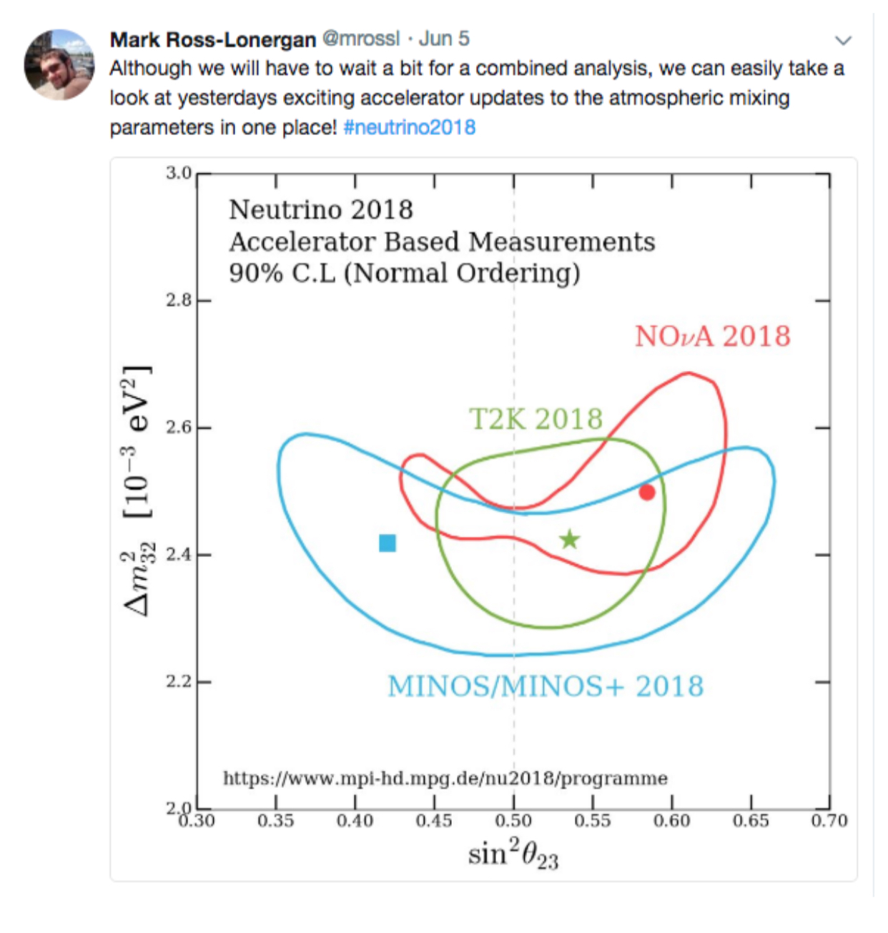
Comparisons

Slide 29
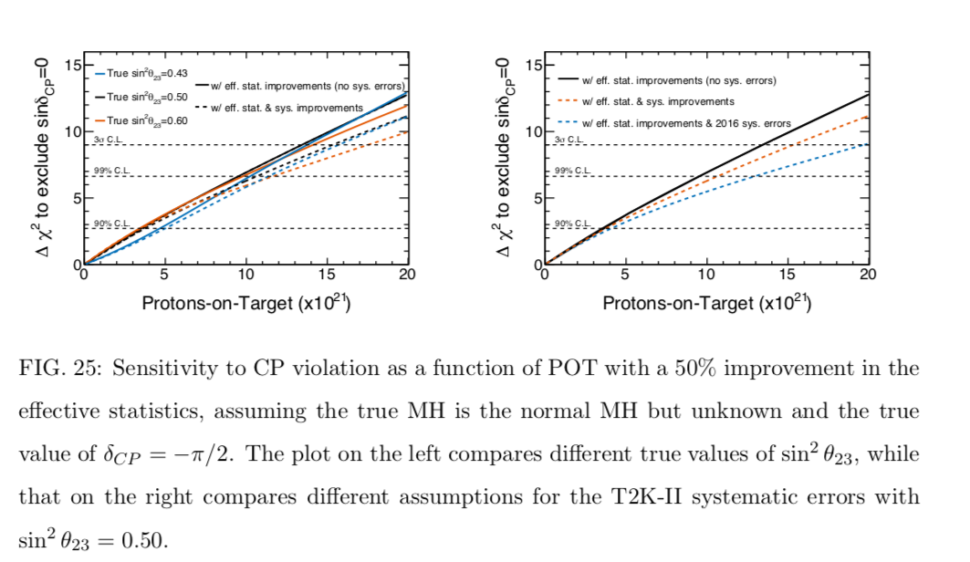
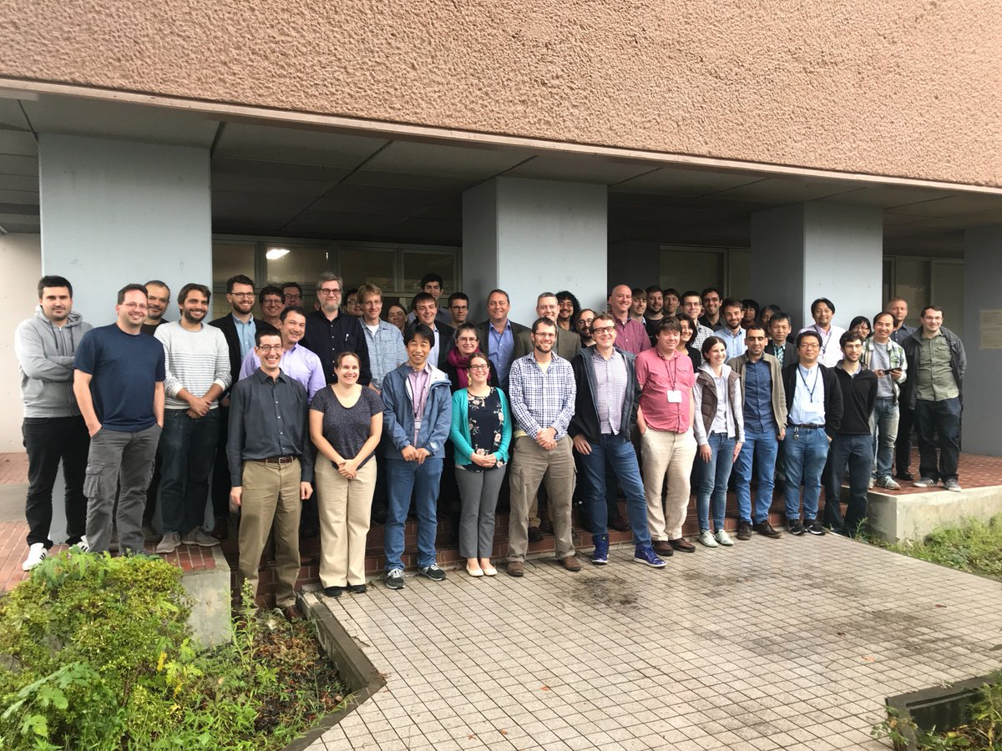
Outlook
NOvA
(stats. only)
  T2K
  arXiv:1609.04111
For favorable parameters consistent with results, NOvA can achieve 3 sigma mass hierarchy sensitivity by 2020
  3 sigma sensitivity for 30-50% of delta CP range by 2024
  >5 sigma in favorable cases by 2024
T2K projects 3 sigma median sensitivity to CP violation with 20x10²¹ POT, achievable by 2026
Both collaborations working towards a joint analysis
NOvA T2K joint analysis workshop, Tokai Japan

Slide 30
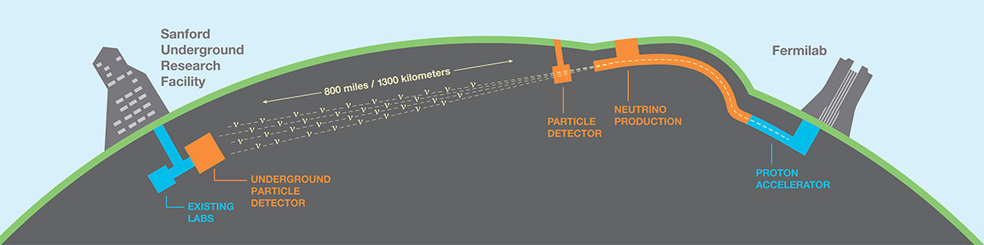
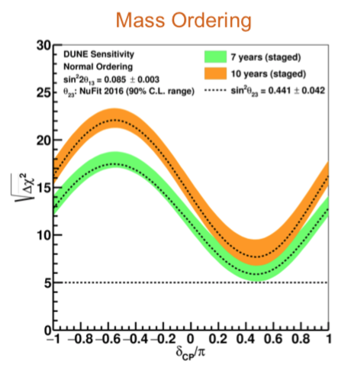
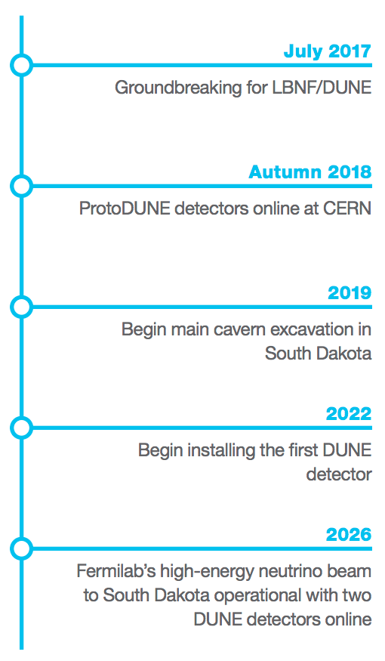
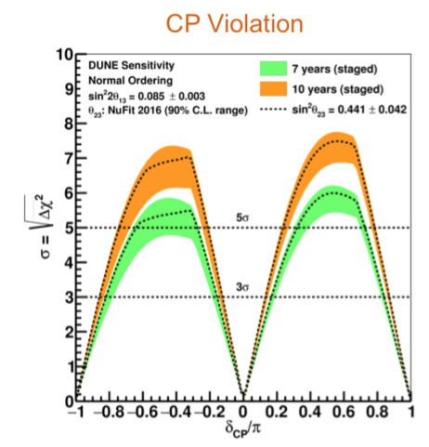
The Future of Long-baselines: DUNE
1.2 MW neutrino beam
Upgradable to 2.4MW
PIP-II design phase approved by DOE
E. Worchester,
Neutrino 2018
See:
S. Gollapinni, Thurs. Plen.
A. Chatterjee, Thurs WG1

Slide 31
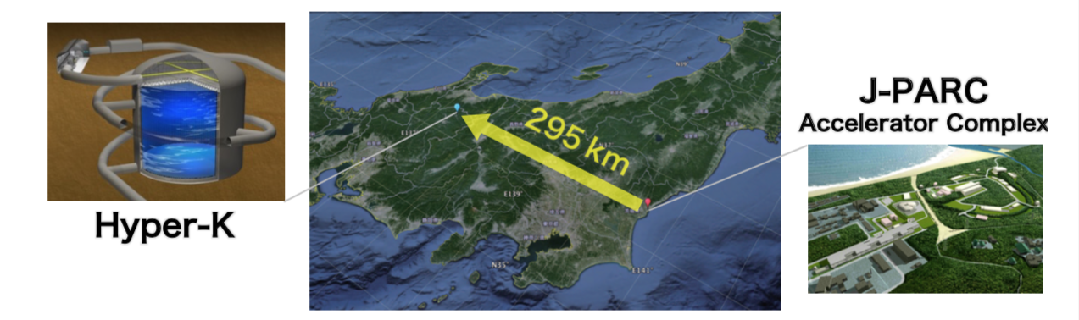
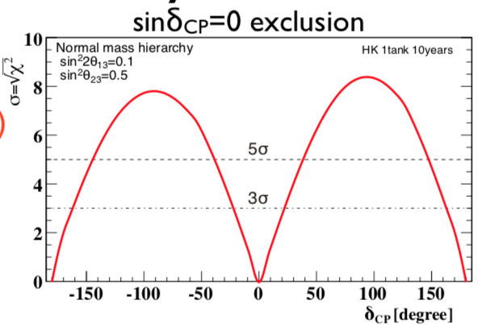
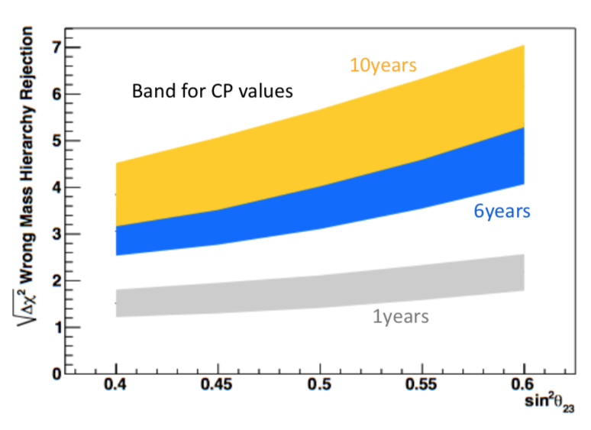
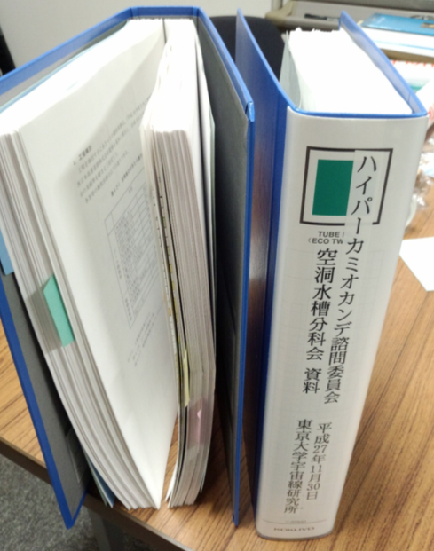
The Future of Long-baselines: HyperK
See: A. Blondel, Thurs. Plen., Thurs. WG1
Gigantic neutrino and nucleon decay detector—10x SuperK
MW beam from upgraded JPARC complex
Aiming for construction start 2019, beam 2026
M. Shiozawa,
Neutrino 2018
Design report released in May, arXiv:1805.04163

Slide 32
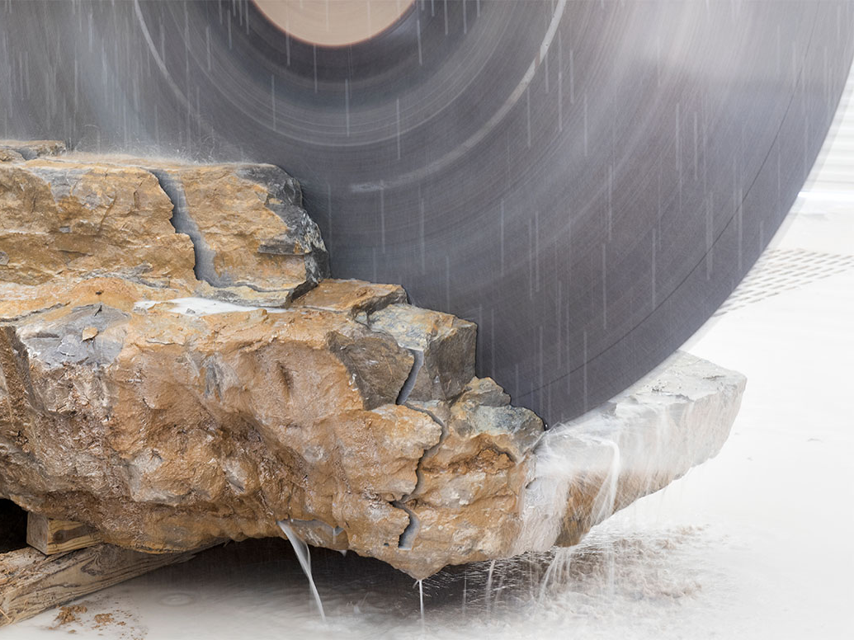
Beyond Three Flavor Oscillations
Photo Credit:
https://www.vtmag.vt.edu/winter17/virginia-tech-quarry.html

Slide 33
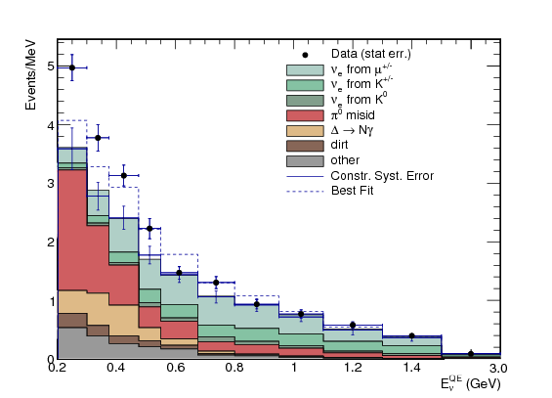
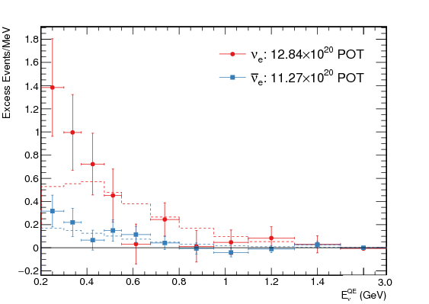
MiniBooNE
Excess of electron neutrinos observed in MiniBooNE persists with double the neutrino data set
MiniBooNE excess in neutrino and antineutrino: 4.8 sigma
Combined with LSND: 6.1 sigma
See: Z. Pavolvic, Thurs. Plen.
arXiv:1805.12028

Slide 34
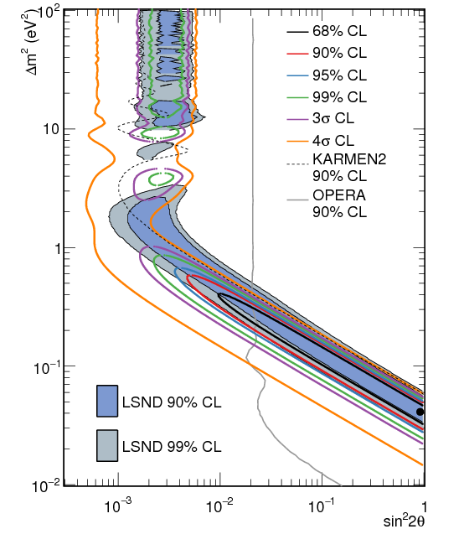
MiniBooNE
Data fit using a 2-neutrino oscillation model
Joint fit to neutrinos and antineutrinos shown
arXiv:1805.12028

Slide 35
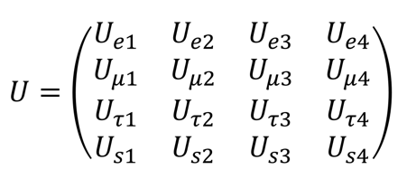
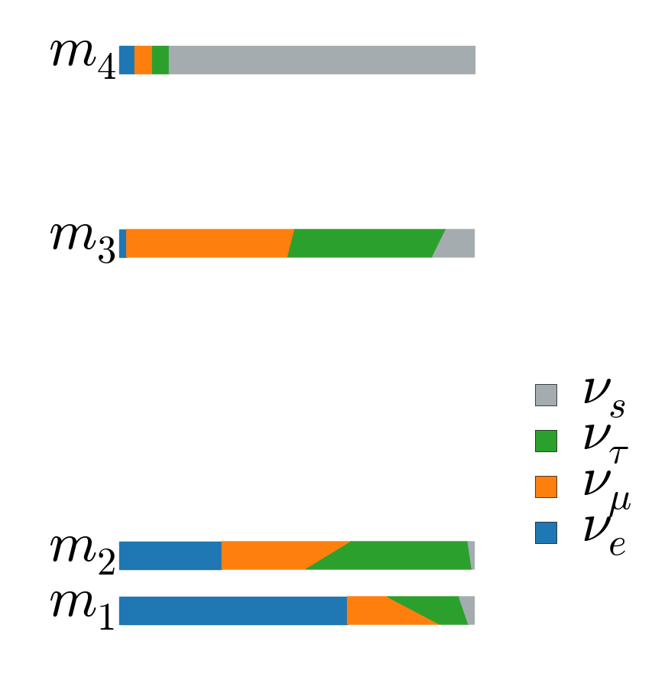
3+1 Model
To incorporate MiniBooNE excess into oscillation framework requires a new mass state and new sterile flavor
Expand PMNS: 3x3->4x4
6 additional parameters
  new mass splitting
  three mixing angles
  two CP-violating phases
A. Aurisano,
Neutrino 2018

Slide 36
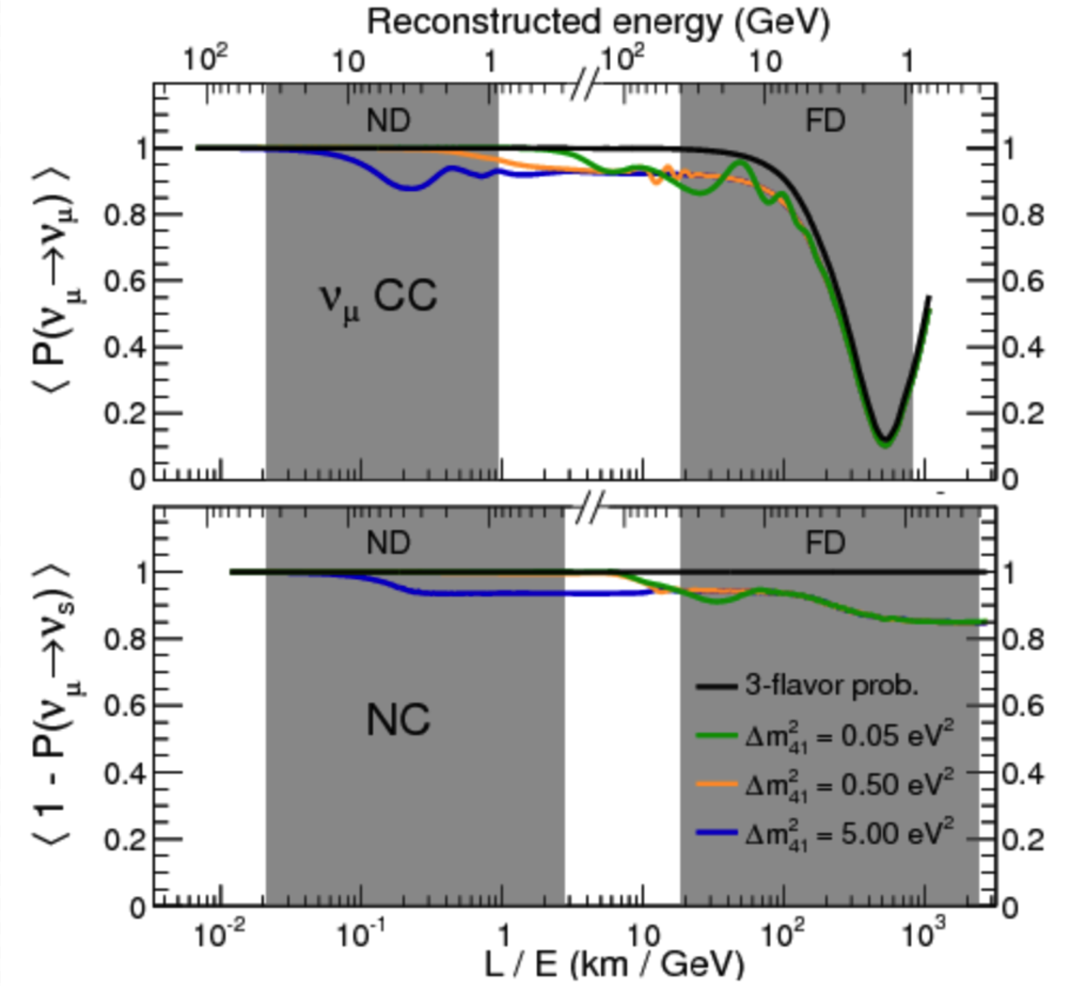
4 Flavor Oscillations at Long-baselines
Small mass splitting
  FD sees anomalous muon-neutrino disappearance at high energies and energy dependent suppression of neutral currents
  ND sees no oscillations
Large mass splitting
  Rapid oscillations at FD at high energies average out
  Large oscillation effects at the ND
arXiv:1710.06488

Slide 37
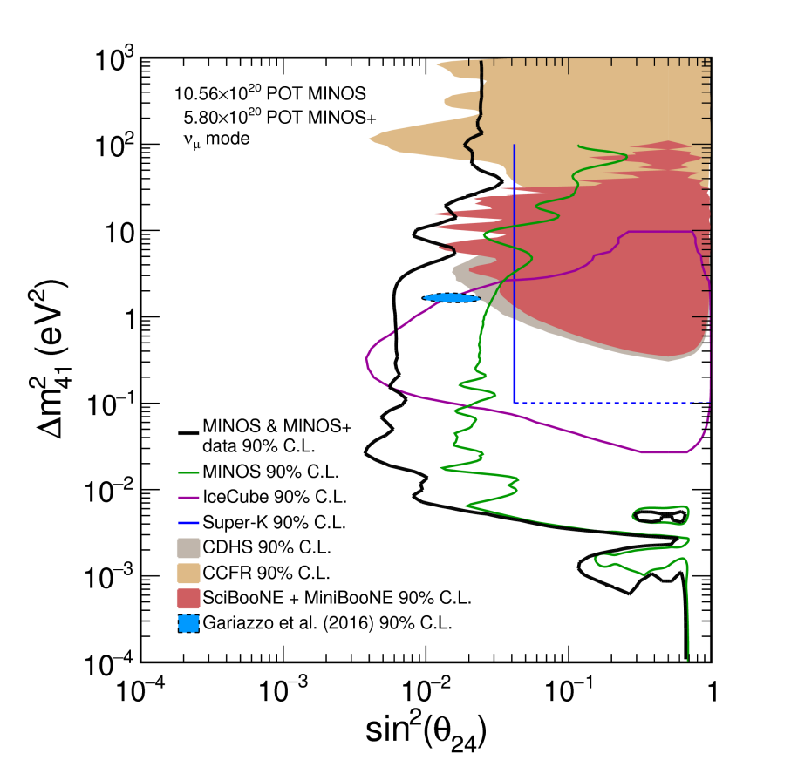
4 Flavor Oscillations at Long-baselines
2 detector fit to MINOS and MINOS+ data provides limit on mixing angle over 7 orders of magnitude in Δm²₄₁
Combining LBL limits on θ₂₄ with reactor limits on θ₁₄ allows for comparison with MiniBooNE results
arXiv:1710.06488
A. Aurisano,
Neutrino 2018
See: J. Todd, Fri. WG1+5

Slide 38
NOvA NC Disappearance
Neutrino mode:
expect 188+/-13 (syst.) with 38 bkg. Observe 201 events
Antineutrino mode:
expect 69+/-8 (syst.) with 16 bkg. Observe 61 events
No significant suppression of Neutral Current interactions in either neutrino or antineutrino mode
See: M. Wallbank, Fri. WG1+5

Slide 39
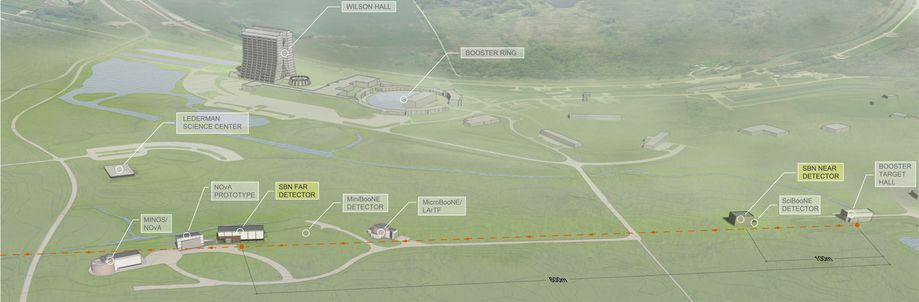
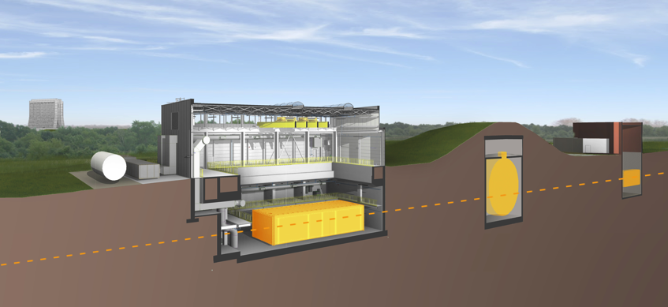
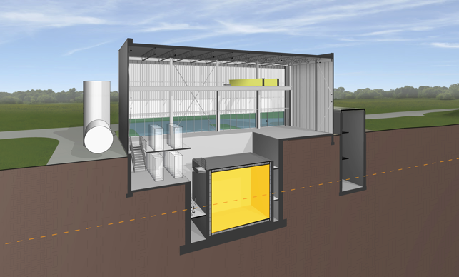
Short-Baseline Neutrino Program at Fermilab
Slide Courtesy D. Schmitz
Detector | Distance from BNB Target | Active LAr Mass
SBND | 110 m | 112 ton
MicroBooNE | 470 m | 87 ton
ICARUS | 600 m | 476 ton
Booster Neutrino Beam
arXiv:1503.01520
MicroBooNE
Far Detector
ICARUS
MiniBooNE
Near Detector
SBND

Slide 40



Short-Baseline Neutrino Program at Fermilab
Detector | Distance from BNB Target | Active LAr Mass
SBND | 110 m | 112 ton
MicroBooNE | 470 m | 87 ton
ICARUS | 600 m | 476 ton
Booster Neutrino Beam
arXiv:1503.01520
R. Guenette, Neutrino 2018
MicroBooNE
Far Detector
ICARUS
MiniBooNE
Near Detector
SBND

Slide 41


MicroBooNE: Phase 1
See: L. Yates, Thurs. WG1
MicroBooNE will characterize the observed MiniBooNE excess with a high resolution detector
Neutrino interaction measurements demonstrate/benchmark reconstruction and detector response simulation
arXiv:1805.06887
MicroBooNE-Note 1032-PUB, 2018
First measurement of CC-π⁰ production on Ar
R. Guenette, Neutrino 2018

Slide 42

MicroBooNE results
See: L. Jiang, Tues. WG1+2
MinibooNE ν_{μ}-CC inclusive cross section measurement
MicroBooNE-Note 1045-PUB, 2018
R. Guenette, Neutrino 2018

Slide 43



SBN Near Detector – SBND
New detector hall at 110m on the BNB
Cathode just
arrived to FNAL
SBND is a new construction 112-ton active mass LArTPC
Detector construction well underway at collaborating institutions
  TPC in the US and UK
  Photon systems in the US, UK, and Brazil
  Cosmic tagger system in Switzerland
Detector assembly at Fermilab begins fall 2018
Data taking expected in mid-2020
At only 110 m from the target and 112-ton mass, SBND will record more than 1 million neutrino-argon interactions per year
Slide Courtesy D. Schmitz
Anode plane construction
well underway
PMT testing on-going
See:
J. Zennamo, Tues. WG1+2
A. Fava, Thurs. Plen.
CRTs in SBND building

Slide 44




Status of SBN Far Detector – ICARUS
Detector upgrades at CERN
Transport to FNAL in 2017
At 476-tons, ICARUS is the largest LArTPC to operate to date
ICARUS refurbishment by CERN/INFN in preparation for SBN
  New cold vessel and updated cryogenics
  Expanded PMT system for surface operation
  Updated TPC and PMT electronics
  New cosmic tagger system
Transported to Fermilab, final placement in detector hall along the BNB just last week
Data taking expected in 2019
Moving into final position
8/9/2018
Slide Courtesy D. Schmitz

Slide 45

SBN Outlook
R. Guenette, Neutrino 2018

Slide 46

Summary
20 years from the discovery of neutrino mass and oscillations, we still have exciting discoveries to make.
New results from accelerator experiments released this summer
  NOvA has strong evidence of electron-antineutrino appearance
  T2K favors non-CP conserving values of δ_{CP} at 2σ
Beyond the 3-flavor framework
  MiniBooNE excess gains significance
  Long-baseline experiments do not see a corresponding anomalous disappearance
  MicroBooNE is primed to characterize the low energy excess
  Fermilab’s SBN program is underway
Photo credit:
https://vt.edu/admissions/undergraduate/visit/phototour.html

Slide 47
Backup

Slide 48




NOvA
Long-baseline, off-axis neutrino oscillation experiment
Study neutrinos from NuMI beam at Fermilab
At 14 mrad off-axis, energy peaked at 2 GeV
Functionally identical detectors
  ND on site at Fermilab
  FD 810 km away in Ash River, MN
  Measurement at ND is directly used to predict FD

Slide 49








NOvA Collaboration
238 collaborators at 49 institutions across 7 countries
Sussex,
University College London
JINR Dubna, INR Moscow, Lebedev Institute
Argonne, CalTech, UC Irvine, Cincinnati, Colorado State, Dallas, Fermilab, Harvard, Houston, IIT, Indiana, Iowa State, Michigan State, Minnesota Duluth, Minnesota Twin Cities, Pittsburgh, SMU, South Alabama, South Carolina, South Dakota SMT, Stanford, Syracuse, UT Austin, Tennessee, Tufts, Virginia, Wichita State, William & Mary, Wisconsin
Charles University,
Czech Technical University, Institute of Physics, Institute of Computer Science-Czech Academy of Sciences
Banaras Hindu University,
Cochin University of S&T, Delhi University, IIT Guwahati, IIT Hyderabad, University of Hyderabad, Jammu University, Panjab University, NISER
Universidad del Atlantico
Universidade Federal de Goias
19 Remote Control Rooms across the globe

Slide 50

Publications and PhDs
5 Publications + 1 submitted
  arXiv:1806.0096 (2 cites)
  Phys.Rev.D96 (2017) no. 7, 072006 (19 cites)
  Phys.Rev.Lett. 118 (2017) no. 23, 231801 (83 cites)
  Phys.Rev Lett. 118 (2017) no. 15, 151802 (83 cites)
  Phys.Rev.D93 (2016) no. 5, 051104 (102 cites)
  Phys.Rev. Lett.116 (2016) no. 15, 151806 (167 cites)
19 PhDs, 5 since last summer
  Dan Pershey, CalTech
  Stefano Tognini, Universidade Federal de Goias, Brazil
  Fernanda Psihas, Indiana
  Bio Wang, SMU
  Luke Vinton, Sussex, UK

Slide 51
Making an off-axis neutrino beam
Target
Focusing Horns
π⁻
2 m
ν_{μ}
120 GeV p⁺ from MI
ν_{μ}
π⁺

Slide 52
Beam Spectra
Events 1-5 GeV
96% | ν_{μ}
3% | ν̅_{μ}
1% | ν_{e}
Events 1-5 GeV
15% | ν_{μ}
84% | ν̅_{μ}
1% | ν_{e}

Slide 53
Beam Performance
Run at 700 kW design goal since January 2017
  5.64e20 POT delivered in FY18, exceeding goal, best year so far by 10%
  34 weeks of running at 98.7% uptime
8.9×10²⁰ POT Neutrino Beam
New! 6.9×10²⁰ POT
Antineutrino Beam

Slide 54

NOvA Detectors
POT Delivered
POT Recorded
Weekly Far Detector Uptime (with beam on)
Functionally identical detectors designed for electron ID
  Low Z materials (PVC+Liquid Scint.)
  65% active
ND: underground at FNAL
FD: on the surface in Ash River, MN
More than 99.9% of 300k+ FD channels are operational!

Slide 55
Event Selection
Candidate Events from ND data
NOvA has pioneered the use of computer vision and deep learning techniques for event selection
ν_{μ} CC
Long, straight track
~5m
Calibrated hit maps are inputs to Convolutional Visual Network (CVN)
Series of image processing transformations applied to extract abstract features
Extracted features used as inputs to a conventional neural network to classify the event
ν_{e} CC
Shorter, wider, fuzzy shower
~2.5m
NC
Diffuse activity from nuclear recoil system
A. Aurisano et al., arXiv:1604.01444

Slide 56
Improved Event Selection
This analysis features a new event selection technique based on ideas from computer vision and deep learning
Calibrated hit maps are inputs to Convolutional Visual Network (CVN)
Series of image processing transformations applied to extract abstract features
Extracted features used as inputs to a conventional neural network to classify the event
Aurisano et al., arXiv:1604.01444
Posters P1.028 by A. Radovic, P1.032 by
F. Psihas and A. Himmel for more detail

Slide 57
Improved Event Selection
This analysis features a new event selection technique based on ideas from computer vision and deep learning
Calibrated hit maps are inputs to Convolutional Visual Network (CVN)
Series of image processing transformations applied to extract abstract features
Extracted features used as inputs to a conventional neural network to classify the event
Aurisano et al., arXiv:1604.01444
Posters P1.028 by A. Radovic, P1.032 by
F. Psihas and A. Himmel for more detail

Slide 58
Improved Event Selection
This analysis features a new event selection technique based on ideas from computer vision and deep learning
Calibrated hit maps are inputs to Convolutional Visual Network (CVN)
Series of image processing transformations applied to extract abstract features
Extracted features used as inputs to a conventional neural network to classify the event
Improvement in sensitivity from CVN equivalent to 30% more exposure

Slide 59

CVN Architecture
Aurisano et al., arXiv:1604.01444
Posters P1.028 by A. Radovic and A. Himmel, P1.032 by F. Psihas
CVN Architecture
GoogLeNet
Inception Module
C. Szegedy et al., arXiv:1409.4842
Example image processing transformation
Convolution, or kernel map
Example Convolutional
Filter Layer
Network implemented and trained in the Caffe Framework
(Y. Jia et al., arXiv:1408.5093)
Process Flow
Trained over 4.7M simulated events,
Trained on FNAL GPU farm

Slide 60

Simulation
Beam line production, propagation and neutrino flux: FLUKA/Flugg
Cosmic Ray flux: CRY
Neutrino interaction and FSI: GENIE
Detector: Simulation: Geant4
Detector response: Custom simulation Routines

Slide 61
NOvA Simulation
All NOvA oscillation analyses use ND data to predict FD
  2 detector technique naturally mitigates uncertainties on flux and cross sections
  Simulation used for acceptance and resolution corrections, helps characterize impact of residual systematic uncertainties
Perfect ND data/mc not required, tuning makes for a more robust prediction
  Flux from PPFX—package developed on MINERvA based on hadron production data
  (Phys. Rev. D 94, 092005. 2016)
  neutrino interaction tuning guided by MINERvA experience (arXiv:1705.02932 and Eur. Phys. J. C76. 2016. )
  Custom tuning of GENIE Empirical MEC model
Workshop with MINERvA planned for this fall to share GENIE tuning techniques

Slide 62
Scattering in a Nuclear Environment
Near detector hadronic energy distribution suggests unsimulated process between quasi-elastic and delta production
Similar conclusions from MINERvA data reported in P.A. Rodrigues et al.,
PRL 116 (2016) 071802

Slide 63
Scattering in a Nuclear Environment
Enable GENIE empirical Meson Exchange Current Model
Reweight model to match NOvA excess as a function of 3-momentum transfer
Eliminate falloff of xsec with energy
Fix final state nucleon composition
Match MEC q₀ distribution to quasi-elastic distribution
scale normalization in bins of 3-momentum transfer to match data/mc disagreement
Include 50% systematic uncertainty on size of MEC component
Additionally, reduce single non-resonant pion production by 50%
(P.A. Rodriques et al, arXiv:1601.01888.)

Slide 64



Calibration
Calibration achieved using cosmic rays
Light levels drop by a factor of 8 across a FD cell
Stopping muons provide a standard candle
Far Detector Data
calibration
window

Slide 65


Energy Scale
NC 𝜋⁰
events
Data
MC 𝜋⁰ signal
MC bkgd
Data 𝜇: 134.2 ± 2.9 MeV
Data 𝜎: 50.9 ± 2.1 MeV
MC 𝜇: 136.3 ± 0.6 MeV
MC 𝜎: 47.0 ± 0.7 MeV
Near Detector
  cosmic μ dE/dx [~vertical]
  beam μ dE/dx [~horizontal]
  Michel e⁻ spectrum
  𝜋⁰ mass
  hadronic shower E-per-hit
Far Detector
  cosmic μ dE/dx [~vertical]
  beam μ dE/dx [~horizontal]
  Michel e⁻ spectrum
All agree to 5%

Slide 66






Reconstruction
Vertexing: Find lines of energy depositions w/ Hough transform CC events: 11 cm resolution
Clustering: Find clusters in angular space around vertex. Merge views via topology and prong dE/dx
Tracking: Trace particle trajectories with Kalman filter tracker.
Also, cosmic ray tracker: lightweight, fast, and for large calibration samples, online monitoring.

Slide 67

Extrapolation
All NOvA analyses use ND data to predict the FD spectrum
Muon Neutrino analyses: unfold reco energy, use true F/N ratio for FD prediction of track events
Electron Neutrino signal: use Muon-neutrino FD prediction
NC and Electron Neutrino background analyses: Far to Near spectrum in reconstructed energy ratio for FD prediction of shower events

Slide 68
Backup—Disappearance Results

Slide 69
Analysis in more detail
Data
Area-normalized MC
Shape-only systematics
Wrong-sign
Full power comes from joint fit to energy dependence of both disappearance and appearance in neutrinos and antineutrinos
  Muon neutrino spectra further separated by energy resolution
  Electron neutrino spectra further separated by event sample purity
Quantile 1
Best Resolution ~6%
Quantile 4
Worst Resolution ~12%
ND muon-neutrinos
Data/MC
+2.8%
Data/MC
-0.7%
Data/MC
-1.4%
Data/MC
+1.6%
ND muon-antineutrinos
Data/MC
+7.9%
Data/MC
+2.5%
Data/MC
-5.3%
Data/MC
-11.6%

Slide 70
Disappearance
If fit separately, the ν̅_{μ} data prefers non-maximal while ν_{μ} prefers maximal.
  Consistent with joint oscillation parameters to >4%.
Matter effects introduce a small asymmetry in the point of maximal disappearance.
Gives a 1.3σ preference for the Upper Octant from just the ν_{μ} +ν̅_{μ} fit in NH.
  The asymmetry is flipped in the Inverted Hierarchy, so there is a similar preference for the lower octant there.

Slide 73
Appearance and Disappearance
Fit Results

Slide 74
Backup—NC Results

Slide 75

Disappearance
A. Aurisano,
Neutrino 2018

Slide 76
Backup—Appearance Results

Slide 77

Event Migration
Core:
  Expected to lose 7 and gain 3.5 vs. 2017.
  Actually lost 10 and gained 2.
  No events lost or gained in the high PID bin, but some did move from/to lower PID bins.
Peripheral:
  Expected to gain and lose 2.5 events.
  Actually no events lost or gained.

Slide 78
Wrong-sign Background
ν̅_{μ}
The 11% wrong-sign fraction of the ν̅_{μ} events is important since it becomes the WS background in the ν̅_{e} appearance analysis.
~10% systematic uncertainty on wrong-sign from flux and cross section
  Does not include uncertainties from detector effects.
Confirmed using data-driven cross-check of the wrong-sign contamination
  11% wrong-sign in the ν̅_{μ} sample checked using neutron captures in the neutrino and antineutrino beams.

Slide 79
Backup—TestBeam

Slide 80



New neutron response systematic
ν_{l}
l⁻
ν_{l}
l⁺
W
W
ν̅_{μ}
n
p
p
n
ν̅’s have neutrons where ν’s have protons.
  Often several hundred MeV of energy.
  Modeling these fast neutrons is known to be challenging.
See some discrepancies in an enriched sample of neutron-like prongs.
New systematic introduced:
  Scales the amount of deposited energy of some neutrons to cover the low-energy discrepancy.
Shifts the mean ν_{μ} energy by 1% in the antineutrino beam and 0.5% in the neutrino beam.
  Negligible impact was seen on selection efficiencies.

Slide 81


Scintillator Model
Absorbed and re-emitted Cherenkov light is a small but important component of our scintillator response.
  Particularly for low-energy protons in hadronic showers.
Was one of our largest uncertainties, now reduced by an order of magnitude.
  Previously accounted for with second order terms in our scintillator model.
  Those terms were unusual, so we placed large systematics.
Expected energy resolution for ν_{μ} CC events increased from 7% to 9%.

Slide 82


Systematics and Testbeam Motivation
Testbeam effort affords detailed understanding of detectors energy scale (muon, electromagnetic, and hadronic)
Allows study of light model, scintillator quenching
Provides real data for study of particle identification techniques
Estimate of energy/calibration uncertainty comes from ~5% difference in data vs. MC when comparing pi0 mass and Michel e distributions
Testbeam data decouples detector response from hadronic final state, neutrino cross section, flux uncertainties

Slide 83


Testbeam
Testbeam program addresses dominant NOvA systematic errors
  energy scale for muons, hadrons, EM showers
  relative calibration
  light/scintillator response model
Provides real (tagged) data for sophisticated machine learning particle ID algorithms
Installation begins this summer
  Data collection starts end of the calendar year
MCenter Tertiary beam
0.2-2GeV/c

Slide 84



Testbeam
Installed in the MCenter Beamline
  MC7
  Space formerly used by MIPP
  Downstream of Lariat
Tertiary beam
  e, mu, pi, p, K
  momentum 0.2-2GeV/C
X
NOvA

Slide 85


Testbeam

Slide 86
Backup—Sensitivity

Slide 87
Proposed
Accelerator Improvement Projects
2 accelerator improvement projects have the potential to boost NuMI power beyond 700kW (up to 900kW-1MW)
  Target System
    New target design rated for 1MW
    Improved horn stripline cooling
    Radioactive water system upgrade
    Target chase chiller and air handling upgrade
  Intensity
    Assorted projects to lower Booster losses
Projects not only enable higher power, but improve reliability, mitigate risk
  Lifetime extension to 2024
  Support plan to run 40+ weeks/year (recent experience is 34-40)
In our projections, we assume:
  Power at 800 kW in FY19, 900kW in FY20-21, 1MW beyond
  40 weeks of running a year with uptime comparable to current running

Slide 88
AIP Sensitivity Gain

Slide 89
AIP Sensitivity Gain

Slide 90
Future Sensitivity
Sensitivity dependent on true values in nature
For favorable parameters consistent with results, we can achieve 3 sigma mass hierarchy sensitivity by 2020
  3 sigma sensitivity for 30-50% of delta CP range by 2024
  >5 sigma in favorable cases by 2024, possible only with POT boosts from AIP work
(stats. only)
Compare to other experiments*:
  T2K reports Bayes factor NH/IH=7.9 (NH preferred at ~89%)
  SK prefers NH at at 80.6% to 96.7% (depending on θ₂₃)
  Juno 3-4 sigma sensitivity 6 years after start in 2021(depending on error on Δm²_{μμ})
  KM3Net/Orca 5 sigma in 2024/2025 (depending on θ₂₃)
*Taken from Neutrino2018 talks by M. Wascko, Y. Hayuto, B. Wonsak, U. Katz

Slide 91
CP Violation Sensitivity
2+ σ sensitivity for CP violation in both hierarchies at δ_{CP}=3π/2 or δ_{CP}=π/2 (assuming unknown hierarchy) by 2024

Slide 92
Future Sensitivity
Max mixing rejection
Octant

Slide 93
Other Experiments
T2K
  M. Wascko—Nu2018
  Bayes factor for NH/IH=7.9->NH prefered at 89%
SuperK
  Y. Hayuto—Nu2018
  NH favored at 80.6 to 96.7% depending on theta_23
  Expanding the fiducial volume
Juno
  Bjorn Wonsak—Nu2018
  Start datataking in 2021
  after 6 years, 3sigma or 4sigma MH resolution depending on constraint on dm_mumu
KM3Net/Orca
  U. Katz—Nu2018
  5sigma by 2024 at nova favored theta_23

Slide 94

Y. Hayato, Nu2018

Slide 95


Slide 96

Mod.Phys.Lett. A29 (2014) 1430016 arXiv:1405.7217

Slide 97
Question #3—Delta CP
(stats. only)
Sensitivity to CP violation for representative values of delta CP. Shaded region represents the range spanned for different true values of the theta_23 mixing angle.

Slide 98
Question #3—Delta CP
(stats. only)
Fraction of delta CP range for which NOvA can achieve the desired sensitivity to CP violation by 2024 (72e20 POT)

Slide 99

Question #3—Delta CP

Slide 100
Question #3—Delta CP
  arXiv:1609.04111

