Slide 1


T2K Near Detector Upgrades and Plans for T2HK
Thorsten Lux
On behalf of the
ND280 Upgrade Working Group

Slide 2
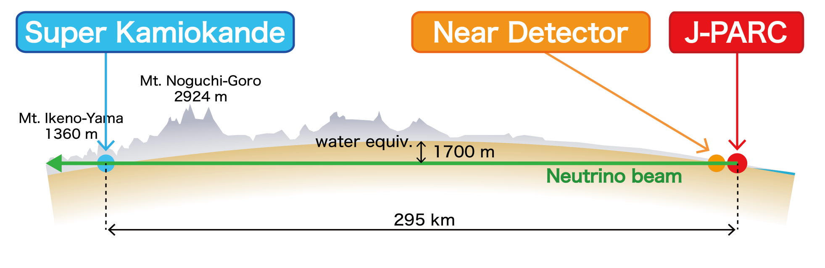
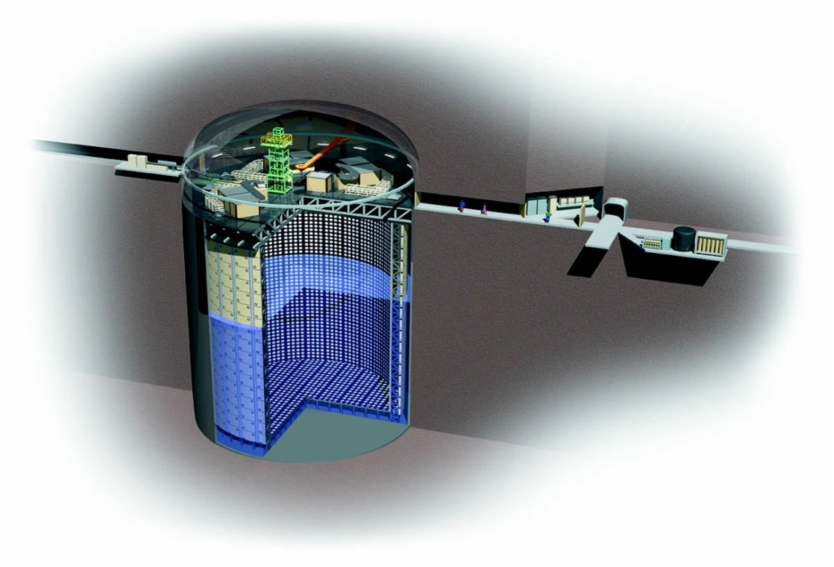
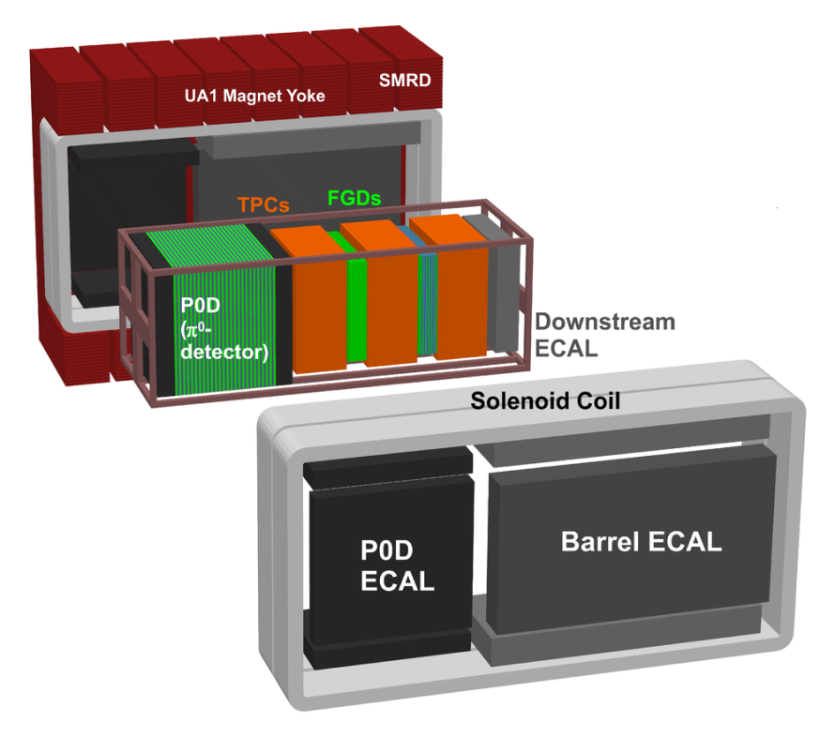
Notes:
Sk 4pi detector

Slide 3

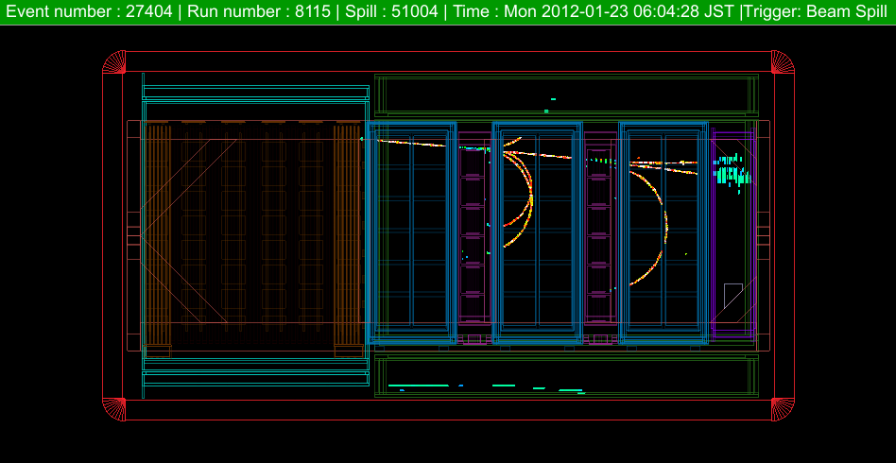
ND Purpose: Measurement of neutrinos before oscillation
ND components:
UA1 magnet: 0.2 T
π0 detector (POD)
2 Fine Grain Detectors (FGD):
  target, FGD2 with H2O
  XY scintillator bars
  1 ton each
3 Time Projection Chambers (TPC)
Electromagnetical Calorimeter (ECAL)
Side Muon Range Detector (SMRD)

Slide 4
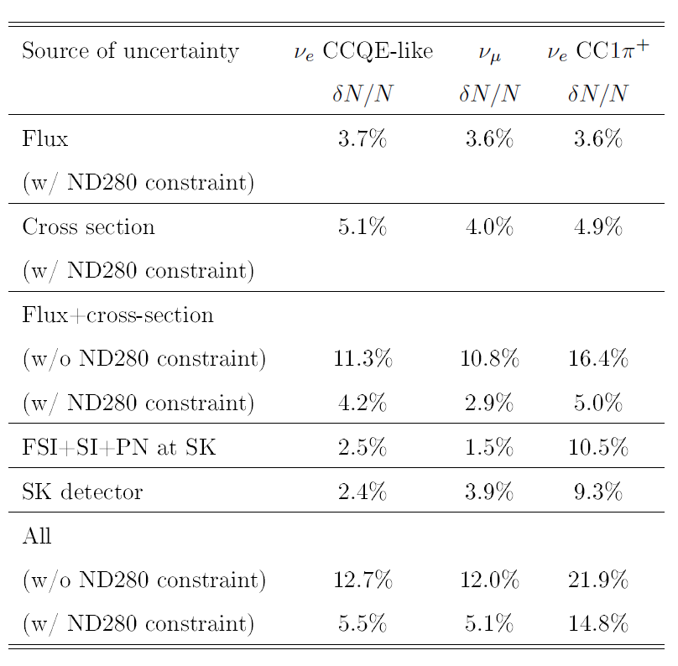
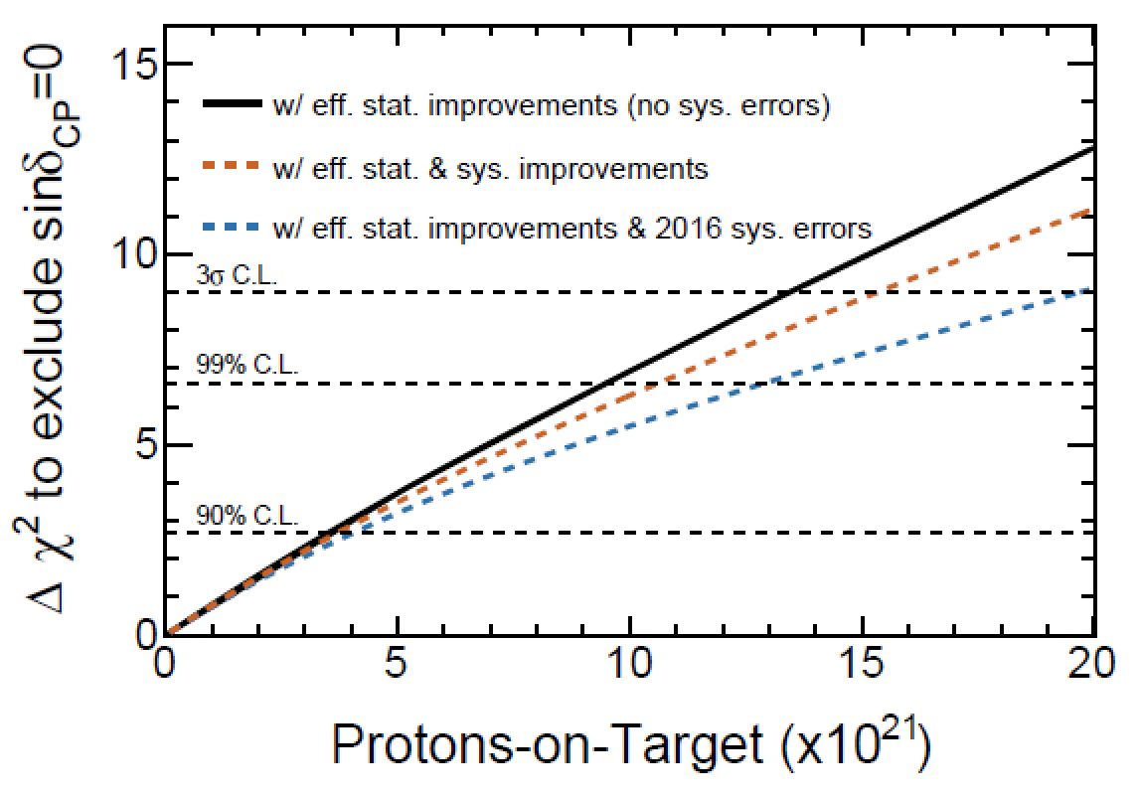
T2K-II
Phys. Rev. D, 96:092006, 2017
arxiv:1609.04111
aim: systematics from 5-6% to 4%
beam power upgrade:
485 kW → 1.3 MW
statistics:
3E21 POT (2018) → 20E21 POT (2026)
Aim for CPV observation in optimal scenario at 3σ
arXiv:1609.04111
Notes:
Updated table for 2018 presented in other talks

Slide 5
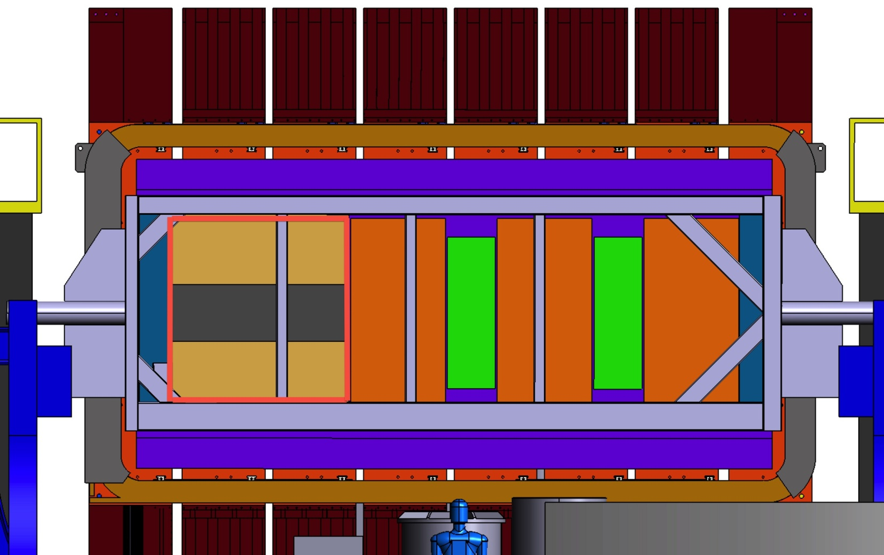
N280 Upgrade replace POD by:
1 fine graned scintillator target (SuperFGD)
2 high angle TPCs (HA-TPC)
6 time of flight panels (TOF)
 | Current (FGDs) | Upgrade (FGDs + SuperFGD)
Target mass (tons) | 2.2 | ~4.2
CERN-SPSC-P357
“4π” detector
μ
TOF
HA-TPC
ν beam
SuperFGD
HA -TPC

Slide 6
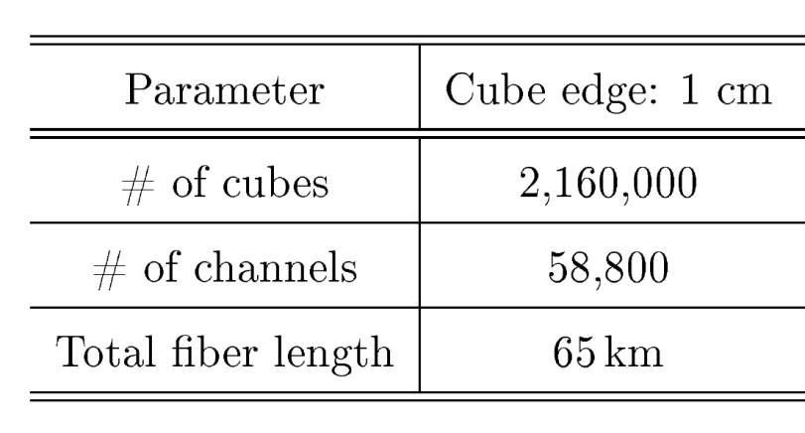
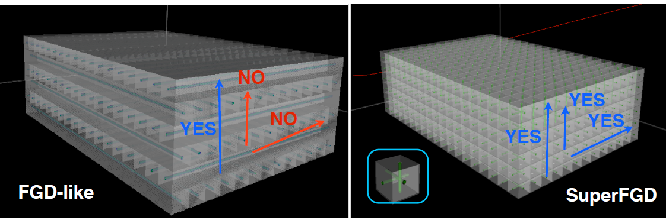
SuperFGD
JINST 13 (2018) no.02, P02006
scintillator, WLS fibers + MPPCs
classical 2D approach reconstruction limitations
new 3D approach: 1x1x1 cm³ cubes with 3 WLS fibers
size: ~1.8x0.6x2 m³

Slide 7
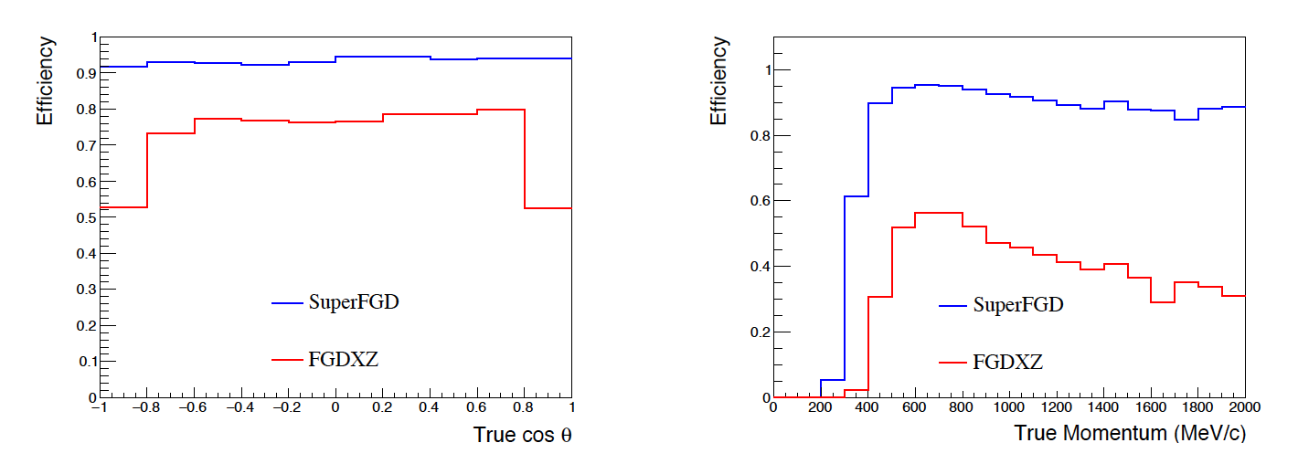
SuperFGD
e
Simulation studies:
high granularity allows excellent pattern recognition
light yield from the 3 fibers helps to distinguish 1 from 2 particles => e/γ separation
significant improvement on p reconstruction efficiency
γ
p
μ

Slide 8
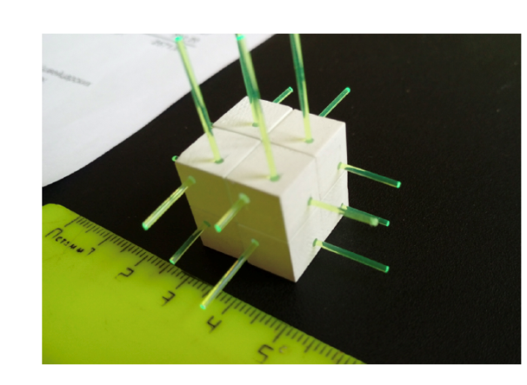
SuperFGD
Cube production by injection mold method at INR RAS ( uncertainty ~35 μm)
Reflector coating (~50 μm) by chemical etching Uniplast (Russia)
2017: prototype of 5x5x5 tested at CERN testbeam:
  light yield
  cross talk
  timing resolution

Slide 9
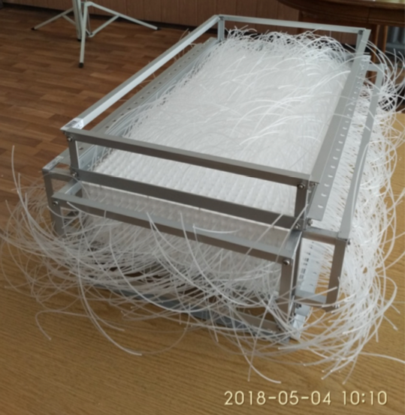
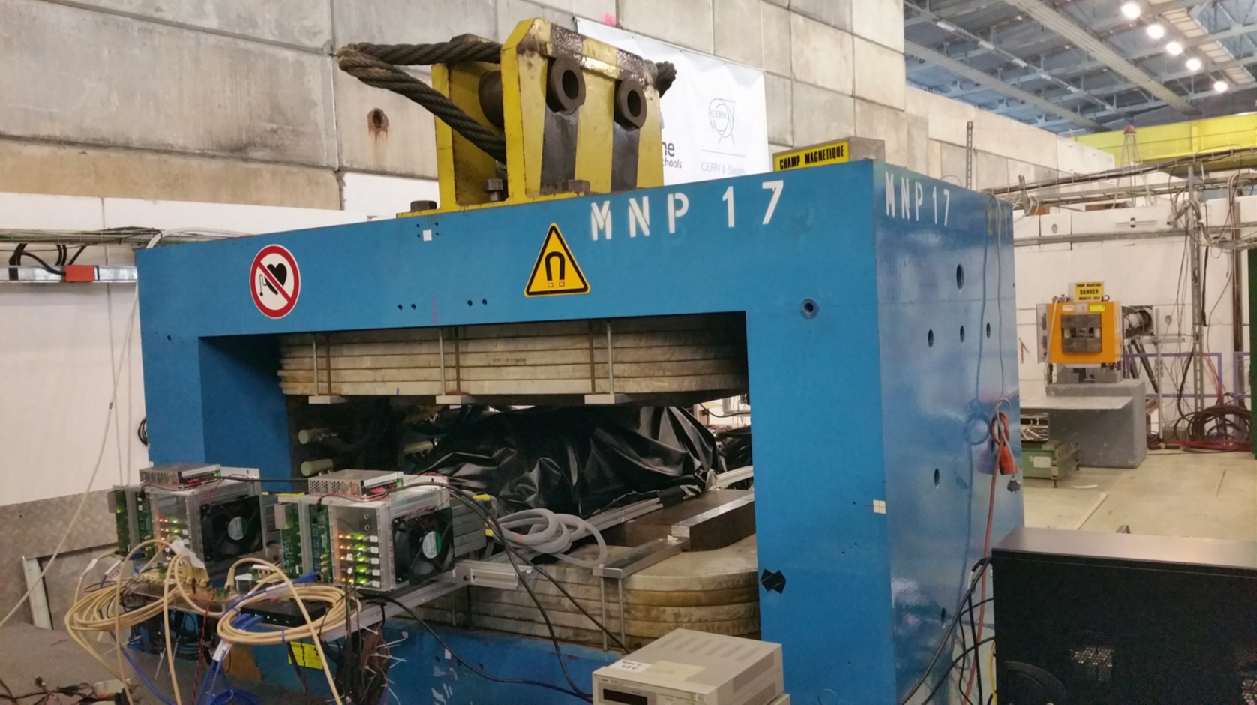
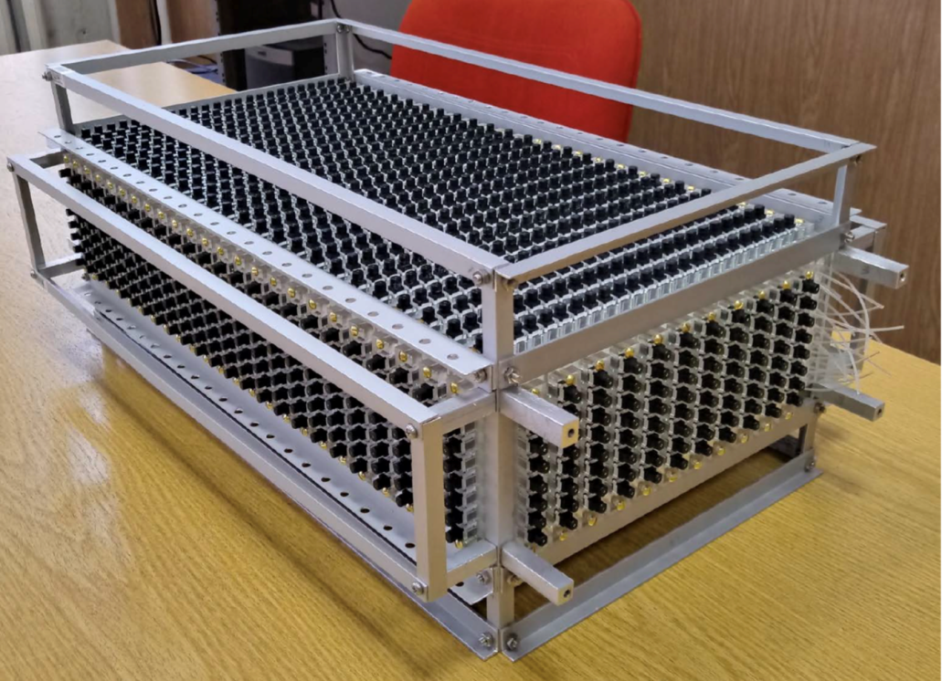
SuperFGD: Is it scaleable?
prototype of 9216 cubes
size: 8x24x48 cm³
1728 fibers/MPPCs
3 type of MPPCs
adapted Baby MIND electronics (based on CITIROC chip) for readout
Testbeam at CERN beginning of July
e, μ, π, protons and γ (!)

Slide 10
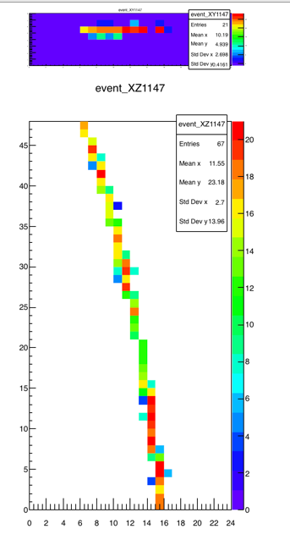
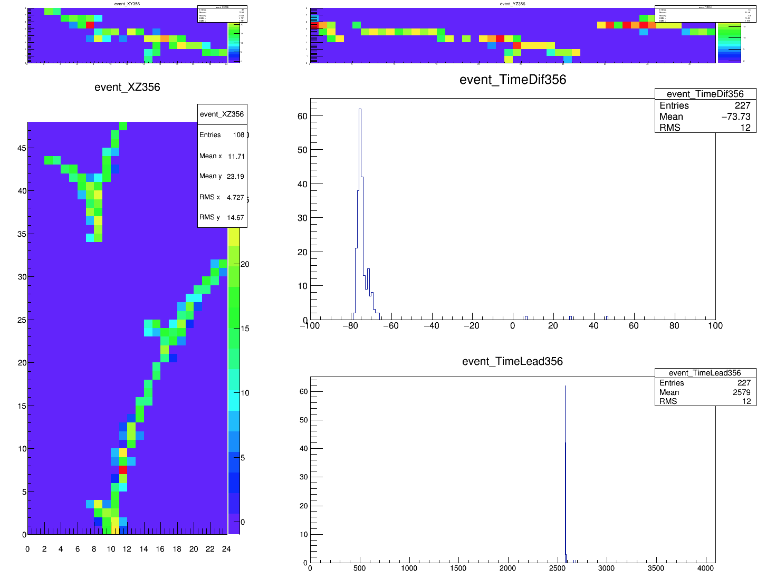
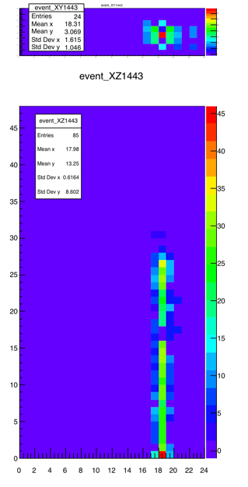
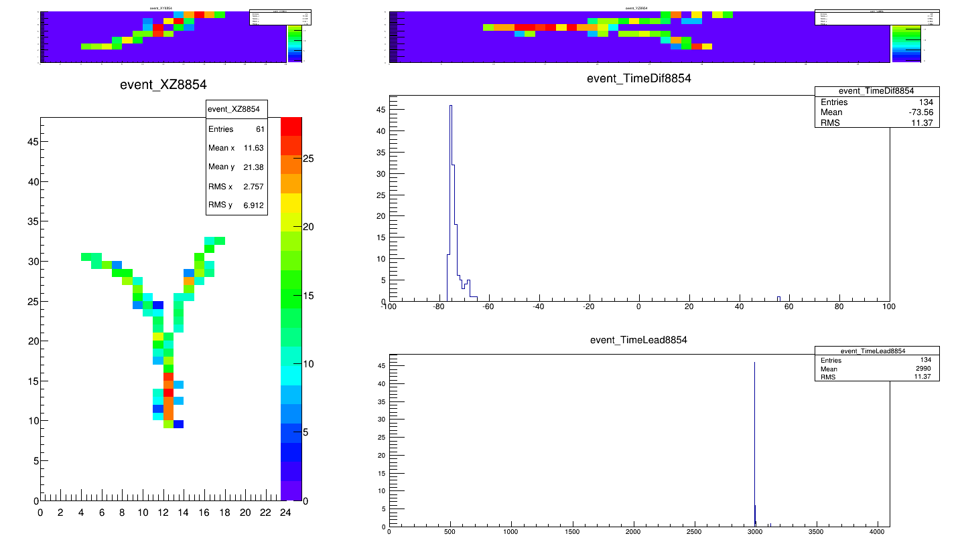
SuperFGD:
Simulation
very successful data taking
important step towards full size detector
detailed data analysis ongoing
Single track
Pion beam
Stopping proton
Photon beam
Data
Notes:
Photon momentum simulated between 0.2 and 0.6 GeV/c. Data not known, electron beam had 0.7 GeV/c.

Slide 11
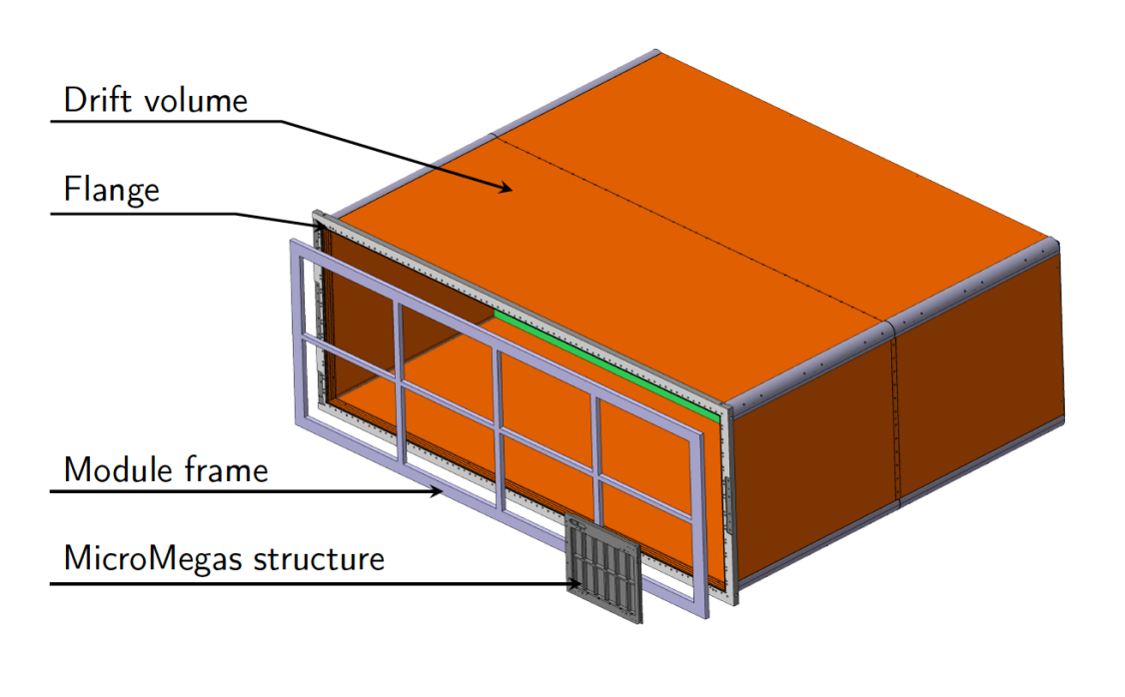
HA-TPC:
2 rectangular TPCs
inner dimensions:
  1.8 m wide
  0.7 m height
  2 x 1.06 m drift
single gas volume
composite material FC
radiation length: 2-3% X₀
8 resistive MicroMegas
T2K gas: 93% Ar, 3% CF4, 2% iC4H10
Cathode voltage: ~25 kV
readout electronics based on AFTER chip
10% Δp/p at 1 GeV/c
Material | Thickss (mm)
Copper coated polymide film | ~ 0.15
Aramid Fiber Fabric (Kevlar) | 2.00
Aramide HoneyComb panel | 30.00
Aramid Fiber Fabric (Kevlar) | 2.00
Polymide film (insulation) | ~ 0.10
Strips (double later) on Kapton foil | ~ 0.15
TOTAL | ~34.40

Slide 12
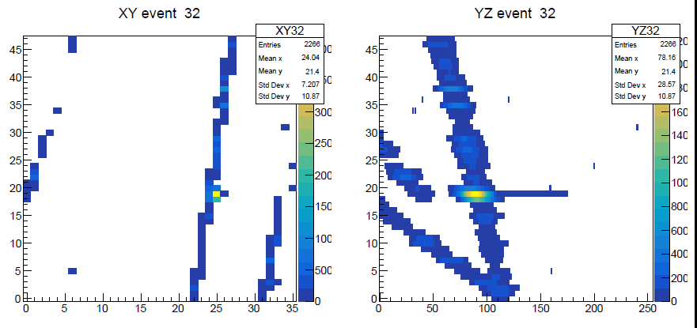
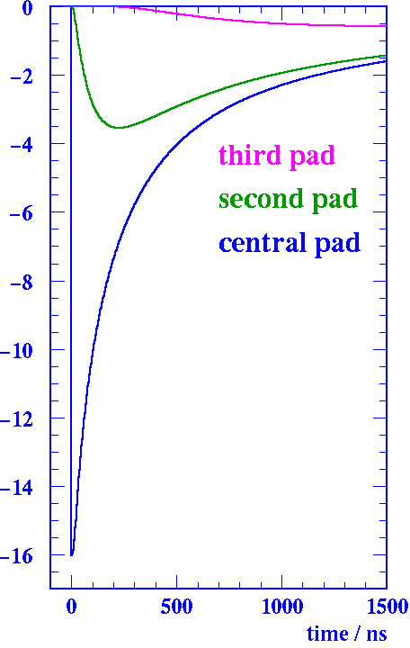
HA-TPC:
avalanche size in MM few microns => no charge sharing between pads
adding resistive layer to spread charge (NIM A518 (2004) 721) => reduction of electronics channels
first prototype tested with cosmics and 15 cm drift at Saclay
testbeam with 150 cm drift end of August
e
Amplification gap ~100 μm
Resistive layer ~75 μm
+ HV
Insulator ~100 μm
PCB

Slide 13
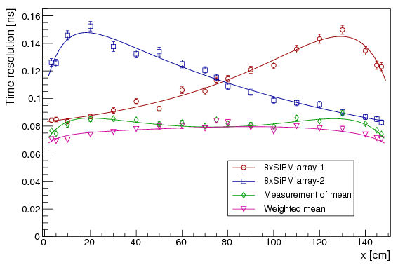
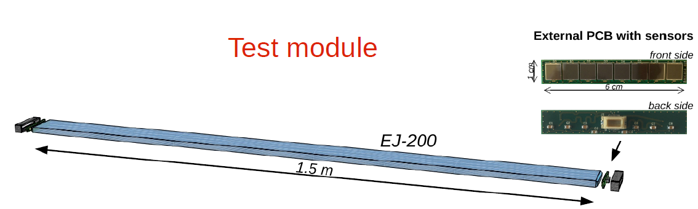
TOF:
JINST 12 (2017) no.11, P11023 (arXiv:1709.08972)
Baseline choice:
Cast plastic scintillator: EJ-200
8 SiPM (6x6 mm2) directly coupled to scintillator
readout from both sides
tested in CERN testbeam 2017
~70 ps time resolution for 1.5 m bars achieved

Slide 14
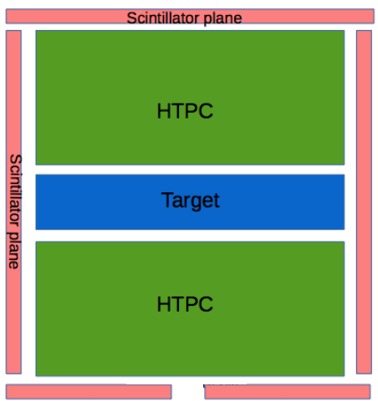
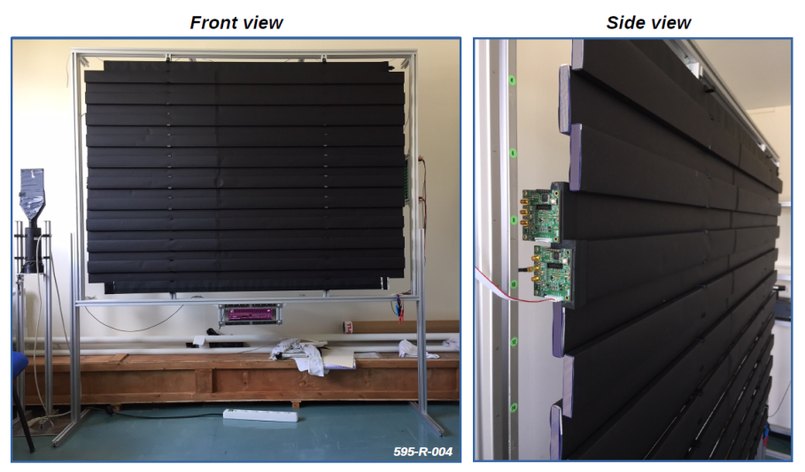
TOF:
Magnet
ND280 panels: 12x230x1 cm³
readout electronics based on MUSIC ASIC (UB) and SAMPIC digitizer (LAL)
purpose: identify if particles from target to magnet and improve backward efficienty for current tracker
or
or
Magnet

Slide 15
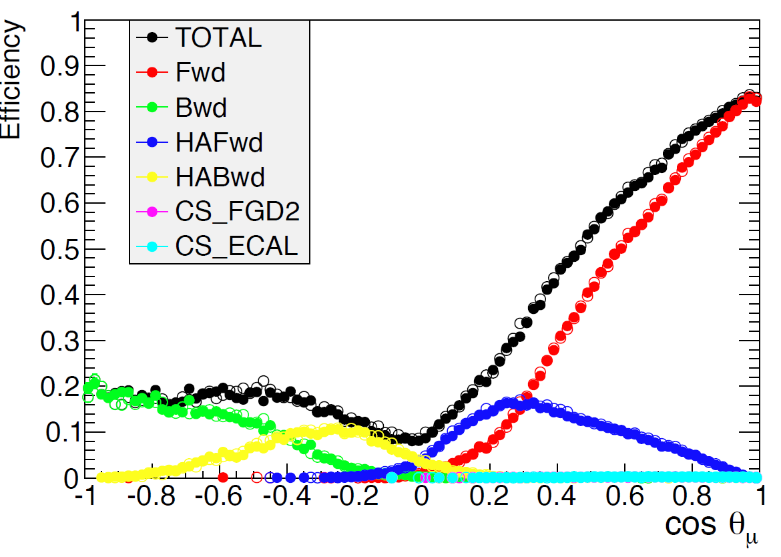
data
simulation

Slide 16
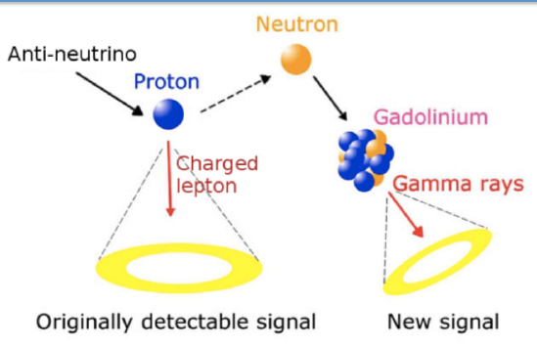
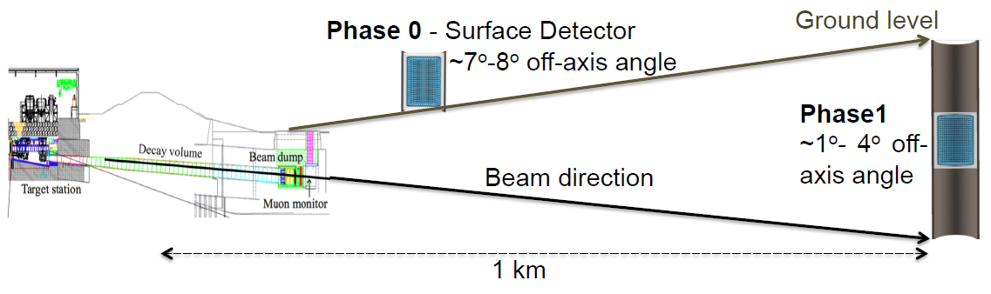
Beyond T2K II:
T2K-II will improve systematics to 4%
aim for HK is 3%
idea is to add intermediate detector
Water Cherenkov detector doped with Gd
intense R&D program
2 phases:
  Phase 0: 50 ton test experiment at Fermilab or CERN (2021/22)
  Phase 1: full detector, movable (2025 and beyond)
HK talk on the 16th of August

Slide 17
Conclusions
ND280 and Beam Upgrade for T2K-II
  High angle acceptance and low momentum measurement by SuperFGD, HA-TPCs and ToF counters
  R&D and simulation studies in progress
  Proposal submitted Jan 2018 (SPSC@CERN & PAC@J-PARC)
  Beam power increased to 1.3 MW
Schedule for the ND280 Upgrade:
  June - August 2018: SuperFGD and HA-TPC beam test @ CERN
  Acknowledgement: Many thanks to CENF for support!
  End of 2018: Technical Design Report
  2021: Installation and commissioning in Japan
  Reduction of systematics to about 4%
Plans for time beyond T2K-II well progressing:
  Intermediate water Cherenkov detector, movable
  Aim: reduce systematics to 3%

Slide 18
BACKUP SLIDES

Slide 19
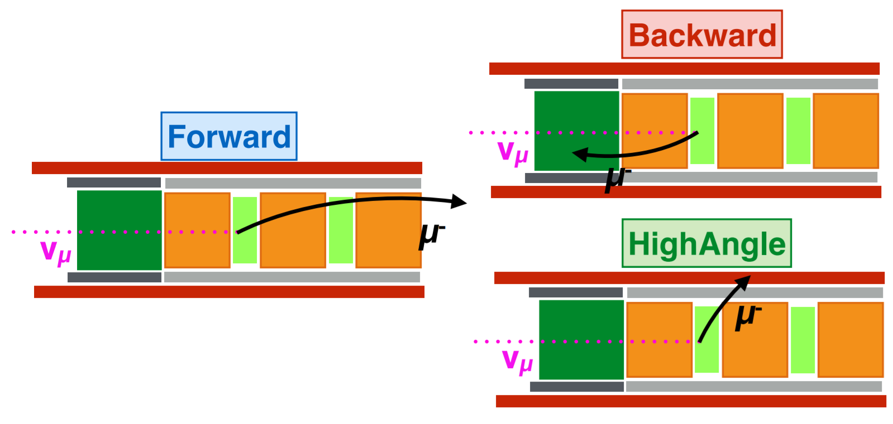

Slide 20
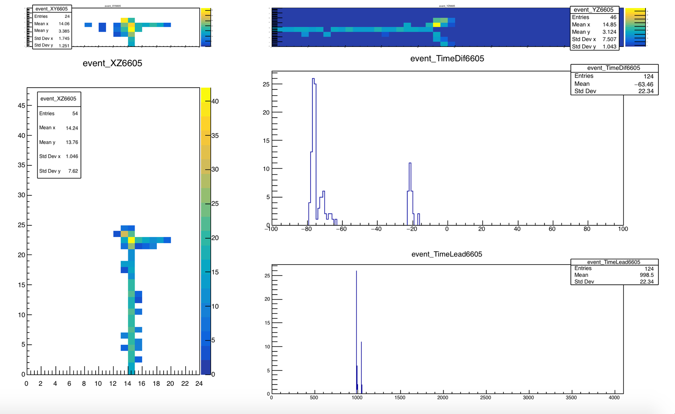
Event displays (decay candidate)
Muon life time is 2µs
150 ns

Slide 21

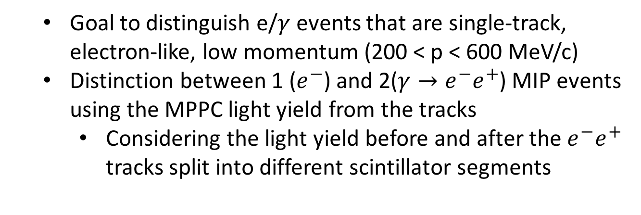
e/$γ$ Separation in ND280 Upgrade Target
  Goal to distinguish e/$γ$ events that are single-track, electron-like, low momentum (200 < p < 600 MeV/c)
  Distinction between 1 ($e^{−}$) and 2($γ→e^{−}e^{+}$) MIP events using the MPPC light yield from the tracks
    Considering the light yield before and after the $e^{−}e^{+}$
    tracks split into different scintillator segments
z
y
Notes:
e-e+ pair where the positron was not reconstructed as a separate track due to the low momentum
GEANT4 SuperFGD 2D particle gun track projection as a function of the total photo-electron (p.e.) counts

Slide 22
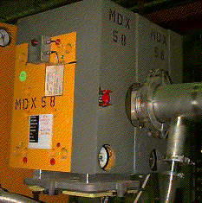
A Photon beam in T9 area
A. Blondel, L. Gatignon
Principle
e⁻ beam
Cu radiator
MDX magnet
0.51 T.m
γ beam
may need a position detector
best is probably
around 2 GeV/c e-
for 200-800 MeV
photons
(should be simulated)
hodoscope
(measures electron momentum
➔ photon energy)

Slide 23
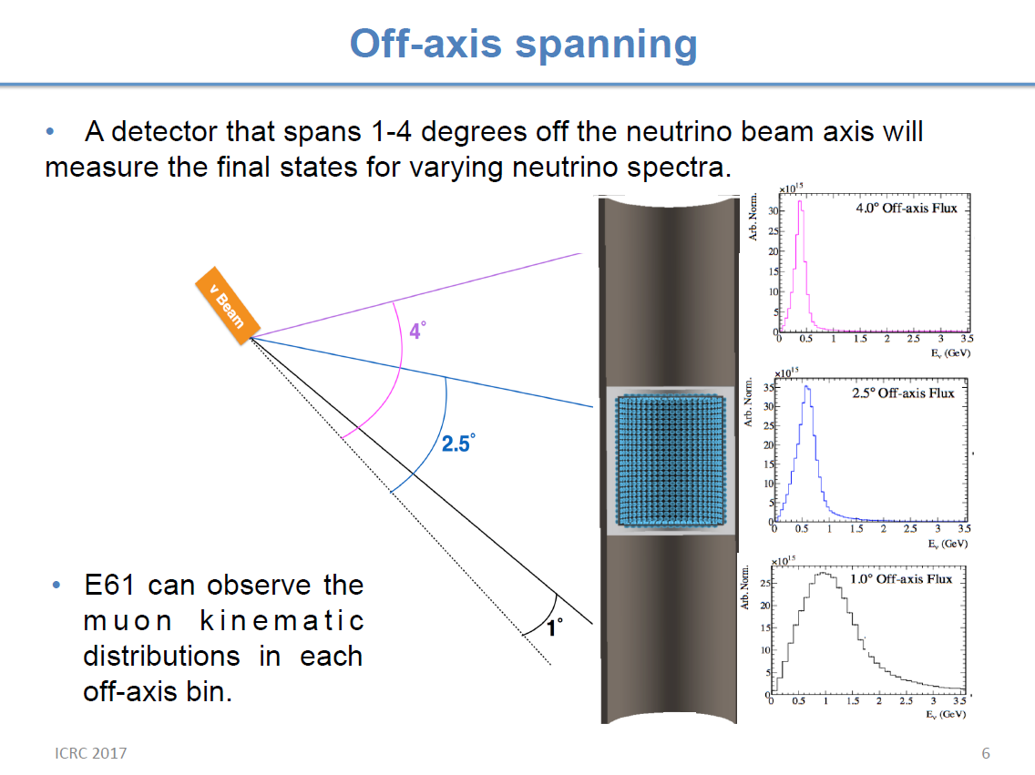

Slide 24
