Slide 1

MICE Results
NUFACT 2018
Virginia Tech, 16 August 2018
Paul Soler
University of Glasgow
on behalf of the MICE Collaboration

Slide 2
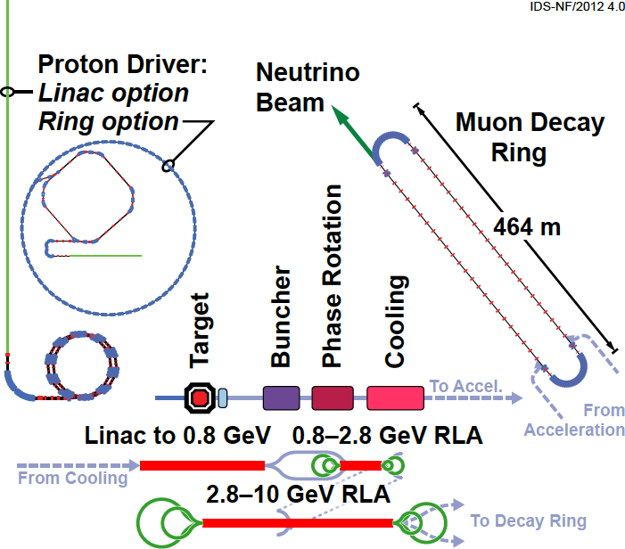
Neutrino Factory
International Design Study for a Neutrino Factory (IDS-NF):
  Most sensitive facility for the study of CP violation in neutrinos
IDS-NF
P. Huber
562 m
Can reach uncertainty in δ_{CP} of 5º
Test three-neutrino mixing paradigm

Slide 3
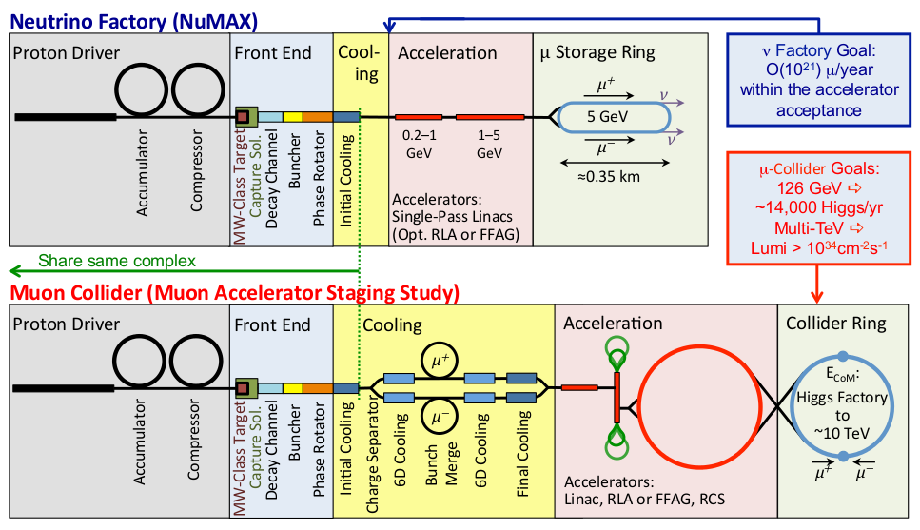
From Neutrino Factory to Muon Collider
Staging of Neutrino Factory, leading to a Muon Collider, carried out within the US Muon Accelerator Programme (MAP)
Only high energy lepton collider that can reach 10 TeV and beyond

Slide 4
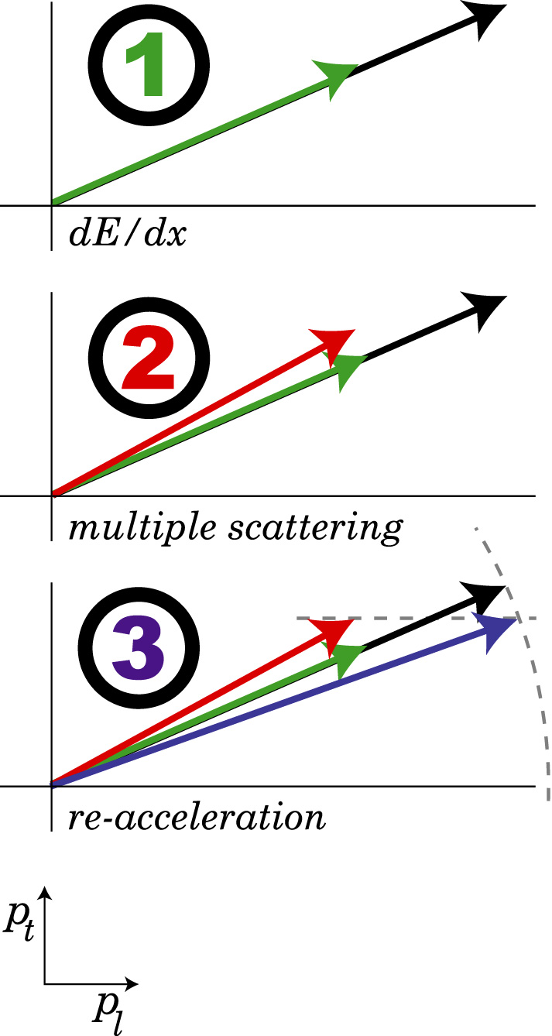
Muon Cooling
Muon Ionization Cooling:
  Muon Ionization Cooling is the key technology required to be able to realise a Neutrino Factory and a Muon Collider (akin to stochastic cooling that enabled proton-antiproton collider in 1980s)
Principle
Practice
Small β⊥ ⇒ strong focusing
Ionization: cooling
Multiple scattering: heating

Slide 5
Muon Ionization Cooling Experiment
Muon Ionization Cooling Experiment:
  Letter of Intent: November 2001
  Proposal at Rutherford Appleton Laboratory (RAL): January 2003
  International collaboration built muon ionization cooling experiment at RAL

Slide 6
Muon Ionization Cooling Experiment
We are extremely grateful to all the funding agencies that are contributing and have contributed to MICE
  STFC from UK
  NSF and DoE from USA
  INFN in Italy, Swiss National Science Foundation, European Community, Institutional Funding in Bulgaria, Netherlands, Serbia
  Japan Society for the Promotion of Science, Chinese Academy of Sciences, institutional funding South Korea

Slide 7
MICE Beam
Muon beam from ISIS (800 MeV proton synchrotron)
Pion channel
Pion momentum
Muon cooling channel
Pion to muon decay
Muon momentum
Muon optics

Slide 8
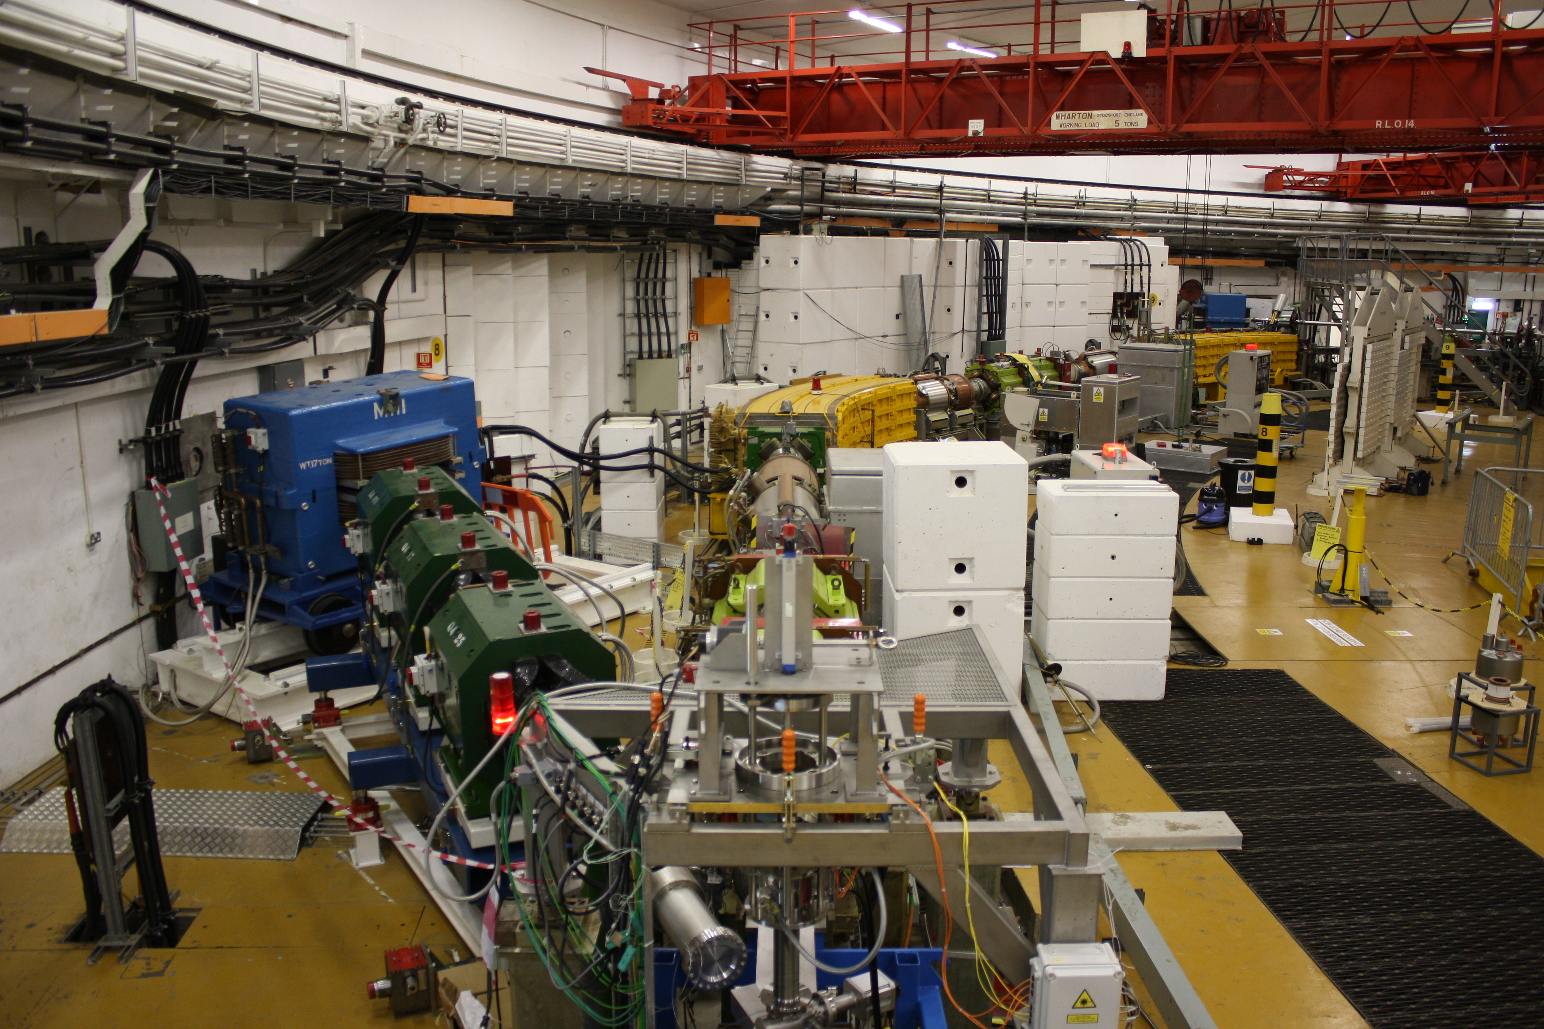
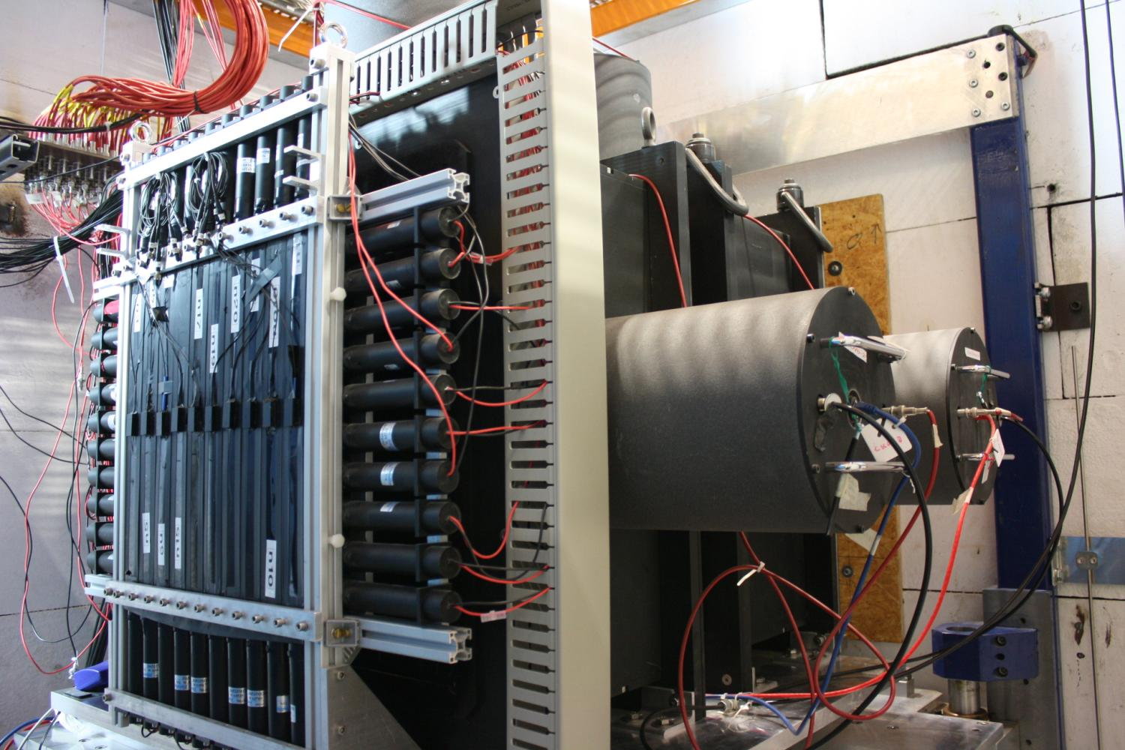
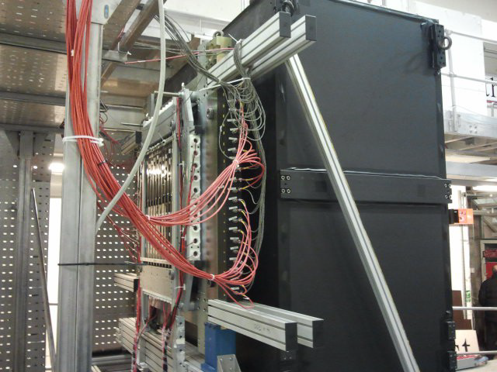
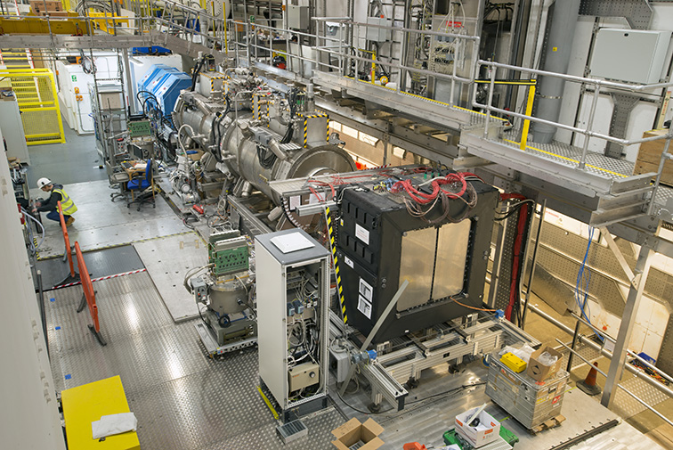
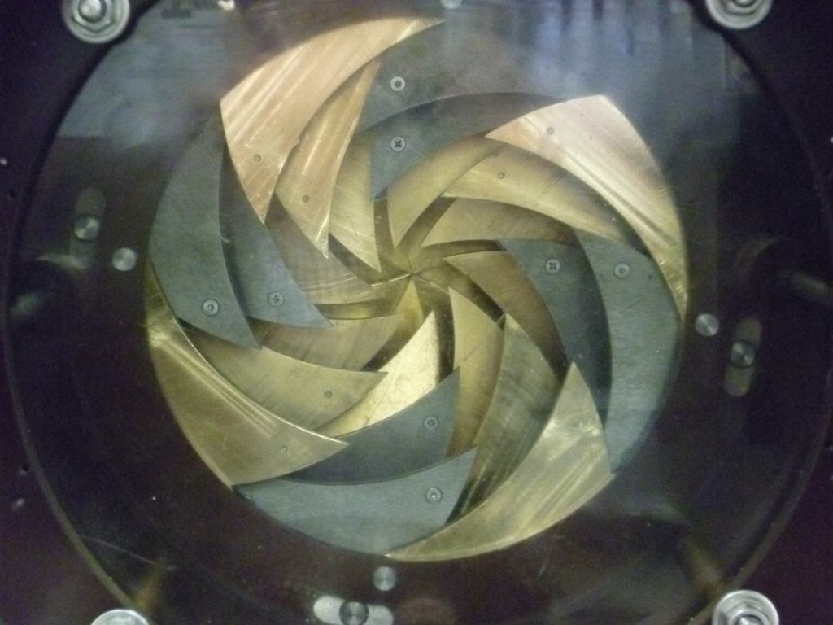
MICE Beam and detectors
Muon beam, target, detectors and diffuser:

Slide 9
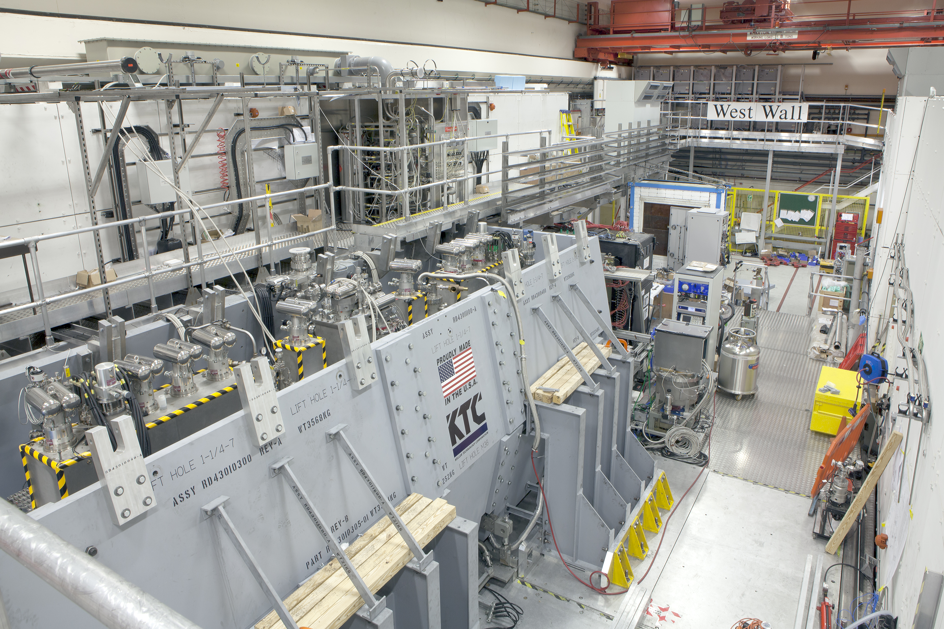
Muon Ionization Cooling Experiment
Cooling Channel with Partial Return Yoke

Slide 10
MICE Science Goals
MICE goals: make first measurement of ionization cooling and explore change of emittance as a function of:
  Input emittance: vary beam optics and diffuser thickness
  Absorber material: liquid hydrogen (350mm), lithium hydride (65 mm) and 45º polyethylene wedge absorber
  Momentum and optical beta function
Change parameters of cooling formula to explore potential cooling performance of future facilities in detail
ε_{T} = 3 mm, 6 mm, 10 mm
X₀(LH₂) = 890 cm, X₀(LiH) = 102 cm, X₀(CH) = 47.9 cm
p_{μ}= 140 – 240 MeV/c

Slide 11
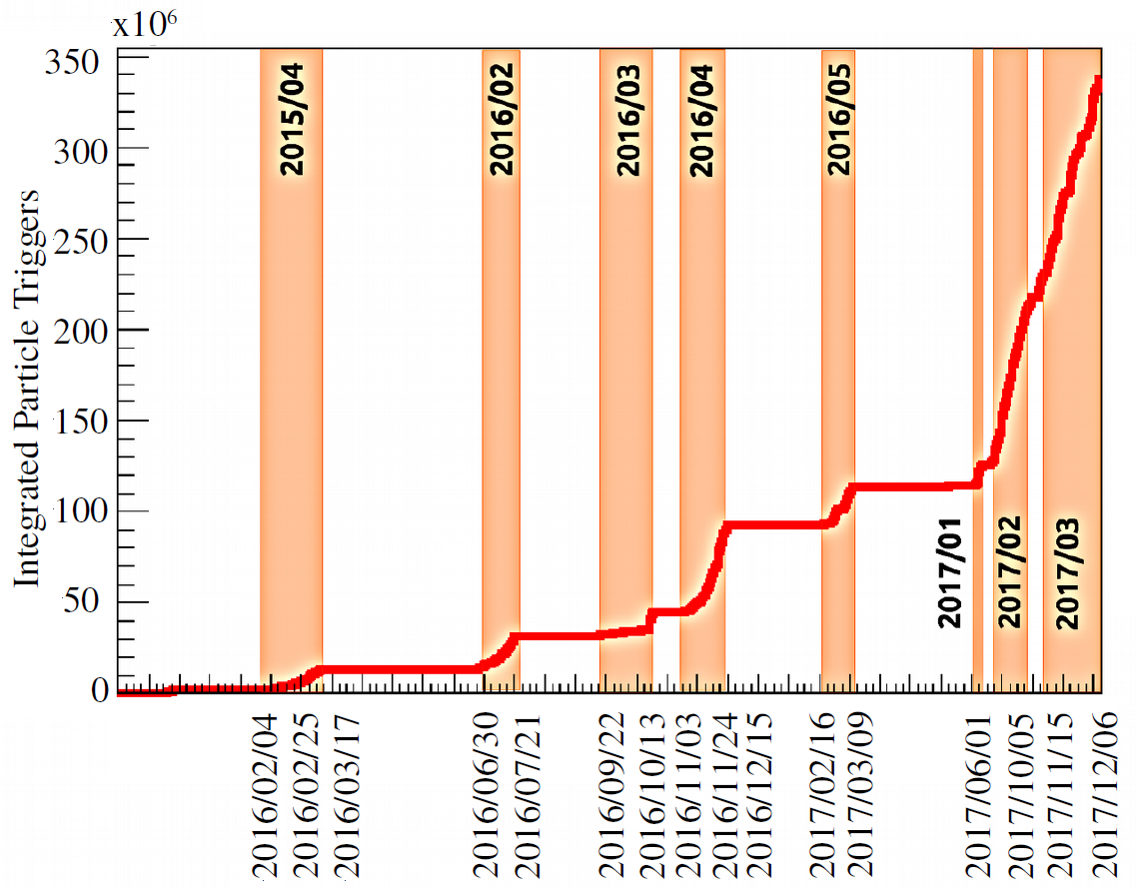
MICE Data
MICE data set (2015-2017): 350x10⁶ triggers

Slide 12
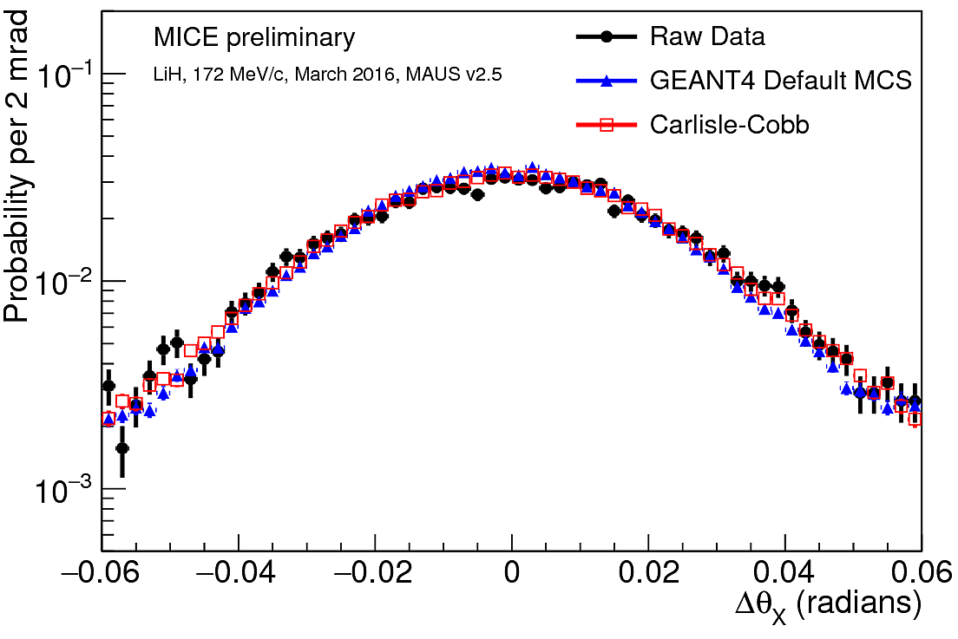
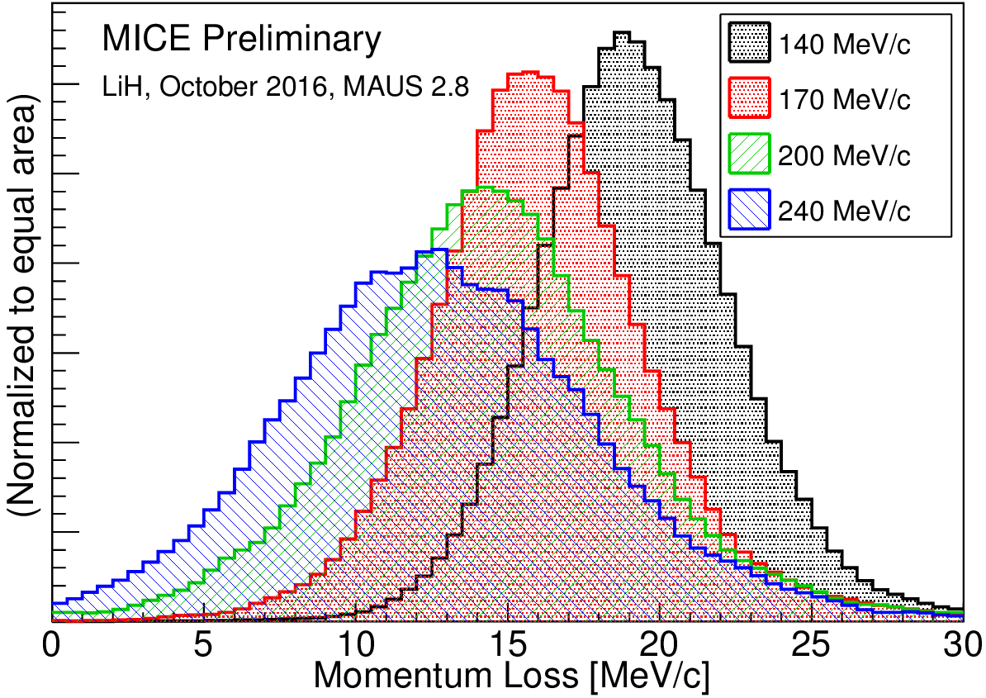
Multiple Coulomb Scattering
First measurement of muon Multiple Coulomb Scattering in lithium hydride at 140-240 MeV/c: see Monday WG3 parallel talk by John Nugent for details
  Validation of Molière scattering model and Geant4
Validation of energy loss model

Slide 13
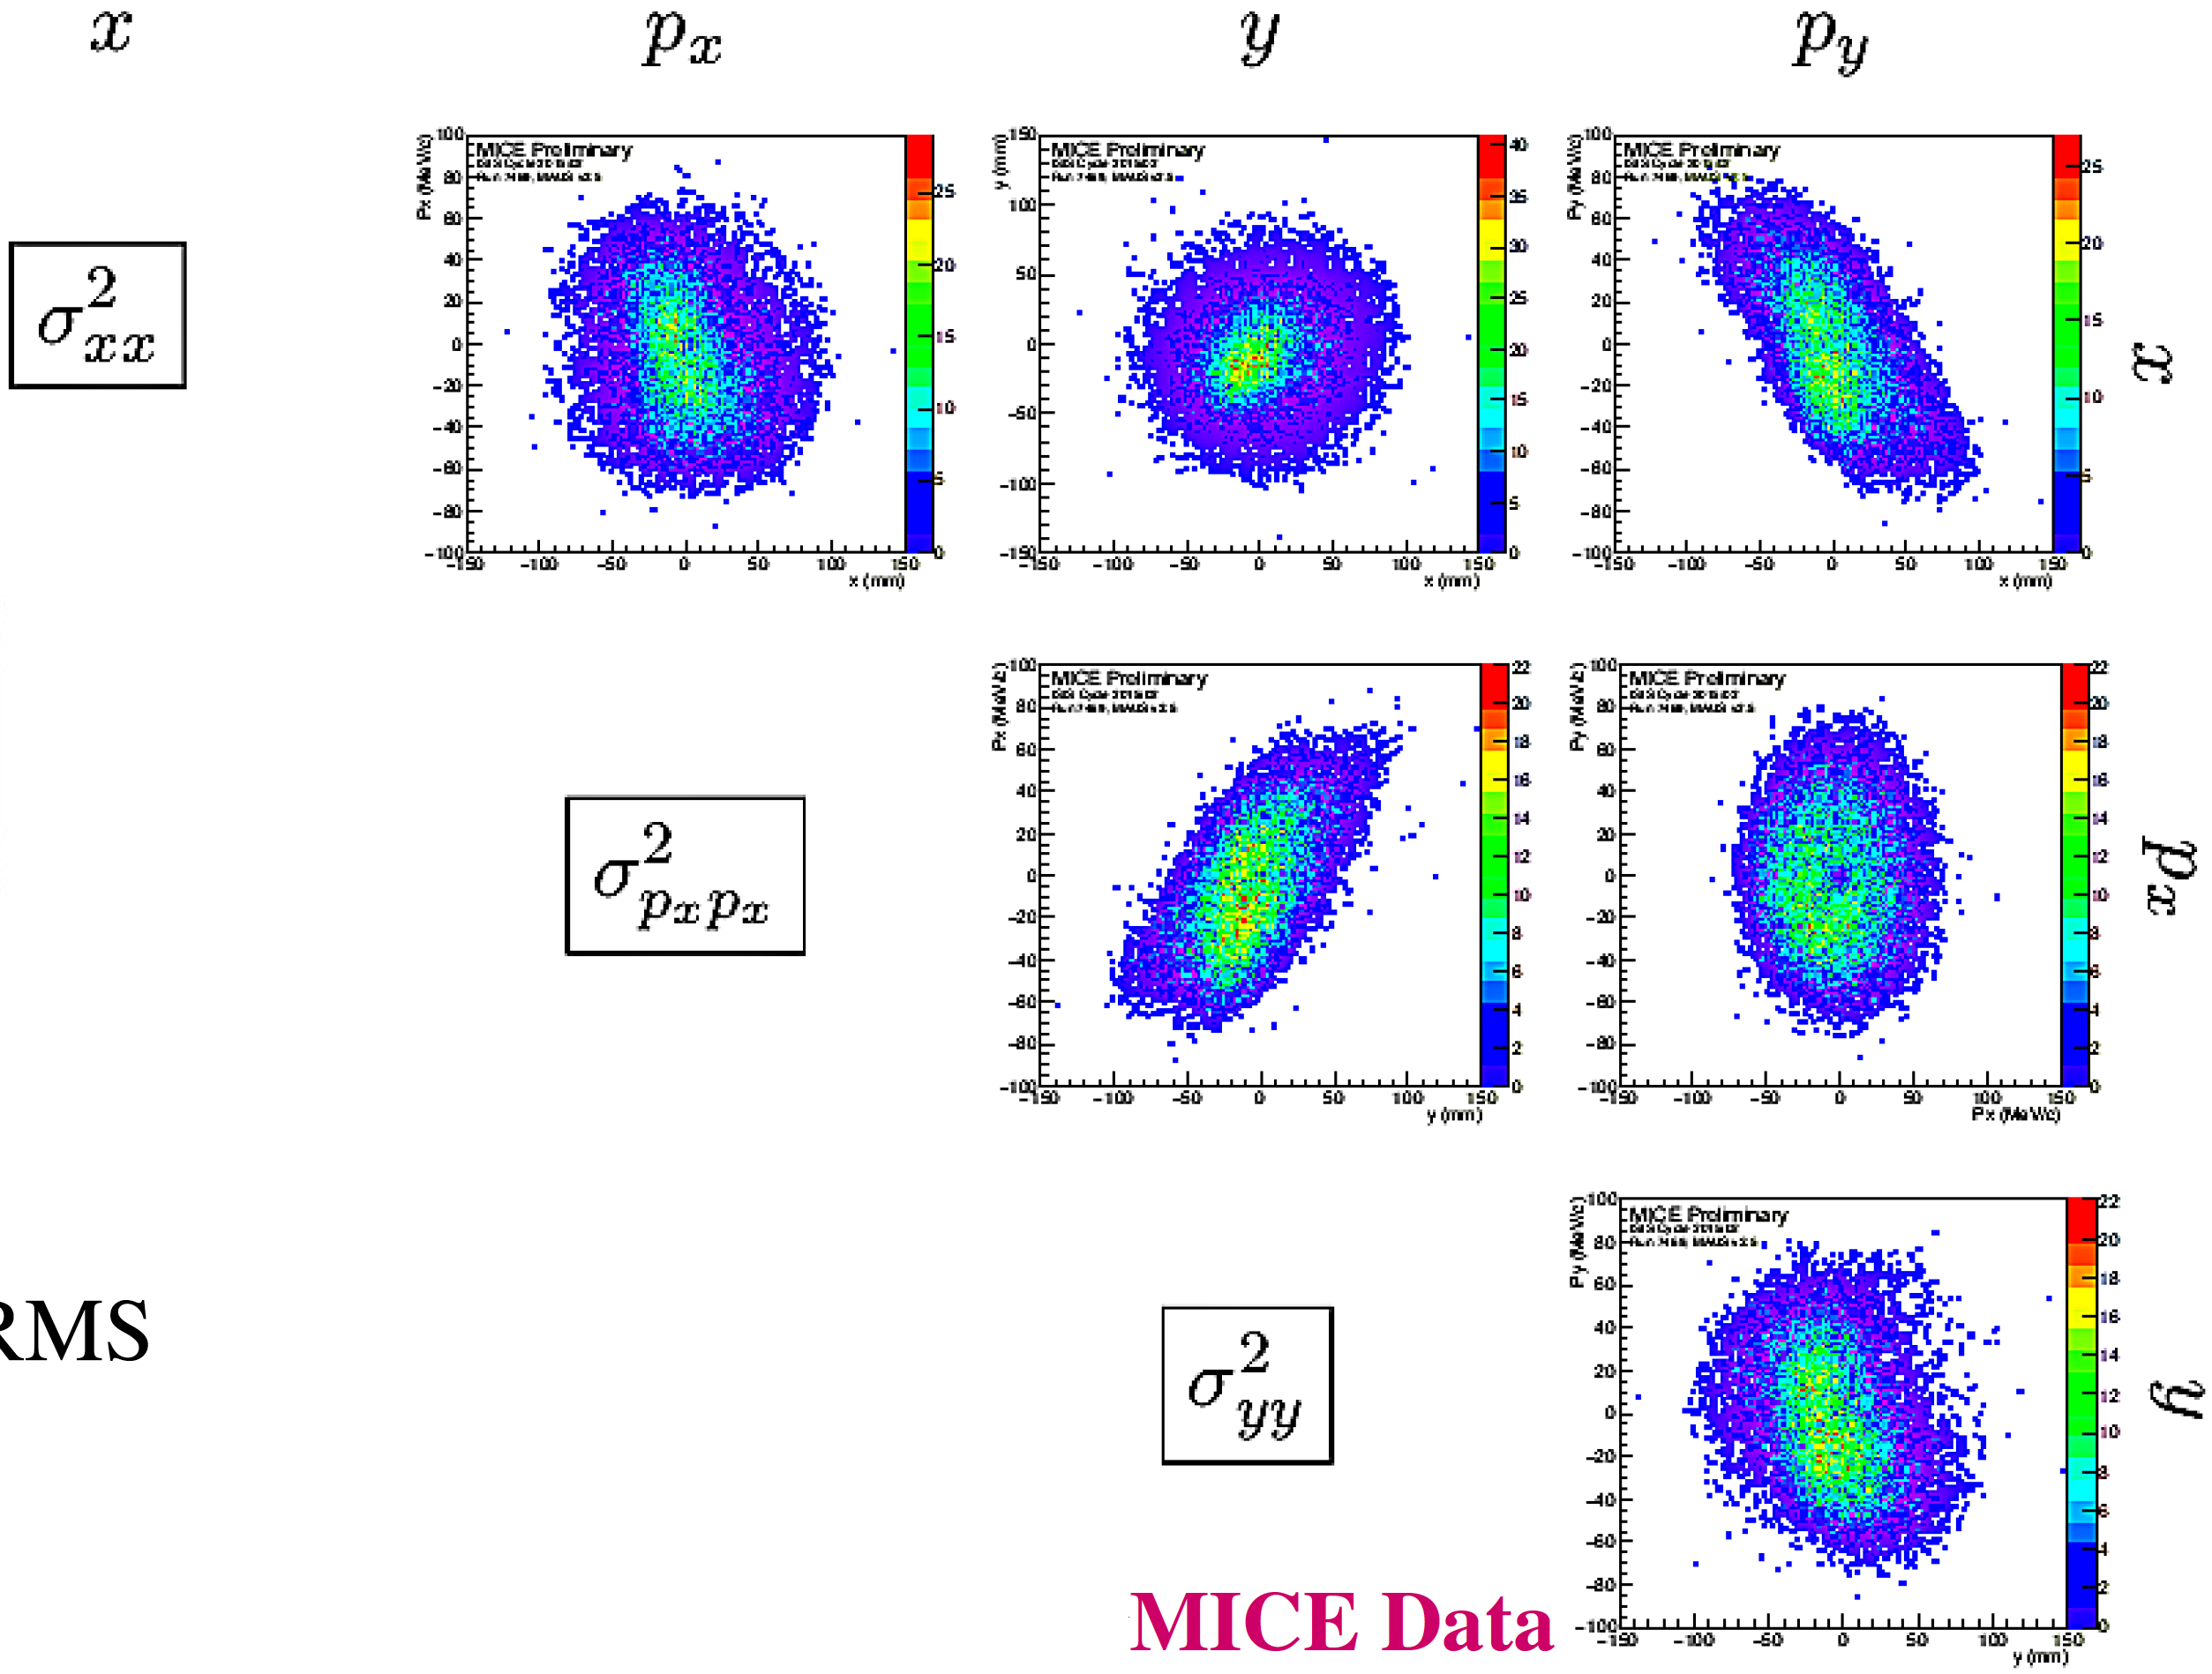
Measurement of beam emittance
Single particle reconstruction: creates virtual beams by performing ensemble of all particles
4D-phase space of particles:
Normalised RMS transverse emittance:
4D covariance
matrix:
Ellipsoid containing
4D phase-space
RMS volume
Reconstructed phase space
shows coupling of different
variables for emittance
calculation
Ionization cooling implies reduction of transverse emittance after absorber

Slide 14
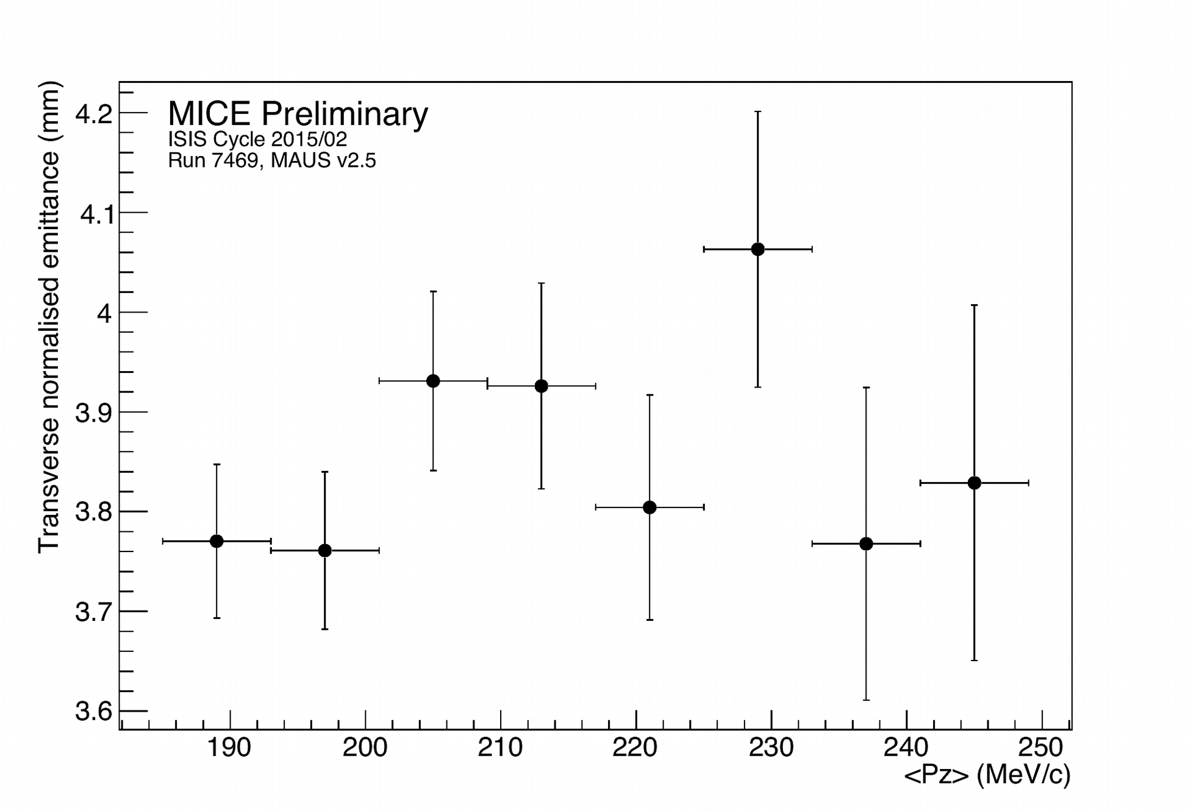
Emittance evolution
Measurement of emittance using single-particle method:
  MICE data shows flat emittance as function of momentum

Slide 15
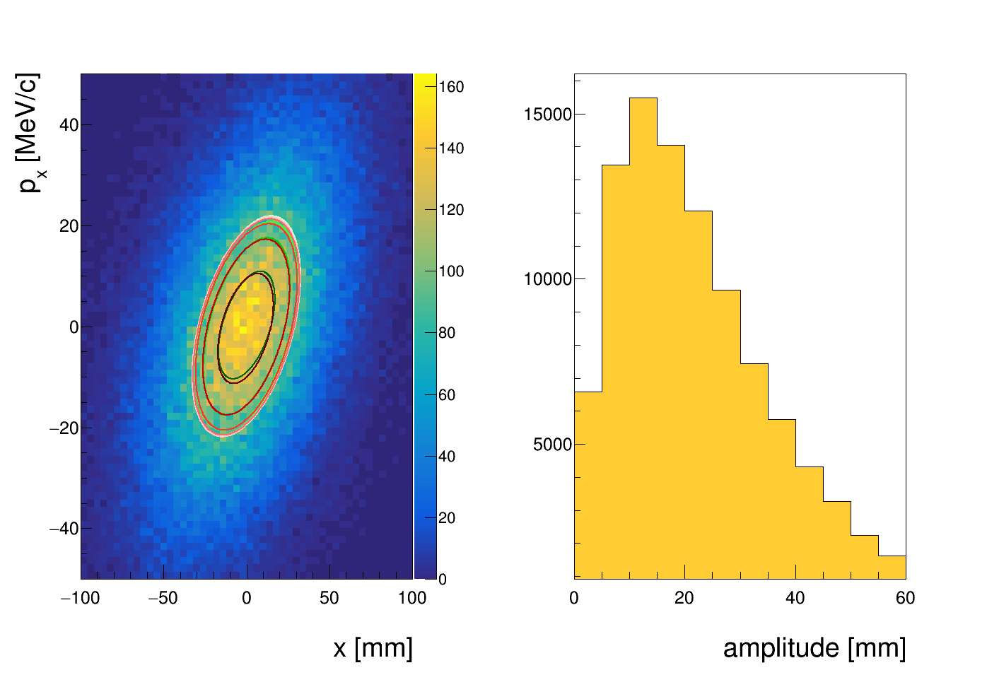
Transverse single-particle amplitude
Transverse single-particle amplitude:
  Phase-space distance of muon from beam core
Mean amplitude is proportional to RMS emittance
Ionization cooling reduces amplitude in the core of the beam (higher amplitude density at low amplitudes)

Slide 16
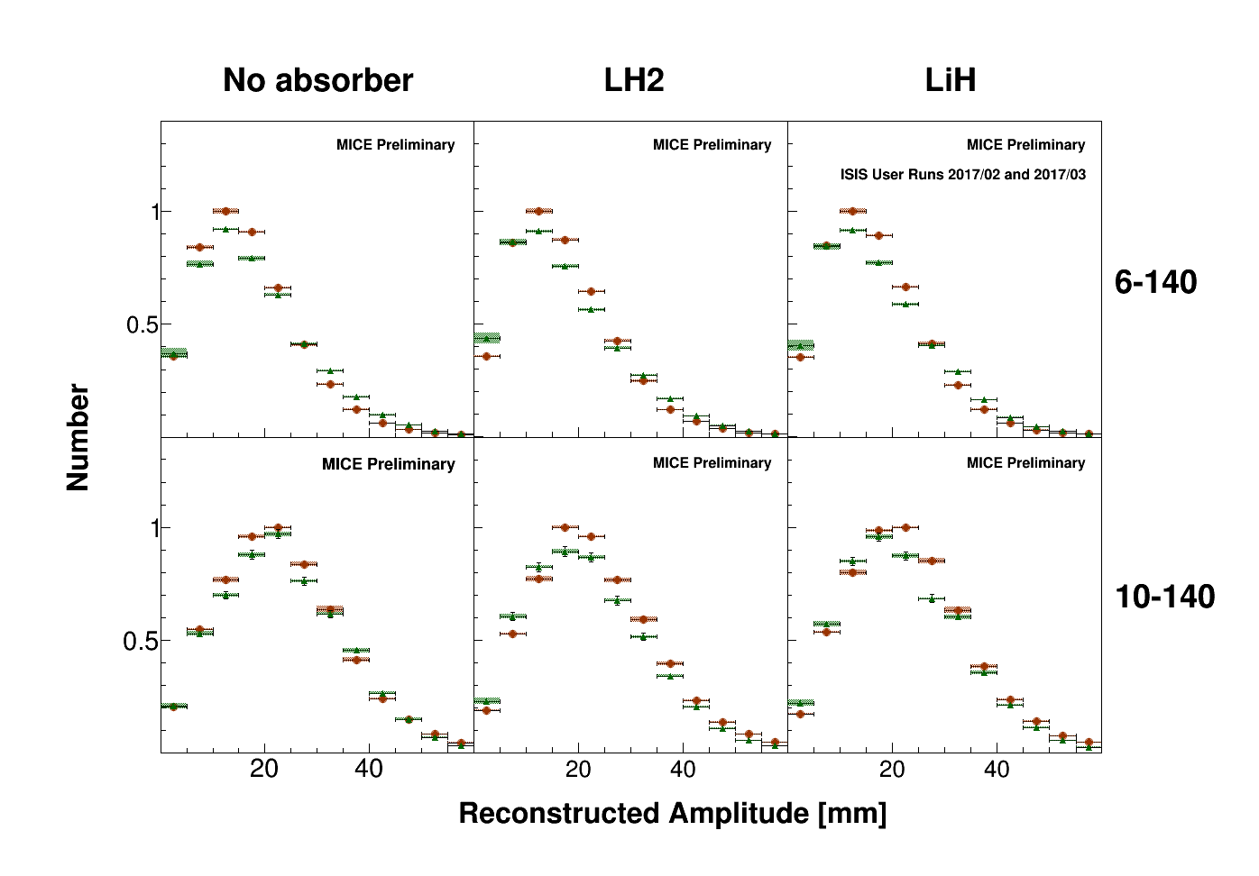
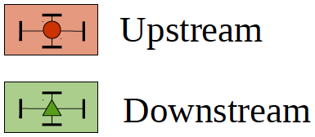
Change in amplitude across absorber
No absorber: decrease in number of core muons
Absorber: increase in number of core muons (cooling signal)
See Chris Hunt’s talk
(Monday WG3)

Slide 17
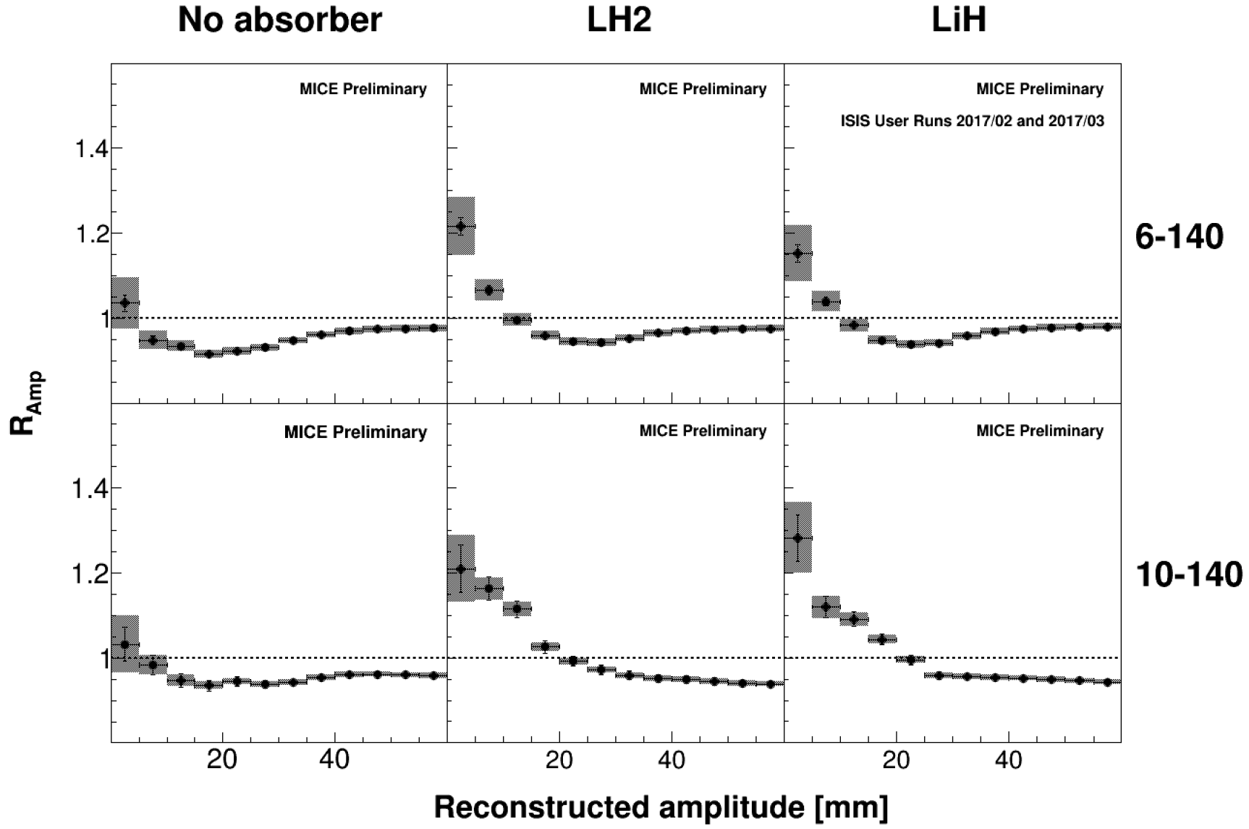
Ratio of cumulative core densities
Cumulative core density increase for LH2 and LiH absorbers
More cooling (R_{Amp}>1) at higher input emittances
See Chris Hunt’s talk
(Monday WG3)
First demonstration and characterisation of ionization cooling!

Slide 18
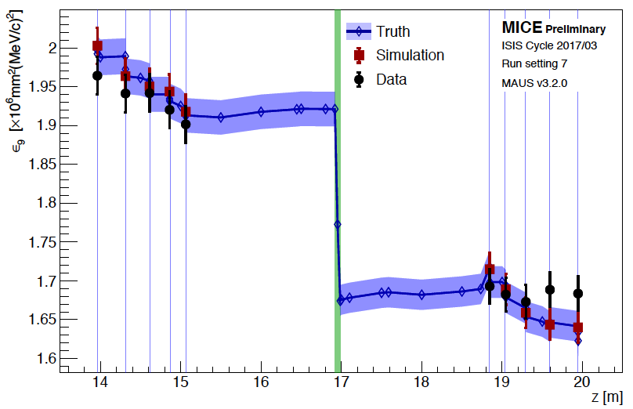
Fractional emittance evolution
Fractional emittance is phase-space volume occupied by fraction α of beam (α=9% is 1σ of 4D phase space)
Fractional (9%) emittance evolution 6 mm, 140 MeV/c, LiH, flip
Yagmur Torun’s
talk (Monday WG3)
Also shows
ionization
cooling!

Slide 19
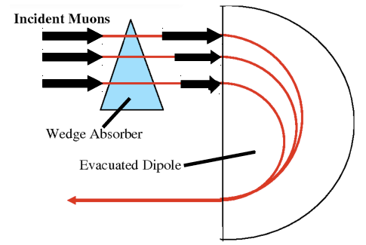
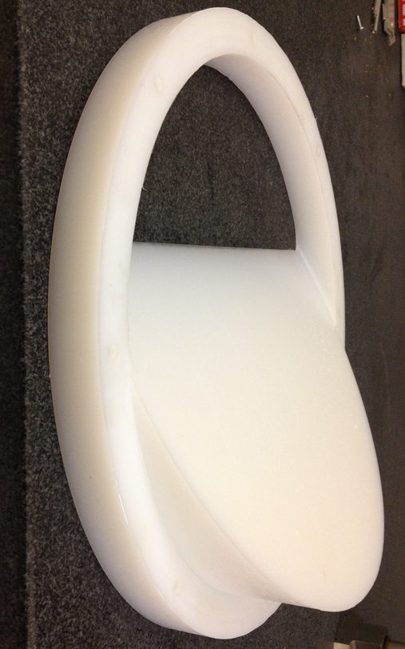
Reverse emittance exchange
Emittance exchange: muon collider 6D cooling and g-2
Reverse emittance exchange lengthens bunch and increases luminosity in MC
Polyethylene wedge absorber
See Yagmur
Torun’s talk
(Monday
WG3 parallel
session)
Simulation
Simulation
Reverse emittance exchange: transverse cooling and longitudinal heating

Slide 20

Conclusions
The Muon Ionization Cooling Experiment (MICE) was constructed at RAL and collected 350 million triggers to fully characterise ionization cooling
MICE is studying ionization cooling in detail: evolution transverse emittance beam amplitudes, multiple Coulomb scattering, energy loss, reverse emittance exchange
MICE has demonstrated
ionization cooling for the first time
July 2018
All main technologies required for neutrino factory and muon collider have now been demonstrated: ionization cooling (MICE), liquid mercury target (MERIT), Fixed Field Alternating Gradient accelerators (EMMA)

