Slide 1
Expression of Interest for hosting the “Applied Antineutrino Workshop, AAP-2017” at Bhabha Atomic Research Centre (BARC), Mumbai, India
BARC has a growing neutrino physics program
50000 ton INO detector recently approved for construction
Reactor monitoring demonstration initiated at 100 MWt DHRUVA reactor
A large phenomenological and theoretical neutrino community in associated institutions interested in the applied antineutrino physics program
If approved by our management, we can host AAP-2017 at BARC conference center

Slide 2
Mutual benefits:
Benefit to our program : exposure to experienced community of neutrino detector developers and new results
Benefit to foreign participants : first-ever meeting in India; new community of enthusiasts for fundamental and applied neutrino physics

Slide 3
Details
Up to 50 foreign participants
100 Indian participants
Plenary and poster sessions
Can prepare conference proceedings
Easy access to Mumbai from many foreign cities
Can accommodate a 2-3 day workshop in November-December 2017

Slide 4
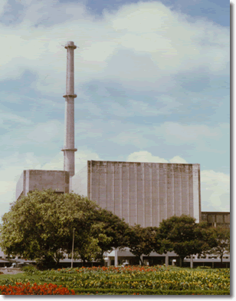
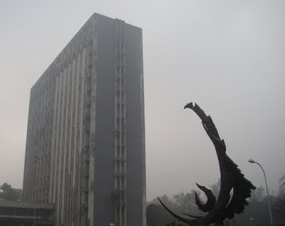
Where ?
Dhruva Reactor
Meeting Venue
Guest House, Anushaktinagar,
adjacent to BARC Campus

Slide 5
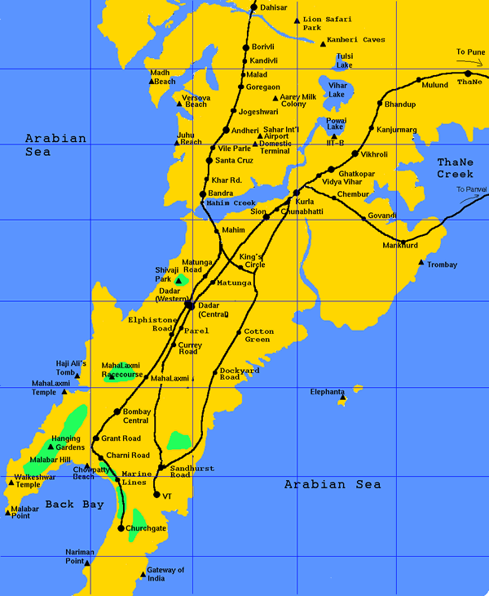
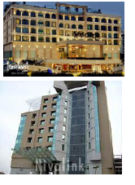
Hotel Accomodation & Transportation
Pickup from airport to Hotel and drop to airport
Transport from hotel to Workshop venue
Assistance in any local transport
BARC
Hotels :
www.tungahotels.com : 10 km, 100-150 $
www.jewelofchembur.com : 5 km 100-150 $
Fortune Exotica : 12 km
Few accommodation in BARC Guest House

Slide 6
Local Support
Main Auditorium adjacent to BARC campus
Poster and parallel discussion sessions
Canteens & Banquet Dinner
Partial Financial support : from BRNS
(Board of Research in Nuclear Sciences)

