Slide 1
Nuclear Data for Reactor Fluxes
A.A. Sonzogni, E.A. McCutchan, T.D. Johnson
National Nuclear Data Center

Slide 2
Outline
Summation method to calculate antineutrino spectra.
How did we get involved in this???? (decay heat and delayed nu-bar work, libraries)
Some recent work on the data involved in summation calculations.

Slide 3
How to calculate antineutrino spectra
Conversion Method: Use the precisely measured electron spectra following the thermal neutron fission of ^{235,238}U and ^{239,241}Pu.
Fit the electron spectrum with a set of hypothetical decay branches.
Uses nuclear data to obtain effective Z as function of end point energy.
P. Huber, Phys. Rev. C 84, 024617 (2011).
(2) Summation Method: Combine fission yields with decay data.
P. Vogel et al. Phys. Rev. C 24, 1543 (1981).

Slide 4
Summation Method
The antineutrino spectrum for an equilibrated fissioning system is calculated as:
where CFY_{i} is the cumulative fission yield defined recursively as:
with b_{ki} the decay probability from level k to level i. In matrix notation:
where IFY are the independent fission yields, and the matrix A has the decay probability data.
is the spectrum generated by the decay of a single level:
is the antineutrino spectrum generated in the decay to the level E_{lk} with intensity Iβ_{lki} in the daughter, normalized to 1.

Slide 5
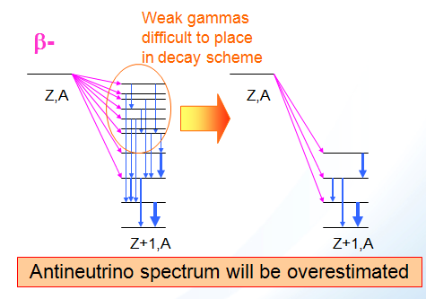
Summation Method
Some issues in this method:
Cumulative Fission Yields have embedded decay probabilities, which should be compatible with the decay probabilities used in the spectra calculation.
Decay data is only complete and of high quality for nuclides close to the valley of stability.
For nuclides with a large Q-values, decay schemes obtained using Germanium detectors lead to large beta intensities for low-lying levels. One should use data from Total Absorption Gamma Spectroscopy (TAGS) experiments.

Slide 6
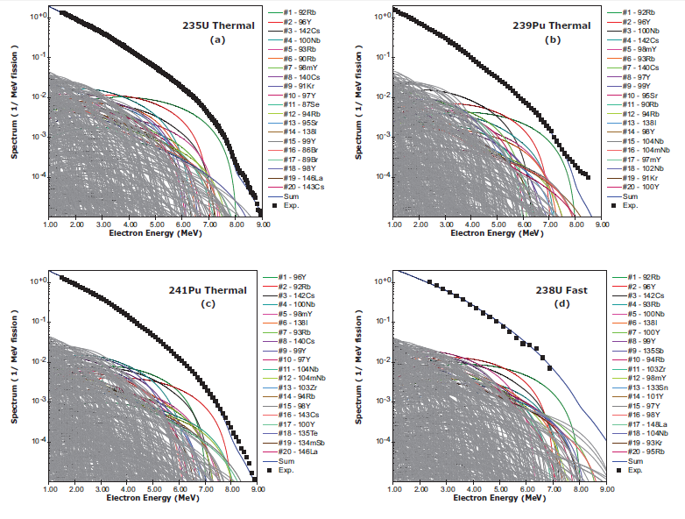
Summation Method
Update ENDF/B decay data with Iβ from TAGS and Rudstam data.
Surprisingly, fewer contributors at high energy.
Calculations using JEFF yields (compatibility).
It includes calculated spectra for very neutron rich nuclides (Moller-Kawano)
A.A. Sonzogni, T.D. Johnson, E.A. McCutchan, PRC91, 011301(R) (2015)

Slide 7
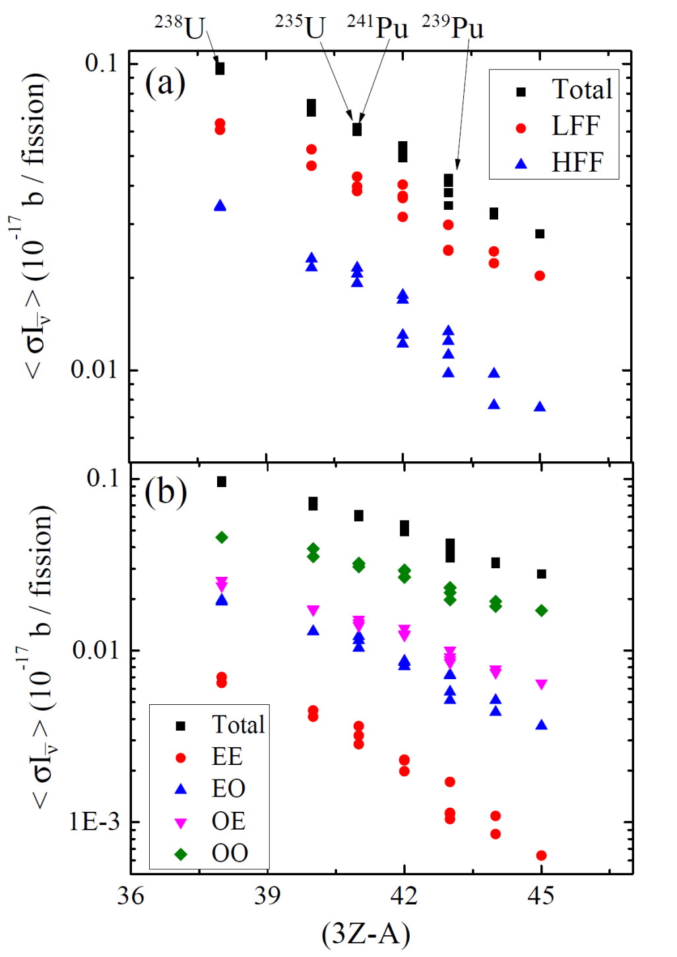
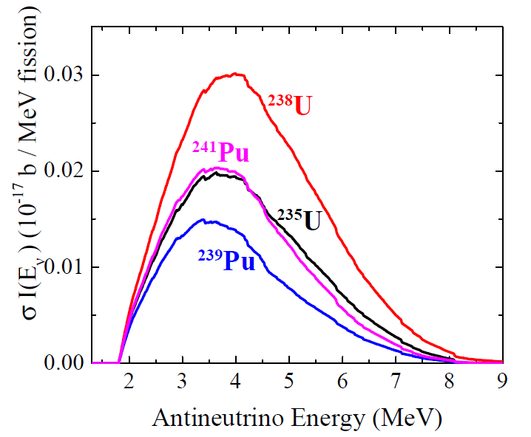
Systematics of all fissioning systems
Integral of the signal is needed to study the anomaly
Link to delayed neutron yield commonly parameterized by
3Z-A

Slide 8
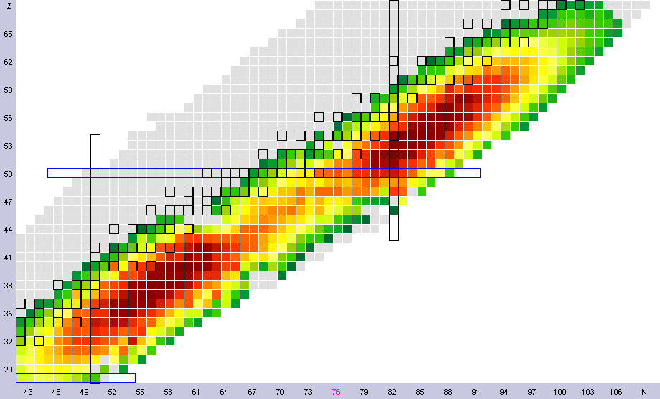
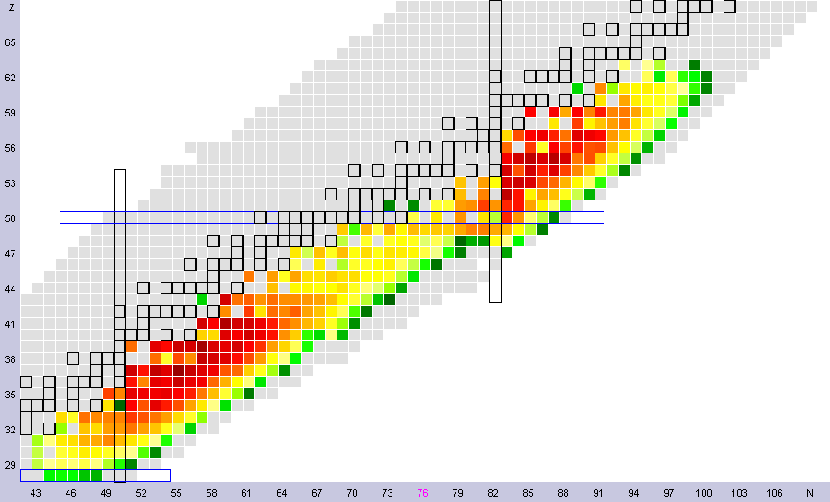
²³⁵U thermal fission yields
²³⁵U thermal Y_{i}/<σI>
Y_{i}/<σI>: fractional contribution to antineutrino multiplicity above threshold
Y_{i}=CFY_{i}∫σ(e)Iνi(e)
<σI>=ΣY_{i}

Slide 9
Data Libraries
Managed by the NNDC
ENSDF, www.nndc.bnl.gov/ensdf
Contains nuclear structure and decay data.
ENDF/B, www.nndc.bnl.gov/endf
American. Main effort is for neutron-induced cross sections and spectra. It also contains fission and decay data in a numerical format.
JEFF, www.oecd-nea.org/dbdata/jeff/
European. Similar to ENDF/B.
JENDL, wwwndc.jaea.go.jp/jendl/jendl.html
Japanese. Similar to ENDF/B.
Additionally the NNDC is responsible for the decay data in ENDF/B that is needed for the calculations.

Slide 10
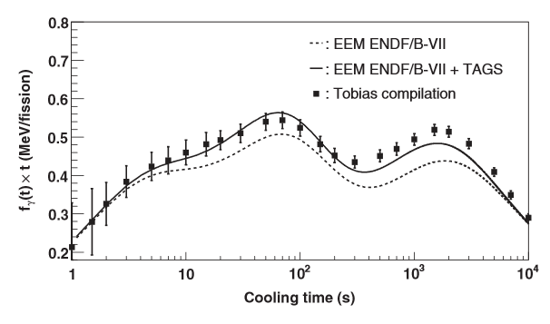
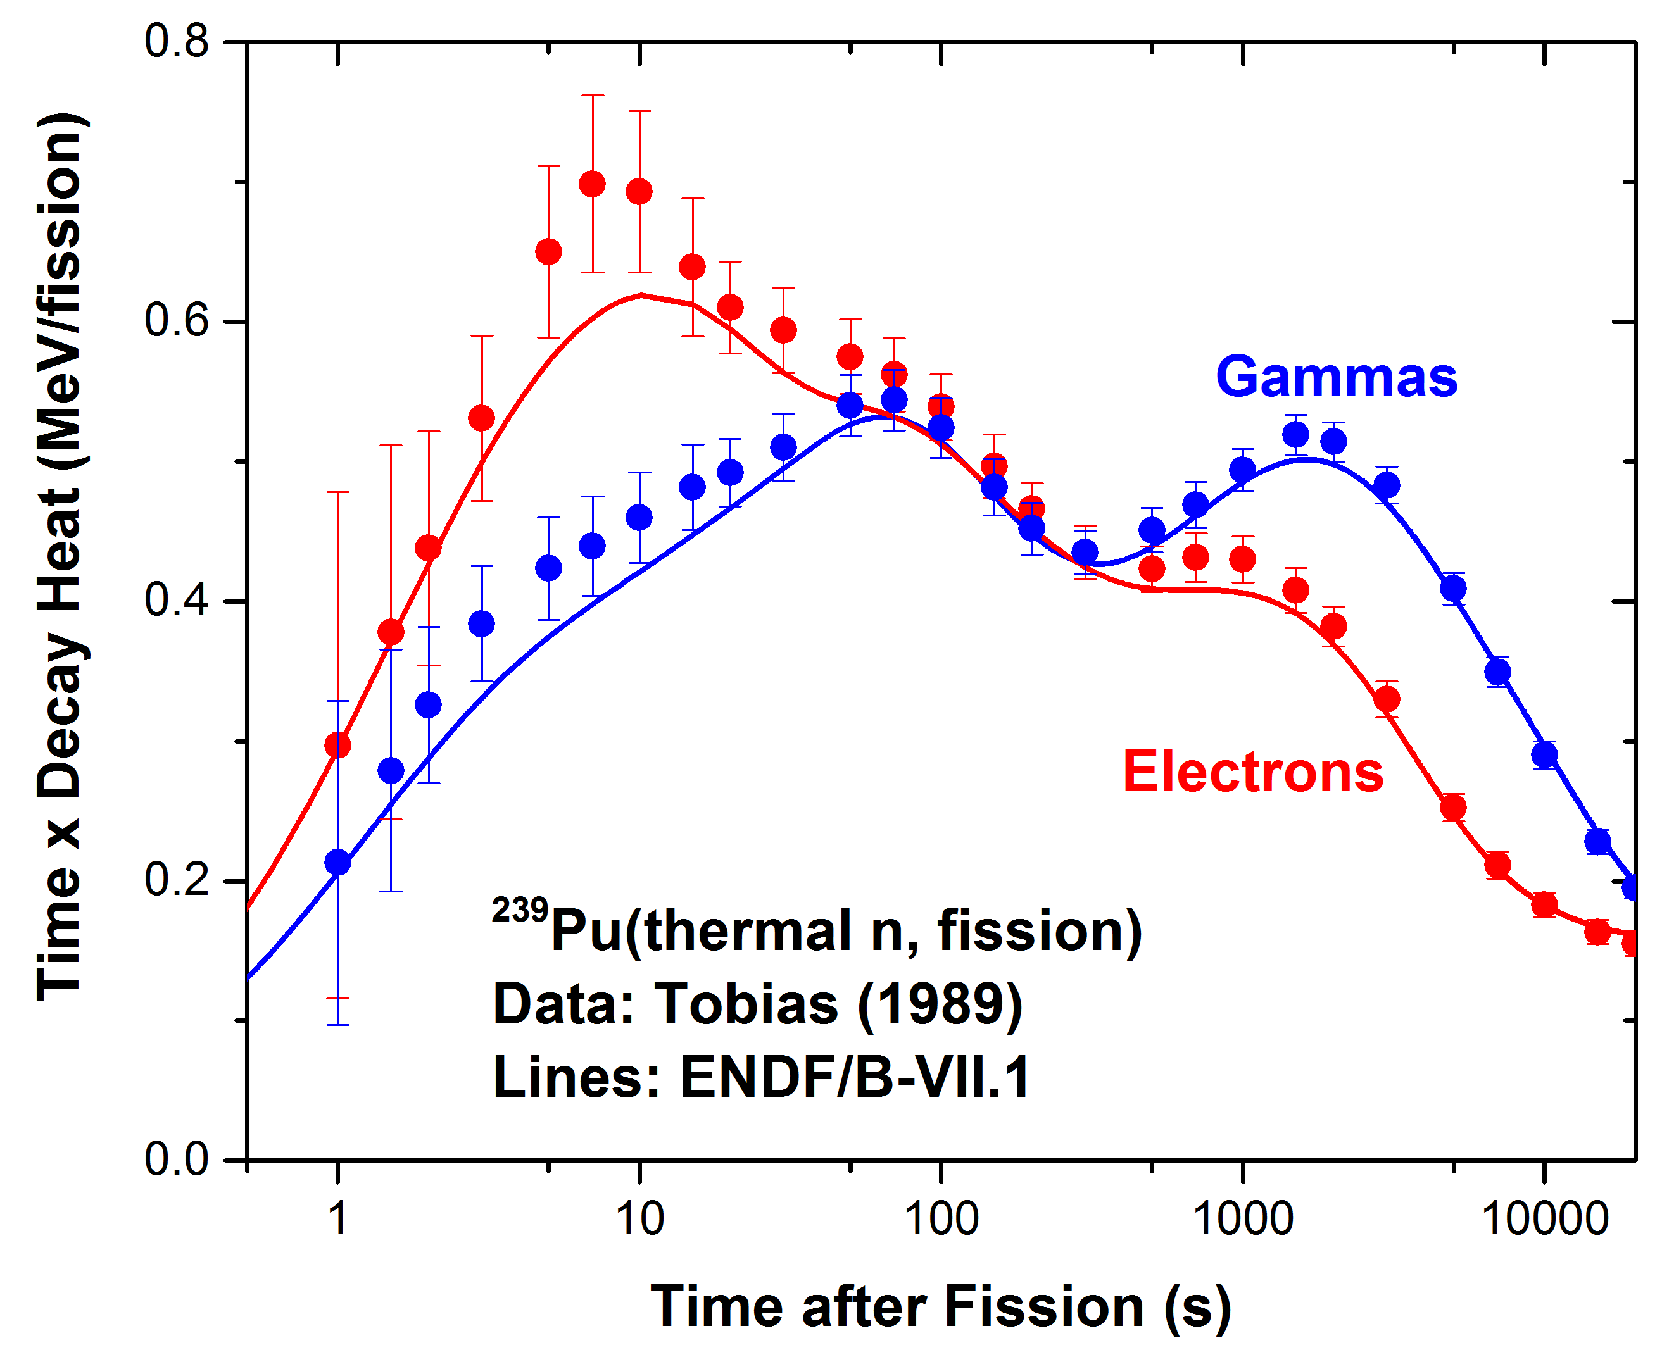
Earlier Work on Decay Heat
²³⁹Pu gamma decay heat
A. Algora et al, PRL 105, 202501 (2010).
High excitation energy β- feeding
Low excitation energy β- feeding
Large <Eγ>
Small <Eβ>
Small <Eν>
Neutrons
Longer T_{1/2}
Small <Eγ>
Large <Eβ>
Large <Eν>
No neutrons
Shorter T_{1/2}

Slide 11
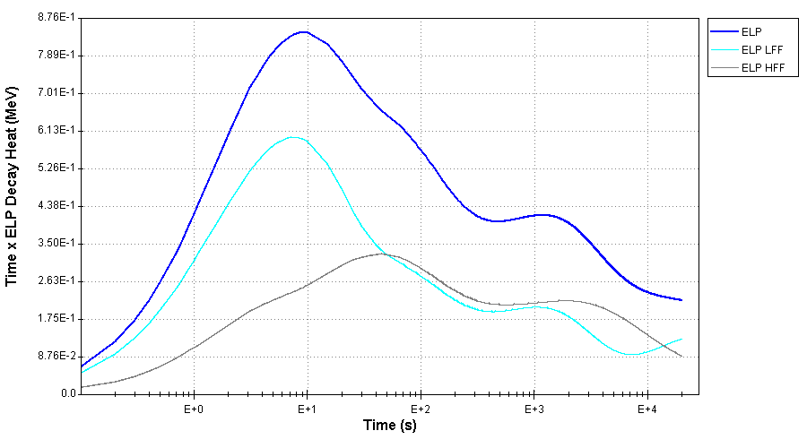
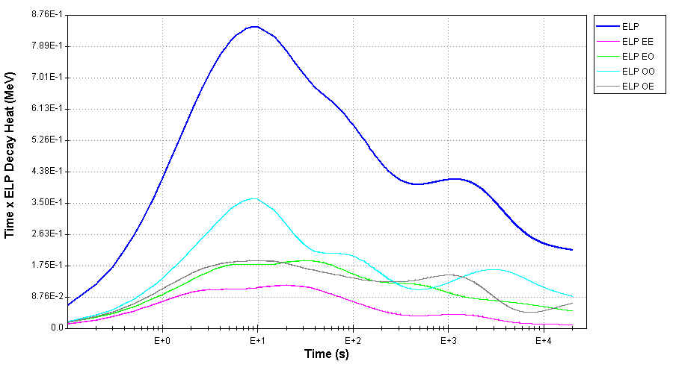
Relation to decay heat
235U Thermal

Slide 12
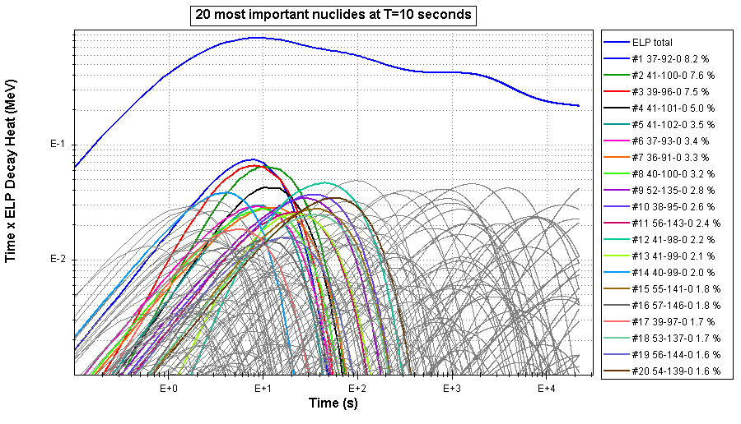
235U Thermal
92Rb, 100Nb, 96Y, 101Nb,102Nb

Slide 13
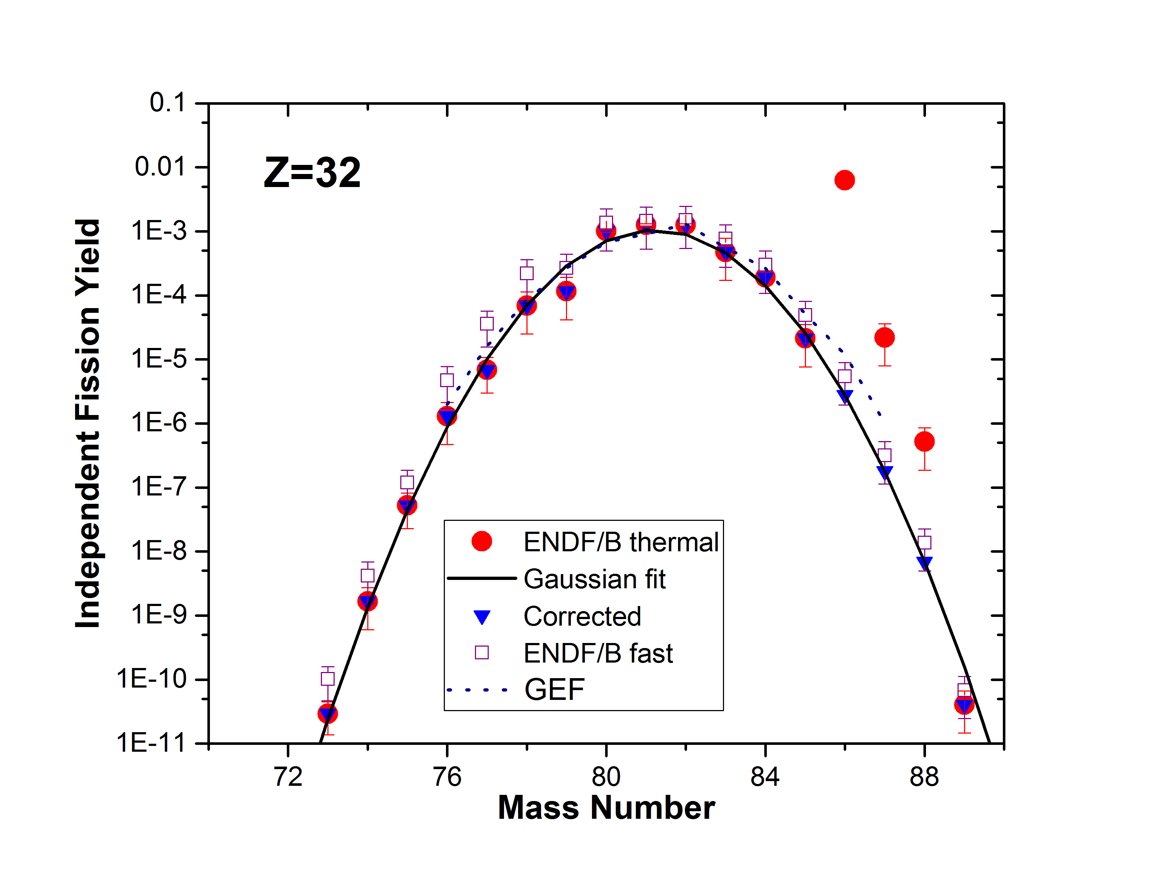
Fission Yield Effects
ENDF/B fission yields were released in 1992. We studied the effect of corrections due to a) better decay data, b) improved isomeric ratios, c) anomalous yields.
ENDF/B-VII.1 Fission Yields (1992)
3
IT 100%
0
β- 100%
⁹⁶Y
ENSDF (Current)
β- 100%
8+
0-
⁹⁶Y

Slide 14
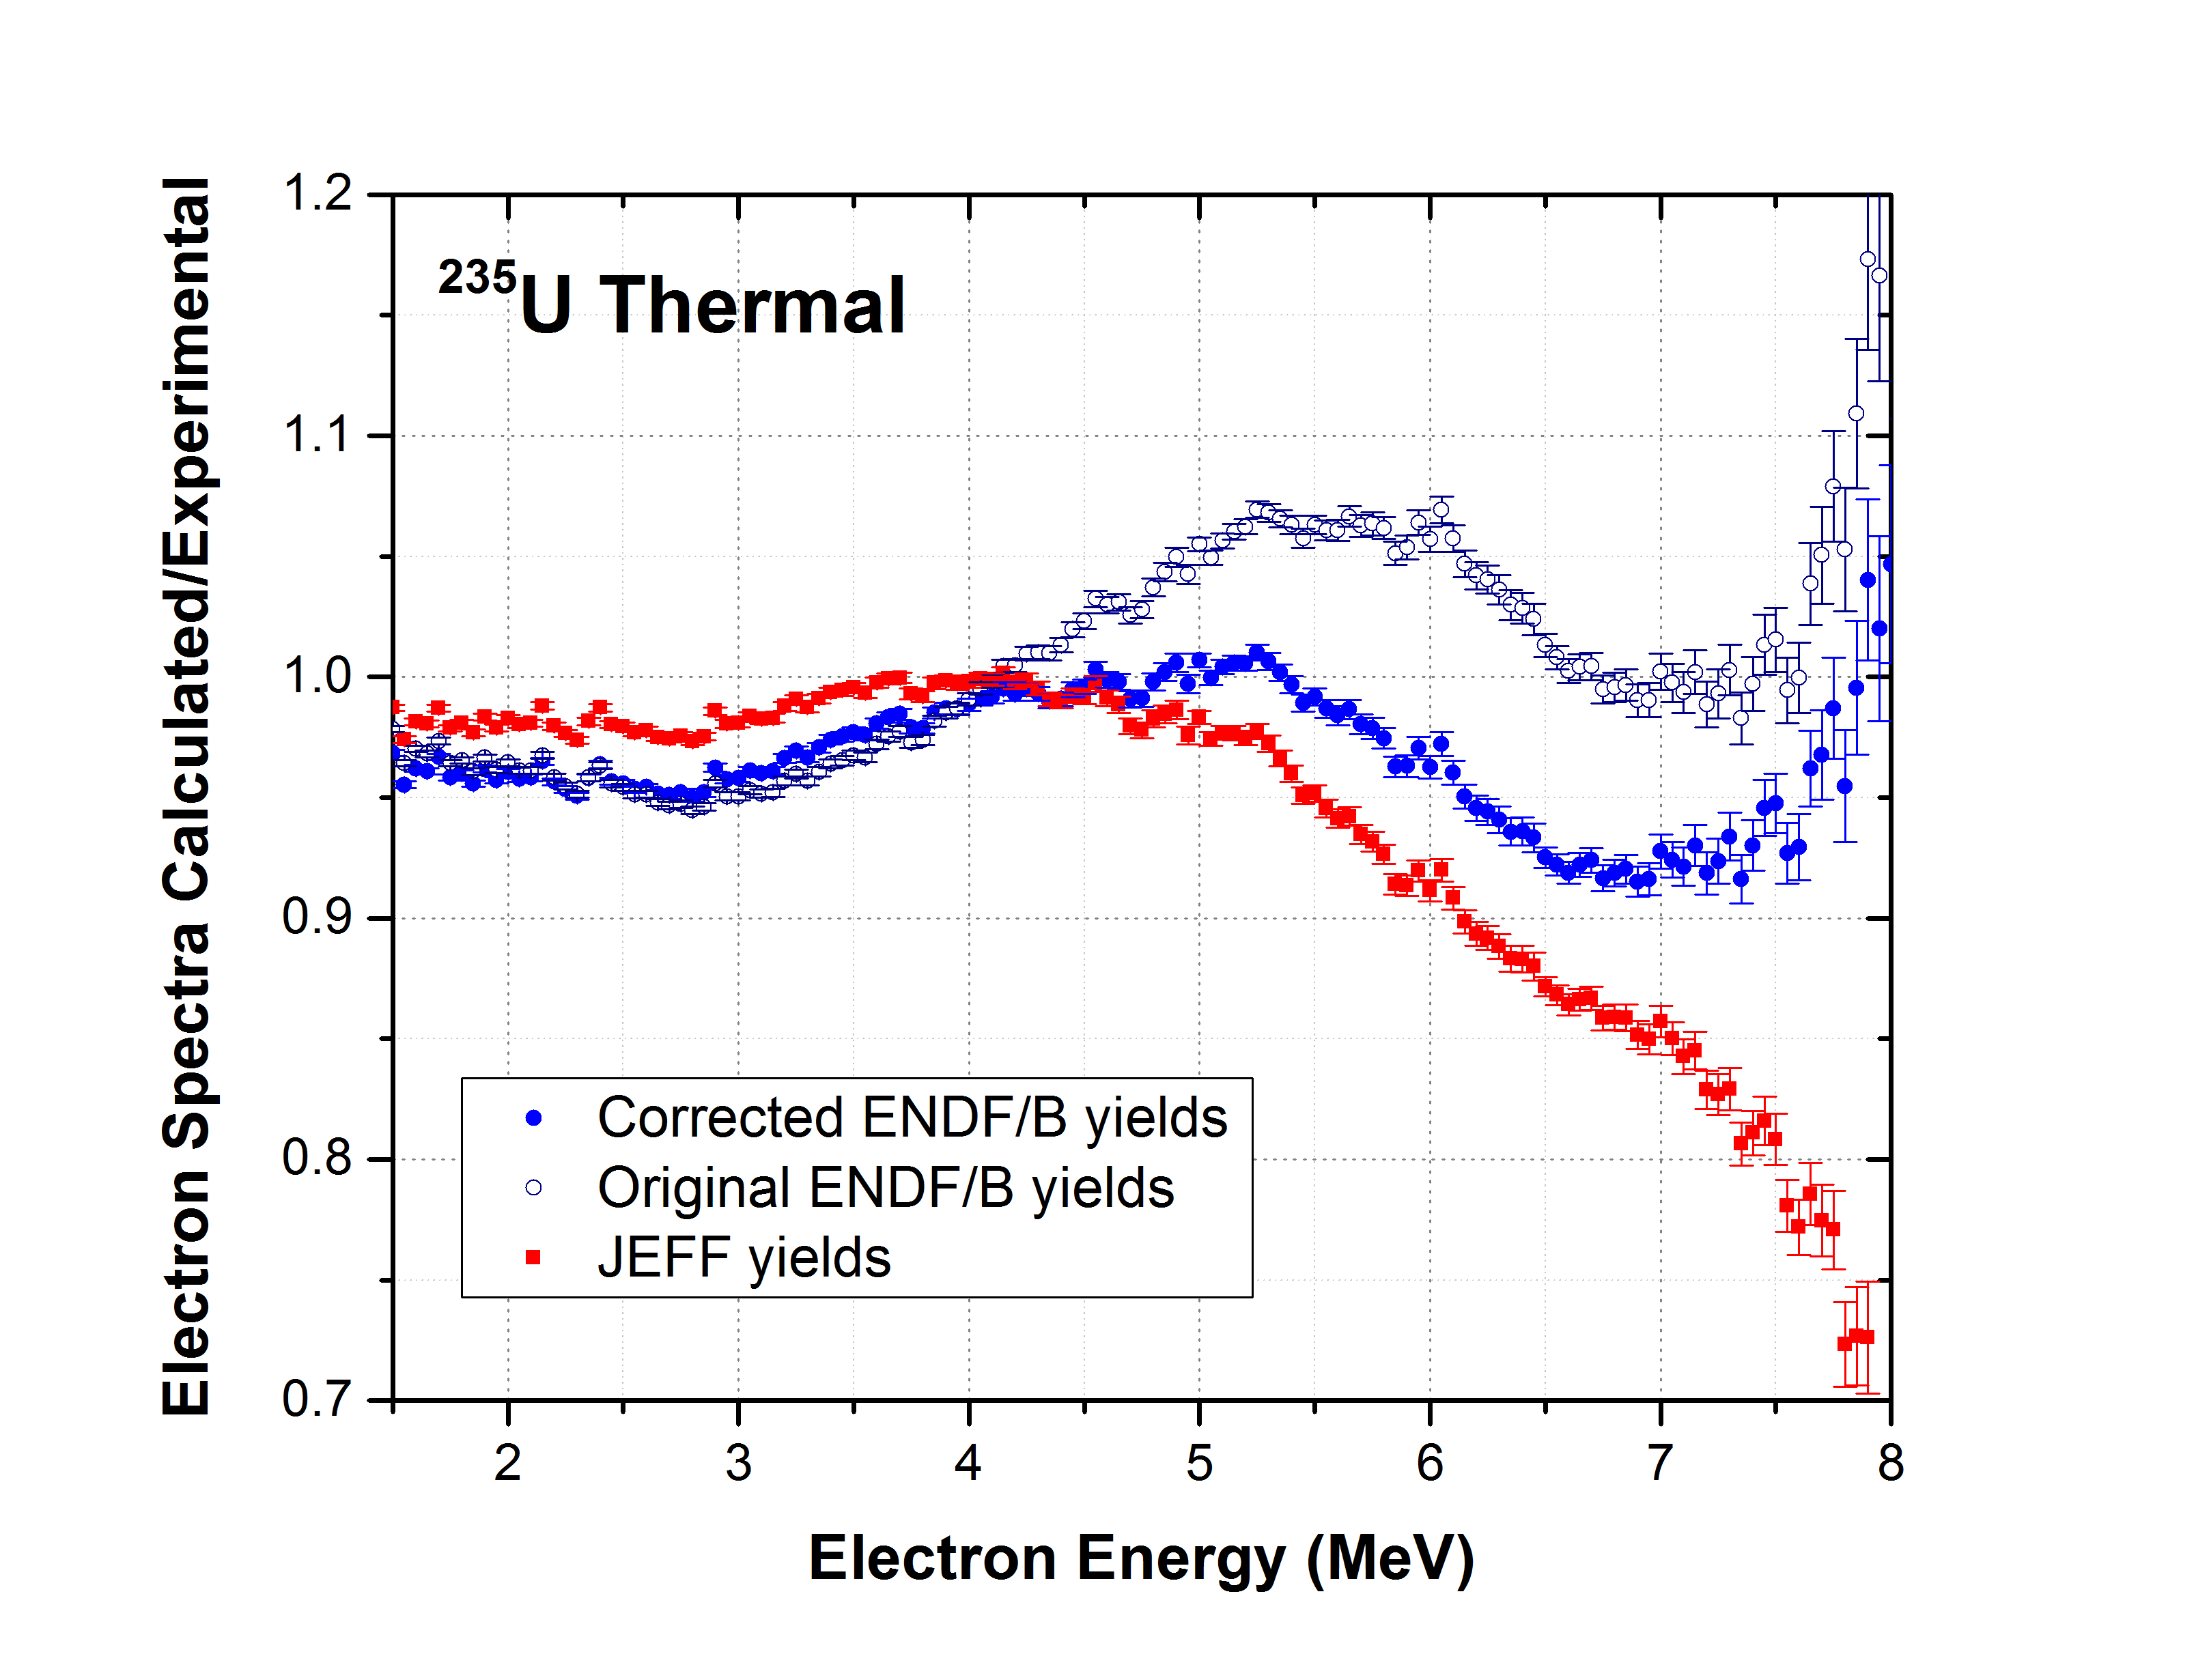
Thermal ²³⁵U spectrum
Corrected yields:
No electron excess.
Better agreement with JEFF.

Slide 15
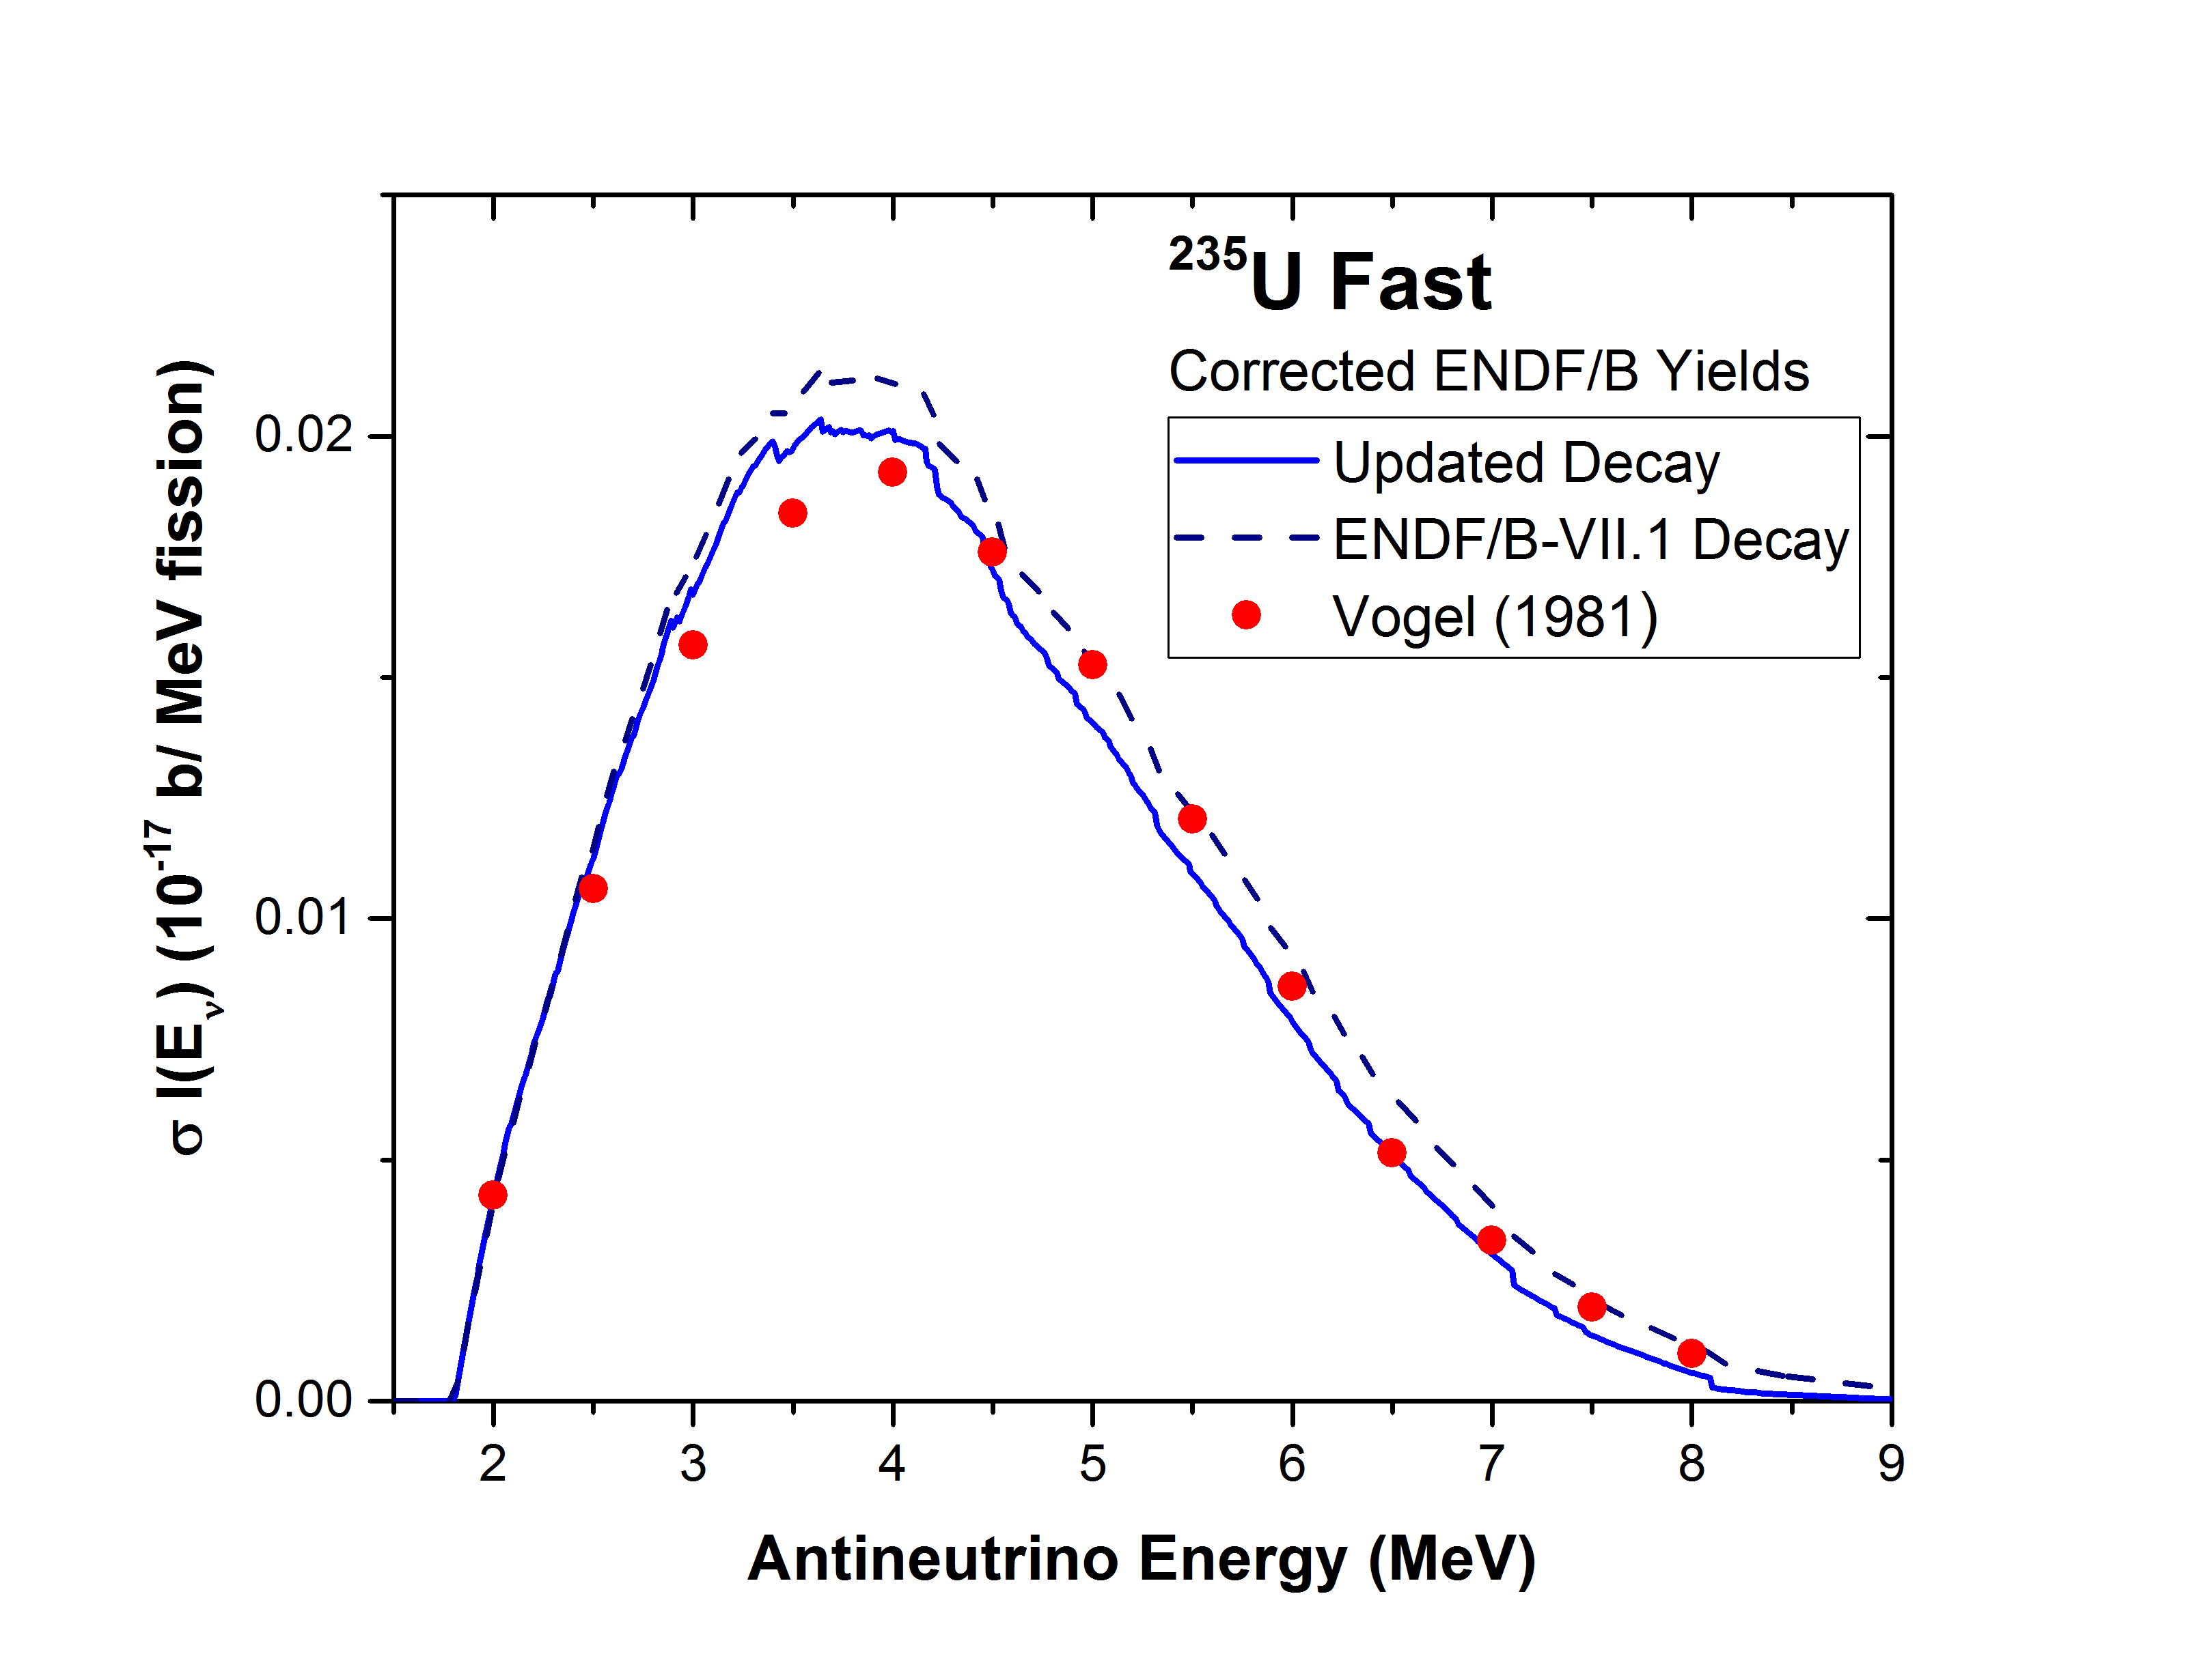
Spectrum for fast reactors
HEU reactors.
²³⁵U contributes most of the fission.
Needed for future experiments pursuing the anomaly.
Currently, it can only be obtained by summation.
Use corrected ENDF/B yields.
Incorporate TAGS results.
Significant differences in the shape with 1981 values.
TAGS data make a big difference.

Slide 16
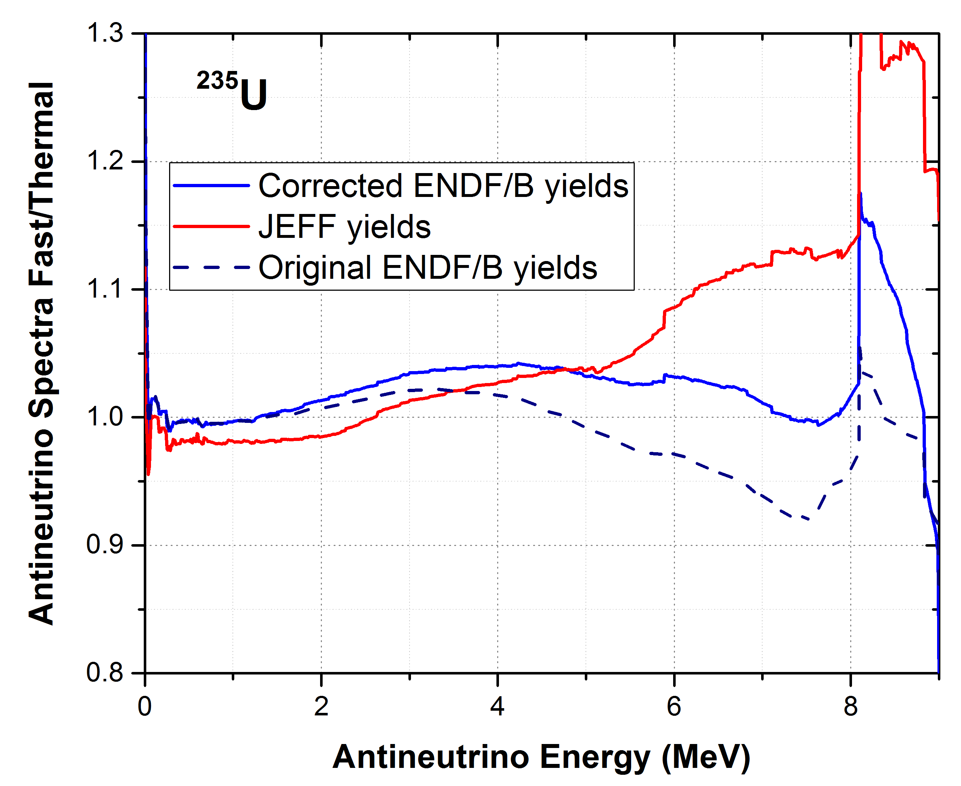
Spectrum for fast reactors II
For fast neutrons, the increase in excitation energy makes the fission yield distribution broader.
The delayed nu-bar per 100 fissions increases from 1.585 to 1.67.
When using corrected fission yields, the antineutrino spectrum for fast neutrons is harder than the spectrum for thermal neutrons.
In agreement with JEFF yields and as expected.

Slide 17
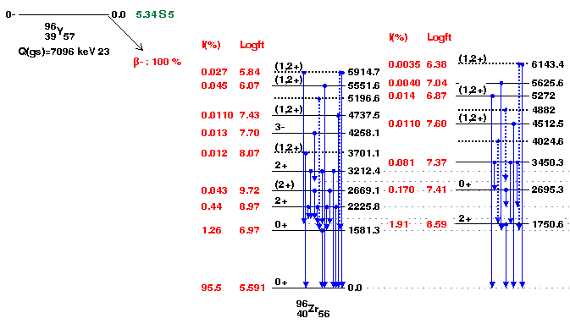
96Y – one nuclide with a large effect
95.5 % of the decay is ground state to ground state

Slide 18
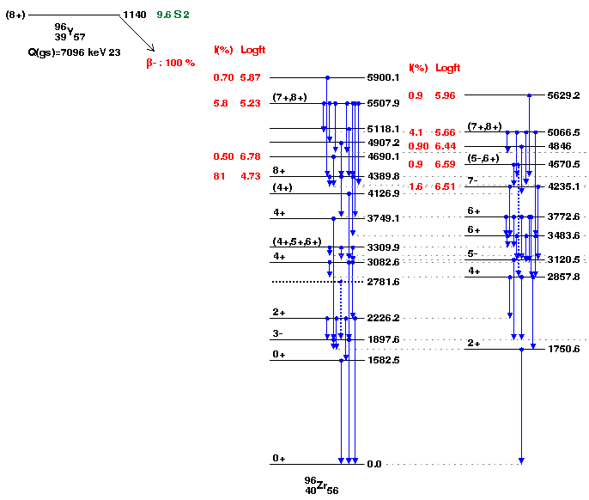
96Y – one nuclide with a large effect
For the isomer, on the other hand, due to angular momentum, the feeding is concentrated at high excitation energies

Slide 19
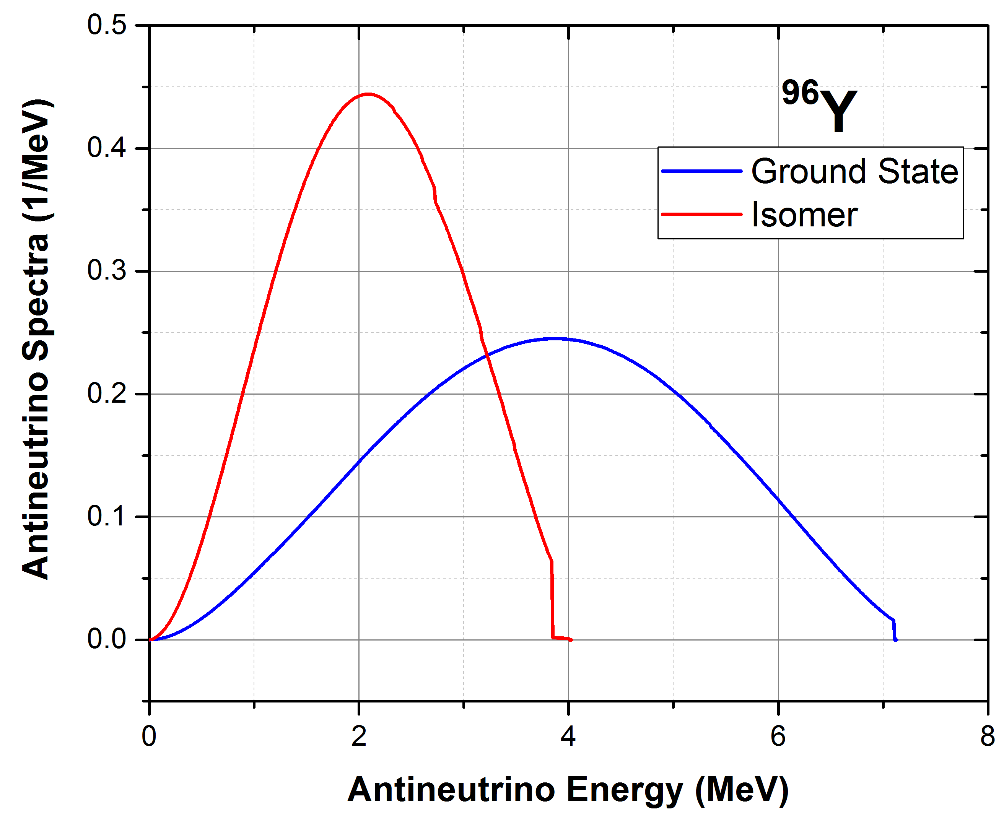
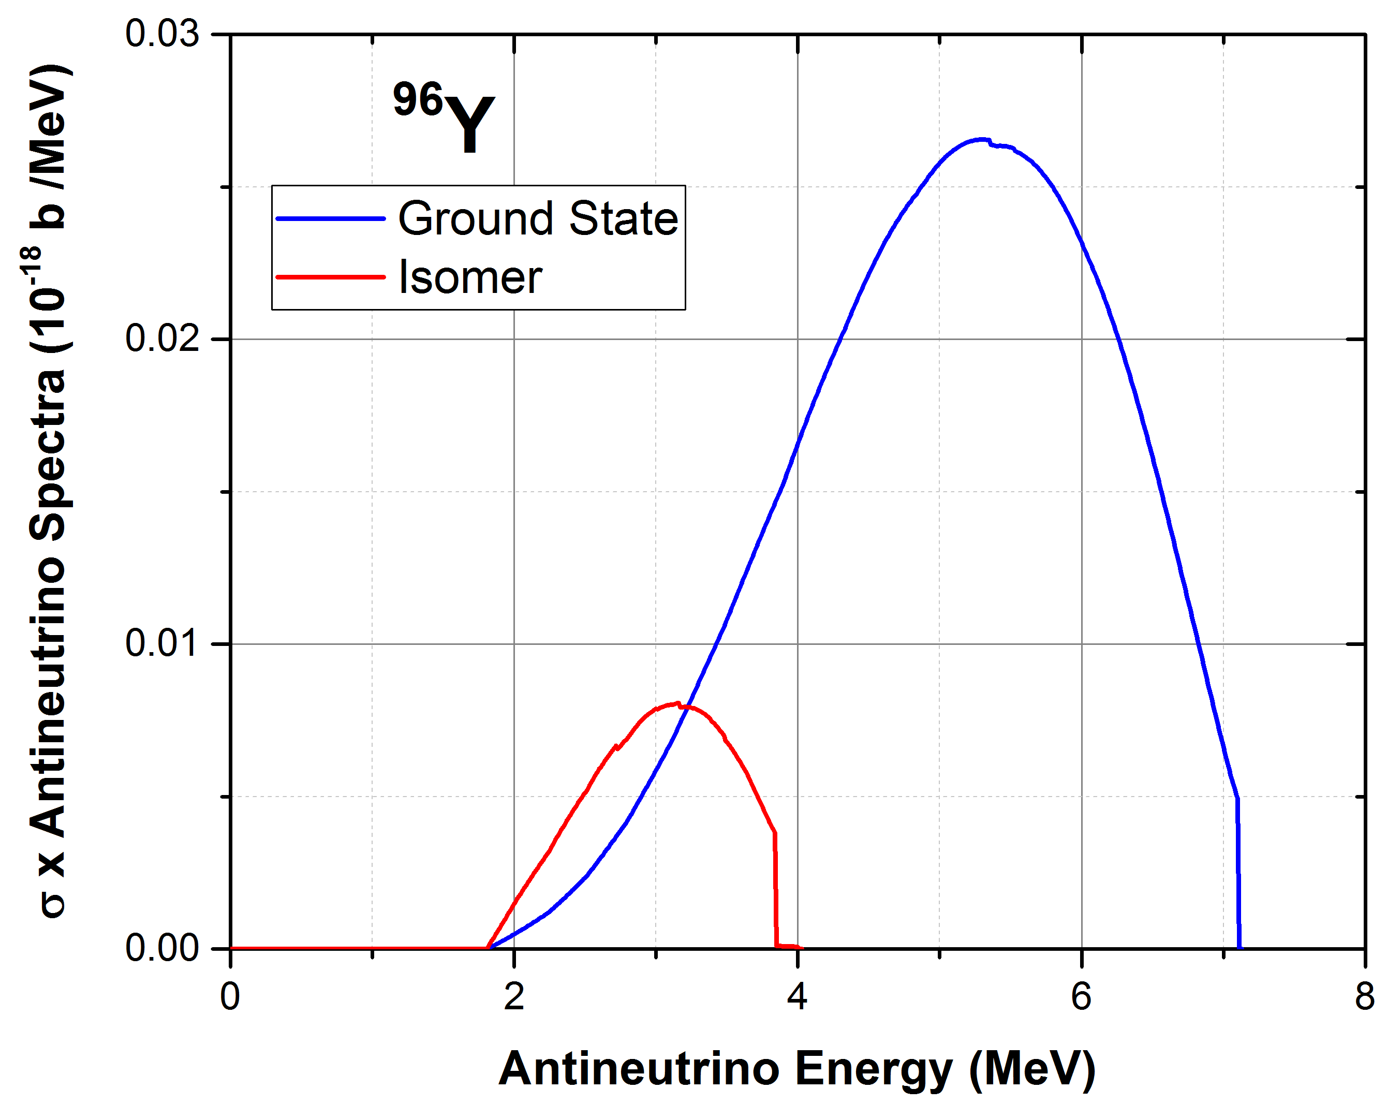
⁹⁶Y – Two Different Isomers
The ground state produces about 7 times more antineutrinos above the threshold than the isomer
Both spectra are normalized to 1

Slide 20
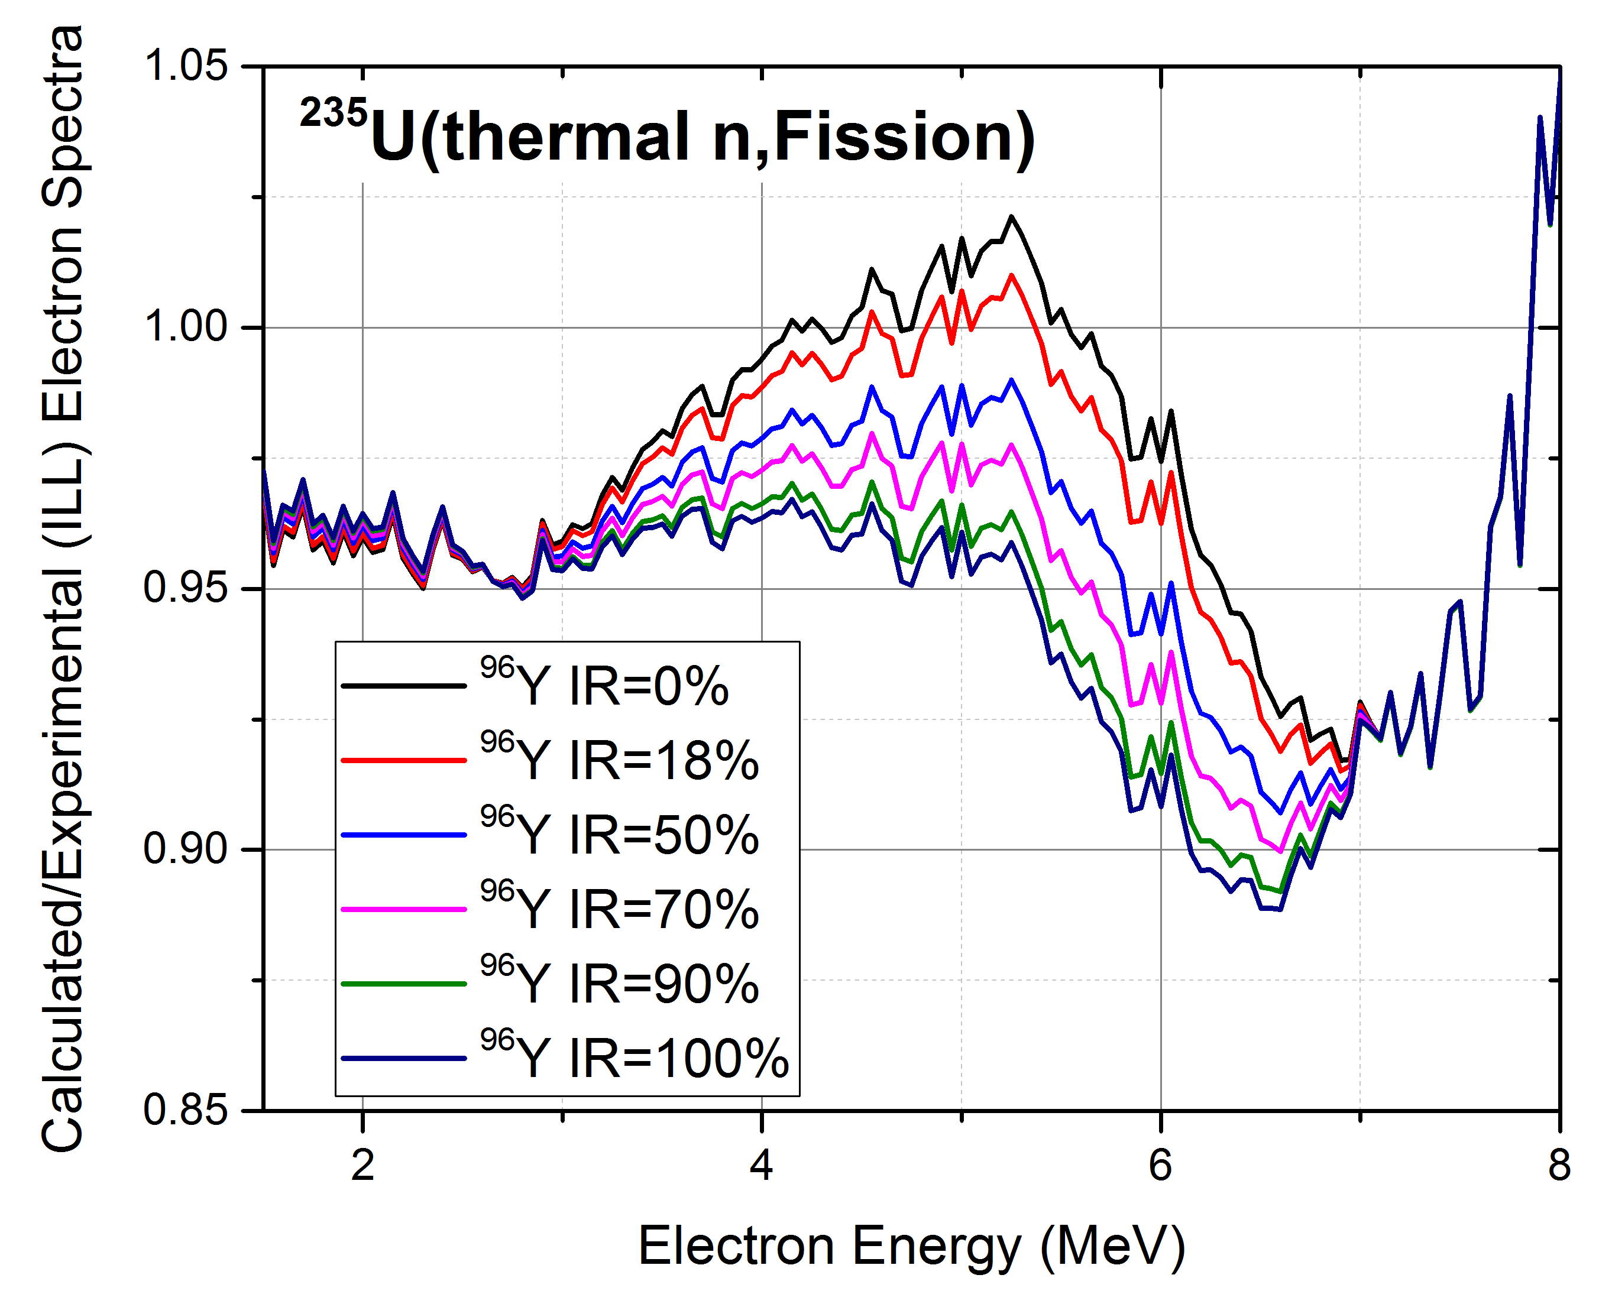
⁹⁶Y – Isomeric Ratio Effect
⁹⁶Y Isomeric Ratio:
At about 5.2 MeV, changing IR from 0 to 100% changes the calculated to experimental ratio by 7%.
CFY ~ 0.05
There is no journal publication of IR.
Estimates of IR vary from 18% to 70%

Slide 21
Conclusions
Updated the ENDF/B decay data to incorporate new TAGS and other decay data that are relevant to antineutrinos or decay heat.
Decomposed total spectrum into individual contributions, derived systematics of the energy integrated cross section weighted antineutrino spectrum.
Studied the effect of correcting thermal ²³⁵U ENDF/B fission yields. Without these corrections results will not be reliable, leading to a fast spectrum softer than the thermal.
Calculated the fast ²³⁵U antineutrino spectrum, good agreement with JEFF yields, TAGS data make a big impact.
Identified pieces of data, such as the ⁹⁶Y Isomeric Ratio, that have big impact and could merit a precise measurement.

Slide 22
TAGS (Total Absorption Gamma Spectroscopy) experiments
NaI crystals
Radioactive source
Plastic detector for beta-gamma coincidences
TAGS measure the gamma spectrum after beta decay with low resolution but high efficiency.

Slide 23
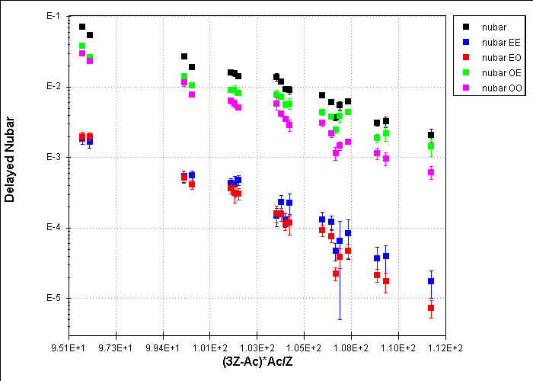
Systematics of Delayed nu-bars
232Th
238U
235U
238Np
241Pu
233U
239Pu
252Cf

